Slide 1
History of LAr Detector Development at BNL
Veljko Radeka
radeka@bnl.gov
April 10, 2024

Slide 2
Select events in LAr detector technology development
Germanium p-i-n detector, Tavendale (1963-4), gamma-ray and x-ray spectroscopy; first cold front end (JFET).
Liquid Argon Ionization Calorimetry, Willis, Radeka (1972) → CERN ISR → ATLAS
TPC , Nygren (1974), lasting impact from gas to noble liquid TPCs
Herbert Chen, C. Rubbia, independently propose TPC with LAr (1977) → leads to ICARUS
Herbert Chen, (1985) proposal for a large LAr TPC
Uranium-LAr hadron calorimeter (…), first use of cold electronics (JFETs),(1986)
Major realizations at FNAL(D0), HERA(H1), SLAC(SLD), (1985-1993)
LAr, LKr EM calorimeter R&D for GEM/SSC and ATLAS/LHC (1989-1994)
ATLAS LAr EM calorimeter (2004 -); high speed-high precision; highest confidence limit on Higgs (2012)
Argoneut (2004); MicroBooNE (MB) proposal (2007) with cold electronics (JFETs);
MicroBooNE; in 2009 decision to use cold CMOS (LARASIC); in operation 2015-2021;
Technology selection for DUNE in 2011: LAr TPCs
MB in operation for 4 years; protoDUNE rapid realization and successful test in 2018;
Technology path open for DUNE …

Slide 3
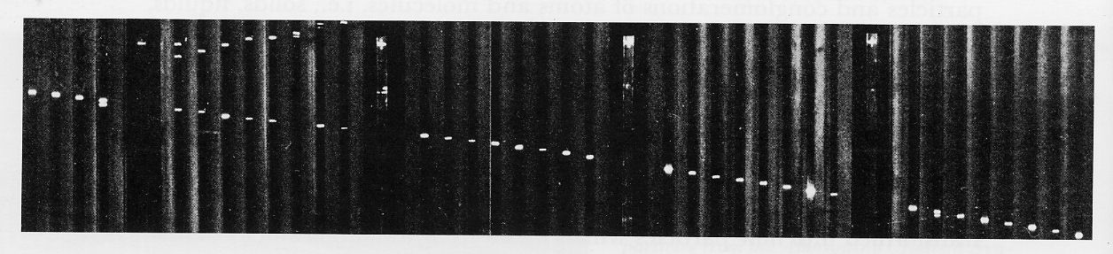
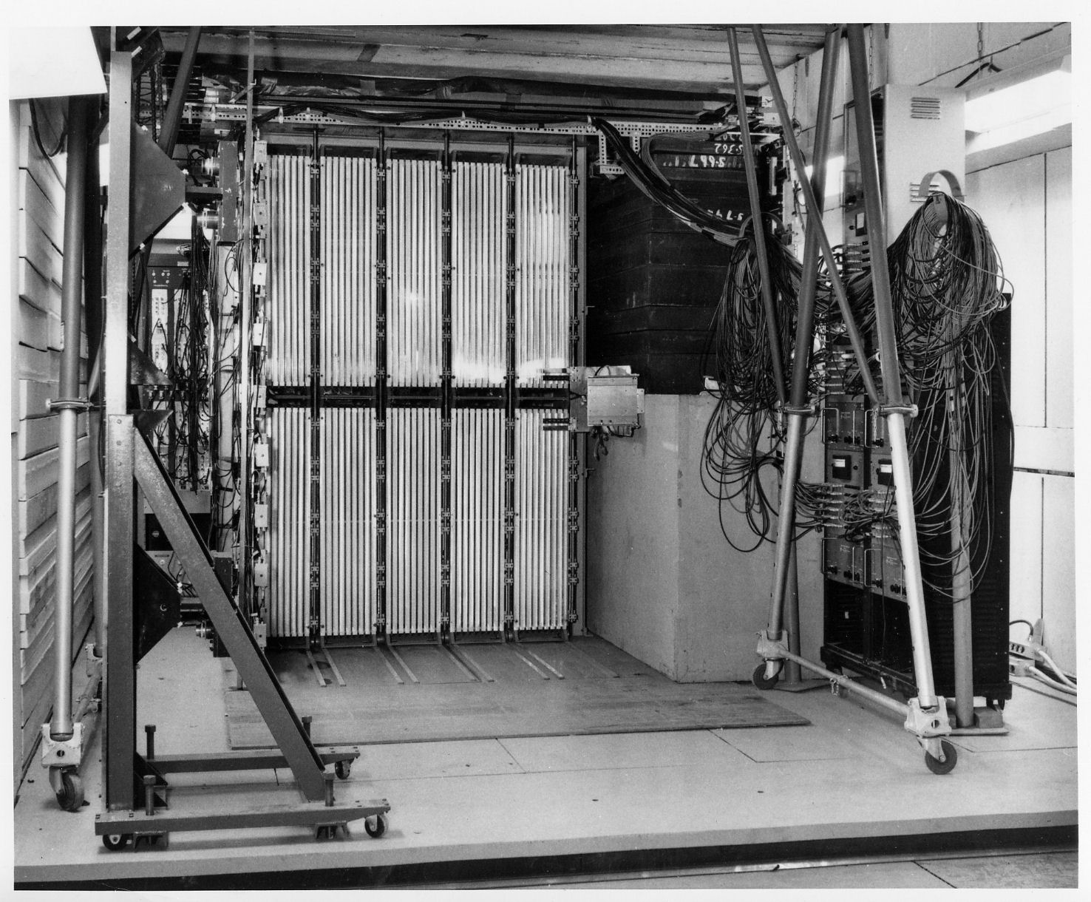
Spark Chambers in the Muon Neutrino Experiment 1962
Muon track
13m of Fe
(Danby, et al., 1962)
Spark chambers also used in CP violation experiment (Fitch and Cronin, 1964)
Two Nobel Prizes with such detectors!
10 tons of Al plates

Slide 4
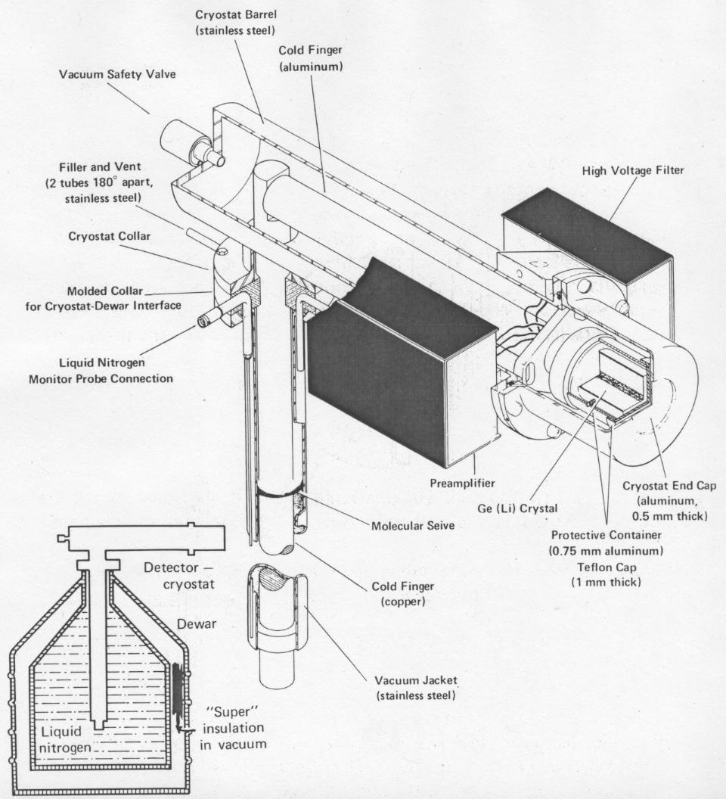
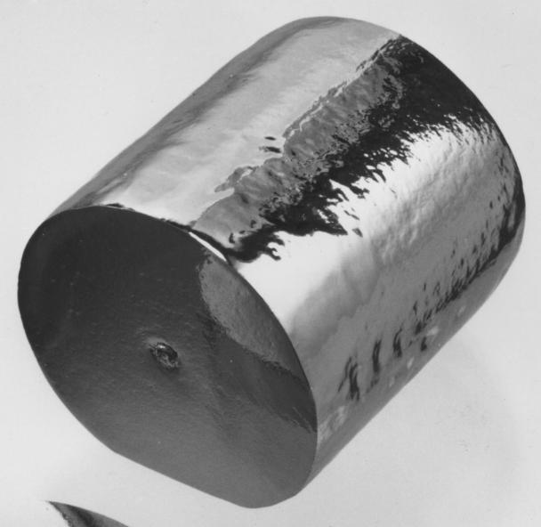
1963 Germanium Detector Breakthrough
Large Ge detectors 1968 -
First cold JFET on a detector
Coaxial det.contacts
From: A.J. Tavendale (1963)
Ge-crystal ~50-100 cm³

Slide 5
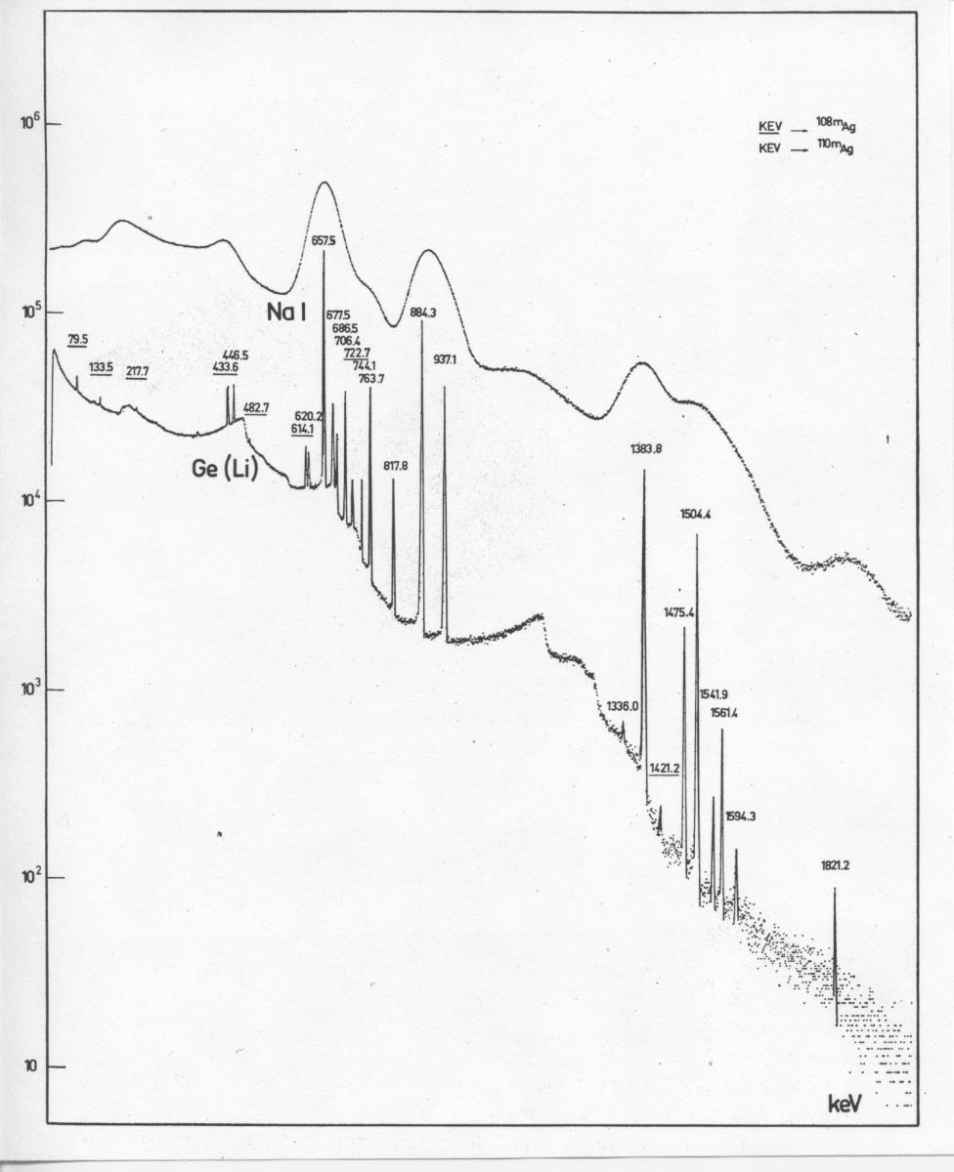
Comparison of Germanium with Sodium Iodide for gamma-ray spectrometry
Low noise electronics and signal processing (for gamma ray energy resolution of ~0.1%) developed for germanium detectors in ~ 1965-1972 provided the basis for later use of these techniques in particle physics, solar neutrino detection, x-ray and neutron detectors … in LAr calorimeters and later in TPCs …
1821.2 keV

Slide 6
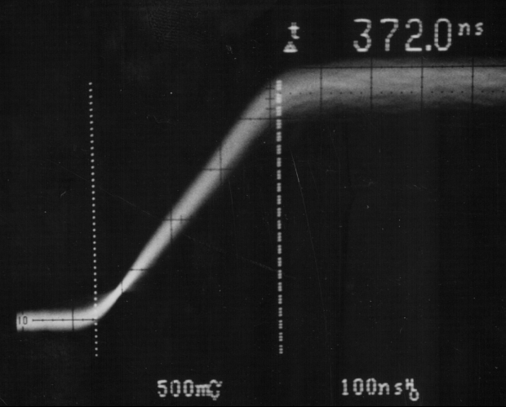
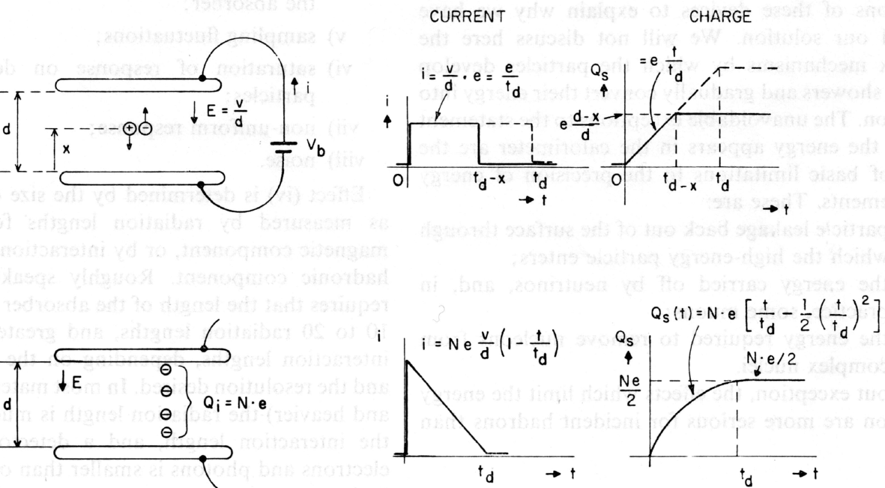
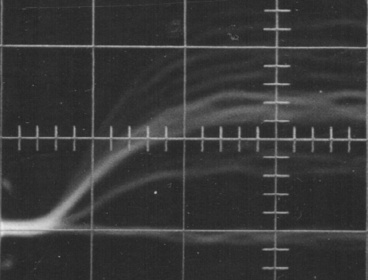
W.J. Willis, V. Radeka (1972): Charge Collection and Drift Velocity Studies in LAr
Electroplated α - source
2 mm electrode spacing → ~400ns at 10kV/cm
β-source
Only electrons induce a signal in the time of interest <1 µs; mobility µ_{electron}» µ_{ion}
W.J. Willis, V. Radeka, NIM 120 (1974) 221-236

Slide 7
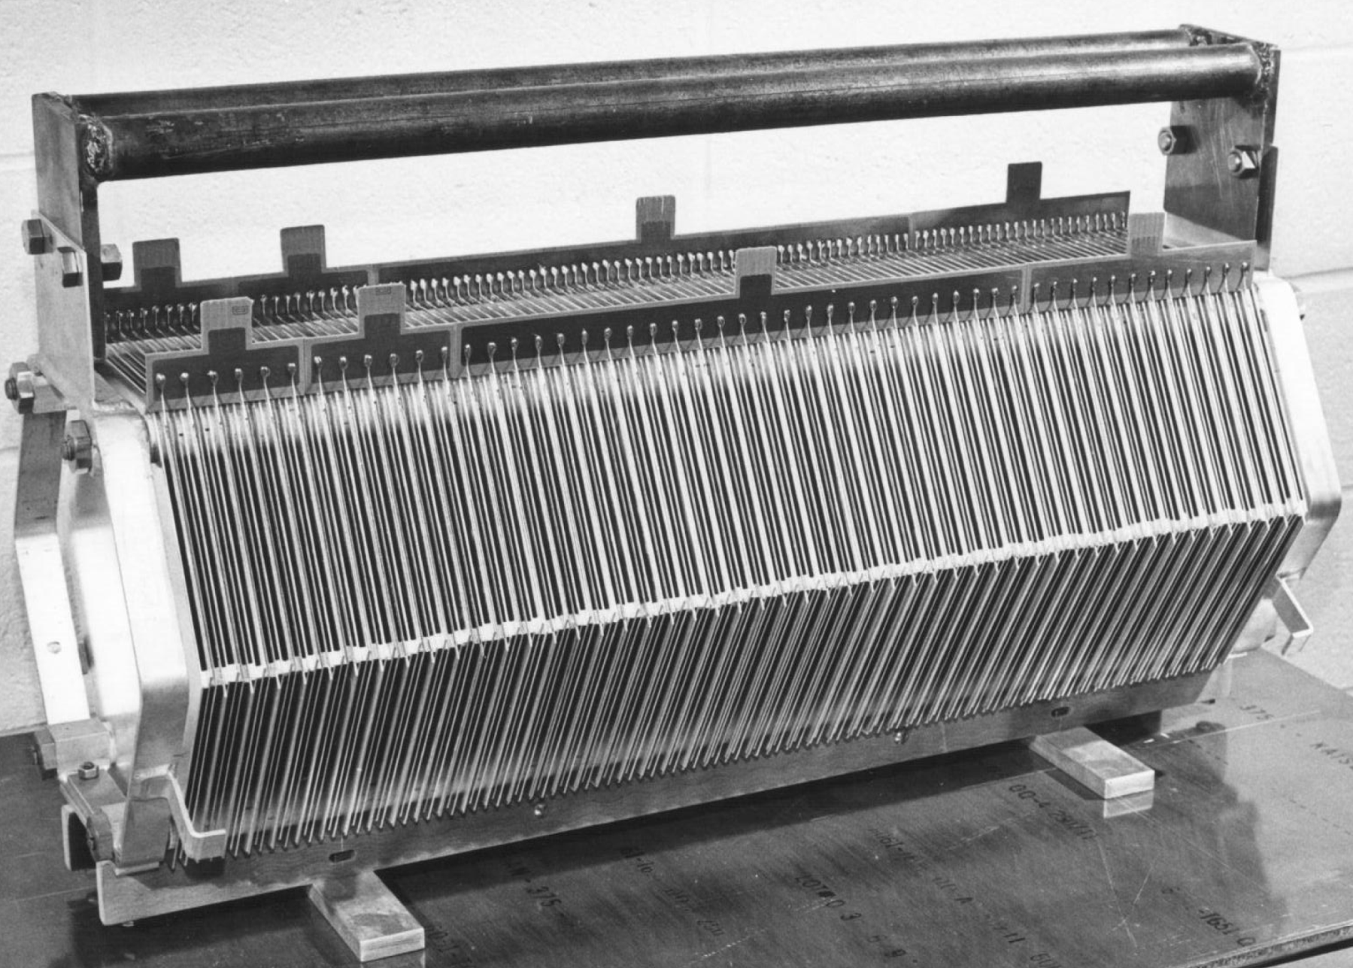
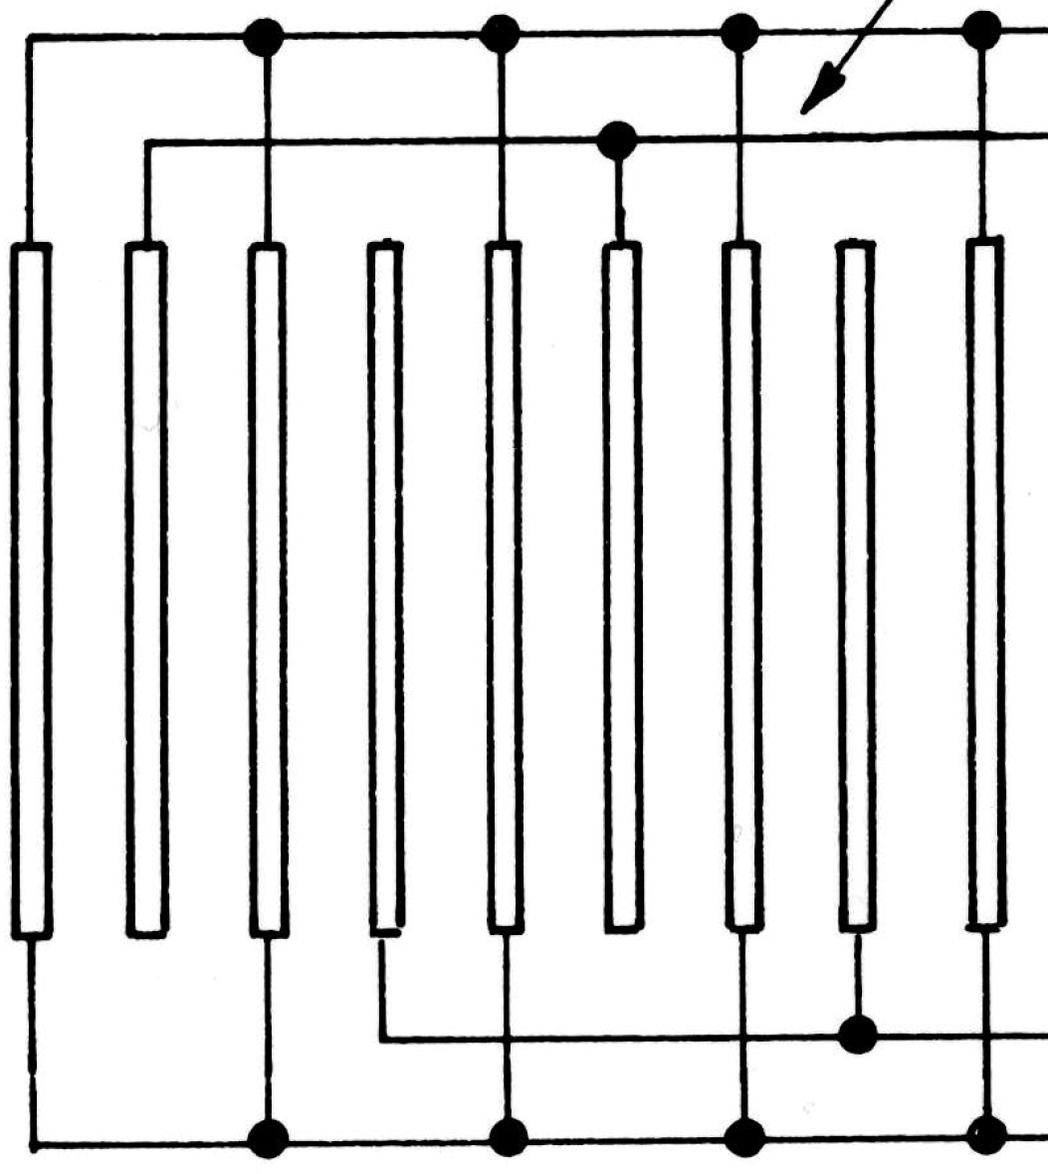
Jan-Apr 1973: Design and build the first LAr sampling electromagnetic calorimeter 20 radiation lengths long, 200 steel 1.6 mm plates with 2 mm LAr gaps; ΔE/Δx ≈ (11.6 + 2.1) MeV/cm, or 0.1 X₀
Charge from ion chamber with ~100 nF electrode capacitance brought out on low impedance strip transmission lines;
Interleaved readout from alternate gaps for studies of sampling fluctuations
S1
S2
HV
W.J. Willis, V. Radeka, NIM 120 (1974) 221-236

Slide 8
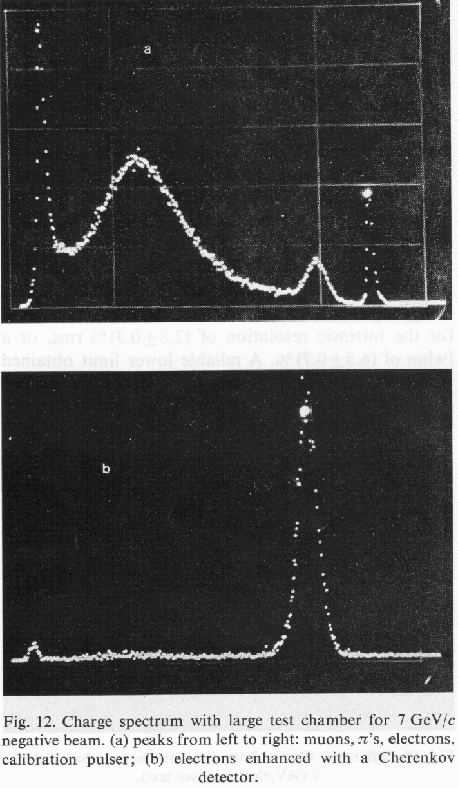
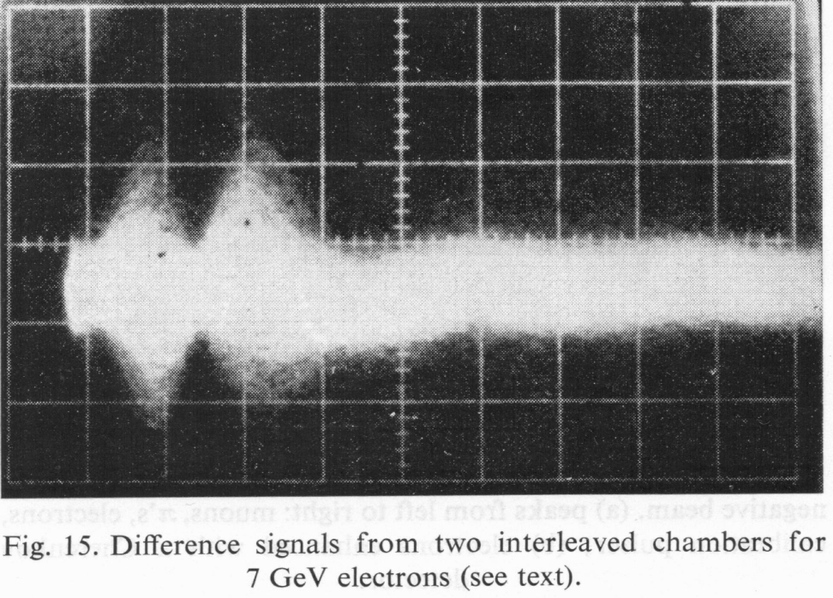
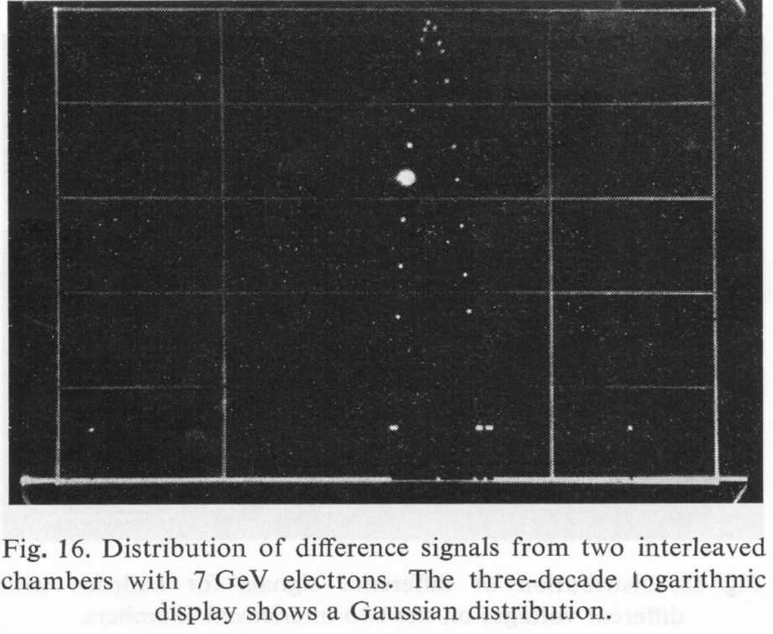
May-June 1973: The 1st LAr EM Cal. – Spectra and Difference Signals
S1+S2
S1-S2
Sampling fluctuations
µ
π
7GeV e’s Pulser
S1
S2

Slide 9
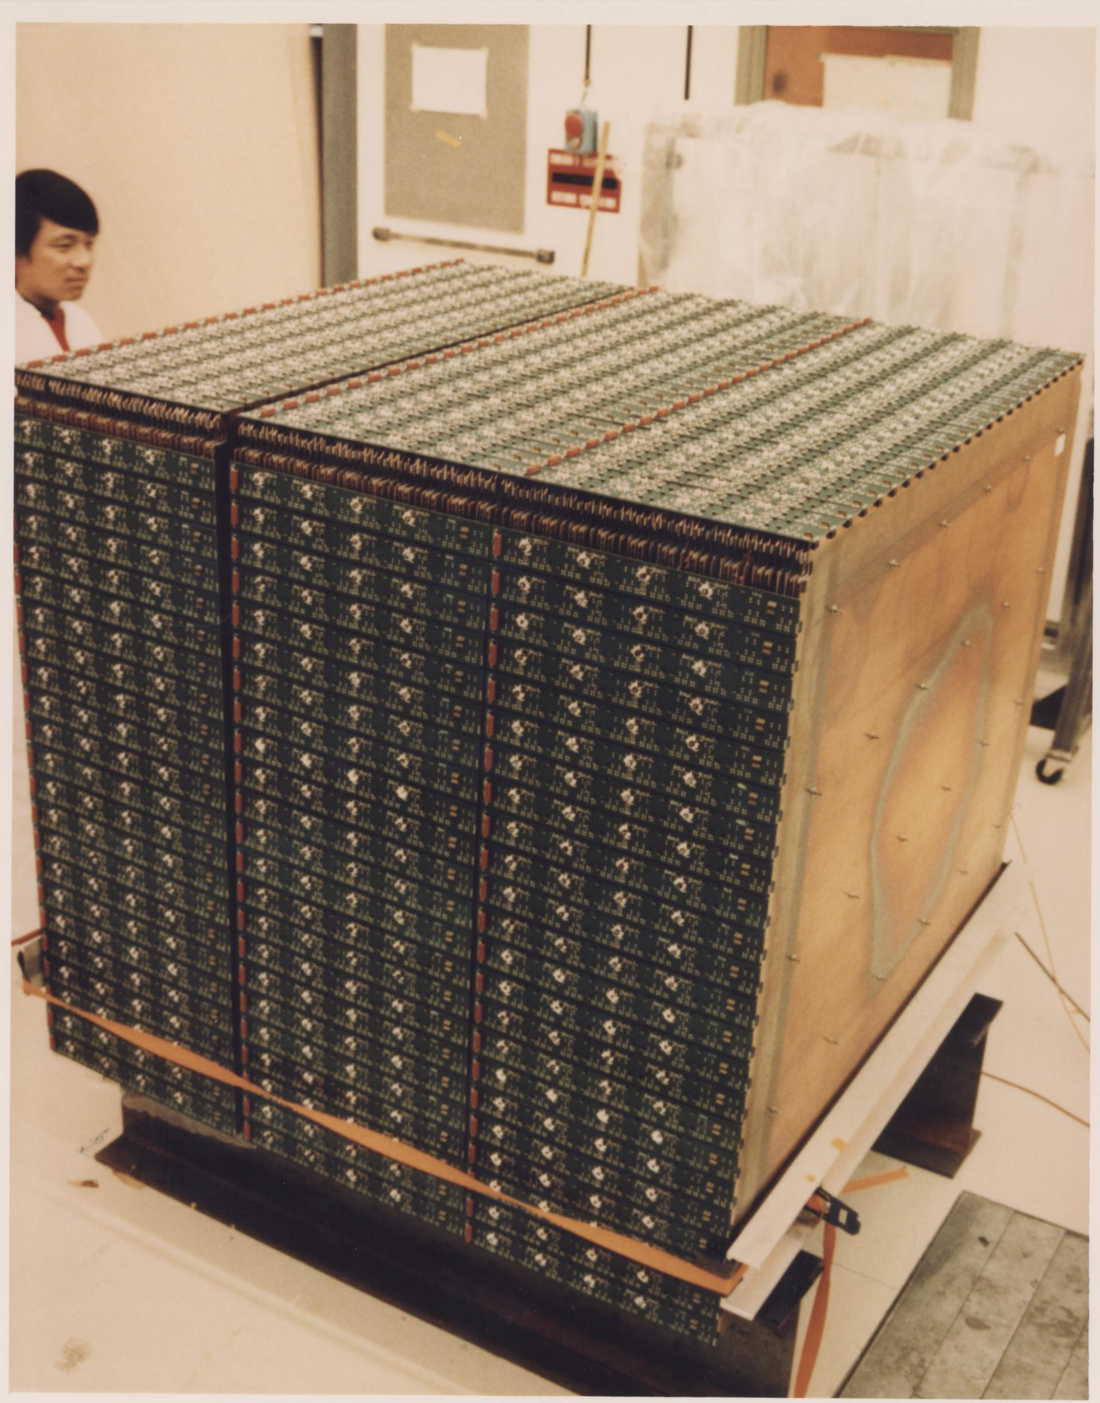
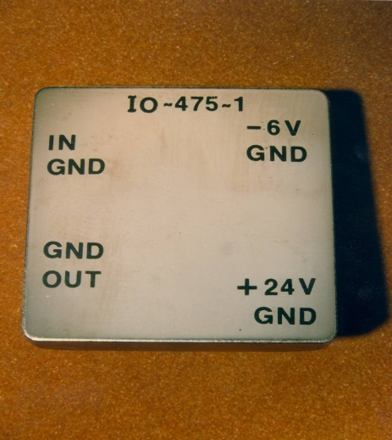
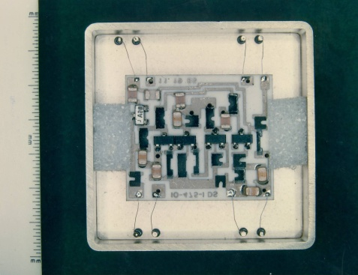
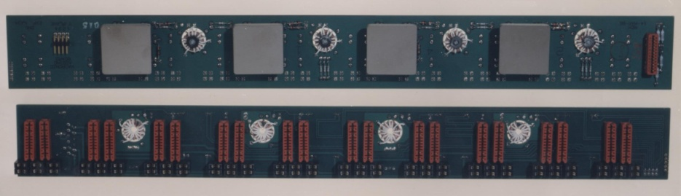
HELIOS Uranium-LAr: Hadronic Module (1987)
576 x and y strips with interleaved readout and preamplifiers operated in LAr
Hideto En’yo looking on …

Slide 10
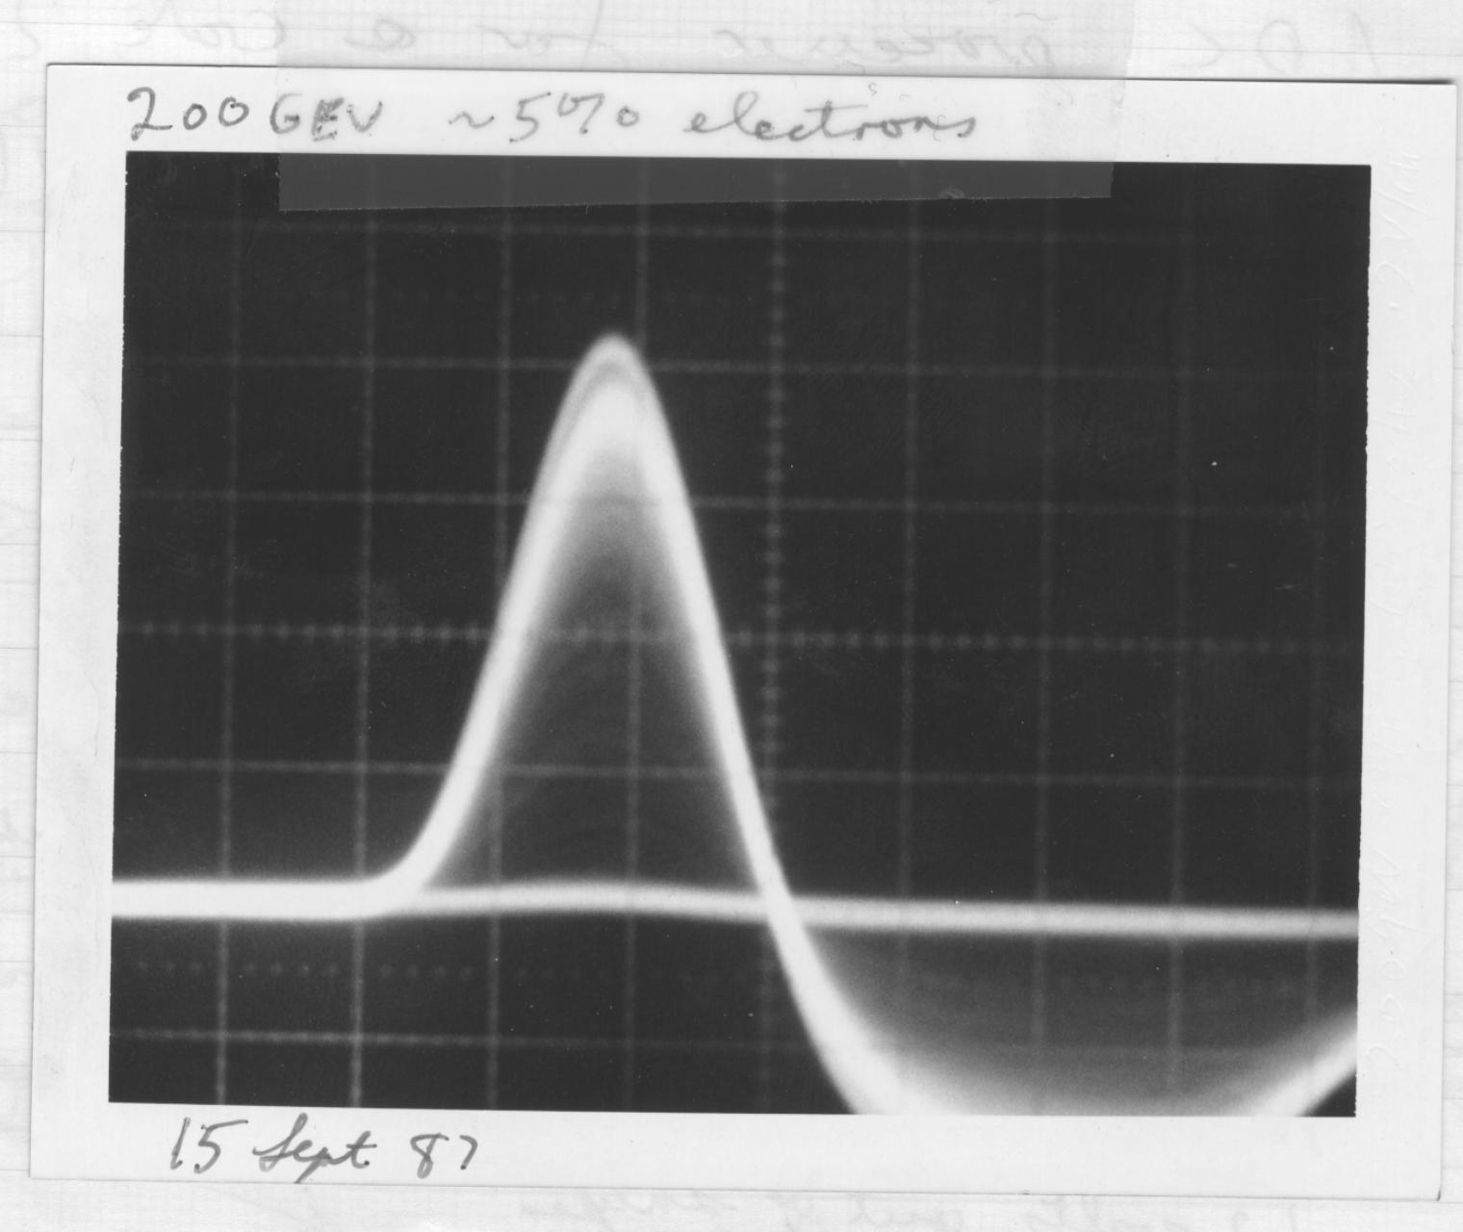
HELIOS Uranium-LAr: Electrons and Pions (e/π ≈ 1.15)
The sum of 576 channels
Energy resolution (single particles):
~21%/E^{1/2}

Slide 11
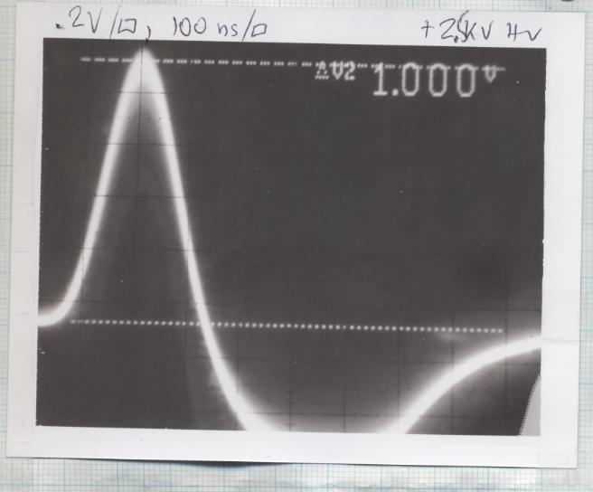
HELIOS Uranium-LAr: Sulphur ions 200 Gev/nucleon
6.4 TeV total

Slide 12
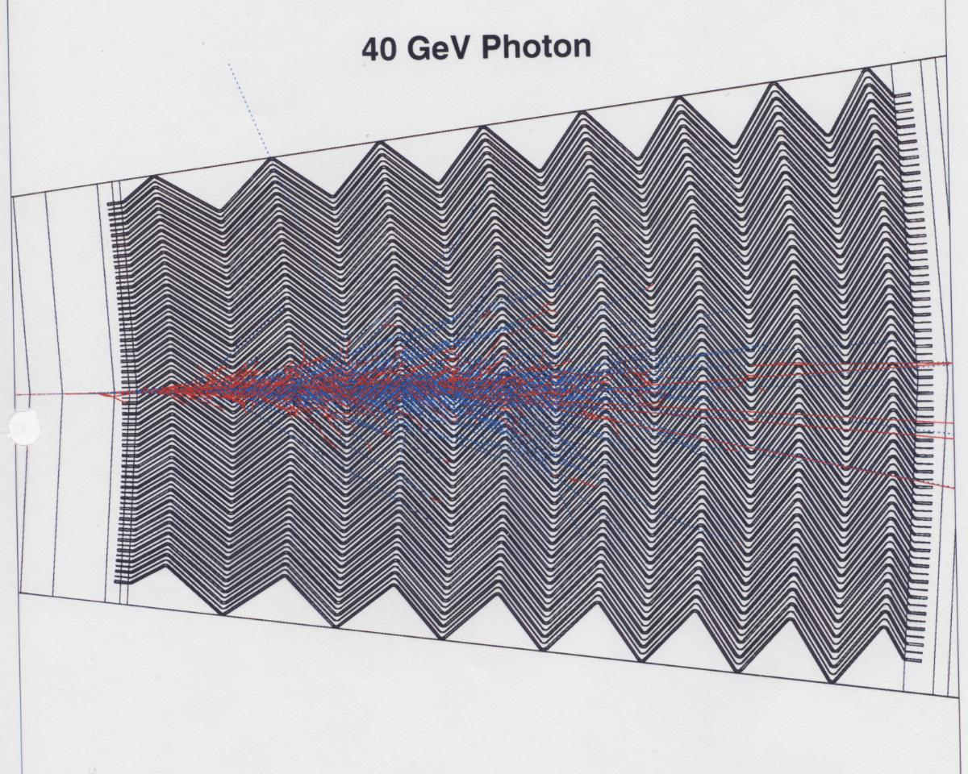
Toward GEM/SSC and ATLAS/LHC: LAr and LKr Accordion EM Calorimetry (accordion by Daniel Fournier in 1990)

Slide 13
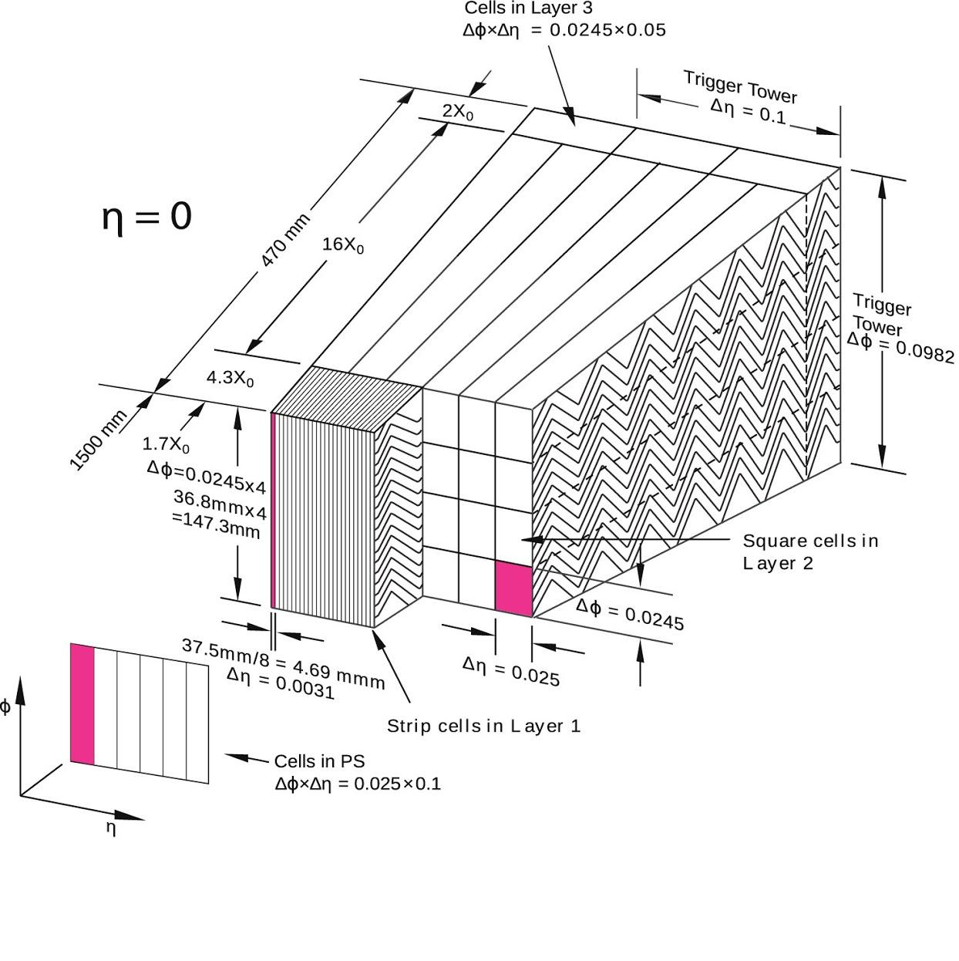
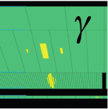
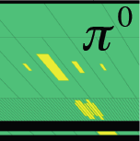
Design of LAr Calorimeter
Accordion-shaped electrodes with pointing feature to ease segmentation (Bo Yu design!)
Excellent energy resolution in large dynamic range (~50MeV to ~3TeV) and precision calibration (< 0.25%)
Trigger Tower: ΔηxΔφ = 0.1x0.1, sum of 60 cells → stringent noise requirement
Fine strip layer to allow efficient π⁰ rejection and high γγ purity
Notes:
Detector design dictated by physics goals → high energy EM final states.
Liquid argon chosen for radiation hardness and speed.
Fast shaping can reduce pileup effects, but requires low inductance from detector to preamps.
Accordion geometry reduces interconnects, and allows this fast rise time even for high granularity.
Hermetic coverage in φ with minimum modulation in response.
Accordion structure chosen to ensure azimuthal uniformity (no cracks).
Calorimeter pointing alone reduces vertex uncertainty from beam spot spread of ~ 5-6 cm to ~ 1.5 cm and is robust against pile-up, good enough to make contribution to mass resolution from angular term negligible.
Cell-to-cell uniformity ensured by mechanical precision and electronics calibration for small constant term.
Fine strip layer to allow efficient pi0 rejection or high rr purity.
EM calorimeter has longitudinal (and lateral) segmentation.
Trigger tower has sum of 60 cells longitudinal and lateral, coherent noise < 5%. Trigger is the place to be improved in Phase-I and HL-LHC upgrade.

Slide 14
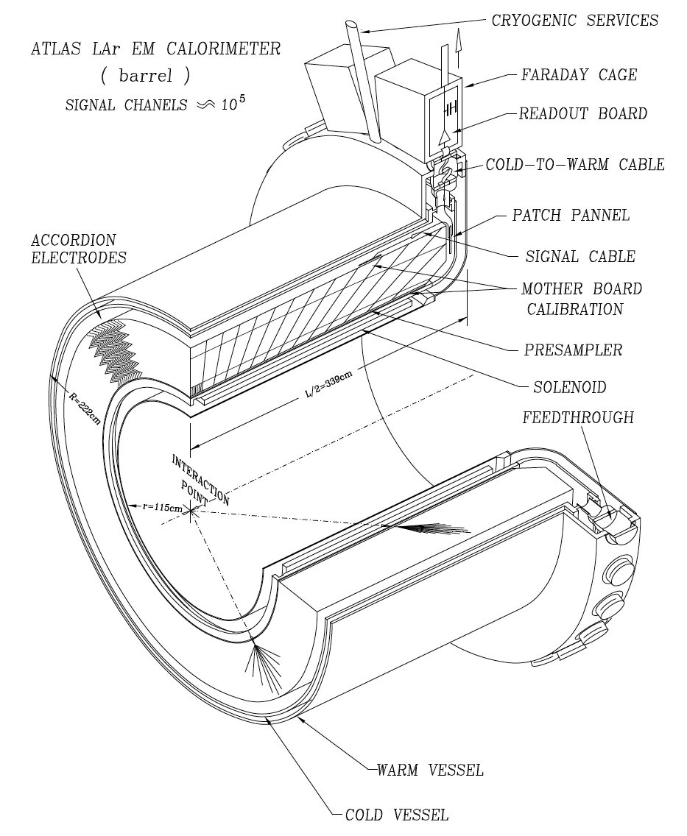
LAr Calorimeter Readout → Faraday Cage with Cryostat
Electrodes
  Calibration resistors, 0.1%
System crate: on detector electronics
  Preamplifier+aml., ADC, SCA
  Monitoring Board
  Baseplane – analog trigger sums
  Radiation Hard Power Supply
An integral system design approach - from detector electrode to readout electronics, plus system integration test. This approach was followed later in MicroBooNE and protoDUNE
Notes:
I started to work on LAr readout system development and integration since 2000
All items highlighted in blue are what I have been involved, with focus on system integration test.
Front end crate serves as an extension of cryostat as Faraday Cage.

Slide 15
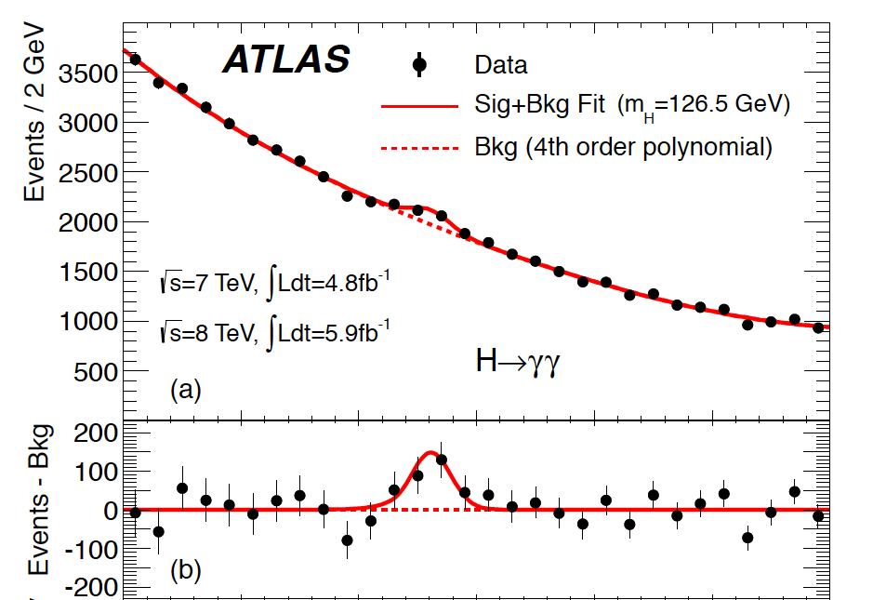
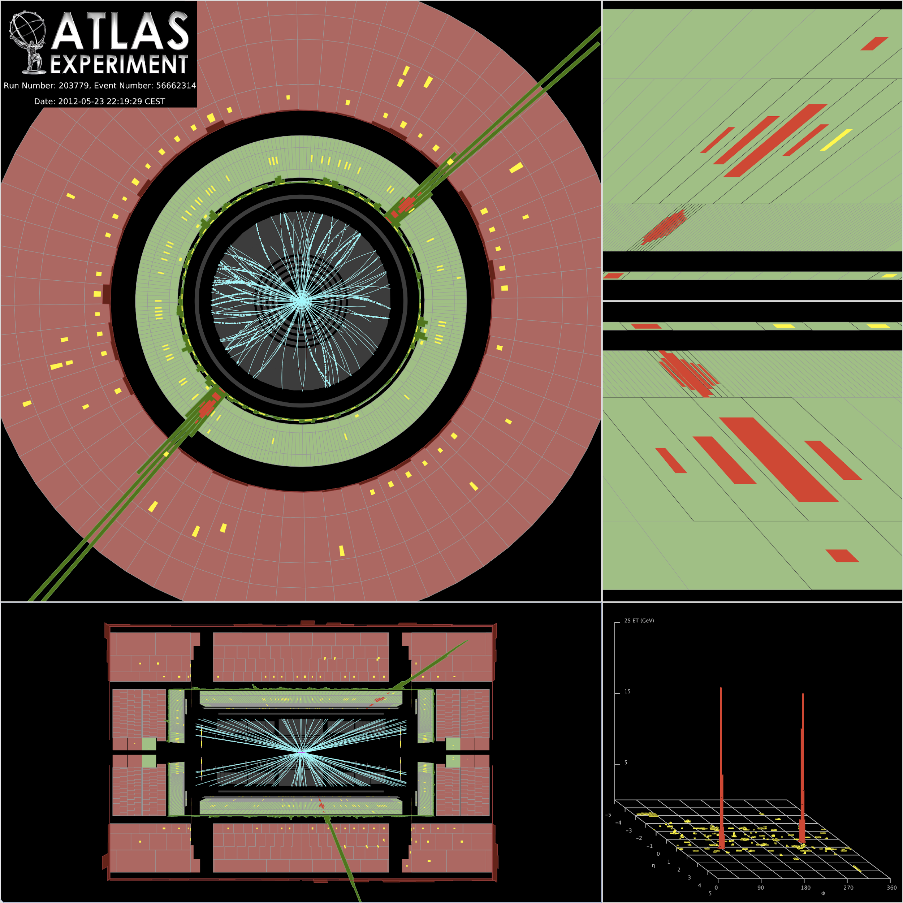
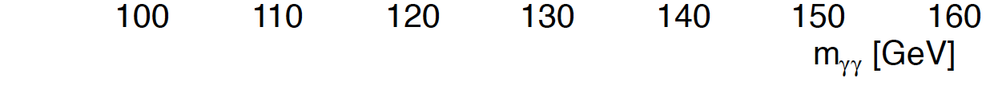
Higgs Discovery in 2012
2012: ATLAS and CMS find evidence of Higgs-like events
ATLAS LAr calorimeter provides more than 5σ confidence level
Notes:
ATLAS higgs paper shows analysis on H -> gg; H -> ZZ -> 4l and H -> WW -> lvlv, LAr calorimeter is the principle subsystem for Higgs measurement, contributes to all of them except H - > ZZ -> 4u channels.

Slide 16
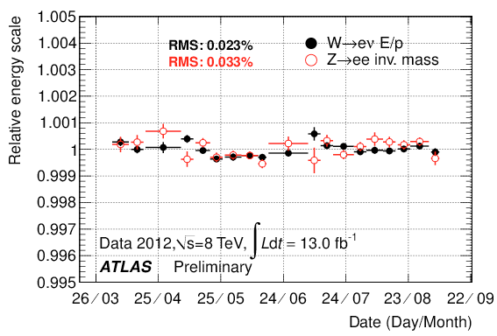
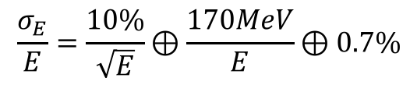
Stability and Performance of ATLAS LAr EM Calorimeter
Temperature stability
  ~5mK
Electronic calibration
  A few per mil
Energy scale stable
  ~ per mil, vs. time and pileup
Excellent energy resolution
  Allows a mass resolution of ~1% for the Higgs between 100 and 200 GeV
Notes:
Temperature stability is 5 mK, while homogeneity is ~50mK (https://twiki.cern.ch/twiki/bin/view/AtlasPublic/LArCaloPublicResultsDetStatus#Liquid_argon_temperature_stabili).
BNL and Orsay (LAL) designed the EM calorimeter. Saclay was involved in construction.

Slide 17
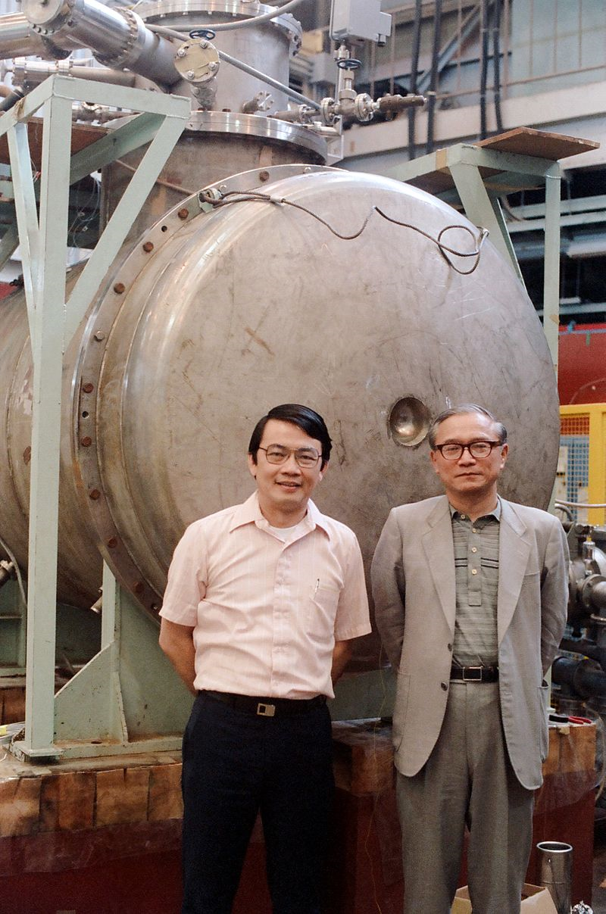
Liquid Argon Time Projection Chambers:
The idea originated from the work of a number of people, (e.g., gas TPC Nygren, 1974). Two focused proposals:
In 1976 Herbert H. Chen, U.C. Irvine proposed one of the earliest uses of liquid argon in a time projection chamber (liquid Ar TPC). Chen's initial goals with such a detector were to study neutrino-electron scattering, but the goals evolved to measure solar or cosmic neutrinos or proton decay.
In 1978 he reported a drift distance of 35 cm (!).
In the eigthies he pursued actively a proposal for a large LAr TPC, an effort cut short by his untimely passing in 1987.
In 1977 Carlo Rubbia proposed to construct such a device at CERN for rare event particle physics experiments. This led to ICARUS, the only large LAr TPC (600 tons) until 2007-2015.
The anode based on three planes of long wires essentially remained into the first DUNE module.
Chen (left) and Tadayoshi Doke (right) at Waseda University in Tokyo in 1986.

Slide 18
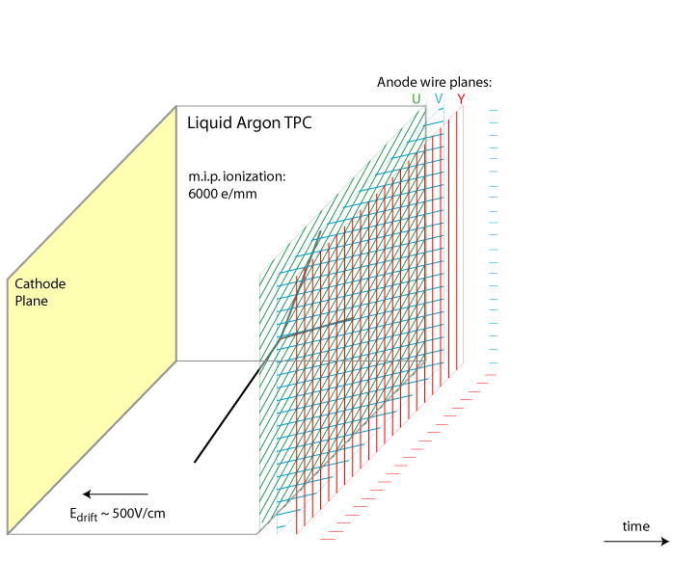
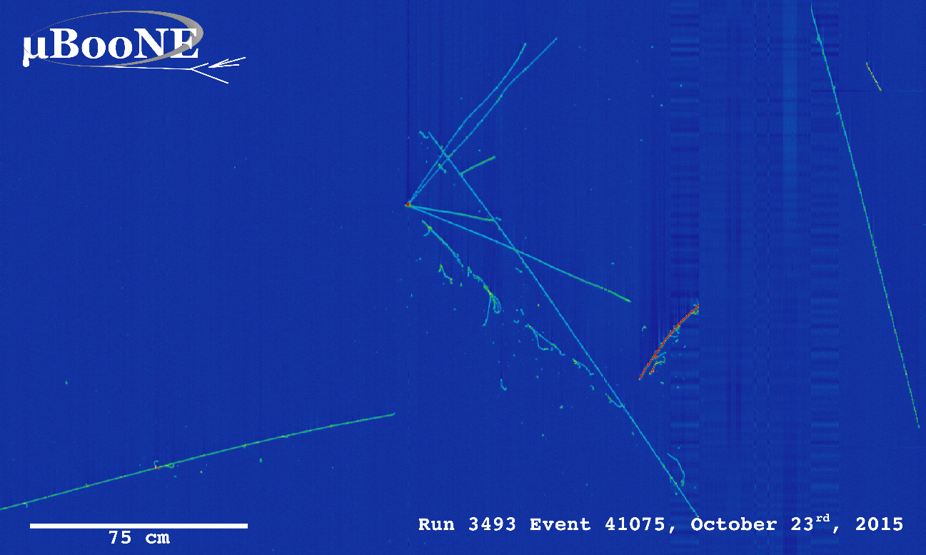
Principle of Liquid Argon Time Projection Chamber (LArTPC)
~mm scale position resolution with multiple 1D wire/strip/pad readouts
By Bo Yu (BNL):
time
Drift velocity 1.6 m/ms → ms drift time

Slide 19
2002-2010
With the new millenium and after the resolution of the solar neutrino puzzle, there was a resurgence of activity on liquid argon TPC detectors …..

Slide 20
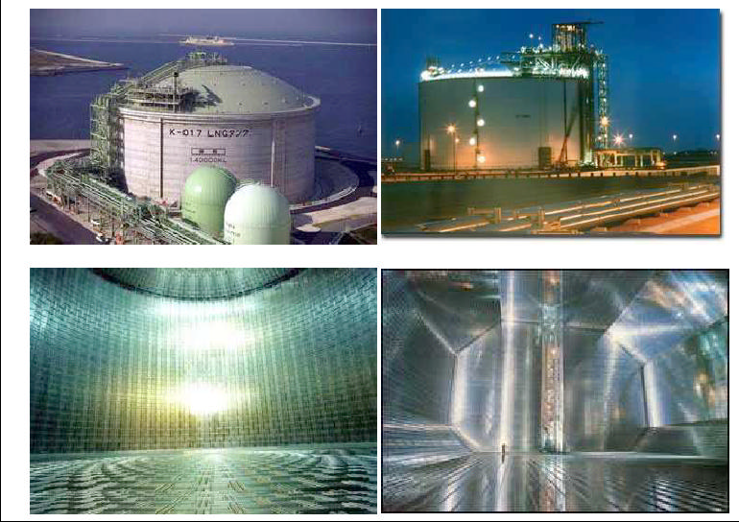
Visions of a Truly Large LAr TPC
How do we get to 100 kt?
LNG

Slide 21
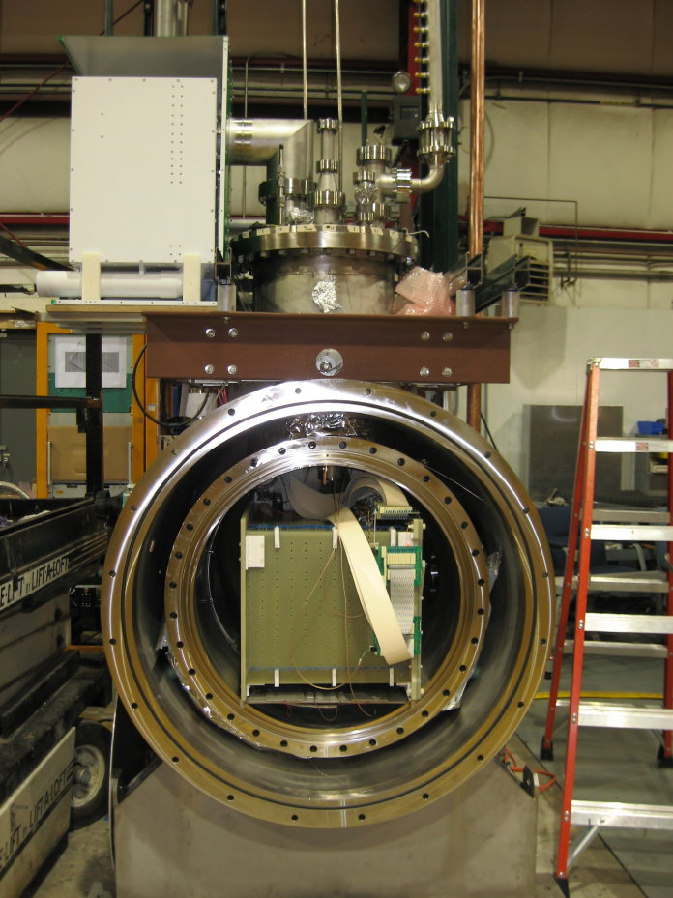
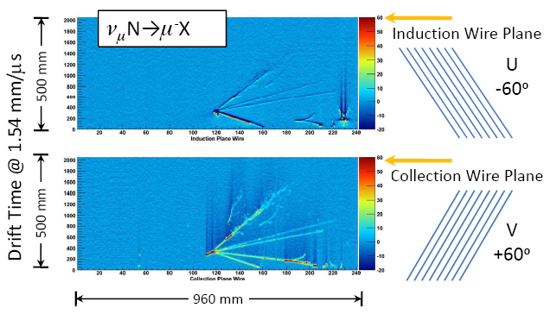
… a more modest start with 175 liters of LAr: ArgoNeuT
2006: Bonnie Fleming receives NSF Career Grant to operate small LArTPC at Fermilab in NuMI location where PEANUT (Fermilab T952) had run previously. She had started previously with a small chamber at Yale.
0.175 m³ (0.244 kg) of LAr
0.5 m drift
3 wire planes, each with 240 wires
4 mm wire spacing
Only 2 planes read out
NuMI neutrino beam

Slide 22
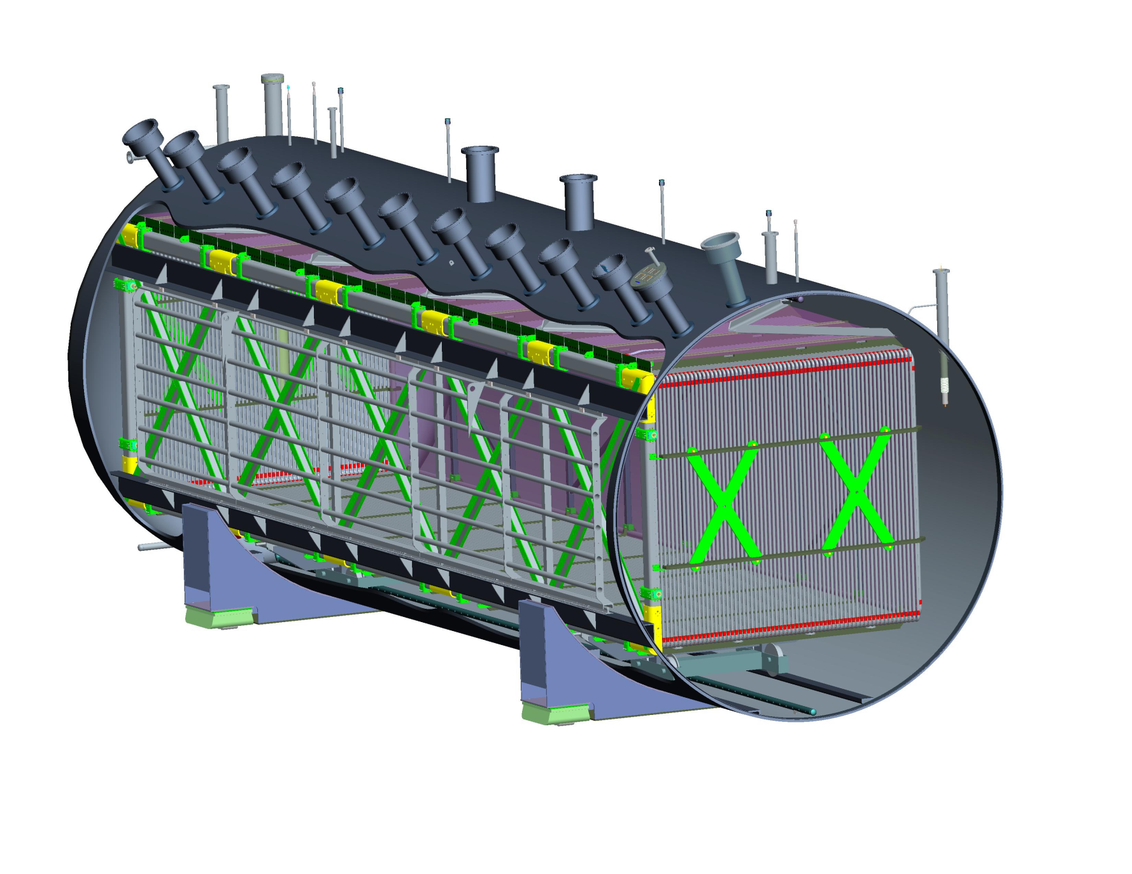
New in MicroBooNE (with respect to ICARUS):
Cryostat uses foam insulation to simplify construction (cryostat, feedthroughs,…).
It will be purged with argon gas instead of vacuum evacuation to demonstrate the feasibility of very large non-evacuable cryostat for LBNE.
All front end analog electronics are submerged in LAr, directly connected to the sensing wires to reduce electronic noise (< 400e in MB vs. ~ 1500e in ICARUS).
2.5 m maximum drift length (vs. 1.5m).

Slide 23
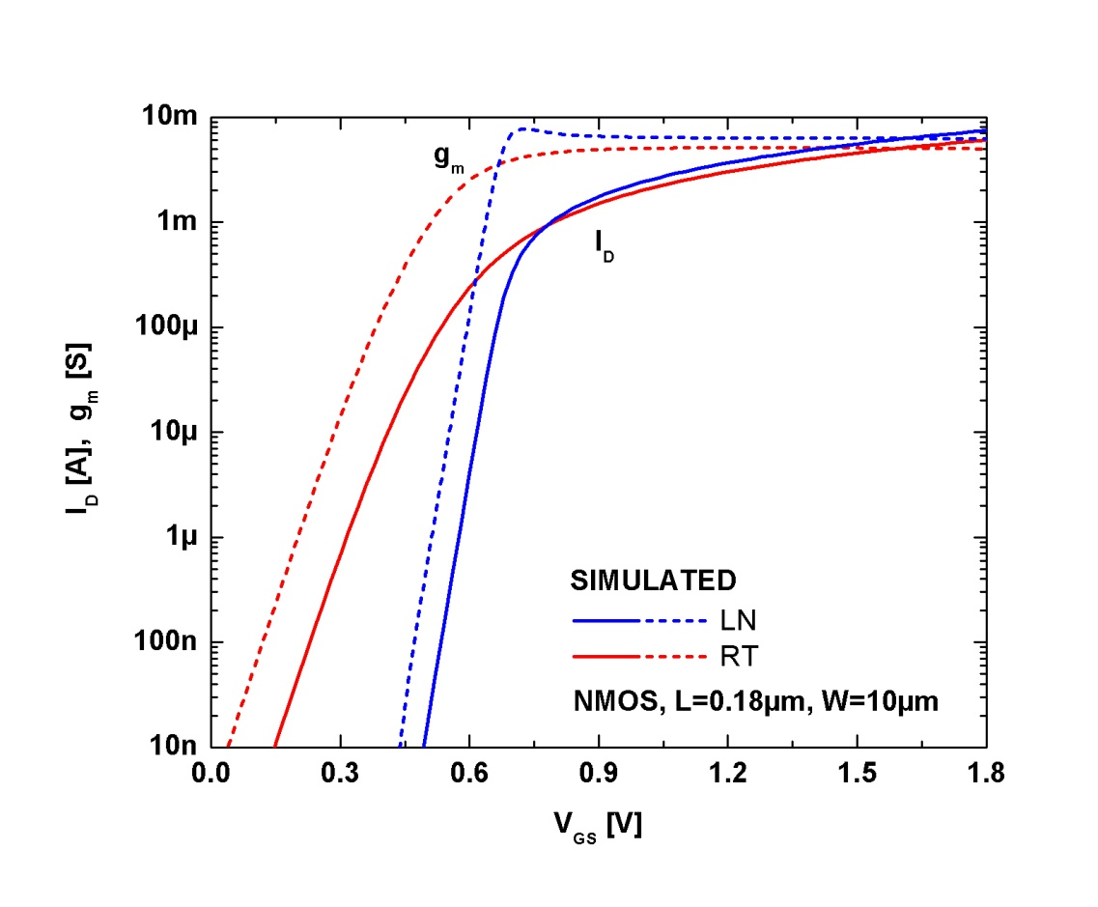
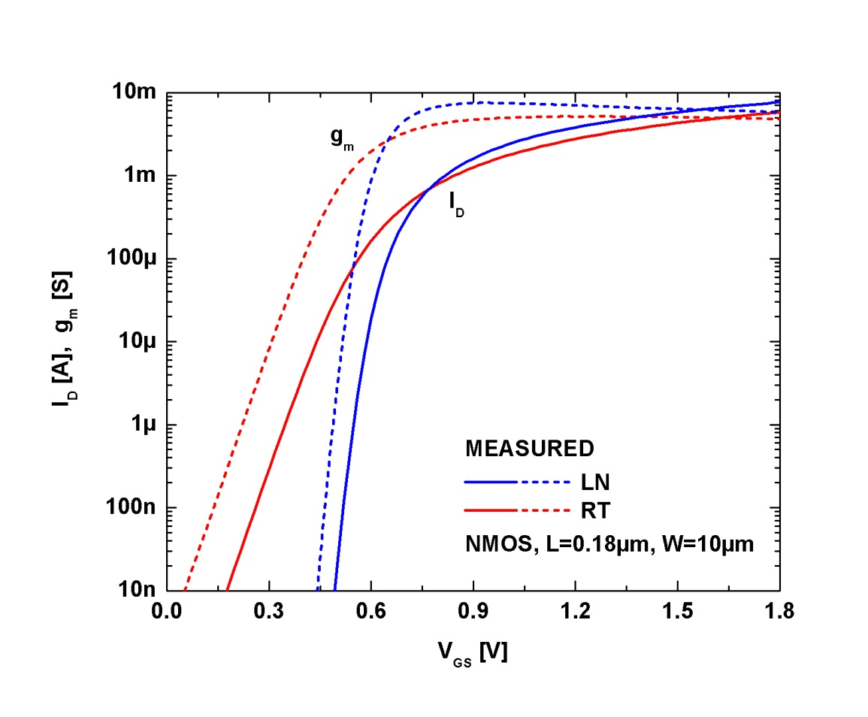
Did God create CMOS to work at 77K?
(higher g_{m}/I_{D} … and lower noise)
MicroBooNE proposal (2007) with cold electronics (discrete JFETs); In 2009 decision made to go with cold CMOS ASICs

Slide 24
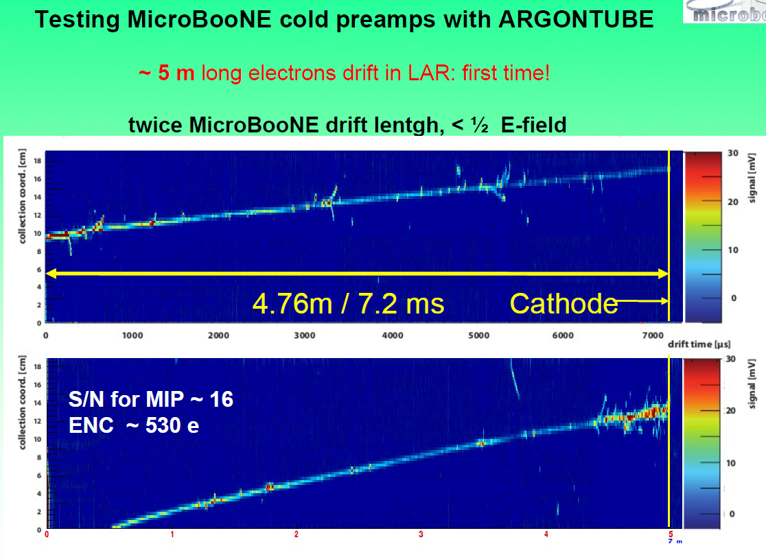
Τ~3.5ms
τ_{e}≈ 3.5 ms
From: Igor Kreslo, Bern

Slide 25
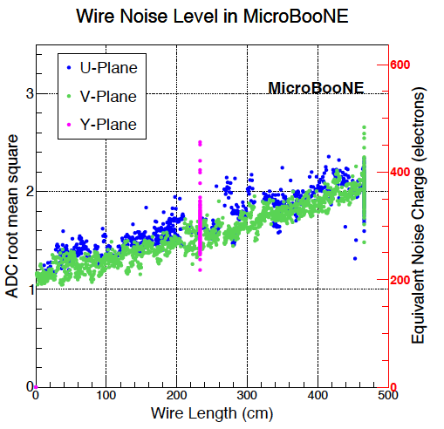
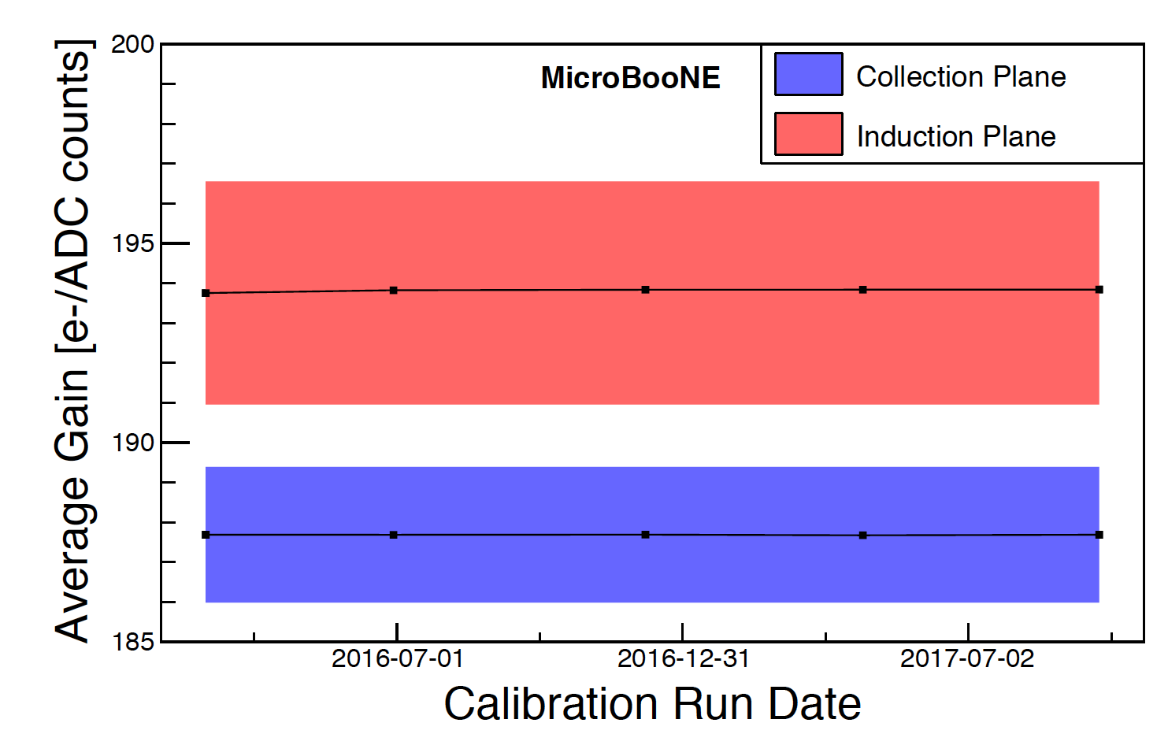
Stability and Performance of MicroBooNE TPC
Electronic calibration
  Cold electronics gain stable over two year period, variation ~0.2%
Excellent noise performance
  ENC after excess noise filtering is < 400 e⁻ for 85% of channels.
Notes:
Gain measurements of the TPC cold electronics channels taken over time, with red and blue colored bands representing the RMS variation of the corrected channel gain in the induction and collection planes, respectively.
The average discrepancy in channel gain measurements between calibration data runs is less than 0.2% and is significantly smaller than the variation in channel gain
within the induction and collection wire planes.

Slide 26
Scaling up to multi-kiloton size?
A key question: Can a large TPC be built with a performance (resolution, S/N) independent of the fiducial volume?
Several institutions were working on modular/cellular concepts.
BNL generated the solutions for the active part of the TPC (electrodes, field cage, cold electronics readout).

Slide 27
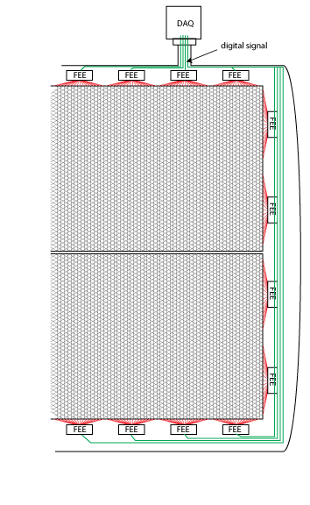
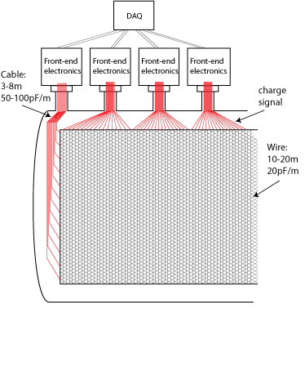
Cryostat Design: “Warm” vs “Cold” Electronics
Cold electronics decouples the electrode and cryostat design from the readout design: noise independent of fiducial volume.
Multiplexing reduces the number of feedthroughs
Signal cable lengths increasing to >10-20 meters for detector fiducial volume > 1kton resulting in high capacitance and high noise.
27
14

Slide 28
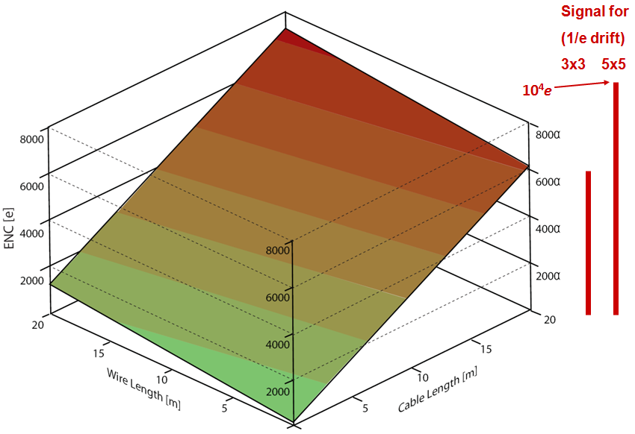
Noise (ENC) vs TPC Sense Wire and Signal Cable Length for CMOS at 300K and 89K
MIP Signal for 3x3 and 5x5 mm Sense Wire Spacing
DUNE with warm electronics (300K)
ENC~6x10³ e⁻ rms
ProtoDUNE
ENC~660 e⁻ rms
CMOS at 77K: ENC<<10³ e⁻ rms
MicroBooNE
ENC~400 e⁻ rms
Notes:
DUNE with warm electronics, noise would swamp the signals
ENC: equivalent noise charge

Slide 29
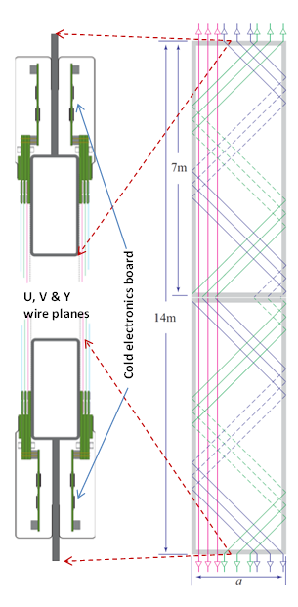
A key development for scalability: Anode Plane Assembly (APA), 2008
APAs are structural and electrical units containing all sense wires and readout electronics.
They can be tested in LN2 and stored and transported in shipping containers.
Concept developed at BNL in 2008
u v y
(x, w)
Wire wrap-around concept due to H. Jostlein (2004)

Slide 30
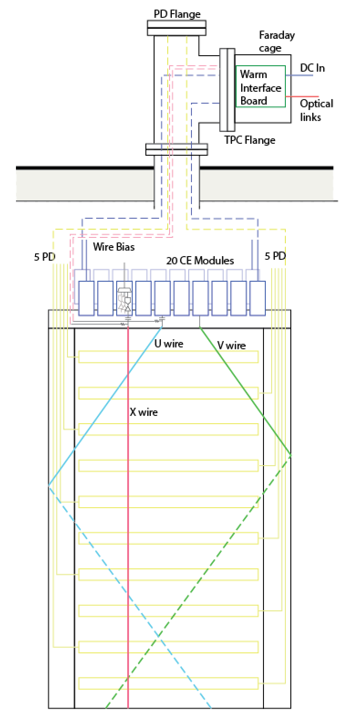
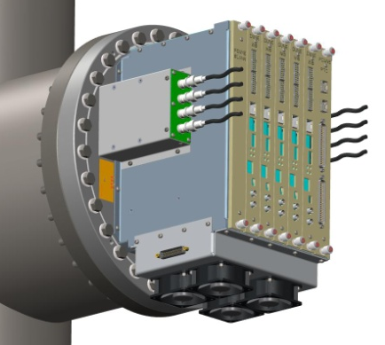
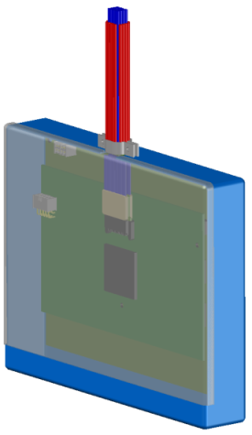
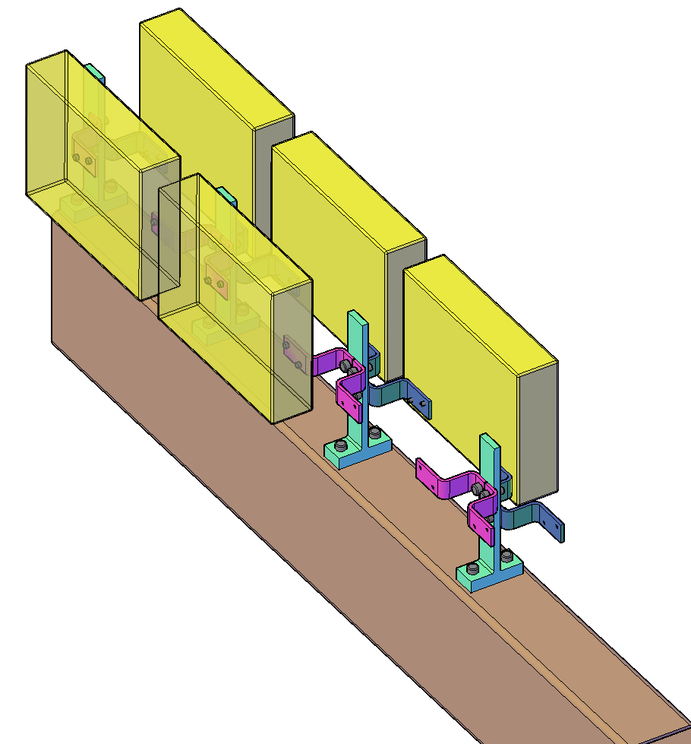
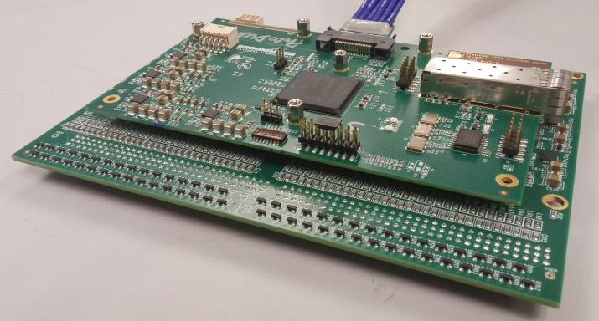
A Critical Concept: Integral System Design
A necessary condition to achieve a good system performance, the integral design concept of APA + CE + Feed-through, plus Warm Interface Electronics with local diagnostics and strict isolation and grounding rules
Cryostat
Cold electronics (CE) module and its attachment to the APA frame
Anode Plane Assembly (APA)
Notes:
System design of large scale complex system with digitization on detector to work with cryogenic and other service systems in cryostat as Faraday Cage.

Slide 31
ProtoDUNE electrical connections within the cryostat ‘The Commandments’:
APAs shall be insulated from each other.
All electrical connections (power and signal) from an APA shall lead to a single feedthrough.
APA frame shall be connected to the COMMON of all FE ASICs.
The COMMON of the FE ASIC and of the rest of cold readout shall be connected to the common plane/enclosure of the cold FE module.
APA Power line return leads and any shields shall be connected to the common plane of the cold FE module at one end and to the flange of the feedthrough at the other end. This shall be the only connection of the APA frame to the cryostat.
APA mechanical suspension from the frame to the cryostat shall be insulated.
The last stage of the sense wire bias filters shall be connected to the frame (i.e., ASICs common).

Slide 32

ProtoDUNE Experiment:
Verifying LAr TPC Technologies for DUNE (and SBND)
Single-phase LAr TPC prototype
  Sits in H4 beam line in EHN1 @ CERN
  Consisting of 6 full-size APA’s plus CPA’s → 2 x 3.6m drift regions
  Total 15,360 TPC channels
  Use photon detectors of different fabrication methods
  Successful operation with beam data taking in 2018
A key test platform for DUNE:
  Components
  Construction methods
  Installation procedures
  Commissioning
  Detector response to particles
e⁻
e⁻

Slide 33
Liquid Argon Time Projection Chamber (LArTPC)
~mm scale position resolution with multiple 1D wire/strip/pad readouts
Bo Yu (BNL):
time
1.5, 2.5, 3.6 m
Drift velocity 1.6 m/ms → ms drift time

Slide 34



DUNE Far Detector
U, V, X wires
12 m
DUNE 10 kt Far Detector (“Module 1”)
  Consisting of 150 APA’s plus 200 CPA’s → 4 x 3.6m drift regions
  Active volume: 12m x 14m x 58m
  Total 384,000 TPC channels
6 m
2.3 m
Notes:
APA assemblies are stacked together with height of 12 meters like a 4 story building.

Slide 35
The Concepts that made scaling up of LAr TPCs possible
Purification of LAr by purging
TPC modular concept, APA
Cold Electronics
Membrane cryostat technology developed by LNG industry made large cryostats feasible.

Slide 36
Future developments
Some ideas under active exploration:
Long drifts
Vertical drift – horizontal APAs/CPAs
pc board anode instead of wire plane
Pixel anode and readout
Charge readout by luminescence light

Slide 37



What is new for LAr DUNE-FD2 : A 3-View Perforated PCB Anode Readout Concept
A 3-view (+/-30°, 90°) strip readout. The substrate of the two PCBs are removed for clarity. One strip from each readout plane is highlighted.
E₂
Induced current waveforms from a strip in each view for a point charge passing through the middle of each strip.
V3=+900V
V2=0V
E₁
V1=-340V
e
V_{shield}=-1240V
Typical PCB thickness: ~3mm
PCB separation: ~1cm
Hole size: 2-3mm
E_{D}
The first plane (“grid”) facing the drift volume is not segmented, it is used for shielding the readout strips from charge injection from the cathode.
With proper bias voltage on each plane, ionization electrons can be pulled through multiple planes (induction views) without loss and be collected on the last one (collection view).
Concept developed by F. Pietropaolo (CERN) and B. Yu (BNL)

Slide 38

FD2-VD CRP Bottom Drift Electronics System
Total 245,760 cold electronics channels
  15,360 FE/15,360 ColdADC/3,840 COLDATA ASICs
  1,920 FEMB assemblies
  80 sets of cold cable bundles and patch panels
  80 sets of signal feed-throughs on 40 cryostat penetrations
  80 WIECs
    480 WIBs
    80 PTCs
    80 PTBs

Slide 39


DUNE Far Detector: FD2-VD
Top Drift Electronics (TDE)
Charge Readout Plane (CRP)
Bottom Drift Electronics (BDE)
DUNE second 10 kt Far Detector: FD2-VD
  Consisting of 160 CRPs plus 80 cathode modules → 2 x 6 m vertical drift regions
  Active volume: ~12 m x 14 m x 60 m
  Total 491,520 TPC channels: TDE + BDE
BDE for the 80 CRPs on the bottom drift volume are the same as FD1-HD
  Total 245,760 TPC channels read out by cold electronics

Slide 40



A footnote:
With LAr TPCs we have gone a long way from the bubble chambers of fifty years ago, with certain aspects not much different:
Charmed baryon decay (Bubble chamber1975)
From: C. Rubbia 1977
CF₃Br was used in bubble chamber Gargamelle for neutrino detection 1970-1978

