Slide 1

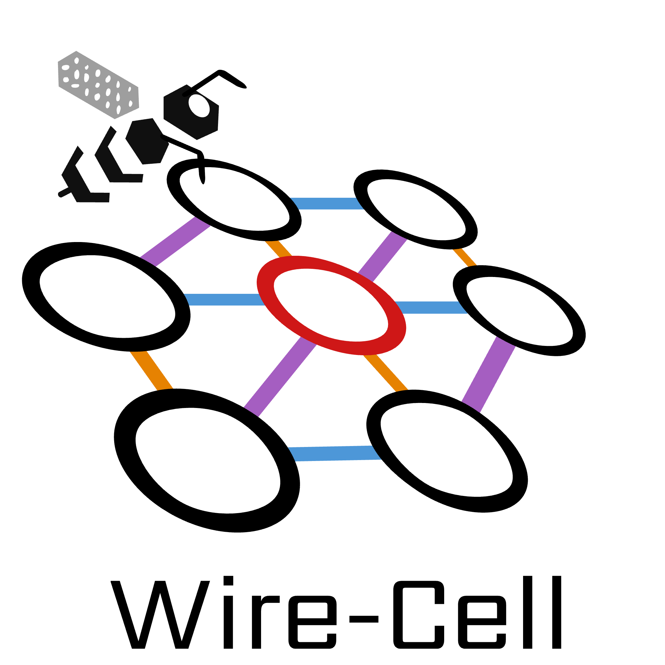
Wire-Cell Pattern Recognition and AI/ML
Haiwang Yu (BNL)
https://www.bnl.gov/wirecellsummit/
Notes:
Hi I am Haiwang Yu. Currently working at BNL. Thanks a lot for Jingbo’s invitation and organization of this Colloquium.
As Jingbo introduced, I have a background in nuclear physics and consider my self a newbie in the neutrino field.
Meanwhile, my personal interests are in algorithm and software developments, which can be universal in some sense.
So, I will try my best to summarize the experience from the BNL wire-cell team for the past 7 years.
And bring you today’s topic “LArTPC Reconstruction for Neutrino Experiments.”

Slide 2

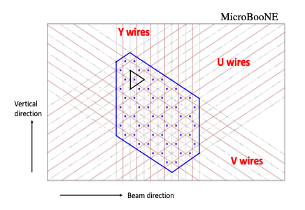
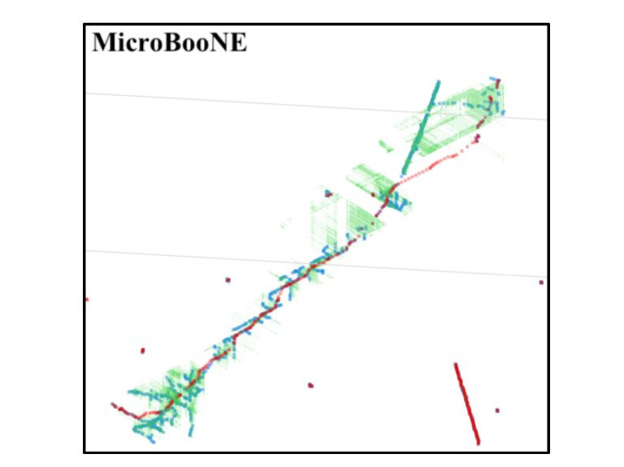
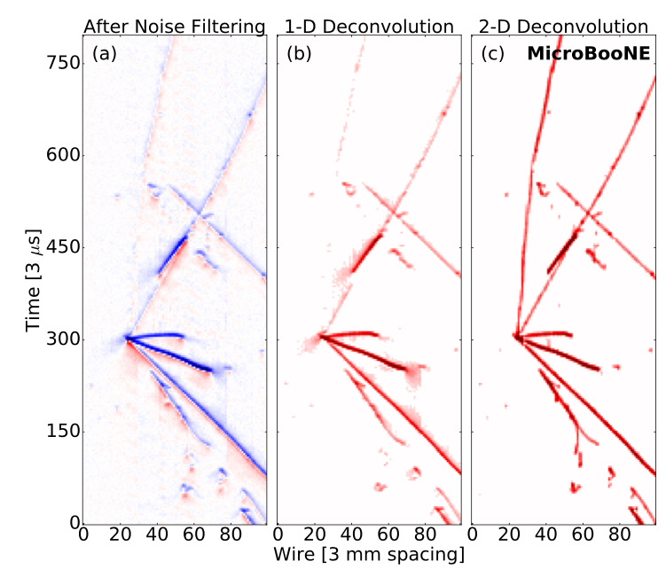
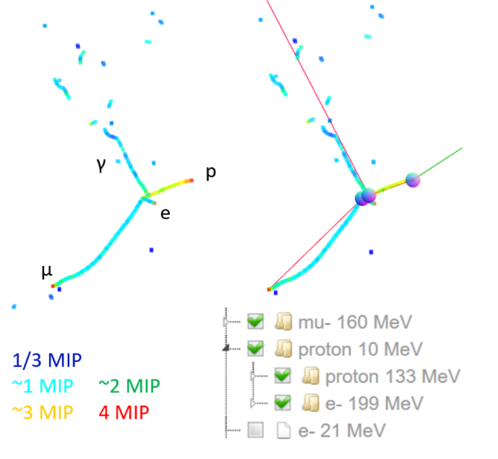
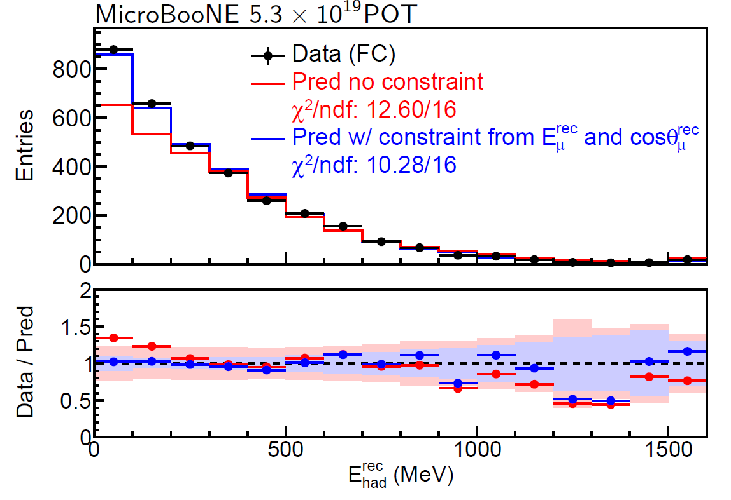
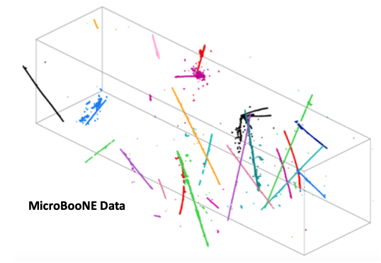
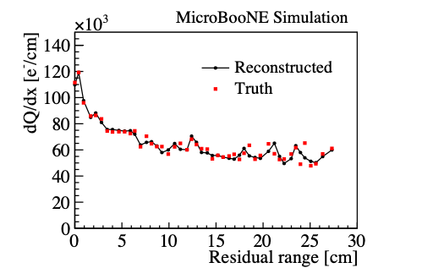
Wire-Cell Event Reconstruction
W. Gu’s Talk
This talk
TPC simulation
noise filtering
signal processing
3D imaging
clustering
charge-light matching
3D trajectory &
dQ/dx fitting
cosmic muon tagger
multi-track fitting
DL-3D 𝑣-vertex ID
particle identification
Energy estimator
𝑣-flavor ID
Model validation
Statistics
Data Analysis
PRApplied 15 064071 (2021)
JINST 12 P08003 (2017)
JINST 13 P07006 (2018)
JINST 13 P07007 (2018)
JINST 16 P01036 (2020)
JINST 13 P05032 (2018)
JINST 16 P06043 (2021)
JINST 17 P01037 (2022)
PRD 105, 112005 (2022)
PRL 128, 151801 (2022)

Slide 3
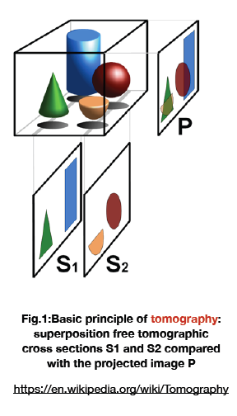
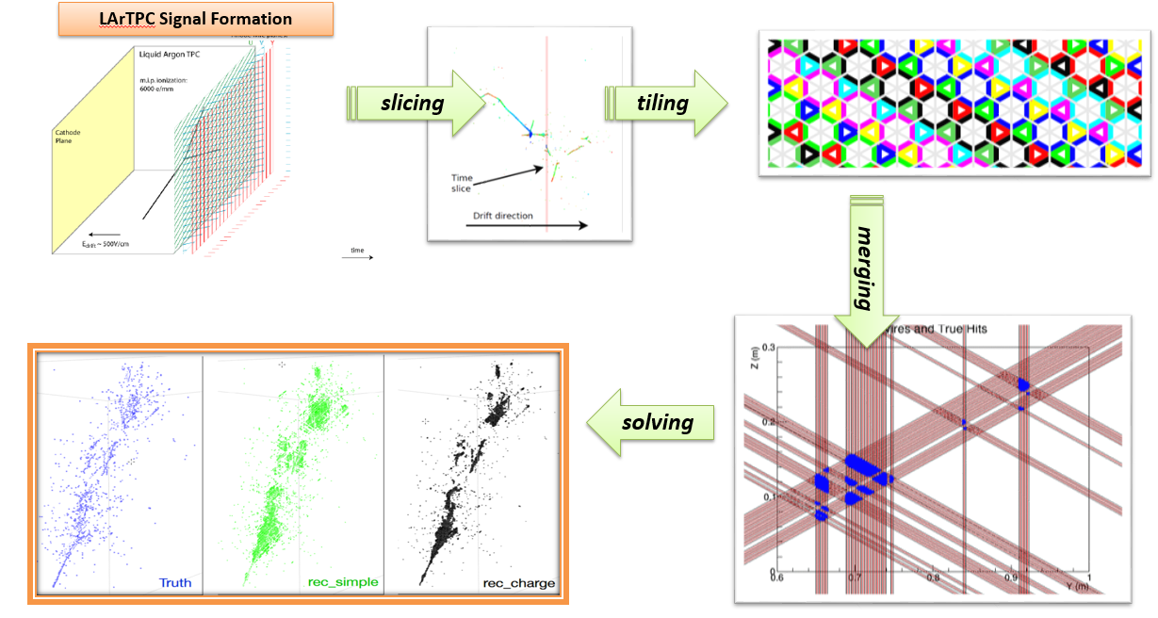
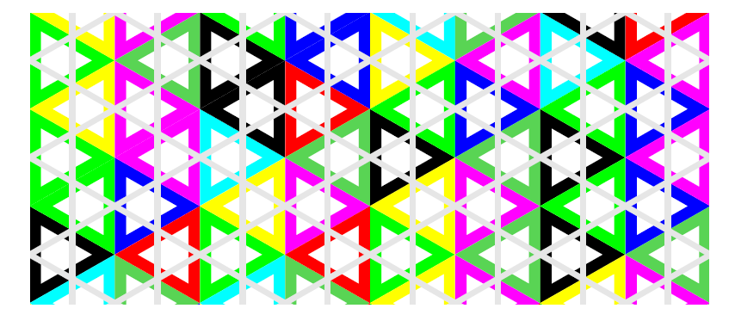
Wire-Cell 3D Imaging Principle
“Wire-Cell”
“Three-dimensional Imaging for Large LArTPCs”, JINST 13, P05032 (2018)
Notes:
The wire-cell 3D imaging is topology-agnostic, meaning no pattern recognition is needed for this step.
The principle is similar as computer aided tomography.
Here, axial slicing is replaced by time slicing. Filtered back propagation is replaced by tiling and solving.
Original tiling builds triangle shaped cells like this by requiring coincidence of multiple active layers. That is where “wire-cell” got its name.
Neighboring cells are merged into larger polygons or “blobs” in the initial version.

Slide 4
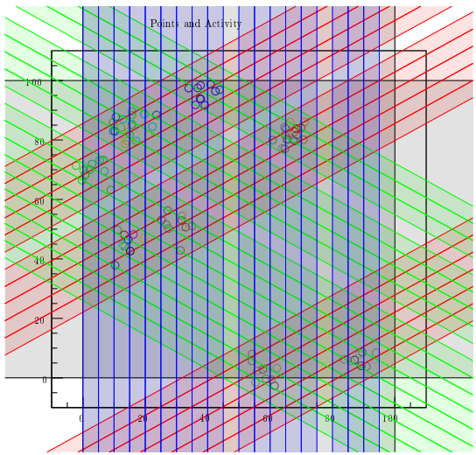
Wire-Cell 3D Imaging Principle
B. Viren’s “Grid Tiling”
“Three-dimensional Imaging for Large LArTPCs”, JINST 13, P05032 (2018)
Notes:
One major improvements we made during this porting campaign is the tiling and merging ad achieved in one step of tiling.

Slide 5
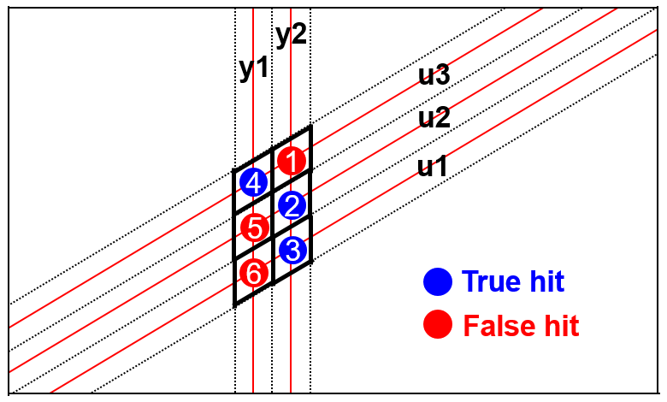
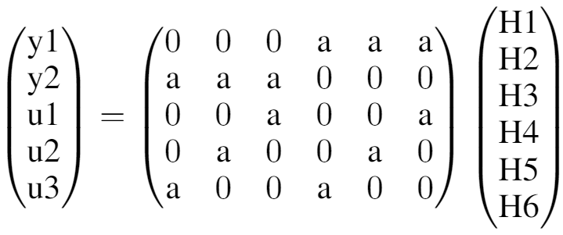

Solving: usage of Charge, Sparsity, Positivity, Proximity
measured charges on Wires
$$y=A ⋅X$$
true charge to be resolved
matrix determined by geometry, a=1
The goal is to differentiate the true hits from fake ones by using the charge information
  ~ large charge → true hits
  ~ zero charge → fake hits
Sparsity, positivity, and proximity information are added through compressed sensing (L1 regularization)
E. Candes, J. Romberg, T. Tao
arXiv-math/0503066
Notes:
Compared to CT machines, LArTPC only has limited number of views, which creates additional challenges. Let’s look at a 2-view example.
Let’s assume we have three true hits, which fire five wires. By looking at the crossing point, we have six hit candidates with three being true and the others being false.
With geometry, we can form a linear equation connecting the unknown charge at each hit location to the measured charge on each wire.
In principle, we can invert this matrix and solve the charge at each hit location.
But the problem is that this matrix cannot be inverted, given we have five constraints and six unknowns.
Meaning this is an underdetermined system.
To solve this problem, one has to utilize sparsity, positivity, and connectivity information in addition to the charge information through a technique called compressed sensing.
Here, sparsity means that not all hits can be true hits.
positivity means that the charge at each hit location cannot be negative.
And connectivity means that the charge deposited in true hits tends to be connected with other true hits.

Slide 6
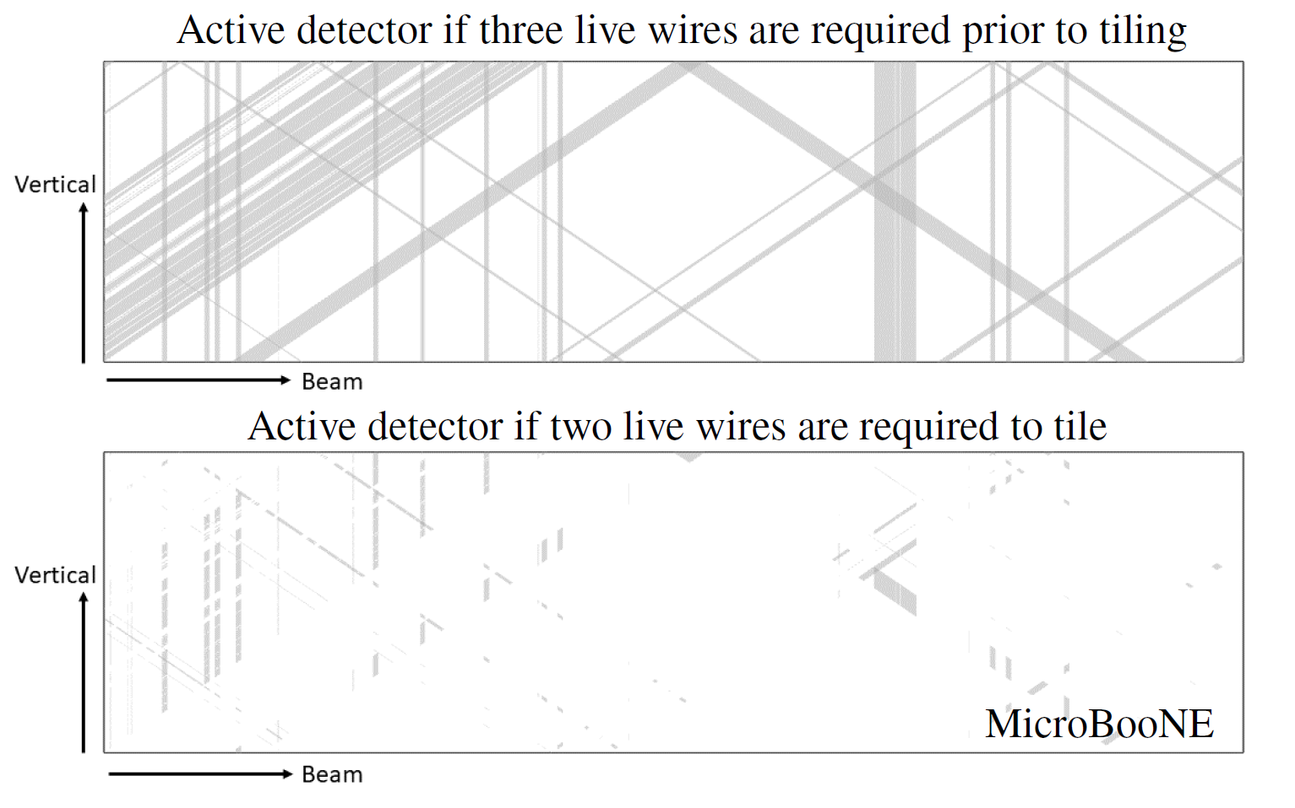

Overcome Challenges of 10% non-functional channels
Impact of 10% non-functional channels is reduced from ~30% → ~3% dead volume by requiring only 2 out 3 wire planes in reconstruction when necessary
  Utilizing coverage of 3 planes, but generating a lot of fake 3D activities (ghosts)
  Dedicated algorithm in deghosting, clustering, charge solving etc. have to be developed
Before deghosting
JINST 16, P06043
30% dead volume
After deghosting
3% dead volume
Notes:
In addition, In real life, detectors are usually not perfect, uboone for example, has about 10% non-functional channels.
Which created a big challenge in the later event reconstruction, since it represents 30% dead volume if we only consider regions with all 3 planes active.
This impact was reduced from 30% to about only 3% by reducing the requirement to 2 out of 3.
The downside of this approach is a lot of fake 3D activities or ghosts are generated.
This challenge was overcome by developing dedicated algorithms in de-ghosting, clustering, and charge solving.

Slide 7
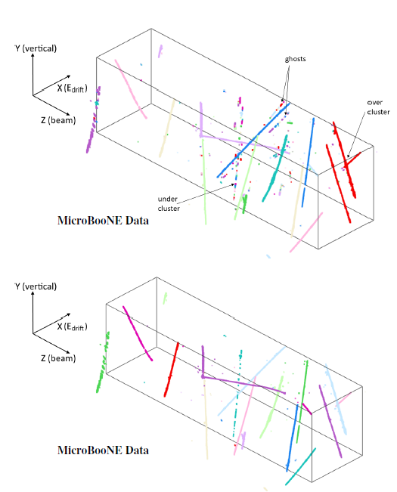
Clustering
Slide from Chao
same color: same cluster
Cluster 3D points into individual objects based on proximity
  Tool: k-d tree, an efficient space-partitioning data structure for organizing spatial points
Realistic issues:
  gaps caused mainly by dead channels → under-cluster
  accidentally overlapping tracks → over-cluster
  Residual ghosts

Slide 8
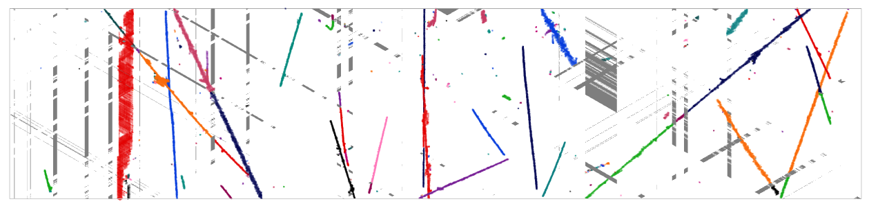
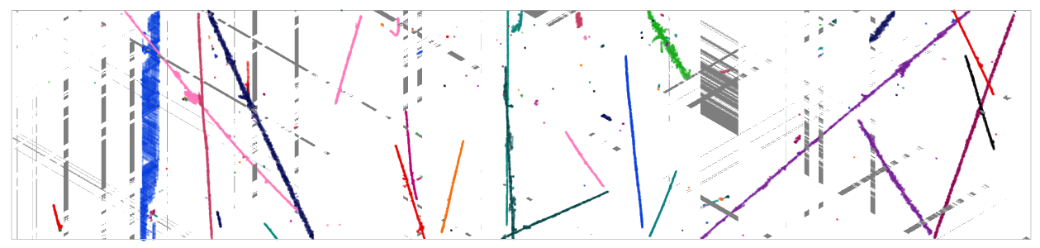
Clustering in WCT
Partially available in WCT
Preparing for following PatRec
  Q-L matching, Traj. fitting, etc.
Currently most heuristic -> very likely replaced/improved by AI/ML
https://www.phy.bnl.gov/twister/bee/set/b2dbddbe-e11a-4d7c-a1d2-a00d929ac7f4/event/6501/

Slide 9
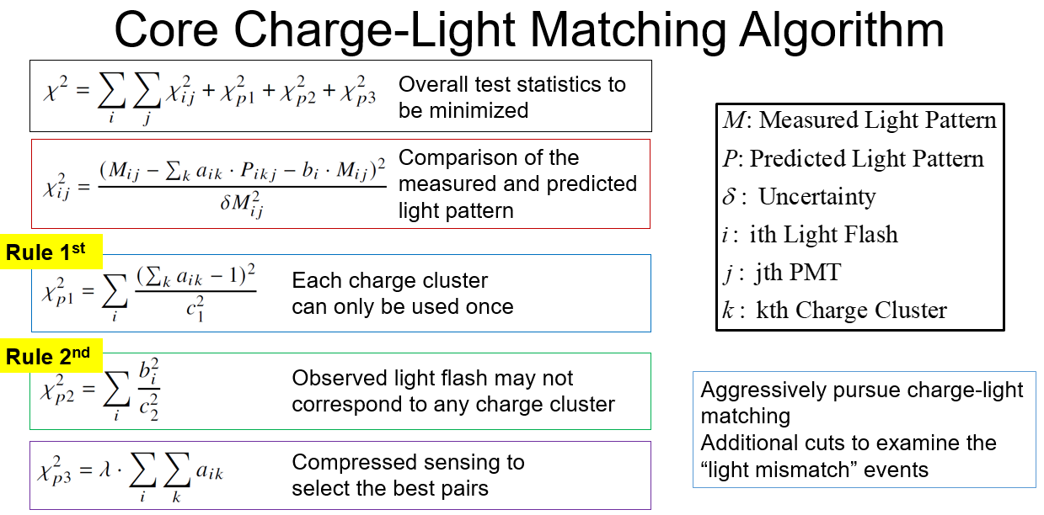
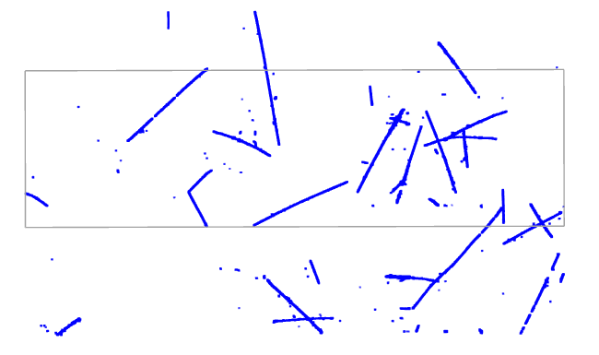
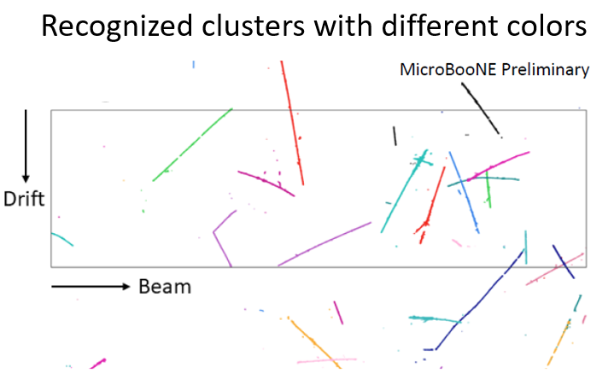
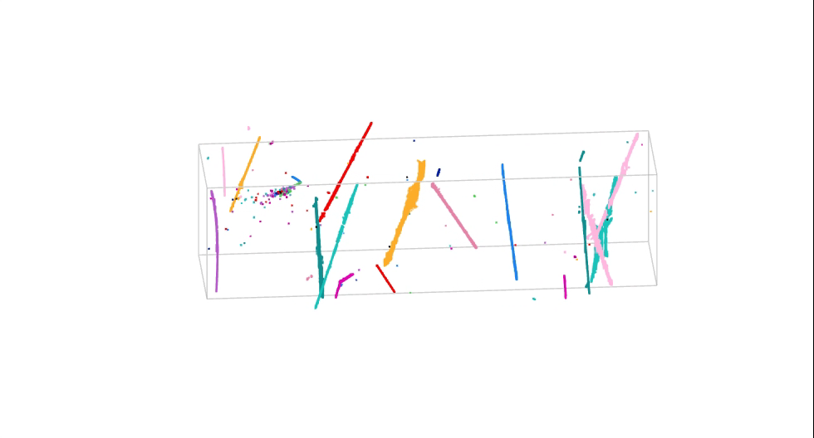
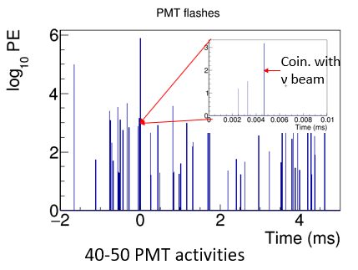
Matching Principle
4.8 ms drift window
JINST 16 P06043 (2021)
Matching Hypotheses
Clustering
3D Image
Light Reconstruction
Hypotheses Selection
20-30 TPC activities
Light signal proportional to (reconstructed 3D) charge
Known light acceptance given position
Predicted vs. Measured light pattern with Compressed Sensing
All possible hypotheses
One cluster → at most one flash (inefficiency in the light system)
One flash → many or zero TPC clusters within corresponding active volume (activities in inactive volume)
Notes:
Here is how this algorithm works. We have 20-30 TPC charge activities.
At the same time, we have 40-50 PMT light activities.
First, we perform a charge clustering algorithm to group all reconstructed 3D charge into separate clusters, each cluster represents a possible particle or physics activity.
Then, all possible hypotheses of charge-light matching pairs are calculated in P_ijk.
Then 3 extra constrains are added
1, each TPC cluster can be only used once;
2, some light may won't match due to e.g., TPC activities outside the active volume;
and 3, L1 regularization for compressed sensing.
This animation shows one charge-light matching result by showing individual TPC clusters, the predicted PMT pattern in green and the measured PMT pattern in red.
Given the matched charge-light pair, if we cut on the light signal in coincidence with the beam, we can select the neutrino interaction candidate.

Slide 10
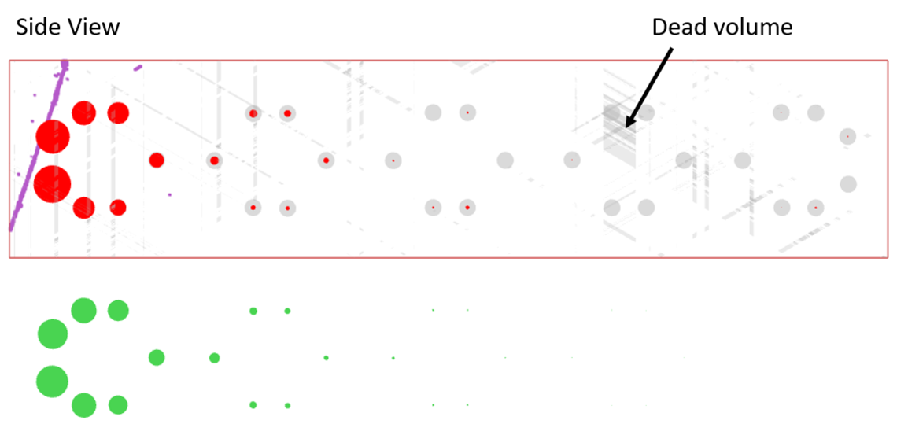
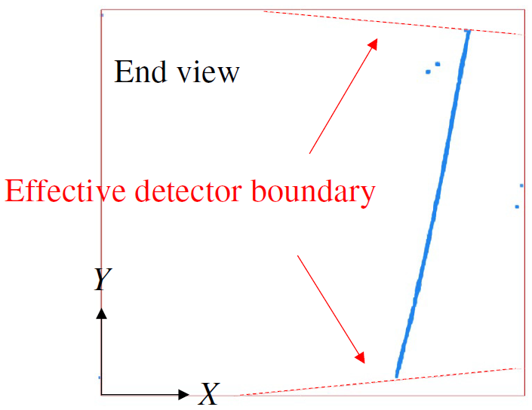
Rejecting Through-Going Muons (TGM)
Only event with flash(light) time matching the neutrino beam spill window is a neutrino candidate
Y
TGM: cosmic-ray muons go all way through the active TPC volume
Z (beam direction)
Identification: the two endpoints of TPC cluster at/outside the effective detector boundary
Effective detector boundary because of space charge effect
Neutrino:Cosmic-ray
Charge-light matching
1 : 6.4
Fiducial volume used in analysis: 3 cm inside the effective boundary
Improved by factor of 6
TGM rejection
1 : 0.9
Notes:
With the charge-light matching, the main background is the cosmic muon in random coincidence with the beam spill.
Within which, The dominated one is the through-going muons that cross through the active TPC volume.
This kind of background can be identified by examining if the two end points of the TPC clusters are outside the effective detector boundary.
After rejecting this kind of through-going muon background, we improve the neutrino signal to noise ration from 1:6.4 to about 1:1.

Slide 11
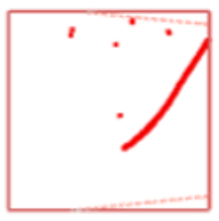
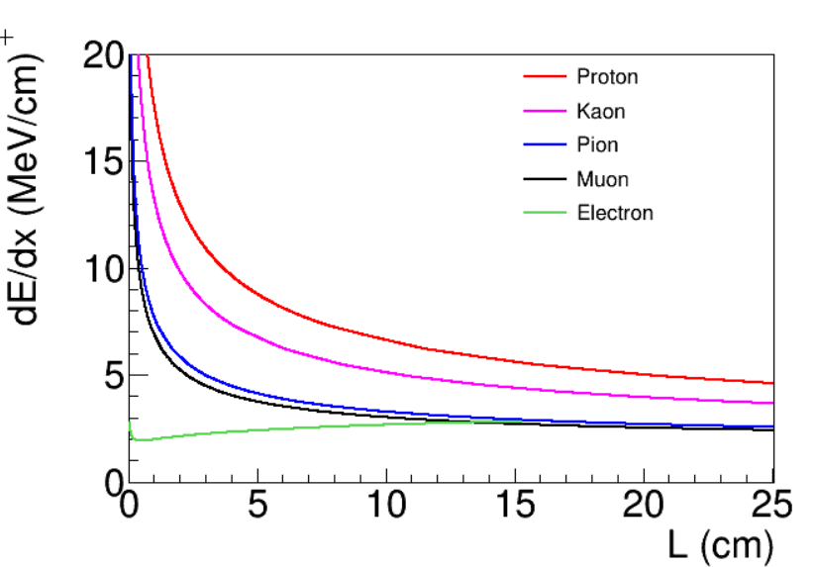
Rejecting Stopping Muons
STM: cosmic-ray muons enter and stop inside the active volume
Y
Identified by directionality: from outside to inside
  Tracks from neutrino activities will go out of detector from inside
  Tracks from background will enter the detector from outside
X (drift direction)
Trajectory and dQ/dx fitting → Bragg peak → directionality
dQ/dx vs. residual range is also important for the particle identification for tracks
Notes:
The second largest background is the random-coincident cosmic-ray muon stopped inside the detector. The topology of this kind of background is very similar to the case where you have a neutrino interaction, and the muon exiting the detector.
This kind of background can be rejected by identifying the direction of the track:
tracks from neutrino activities start from inside and end outside
while the bkg. stopping muons start from outside and end inside.
The direction of the track, can be determined by searching for the Bragg peak near the stopping point. At the same time, the charge per unit distance: dQ/dx vs. the residual range is also important to perform particle identification for tracks.
To achieve this, Wire-Cell invented a new algorithm to fit the track trajectory as well as the dQ/dx.

Slide 12
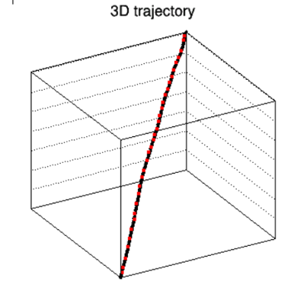
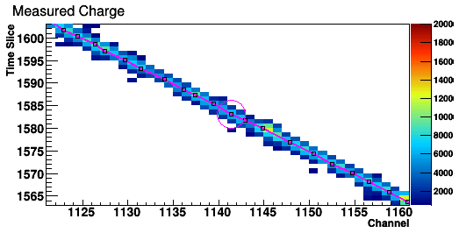
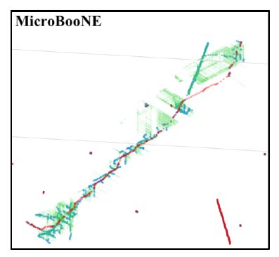
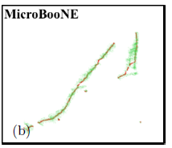
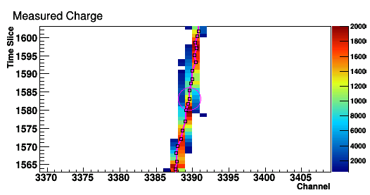
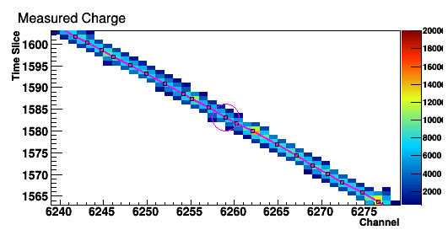
Principle of the Fit
Come up with a 3D track hypothesis (3D trajectory points and dQ/dx)
  Seed from Steiner tree (Graph theory): find shortest path through point of interests
Predict the deconvolved signals on all projection views
  Fast prediction with simplified model
Minimize the difference between the observation and prediction
  Minimization: biconjugate gradient stabilized method (BiCGSTAB)
U view
V view
Green: original 3D points from imaging/clustering
Red: trajectory seed found with Steiner Tree
W view
Notes:
Here is the principle of the fit. First, we need to come up with a 3D track hypothesis, which includes the 3D trajectory and their associated dQ/dx.
Then, we can predict the deconvolved signal on each of the projection view. The minimization of the difference between the observation and prediction would help us to find the best 3D track hypothesis.

Slide 13
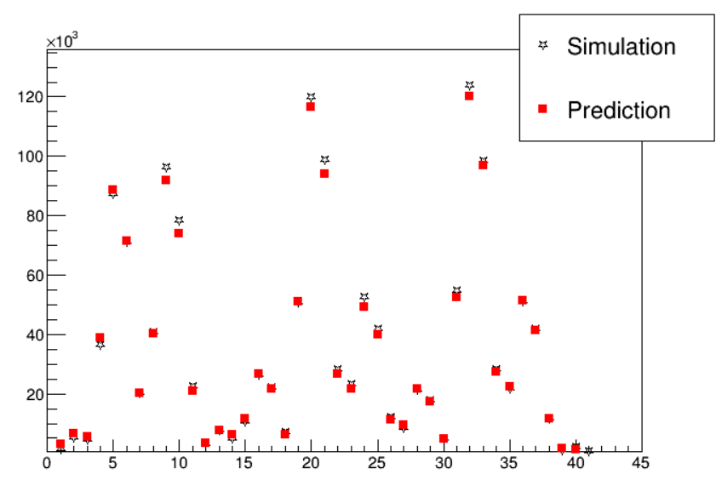
Simplified Prediction of the Deconvolved Signal
Convolve with field res.
dQ/dx at generation
diffusion
Electron at anode plane
Induced current on wires
Charge
At signal processing stage, we have two additional effects:
Software filters (time and wire dimension)
Usage of position-averaged overall response function
Simplified model
Convolve with elec res.
Pixel # in 2D Projections
Deconvolved signal
Signal Processing Chain
Digitized amplified current
Full process of signal formation and signal processing is complex → significant burden in computation
A simplified model was developed
Notes:
One key of this technique is to be able to make prediction of the deconvolved signal based on each track hypothesis. This is challenging, given the long chain in TPC signal simulation and signal processing.
Since we spent a long time studying the signal formation/processing, we come up with a simplified model based on smearing, which allows us to quickly and accurately model the deconvolved signal.

Slide 14
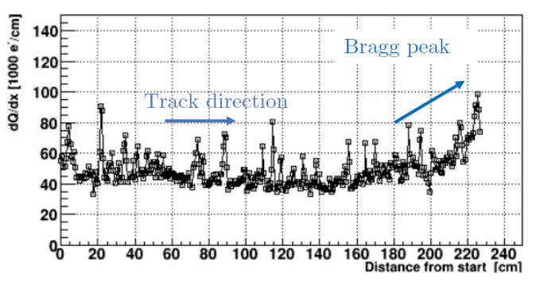
Trajectory and dQ/dx Fitting
Phys. Rev. Applied 15, 064071 (2021)
Unknowns
Measurements
Neutrino:Cosmic-ray
Charge-light matching
1 : 6.4
TGM rejection
1 : 0.91
Improved by factor of >6
STM rejection
1 : 0.36
Improved by factor of ~3
Additional Cuts
1 : 0.20
Notes:
The minimization is achieved through a two-step process. The first step focuses on the 3D track trajectory positions, and the second step focuses on the dQ/dx extraction.
With this technique, we reliably reconstruct the track trajectory and dQ/dx, which allow us to identify Bragg peak. After rejecting the stopping muons and some additional background, we achieved a signal to background ratio of 5:1.

Slide 15
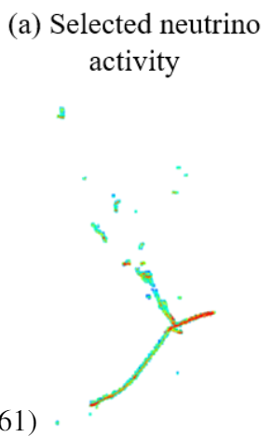
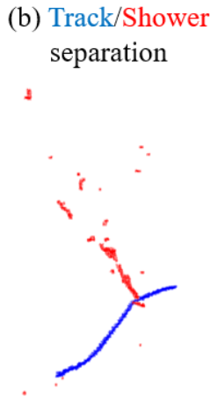
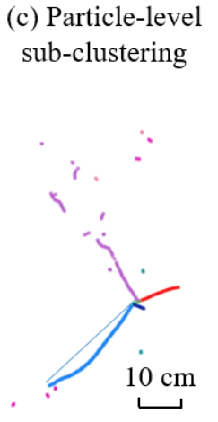
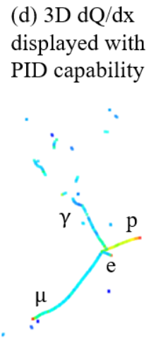
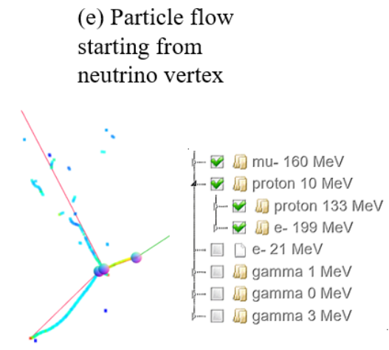

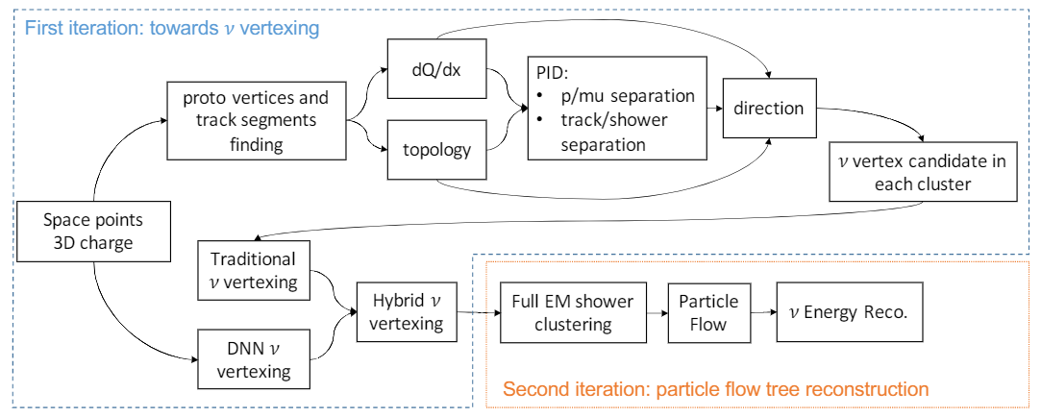
3D Pattern Recognition
JINST 17 P01037 (2022)

Slide 16
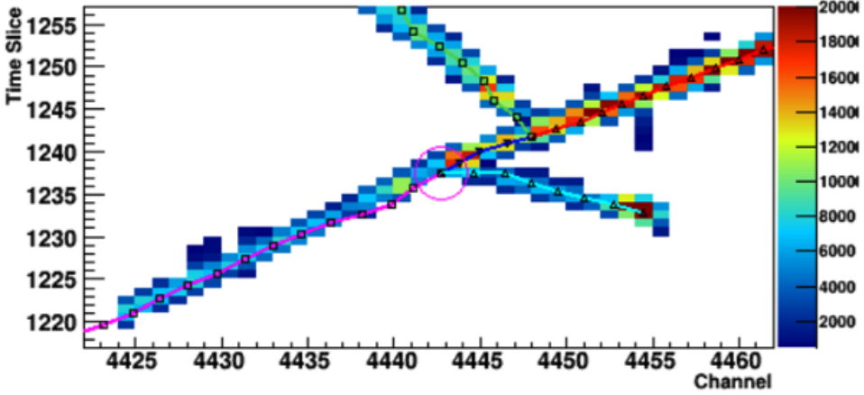
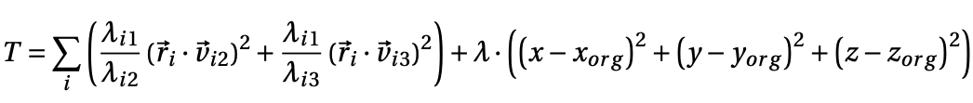
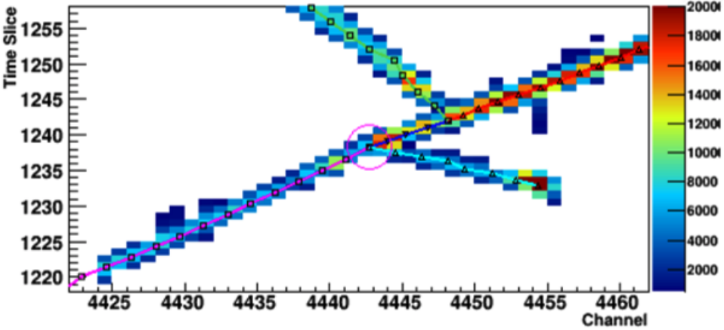
3D vertex fitting
3D vertex fitting: further improvement on proto-vertices (track-segment joints) and near-by track trajectory
Loss:
vertex ~ cluster-center distance projected to cluster non-primary PCA axes weighted by PCA eigen values
regularization

Slide 17
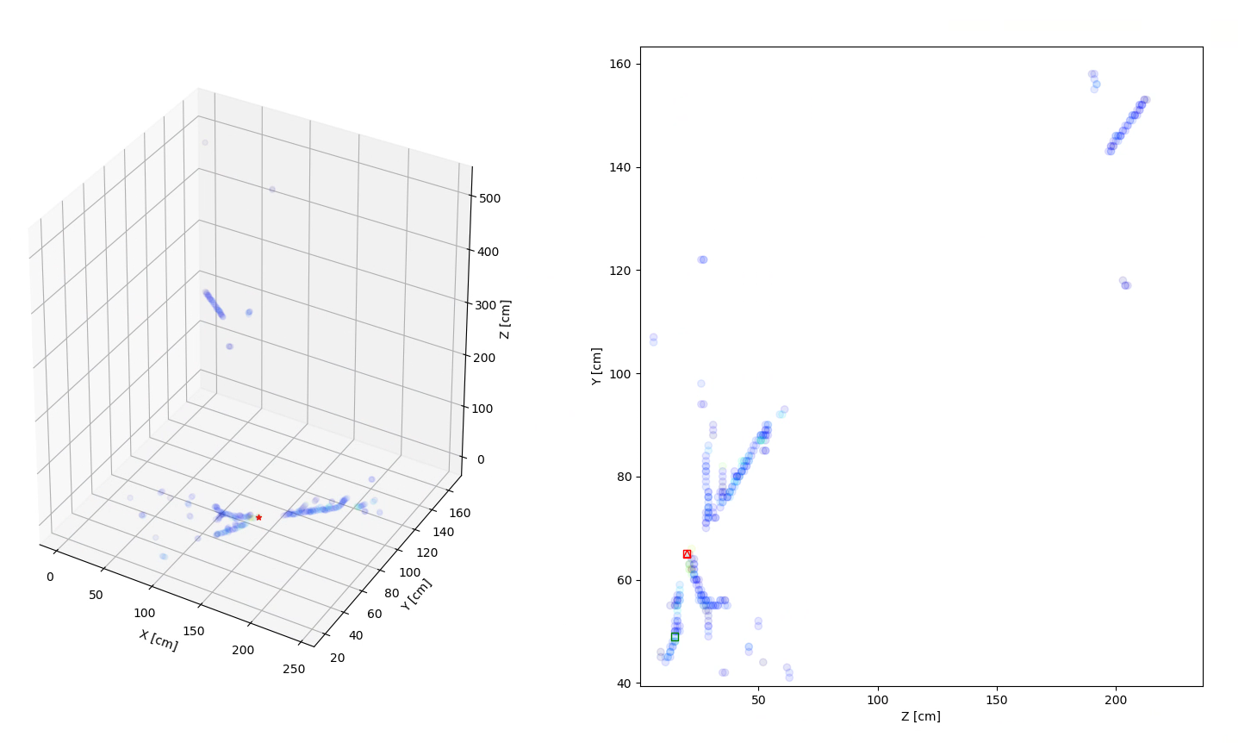
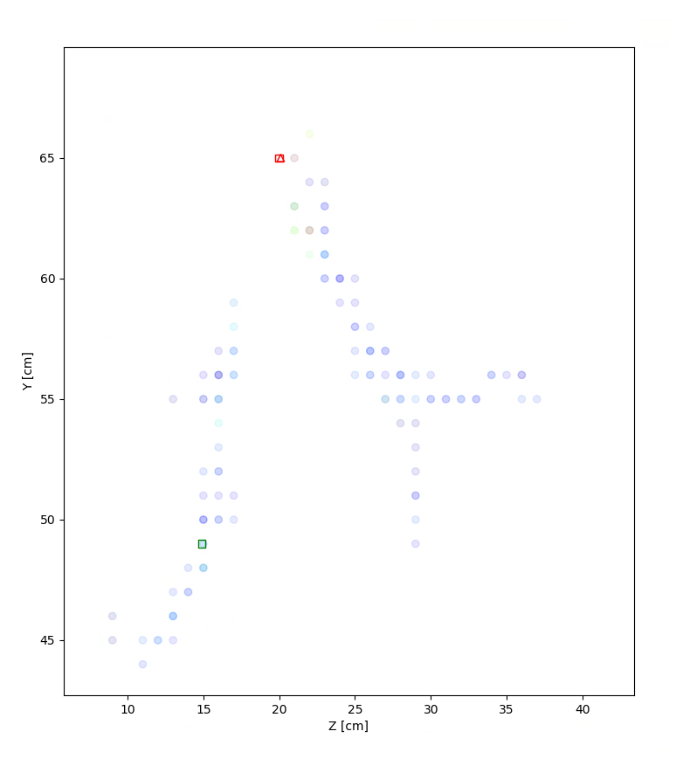
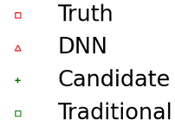
Deep Learning based Neutrino Interaction Vertex Finding
Regressional segmentation with a sparse U-Net
U-Net: efficiently use geometry info which is critical
  compared to graph networks
Regressional loss on distance based “confidence map” to use a region of points instead of only one
  otherwise, data is highly imbalanced (Z. Cao etc, arXiv:1812.08008)
Sparse: boosted computing efficiency with our sparse 3D data
  Submanifold Sparse Convolutional Networks (B. Graham etc, arXiv:1706.01307)
3D points from Wire-Cell
2D projection
Zoom in
Notes:
The neutrino vertex ID can be phrased as to identify a special voxel from this 3D image.
Our current strategy is to do 3D segmentation using a U-Net.
The geometry-based convolution operations could efficiently use the geometry information, which is critical in this task.
In addition, we used regressinal loss and sparse implementation which will be detailed in next two slides.

Slide 18
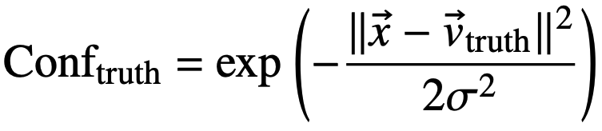
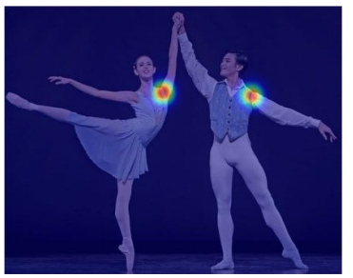
Regressional segmentation
Initially we used Cross Entropy loss
effectively only use the vertex information for one space point
doesn’t care about the distance between the prediction and the target.
  while our main metric is this distance.
⟶ encode the distance information for a region of points
predicting the full “confidence map” instead of only one point
current mapping:
OpenPose: https://arxiv.org/pdf/1812.08008.pdf
 |  |  | P=B
 |  | P=A | T
 |  |  | P=B
 |  | P=A | T
Notes:
Each 3D image has about 1k voxels in two categories, only 1 is neutrino vertex and others are not.
This means the data is highly imbalanced.
Which means reduced training efficiency if we use traditional cross entropy loss for categorization.
So instead predict yes or no for a voxel, we predict a conf. value which is related to the distance to the vertex.
Now, predict A or B as vertex makes some difference in the loss function.
So that the training efficiency is boosted.
The same idea was used in this OpenPose paper.

Slide 19

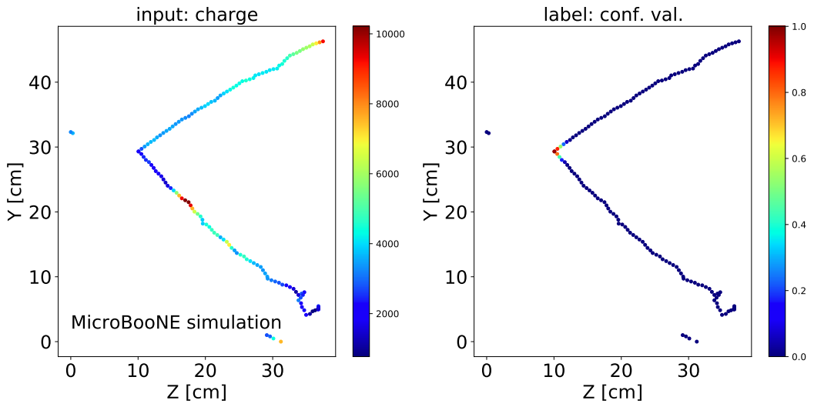
Network structure and data format
SparseConvNet
Used SparseConvNet to realized 3D sparse conv. DNN
https://github.com/facebookresearch/SparseConvNet
This work: https://github.com/HaiwangYu/uboone-dl-vtx
3D charge reco’ed from Wire-Cell
Sparse U-Net
Fully connected + sigmoid
confidence value for each voxel
input: color is
charge
label: color is truth
confidence map
coordinates |  |  | features |  | label
x | y | z | q | ... | conf.
int | int | int | float | ... | float
int | int | int | float | ... | float
int | int | int | float | ... | float
... | ... | ... | ... | ... | ...
Notes:
The next trick for the implementation is To make use of the sparse feature of our 3D images.
We built a sparse implementation based on the SparseConvNet lib.
The basic idea is to only do convolutions around non-zero voxels.
Basically, instead of a dense 3D array, the input is sparsified as a list of non-zero voxels with an input feature vector and a label vector attached to each voxel.
The Sparse U-Net extracts an output feature vector for each voxel and then summarizes it by the Fully connected + sigmoid layers to predict the conf. value for each voxel.
Here is an example of the input/label projected to 2D.

Slide 20



Deep Learning based Neutrino Interaction Vertex Finding
JINST 17 P01037 (2022)
Illustration of impact of vertex ID on the full event reconstruction
$ν_{e}$CC vertex identification efficiency
Rel. improved 30%
trained with 48k samples
Distance between reco. and true vertex (cm)
Notes:
The neutrino vertex ID is a critical step for the full 3D PatRec. Here is an example that an incorrectly reco’ed nu vertex can lead to failure of the 3D PatRec.
Prior to the DNN vertexing, we had a traditional alg. based on particle directions and topologies plus human learning.
The DNN one improved the efficiency by rel. 30% at 1cm cut.

Slide 21


Energy estimator using a recurrent neural networks
Method established at NOvA, applicated to LArTPCs - D. Torbunov
  Validated and physics sensitivity improvements performed using MicroBooNE data
  Paper coming soon
Based on reconstructed particle flow
Substitute original sum-based energy estimator

Slide 22


Boosted Decision Trees (BDT) for neutrino flavor tagging
Gradient Boosting
https://towardsdatascience.com/https-medium-com-vishalmorde-xgboost-algorithm-long-she-may-rein-edd9f99be63d
Notes:
After the 3D PatRec, we are at the final stage, neutrino flavor tagging.
Originally, we used human learning plus cut-based selection with hundreds of variables engineered based on ~1000 event hand scans.
And the results are not ideal as you may guess.
We decided to move to the BDT method, which sequentially combines weak learners in a way that each new learner fits to the residuals from the previous step.
To be more specific, we used the xgboost package.

Slide 23


Neutrino Selection through Machine Learning
$$\frac{1−0.97}{1−0.999}$$
Human feature engineering
+
Maching learning algorithm:
XGBOOST: extreme Gradient Boosting
Notes:
To adapt the variable length of the particle-level variables, we used a nested BDT structure or Hierarchical BDT.
These red BDTs works on particle level, while the final BDT works on event level.
This plot shows significant improvement of the nueCC selection performance from box-cut to TMVA and then to xgboost.
The application of the XGBoost leads to a factor of 30 improvement in rejecting background of nueCC events.

Slide 24
Human to machine
pattern
complexity
We learned that some tasks in the chain fit better for conventional alg. while some others fit better for ML alg.
I believe combining both would give us the best performance with limited data and computing resources
Conventional
Combine Both
# patterns
Either
Machine Learning
Notes:
To summarize, the Wire-Cell team has developed a fully automated reconstruction chain for LArTPC and
Its good performance was demonstrated in MicroBooNE.
We learned that some tasks in the chain fit better for conventional alg. while some others fit better for ML ones.
In my over simplified picture of reconstruction tasks, there are two dimensions: # of patterns and the complexity of each pattern.
I think conventional alg. fit better for tasks with fewer but more complicated patterns, while ML ones fit better for tasks with more but simpler patterns.
I also consider combining both would give us the best performance with limited data and computing resources for the LArTPC reco.
And this will be an important direction we will pursue in the future.
This is the end of my talk and thanks for staying with me.

Slide 25










2:52
3:17
3:24
3:25
3:28
3:45
3:52
4:08
4:22
Thanks!

