Slide 1
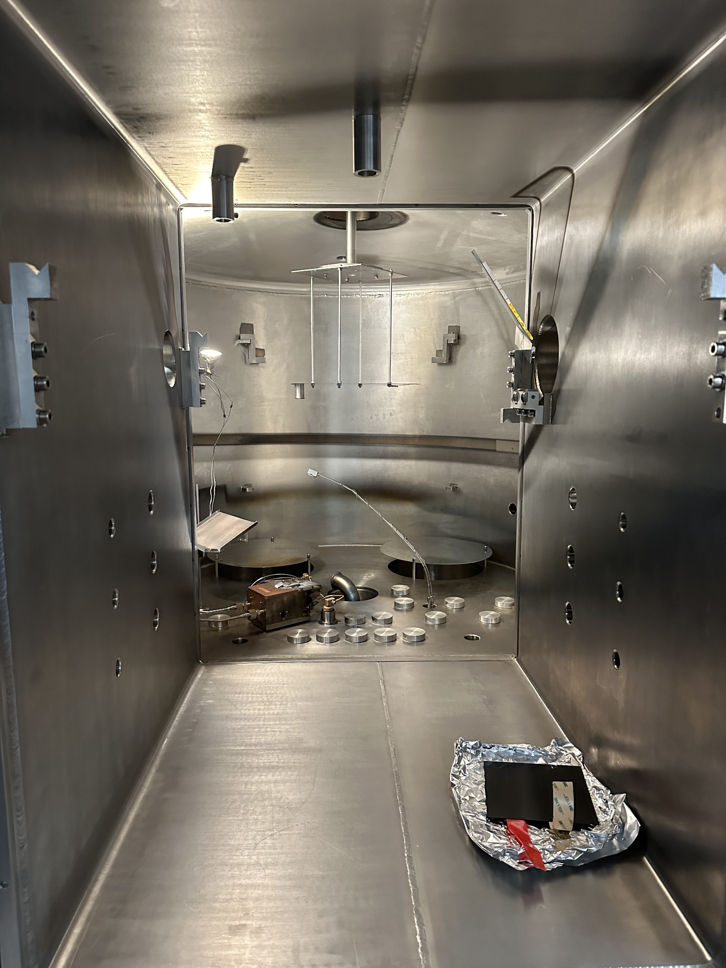
Mounting Fixture + Test Samples
Monitoring Mirrors
Quartz Crystal Microbalance
Test Carbon Fiber Sample + Tape stability
Electron gun + Filled Crucibles

Slide 2
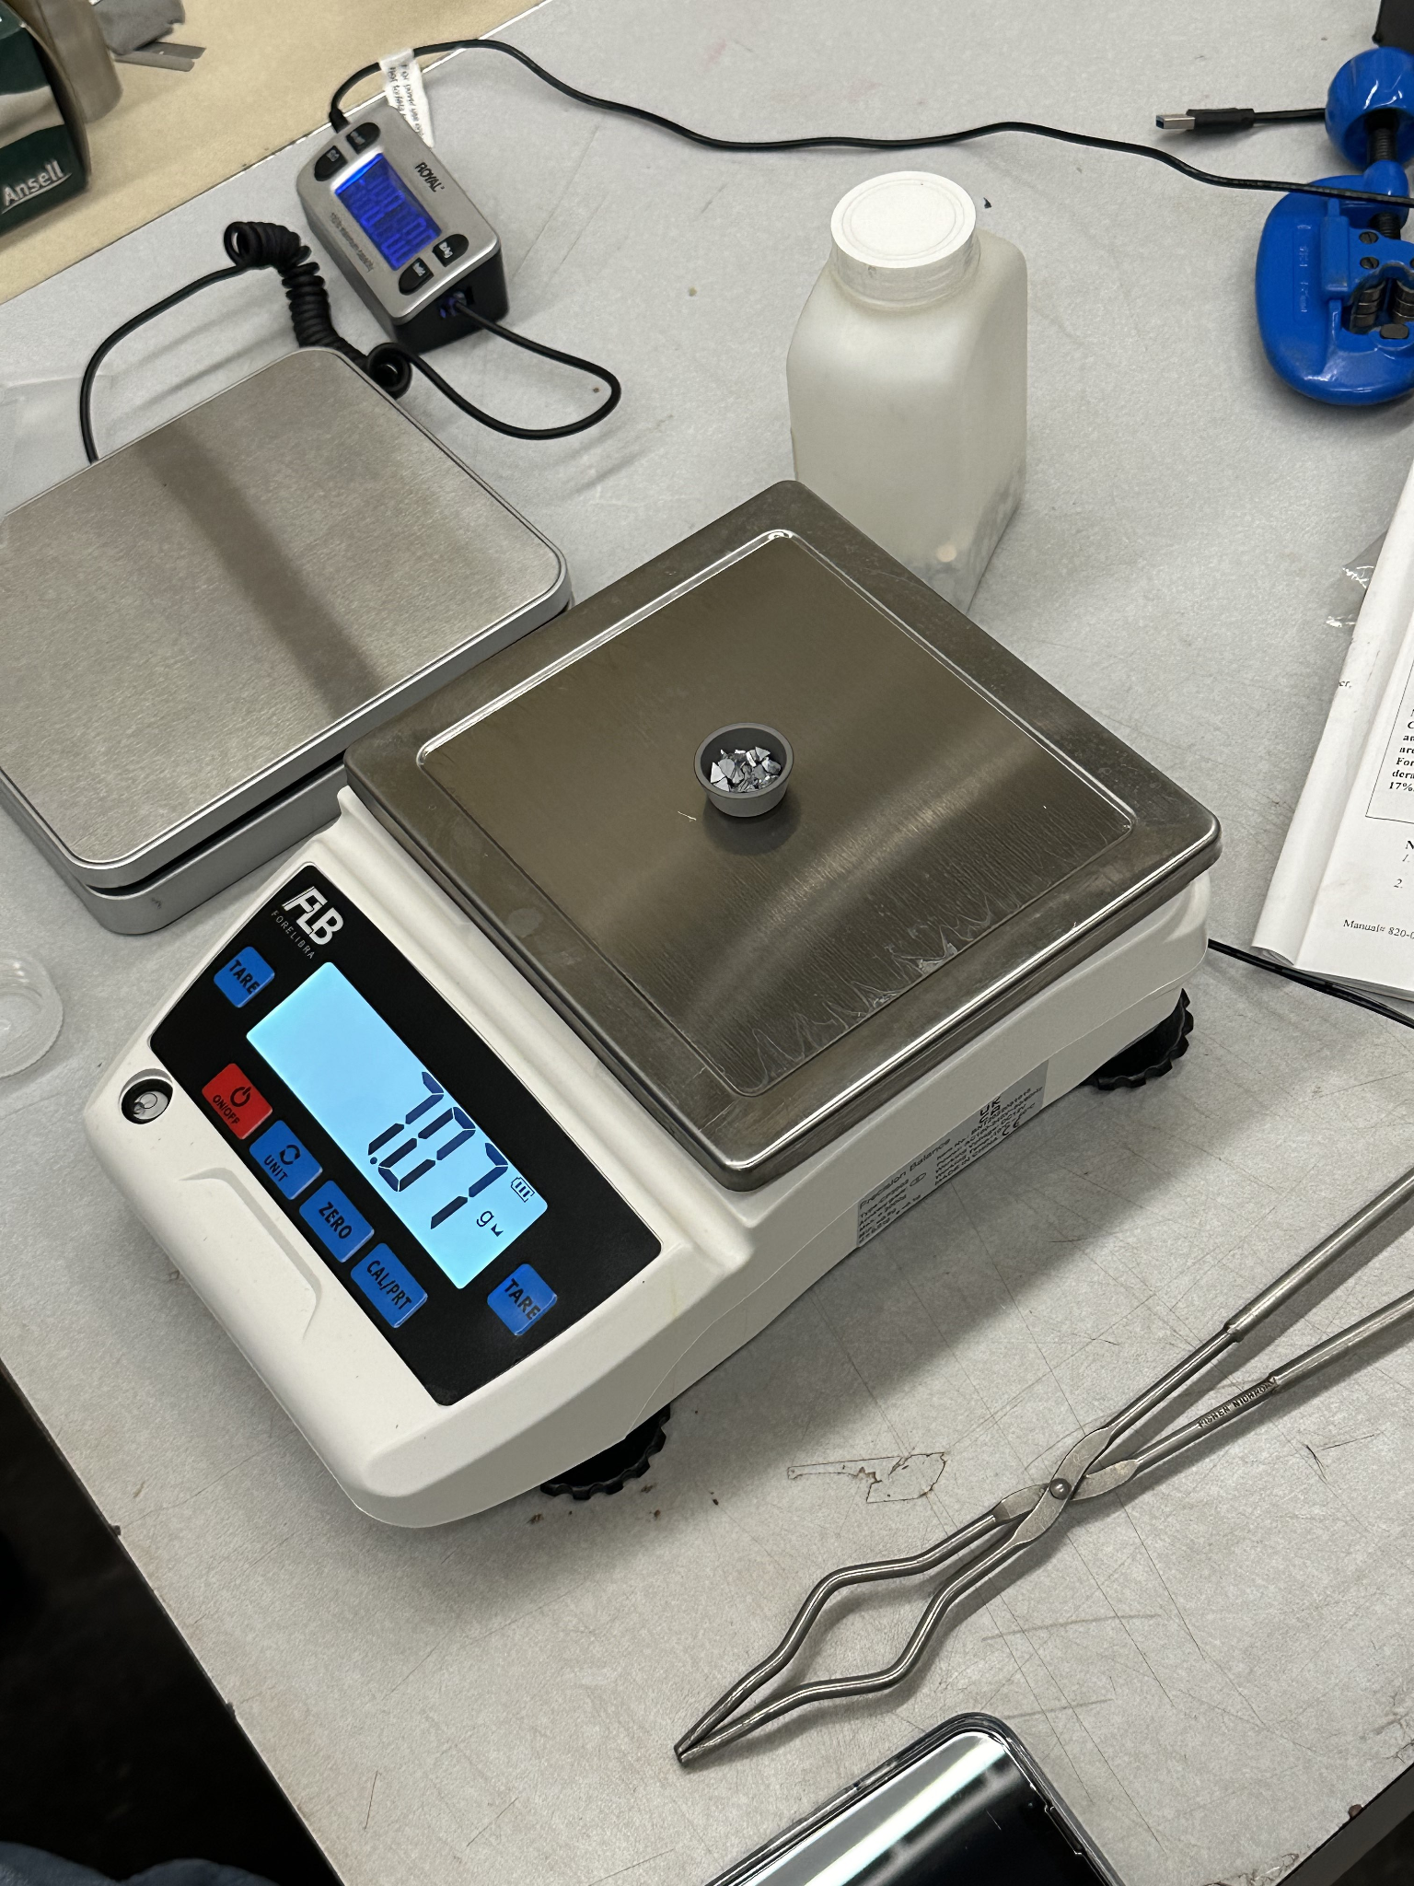
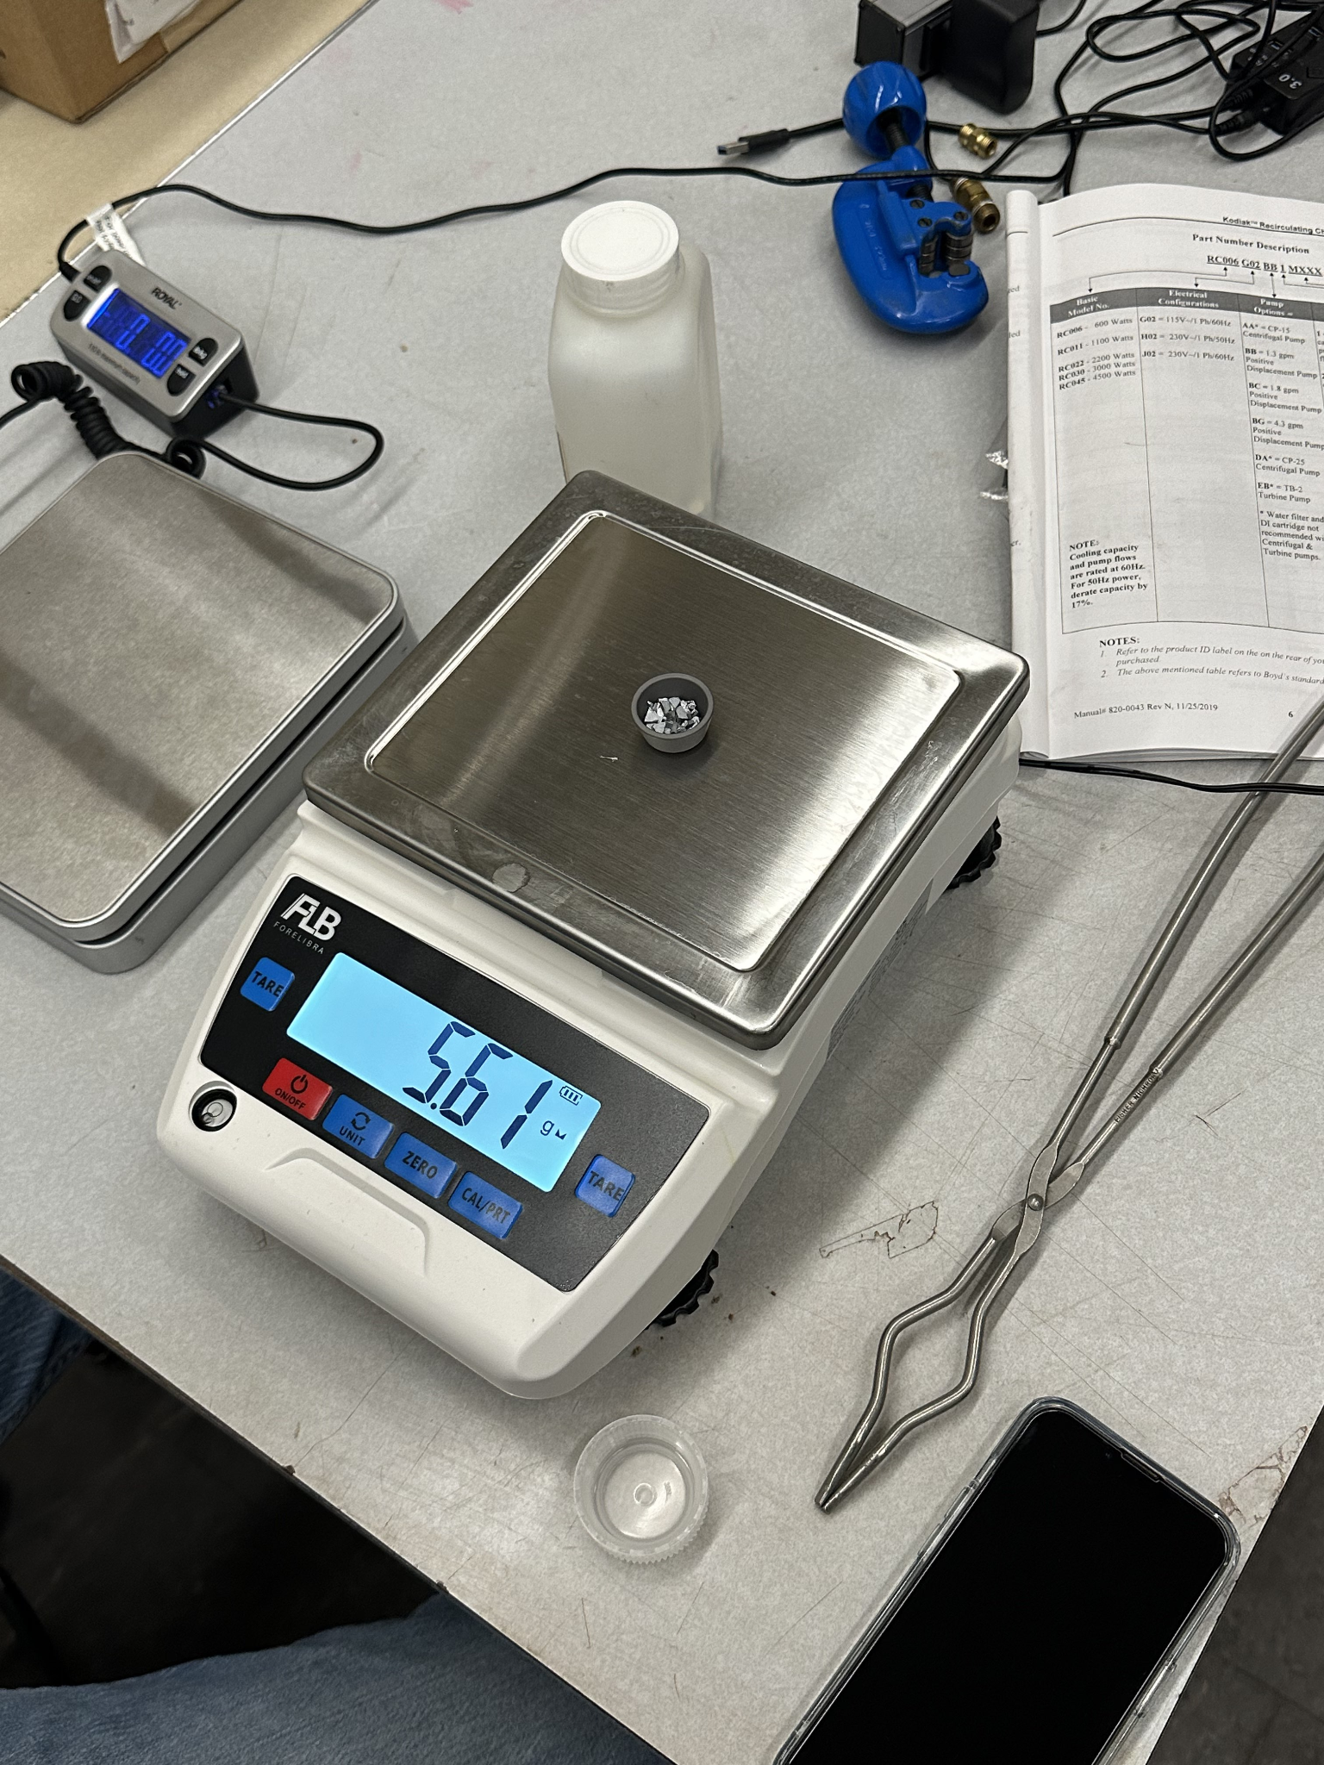
Material Loaded into crucibles:
Initial Mass Crucible 1:
5.10 grams
Mass of Al added:
3.65 grams
Initial Mass Crucible 2:
5.06 grams
Mass of Cr:
7.12 grams
Roughly ~¾ of the crucibles to prevent overflow

Slide 3
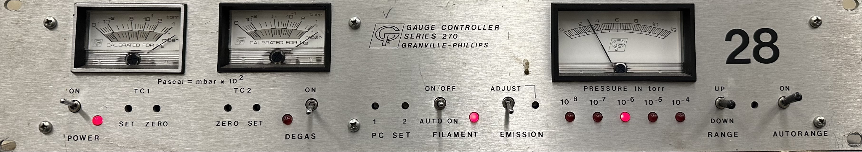
Ionization Gauge: Measure of pressure inside the chamber (~ 3 * 10^-6 torr )

