Slide 1
EIC Project News
E.C. Aschenauer (BNL), R. Ent (JLab)
Co-Associate Directors for the Experimental Program
EIC Detector Leads
ePIC Bi-Weekly
February 22nd, 2024

Slide 2
Outline
Design Review 2024 Plans – Update
Design Maturity – what does 60% and 90% design maturity mean?
Engineering Work Meetings
Inner Tracker Integration Meeting
Cooling - Integration
Gas Handling Systems - Integration

Slide 3
Design Review 2024 Plans – Updates in Blue
Design Reviews
PDR2: IR Integration and Auxiliary Detectors – February 12, 2024 – main emphasis on baseline choices and progress
PDR1: Tracking Detectors – March 20-21, 2024 – main emphasis on baseline tracking layout, if we are on track and plans
PDR2: Electronics/DAQ – May 2024? – continuation of PDR1 to ensure we are on track and show progress
PDR: Integration, Infrastructure and Installation – Summer/Autumn 2024? – includes detector support structures
PDR2: Particle Identification Detectors – Summer 2024?
PDR2: Barrel EM Cal – Summer/Fall 2024 – emphasis on mechanical design & AstroPix readiness
FDR: Backward & Forward EM Calorimetry, Barrel & Forward HCAL – Fall 2024
PDR2: Polarimetry – timescale TBD (but before CD-2)
FDR for any potential CD-3B scope: Magnet Power Supply, perhaps VTRx+/lpGBT, perhaps magnet steel – see NOTE
FDR Magnet Power Supply – Spring 2024; Magnet Steel perhaps Summer 2024; VTRx+/lpGBT add ½ day to electronics/DAQ PDR2
Detector R&D Day – March 25 – check R&D progress and outlook to FY25
DAC-Meetings 2024 under planning:
~April 2024: Project Status, Baseline Detector, International Engagement, Detector R&D progress (expect 1+ day)
~August 2024: Detector R&D annual review (expect 2 days) – deadline for submission July 1, 2024
Next ePIC Computing & Software review by host labs – Late Summer 2024?
NOTE: CD-3B for detector will include continuation phases for SiPMs, SciFi, PbWO4, Forward HCAL. Further scope has to be known essentially now and needs FDRs.

Slide 4
PDR2: IR Integration and Auxiliary Detectors
Reviewers: Eugene Chudakov – JLab, Wolfram Zeuner – CERN, Gerrit van Nieuwenhuizen – BNL,
Fulvia Pilat – ORNL

Slide 5
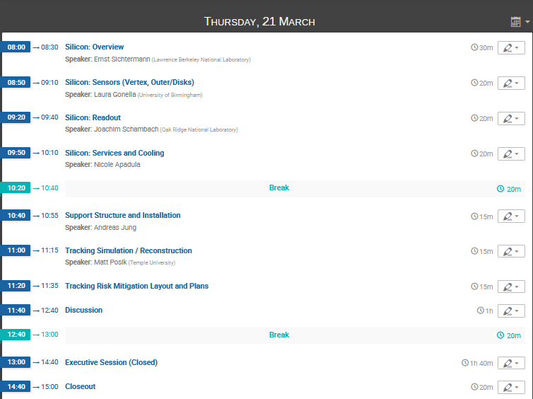
Tracking Systems Preliminary Design Review
https://indico.bnl.gov/event/21945/
Contact: Brian Eng
Dates: March 20-21
Reviewers: Andy White (U Texas Austin, Chair), Michael Begel (BNL), David Lynn (BNL), Piotr Gasik (GSI), Maxym Titov (CEA)

Slide 6
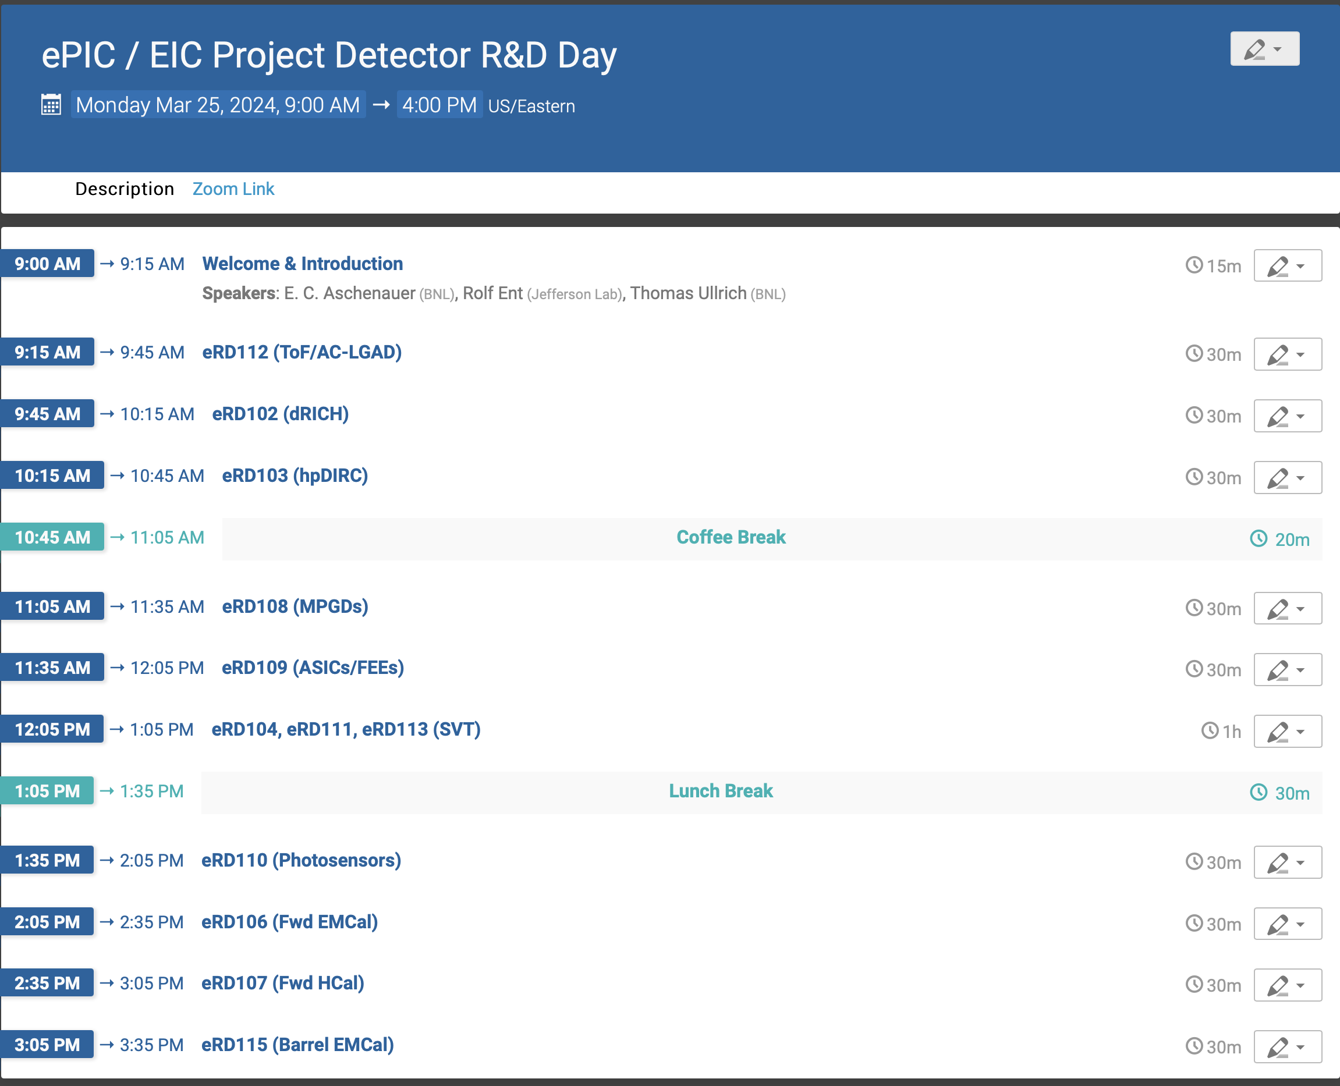
Detector R&D Day
https://indico.bnl.gov/event/22388/
commonly organized by ePIC
and the EIC Project

Slide 7
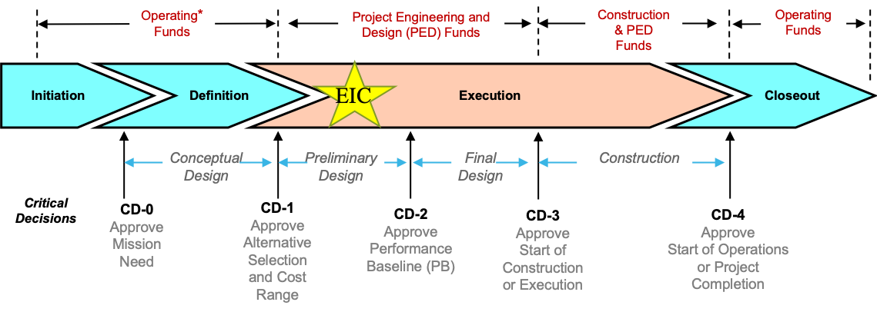
Design Maturity
What does 60% design maturity roughly mean:
One matured from a conceptual design (CD-1) to a preliminary design (CD-2)
There can still be open E&D questions but no showstoppers
One needs to have detailed knowledge that one can define the cost and schedule
The review committee can judge that one will be able to address those open questions by the projected time of CD-3.
What does 90% design maturity roughly mean:
The design matured to final (CD-3), i.e., there are no open E&D questions
One can still do design detailing and producing drawings to accompany procurements
One can still do design validations as found needed during the vendor construction process; for vendor design-build contracts such as the detector solenoid one can still do design updates as needed.

Slide 8
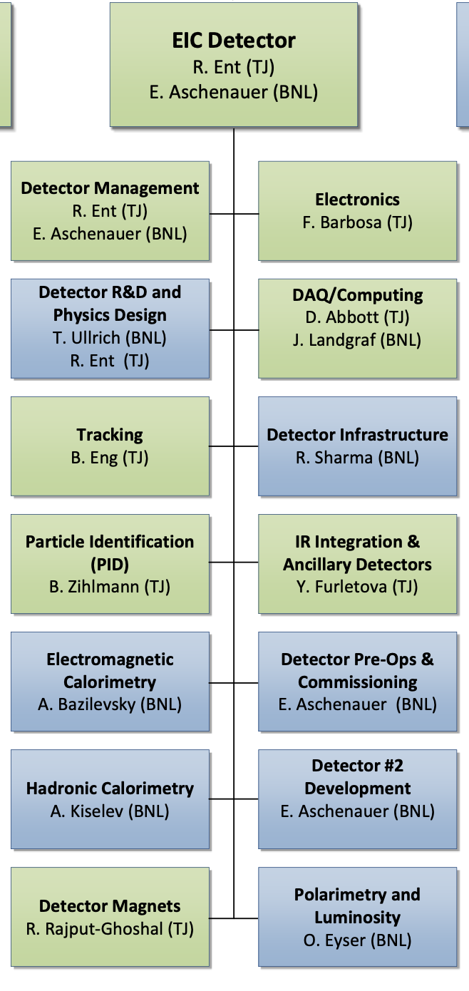
WBS 6.10 EIC Detector & 6.10.01 Management
Reminder How We Work:
The highest-level detector management consists of:
Elke & Rolf L2 Leads
Walt Akers 6.10 Systems Engineer
Fernando Barbosa Chief Electrical Engineer
Rahul Sharma Chief Mechanical Engineer
Do not use this CAM responsibility organization as Black and White, we work together as a scientific collaboration and use expertise from each lab as it fits independent of high-level responsibility
We include user efforts where it makes sense, and lean to more
We have
Weekly meetings with ePIC spokesperson and deputy
Weekly meetings with the mechanical engineering team
Biweekly meetings with the electrical engineering team
Weekly meetings with the Detector Control Account Managers
As needed meetings with various detector subsystems
Walt, Fernando and Rahul have also separate meetings, for Walt with the Systems Engineering Group, for Rahul with also various non-BNL/non-Jlab engineers/designers, etc.
We report at the biweekly ePIC meetings and many other meetings on general detector progress or requested topics
Blue/Green show nominal BNL/JLAB responsibility
v
O. Eyser (BNL)
v
F. Rathmann (BNL)

Slide 9
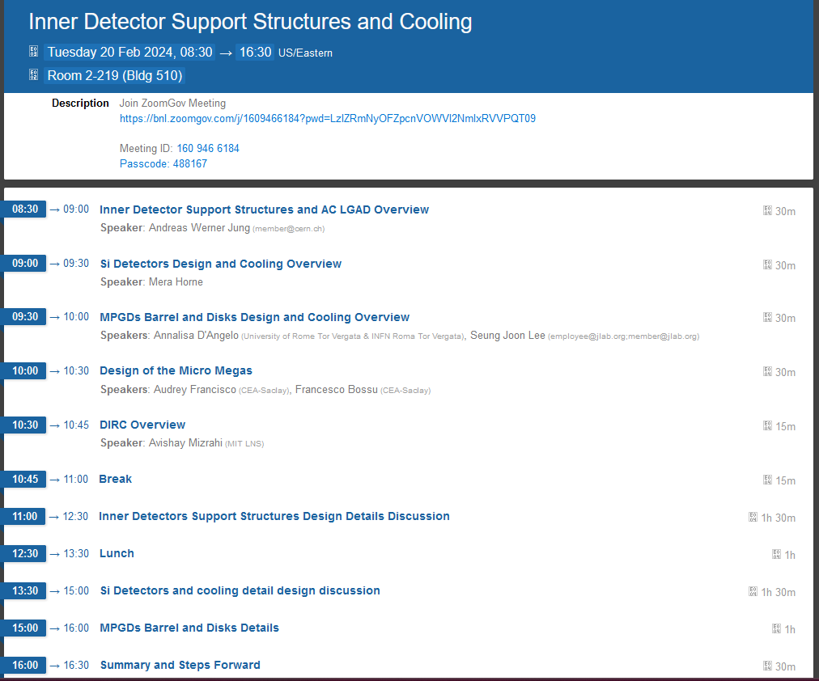
Detector Inner Detector Support Structure
Rahul’s meeting: https://indico.bnl.gov/event/22387/
next integration update
TIC Meeting
March 11th 2024

Slide 10
Detector Cooling Integrated View
We are ready to go the next step → To further define integration constrains and envelops → we need to refine the following information
what is the power, which needs to be cooled → both Sensor and Electronics
we need a schematics of the readout chain, so all important items can be integrated in ME model
Example:
MAPS Sensor → Cable → VTX+ → Cable → RDO → Cable → ……..
Size/Length 30 cm 5x3x1cm³ 1.5m 8x6x1cm³ 40cm
Power 2W 0.1W
need to detail Requirements:
size of boards and how many sitting in the inner part of the detector
Next iteration of cable needs → update services
information of power and heat distribution will flow into ANSYS simulations
→ input to optimize the cooling for the different subsystems and ePIC globally
Will work with all the DSCs and DAQ WG to find all the info, collect it and integrate it

Slide 11
Detector Gas Handling Systems Integrated View
Will approach the gas systems the same way as the services and cooling system
Will collect requirements and general information on the gas systems
Will provide experts to help to design the gas systems, integrate them into BNL, so they fulfill the national lab rules
Environmental sustainability will be crucial

Slide 14
Goals for 2024 (towards CD-2!)
DAC meetings in ~April (topics: detector status, international engagement, R&D status) and ~August (topic: Detector R&D advise)
Completion of Non-Si R&D
Advise on follow-up of MAPS/ITS3, ASICs, and AC-LGAD
Quantify (time, cost, performance) and document, before CD2, mitigation plans for the possibility that some R&D components will not meet expectations
Tracking layout with branching points defined and documented
HRPPD backup option documented, etc.
Ensure good project progress
Implement procurements for CD-3A scope and manage progress
Continue work on design maturity for all (non-CD-3A) systems.
Define CD-3B needs: next phases of CD-3A, magnet power supply, perhaps VTRx+ optical transceivers, perhaps magnet steel
PDRs of Tracking, Far-Forward/Far-Backward, Electronics/DAQ, Particle Identification
FDRs of Magnet Power Supply, Calorimetry
Continue work on integration aspects, e.g., service needs of various detectors, cable routing, electronic rack layouts, survey & alignment planning, monitoring systems, controls needs.
System engineering for electrical and services (per DOE/OPA recommendation)
Document controls needs
Collect interfaces beyond CD-3A scope, and document towards ICDs
Simulations with Full Materials, Background and Reconstruction
Draft Technical Design Report in collaboration with ePIC
Formalize in-kind agreements in form of high-level agreements and project planning documents, as appropriate: Italy/INFN (Detector, Magnet), France/IN2P3, France/IRFU, UK/STFC, perhaps NSF, other

Slide 15
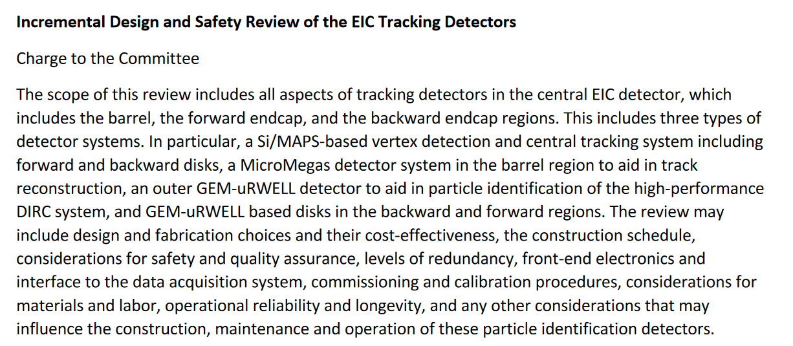
Tracking Systems Preliminary Design Review

Slide 16
Tracking Systems Preliminary Design Review

