Slide 1
EIC Project News
E.C. Aschenauer (BNL), R. Ent (JLab)
Co-Associate Directors for the Experimental Program
EIC Detector Leads
ePIC Bi-Weekly
March 21st, 2024

Slide 2
Outline
Schedule/Budget Update
Design Review 2024 Plans – Update
Tracking Detector Preliminary Design Review
DAC Planning Update
RRB Update
Planning for the Production Phase – Collection of Test Setups

Slide 3
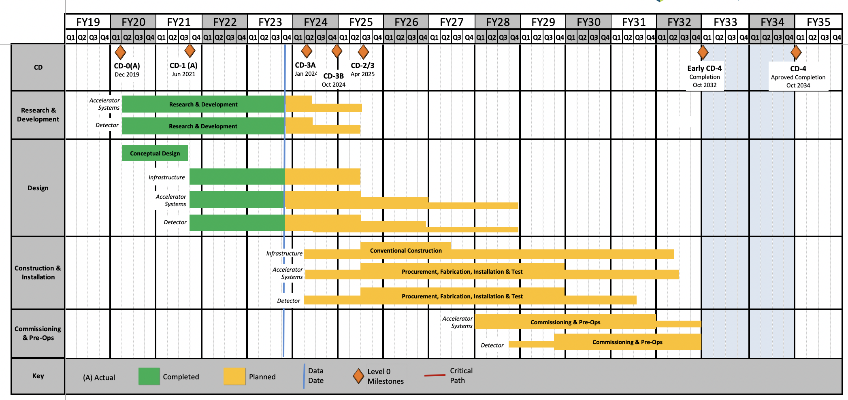
EIC Schedule
CD-3A:
Approve start of long-lead procurements
CD-3A items passed final design review
All interfaces related to them are frozen
Waiting for ESAAB meeting for authorization
Construction Phase
Conclusion of
RHIC Operation
Science Phase
CD-2:
Approve prelim. design for all subdetectors
Design Maturity: >60%
Need “pre-”TDR (or draft TDR)
Baseline project in scope, cost, schedule
The thinner bars indicate that R&D and design
can continue at a small level beyond CD-2 and CD-3
CD-3:
Approve final design for all subdetectors
Design Maturity: ~90%
Need full TDR
    EIC Critical Decision Plan
    CD-0/Site Selection December 2019 ✓
    CD-1 June 2021 ✓
    CD-3A ESAAB March 25th 2024
    CD-3B October 2024
    CD-2/3 April 2025
    early CD-4 October 2032
    CD-4 October 2034
Speculation based on EIC accelerator project status, on only just appropriated FY24 funding ($98M), on still uncertain FY25 budget scenarios (President’s Budget is ~$110M), and projected RHIC FY24 run:
Late 2024 Path to CD-2 review, possible CD-3B Approval Dec. 2024
RHIC operations conclude at end of FY25, in September 2025
CD-2/3 Approval Dec. 2025, Possibility of CD-3C as needed.

Slide 4
Design Review 2024 Plans – Updates in Blue
Design Reviews
  PDR2: IR Integration and Auxiliary Detectors – February 12, 2024 – main emphasis on baseline choices and progress
  PDR1: Tracking Detectors – March 20-21, 2024 – main emphasis on baseline tracking layout, if we are on track and plans
  PDR2: Electronics/DAQ – May 2024? – continuation of PDR1 to ensure we are on track and show progress
  PDR: Integration, Infrastructure and Installation – Summer/Autumn 2024? – includes detector support structures
  PDR2: Particle Identification Detectors – Summer 2024?
  PDR2: Barrel EM Cal – Summer/Fall 2024 – emphasis on mechanical design & AstroPix readiness
  FDR: Backward & Forward EM Calorimetry, Barrel & Forward HCAL – Fall 2024
  PDR2: Polarimetry – timescale TBD (but before CD-2)
  FDR for any potential CD-3B scope: Magnet Power Supply, perhaps VTRx+/lpGBT, perhaps magnet steel – see NOTE
  FDR Magnet Power Supply – Spring 2024; Magnet Steel perhaps Summer 2024; VTRx+/lpGBT add ½ day to electronics/DAQ PDR2
Detector R&D Day – March 25 – check R&D progress and outlook to FY25
DAC-Meetings 2024 under planning:
  ~April 2024: Project Status, Baseline Detector, International Engagement, Detector R&D progress (expect 1+ day)
  ~August 2024: Detector R&D annual review (expect 2 days) – deadline for submission July 1, 2024
Next ePIC Computing & Software review by host labs – ~October 2024?
NOTE: CD-3B for detector will include continuation phases for SiPMs, SciFi, PbWO4, Forward HCAL. Further scope has to be known essentially now and needs FDRs.

Slide 5
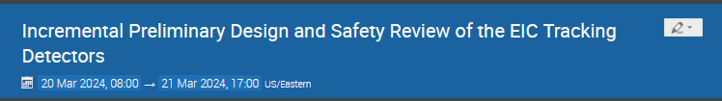
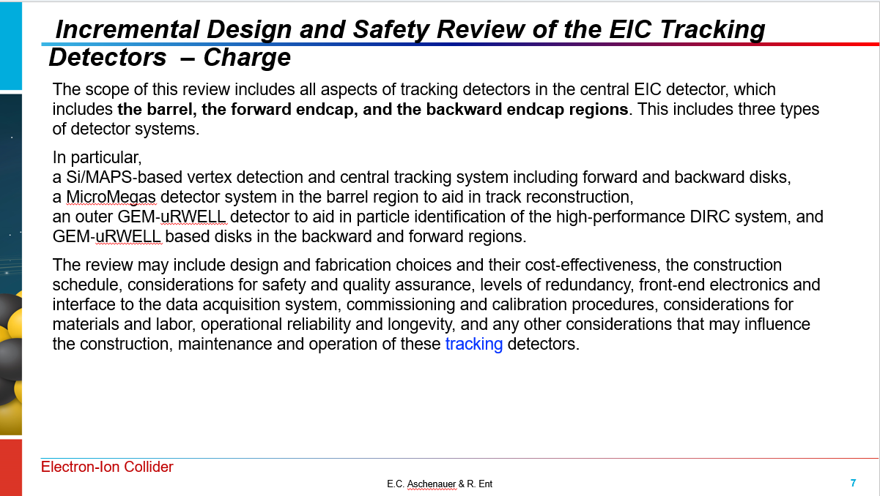
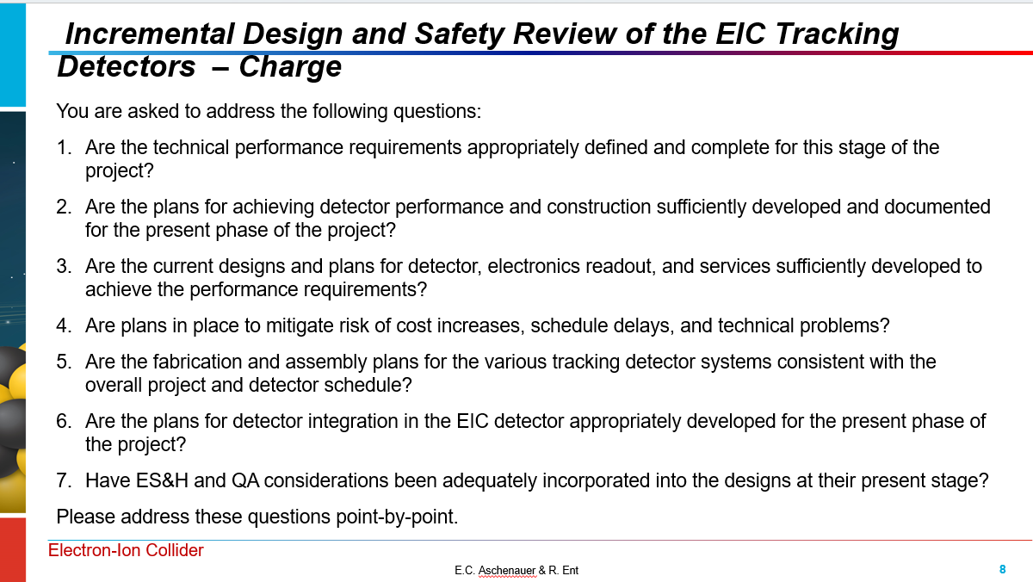
Tracking Systems Preliminary Design Review
https://indico.bnl.gov/event/21945/
Contact: Brian Eng
Dates: March 20-21
Reviewers: Andy White (U Texas Austin, Chair), Michael Begel (BNL), David Lynn (BNL), Piotr Gasik (GSI), Maxym Titov (CEA)

Slide 6
Tracking Systems Preliminary Design Review
Our General Review Summary:
Excellent presentations
Many probing questions
First day (dedicated to general and MPGDs) we ended right on schedule (within two minutes), second day (dedicated to Si detectors) we ran far behind but by not using the last hour of extra discussion/question time we ended up only 20 minutes behind.
Review was very timely; it was a good point to pull all together and take a snapshot getting independent feedback from an excellent expert review committee.

Slide 7
Tracking Systems Preliminary Design Review
Closeout Excerpts:
Many, many useful comments!
7 recommendations (in shorthand)
    Flowdown of requirements to detector components
    Include calorimeters in tracking performance
    Develop alternate tracker solutions, including potentially time-phasing installation of the silicon tracker
    Build thermomechanical models and mockups for each silicon detector subsystem
    Develop a fabrication and assembly plan for the silicon tracker with emphasis on institutional commitments
    Document quality assurance procedures for each component.
    Document requirements for qualifying each production site for deliverables distributed across multiple sites.
The review committee congratulates the ePIC tracking system team on its significant progress since the definition of the system in 2023. The technologies for each component of the tracker have been settled and development paths are being defined from final prototypes to pre-production and final production. The schedule is aggressive and critically dependent on the success of the ITS3 project.

Slide 8
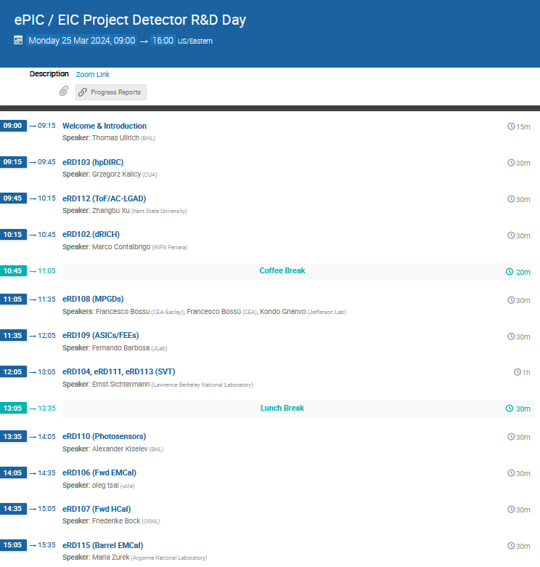
Detector R&D Day
https://indico.bnl.gov/event/22388/
commonly organized by ePIC
and the EIC Project

Slide 9
DAC Update
In the process of doing the DAC rotations, four out of twelve DAC members roll off per the charter
  One comes back as incoming chair
  Two new DAC members confirmed
  One new DAC member invitation out – confirmed today
This year we plan to have the 8th and 9th DAC meeting. In the 8th DAC meeting you will hear about the overall progress and status of the EIC Project, the technical baseline of the detector and ePIC collaboration contributions, and the planning for the construction phase of the Detector. Mid-Summer there will be a further two-day 9th DAC meeting dedicated to the review of the ongoing EIC project detector R&D and advise on possible continuations.
For the 8th DAC meeting, the DAC is asked to answer the following charge questions:
  The progress and status of the ePIC detector.
  The adequacy of the ePIC detector scope to achieve the key physics goals.
  The technical readiness of the detector for CD-2 baselining by Fall of 2025.
  The number of detector technologies in the EIC detector, their risk and opportunities.
  The adequacy of the resources – people and infrastructure for production and testing.
  Gaps or opportunities the labs and project should pursue for further international outreach.
We welcome any other suggestions you can make that will improve the success of delivery for the ePIC detector.

Slide 10
Planning for Production Phase
We plan to collect information on all test setups for component quality assurance
Following slides show some examples, note that this will also come up in a Final Design Review!

Slide 11
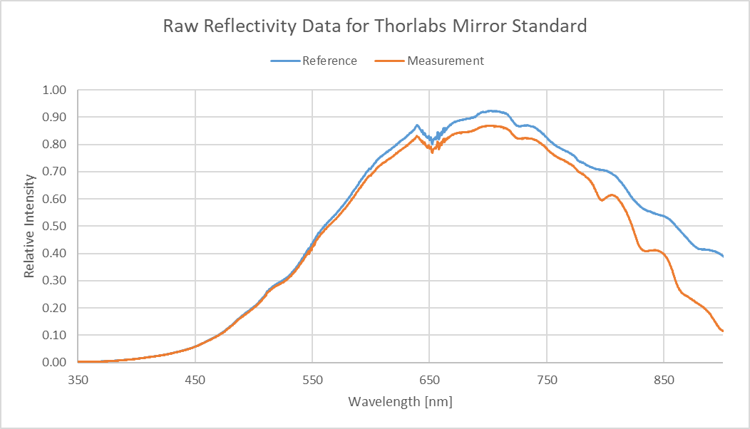
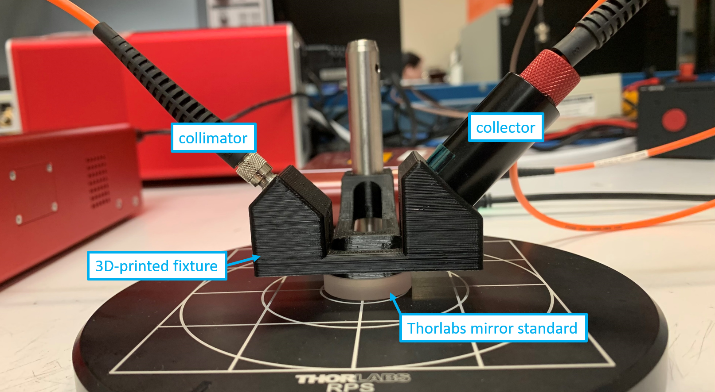
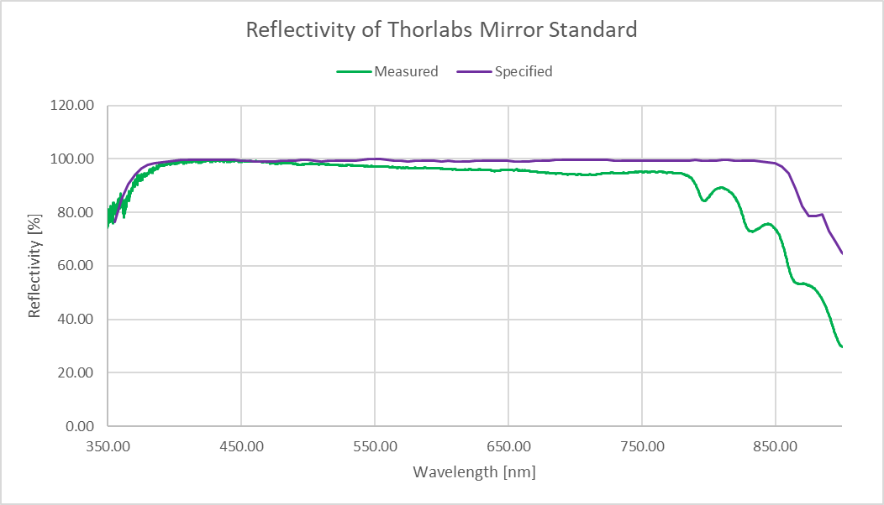
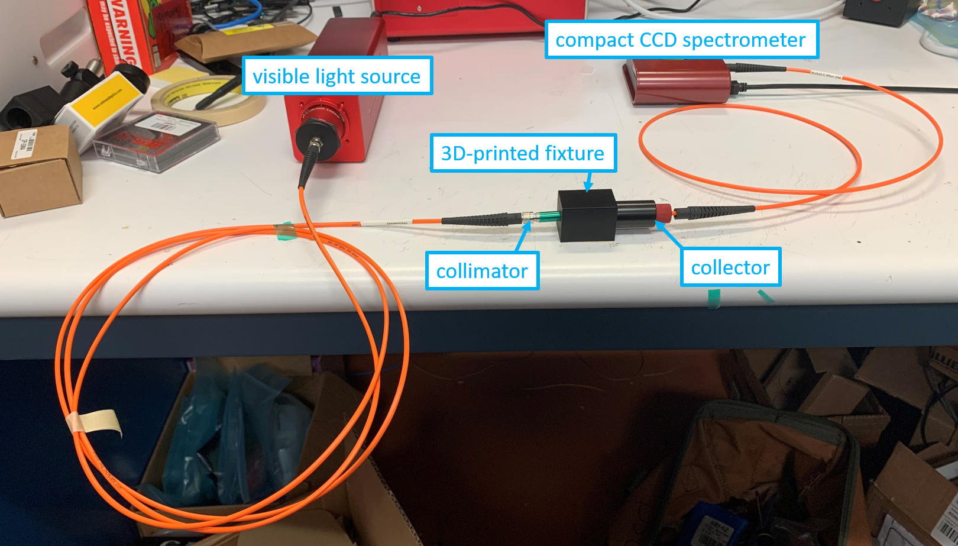
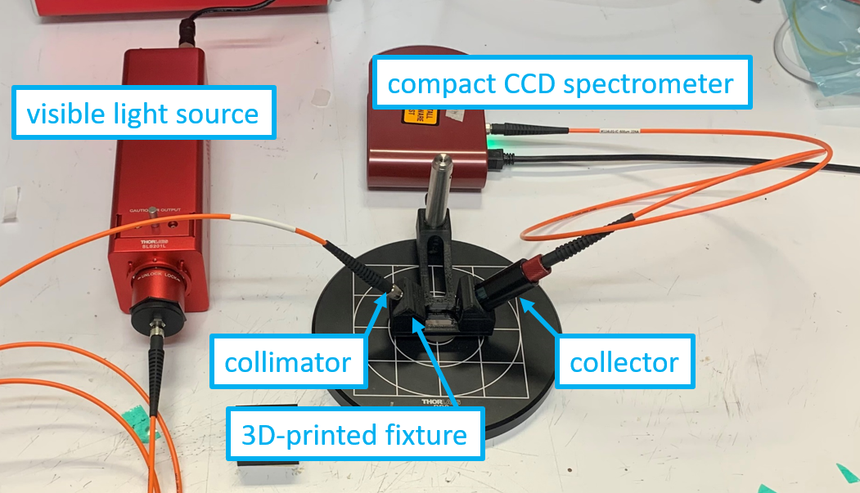
EIC - RICH
Tyler Lemon
From Detector Support Group at JLab
Mirror reflectivity test setup a JLab resurrected and expanded at request of dRICH/INFN
EIC dual-radiator RICH and proximity-focusing RICH detectors generate Cherenkov light in UV spectrum (down to 200 nm)
  Mirrors in detectors must reflect 95% of light
Developing setup to test mirror reflectivity
  For λ ∈ [200 nm, 350 nm]
  Previous reflectivity test station used visible light λ ∈ [400 nm, 850 nm]
Researched components, procured, and set up test stand for visible light—proof-of-concept test
  Measured reflectivity of Thorlabs mirror sample is close to its specified reflectivty
Next step: set up for UV light
Raw data acquired using CCD. Blue trace is reference measurement (test beam collected directly). Orange trace is reflectivity measurement (test beam reflects off of mirror at a 45° angle of incidence).
3 D Printed fixture
Setup for reference measurement. 3D printed fixture holds collimator to point directly at collector. Test beam does not reflect off of any mirror.
Test station set up for reflectivity measurement. 3D printed fixture holds collimator over mirror at 45°. Test beam reflects off of mirror and onto collector.
Specified reflectivity (purple). Calculated reflectivity (green by dividing measurement (orange trace) by reference data (blue trace) in the figure at the top

Slide 12

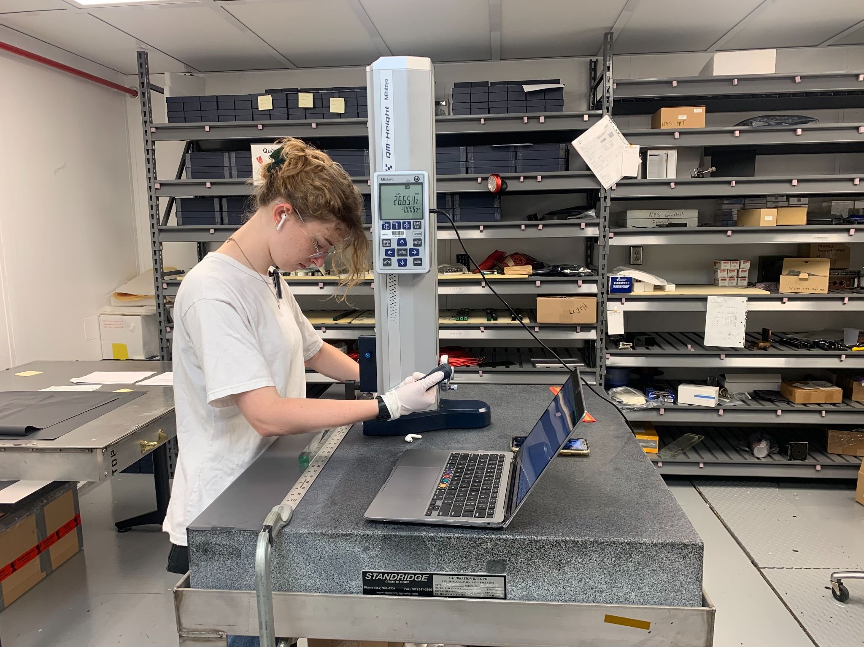
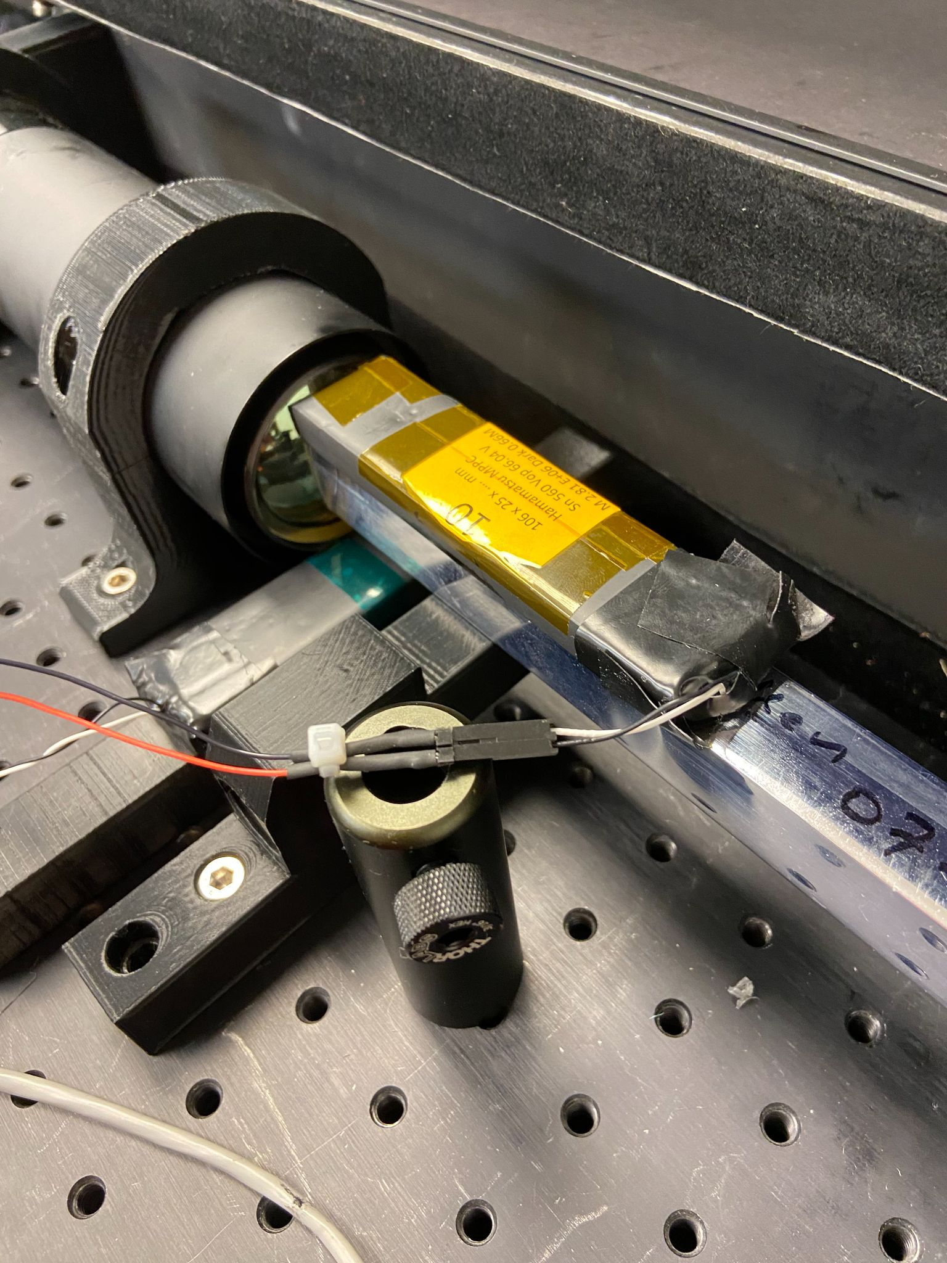
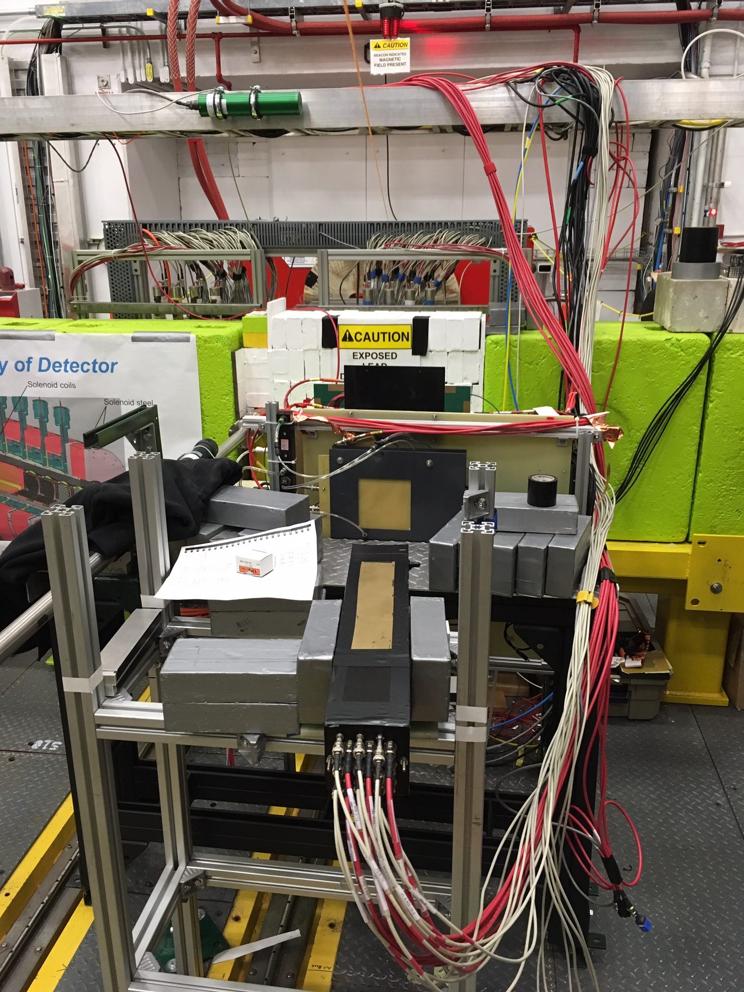
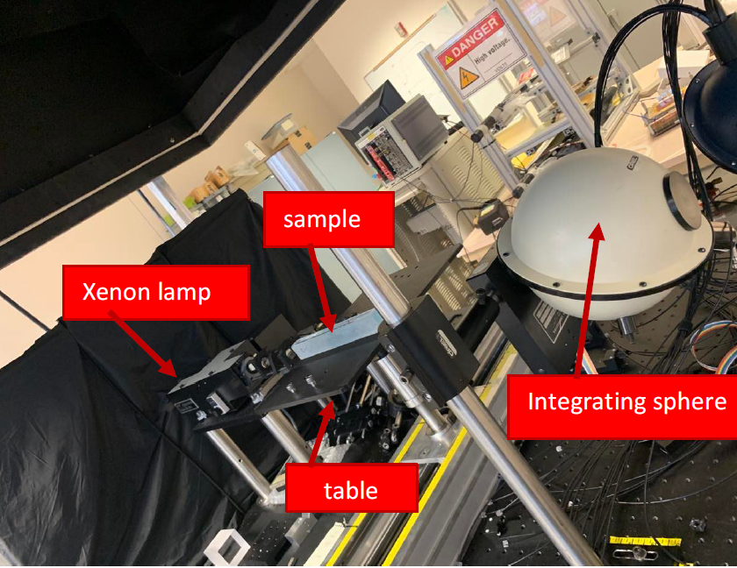
JLab crystal test facility for PbWO₄ QA and prototype
From PbWO4 Final Design Review
Dedicated cleanroom facility for crystal characterization
  Mitutoyo QM - for mechanical dimensions measurements. Precise to 1 micron.
  Crystal Light Yield measurements
  Optical transmittance with integrating sphere
  Radiation hardness in beam
Beam test facility with tagged photon beam up to 4-5 GeV
  Technique demonstrated successfully for NPS can be adapted for EIC prototype tests
12

Slide 13
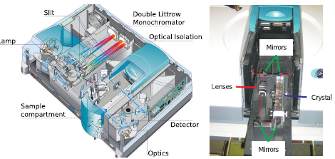
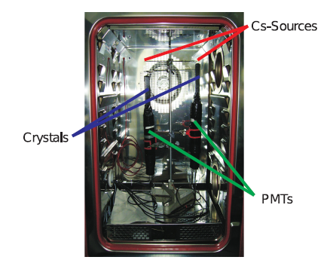
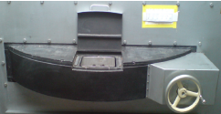

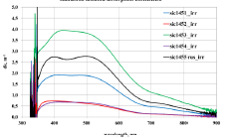
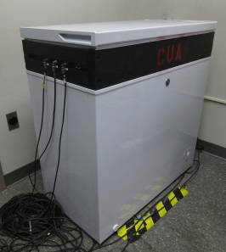
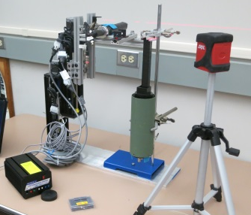
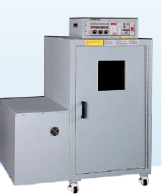

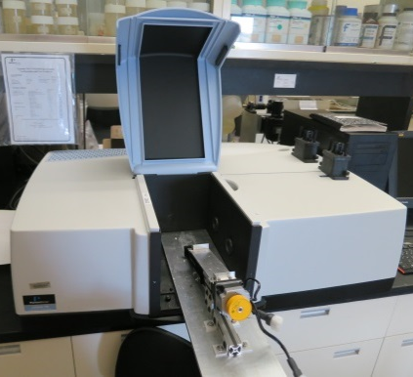
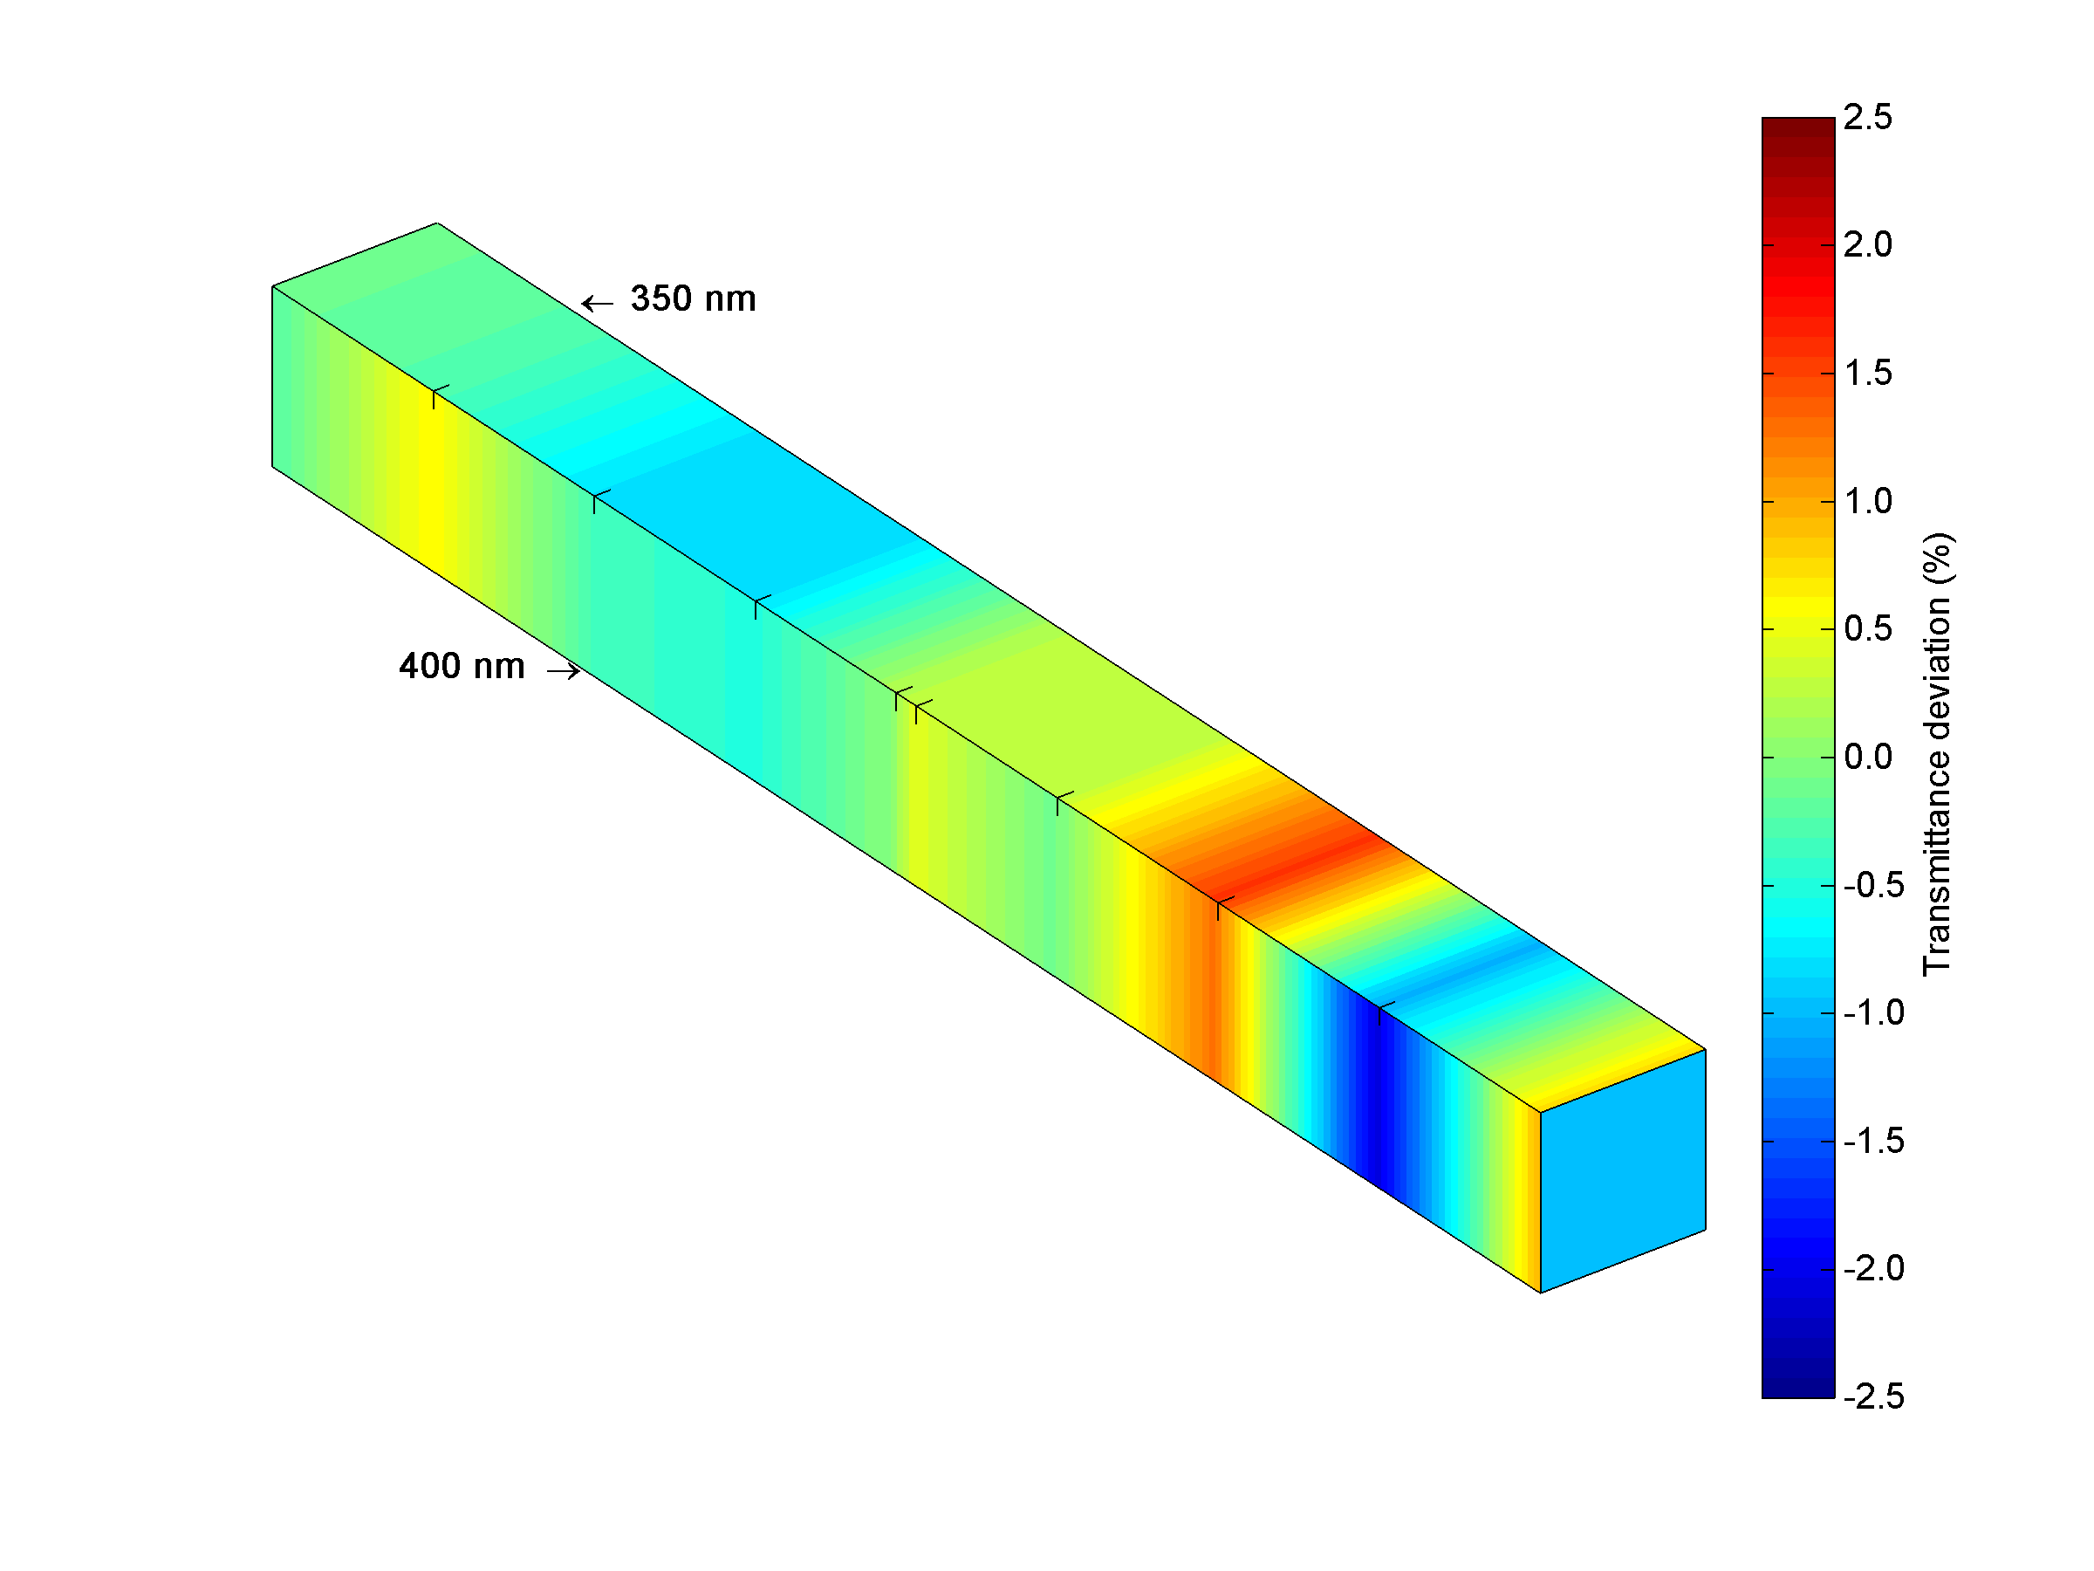
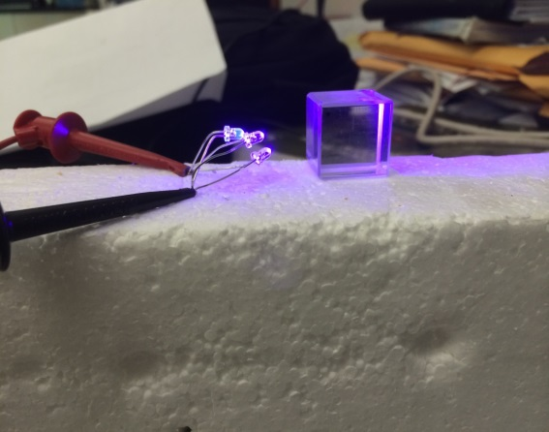
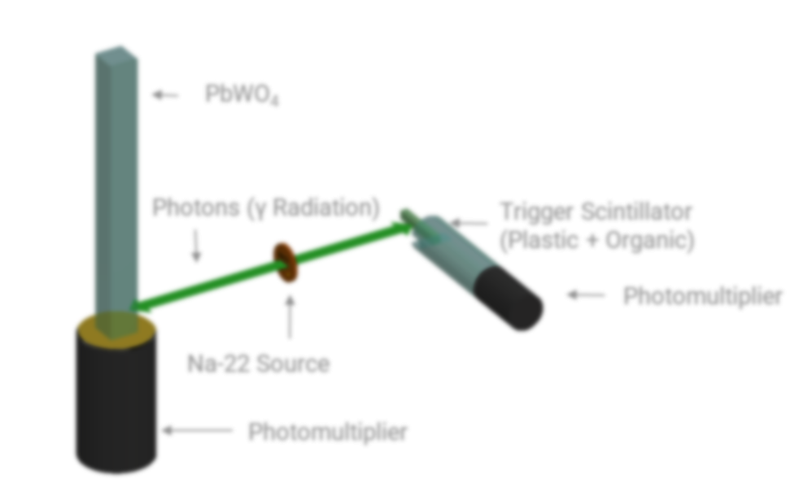
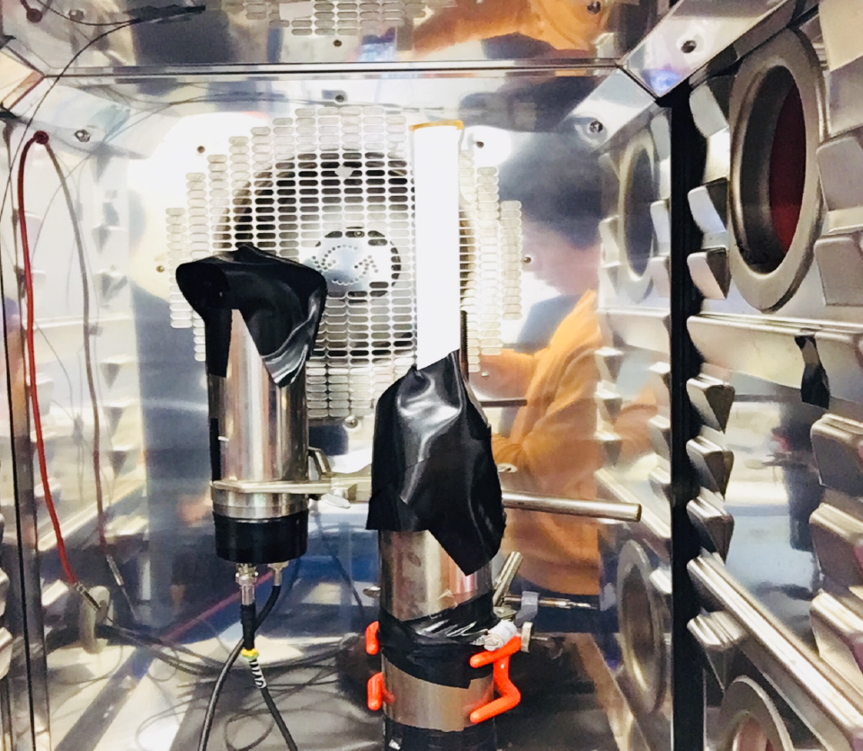
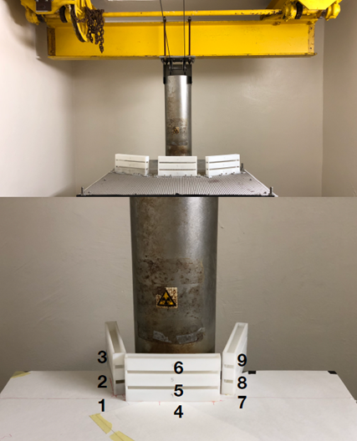

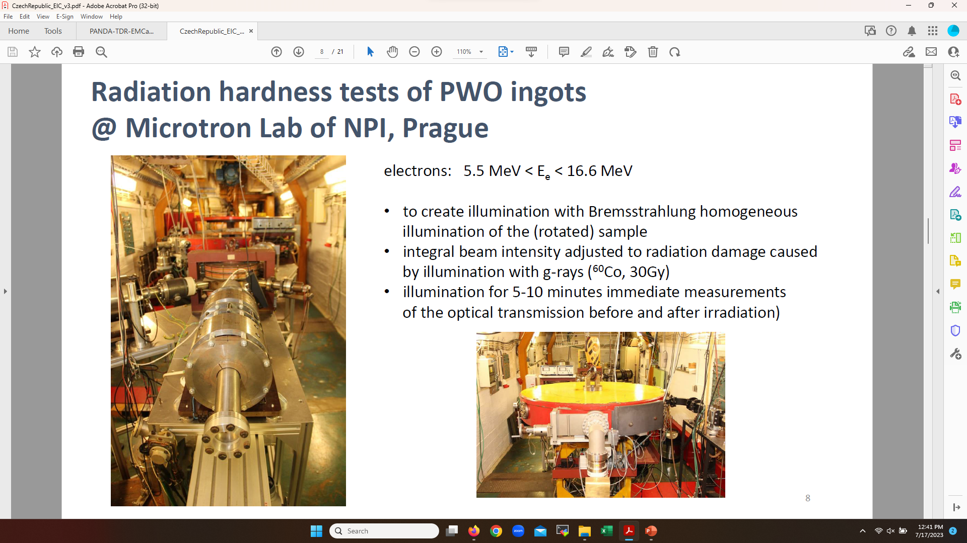
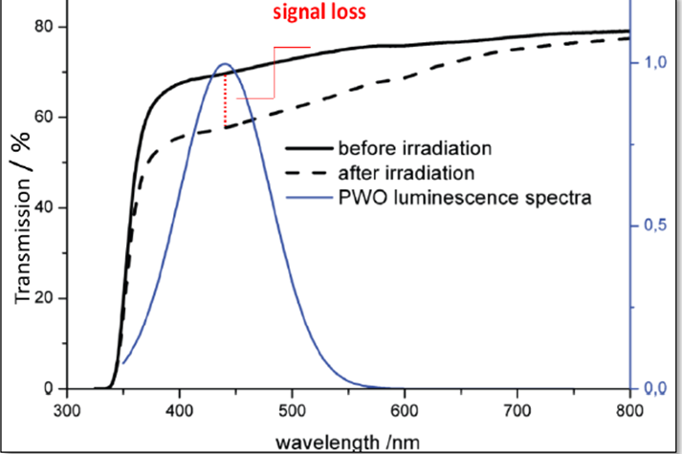
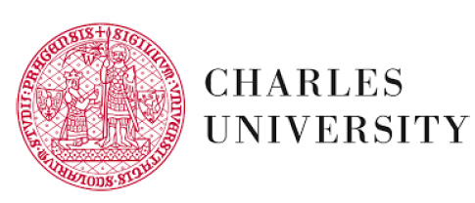
QA facilities at Universities
Optical Transmittance (L/T)
Crystal light yield and timing
Radiation Hardness and recovery
Cs-137 source and calibrated 2-inch PMT (Hamamatsu R2059-01) with QE(420nm)=24%.
Co-60 sources
Modified Varian Cary 5000 spectrometer
PbF₂
x-ray irradiation system (Faxitron CP-160)
Perkin-Elmer Lambda 950 spectrometer
Na-22 source and 2-inch PMT (XP2262)
Cs-137 source and 2-inch PMT
Co-60 source, 222 TBq, simultaneous irradiation of nine crystals/water; different dose rates possible
Varian Cary 5000 spectrometer
Electrons 5.5 MeV < E_{e} < 16.6 MeV; adjust beam intensity to illumination with g rays (Co-60, 30 Gy)
From PbWO4 Final Design Review
13

Slide 14
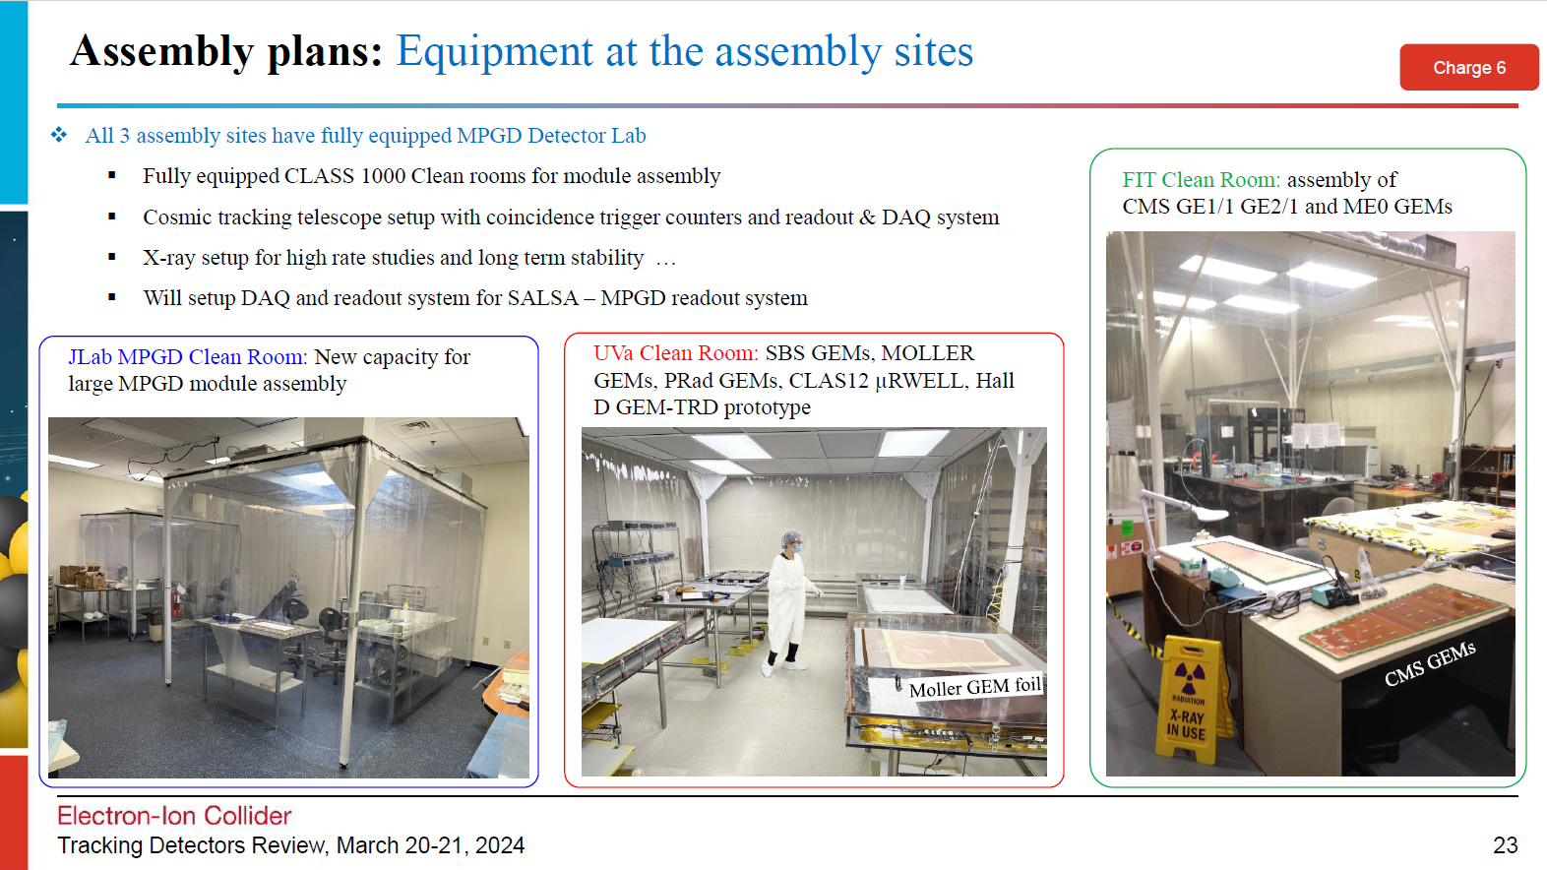
From this week’s Tracking Detector Preliminary Design Review

Slide 15
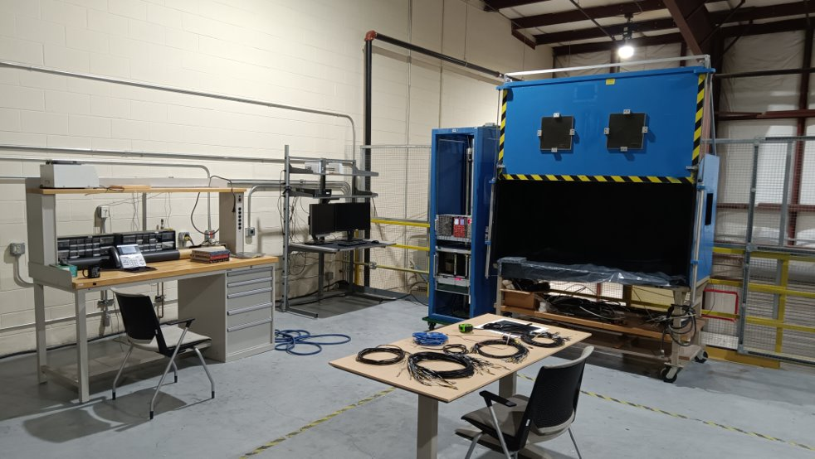
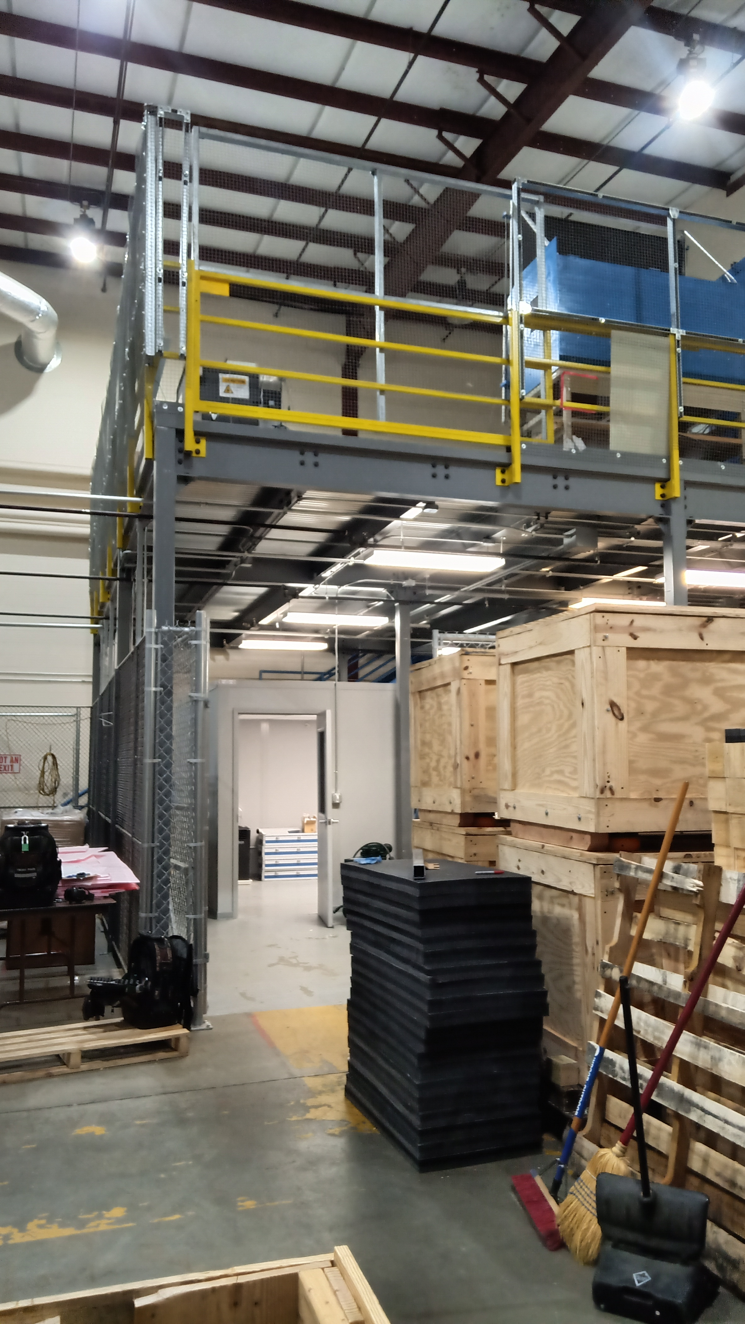
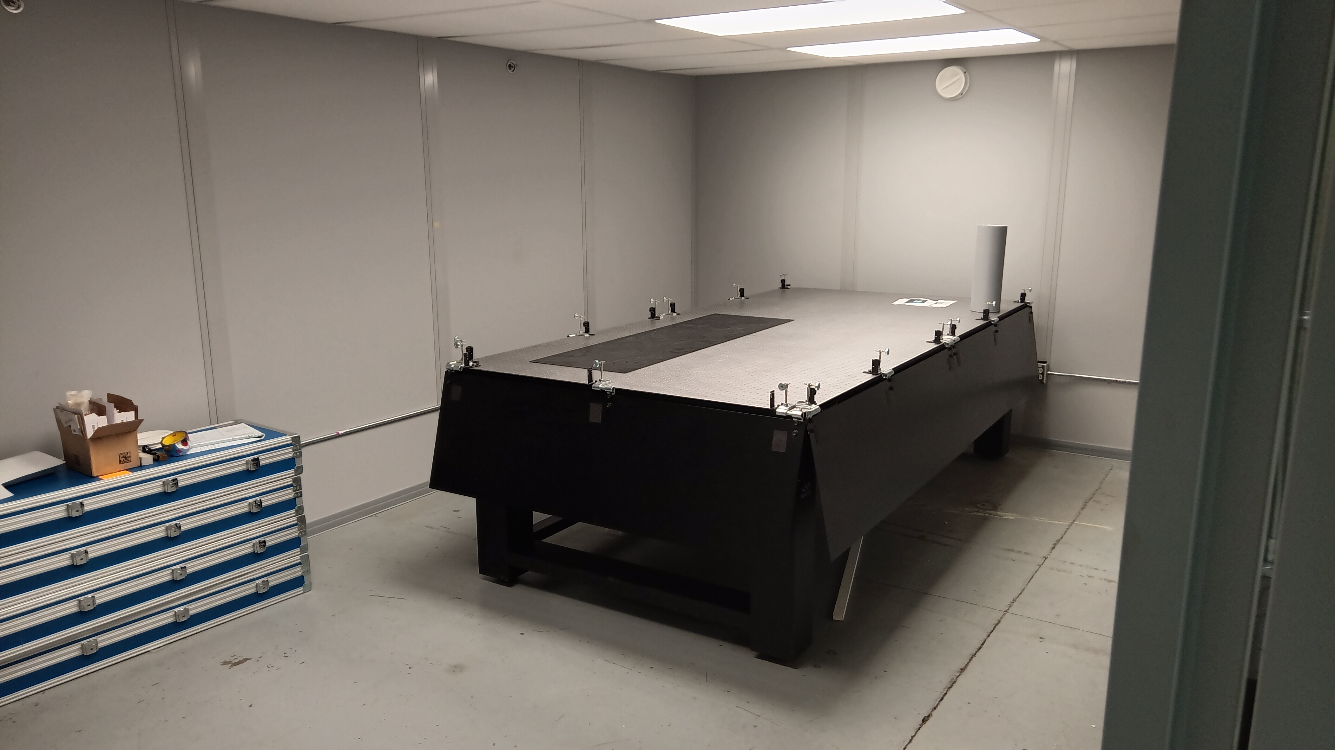
EEL108 Mezzanine
Dark box
3D motion stage
PC, electronic rack with WEINER and NIM crate are in place
In parallel a test setup in the ARC building​
  Dark box
  CAEN Digitizer as signal readout
  Electronics for trigger
EEL-108A Clean Room
(for hpDIRC bar QA)
Optical table
Laser and alignment diagnostics
Cabinet for bar storage
Dedicated area for various photosensor tests and also the hpDIRC bar quality assurance
Possible photosensor tests:
Gain
Gain in magnetic field (FROST 5T magnet)
Time Resolution (scope and/or CAEN-DT5742 Digitizer)
Quantum Efficiency (QE)
Homogeneity by using XY-scanner
Dark Count Rate
Etc.
EEL 108 Mezzanine for testing EIC HRPPDs
Clean room for EIC hpDIRC Quartz bars

Slide 16
Planning for Production Phase
We plan to collect information on all test setups for component quality assurance
Following slides show some examples, note that this will also come up in a Final Design Review!
  Beyond what is shown, both BNL and JLab have SiPM testing facilities for single SiPMs and assembled boards
  Similar, initial HRPPD inspections and functionality tests can be done at JLab, more detailed QA at BNL
  DIRC bar QA assurance laser room exists at JLab (a clone from the one at GSI)
We encourage all of you to send Rolf/Elke and John/Silvia slides (one slide for each component setup) on similar EXISTING test setups at your institutions
  As one example, the aerogel test setup at Temple
  As another example, the dRICH–related test setups at INFN
  Etc., etc.
We are interested to find strengths, weaknesses and gaps in the planning for the production phase
Fold in that we have 25+ different detector technologies, so we have to assume this is a risk.

Slide 17


Slide 18


Slide 19
Goals for 2024 (towards CD-2!)
DAC meetings in ~April (topics: detector status, international engagement, R&D status) and ~August (topic: Detector R&D advise)
  Completion of Non-Si R&D
  Advise on follow-up of MAPS/ITS3, ASICs, and AC-LGAD
Quantify (time, cost, performance) and document, before CD2, mitigation plans for the possibility that some R&D components will not meet expectations
  Tracking layout with branching points defined and documented
  HRPPD backup option documented, etc.
Ensure good project progress
  Implement procurements for CD-3A scope and manage progress
  Continue work on design maturity for all (non-CD-3A) systems.
  Define CD-3B needs: next phases of CD-3A, magnet power supply, perhaps VTRx+ optical transceivers, perhaps magnet steel
  PDRs of Tracking, Far-Forward/Far-Backward, Electronics/DAQ, Particle Identification
  FDRs of Magnet Power Supply, Calorimetry
Continue work on integration aspects, e.g., service needs of various detectors, cable routing, electronic rack layouts, survey & alignment planning, monitoring systems, controls needs.
  System engineering for electrical and services (per DOE/OPA recommendation)
  Document controls needs
  Collect interfaces beyond CD-3A scope, and document towards ICDs
Simulations with Full Materials, Background and Reconstruction
Draft Technical Design Report in collaboration with ePIC
Formalize in-kind agreements in form of high-level agreements and project planning documents, as appropriate: Italy/INFN (Detector, Magnet), France/IN2P3, France/IRFU, UK/STFC, perhaps NSF, other

