Slide 1

ePIC Collaboration News
J. Lajoie, S. Dalla Torre
March 21, 2024

Slide 2
Hey John, start the recording….

Slide 3
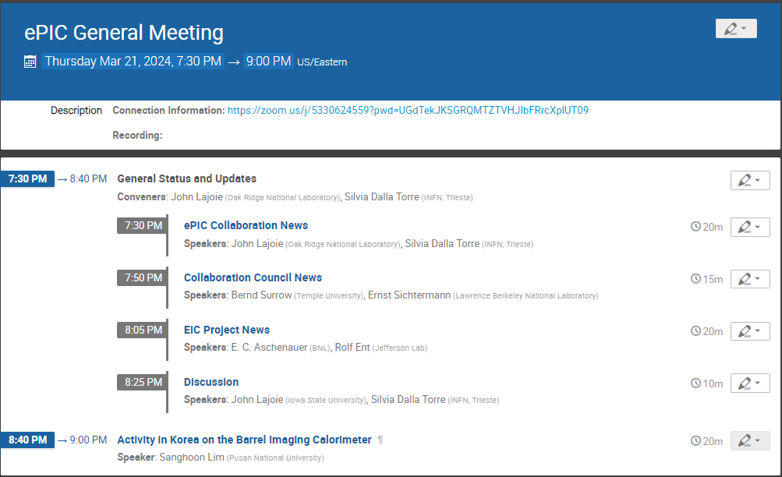
Today’s
Agenda

Slide 4
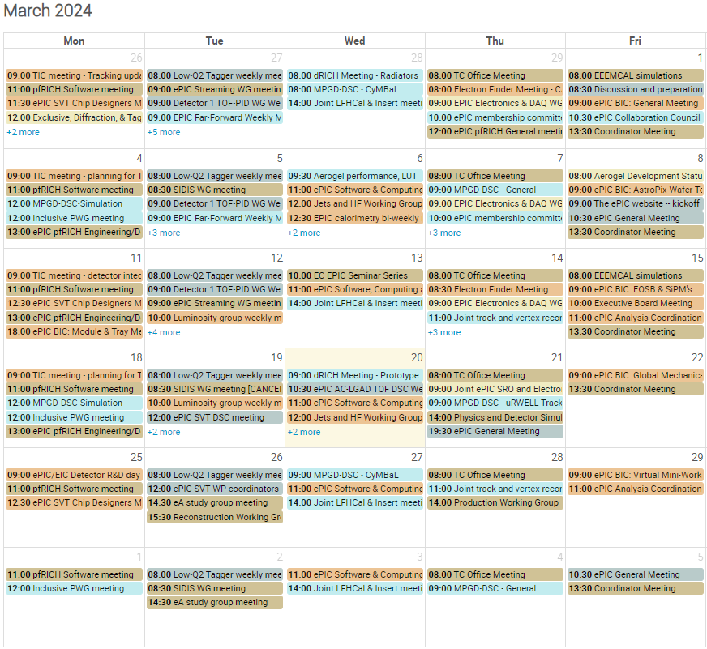
Activity in ePIC
ePIC Momentum Continues…
Tracking IDR Page Turns
Tracking IDR Rehearsals
Tracking IDR
More in the EIC Project News talk
Closeout talk at Apr. 8th TIC Meeting

Slide 5
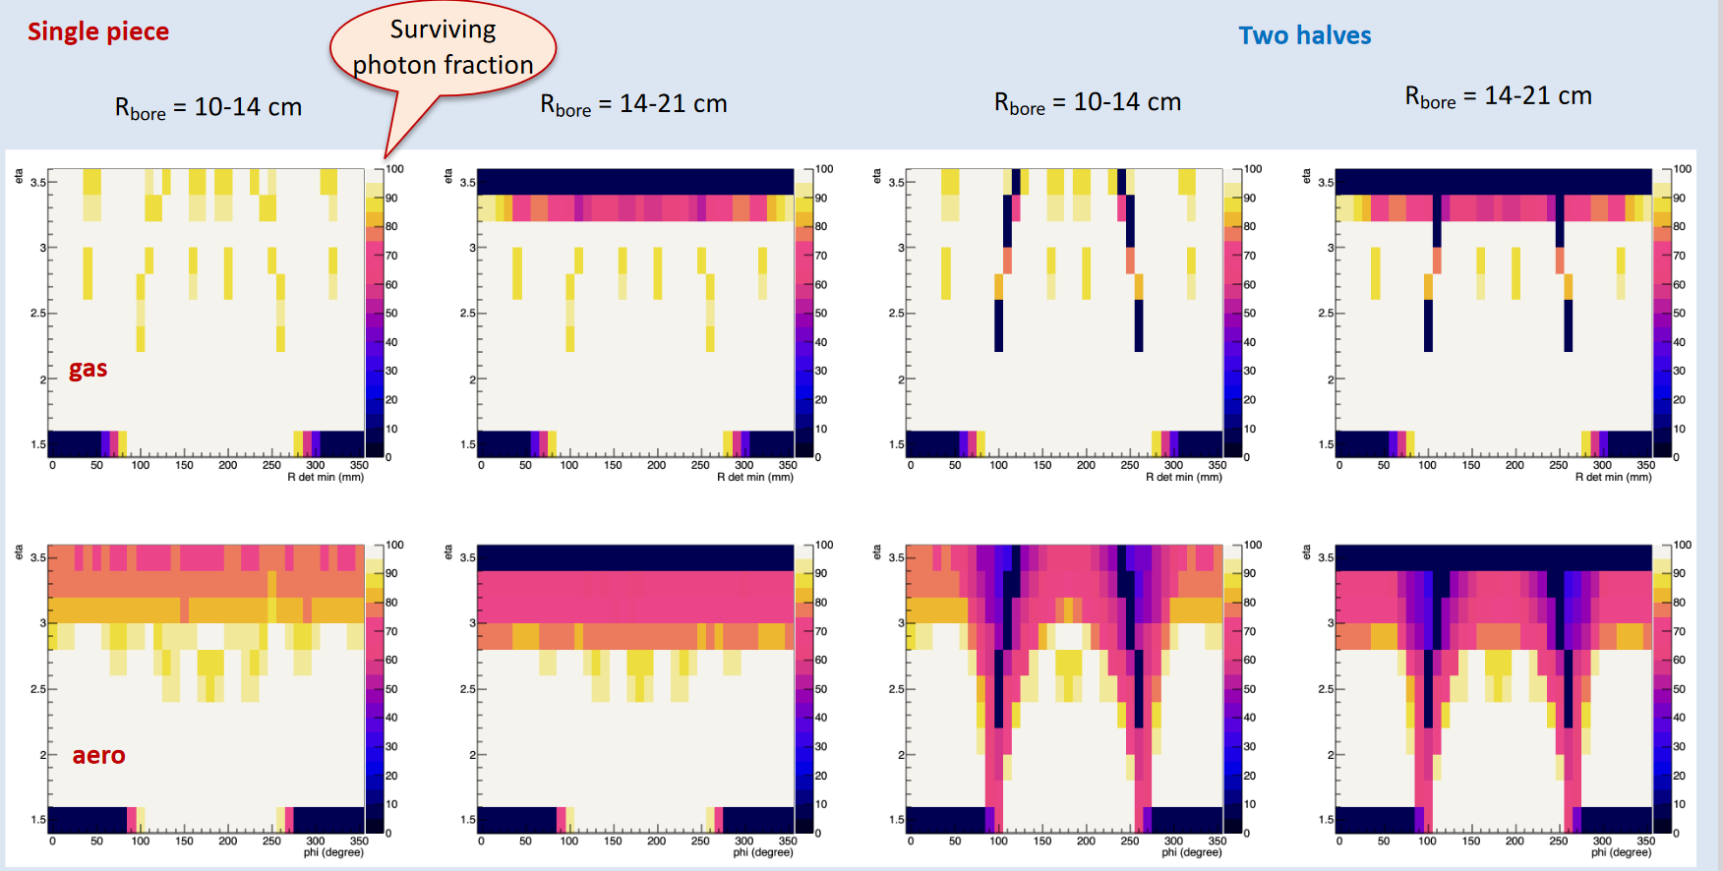
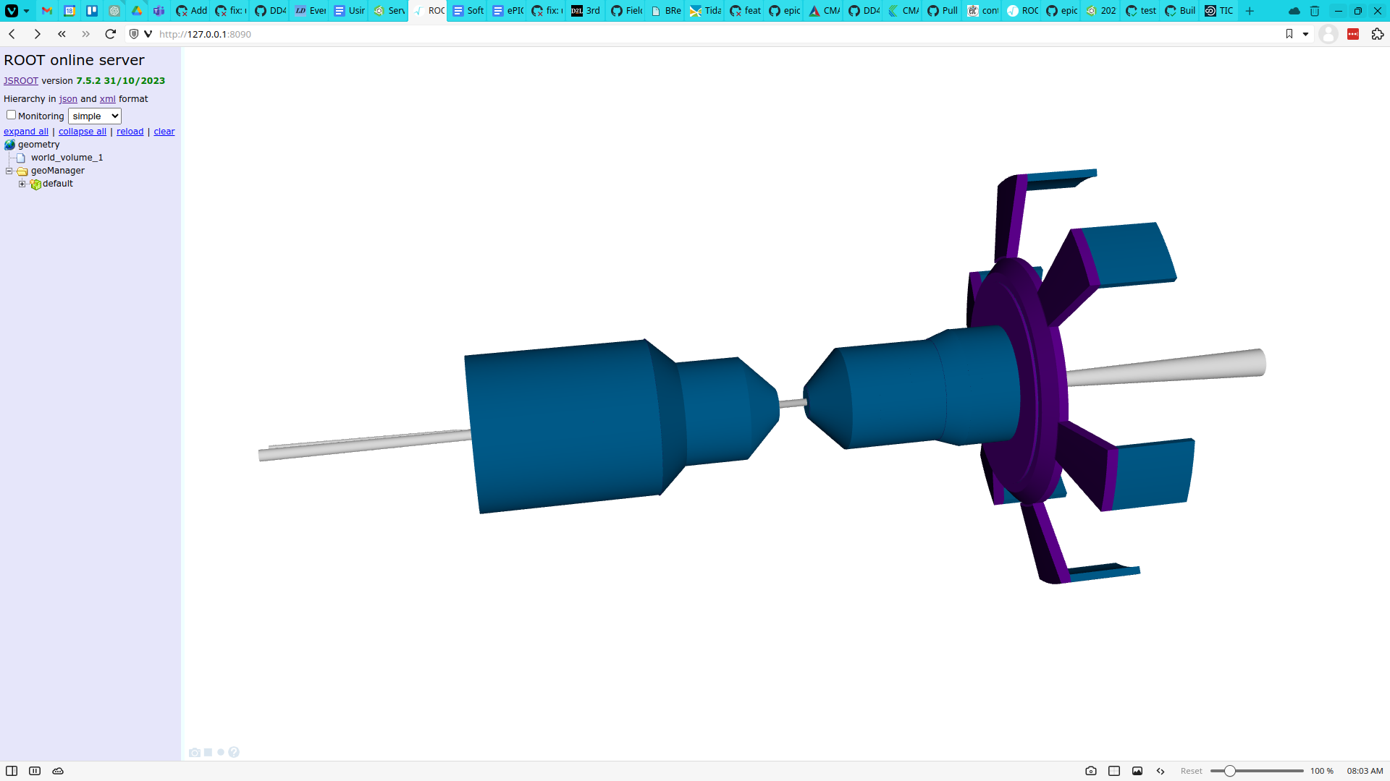
TIC Report from Recent Meetings – 3/11
Single vessel
An update about detector integration progress
The project engineers have provided an update about Integration, Installation and Infrastructure by project engineers
  Some minor adjustments have been applied to AC-LGAD, Inner MPGDs and MPGD disks for cable and service routing;
  Full bars from STAR (reused) for barrel HCal instead of bars alternating full and empty sections.
  The barrel ECal weight is approaching 50t; is weight reduction possible?
  Two relevant open points:
  The mechanical interference between DIRC and outer gaseous tracker;
  Two options for the dRICH implementation related to assembly and maintenance considerations (also discussed in a dedicated report):
    The one single vessel option would reduce the acceptance at large η;
    The two-vessel option result in non-uniform acceptance in Φ.
Layout of the detector information in the TDR
A proposal for the layout of the detector information in the TDR is presented and comments have been collected.
The revised version is available at the INDICO agenda page.
A second discussion is foreseen before freezing the scheme.
gas
DD4hep Implementation of Services Effective Model (#661)
aerogel
dRICH acceptance (η vs Φ)
2 halves
3/20 S&C Meeting: https://indico.bnl.gov/event/22802/

Slide 6
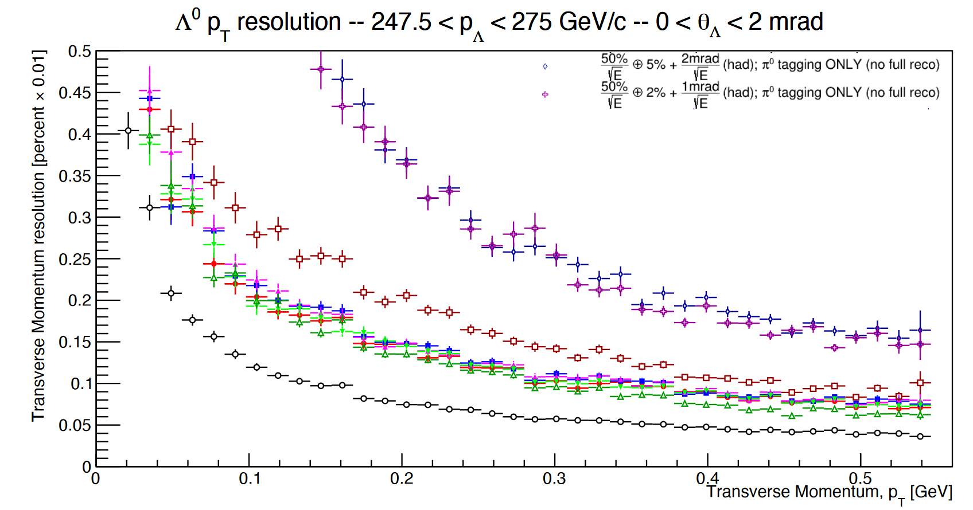
TIC Report from Recent Meetings – 3/18
Planning for the TDR effort, Calorimetry
The effort of the different calorimeter subsystems for pre-TDR is analyzed in detail with goal; completion by 2024
No intermediate timelines provided → they will be requested to the DSCs for the most demanding items
The backward HCal is the subsystem where reaching the pre-TDR level by the end of 2024 is more critical due to the limited workforce available and aspects of novelty in the role of this detector.
ZDC Simulation Studies
ZDC resolution for Λ⁰ reconstruction in the neutral decay channel presented assuming Λ⁰ p_{T} resolution as figure of merit;
  Dominant role: neutron reconstruction, in particular, the angular resolution
  π⁰ reconstruction also helps if compared to a
  simple π⁰ tagger.
An electromagnetic section in ZDC by long crystal is not beneficial because it can destroy the angular information;
Comparison between short crystals or no crystal configurations would require full simulation studies.
Simulations dedicated to soft gamma and to vector meson production are also needed: they require the contribution of the physics WGs.
σ_{θ}-neutron: 2 mrad
No π⁰ reconstruction,
only tagger
σ_{θ}-neutron: 1 mrad
σ_{θ}-neutron: 3 mrad

Slide 7
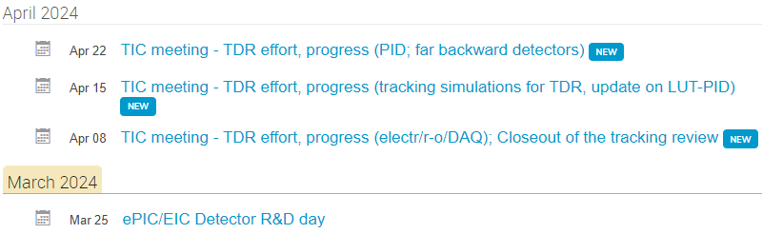
WHAT’s COMING
NOTE: No TIC meeting Monday, April 1st
Joint ePIC/EIC project R&D day on Monday March 25 (organized by Thomas Ullrich)
Starting in April, follow up on TDR effort at the TIC meetings:
  Following the progress according to the timelines presented by each DSC by a light-load exercise.
  At each TIC meeting, we will have a SHORT report (~ 5 min) by one of the CC WGs to confirm the progress and inform about discrepancies.
  In case of alerting indications, a dedicated TIC session organized at a following meeting.

Slide 8
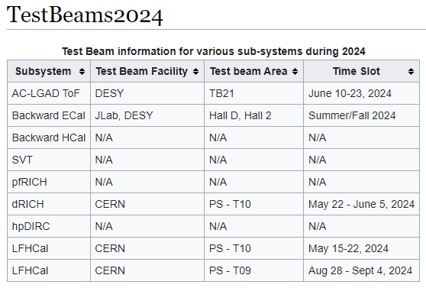
Call for DSC Input on Test Beams
Deputy TC Prakhar Garg collecting test beam information
  https://wiki.bnl.gov/EPIC/index.php?title=TestBeams2024
Things change quickly with test beam planning – please keep Prakhar updated with any change in plans.
Also – information for 2025 planning would be very helpful!

Slide 9
Rotation of PWG Conveners
SIDIS:
Charlotte - 1 year
Stefan - 2 years
BSM:
Michael - 1 year
Ciprian - 2 years
Inclusive:
Claire - 1 year
Tyler - 2 years
Exclusive:
Rachel - 1 year
Raphael - 2 years
Jets/HF:
Brian - 1 year
Olga - 2 years
Physics WG’s
  Conveners were originally endorsed for 1 yr/2 yr terms
  Half of the existing PWG conveners due to rotate off
  Do not want to create disruption at a time when we are trying to ramp up efforts for the TDR
  Plan to present new PWG conveners to the CC for endorsement at July Collaboration meeting
    Follows split of CC elections
    Allows time for AC’s to consider/develop candidates
    This is an opportunity to rotate experienced ePIC members
    to new roles!
Contact the Analysis Coordinators (Rosi and Sal) with suggestions and nominations!

Slide 10
Collaborative Tools I
In mid-2023 we formed a small group to look at options for collaborative tools:
  Technical support: Implementation of the technical solutions and interface with the host labs, in particular with BNL (Maxim Potekhin)
  Website design: The overall structure and navigation within the website and integration with external resources (Thomas Ullrich)
  Document management: An initial solution to archive talks, images, technical notes, etc. in a way that they can be easily accessed by the collaboration (Peter Steinberg)
  User-centered design: Ensure that web resources are properly organized and can be navigated in a way that is useful and straightforward, both to existing and new collaborators (Markus Diefenthaler)
There has been substantial progress in developing options, as well as a broadening of the discussion to include database needs as well.
  Some BNL resources have been allocated to this effort as well.
We are nearing the point where decisions will need to be made on the implementation of some of the collaborative tools.
The SP and CC Offices have discussed this, and see a need to re-organize these efforts so there is a decision-making process that:
  Offers the opportunity for all relevant stakeholders in the collaboration to have input
  Makes clear to the collaboration how important decisions will be made
  No “one size fits all” solution
What follows was discussed with EB (3/14) and Coordinators (3/15)

Slide 11
Collaborative Tools II
For the “phone book” or collaboration database:
  Requirements document developed
  Existing solution based on sPHENIX/EICUG phonebook, with extensions for ePIC
  Overseen by CC Office and Membership Committee
  This arrangement will continue
Databases
  This spans an enormous range – from simple parts-tracking DB up to real-time DB to interact with Streaming Readout
  No yet at the implementation stage
    Requirements document for detector construction DB needs being developed (Prakhar Garg)
  TC Office and Software and Computing will work together to develop requirements and implementation options

Slide 12
Collaborative Tools III
Website and Document Management
  Requirements documents developed, including access requirements
  Proposal for website framework (Maxim and Thomas)
  Competing ideas for document repository and management (Zenodo, InvenioRDM, Glance…)
    Key issues are search and document review workflow
  SP/CC Offices have formed a joint ad-hoc Committee charged to make implementation recommendations:
    Original four (Maxim, Thomas, Peter and Markus)
    Conferences and Talks Committee chair Maria Zurek has agreed to serve
    CC/SP Office are ex-office
  Will report to General and/or CC Meetings
  Recommendations to be presented to CC
Charge to ad-hoc committee:
  The Collaborative Tools ad-hoc committee is charged to examine implementation options that have been developed for (i) an ePIC Collaboration website and (ii) a document database and to make specific recommendations to the CC and SP Offices for implementation of these important collaboration tools. The committee should carefully consider the previously developed requirements documents for the website, document database, and document handling when making their recommendations. Issues surrounding the hosting of these services, the level of support provided by the host laboratories, access and usability for collaboration members, and the workforce required by the collaboration to maintain these resources should also be considered.

Slide 13
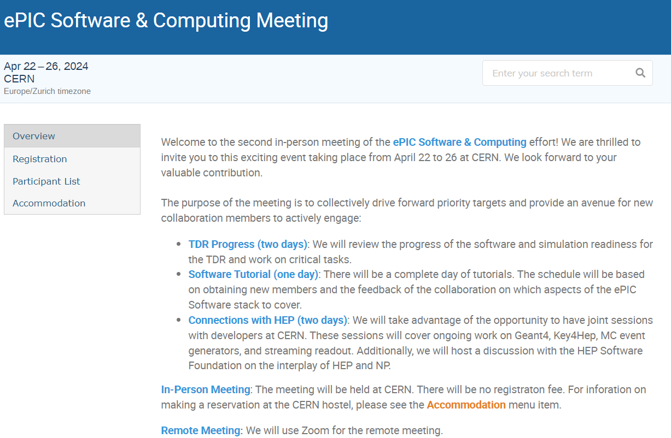

Software and Computing
Meeting
@ CERN
Registration:
https://indico.cern.ch/event/1343984/registrations/102560/

Slide 14
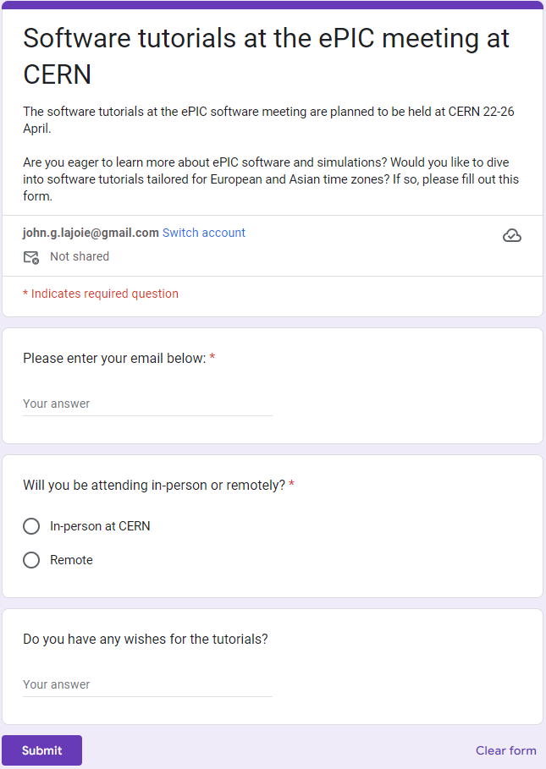
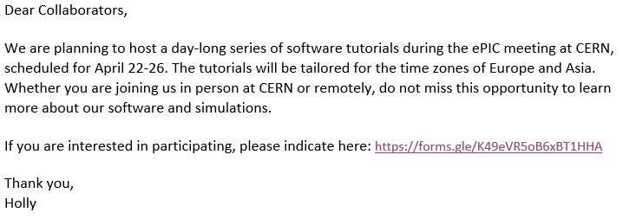

Tutorials!
email to collaboration 3/5:

Slide 15

ePIC Talks @ DIS 2024
https://lpsc-indico.in2p3.fr/event/3268/
Invited Talks:
  ePIC Detector Overview - Shujie Li
Contributed Talks:
  Overview of the ePIC Calorimetry –
  Henry Klest
  Silicon Vertex Tracker for the ePIC experiment at the Electron-Ion Collider –
  Gian Michele Innocenti
  Particle Identification with the ePIC detector at the EIC –
  Chandradoy Chatterjee
  Physics Perspectives with the ePIC Far-Forward and Far-Backward detectors -
  Michael Pitt
Many thanks to the Conferences and Talks Committee for organizing this!

Slide 16
Next ePIC Collaboration Meeting
Lehigh University
Bethlehem, PA
July 22-28
Jointly organized with the EICUG
Planning a joint session with talks of common interest
ePIC Meeting
July 24-28th
In contact with Tim Hallman regarding DOE meeting limits
https://indico.bnl.gov/event/20727/

Slide 17
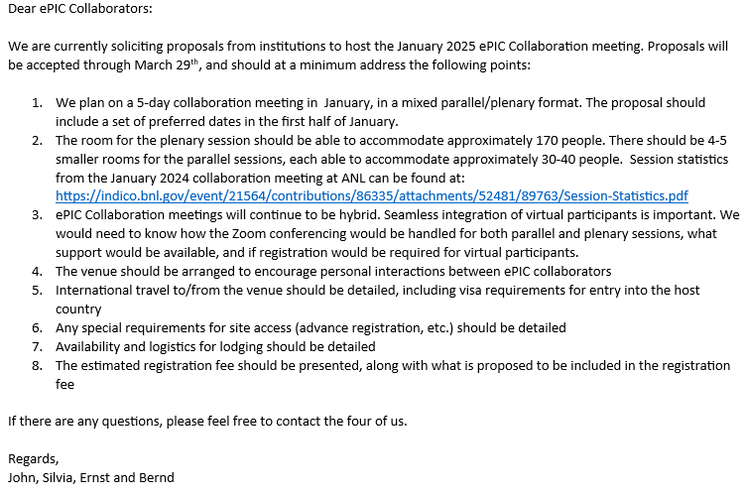
Higher Order Collaboration Meeting (NNCM)
Call sent Feb. 6th:
  We realize that a lot of time is needed to plan these events
  Call will be open through Mar. 29th
  Expect a decision a few weeks after call closes
Looking forward to many exciting proposals!
Please let the SP/CC Offices know if your institution is planning to submit a proposal.

Slide 18

Summary
The ePIC Collaboration is strong, active and growing!
There’s a heckuva lot going on in ePIC!
  The collaboration is mobilized for the TDR effort
  DSC’s working towards next set of design reviews
  CC Committees are formed and developing policies
  Good luck to our DIS 2024 speakers!
  S&C Meeting and Tutorials @ CERN in April
  EC Seminar series going strong
  Planning for the next collaboration meeting(s)
  underway
Next ePIC General Meeting:
Friday, April 5th @ 10:30AM ET

Slide 19


Slide 20
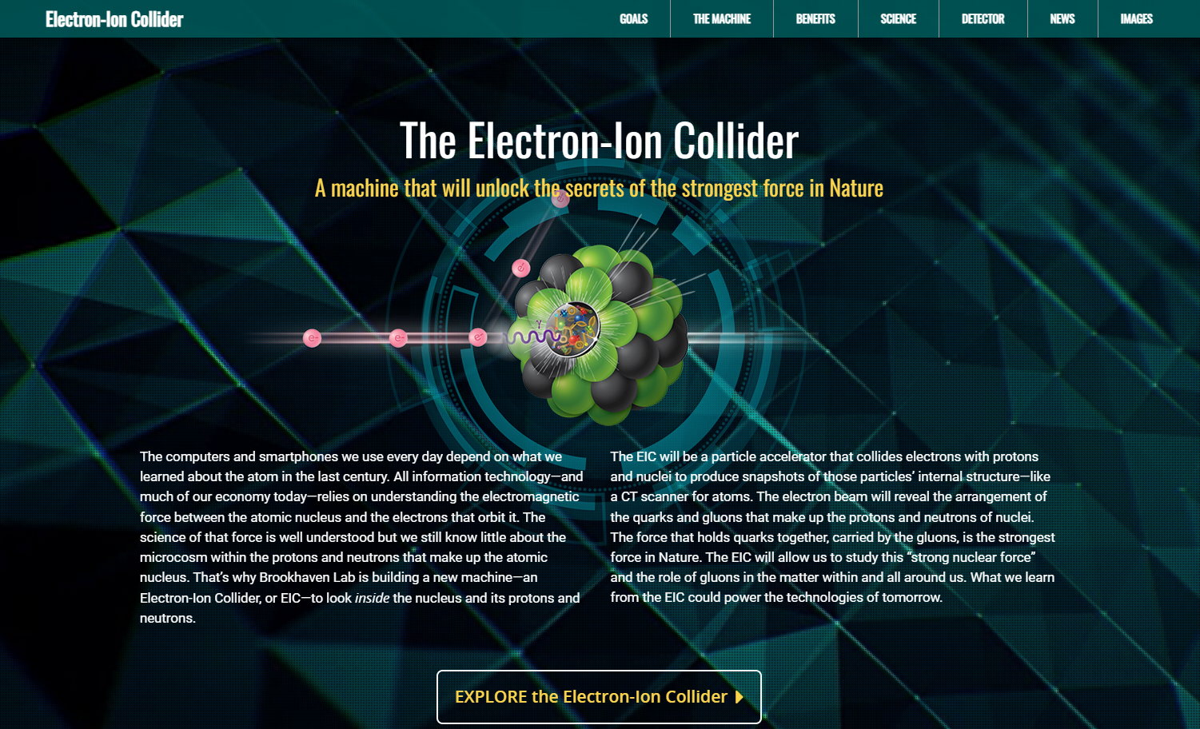
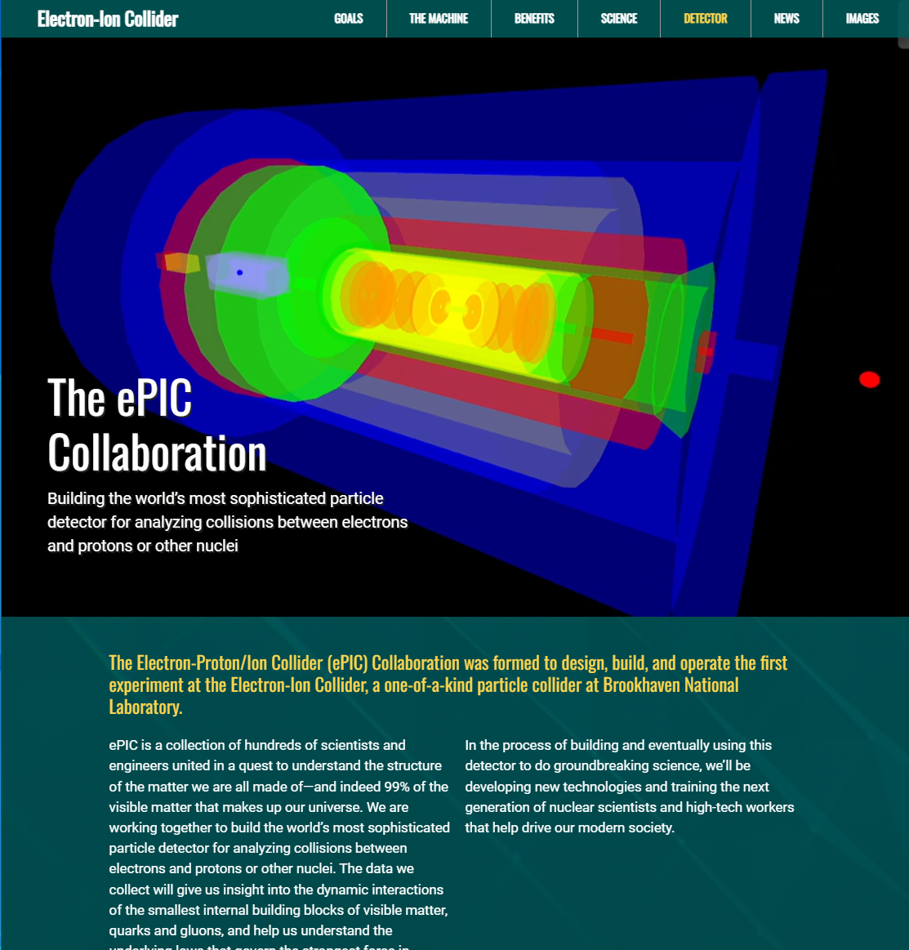
ePIC Collaboration Web Presence
Integrated into the main EIC website through the top navigation. Page contains contact information and link to the ePIC Wiki.
Gary Schroeder, Karen McNulty Walsch, Thomas Ullrich, JGL
Animations courtesy of UC Riverside group.
Continuing to update and improve.
https://www.bnl.gov/eic/epic.php

Slide 21
ePIC Resources
Public Website - https://www.bnl.gov/eic/epic.php
Mailing Lists – https://lists.bnl.gov/mailman/listinfo
Indico Agenda - https://indico.bnl.gov/category/402/
  ePIC Software and Computing: https://indico.bnl.gov/category/435/
Wiki - https://wiki.bnl.gov/EPIC
ePIC Software Training:
  Landing Page: https://eic.github.io/documentation/landingpage.html
  Tutorials: https://eic.github.io/documentation/tutorials.html
Mattermost: https://chat.epic-eic.org

Slide 22


EICUG Membership
The EICUG is a vital organization to promote the interests of the EIC community!
  Without the EICUG we would never have gotten far enough to form ePIC!
Please register your institution!
Check with your EICUG IB representative to get registered as a member
https://www.eicug.org/content/join.html

Slide 23


Upcoming Notable Events…
DIS 2024 in Grenoble, France April 8-12th , 2024
  https://lpsc-indico.in2p3.fr/event/3268/
ePIC Software and Computing meeting
@ CERN April 22nd-26th
  https://indico.cern.ch/event/1343984/
EIC RRB Meeting – May 6-7th in Italy
MC4EIC @ Durham University June 5-7th
  https://conference.ippp.dur.ac.uk/event/1292/
JLab Users Meeting, June 8-12th
  https://www.jlab.org/conference/2024-jluo
4th EIC-Asia Workshop in Shanghai July 1-5, 2024
  https://indico.cern.ch/event/1361239/
Joint EICUG/ePIC Collaboration Meeting
@ Lehigh University July 22nd-28th
  https://indico.bnl.gov/event/20727/

Slide 24
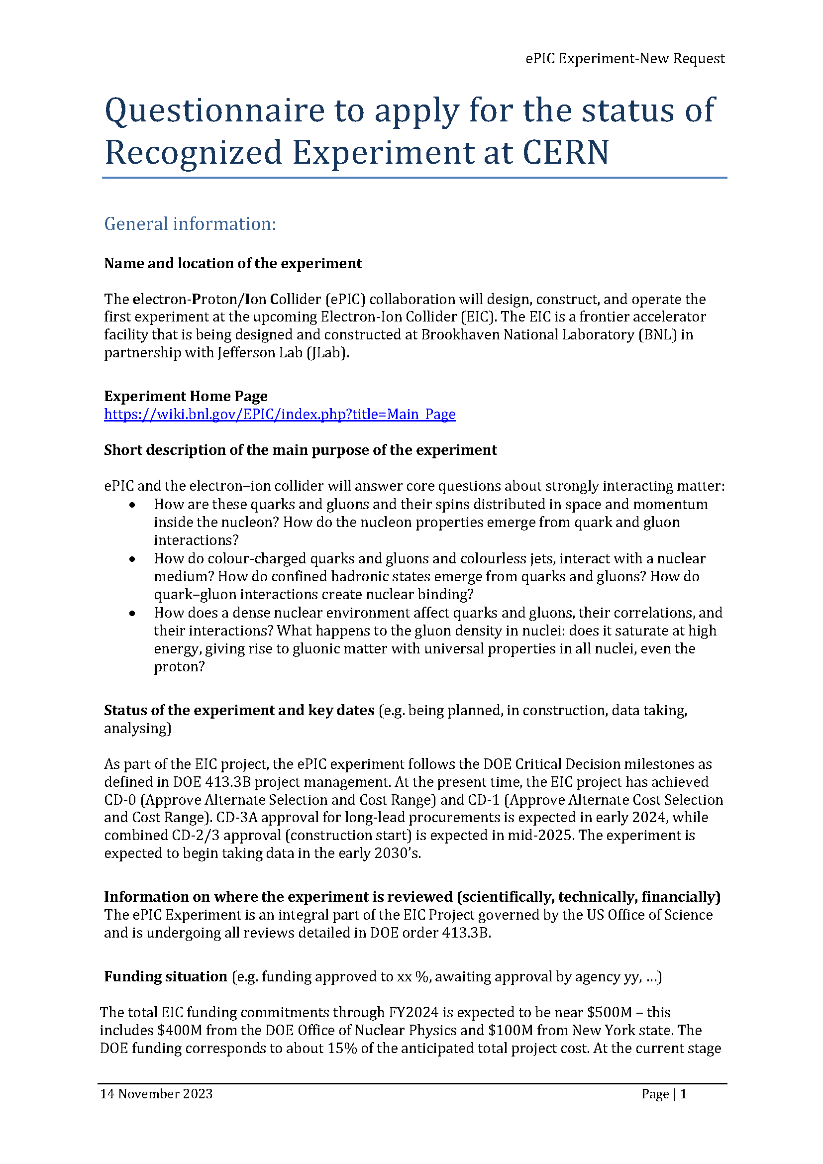
CERN Recognized Experiment
ePIC Application for CERN Recognized Experiment:
  ePIC leadership has submitted an application to become a CERN Recognized Experiment
  Strong synergies between CERN and EIC
  Important for access to CERN resources (test beams, …)
  Increase visibility in the European community
ePIC presentation Thursday, Feb 8th at 1:15M @ CERN
  Well received!
Next CERN Council Meeting March 21-22nd

Slide 25
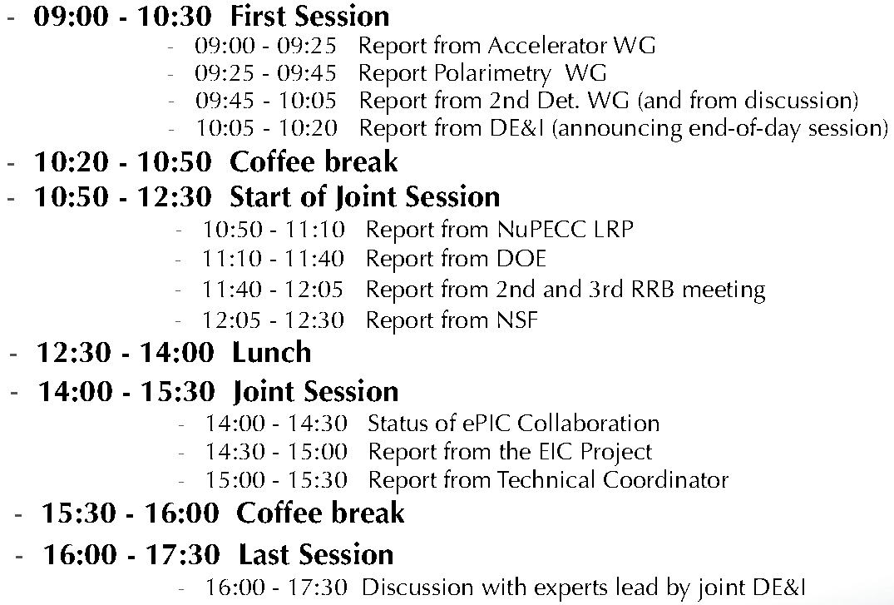
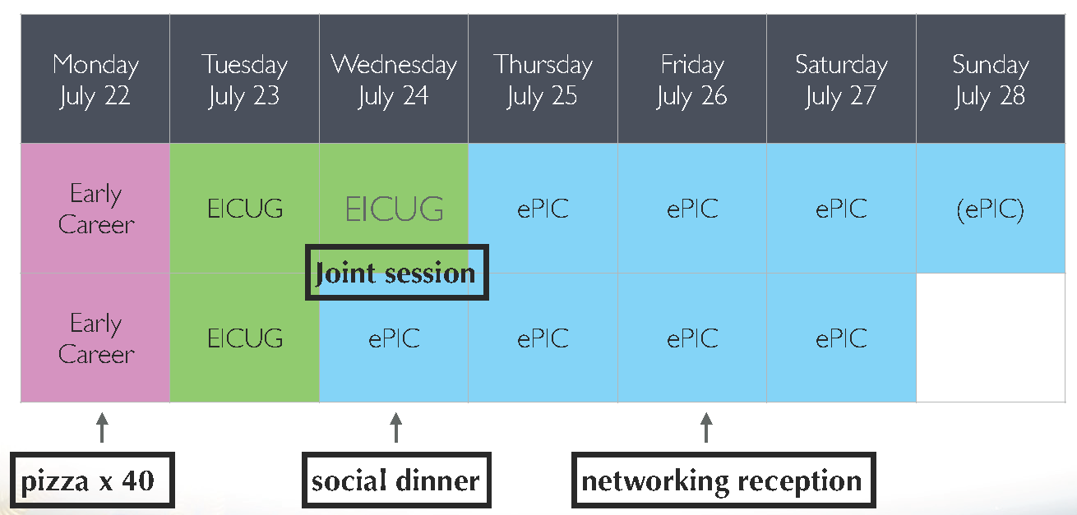
High-Level Agenda July 22-28 (DRAFT)

Slide 26
TDR Strategy and Publications
In 2024 the ePIC collaboration will produce:
  The ePIC contributions to the EIC TDR
    The EIC TDR is the top priority
      Chapters on Physics Goals and Requirements and Experimental Systems
      Not just the document, but the simulations and detector R&D that form the basis
      Requires close cooperation between the collaboration and the project!
An ePIC Detector Design paper:
    Derived and expanded from the Experimental Systems TDR chapter
An ePIC Physics Performance paper:
    Derived and expanded from the Physics Goals and Requirements TDR chapter
Both to be published in a scientific journal (such as NIMA, JINST, or PRC)
These publications will serve as a focus in developing the ePIC Membership and Publication policies.
Focused activity in the TIC:
Report by Silvia to follow
AC Report in last General Meeting:
https://indico.bnl.gov/event/21562/
process design phase
structuring the
effort
draft ePIC pre-TDR
ePIC pre-TDR (CD-2)
writing
(TDR/notes)
Preparing papers for
publication
Mid Jan.24
Mid Mar.24
End July 24
Late 2024
Early/Mid 2025

