Slide 1
EIC Project News
E.C. Aschenauer (BNL), R. Ent (JLab)
Co-Associate Directors for the Experimental Program
EIC Detector Leads
ePIC Bi-Weekly
February 2nd, 2024

Slide 2
Goals for 2024 (towards CD-2!)
DAC meetings in ~April (topics: detector status, international engagement, R&D status) and ~August (topic: Detector R&D advise)
Completion of Non-Si R&D
Advise on follow-up of MAPS/ITS3, ASICs, and AC-LGAD
Quantify (time, cost, performance) and document, before CD2, mitigation plans for the possibility that some R&D components will not meet expectations
Tracking layout with branching points defined and documented
HRPPD backup option documented, etc.
Ensure good project progress
Implement procurements for CD-3A scope and manage progress
Continue work on design maturity for all (non-CD-3A) systems.
Define CD-3B needs: next phases of CD-3A, magnet power supply, perhaps VTRx+ optical transceivers, perhaps magnet steel
PDRs of Tracking, Far-Forward/Far-Backward, Electronics/DAQ, Particle Identification
FDRs of Magnet Power Supply, Calorimetry
Continue work on integration aspects, e.g., service needs of various detectors, cable routing, electronic rack layouts, survey & alignment planning, monitoring systems, controls needs.
System engineering for electrical and services (per DOE/OPA recommendation)
Document controls needs
Collect interfaces beyond CD-3A scope, and document towards ICDs
Simulations with Full Materials, Background and Reconstruction
Draft Technical Design Report in collaboration with ePIC
Formalize in-kind agreements in form of high-level agreements and project planning documents, as appropriate: Italy/INFN (Detector, Magnet), France/IN2P3, France/IRFU, UK/STFC, perhaps NSF, other

Slide 3
Design Review 2024 Plans -
Design Reviews
PDR2: IR Integration and Auxiliary Detectors – February 12, 2024 – main emphasis on baseline choices and progress
PDR1: Tracking Detectors – 2nd half of March 2024 – main emphasis on baseline tracking layout, if we are on track and plans
PDR2: Electronics/DAQ – May 2024? – continuation of PDR1 to ensure we are on track and show progress
PDR: Integration, Infrastructure and Installation – Summer/Autumn 2024? – includes detector support structures
PDR2: Particle Identification Detectors – Summer 2024?
PDR2: Barrel EM Cal – Summer/Fall 2024 – emphasis on mechanical design & AstroPix readiness
FDR: Backward & Forward EM Calorimetry, Barrel & Forward HCAL – Fall 2024
PDR2: Polarimetry – timescale TBD (but before CD-2)
FDR for any potential CD-3B scope: Magnet Power Supply, perhaps VTRx+/lpGBT, perhaps magnet steel – see NOTE
FDR Magnet Power Supply – Spring 2024; Magnet Steel perhaps Summer 2024; VTRx+/lpGBT add ½ day to electronics/DAQ PDR2
Detector R&D Day - late March? – check R&D progress and outlook to FY25
Recall that completion of Non-Si R&D is expected well before baselining (i.e., in 2024)
MAPS/ITS3, ASICs, and AC-LGAD are expected to continue although we may do later engineering runs as PED effort
Next ePIC Computing & Software review by host labs – Late Summer 2024?
NOTE: CD-3B for detector will include continuation phases for SiPMs, SciFi, PbWO4, Forward HCAL. Further scope has to be known essentially now and needs FDRs.

Slide 4
Detector Advisory Committee
We assembled the DAC in 2020
Per the charter, 1/3 of the committee was replaced early 2023, we are in the process of early 2024 changes
Will replace in 2024: Heidi Schellman, Chi Yang and Etiennette Auffray
Transition Chair from Ed Kinney to Andrew White
Meetings 2024 under planning:
~April 2024: Project Status, Baseline Detector, International Engagement, Detector R&D progress (expect 1+ day)
~August 2024: Detector R&D annual review (expect 2 days) – deadline for submission July 1, 2024
Edward Kinney (Chair) | Boulder CO
Ken Wyllie | CERN
Petra Merkel | FNAL
Antonis Papanestis | Rutherford Appleton Laboratory
Peter Krizan | U Ljubljana
Ana Amelia Machado | University of Campinas, Brazil
Heidi Schellman | Oregon State
Brigitte Vachon | McGill
Stefano Miscetti | INFN Frascati
Etiennette Auffray | CERN
Andrew White | U. Texas Arlington
Chi Yang | SDU China

Slide 5
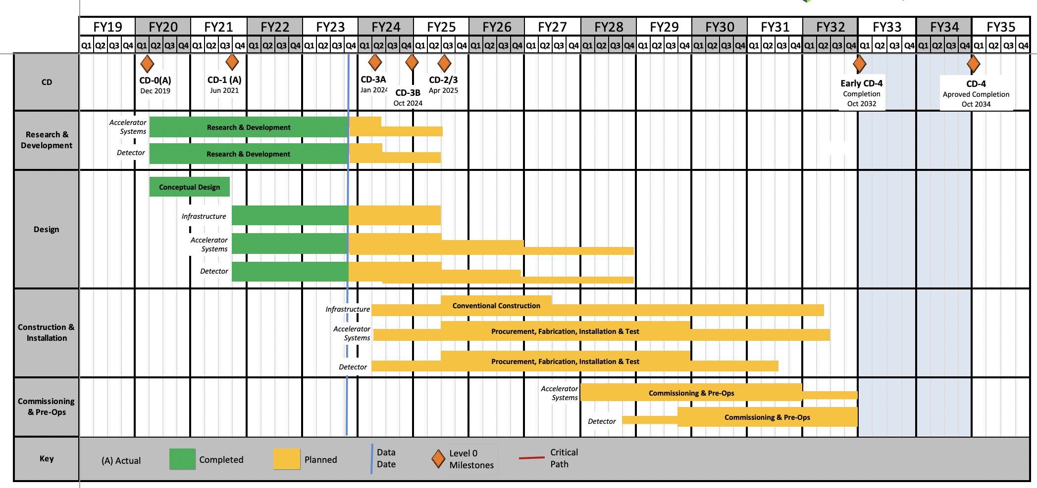
EIC Schedule
CD-3A:
Approve start of long-lead procurements
CD-3A items passed final design review
All interfaces related to them are frozen
Waiting for ESAAB meeting for authorization
Construction Phase
Conclusion of
RHIC Operation
Science Phase
CD-2:
Approve prelim. design for all subdetectors
Design Maturity: >60%
Need “pre-”TDR (or draft TDR)
Baseline project in scope, cost, schedule
The thinner bars indicate that R&D and design
can continue at a small level beyond CD-2 and CD-3
CD-3:
Approve final design for all subdetectors
Design Maturity: ~90%
Need full TDR
EIC Critical Decision Plan
CD-0/Site Selection December 2019 ✓
CD-1 June 2021 ✓
CD-3A January 2024
CD-3B October 2024
CD-2/3 April 2025
early CD-4 October 2032
CD-4 October 2034
Speculation based on EIC accelerator project status, on still uncertain FY24 and FY25 budget scenarios, and projected RHIC FY24 run:
CD-3B Approval Dec. 2024
RHIC operations conclude at end of FY25, in September 2025
CD-2/3 Approval Dec. 2025, Possibility of CD-3C as needed.

Slide 6
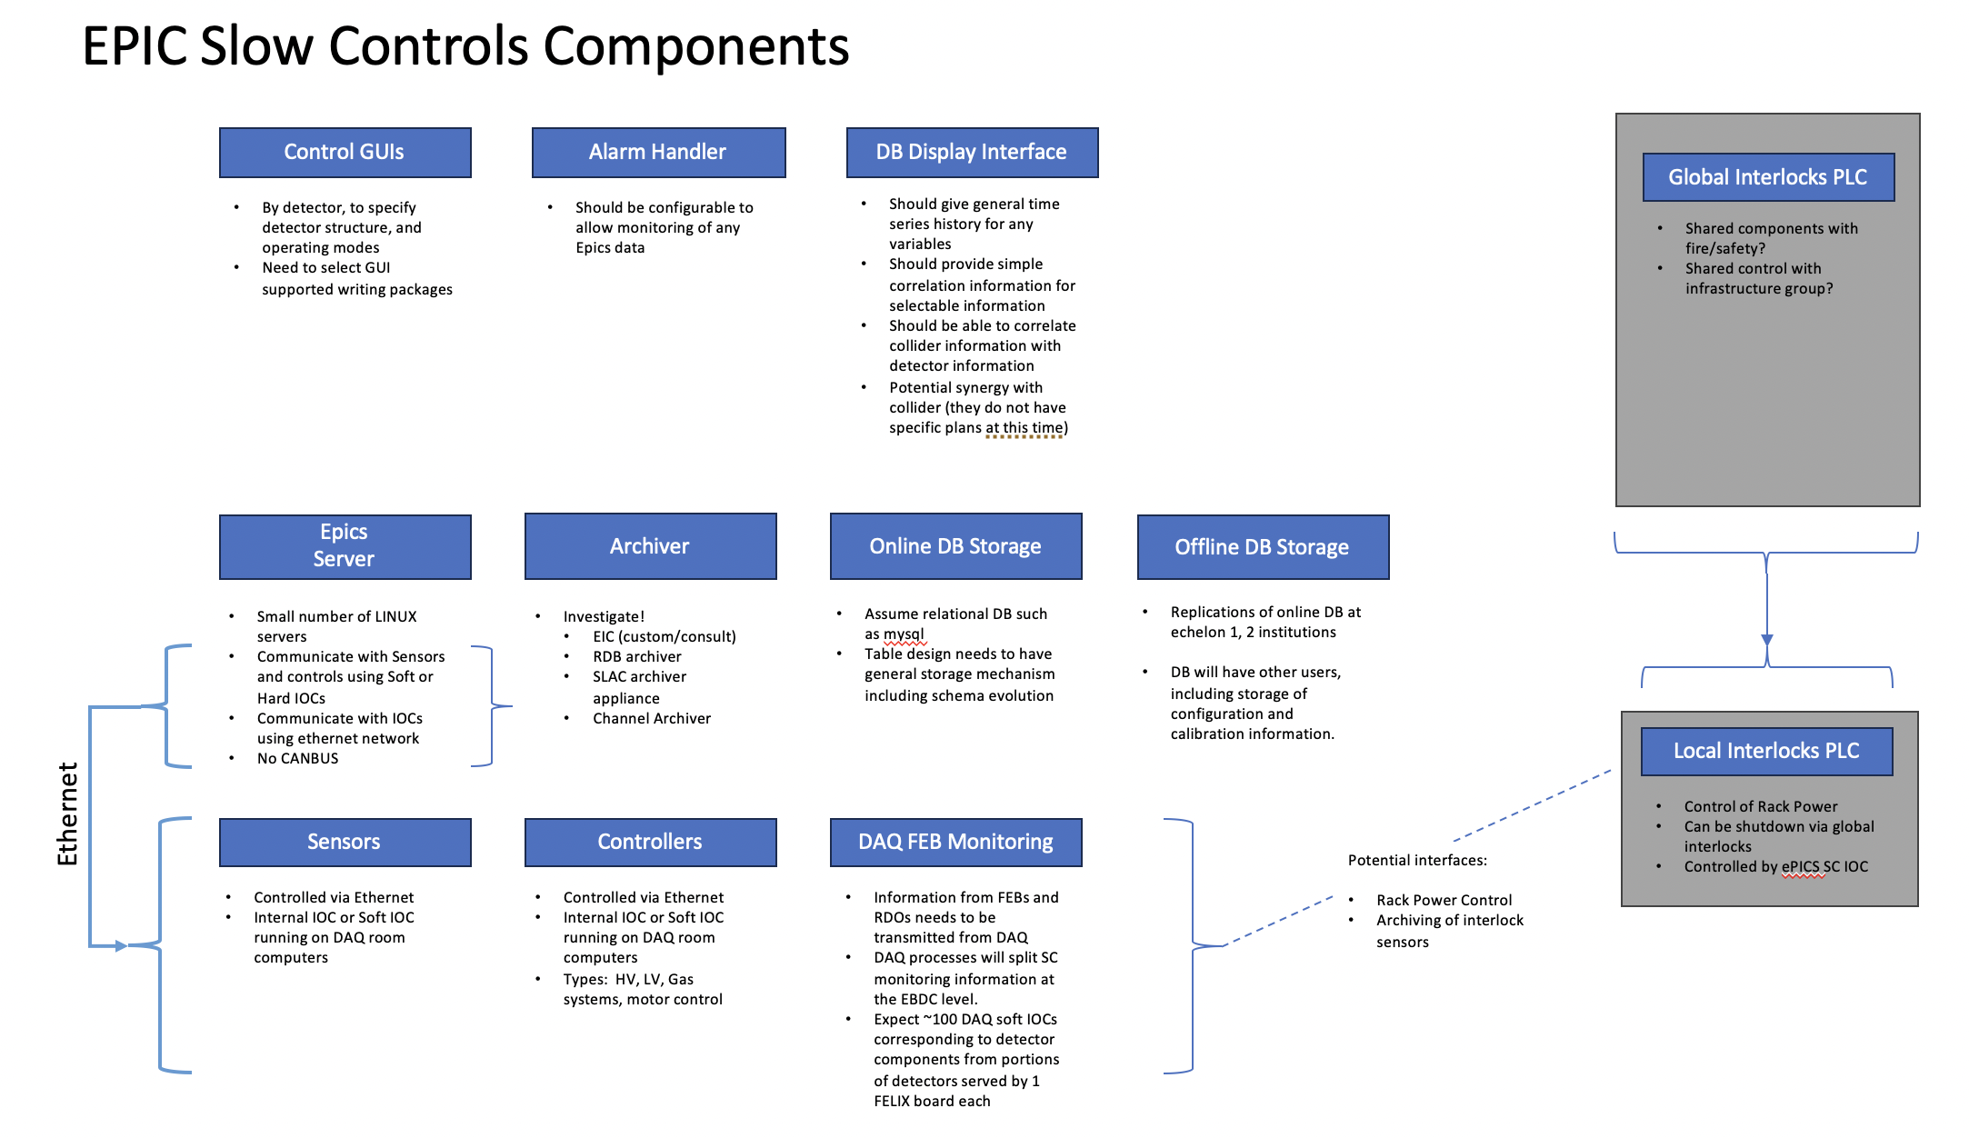
REMINDER: Request for Information – Readout and Controls
Need to start to pay attention on controls → developed a survey
Slow Controls Survey.xlsx click insert and on view survey in the pull-down menu from survey
→ followed up with detailed email to all DSCs
thanks to Lee Flader,
Jeff and Dave

Slide 7
REMINDER: Request for Information – Readout and Controls
Need input from all DSCs to help the ASIC Designers
Document to be filled: ePIC Detector Information Request.xlsx
Details have been discussed in Fernando’s email from December 12th
“Hello Everyone,
We need your help with some specifications for the Electronics & DAQ, which will help the ASIC designers and SRO and further developments.
Please enter the requested information for Qmin, Qmax and Expression of Interest for the various electronics & DAQ developments under each detector sub-system (a few entries are already filled). The Expression of Interest will let us know if resources (scientists, engineers, technicians) are already identified to address the design and implementation of the various parts of the readout (Adapters, FEBs, etc.)
The maximum rate per channel, per detector, is another critical specification that will be available soon.
In advance, my apologies for the large distribution list but I wanted to keep everyone in the loop. In the event I missed some people, please feel free to forward this email, as well.
Thanks for your support and best regards,
Fernando”

