Slide 1

ePIC Collaboration News
J. Lajoie, S. Dalla Torre
February 2, 2024

Slide 2
Hey John, start the recording….

Slide 3
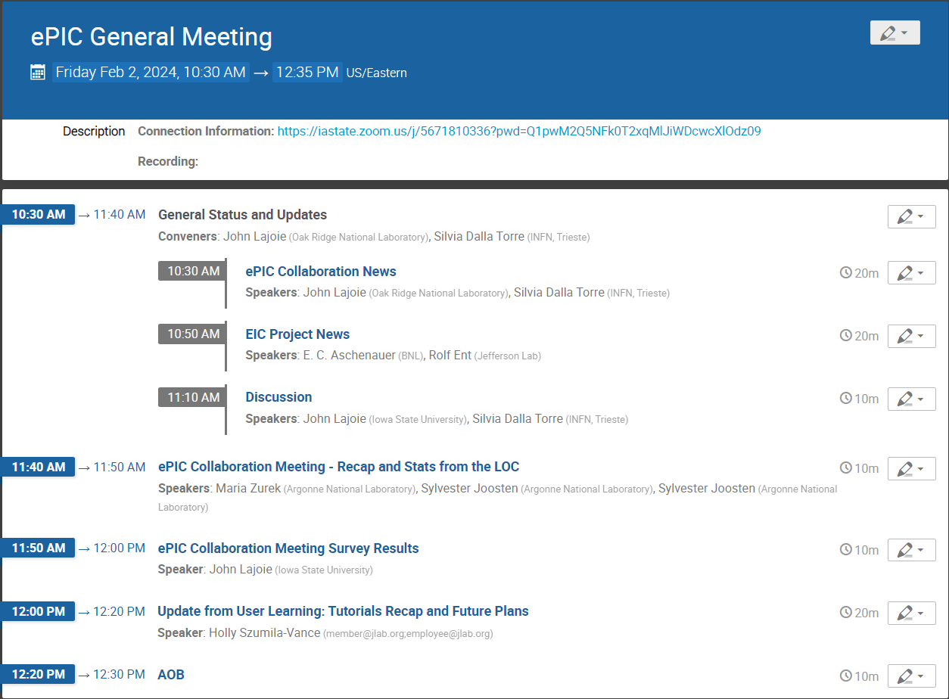
Today’s
Agenda

Slide 4

Ongoing CC Voting
Voting to endorse the DE&I committee and application of five new institutions for membership underway
CC members – don’t forget to vote!
New Institutions Applying for Membership:
ePIC DE&I Committee:
Chair: Megan Connors (GSU)
Vice-Chair: Christine Nattrass (UTK)
Proposed Members:
Francesco Bossù (CEA-Saclay)
Wouter Deconinck (University of Manitoba)
Narbe Kalantarians (Virginia Union University)
Iris Ponce Pinto (Yale University)
Maya Shimomura (Nara Women’s University)
Allison Zec (University of New Hampshire)

Slide 5
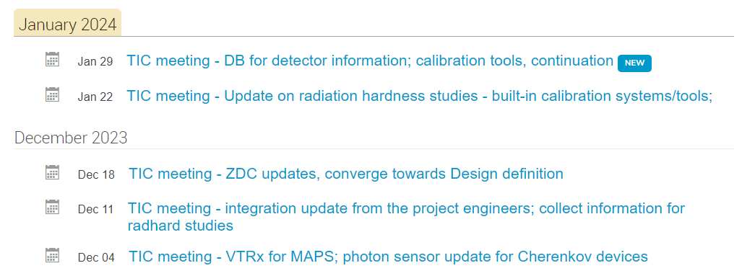
TIC Meetings….
TIC Meetings (almost) every Monday 9AM ET.
(No TIC Meeting Feb. 12th)

Slide 6
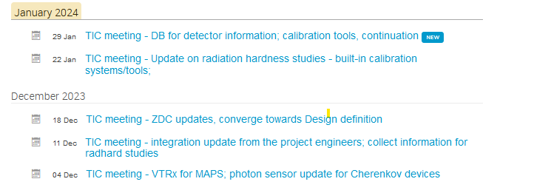
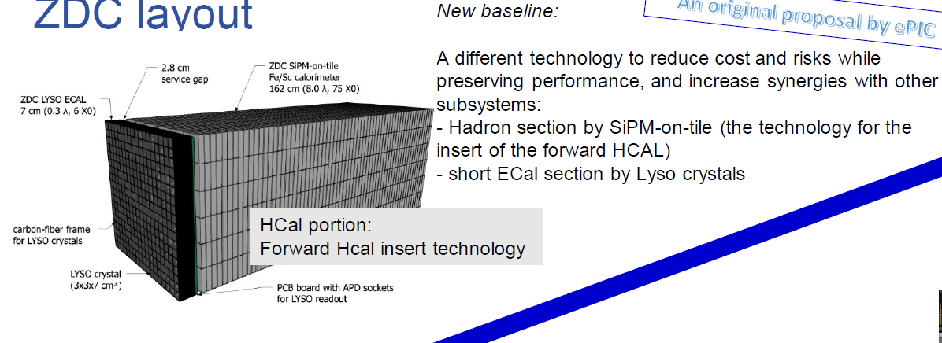
Recent TIC Activity
A long-term report provided at the ePIC Collaboration meeting 3 weeks ago:
Here an update with focus on recent and next coming steps
Support the collection of technical information:
  VTRx (12/4, 2023), optical links selected for MAPS and dRICH with dead-line to submit to CERN the ePIC projected needs
Help in planning ancillary activities:
  Collect information on rad-hard studies (12/11, 2023, 1/22, 2024)
Recommend technological choices for the ePIC detector design:
  ZDC (12/18, 2023 – third in a series of dedicated meetings)
Facilitate exchange of information about detector aspects:
  Integration update from the project engineers (12/11, 2023)
Focus DSCs onto needs not yet/limited considered:
  Built-in calibration systems/tools (1/22, 2024)
  DB for detector information in QA and assembly phase

Slide 7
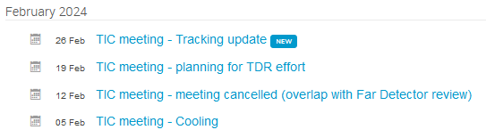
TIC “Coming Soon”
Coming: a continuation along the lines adopted in the recent past & support to the ePIC engagement in TDR
Support the collection of technical information:
  Cooling (2/5, 2023)
Follow the development of complex systems:
  Tracking update (2/26, 2024)
Support to ePIC engagement in the TDR:
  Planning for the TDR effort (2/19, 2024)

Slide 8

TDR Strategy and Publications
In 2024 the ePIC collaboration will produce:
  The ePIC contributions to the EIC TDR
    The EIC TDR is the top priority
      Chapters on Physics Goals and Requirements and Experimental Systems
      Not just the document, but the simulations and detector R&D that form the basis
      Requires close cooperation between the collaboration and the project!
An ePIC Detector Design paper:
    Derived and expanded from the Experimental Systems TDR chapter
An ePIC Physics Performance paper:
    Derived and expanded from the Physics Goals and Requirements TDR chapter
Both to be published in a scientific journal (such as NIMA, JINST, or PRC)
These publications will serve as a focus in developing the ePIC Membership and Publication policies.
This strategy was a focus of discussion and refined at the Jan 2024 collaboration meeting.
process design phase
structuring the
effort
finalizing EIC TDR
Preparing papers for
publication
writing
(TDR/notes)
Mid Jan.24
End Sep.24
End Dec.24
Mid Mar.24
End July 24

Slide 9
ePIC TDR Planning Meetings
ePIC Software, Computing and Physics Discussion
  https://indico.bnl.gov/event/21772/
TIC Meeting Feb. 19th
  https://indico.bnl.gov/event/21932/
  Planning for the TDR effort
Weekly Software and Computing Meetings:
  Wednesdays @ 11AM ET
  https://indico.bnl.gov/category/435/
Work has already started at the Collab. Mtg. and in the DSC’s, CC WG’s. and the TIC and SC:
  https://indico.bnl.gov/event/20473/
  DSC’s and CC WG’s asked for plans and timelines
ePIC Analysis Coordination Meeting Jan. 26th
  https://indico.bnl.gov/event/21725/
  Status of analysis efforts in ePIC and discussion
Analysis TDR Kick-Off Meeting Feb.5th
  https://indico.bnl.gov/event/21775/
  Physics WG needs, coordination and planning
Plus: Doug Higinbotham has volunteered to help with managing
the Overleaf for the TDR and papers, currently investigating hosting and setup options.

Slide 10

DSC Requests for Information
Electronics, Readout and DAQ:
  Q_{min}/Q_{max}, VTRX+ needs, development assignments
  DAQ/Electronics Sharepoint
  Request has been pending for a while
  Email sent to all DSC’s 1/31
  https://wiki.bnl.gov/EPIC/index.php?title=DSC_Requests
This information is needed to keep progress on the ePIC technical design moving forward!
Even if you need some time to develop the responses, connect with the requesters and let them know the status.
Please update “Pending Requests” page in the Wiki when complete so we can track progress

Slide 11
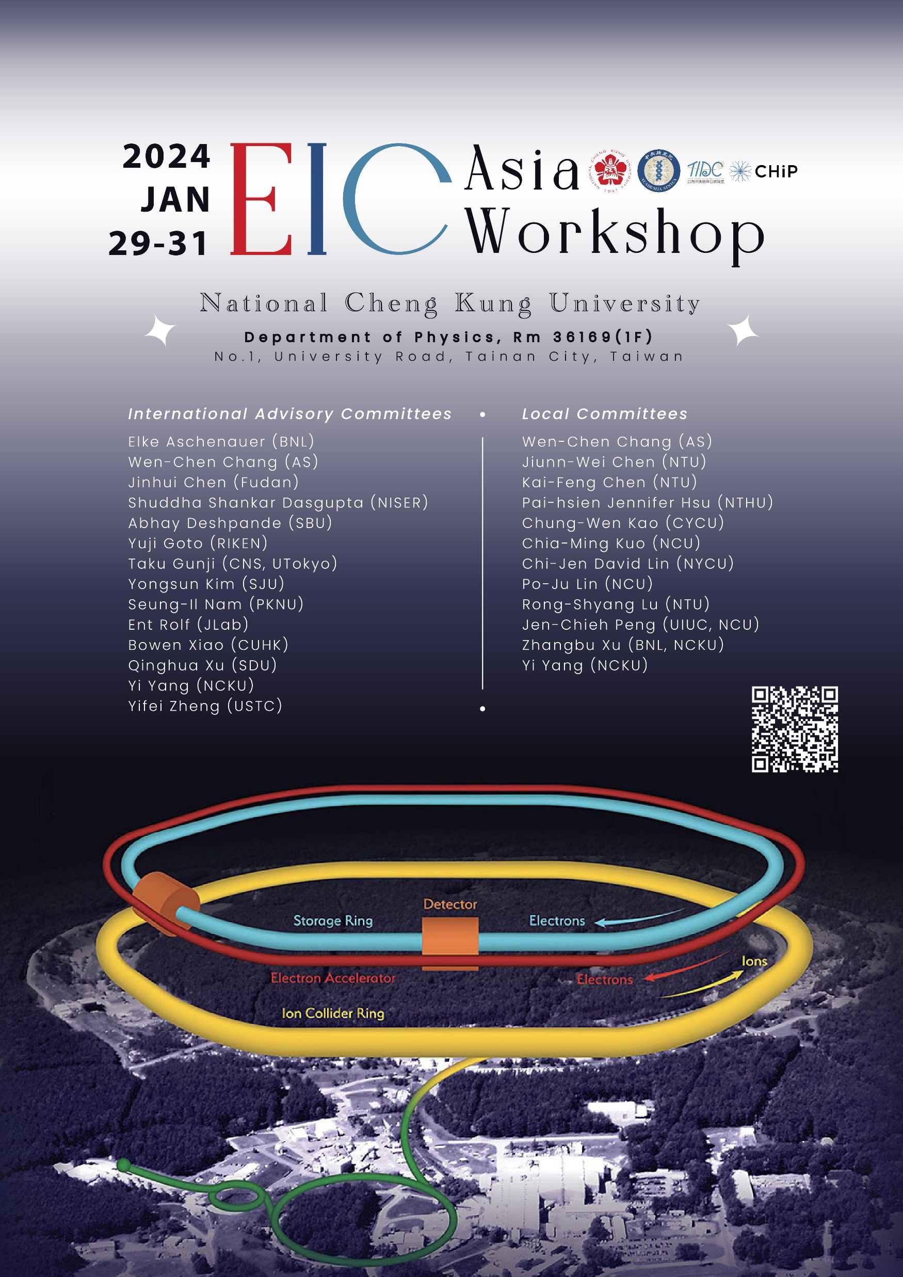

3rd EIC-Asia Workshop
A very useful meeting and discussions!
Lots of progress in the past year!
https://indico.phys.sinica.edu.tw/event/88/
ITS School and Workshop also ongoing
in India (Jan 29-Feb 9)
  https://www.icts.res.in/program/QEICIII2024

Slide 12
Next ePIC Collaboration Meeting
Lehigh University
Bethlehem, PA
July 22-28
Jointly organized with the EICUG
Planning a joint session with talks of common interest
ePIC Meeting
~July 24-28
https://indico.bnl.gov/event/20727/

Slide 13
Higher Order Collaboration Meeting (NNCM)
A call for institutions interested in hosting the next ePIC collaboration meeting in early 2025 will be going out very soon (next week).
  We realize that a lot of time is needed to plan these events
  Call will be open for about one month
    Will go out to CC and collaboration lists
  Expect a decision a few weeks after call closes
Guidelines for hosting institutions:
  We will continue to hold hybrid meetings, seamless integration of virtual participants is a must
  We expect to hold mixed parallel/plenary format
  Plan on a 5-day meeting
  Venue should encourage personal interactions

Slide 14
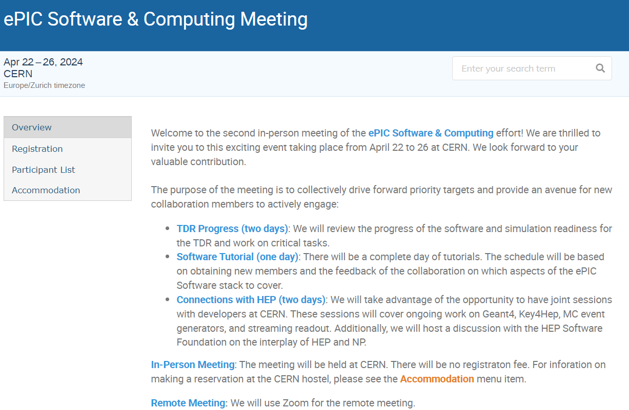

Software and Computing
Meeting
@ CERN
Registration:
https://indico.cern.ch/event/1343984/registrations/102560/

Slide 15
EC Seminar Series – Next Seminar Feb. 20th!
Seminar Details:
- Speaker: Dorota Bragg, James Cook University
- Topic: Data Visualization - How to Present Our Research?
- Date & Time: 20th February at 2:00 PM EST(Tuesday)
- Description: The skills coaching session will cover the fundamentals and best practices in data visualization, exploring techniques to enhance the effectiveness of presenting data in a scientific setting.
In this session, Dorota will delve into the fundamentals and best practices of data visualization, providing valuable insights and skills coaching on how to enhance the presentation of research data. Her expertise in the field will be particularly beneficial for early career researchers seeking to improve the effectiveness of their data presentation in scientific settings.
We encourage all early career ePIC members to join us for this informative session and kindly share this invitation with your colleagues who might be interested.
Zoom Meeting Details:
- Date: 20th February (Tuesday)
- Time: 2:00 PM EST
- Zoom Link: https://osu.zoom.us/j/95086352845?pwd=UXo0eXFBSVNpbVU3cTRBcEFZMVBUQT09

Slide 16

Deep Inelastic Scattering 2024
Grenoble, France April 8-12th , 2024
  http://dis2024.org
Deadlines Extended:
  Abstract Submission: Feb. 9th
  Registration: Feb. 16th
Call for nominations for overview talk at a joint session organized by "Future Experiments" conveners
  Send nominations to Talks Committee by Feb. 7th
ePIC should continue to engage with the worldwide community about the exciting future at the EIC!

Slide 17

Speaking
Opportunity
16th International Workshop on Heavy Quarkonium in Mohali, India Feb 26 - Mar 1, 2024
  https://indico.cern.ch/event/1226860/
Talk solicited on ePIC's experimental/hardware aspects in the "future facilities" session (25 minutes)
Contact the Conferences and Talks Committee to submit nominations
  Self nominations are also OK! Don’t be shy!

Slide 18

Upcoming Events…
CERN Recognized Experiment - Feb 8th , 2024
FFWD/FBKWD Preliminary Design Review
  February 12, 2024
DIS 2024 in Grenoble, France April 8-12th , 2024
  https://lpsc-indico.in2p3.fr/event/3268/
ePIC Software and Computing meeting
@ CERN April 22nd-26th
  https://indico.cern.ch/event/1343984/
MC4EIC @ Durham University June 5-7th
  https://conference.ippp.dur.ac.uk/event/1292/
JLab Users Meeting, June 8-12th
  https://www.jlab.org/conference/2024-jluo
4th EIC-Asia Workshop in Shanghai July 1-5, 2024
  https://indico.cern.ch/event/1361239/
Joint EICUG/ePIC Collaboration Meeting
@ Lehigh University July 22nd-28th
  https://indico.bnl.gov/event/20727/

Slide 19
Summary
The ePIC Collaboration is strong, active and growing!
There’s a lot going on in ePIC!
  EIC-Asia meeting highlights progress over the past year
  Extensive planning underway for a coordinated effort to evolve the ePIC technical design and document it in a TDR and publications
  FFWD/FBKWD PDR Feb 12th
    Tracking PDR next, more to follow….
  Opportunities to talk about ePIC to the community
  Planning for the next collaboration meeting(s)
  EC Seminar series
TDR planning and work ramping up in February
Next ePIC General Meeting: Feb 22nd @ 7:30PM ET

Slide 20


Slide 21
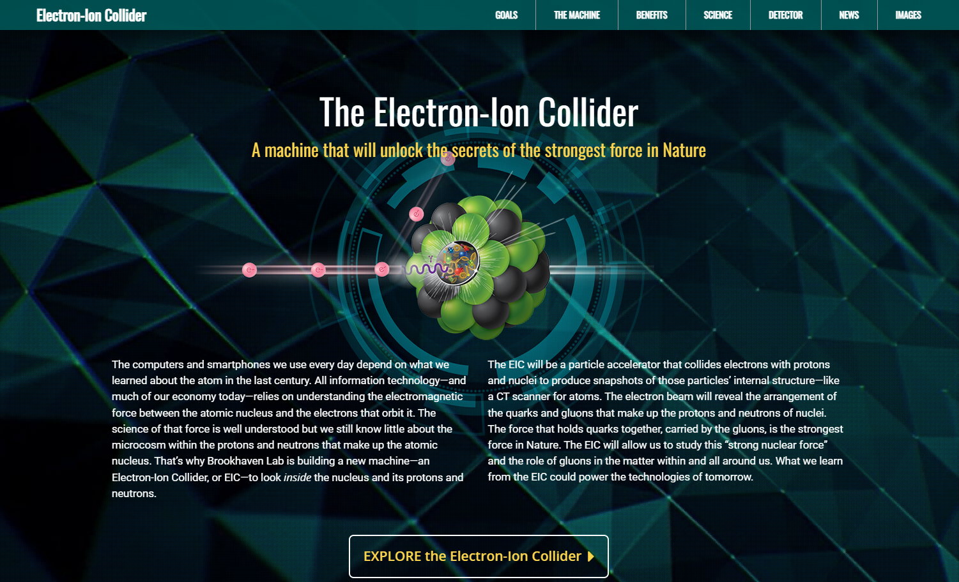
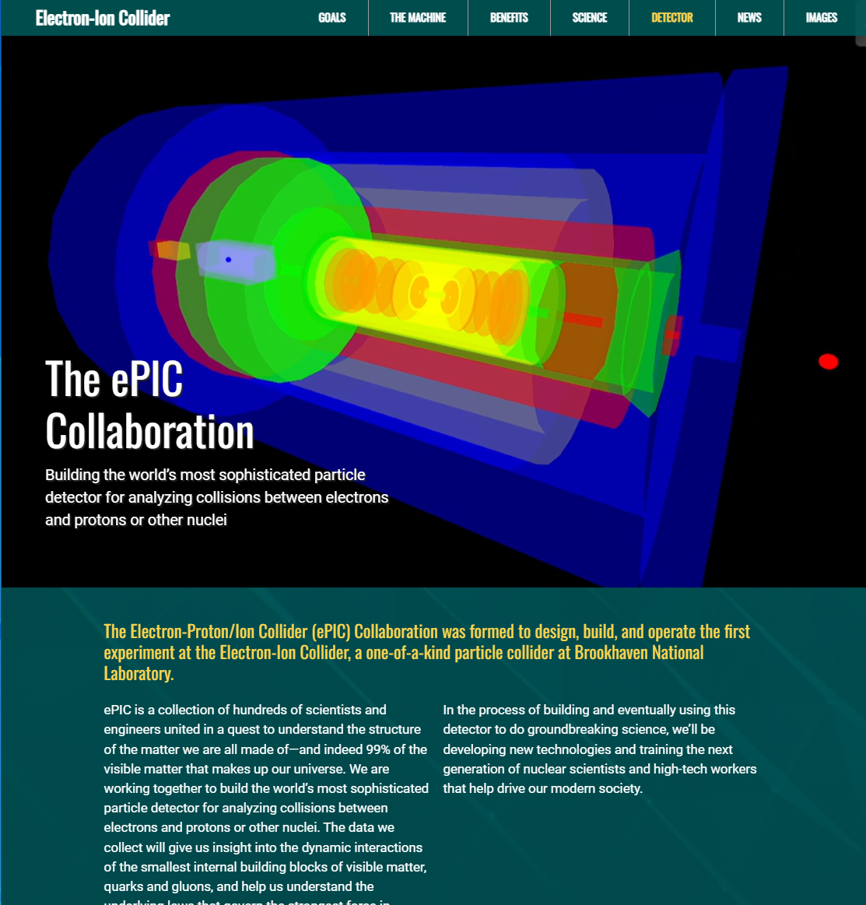
ePIC Collaboration Web Presence
Integrated into the main EIC website through the top navigation. Page contains contact information and link to the ePIC Wiki.
Gary Schroeder, Karen McNulty Walsch, Thomas Ullrich, JGL
Animations courtesy of UC Riverside group.
Continuing to update and improve.
https://www.bnl.gov/eic/epic.php

Slide 22
ePIC Resources
Public Website - https://www.bnl.gov/eic/epic.php
Mailing Lists – https://lists.bnl.gov/mailman/listinfo
Indico Agenda - https://indico.bnl.gov/category/402/
  ePIC Software and Computing: https://indico.bnl.gov/category/435/
Wiki - https://wiki.bnl.gov/EPIC
ePIC Software Training:
  Landing Page: https://eic.github.io/documentation/landingpage.html
  Tutorials: https://eic.github.io/documentation/tutorials.html
Mattermost: https://chat.epic-eic.org

Slide 23


EICUG Membership
The EICUG is a vital organization to promote the interests of the EIC community!
  Without the EICUG we would never have gotten far enough to form ePIC!
Please register your institution!
Check with your EICUG IB representative to get registered as a member
https://www.eicug.org/content/join.html

Slide 24
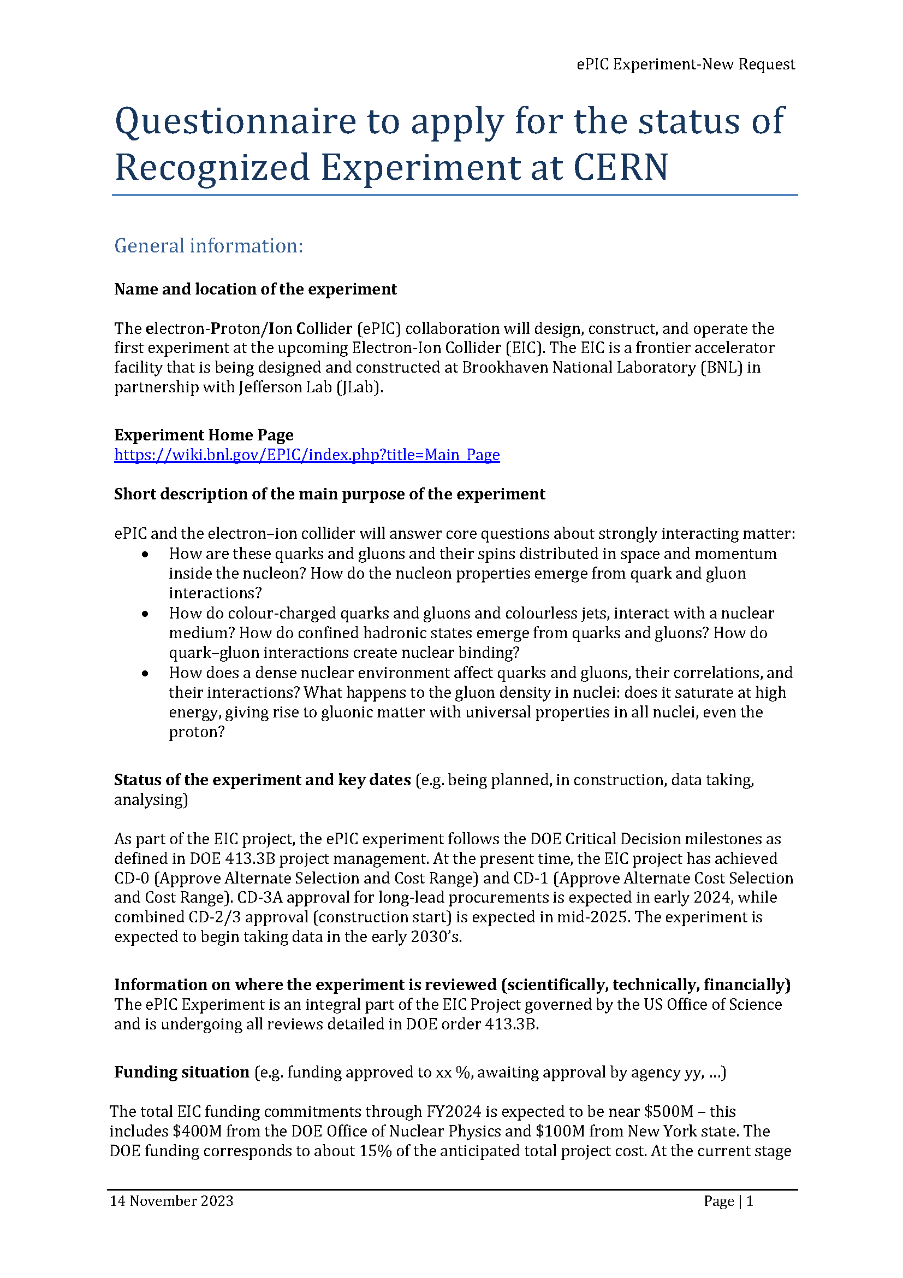
CERN Recognized Experiment
ePIC Application for CERN Recognized Experiment:
  ePIC leadership has submitted an application to become a CERN Recognized Experiment
  Strong synergies between CERN and EIC
  Important for access to CERN resources (test beams, …)
  Increase visibility in the European community
ePIC presentation scheduled for Thursday, Feb 8th at 1:15M @ CERN

