Slide 1
ePIC Jan 2024 Collaboration Meeting Survey Results
J. Lajoie
February 2, 2024

Slide 2
Metadata
Survey opened 1/17/2024
62 responses
Different paths based on attendance
In-person, virtual or did not attend
Attended workfests
Some PII in the comments was redacted in the comments
Some comments highlighted for illustration purposes in this presentation

Slide 3
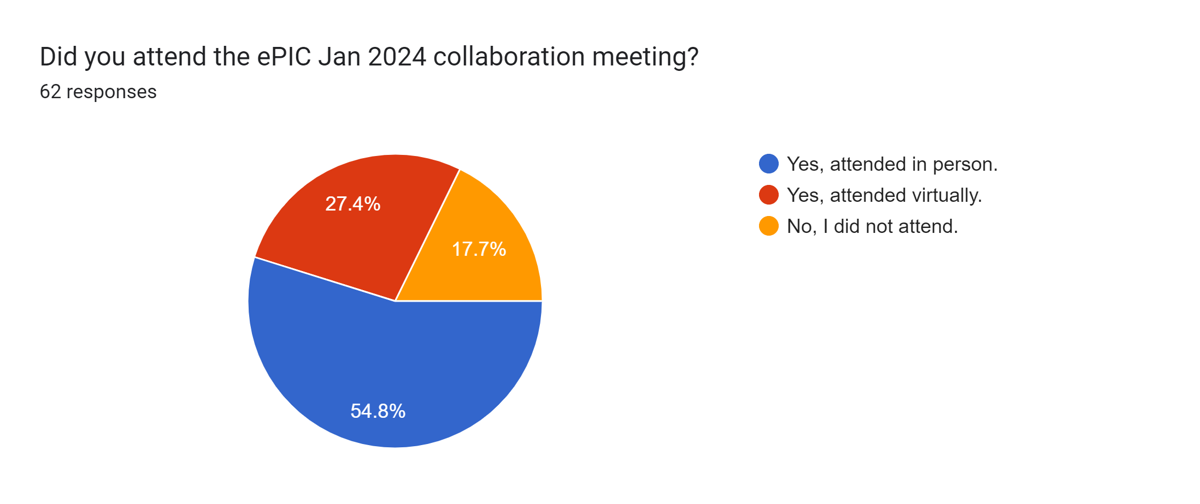
Did you attend the ePIC Jan 2024 collaboration meeting?

Slide 4
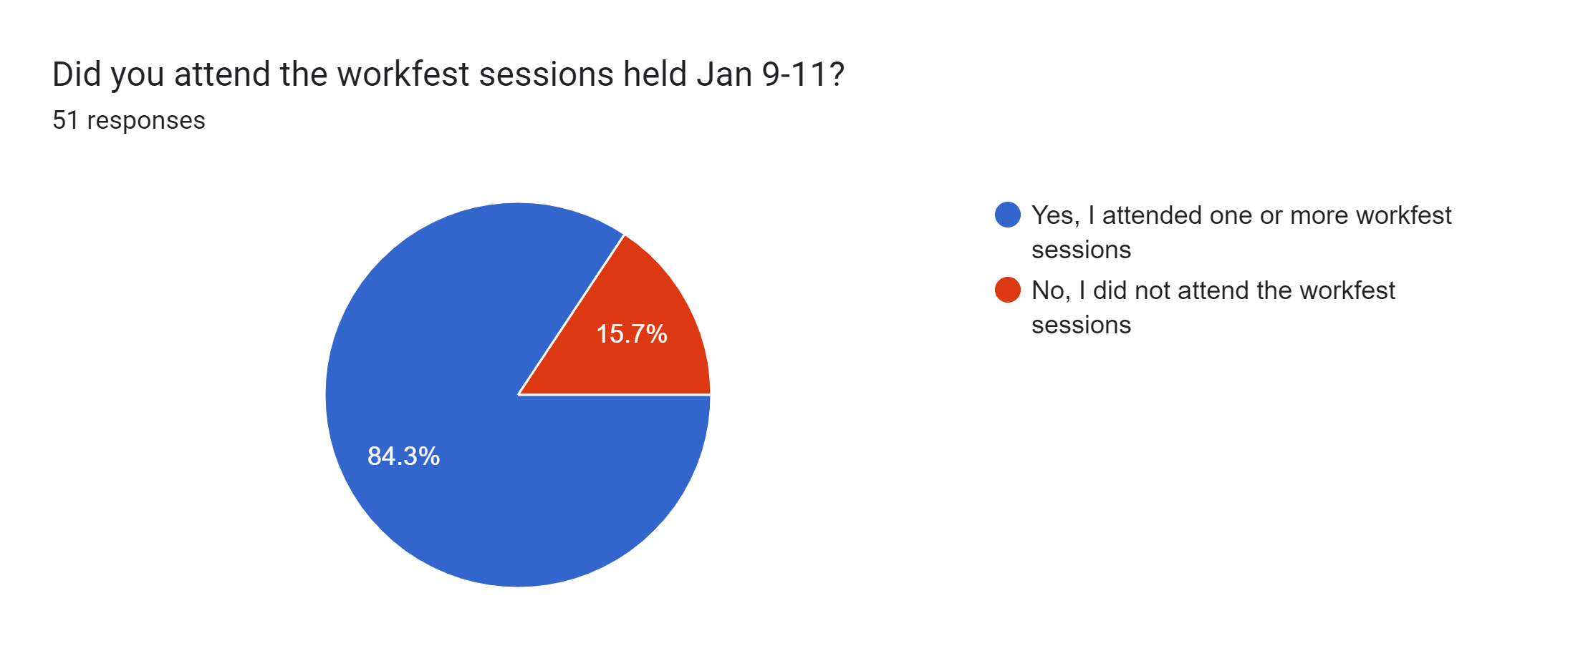
Did you attend the workfest sessions held Jan 9-11?

Slide 5
Please give us your feedback on the workfest sessions, including how useful you feel they were, the number of sessions running in parallel, and any other considerations you feel are important.

Slide 6
Workfest Comments (1)
Workfests are very useful and my opinion is that these were as well. I think groups would benefit from having more workfests outside of the collaboration meeting, where (potentially) smaller groups of people could sit down together and get real work done. These workfests were a good balance of getting actual work done and having important discussions.
Very useful; number of parallel sessions was good (at least for me).
the parallel running was fine and not an issue. the workfest I partook in was very productive and I would like to see this feature included again in future meetings.
The workfest were very useful and highly productive. I think more care could be taken to have less overlap between some sessions (e.g. SVT and Tracking), although it is realistically also never going to be perfect.
I like workfests, but I'm used to them being more like intense working sessions. These were a bit more like parallel sessions at a conference. They were OK. If I were in charge, I'd put the plenary at the start of the week. It was a bit odd to re-hear logistics and such during the late-in-the-week plenary.
I primarily attended the AC-LGAD work fest sessions, as I'm working on the TOF sub-system. It was an extremely productive few days, and very useful to meet in person as we work through the preliminary design of the detector. Having all the experts from the various aspects of the project (support structures, electronics, sensors, etc) in one place where we could discuss how to integrate the components into a final design was very productive. I believe we could have benefited from another day, or at least another 1-2 sessions (without any more content) such that the sessions could have had more time for discussion. All in all, it worked very well.
they weren't exactly as envisioned, but they were all productive. it was a good meeting!
The workfest was definitely useful. It would've been more useful if I wasn't brand new to EPIC and had a group with me to take on a focused task. It also would've been useful to have some ideas in advance on how to be prepared to work on projects during the working session.

Slide 7
Workfest Comments (2)
Very useful! There were many running in parallel and some others complained about this, but that is sorta the point: there is a lot of activity going on and we need to be able to do things at a level of detail that is not an efficient use of time for those not in the room.
There are always ways in which scheduling can be tweaked (fewer tracking-related workfests in parallel), but that's likely a problem with lack of focus on the requests and maybe there was some hedging by requesting more workfests than people expected would get approved. For future workfests, I think it might be useful to request a clearer set of goals: what questions is the workfest going to address, how will a workfest help with this, and is it the most optimal format? I maintain that there is also a lot of work that can be done virtually and some workfests could have benefited from more structured preparation so they didn't have to start from scratch.
Summaries of the workfests were generally good.
Workfest sessions went well. I was productive and informed throughout.
I think this is a good idea. For me it was an opportunity to have a more detailed discussion on the topic related specifically to the detector I'm working on. Also I had very productive meetings with experts in the meantime. I think such focused sessions where there is time to do work are necessary during detector development stage.
The workfest have been very useful, having said this to make tem more useful we should have many a little bit less in parallel and maybe align the schedule like not all ME discussion of different detectors in parallel.
they were useful, but the attendance was not as good as i expected. many people still zooming in other meeting during the workfest... something we cannot change. maybe we will assign in-class tasks to 'force' engagement.
workfest sessions I attended were useful, however several times there were several sessions I wanted to visit running parallelly. this concept was new to me and I did not know what exactly to expect from this.
the BIC sessions were extremely useful. All the experts were in one room! Very good discussions and brain storming.
It seemed to be a good mix of presentations and real collaborative work.

Slide 8
Workfest Comments (3)
I didn't find it very useful. It wasn't really a "workfest", but more of a presentation-fest. In that sense, it was like an ordinary conference session packed with talks and some discussion time. I was hoping for something much less formal and structured: just 1 presentation at the start to guide people and then several hours of working next to each other.
Worfest was an extended version of a WG meeting. Usefulness is debatable. There should be cross group sessions to bridge all the WGs.
It was a very useful exercise; number of sessions in parallel was perhaps a tad too high. Needs some improvement: working set-up (desks if possible, ad minimum -- power plugs/cords/access)
I participated in several workfests and found them productive overall. Wednesday probably had too many. The absence of BNL engineer(s) for at least part of the detector workfests was a missed opportunity.
The discussions at the various parallel sessions have been engaging and insightful, leading to significant progress. It is my hope that there will be numerous parallel sessions at the upcoming collaboration meetings. I would not restrict their number, provided each parallel session has a well-defined scope and goal, and there is no duplication of efforts. ePIC will represent a large collaboration by NP standards, and we must acclimate to the idea that it is not possible to follow all discussions.
I mostly attended the TOF sessions, which were extremely productive and well attended. More progress towards actual prototypes has been made in these sessions than over the past year.
I found the tutorials very useful. It would be good if every lesson had us start with working code in an example of some sort. The workfests themselves were useful, it's easier to get things done when everyone is in the same room. It might have been better to have a daily report of progress rather than summaries at the very end to keep us on track as the days went on. I don't think having more than 3 sessions at a time works.
I did not see any advantage in the workfest format. I would prefer regular parallel sessions in the future and plenary status reports from the subsystems. I can see the benefit of a dedicated day or two for cross-cutting sessions, but those can/should be in a parallel format.

Slide 9
Workfest Comments (4)
For the SVT the workfest was incredibly useful and a success. It delivered exactly what is planned more. There were a lot of interesting discussions at the workfest and they continue outside of it, and real progress has been made. Many people agreed that they could finally see how everything is coming together and also said they feel now more involved in the project.
Workfest sessions have been very interesting and useful, triggering also many “coffee break” discussions. To maximize participation and efficiency maybe they could be interleaved with plenaries. Going through summaries the last afternoon does not help attendance, imho.
I thought they worked OK but clearly this is something that benefits from in-person participation.
Fantastic! I enjoyed this format far more than the traditional plenary-parallel format, and felt it was extremely productive! There were moments were it was challenging to participate in all of the sessions I felt I should be attending, though, and I think at least a few others felt the same way. This might be ameliorated to some extent by reducing the number of parallel sessions happening at once, and/or a more conscious selection of workfest topics. That being said, for a 1st iteration it was great and extremely well-planned!
The ones I attended were generally useful, although some didn't quite adhere to the workfest paradigm and were closer to traditional parallel sessions. Personally, I found there were too many parallel sessions which weakened the opportunity of joint sessions which should be a strong point of a collaboration meeting.
The workfest sessions were a fantastic idea. Please do this again in future.
The sessions were useful. There were several technical sessions I would have preferred to attend but couldn't because they were at the same time
This was very useful. I (e.g.) could follow a topic in depth.
The work fest sessions were very fruitful. They allow to exchange in much deeper details compared to plenary sessions. For the future ePIC collaboration I would appreciate even more specialized work fest sessions.
extremely useful. running in parallel was highly beneficial

Slide 10
Workfest Comments (5)
I think they were quite useful and well organized. No special problems for the overlaps among them but for some clashes between tracking and SVT when not combined but I feel that was rather unavoidable.
some of the overlap was unfortunately preventing me from participating in all sessions that I should have been in
I think they were extremely helpful for generating new ideas. The relatively narrow scopes allowed the experts to really dig into the detail and bring the other experts up to speed. I do think that for students some of the workfests may have been a bit too technical, but that's an inevitable trade-off.
Very useful. I much prefer this workfest format to the more traditionnal parallel sessions.
The primary workfest of interest to me (SVT DSC) was very useful and informative, however the overly parallelised nature of the workfests make it near impossible to check on other areas of interest (e.g. Tracking WG).

Slide 11
Please comment on aspects associated with attending virtually. Were you able hear and follow the presentations on Zoom? Were you able to contribute to the conversation?

Slide 12
Attending Virtually Comments (1)
Yes
For the most part, yes
Chicago in January wasn't a good choice. For January meetings we should have more weather friendly locations.
Yes, no problems
Reasonably well; some audience communication was muffled.
Yes, I was able to follow along. I even asked a question during the plenary and appeared on the screen in the auditorium, larger than life, like the face in the 1984 Apple commercial.
The BC workfest was in a good room and almost everyone could be heard from anywhere in the room. That was not the case with the plenary sessions on Fri and Sat, unless people came close to the microphones. In the former case, if the person at the podium can repeat the question asked from the back of the room, that should work. Thank you.
yes
With zoom are OK and I can contribute to the conversation.
It is always more difficult to contribute via zoom, but I was able to ask questions or provide answers, when required.
I did not encounter any issue in the zoom attendance
Everything was fine

Slide 13
Attending Virtually Comments (2)
The speaker microphone was often not very loud, and I had to strain to hear. The chat box for asking questions was sometimes monitored very well, and other times not sufficiently well.
There's the usual problem on Zoom meetings with a room of people chatting to each other. Cacophony.
some of the room conversations were quite a bit muffled, but at least the presentations were ok

Slide 14
Were there any impediments to your attendance at the collaboration meeting that we should be aware of? What could be done to enable your ability to participate in the future?

Slide 15
Did Not Attend
I intended to attend virtually but my schedule got completely filled up. This is a very tough time of year with child care and the beginning of the semester.
Due to busy schedule, I could not attend this meeting.
The 11.5h time difference from India during the start of the semester.
If possible support financially
Too close to start of teaching term. Too inhospitable a location. Chicago. Deepest winter. No public transport.
No, just difficulty managing competing priorities during the academic year.
Mostly the time of the meeting and the travel budget constraints. The organization of the meeting could also improve somewhat.
I was simply busy with other commitments. In general, if hybrid format is chosen, an effort should be made to at least partially adapt the agenda to different time zones.
No. The [INSTITUTION REDACTED] effort in ePIC is still ramping up. We did send a graduate student to the meeting. Polls like this do help. It helps me to know that you are checking up on my group.

Slide 16
Please comment on the collaboration meeting structure and venue, including the balance between workfest and parallel sessions, and any other considerations you may feel are important.

Slide 17
Overall Meeting Comments (1)
It was very nice!
I think we should consider venues that maximize the in person attendance. There will always be some difficulties on this, however, but maybe some survey or something like this could be sent out before a location is decided upon from which a decision could be made based on what location maximizes in person attendance.
Chicago in January wasn't a good choice. For January meetings we should have more weather friendly locations. More time for postdocs or junior faculty to present their work in plenary sessions will be good.
structure was appropriate, balance was appropriate
balance was right between workfest and parallel and plenary sessions. In some cases the plenary talks seem more aimed to outsiders of the collaboration which is not very relevant to those who regularly attend meetings, but I understand we need to welcome new comers too. The TDR discussion sessions were useful. The venue was difficult to arrange transport to and from without a car. I had a hard time getting a taxi/uber at the end. Rental cars are too expensive for some budgets, especially if already paying for international flights. I have the same concern for the upcoming Leighigh meeting. The start of the meeting was a bit too close to the holidays in Europe, with Jan 8th being the first day back for many. So there was not enough time to prepare material for the meeting with the holidays before then and December being a busy time for many, especially those who teach. Later in January in the future would be better.
I believe the meeting format would have benefitted from at least a brief plenary session at the start to the meeting, e.g. a high-level status update from the collaboration and the Project to make sure everyone is on the same page at the start of the workfests.
I think it's more understandable to begin the week with the plenary. Seemed like a lot of days for a collaboration meeting. Probably hard for people to set aside so many days to attend in person, so you'll get a fair number of drop-in attendees.
Venue was great, no significant feedback on this.
structure was fine and venue/amenities were great. Thanks to all the organizers!!!

Slide 18
Overall Meeting Comments (2)
I thought the meeting was great and well organized. The organizers did a fantastic job and it was well attended by members of the collaboration. People were very engaged and focused and there were many forums for both informal and formal discussions. The environment felt mostly inclusive and open to new people joining.
Balance was optimal. There has been discussion about splitting plenaries in a pre-workfest and post-workfest plenary, but I fear this might lead to lower attendance since we had a number of people fly in just for the plenary and I fear they would stay home.
The venue was excellent, and I appreciated the close proximity of venue to primary accommodation, which facilitated morning breakfast, lunch, and evening social interchanges that are hard to organize equitably otherwise. This is arguably going to be the more important aspect of this meeting: collaboration forming through informal contacts rather than workfest/workshop presentations.
Venue and all the services were great, very professionally organized, very welcoming atmosphere. I've noticed that often I would want to be in several parallel sessions at the same time. The workfest and parallel sessions were quite balanced where I attended. I think leaders could do a bit better to make sure that everyone has a task during workfest.
The structure was good. I would only devote more time for individual self-nominated presentations, but this was good enough.
I like all of it, just one small comment, maybe I would start the next time with a 0.5 day pleanary session with talks which are critical for the workfests.
structure and balance seem to be fine. maybe a little bit less talks for plenary sessions is better IMO
very well organized meeting, everything works perfectly
I think the meeting was well organized and really liked the structure, although I was not able to attend the workfests I enjoyed the summaries and learned a lot even just looking at the slides. ANL went above and beyond while hosting the meeting, I thought they provided a great venue and plenty of opportunities to socialize and exchange ideas.

Slide 19
Overall Meeting Comments (3)
Overall I thought it was well structured, having the workfests in the beginning so that people can get the heavy work out of the way and then enjoy the parallel sessions.
Excellent meeting space. Room to work and talk and meet folks. Lunches made things convenient also.
The plenary sessions were fine as usual. For a real work-fest, I would suggest that it completely detaches from the collaboration meeting. That way, there isn't a sense of pressure that we have to solve major problems within 3 days and then report a victory to the collaboration the next day.
Same as previous.
The meeting was exceptionally well organized; huge thanks to the ANL team!
Consider if the/a collaboration meeting at this stage should start with a plenary session e.g. to convey some of the project information upfront. The quota on in-person participation by colleagues at U.S. needs to get addressed.
I propose beginning the meeting with a plenary session to unite everyone for a common status report and to provide an opportunity to define additional goals for the parallel sessions. Apart from that, I would not alter the structure of the collaboration meeting.
ANL was a most excellent host. Many thanks to Sylvester, Maria and everyone else who made it all possible with all the difficult surrounding conditions. Many thanks also to "the lab" for providing support for coffee breaks, travel support etc.
The venue worked quite well despite the snow. We were all in one place which was helpful both for work and building collaboration. I think the dividing line was about right - though it could be useful to have one day of parallel sessions that aren't workfests with the idea of giving talks - though some sessions did that so perhaps that would be too much micromanaging. I do think we should probably end shortly after lunch on the last day, especially if we go into the weekend. Some people left early because of the storm, but others were planning on leaving Saturday in order to be home that night to spend a weekend day at home. This meant that the important discussions at the end of the last day were more sparsely attended than maybe we would have wanted.

Slide 20
Overall Meeting Comments (4)
I did not find the workfest aspect useful. I would have preferred to also see parallel session opportunities for the DSCs.
I think the balance was right. There were some overlaps in the workfests that did work very well, so something to plan differently next time, but overall this structure was fine.
The collaboration meeting, especially the plenary session should be on weekdays. It is good, that the virtual attendance was without a fee this time. This enables the participation of interested people who just want to / can attend selected sessions and have no funding.
Besides my comment about workfest sessions, I found the meeting very well conceived, interesting and stimulating. To add a suggestion, for the sake of
wider involvement, also self proposed talks could be inserted between plenary talks. Venue was excellent, in general offering meeting rooms at walking distance from lodging and on-site meals makes it much easier.
I think the timing of the January meeting is a little too early in the year. One week later would be more convenient. Also, I was a bit baffled that the meeting ran Tuesday to Saturday rather than just Monday to Friday.
No specific comment.
It was a fantastic meeting overall, and Argonne really knocked it out of the park with their organization! A huge thanks to the lab staff, meeting organizers, and everyone who made it happen!
Good structure, great venue, maybe Chicago winter isn't the best time though.
The meeting should not extend into the weekend. Our community suffers from inequity issues, and extending into the weekend makes it harder for those with family obligations to attend.
The venue was excellent. There wasn't anything I would get rid of, yet 5 days is a long time to drop other work twice a year...
I thought it was fine as-it-was.

Slide 21
Overall Meeting Comments (5)
The Argonne local organizing committee did a very great job! A special thanks to the registration team which was brilliant, so helpful, specially considering the weather conditions. The balance between work fest and parallel was ok. I would have appreciated to be able to attend the tutorial on the first day, but it was at the same time as a work fest session I was involved in. From my point of view, as the timeline of the project is very agressive, specialized work fest sessions are a key point. Zoom meetings cannot replace in person exchanges.
I found it well organized overall. Maybe one could think to have an initial plenary session (general info on the project status etc), then the parallels (workfests) and then back to the plenary at the end for summary from the workfests and general wrap-up.
was ok with me
I think the format was great, personally. I do think that in lieu of the workfest summaries, summaries of the statuses of the detector subsystems (like those in the previous collaboration meetings) might be a bit more beneficial. One of the big benefits of the previous format was that it gave a holistic view of the detector, which helps people working on one subsystem understand how the choices they make may influence the other subsystems or the physics.
Was very nice. Maybe spreading the plennary sessions more in the program could have been nicer.

