Slide 1

ePIC Collaboration News
J. Lajoie, S. Dalla Torre
March 8, 2024

Slide 2
Hey John, start the recording….

Slide 3

Reminder…
Daylight Savings Time begins in the U.S. this Sunday, March 10th
European Summer Time begins Sunday, March 31st
Israel implements DST on Friday, March 29th
So… we are in these funny few weeks when your favorite ePIC meetings may be at an earlier local time if you are not in the U.S.

Slide 4
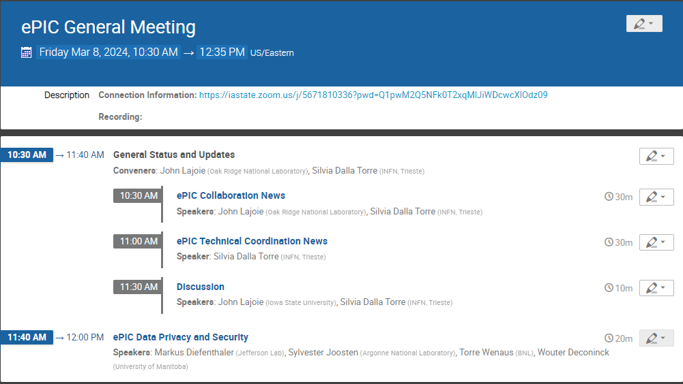
Today’s
Agenda
An important discussion!

Slide 5
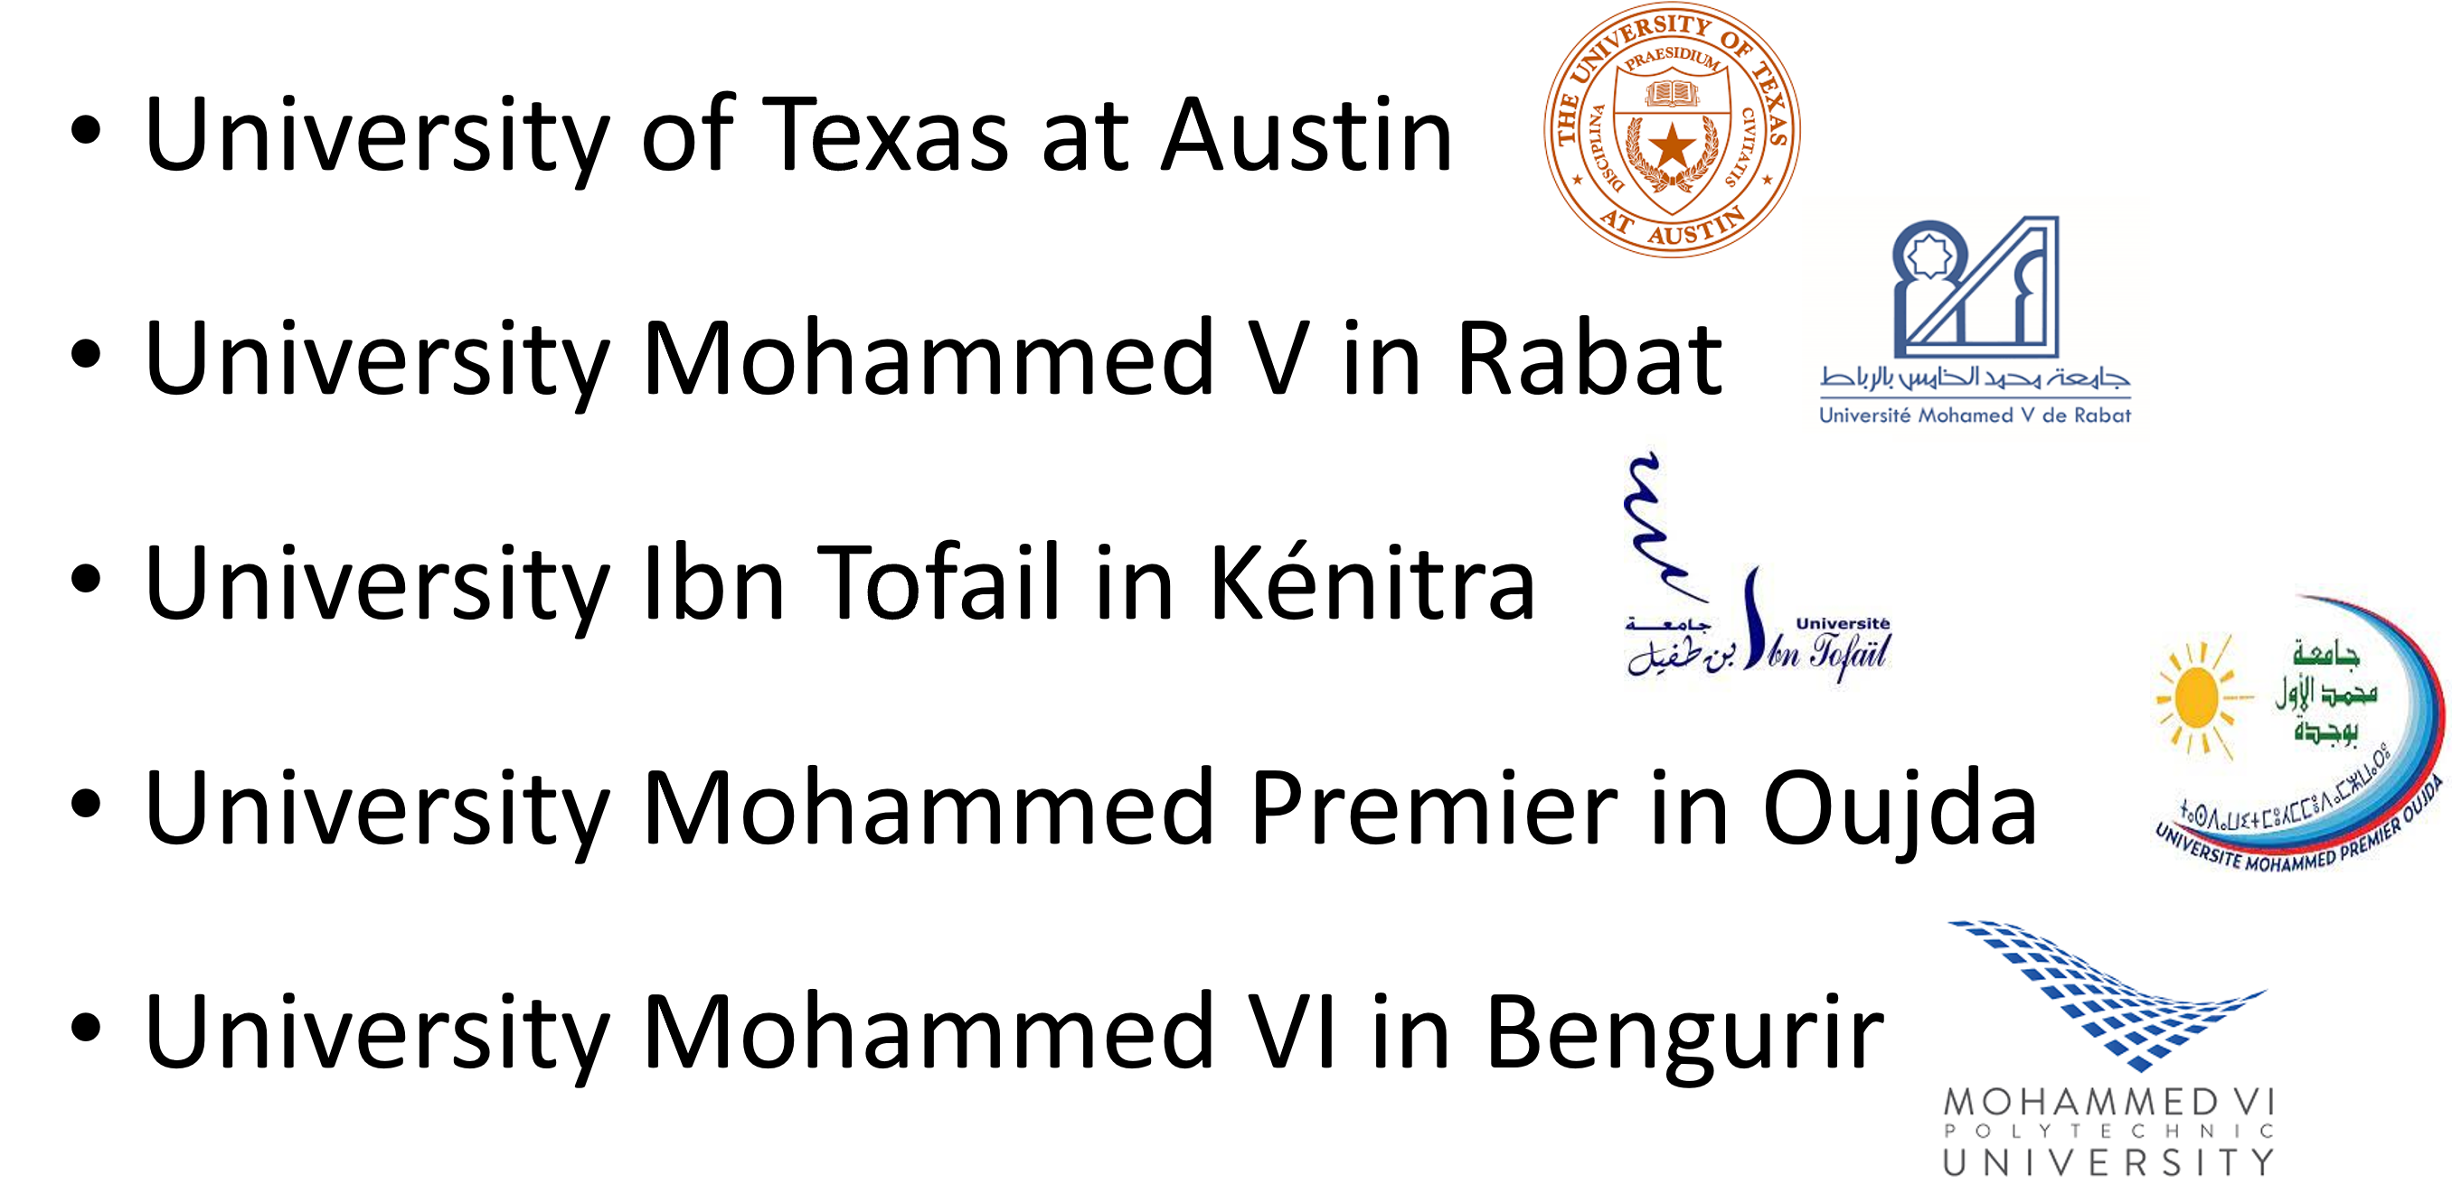
Results of Recent CC Votes:
Voting to endorse the DE&I committee and application of five new institutions for membership completed Feb. 5th
  Endorsed the composition of the ePIC DE&I Committee
  Approved admission of five new ePIC Institutions
ePIC DE&I Committee:
Chair: Megan Connors (GSU)
Vice-Chair: Christine Nattrass (UTK)
Members:
Francesco Bossù (CEA-Saclay)
Wouter Deconinck (University of Manitoba)
Narbe Kalantarians (Virginia Union University)
Iris Ponce Pinto (Yale University)
Maya Shimomura (Nara Women’s University)
Allison Zec (University of New Hampshire)
Welcome to the ePIC Collaboration!

Slide 6
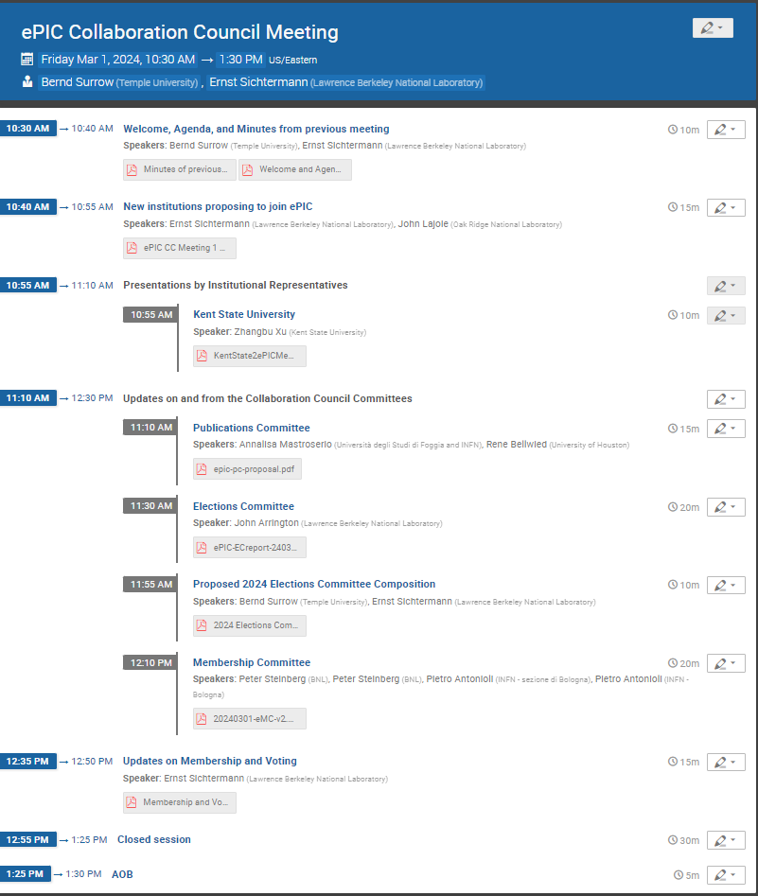

CC Meeting March 1st
https://indico.bnl.gov/event/22407/
Proposal for Kent State to join the collaboration
Updates and reports from the ePIC Committees
Touch base with your CC rep

Slide 7

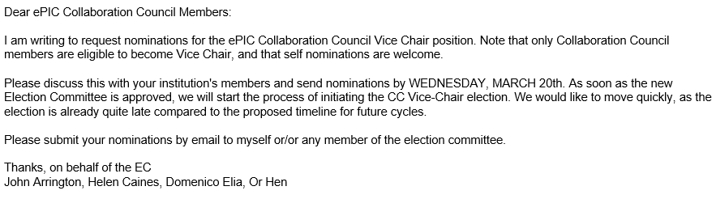
Call for CC Vice-Chair Nominations
From the Elections Committee – 3/7/2024

Slide 8
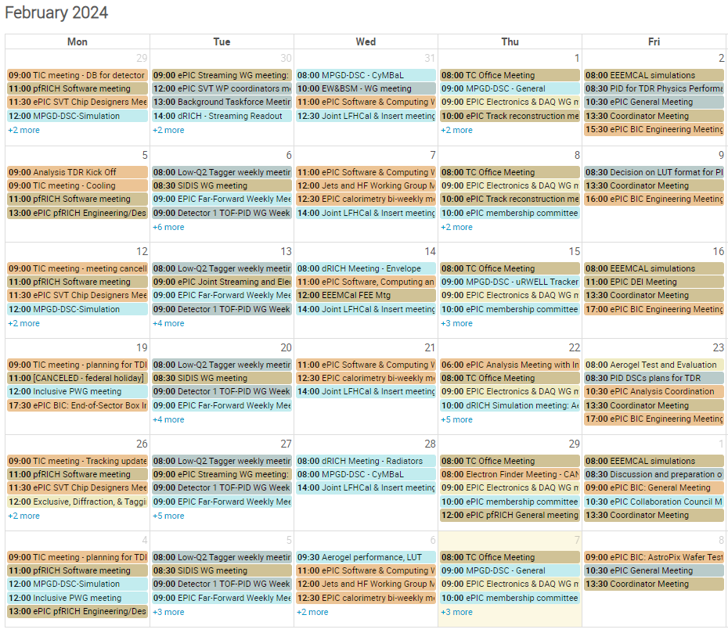
Activity in ePIC
Tremendous momentum coming out of the Jan. 2024 Collaboration Meeting.
An enormous amount of activity focused on preparation for the TDR at all levels in ePIC.

Slide 9

TDR Strategy and Publications
In 2024 the ePIC collaboration will produce:
  The ePIC contributions to the EIC TDR
    The EIC TDR is the top priority
      Chapters on Physics Goals and Requirements and Experimental Systems
      Not just the document, but the simulations and detector R&D that form the basis
      Requires close cooperation between the collaboration and the project!
An ePIC Detector Design paper:
    Derived and expanded from the Experimental Systems TDR chapter
An ePIC Physics Performance paper:
    Derived and expanded from the Physics Goals and Requirements TDR chapter
Both to be published in a scientific journal (such as NIMA, JINST, or PRC)
These publications will serve as a focus in developing the ePIC Membership and Publication policies.
Focused activity in the TIC:
Report by Silvia to follow
AC Report in last General Meeting:
https://indico.bnl.gov/event/21562/
process design phase
structuring the
effort
draft ePIC pre-TDR
ePIC pre-TDR (CD-2)
writing
(TDR/notes)
Preparing papers for
publication
Mid Jan.24
Mid Mar.24
End July 24
Late 2024
Early/Mid 2025

Slide 10
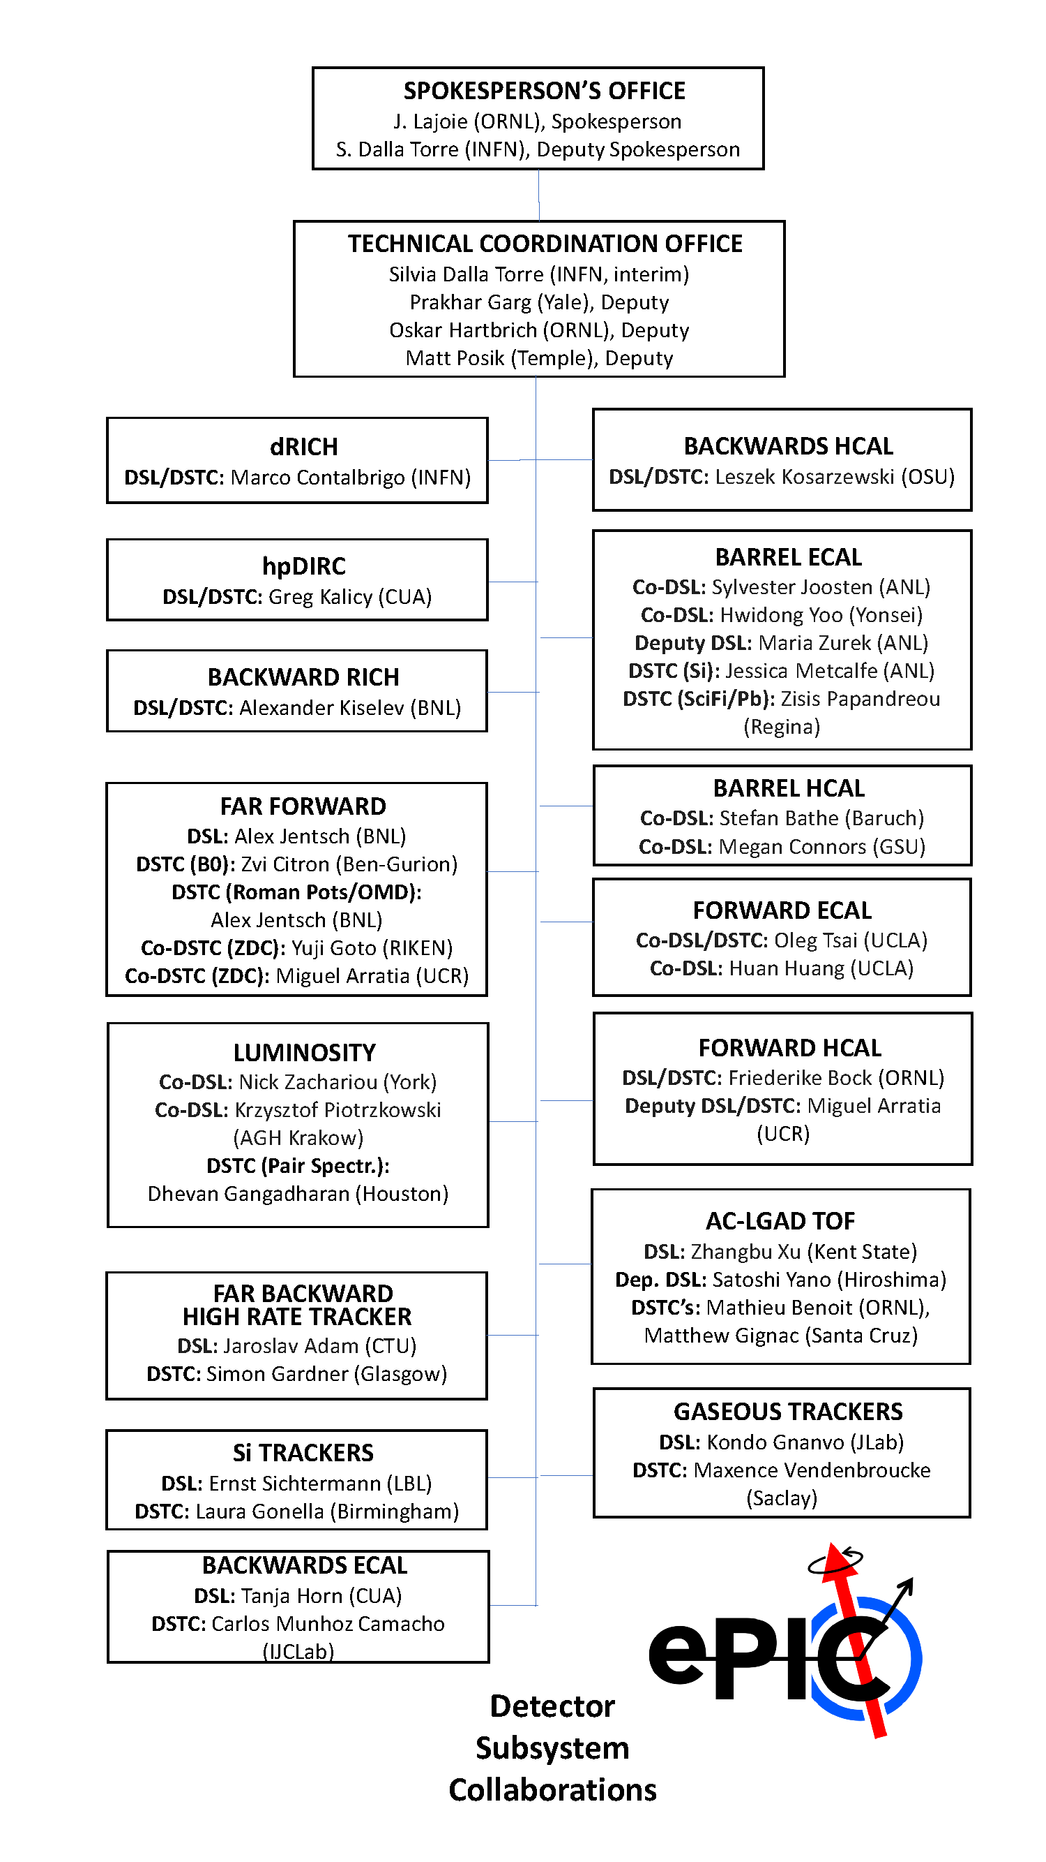
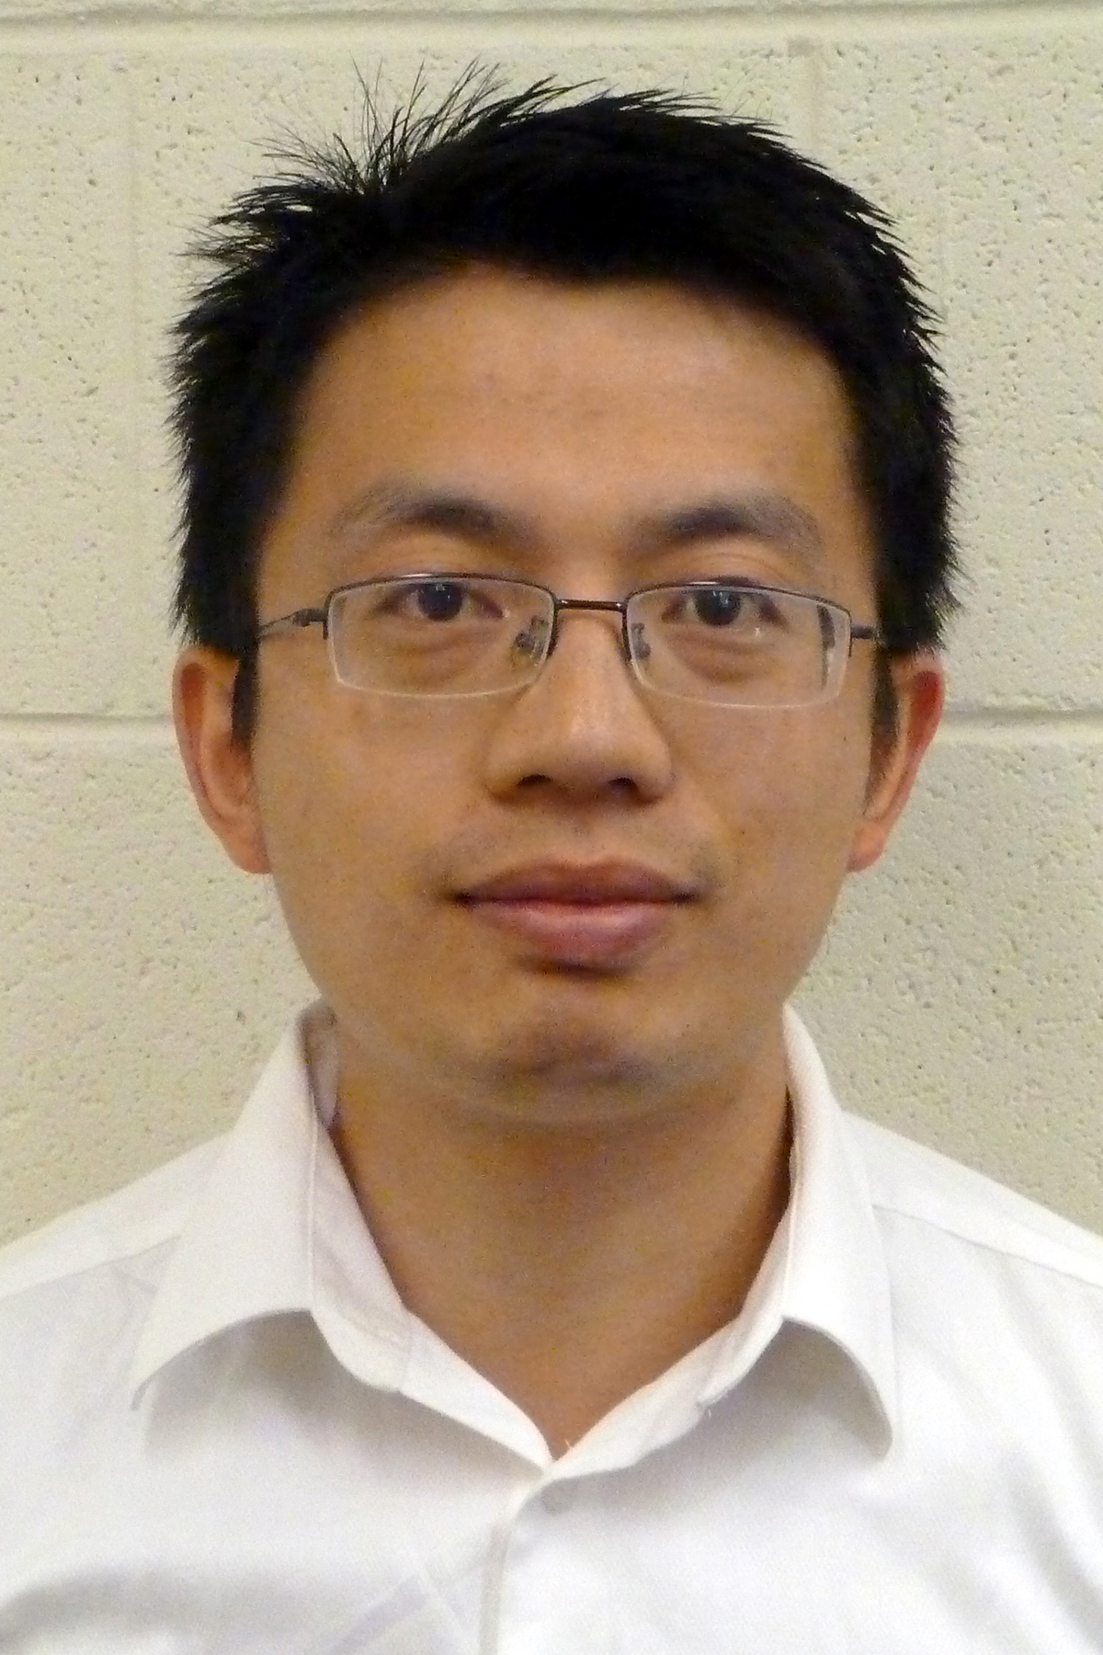
New TOF DSC Leadership
Discussed in TOF meeting Feb. 20th:
  DSL: Zhangbu Xu (BNL -> Kent State)
  Co-DSL: Satoshi Yano (Hiroshima)
  DSTC (Forward): Mathieu Benoit (ORNL)
  DSTC (Barrel): Matthew Gignac (Santa Cruz)
Many thanks to Zhenyu Ye for his outstanding leadership of the TOF DSC over the past year!

Slide 11
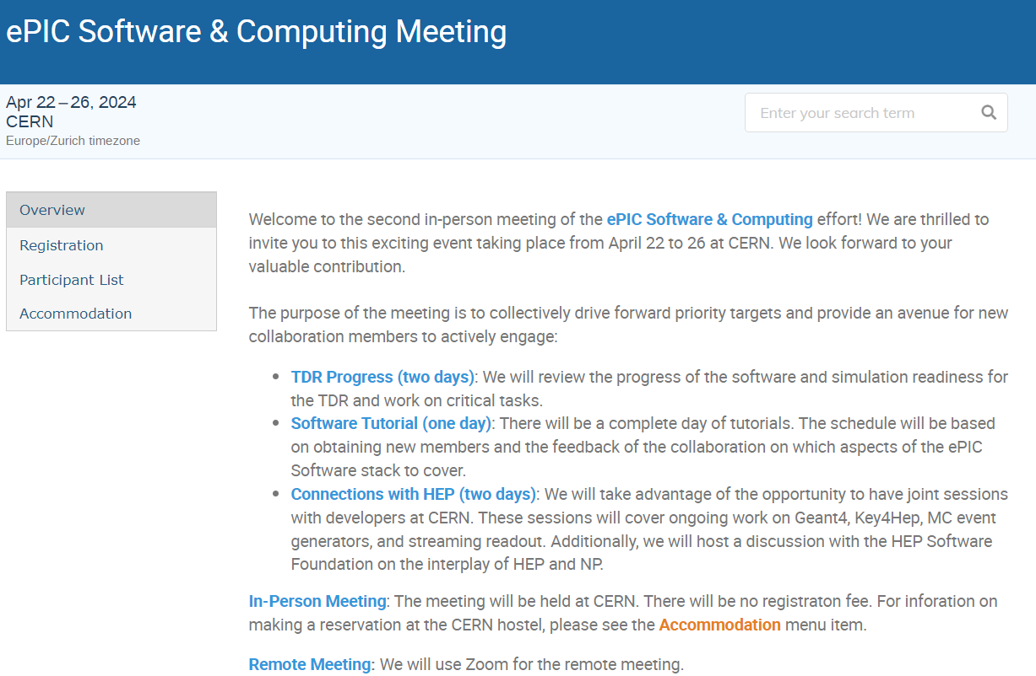

Software and Computing
Meeting
@ CERN
Registration:
https://indico.cern.ch/event/1343984/registrations/102560/

Slide 12
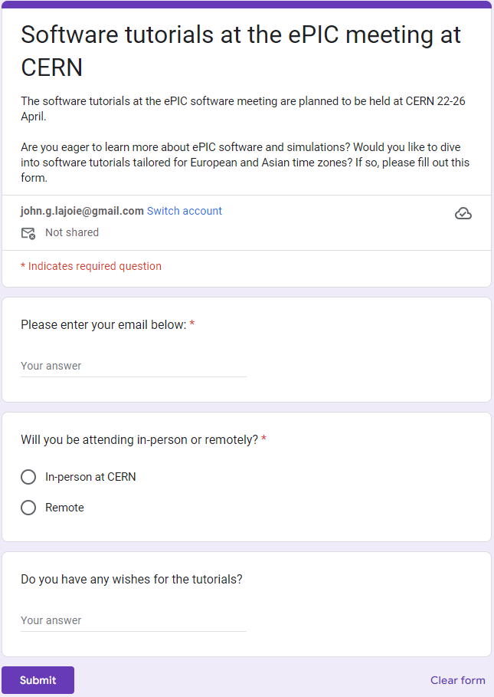
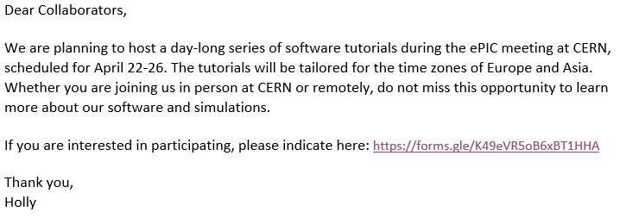

Tutorials!
email to collaboration 3/5:

Slide 13

ePIC Talks @ DIS 2024
https://lpsc-indico.in2p3.fr/event/3268/
Invited Talks:
  ePIC Detector Overview - Shujie Li
Contributed Talks:
  Overview of the ePIC Calorimetry –
  Henry Klest
  Silicon Vertex Tracker for the ePIC experiment at the Electron-Ion Collider –
  Gian Michele Innocenti
  Particle Identification with the ePIC detector at the EIC –
  Chandradoy Chatterjee
  Physics Perspectives with the ePIC Far-Forward and Far-Backward detectors -
  Michael Pitt
Many thanks to the Conferences and Talks Committee for organizing this!

Slide 14
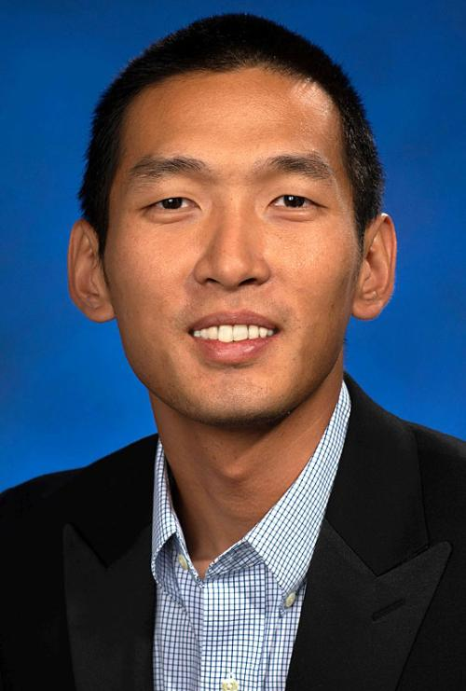
EC Seminar Series – Mar. 13th!
Vector Meson Production – Kong Tu (BNL)
Our esteemed speaker Kong Tu (BNL), will delve into the intriguing realm of Vector Meson production, shedding light on recent experimental findings and engaging in discussions about their implications. This seminar will not only serve as an opportunity to deepen your understanding of this fascinating subject matter but also to connect with fellow researchers and explore potential avenues for collaboration.
Date: Wednesday, March 13th
Time: 10:00 AM (BNL Time)
Zoom: https://osu.zoom.us/j/97494262621?pwd=b3k5RnRyeEsvWW94UUhidVYyd2pydz09

Slide 15
Next ePIC Collaboration Meeting
Lehigh University
Bethlehem, PA
July 22-28
Jointly organized with the EICUG
Planning a joint session with talks of common interest
ePIC Meeting
July 24-28th
In contact with Tim Hallman regarding DOE meeting limits
https://indico.bnl.gov/event/20727/

Slide 16
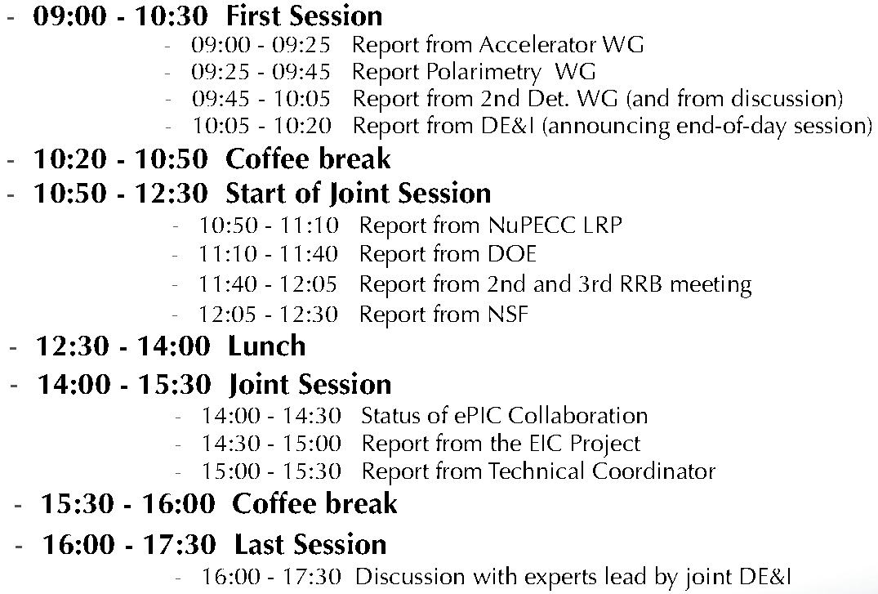
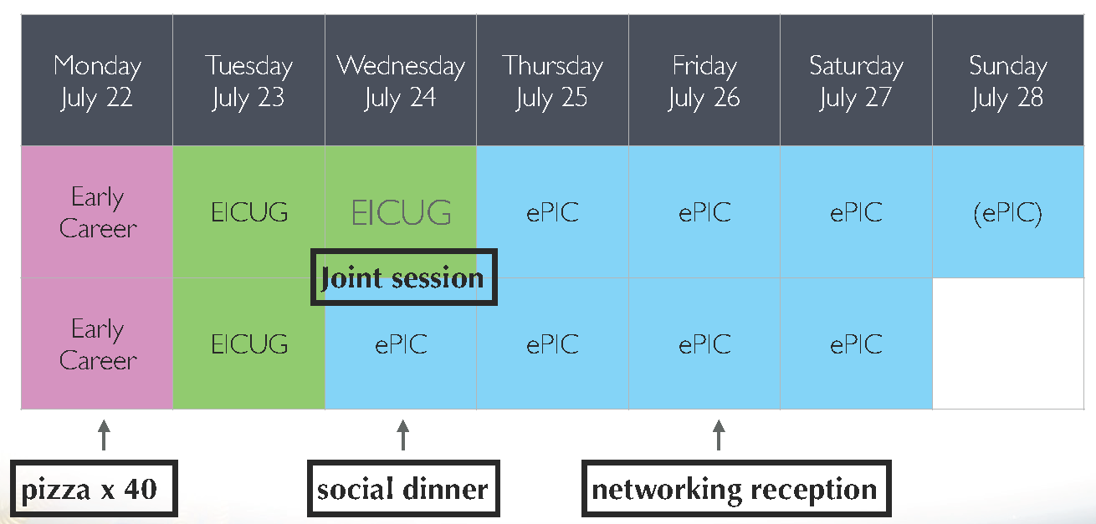
High-Level Agenda July 22-28 (DRAFT)

Slide 17
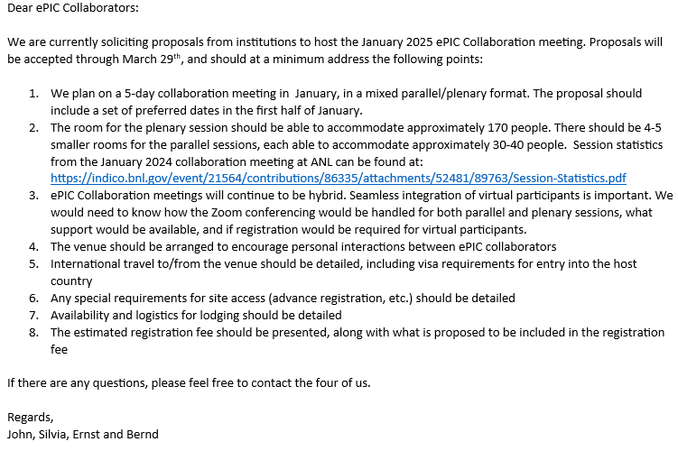
Higher Order Collaboration Meeting (NNCM)
Call sent Feb. 6th:
  We realize that a lot of time is needed to plan these events
  Call will be open through Mar. 29th
  Expect a decision a few weeks after call closes
Looking forward to many exciting proposals!

Slide 18
Summary
The ePIC Collaboration is strong, active and growing!
There’s a heckuva lot going on in ePIC!
  The collaboration is mobilized for the TDR effort
  DSC’s working towards next set of design reviews
  CC Committees are formed and developing policies
  Good luck to our DIS 2024 speakers!
  S&C Meeting and Tutorials @ CERN in April
  EC Seminar series going strong
  Planning for the next collaboration meeting(s)
  underway
Next ePIC General Meeting:
March 21st @ 7:30PM ET

Slide 19


Slide 20
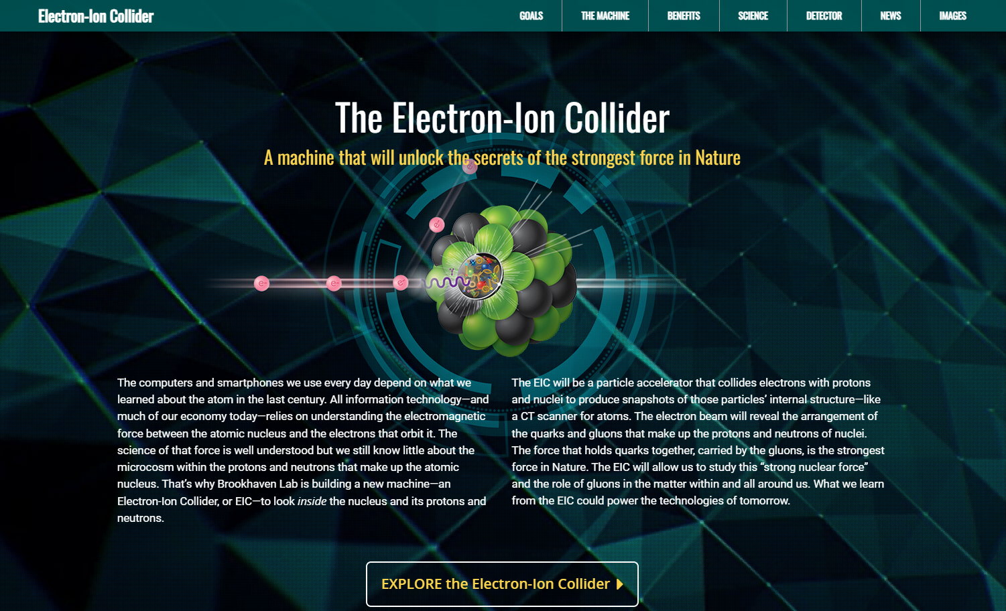
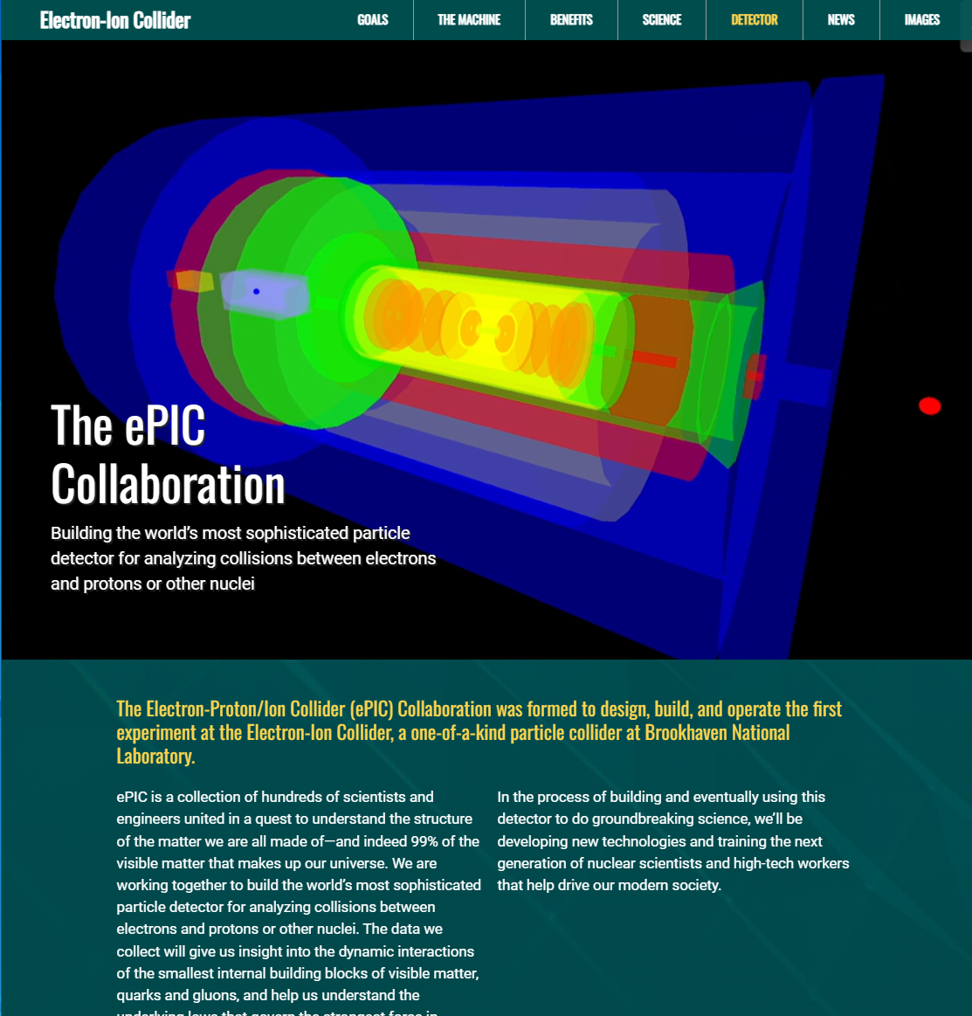
ePIC Collaboration Web Presence
Integrated into the main EIC website through the top navigation. Page contains contact information and link to the ePIC Wiki.
Gary Schroeder, Karen McNulty Walsch, Thomas Ullrich, JGL
Animations courtesy of UC Riverside group.
Continuing to update and improve.
https://www.bnl.gov/eic/epic.php

Slide 21
ePIC Resources
Public Website - https://www.bnl.gov/eic/epic.php
Mailing Lists – https://lists.bnl.gov/mailman/listinfo
Indico Agenda - https://indico.bnl.gov/category/402/
  ePIC Software and Computing: https://indico.bnl.gov/category/435/
Wiki - https://wiki.bnl.gov/EPIC
ePIC Software Training:
  Landing Page: https://eic.github.io/documentation/landingpage.html
  Tutorials: https://eic.github.io/documentation/tutorials.html
Mattermost: https://chat.epic-eic.org

Slide 22


EICUG Membership
The EICUG is a vital organization to promote the interests of the EIC community!
  Without the EICUG we would never have gotten far enough to form ePIC!
Please register your institution!
Check with your EICUG IB representative to get registered as a member
https://www.eicug.org/content/join.html

Slide 23


Upcoming Notable Events…
DIS 2024 in Grenoble, France April 8-12th , 2024
  https://lpsc-indico.in2p3.fr/event/3268/
ePIC Software and Computing meeting
@ CERN April 22nd-26th
  https://indico.cern.ch/event/1343984/
EIC RRB Meeting – May 6-7th in Italy
MC4EIC @ Durham University June 5-7th
  https://conference.ippp.dur.ac.uk/event/1292/
JLab Users Meeting, June 8-12th
  https://www.jlab.org/conference/2024-jluo
4th EIC-Asia Workshop in Shanghai July 1-5, 2024
  https://indico.cern.ch/event/1361239/
Joint EICUG/ePIC Collaboration Meeting
@ Lehigh University July 22nd-28th
  https://indico.bnl.gov/event/20727/

Slide 24
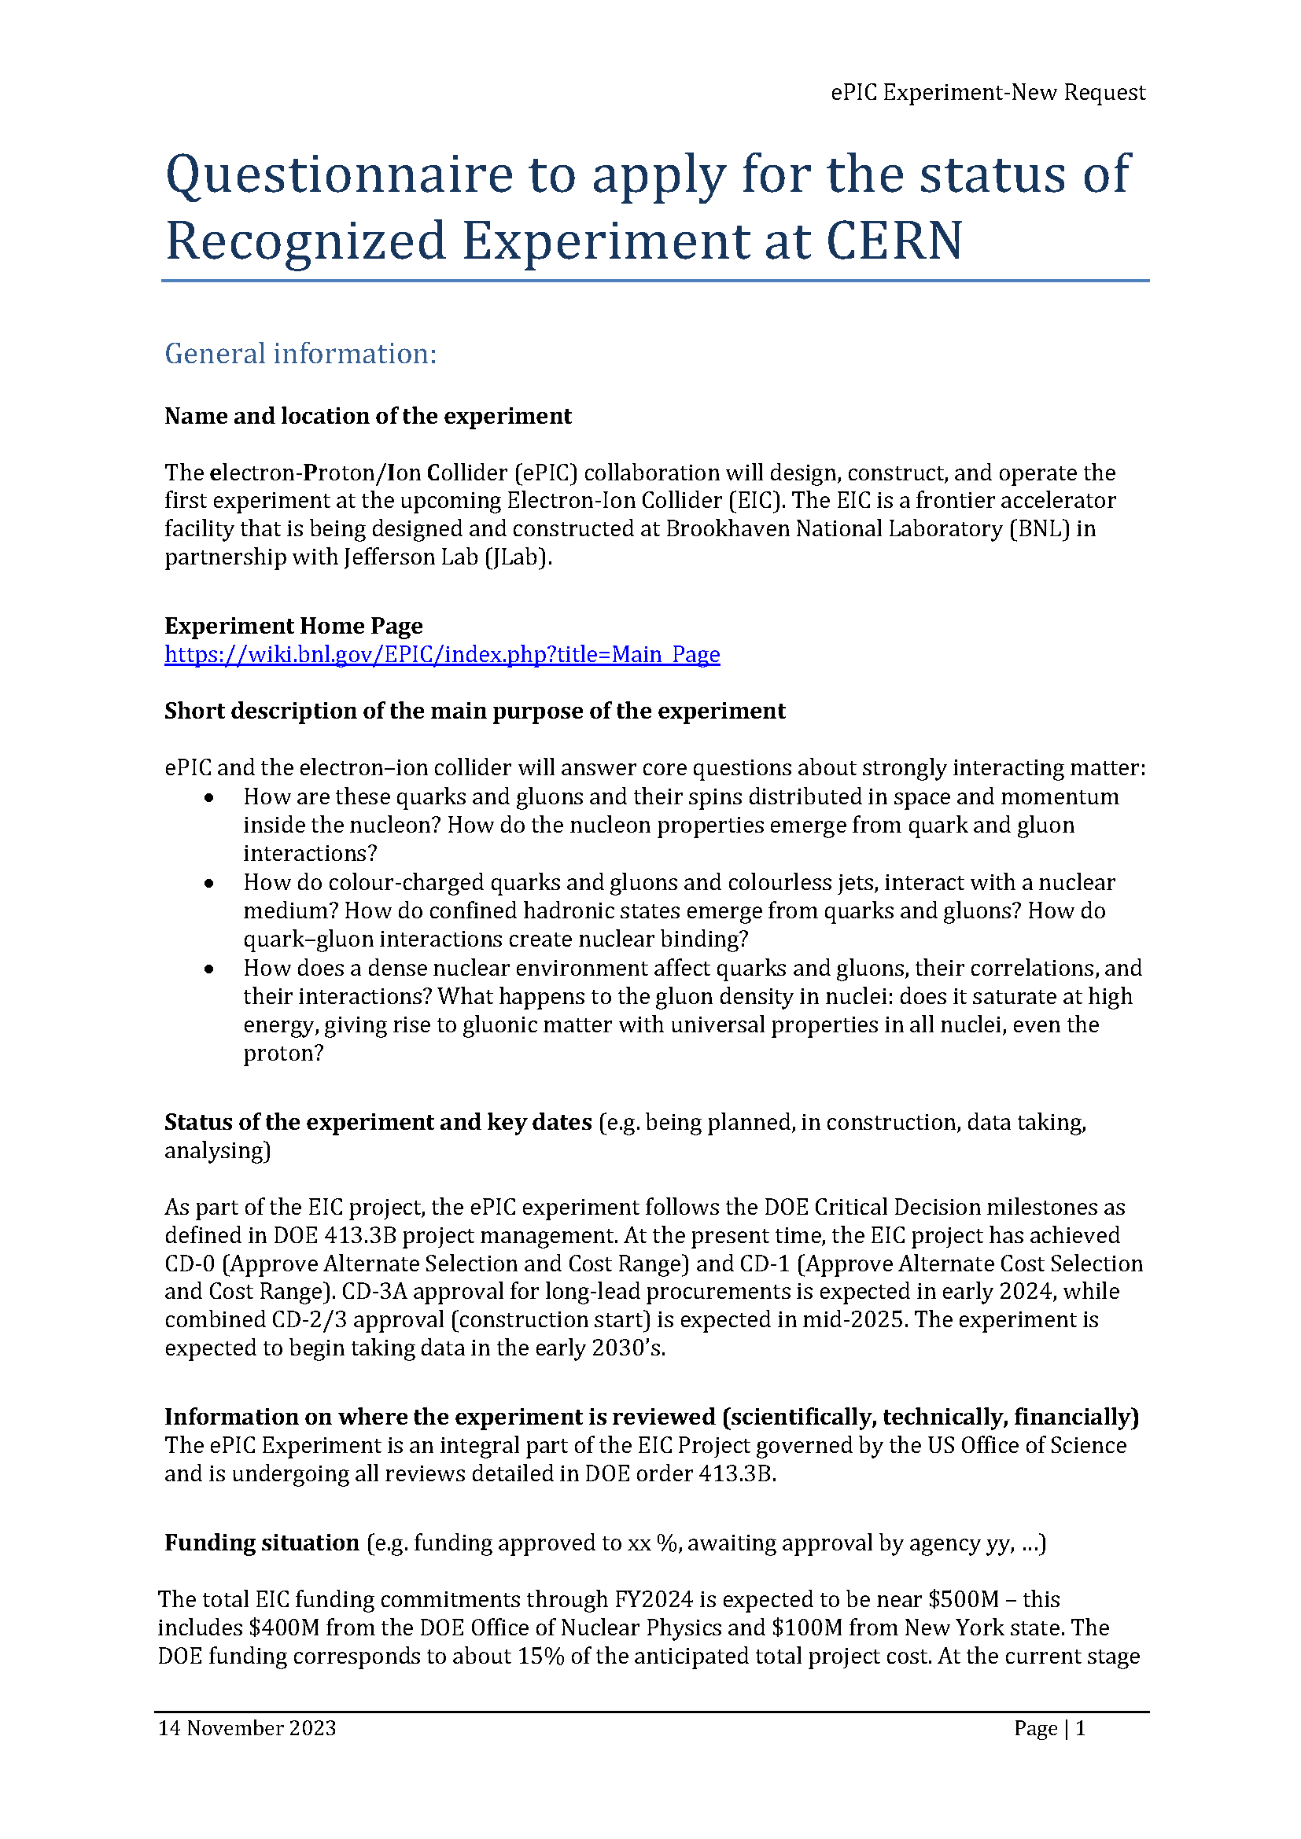
CERN Recognized Experiment
ePIC Application for CERN Recognized Experiment:
  ePIC leadership has submitted an application to become a CERN Recognized Experiment
  Strong synergies between CERN and EIC
  Important for access to CERN resources (test beams, …)
  Increase visibility in the European community
ePIC presentation Thursday, Feb 8th at 1:15M @ CERN
  Well received!
Next CERN Council Meeting March 21-22nd

