Slide 1
ePIC Synchronization and Clock distribution
- William Gu’s exploration*
EIC beam (crossing) structure
Overall hardware design
Detailed signal implementations
Exceptions
Current status
To do
* Credits give to all the community

Slide 2
EIC beam (crossing) structure
 | Electron Storage Ring (ESR) | Hadron Storage Ring (HSR) (N_{b}=290) | HSR (N_{b}=1160)
Circumference C [m] | 3833.940 | match T_{rev} | match T_{rev}
Revolution period T_{rev}=C/c [µs] | 12.7886
RF harmonic number h [-] | match HSR | 2520 | 7560
RF bucket spacing T_{b}=T_{rev}/h [ns] NOT bunch spacing!!! | match HSR | 5.075 | 1.692
Number of bunches N_{b} | match HSR | 290 | 1160
Bunch spacing T_{bun} [ns] | match HSR | 40.599 | 10.150
Gap length [ns] | match HSR | 1015 | 1015
Beam crossing: 98.5MHz
Orbit period: 12.7886 µs
 | ESR | HSR
RMS bunch length σ_{z} [mm/ps] | 7-9/23-30 | 75-60/250-200
RMS momentum spread [10⁻⁴] | 5.8-10.9 | 10.3-6.8
RMS horiz beam size σ_{x} [um] | 100-250
σ_{z}/σ_{x} ratio [-] | 28-90 | 240-750

Slide 3
EIC beam (crossing) structure
Streaming Data
Time Slice M-1
Time Slice M
Time Slice M+1
Time Slice M+2
Time Slice M+3
Time Slice M+4
Time Slice M+5
Beam crossing
1 1 1 1
1 1 1 1 1 1 1 1 1 1 1 1
1 1 1 1
2 2 2 2
1 1 1 1 1 1 1 1 1 1 1 1
2 2 2 2
5 5 5 6
5 5 5 5 5 5 5 6 6 6 6 6
5 5 5 6
7 8 9 0
1 2 3 4 5 6 7 8
3 4 5 6 7 8 9 0 1 2 3 4
7 8 9 0
1 2 3 4
1160 (all or 1/4 with beam)
100 (no-beam /gap)
Orbit period: 1260*10.150 ns = 12.7886 µs
SRO data header:
Packet number,
Data source ID,
Starting orbit count
SRO data trailer:
Ending orbit count
Sync/Error/buffer status
Total word count
The natural streaming readout time slice: N*12.7886 µs
*If this is used, there will be less data overlapping in between the time slice (the overlap can still occur if the detector response time is longer than 1 µs). There will be easier synchronization check.

Slide 4
2. Overall hardware design
ePIC
System Clock: 98.5 MHz (100MHz nominal)
GTU: Global Timing Unit
control encoding, status decoding.
The interface for machine clock source,
Data acquisition control and monitor etc.
DAM: Data Aggregation Module:
The clock/control fanout, and status/busy accumulation.
local control over the RDO boards connected, though the main function of the DAM is for Data Acquisition.
RDO: optical interface of detector ReaDOut
control decoding, status encoding.
The clock/control interface to the front end electronics.
Data collection from Frontend boards, and data transmission to the DAM
FEE:
Detector dependent Front End / ASIC carrier boards.
Online computer
Status
GTU
Control
GTU
EIC/RF
Clock
Data Acquisition
DAM
DAM
DAM
RDO
RDO
RDO
RDO
RDO
FEE
FEE
FEE

Slide 5
2. Overall hardware design
Online computer
Run control
2.1 GTU
EIC
RF
in
EIC/ePIC clock & beam orbit info
SFP
DAM
(dRICH)
GT
Clock buffers
1 : ~200
FPGA
RDO (TOF)
SFP
GTU
RunControl
CLOCK
STATUS
RDO (TOF)
DAM
DAM
DAM
Could be a separate clock fanout PCB, if needed
RDO
RDO
RDO
RDO
May be needed, RDO(TOF) , DAM(dRICH)

Slide 6
2. Overall hardware design
2.2 DAM
CLOCK
98.5MHz
Clock
buffer
RJ45
HDMI
(?)
GTU
RunControl
Fabric
Clock
RefClks
STATUS
FireFly
TX
RDO
TXs
RunControl
RDO/FEE config
GTYs
(24/48)
FireFly
RX
Status merging
DataProcessing
RXs
RDO
RJ45
GigaBitEth
FPGA
Xilinx Versal
PCIexpress 4/5x16
100 GBE (400?)
Host Computer/DAQ
Network Switch/DAQ

Slide 7
2. Overall hardware design
2.3 RDO
Zero Delay FB
optional emergency circuit I²C
IN3
OUT
N* 98.5 MHz
O1
pseudoClock
98.5 MHz
O1
O2
1:2 fanout
Si53x5
Fiber
RX
197 or
98.5 MHz
IN
FEB
DAM
Optic transceiver
O0
O2
TX
Phase difference detection
RX
RxRecClk
FEB
GTY
control
TX
ClkRef
GENIO
FPGA
RDO

Slide 8
3. Detailed signal implementations
3.1 Clock Distribution
RunControl computer
3.2 RunControl and DAQ
EIC, RF
Ethernet
PCB and fanouts:
Additive Jitter <1ps
Phase: fixed
System clock
(98.5MHz)
Two-level fanouts
Beam orbit
Beam Orbit synchronized RunControl
RunControl: Run_Start/Stop, Run_type, config, Reset, Synchronization, SRO time_start/stop, Trottling…
GTU
Status: Buffer busy, out of sync …
Copper cable:
Additive Jitter <1ps
Phase: fixed
Host PC
PCB and fanouts:
Additive Jitter <1ps
Phase: fixed
Clock fanout
(optional jitter cleaner)
DAM
Control config, status
DAQ
RunControl: forward or ‘hijack’ the GTU control;
DAM, RDO, FEE/ASIC configuration, readout backpressure
RefClk
TX/RX
Status: Buffer, sync, etc.
GTY
Optic fiber cable:
Additive Jitter <1ps
Phase: fixed
Clock recovery
(optional iitter cleaner)
Clock fanouts
RefClk
TX/RX
Control
Config
DAQ
Config synchronized with beam orbit, FEE/ASIC readout and control
GTY Rec Clock:
Additive Jitter <3ps
Phase: stable, but NOT fixed;
TClink or dedicated clock from GTU
RecClk
GTY
RDO
Status: Buffer, sync, etc.
FEE/ASIC

Slide 9
3. Detailed signal implementations
3.3: Synchronization
DAM/RDO to implement time measurement, so that RDOs can compensate the fiber length delay to within one clock period;
GTU/DAM/RDO to keep a 11-bit beam crossing counter (terminates at 1260), synchronization check with streaming readout time slice (start/stop) commands; online/offline check with beam orbit structure (collision or no collision);
RDO to keep a 5-bit (min. ~409ms), 21-bit (preferred, ~26seconds), or 32-bit (over 15 hours) beam orbit counter;
GTU and DAM should keep a larger beam orbit counter;
RDO to keep a 16-bit (min), or 32-bit (preferred) time slice counter. This counter should not overflow for a run (start/stop).
RDO should assert buffer high_marker no later than one orbit period before it is full and starts to lose data.
RDO starts a new data packet upon receiving time-slice_start, and end the current packet upon receiving time-slice_end or upon receiving a new time-slice_start.
RDO to hold data if the DAM is busy (potential buffer full), and the DAM to hold data if the host computer/Network switch is busy.
The GTU can record dead time by sending TimeSlice_end, and holding TimeSlice_start in responding to RDO busy.
RDO should generate one packet on every readout time slice. The RDO can discard detector data to avoid buffer overflow, or out of synchronization, but this occurrence must be recorded in the data package/trailer.
GTU
DAQ
Data Buffer ‘FULL’ backpressure
DAM
Status accumulation:
Data Buffer conditions, Out of Sync, Reset_request, etc.
Run_control:
SRO_time_start/stop, RESETs, etc.
RDO

Slide 10
3. Detailed signal implementations
3.4: Copper link between GTU and DAM:
Three pairs of differential copper wires (LVDS?, RJ45 or HDMI?)
All these copper cables to be the same length (5 meter? Within the DAQ computer/DAM racks.
3.4.1: signal#1, Clock: GTU_TX → DAM_RX
3.4.2: signal#2, RunControl: GTU_TX → DAM_RX
Downlink:
8-bit (8b/10b encoding) every beam crossing period (788 Mbps)
8-bit plus K-bit, Beam Orbit synchronized RunControl command
3.4.3 signal#3, Status: GTU_RX ← DAM_TX
Uplink:
8-bit (8b/10b encoding) every beam crossing period (788 Mbps)
8-bit plus K-bit, DAM and the DAM connected RDO/FEE/ASIC status
To use the FELIX (DAM) optical link (LTI/100GBE), the GTU would host multiple FPGAs with connections between FPGAs.
This will also disable the 100 GBE feature on the FLX182.
There will be clock recovery and RunControl commands alignments on the DAM. I believe that the simpler the better (more reliable)

Slide 11
3. Detailed signal implementations
3.5: Fiber link between DAM and RDO:
One pair (two) of optic fibers (850nm Multimode), less than 150 meters
Fiber length/signal delay to be measured, and delay compensated on RDO
3.5.1: DAM_TX → RDO_RX
Downlink:
98.5 MHz clock, Serial speed at 1.97 Gbps, 3.94 Gbps, or 7.88 Gbps
RunControl, forward or “hijack” the GTU
RDO/FEE configuration from DAM
* 1.97 Gbps is required, if the VTRX+ is used on RDO.
* 7.88 Gbps may be able to shorten the RDO/FEE configure time, but the I2C clock may be the limiting factor.
RunControl (from GTU) is guaranteed every beamcrossing cycle (98.5MHz). It can be hijacked by the DAM for sub-system test
The RDO/FEE configuration depends on the specific DAM (which comes from the host computer). The available bandwidth is 788 Mbps, 1.97 Gbps, or 3.94 Gbps depending on the downlink speed.

Slide 12
3. Detailed signal implementations
3.5.2: DAM_RX ← RDO_TX
Uplink:
98.5 MHz clock (or maybe other frequencies) , Serial speed up to 12 Gbps
FEE data
64-bit
Status
56-bit + K-code
Data:
time-slice packaged data
Can have K-code package header/trailers
Status:
I2C/SPI returned data,
BUSY
Fifo/buffer status
……
Higher priority
MUX
The Data and Status are recovered by the FPGA’MGT
By DAM board
8B/10B encoding
98.5 MHz clock
80-bit per clock cycle for 7.88 Gbps (Data, Status, or idle/no_useful_data)
* It is possible to use 64B/66B or other encoding for high efficient data link…, or higher clock frequencies

Slide 13
4. Exceptions
4.1 What if the TClink does not work here?
4.2 What if the DAM is too far away from GTU?
Use SFP transceivers (from GTU MGT) via optic fibers
Dedicated clock from GTU/Fanout to RDO via optic fibers
EIC/ePIC clock & beam orbit info
SFP
DAM
(dRICH)
GT
Clock buffers
1 : ~200
FPGA
RDO (TOF)
SFP
GTU
RunControl
CLOCK
STATUS
RDO (TOF)
DAM
DAM
DAM

Slide 14
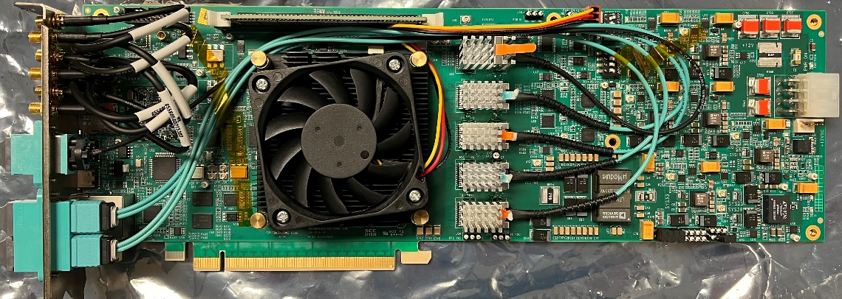
5. Current status
5.1 DAM: BNL FELIX card FLX182
Xilinx Versal Prime VM1802
DDR4 memory
Samtec FireFly, 4Tx/4Rx
LEMO_IOs
TRG, WR
LEDs, USBs
MTP, 4Tx/4Rx
LTI, 100 GBE
2* MTP, 12Tx/12Rx
RDO/FE
RJ45, 1000BASE-T
Clock management
Si5345s, oscillators…
PCIexpress
Gen4, 16 lanes
Samtec FireFly,
2* 12Tx, & 2* 12Rx
Power management
Single +12V input

Slide 15
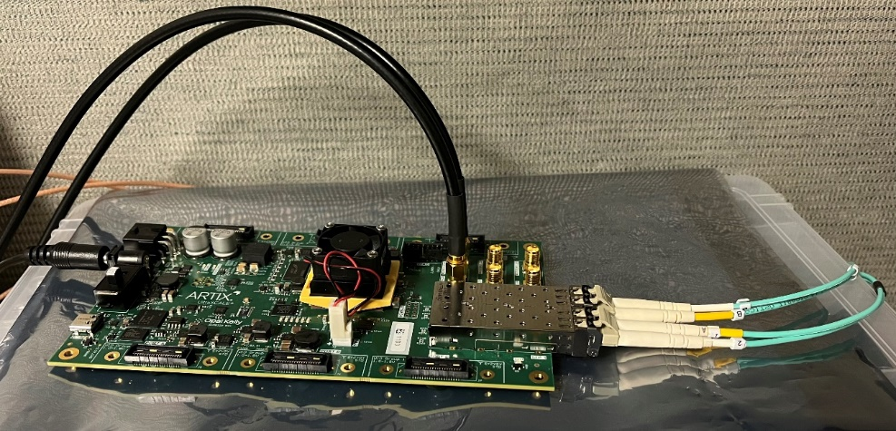
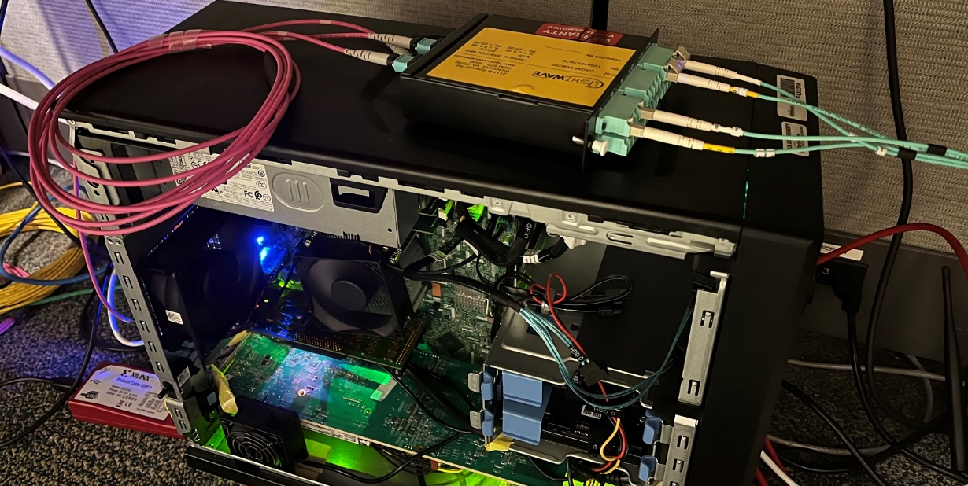
5. Current status
5.1 DAM: BNL FELIX card FLX182
1x24 → 3x8(MTP 12)
2x12 (MTP) → 24x1 (LC)
XEM8320, Artix Ultrascale+
Powered up as PCIe4x16 inside the computer;
Successfully loaded Jlab’s Readout on the GBE interface (standalone, without the PCIexpress or host computer);
Reconfigured the clock tree (Si5345), and generated ePIC 98.5MHz clock for the MGT RefClkIn;
Downloaded the ATLAS firmware, and compiled locally;
Modified the firmware for ePIC, and loaded the QSPI flash memory and the Versal FPGA;
FLX182

Slide 16
5. Current status
5.1 DAM:
FLX182:
The only major limitation for ePIC clock distribution is the lack of external clock input to the Si5345.
Current FLX182 clock diagram
ZDM
LEMO_IN
ADCMP561BRQZ
IN3±
OUT9±
OUT8±
Cascade to next Si5345
SN65LVDS100D
SI_OSC
200 MHz
IN1±
LEMO_IN
SN65LVDS1D
Si5345
WR_OSC
100 MHz
IN0±
OUT7±
LEMO_OUT
OUT1±
SN65LVDT2D
IN2±
OUT0±
XPOut±
XPIn±
XPIn±
XPIO±
MGT_REFclkIN
Versal FPGA
Because of the (slow) buffers, the LEMO_IN/OUT may be used for RunControl/Status signals (788 Mbps), but not the dedicated CLOCK (~1ps jitter) (the red line above).

Slide 17
5. Current status
5.1 DAM:
To request the addition on FLX155 (FELIX board with Versal Premium VP1552, 48-channel)
Keep the MGT quad fiber connection (100 GBE), and other common FELIX functions (PCIe, etc)
WR osc.
INB±
2:1 mux
? Should we ask for VP1202 compatibility? cheaper, but 24-channels only.
Clock_98.5MHz, ~ps jitter
INA±
Front panel connector
IN0±
SEL
Control, ~gbps
IN2±
INB±
Si5345
(ZDM)
Status, ~gbps
2:1 mux
INA±
RxUsrClk
RxRecClk
I/ObufDS
RefClkA
FPGA
RefClkB
FPGA
GT(204?)
Existing on FLX182
Needs be added on FLX155
FLX155 can be used as ePIC DAM

Slide 18
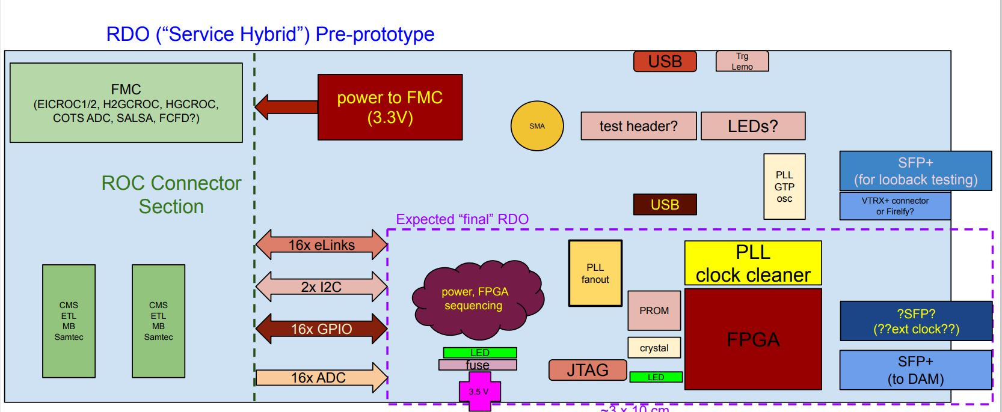
5. Current status
5.2 RDO, pre-prototype
Working on the schematics
Fully assembled boards are expected in the summer of 2024

Slide 19
6. To Do
6.1 TClink (trick) implementation on the DAM (FLX182/FLX155) → RDO (preprotype)
6.2 Define the data format
6.2.1 define the 8-bit RunControl commands,
6.2.2 define the status word,
6.2.3 define the (DAM→RDO) configure protocols,
6.2.3 define the data format,
6.3 Subsystem DAQ setup (one DAM plus many RDOs)
6.4 GTU design, and the full system setup

Slide 20
Backup Slides

Slide 21
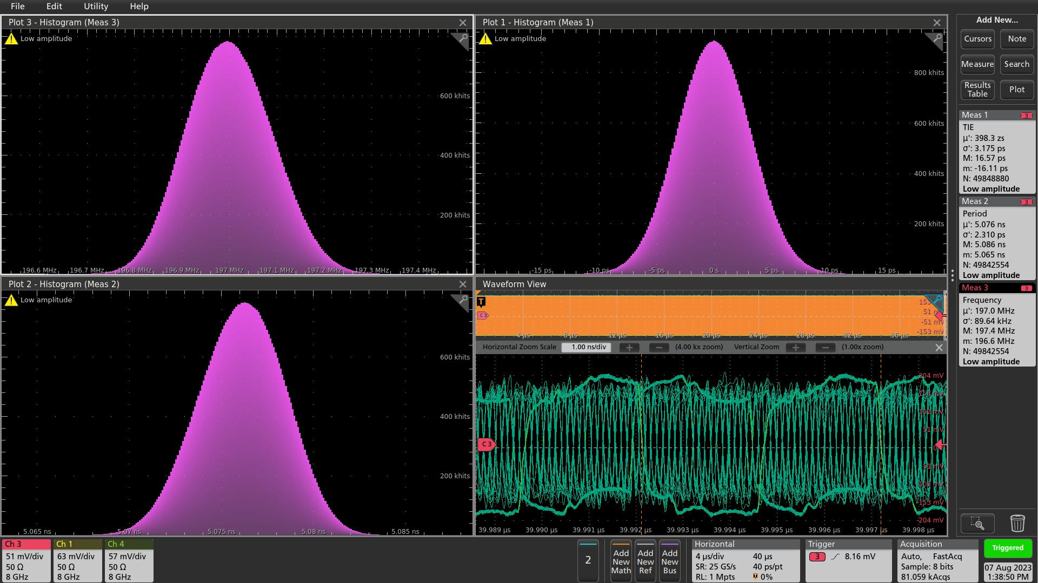
Artix Ultrasale+ GTY Recovered clock (RxRecClk, ClkRef_out), with regular 8b/10b coding, SFP+, 7.88gbps
Frequency
TIE
Period
All eight bytes are regular data (8b/10b encoded)
RxRecClk: TIE σ = 3.2 ps, Phase stable (aligned with source clock) @ 40 µs
Through Avago AFBR-710SMZ optic transceivers and a short multimode LC fiber (850nm)

Slide 22
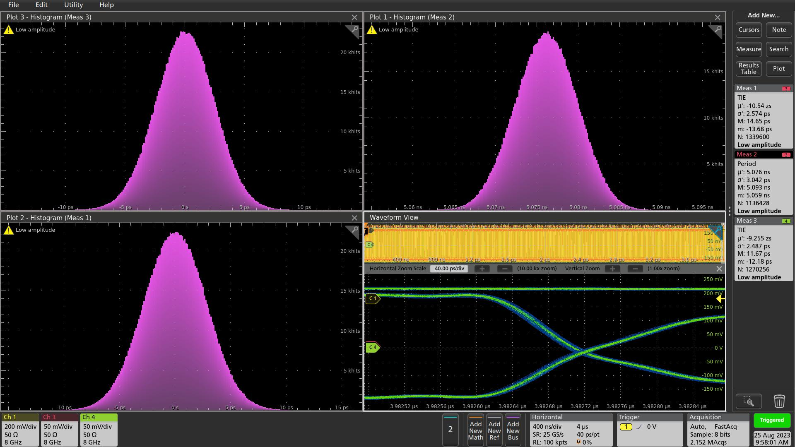
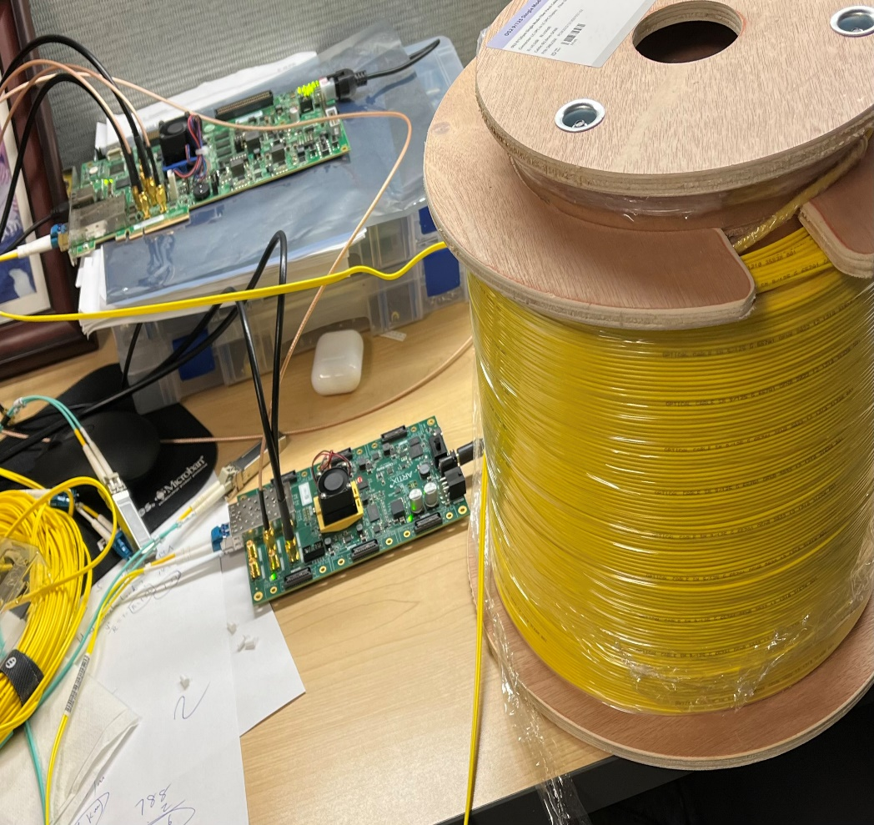
Artix Ultrasale+ GTY Recovered clock (ClkRef_out), with regular 8b/10b coding, Single Mode Fiber, 7.88gbps
TIE, ch#4
Period
TIE, Ch#3
Original Clock (triggered 4us earlier)
40 ps
RxRecClk _P, _N crossing
Through FS.COM SFP-25GLRL-31-4 “single mode, 25G, 1310 nm, 2 km” optic transceivers,
a short single mode LC fiber, 30 meters
A long single mode LC fiber, 609 meters
All eight bytes are regular data
RxRecClk: TIE σ < 3 ps, Phase stable @ 4 µs,
Rising edges, or Falling edges
RxRecClk_P, or RxRecClk_N
30 meter fiber, or 609 meter fiber

