Slide 1

Low Q2 detector
Jaroslav Adam
Electron Ion Collider

Slide 2
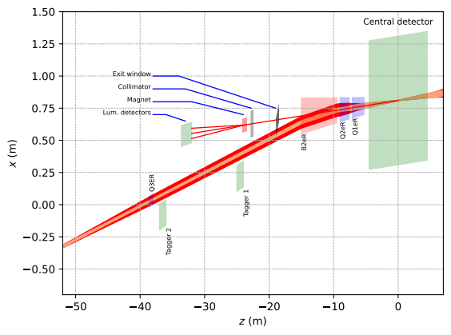
Introduction
The aim is to detect electrons scattered at very small polar angles, theta < 10 mrad
Detectors are placed after Q1eR, Q2eR and B2eR magnets in electron-outgoing direction
Electron energies are Ee > 6 GeV, B2eR acts as a spectrometer magnet
Corresponding event virtuality is Q^2 < 0.1 GeV^2
Also involved is luminosity calibration by detecting electrons from bremsstrahlung process
Tracking information is sufficient to get full electron kinematics, with help of machine learning
<number>

Slide 3
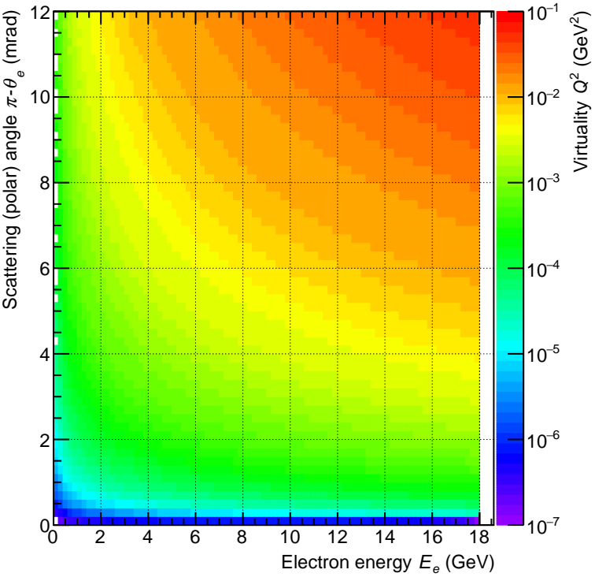
Electron energy – scattering angle – virtuality
The Q^2 (color scale) is determined by electron energy Ee and polar angle theta
Polar angle is given in terms of pi-theta because of negative z for outgoing electrons
The same virtuality Q^2 is achieved at high energies and smaller angles or opposite – lower energies and larger angles
<number>

Slide 4
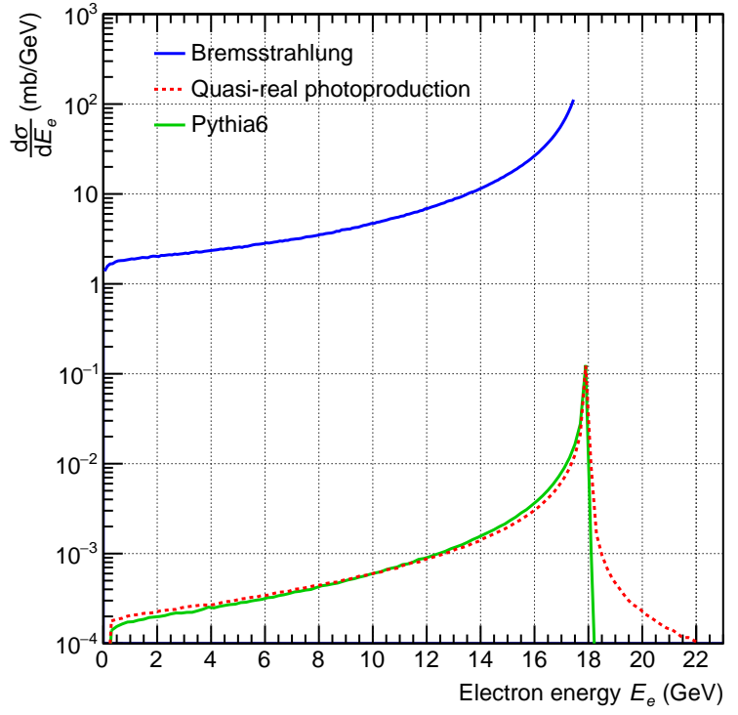
Cross section as a function of electron energy
Total cross section is shown for elastic bremsstrahlung and for two models for inelastic ep scattering
Quasi-real photoproduction is approximation of the full Pythia6 calculation at very low Q^2
Large bremsstrahlung cross section implies a pile-up interaction in each bunch crossing
The bremsstrahlung makes a background in photoproduction measurement
<number>

Slide 5
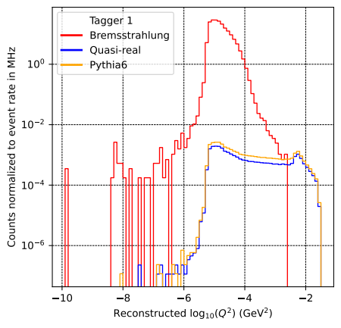
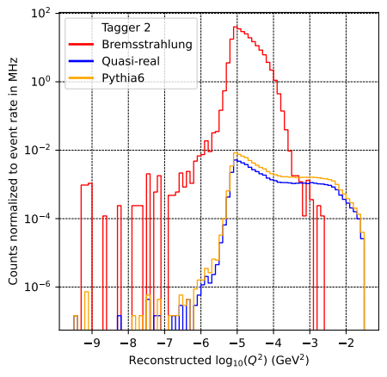
Spectrum of observed Q^2 for bremsstrahlung and photoproduction
Reconstructed Q^2 is shown for bremsstrahlung and photoproduction (quasi-real and Pythia6)
True Q^2 for bremsstrahlung in consistent with zero
Distributions are normalized to event rates
Electrons from bremsstrahlung reconstruct to the lowest values of Q^2
Opportunity to extract clean photoproduction signal over a limited interval in Q^2
<number>

Slide 6
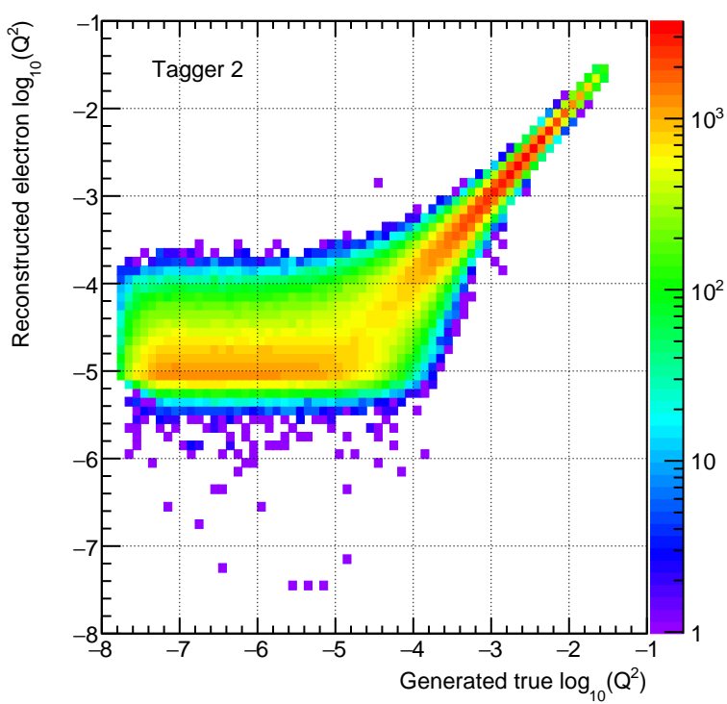
Q^2 reconstruction
Reconstructed virtuality Q^2 is compared to generated true event Q^2
The Q^2 is given by electron energy Ee and scattering (polar) angle theta
Beam effects (vertex spread, angular divergence) are included in the simulation
Shown for Tagger 2, similar for Tagger 1
Beam angular divergence limits the resolution at Q^2 < 10^-3 GeV^2
<number>

Slide 7
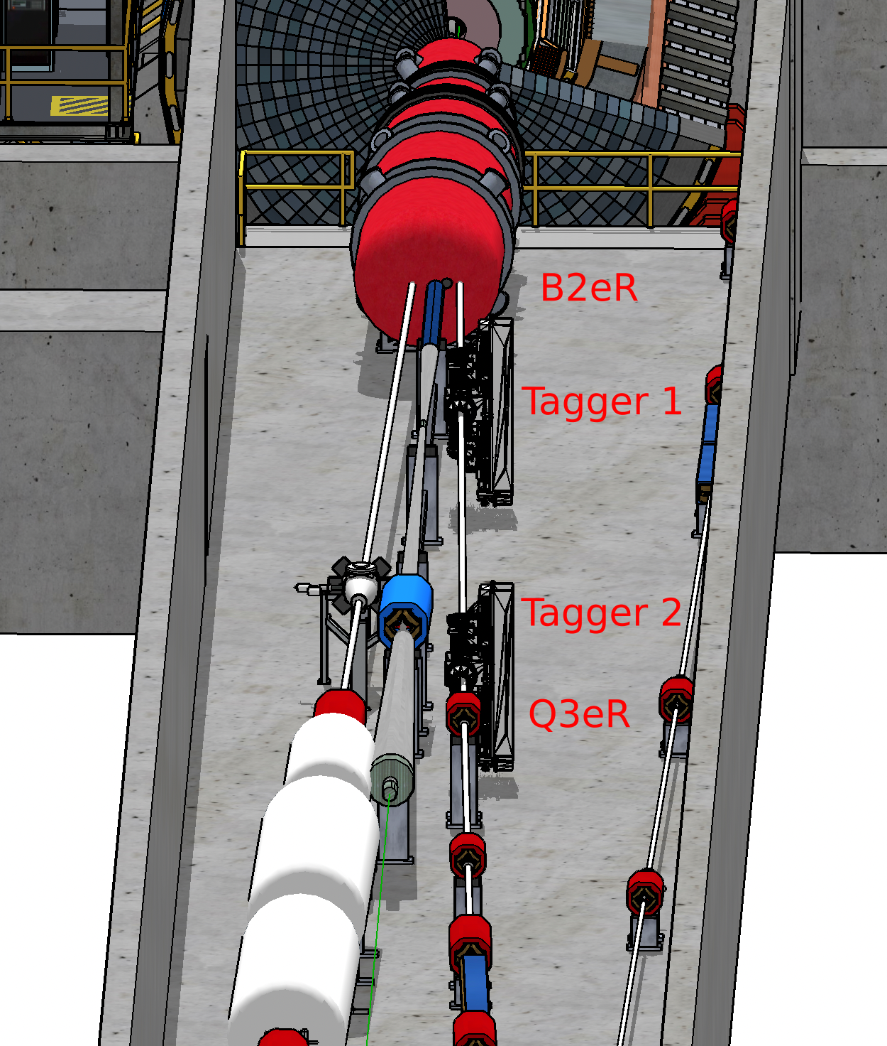
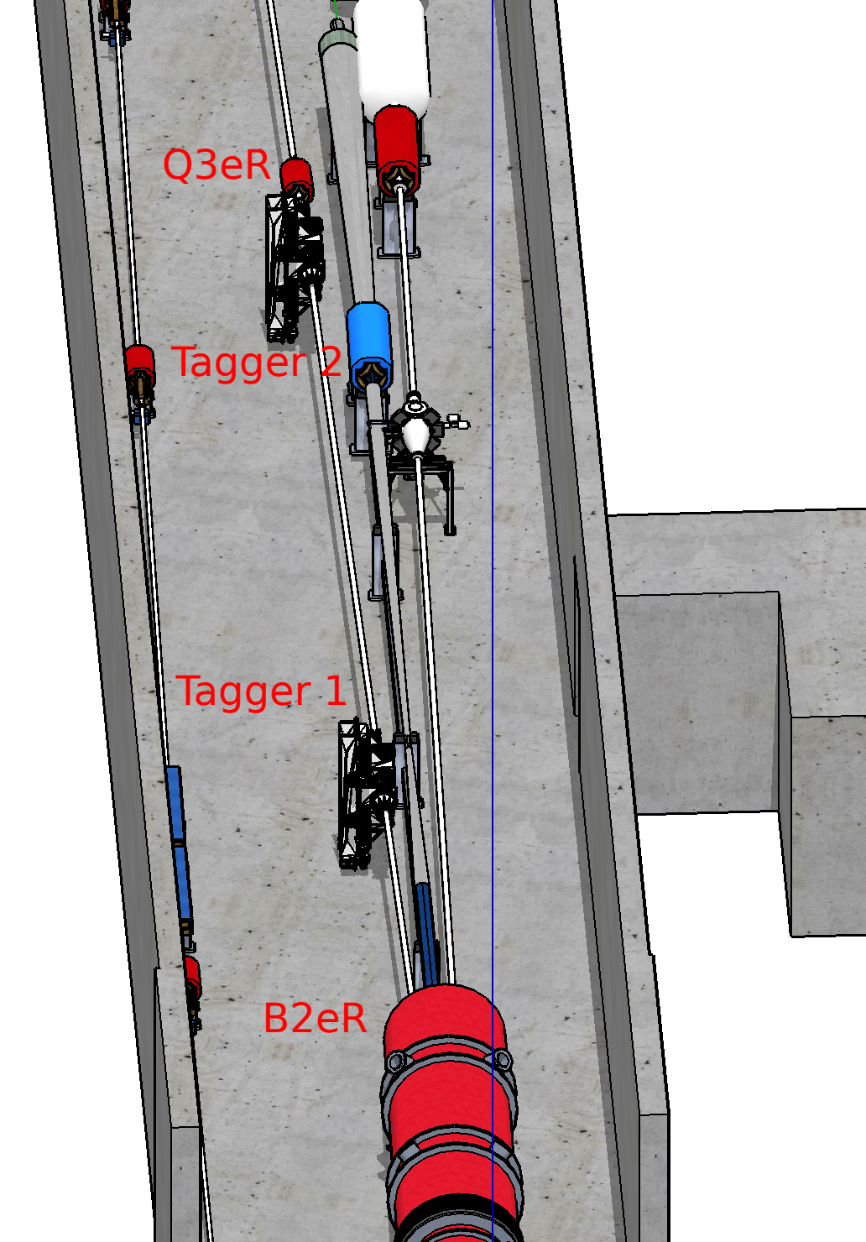
Detector location in the IR
Towards the central detector
Towards the tunnel
<number>

Slide 8
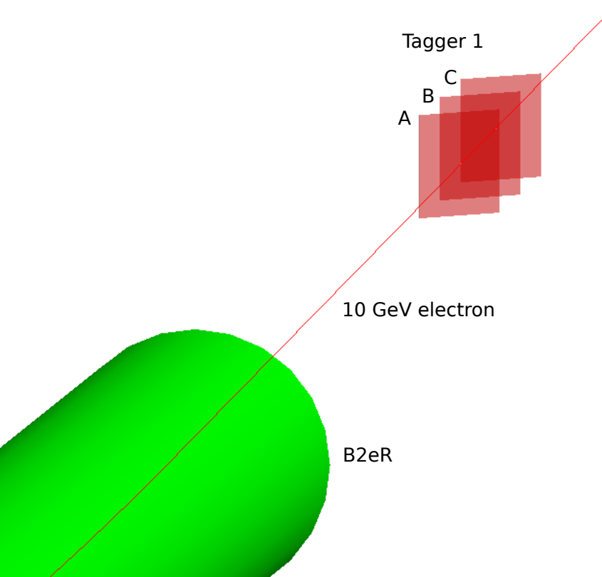
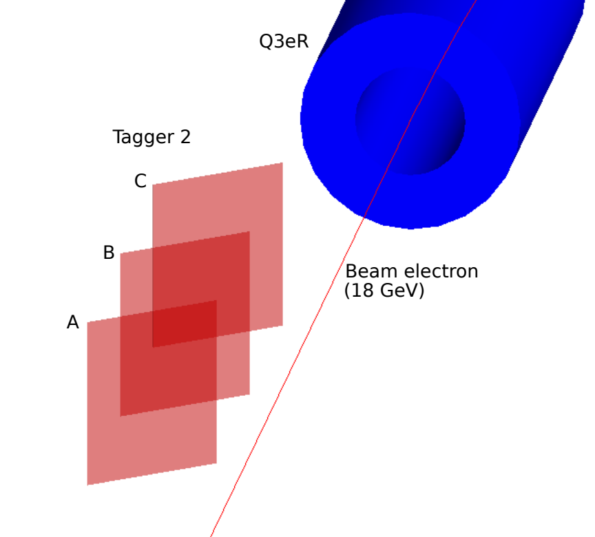
Detector implementation in Geant4
Both detectors are implemented as a set of position sensitive planes
Tagger 1 (closer to B2eR) takes more acceptance at lower energies, opposite for Tagger 2
<number>

Slide 9
Requirements on detector sensors
A signal will be present at every bunch crossing as a result of large bremsstrahlung cross section
The detector has to separate all individual electron tracks from the same bunch crossing for successful Q^2 reconstruction
Maximal detector dimensions will be imposed by considerations on beam vacuum
Requirements on impedance are fulfilled by an angle of detector planes and conductive foils in downstream direction
<number>

Slide 10
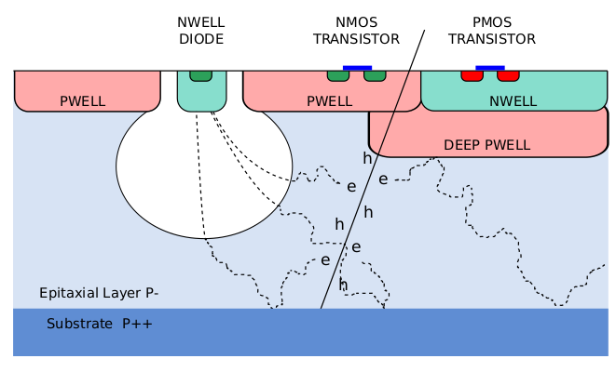
Technology option for the sensors: Monolithic Active Pixel Sensor MAPS
Selected technology for high luminosity LHC upgrades
Segmentation for position measurement is ~200 um; driven by ability to distinguish separate electron tracks
Timing response is needed within 1 ns; just to separate individual bunch crossings, no need for precise timing resolution
Ongoing studies on radiation hardness, analogy with high luminosity LHC
<number>

Slide 11
Summary
We are in the process of integration into the beam pipe layout
Large rates from bremsstrahlung background are handled by Q^2 reconstruction; improvement in the procedure will enhance the separation of the photoproduction signal
The MAPS technology is expected to provide sufficient segmentation and timing capability
<number>

Slide 12
Backup
<number>

Slide 13
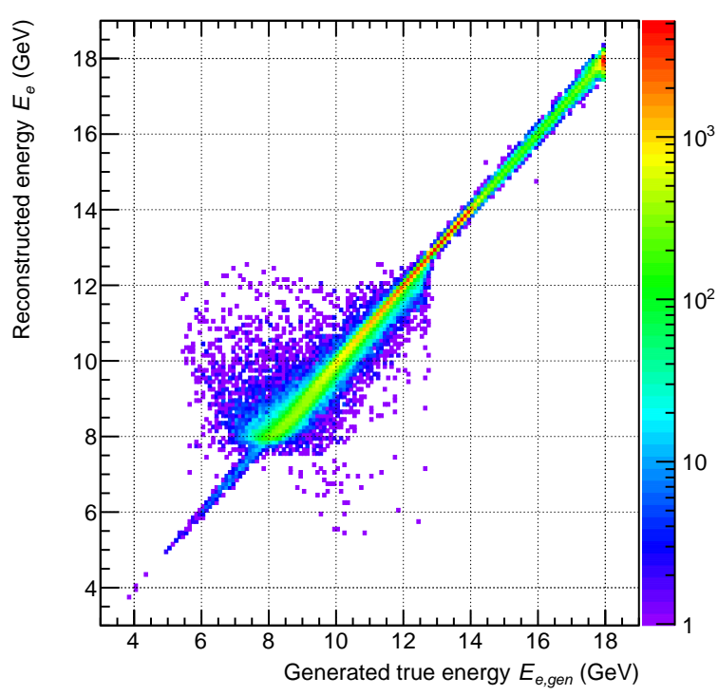
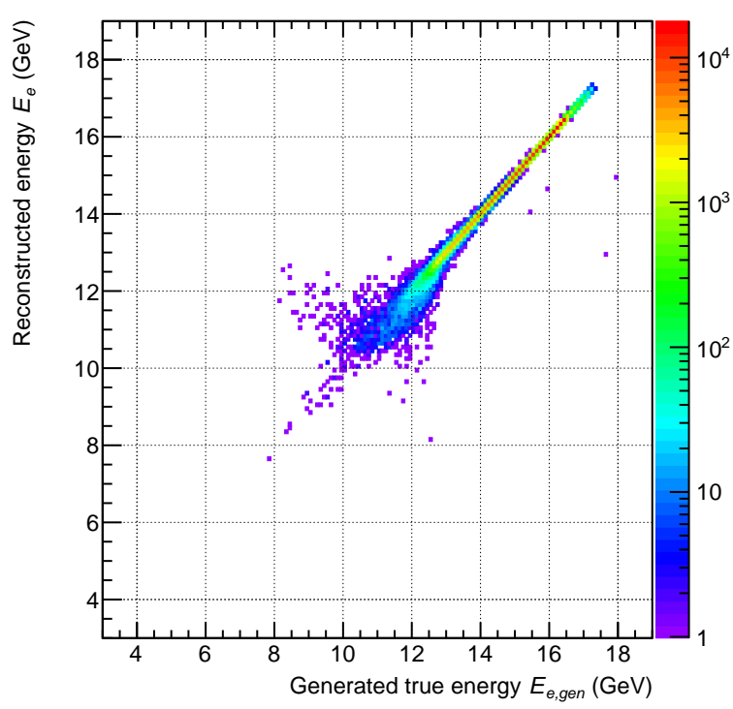
Electron reconstruction in tagger detectors
A machine learning algorithm takes track position and angles along the detector planes and provides original electron energy E e and its scattering and azimuthal angle
Energy for Tagger 1
Energy for Tagger 2
<number>

Slide 14
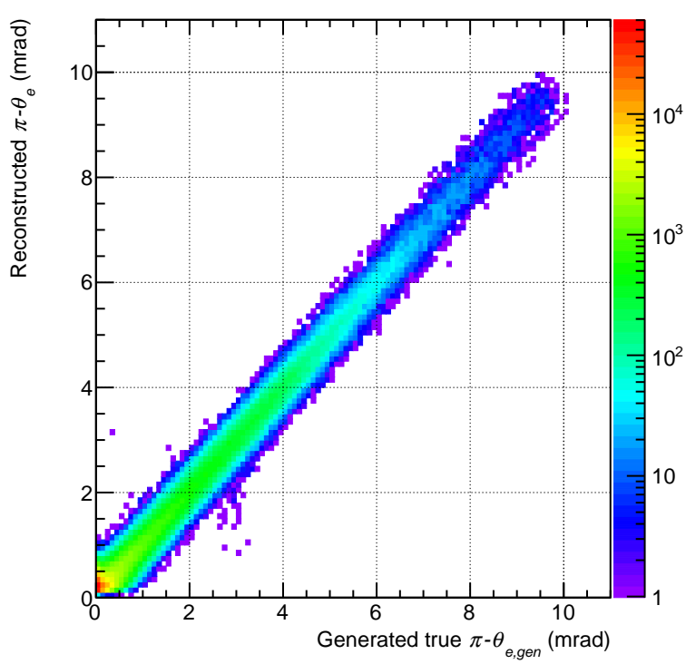
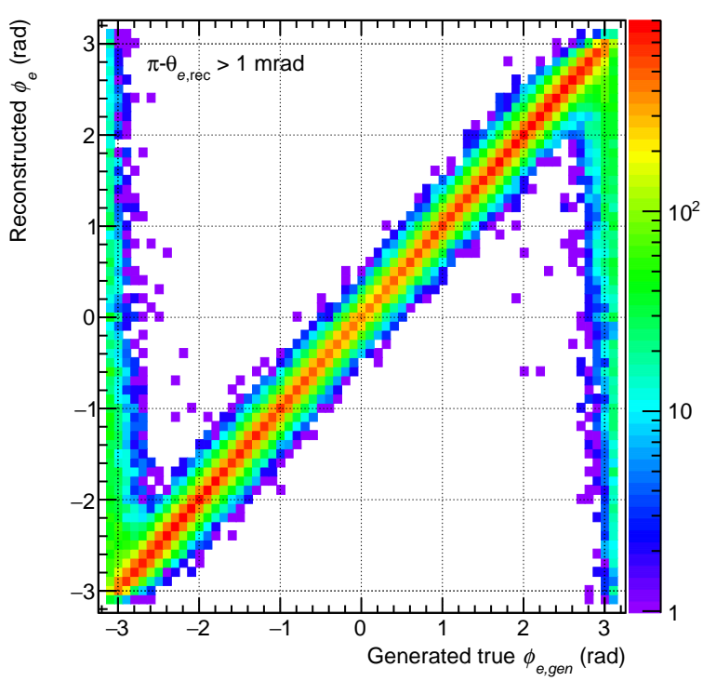
Polar and azimuthal angles
Example is shown for Tagger 2 (similar performance for Tagger 1)
Very small scattering (polar) angles (pi-theta < 1 mrad) are smeared by beam angular divergence
Reconstruction of azimuthal angle phi works well away from small polar angles
<number>

