Slide 1
Ring Finder Algorithm for mRICH Detector
Using Circular Hough Transform
Cheuk-Ping Wong
Georgia State University
2016-08-15

Slide 2
Motivation
Quantitative data analysis on beam test data and on Simulation result
  Number of Cherenkov photon detected per event
    Both signal and background
  Cherenkov ring radius
  (Ring finder algorithm required)
  Performance of Fresnel lens
Method
  Ring Finder Algorithm
  Maximum Likelihood

Slide 3
Motivation
Obtain the most likely circle : center (a,b) and radius r, from limited information

Slide 4
Circular Hough Transform
Start from the basic
A circle can be formed with at least 3 points:
Find out all possible Circles
Pick any three hits from a list of hits
And try all possible three-hit combinations.

Slide 5
Circular Hough Transform
Then find out which circle passes through most hits.
Blue ring – 5 hits
Green ring – 4 hits
Orange ring – 10 hits
3 hits
2 hits
Signal Cherenkov photons
1 hit
Noise photons
0 hit

Slide 6
Assumptions
There is only one incident particle per event
  Only one Cherenkov ring per event, that is (a,b,r) is unique
Number of background hit is much lower then signal hits in each event
Hit position = center of pixel

Slide 7
Drawback of CHT
Then there are up to _{n}C₃ Possible circles!!!
Let’s say there are 10 hits in one event, there are 120 combinations.

Slide 8
Combinations restrictions
1
2
3
4
5
Combinations restrictions :
Any two hits that are on the same pixel
All three hits are collinear
a
b
c
d
e

Slide 9
Drawback of CHT
1
2
3
4
5
Combinations restrictions :
Any two hits that are on the pixel
All three hits are collinear
a
b
c
d
e

Slide 10
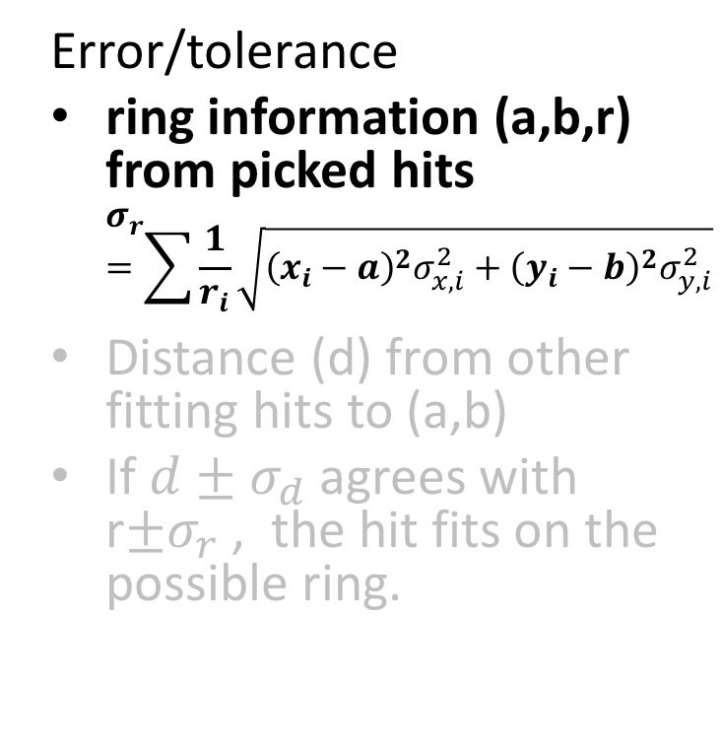
CHT Implementation on mRICH
Error/tolerance
ring information (a,b,r) from picked hits
$σ_{r}=\sum{\frac{1}{r_{i}}\sqrt{{\left(x_{i}−a\right)}^{2}σ_{x,i}^{2}+{\left(y_{i}−b\right)}^{2}σ_{y,i}^{2}}}$
Distance (d) from other fitting hits to (a,b)
If $d±σ_{d}$ agrees with r$±σ_{r}$ , the hit fits on the possible ring.

Slide 11
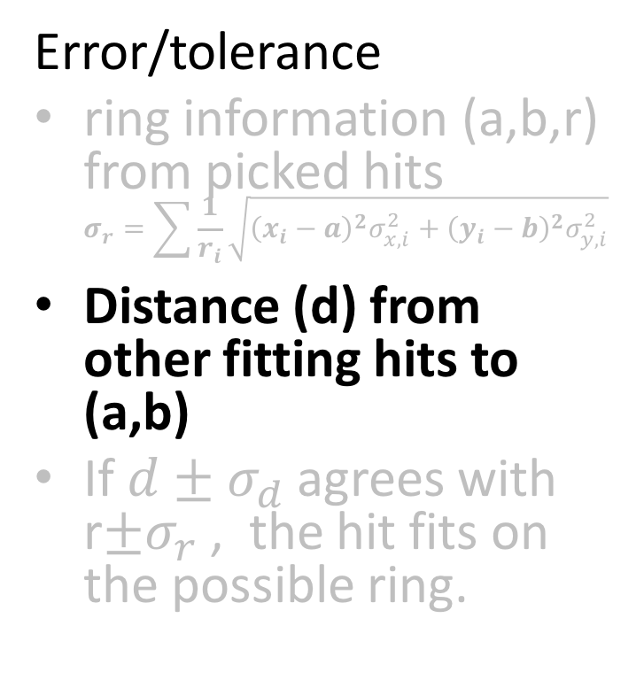
CHT Implementation on mRICH
Center of the pixel
Error/tolerance
ring information (a,b,r) from picked hits
$σ_{r}=\sum{\frac{1}{r_{i}}\sqrt{{\left(x_{i}−a\right)}^{2}σ_{x,i}^{2}+{\left(y_{i}−b\right)}^{2}σ_{y,i}^{2}}}$
Distance (d) from other fitting hits to (a,b)
If $d±σ_{d}$ agrees with r$±σ_{r}$ , the hit fits on the possible ring.

Slide 12
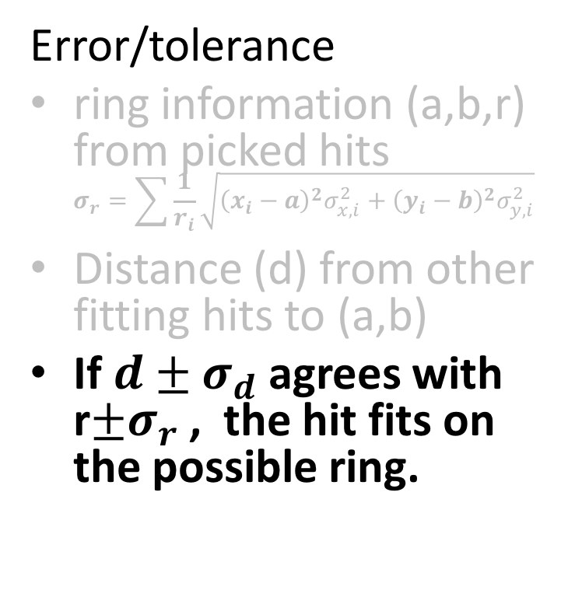
CHT Implementation on mRICH
Error/tolerance
ring information (a,b,r) from picked hits
$σ_{r}=\sum{\frac{1}{r_{i}}\sqrt{{\left(x_{i}−a\right)}^{2}σ_{x,i}^{2}+{\left(y_{i}−b\right)}^{2}σ_{y,i}^{2}}}$
Distance (d) from other fitting hits to (a,b)
If $d±σ_{d}$ agrees with r$±σ_{r}$ , the hit fits on the possible ring.

Slide 13
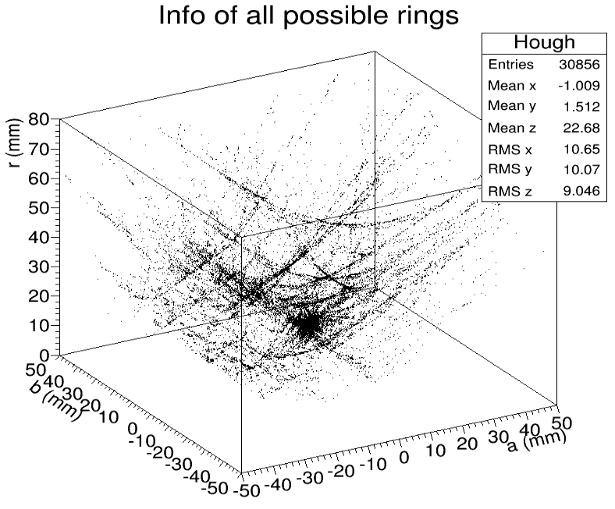
CHT Implementation on mRICH
Weighting
Fill every combination (a,b,r) with voting number n
3D (a,b,r) distribution
Data of the densest bin in the histogram = most possible ring

Slide 14
CHT Implementation on mRICH
Weighting
Fill every combination (a,b,r) with voting number n
3D (a,b,r) distribution
Extract data of the densest bin in the histogram → most possible ring

Slide 15
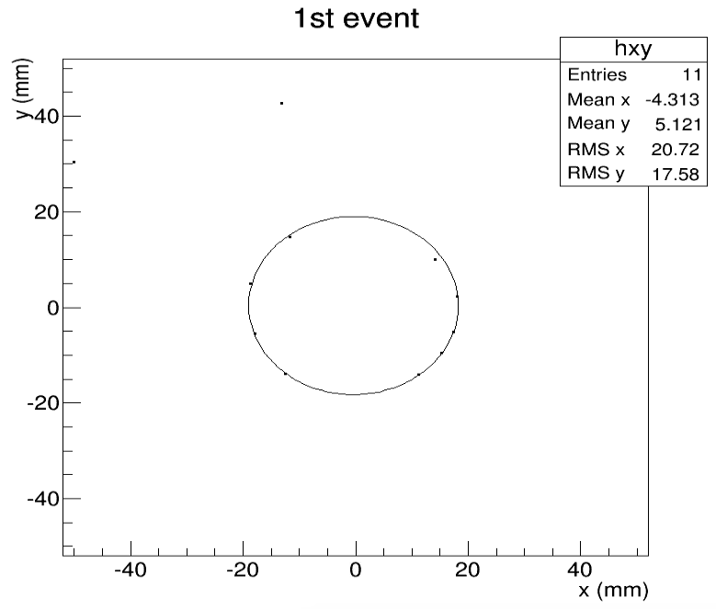
Simulation Result
Single 9GeV Pion
9GeV single pion launched perpendicularly toward the center of the detector
(Quantum efficiency applied)
Most Possible Ring

Slide 16
To do
CHT Implementation on Beam test data analysis

Slide 17
Back Up

Slide 18
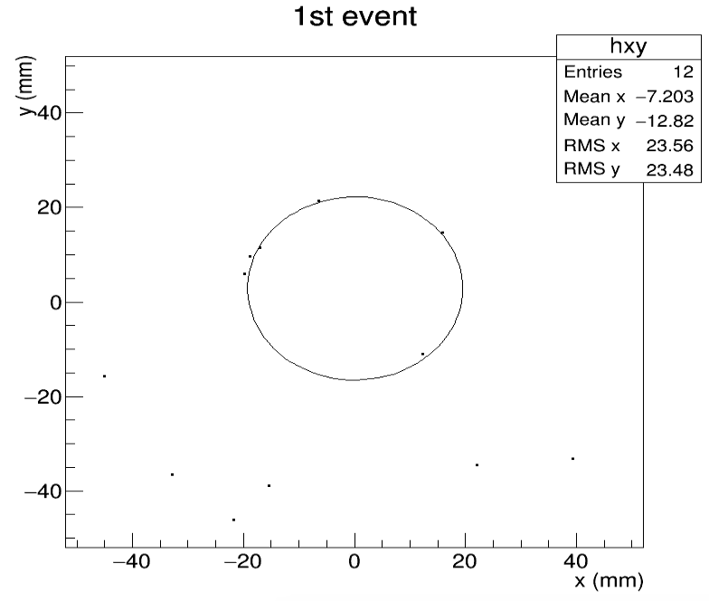
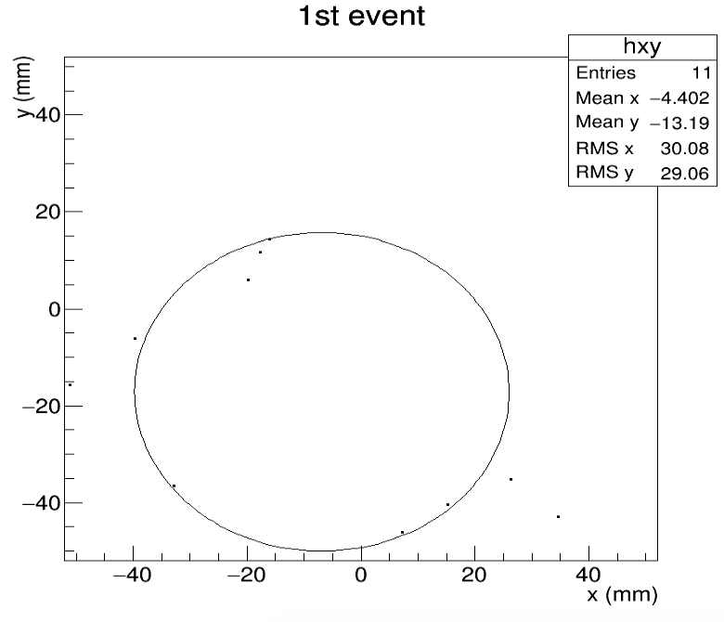
Simulation Result
9GeV Single Pion
9 GeV single Pion launched perpendicularly at (x,y)(-24,-24)mm
(Quantum efficiency applied)
Same event
The ring finder algorithm does work well if background hits are outnumber signal hits

Slide 19
C.H.T. Implementation on mRICH
Weighting
Fill every combination (a,b,r) with voting number n
3D (a,b,r) distribution
Extract data of the densest bin in the histogram → most possible ring
Thus, final result (a,b, r) is averaged

