Slide 1
26th ATF Users Meeting – Logistics & Opening Remarks
Mark Palmer
March 26, 2024
ATRO – Accelerator Facilities Division

Slide 2
Welcome
We apologize for the last-minute rescheduling of the Users Meeting this year
Covid surge with masking requirements hit NY are just before the originally planned dates
It is great to see those who are here in person
We appreciate all of those participating remotely
We hope that this will be the last of our virtual/hybrid Users Meetings

Slide 3
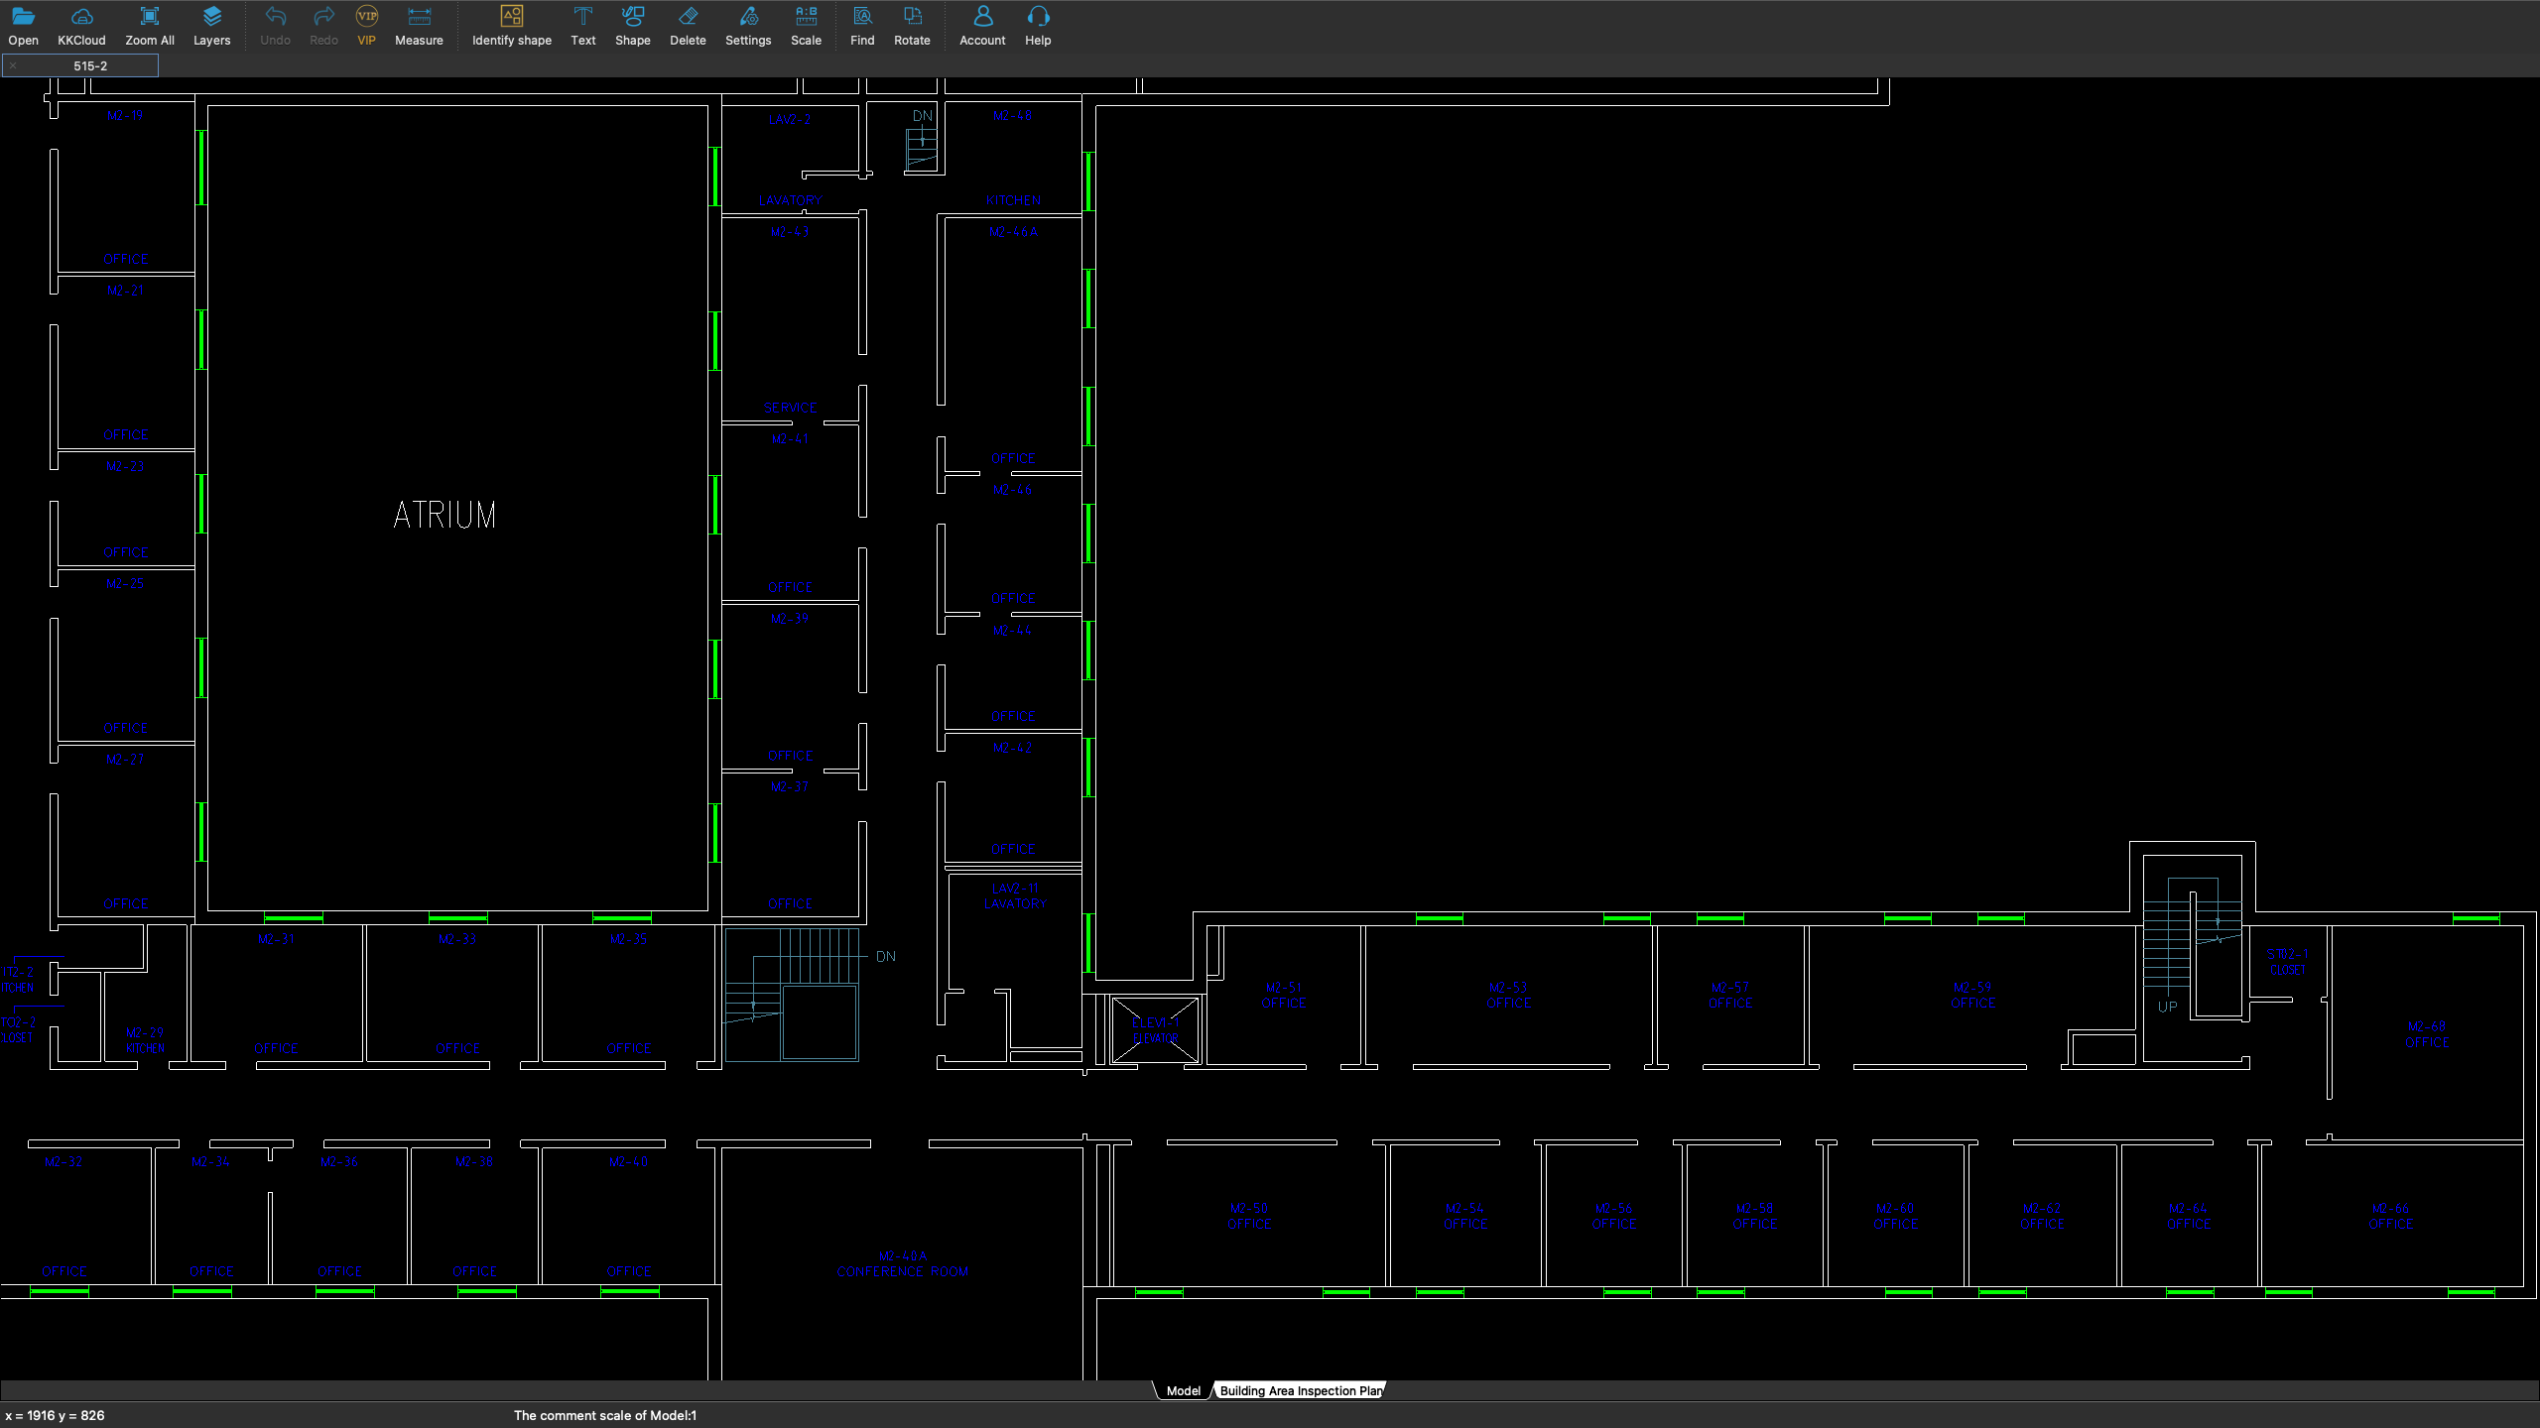
Safety First
Closest building exit is just down the stairs and out the front door.
Additional stairwells at ends 2 hallways
We are here
3

Slide 4
Logistics for the Meeting
Tuesday
AM – General ATF and ARDAP updates
Lunch on your own
PM – Experimental Status and Closeout Reports
UM Dinner at Cooperage Inn
Wednesday
AM – Experimental Status Reports
Lunch on your own
PM – New Proposals
Thursday
AM Part I – Experimental Status Reports
AM Part II – June Science Planning Workshop & Closeout
Lunch on your own
PM – ATF Tours starting at 1pm
In order to streamline the agenda, experiments that did not receive time in the last year aren’t required to report unless they have special developments to relate.

Slide 5
Lunch at Berkner
On-site option is the Pop-Up Café at Berkner
Grab & Go or Pre-Order
Berkner seating area is open

Slide 6
Users Meeting Dinner
Cooperage Inn
6pm this evening
2218 Sound Ave Baiting Hollow, NY 11933
Lab main entrance

