Slide 1
26th Accelerator Test Facility (ATF) Users' Meeting Facility Modification Status
Andrew Simmonds
March 26, 2024
Accelerator Facilities Division

Slide 2
ATF Modifications Status
Design Process
Configuration Control
B820
Laser Capability
Capability and Safety Upgrades
Facility Upgrades
B912
Accelerator Facilities Division

Slide 3
Design Process
Scientific need is identified by the user community or AF staff member
A specification document is generated
Development of a conceptual design
Hold design review with AF staff and relevant outside experts
Conduct detailed design and structural analysis
Check & approval of drawings and critical analyses
Archival of drawings and analyses
Utilize matrixed support from ATRO for engineering and drafting
Accelerator Facilities Division

Slide 4
Configuration Control
For wider accessibility, SharePoint will host a drawing repository for reference only copies of relevant drawing packages
Radiation calculations are archived by the C-AD RSC
Shielding is approved by the C-AD RSC. The drawings are reviewed and approved before being archived in Windchill.
Utilize Windchill to release and archive controlled documents
The part numbering and controlled document release process are fully AF’s responsibility
Accelerator Facilities Division

Slide 5
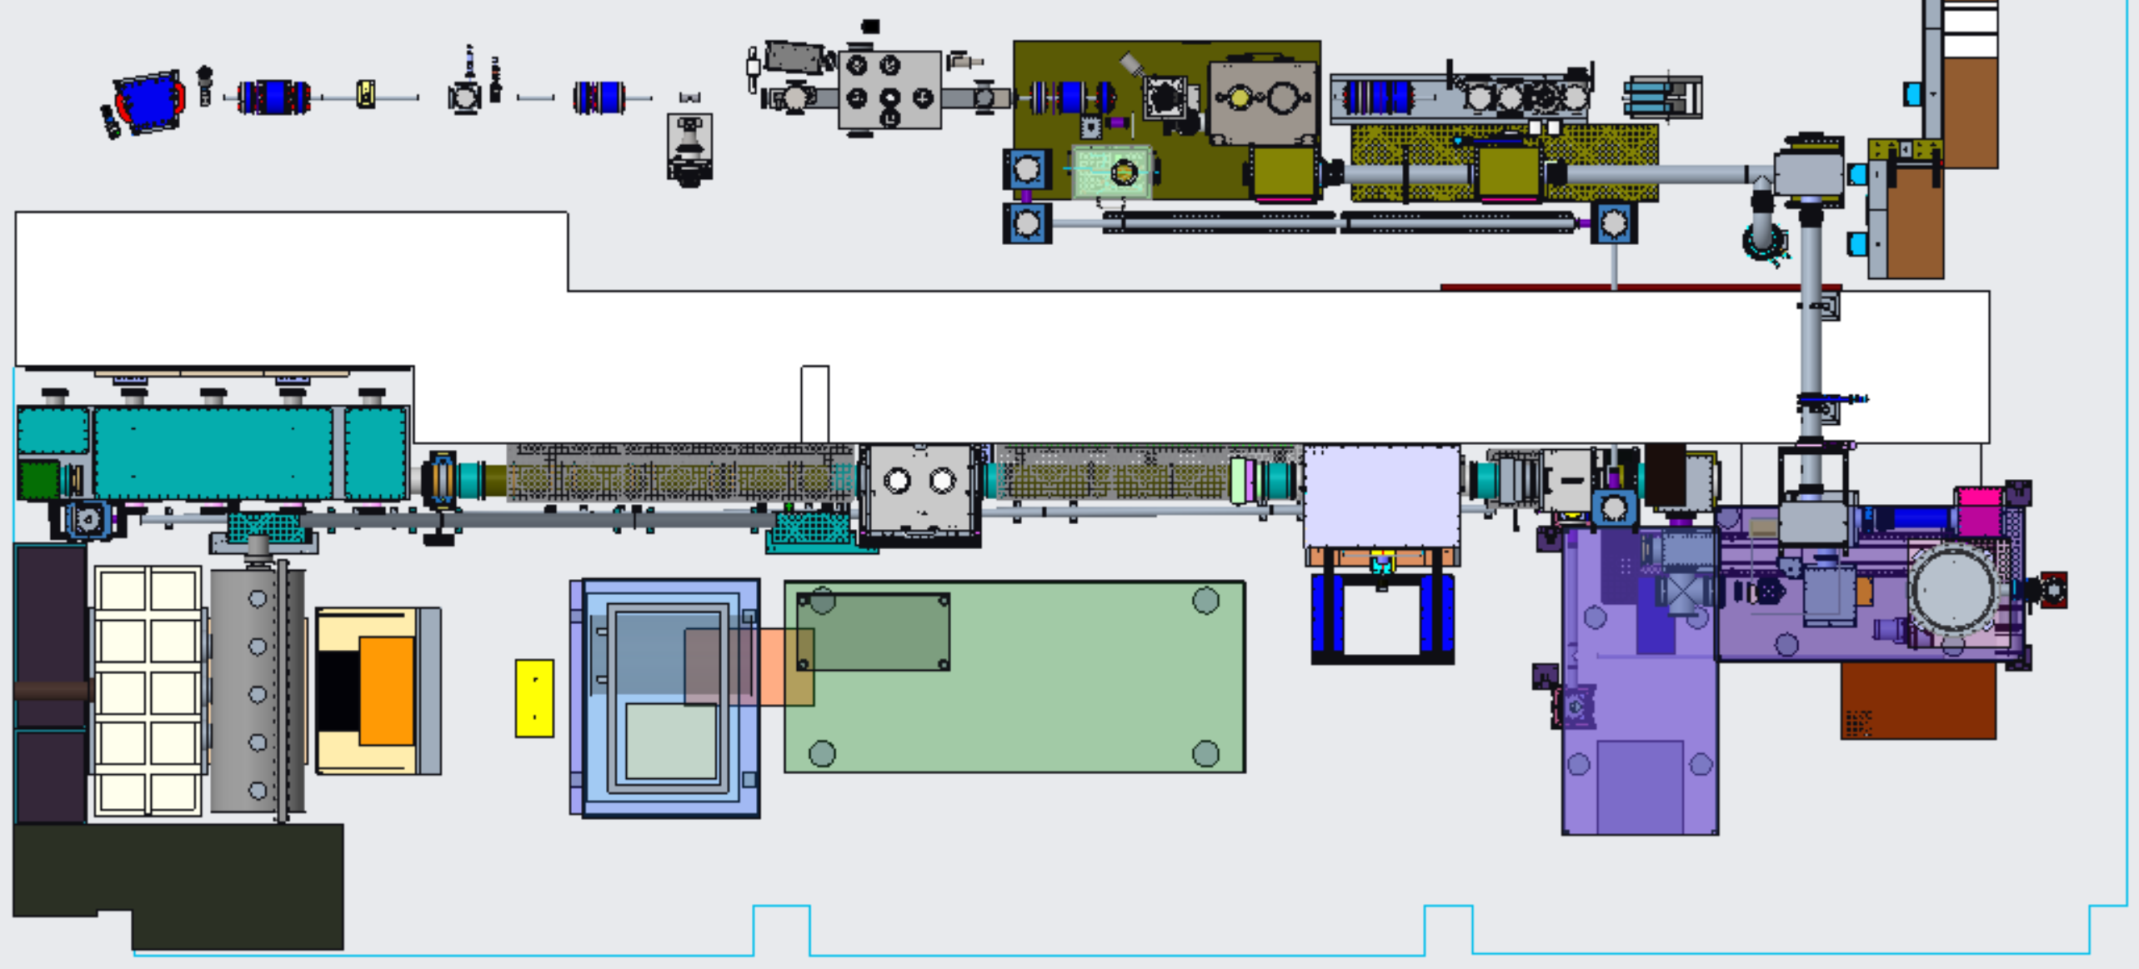
Present Laser Configuration w/ FY23 upgrades
LWIR
NIR
Shielding wall
NLPC 1
NLPC 2
CPA Chamber
Seed Laser Table
Polarization Rotator Chamber
Final Amplifier
Accelerator Facilities Division

Slide 6
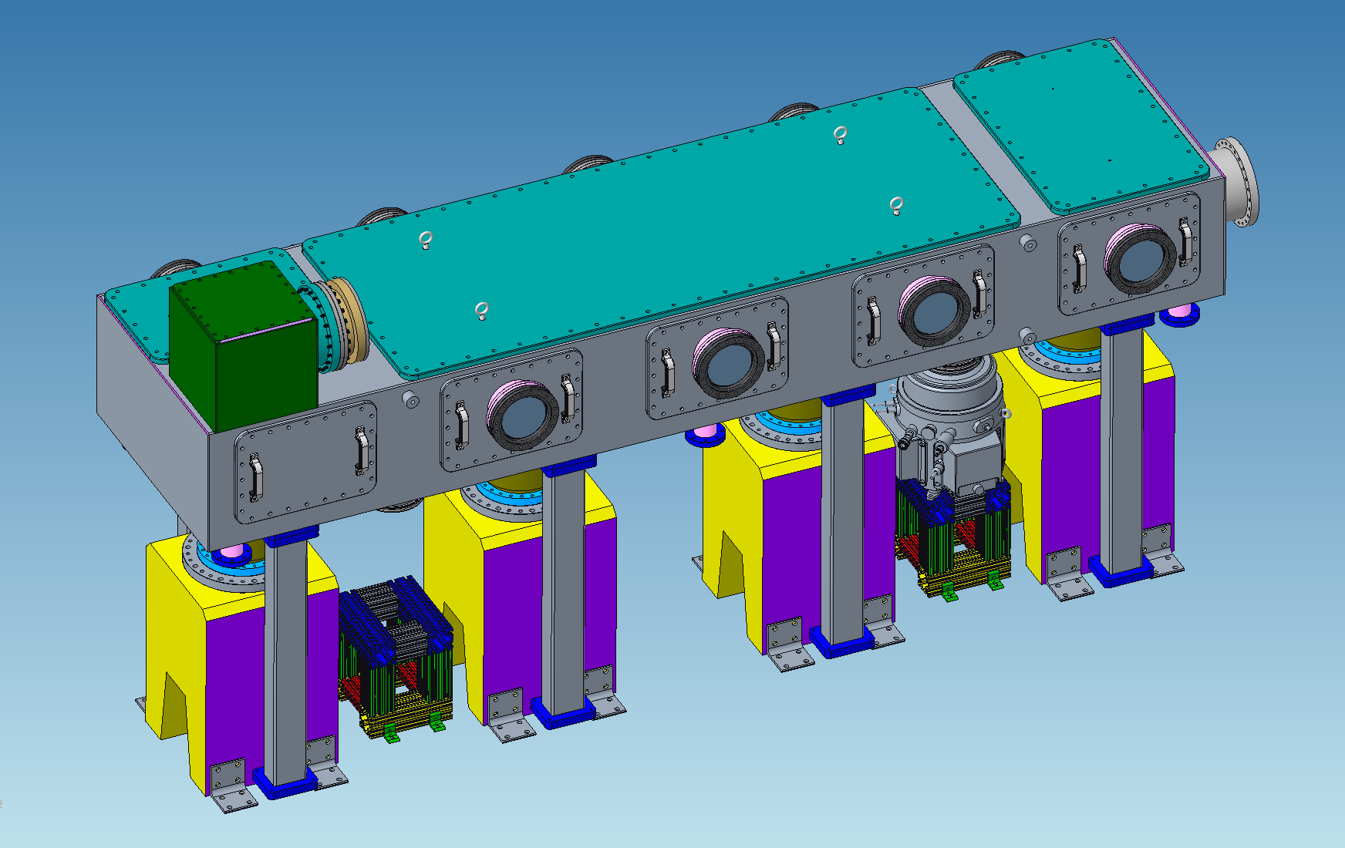
CPA Vacuum Chamber
Optics mounted to concrete pedestals for thermal stability and vibration isolation
Vacuum chamber supported by SS legs
Bellow is only mechanical connection
Breadboard frames are made from solid flat plate
Breadboard legs are made with a solid center section for increased rigidity
Accelerator Facilities Division

Slide 7
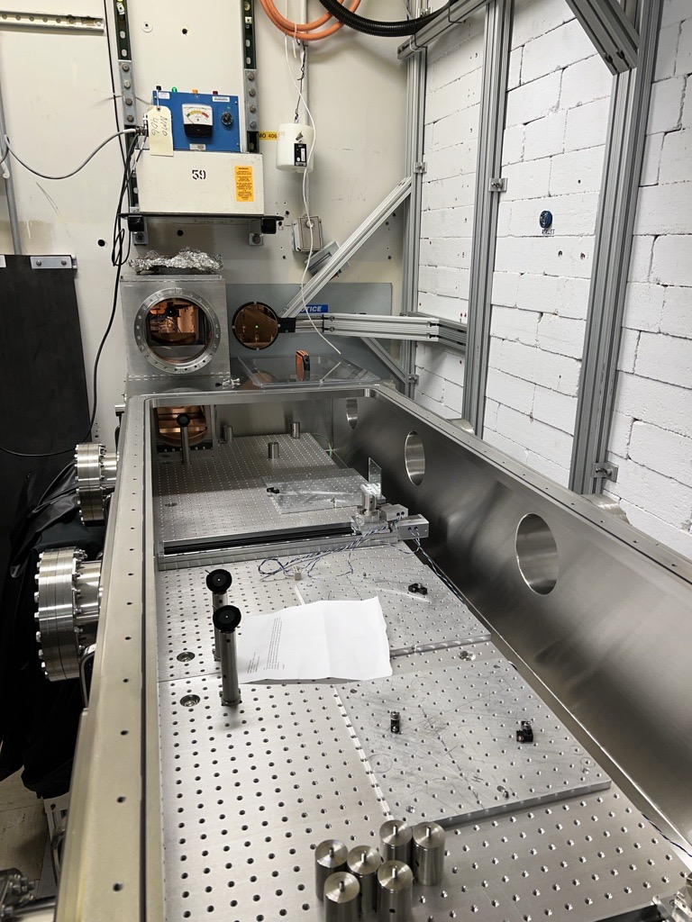
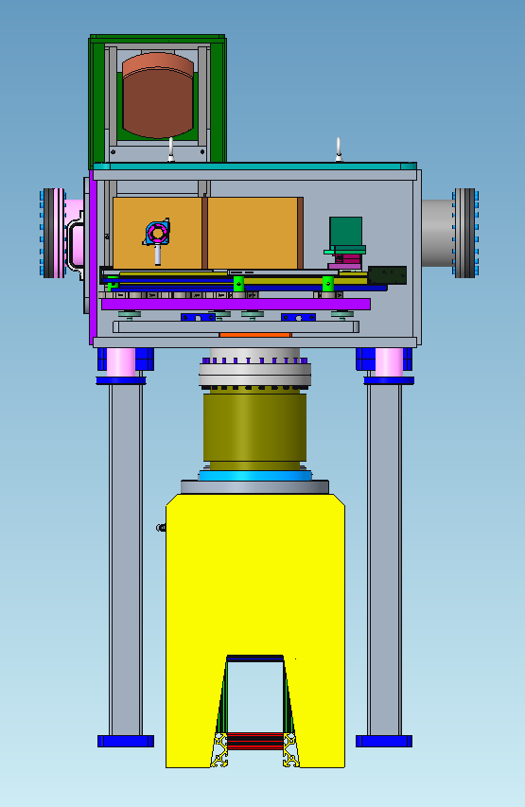
Inside the CPA Chamber
Breadboard support frames are made from solid flat plate, providing a flatter and stiffer base for the breadboards
Breadboard legs are made with a solid center section for increased rigidity
Accelerator Facilities Division

Slide 8
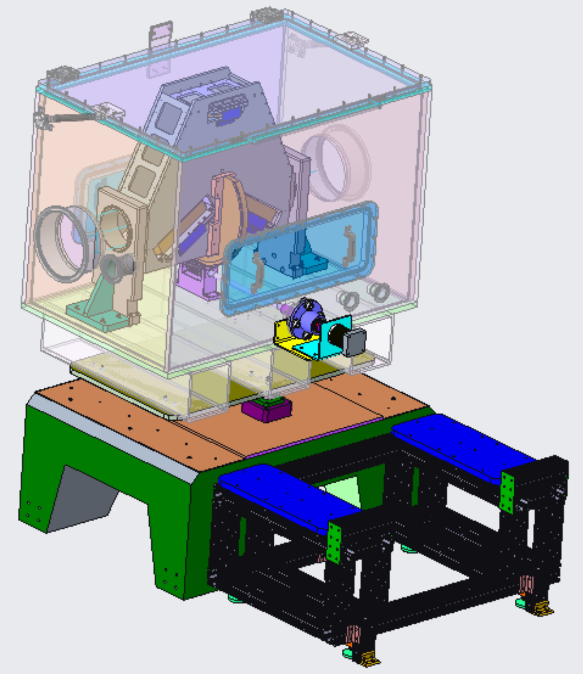
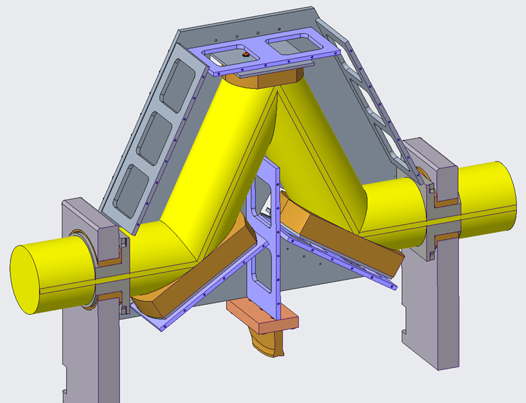
Flexible Polarization Rotator (FPR)
Provides infinitely adjustable beam polarization from horizontal to vertical
6” diameter clear aperture
Accelerator Facilities Division

Slide 9
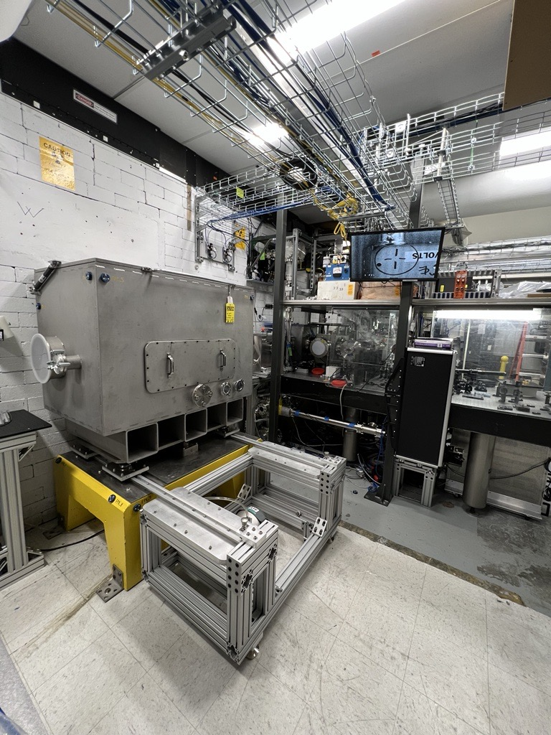
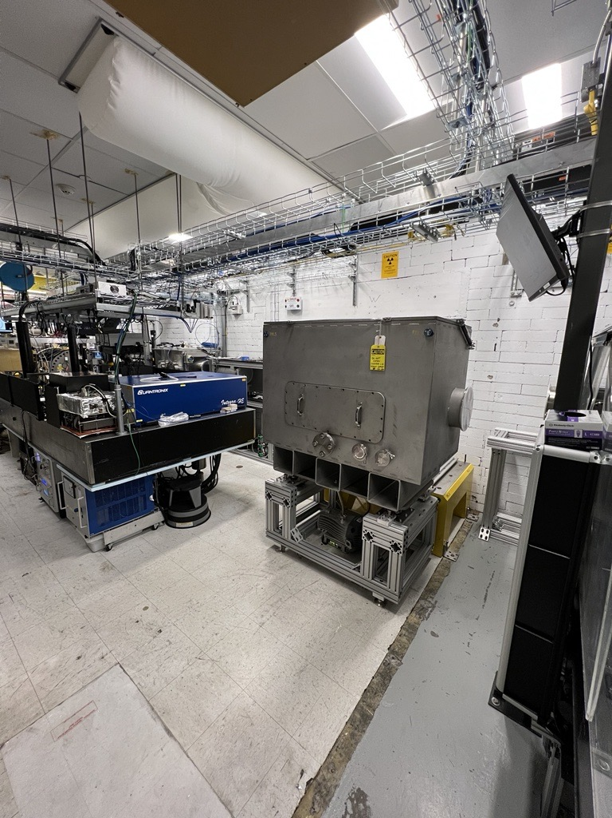
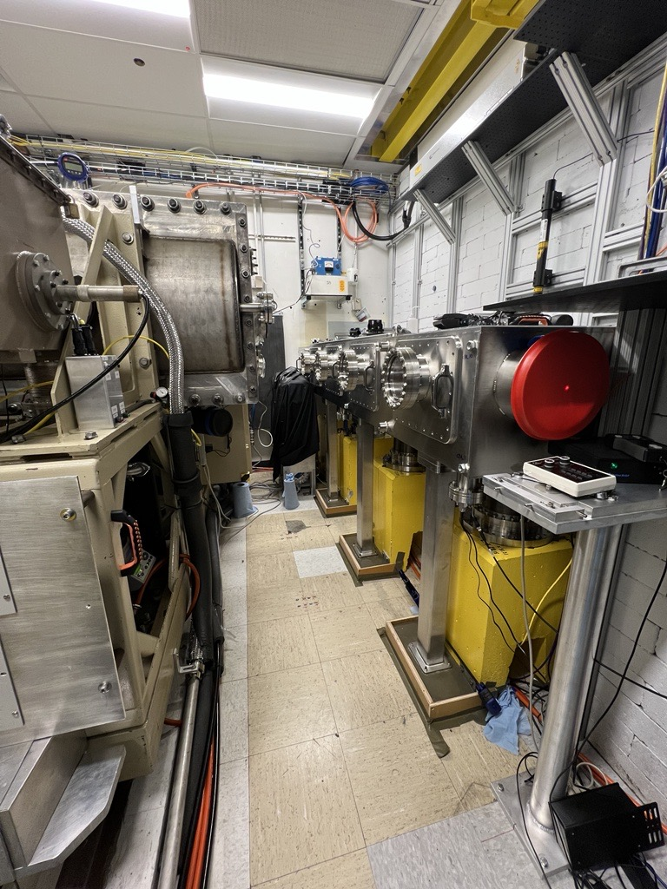
FPR and CPA Installation Pictures
Accelerator Facilities Division

Slide 10
B820 Capability and Safety Upgrades
Experimental Hall
Installed improved shielding after Spectrometer Dipole at the end of BL#2
CO2 Room
Completed LWIR vacuum transport installation through BL1 IPs
LWIR Water Capacitor was completely drained, cleaned and refilled with fresh fluid
Began installation of the additional shielding of the plasma shutter
Front End
YAG laser heads were completely rebuilt
Designed and soon to be implemented NIR vacuum transport upgrade
Accelerator Facilities Division

Slide 11
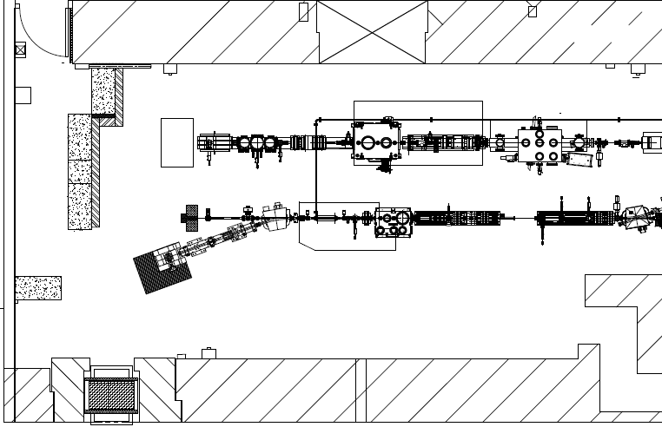
EH Shielding
Labyrinth/Shielding
Inverse Compton Scattering
Laser Wakefield
Additional local shielding was installed in response to radiation simulations of potential fault conditions
20° Leg of BL2
Accelerator Facilities Division

Slide 12
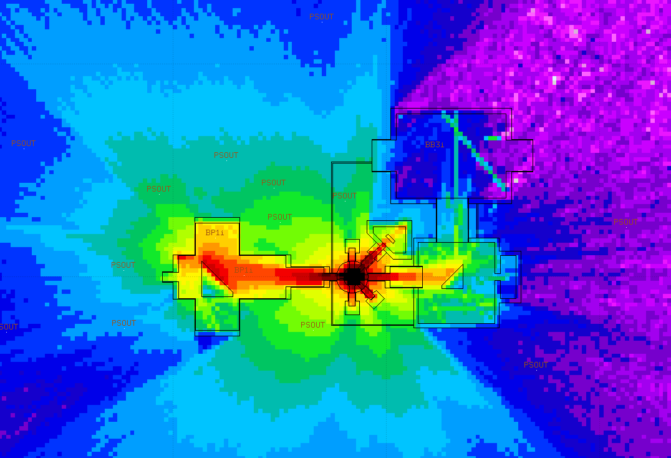
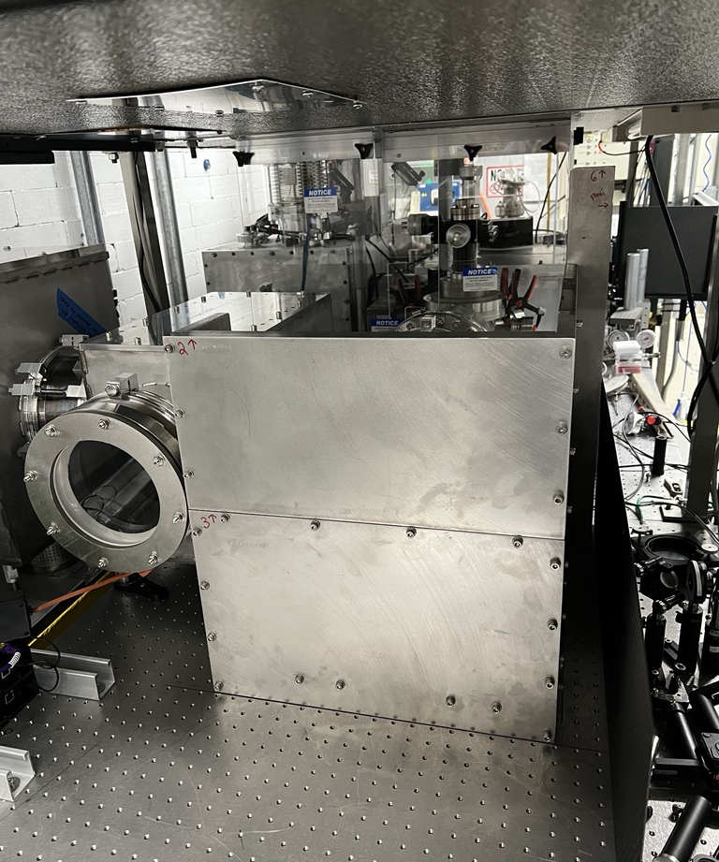
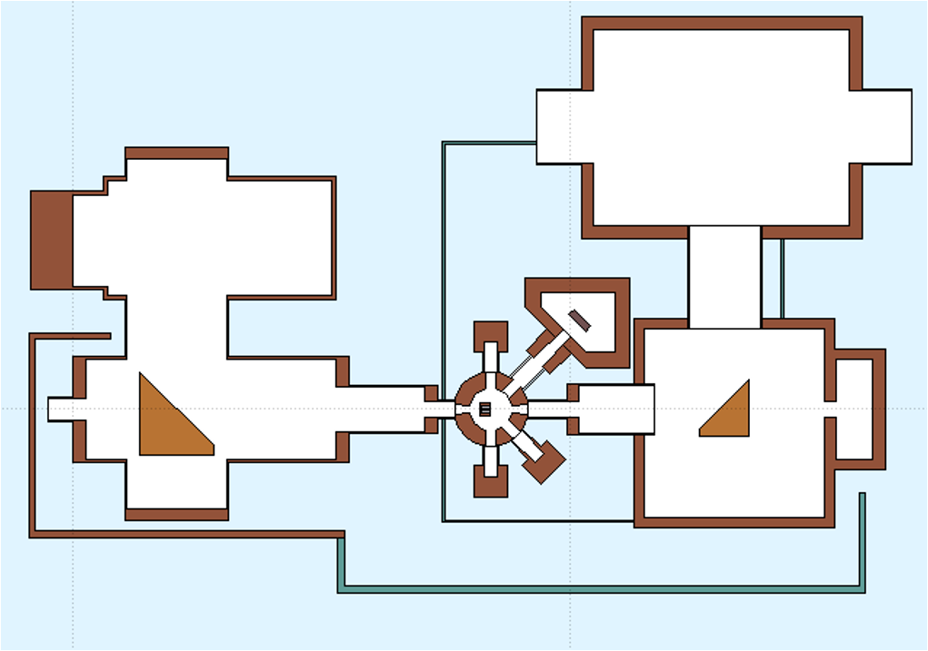
CO2 Shielding
Designed to protect against the radiation produced by increased power with maintenance in mind. The shielding was kept to manageable pieces for easy removal when required
Accelerator Facilities Division

Slide 13
B820 Facility Upgrades
CO2 Room
Blue steel wall separating CO2 and FEL rooms was removed ✓
New LED lighting throughout the CO2 room ✓
Cable tray system installed ✓
Bridge Crane installed to service water capacitor and CPA chamber ✓
Replace drop ceiling with clean room ceiling tiles ✓
YAG optical trombone and amplification & transport in CO2
Experimental Hall
BL#1 Electrical reconfiguration ✓
Better organization of power to the BL from panel in the EH ✓
Power strips removed and replaced with hard mounted wiremold ✓
Floor level utility crossover has been eliminated ✓
High Bay
Continued removal of abandoned Utilities to make room for cable tray upgrades
Moving Machine Shop. Previous location will become a dedicated utility room
New lighting installed in the West hallway, outside between the parking lots & entrances, and in the clean storage & large assembly area ✓
Accelerator Facilities Division

Slide 14
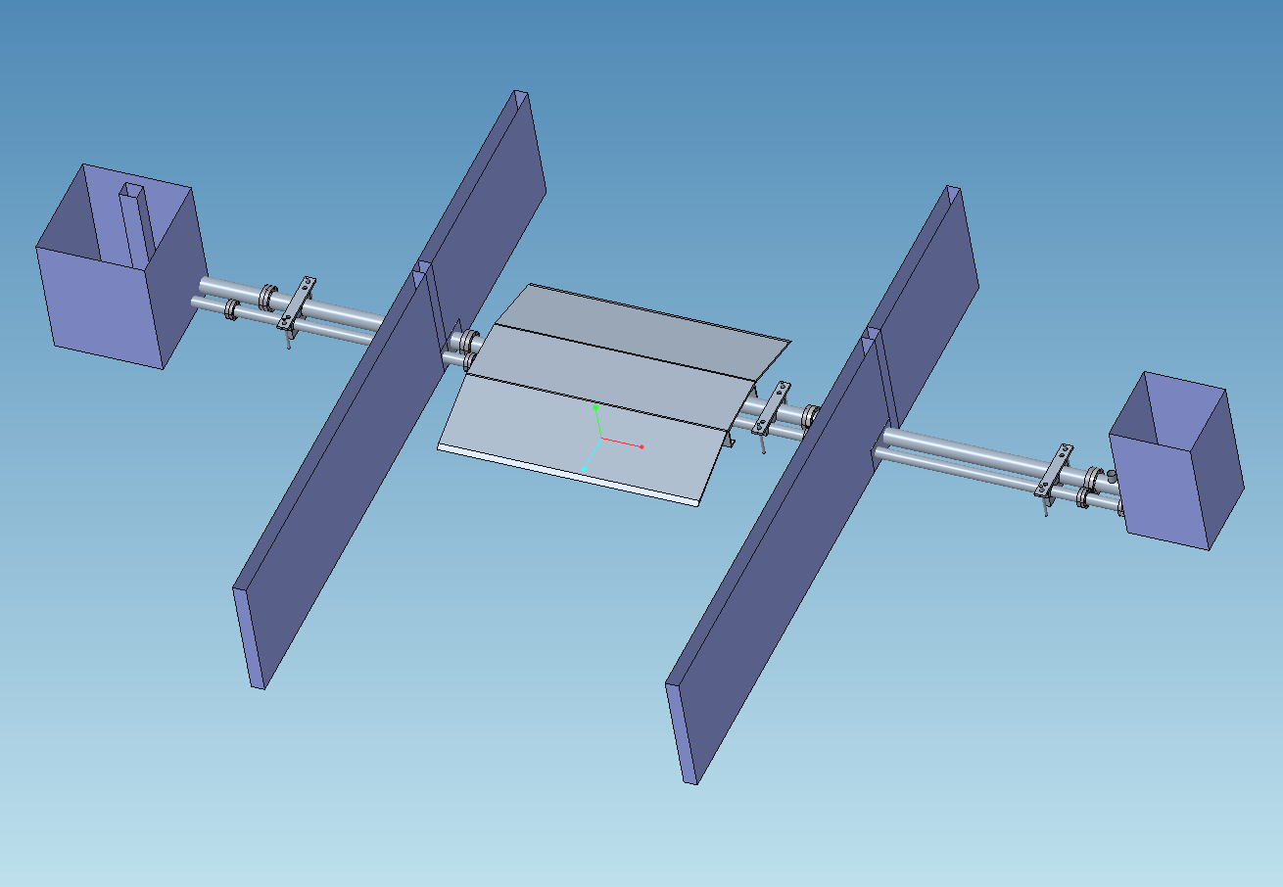
NIR Front End Upgrade
Vacuum transport upgrade between the Laser Lab and Gun Hutch
Separates the two crossing beams sharing one vacuum transport currently into their own parallel vacuum transport lines
Increases aperture to alleviate clipping issues allowing for higher power transmission
Accelerator Facilities Division

Slide 15
ATF Summary Next Steps
FY24-25
Major focus will shift to further improvements in Electron Beam Performance as strongly driven by user needs
LINAC RF system improvements
Pulse compression (to better match with combined e-beam/laser requests)
Short-pulse diagnostics
Continue facility-level corrective action plans (CAPs) as developed during ARR process
Example: Electrical Systems CAP will continue for multiple years
Facility Upgrade Proposal – a few identified thrusts
Path to <500 fs & >20 TW LWIR capabilities
Dedicated shielded research space to pursue laser-only particle source experiments
Further development of multi-beam research capabilities
Dedicated IPs
Improved multi-beam timing and synchronization
LWIR rep-rate path
User requirements to be further explored during upcoming Science Planning Meeting
Accelerator Facilities Division

Slide 16
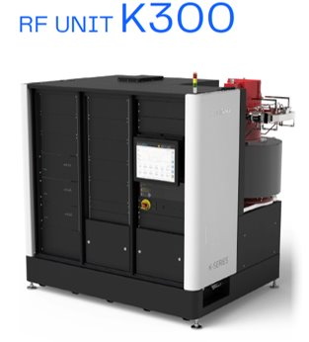
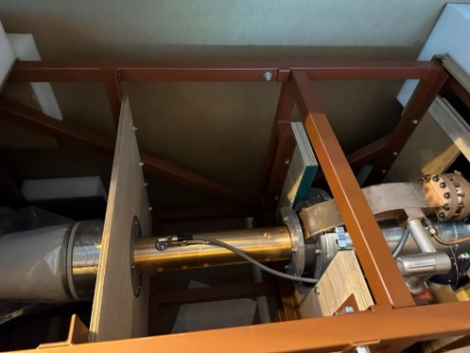
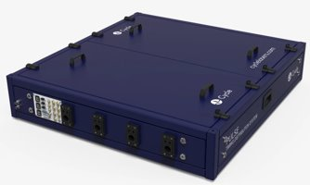
ATF LINAC Upgrades
The next three years will focus on replacement of aging LINAC hardware( XK-5 klystron, old-style modulators, and magnet systems) and timing systems to enable a true multi-beam operations with 10s of femtoseconds resolution
Toshiba E3730A, 50MW S-Band Klystron
Cycle- Femtosecond Class
Timing Distribution
Next Generation CAEN PS
System for ATF Magnets
Accelerator Facilities Division

Slide 17
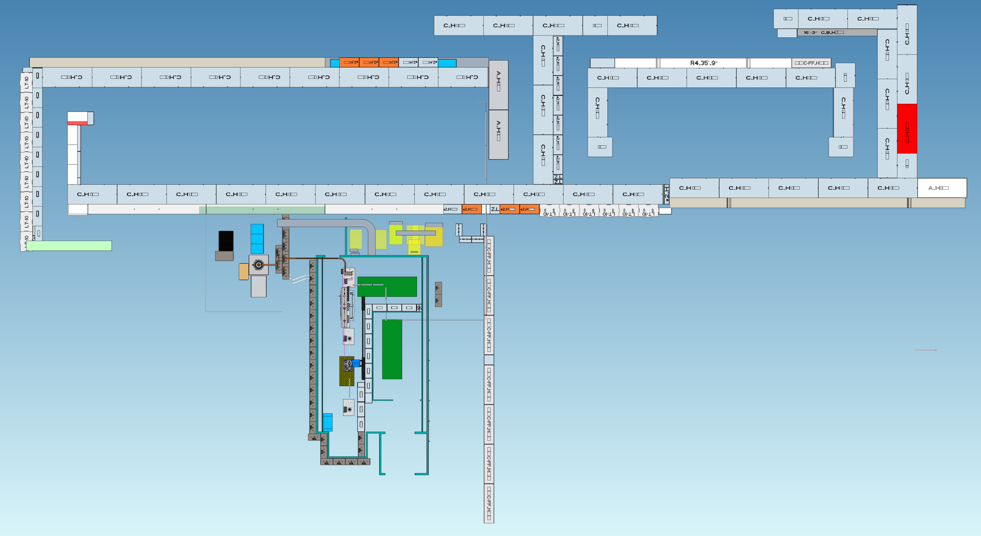
B912
The Lead Facility will include the UED and the AS&T bunkers 1 & 2. The bunkers are currently being outfitted
Accelerator Facilities Division

Slide 18
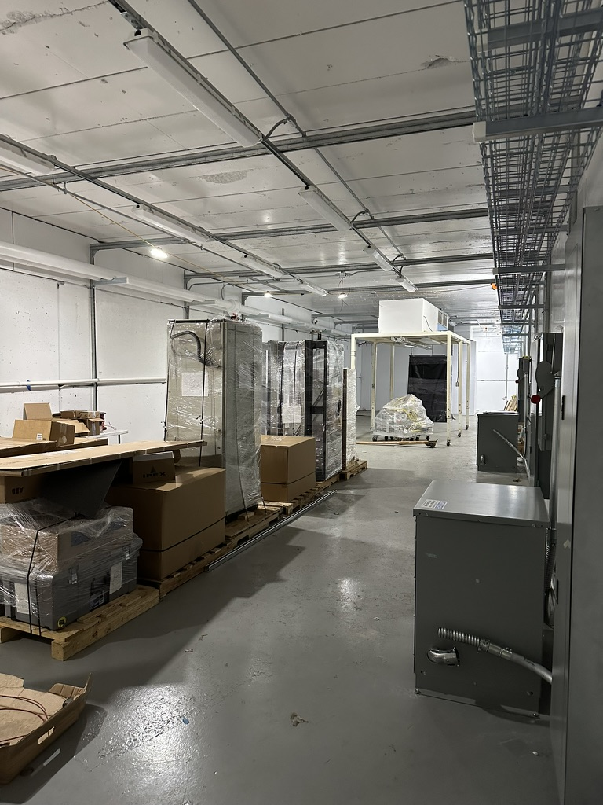
B912
The UED Facility​
Beamline updates now going into place for a NASA-JPL electron irradiator beamline for Single Event Effects (SEE) testing​
Expanded capability for UED/UEM testing​
Deployment of new highly stable solid-state modulator and klystron
AS&T Research Bunkers now being installed​ that will provide flexible research space
LEAD Research Bunker #1
LEAD Research Bunker #1
Accelerator Facilities Division

Slide 19
Questions?
Accelerator Facilities Division

