Slide 1
ATF ARR,
FY24-25 Running Plans, and Other News
Mark Palmer
March 26, 2024
ATRO – Accelerator Facilities Division

Slide 2
Overview of ARR History
2018 – Accelerator Safety Order Review at BNL
2019 – Corrective Action Plan Implemented
  Requires all BNL accelerator facilities that commissioned prior to the mid-1990s to complete current
  Primarily impacts facilities managed by the Collider-Accelerator Department
  (C-AD) in the Nuclear & Particle Physics (NPP) Directorate
2020 – ATF moves from NPP/C-AD to the new Advanced Technology Research Office (ATRO) and becomes part of the Accelerator Facilities Division (AFD)
  AFD becomes the new “owner” to prepare an updated Conduct of Operations Program, Safety Assessment Document (SAD) and Accelerator Safety Envelope (ASE) for future ATF Operations
2021 onwards – AFD has been preparing the ATF for its ARR
  Significant operational impacts:
    FY21 Delivered 2998 User Hours
    FY22 Delivered 1972 User Hours
    FY23 Delivered 2021 User Hours
    FY24 Expect to Deliver 2100 User Hours
    FY25 will still be impacted because at least one quarter of the year will be lost to ARR activities (2300 User Hours?)
  Complete re-evaluation of ATF shielding, radiation simulations, and facility state.
  Several 5-year Corrective Action Plans for facility hardware improvements will still be in progress in FY25
    Ongoing draw on resources
    Requires careful coordination with upgrade planning
2022-23 – Accelerator Safety Order 420.2D rollout
  Full implementation at BNL effective Fall 2023
  ATF documentation consistent with
2024 – ATF IRR/ARR
  Must complete ATF ARR review process by end of December 2024

Slide 3
FY24 Running Plans – Next Steps
As noted by Igor – as of last week, we have delivered about 60% of the planned user hours for FY24, but we have several experiments that requested CY2023 running time that are still to be provided time
  Significant backlog driven by the limited running hours during the ARR process
April 1 – July 19: Remaining FY24 Running
  We intend to trial a 6 day/week running schedule for roughly the last
  2 months of this running period
  A bump in ARDAP funding for ATF Operations supports a hiring campaign that is presently underway
Run conclusion on July 19 enables staff retraining and final preparations for our ARR process:
  IRR – tentatively scheduled for August 20-22, 2024 (required by 9/30/24)
  ARR – tentatively scheduled for October 15-17, 2024 (required by 12/20/24)
  We hope that authorization to operate will be in hand by January 2025
    Highly dependent on whether there are required pre-start actions

Slide 4
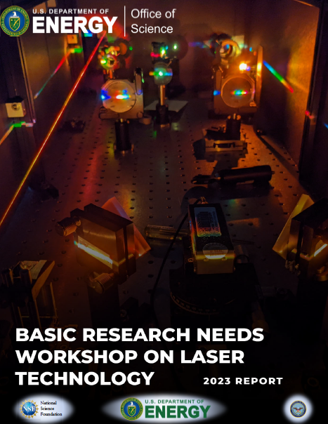
Focus of the Upcoming ATF Science Planning Workshop: June 20-21
  An in-person meeting to discuss priorities for the ongoing ATF program and an expanded mission footprint in response to the DOE BRN on Laser Technology
    PRD 2: Transform Mid-IR Sources for Science from THz to X-Rays
    Key Questions: Can we create the new laser technologies needed to meet the significant demands for high average and peak power mid-infrared (mid-IR) science, and for driving secondary sources with extreme spectral coverage? How do we overcome the current limitations in mid-IR laser intensity to take full advantage of wavelength-dependent scalings? What are the ideal wavelengths, platforms, and architectures for nonlinear conversion to generate transformative sources in hard-to-access spectral ranges?
  Discussion underway with DOE ARDAP for the ATF to develop a plan to support mid-IR (2-10 μm) Laser Science & Technology development
  ATF Pivot: BNL Program Development funded effort to develop a new proposal for the future of the ATF
    Collaborative opportunity with the SBU ECE Department!

Slide 5
FY25 Running Plans – Next Steps
FY25 will be a highly constrained running year under all scenarios
  Assuming no pre-start requirements from the ARR, the earliest user time would likely begin in February after a January startup of all capabilities
  We still have significant exposure to aging hardware
    We do plan to continue our remedial maintenance program throughout the IRR/ARR down period
    We plan to start executing a plan for major LINAC refurbishment
  A successful trial run of an expanded ATF weekly operations schedule will, we hope provide the ability to achieve a minimum of 2300 user hours in FY25
    Ultimately, we would like to aim for delivery of 3500 user hours/year when our remedial maintenance program is completed
  FY25 will be a preparatory year for an upgrade program for the LINAC systems that will execute in FY26-27.
    Current updates to staffing are, in part, targeted at enabling this effort.

Slide 6
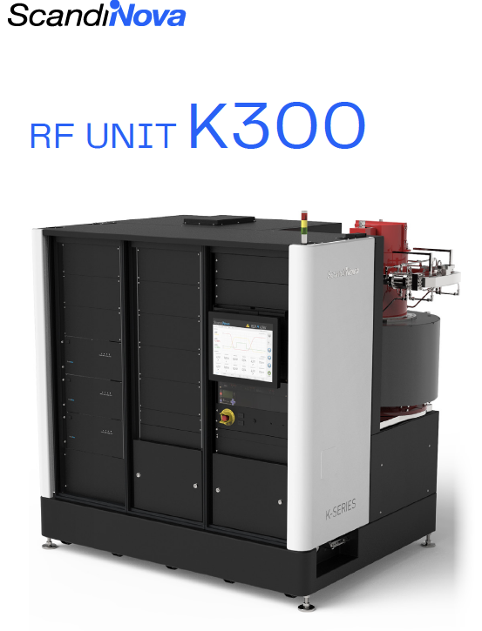
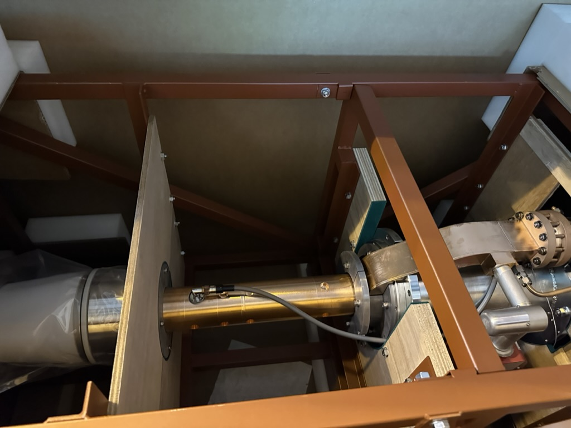
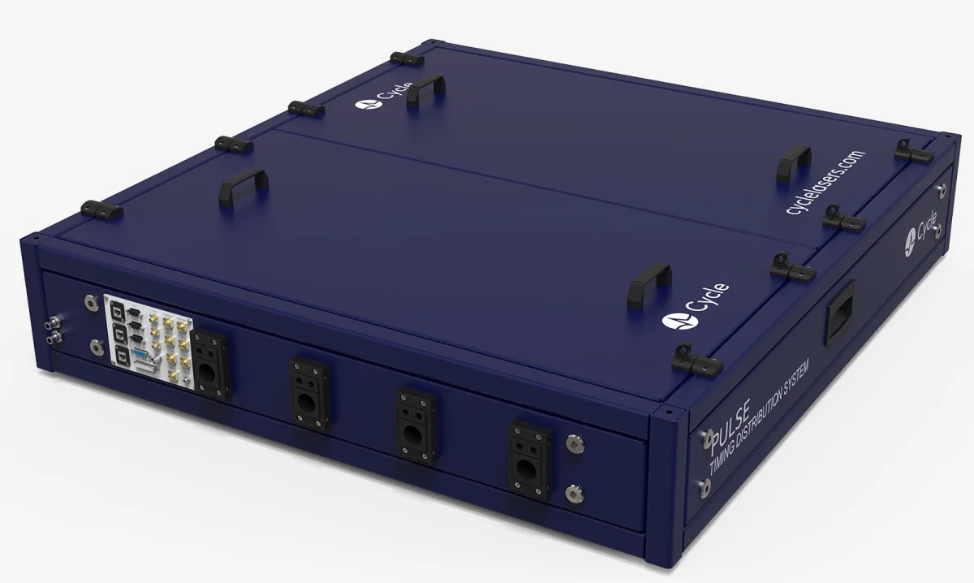
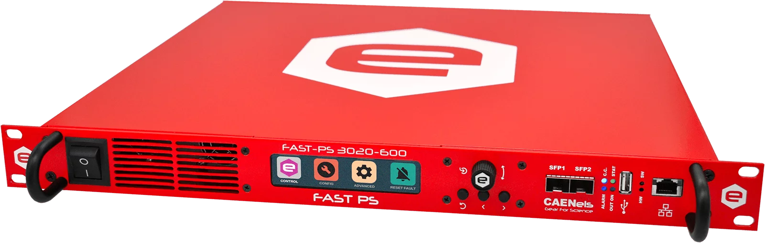
Plans for the ATF Operational Improvements
LINAC and Timing System
  To support next generation multi-beam experiments
  Updating the ATF LINAC
    Expect the next 3 years to focus on replacement of aging LINAC hardware (XK-5 klystrons, old-style modulators, magnet systems) and timing system with new and improved hardware to enable true multi-beam operations with 10s of femtoseconds resolution
Toshiba E3730A, 50MW S-band Klystrons
Cycle – Femtosecond Class
Timing Distribution
Next Generation CAEN PS
System for ATF Magnets

Slide 7
Other ATF Plans
  Support for a new ARDAP Initiative: BeamNetUS
  Chair: Navid Vafaei-Najafabadi
  First User Hours
  to be delivered in
  FY25
  FY26: Anticipate
  expanded access
  to the ATF and all
  LEAD capabilities

Slide 8
Other News
There are many developments in the field:
At BNL, the EIC effort is ramping up
For HEP, the P5 report supports new research efforts for future colliders
  Higgs Factory
  10 TeV pCM machine [proton-proton, muon collider, or possibly wakefield accelerator based]
BNL has new leadership
This drives evolution and change in our organization
  Effective April 1, I will be stepping down as ATF Director in conjunction with moving on from leading the ATRO Accelerator Facilities Division to chair the new Accelerator Science & Technology Department
    Igor Pogorelsky has kindly agreed to act as Interim ATF Director
    We will be conducting an international search for a new Accelerator Facilities Division Director who will also serve as ATF Director
    We are counting on all of you to recommend outstanding candidates for this role!

Slide 9
AS&T Department Organization Chart
Accelerator S&T Department (AS)
Mark Palmer, Chair
MJ Ilardi, Department Administrator
Deputy Chair Kathleen Amm
Deputy for Operations (Kristen Rubino) (A)
Deputy for Projects (Shresht Joshi) (A)
EIC Coordination (Bill Wahl)
Chief ME Andrew Simmonds
Chief EE Piyush Joshi
Effective April 1, 2024
Administrative Support
(MJ Ilardi) (GL)
Andrea Volk
Anna Shaftan
New Hire
Accelerator Facilities Division (AF)
(Mark Palmer) (I), Director*
(MJ Ilardi), Division Assistant
Karl Kusche, ESH Manager
ATF Director* Igor Pogorelsky (I)
LEAD Facility Manager TBD
Research & Development/BeamNetUS Navid Vafaei-Najafabadi (JA)
Facilities Operations & Research
LWIR Laser Systems Igor Pogorelsky
NIR Laser Systems Marcus Babzien
E-Beam Systems Mikhail Fedurin
Facilities Engineering & Technical Support (Andrew Simmonds)
Magnet Division (AM)
Michael Anerella (A), Director
(Andrea Volk), Division Assistant
Marteenio Samms, ESH Manager
Mechanical Engineering Jesse Schmalzle(I)
Electrical Systems (Piyush Joshi)(I)
Cryogenic Systems New Hire
Magnet Science & Technology Vikas Teotia
JA = Joint Appointment
I = Interim
A = Acting
() = Dual Role
* = Combined Role
Red = New Search
DRAFT

