Slide 1
Project ID:
AE93
Project Title:
Direct Measurements of Fields and Radiation in the Self-Modulated Plasma Wakefield Regime
Collaborators:
V.N. Litvinenko (PI), N. Vafaei-Najafabadi (PI), R. Samulyak (PI)
Research Scientists I. Petrushina, A. Jain, L. Diana Amorim,
Grad Students: A. Gaikwad, A. Cheng, P. Iapozzuto (MSI), P. Kumar, R. Patil (MA)
Undergrad Students: E. Trommer, B. Romasky, N. Manzella, M. Petrusky, I. Yousuf
Stony Brook University
Brookhaven National Laboratory
University of Texas at Austin
University of California Los Angeles
I. Pogorelsky (PI), M. Fedurin, M. Polyanskiy, M. Babzien, W. Li,
K. Kusche, I. Bromberg, M. Palmer
M. Downer (PI), R. Zgadzaj, Y. Cao, B. Dinh, J. Welch, Ganesh Tiwari
C. Joshi (PI), A. Farrell, M. Sinclair, C. Zhang, K. Miller, Y. Wu
Funding Source:: DOE HEP DE-SC0014043 (Received)
CORI @ NERSC under contract DE-AC02-05CH11231
SEAWULF @ Stony Brook University

Slide 2
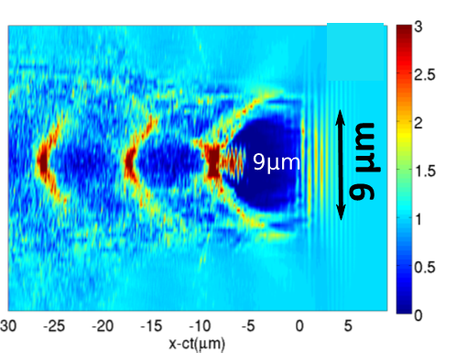
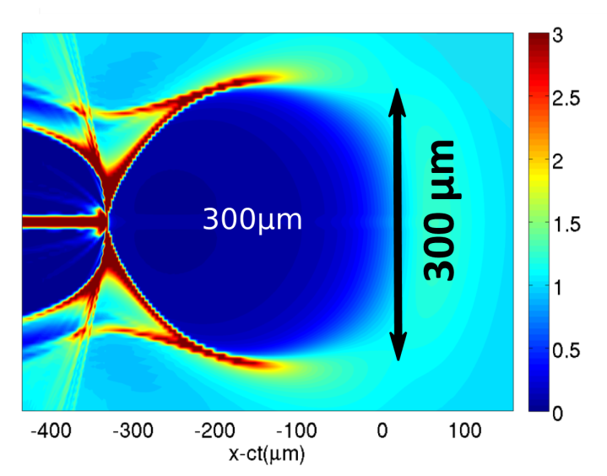
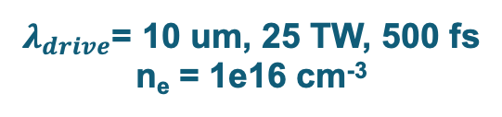
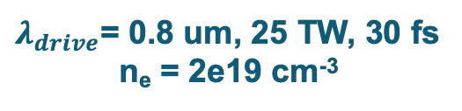
Motivation: what is available at ATF that we can use for LWFA?
CO₂ laser system: 2 ps pulses, up to 10 J energy, wavelength ~10.2 um
$λ_{drive}$= 0.8 um, 25 TW, 30 fs
n_{e} = 2e19 cm⁻³
$λ_{drive}$= 10 um, 25 TW, 500 fs
n_{e} = 1e16 cm⁻³
Courtesy of Gennady Shvets
Courtesy of Gennady Shvets
Precise and controllable external injection!
Diagnostic tools are needed to characterize the fields inside such structures and to improve the means of external injection.
How is LWFA diagnostic usually done?
Use optical methods—lasers.
These methods rely on the index of refraction of plasma.
Optical methods have been extensively studied and have successfully demonstrated the ability to capture shadowgraphs of the plasma wakes.
BUT: difficult at low plasma densities.

Slide 3
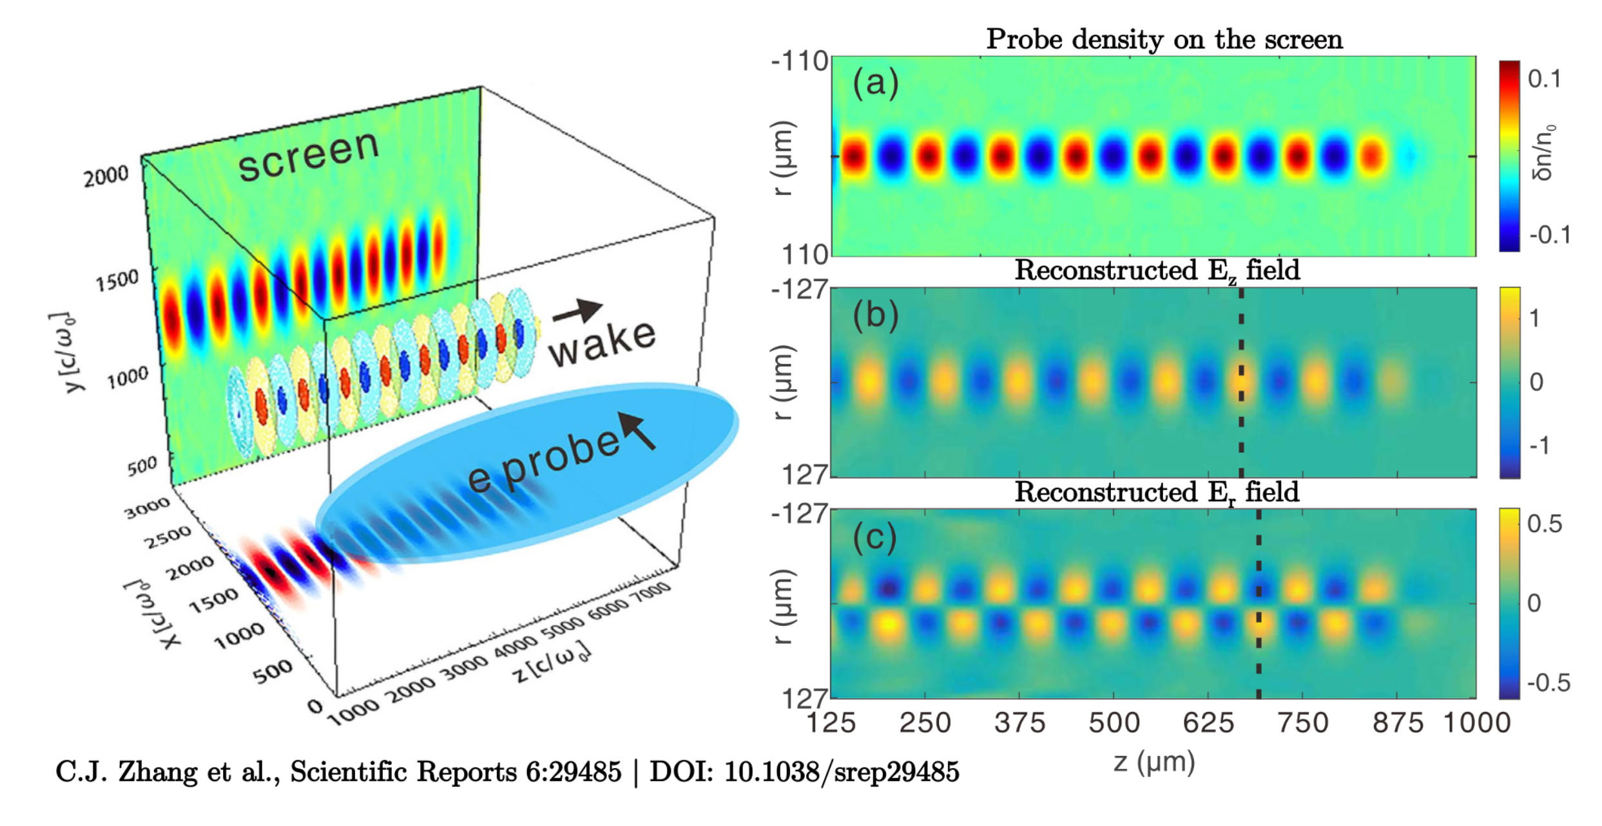
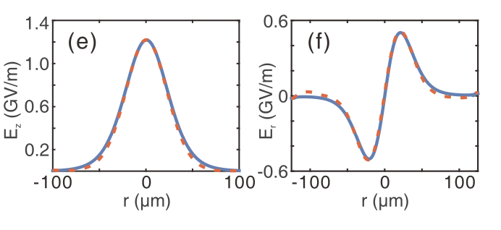
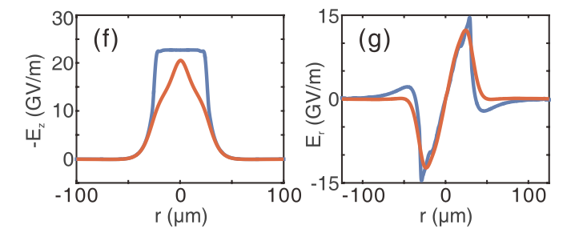
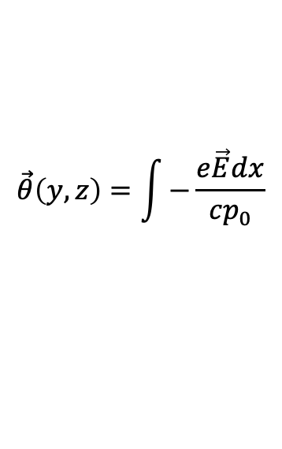
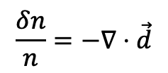

Fluid-based formalism for electron probing of fields in LWFA developed in 2018
Linear Wake Reconstruction
Nonlinear Wake Reconstruction
$$\vec{θ}\left(y,z\right)=\int{−\frac{e\vec{E}dx}{cp_{0}}}$$
$$\frac{δn}{n}=−∇⋅\vec{d}$$
$$\vec{d}=\vec{θ}L$$
Fluid theory reconstruction works well in the linear regime, but not very well in the nonlinear regime

Slide 4
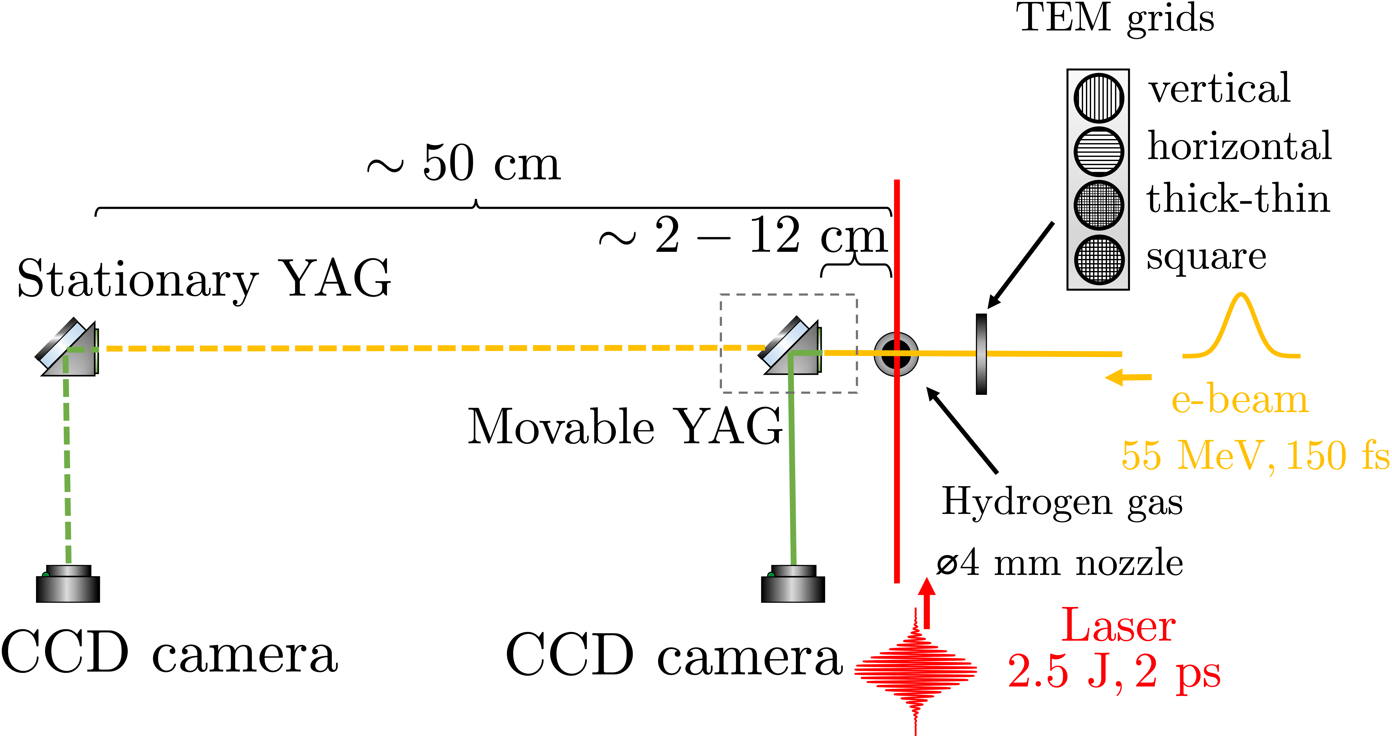
Experimental Overview: Initial Static Imaging
2022
2019

Slide 5
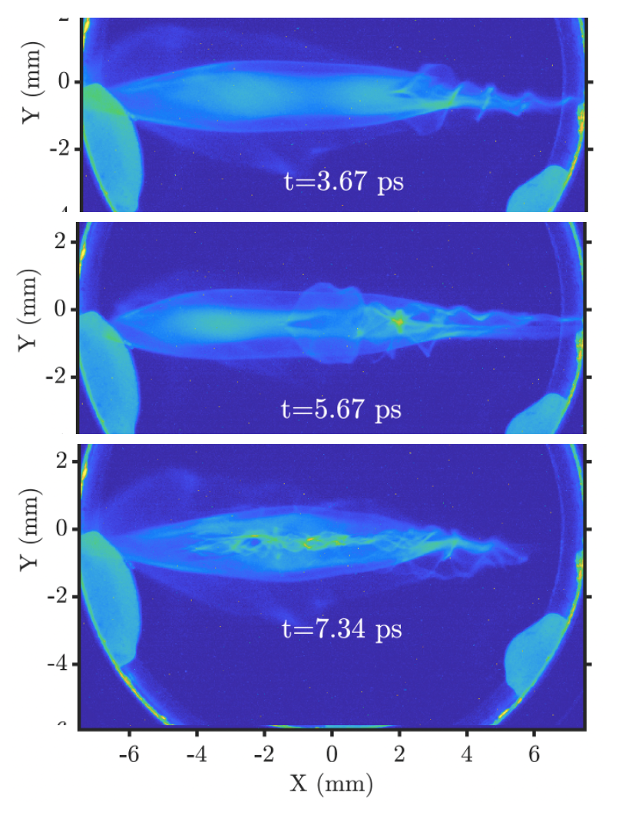


First results at ATF observed in 2019
Observed ps evolution of plasma structures at low density ($\sim 1×{10}^{15}$ cm⁻³) and “high density” ($\sim 1×{10}^{17}$ cm⁻³)
$n_{e}\sim 1×{10}^{15}$ cm⁻³
$n_{e}\sim 1×{10}^{17}$ cm⁻³
Y (mm)

Slide 6
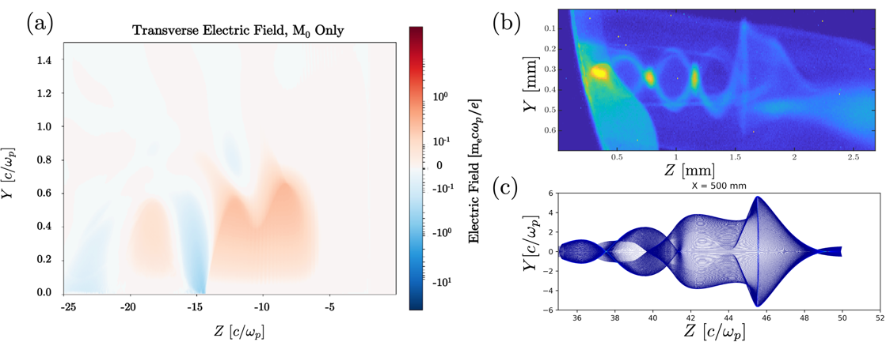
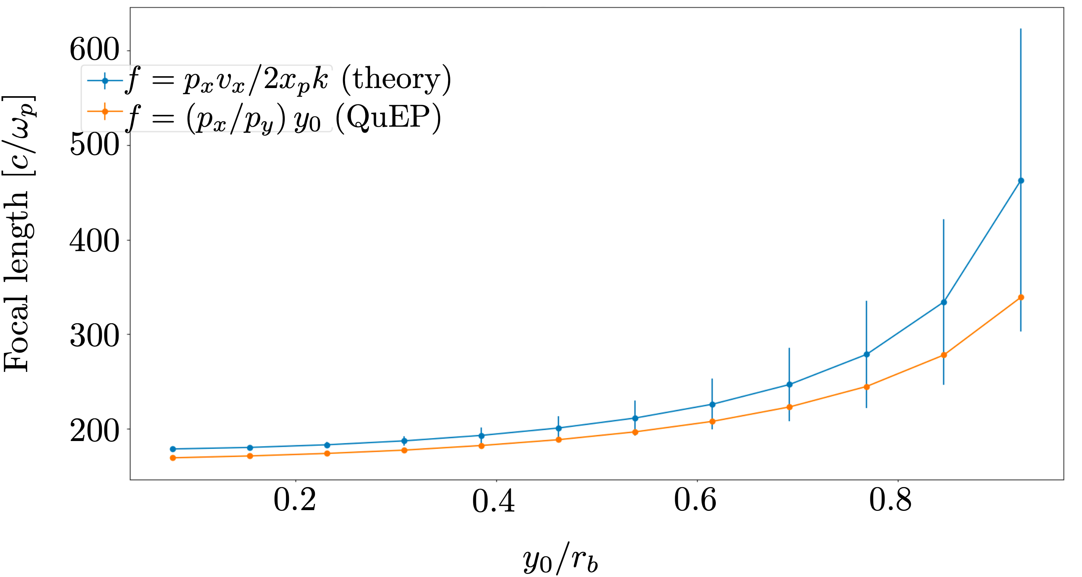
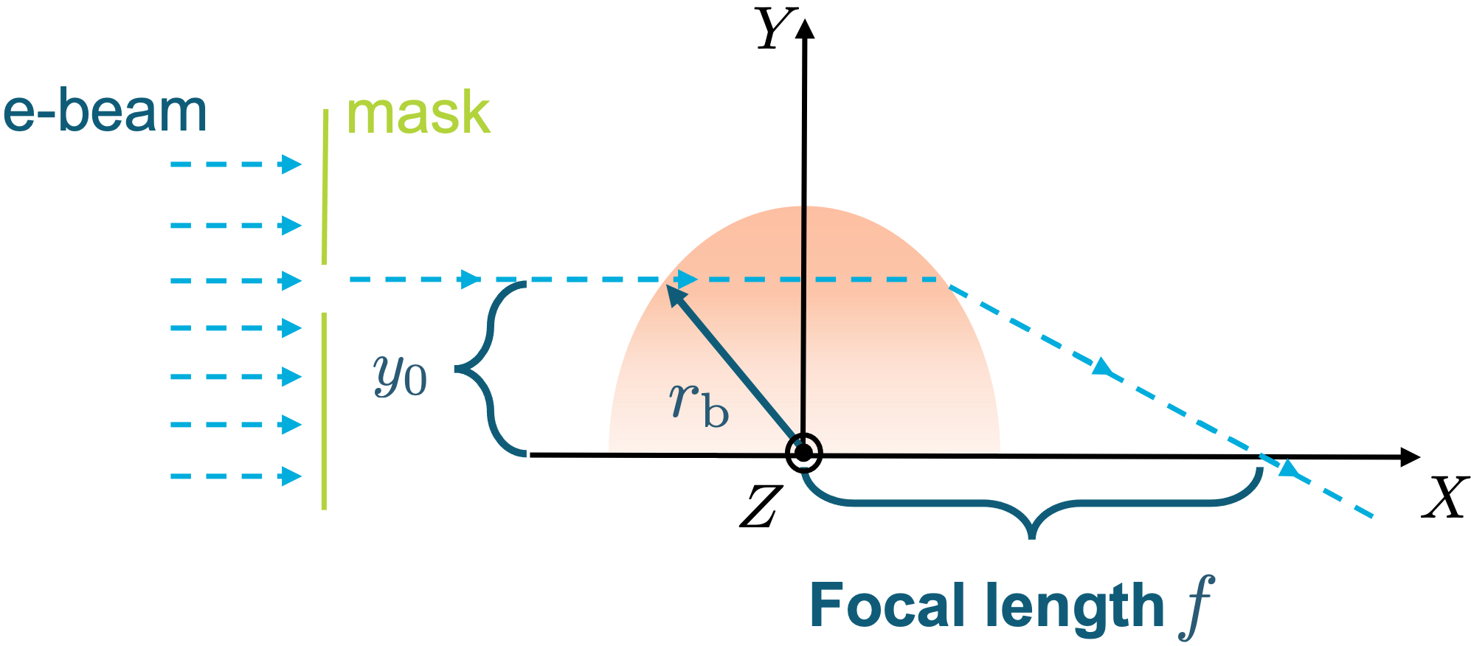
Developed Theoretical Model and Simulation Tools
Linear focusing force in a bubble: (wakefield theory suggests )
, where
Focal length
Depth of field
If we can measure the focal length, we can characterize the field inside the bubble.

Slide 7
Implemented Movable BPM to Discern Individual Tracks
2022
2019
2021

Slide 8

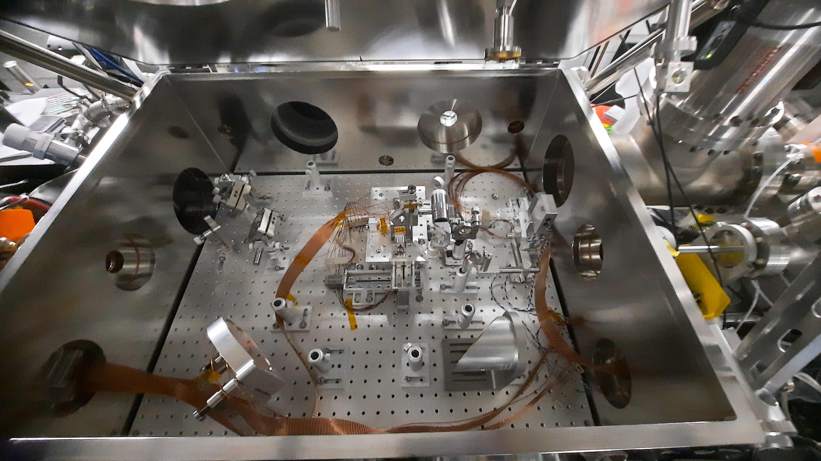
Experimental overview: LWFA chamber setup
nozzle
CO₂ in
CO₂ out
TEM grids assembly
e-beam in

Slide 9
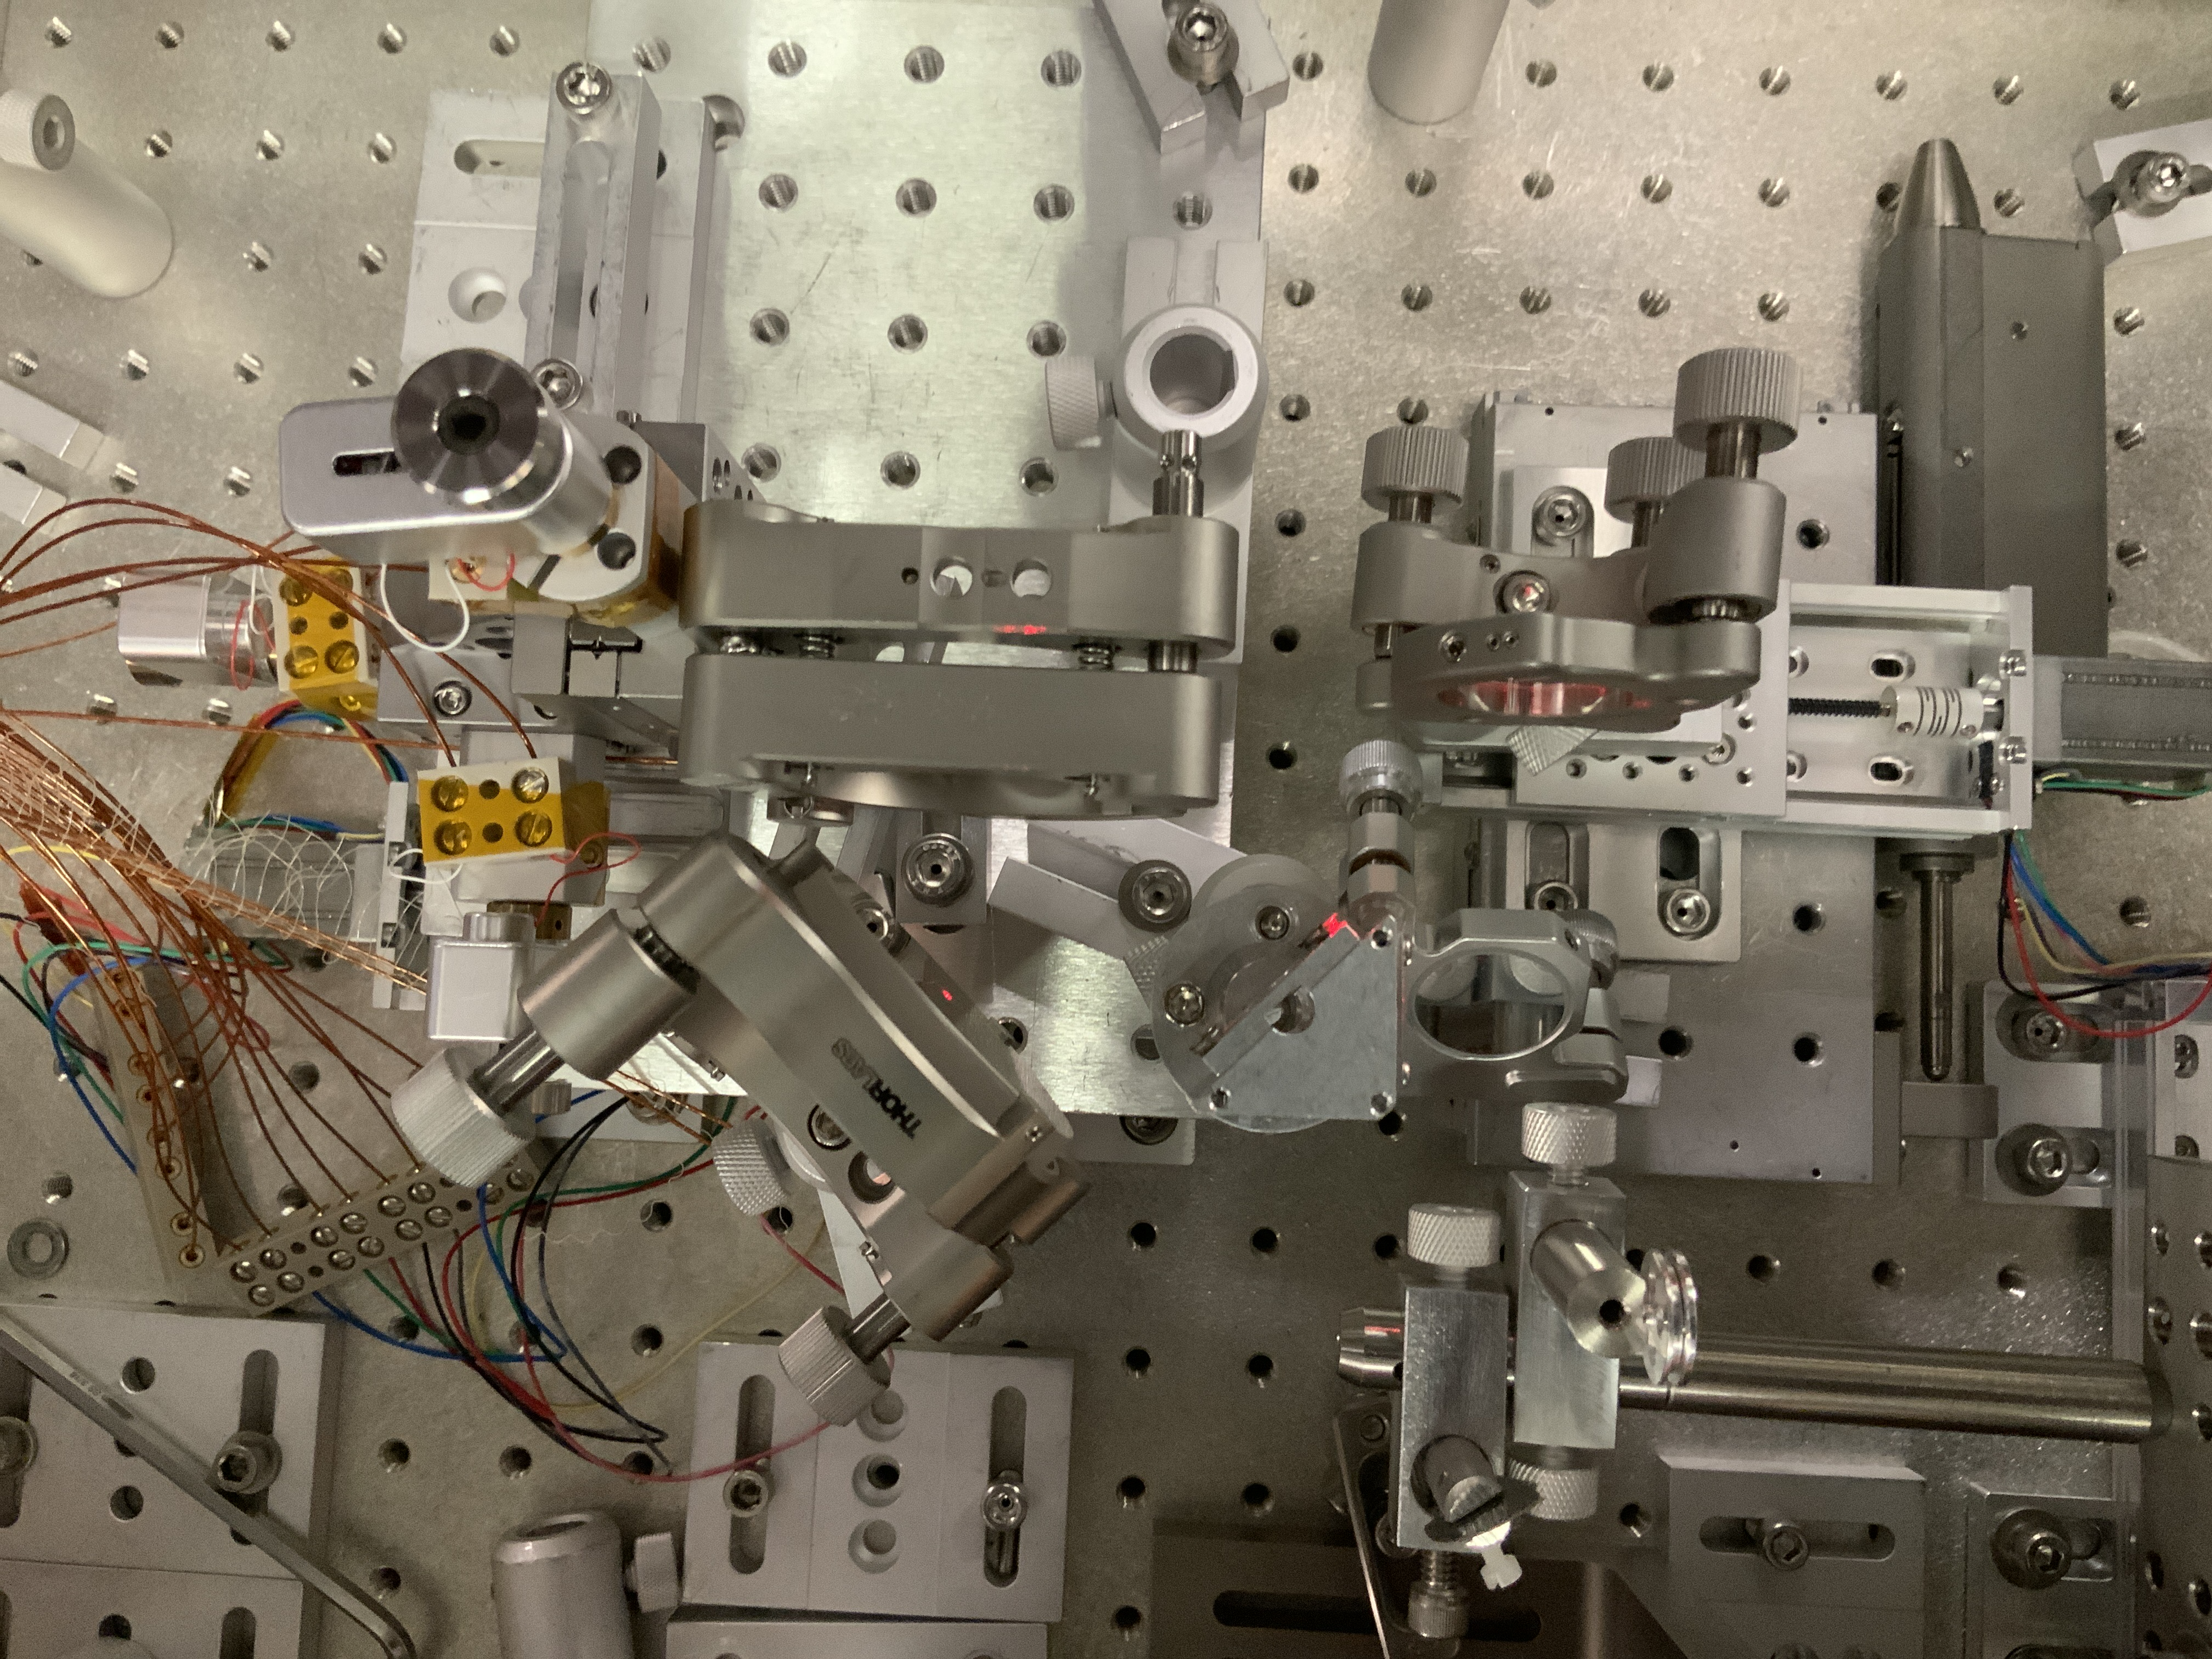
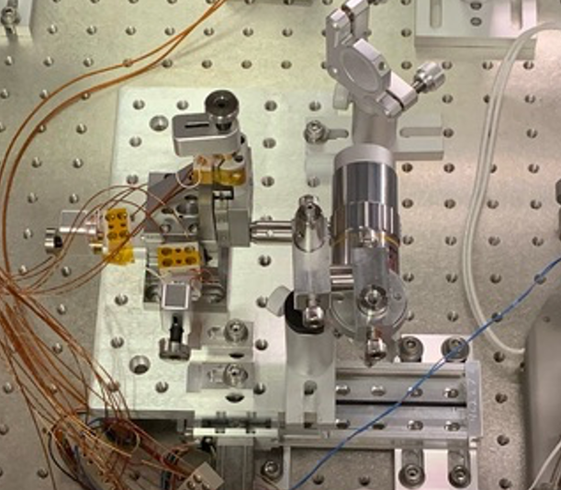
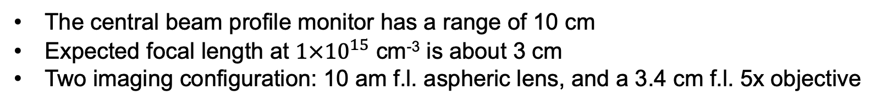
Experimental overview: Movable BPM
e-beam
The central beam profile monitor has a range of 10 cm
Expected focal length at $1×{10}^{15}$ cm⁻³ is about 3 cm
Two imaging configuration: 10 am f.l. aspheric lens, and a 3.4 cm f.l. 5x objective

Slide 10
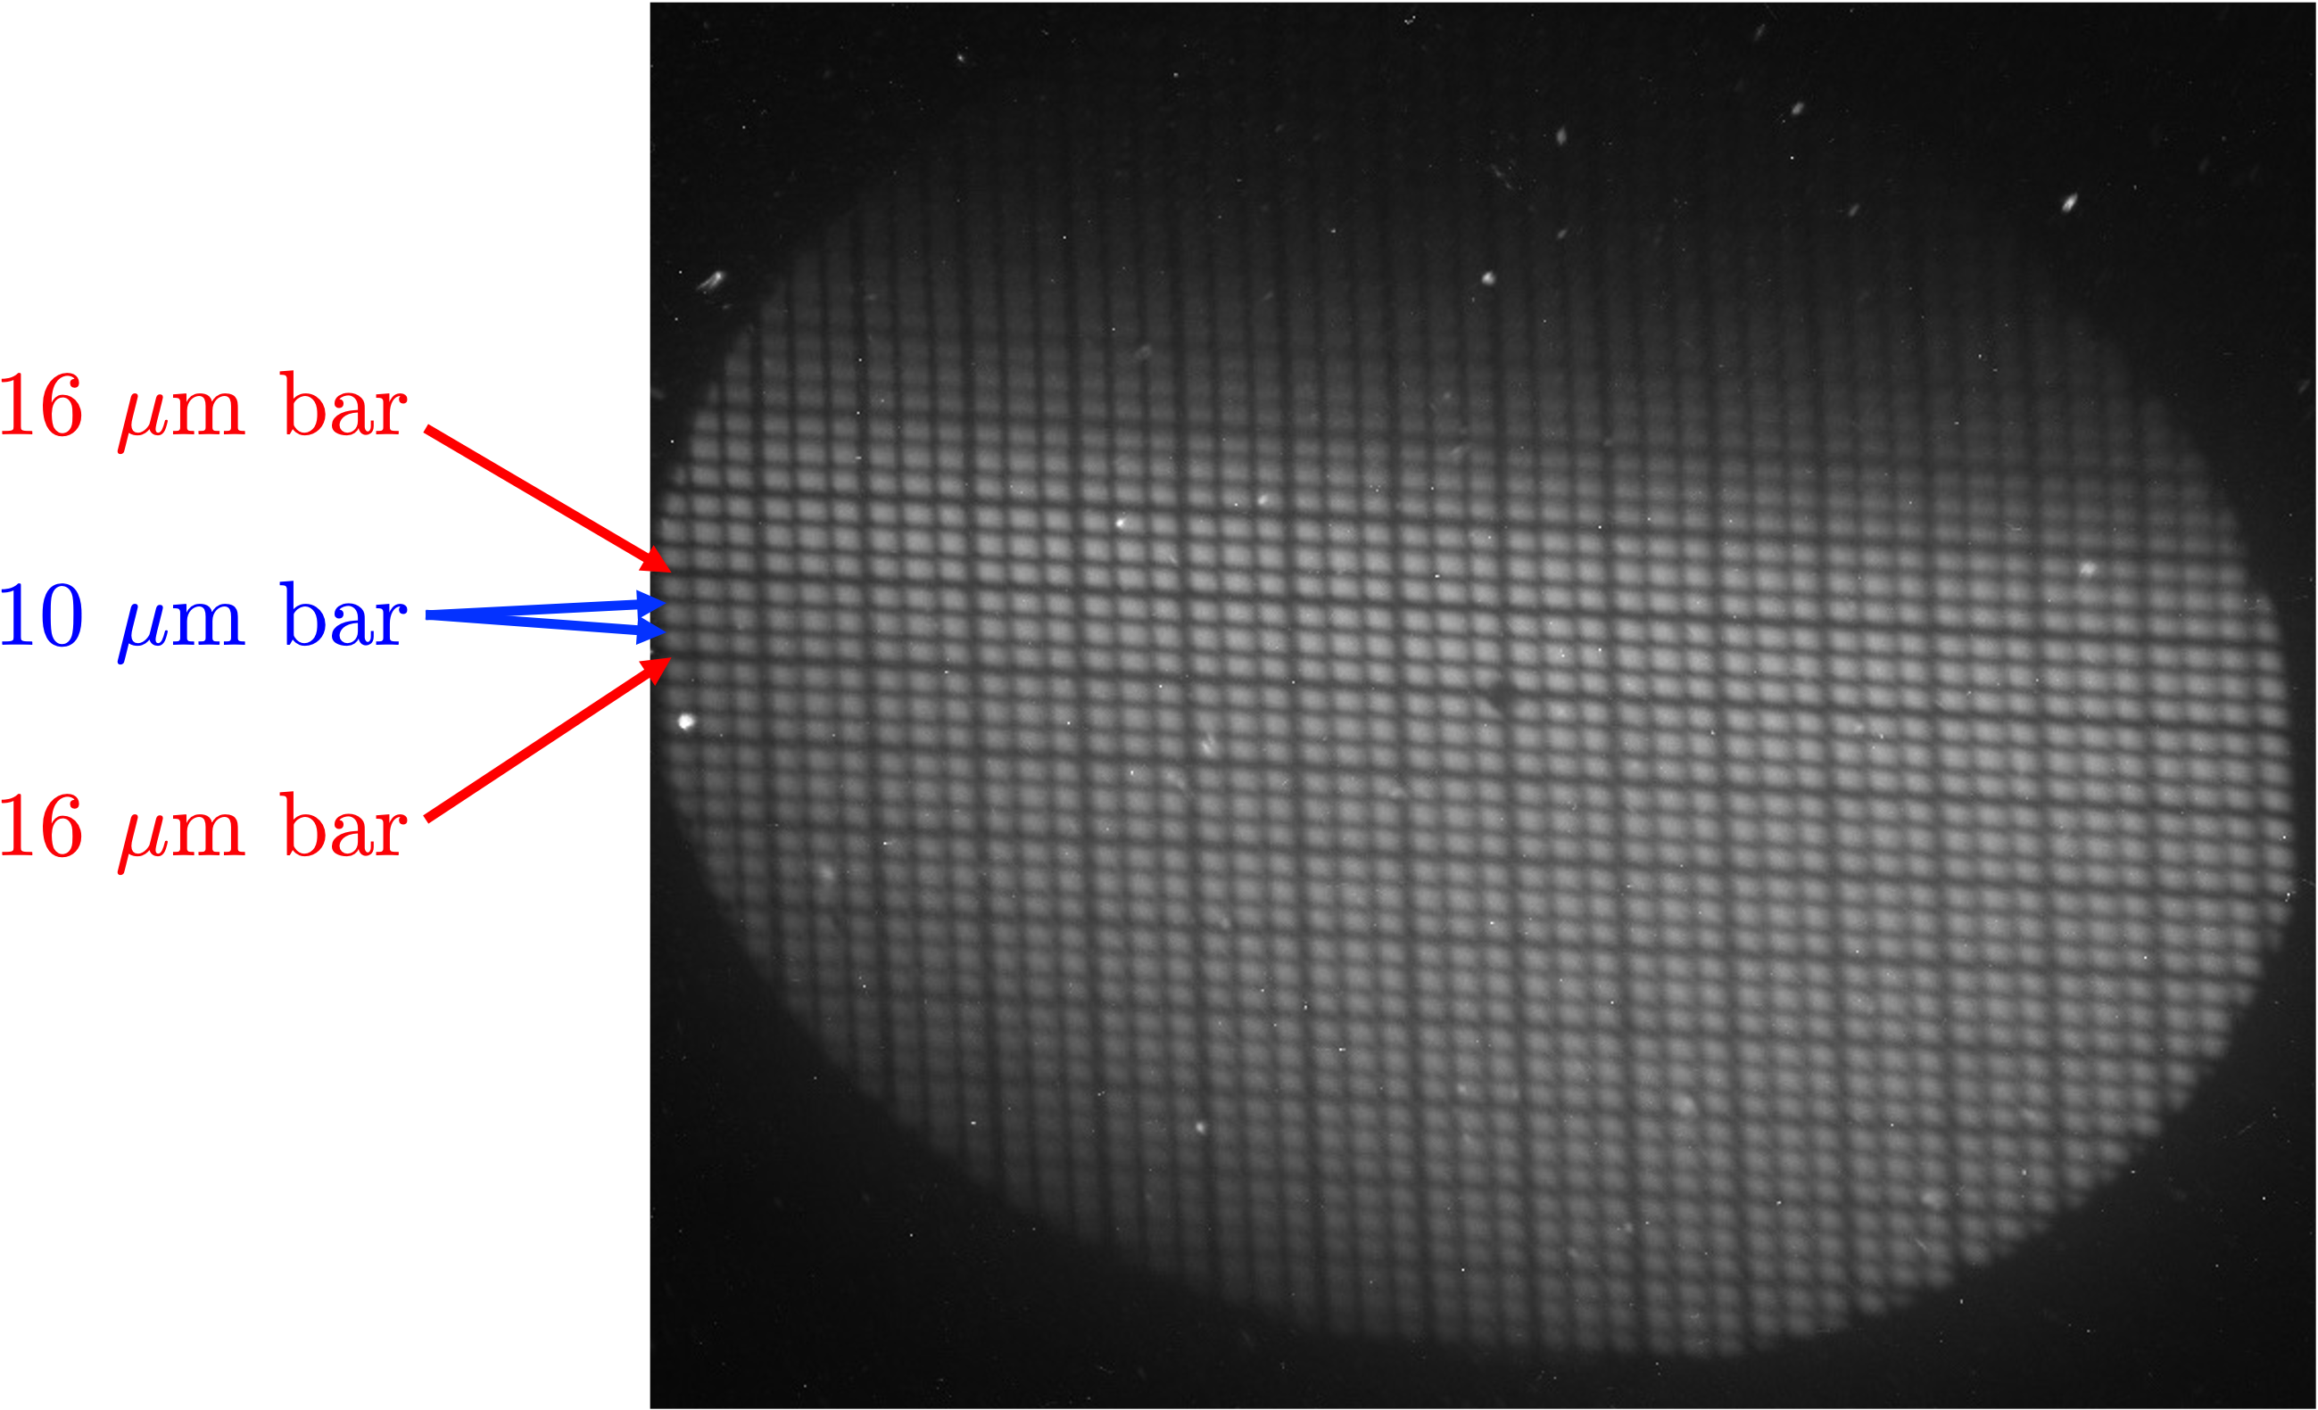
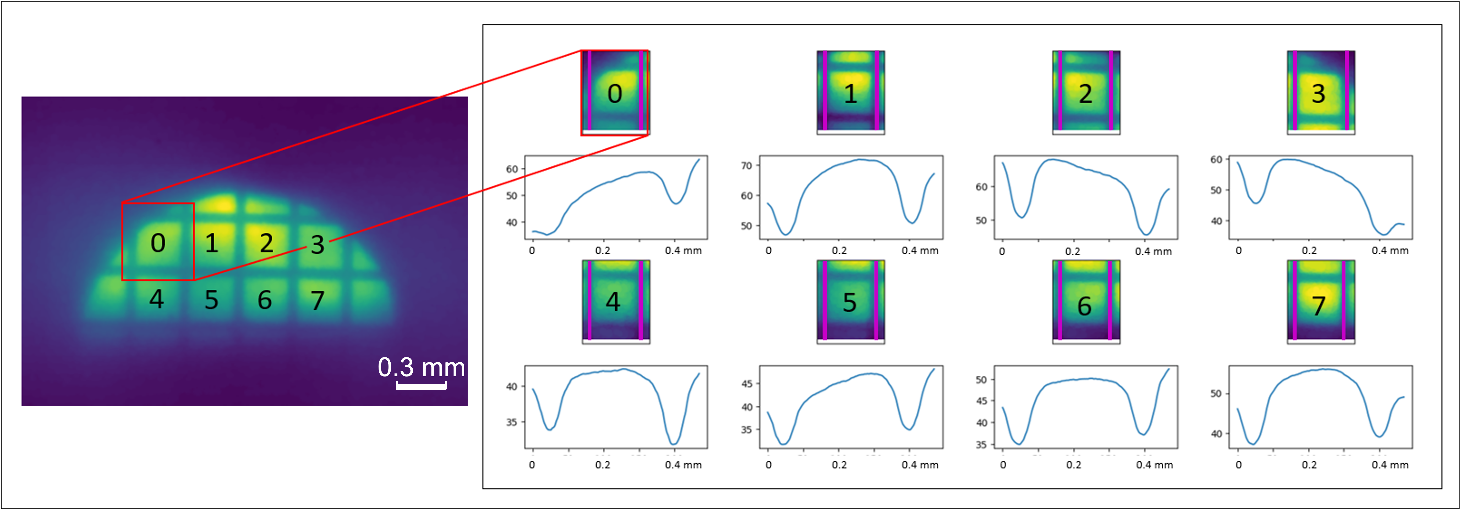
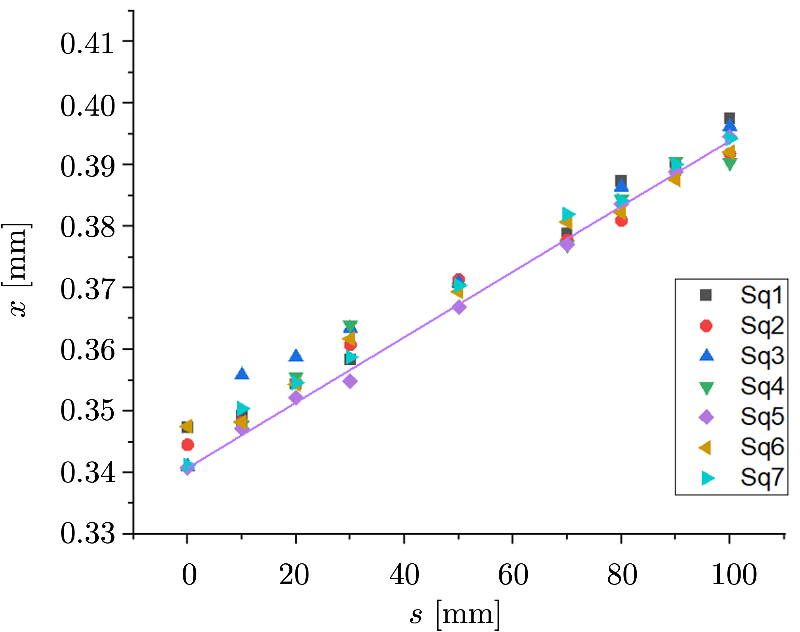
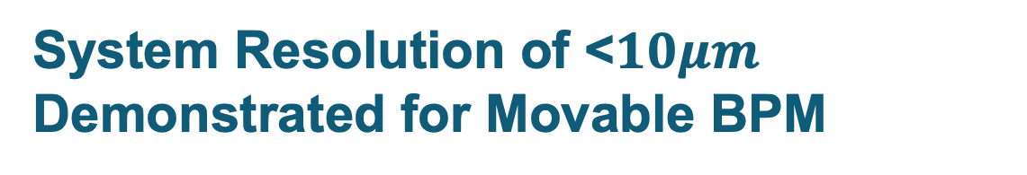
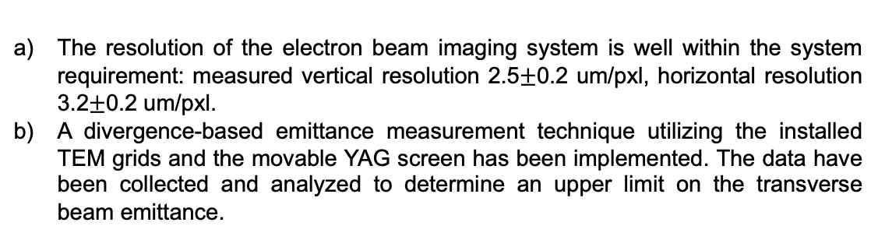
System Resolution of <$10μm$ Demonstrated for Movable BPM
The resolution of the electron beam imaging system is well within the system requirement: measured vertical resolution 2.5$±$0.2 um/pxl, horizontal resolution 3.2$±$0.2 um/pxl.
A divergence-based emittance measurement technique utilizing the installed TEM grids and the movable YAG screen has been implemented. The data have been collected and analyzed to determine an upper limit on the transverse beam emittance.
Shadow of the TEM grid (square thick/thin 30um opening/16-10-10um bars) obtained using an improved e-beam imaging system.
Divergence-based emittance estimate: (a) Electron beam image with a coarse grid inserted. The respective grid squares are labeled, and the profile of each square is obtained at various locations of the YAG screen. (b) Average square width vs. imaging plane location for each grid square; linear fit with least error is shown in purple.

Slide 11
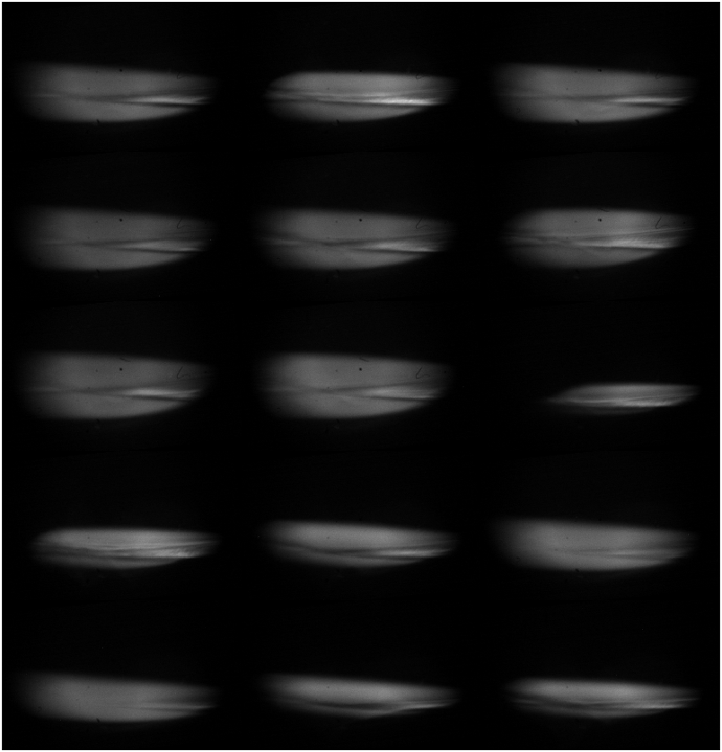
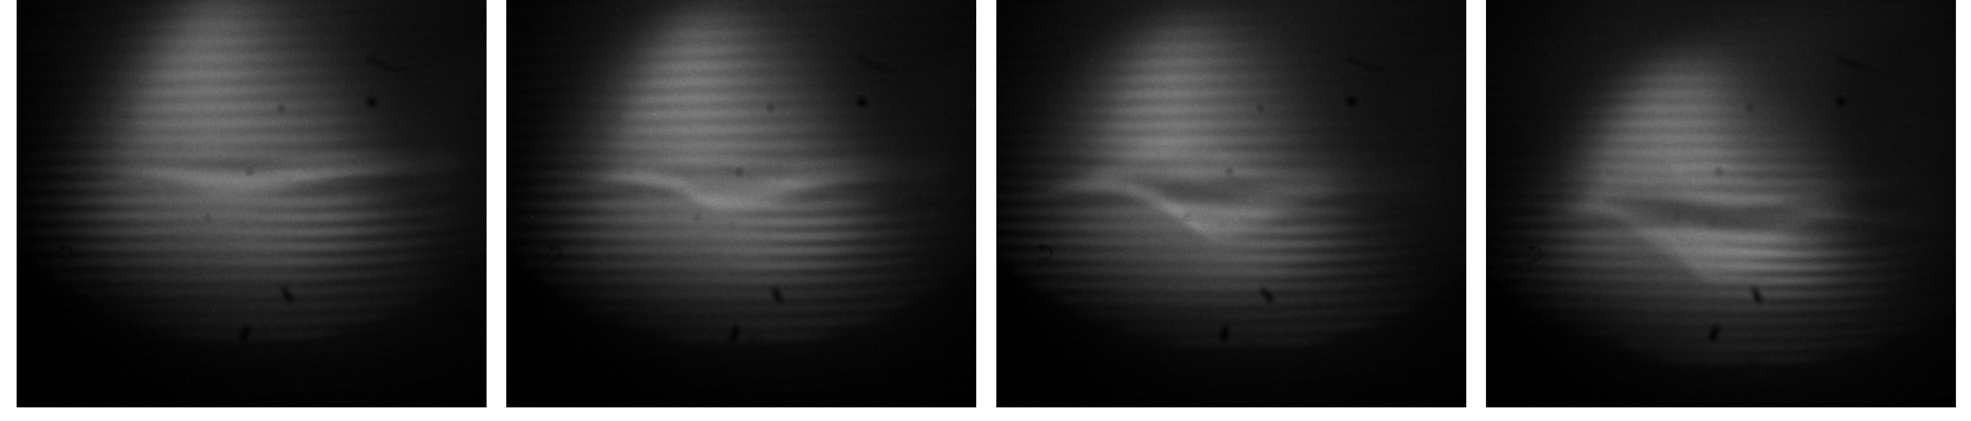
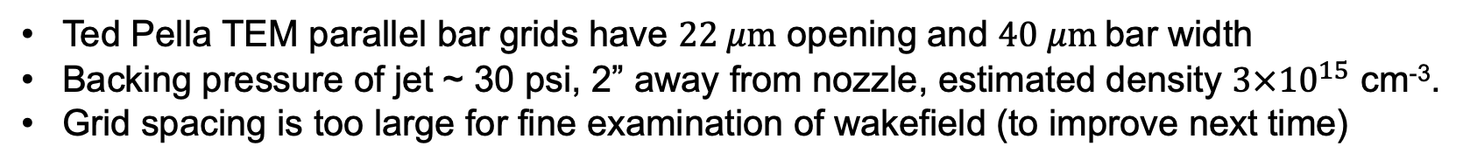
Measurement of Focal Length Using Movable BPMs
Two sets of data have been collected to confirm the proposed method of characterizing the radial field in the wake at very low densities (<10¹⁵ cm⁻³).
#93: E = 3.55 J ; x = 3.16 cm
#89: E = 4.01 J; x = 4.16 cm
#85: E = 4.56 J; x = 5.16 cm
#98: E = 4.82 J ; x = 6.16 cm
#211: E_{L} = 2.8 J, x = 4.66 cm
#204: E_{L} = 2.8 J, x = 6.66 cm
#220: E_{L} = 3.1 J, x = 2.66 cm
#216: E_{L} = 2.3 J, x = 3.66 cm
Ted Pella TEM parallel bar grids have $22 μm$ opening and $40 μm$bar width
Backing pressure of jet ~ 30 psi, 2” away from nozzle, estimated density $3×{10}^{15}$ cm⁻³.
Grid spacing is too large for fine examination of wakefield (to improve next time)

Slide 12
Identifying Fringe Shifts

Slide 13
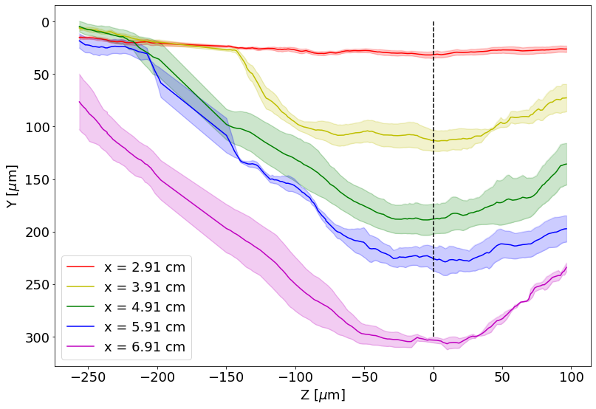
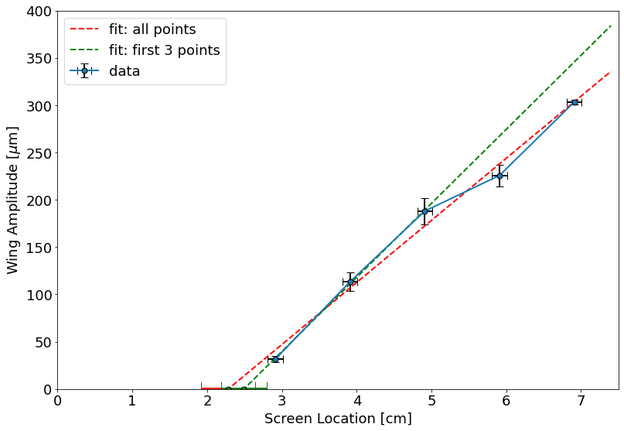
Extraction of Focal Length

Slide 14
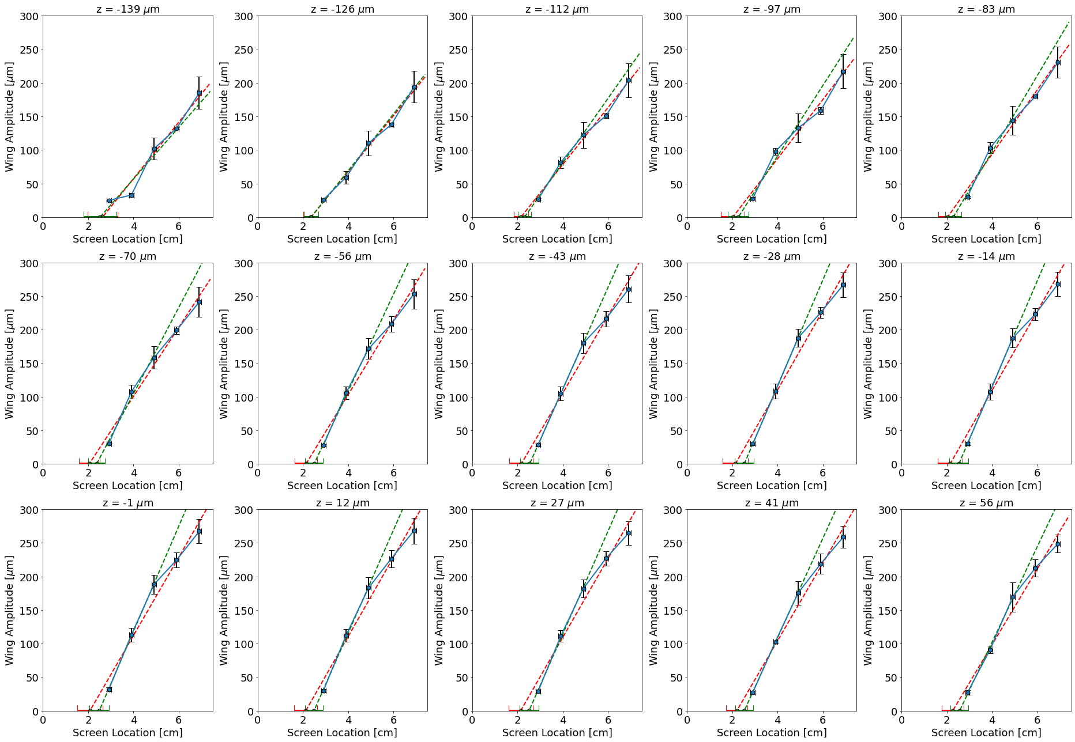
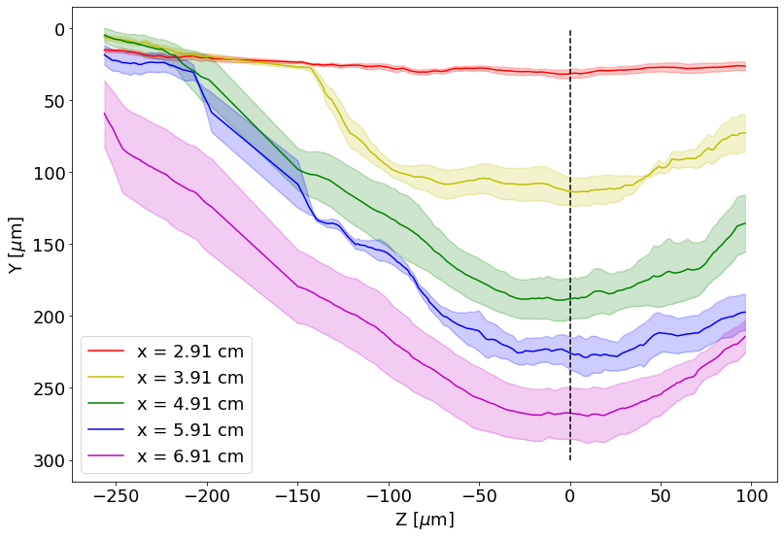
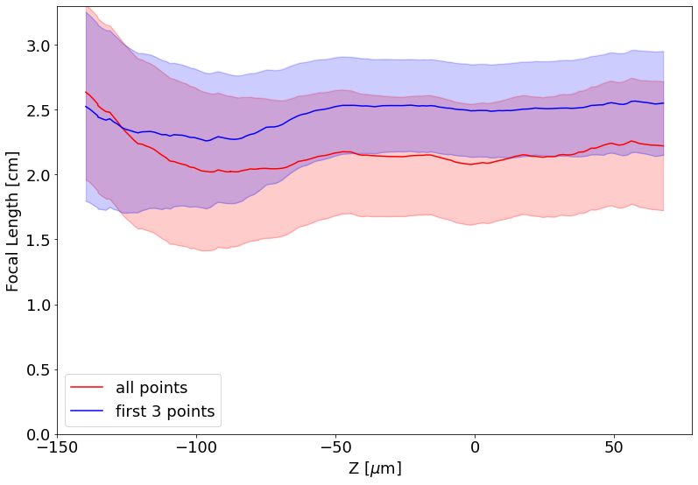

Slide 15
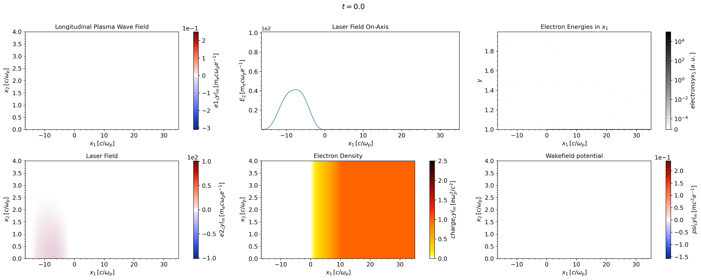
Comparison With Quasi-3D OSIRIS Simulations
4 J, 2 ps laser pulse, in $n_{e}\sim 3×{10}^{15}$ cm⁻³ with 1 mm ramp
Courtesy of Kyle Miller

Slide 16
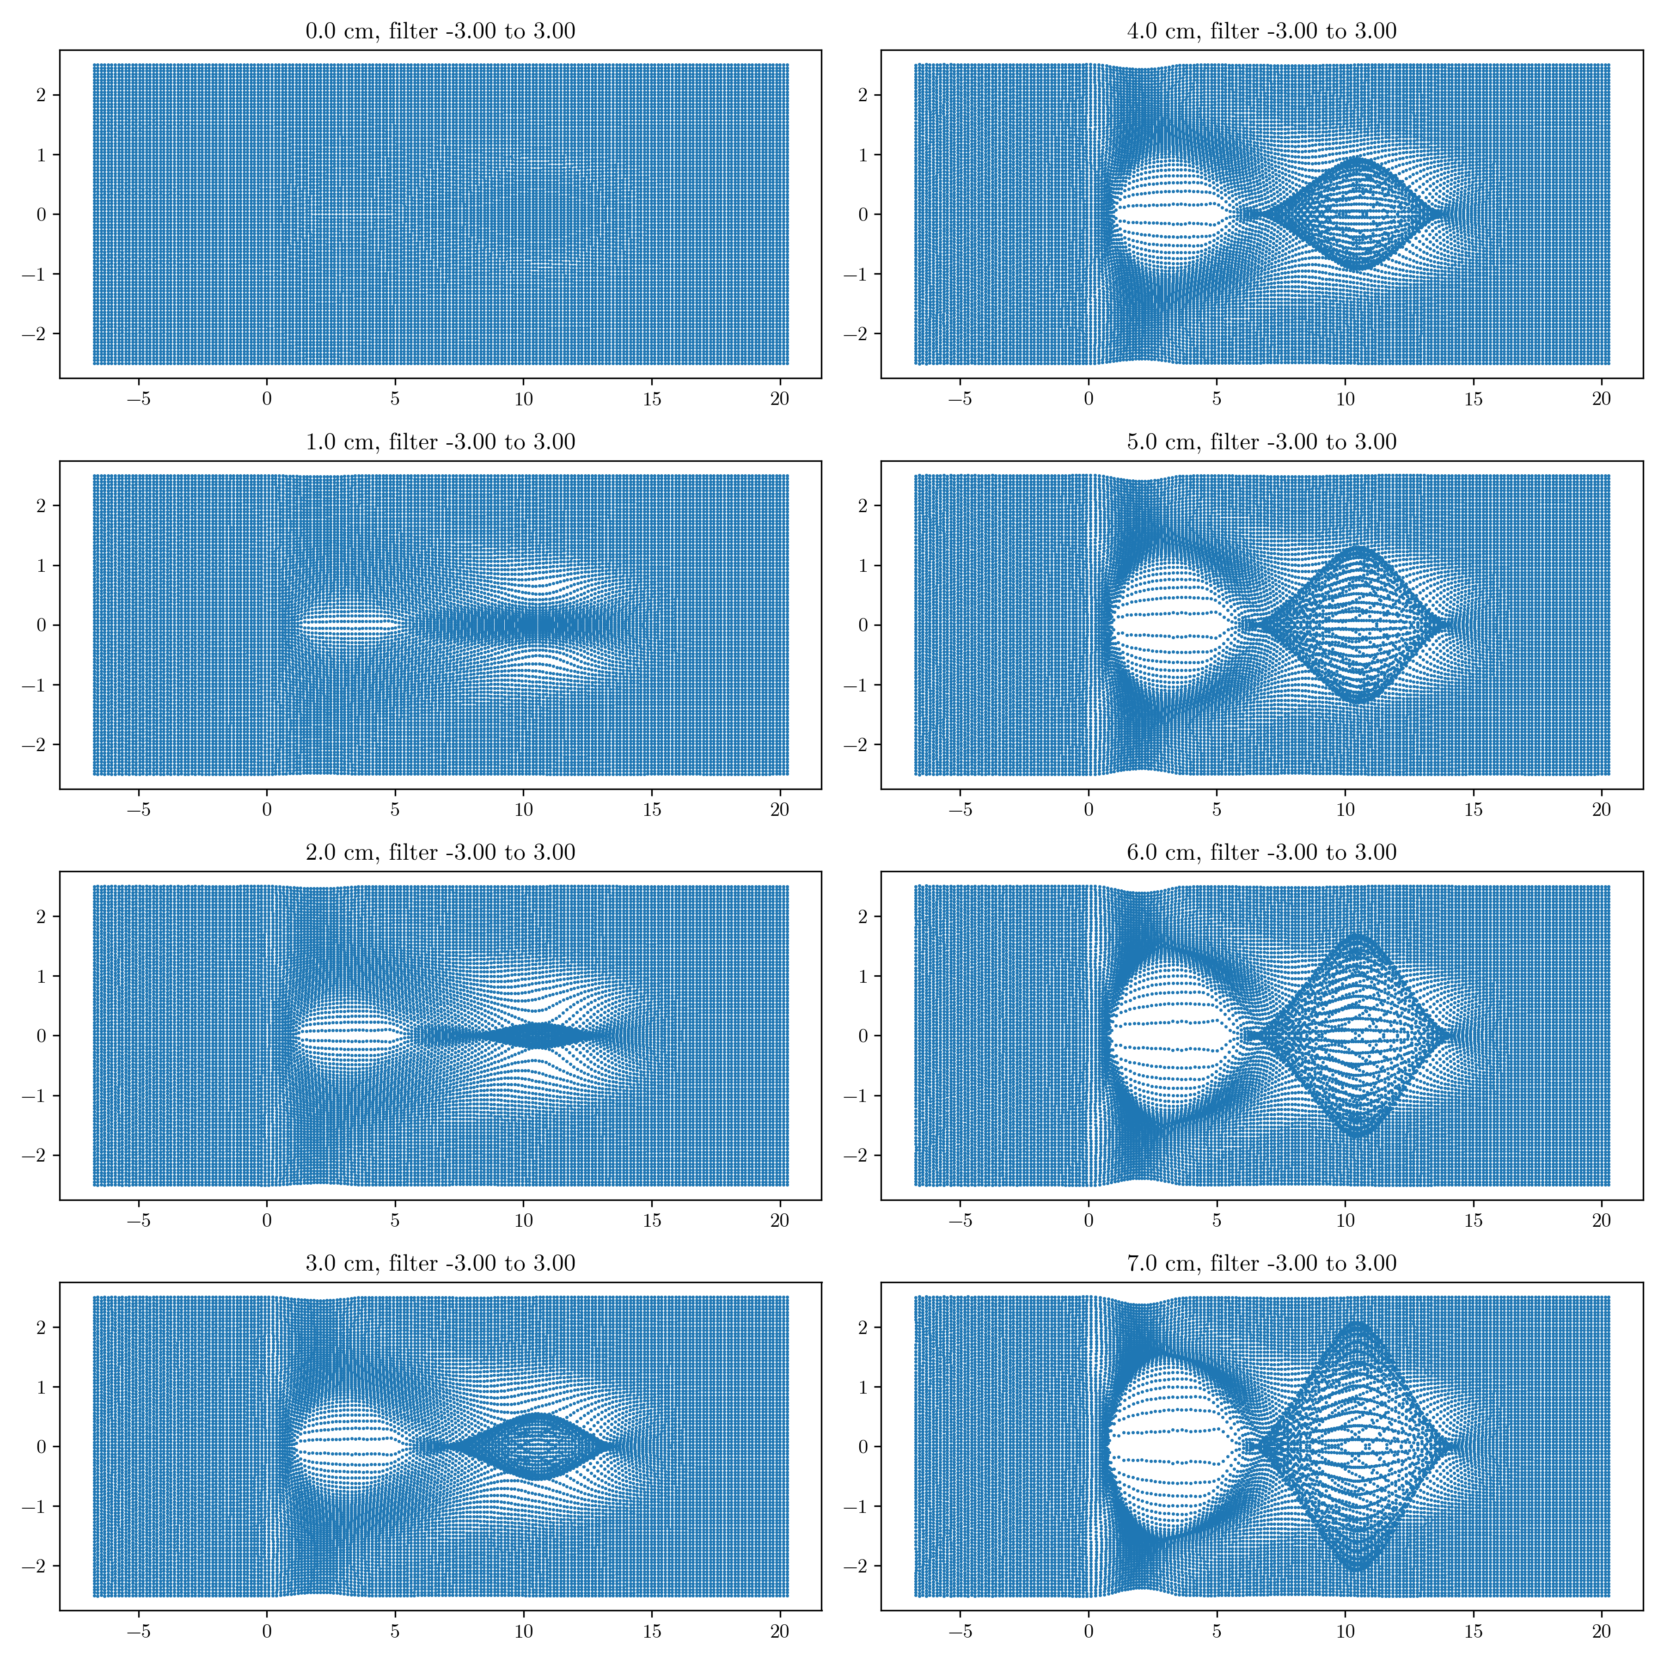
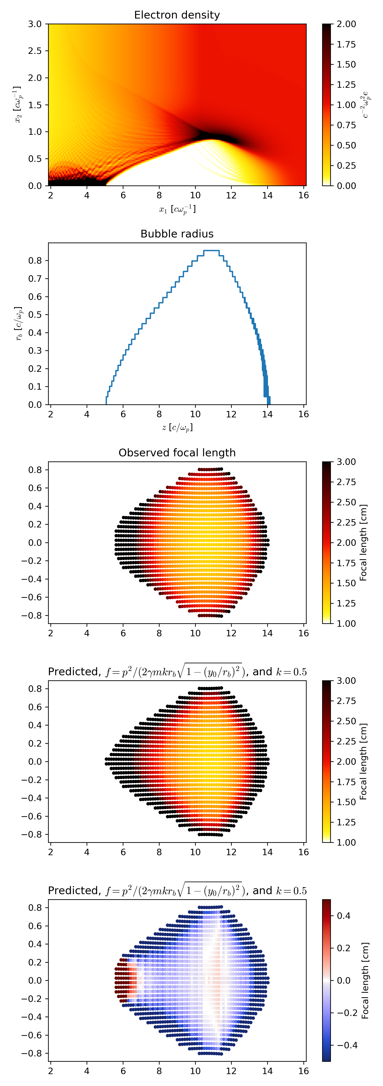
Comparison With Quasi-3D OSIRIS Simulations
3
cm
Simulation Focal Length
1
3
cm
Theoretical Focal Length
1
Courtesy of Kyle Miller
Simulation agree reasonably well with the theoretical model and experiment

Slide 17
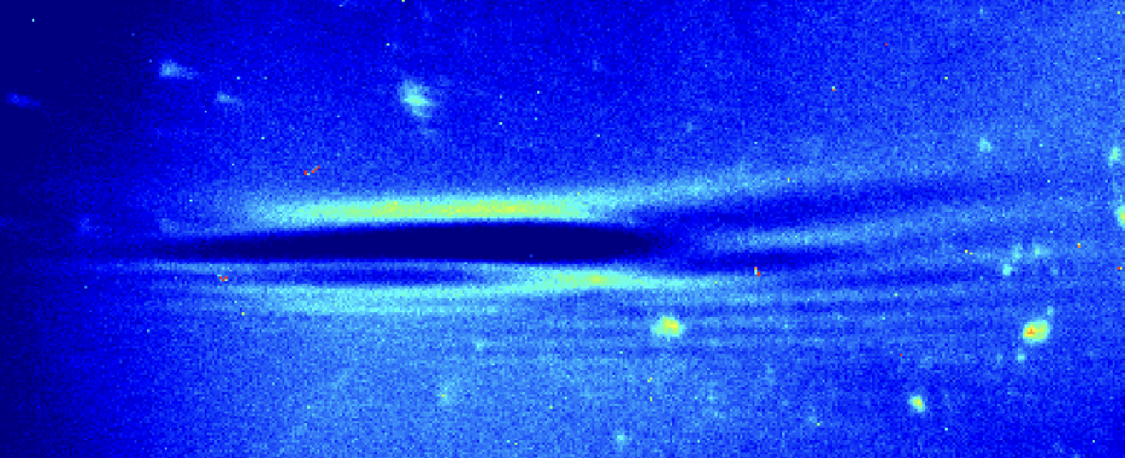
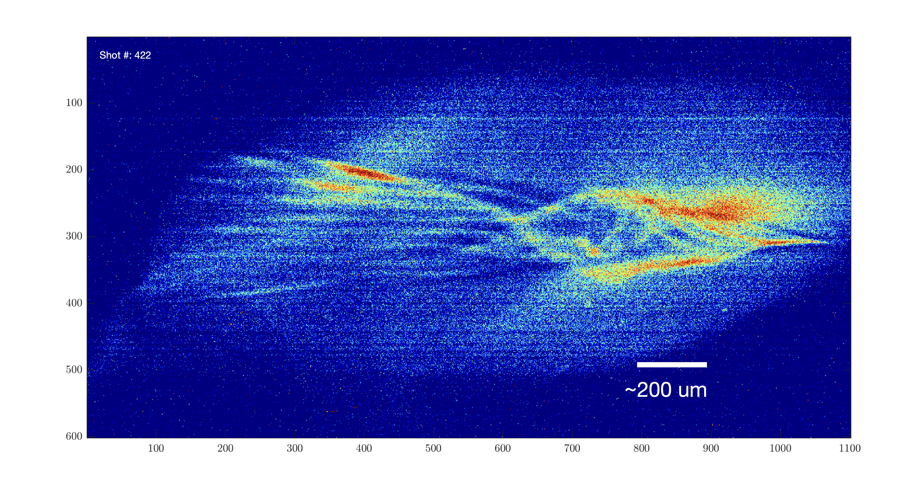
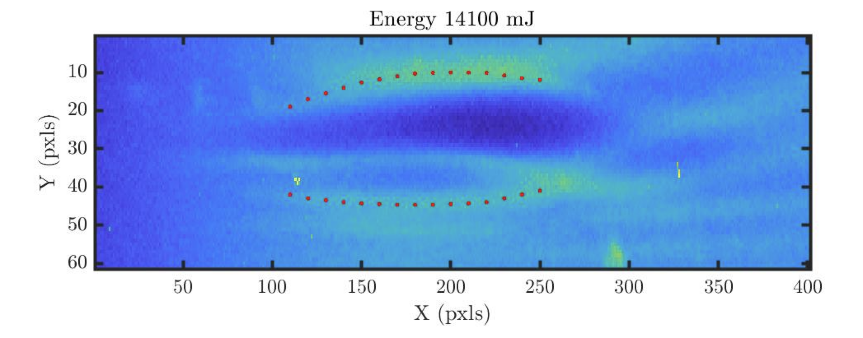
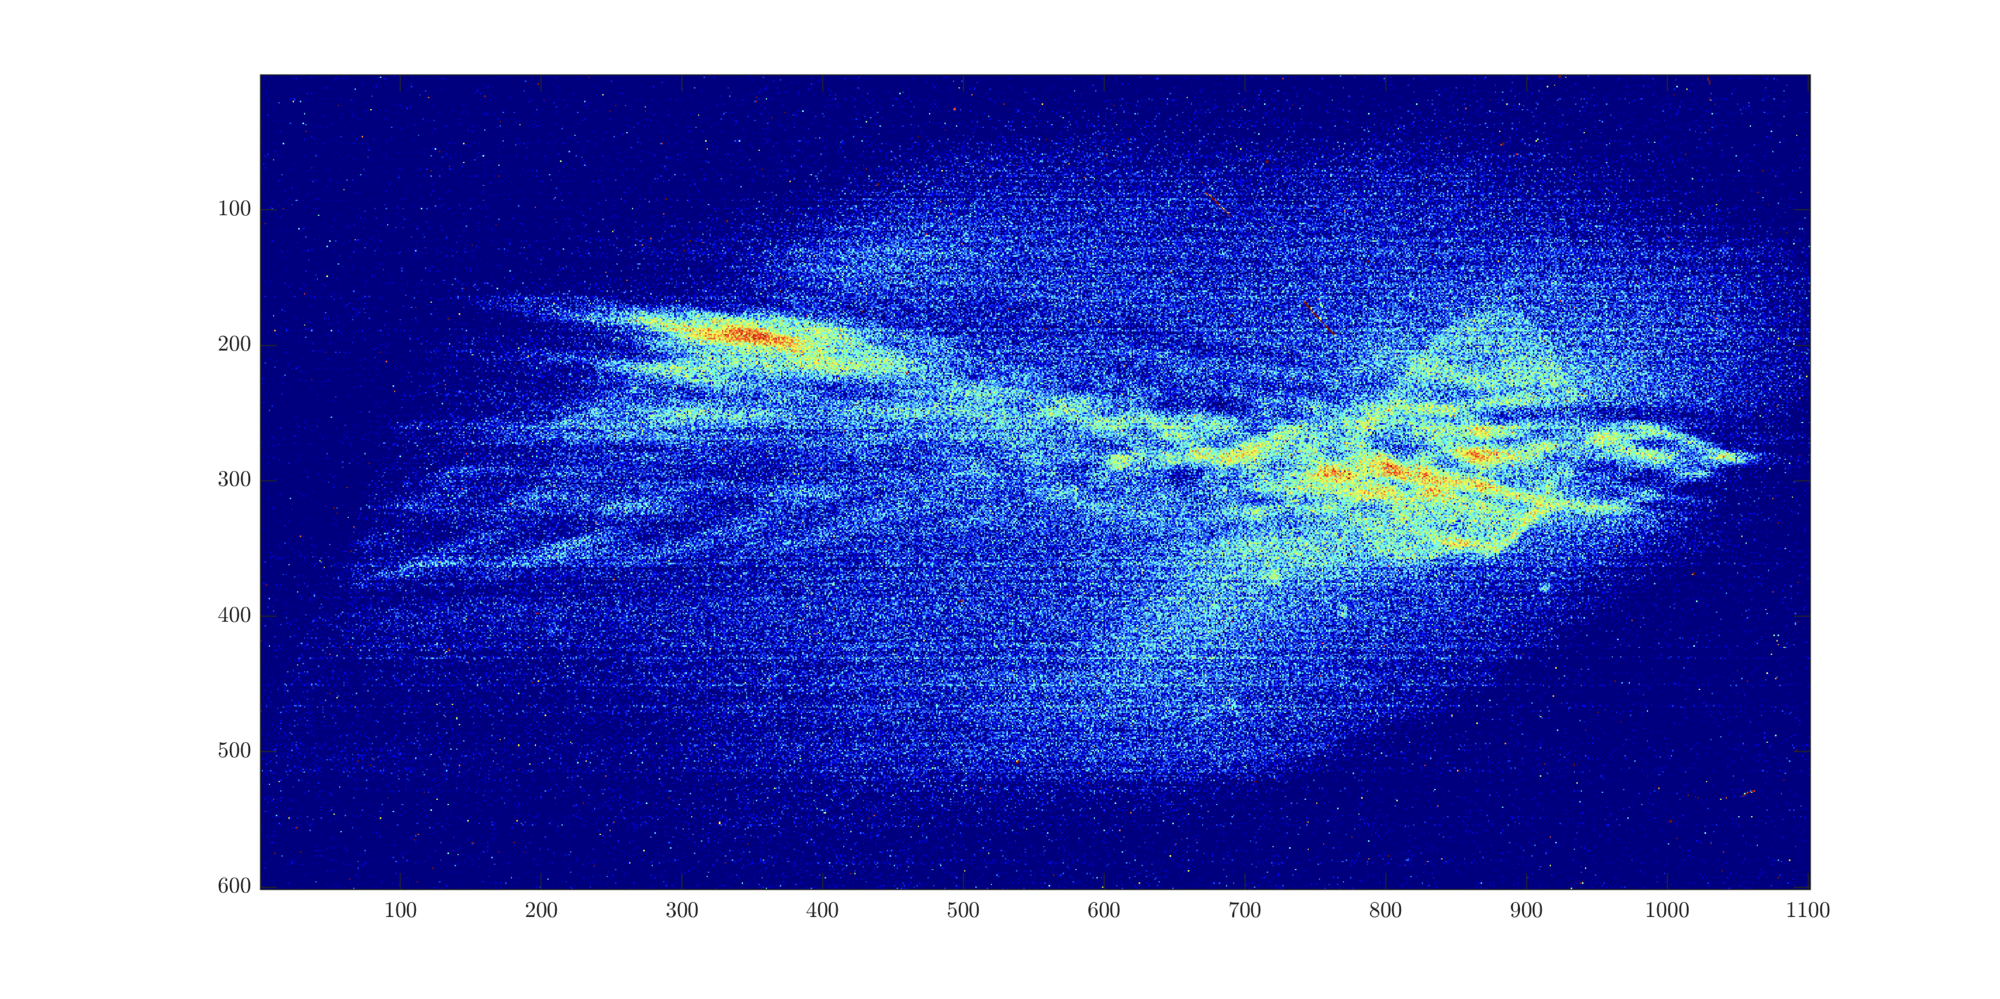
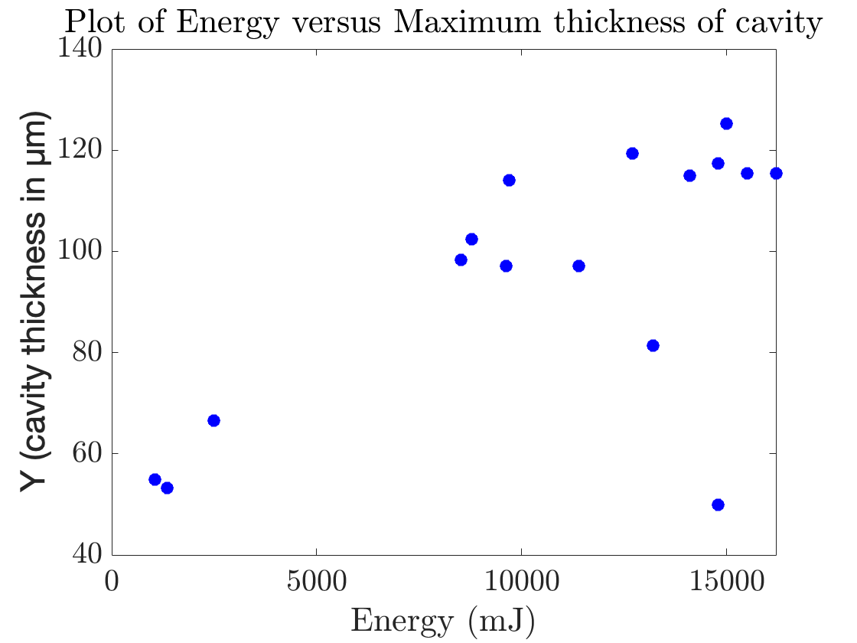
Other Observations
Direct Laser e-beam Interaction – Alignment Diagnostics for two color experiments
Highly Structured data appearing to show distinct filaments
Expanding edge associated with plasma wave

Slide 18
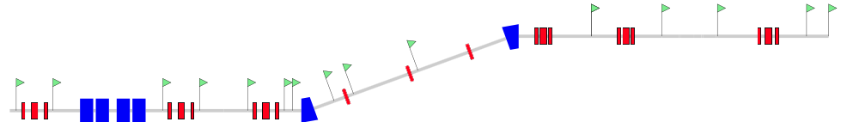
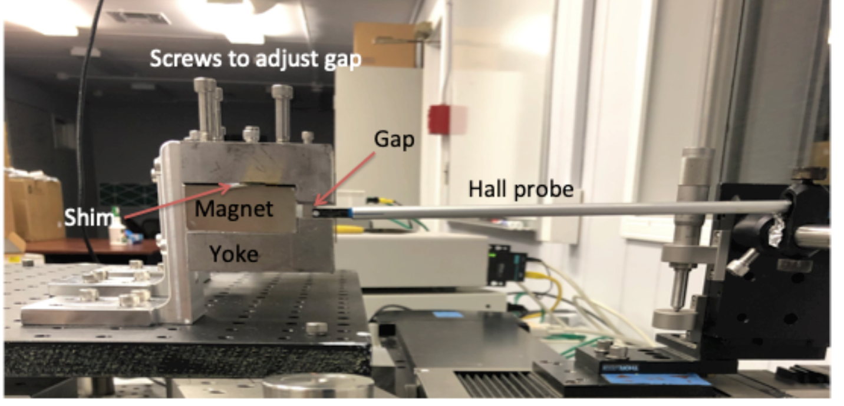
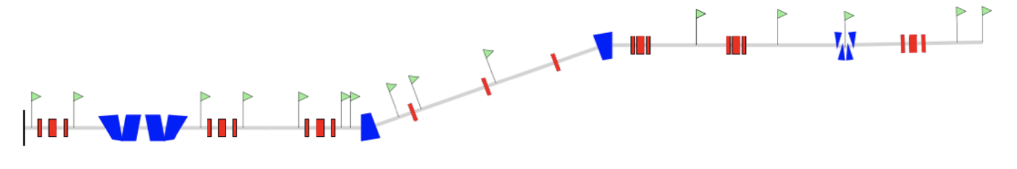
Other Work: Design of e-beam Compression
Current option: Bunch shaping using HES. Resulting bunch length 150-250 fs.
e-beam
HES
Future option: Bunch shaping using chicane
e-beam
MS student, Roshni Patil, has graduated in December 2020 with the thesis titled “Design of a Permanent Magnet Chicane to Compress Electron Beams for LWFA Experiments at BNL”

Slide 19
Summary of major results:
Implemented high-resolution and high-field-of-view BPMs
Implemented movable BPM along with TEM masks, which allow us to track electrons and circumvent the issue of beam trajectory crossing
Developed theoretical and numerical tools for evaluating the radiographs
Developed and simulated e-beam compression chicane scheme
Performed simulation studies of LWFA driven by LWIR laser to understand the emerging structures at various laser and density parameters
These activities move us towards performing simultaneous laser and electron beam diagnostic of LWFA in the blowout regime

Slide 20
Activities & Impacts Associated with this Experiment – All Years
Manuscripts (books, conference and journal articles, other; please include works submitted but not yet accepted):
  A. Cheng, et al., “Efficient numerical algorithm for multi-level ionization of high-atomic-number gases”, Physics of Plasmas (Accepted)
  S. Yuan, et al., “Massively-parallel Lagrangian particle code and applications,” Mechanics Research Communications 129, 104075 (2023).
  I. Petrushina, R. Zgadzaj, M. Petrusky, et al. “Characterization of the fields inside the CO2-laser-driven wakefield accelerators using relativistic electron beams,” submitted for publication in Proceedings of the 20th Advanced Accelerator Concepts Workshop (AAC’22), 2022.
  A. Jain, et al. “Self-injection process in laser‑wakefield accelerator driven by CO2 laser pulses,” submitted for publication in Proceedings of the 20th Advanced Accelerator Concepts Workshop (AAC’22), 2022.
  K. Yu, P. Kumar, S. Yuan, A. Cheng, R. SAMULYAK, SPACE: 3D parallel solvers for Vlasov-Maxwell and Vlasov-Poisson equations for relativistic plasmas with atomic transformations, Computer Physics Communications 277, 108396 (2022).
  P. Kumar, et al. “Evolution of the self-injection process in long wavelength infrared laser driven LWFA” , Physics of Plasmas, 28, 013102 (2021)
Presentations:
  N. Vafaei-Najafabadi, “Direct probing of fields inside an LWFA using a relativistic electron beam probe”, Presented at Physics and Applications of High Brightness Beams, 2023
  I. Petrushina, “Characterization of the fields inside the CO2-laser-driven wakefield accelerators using relativistic electron beams,” presented at the 20th Advanced Accelerator Concepts Workshop (AAC’22), 2022.
  A. Jain, “Self-injection process in laser‑wakefield accelerator driven by CO2 laser pulses,” presented at the 20th Advanced Accelerator Concepts Workshop (AAC’22), 2022.
  N. Vafaei-Najafabadi, “Probing the fields of an LWFA in blowout regime using a relativistic electron beam”, presented at the 63rd APS DPP, 2021
  I. Petrushina, Electron beam probing: essentials for the direct measurements of plasma wakefields, Poster presented at the 63rd APS DPP, 2021
  I. Petrushina, “Experimental investigation of interactions of long CO2 laser pulse with plasma at ATF”, presented at the 62rd APS DPP, November 2020
Theses awarded
  R. Patil, “Design of a Permanent Magnet Chicane to Compress Electron Beams for LWFA Experiments at BNL”, Master of Arts Thesis, Stony Brook University, Stony Brook, NY (2020).
  P. Iapozzuto, “Plasma Wakefield Chamber Differential Pumping and BPM System on the ATF Beam Line”, Master of Science in Instrumentation Thesis, Stony Brook University, Stony Brook, NY (2020).
  E. Trommer, “Transverse probing of laser-driven plasma wakefields using relativistic electrons”, Bachelor’s Thesis, Stony Brook University, Stony Brook, NY, (2023)
  N. Manzella, “Development of methods for modeling the interactions of plasma wakefields with a realistic 3D electron probe.” *Bachelor’s Thesis, Stony Brook University, Stony Brook, NY (2022)
  M. Petrusky, “Picturing Plasma: Studying the simulated transverse probing of laser wakefield accelerators”, Bachelor’s Thesis, Stony Brook University, Stony Brook, NY (2021);

Slide 21
COVID-19 Pandemic Impacts
Access to Facilities: ATF was shut down throughout most of 2020
Limited number of participants: Social distancing throughout 2021 significantly reduced the number of participants, down to only one person working on the setup and one-two experimenters in the control room. This significantly restricted the number of students participating (down to zero through 2021). This also impacted the experimental portion of thesis projects for several students.
Limited Travel: Travel from UT was not possible until Fall 2022
Complications with the equipment procurement: Longer lead times on the equipment procured during the experiments in 2020-2022 caused delays with the setup assembly. Limited manufacturing capacity at the companies didn’t allow for custom designs necessary for the experiment, i.e. Cu parabolic mirror for CO2.

Slide 22
The End

Slide 23
Inferring Density in Experiments

Slide 24
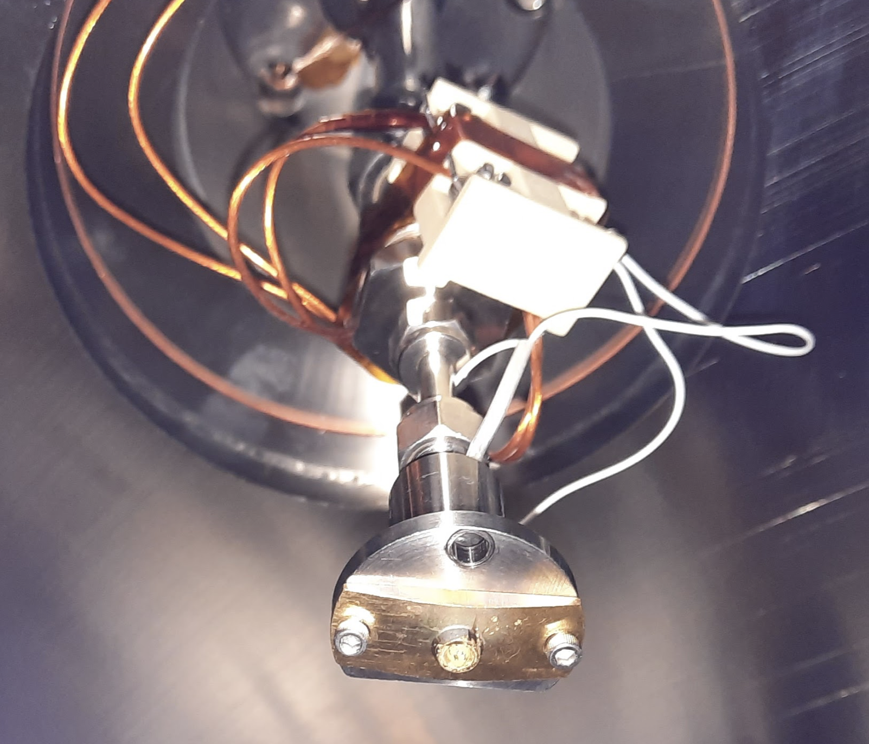
  Nozzle parameters
Backing pressure ~30 psi
1” away for the no grid focusing data
2” away for the data with grids and wake data
30 psi, 3 mm away
20 psi, 3 mm away
20 psi, height scan
20 psi, 10 mm away

Slide 25
  Nozzle parameters
Ratio: 1.31+/-0.15
Assuming linear dependence, at 30 psi:
@ 1 inch: 2.77x10¹⁶ cm⁻³
@ 2 inch: 2.98x10¹⁵ cm⁻³
From the wavelength: 2.95x10¹⁵ cm⁻³

Slide 26
Measured Period: 57.6+/-0.2 pxls
Square grid period: 58+25 um = 83 um
Horizontal Resolution: 1.44 um/pxl
  Square grid

