Slide 1
ATF User’s Meeting
26-28 March 2024
AE95: Relativistic electron beams from
a CO₂-laser-driven wakefield accelerator
PI: Mike Downer, University of Texas at Austin
Collaborators:
University of Texas at Austin:
Faculty: M. C. Downer
Research Scientist: R. Zgadzaj
PhD students: Y. Cao, B. Dinh,
G. Tiwari,* J. Welch*
Stony Brook University:
Faculty: Navid Vafaei-Najafabadi
Roman Samulyak
V. N. Litvinenko
Research Scientists: Ligia D. Amorim,
Irina Petrushina
PhD Students: A. Cheng, A. Gaikwad,*
P. Kumar*
Other Students: P. Iapozzuto (MSI),*
I. Bromberg (undergraduate)*
Brookhaven NL:
ATF Director: M. A. Palmer
Research Scientists: M. Babzien,
M. Fedurin, R. Kupfer, K. Kusche,
W. Li, I. V. Pogorelsky,
M. N. Polyanskiy
UCLA:
Faculty: C. Joshi
Research Scientist: C. Zhang
*degrees awarded
Main Group Funding: US Department of Energy grant DE-SC0014043 (thru 2025)
Additional Individual Support: DE-SC0011617 (UT-Austin); DE-SC0012704 (BNL)
1

Slide 2
Goal: develop LWFAs that routinely produce e-beams
with ∆E_{e}/E_{e} and ℇ_{n} low enough to drive XFELs
Key ingredients:
*
1) Large plasma bubbles (R_{b} ≳ 0.3 mm)
⇒ n_{e} ≲ 10¹⁶ cm⁻³
**
2) External injection of low ∆E_{e}/E_{e}, low ℇ_{n} e-bunches
*
Efficiently excited by LWIR laser pulses uniquely realizeable at ATF
**
• Pogorelsky et al., Phys. Rev. Accel. Beams 19, 091001 (2016);
Kumar et al., Phys. Plasmas 28, 013102 (2021)
Synchronized, compressed ATF linac bunches uniquely enable 1st-generation experiments.
AE95 represents a middle stage of progress toward this goal.
Project # | CO₂ laser parameters | Main results
AE-71 | 2 J, 4 ps, 0.5 TW, 10.3 µm | • Generation, characterization of self-modulated (SM) wakes. No electrons.
AE-95 | 4 J, 2 ps, 2 TW, 9.2 µm | • Self-injected MeV electrons produced at n_{e} ≳ 3 × 10¹⁶ cm⁻³ • Quasi-monoenergetic, collimated features observed.
next | 10-20 J, < 2 ps, 5-20 TW | • Excite, characterize R_{b} ~ 0.3 mm bubbles at n_{e} ~ 10¹⁶ cm⁻³ w/o self-injection • Inject e⁻ from ATF linac, characterize ∆E_{e}/E_{e} and ℇ_{n}
[1]
[2]
[1] Predicted by Kumar et al., Phys. Plasmas 26, 083106 (2019)
[2] Zgadzaj et al., Nat. Comms., in press (2024)
2

Slide 3
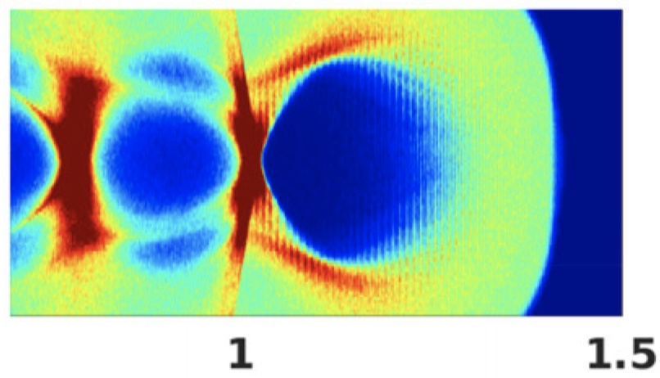
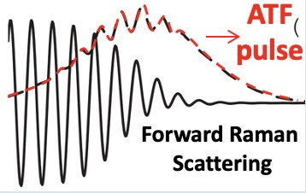
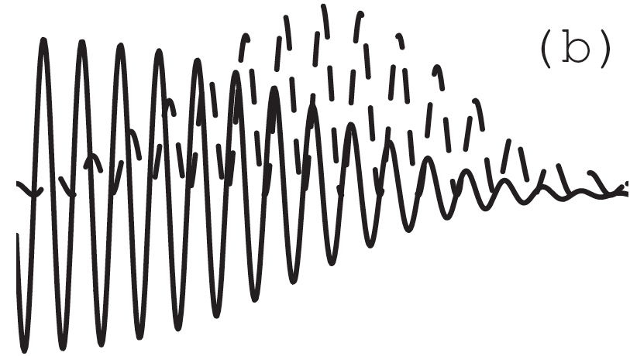
TW CO₂ laser technology & LWFA science advance hand-in-hand
CO₂ laser technology
LWFA regime
wake structure
plasma parameters
& diagnostics
electrons
10-15J, 0.5 ps, 20-30 TW
CO₂: isotopically enriched,
9R + 9P branches
CPA: augmented by nonlinear
post-compression
Polyanskiy, Opt. Expr. 29, 31714 (2021)
Kumar, Phys. Plasmas 28, 013102 (2021)
bubble
regime
AE-?? (2024-26)
100
x [µm]
𝛿n/n_{e0}
1 < n_{e} ≲ 4 × 10¹⁶ cm⁻³
external injection
• linac (synched, compressed)
• 2-color ionization
0
electron radiography,
Faraday rotation
-100
z [mm]
P = 20 TW, n_{e0} = 2x10¹⁶ cm⁻³, a₀ = 3.8
3-10J, 2 ps, 1.5-5 TW
CO₂: isotopically enriched,
9R branch, 𝜆 = 9.2 µm
CPA: 140 ps stretch; 100 l/mm,
75% T compressor
Polyanskiy, OSA Cont. 3, 459 (2020)
ATF
pulse
nonlinear
SM-LWFA,
forced LWFA
AE-95 (2020-23)
1 < n_{e} < 4 x 10¹⁷ cm⁻³
1.7 > P_{cr} > 0.5 TW
electron spectrometer
Q ≈ 1-500 pC
E_{e} ≈ 5-25 MeV
exponential & peaked
electron spectra
nonlinear wake
2J, 4 ps, 0.5 TW
CO₂: natural, 10R branch,
𝜆 = 10.3 µm
CPA: 25 ps stretch; 75 l/mm,
50% T compressor
Polyanskiy, Optica 2, 675 (2015)
linear
SM*-LWFA
(*Self-Modulated)
AE-71 (2018-19)
0.5 < n_{e} < 2 x 10¹⁸ cm⁻³
0.4 > P_{cr} > 0.1 TW
collective Thomson scatter
CPA (ATF) →
NONE
linear wake
60J, 300 ps, 0.2 TW
λ₁ = 10.59 µm;
λ₂ = 10.29 µm
PBWA
Plasma Beat-
Wave Accelerator
Clayton, PRL 70, 37 (1993)
laser
2-color
(MARS)
Q ≈ 5 fC
E_{e} ≈ 9 MeV
n_{e} = 8.6 x 10¹⁵ cm⁻³
linear wake
3

Slide 4
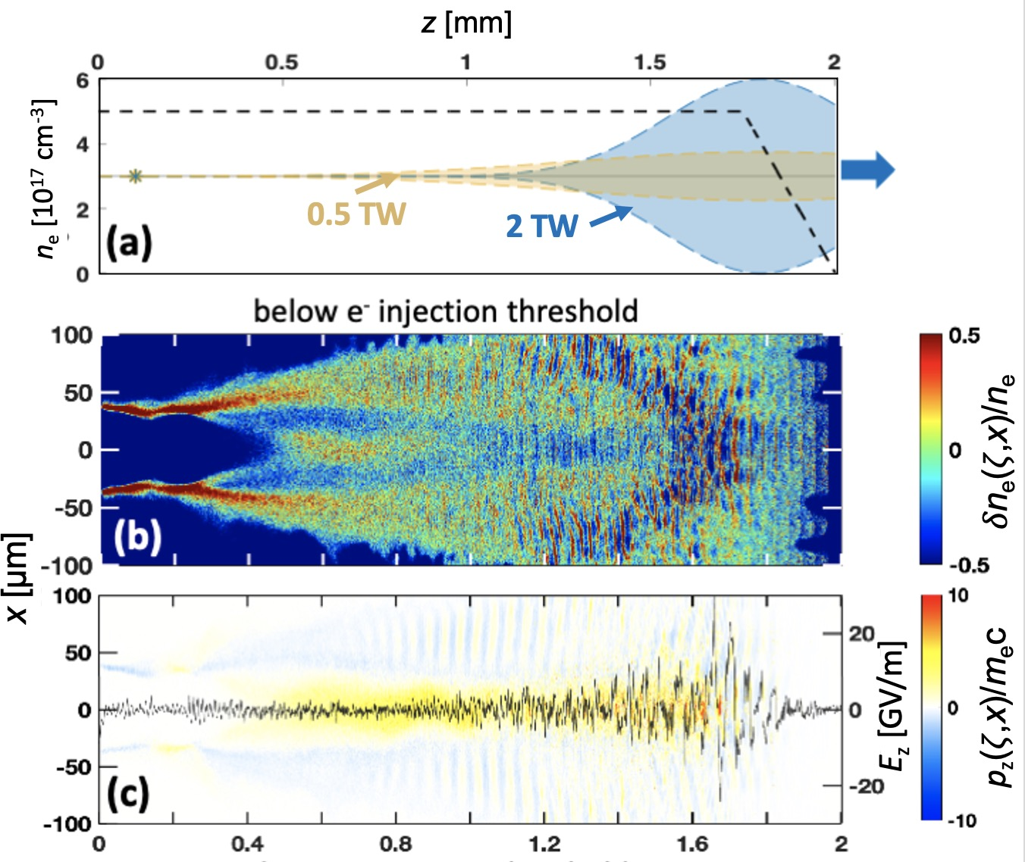
AE71: SPACE* simulations predicted detectable SM wakes,
but no accelerated electrons for P_{L} = 0.5 TW (2 J, 4 ps) CO₂ pulses
*
Yu et al., Comp. Phys. Commun. 277, 108396 (2022).
Kumar et al., J. Plasma Phys. 26, 083106 (2019)
SPACE code
• 3D, parallel, relativistic PIC
• Yee’s FDTD method solves field eq^{n}s.
• Boris-Vay pusher advances macroparticles
• algorithms for atomic physics processes
induced by intense laser or particle beams:
- ADK ionization
- computes ionization/recombination rates
on grid, then transfers them to particles
SIMULATIONS
• ions mobile
• dynamic ionization included
• computational box:
- transverse: 600 µm range,
dx = dy = 2 µm (10 cells/w₀)
- longitudinal: 3-5 mm range,
dz = 0.5 µm (20 cells/𝜆)
Only p_{z} attributable to
wake itself are observed.
z [mm]
simulations by A. Cheng, R. Samulyak
4

Slide 5
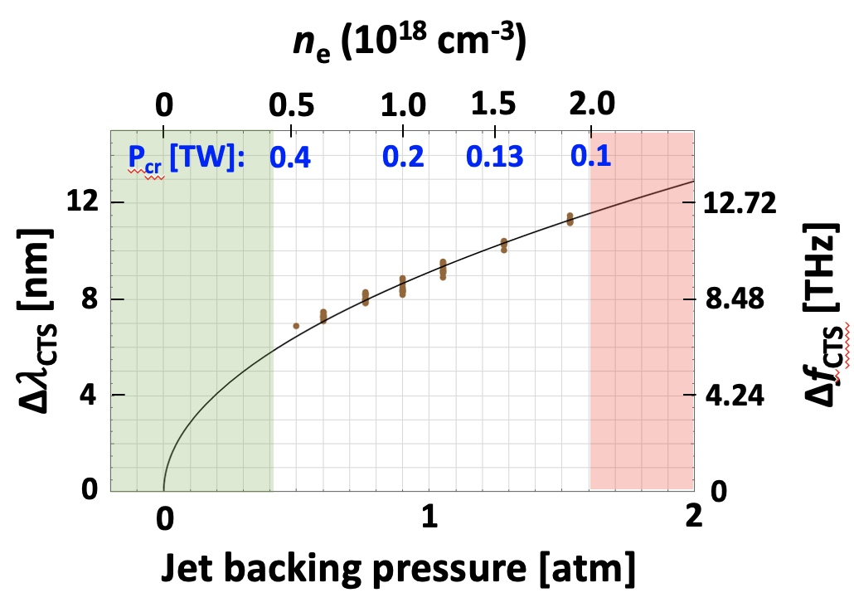
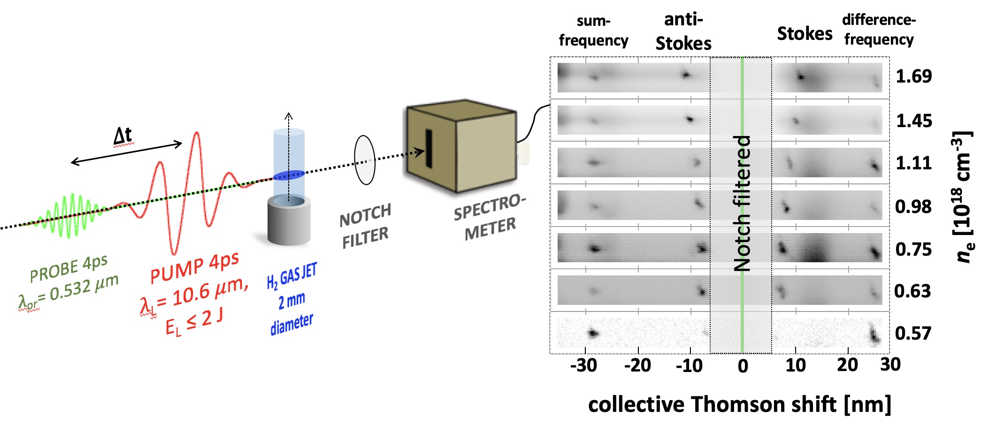
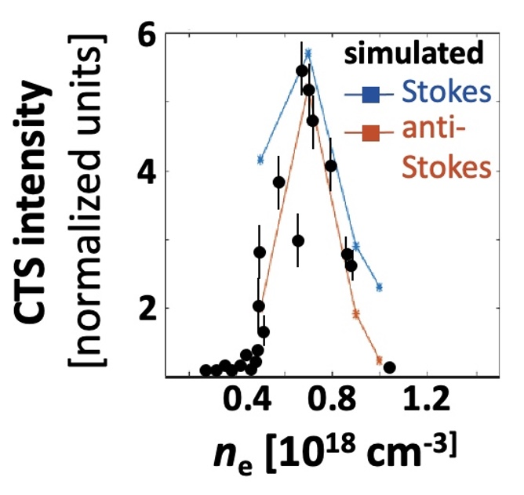
AE71: Experimental detection of self-modulated wakes: CTS*
(this slide: ∆t = 0, P = 0.5 TW, n_{e} variable)
*Collective Thomson Scatter
Slusher, Phys. Fluids 23, 472 (1980)
Villenueve, JOSA B 8, 895 (1991)
back-
reflec-
tions
*
*
∆𝜔_{CTS} = 𝜔_{p}(n_{e})
wake
threshold
*rms jitter 1 ps
*120 cycles,
~30 𝜈_{p}⁻¹
growing
𝛿n_{e}/n_{e0}
SM wakes “turn on” when:
Simulations
capture complex
wake-probe
dynamics
P ≥ P_{cr}(TW)
= .017 $\frac{n_{cr}}{n_{e}}$
• wake-probe
dephasing
• decreasing wake
lifetime
• more chaotic
wake structure
n_{cr} (cm⁻³)
n_{e} for P_{cr} = 0.4 TW
1
10²¹ | 4 × 10¹⁹ cm⁻³
10¹⁹ | 4 × 10¹⁷ cm⁻³
𝜆 (µm)
10
5

Slide 6
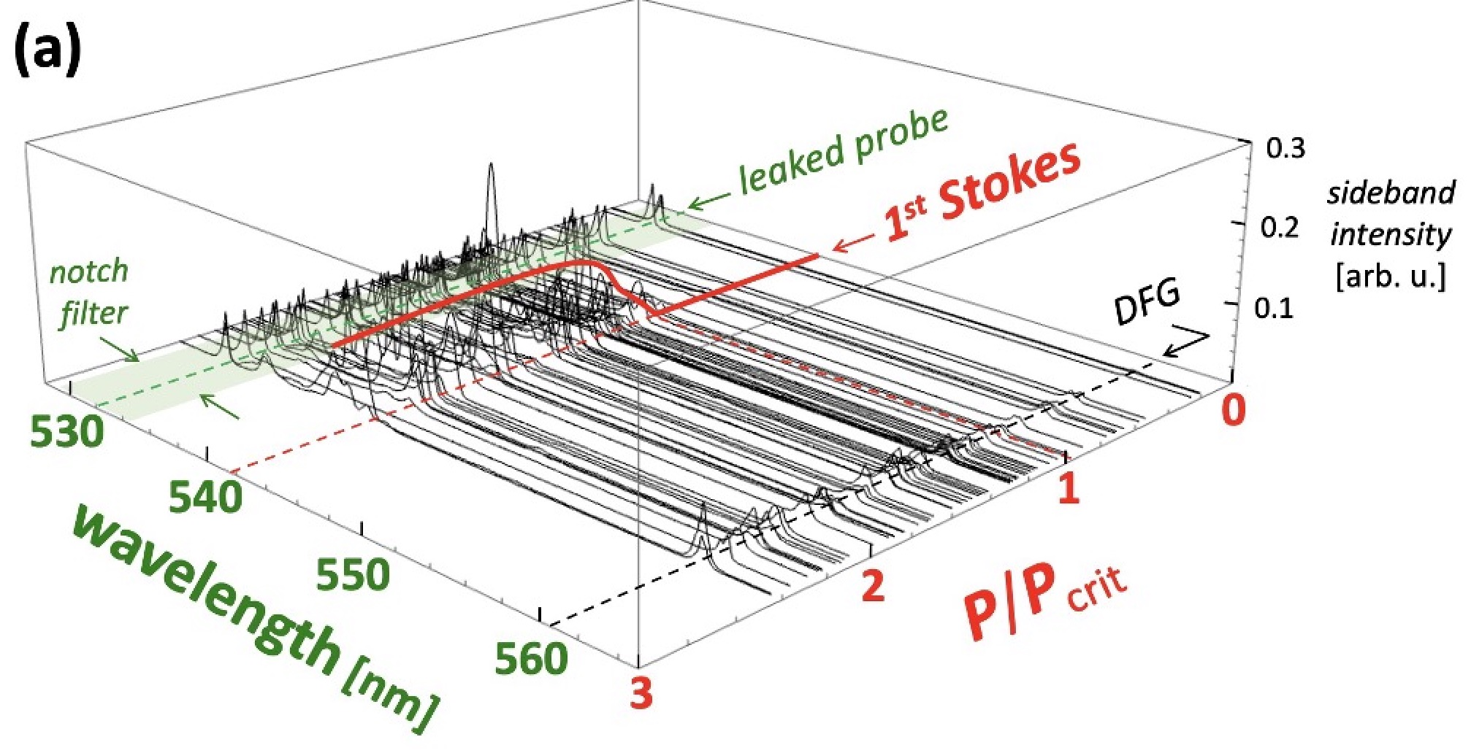
AE71: Experimental detection of self-modulated wakes: CTS
(this slide: ∆t = 0, n_{e} = 1.3 × 10¹⁸ cm⁻³ , P variable)
Stokes/anti-Stokes sidebands appear for P > P_{cr}
6

Slide 7
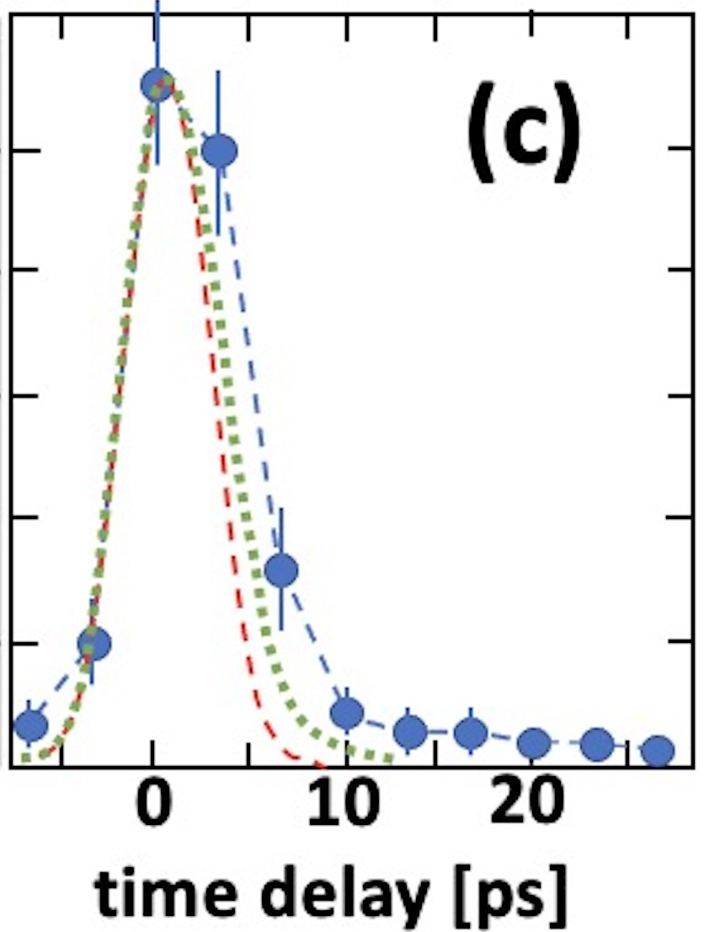
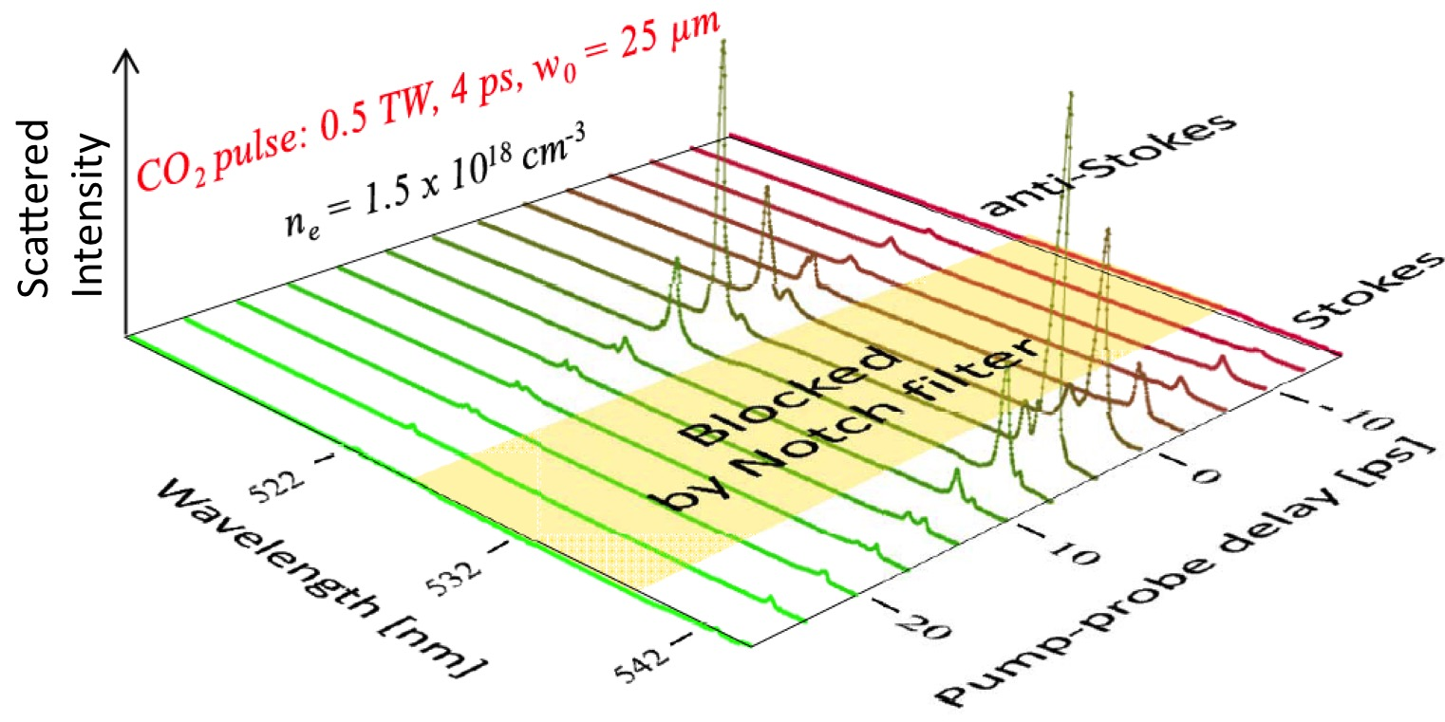
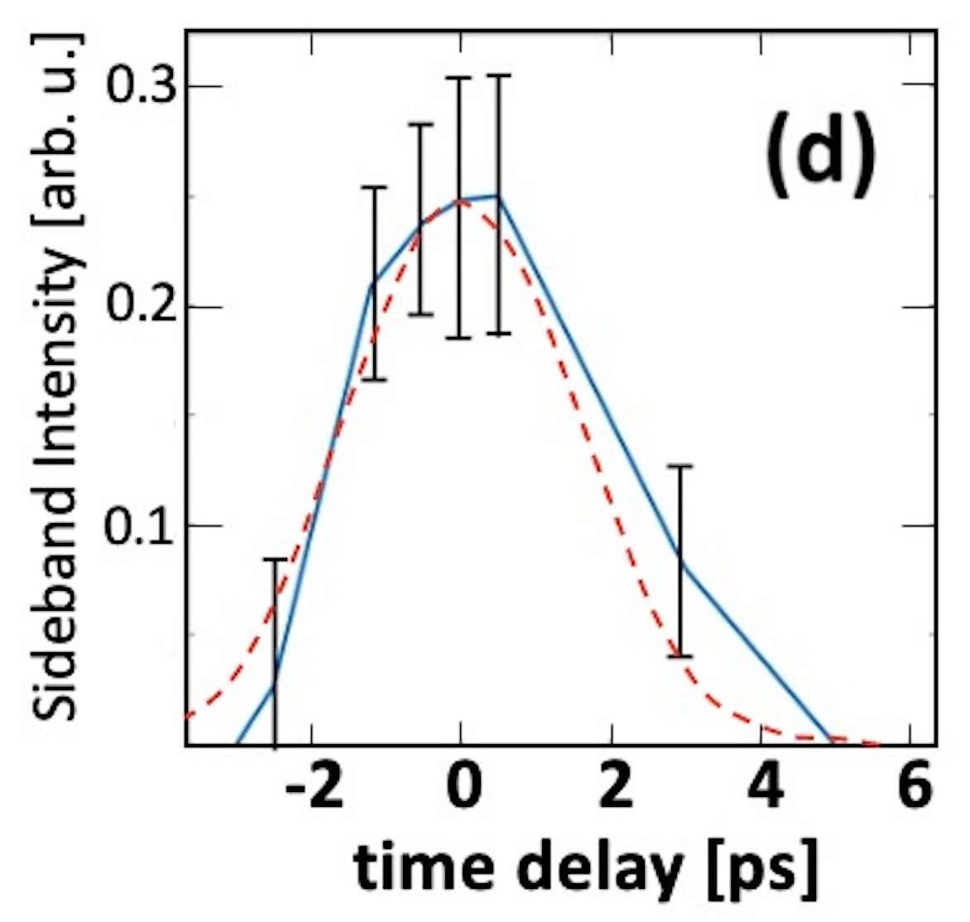
AE71: Experimental detection of self-modulated wakes: CTS
(this slide: n_{e} = 1.5 × 10¹⁸ cm⁻³ , P = 0.5 TW = 3.75 P_{cr} , ∆t variable)
1
pu-pr
x-corr^{n}
PIC
Averaged & normalized
sideband amplitude
0.5
EXP
0
SPACE
simulations
(co-propa-
gating probe)
pump
profile
PIC
• transverse wakes
• plasma channel
• ion acoustic waves
Suspected decay via conversion of epw into
7

Slide 8
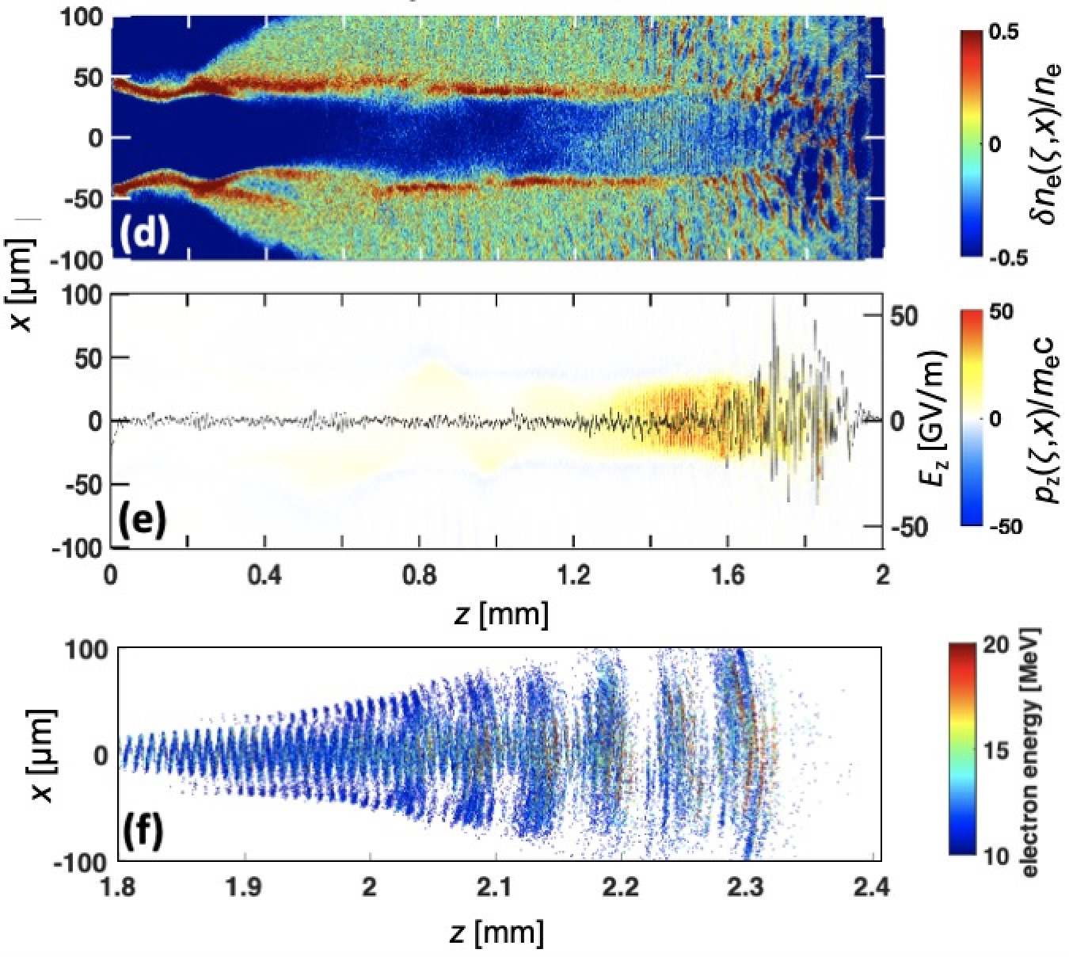
AE95: SPACE* simulations predicted electron injection
and acceleration for P_{L} = 2 TW (4 J, 2 ps) CO₂ pulses
Yu et al., Comp. Phys. Commun. 277, 108396 (2022).
Kumar et al., J. Plasma Phys. 26, 083106 (2019)
P_{L} = 0.5 TW (2 J, 4 ps)
n_{e} = 5 × 10¹⁷ cm⁻³
P_{L} = 2 TW (4 J, 2 ps)
n_{e} = 5 × 10¹⁷ cm⁻³
p_{z} from trapped,
accelerated e- observed
e⁻ output
Q ≈ 50 pC
$\left\langle E_{e}\right\rangle ≈8$ MeV
$∆θ_{HWHM}$~ 75 mrad
z [mm]
simulations by A. Cheng and R. Samulyak
8

Slide 9
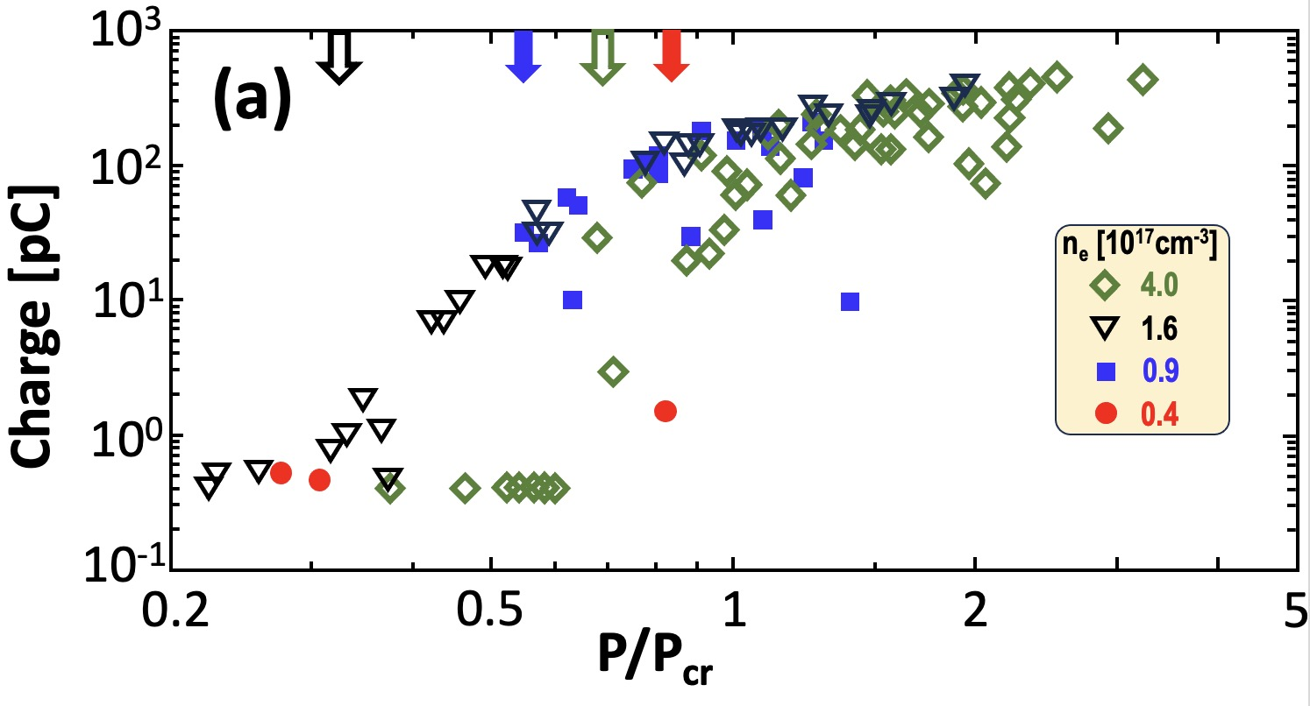
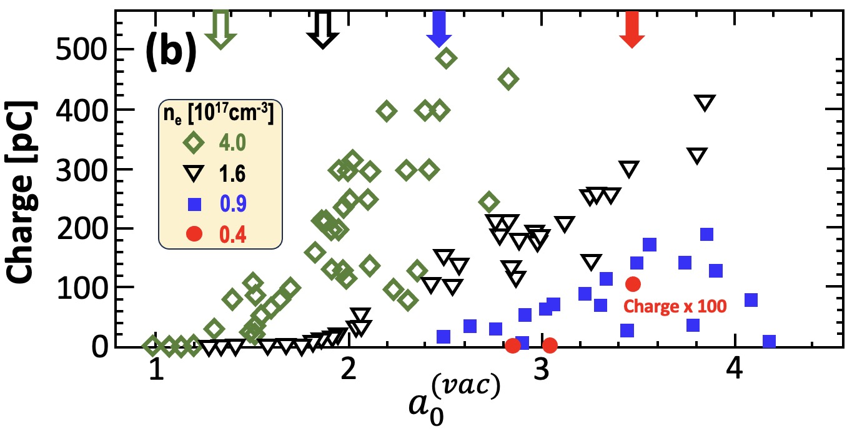
AE95: Detection and Characterization of
relativistic electron beams
P appearance thresholds
⇒ all are sub-P_{cr}
Q_{max} ≈ 500 pC
For 2 TW pulses,
self-focusing no
longer essential
to trigger LWFA...
H₂
jet
e⁻
$a_{0}^{(vac)}$appearance thresholds
⇒ all are relativistic
Lanex
...as long as
$a_{0}^{\left(vac\right)}>1.$
CO₂ pulse
2-5 J, 2ps
CCD
integrated luminescence
⇒ total charge Q
9

Slide 10
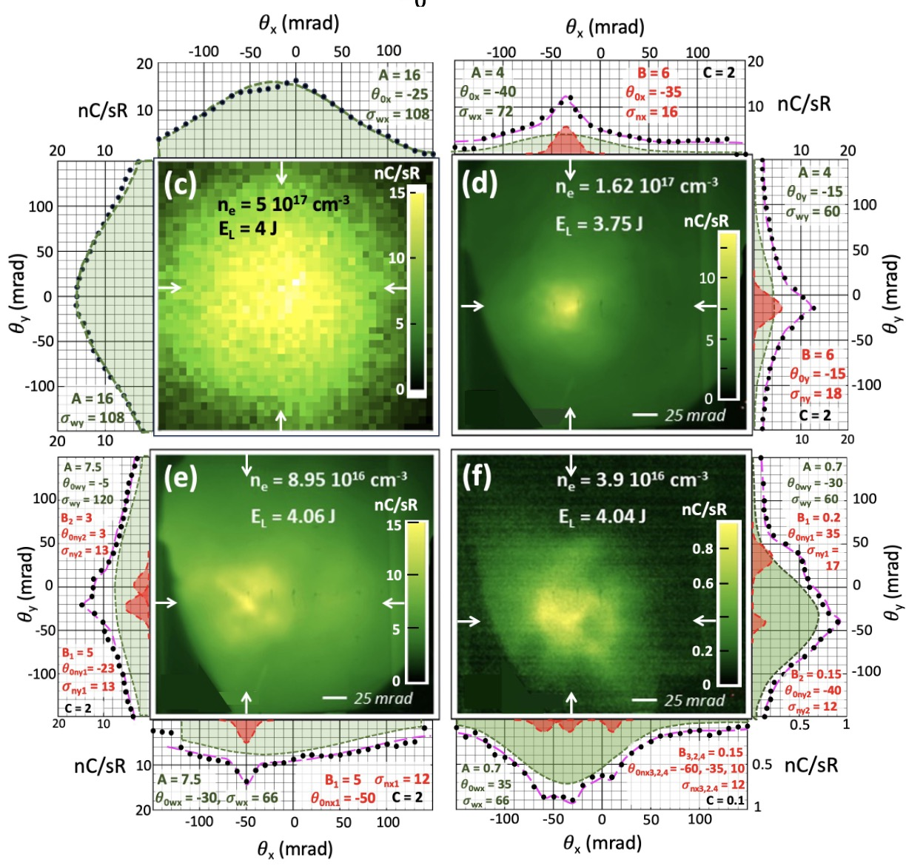
AE95: transverse profiles of 90% of
observed e-beams have 2-components
Key to lineouts
H₂
jet
data
wide
Gaussian
simulation
e⁻
$$Ae^{−{{\left(θ_{i}−θ_{0i}\right)}^{2}}/{σ_{wi}^{2}}}$$
Lanex
narrow
Gaussian
$$B_{j}e^{−{{\left(θ_{i}−θ_{0ij}\right)}^{2}}/{σ_{nij}^{2}}}$$
CO₂ pulse
2-5 J, 2ps
C: constant
background
CCD
wide Gaussians: 60 < 𝜎_{w} < 120 mrad
narrow Gaussians: 12 < 𝜎_{n} < 18 mrad
10

Slide 11
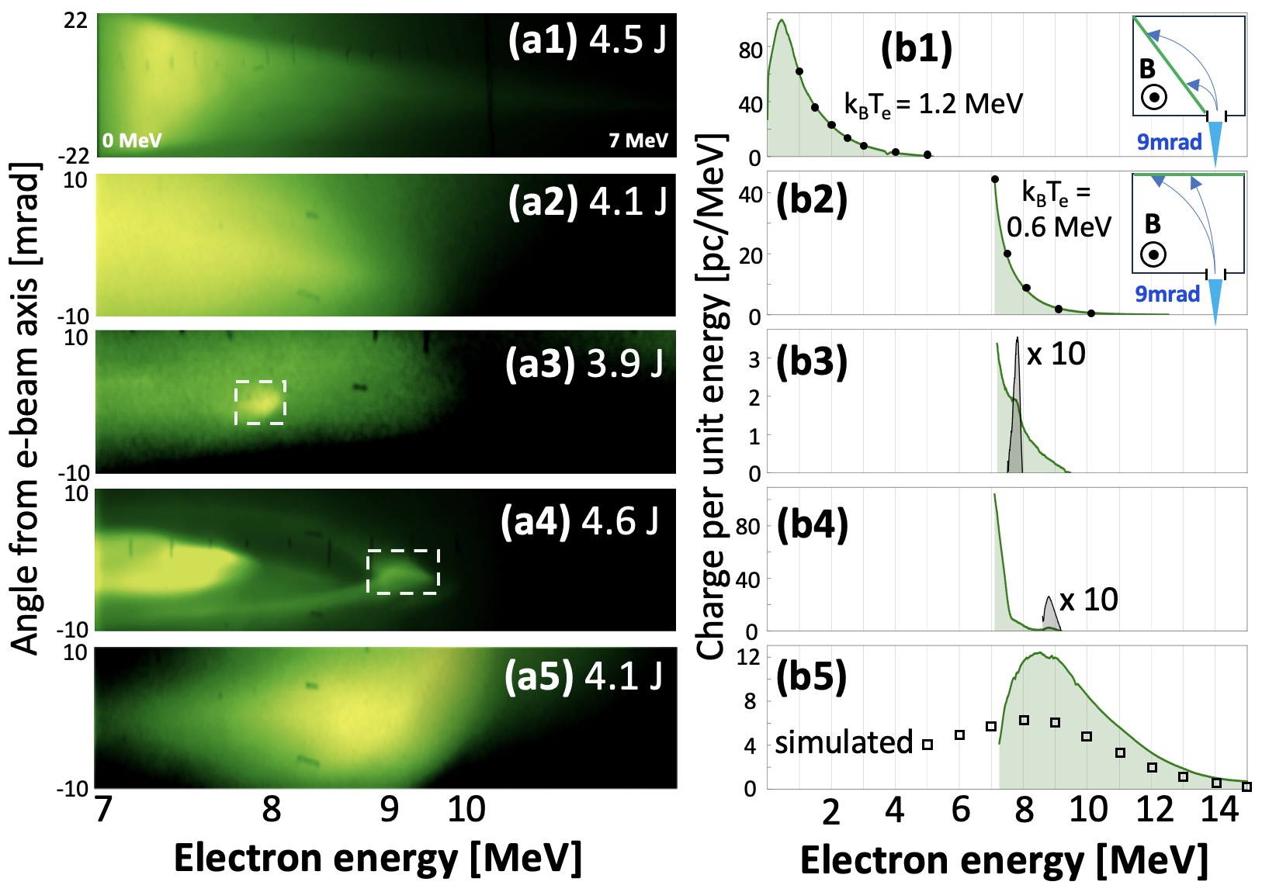
AE95: Electron energy spectra have
2 corresponding components
LANEX luminescence images
angle-integrated energy distributions
expo-
nential
spectra
(7 of 70
shots)
H₂
jet
magnet
CCD
Lanex
peaked
spectra
with
exponential
background
(63 or 70
shots)
CO₂ pulse
2-5 J, 2ps
$$n_{e}({{10}^{17} cm}^{−3})=\left\{\begin{matrix}2.4 \left(row 1\right) \\ 4.1 (rows 2−5)\end{matrix}\right.$$
11

Slide 12
AE95: Significance of observing colli-
mated, quasi-monoenergetic electrons
*
• Transitioning from SM to bubble regime (a.k.a. “forced” LWFA. )
• 3-10 plasma periods within 𝜏_{L} when these features observed
⇒ pulse energy channels preferentially into single plasma period as it self-steepens.
• The next ATF upgrade could usher in the full bubble regime @ n_{e} ~ 10¹⁶ cm⁻³
⇒ no uncontrolled background injection (main origin of energy spread, spin depolarization)
⇒ bubbles large enough for precise injection of ∆E_{e}/E_{e} < .01, high Q, spin-polarized bunches
from an external linac, given tolerances on pointing, timing jitter, bunch compression.
• Reviewers of NCOMMS-23-38185 endorsed this significance:
Reviewer #1: “The results shown are of high significance for laser-plasma electron acceleration.”
Reviewer #2: “The results extend notably the driving laser wavelength used in LWFA experiments, [enabling]
acceleration at low plasma density driven by low-power lasers. Low densities open...sub-mm accelerating
structures...[and] easier coupling with conventional linear accelerators.”
Reviewer #3: “This is an important work...”
*
(cf. Malka et al., “Electron acceleration by a wake field forced by an intense ultrashort laser pulse” Science 298, 1596 (2002)
12

Slide 13
Activities & Impacts Associated with AE95
• Invited Talks
Date | Title | Speaker | Occasion
3-8-2023 | Plasma electron acceleration driven by a long-wave infrared laser | R. Zgadzaj | Laser and Plasma Accelerators Workshop (LPAW 2023), Lagos, Portugal
5-23-2022 | CO₂-laser-driven wakefield acceleration | M. C. Downer | Helmholtz-Zentrum Dresden-Rossendorf (HZDR) Plasma Acceleration Conference, Germany
2-18-2022 | Unsolved problems in laser wakefield acceleration | M. C. Downer | U. Colorado-Boulder, Physics Department, Plasma Physics seminar
• Manuscripts
R. Zgadzaj, J. Welch, Y. Cao, L. D. Amorim, A. Cheng, A. Gaikwad, P. Iapozzuto, P. Kumar, V. N. Litvinenko, I. Petrushina, R. SAMULYAK, N. VAFAEI-NAJAFABADI, C. JOSHI, C. Zhang, M. Babzien, M. Fedurin, R. Kupfer, K. Kusche, M. A. Palmer, I. V. Pogorelsky, M. N. Polyanskiy, C. Swinson, and M. C. DOWNER, "Plasma electron acceleration driven by a long-wave-infrared laser," Nat. Commun., mss #NCOMMS-23-38185, in press (2024).
A. Cheng, R. SAMULYAK, R. Kupfer, J. Pérez-Ríos, N. VAFAEI-NAJAFABADI, “Efficient numerical algorithm for multi-level ionization of high-atomic-number gases,” Phys. Plasmas 31, in press (2024). DOI: 10.1063/5.0189930
S. Yuan, M. Zepeda Aguilar, N. Naitlho, R. SAMULYAK, “Massively-parallel Lagrangian particle code and applications,” Mechanics Research Communications 129, 104075 (2023).
K. Yu, P. Kumar, S. Yuan, A. Cheng, R. SAMULYAK, SPACE: 3D parallel solvers for Vlasov-Maxwell and Vlasov-Poisson equations for relativistic plasmas with atomic transformations, Computer Physics Communications 277, 108396 (2022).
13

Slide 14
• Manuscripts (cont’d)
Prabhat Kumar, K. Yu, R. Zgadzaj, M. C. DOWNER, I. Petrushina, R. Samulyak, V. Litvinenko and N. Vafaei-Najafabadi, “Evolution of the self-injection process in long-wavelength infrared laser-driven wakefield accelerators,” Phys. Plasmas 28, 013102 (2021). DOI: 10.1063/5.0027167.
Y. Y. Chang, X. Cheng, A. Hannasch, M. LaBerge, J. M. Shaw, K. Weichman, J. Welch, A. Bernstein, W. Henderson, R. Zgadzaj and M. C. DOWNER, "Faraday rotation study of plasma bubbles in GeV wakefield accelerators," Phys. Plasmas 28, 123105 (2021). DOI: 10.1063/5.0072262. Chosen as "Editor's pick" for display on journal home-page. Featured as AIP "Scilight" (Science Highlight) https://aip.scitation.org/doi/10.1063/10.0009139). DOI: 10.1063/10.0009139.
• Theses awarded
J. R. Welch, “Self-modulated laser wakefields driven by a CO₂ laser,” PhD, U. Texas-Austin (2019).
G. Tiwari, “On the generation and detection of multi-MeV photons from petawatt-class lasers,” PhD, U. Texas-Austin
(2019).
P. Kumar, “Mathematical models and numerical algorithms for laser-matter interaction with applications to laser-
wakefield accelerators”, Stony Brook Univeresity (2020).
P. Iapozzuto, “Plasma wakefield chamber differential pumping and beam-position-monitor system on the ATF beam
line,” MS in Instrumentation, Stony Brook University (2022).
E. Trommer, “Transverse probing of laser-driven plasma wakefields using relativistic electrons.” Bachelor’s Thesis,
Stony Brook University, Stony Brook, NY (2022).
• Patents
Nothing to report.
14

Slide 15
Covid-19 Pandemic Impacts
• Facility Access: ATF was closed March – December 2020.
• Limited Number of Participants: Social distancing rules throughout 2021 reduced
on-site participation to 1 person in experiment/target area and 1-2 in control room.
The number of student participants fell to 0.
• Limited Travel: Travel from U. Texas to work at ATF was not possible from March 2020
until late Fall 2022.
• Complications with Equipment Procurement. Longer lead times on the equipment
procured during the experiments in 2020-2022 caused delays with the setup assembly.
Limited manufacturing capacity at the companies didn’t allow for custom designs
necessary for experiments, i.e. Cu parabolic mirror for CO₂ laser beam.
15

