Slide 1
Accelerator Test Facility
AE-98: Probing electron Weibel instability in optical-field ionized plasmas
AE-99: Directional x-ray radiation produced by plasma magneto-static undulator
UCLA:
Chan Joshi (P.I.), Chaojie Zhang, Yipeng Wu, Mitchell Sinclair, Audrey Farrell, Zan Nie, Ken Marsh
ATF:
I. Pogorelsky, M. Fedurin, M. Babzien, M. Polyanskiy, W. Li, R. Kupfer, K. Kusche, A. Simmonds, T. Ilardi, M. Peniera, R. Malone, G. Stenby, P. Jacob, T. Morris, K. Roy, B. Romasky, M. Long, L. Armstrong, D. Choge, M.J. Ilardi, M. Palmer (Director)
SBU:
Irina Petrushina, Apurva Gaikwad, Navid Vafaei-Najafabadi
Supported by:
DOE, DOE-NNSA, DOE-HEP, NSF
Presenter:
Mitchell Sinclair
Accelerator Test Facility

Slide 2
Activities & Impacts Associated AE-98 & 99
Completed Publications:
Mapping the self-generated magnetic fields due to thermal Weibel instability, PNAS 119 (50), e221171 3119 (2022), C. Zhang et. al, Highlighted on the DOE’s website Jan 17, 2023
Self-organization of photoionized plasmas via kinetic instabilities, Rev. Mod. Plasma Phys. 7, 34 (2023), C. Zhang et. al
Electron Weibel instability induced magnetic fields in optical-field ionized plasmas, invited paper, Phys. Plasmas 29, 062102 (2022) C. Zhang et. al, Editor’s Pick
Ultra-short pulse generation from mid-IR to THz range using plasma wakes and relativistic ionization fronts, Z. Nie, Phys. Plasmas 28, 023106 (2021)
Work In-prep:
Thermal Weibel instability induced magnetic fields co-exist with linear wakes in laser-ionized plasmas, In-prep for Physics of Plasmas, Y. Wu et. al, available on arXiv
Characterization of the Wentzel-Kramers-Brillouin amplification limit to parametric instabilities by utilizing Backwards Stimulated Raman Scattering in a plasma density gradient, (In-prep TBD), M. Sinclair et. al.

Slide 3
Activities & Impacts Associated /w the Experiment
Conference Talks
Chaojie Zhang:
Invited talk at the 63rd APS-DPP: Measurements of Weibel magnetic fields in optical-field ionized plasmas (2021)
Talk at the 64th APS-DPP: Self-magnetization of CO2-produced plasmas by electron Weibel instability (2022)
Yipeng Wu:
Talk at the 63rd APS-DPP: Generation of Mega-Gauss Magnetic Vortices (2021)
Talk at the 64th APS-DPP: Efficient generation and amplification of intense vortex and vector laser pulses via strongly coupled stimulated Brillouin scattering in plasmas (2022)
Mitchell Sinclair:
Talk at the 51st Anomalous Absorption Conference: Testing the Applicability of the WKB Method to Parametric Instabilities in Inhomogeneous Plasmas Using Stimulated Raman Backscatter in Steep Density Gradient Plasmas (2023)
Talk at the 64th APS-DPP: Generating tunable frequency upshifts in mid-infrared laser pulses using relativistic ionization fronts (2022)
Talk at the 63rd APS-DPP: Frequency upshifting a CO₂ laser pulse by collision with a relativistic ionization front (2021)
Audrey Farrell
Poster at the 64th APS-DPP: Modeling non-equilibirium Thompson Scattering for from above-threshold ionized plasma (2022)
Poster & Proceedings at the 20th AAC Workshop: Thomson scattering diagnostics of nonthermal plasma from particle-in-cell simulations (2022)

Slide 4
Covid-19 Pandemic Impacts
Impacts to AE-98 & AE-99
No Experimental Campaign in 2020

Slide 5
Electron Weibel Instability
AE-98
Co-existence of Wakes & Weibel
AE-99
X-Rays via Magnetostatic undulator
AE-98
AE-99
Characterization of the WKB amplification lengths

Slide 6
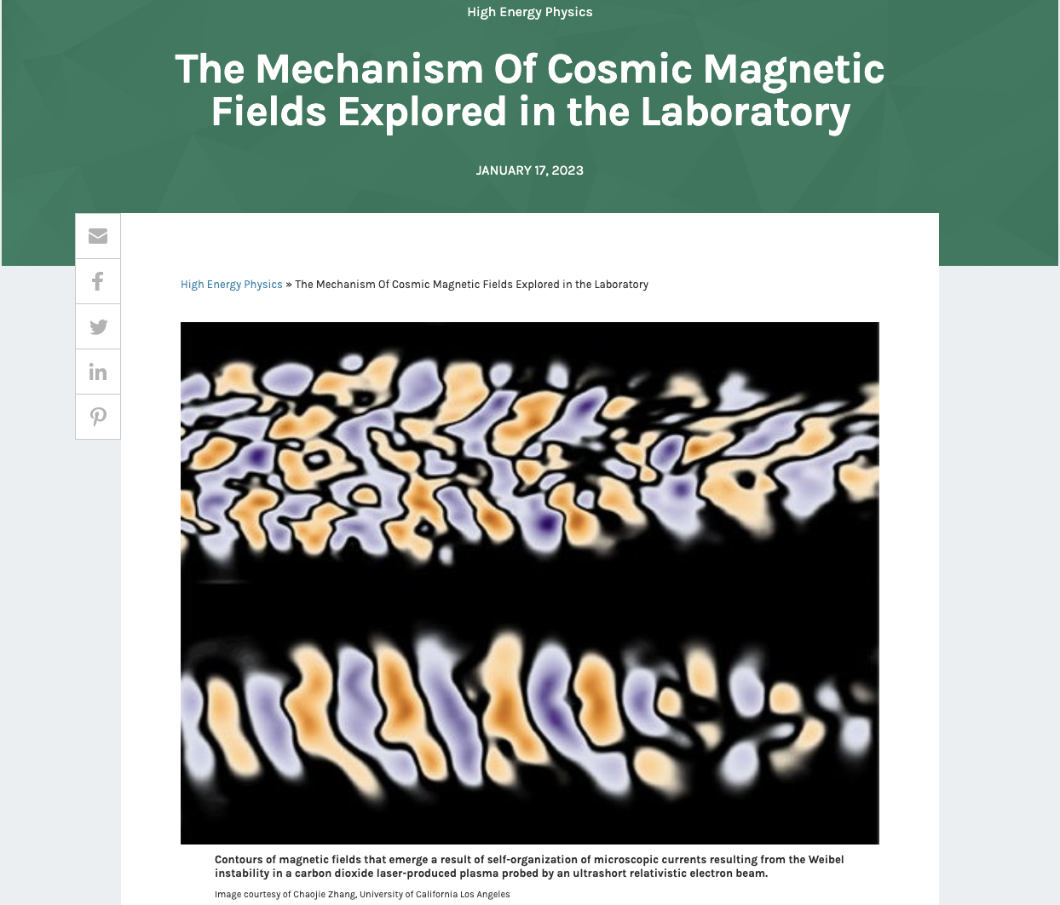
Our experiment done in 2021, published in PNAS and highlighted on the DOE website
AE-98 closeout Probing electron Weibel instability in optical-field ionized plasmas
PI’s: ChaoJie Zhang and Chan Joshi (UCLA)
Collaborators:
Yipeng Wu, Audrey Farrell, Mitchell Sinclair, Ken Marsh, Warren B. Mori (UCLA)
Irina Petrushina, Apurva Gaikwad, Navid Vafaei-Najafabadi (SBU/ATF)
I. Pogorelsky, M. Fedurin, M. Babzien, M. Polyanskiy, W. Li, R. Kupfer, K. Kusche, A. Simmonds, T. Ilardi, M. Peniera, R. Malone, G. Stenby, P. Jacob, T. Morris, K. Roy, B. Romasky, M. Long, L. Armstrong, D. Choge, M.J. Ilardi, M. Palmer (Director) (ATF)
Thank you so much!

Slide 7
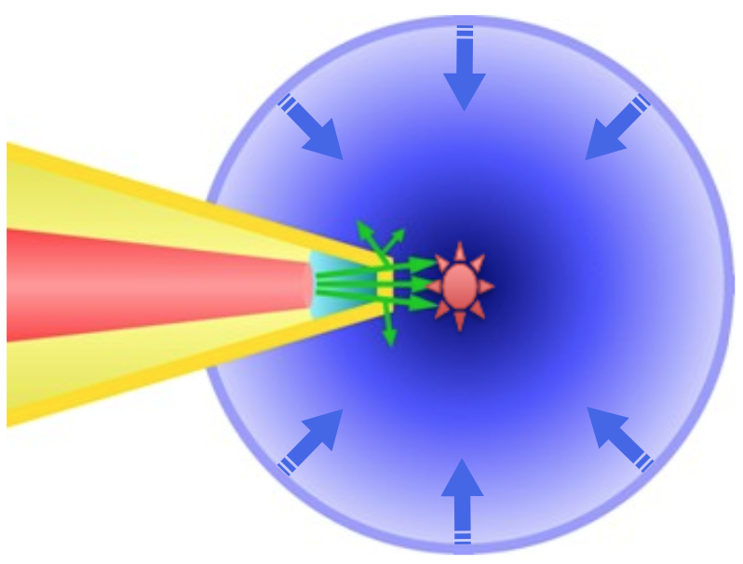
Weibel instability is relevant in many lab and astrophysical plasmas
An important mechanism for self-magnetization of many laboratory and astrophysical plasmas
Its unambiguous demonstration remains a challenge
Mediate collisionless shocks (possible accelerator for cosmic rays)
Generate bright gamma ray flashes (novel light sources)
Affect energy deposition in the fast ignition scenario (energy)
Acceleration: Collisionless shock¹
Light source: Gamma ray flash²
Energy: Laser-driven fusion³
the galaxy Cygnus a
colliding plasma creates collisionless shocks
laser
compressed fuel
filamentation of dense e-beam in plasma generates bright γ-ray flashes
electron/proton tranport in dense plasma
1) J. Meinecke et al., Nat. Phys. 2014; C. M. Huntington et al., Nat. Phys. 2015, etc.
2) A. Benedetti et al., Nat. Photonics 2018, etc.
3) M. Tabak et al., PoP 1994; A. Pukhov et al., PRL 1997; M. Honda et al., PRL 2000; M. Roth et al., PRL 2001, etc.

Slide 8
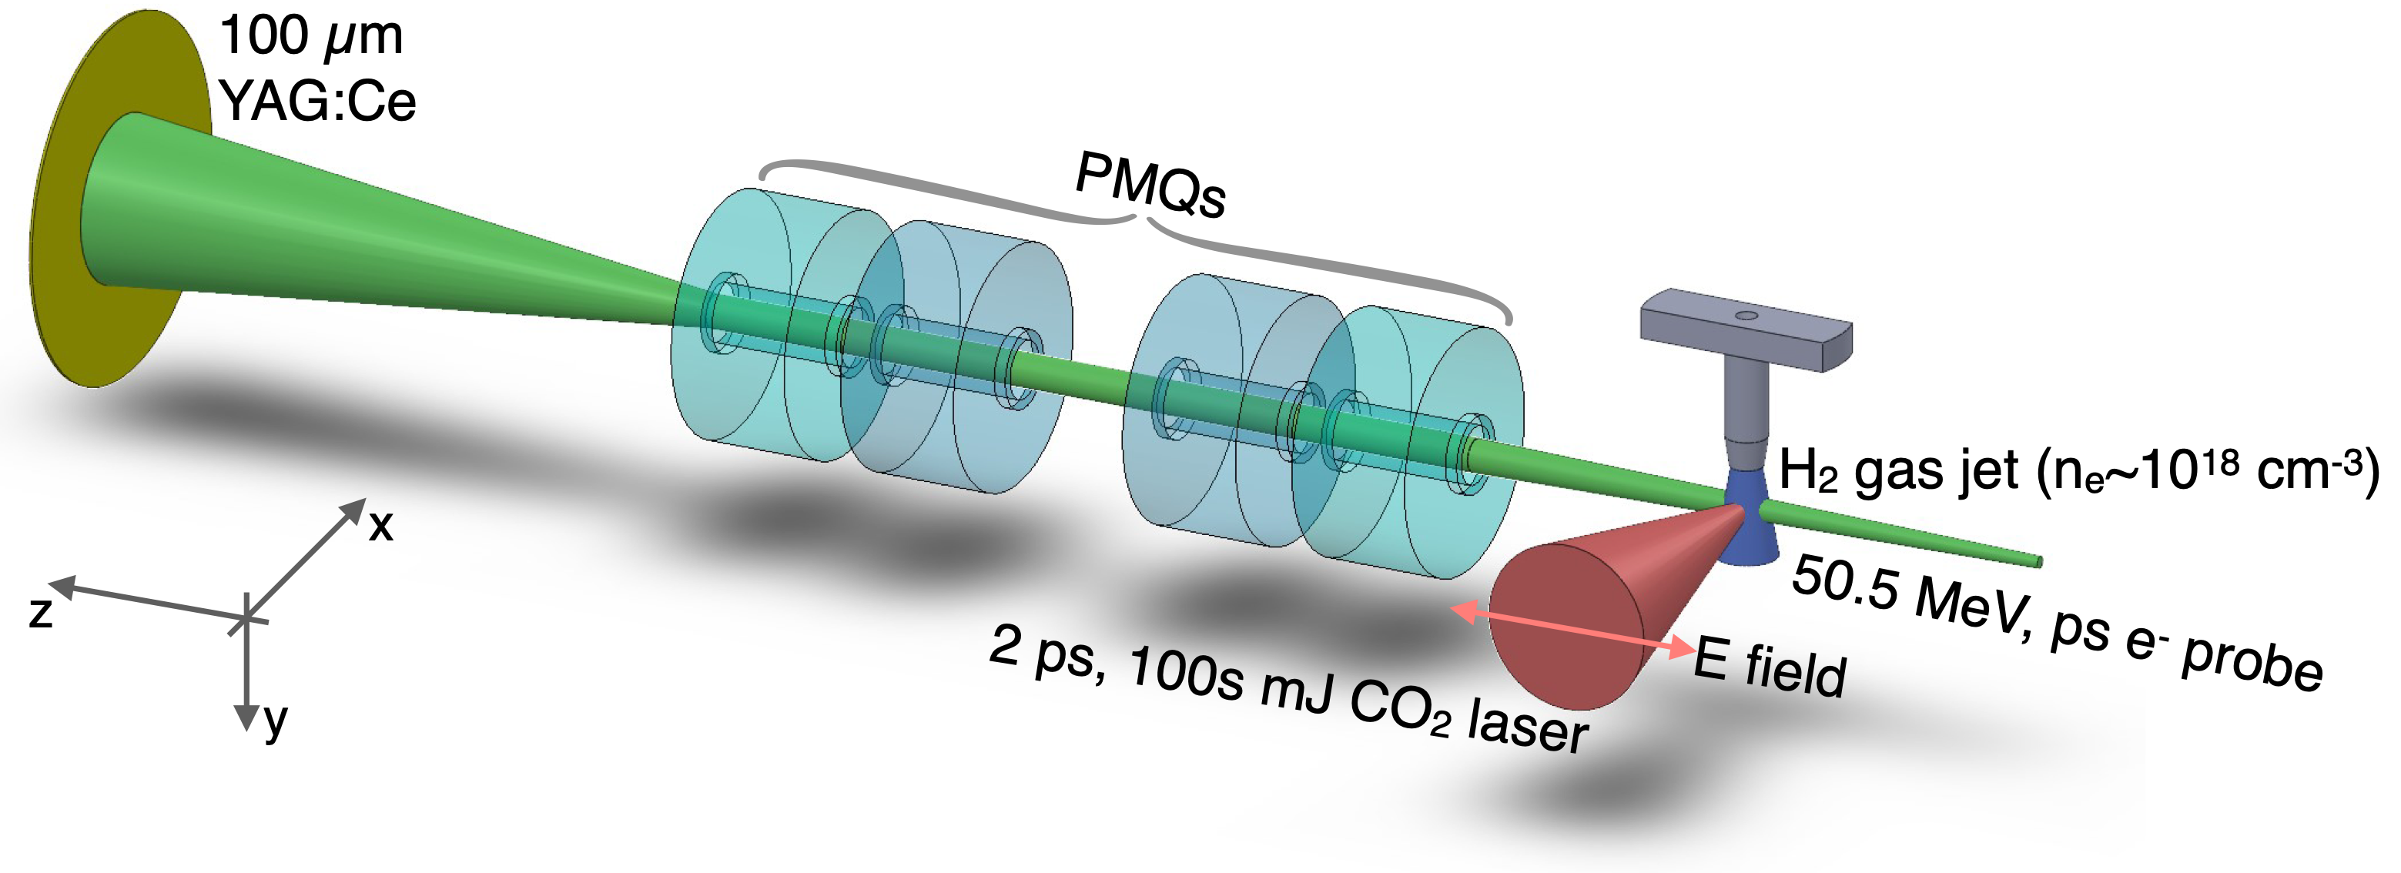
Experiment was successfully done in 2021, results published in PNAS
Optical-field ionization by CO₂ laser
Tri-Maxwellian electron velocity distribution
Plasma unstable to Weibel instability
B fields are probed by e- bunches
C. Zhang et al, PNAS 50, 119 (2022)

Slide 9
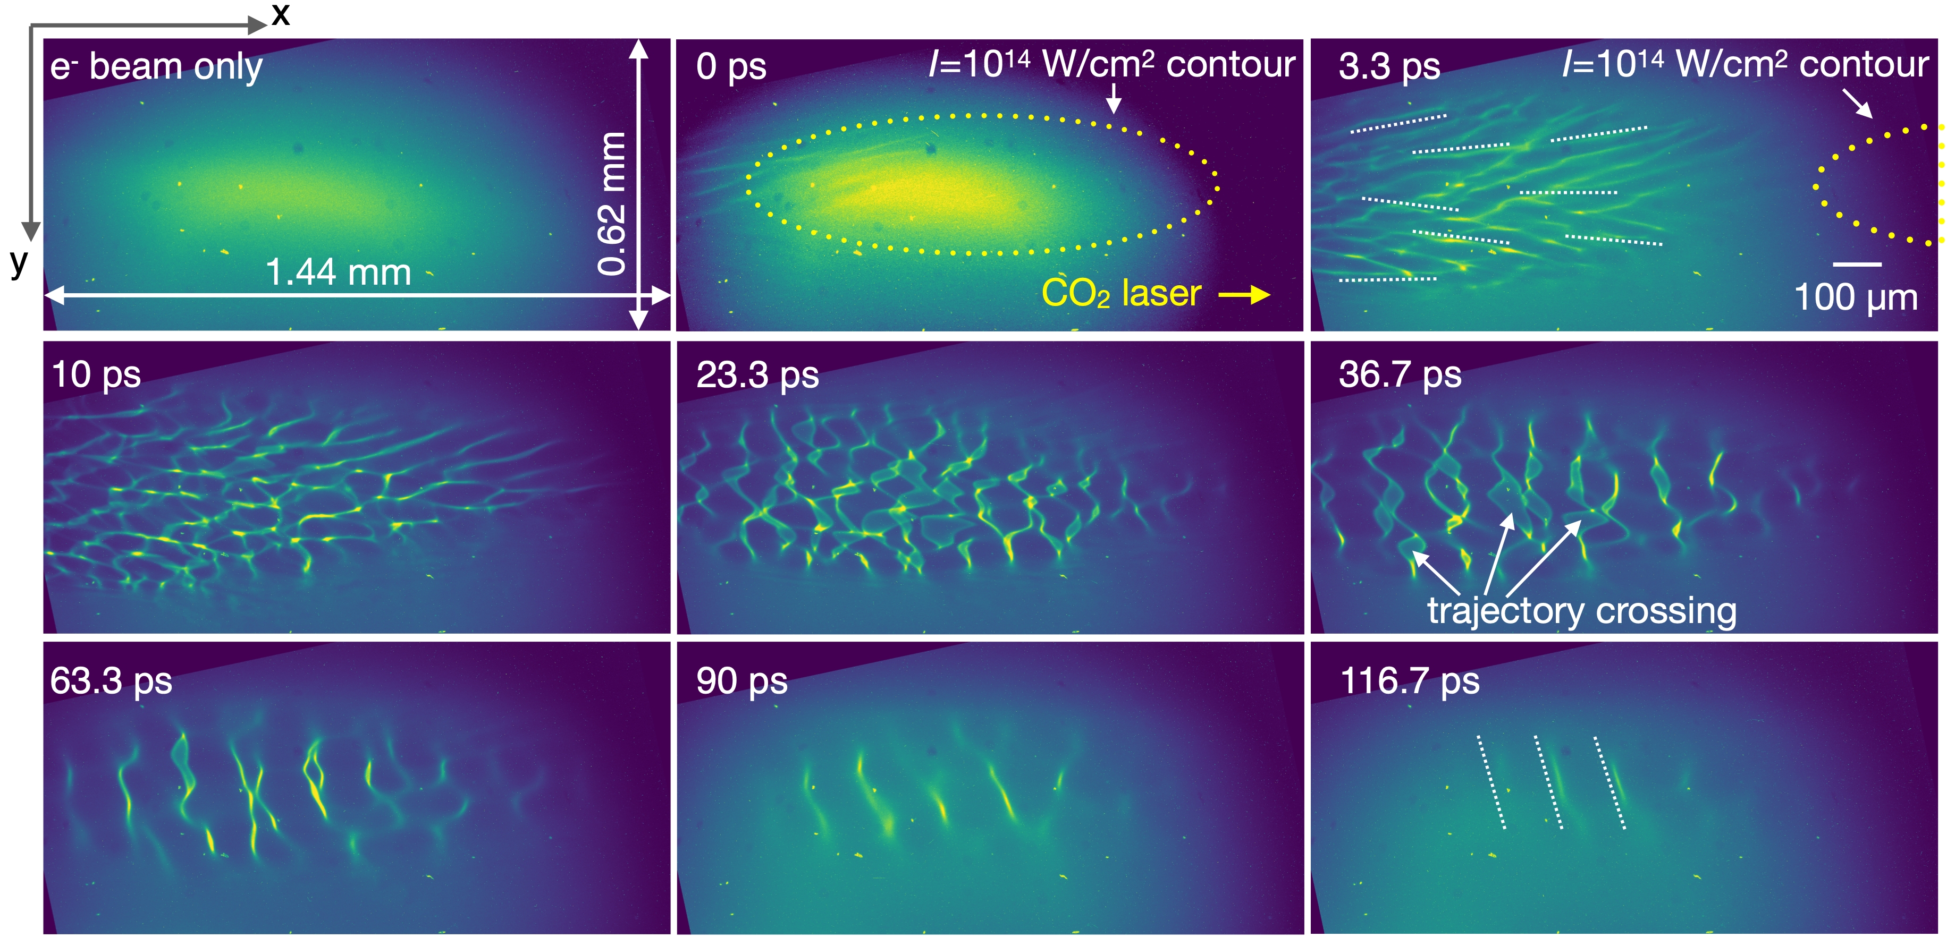
First direct observation of 2D evolution of the Weibel B fields
C. Zhang et al, PNAS 50, 119 (2022)

Slide 10
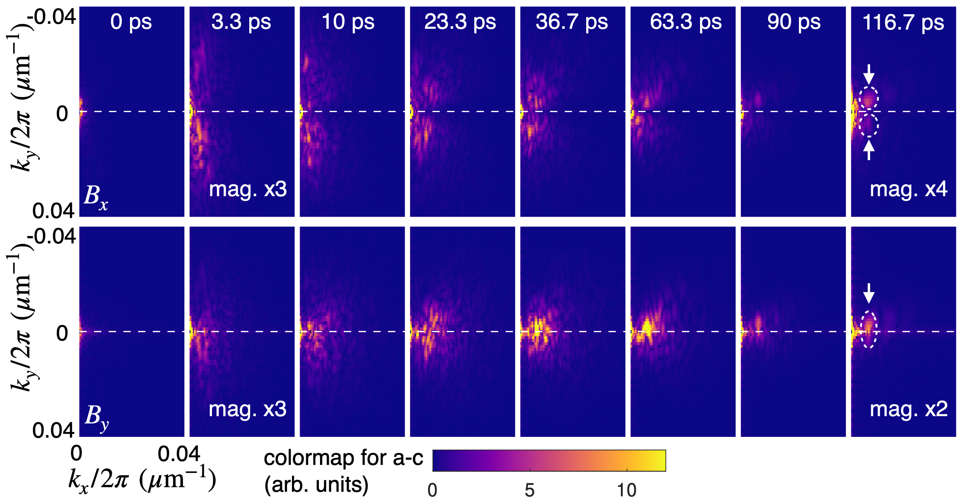
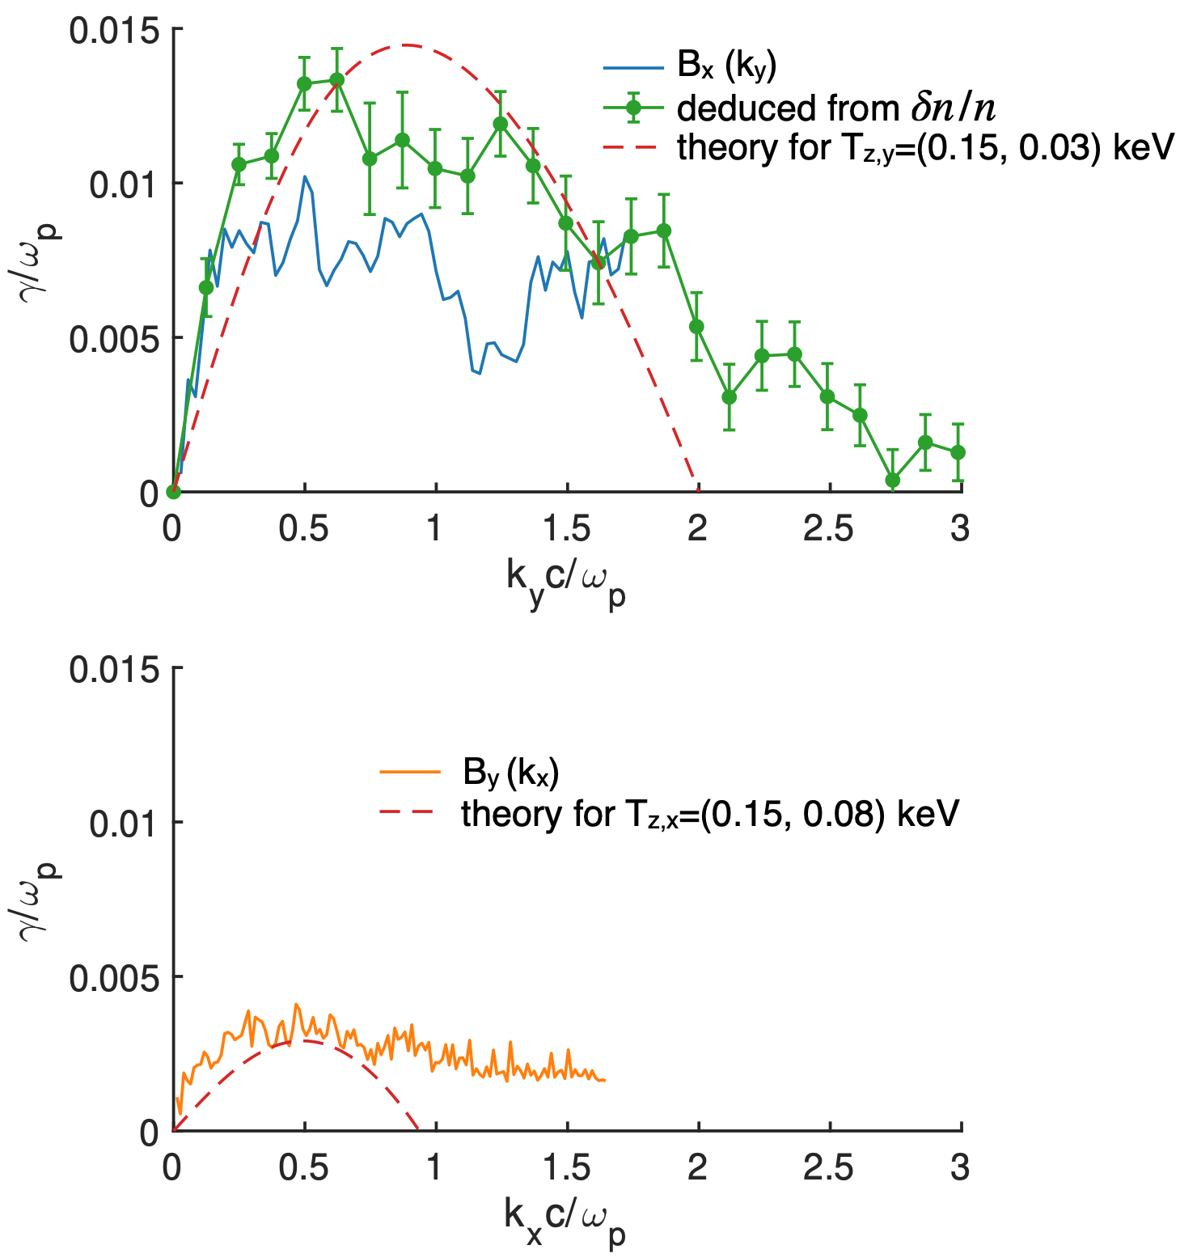
First measurement of the k-resolved growth rate
The unstable mode starts with narrow $k_{x}$ and broad $k_{y}$ and then spreads in the 2D k space
The dominating k redirects from y to x
Eventually a quasi-single mode forms
Time-resolved measurements of the k spectra allows us to calculate the k-resolved growth rate
Measured growth rates agree with theory
C. Zhang et al, PNAS 50, 119 (2022)

Slide 11
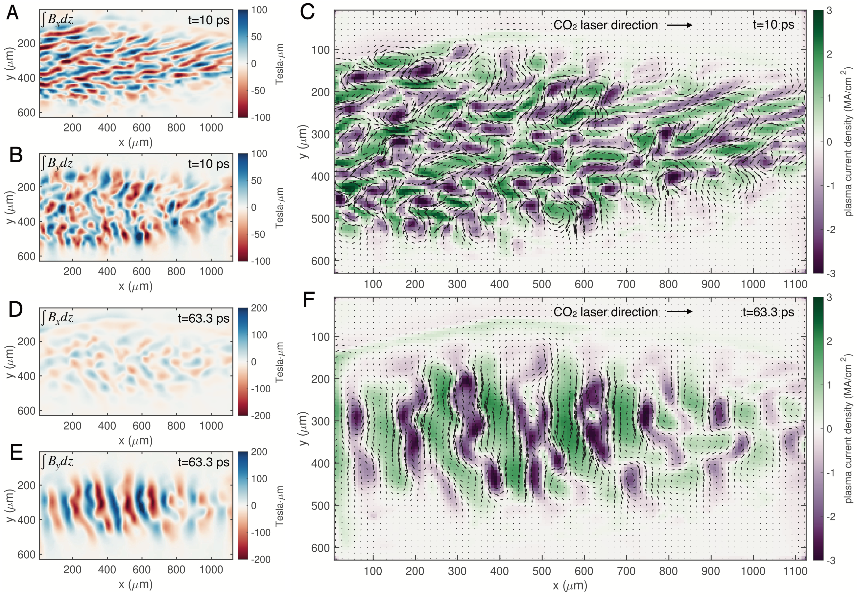
Self-organization of OFI plasma by Weibel instability
Significant amount (~1%) of thermal energy was converted to magnetic energy
Supports the hypothesis that the Weibel instability may provide the seed for galactic dynamo to produce ~µG magnetic fields that exist in the cosmos
C. Zhang et al, PNAS 50, 119 (2022)

Slide 12
The origin of galactic magnetic fields?
NASA/Hubble + SOFIA of Messier 51 “Whirlpool Galaxy"
Magnetic Streamlines
~µG magnetic fields detected by SOFIA
Background
Optical image taken by Hubble Space Telescope
What is the origin of these fields?
Primordial (fG - nG) + compression during structure formation
Weak seeds by plasma mechanisms + dynamo amplification
Weibel instability (AE-98)
Biermann battery (NP-315759)

Slide 13
Summary of results
Motivation
Self-generated magnetic fields due to Weibel instability were measured
With unprecedented picosecond, micrometer resolution
First k-resolved growth rate measurements
Conclusively demonstrated the thermal Weibel instability driven by anisotropic EVD
~1% of the thermal energy was converted to magnetic energy
Agrees with theoretical prediction
Supports that Weibel instability may be able to provide a seed for the galactic dynamo

Slide 14
PI: Chan Joshi (UCLA)
AE-98 closeout
Thermal Weibel instability induced magnetic fields co-exist with linear wakes in laser ionized plasmas
Collaborators:
Yipeng Wu, Audrey Farrell, Mitchell Sinclair, Ken Marsh, Warren B. Mori, Chan Joshi (UCLA)
Irina Petrushina, Apurva Gaikwad, Navid Vafaei-Najafabadi (SBU/ATF)
I. Pogorelsky, M. Fedurin, M. Babzien, M. Polyanskiy, W. Li, R. Kupfer, K. Kusche, A. Simmonds, T. Ilardi, M. Peniera, R. Malone, G. Stenby, P. Jacob, T. Morris, K. Roy, B. Romasky, M. Long, L. Armstrong, D. Choge, M.J. Ilardi, M. Palmer (Director) (ATF)
Thank you so much!

Slide 15
Self-modulated linear wakes formation
SM-LWFA
Linear wake formation:
CO₂ Laser
9.2µm
a_{o}: 0.2
Wake:
n_{e}: 1x10¹⁷ cm⁻³
λ_{wake}: 105.5 µm
Thermal Weibel instability induced magnetic fields co-exist with linear wakes in laser-ionized plasmas, In-prep for Physics of Plasmas, Y. Wu et. al, available on arXiv

Slide 16
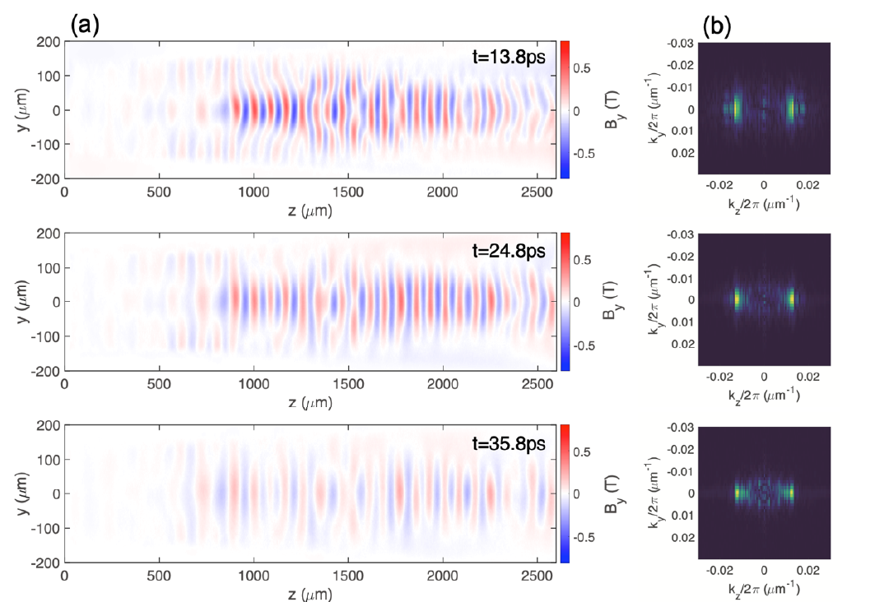
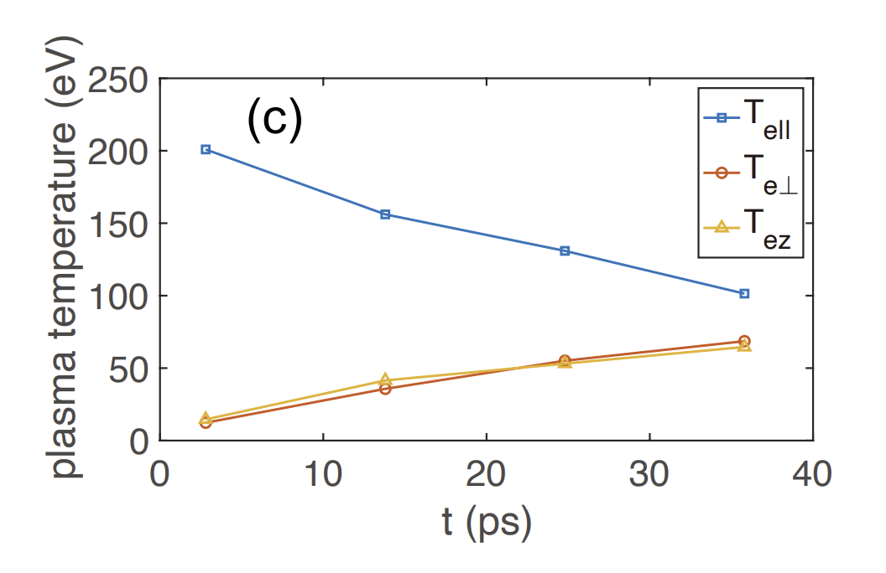
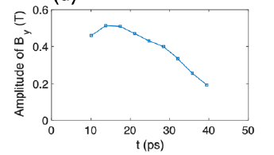
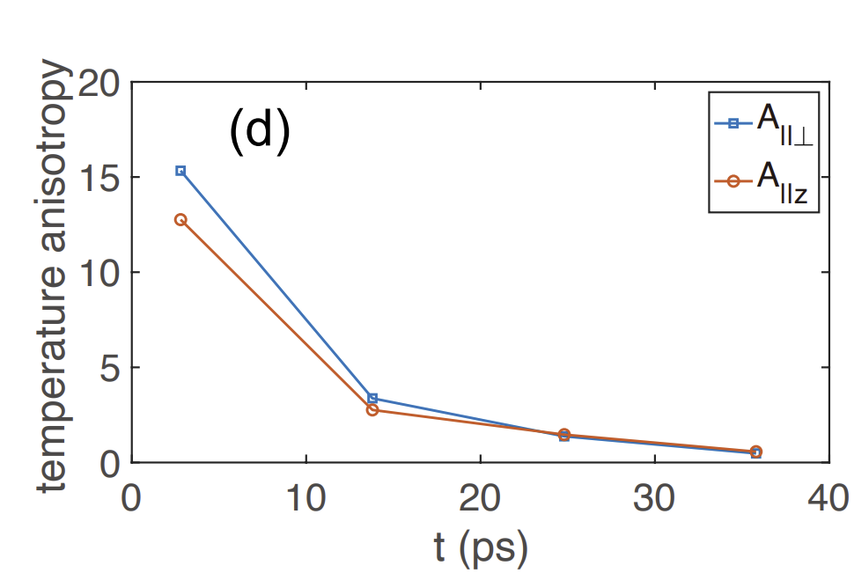
Weibel magnetic field evolution
Weibel fields /w linear wake
Magnetic Field morphology:
$\overset{⃑}{J}$ (Weibel induced currents)
counter-propagating → repel
co-propagating → attract
$\overset{⃑}{B_{x,y}}$ (Weibel magnetic fields)
spatially limited by the transverse width
$\overset{⃑}{B_{y }}$ 0.5 T
Thermal Weibel instability induced magnetic fields co-exist with linear wakes in laser-ionized plasmas, In-prep for Physics of Plasmas, Y. Wu et. al, available on arXiv

Slide 17
Synthetic Probe (50.5 MeV) Images

Slide 18
Experimental Evidence: Wake co-exists /w Weibel
Electron Beam probing Results
Probed and characterized the Weibel fields present in SM-LWFA Wakes
Shown co-existence of Weibel fields in self-modulated wakes
Reconstructed the magnetic fields associated with the bounded wakes.
Thermal Weibel instability induced magnetic fields co-exist with linear wakes in laser-ionized plasmas, In-prep for Physics of Plasmas, Y. Wu et. al, available on arXiv

Slide 19
PI: Chan Joshi (UCLA)
AE-99
Directional x-ray radiation produced by a plasma magneto-static undulator
Collaborators:
Yipeng Wu, Mitchell Sinclair, Audrey Farrell, Chaojie Zhang, Ken Marsh, Frank Tsung, Warren B. Mori (UCLA)
Irina Petrushina, Apurva Gaikwad, Navid Vafaei-Najafabadi (SBU/ATF)
I. Pogorelsky, M. Fedurin, M. Babzien, M. Polyanskiy, W. Li, R. Kupfer, K. Kusche, A. Simmonds, T. Ilardi, M. Peniera, R. Malone, G. Stenby, P. Jacob, T. Morris, K. Roy, B. Romasky, M. Long, L. Armstrong, D. Choge, M.J. Ilardi, M. Palmer (Director)
Thank you so much!

Slide 20
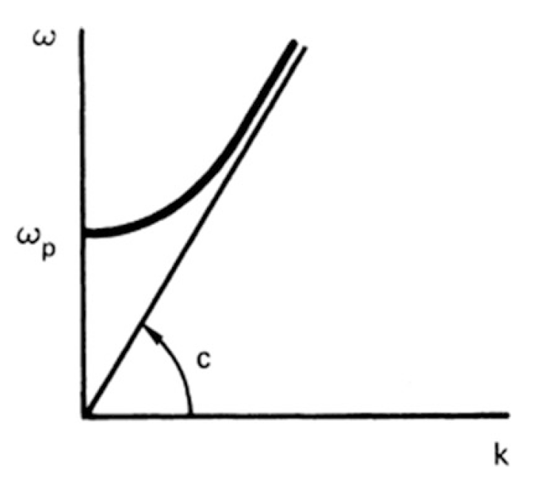
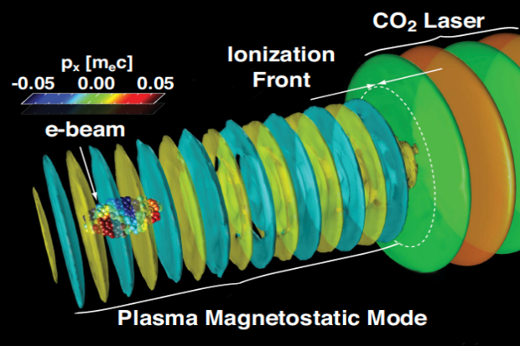
Fundamental Modes in an Unmagnetized Plasma
Electromagnetic Mode | ElectroStatic Modes | Magnetostatic Mode
Light Waves | Langmuir Wave Ion Acoustic wave | Stationary ω=0 magnetic mode
Fiuza, F., Silva, L. O., & Joshi, C. (2010). High-brilliance synchrotron radiation induced by the plasma magnetostatic mode. Physical Review Special Topics - Accelerators and Beams, 13(8), 1–5. http://doi.org/10.1103/PhysRevSTAB.13.080701
F. F. Chen, Introduction to Plasma Physics and Controlled Fusion. Cham: Springer International Publishing, 2016. doi: 10.1007/978-3-319-22309-4

Slide 21
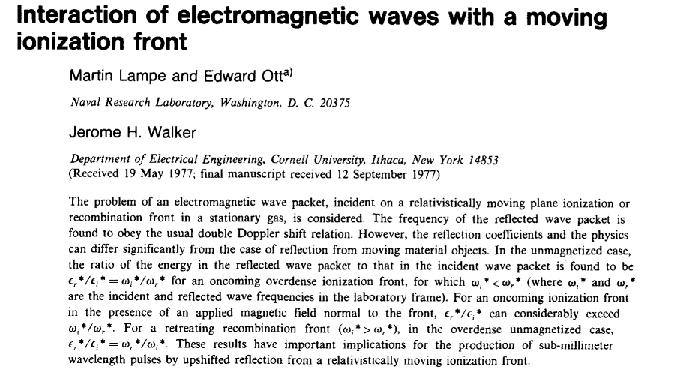
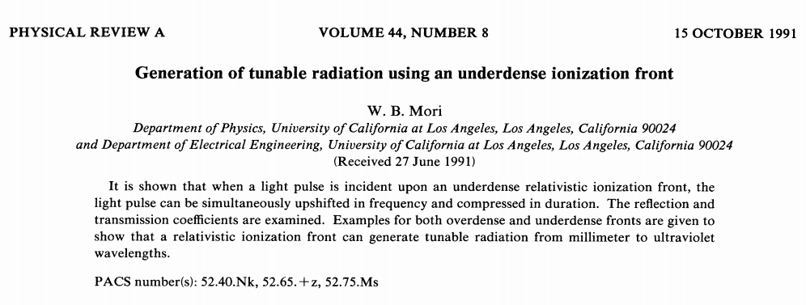
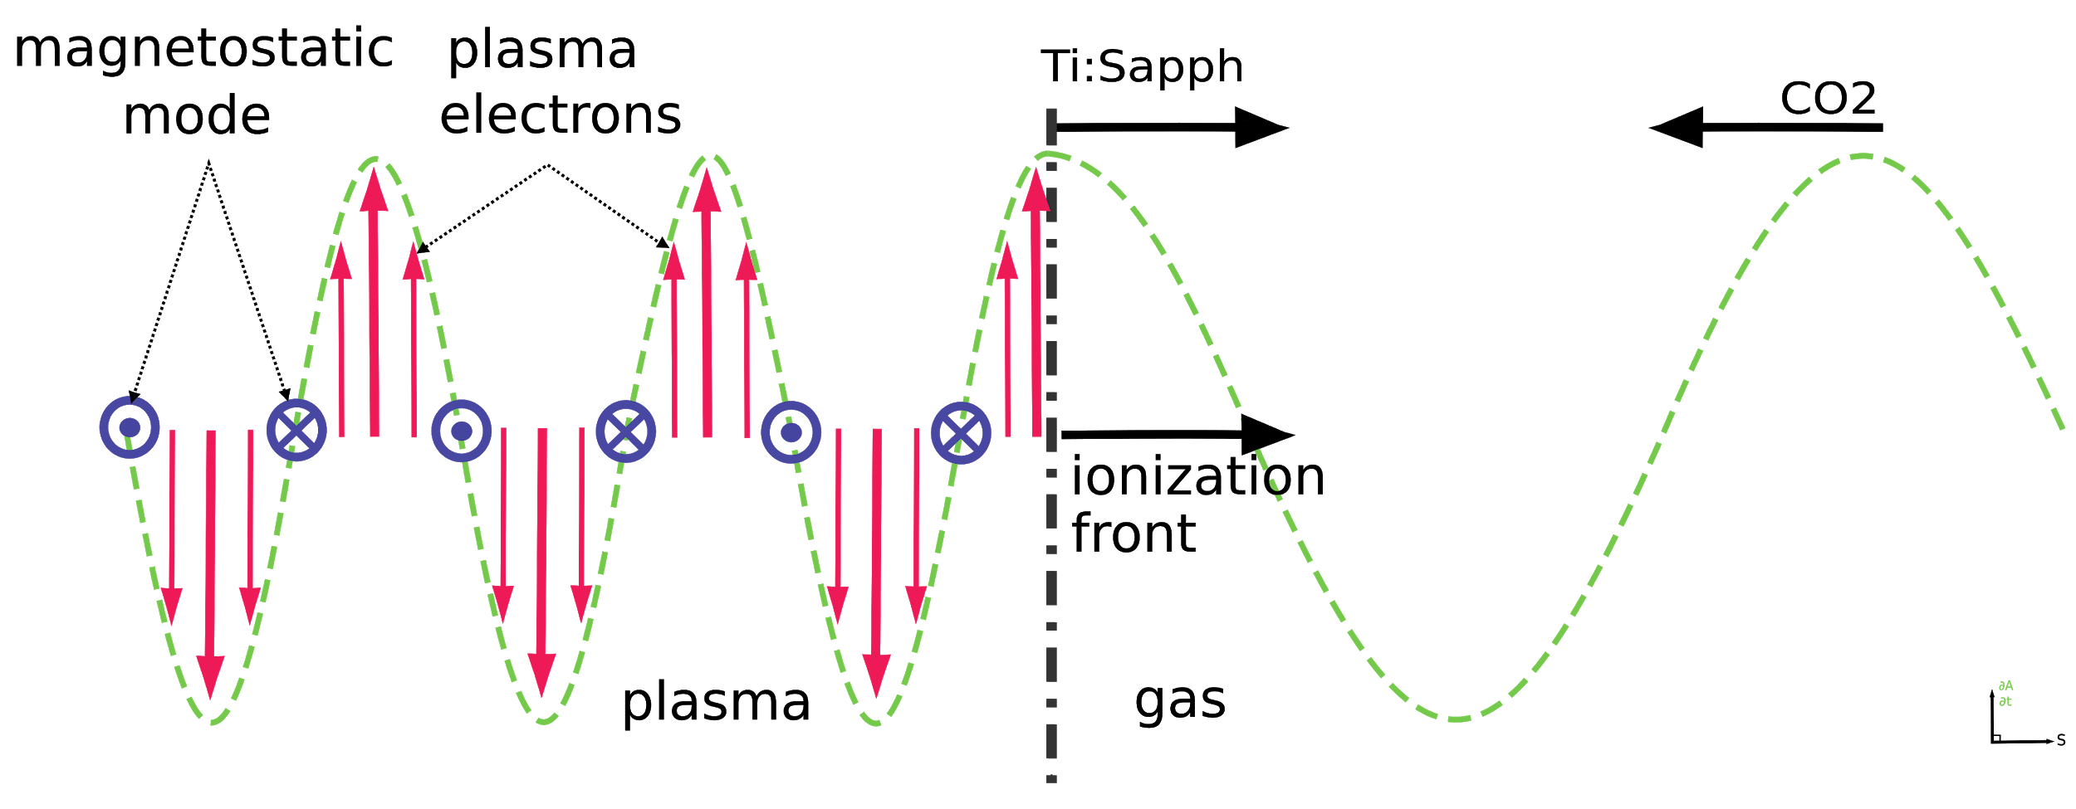
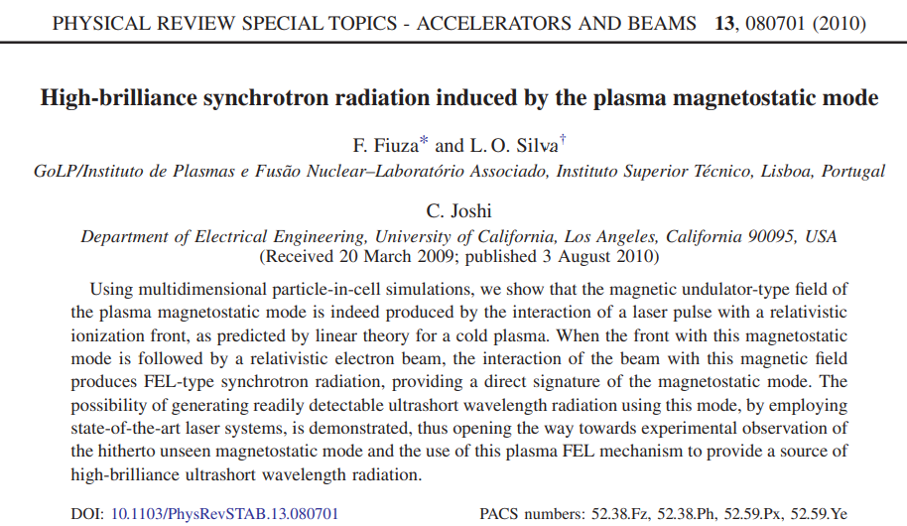
Experimental Method to Excite the Magneto-Static mode
TiSa Laser
TiSa Driven
Ionization Front /w Width < 4.6 μm
CO₂ Laser
Underdense
ionization
fronts
Synchrotron
radiation
via a static magnetic field in plasmas
Overdense ionization
fronts
I_{o} >> 10¹⁴ W/cm²
λ_{laser} = 800 nm
τ_{laser} < 70 fs (21 µm)
I_{o} < 10¹⁴ W/cm²
λ_{laser} = 9.2 µm
cτ_{Laser}:
750 µm (2.5 ps)
H₂ Gas Jet n_{e} = 1-10x10¹⁹ cm⁻³
$$\frac{∂A}{∂t}=−E_{CO2}$$
Fiúza F., ‘Multi-scale PIC modeling of high energy density scenarios: from laboratory to astrophysics’, Doctorate Thesis, Universidade Técnica de Lisboa Instituto Superio Técnico, Lisbon

Slide 22
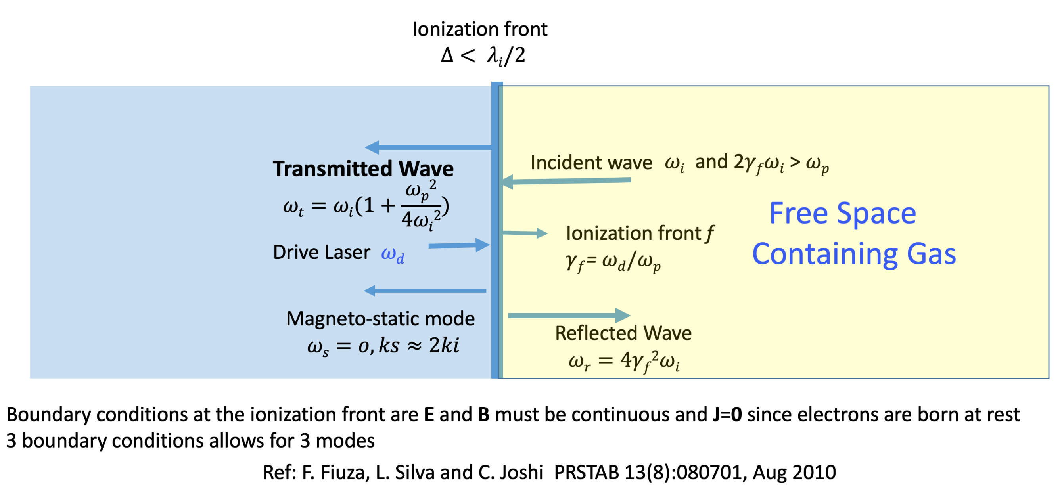
What happens when e.m. wave is incident on a relativistic underdense plasma ionization front?
Plasma

Slide 23
AE-99 Layout
Lens
Tx Spec.
5 - 9.2um
Wavelength
dispersive
element
Focusing
lens
Pyrocam IV
CO2 laser
Ti:Sapph
Experimental Setup
Counter propagating CO2 & Ti:Sapph lasers
Ti:Sapph laser creates an ionizing front as it passes through the gas jet
CO2 laser strikes the ionization front and sets up the magnetostatic mode
Plasma Diagnostics
Electron beam performs first imaging of the imaging ms-mode B-field
Reflected or Transmitted light are analyzed by their respective spectrometers
Thomson Scattering diagnoses ion density perturbations of the ms-mode
Tx collimating
OAP
Quads
Linac
BPM
gas jet
IP
Beam dump
PMQ’s
e - diag
Bragg Diffraction Spectrometry
CO₂
OAP
Ti:Sapph Spot Sizes 5mJ energy
Position | Distance from IP | Spot Size
IP | - | 80.2 um
Tx OAP | 152 mm | 479 um
Window | 359 mm | 1.13 mm / 0.12 J/cm²
Lens | 2000 mm | 12.7 mm
Focusing
lens
Wavelength
dispersive
element
Collimating
lens
Pyrocam IV
Rx Spec. 2-5um

Slide 24
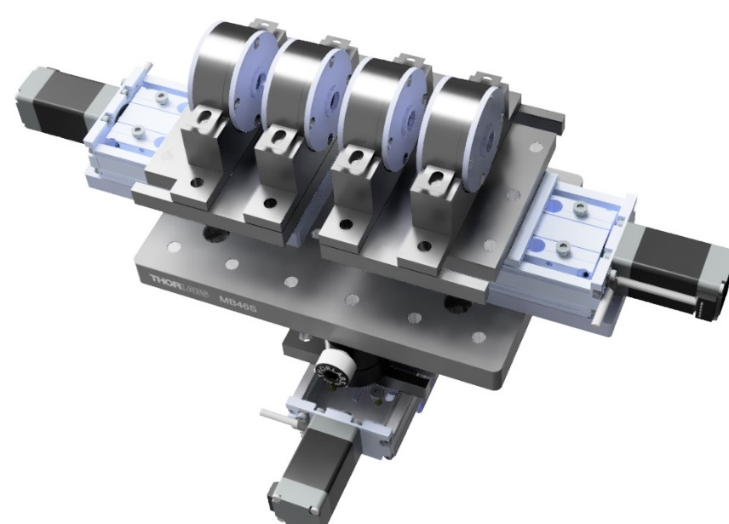
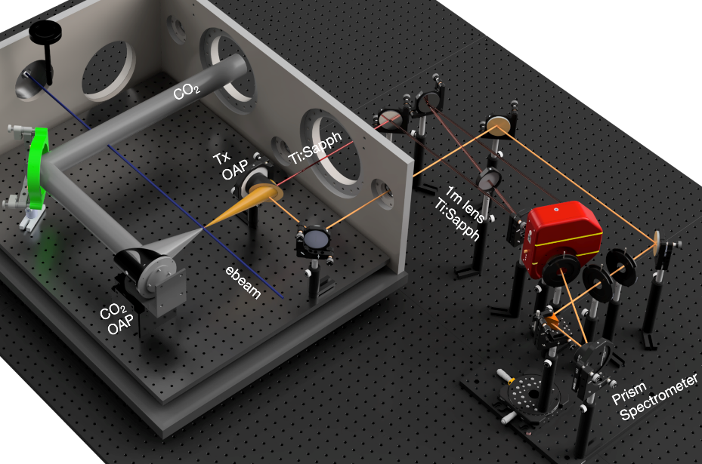
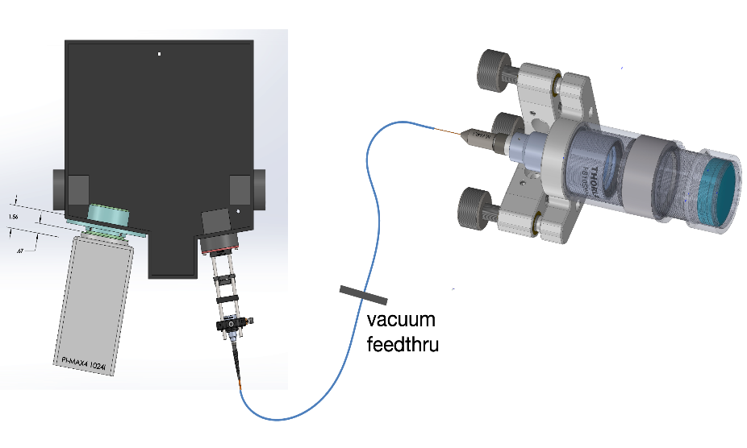
Experimental campaign for Year 2022
Developed/optimized the PMQ imaging system, LWIR spectrometer, and Thomson scattering diagnostic
We attempted the AE99 experiment at ATF. Although we did not obtain the desired results, we made some progress. The preliminary data we collected allow us to figure out how to improve the AE99 experiment in the future.
With the similar setup, we obtained some interesting results of Weibel instability and stimulated Raman backscattering instability
PMQ
LWIR spectrometer
Thomson scattering

Slide 25
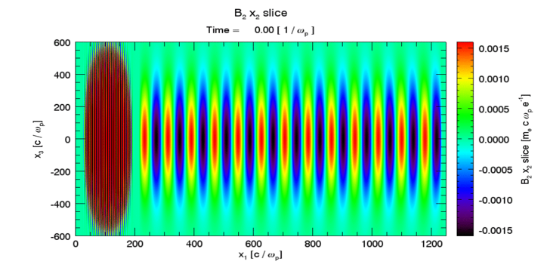
2D Slab Visualization of the 3D Magnostatic Mode
Ti:Sapph Laser
CO₂ Laser
[8] 2D Osiris PIC
Plasma density: n_{e} =1x10²⁰ cm⁻³
[9] Slide courtesy of Dr. Yipeng Wu

Slide 26
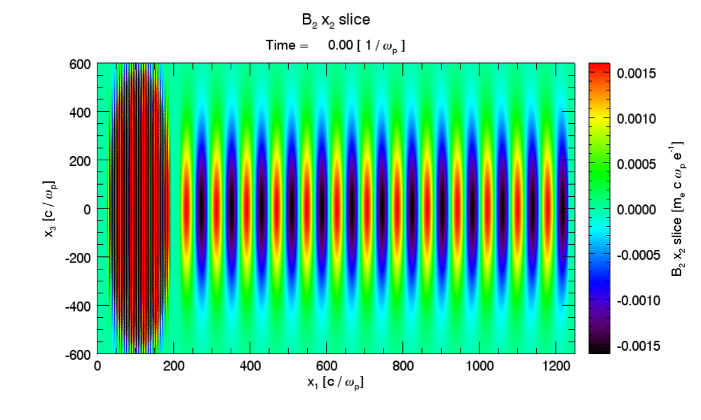
2D Slab Visualization of the 3D Magnostatic Mode
Ti:Sapph Laser
CO₂ Laser
[8] 2D Osiris PIC
Plasma density: n_{e} =1x10²⁰ cm⁻³
[9] Slide courtesy of Dr. Yipeng Wu

Slide 27
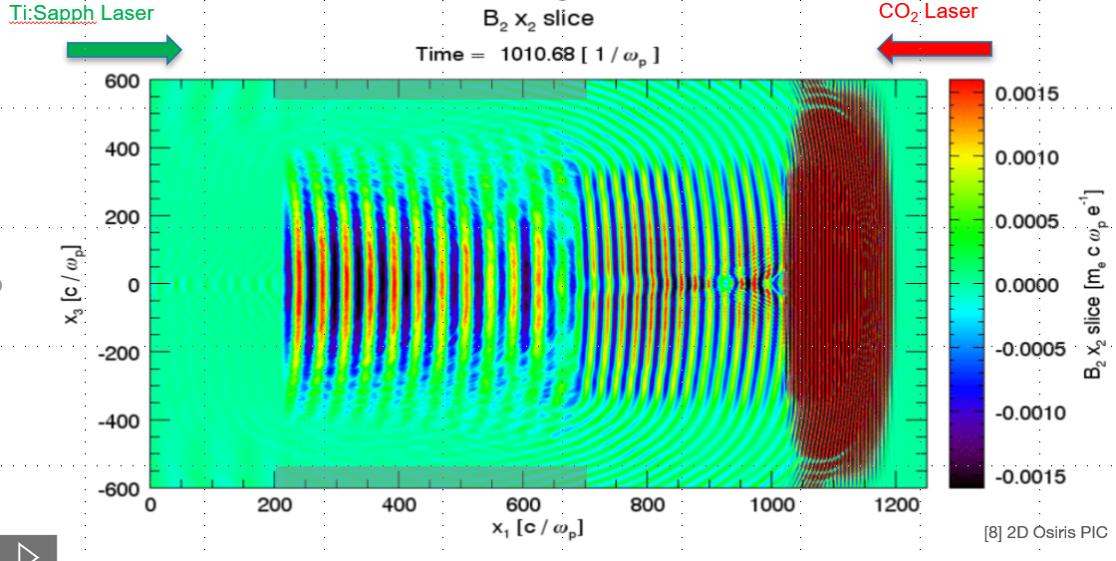
Observable 1: Magneto-static (MS) mode
Ti:Sapph Laser
CO₂ Laser
[8] 2D Osiris PIC
Plasma density: n_{e} =1x10²⁰ cm⁻³
[9] Slide courtesy of Dr. Yipeng Wu

Slide 28
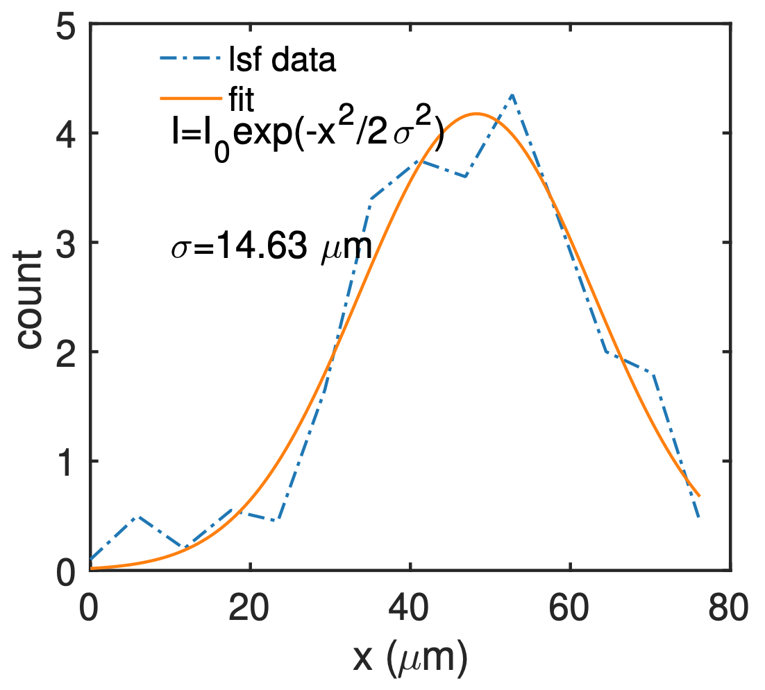
Observable 1: Magneto-static (MS) mode
2.8 µm resolving power measured using the 2000-mesh TEM grid at GPOP10
Bar width 5 µm
Hole width 7.5 µm
σ = 14.63/12.37 ≈ 1.2 µm
Resolving power: ~2.8 µm
B field wavelength: 4.6 µm
Overall magnification (e- beam + optical): ~12.4x
Optical magnification: 3.34x
PMQ e- beam magnification: 3.7x (design ~3.8x)

Slide 29
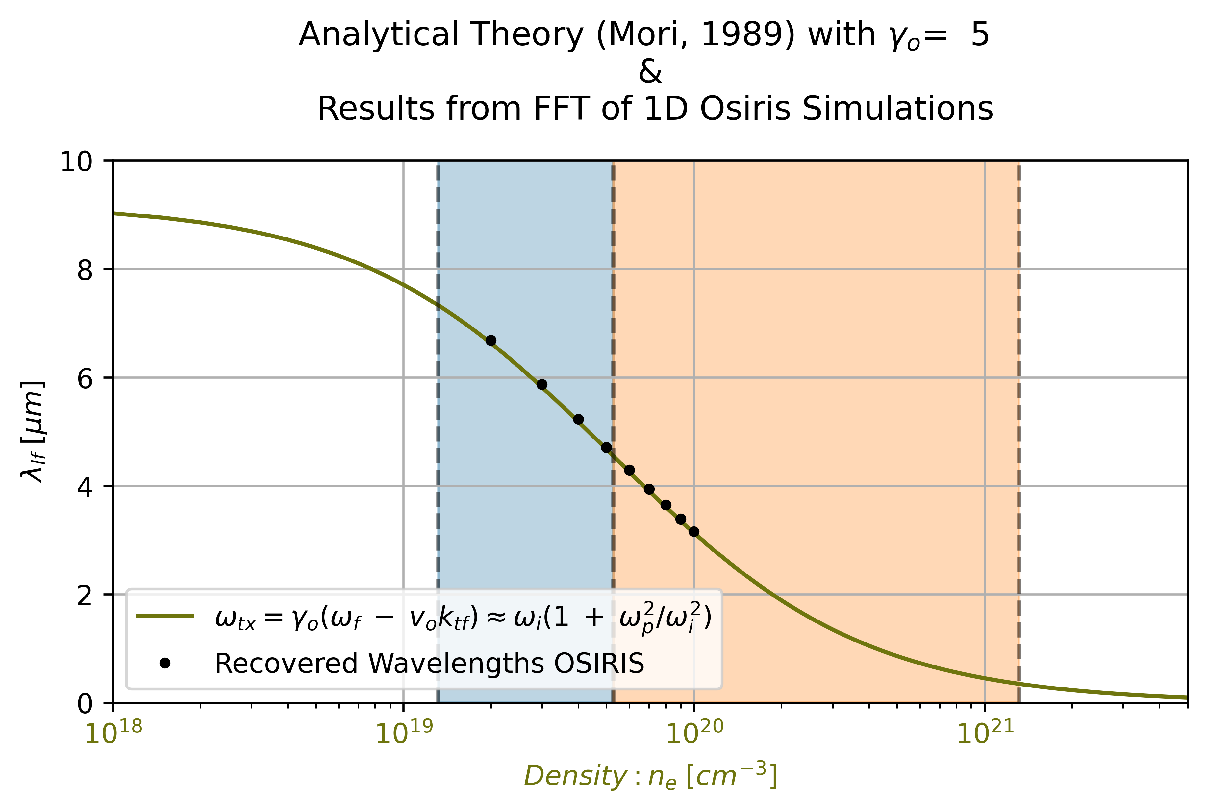
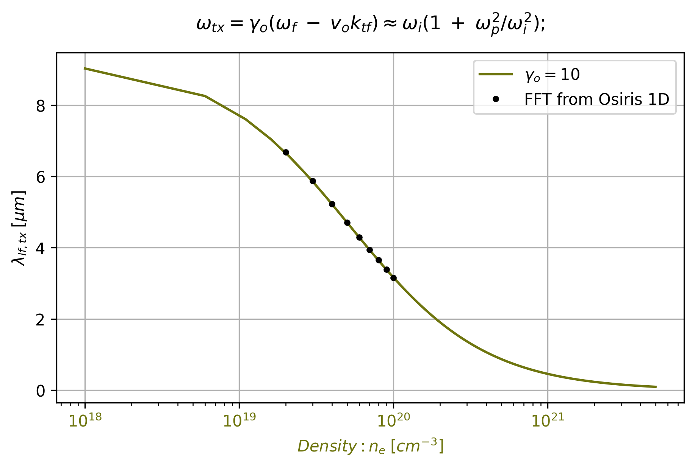
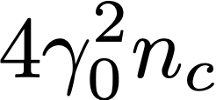
Observable 2: Frequency upshifted electromagnetic waves
When: $ω_{ff,tx }^{2}≫ γ_{o}^{2} ω_{p}^{2}$
η → small & we have
$ω_{ff,tx }^{2}γ_{o}^{2} /ω_{p}^{2}≈4ω_{lf,i}^{2}/ω_{p}^{2}≫1$
small frequency upshift
When: $ω_{ff,tx }^{2}≪ γ_{o}^{2} ω_{p}^{2}$
η → 2, efficient to excite magnetostatic mode
Large frequency upshift & pulse compression
+k_{tx}
-k_{tx}
+k_{rx}
Relativistic Underdense
Underdense
$$n_{p}< {4n}_{c}$$
$$4n_{c}{≪n}_{p}≪4γ_{o}^{2}n_{c}$$
Overdense
$$n_{p}< n_{c}$$
$$n_{p}≫4γ_{o}^{2}n_{c}$$
$$v_{g, CO2}<v_{interface}$$

Slide 30
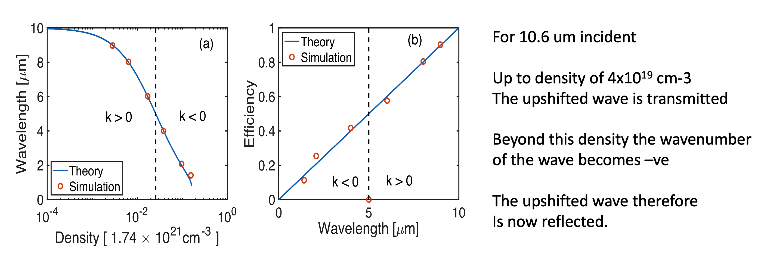
Observable 2: Frequency upshifted electromagnetic waves
Zan Nie, Yipeng Wu, et al., Phys. Plasmas 28, 023106 (2021)

Slide 31
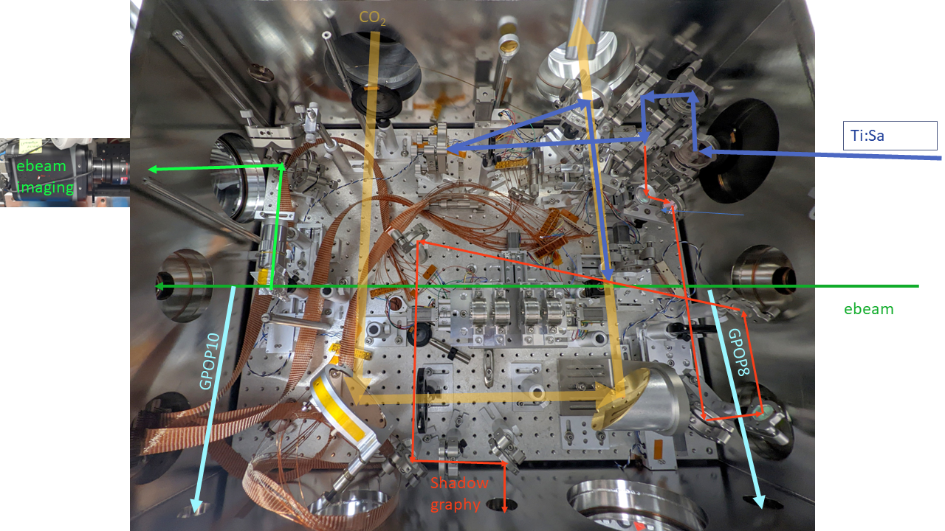
AE-99: Experimental layout 2022
CO2 laser
IR spectrometer
Ti:Sa laser ~10-20mJ, ~68fs
100 µm YAG:Ce
IP
50.5 MeV e-beam
~0.2% energy spread (use slit)
motorized PMQs

Slide 32
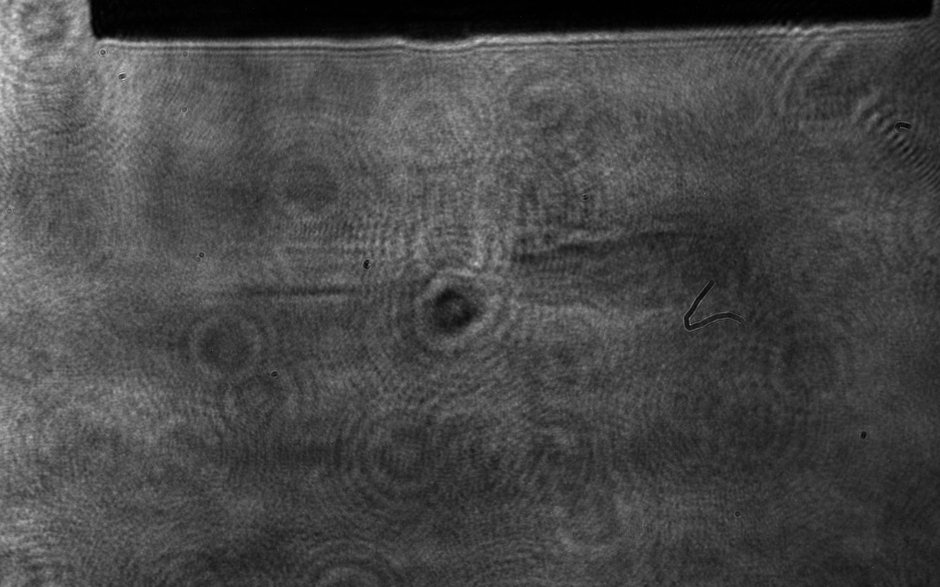
Observation /w Optical Shadowgraphy
Synchronization and overlapping
Synchronization of Ti:Sa and CO₂ is done using the optical shadowgraph (relatively large jitter ~10ps)
Synchronization of e-beam and CO₂ is done using the electron imaging method
Spatial overlapping of Ti:Sa and CO₂ is done using the optical shadowgraph (vertical direction) and a needle tip (within 100 µm)
Gas jet
metal needle
Ti:Sa
CO2
CO2
ionization due to Ti:Sa
ionization due to CO2

Slide 33
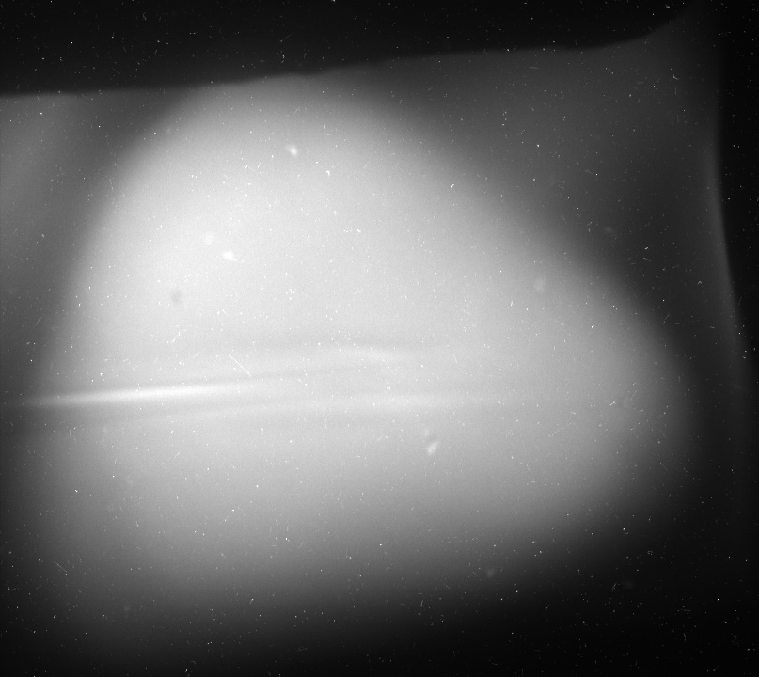
e-probing data with PMQ
The PMQ e-beam imaging system could probe the ionization line very well.
CO2
Ti:S
Ti:Sa

Slide 34
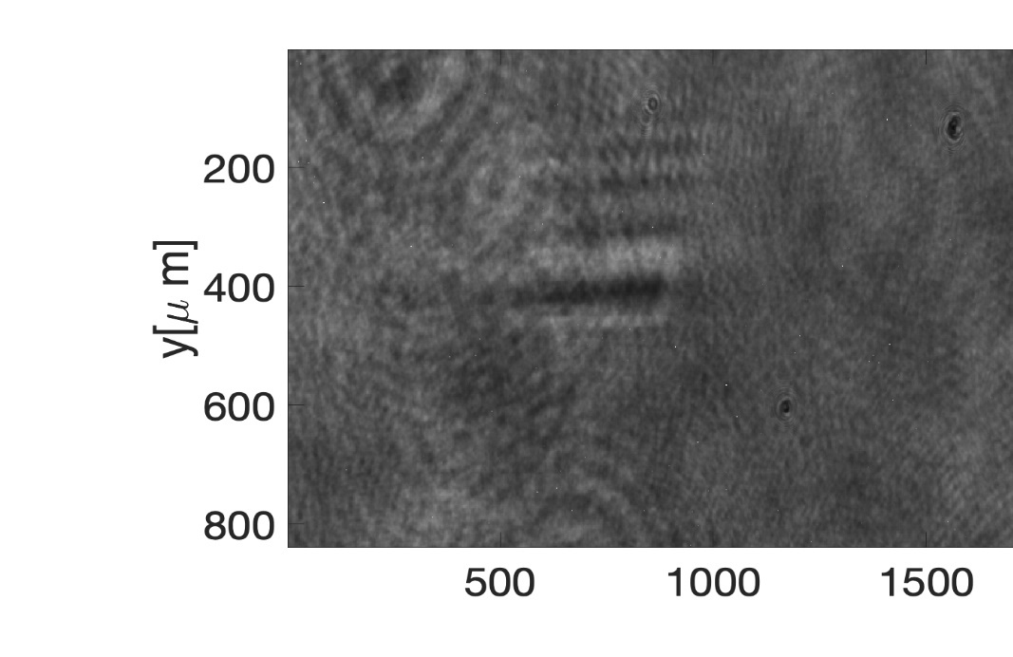
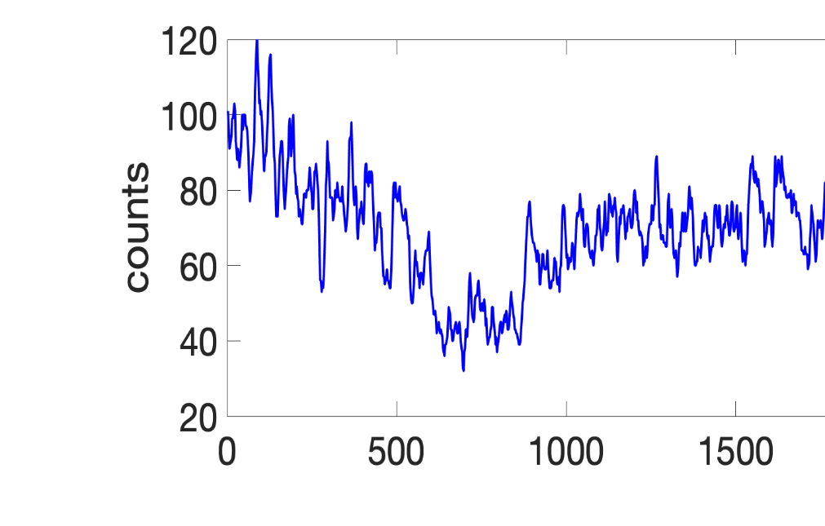
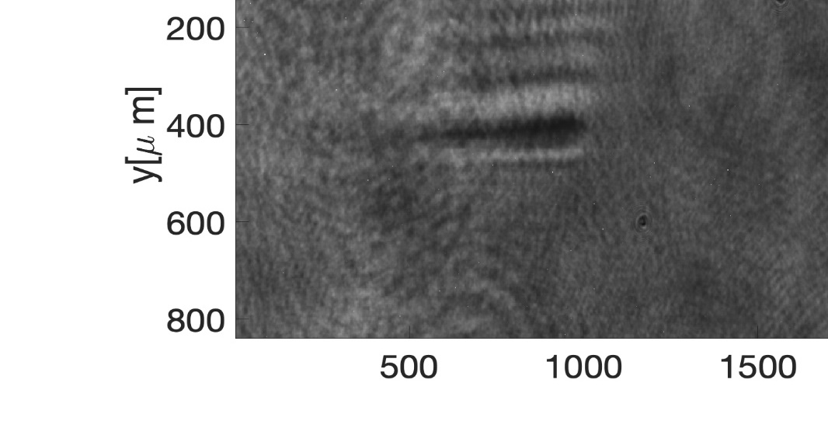
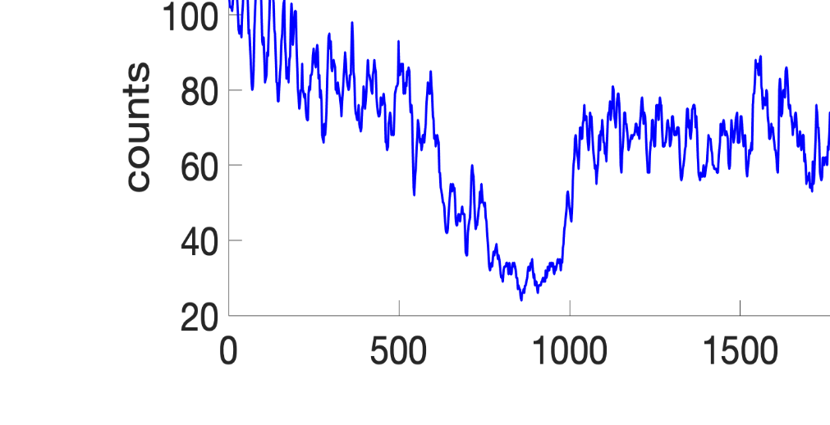
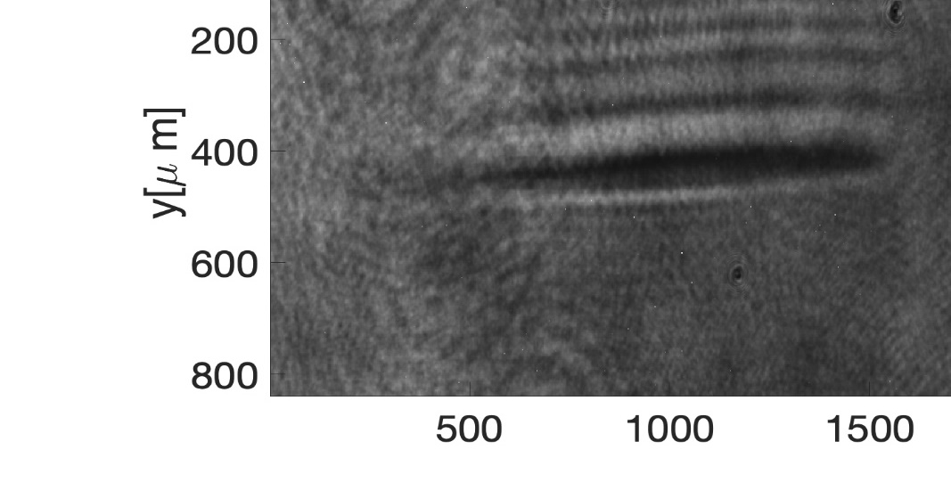
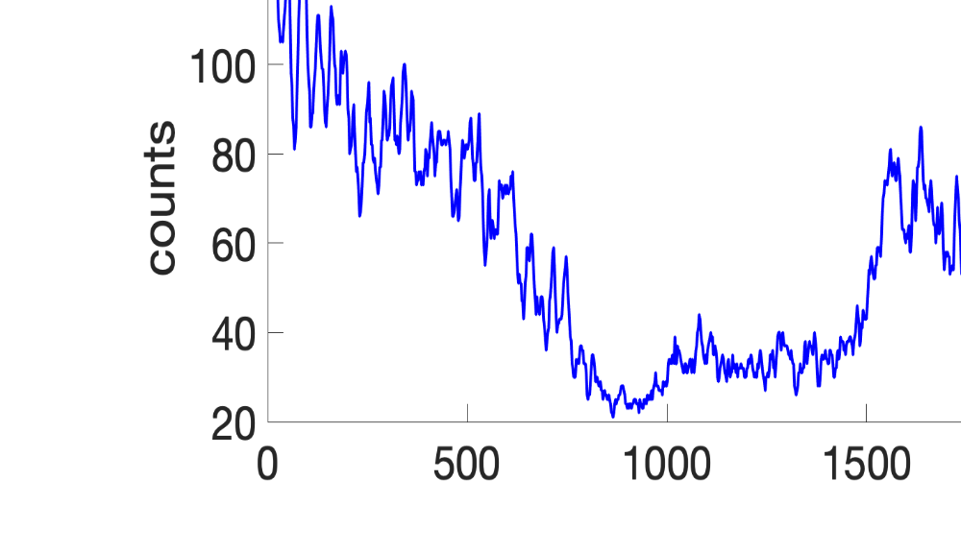
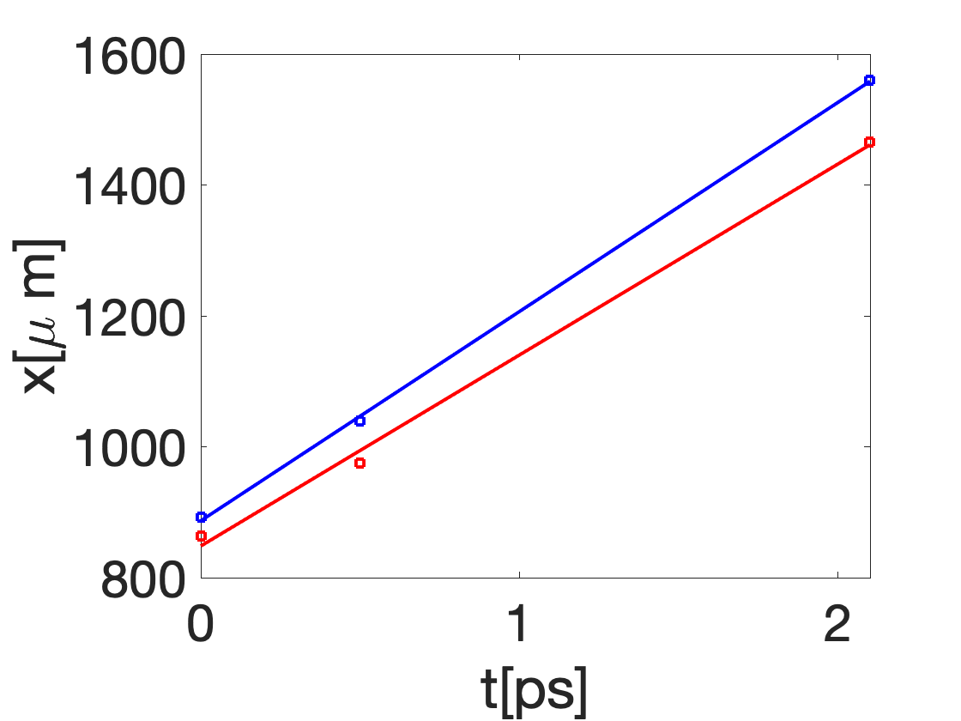
Ionization front measured using optical shadowgraph (2021)
Associated Ti:S Laser Parameters
Pulse length >70 fs
Energy: ~4 mJ on target
Focal spot size ~50 µm
Focal quality not good due to aberration and maybe spatial chirp
Ti:Sa
T=0 ps
ionization front
~31 µm
Resulting Experimental Observables
Excite an ionization front over 2 ps (600 µm, 120 periods of B field)
Ionization front width > 30 µm, larger than ½ CO2 wavelength
T=0.5 ps
~65 µm
Ionization Front speed
T=2.1 ps
right: 1.066 c
2.095 µm/pixel
~94 µm
left: 0.973 c

Slide 35
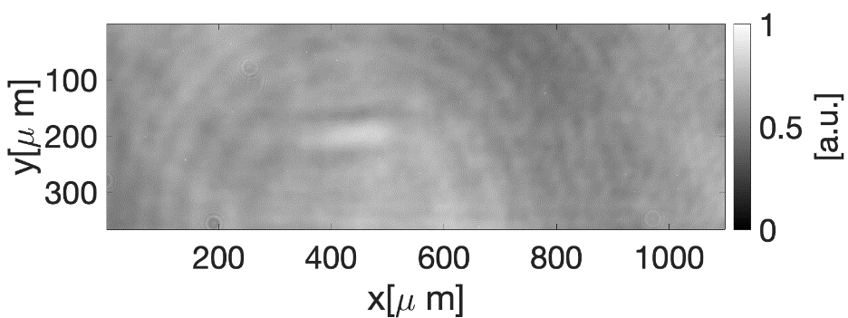
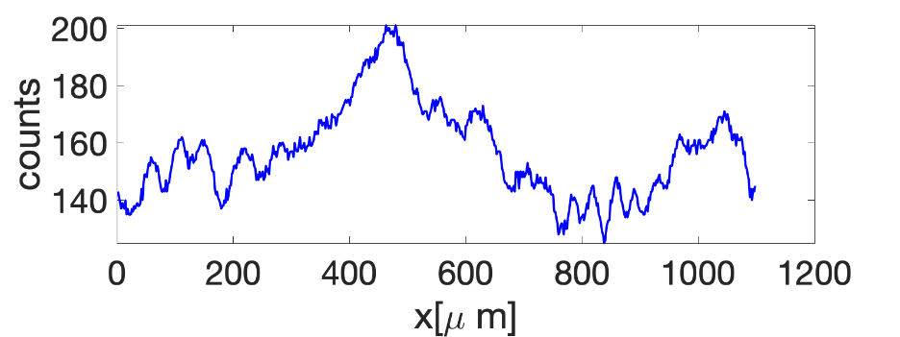
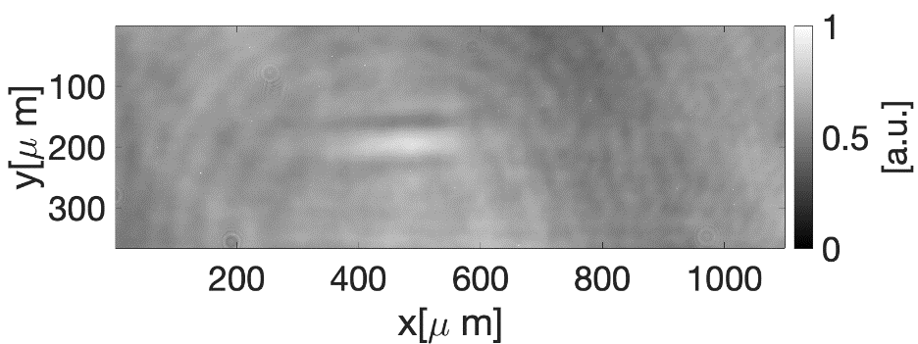
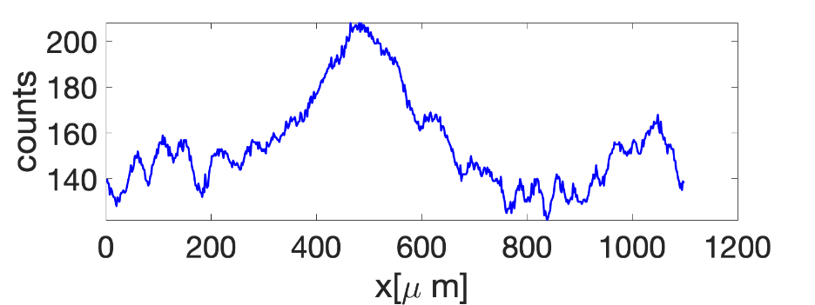
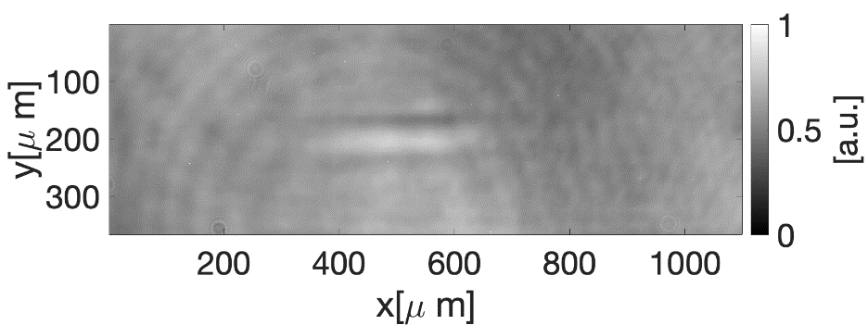
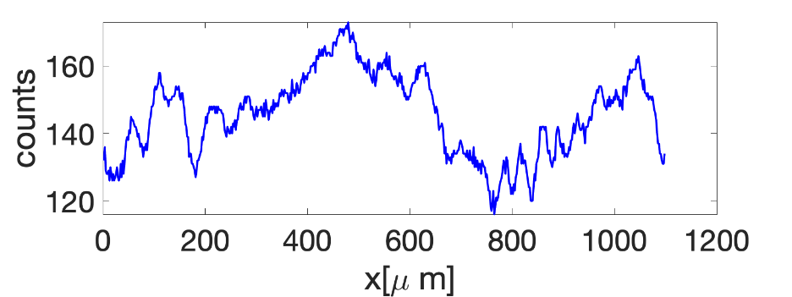
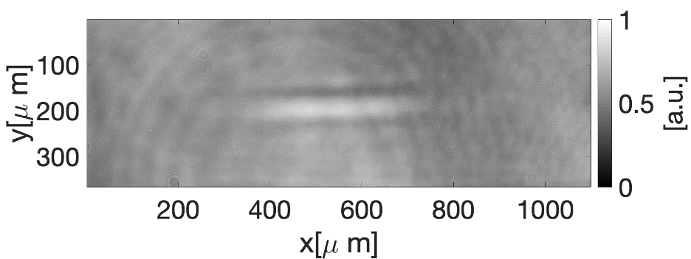
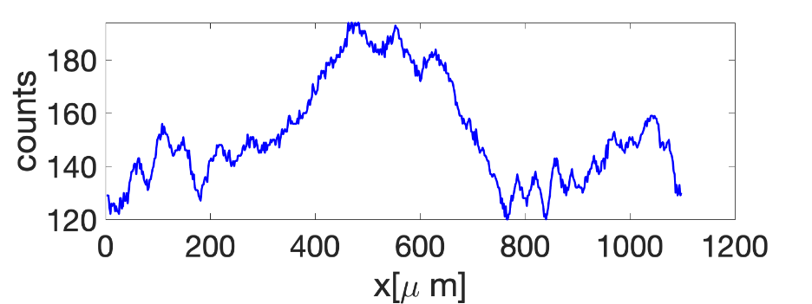
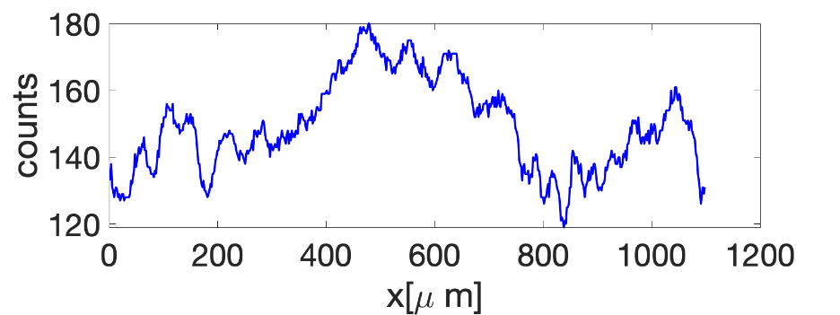
Ionization front measured using optical shadowgraph (2022)
Ti:Sa
Ti:Sa Laser Parameters
Pulse length ~68 fs
Energy: ~12 mJ on target
Spot size ~50 µm FWHM
Gas: He, 50psig
T=0.33ps
T=0.67ps
Excite an ionization front
length ~400 µm (80 periods of CO2 B field)
width > 100 µm, much larger than half of the CO₂ wavelength.
T=1ps
measured ionization front
required ionization front
T=1.33ps
Experimental Requirements on Ti:Sa laser system
High Laser Contrast / Eliminate the prepulse -> Complete
Decrease the pulse length
T=1.67ps

Slide 36
AE-99
Characterization of the Wentzel-Kramers-Brillouin amplification limit to parametric instabilities by utilizing Backwards Stimulated Raman Scattering in a plasma density gradient
Collaborators
UCLA: Yipeng Wu, Audrey Farrell, Chaojie Zhang, Ken Marsh, Chris Clayton, Humberto Figueroa Lopez, Frank Tsung, Warren Mori, Chan Joshi (PI)
SBU: Irina Petrushina, Apurva Gaikwad, Navid Vafaei-Najafabadi
ATF: I. Pogorelsky, M. Fedurin, M. Babzien, M. Polyanskiy, W. Li, R. Kupfer, K. Kusche, A. Simmonds, T. Ilardi, M. Peniera, R. Malone, G. Stenby, P. Jacob, T. Morris, K. Roy, B. Romasky, M. Long, L. Armstrong, D. Choge, M.J. Ilardi, M. Palmer (Director)
PI:
C. Joshi
Presenter: Mitchell Sinclair

Slide 37
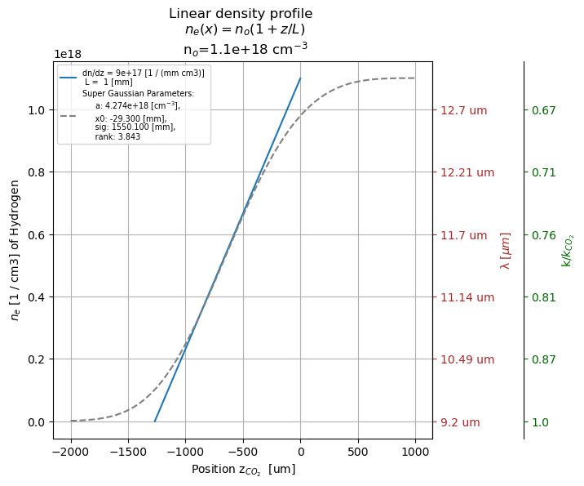
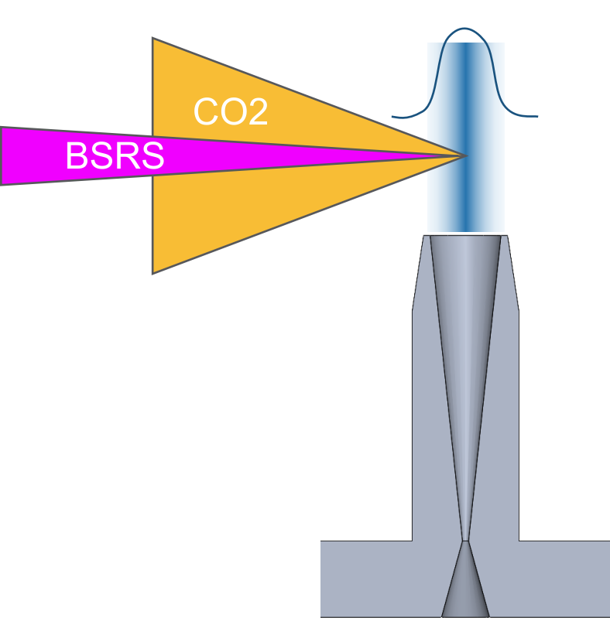
Analysis Methodology
F/2 OAP
+H, Nozzle
$$ΔK2 − ΔK1$$
$$ξ_{int}$$
+X, Ti:Sa
+Z, CO2

Slide 38
BNL - ATF 2023 Experimental Setup
F/2 OAP

Slide 39
Long Wavelength IR Spectrometer
Wavelength
dispersive
element
Rx Spec.
9.2 – 14 um
Aperature
3 mm
y - CO2
x
Pyrocam IV
Focusing
Lens
ZnSe f = 200mm
12.4 um
Collimating Optic
OAP 381mm
Stage with filters
11.6 um
10.6 um

Slide 40
Relative Intensity
210 psi
2 mm
110 psi
8 mm
2 mm
Z _{(focus)} -1.0mm
6 mm
4 mm
6 mm
4 mm
Laser offset
2 mm
Z _{(focus)} -0.5mm
11.6 um
Ignore Δcamera
10.6 um
12.4 um
Z _{(focus)} -1.5mm
Focal
position

Slide 41
Relative Intensity
150psi
2 mm
4 mm
4 mm
180psi
Z _{(focus)} -0.5mm
6 mm
6 mm
2 mm
2 mm
Laser offset
2 mm
6 mm
Z _{(focus)} -0.0 mm
12.4 um
Z _{(focus)} -0.5 mm
11.6 um
11.6 um
10.6 um
12.4 um
Focal
position
Z -1.0 mm

Slide 42
Aug11: s83
 | ξ_{int} 1/2 rad | ξ_{int} FWHM | φ FWHM
0 | 13 | 266.2 | 4.8
1 | 32 | 85 | 0.7
2 | 12 | 168 | 3.3
3 | 15 | 129 | 2.1
4 | 49 | 40 | 0.2
5 | 74 | 25 | 0.1
6 | 37 | 49 | 0.3
7 | 25 | 73 | 0.7
8 | 38 | 51 | 0.3
9 | 16 | 186 | 2.9

Slide 43
Accelerator Test Facility
Supported by:
DOE-NNSA, DOE-HEP, NSF

Slide 44
Synchronization and overlapping
Synchronization of Ti:S and CO2 is done using the optical shadowgraph (relatively large jitter ~10ps)
Synchronization of e-beam and CO2 is done using the electron imaging method
Spatial overlapping of Ti:S and CO2 is done using the optical shadowgraph (vertical direction) and a needle tip (within 100 µm)
Gas jet
metal needle
Ti:S
CO2
CO2
ionization due to Ti:S
ionization due to CO2

Slide 45
Experimental data using PMQ (ionization of CO2 and Ti:S)
The PMQ e-beam imaging system can probe the ionization line very well!
metal needle
Ti:S
CO2
Ionization due to CO2 (21.6mJ)
ionization due to Ti: S
CO2 47.5mJ
With the last amplifier of CO2, the energy (21.6mJ) is high to ionize the gas (left figure);
Without the last amplifier of CO2, the energy is low, unable to ionize the gas (right figure)

Slide 46
AE-99: Experimental layout 2021
CO2 laser
Ti:S main beam
CO2 focus diag.
(Pyrocam IV)
shadowgraphy
100 µm YAG:Ce
Bar width 5 µm
Hole width 7.5 µm
5x obj
IP
50.5 MeV e- beam
~0.2% energy spread (use slit)
motorized PMQs
camera lens
CCD (GPOP10)
Ti:S focus diag.

Slide 47
AE-99: Experimental layout 2022
CO2 laser
IR spectrometer
Ti:Sa laser ~10-20mJ, ~68fs
100 µm YAG:Ce
IP
50.5 MeV e-beam
~0.2% energy spread (use slit)
motorized PMQs

Slide 48
Resolving power measured using the TEM grids
Overall magnification (e- beam + optical): ~17.8x
Optical magnification: ~4.8x
PMQ e- beam magnification: 3.7x
Resolving power: ~3.2 µm
400-mesh
Bar width 20 µm
Hole width 37 µm
2000-mesh
Bar width 5 µm
Hole width 7.5 µm

Slide 49
Ionization front measured using optical shadowgraph
Ti:Sa
Ti:Sa Laser Parameters
Pulse length ~68 fs
Energy: ~12 mJ on target
Spot size ~50 µm FWHM
Gas: He, 50psig
T=0.33ps
T=0.67ps
Excite an ionization front
length 400 µm (80 periods of B field)
width > 100 µm, much larger than half of the CO2 wavelength (Ti:Sa prepulse)
T=1ps
measured ionization front
T=1.33ps
required ionization front
Desired Upgrades to Ti:Sa laser
Reduce the prepulse -> Complete
Decrease the pulse length
T=1.67ps

Slide 50
Synchronization and overlapping
Try to synchronize the Ti:Sa and CO2 using the optical shadowgraph (Ti:Sa postpulse)
Synchronize three beams using the e-beam probing
Spatial overlap the Ti:Sa and CO2 using a needle tip (within 100 µm) and e-beam probing (vertical direction)
metal needle
Gas jet
Ti:Sa
CO2
Ionization due to Ti:Sa and CO2

Slide 51
e-probing data with PMQ
The PMQ e-beam imaging system could probe the ionization line very well.
CO2
Ti:S
Ti:Sa

Slide 52
Proposed Experimental Aims
Demonstrate the excitation of MS mode through the collision of relativistic ionization front with CO2 laser pulse by measuring:
Magnetic field using electron probe with permanent magnet quadrupoles (PMQ) imaging system
Frequency upshifted radiation using IR spectrometer
Project Cumulative Objective:
Demonstrate X-ray radiation generation through an electron beam propagating through the MS mode
Fiuza, F., Silva, L. O., & Joshi, C. (2010). High-brilliance synchrotron radiation induced by the plasma magnetostatic mode. Physical Review Special Topics - Accelerators and Beams, 13(8), 1–5. http://doi.org/10.1103/PhysRevSTAB.13.080701

Slide 53
Ionization front measured using optical shadowgraph
Ti:Sa Laser Parameters
Pulse length ~68 fs
Energy: ~10 mJ on target
Spot size ~50 µm FWHM
Gas: H2, 25psig
T=-75 ps
Ti:Sa
Gas jet
1.83 µm/pixel

Slide 54
Ionization front measured using optical shadowgraph
T=-73 ps
Ti:Sa
Pre-ionization
prepulse ~15% energy
Gas jet

Slide 55
Ionization front measured using optical shadowgraph
T=-0.67 ps
Ti:Sa
Pre-ionization
prepulse ~15% energy
Gas jet

Slide 56
Ionization front measured using optical shadowgraph
T=0 ps
Ti:Sa
Pre-ionization
prepulse ~15% energy
Gas jet

Slide 57
Ionization front measured using optical shadowgraph
T=0.67 ps
Ti:Sa
Pre-ionization
prepulse ~15% energy
Gas jet

Slide 58
Ionization front measured using optical shadowgraph
T=1.33 ps
Ti:Sa
Pre-ionization
prepulse ~15% energy
Gas jet

