Slide 1
AE-101
Optical Materials for Ultrahigh-Power​
Long-Wave Infrared Lasers
Close-out report
Misha Polyanskiy
26th ATF Users’ Meeting
2024-03-26

Slide 2
AE-101
Title | Optical Materials for Ultrahigh-Power​ Long-Wave Infrared Lasers
Status | Closeout (follow-up experiment will be proposed separately)
PIs | Mikhail Polyanskiy Igor Pogorelsky
Team | BNL: M. Polyanskiy, I. Pogorelsky, M. Babzien, D. Choge UCF CREOL: K. Vodopyanov BAE Systems: P. Schunemann -> K. Zawilski, J. Jesenovec
Funding | DOE ARDAP grant Phase I (2019—2022; PI: M. Polyanskiy) DOE ARDAP grant Phase II (2022—2025; PI: M. Polyanskiy) BNL LDRD grant #20-010 (2020—2023; PI: I. Pogorelsky)
Funding Status | Received

Slide 3
Goals
“We propose a systematic study of the properties of a wide range of materials under the action of ultra-intense long-wave infrared (LWIR) laser pulses. The information that will be obtained during the proposed effort is critically needed for the development of the next-generation multi-terawatt LWIR lasers.”
(DOE ARDAP Accelerator Stewardship proposal, 2019)
Systematically study properties of infrared materials under the action of intense L-WIR laser irradiation
Develop a concept of nonlinear post-compression of picosecond L-WIR pulses to a sub-picosecond
Demonstrate post-compression at multi-TW level

Slide 4
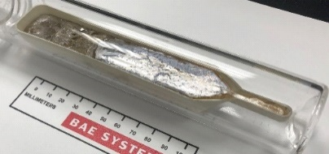
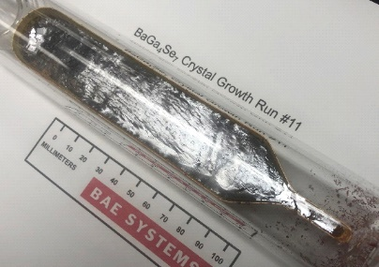
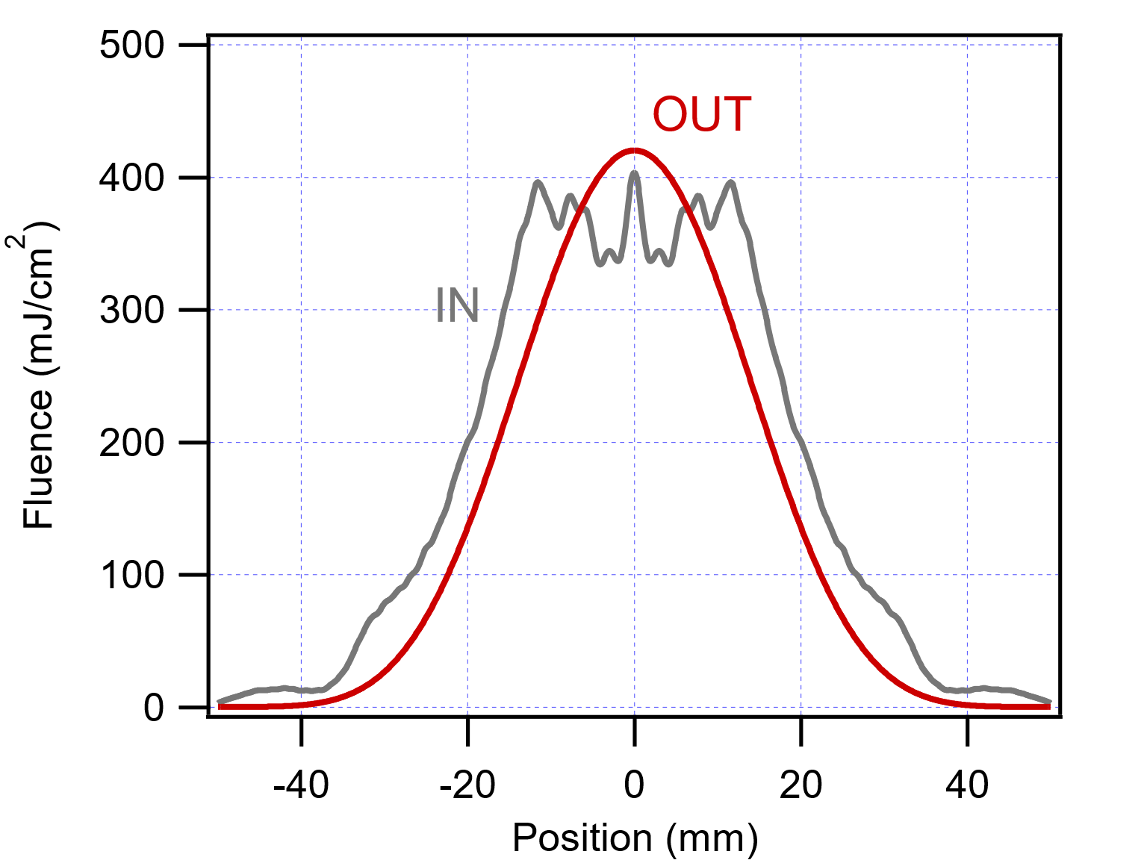
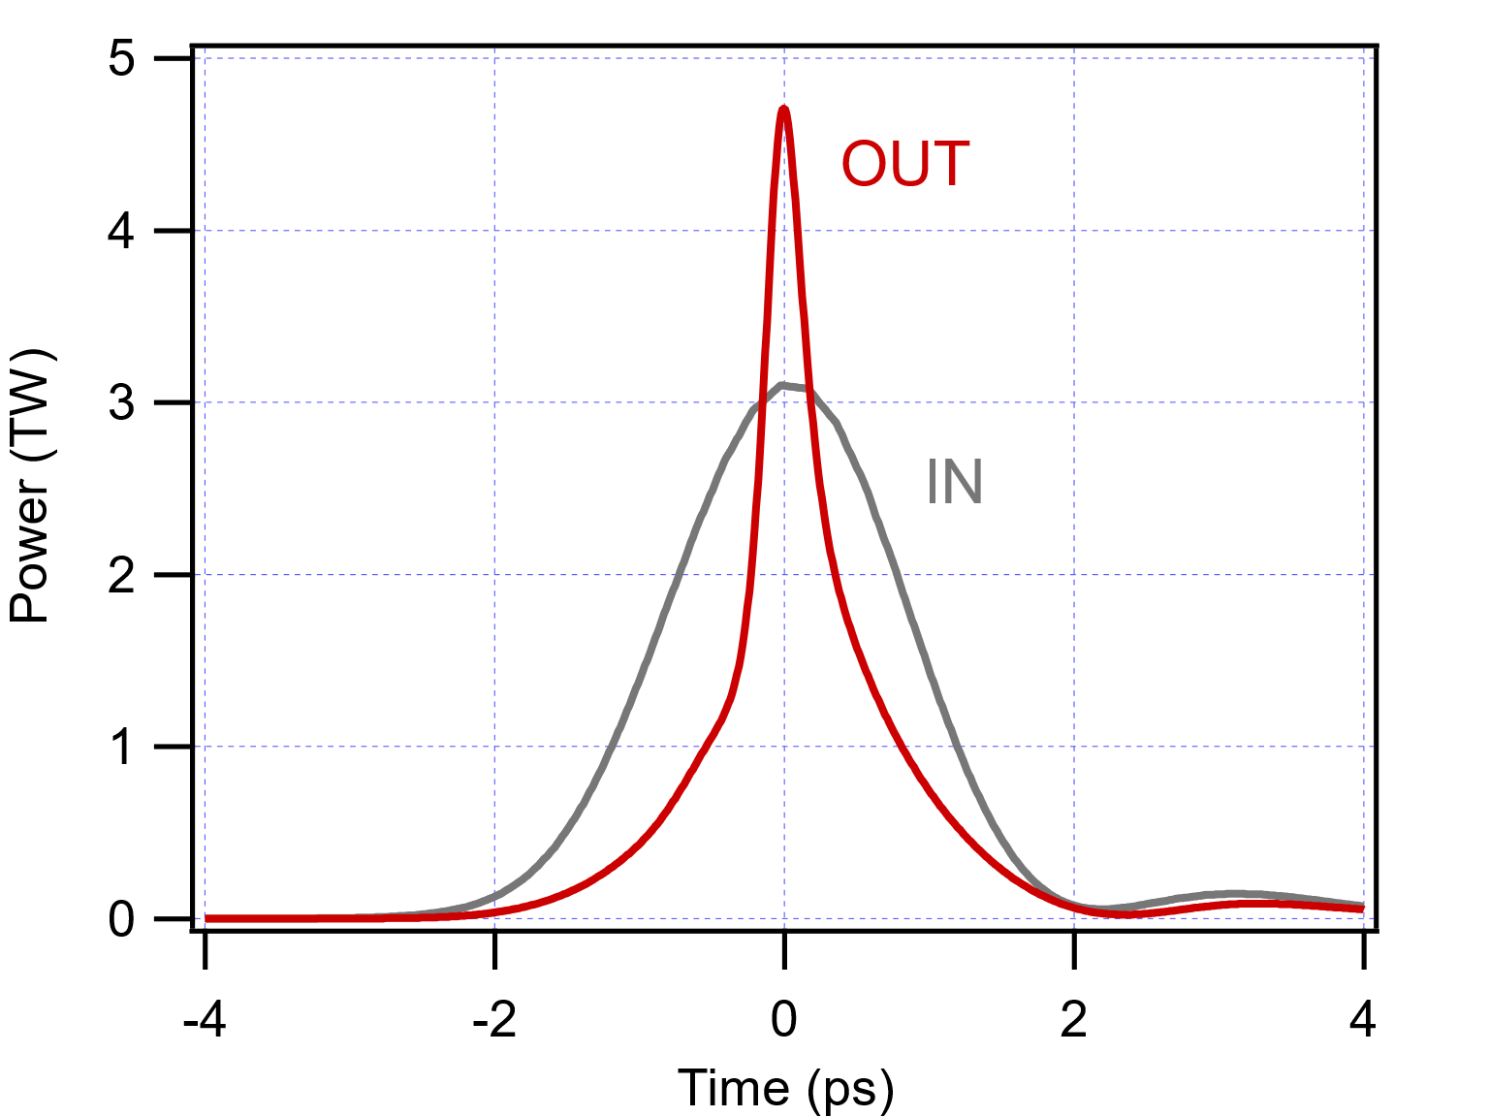
DOE ARDAP project: Team & directions
UCF (Konstantin Vodopyanov)
BNL (Misha Polyanskiy)
BAE (Kevin Zawilski)
BGS
BGSe
Fundamental study: Physics of interaction of IR materials with intense MWIR/LWIR optical fields
Applied science:
Database of nonlinear constants, new concepts of nonlinear LWIR optical systems
Advanced materials:
Fabrication methods for new
types of IR crystals

Slide 5
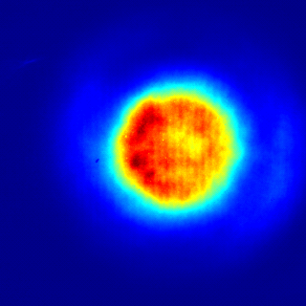
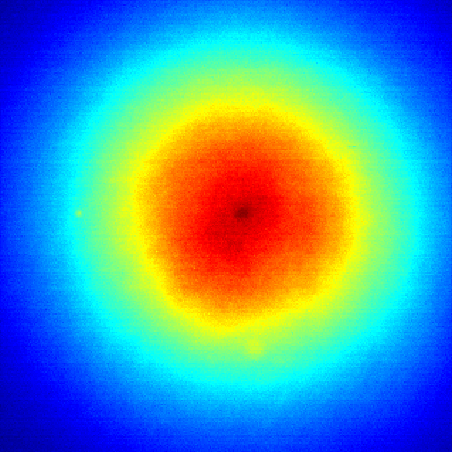
AE-101 pre-requisite 1: beam
100 mm
13 mm
13 mm dia.
aperture
14 m
≤ 500 mJ
Stable,
near-Gaussian
beam profile
≤ 10 J
Energy-dependent,
shot-to-shot varying
beam profile
Polyanskiy et al. Opt. Lett. 46, 2067 (2021)

Slide 6
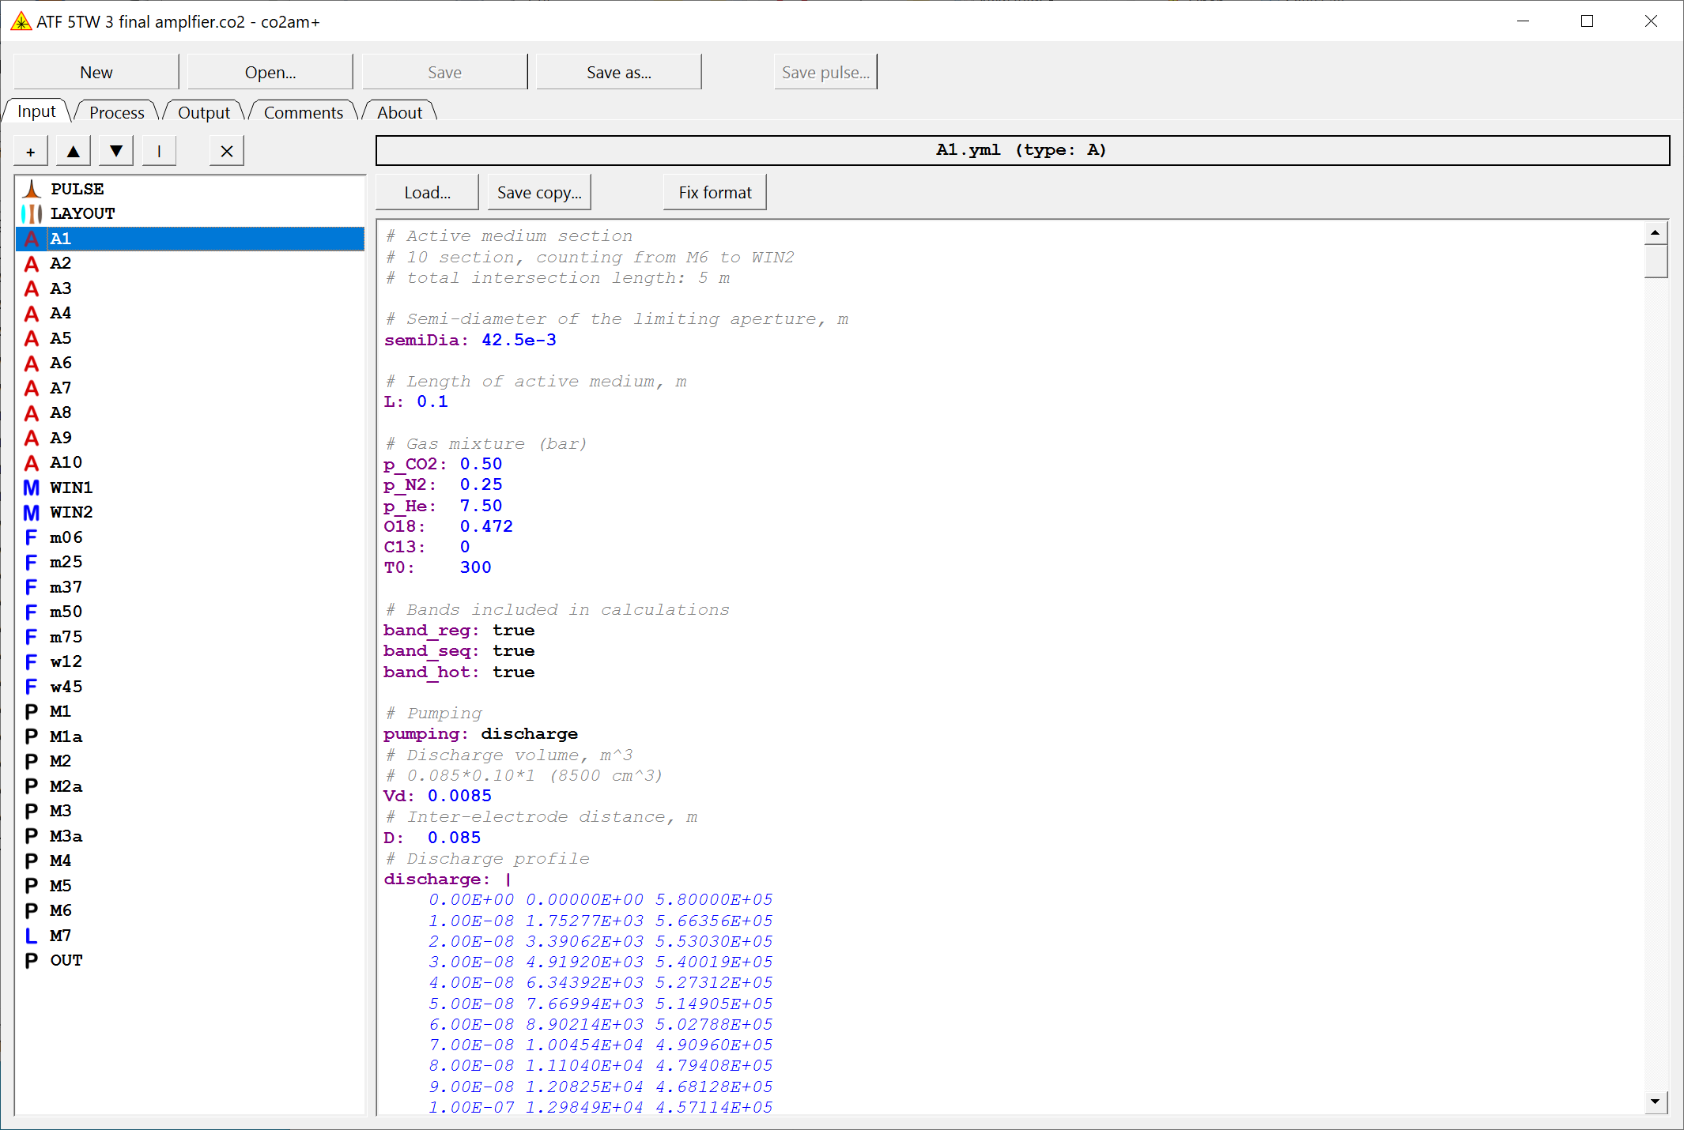
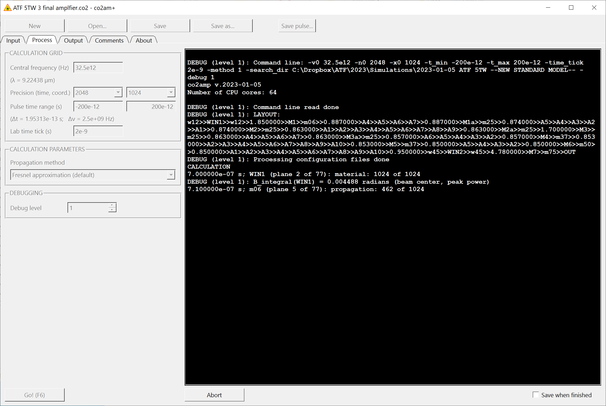
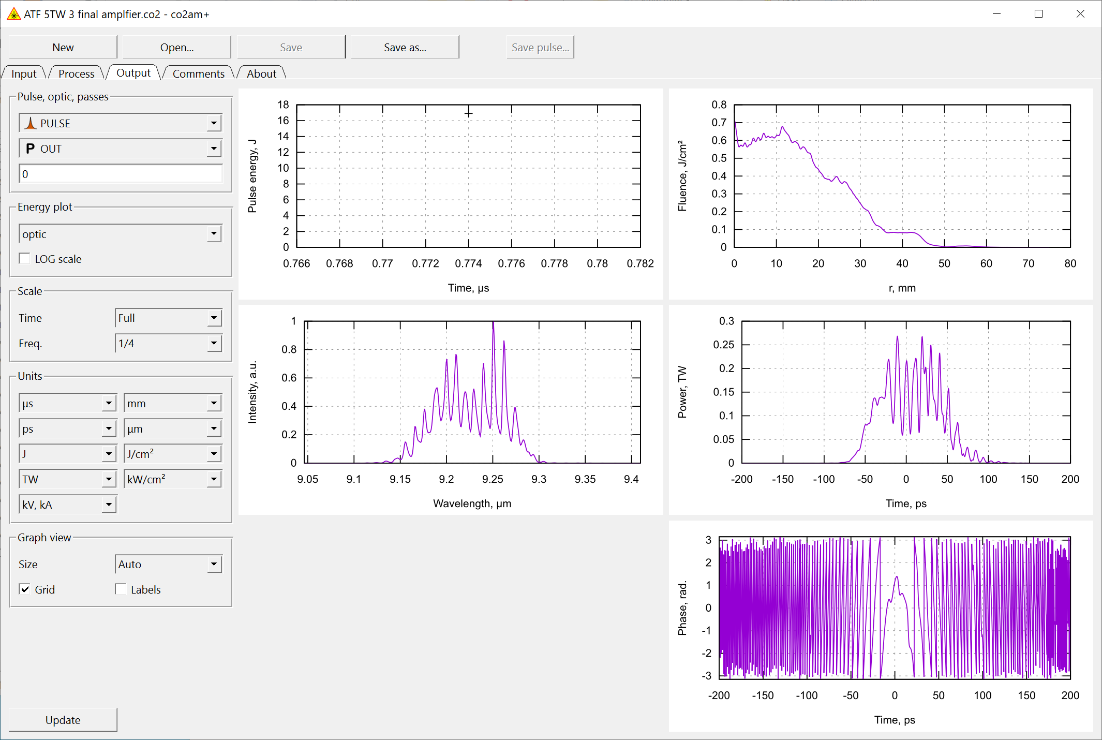
AE-101 pre-requisite 2: Data analysis tool
co2amp 2020
(new interface & advanced material interaction support)
Polyanskiy Appl Opt. 54, 5136 (2015)
https://github.com/polyanskiy/co2amp
Configuration tab
Documentation
Process tab
Results tab

Slide 7
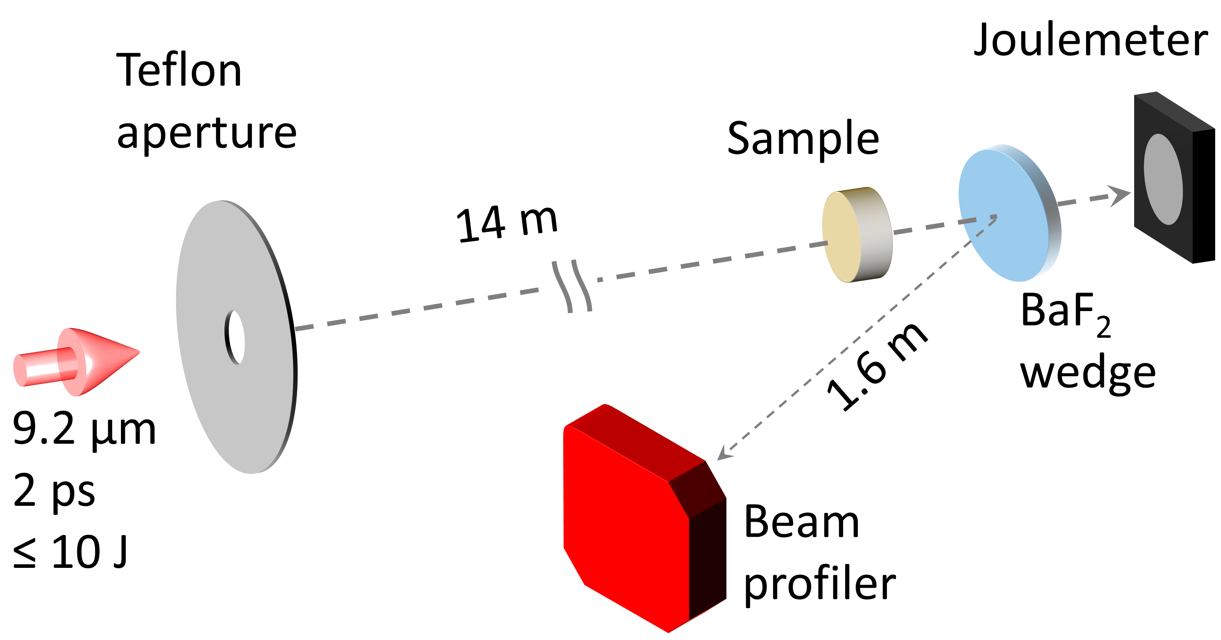
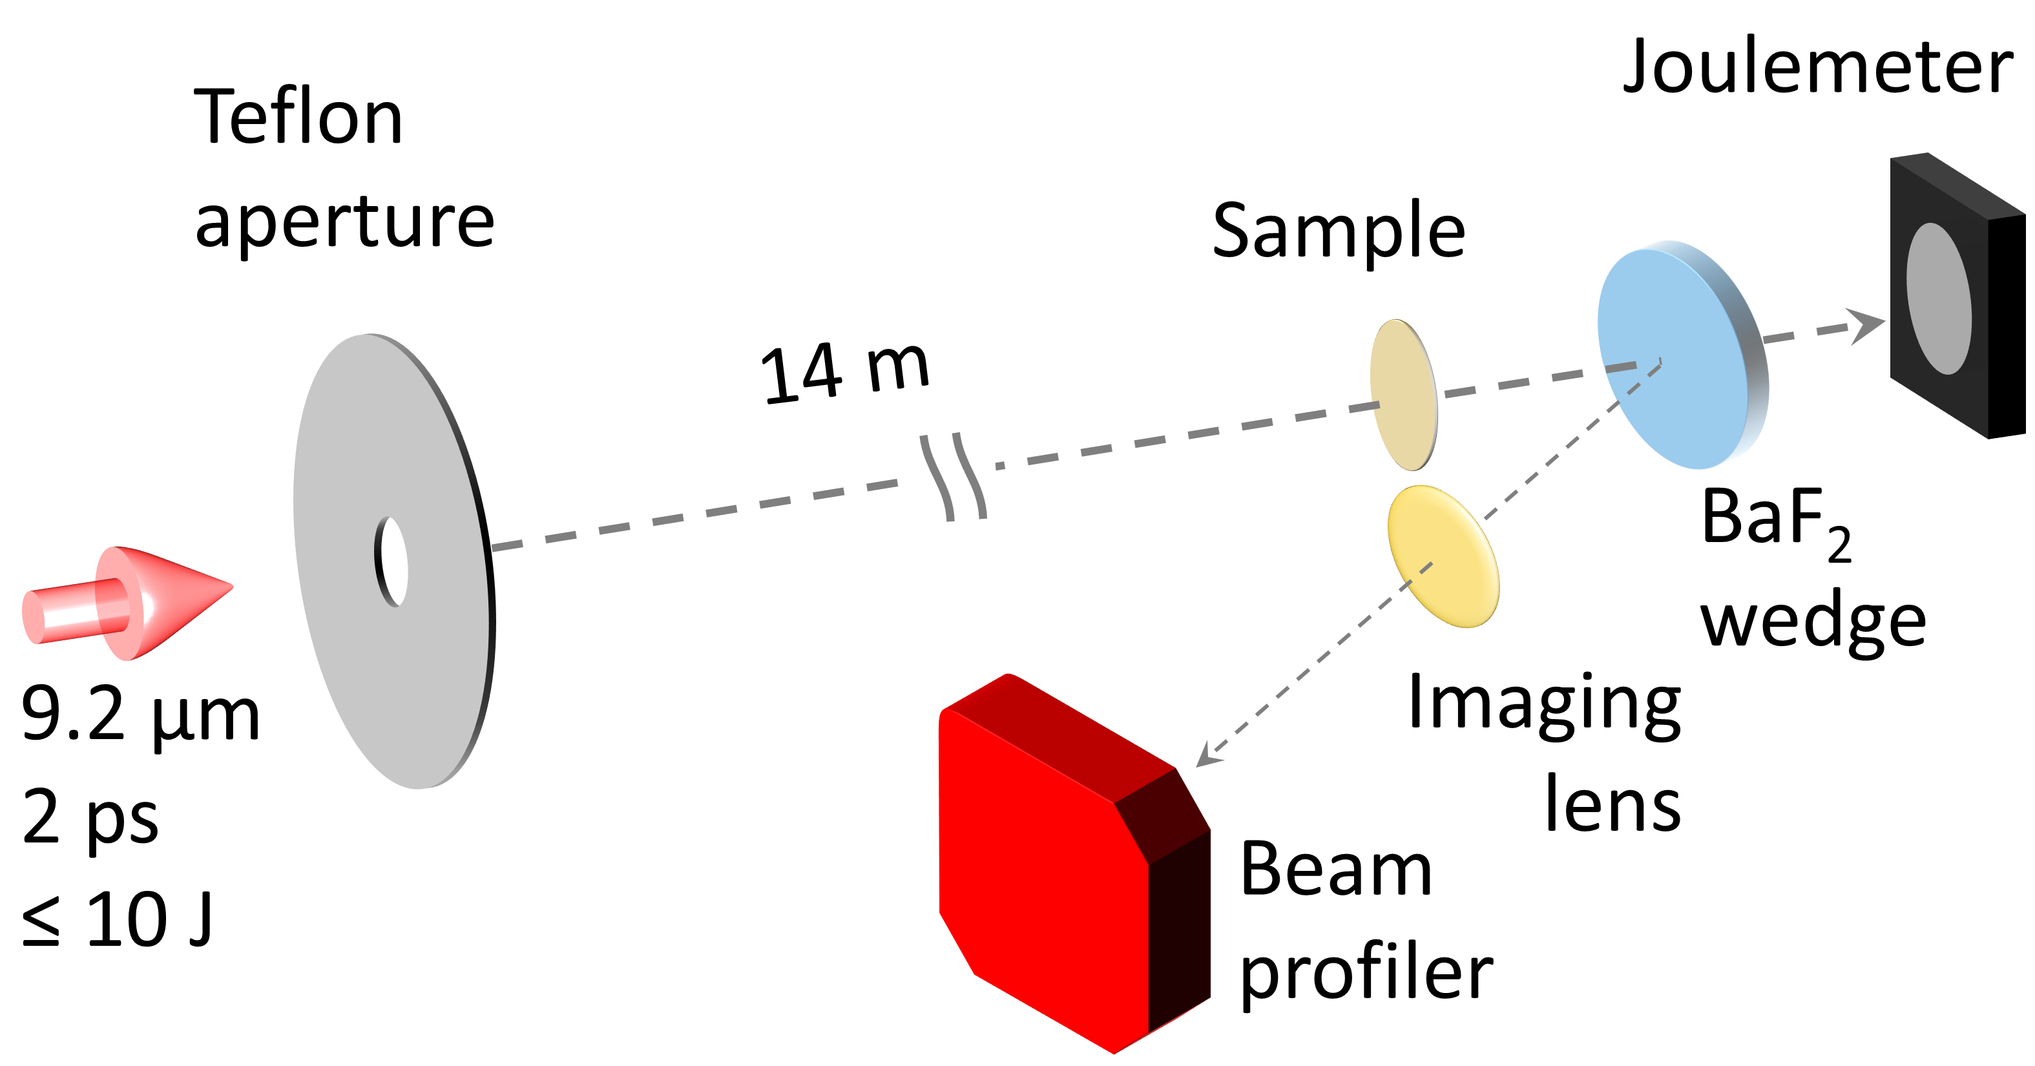
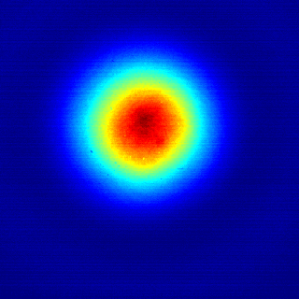
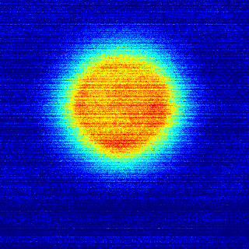
Single-shot measurements
Nonlinear Refraction
Nonlinear Absorption
Non-linear absorption

Slide 8
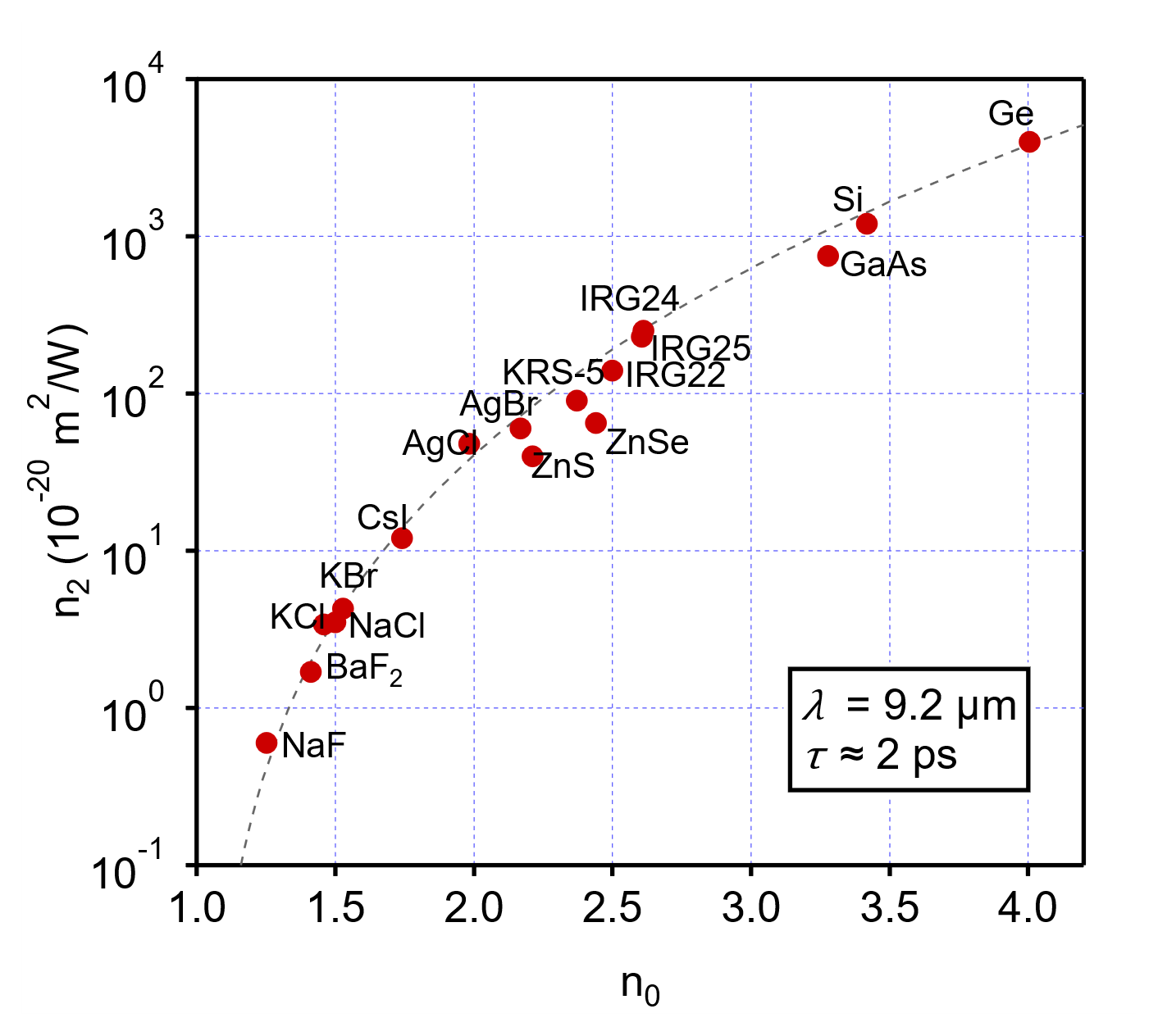
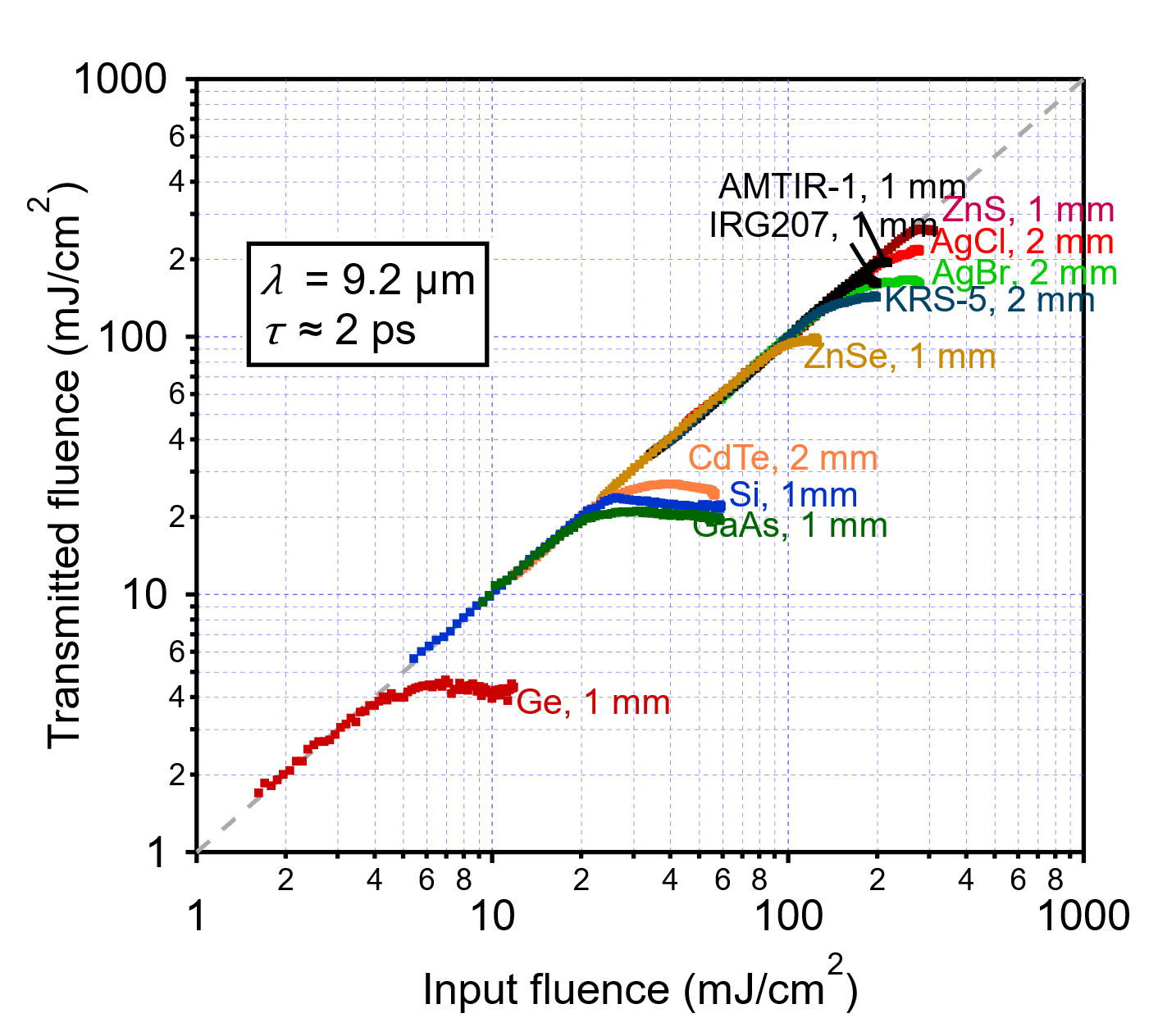

Nonlinear properties of LWIR materials
Nonlinear Refraction
Nonlinear Absorption
Polyanskiy et al. Opt. Mater. Express 14, 696 (2024)

Slide 9
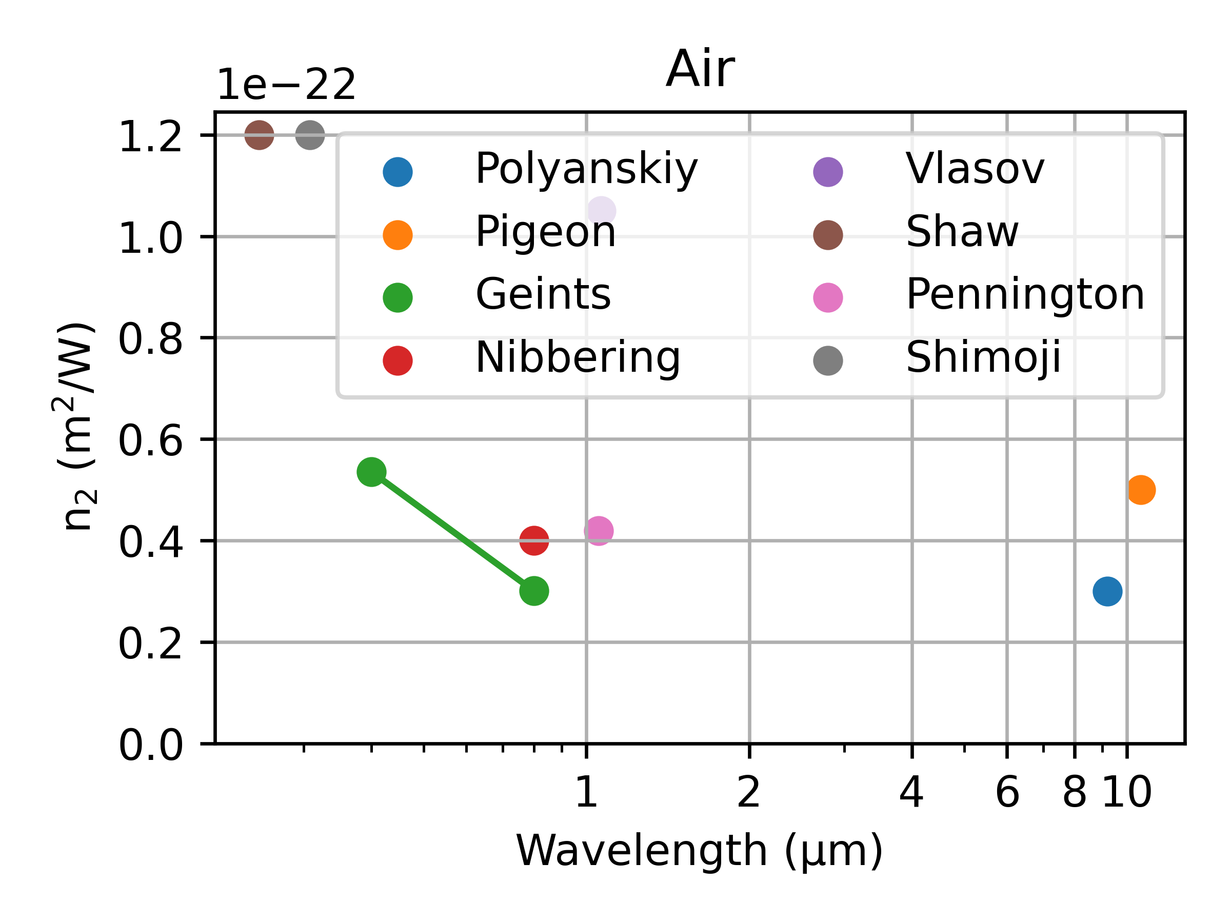
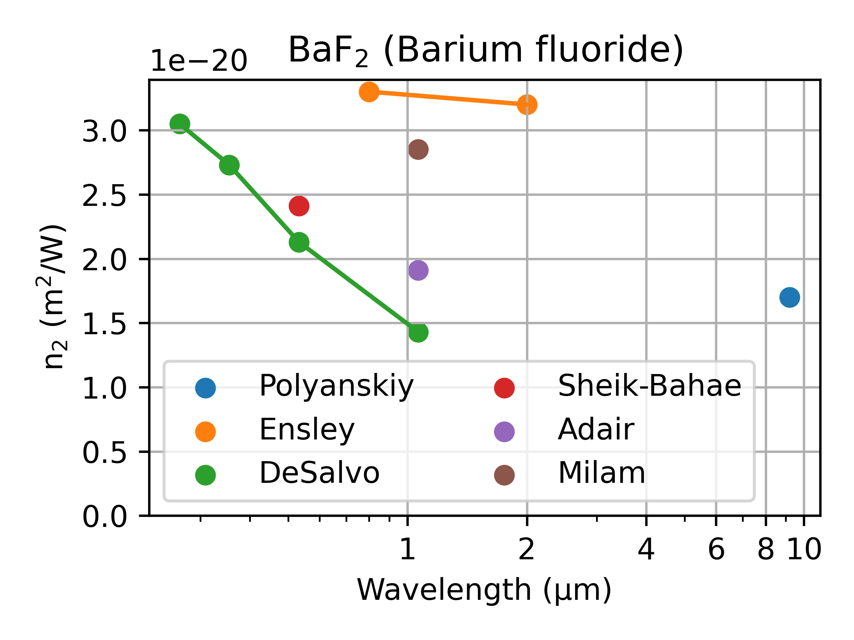
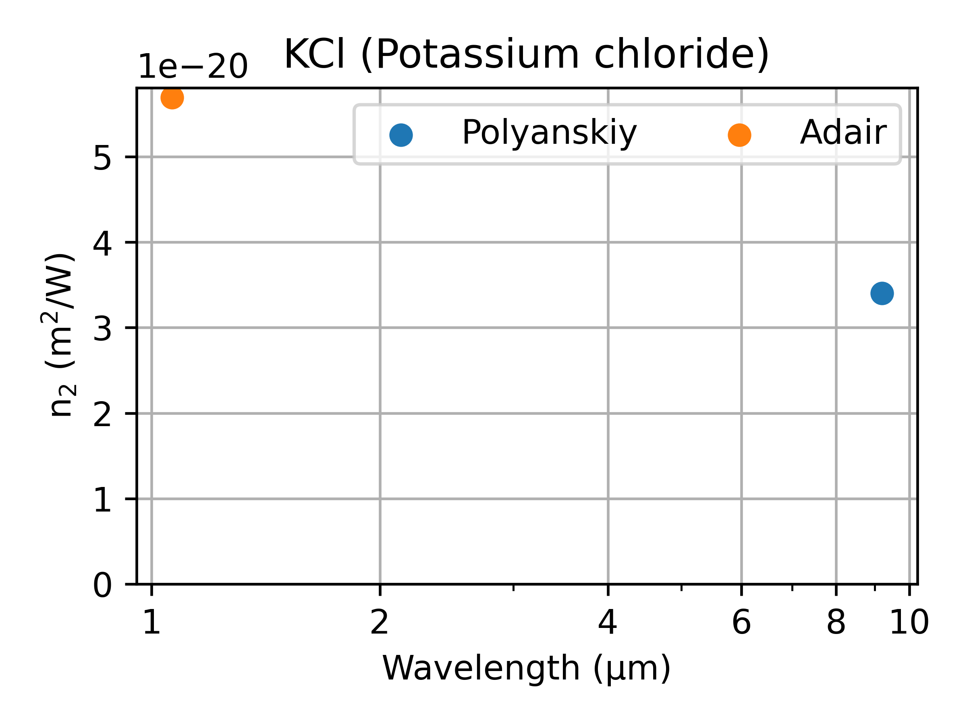
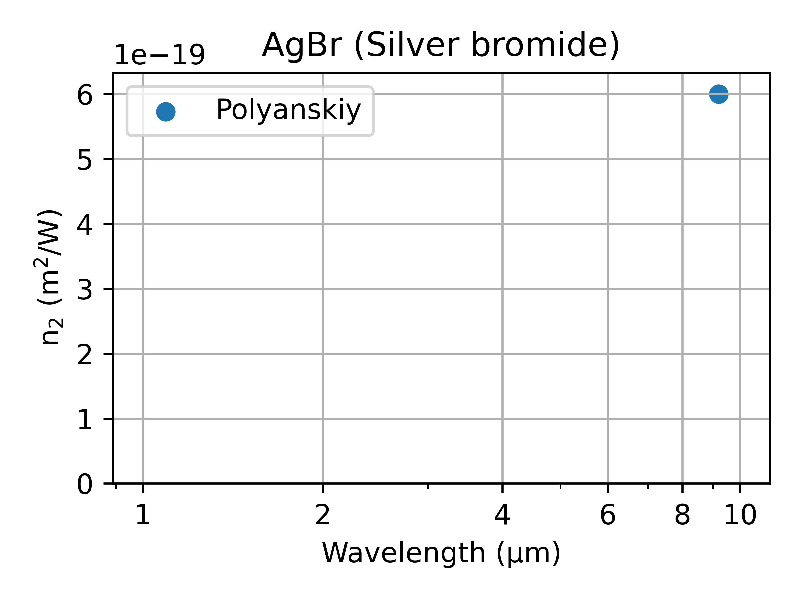
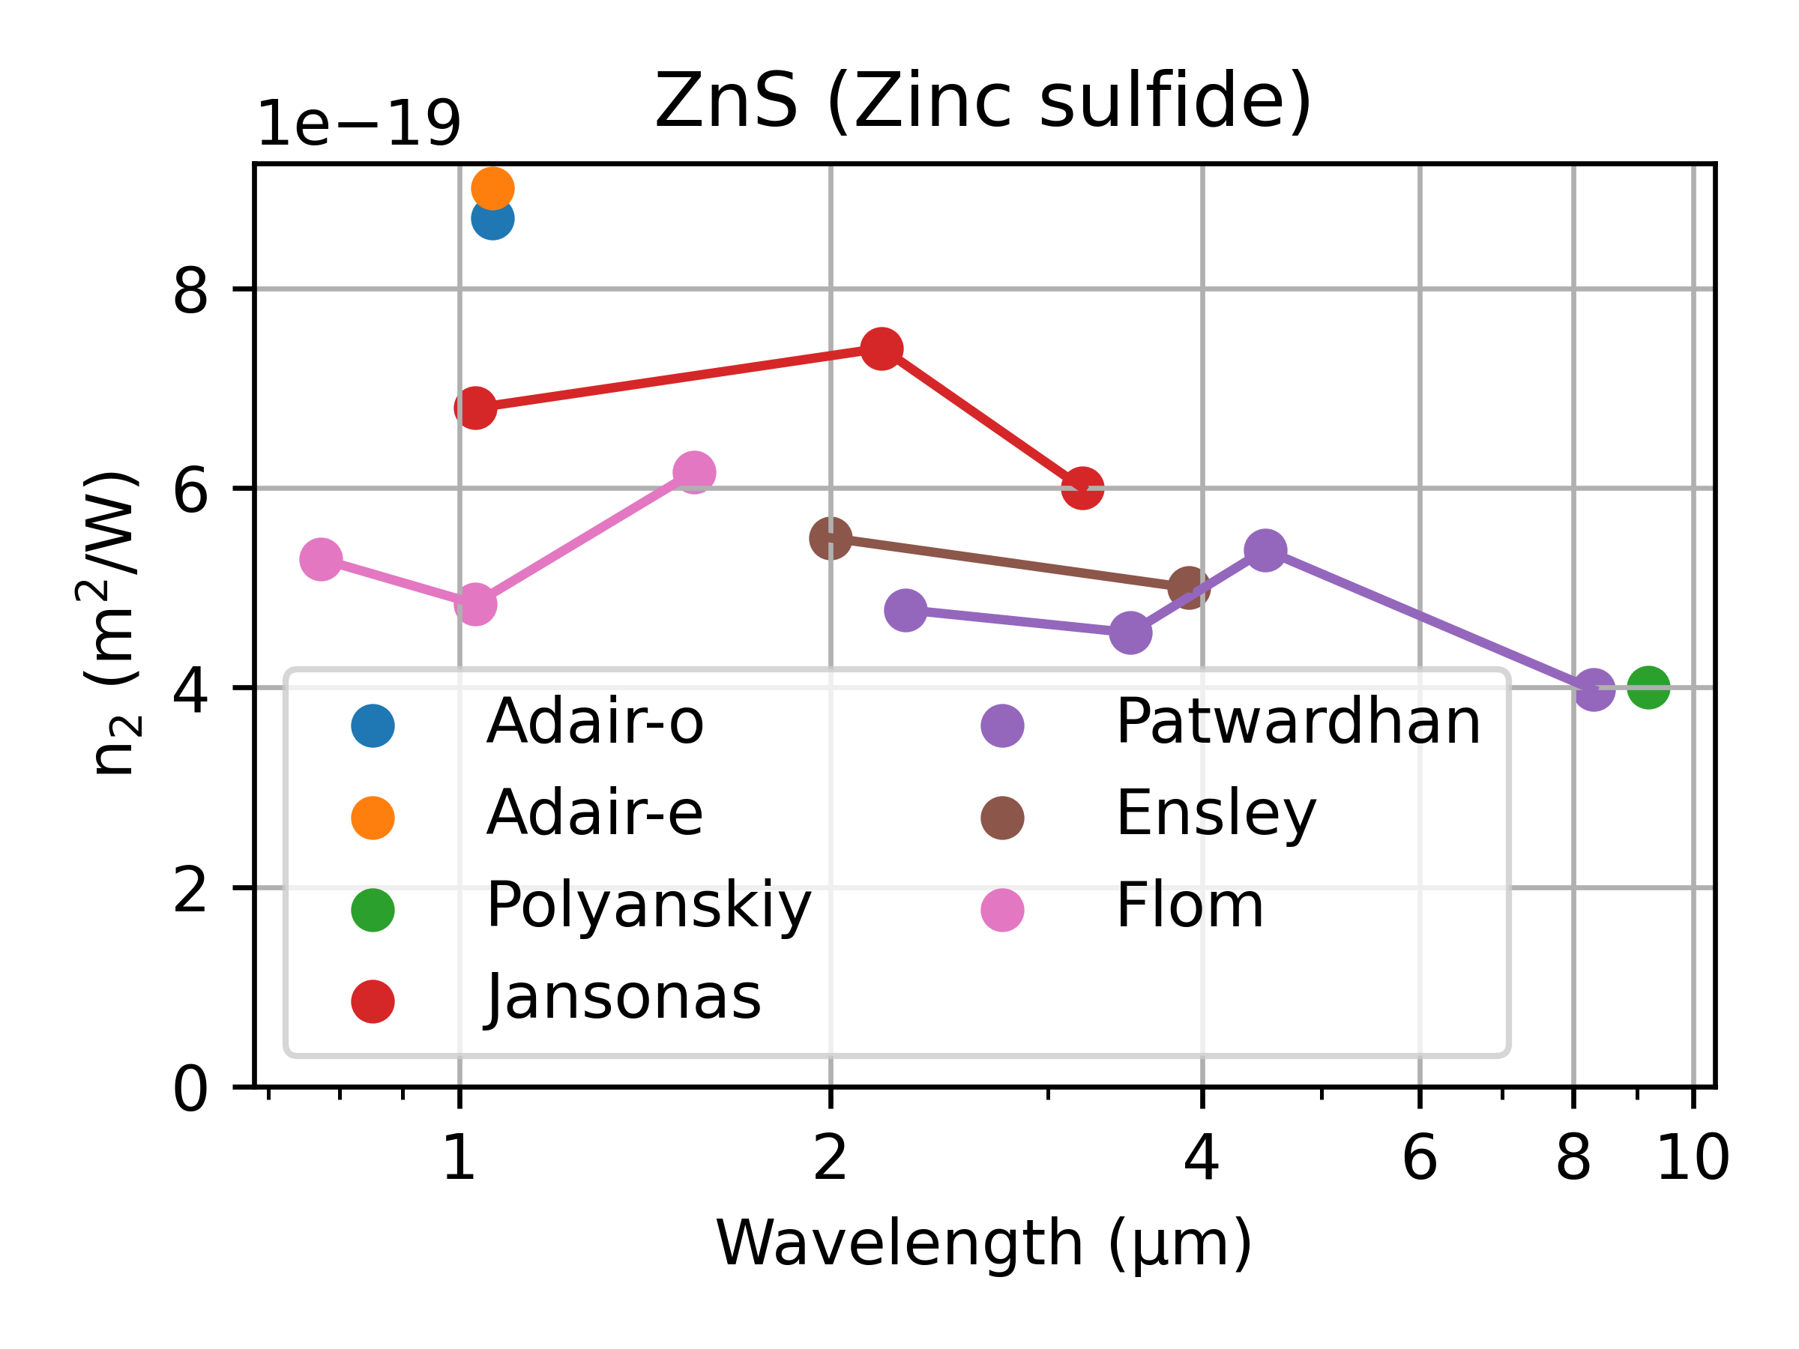
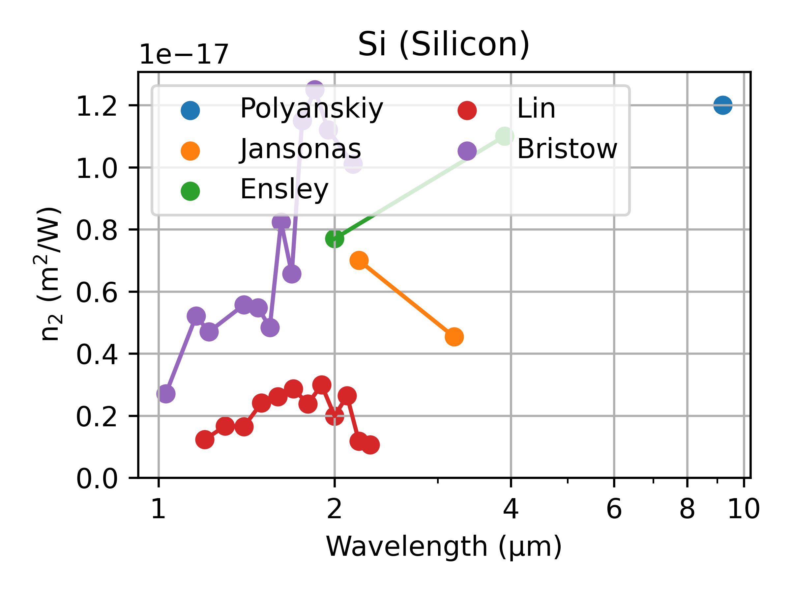
n2 database (now part of refractiveindex.info)
Polyanskiy. Sci. Data 11, 94 (2024)

Slide 10
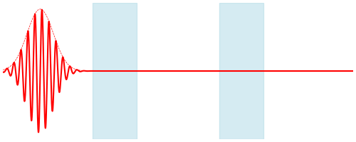
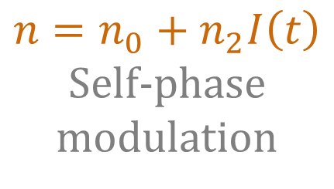
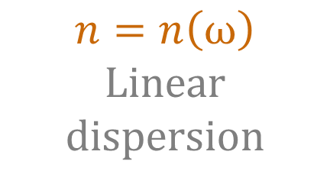
Next-generation CO₂ laser: Post-compression
$$n=n_{0}+n_{2}I\left(t\right)$$
Self-phase modulation
$$n=n\left(ω\right)$$
Linear dispersion

Slide 11
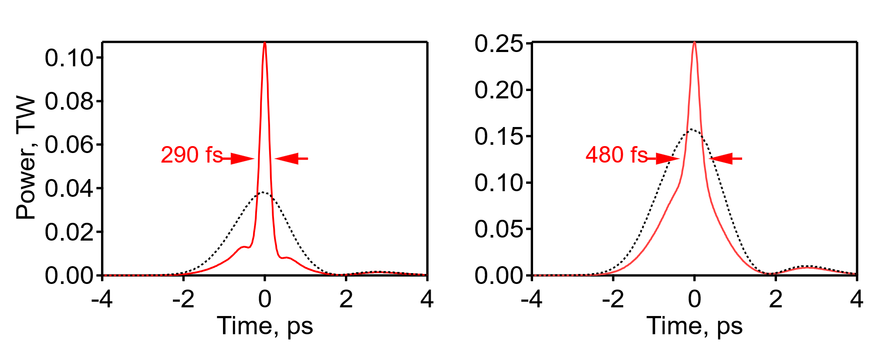
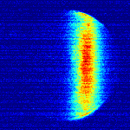
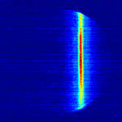
Proof of principle
2 ps
5 mm dia.
beam center
Whole beam
In
Out
out
out
2 ps
290 fs
in
Autocorrelation
in
278 mJ
Polyanskiy et al. Opt. Express 29, 31714 (2021)

Slide 12


1st Prototype
Pogorelsky et al. – Front. Phys. (accepted)
Experiment
Model
IN
$$τ=0.625τ_{auto}= 675 fs$$
OUT
$$P=1.55 TW$$
Beam
center
700 fs
measured within a central portion of the beam containing 30% of the total energy
Most powerful long-wave infrared
sub-picosecond pulse ever obtained

Slide 13
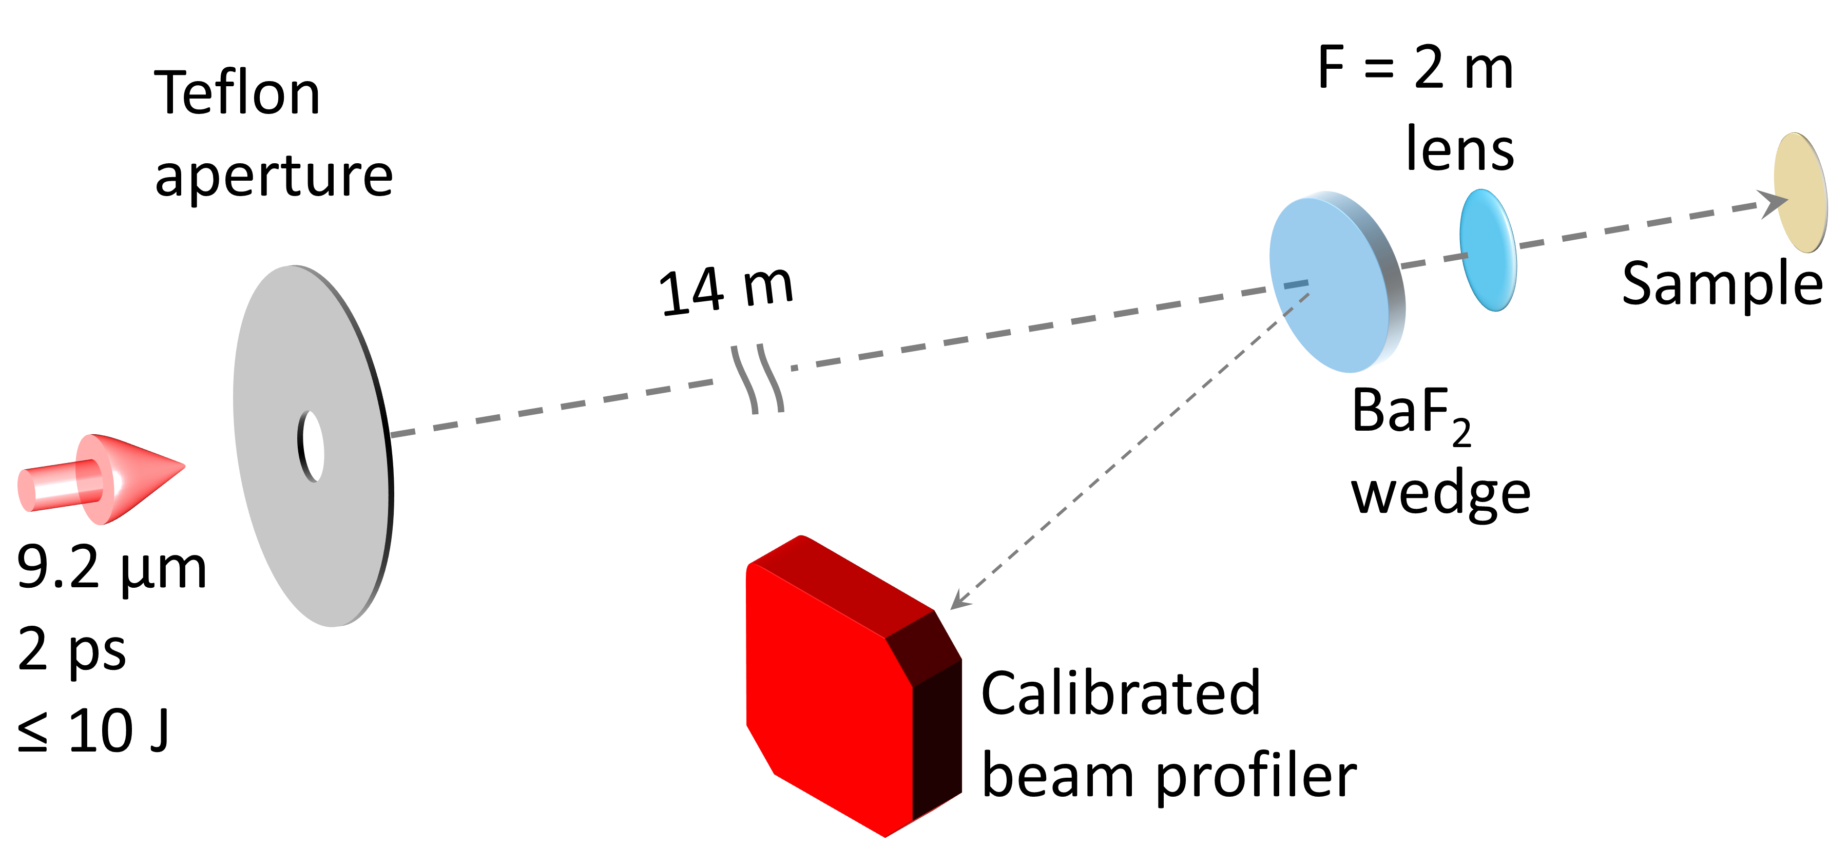
Set-up for laser-damage characterization

Slide 14
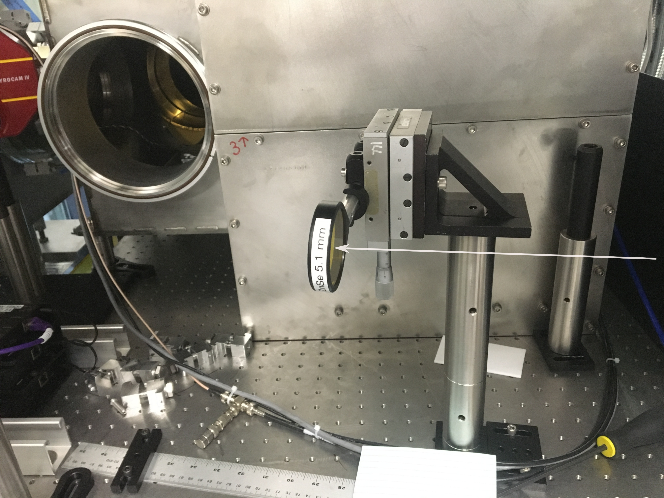
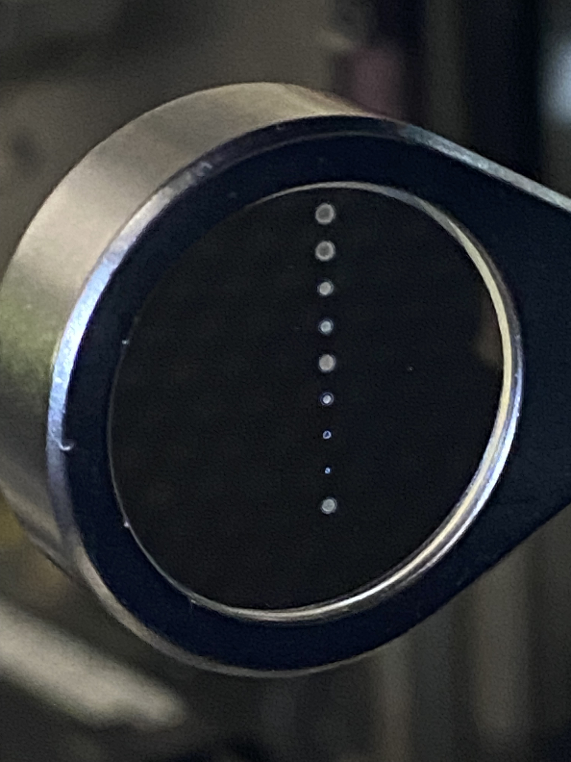
Optical damage experiments
Al mirror
Sample
Sample
Laser in
Laser
Digital image of Al mirror
Optical microscope image of damaged spot for low energy shot (but above damage threshold)

Slide 15
AE-101 Results
Systematic study of nonlinear refraction and absorption properties of materials relevant for high-power LWIR lasers [✔ ✔ ✔]
n2 database [✔ ✔ ✔]
Conceptualization, proof-of-principle demonstration and 1st full-energy prototype of post-compression [✔✔]
Study of laser damage of LWIR materials and optical components [✔]
By-products: ‘perfect beam’ at reduced-energy, improved numerical modelling [🙂]

Slide 16
Activities & Impacts Associated with this Experiment – All Years
Journal papers
  I. V. Pogorelsky, M. N. Polyanskiy, M. Babzien, A. Simmonds, M. A. Palmer, “Terawatt-class femtosecond long-wave infrared laser” – accepted for publication in Front. Phys.
  M. N. Polyanskiy, I. V. Pogorelsky, M. Babzien, K. L. Vodopyanov, M. A. Palmer, “Nonlinear refraction and absorption properties of optical materials for high-peak-power long-wave-infrared lasers” ", Opt. Mater. Express 14, 696, 2024
  https://doi.org/10.1364/OME.513971
  M. N. Polyanskiy, "Refractiveindex.info database of optical constants", Sci. Data 11, 94, 2024
  https://doi.org/10.1038/s41597-023-02898-2
  T. Kawamori, P. G. Schunemann, V. Gruzdev, K. L. Vodopyanov, “High-order (N=4–6) multiphoton absorption and mid-infrared Kerr nonlinearity in GaP, ZnSe, GaSe, and ZGP crystals”, APL Photonics 7, 086101, 2022
  https://doi.org/10.1063/5.0089925
  M. N. Polyanskiy, I. V. Pogorelsky, M. Babzien, R. Kupfer, K. L. Vodopyanov, M. A. Palmer, "Post-compression of long-wave infrared 2 picosecond sub-terawatt pulses in bulk materials", Opt. Express 29, 31714-31725, 2021
  https://doi.org/10.1364/OE.434238
  M. N. Polyanskiy, M. Babzien, I. V. Pogorelsky, R. Kupfer, K. L. Vodopyanov, M. A. Palmer, "Single-shot measurement of the nonlinear refractive index of air at 9.2 μm with a picosecond terawatt CO2 laser", Opt. Lett. 46, 2067, 2021
  https://doi.org/10.1364/OL.423800
  M. N. Polyanskiy, I. V. Pogorelsky, M. Babzien, R. Kupfer, N. Vafaei-Najafabad, M. A. Palmer, "High-peak-power long-wave infrared lasers with CO2 amplifiers", Photonics 8, 101, 2021
  https://doi.org/10.3390/photonics8040101

Slide 17
Conference presentations
  I. Pogorelsky, M. Polyanskiy, W. Li, M. Babzien, M. A. Palmer, “Emerging ultra-fast multi-terawatt long-wave infrared lasers”, Optica High-Brightness Sources and Light-Driven Interactions Congress, Vienna, Austria, March 12–14 2024
  M. N. Polyanskiy, I. V. Pogorelsky, M. Babzien, W. H. Li, R. Kupfer, M. A. Palmer, N. Vafaei-Najafabadi, “Multi-terawatt, sub-picosecond long-wave infrared laser for next-generation particle accelerators”, International Particle Accelerator Conference, Venice, Italy, May 7–12 2023
  I. V. Pogorelsky, M. Babzien, W. Li, M. N. Polyanskiy, M. A. Palmer, “Opportunities for directed energy research with femtosecond long-wavelength lasers”, 2023 Annual Directed Energy Science and Technology Symposium, San Antonio, TX, 3–6 April 2023
  M. N. Polyanskiy, I. V. Pogorelsky, M. Babzien, W. H. Li, R. Kupfer, M. A. Palmer, “9.3 microns: toward a next-generation CO2 laser for particle accelerators”, 20th Advanced Accelerator Concepts Workshop, Long Island, Hauppauge, NY, November 6–11, 2022
  M. N. Polyanskiy, I. V. Pogorelsky, M. Babzien, R. Kupfer, M. A. Palmer, “The choice of materials for post-compression of high-peak-power long-wave infrared pulses”, Conference on Lasers and Electro-Optics, San Jose, CA, May 16–20 2022
  T. Kawamori, P. G. Schunemann, V. Gruzdev, K. L. Vodopyanov, “High order (N=4–6) multiphoton mid-IR absorption in GaP, ZnSe, GaSe, and ZGP and the role of free carriers”, Conference on Lasers and Electro-Optics, San Jose, CA, May 16–20 2022
  K. L. Vodopyanov, P. G. Schunemann, T. Kawamori, “Mid-IR high-order multiphoton absorption and nonlinear refraction in GaP, ZnSe, GaSe, and ZGP crystals”, Laser-Induced Damage in Optical Materials 2021 (virtual), October 12–15 2021
  M. Polyanskiy, I. Pogorelsky, M. Babzien, R. Kupfer, M. Palmer (poster presented by I. Pogorelsky), "Ultrashort-pulse, terawatt, long-wave infrared lasers based on high-pressure CO2 amplifiers", EOS Annual Meeting (EOSAM), Rome, Italy (virtual), September 13–17 2021
  I. V. Pogorelsky, M. N. Polyanskiy, M. Babzien, M. A. Palmer, "Post-compression of 9.2-μm terawatt laser pulses to femtoseconds", EOS Annual Meeting (EOSAM), Rome, Italy (virtual), September 13–17 2021
  I. Pogorelsky, M. Polyanskiy, M. Babzien, M. Palmer, “Long-wave IR terawatt laser pulse compression to sub-picoseconds”, 12th International Particle Accelerator Conference, Campinas, SP, Brazil (virtual), 24–28 May 2021
  T. Kawamori, P. Schunemann, and K. Vodopyanov, “High-order mid-IR multiphoton absorption and nonlinear refraction in GaP, ZnSe, GaSe, and ZGP crystals”. Conference on Lasers and Electro-Optics, San Jose, CA (virtual), May 09–14 2021
  I. Pogorelsky, M. Polyanskiy, M. Babzien, and M. Palmer, “Experiment on long-wave IR terawatt laser pulse compression to sub-picoseconds”. Mid-Infrared Coherent Sources 2020, Washington, DC United States (virtual), 16–20 November 2020

Slide 18
Other
Two graduate students training (UCF)
Significantly re-factored and improved version of co2amp code with advanced support of modelling the pulse interaction with optical materials
“n2” database of nonlinear refractive indices implemented as part of the refractiveindex.info database
Method for reliably generating a reproducible high-quality beam at reduced energy for that is relevant for some user experiments

Slide 19
COVID-19 Pandemic Impacts
There were some delays at the beginning of the project. The most significant one was the delay in the hiring of a post-doc.

