Slide 1
Closeout of the experiment AE120
Funded by LDRD at ANL
Continuation of the ATF experiment 306051
CHARACTERIZATION OF THE COLLINEAR WAKEFIELD ACCELERATOR MODULE
PI: A. Zholents, APS/ANL
S. Lee*, A. Nassiri, M. Qian, B. Popovich, S. Sorsher, K. Suthar, E. Trakhtenberg, G. Waldschmidt, J. Xu (APS/ANL)
S. Siy**, N. Behdad, J. Booske (University of Wisconsin)
M. Fedurin, K. Kusche, W. Li (ATF/BNL)
*) currently at LANL
**) currently at Quaise Energy
ATF user’s meeting, March 27, 2024

Slide 2
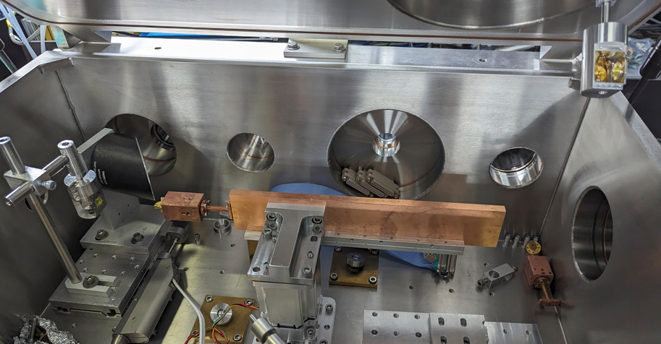
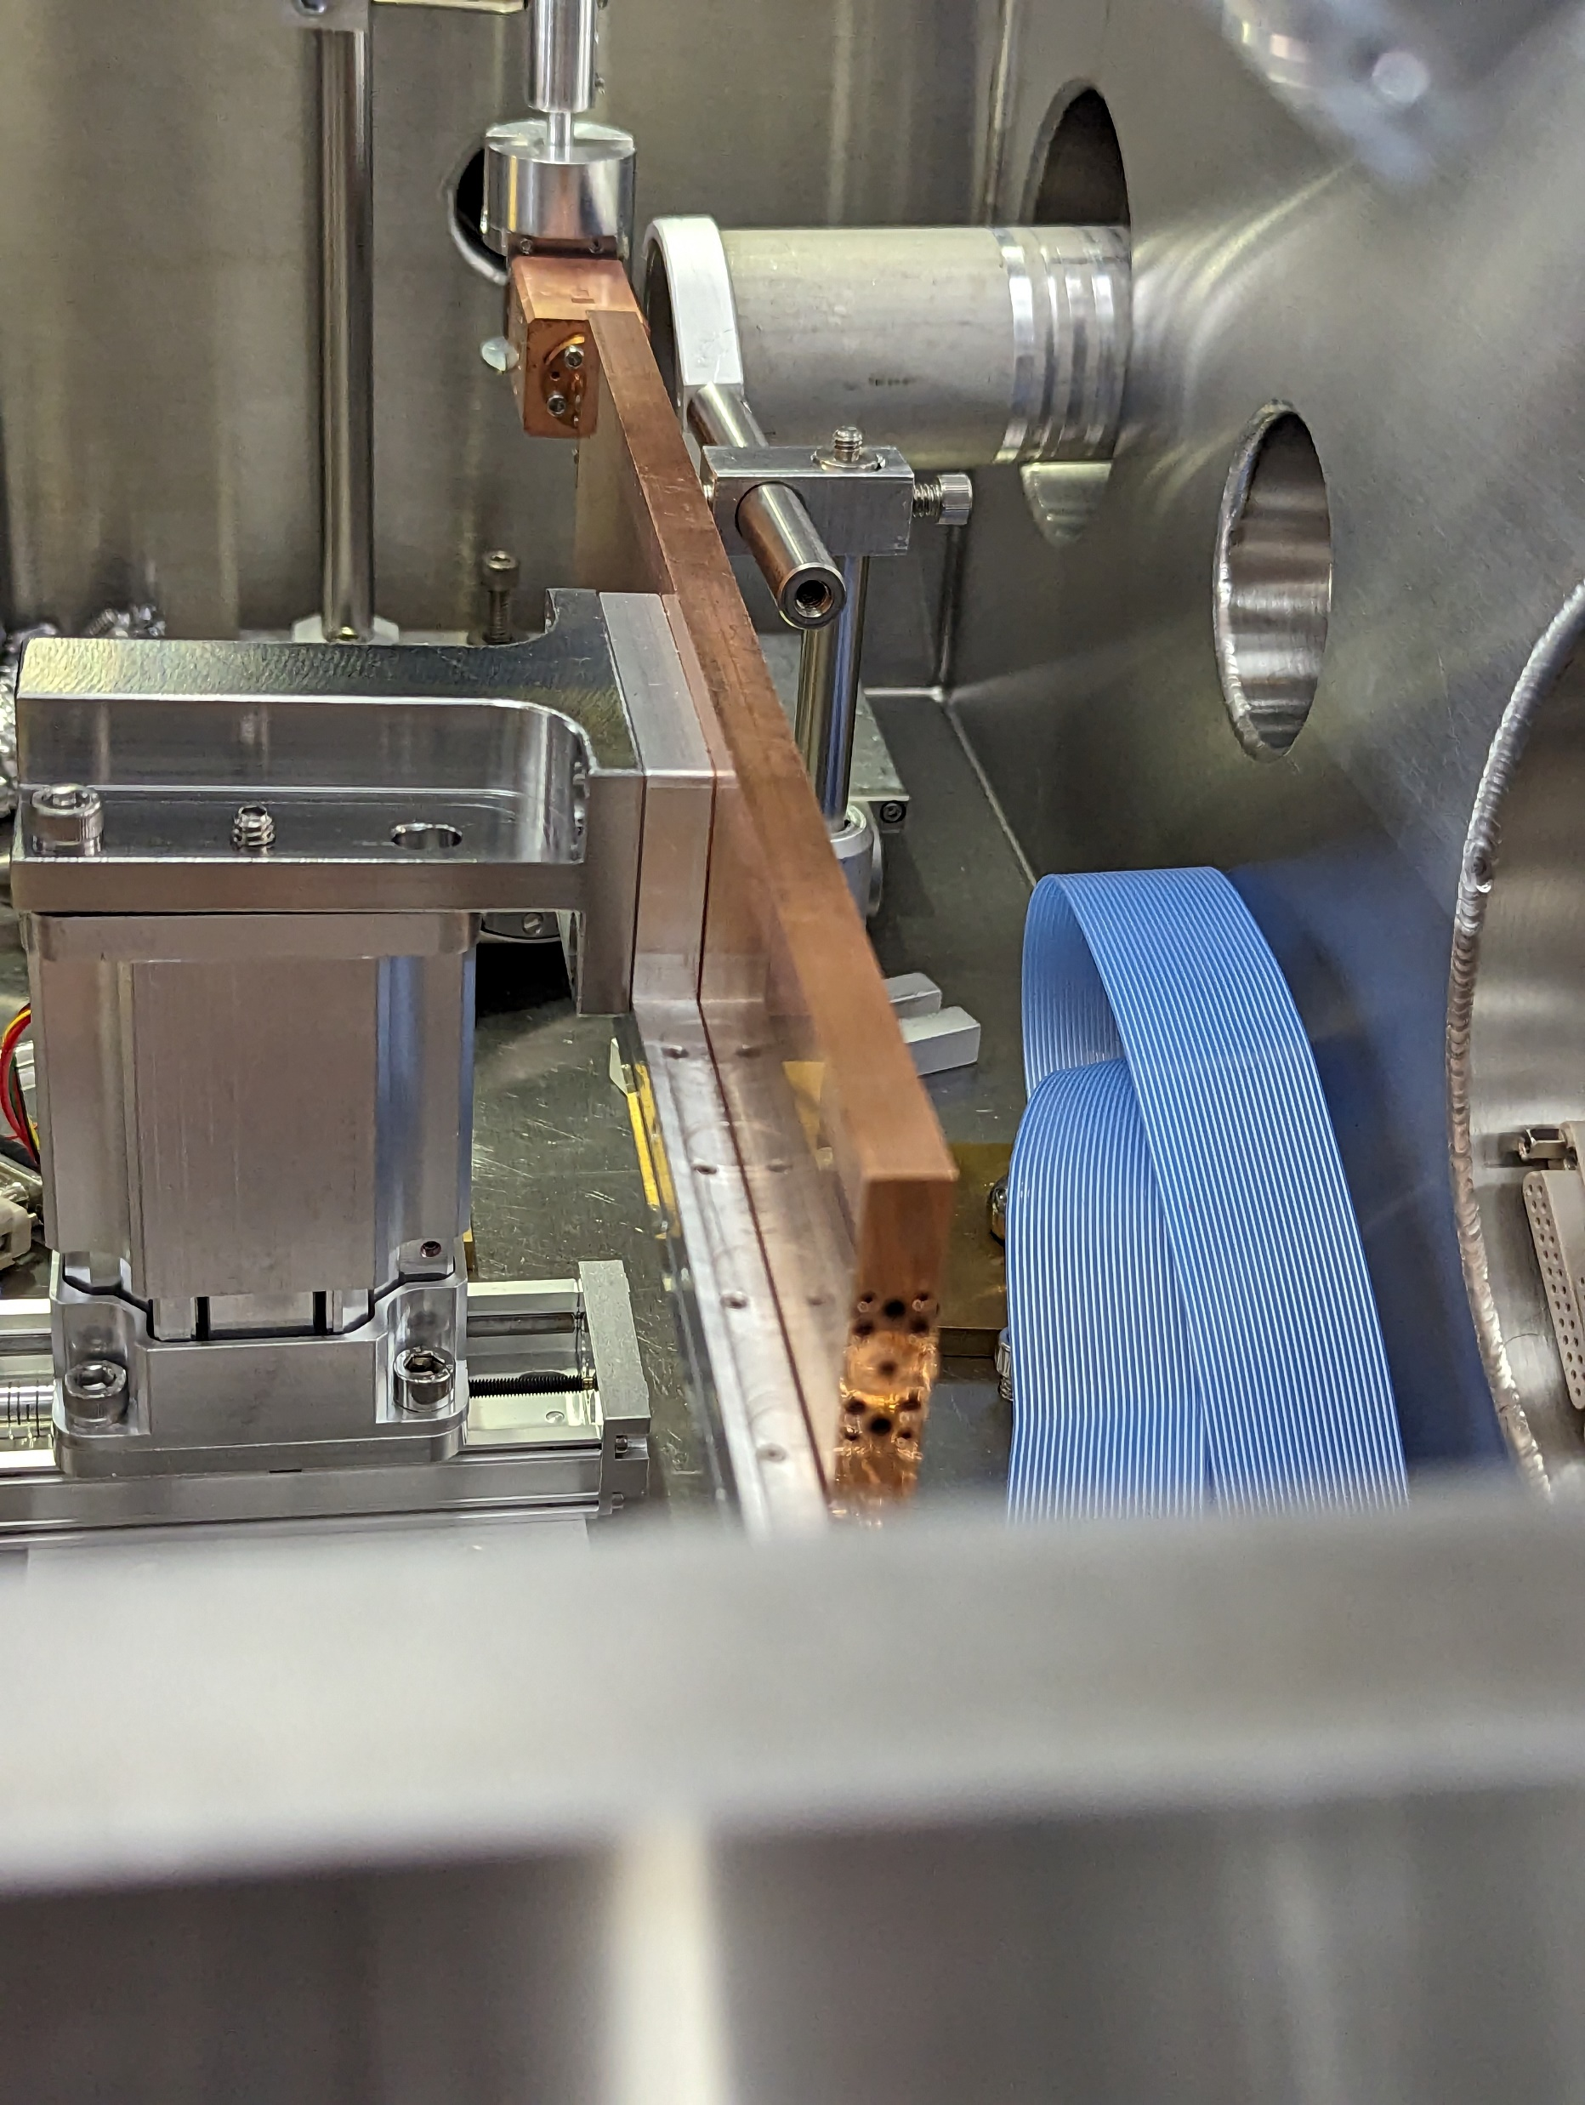
Accelerator module installed inside the experimental chamber
0.3 m
e⁻
2
3
1
Setup 1
Setup 2
Copper structure with the corrugated waveguide in the middle
Transition section between accelerator modules
Cylindrical waveguide adapter

Slide 3
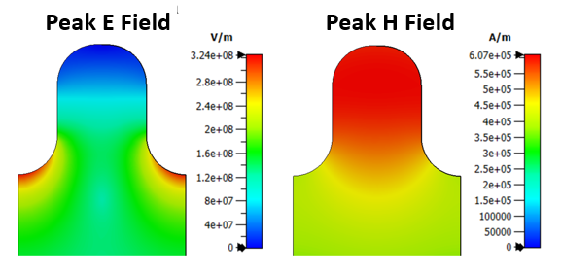
Motivation: a multi-user hard x-ray FEL facility
No use of electricity
witness
<<
drive
180 GHz, 4.5 GeV
SRF, 650 MHz
E-gun
1 GeV
End stations
G. A. Voss and T. Weiland, DESY M-82-10, 1982
10 nC, 200 kHz,
2 mA, 2 MW
2 mm
FELs, x-ray beamlines and end stations,
20 kHz rep rate
A. Siy et al., PRAB, December, 2022
Array of structure-based wakefield accelerators
Accelerator for
drive (10 nC) and witness (0.15 nC) bunches
610 kA/m
20.86mm
324 MV/m
340 μm
94 MV/m on axis

Slide 4
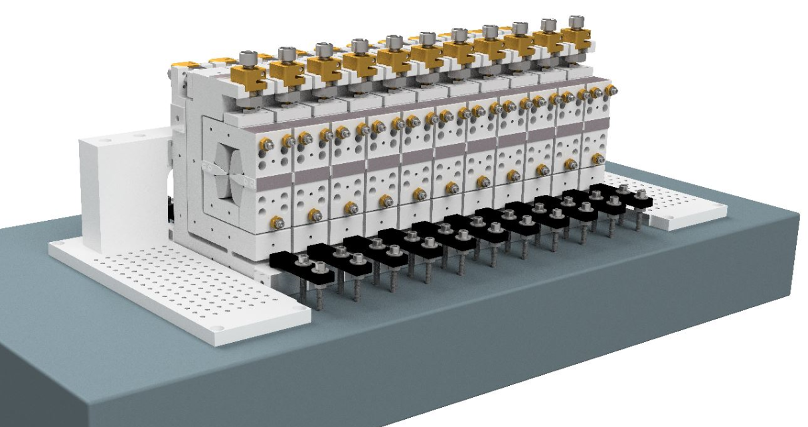
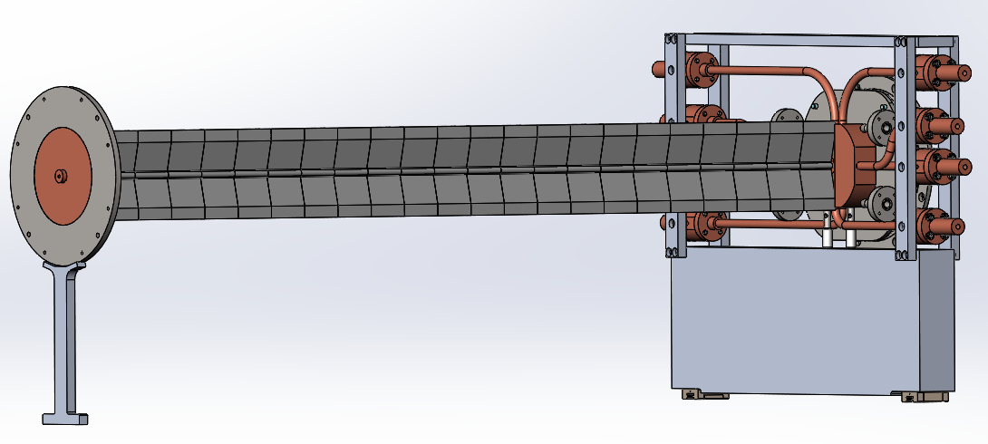
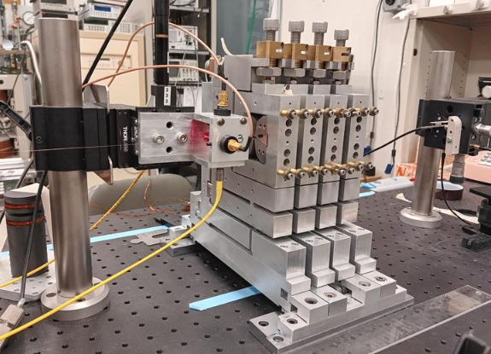
Accelerator module components
Three transition sections were built for ATF experiment
0.5 m
Corrugated waveguide
e-
Two 0.3 m long copper structures were built for ATF experiment
The transition section contains:
TM₀₁ mode output coupler
TE₁₁ mode output coupler (IOM)
Bellows
The quadrupole wiggler

Slide 5
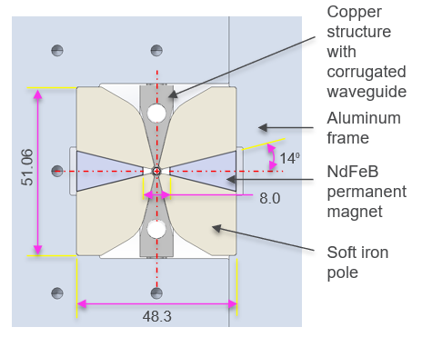
Accelerator module components (2)

Slide 6
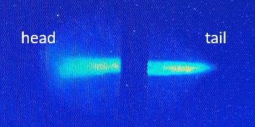
A schematic of the experiment at ATF
slit action
End tip
BPM
9. TPX window
10. BLIS Michelson interferometer
11. LHe bolometer
13. Energy slit
14. HeNe alignment laser
16. Faraday cup

Slide 7
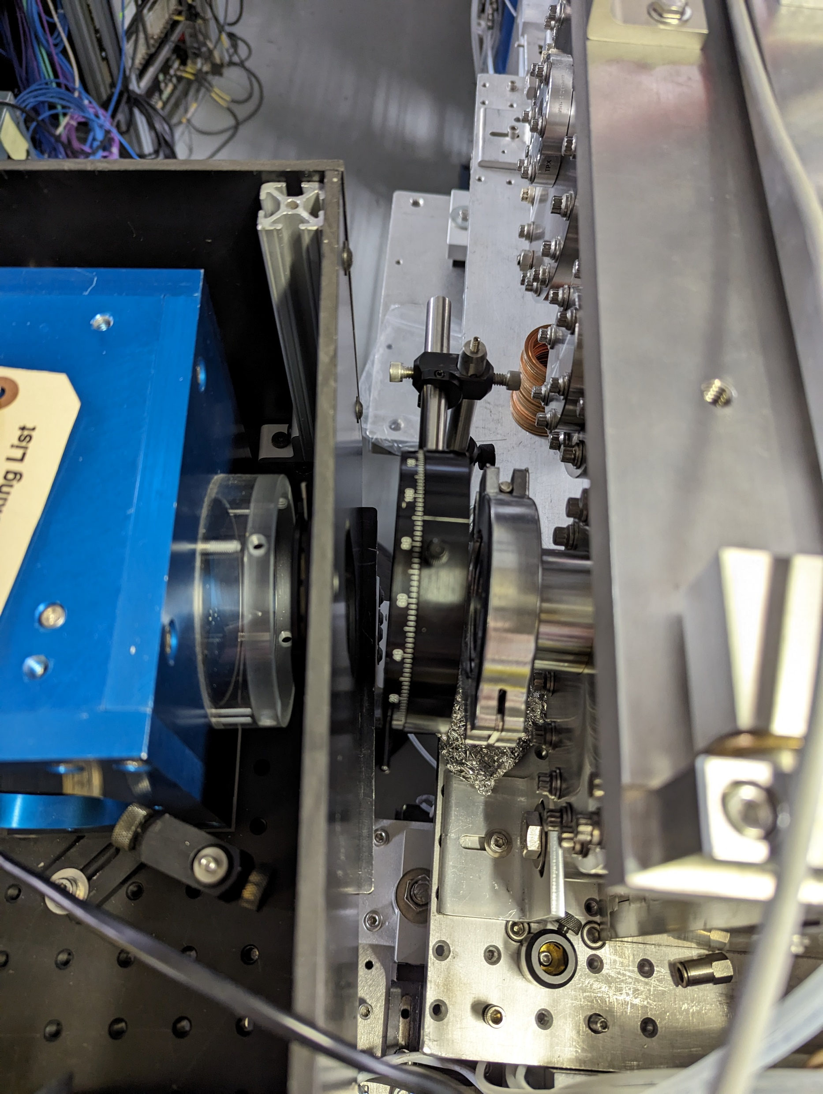
BLIS interferometer
Wire grid polarizer

Slide 8
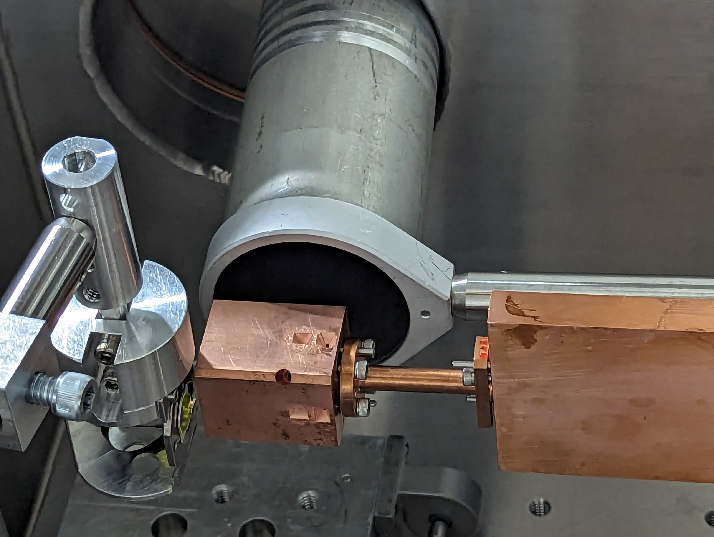
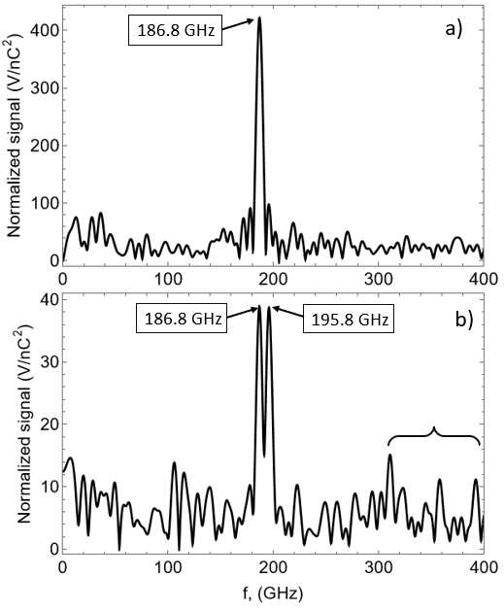
The goal of the experiment was the characterization of the TS
The beam is offset vertically by -150 μm
TE₁₁ coupler
Sub-THz light out
IOM
TM₀₁
TM₀₁ coupler
without polarizer
CWG
TE₁₁
Transition section (TS)
with polarizer in vertical position
locally excited
Experimental setup at ATF for characterization of the transition section attached to the 0.3 m long CWG
Measurement:
Calculation:
where I is a peak amplitude in the spectrum

Slide 9
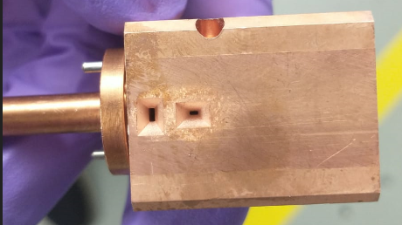
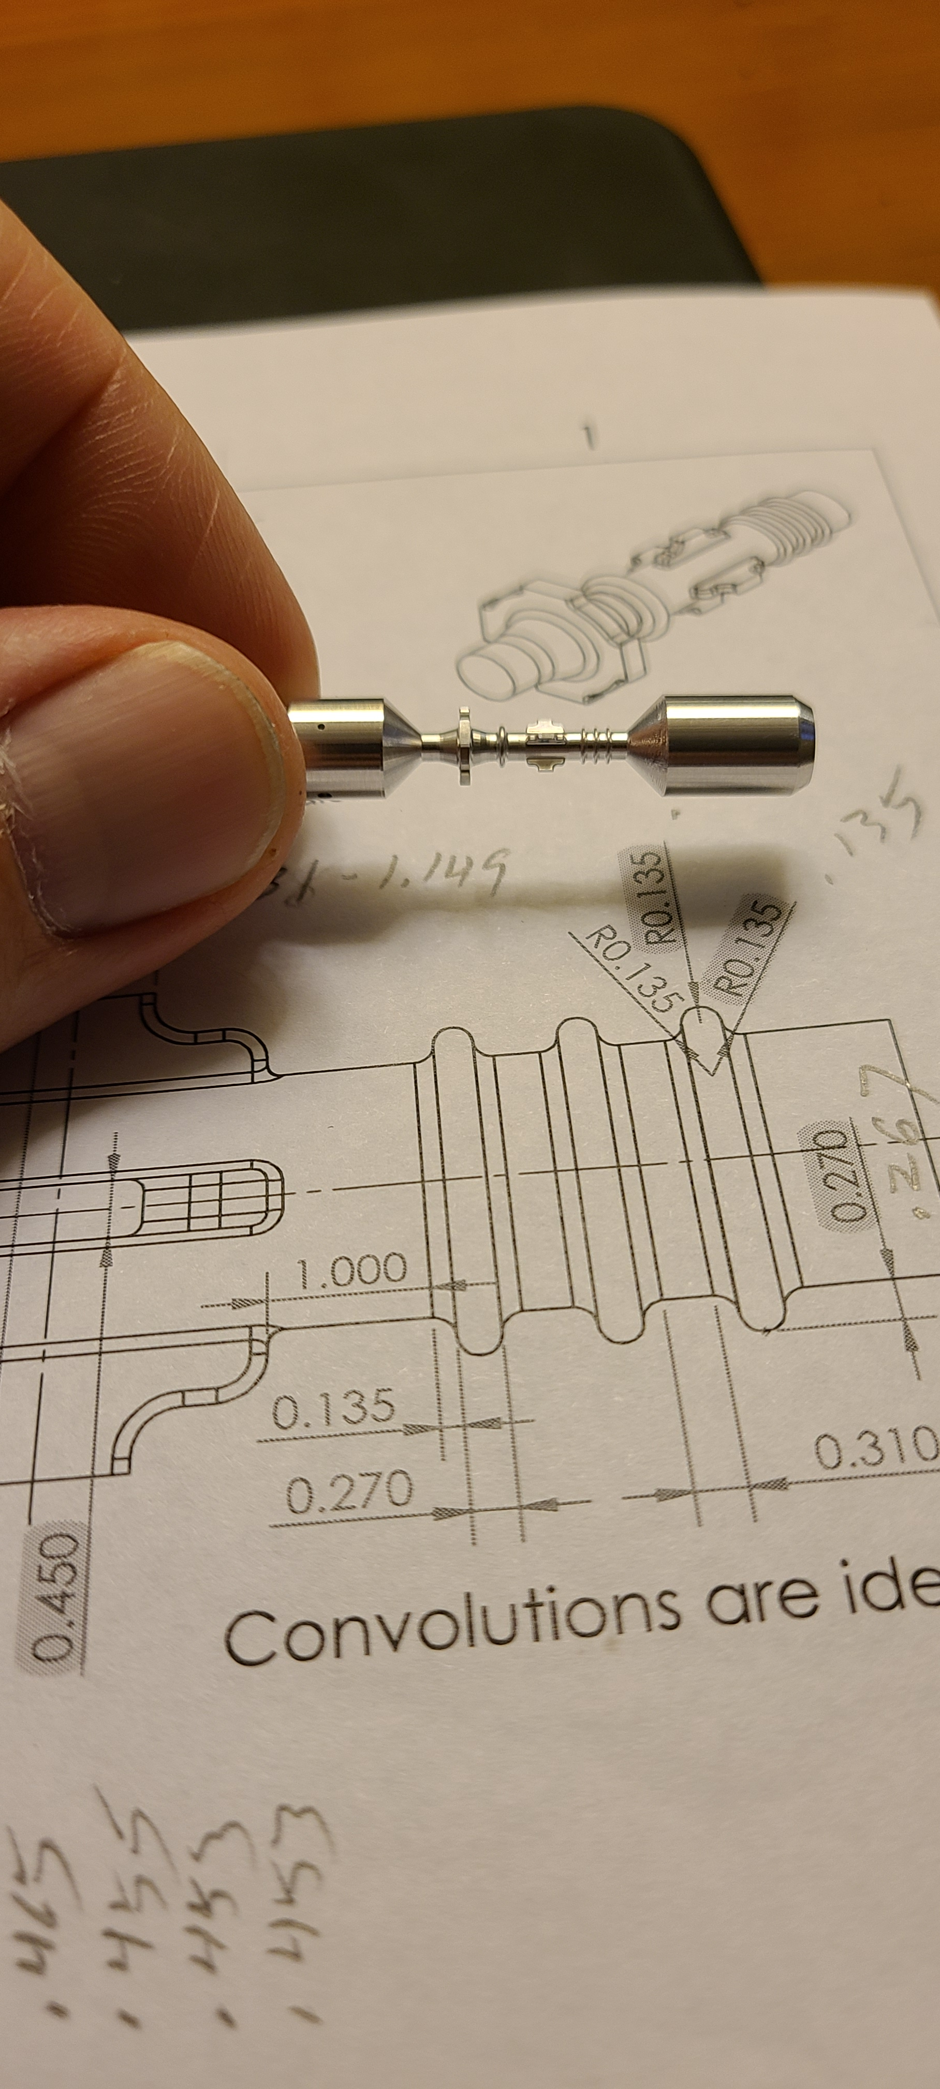
Measurement of isolation efficiency
Measured energy of the sub-terahertz wave pulses radiated by TM₀₁ and HE₁₁ horn antennas.
Aluminum mandrel
place holder for bellows
All four sides have horn antennas on
Horn antenna of TM₀₁ fundamental mode coupler
Horn antenna of TE₁₁ coupler called Integrated Offset Monitor (IOM)

Slide 10
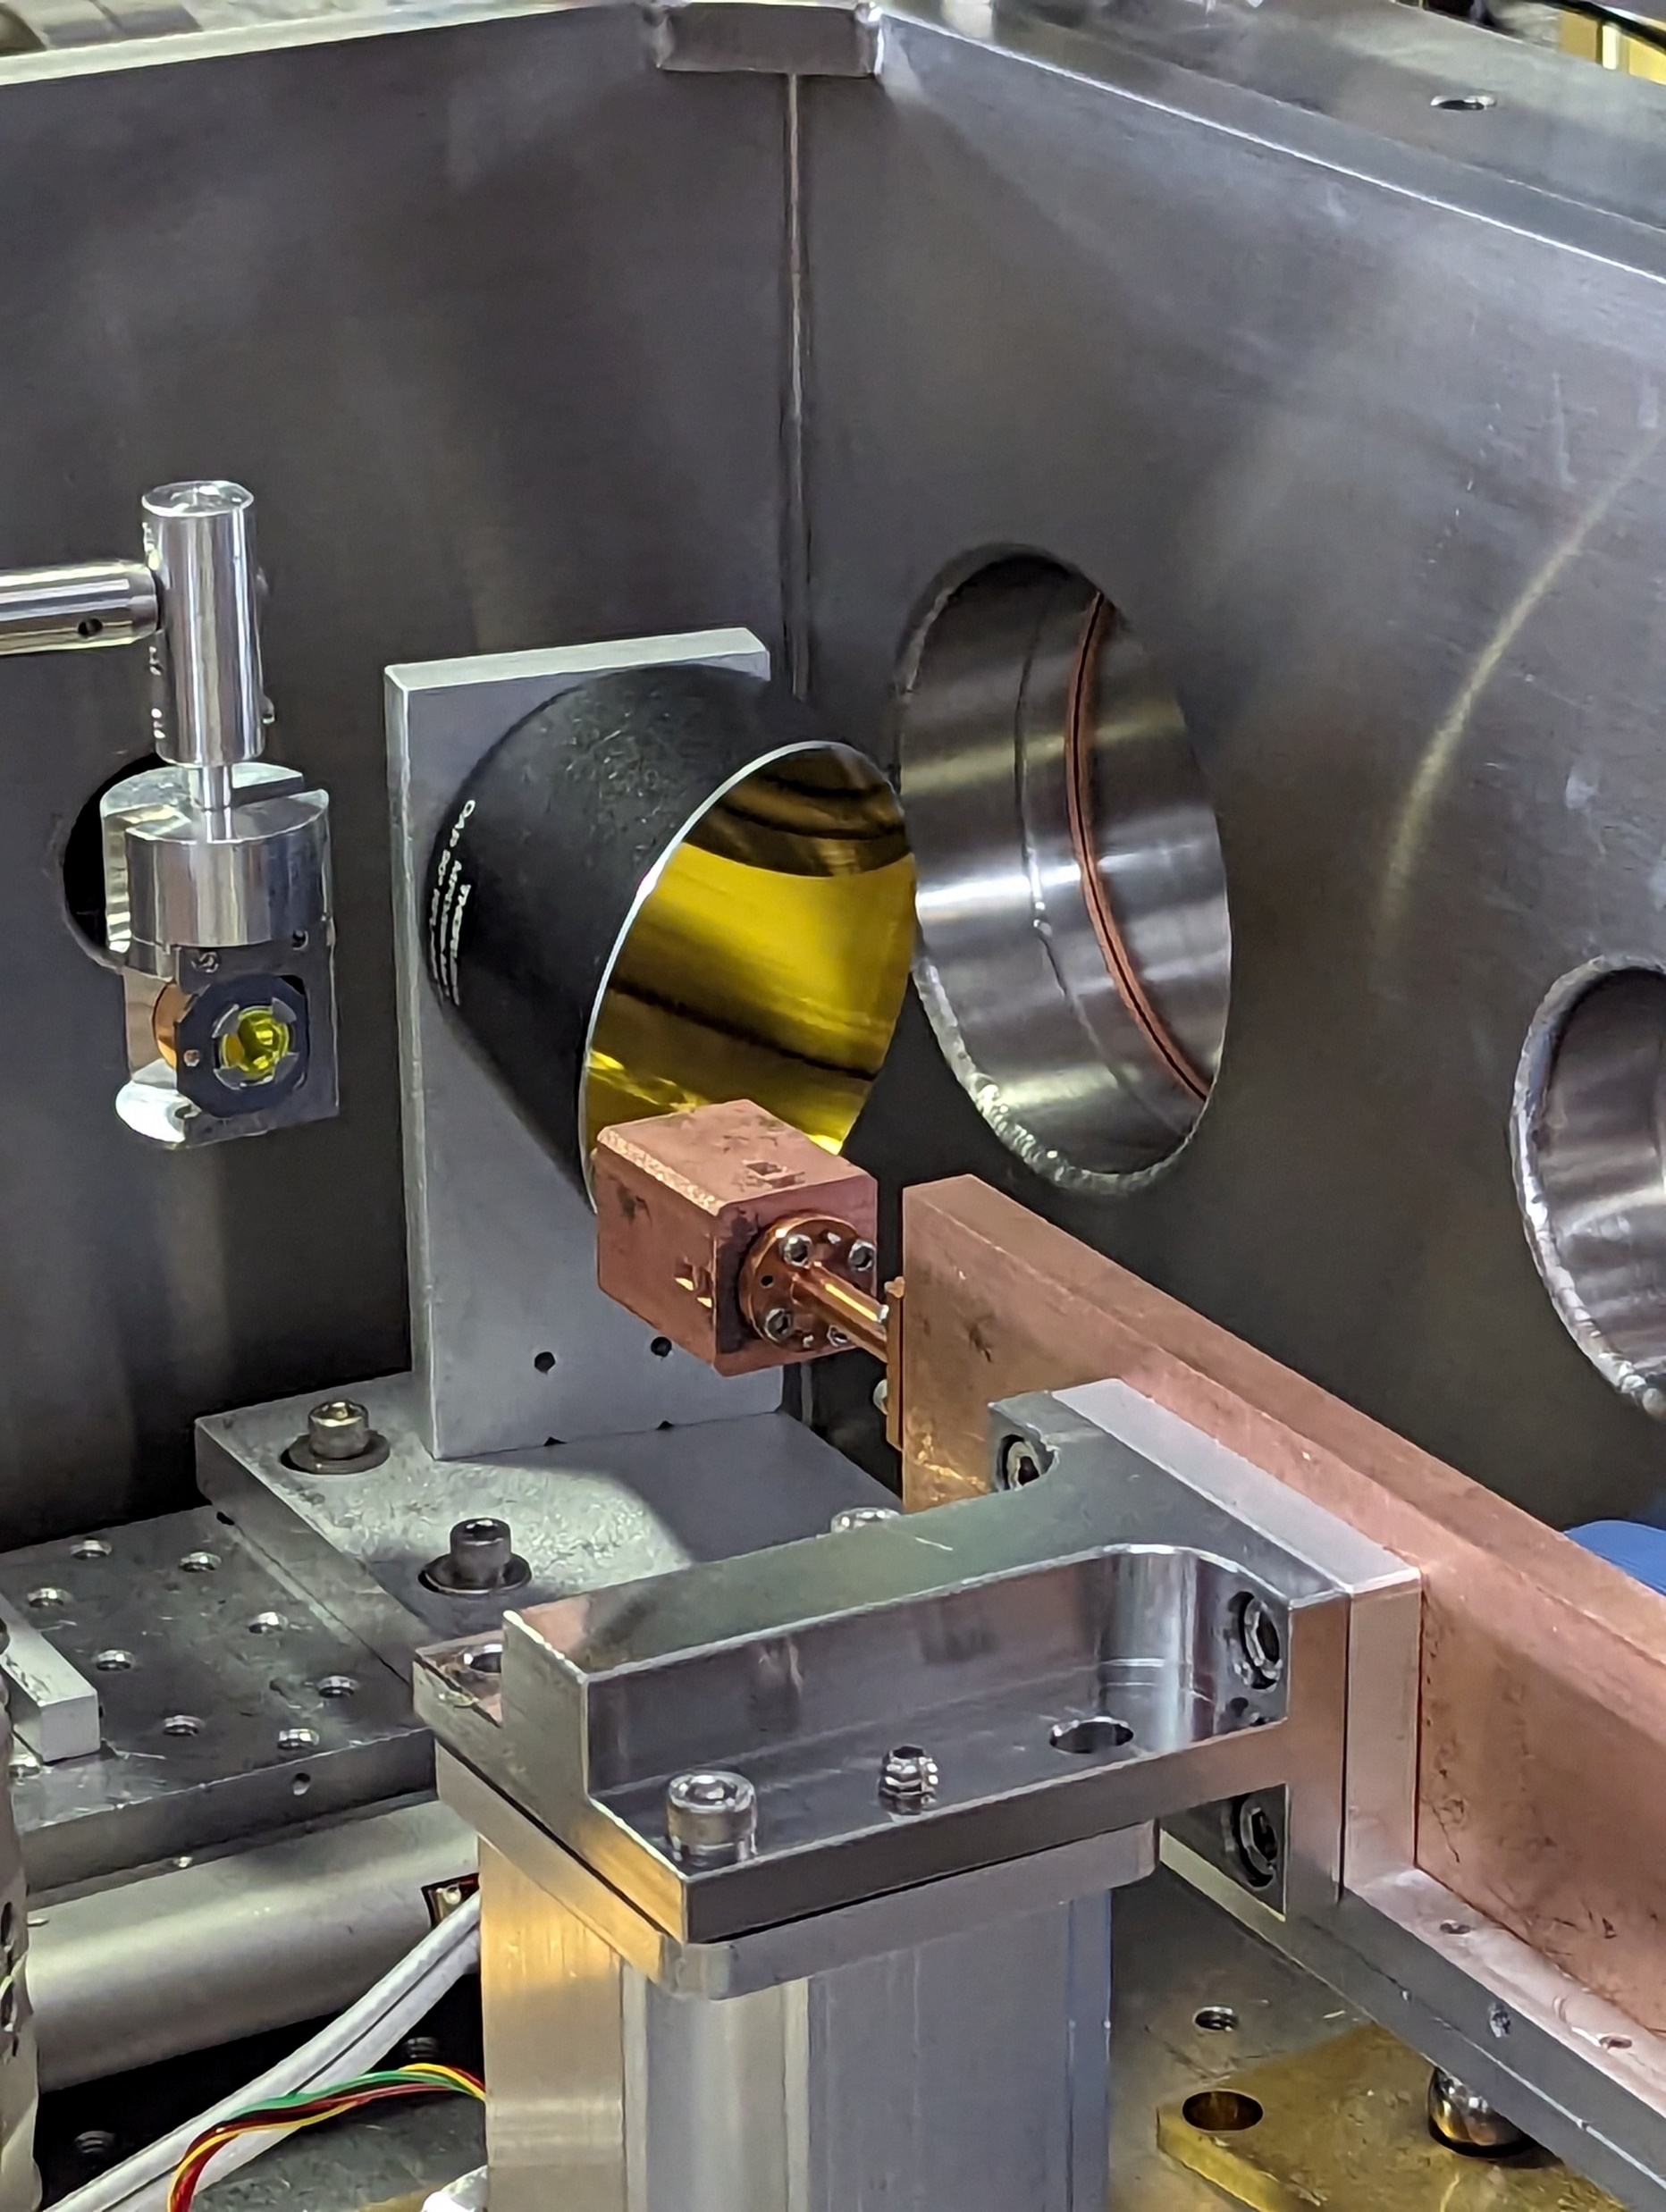
Measurement of isolation efficiency
Measured energy of the sub-terahertz wave pulses radiated from the end piece.
Off-axis parabolic mirror
End piece
The end piece is a cylindrical waveguide with a 45º cut at the end.

Slide 11
Results
Bolometer measurements normalized on the square of the bunch charge
*) units V/nC²
**) Note: TM₀₁ mode Čerenkov radiation splits in four directions in TM₀₁ coupler and TE₁₁ mode Čerenkov radiation splits in two directions in TE₁₁ coupler.
Result
CWG 1 :
TM₀₁ coupler captures (97.9±0.5)% of the TM₀₁ mode of Čerenkov radiation,
TE₁₁ coupler captures (97.1±1.1)% of the HE₁₁ mode of Čerenkov radiation.
CWG 2 :
TM₀₁ coupler captures (95.9±1.6)% of the TM₀₁ mode of Čerenkov radiation,
TE₁₁ coupler captures (95.8±3.0)% of the HE₁₁ mode of Čerenkov radiation.

Slide 12
Summary
The experiment was completed achieving all goals.
Postprocessing of measurements determined that they are in good agreement with design specifications.
Acknowledgments
We are grateful to the ATF staff for their valuable help in the experiment.
We are grateful to Mark Palmer for his unwavering support for the experiment and for accommodating many scheduling constrains.

Slide 13
Impact associated with this experiment and development
Invited Talk:
May 2023, “Fabrication and testing of corrugated Waveguides for a Collinear Wakefield Accelerator”, A. Zholents et al., Int. Part. Acc. Conf. 2023.
Future Invited Talk:
August 2024, “Fabrication and Beam Testing of a 180 GHz Colinear Wakefield Accelerator”, B. Popovich et al., Linac Conf. 2024.
A student was trained and obtained a Ph.D.
Publication in preparation:

Slide 14
Impact associated with this experiment and development
The development of the corrugated waveguide-based collinear wakefield accelerator module marks a significant advancement toward realizing a compact hard x-ray free-electron laser (FEL) facility. This achievement encompasses successful demonstrations of key accelerator and FEL components:
A 30 cm long robust strong-back structure designed to firmly hold and efficiently cool the corrugated waveguide.
Sub-terahertz frequency electromagnetic couplers employed for the extraction of fundamental mode power and precise beam offset diagnostics.
Implementation of high-field gradient quadrupoles crucial for beam guidance and effective suppression of beam breakup instabilities.
Deployment of a compact, small gap force neutral adjustable phase undulator (FNAPU) for enhanced FEL performance.
All structures and couplers underwent rigorous testing at the microwave laboratory at ANL, followed by validation with electron beam experiments at the Brookhaven National Laboratory's Accelerator Test Facility. Magnetic measurements were conducted at ANL to characterize the quadrupoles and a prototype of the quadrupole "wiggler," yielding results in excellent alignment with design specifications. The prototype FNAPU was fabricated. Its performance characterization is in progress.
The comprehensive series of tests and validations revealed a remarkable consistency between actual performance and anticipated design parameters, underscoring the robustness and reliability of the concept of the corrugated waveguide-based wakefield accelerator for future applications in FEL technology.

