Slide 1
High-efficiency laser-driven electron accelerator ATF experiment AE121
PI: Matthias Fuchs,
Ethan Welch, Kyle Jensen, Tian Hu, Shao-Xian Lee, Alexander Saw, Joseph Natal, David Squires, Ping Zhang, Brad Shadwick
University of Nebraska – Lincoln (UNL)
funding: DOE-EPSCoR (HEP), DE-SC0021132 (received)
mfuchs@unl.edu
ATF Users' Meeting, 27. Mar 2024

Slide 2
Experiment Goals
Investigate a novel laser-plasma electron acceleration mechanism to relativistic energies based on Stimulated Raman Scattering (SRS)@quarter-critical plasma density “Parametrically-excited Laser-Plasma Acceleration PEPA”
Generate ultrashort, high-current electron beams
charge: tens of nC !!, energy: up to 10 MeV
High laser-to-electron efficiency (>16% !!)
accelerating gradients >1 TV/m (for 0.8 µm laser); ~200 GV/m for 10 µm laser expected
Highly relaxed restrictions on laser pulse duration (unlike bubble regime, can be several plasma wavelengths long, i.e., picoseconds for CO2 laser)
Interaction widely unexplored in gas jets and at relativistic laser intensities, specifically for electron acceleration
Fundamentally different from self-modulated laser-wakefield acceleration
mfuchs@unl.edu

Slide 3
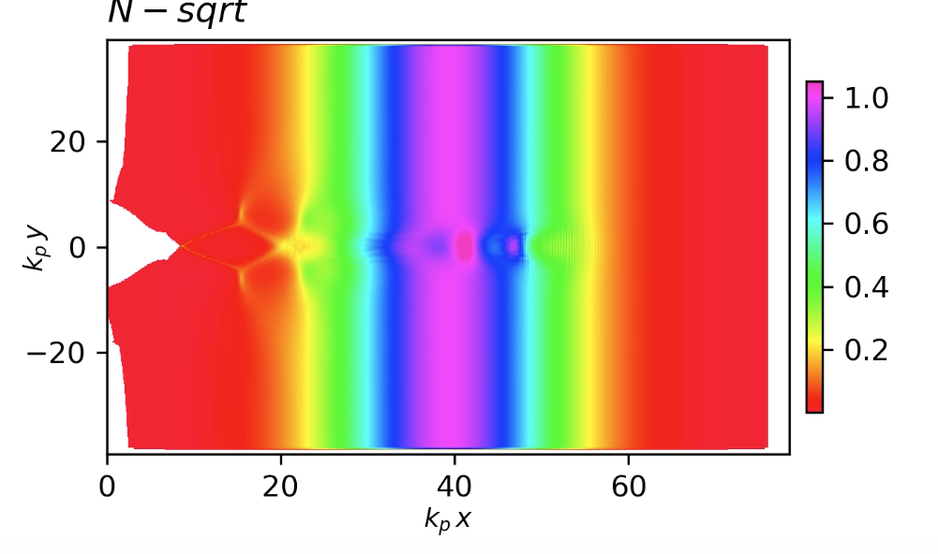
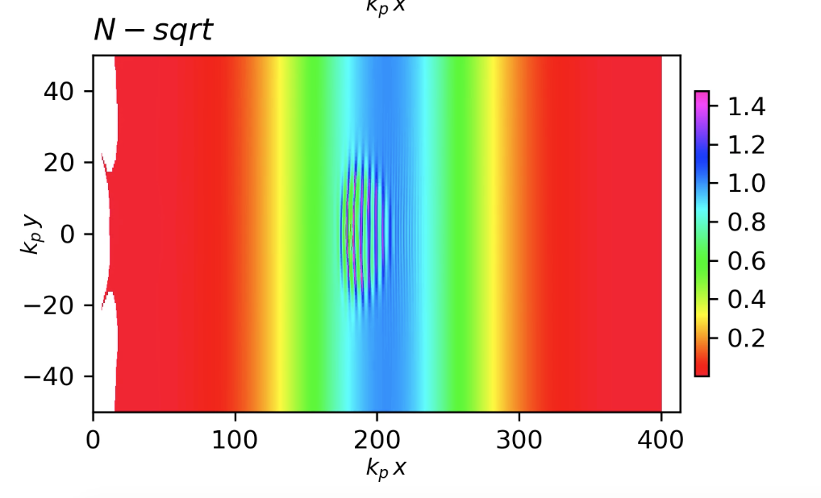
2D PIC Simulations
density << ¼ n_{cr} (k_{l}/k_{p} = 20)
a₀ = 0.5
density @ ¼ n_{cr} (k_{l}/k_{p} = 2.25)
laser B field
(normalized by kp)
plasma density (normalized by peak)
density 2D
snapshot

Slide 4
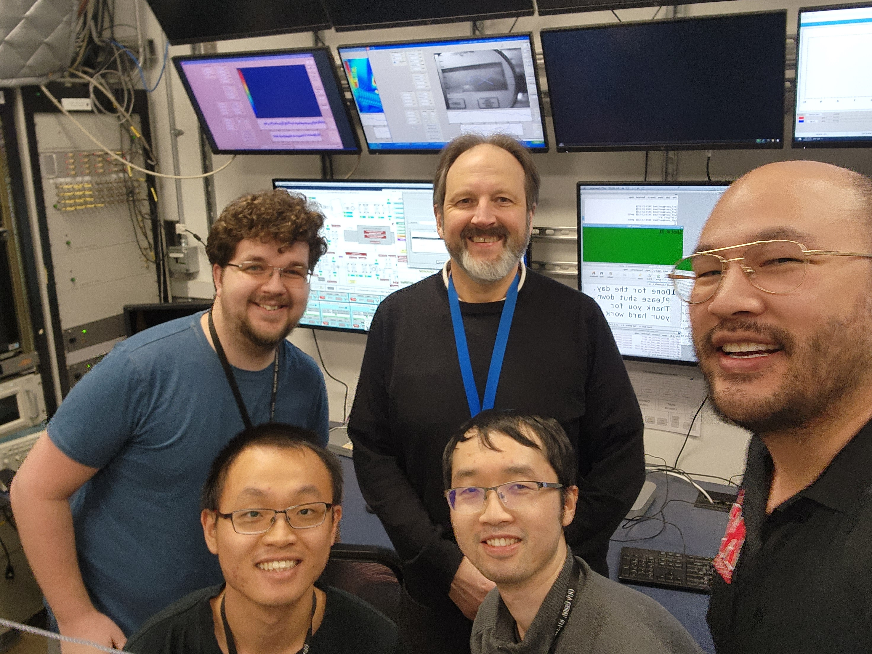
Experiment: Dec 4 – 22, 2023
Collaborators
Rafal Zgadzaj (UT Austin)
Apurva Gaikwad (Stonybrook)
ATF team: Thank you!!
not on picture:
- Joseph Natal
- David Squires
- MF

Slide 5
Experiment Overview: Setup
ATF Rectangular Chamber’s Current Setup:
Stage
LANEX
Magnet and Stage
Laser-driven e-beam
Optics and stage
Optics and stage
Jet
ATF e-beam
OAP
mfuchs@unl.edu

Slide 6
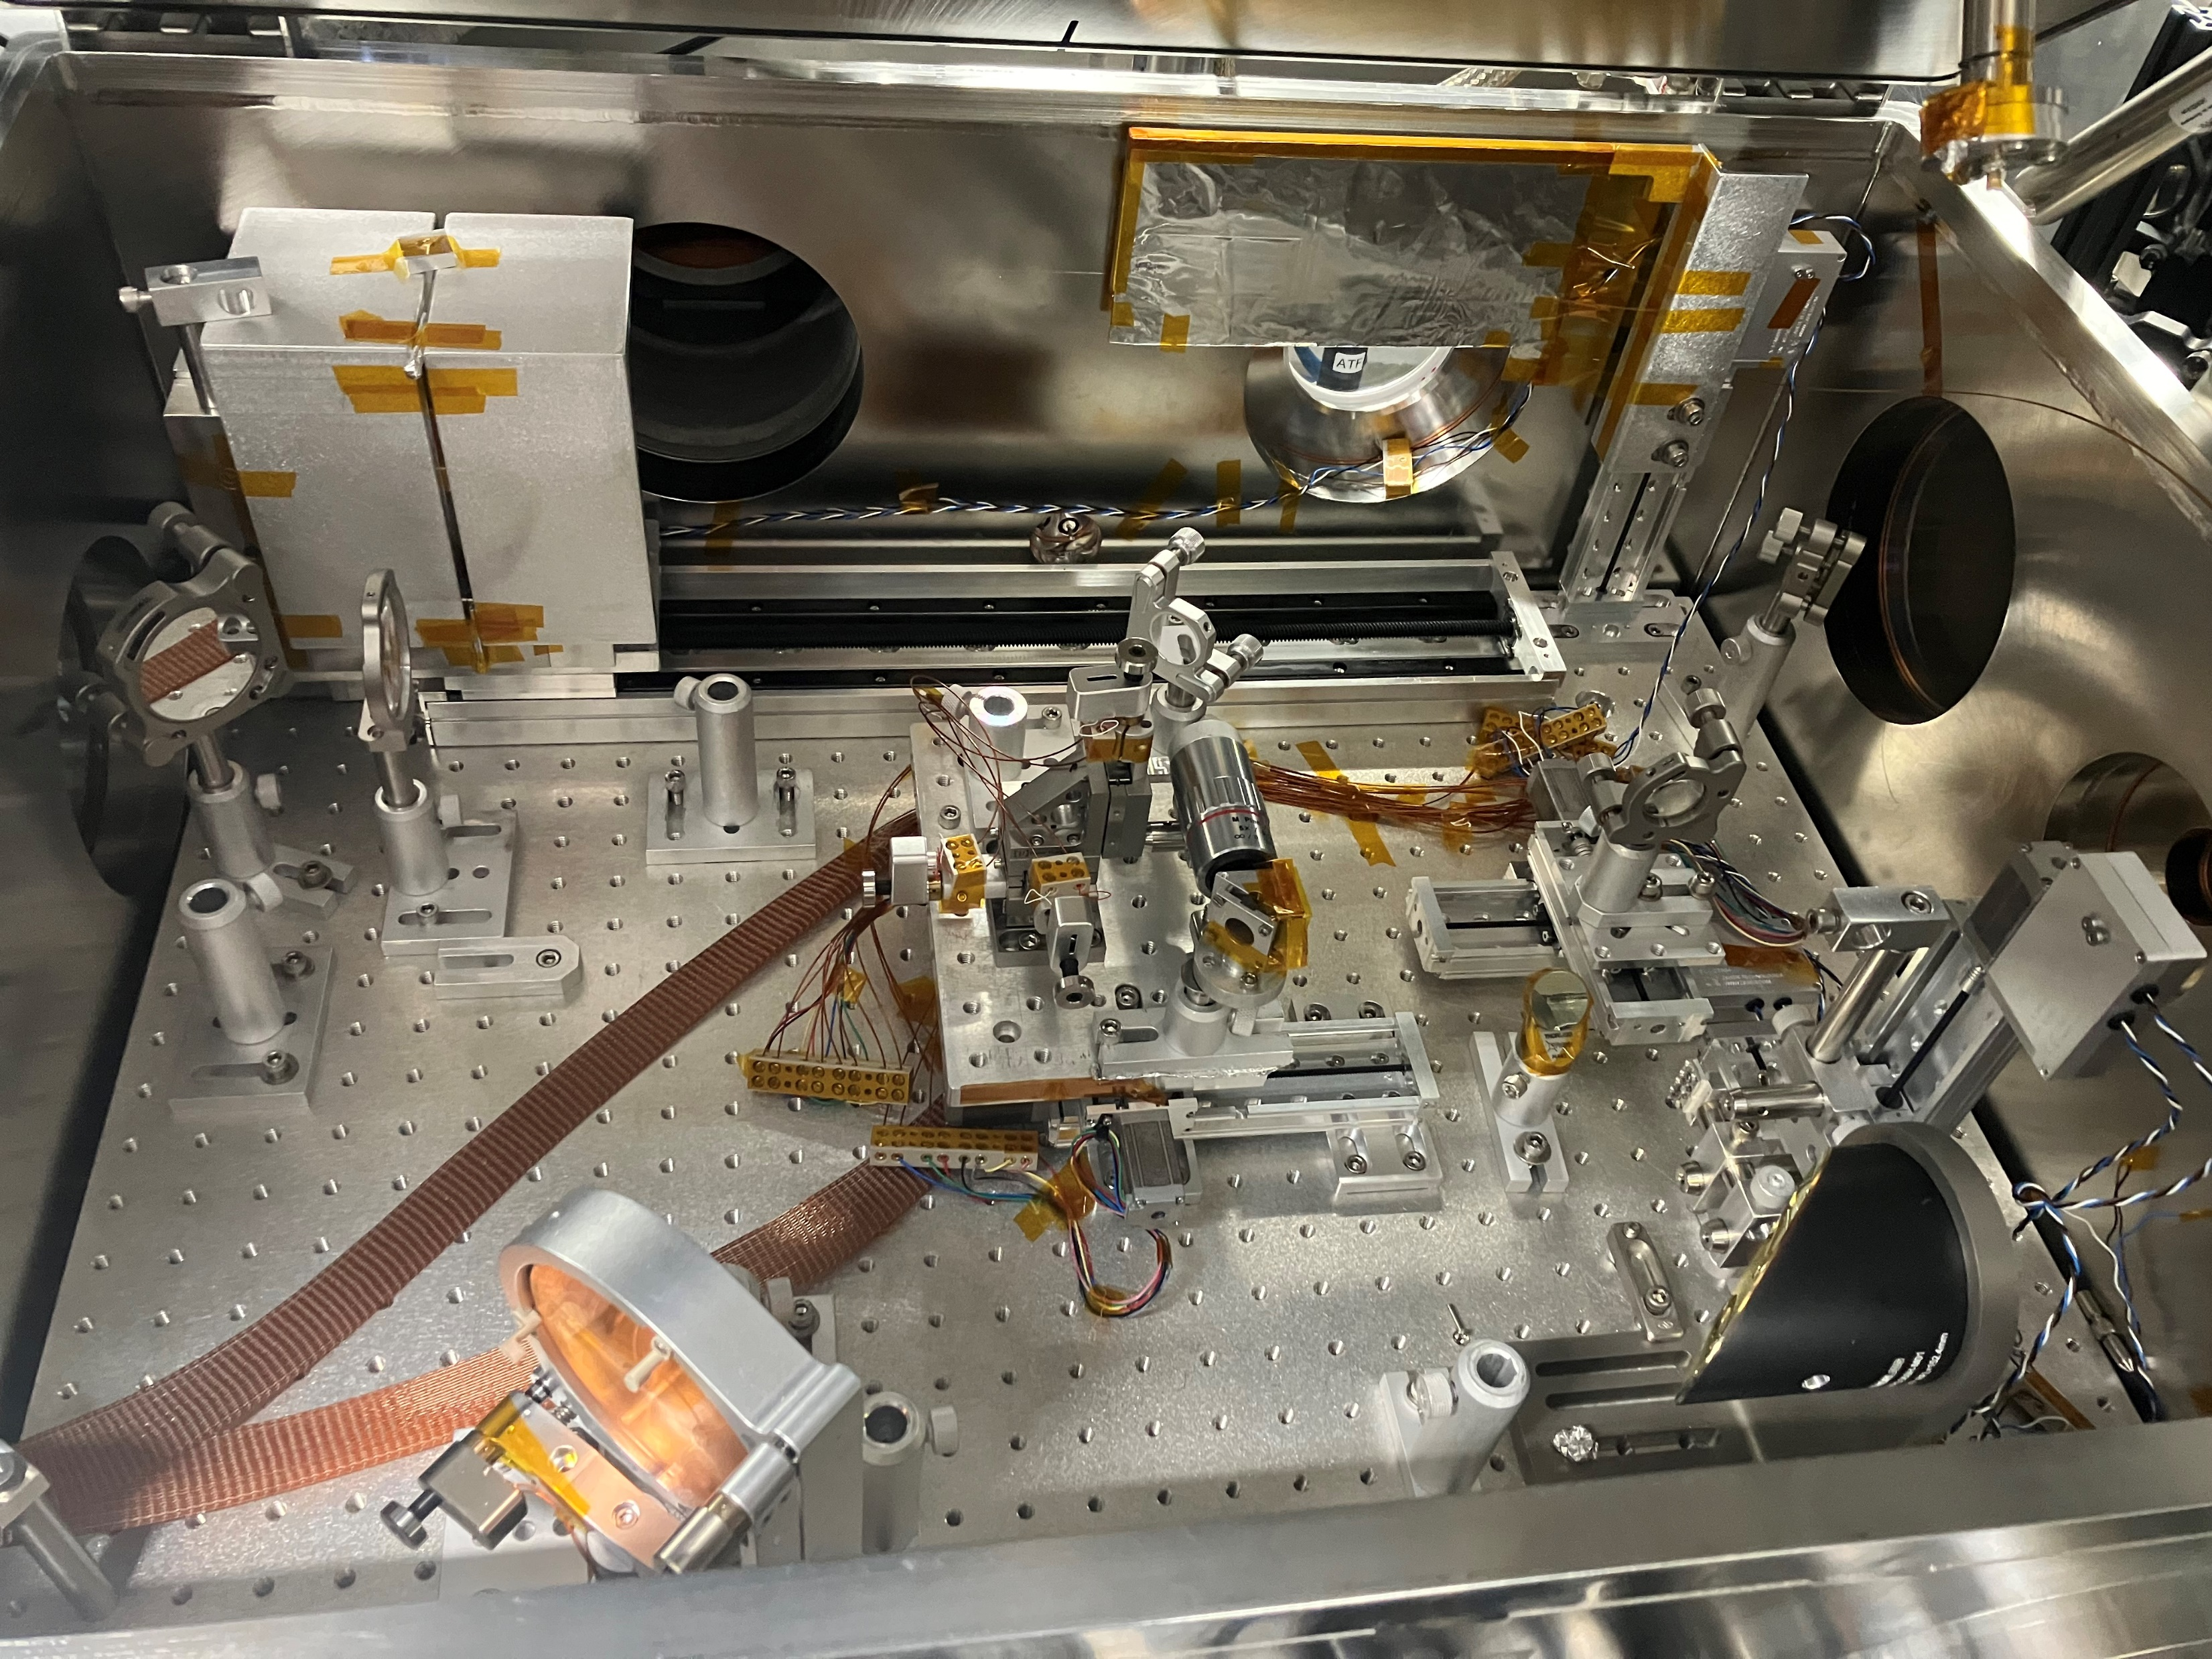
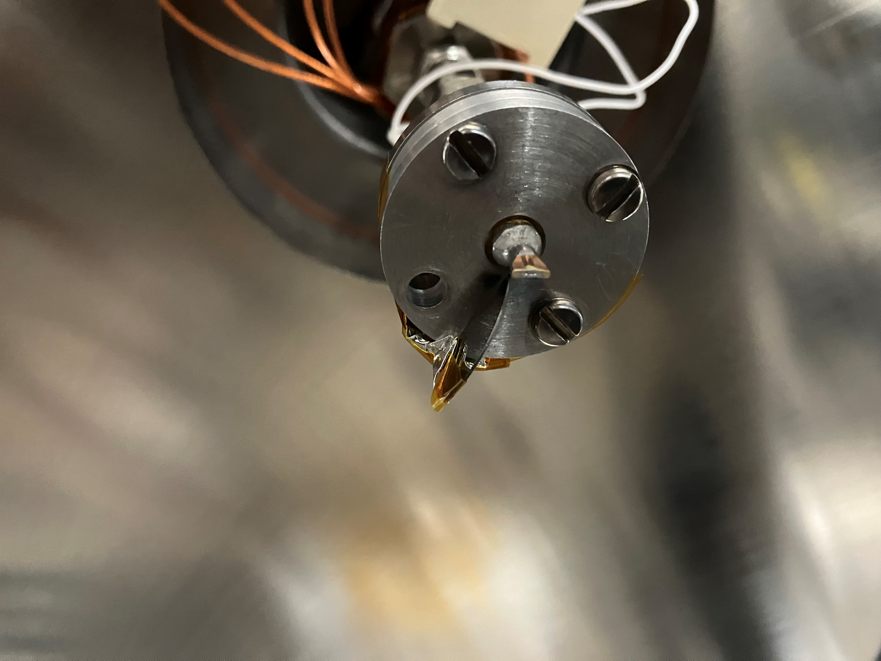
Experiment Overview: Setup
gas jets: 80 / 150 µm nozzle
Laser-driven e-beam
Jet
ATF e-beam
mfuchs@unl.edu

Slide 7
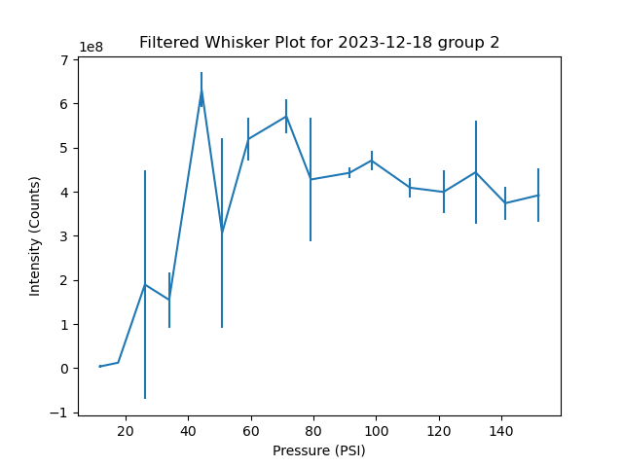
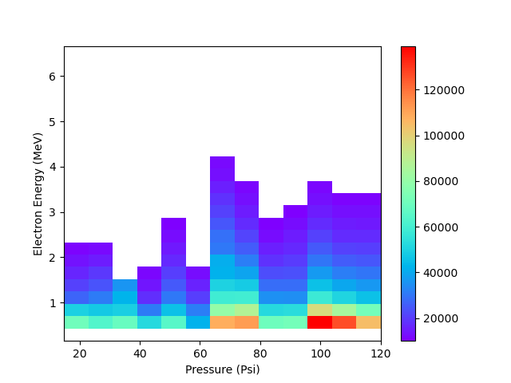
Experimental Results
preliminary
78 -micron nozzle
charge vs plasma density
electron energy vs plasma density
filtered in laser energy [2 to 4 J]
mfuchs@unl.edu

Slide 8
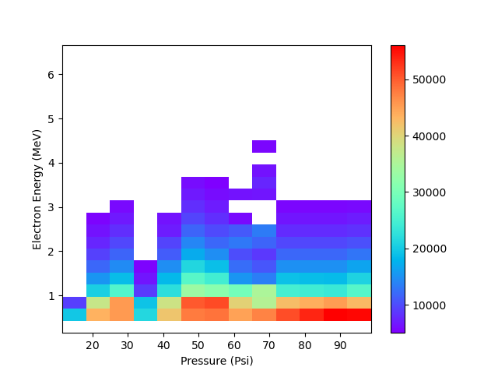
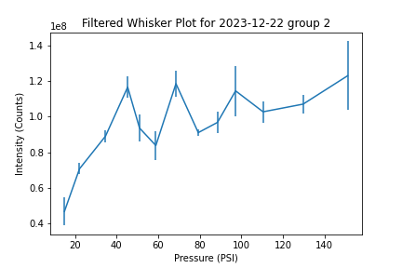
Experimental Results
preliminary
150-micron nozzle
charge vs plasma density
electron energy vs plasma density
filtered in laser energy [2 to 4 J]
mfuchs@unl.edu

Slide 9
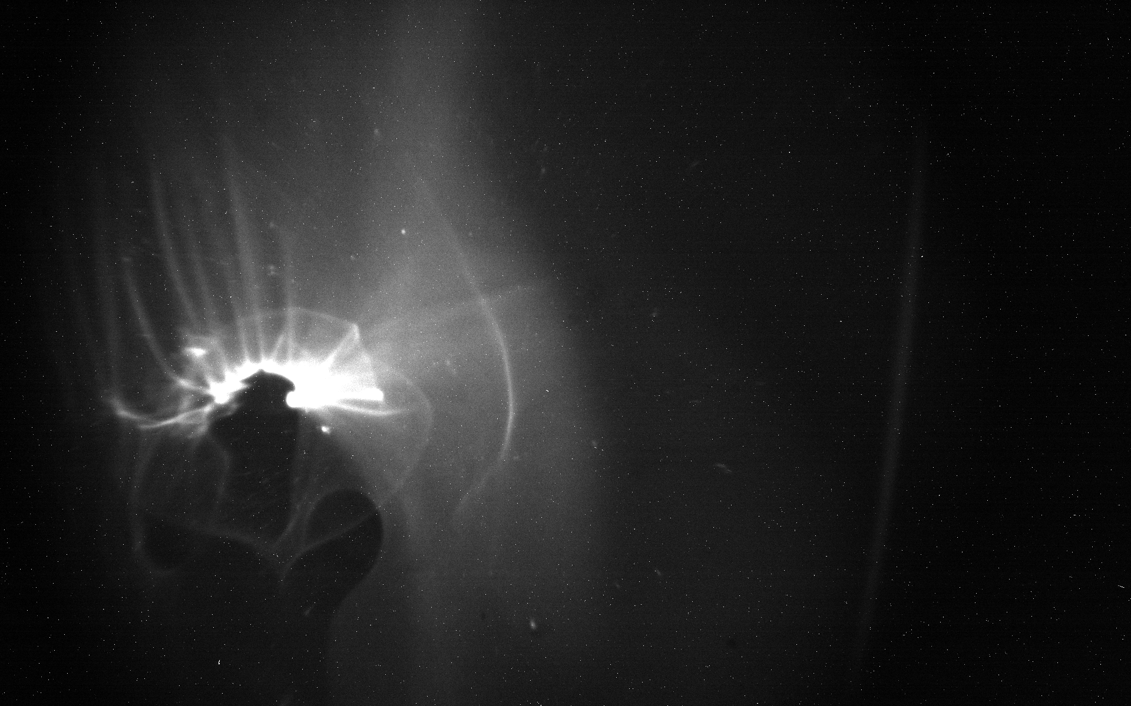
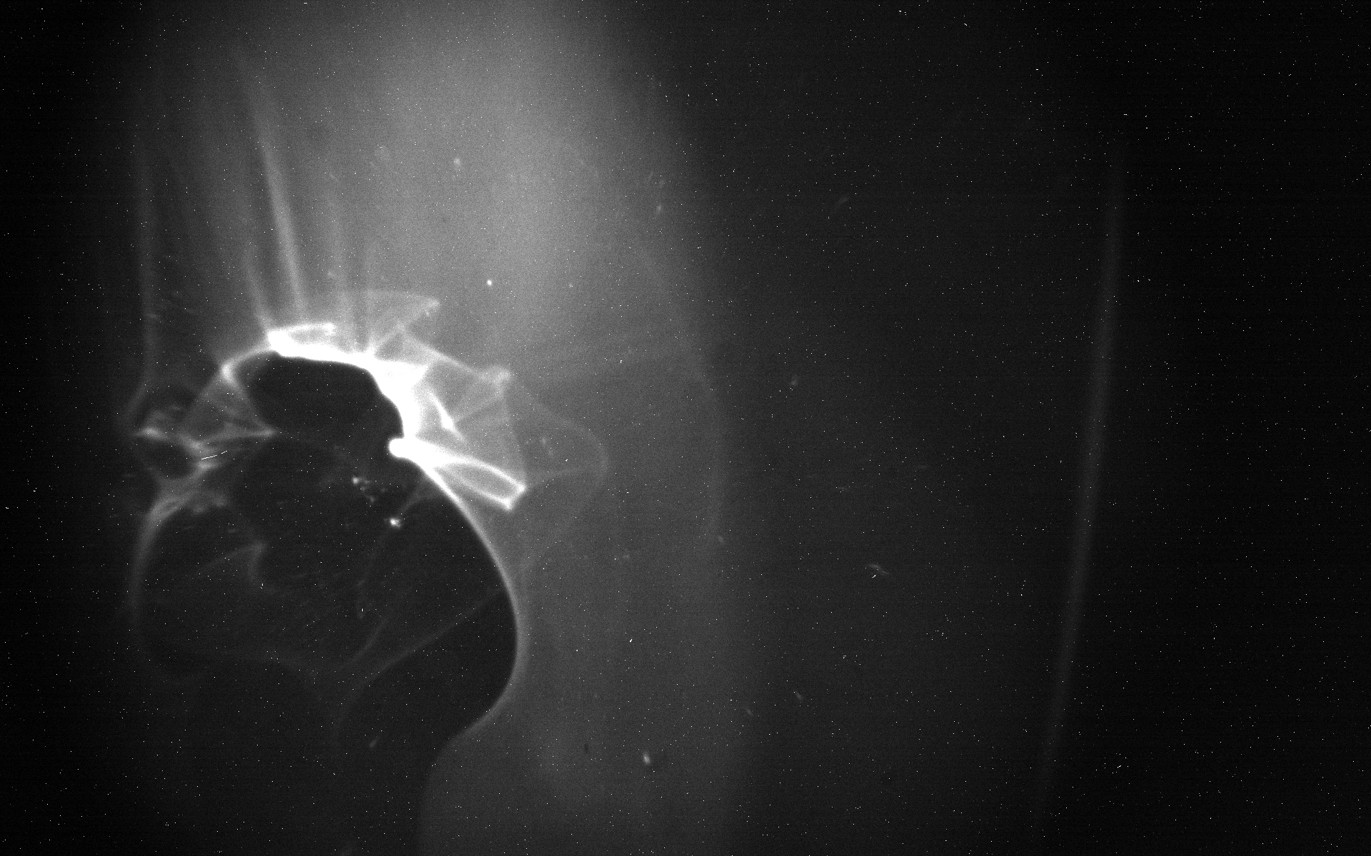
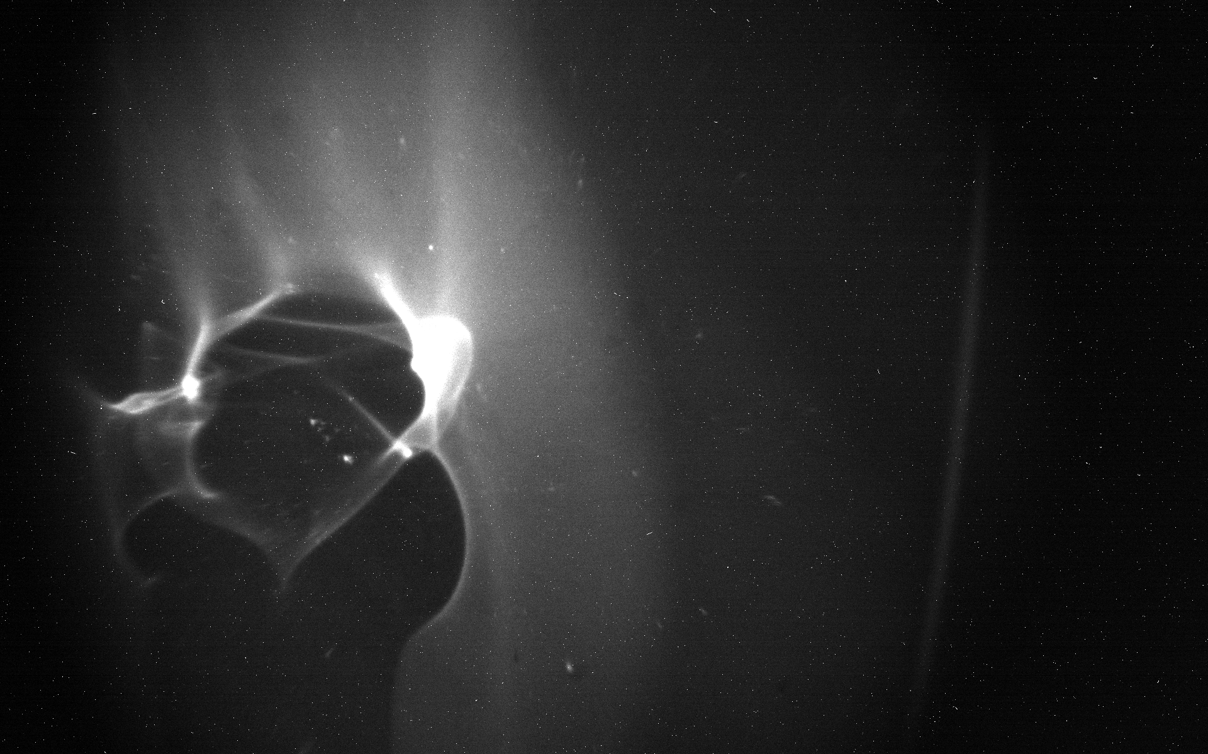
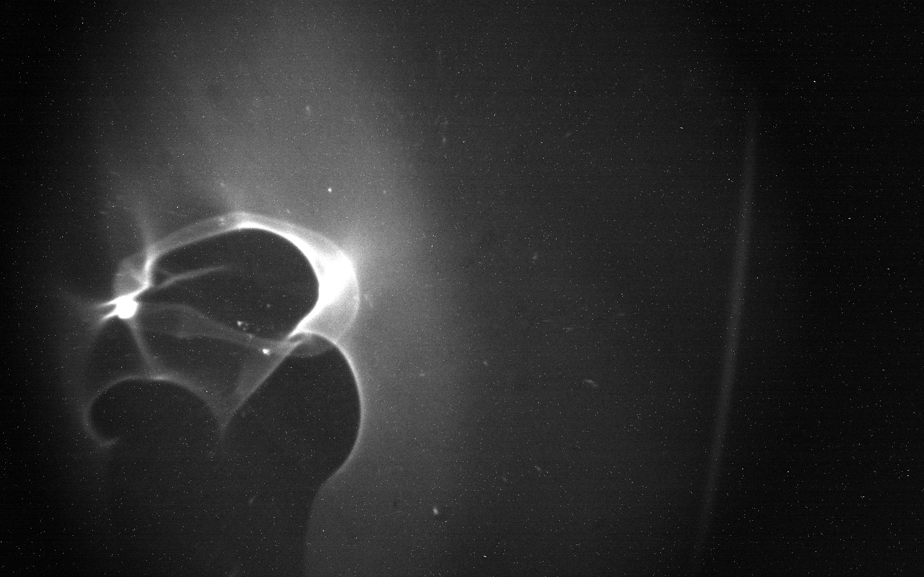
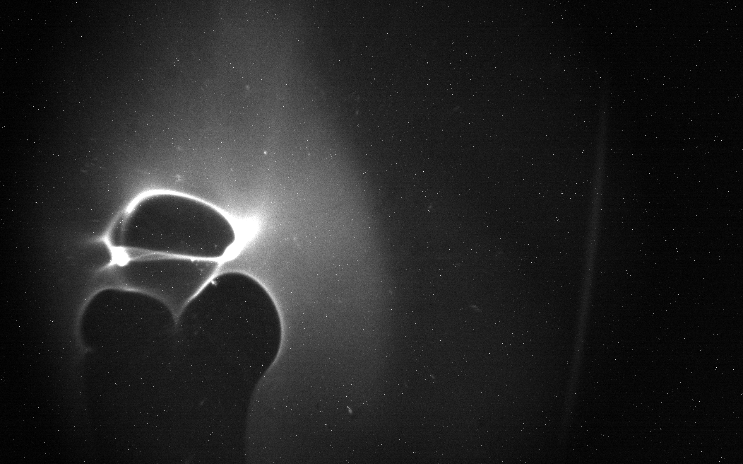
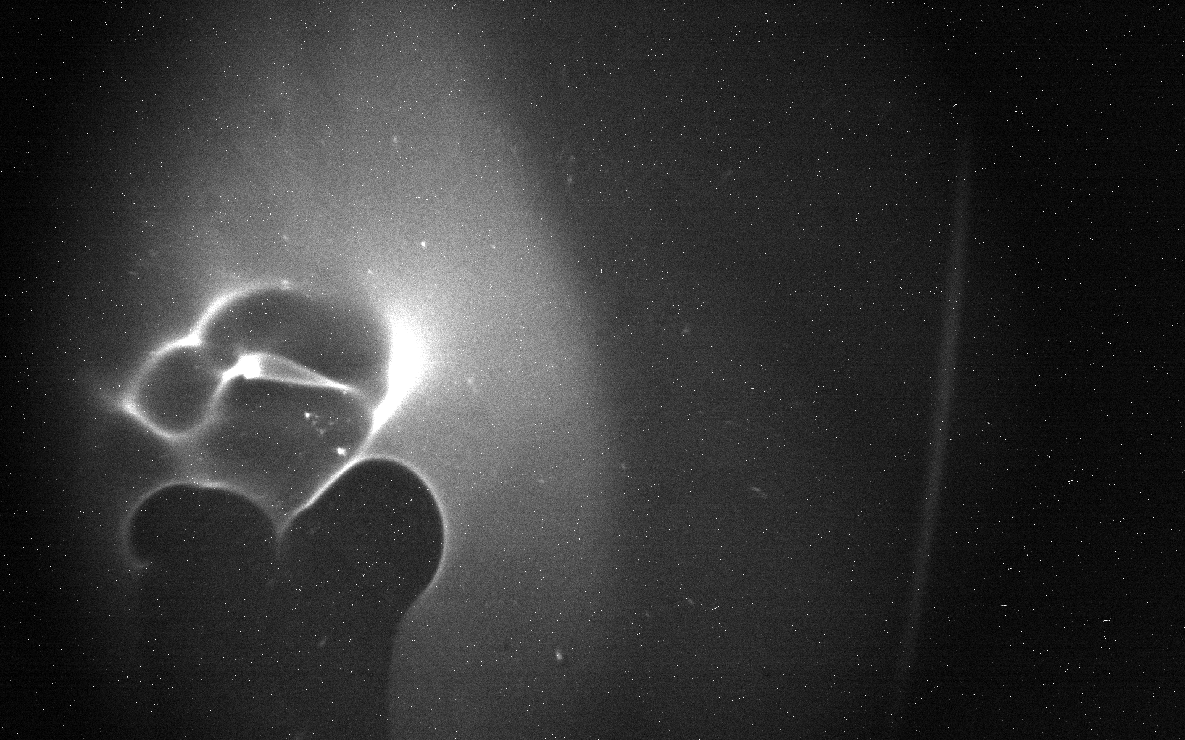
Transverse e-beam diagnostic
P = 50 psi, 150 µm nozzle
Formation of bubbles above nozzle
preliminary
0 ps
60 ps
240 ps
330 ps
405 ps
480 ps

Slide 10
Plan/Schedule (3 years)
2022 23: First investigation of high-efficiency laser-driven é acceleration near the quarter-critical plasma density at LWIR wavelengths - ✓ First results on LWIR-driven é acceleration using near ¼ n_{cr} - ✓ Measure dependence on laser parameters (intensity, pulse energy, pulse duration) - ✓ plasma parameters (plasma density, density profiles incl. ultrathin gas jets with width down to a single plasma wavelength, different plasma gradients). - The experiments will be supported by simulations.
2023 24: Investigation of the plasma wave dynamics using a transverse probe pulse and incorporation of ultrathin gas jet into longer lower-density jet as electron injector
2024 25: Further investigation and optimization of two-stage electron injection and acceleration
mfuchs@unl.edu

Slide 11
Plan/Schedule (3 years)
2024: Systematic study of PEPA regime and investigation of plasma wave dynamics using a transverse probe - systematic study of electron acceleration in PEPA regime for different plasma density profiles with a length down to only a few plasma wavelengths -> will allow direct comparison to 0.8 µm data to identify scalings - plasma wave dynamics will be investigated for different LWIR intensities from well-below to well-above wavebreaking using -> transverse electron beam diagnostic (adapt TEM grids from Navid) -> transverse optical coherent Thomson scattering probe (using Ti:Sa) - The results of years 2023 and 2024 will be used for the dissertation of graduate student Tian Hu.
2025: Further investigation and optimization of electron beam parameters - study of electron acceleration ranging from the quasi-linear to the highly nonlinear regime. - optimization of electron beam parameters using controlled electron injection -> doping with high-Z molecules -> ioniziation injection with Ti:Sa laser - optimization of electron laser-to- electron beam efficiency
mfuchs@unl.edu

Slide 13
Electron Beam Requirements: Transverse probe
Parameter | Units | Typical Values | Comments | Requested Values
Beam Energy | MeV | 50-65 |  | 50-65
Bunch Charge | nC | 0.1-2.0 | Not critical, <1 ps bunch duration
Compression | fs | Down to 100 fs (up to 1 kA peak current) |  | <1 ps
Transverse size at IP (σ) | μm | 30 – 100 (dependent on IP position) |  | 30 µm
Normalized Emittance | μm | 1 (at 0.3 nC) | As low as possible to have small spot size and divergence@IP
Rep. Rate (Hz) | Hz | 1.5 |  | Same as CO2 laser
Trains mode | --- | Single bunch |  | Single bunch

Slide 14
CO₂ Laser Requirements
Configuration | Parameter | Units | Typical Values | Comments | Requested Values
CO₂ Regenerative Amplifier Beam | Wavelength | μm | 9.2 | Wavelength determined by mixed isotope gain media
 | Peak Power | GW | ~3
 | Pulse Mode | --- | Single
 | Pulse Length | ps | 2
 | Pulse Energy | mJ | 6
 | M² | --- | ~1.5
 | Repetition Rate | Hz | 1.5 | 3 Hz also available if needed
 | Polarization | --- | Linear | Circular polarization available at slightly reduced power
CO₂ CPA Beam | Wavelength | μm | 9.2 | Wavelength determined by mixed isotope gain media | Not critical
Note that delivery of full power pulses to the Experimental Hall is presently limited to Beamline #1 only. | Peak Power | TW | 2 | ~5 TW operation is planned within the next year (requires further in-vacuum transport upgrade). A 3-year development effort to achieve >10 TW and deliver to users is in progress. | 2 TW, ideally more
 | Pulse Mode | --- | Single |  | single
 | Pulse Length | ps | 2 |  | 2 ps, ideally shorter
 | Pulse Energy | J | ~5 | Maximum pulse energies of >10 J will become available within the next year | 5J, ideally more
 | M² | --- | ~2 |  | 2
 | Repetition Rate | Hz | 0.05 |  | 0.05 Hz (depending on diagnostics)
 | Polarization |  | Linear | Adjustable linear polarization along with circular polarization can be provided upon request | Linear

Slide 15
Other Experimental Laser Requirements
Ti:Sapphire Laser System | Units | Stage I Values | Stage II Values | Comments | Requested Values
Central Wavelength | nm | 800 | 800 | Stage I parameters are presently available and setup to deliver Stage II parameters should be complete during FY22 | 800
FWHM Bandwidth | nm | 20 | 13 |  | 20
Compressed FWHM Pulse Width | fs | <50 | <75 | Transport of compressed pulses will initially include a very limited number of experimental interaction points. Please consult with the ATF Team if you need this capability. | 50
Chirped FWHM Pulse Width | ps | ≥50 | ≥50
Chirped Energy | mJ | 10 | 200
Compressed Energy | mJ | 7 | ~20 | 20 mJ is presently operational with work underway this year to achieve our 100 mJ goal. | 20
Energy to Experiments | mJ | >4.9 | >80
Power to Experiments | GW | >98 | >1067
Nd:YAG Laser System | Units | Typical Values | Comments | Requested Values
Wavelength | nm | 1064 | Single pulse
Energy | mJ | 5
Pulse Width | ps | 14
Wavelength | nm | 532 | Frequency doubled
Energy | mJ | 0.5
Pulse Width | ps | 10

Slide 16
Experimental Time Request
CY2024 Time Request
Capability | Setup Hours | Running Hours
Electron Beam | 2 days* | 2 weeks
NIR Laser | 1 day* | 1 weeks
LWIR Laser | 3 days for setting up experiment* | 4 weeks
*if we can use existing setup in rectangular chamber
Total Time Request for the 3-year Experiment (including CY2024,25)
Capability | Setup Hours | Running Hours
Electron Beam | 5 days | 3 weeks
NIR Laser | 3 days | 3 weeks
LWIR Laser | 5 days | 8 weeks

Slide 17
Special Equipment Requirements and Hazards
CO₂ Laser
on-target laser intensity of at least 2x10¹⁶ W/cm² (normalized vector potential of a₀>1)
pulse duration 2 ps, ideally shorter
f/#2 focusing; softer focusing acceptable as long as a₀>1
on-target laser diagnostics (spot size, pulse duration, pulse energy)
on-shot spectrum of transmitted CO₂ pulse if possible, ideally also 3/2$ω_{l}$
Interaction Region
Laser-plasma imaging setup
Lanex phosphor screen for electron detection (can bring if needed)
Imaging optics/camera to observe Lanex screen (can bring if needed)
Hazards & Special Installation Requirements
Generation of ionizing radiation
request translation stages in-vacuum for positioning of target, diagnostics (can bring if needed)
request dipole magnet for electron spectrometer (can bring if needed)
request He or H₂ gas line for gas jet and HV feedthrough for driver (will bring own gas jet and HV driver for gas nozzle)
mfuchs@unl.edu

