Slide 1
Enabling R&D for Advanced M/L-WIR Laser Concepts
New proposal
Misha Polyanskiy and Dismas Choge
26th ATF Users’ Meeting
2024-03-27

Slide 2
Title | Enabling R&D for Advanced M/L-WIR Laser Concepts
Status | New proposal
PI | Mikhail Polyanskiy
Team | M. Babzien, D. Choge, W. Li, I. Pogorelsky
Funding | DOE ARDAP grant Phase II (2022—2025; PI: M. Polyanskiy) ATF laser R&D funding
Funding Status | Received

Slide 3
Mission
Systematically study laser-damage characteristics of infrared materials and laser optics under the action of intense LWIR laser irradiation
Deploy a full-scale working prototype of a post-compressor for a 2 ps to 500 fs compression
Initiate a pump/probe study of free carrier dynamics in semiconductor materials relevant for M/L-WIR lasers
Provide a framework for “small” research tasks needed for the development of M/L-WIR lasers

Slide 4
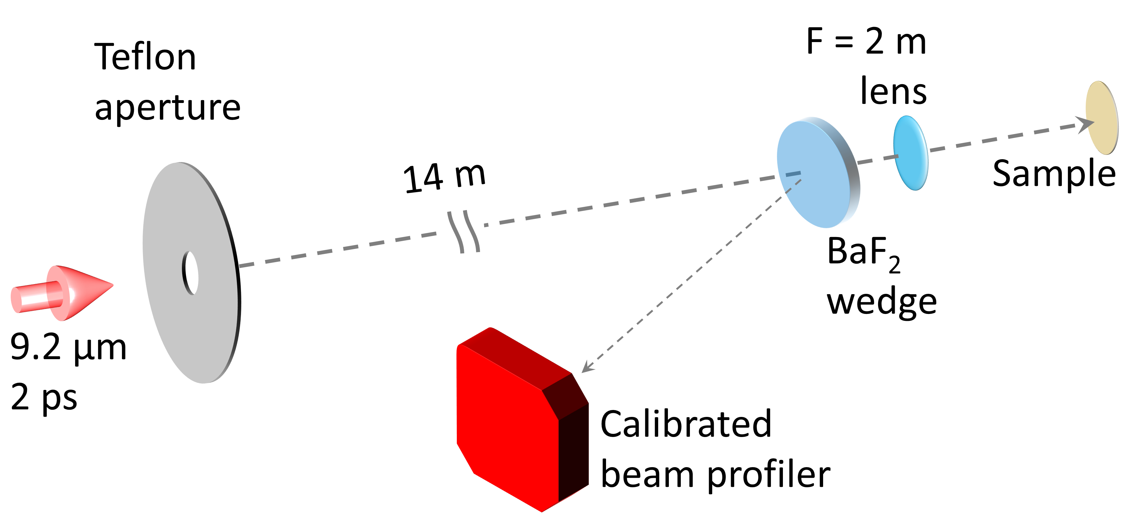
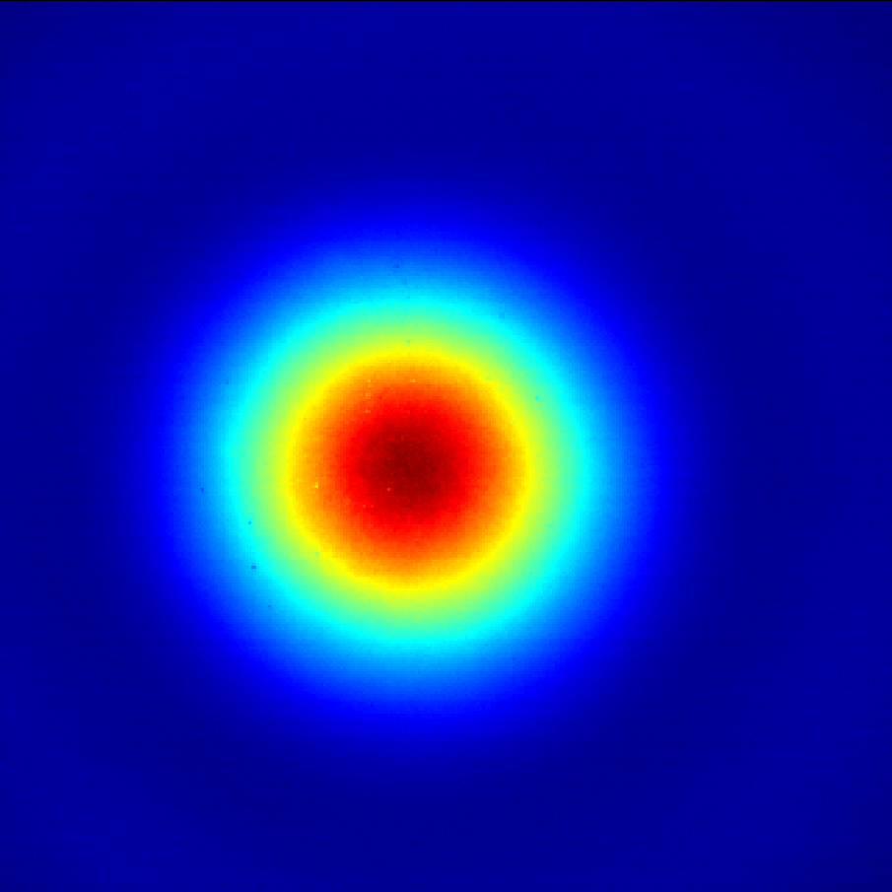
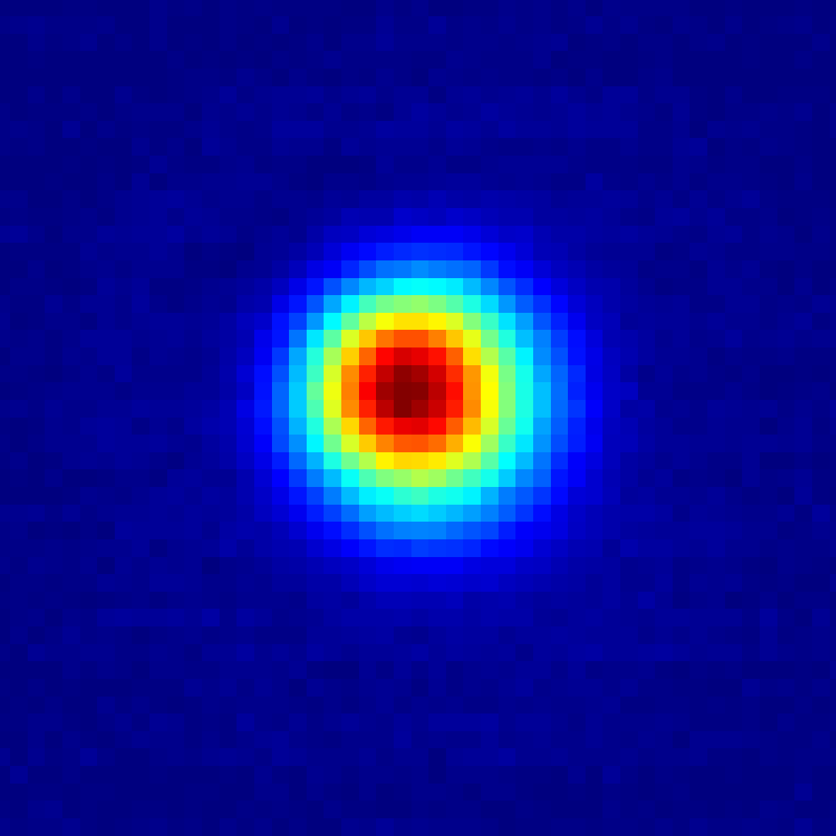
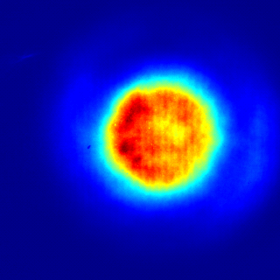
Laser-induced damage characterization
FWHM = 9 mm
FWHM = 0.9 mm
FWHM 38–50 mm

Slide 5
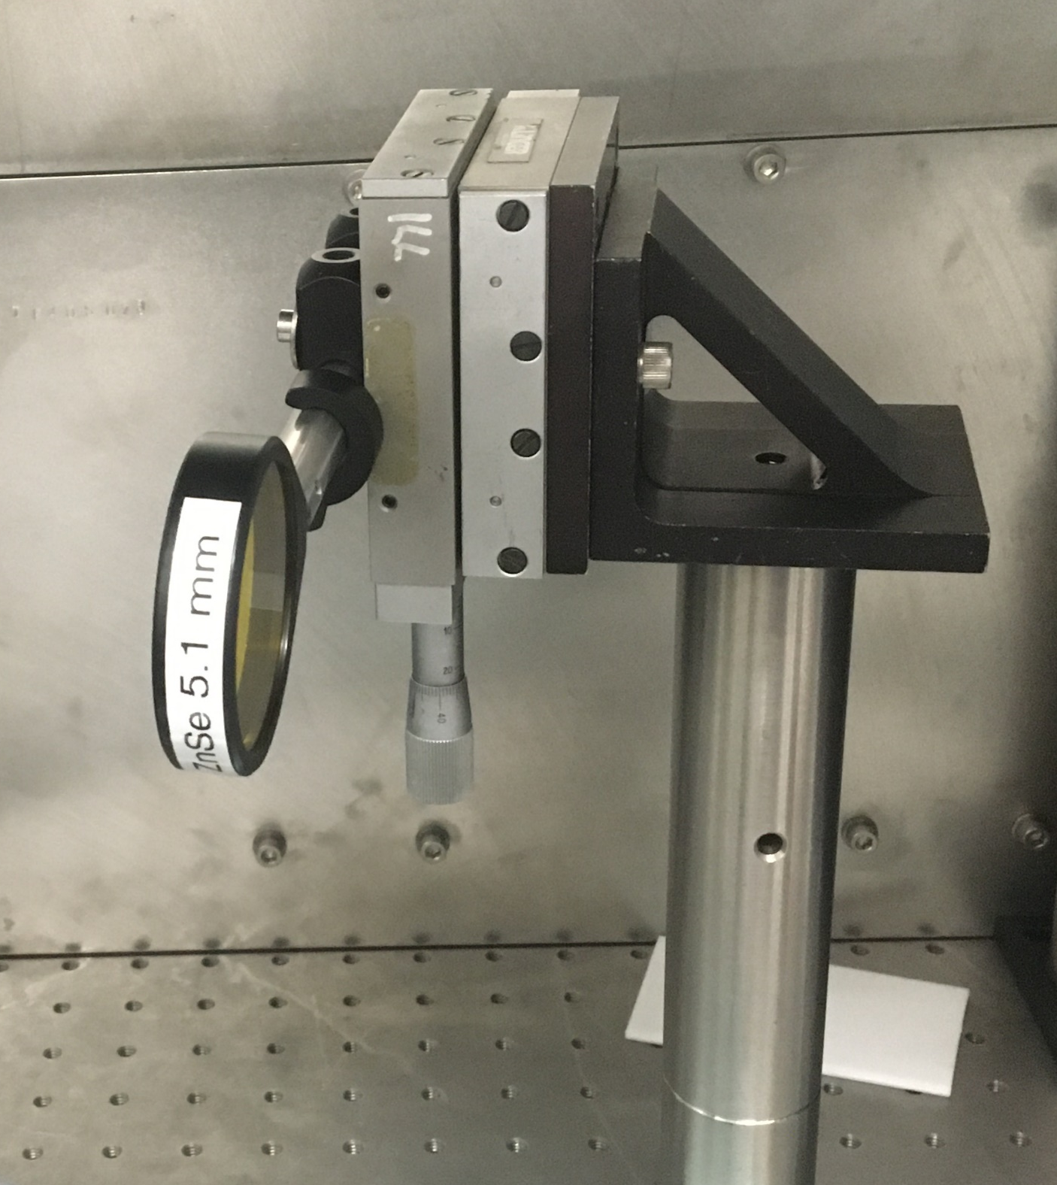
Single-shot laser Damage Experiment
9.2 µm
2 ps
CO₂ Laser
< 100 mJ
Mounted Sample
Beam profiler
(Ophir Spiricon Pyrocam IV)
Sample on
X-Y stage
Wedge
plate
BaF₂ lens)
(F=2m)
Au
Mirror
Cu
Mirror

Slide 6
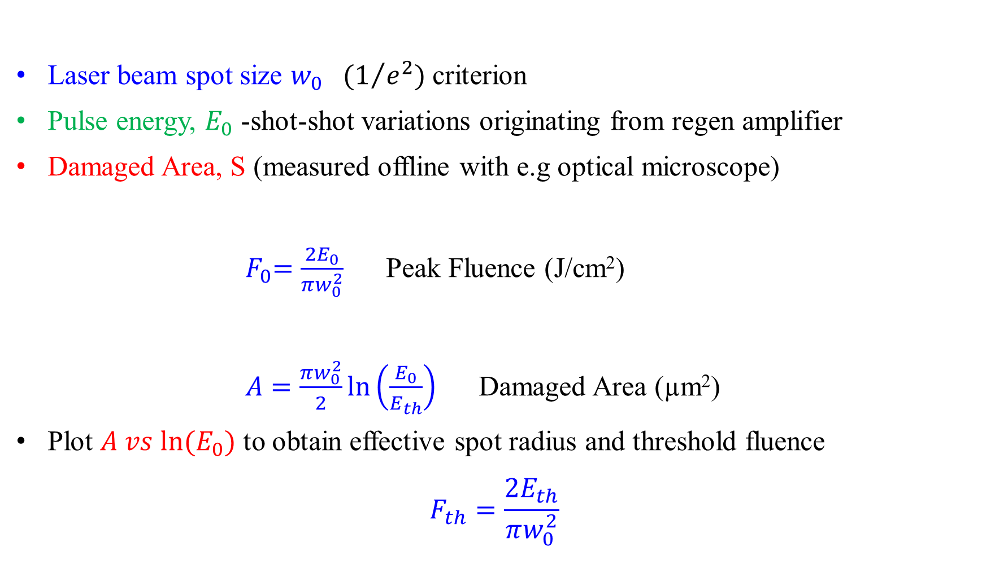
Critical measurements
Laser beam spot size $w_{0} (1/{e^{2})}$ criterion
Pulse energy, $E_{0}$ -shot-shot variations originating from regen amplifier
Damaged Area, S (measured offline with e.g optical microscope)
${ F}_{0}=\frac{2E_{0}}{πw_{0}^{2}}$ Peak Fluence (J/cm²)
$A=\frac{πw_{0}^{2}}{2}\ln\left(\frac{E_{0}}{E_{th}}\right)$ Damaged Area (µm²)
Plot $A vs ln⁡(E_{0})$ to obtain effective spot radius and threshold fluence
$$F_{th}=\frac{2E_{th}}{πw_{0}^{2}}$$
Sergey A. Lizunov et al., Applied Physics A (2022) 128:602

Slide 7

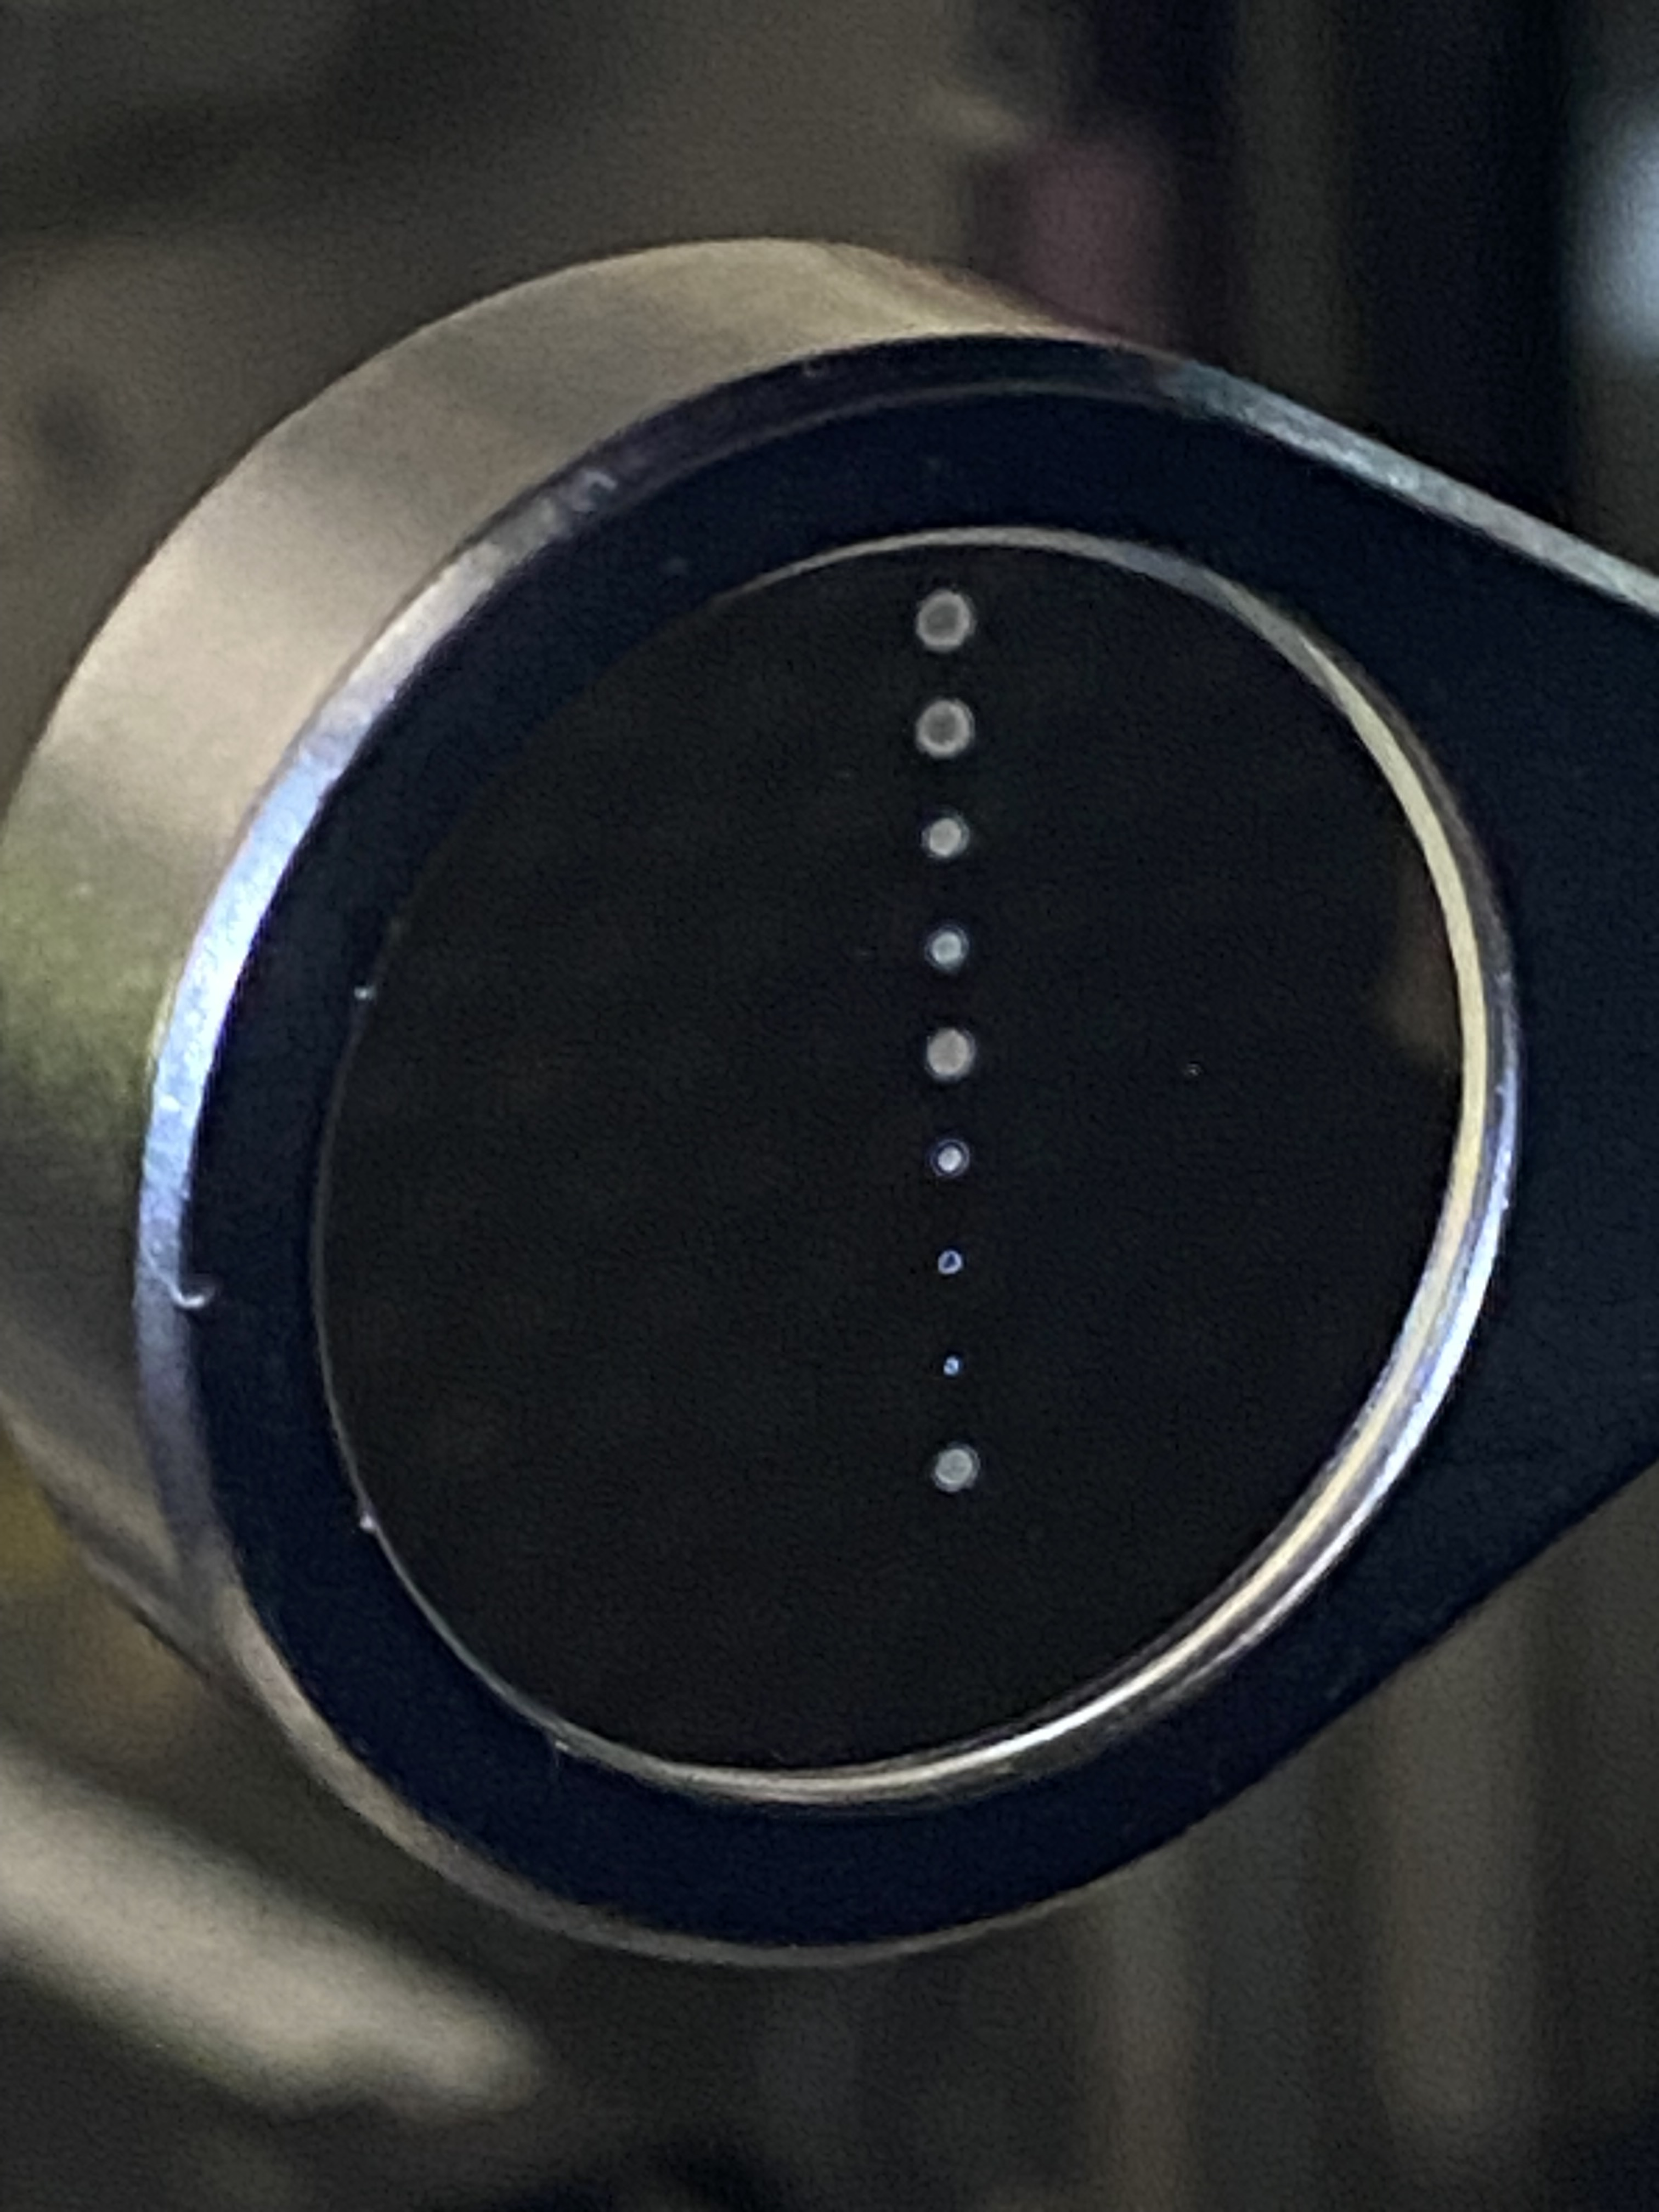
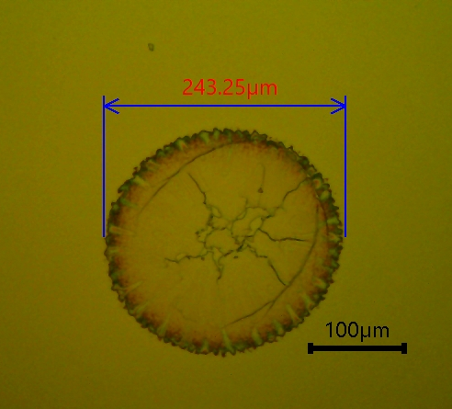
Single-shot approach
Al mirror
10x
Sample
Sample
Laser in
Laser
Digital image of Al mirror
Optical Microscope image of damaged spot for high energy shot
10x
The sample translated to a new position after every shot
Optical microscope image of damaged spot for low energy shot (but above damage threshold)

Slide 8
Liu’s method
Sample:
Nacl window
ω₀
E_{th}-Extrapolation to zero (A=0 µm²; No damage)
ω₀-Obtained from slope
E_{th}

Slide 9
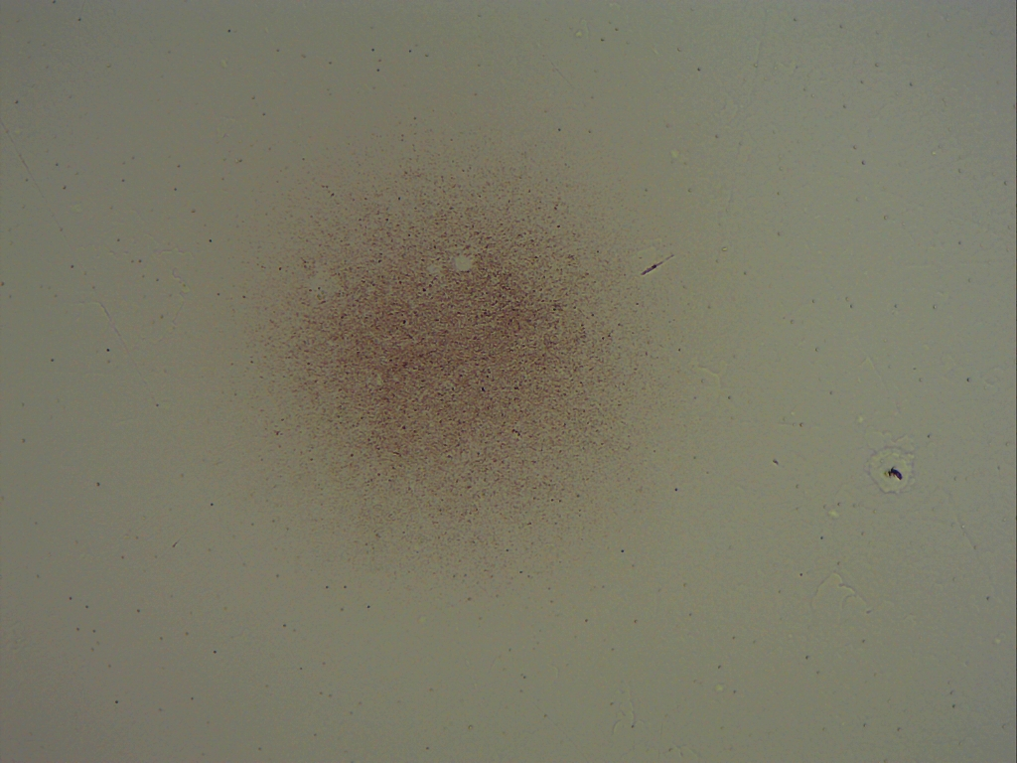
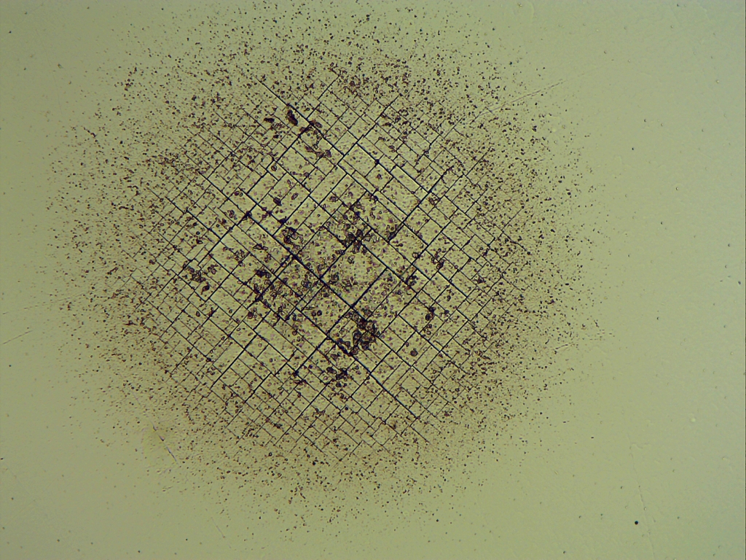
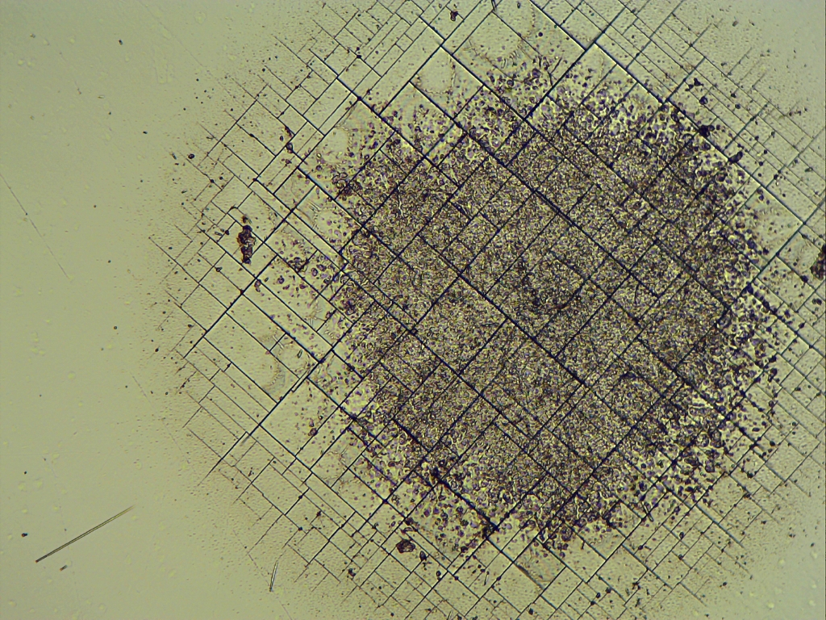
Damage morphologies
NaCl window
10x
10x
10x
Increasing pulse energy
Reported F_{th}: 0.5 J/cm² (P. B. Corkum, IEEE J. Quantum Electron, 1985)

Slide 10
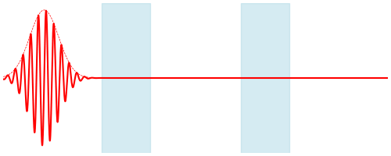
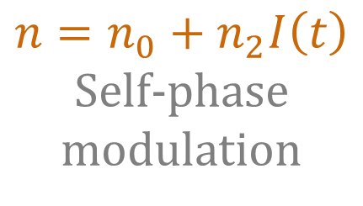
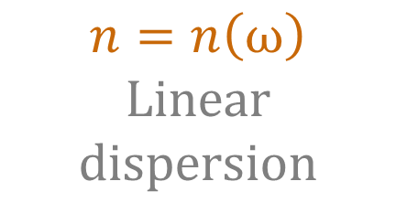
Next-generation CO₂ laser: Post-compression
$$n=n_{0}+n_{2}I\left(t\right)$$
Self-phase modulation
$$n=n\left(ω\right)$$
Linear dispersion

Slide 11
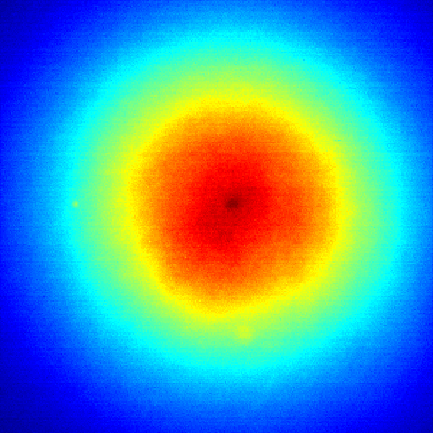
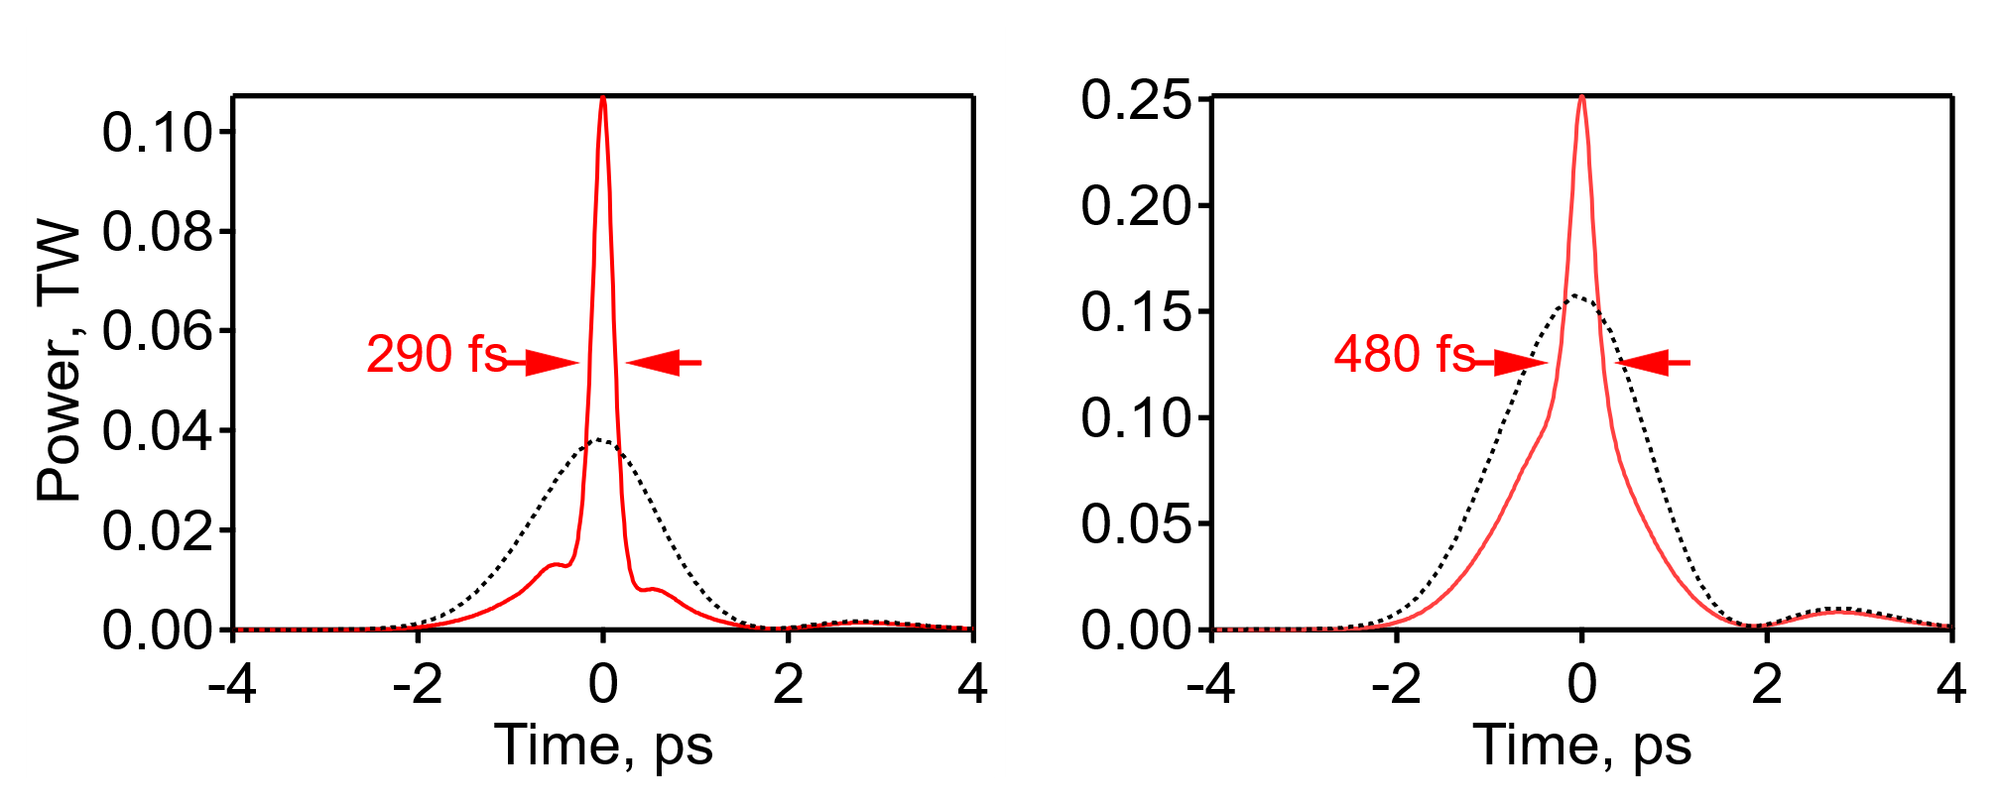
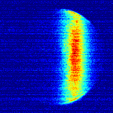
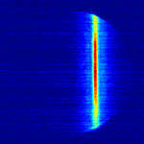
Proof of principle
Polyanskiy et al. Opt. Express 29, 31714 (2021)
2 ps
5 mm dia.
beam center
Whole beam
In
Out
out
out
2 ps
290 fs
in
in
Autocorrelation
278 mJ

Slide 12
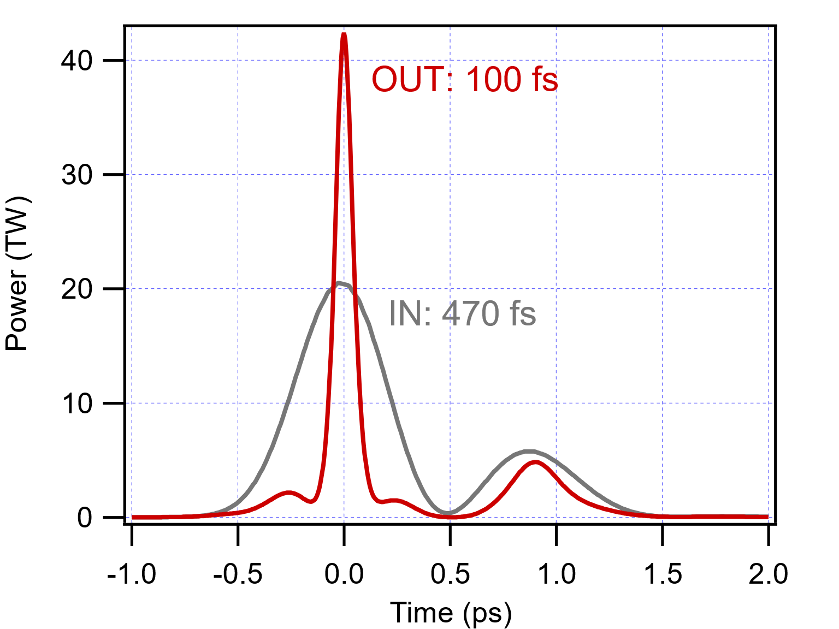
Post-compressor effort roadmap (v. 2023)
Demonstrated post-compression
Opt. Express 29, 31714 (2021)
IN
OUT
Autocorrelation
Next demonstration “3 TW”
2023 to-do
Ultimate design
Proceedings of AAC ‘22
ARDAP Phase I product

Slide 13


1st Prototype
Pogorelsky et al. – Front. Phys. (accepted)
Experiment
Model
IN
$$τ=0.625τ_{auto}= 675 fs$$
OUT
$$P=1.55 TW$$
Beam
center
700 fs
measured within a central portion of the beam containing 30% of the total energy
Most powerful long-wave infrared
sub-picosecond pulse ever obtained

Slide 14
Semiconductor switch
Control pulse
Semiconductor plate

Slide 16




Pump-probe experiments
(Materials for laser-controlled LWIR optical switching elements)
PD₁
PD_{R}
NIR/VIS/UV control - 5 ns
PD_{T}
LWIR probe - 0.5 ps
Sample
PD₂

Slide 17
Mission
Systematically study laser-damage characteristics of infrared materials and laser optics under the action of intense LWIR laser irradiation
Deploy a full-scale working prototype of a post-compressor for 2 ps -> 500 fs compression
Initiate a pump/probe study of free carrier dynamics in semiconductor materials relevant for M/L-WIR lasers
Provide a framework for “small” research tasks enabling the development of M/L-WIR lasers

Slide 18
Electron Beam Requirements
Parameter | Units | Typical Values | Comments | Requested Values
Beam Energy | MeV | 50-65 | Full range is ~15-75 MeV with highest beam quality at nominal values | -
Bunch Charge | nC | 0.1-2.0 | Bunch length & emittance vary with charge | -
Compression | fs | Down to 100 fs (up to 1 kA peak current) | A magnetic bunch compressor available to compress bunch down to ~100 fs. Beam quality is variable depending on charge and amount of compression required. NOTE: Further compression options are being developed to provide bunch lengths down to the ~10 fs level | -
Transverse size at IP (s) | mm | 30 – 100 (dependent on IP position) | It is possible to achieve transverse sizes below 10 um with special permanent magnet optics. | -
Normalized Emittance | mm | 1 (at 0.3 nC) | Variable with bunch charge | -
Rep. Rate (Hz) | Hz | 1.5 | 3 Hz also available if needed | -
Trains mode | --- | Single bunch | Multi-bunch mode available. Trains of 24 or 48 ns spaced bunches. | -

Slide 19
CO₂ Laser Requirements
Configuration | Parameter | Units | Typical Values | Comments | Requested Values
CO₂ Regenerative Amplifier Beam | Wavelength | mm | 9.2 | Wavelength determined by mixed isotope gain media | 9.2
 | Peak Power | GW | ~3 |  | ~3
 | Pulse Mode | --- | Single |  | Single
 | Pulse Length | ps | 2 |  | 2
 | Pulse Energy | mJ | 6 |  | 6
 | M² | --- | ~1.5 |  | ~1.5
 | Repetition Rate | Hz | 1.5 | 3 Hz also available if needed | 1.5
 | Polarization | --- | Linear | Circular polarization available at slightly reduced power | Linear
CO₂ CPA Beam | Wavelength | mm | 9.2 | Wavelength determined by mixed isotope gain media | 9.2
Note that delivery of full power pulses to the Experimental Hall is presently limited to Beamline #1 only. | Peak Power | TW | 5 | ~5 TW operation will become available shortly into this year’s experimental run period. A 3-year development effort to achieve >10 TW and deliver to users is in progress. | 2
 | Pulse Mode | --- | Single |  | Single
 | Pulse Length | ps | 2 |  | 2
 | Pulse Energy | J | ~5 | Maximum pulse energies of >10 J will become available within the next year | ~5
 | M² | --- | ~2 |  | ~2
 | Repetition Rate | Hz | 0.05 |  | 0.05
 | Polarization |  | Linear | Adjustable linear polarization along with circular polarization can be provided upon request | Linear

Slide 20
Other Experimental Laser Requirements
Ti:Sapphire Laser System | Units | Stage I Values | Stage II Values | Comments | Requested Values
Central Wavelength | nm | 800 | 800 | Stage I parameters are presently available and setup to deliver Stage II parameters should be complete during FY22 | TBD
FWHM Bandwidth | nm | 20 | 13 |  | TBD
Compressed FWHM Pulse Width | fs | <50 | <75 | Transport of compressed pulses will initially include a very limited number of experimental interaction points. Please consult with the ATF Team if you need this capability. | TBD
Chirped FWHM Pulse Width | ps | ≥50 | ≥50 |  | TBD
Chirped Energy | mJ | 10 | 200 |  | TBD
Compressed Energy | mJ | 7 | ~20 | 20 mJ is presently operational with work underway this year to achieve our 100 mJ goal. | TBD
Energy to Experiments | mJ | >4.9 | >80 |  | TBD
Power to Experiments | GW | >98 | >1067 |  | TBD
Nd:YAG Laser System | Units | Typical Values | Comments | Requested Values
Wavelength | nm | 1064 | Single pulse | TBD
Energy | mJ | 5 |  | TBD
Pulse Width | ps | 14 |  | TBD
Wavelength | nm | 532 | Frequency doubled | TBD
Energy | mJ | 0.5 |  | TBD
Pulse Width | ps | 10 |  | TBD

Slide 21
Special Equipment Requirements and Hazards
Electron Beam
  Please indicate any special equipment that you expect to need, including (but not limited to) the transverse deflecting cavity, shaped bunch using mask technique, plasma capillary discharge system, bolometer/interferometer setup etc.:
CO₂ Laser
  Please note any specialty laser configurations required here:
Ti:Sapphire and Nd:YAG Lasers
  Please note any specialty non-CO₂ laser configurations required here:
  CW CO2 & ns Nd:YAG @ 355, 512 & 1024 nm
Hazards & Special Installation Requirements
  Large installation (chamber, insertion device, etc.):
  Cryogens:
  Introducing new magnetic elements:
  Introducing new materials into the beam path:
  Any other foreseeable beam line modifications:

Slide 22
CY2024 Time Request
Capability | Setup Hours | Running Hours
Electron Beam
NIR Laser
LWIR Laser | 40 | 2 x 40 = 80
Total Time Request for the 3-year Experiment (including CY2024-26)
Capability | Setup Hours | Running Hours
Electron Beam
NIR Laser
LWIR Laser | 40 x 3 = 120 | 80 x 3 = 240

