Slide 1

26th Annual
Accelerator Test Facility (ATF) Users' Meeting
AE129 “Stony Brook Accelerator Laboratory Course”
Presenter: Mikhail Fedurin
Dmitriy Kayran, William Li, Vladimir Litvinenko (PI)
Brookhaven National Laboratory and Stony Brook University
Accelerator Facilities Division
03/28/2023

Slide 2

CASE course: PHY542 “Fundamentals of Accelerator Physics and Technology with Simulations and Measurements Lab”
Instructors affiliated at Stony Brook University and Brookhaven National Laboratory:
Mikhail Fedurin (2014-present)
Dmitry Kayran (2014-present)
William Li (new instructor, SBU in process)
Accelerator Facilities Division

Slide 3
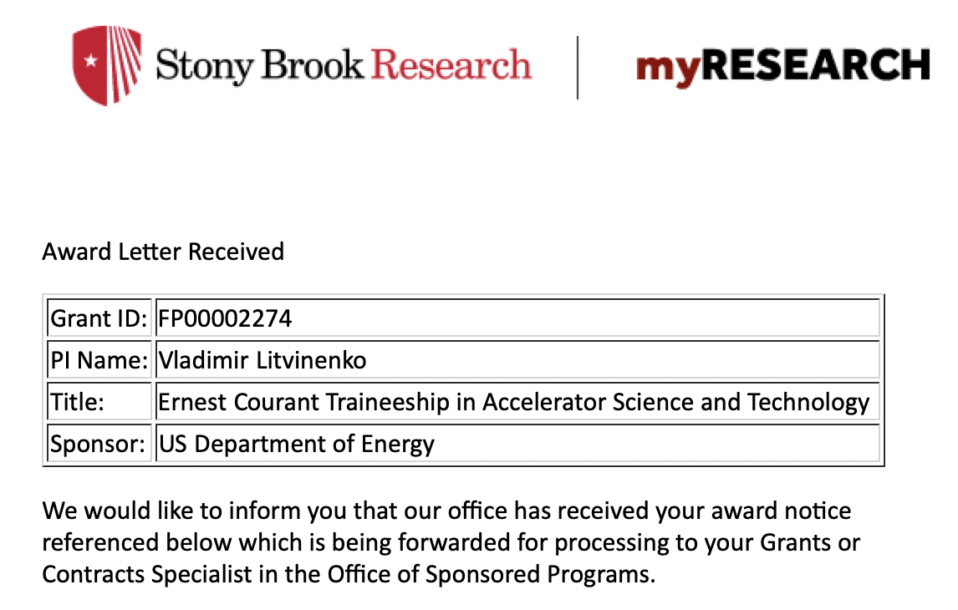
CASE at SBU, Ernest Courant Traineeship
CASE – The Center for Accelerator Science and Education has been established established as a Type I Institute within the University on November 19, 2008 as a Joint venture of BNL and SBU,
  To train scientists and engineers with the aim of advancing the field of accelerator science;
  To develop a unique program of educational outreach that will provide broad access to a research accelerator; and,
  To attract Federal and industrial funding for an expanding interdisciplinary research and education program that utilizes accelerators.
The Stony Brook University / BNL connection provides an ideal educational environment. The close proximity to BNL and the BSA connection provides for a superb combination of both university and national laboratory environment.
http://case.physics.stonybrook.edu/index.php/Main_Page
$2.9M over 5 years
Collaboration of BNL, FNL, Cornell and
Stony Brook Universities

Slide 4
Course goals
Introduce students to the field of experimental Accelerator Physics
Demonstrate e-beam techniques and diagnostics used in Advanced Accelerator Concept experiments at Accelerator Test Facility
Teach students to model experiments, compare model results with measurements.
http://case.physics.stonybrook.edu/index.php/PHY542_spring_2022

Slide 5
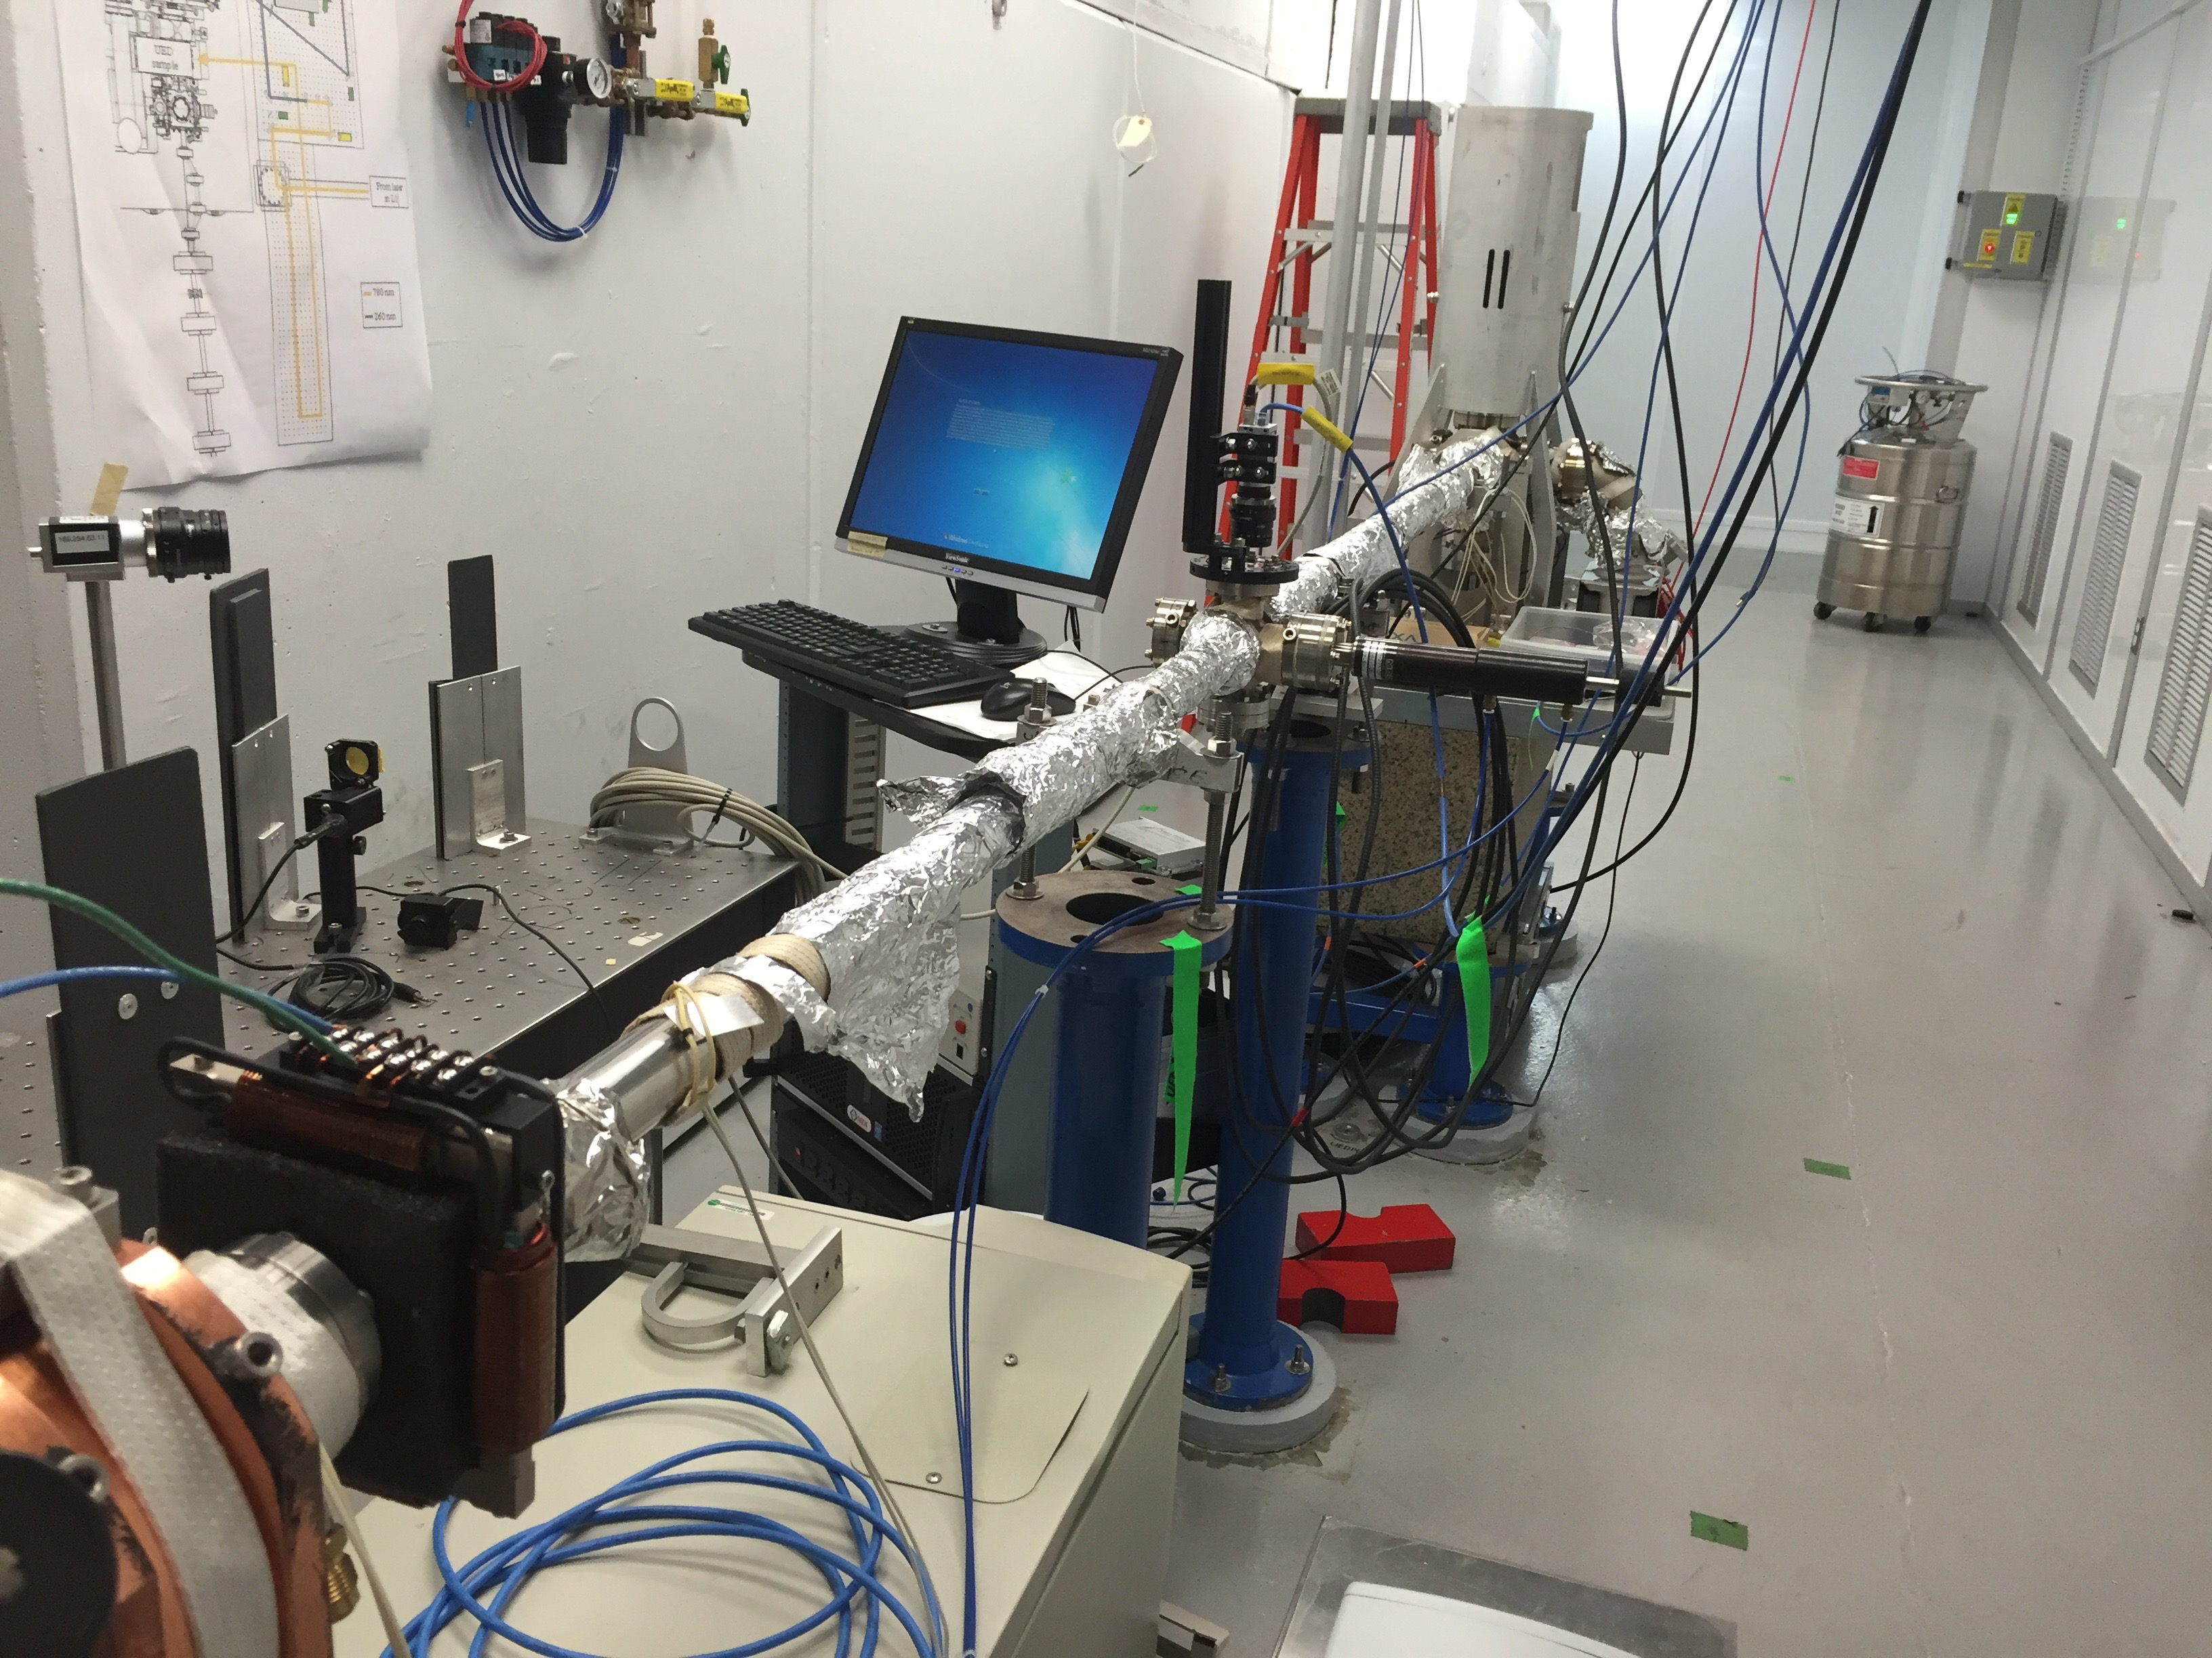
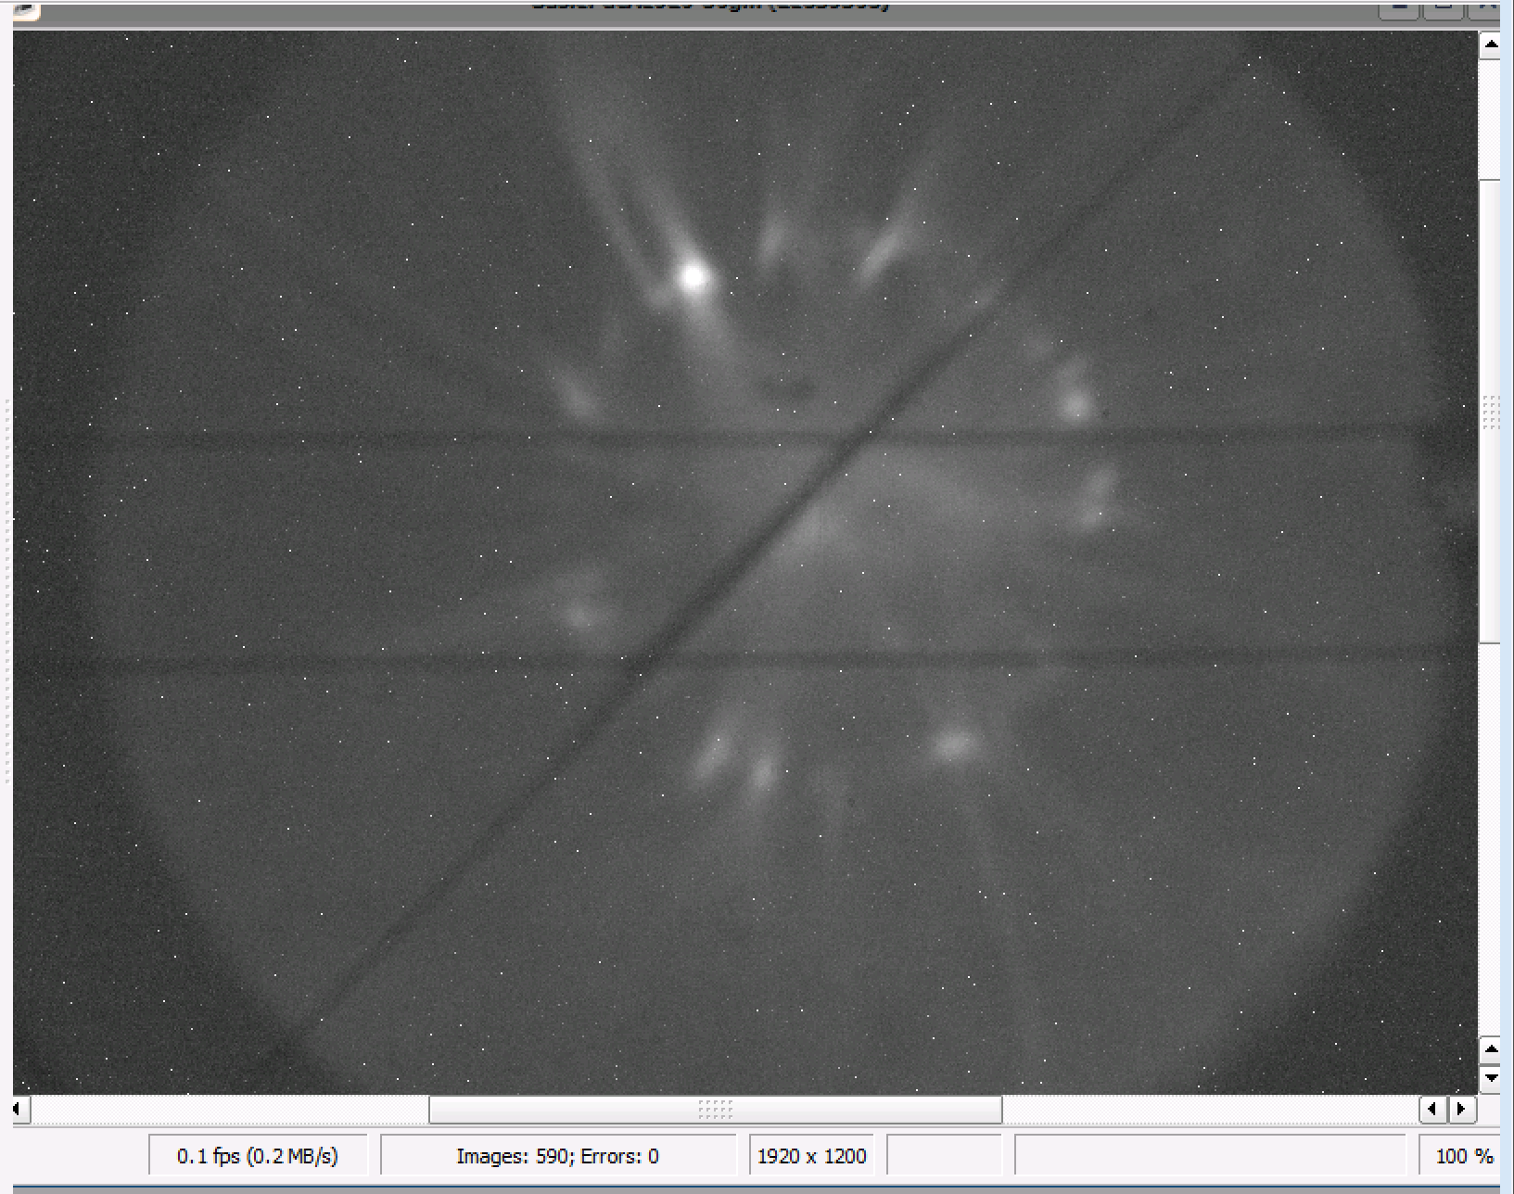
Syllabus (plan for spring 2023)
Course overview, administrative issues
Introduction to photo-injectors
Modeling photo-injectors
Transport of particle beams
Beam Diagnostics, emittance measurement techniques
Beam energy measurement by using diffraction pattern
Measurements for project report and presentation
PHY542 web page (example):
http://case.physics.stonybrook.edu/index.php/PHY542_spring_2023

Slide 6
Evaluation (plan for spring 2023)
Student’s performance was evaluated based on:
  active involvement in the laboratory (25% of final grade);
  lab report (60% of final grade);
  presentation of a project topic (20% of final grade).
Students did prepare Report and one Presentation during semester
  Report and Presentation from one of lab class (see syllabus)
  Content should include: 1) theory of the experiment and explain the objectives; 2) technique used to obtain data; 3) detailed data analysis; 4) conclusion remarks
Presentation was made at the end of semester. Required better preparation. Presentation was performed at front of the class. To avoid the overlap topics was distributed at beginning of semester among students
PHY542 web page (example):
http://case.physics.stonybrook.edu/index.php/PHY542_spring_2023

Slide 7
No time request for FY2024
Spring 2024 class was cancelled due to low student interest in this course this year

Slide 8
Questions?
Accelerator Facilities Division

