Slide 1
ATF User’s Meeting
26-28 March 2024
Toward bubble-regime CO₂-laser-driven
wakefield acceleration*
PI: Mike Downer, University of Texas at Austin
Collaborators:
University of Texas at Austin:
Faculty: M. C. Downer
Research Scientist: R. Zgadzaj
PhD students: Y. Cao, B. Dinh,
T. Araujo
Stony Brook University:
Faculty: Navid Vafaei-Najafabadi
Roman Samulyak
V. N. Litvinenko
Postdoc: N. Pathak
PhD Students: A. Cheng, A. Gaikwad,
B. Romasky, E. Trommer
Brookhaven NL:
ATF Director: M. A. Palmer
Research Scientists: M. Babzien,
M. Fedurin, R. Kupfer, K. Kusche,
W. Li, I. V. Pogorelsky,
M. N. Polyanskiy
UCLA:
Faculty: C. Joshi
*
optical diagnosis emphasis (complementary to Navid’s electron radiography emphasis)
Main Group Funding: US Department of Energy grant DE-SC0014043 (received thru 2025)
Additional Individual Support: DE-SC0011617 (UT-Austin); DE-SC0012704 (BNL)
1

Slide 2
Goal: develop LWFAs that routinely produce e-beams
with ∆E_{e}/E_{e} and ℇ_{n} low enough to drive XFELs
Key ingredients:
*
1) Large plasma bubbles (R_{b} ≳ 0.3 mm)
⇒ n_{e} ≲ 10¹⁶ cm⁻³
**
2) External injection of low ∆E_{e}/E_{e}, low ℇ_{n} e-bunches
*
Efficiently excited by LWIR laser pulses uniquely realizeable at ATF
**
• Pogorelsky et al., Phys. Rev. Accel. Beams 19, 091001 (2016);
Kumar et al., Phys. Plasmas 28, 013102 (2021)
Synchronized, compressed ATF linac bunches uniquely enable 1st-generation experiments.
The Proposed Project builds upon AE71 and AE95 success.
Project # | CO₂ laser parameters | Main results
AE-71 | 2 J, 4 ps, 0.5 TW, 10.3 µm | • Generation, characterization of self-modulated (SM) wakes. No electrons.
AE-95 | 4 J, 2 ps, 2 TW, 9.2 µm | • Self-injected MeV electrons produced at n_{e} ≳ 3 × 10¹⁶ cm⁻³ • Quasi-monoenergetic, collimated features observed.
Proposed Project | 5-20 J, < 2 ps, 5-20 TW | • Excite, characterize R_{b} ~ 0.3 mm bubbles at n_{e} ~ 10¹⁶ cm⁻³ w/o self-injection • Inject e⁻ from ATF linac, characterize ∆E_{e}/E_{e} and ℇ_{n}
[1]
[2]
[1] Predicted by Kumar et al., Phys. Plasmas 26, 083106 (2019)
[2] Zgadzaj et al., Nat. Comms., in press (2024)
2

Slide 3
Year 1-2 Scientific Goals
UTexas team: Dr. R. Zgadzaj, PhD
student B. Dinh
Constraints: • CO₂ laser at or near current parameters: (4 – 10 J, 2 ps, 2 - 5 TW)
• No linac e-beam needed (Navid’s group is developing e-beam probes)
• Ti:S probe laser at current parameters
• Use existing AE95 infrastructure (gas jet, magnetic spectrometer, etc.)
1) Discover low-n_{e}, high-P_{L} limits of self-injected LWIR-driven WFA.
• Can we reach the full bubble regime while still self-injecting?
• In AE95 (4 J, 2 ps) we observed collimated quasi-monoenergetic electrons only at n_{e} = 4 × 10¹⁷ cm⁻³.
We generated electrons down to n_{e} = 3 × 10¹⁶ cm⁻³, but did not have time to spectrally analyze them.
Will quasi-monoenergetic component strengthen for n_{e} < 4 × 10¹⁷ cm⁻³ and P_{L} > 2 TW?
4 × 10¹⁷ cm⁻³
3 × 10¹⁶ cm⁻³
3 × 10¹⁵ cm⁻³
2 ps
4 J
2 ps
4-6 J
2 ps
10 J
10 wake periods
3 wake periods
1 wake period
• Widen experimental conditions: H₂ → He target; lin → circ pol drive pulse; downramp & ionization injection
• Understand self-injection limits thru simulations (with Samulyak).
3

Slide 4
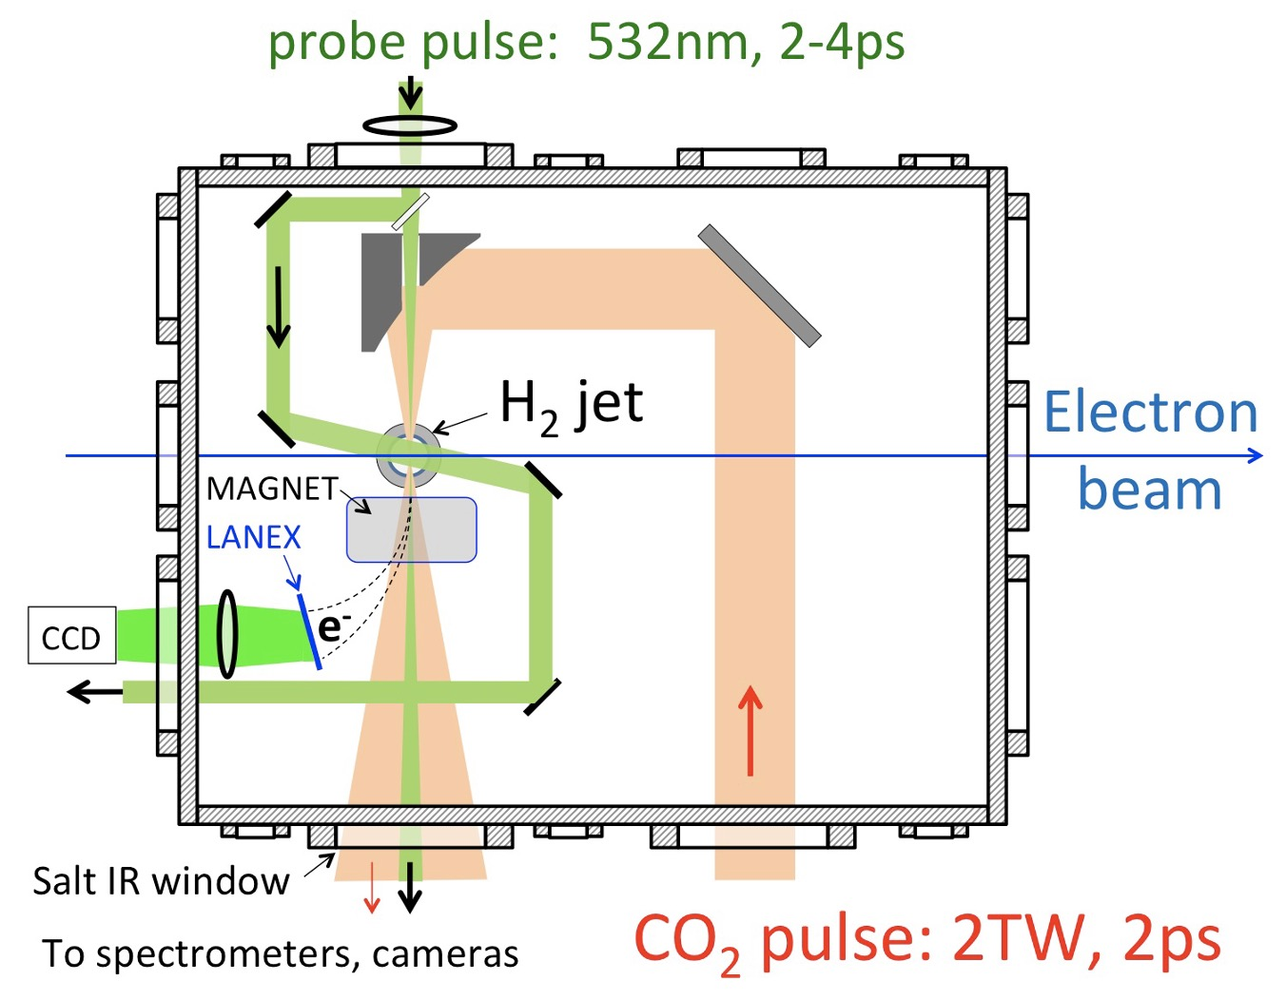
Year 1-2 Scientific Goals (cont’d)
2) Upgrade optical diagnostics of wakes in low-n_{e} plasma
(complement e-beam probes that Navid’s group is leading)
multi-𝜆 (1-5 µm), multi-function (CTS, Faraday)
1) Apply collective Thomson scatter (CTS) probe during e⁻
acceleration (AE95: only empty wakes probed) ⇒ observe
beam-loading effects on wake structure & dynamics.
2) Upgrade CTS sensitivity to 10¹⁵ < n_{e} < 10¹⁷ cm⁻³ plasmas,
using spatial-spectral filtering techniques developed at UCLA.
Probe
Filip et al., “CTS diagnostic system for detection of relativistic waves
in low-density plasmas,” Rev. Sci. Instrum. 74, 3576 (2003)
(AE95: CTS used only for n_{e} ≥ 4 × 10¹⁷ cm⁻³)
3) Add a transverse CTS probe to complement current
co-propagating probe ⇒ diagnose wake evolution due to
self-focusing, mismatched propagation, wake formation,
electron injection, and beam loading.
4) Augment current 𝜆 = 1 µm probe with 𝜆 = 3, 5 µm probes
derived from 3rd, 2nd harmonics of split-off CO₂ pulses
generated in AgGaSe₂ crystals ⇒ improve sensitivity to
low-n_{e} plasma structures, eliminate pu-pr timing jitter.
Detect with cooled InGaAs or InSb CCD camera.
2-5 TW, 2 ps
Proposed upgraded optical diagnostic system
• upgraded CTS + Faraday probes
• longitudinal + transverse probes
• 1 µm + 3, 5 µm CO₂ harmonic probes
4

Slide 5
Year 1-2 Scientific Goals (cont’d)
2) Upgrade optical diagnostics of wakes in low-n_{e} plasma (cont’d)
multi-𝜆 (1-5 µm), multi-function (CTS, Faraday)
5) Observe probe Faraday rotation due to kilo-T fields from
high peak currents ⇒ visualize magnetized plasma structures
at n_{e} < 10¹⁷ cm⁻³.
Chang et al., “Faraday rotation study of plasma bubbles
in GeV wakefield accelerators,” Phys. Plasmas 28, 123105 (2021)
Probe
These upgraded diagnostics will
improve our ability to observe
large plasma bubbles in
n_{e} ~ 10¹⁶ cm⁻³ plasma.
2-5 TW, 2 ps
Proposed upgraded optical diagnostic system
Development of effective diagnostics of low-n_{e} wakes
is a forefront challenge for WFA science:
• upgraded CTS + Faraday probes
Downer et al., “Diagnostics for plasma-based electron accelerators,”
Rev. Mod. Phys. 90, 035002 (2018)
• longitudinal + transverse probes
• 1 µm + 3, 5 µm CO₂ harmonic probes
5

Slide 6
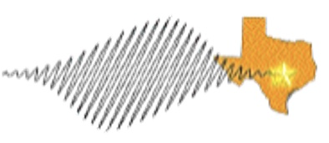
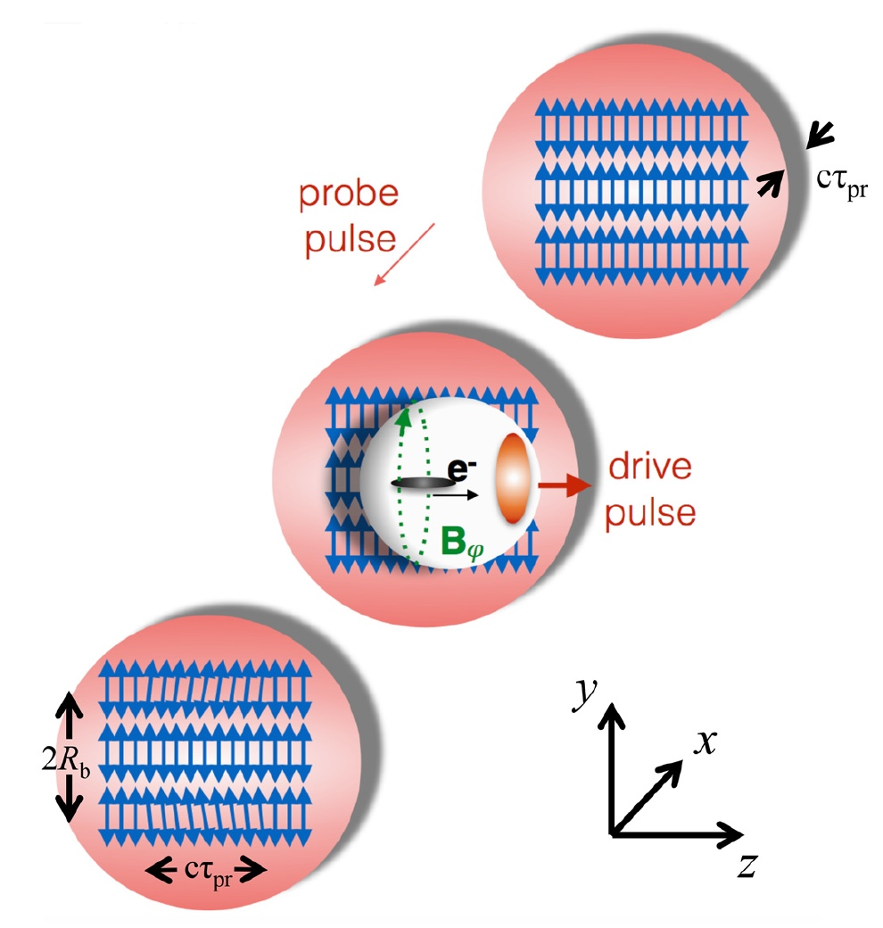
Faraday rotation can image plasma bubbles in low-n_{e} plasma
n_{e} ≈ 10¹⁷ cm⁻³:
⁽¹⁾ Chang et al., “Faraday rotation study of plasma bubbles in GeV wakefield accelerators,” Phys. Plasmas 28, 123105 (2021)
Texas
Petawatt
n_{e} > 10¹⁹ cm⁻³:
⁽²⁾ Kaluza et al., Phys. Rev. Lett. 105, 115002 (2010);
⁽³⁾ Buck et al., Nat. Phys. 7, 453 (2011).
Faraday “streaks” of magnetized plasma bubble walls
in n_{e} ≈ 10¹⁷ cm⁻³ plasma
𝜏_{pr} = 2 ps
𝜏_{pr} = 1-2 ps
𝜆_{pr} = 1 µm
𝜏_{pr} = 2 ps
n_{e} ≈ 10¹⁷ cm⁻³
plasma
Texas PW
drive pulse
𝜏_{pr} = 1 ps
large B_{𝜑} and l
compensate
small n_{e}/n_{cr}^{(pr)}
$φ_{rot}^{(1)}$ at n_{e} ≈ 10¹⁷ cm⁻³ ≥ $φ_{rot}^{(2,3)}$observed at n_{e} ≈ 10¹⁹ cm⁻³
6

Slide 7
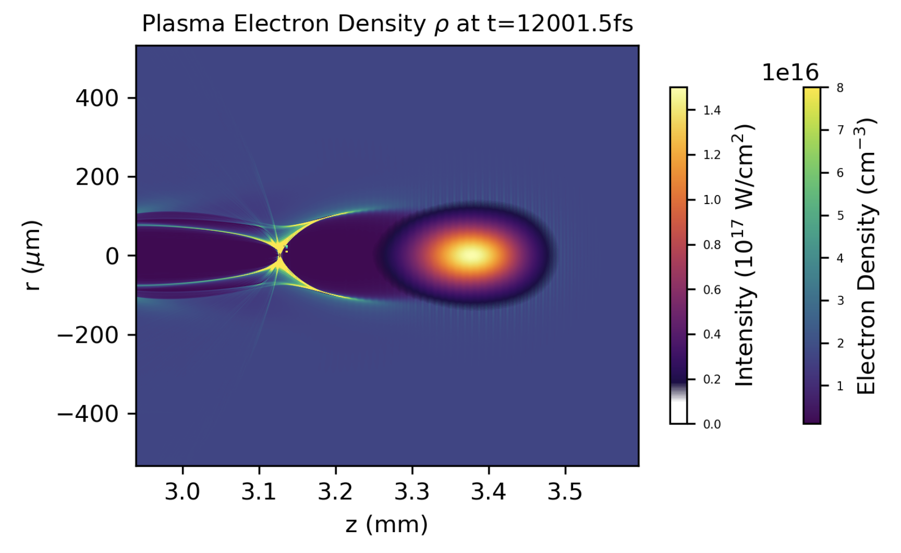
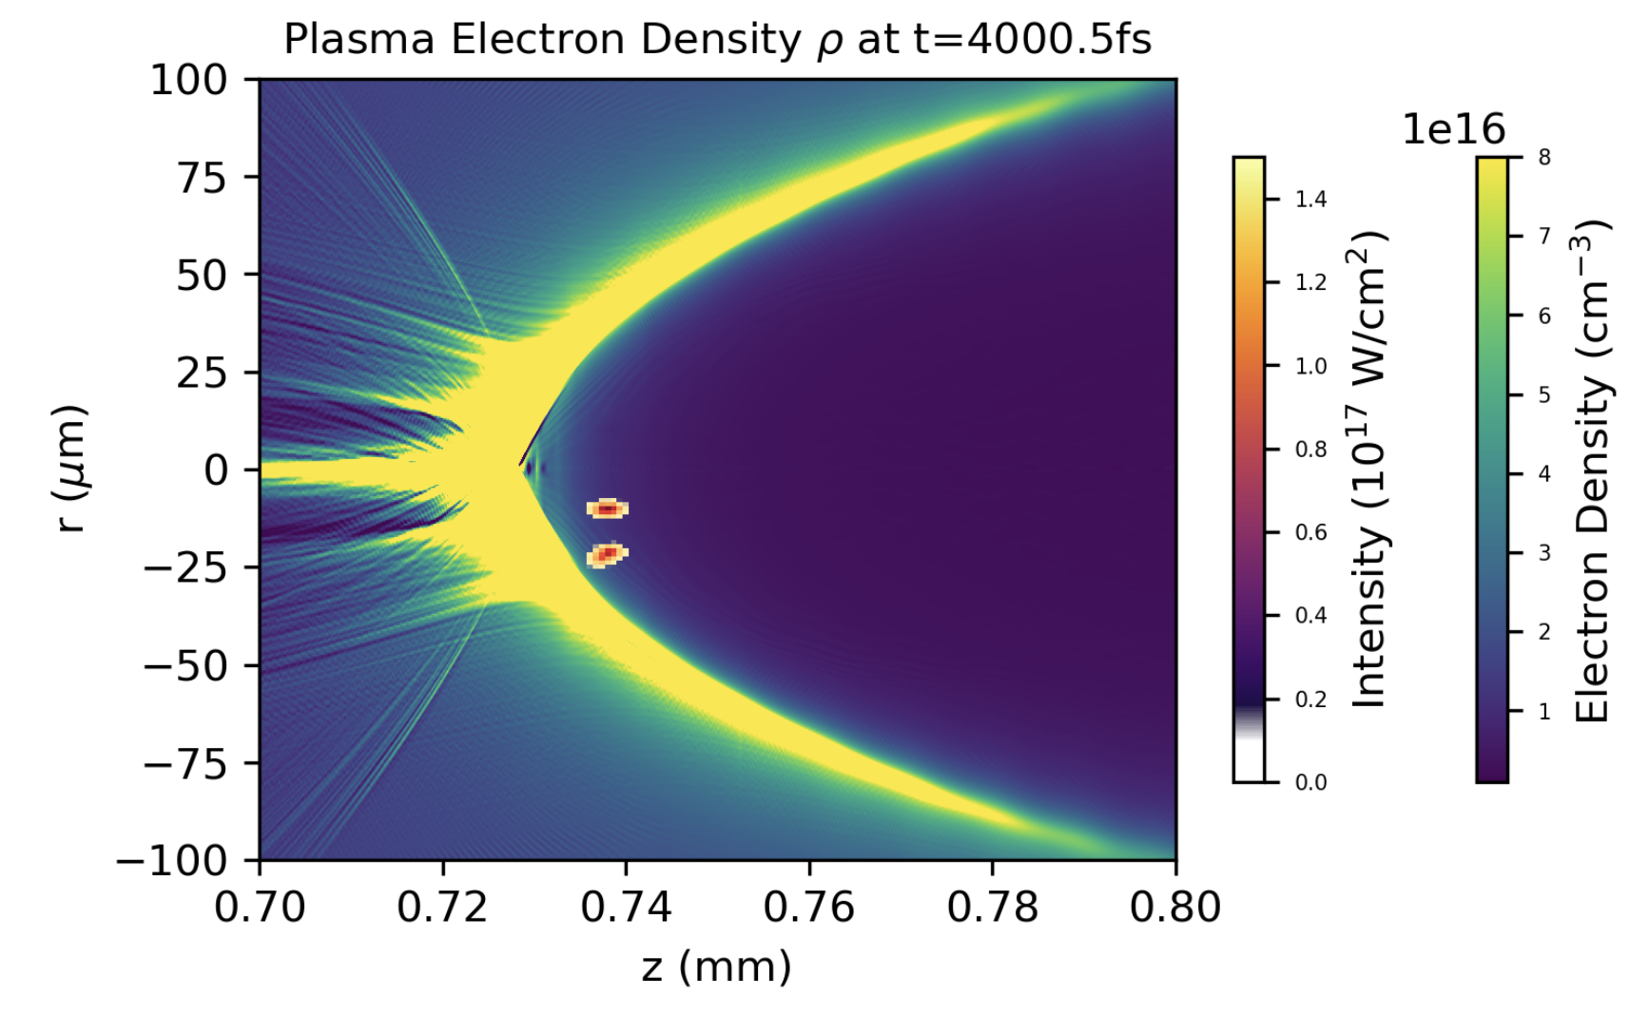
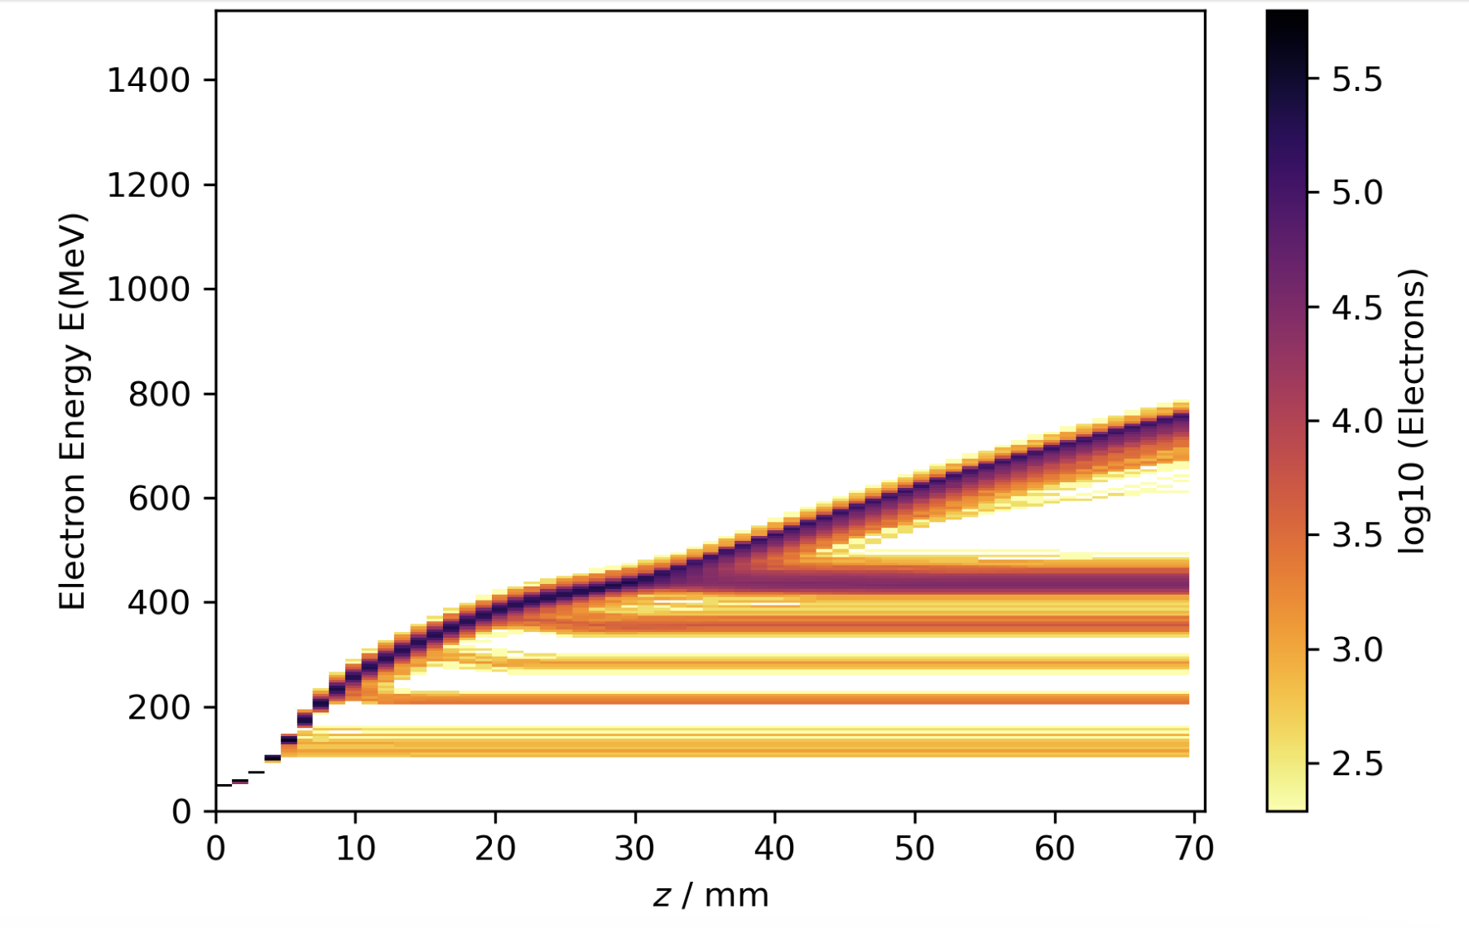
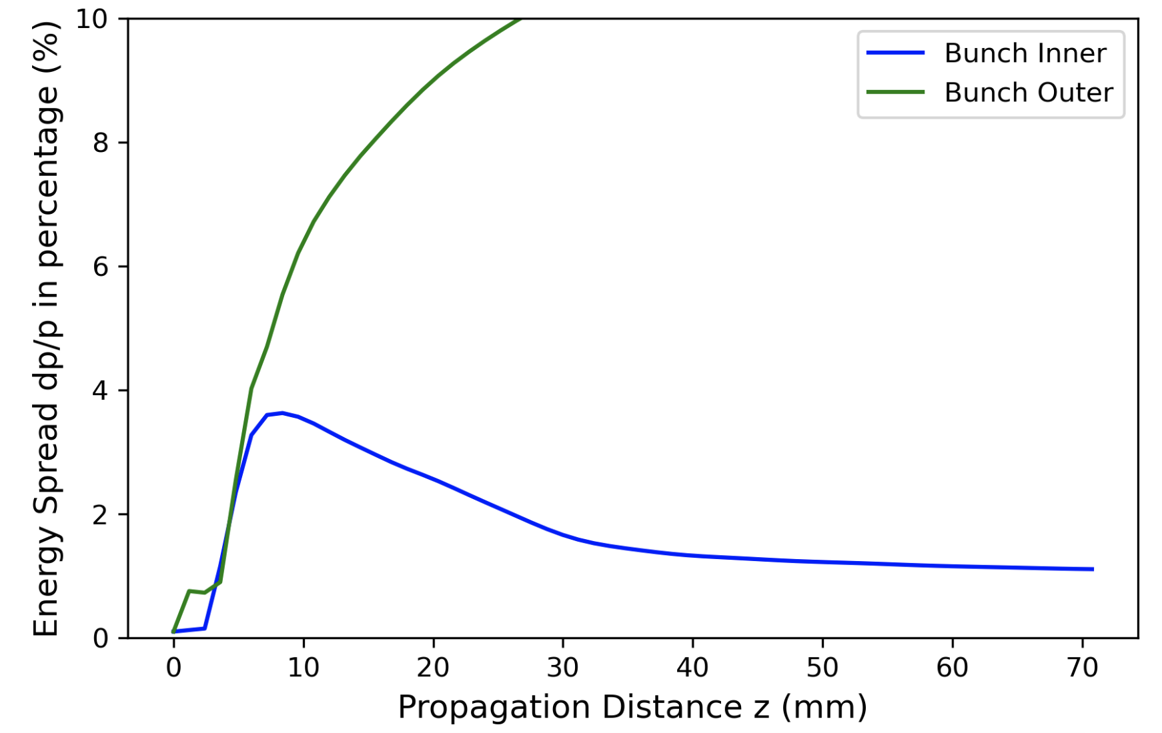
Year 1-2 Scientific Goals (cont’d)
3) Understand ∆E_{e}/E_{e}, emittance growth in large bubbles thru simulations.
(PhD student Yuxuan Cao)
(a) n_{e} = 10¹⁶ cm⁻³
(b)
• PIC simulations take a
long time --- too many
parameters to vary to
search for optimum.
2 externally
injected
e-bunches
0.5 ps CO₂ pulse
• YC will focus on quasi-
static bubbles.
• YC will develop machine-
learning approaches to
optimize the external
injection process, and
determine what ∆E/E and
emittance are achievable
in principle.
(c) Electron Energy
(d)
Evolution of
Energy Spread (%)
FB-PIC simulations by Y. Cao
7

Slide 8
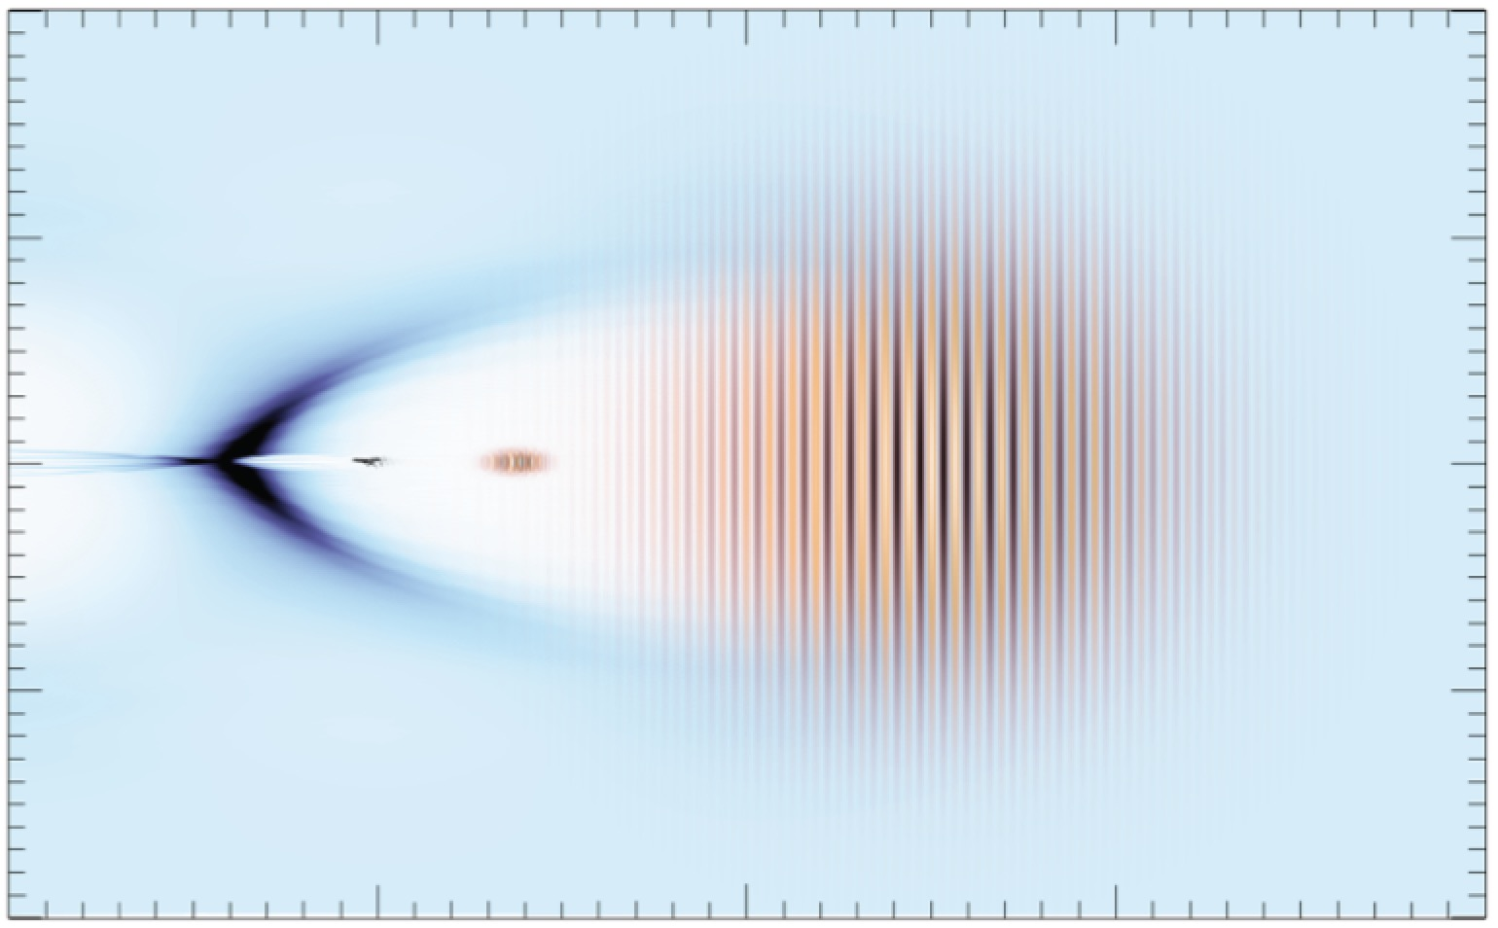
OSIRIS* quasi-3D simulations show that large bubbles preserve energy spread
& spin polarization of strategically injected e-bunches during acceleration
after acceleration
Simulations by Z. Nie, F. Li and W. B. Mori (UCLA)
spin-polarized
injected e-bunch
slightly depolarized
accelerated e-bunch
injection point
∆E/E ≈ 0.25%
s_{z}
s_{z}
E = 65 MeV,
∆E = 0.5 MeV
injected e-bunch
E = 330 MeV,
∆E = 0.8 MeV
accelerated e-bunch
s_{y}
s_{y}
0.07
s_{x}
s_{x}
electron energy
[GeV]
0.34
1.0
1.0
electron energy
[GeV]
s_{z}
0.33
∆E
0.06
0.32
0.8
0.3
0.6
1
0.8
0
2
z [mm]
50
100
-7.0
-6.5
-6.0
-7.0
-6.5
-6.0
longitudinal distance
z – ct [c/ω_{p}]
longitudinal distance
z – ct [c/ω_{p}]
• Depolarization due to spin precession is ~ few %
Simulation
parameters:
• Depends on coordinates of injection point
• Occurs predominantly from γ = 1 →10, constant thereafter
*
Fonseca et al., PPCF 55, 124011 (2013)

Slide 9
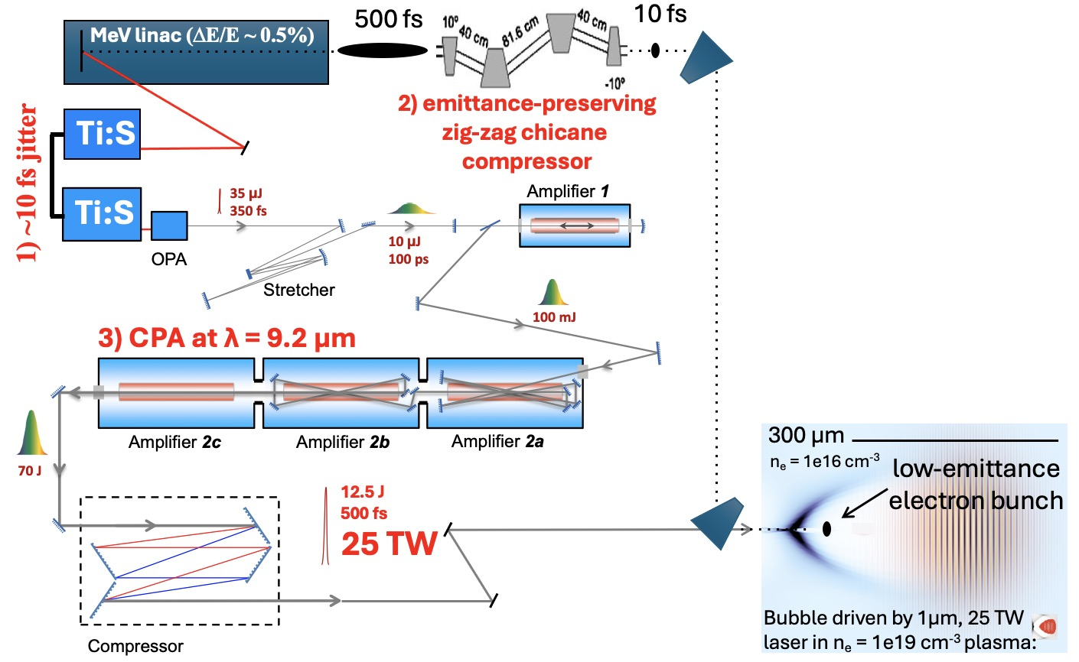
Year 3 Scientific Goal:
New capabilities: • CO₂ laser: >10 J, 2 ps, > 5 TW
• linac e-beam probe synchronized, compressed to fs level?
• optical diagnostic system expanded and tested
1st generation CO₂ LWFA
experiment with external
injection
Dream parameters:
1) 10 fs laser-e-beam rms jitter
2) e-bunch compression to 10 fs
3) 25 TW CO₂ pulse
Actual parameters will depend
on status of laser and linac
development.

Slide 10
SUMMARY
Year 1-2 goals:
1) Explore low-n_{e}, high-P_{L} limits of self-injected CO₂-LWFA
• use current (or slightly upgraded) CO₂ laser parameters
2) Strengthen optical wake diagnostics for n_{e} ~ 10¹⁶ cm⁻³ plasma
• add transverse CTS, Faraday probes; MIR harmonics of CO₂ drive pulse.
3) Simulate energy-spread, emittance growth in low-n_{e} wakes
• relate ∆E, ε_{n} growth to laser and plasma input parameters
• use maching-learning algorithms to hasten search for optimum
Year 3 goal:
1) 1st generation externally-injected CO₂-LWFA experiment.
• take advantage of CO₂ power upgrades & e-beam synchronization/compression advances
• leverages Navid’s work in developing e-beam probes
• a preparatory “Mercury” mission to build experience for a future “Apollo” moon-landing mission
10

Slide 11
CO₂ Laser Requirements
Configuration | Parameter | Units | Typical Values | Comments | Requested Values
CO₂ Regenerative Amplifier Beam | Wavelength | μm | 9.2 | Wavelength determined by mixed isotope gain media | n/a
 | Peak Power | GW | ~3 |  | n/a
 | Pulse Mode | --- | Single
 | Pulse Length | ps | 2
 | Pulse Energy | mJ | 6
 | M² | --- | ~1.5
 | Repetition Rate | Hz | 1.5 | 3 Hz also available if needed
 | Polarization | --- | Linear | Circular polarization available at slightly reduced power
CO₂ CPA Beam | Wavelength | μm | 9.2 | Wavelength determined by mixed isotope gain media | ~9.2
Note that delivery of full power pulses to the Experimental Hall is presently limited to Beamline #1 only. | Peak Power | TW | 5 | ~5 TW operation will become available shortly into this year’s experimental run period. A 3-year development effort to achieve >10 TW and deliver to users is in progress. | initially ~5, higher by year 3.
 | Pulse Mode | --- | Single |  | single
 | Pulse Length | ps | 2 |  | 2 ps or shorter
 | Pulse Energy | J | ~5 | Maximum pulse energies of >10 J will become available within the next year | initially 5-10, higher by year 3
 | M² | --- | ~2 |  | ~2
 | Repetition Rate | Hz | 0.05 |  | best available
 | Polarization |  | Linear | Adjustable linear polarization along with circular polarization can be provided upon request | Linear

Slide 12
Electron Beam Requirements
Parameter | Units | Typical Values | Comments | Requested Values
Beam Energy | MeV | 50-65 | Full range is ~15-75 MeV with highest beam quality at nominal values | 50-65 (year 3 only)
Bunch Charge | nC | 0.1-2.0 | Bunch length & emittance vary with charge | adjust for shortest length & lowest emittance (yr 3 only)
Compression | fs | Down to 100 fs (up to 1 kA peak current) | A magnetic bunch compressor available to compress bunch down to ~100 fs. Beam quality is variable depending on charge and amount of compression required. NOTE: Further compression options are being developed to provide bunch lengths down to the ~10 fs level | ~100 fs or shorter, depending on developments by yr 3.
Transverse size at IP (σ) | μm | 30 – 100 (dependent on IP position) | It is possible to achieve transverse sizes below 10 um with special permanent magnet optics. | ~ 30 µm; exact value will depend on results of yr 1-2 research
Normalized Emittance | μm | 1 (at 0.3 nC) | Variable with bunch charge | as low as achievable
Rep. Rate (Hz) | Hz | 1.5 | 3 Hz also available if needed | match CO2 laser rep. rate
Trains mode | --- | Single bunch | Multi-bunch mode available. Trains of 24 or 48 ns spaced bunches. | single bunch

Slide 13
Other Experimental Laser Requirements
Ti:Sapphire Laser System | Units | Stage I Values | Stage II Values | Comments | Requested Values
Central Wavelength | nm | 800 | 800 | Stage I parameters are presently available and setup to deliver Stage II parameters should be complete during FY22 | 800 nm
FWHM Bandwidth | nm | 20 | 13 |  | 13 nm
Compressed FWHM Pulse Width | fs | <50 | <75 | Transport of compressed pulses will initially include a very limited number of experimental interaction points. Please consult with the ATF Team if you need this capability. | 75 fs
Chirped FWHM Pulse Width | ps | ≥50 | ≥50 |  | 50 ps
Chirped Energy | mJ | 10 | 200 |  | 10 mJ
Compressed Energy | mJ | 7 | ~20 | 20 mJ is presently operational with work underway this year to achieve our 100 mJ goal. | 7 mJ
Energy to Experiments | mJ | >4.9 | >80 |  | 5 mJ
Power to Experiments | GW | >98 | >1067
Nd:YAG Laser System | Units | Typical Values | Comments | Requested Values
Wavelength | nm | 1064 | Single pulse
Energy | mJ | 5
Pulse Width | ps | 14
Wavelength | nm | 532 | Frequency doubled | 532 nm
Energy | mJ | 0.5 |  | 0.5 mJ
Pulse Width | ps | 10 |  | 2-3 ps

Slide 14
Experimental Time Request
CY2024 Time Request
Capability | Setup Hours | Running Hours
Electron Beam | 0 | 0
NIR Laser | 60 | 140
LWIR Laser | 60 | 140
Total Time Request for the 3-year Experiment (including CY2024-26)
Capability | Setup Hours | Running Hours
Electron Beam | 60 (yr 3 only) | 140 (yr 3 only)
NIR Laser | 180 | 420
LWIR Laser | 180 | 420

Slide 15
Special Equipment Requirements and Hazards
Electron Beam
Please indicate any special equipment that you expect to need, including (but not limited to) the transverse deflecting cavity, shaped bunch using mask technique, plasma capillary discharge system, bolometer/interferometer setup etc.: best possible compression and synchronization with CO2 laser (yr 3)
CO₂ Laser
Please note any specialty laser configurations required here: polarization control, harmonics of split-off portions of beam generated in e.g. AgGaSe₂
Ti:Sapphire and Nd:YAG Lasers
Please note any specialty non-CO₂ laser configurations required here: compressed Ti:S pulse at LWFA chamber
Hazards & Special Installation Requirements
Large installation (chamber, insertion device, etc.): no
Cryogens: no
Introducing new magnetic elements: Spectrometer magnet, < 1 T
Introducing new materials into the beam path: no
Any other foreseeable beam line modifications: compressor for e-beam (yr 3)

