Slide 1
Project ID:
NP-315766
Project Title:
Ultrafast Electron Radiography of LWFA
Collaborators:
Stony Brook University
Brookhaven National Laboratory
University of Texas at Austin
University of California Los Angeles
V.N. Litvinenko, N. Vafaei-Najafabadi (PI), R. Samulyak
Neveen Pathak, A. Gaikwad, A. Cheng, E. Trommer, B. Romasky
I. Pogorelsky, M. Fedurin, M. Polyanskiy, M. Babzien, W. Li,
K. Kusche, M. Palmer
M. Downer, R. Zgadzaj, Y. Cao
C. Joshi, A. Farrell, M. Sinclair, C. Zhang, K. Miller, Y. Wu
Funding Source:: DOE HEP DE-SC0014043 (Received)
CORI @ NERSC under contract DE-AC02-05CH11231
SEAWULF @ Stony Brook University

Slide 2
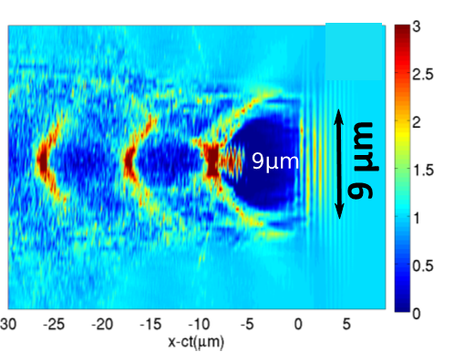
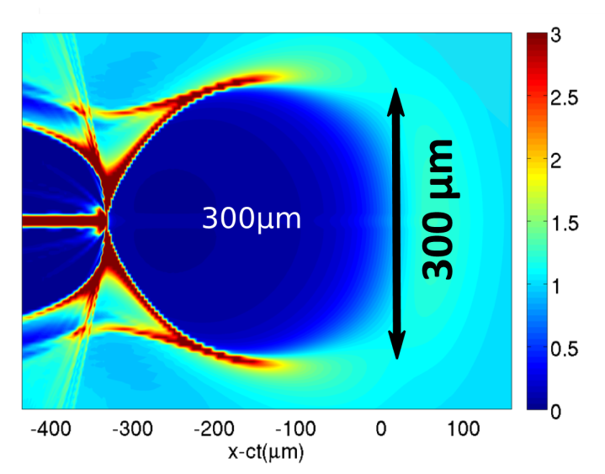
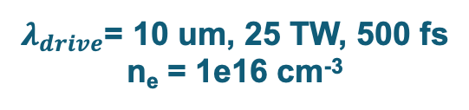
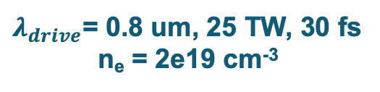
LWFA Using a Long-Wave Infrared (LWIR) Driver
CO₂ laser system: 2 ps pulses, up to 10 J energy, wavelength ~10.2 um
$λ_{drive}$= 0.8 um, 25 TW, 30 fs
n_{e} = 2e19 cm⁻³
$λ_{drive}$= 10 um, 25 TW, 500 fs
n_{e} = 1e16 cm⁻³
Courtesy of Gennady Shvets
Courtesy of Gennady Shvets
Precise and controllable external injection!
Diagnostic tools are needed to characterize the fields inside such structures and to improve the means of external injection.
How is LWFA diagnostic usually done?
Use optical methods—lasers.
These methods rely on the index of refraction of plasma.
Optical methods have been extensively studied and have successfully demonstrated the ability to capture shadowgraphs of the plasma wakes.
BUT: difficult at low plasma densities.

Slide 3
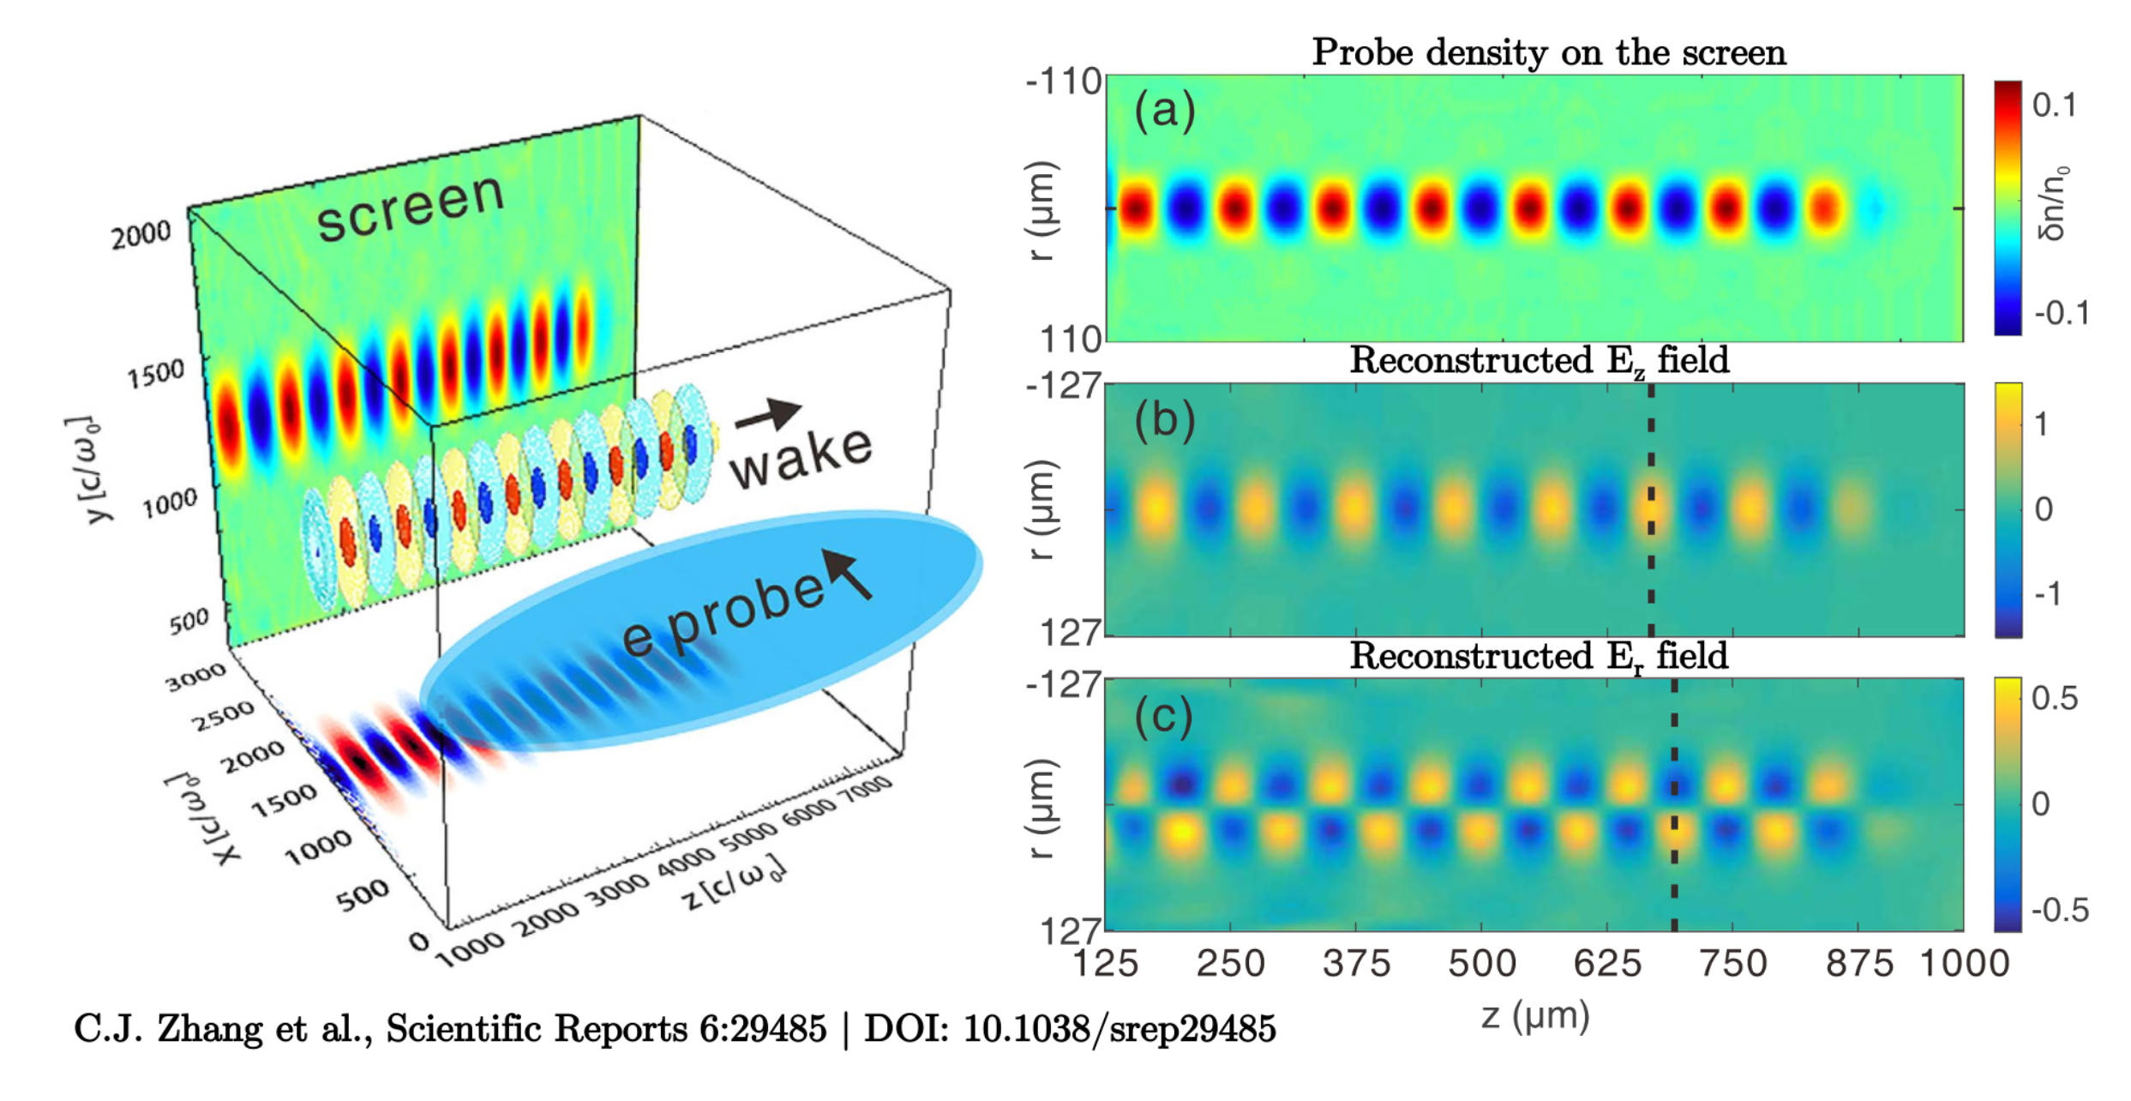
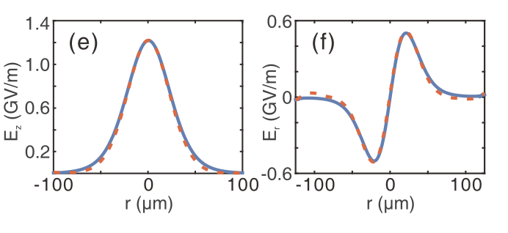
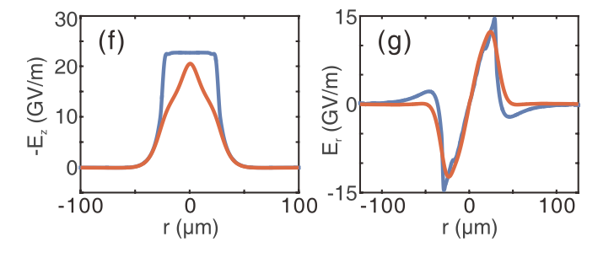
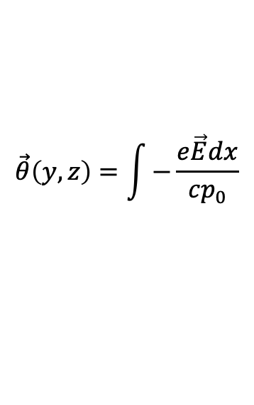
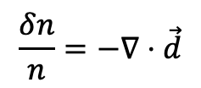

Fluid-based formalism for electron probing of fields in LWFA developed in 2018
Linear Wake Reconstruction
Nonlinear Wake Reconstruction
$$\vec{θ}\left(y,z\right)=\int{−\frac{e\vec{E}dx}{cp_{0}}}$$
$$\frac{δn}{n}=−∇⋅\vec{d}$$
$$\vec{d}=\vec{θ}L$$
Fluid theory reconstruction works well in the linear regime, but not very well in the nonlinear regime

Slide 4
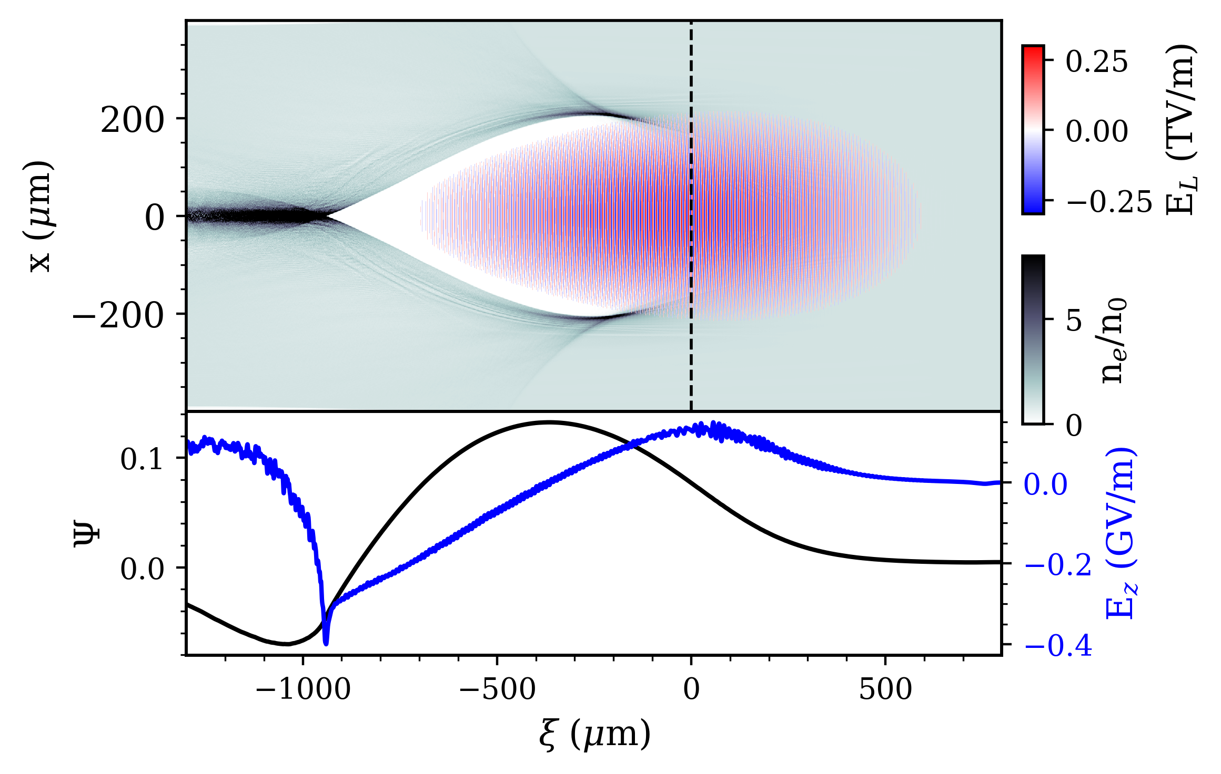
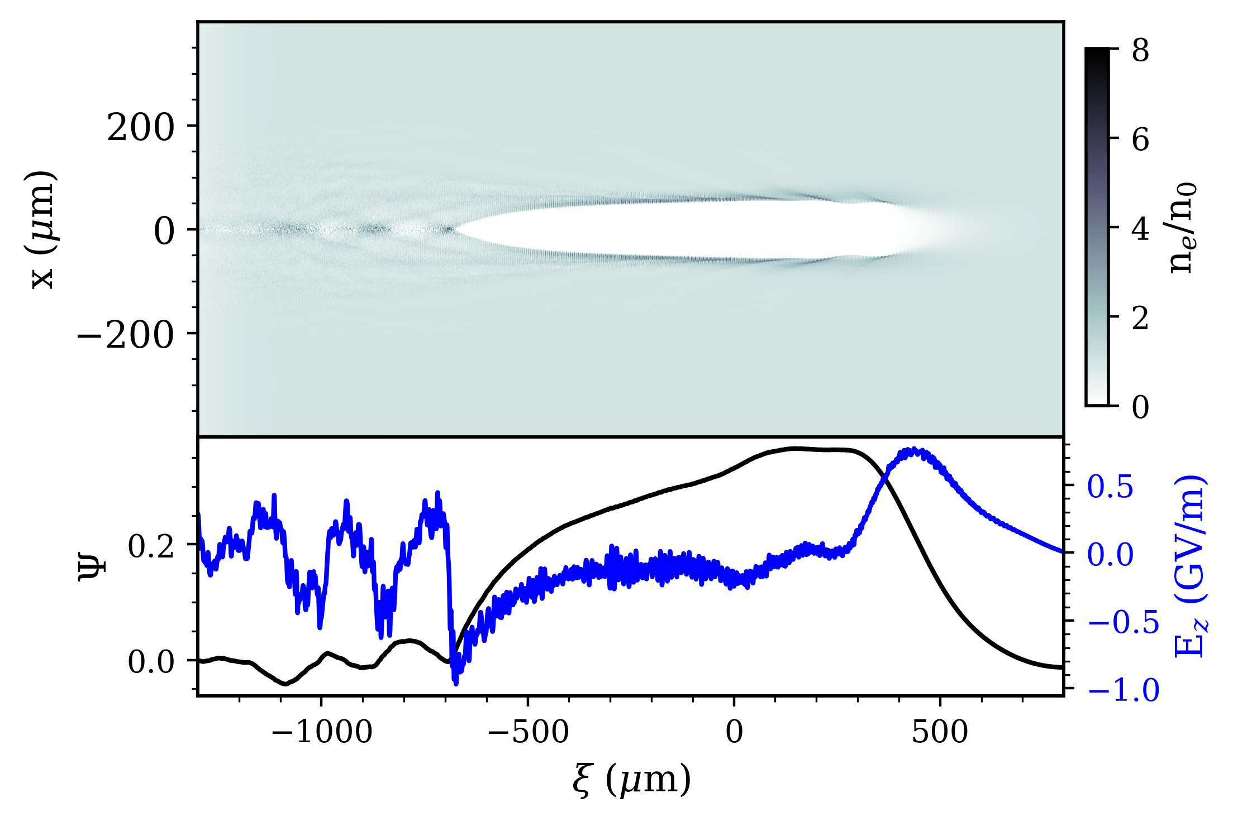
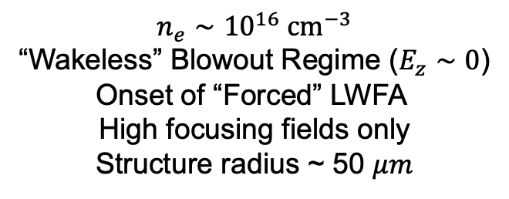
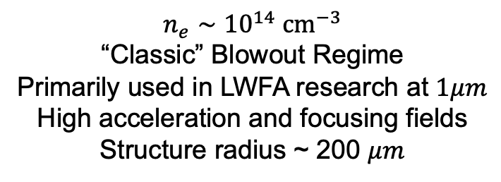
Expected Experimental Regimes with 5 TW Laser Pulse
$$n_{e}∼{10}^{14} {cm}^{−3}$$
“Classic” Blowout Regime
Primarily used in LWFA research at $1μm$
High acceleration and focusing fields
Structure radius ~ 200 $μm$
$$n_{e}∼{10}^{16} {cm}^{−3}$$
“Wakeless” Blowout Regime ($E_{z}∼0$)
Onset of “Forced” LWFA
High focusing fields only
Structure radius ~ 50 $μm$

Slide 5
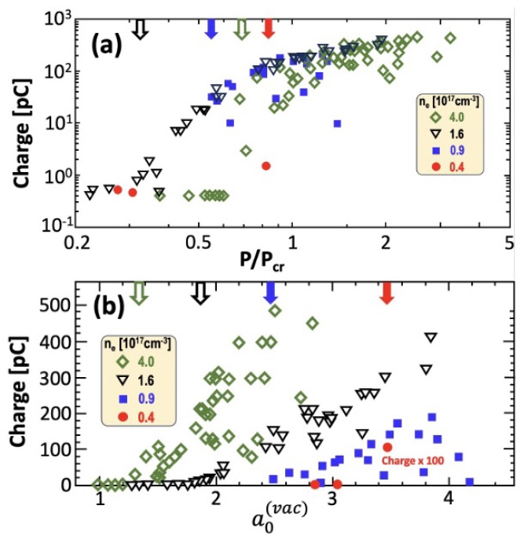
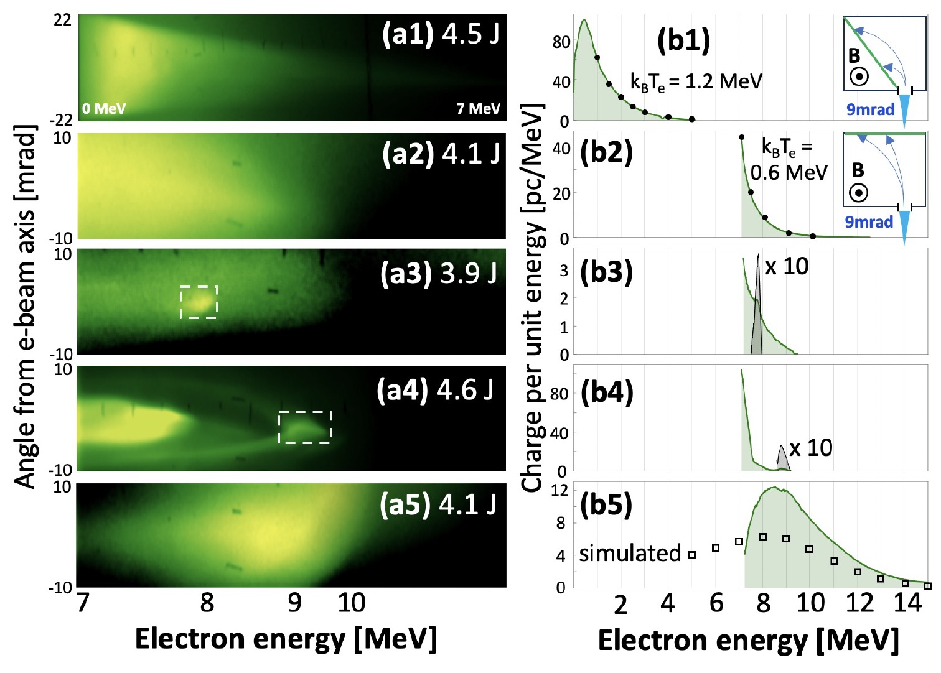
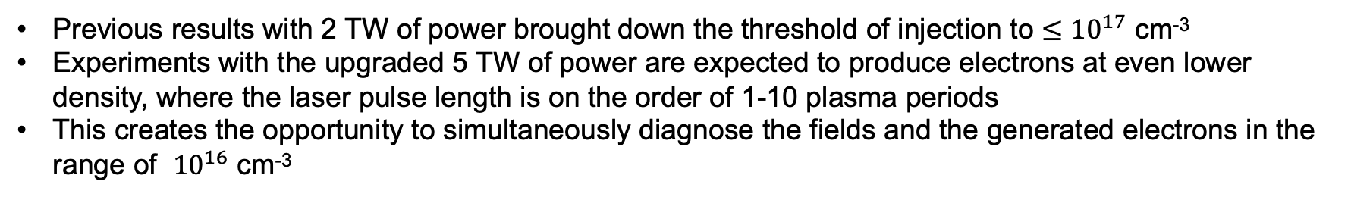
LWFA Using a Long-Wave Infrared (LWIR) Driver
Previous results with 2 TW of power brought down the threshold of injection to $≤{10}^{17}$ cm⁻³
Experiments with the upgraded 5 TW of power are expected to produce electrons at even lower density, where the laser pulse length is on the order of 1-10 plasma periods
This creates the opportunity to simultaneously diagnose the fields and the generated electrons in the range of ${10}^{16}$ cm⁻³

Slide 6
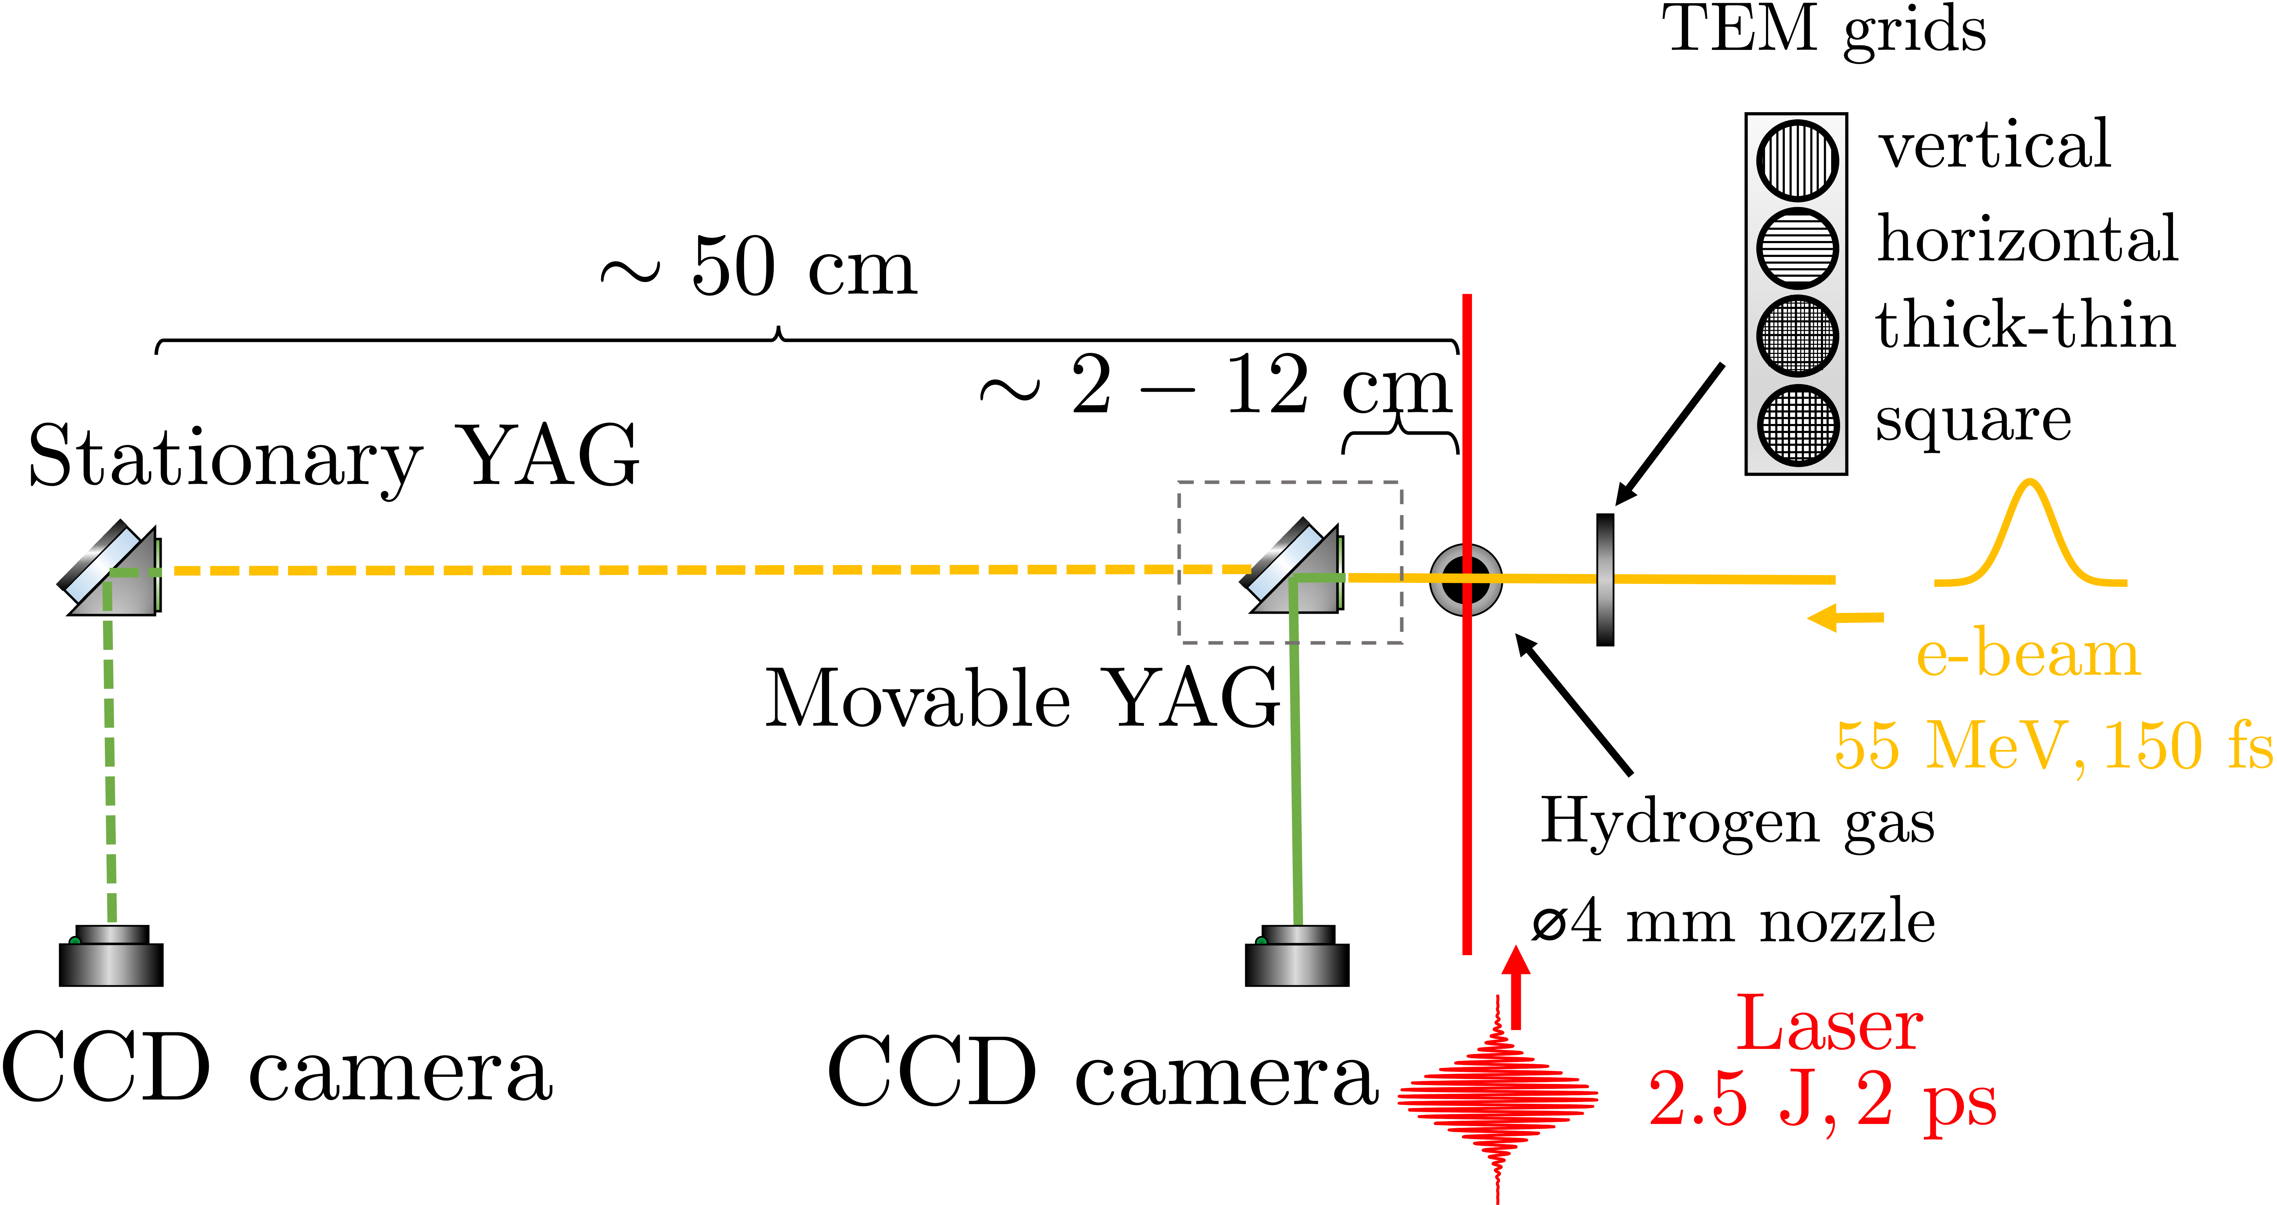
Using Movable BPM as Diagnostics
2022
2019
2021

Slide 7

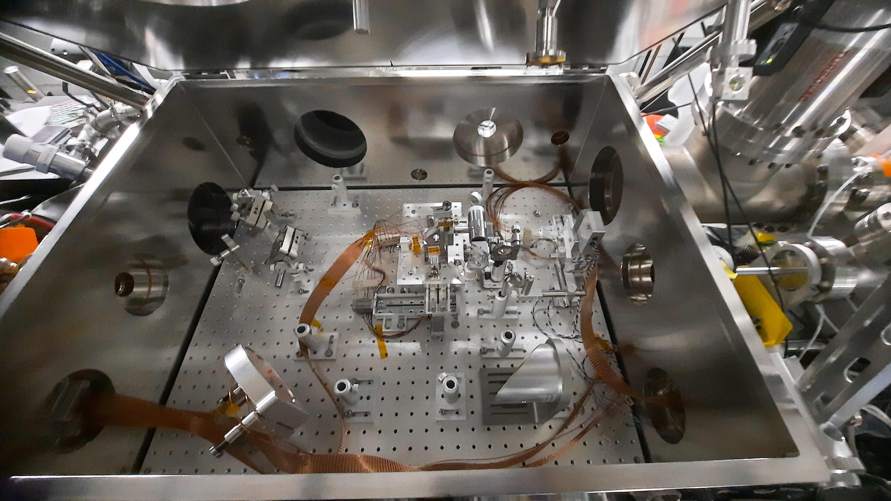
Experimental overview: LWFA chamber setup
nozzle
CO₂ in
CO₂ out
TEM grids assembly
e-beam in

Slide 8
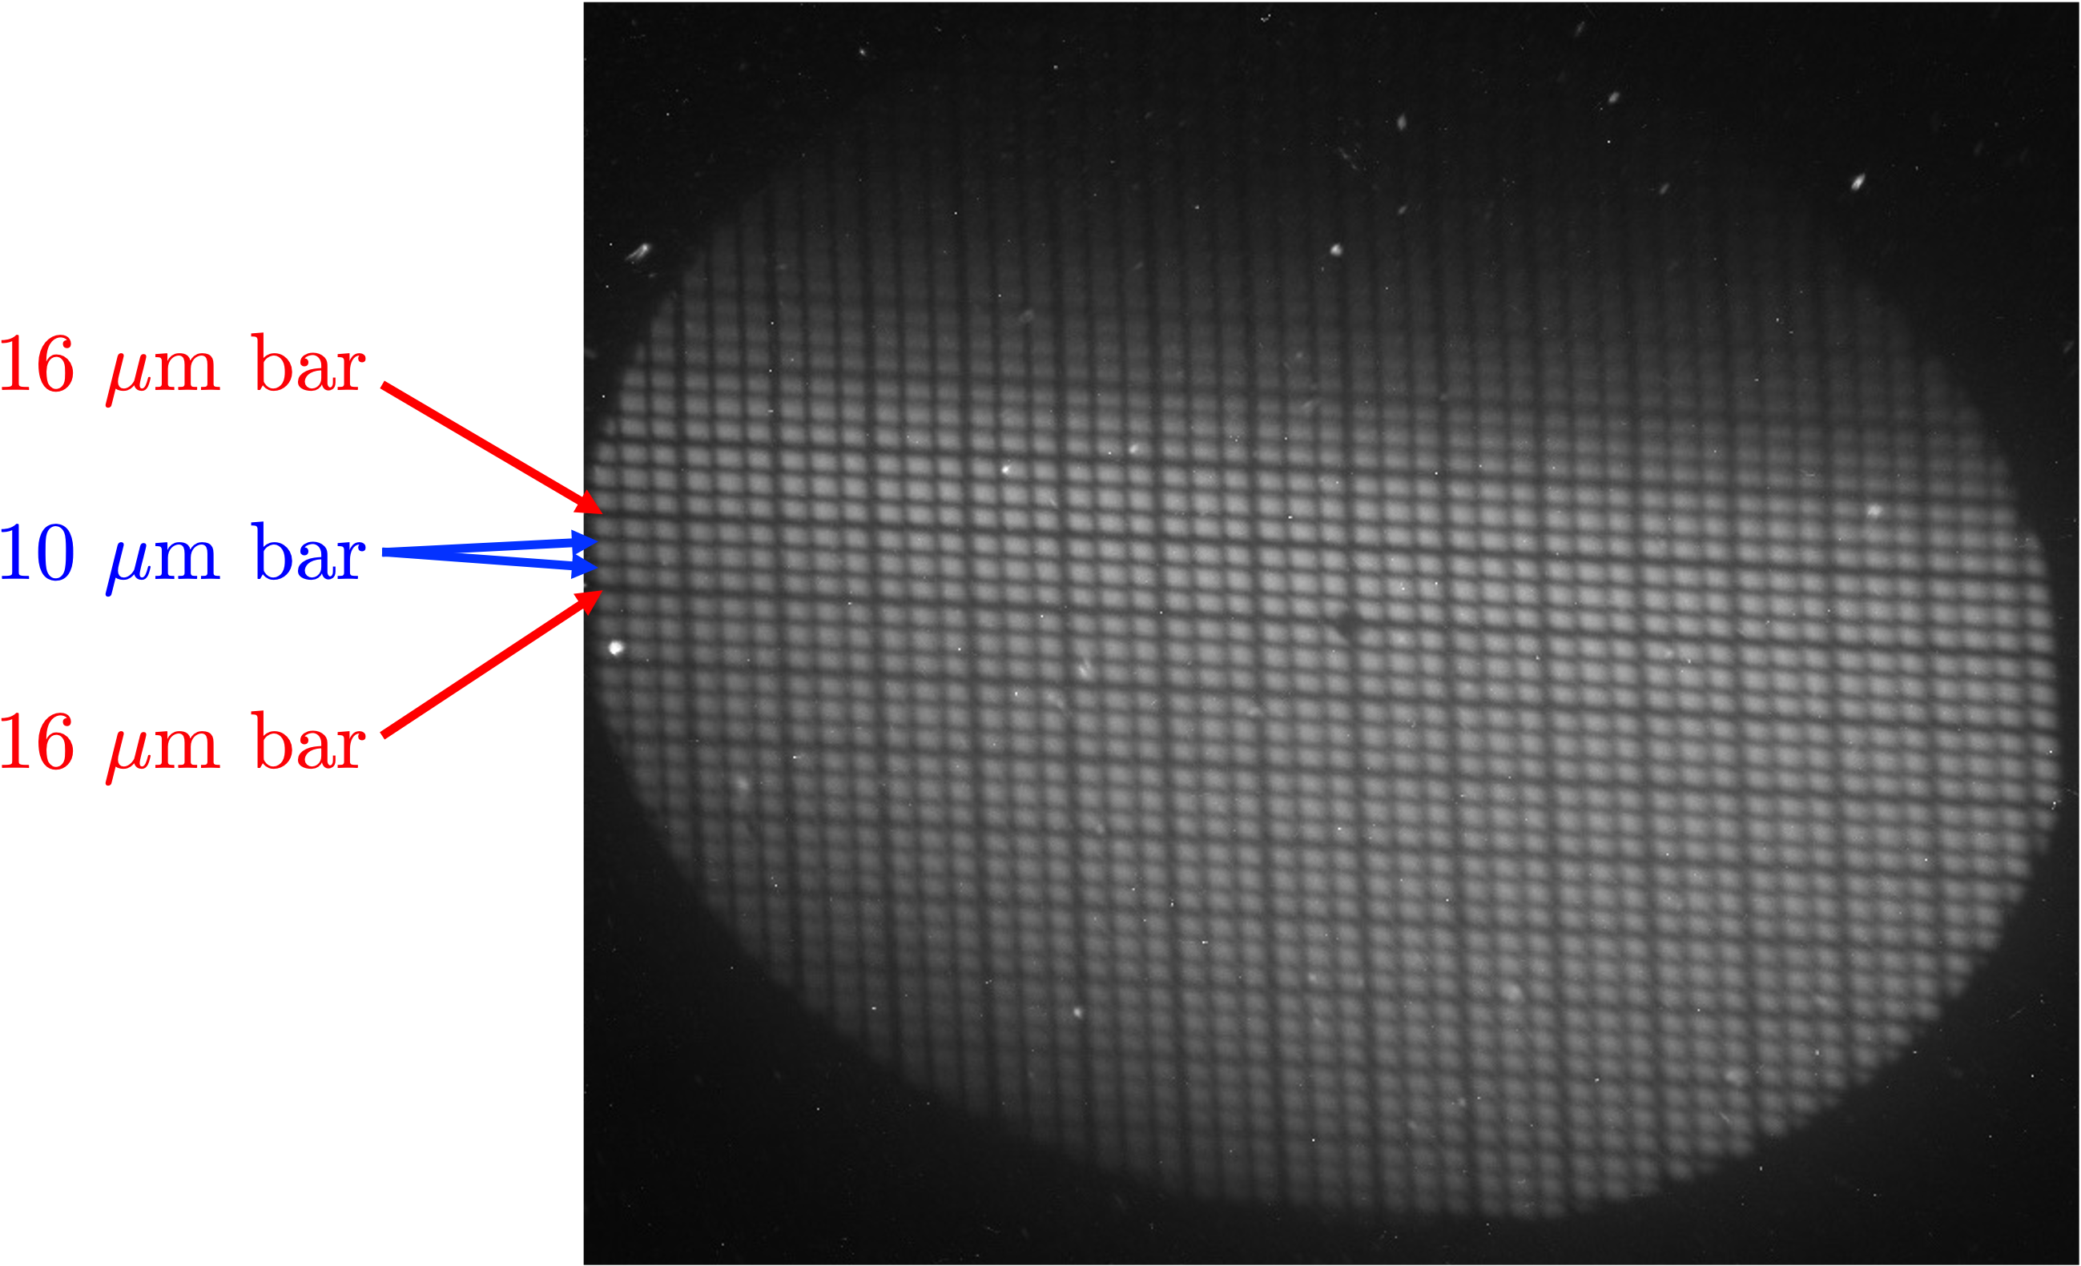
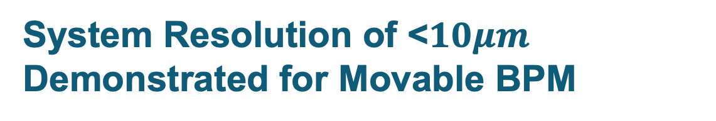
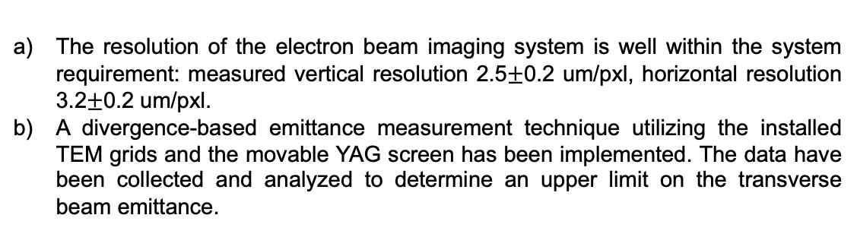
System Resolution of <$10μm$ Demonstrated for Movable BPM
The resolution of the electron beam imaging system is well within the system requirement: measured vertical resolution 2.5$±$0.2 um/pxl, horizontal resolution 3.2$±$0.2 um/pxl.
A divergence-based emittance measurement technique utilizing the installed TEM grids and the movable YAG screen has been implemented. The data have been collected and analyzed to determine an upper limit on the transverse beam emittance.
Shadow of the TEM grid (square thick/thin 30um opening/16-10-10um bars) obtained using an improved e-beam imaging system.

Slide 9
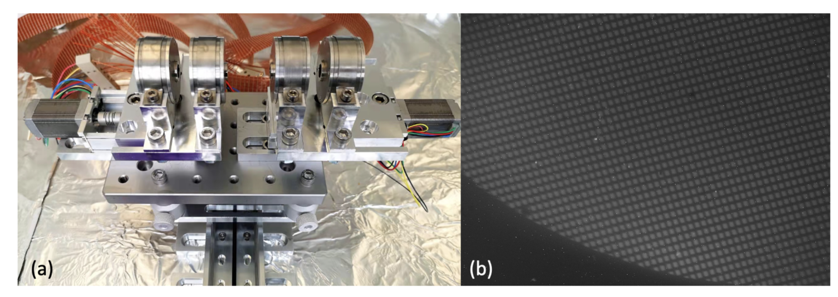
Permanent Quadrupole Diagnostic
e-beam passing through a grid with (5 𝜇𝑚 bar, 7.5 𝜇𝑚 spacing)
Permanent Magnet Quadrupoles (PMQs) developed by UCLA have been characterized and used by AE98/99
This device is available as diagnostic if radiographic information is needed closer to the plasma than the movable BPM can record

Slide 10
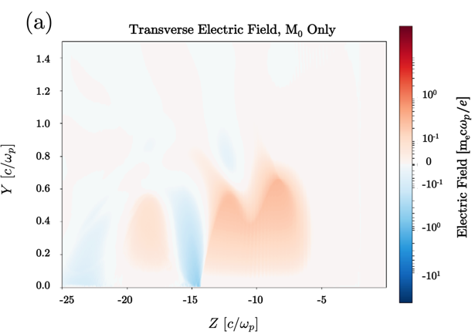
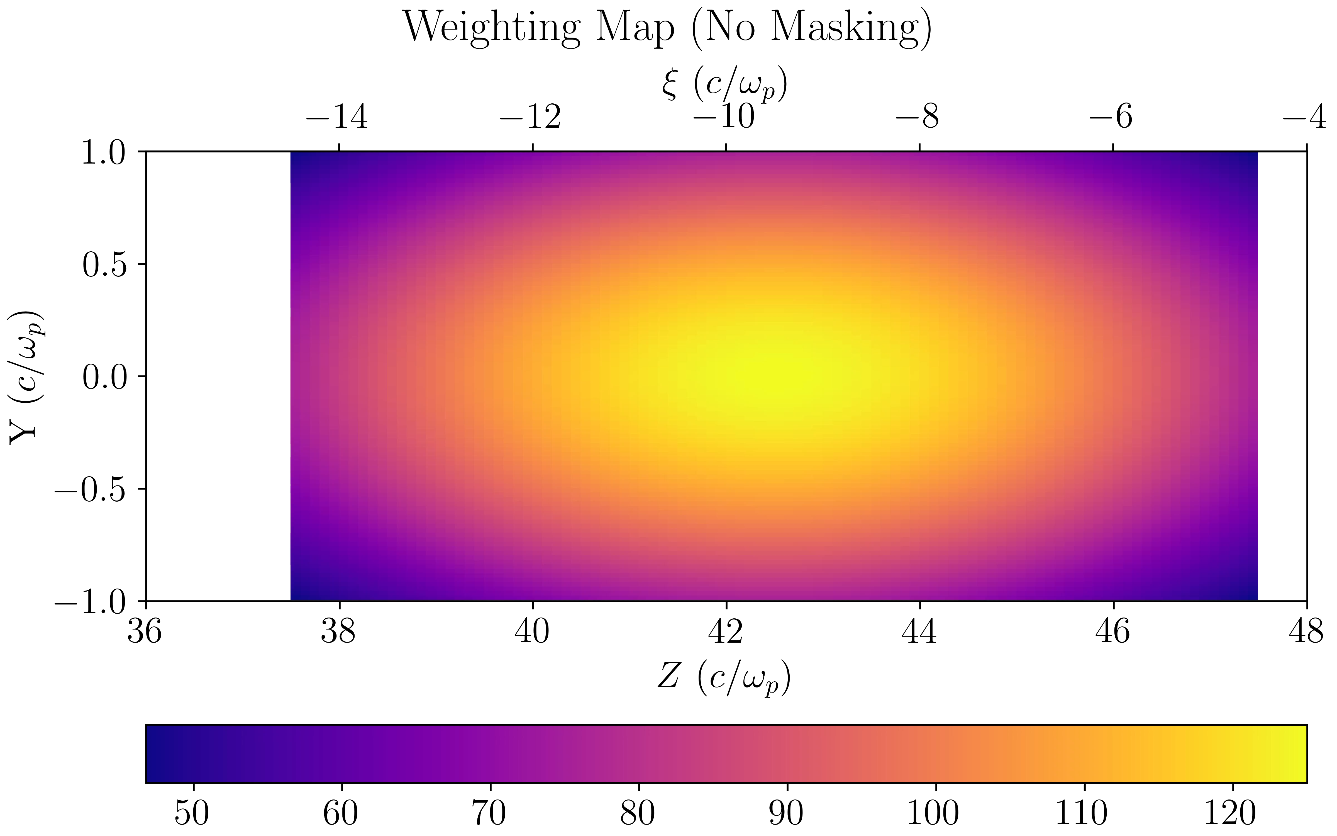
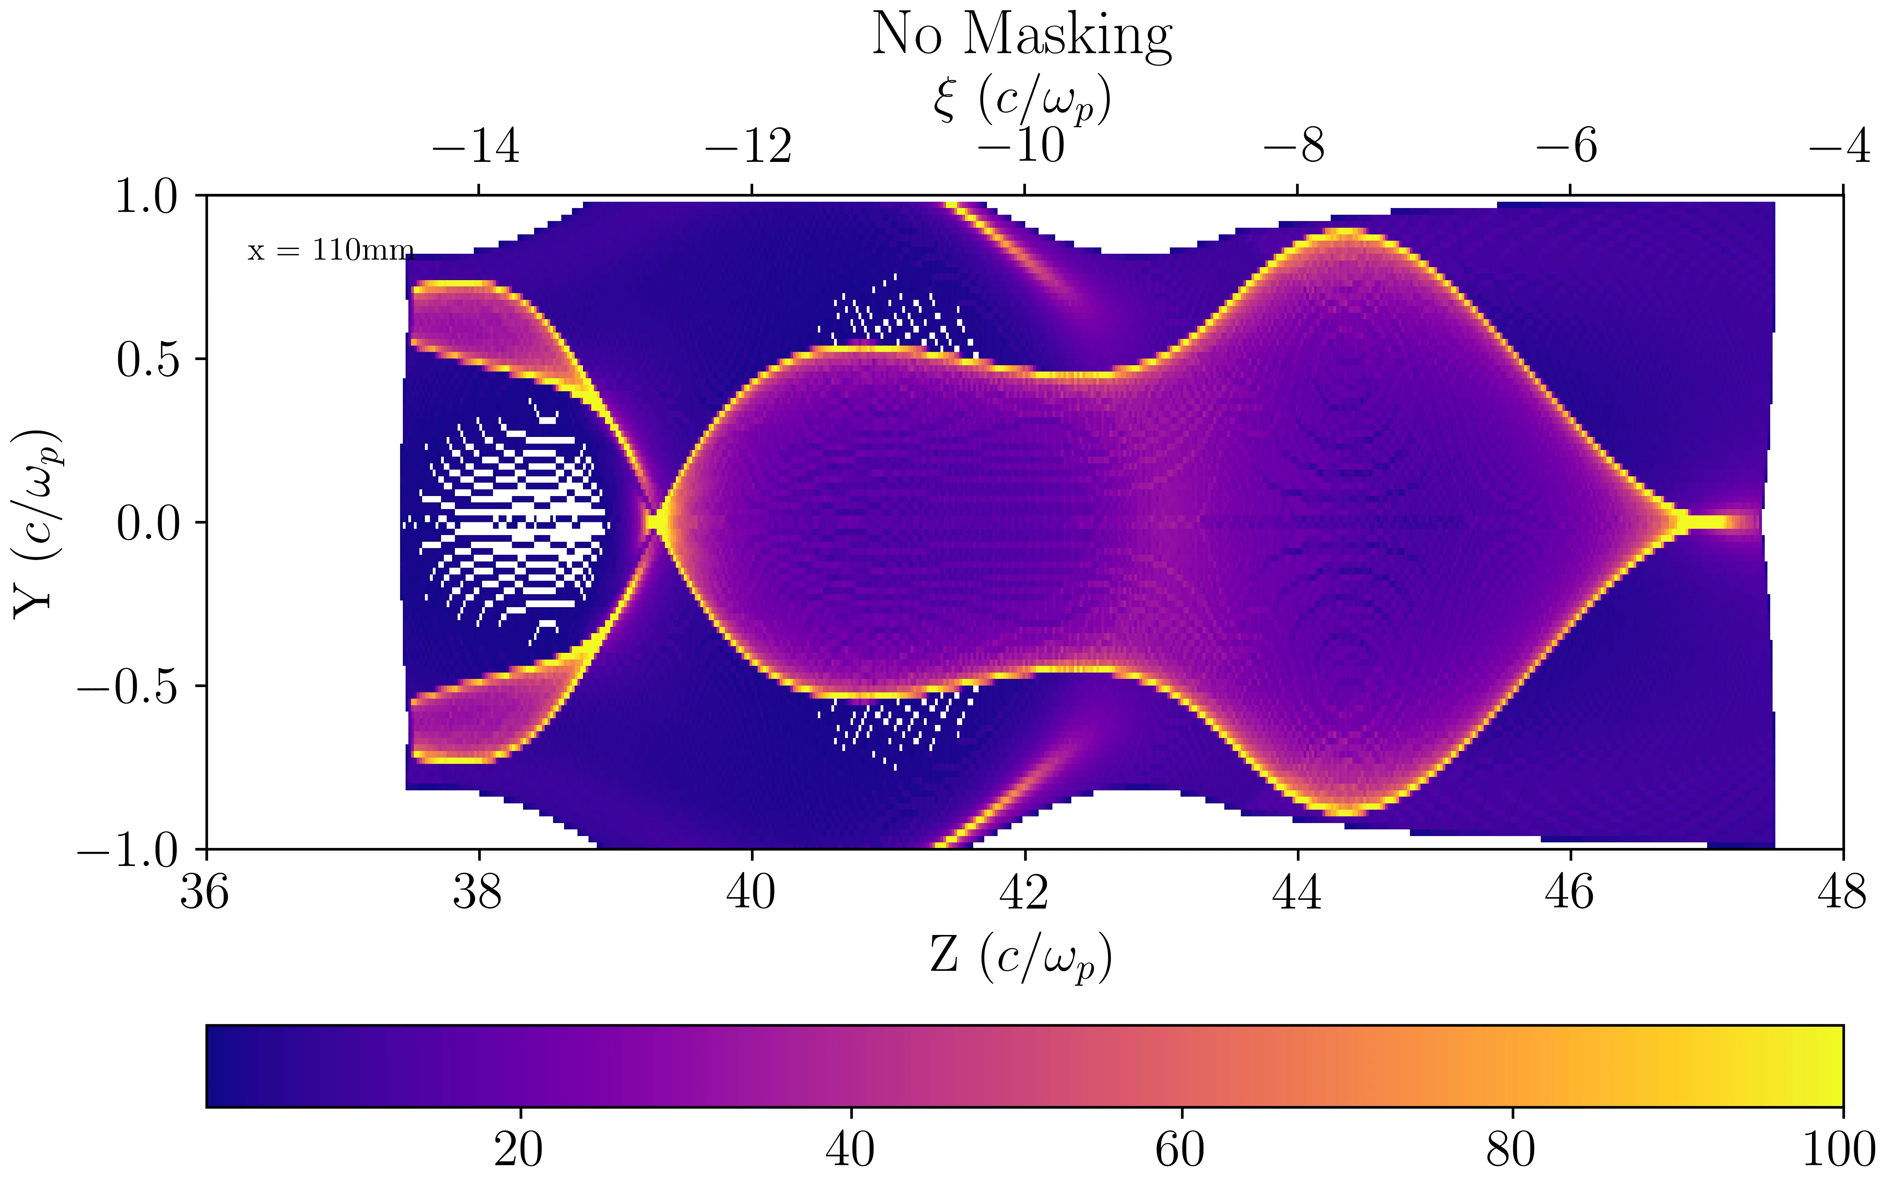
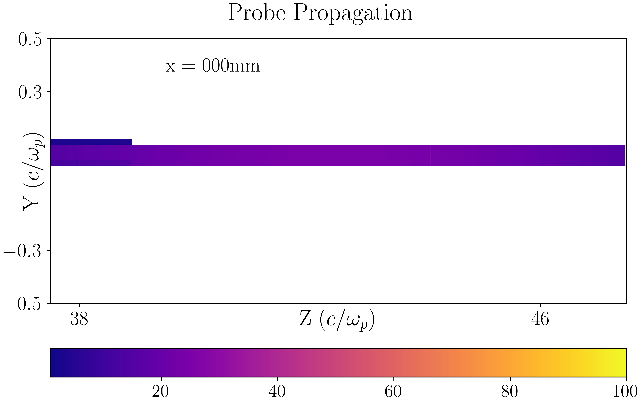
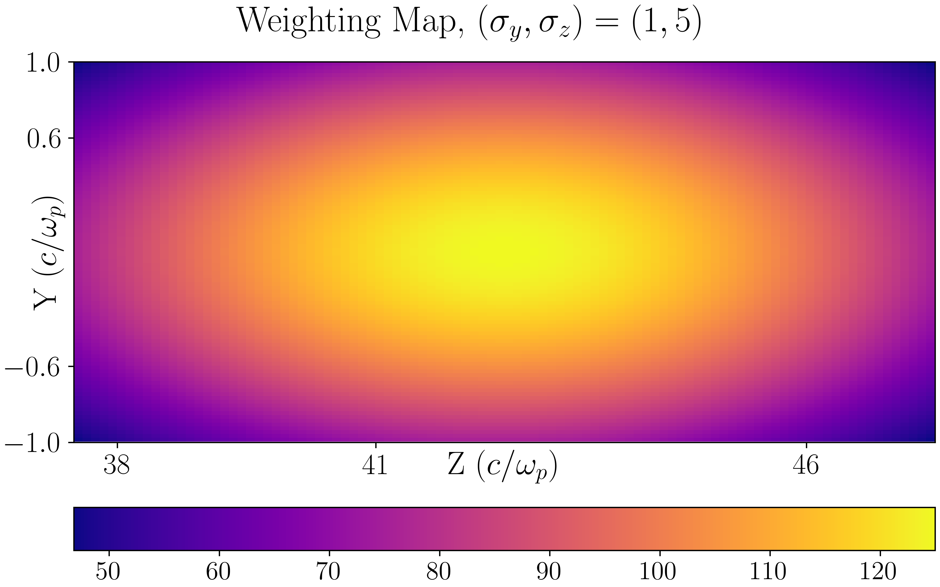
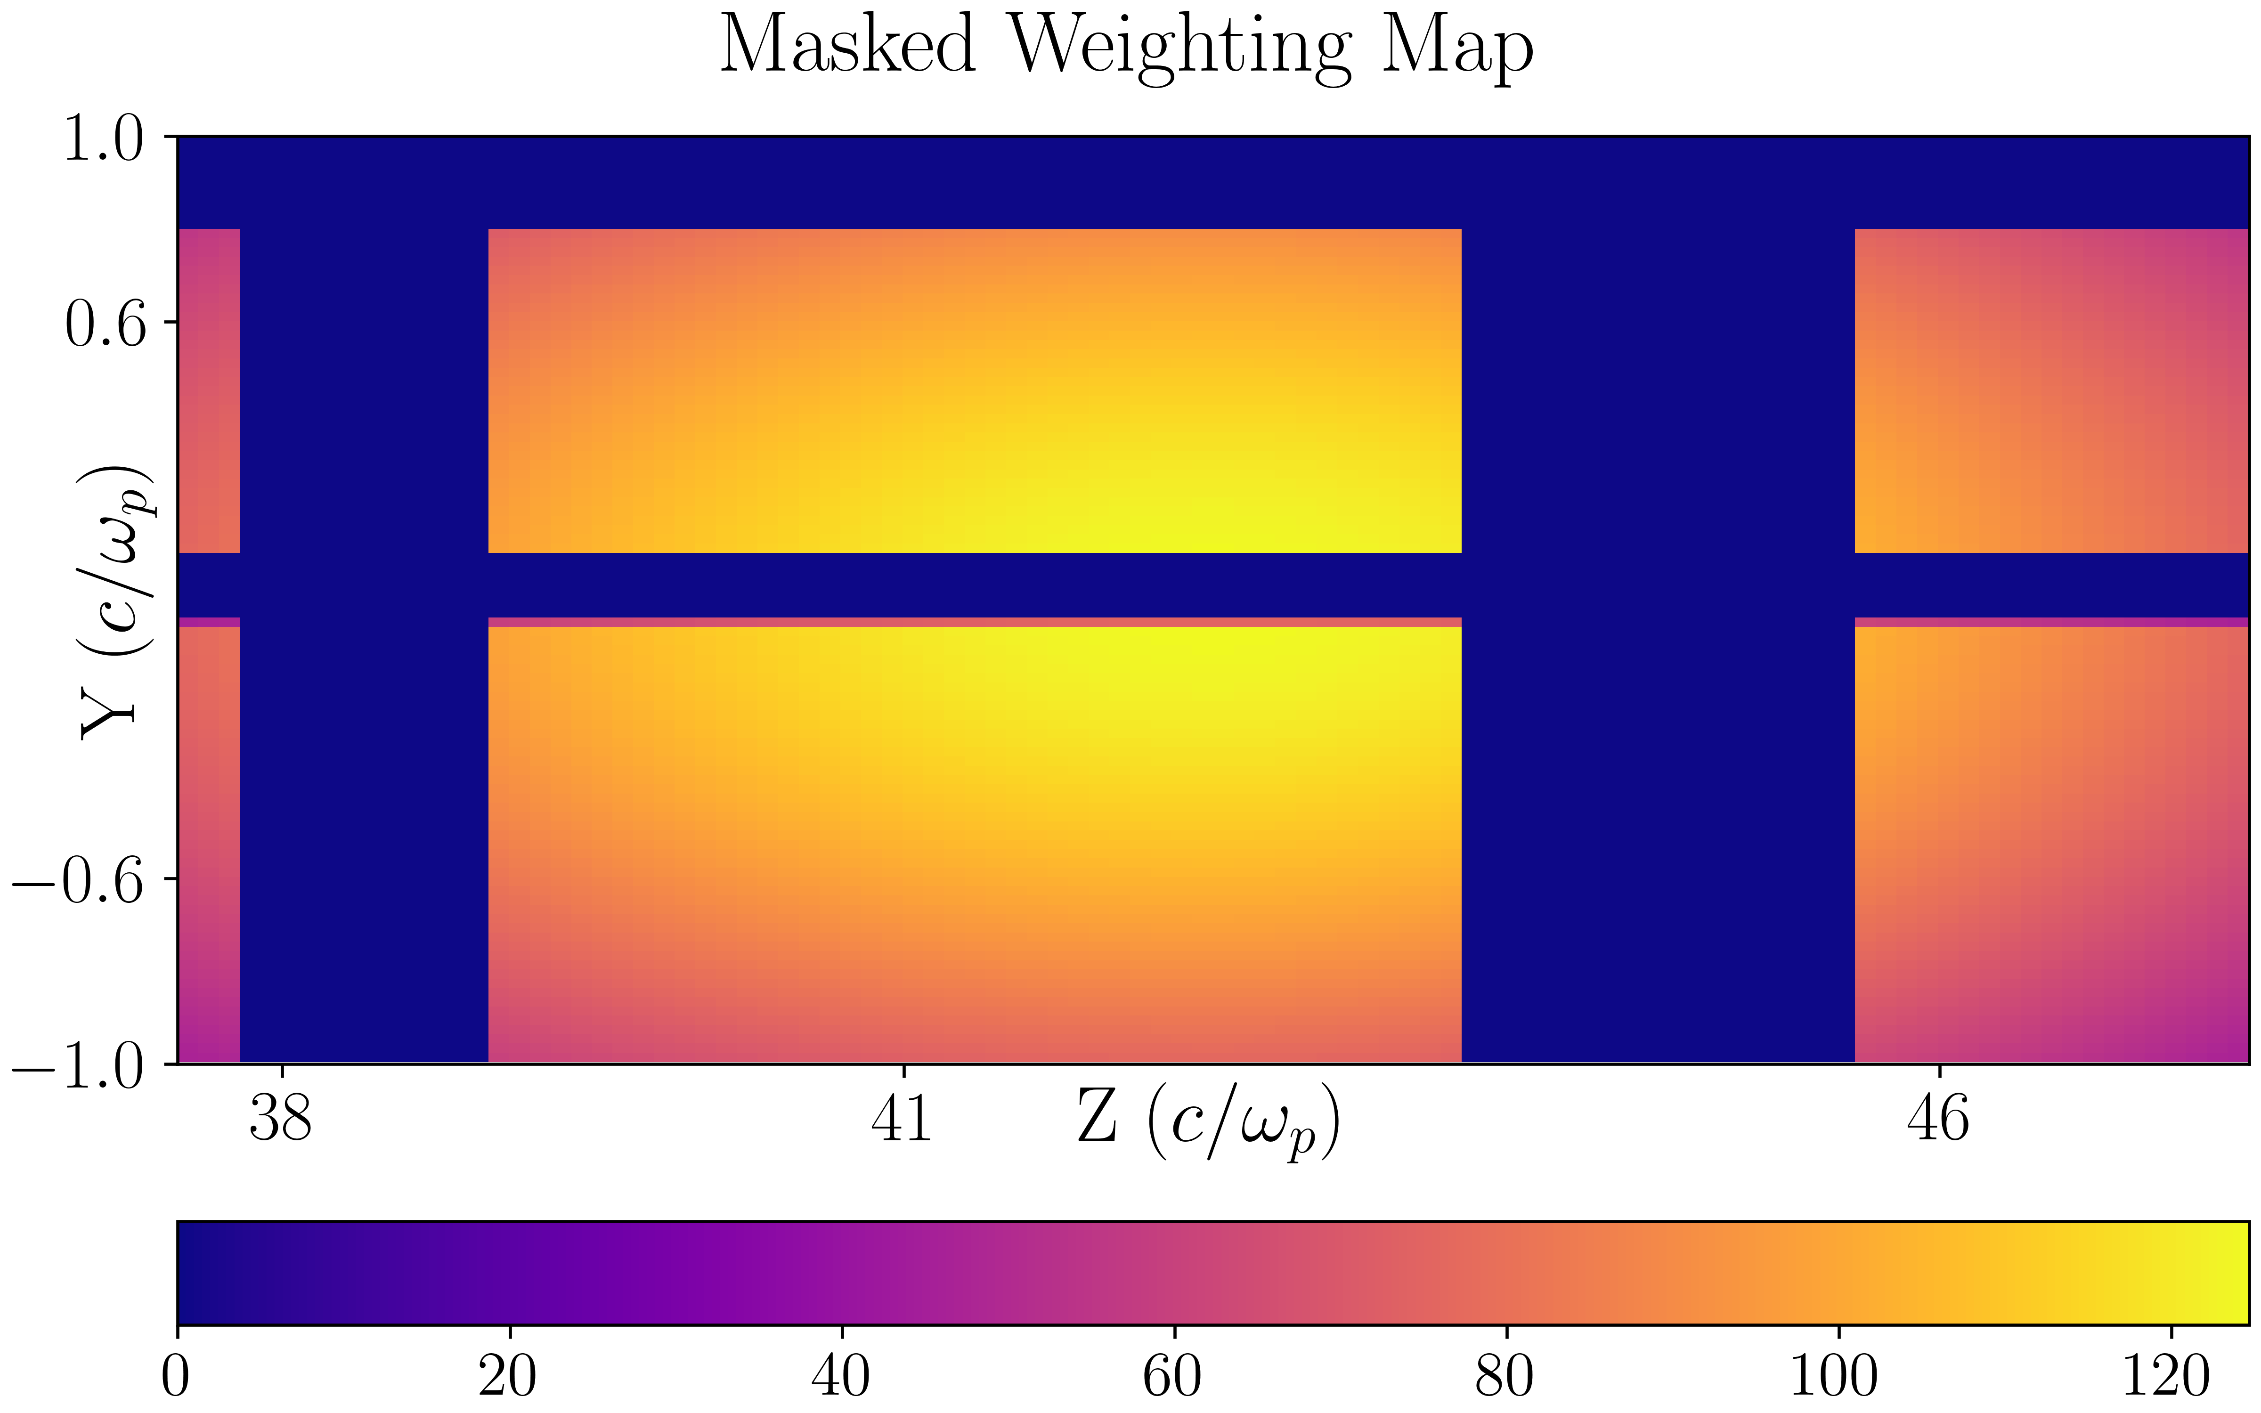
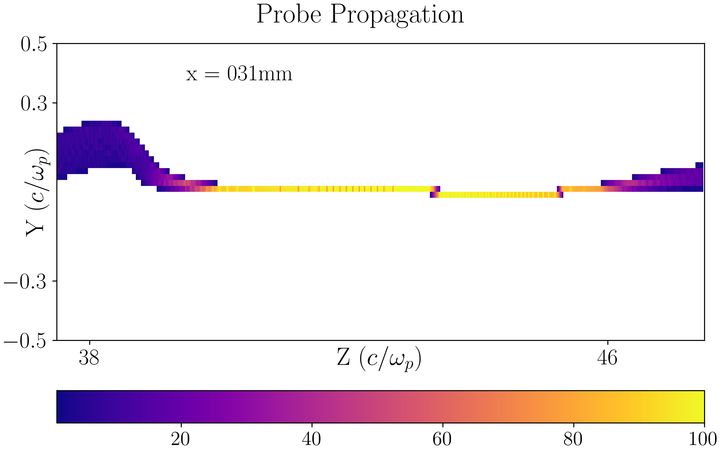


We will Continue Using Beam Probing Simulations
Tracking Probe Propagation
Realistic Beam Shape
Custom Masks as Postprocessing
$$x=0 mm$$
$$x=31 mm$$

Slide 11
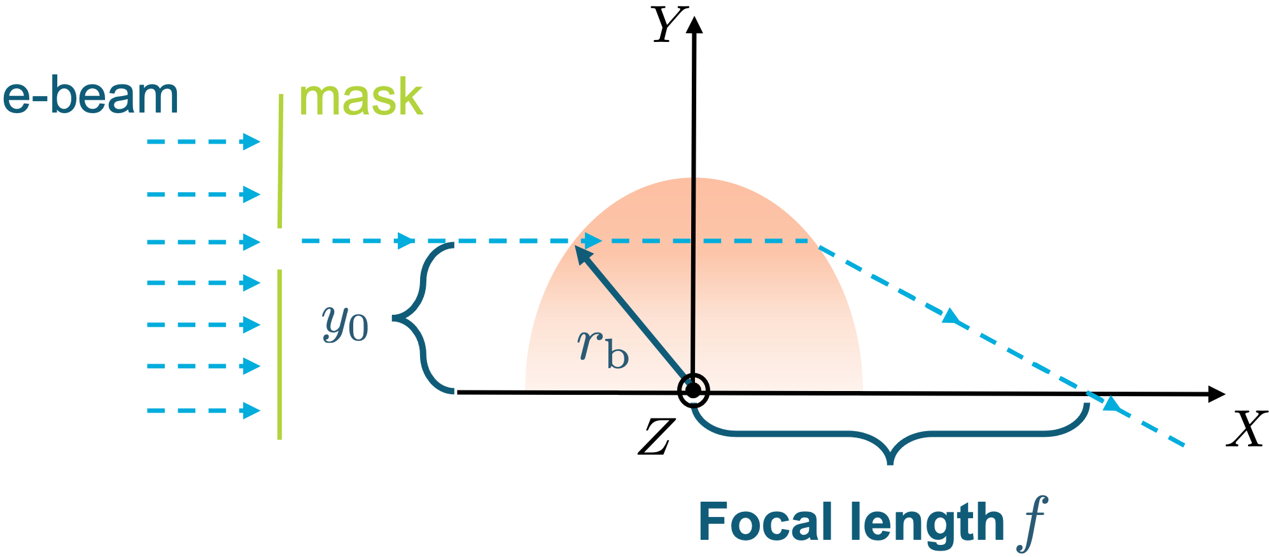
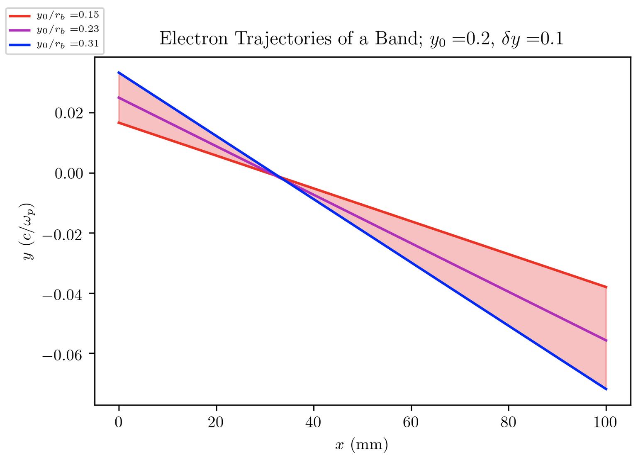
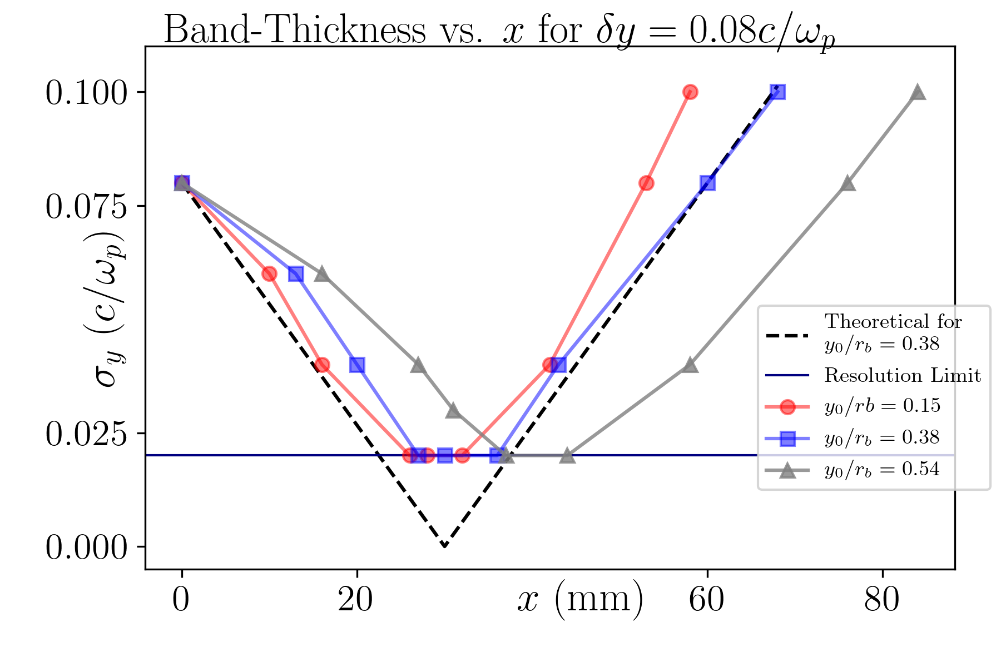
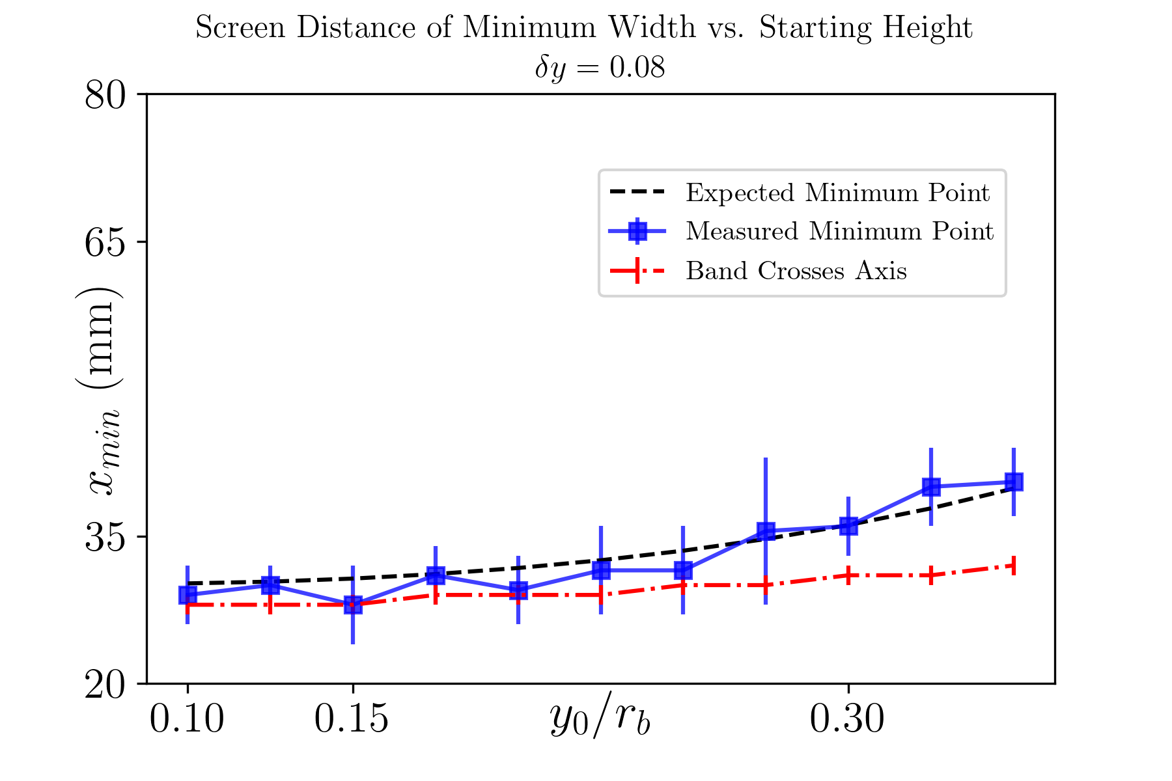
Expansion of Theory Allows Predicting Evolution of “Beamlets”
Linear focusing force in a bubble: (wakefield theory suggests )
, where
Focal length
Depth of field
If we can measure the focal length, we can characterize the field inside the bubble.

Slide 12
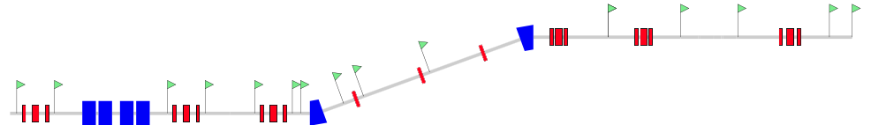
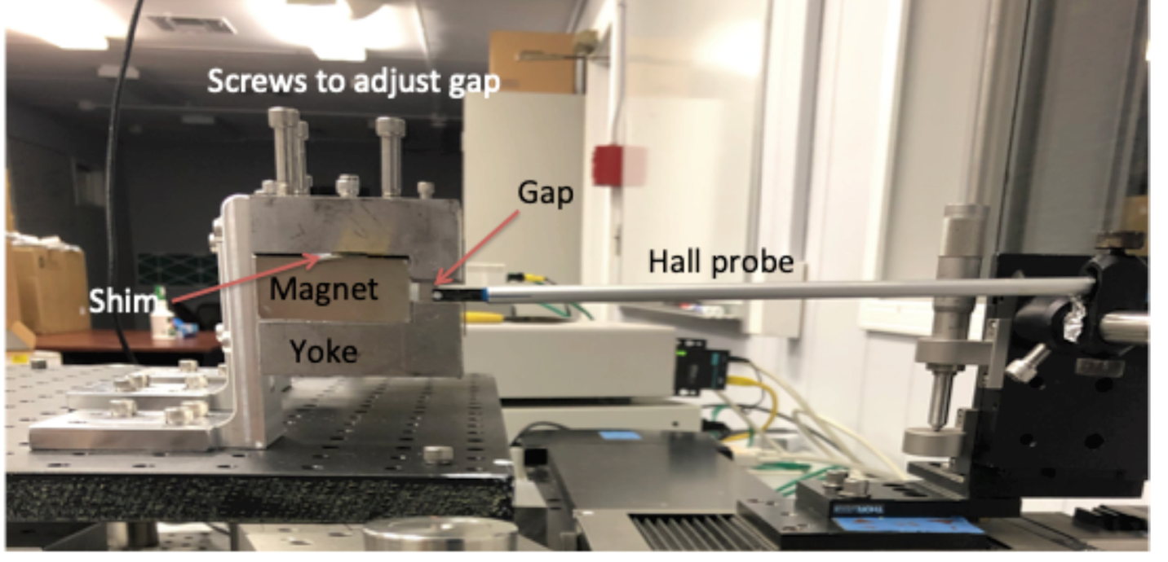
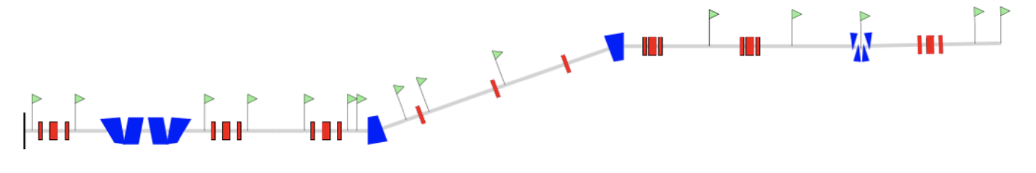
Other Work: Implementation of e-beam Compression Scheme
Current option: Bunch shaping using HES. Resulting bunch length 150-250 fs.
e-beam
HES
Future option: Bunch shaping using chicane
e-beam
MS student, Roshni Patil, has graduated in December 2020 with the thesis titled “Design of a Permanent Magnet Chicane to Compress Electron Beams for LWFA Experiments at BNL”

Slide 13
Summary of Major Goals:
Use the movable BPM to demonstrate operation of CO₂ driven LWFA in blowout regime for the first time.
Examine the fields in the transition regime of SM-LWFA to blowout regime.
Map out the nonlinear fields of LWFA in various interaction regimes parameterized by plasma density, location of the focus spot (the z scan), and distance behind the laser (laser e-beam delay).
Identify the physics of electron injection. Since electron injection occurs near axis, we will use masks to focus on fields near the axis
Correlate findings with electron beam spectrometer and laser diagnostics
Compare the properties of the fields (in particular, the linearity of focusing fields) with those expected from simulations and theory.

Slide 14
Electron Beam Requirements
Parameter | Units | Typical Values | Comments | Requested Values
Beam Energy | MeV | 50-65 | Full range is ~15-75 MeV with highest beam quality at nominal values | Nominal (~55 MeV)
Bunch Charge | nC | 0.1-2.0 | Bunch length & emittance vary with charge | Max possible at max compression
Compression | fs | Down to 100 fs (up to 1 kA peak current) | A magnetic bunch compressor available to compress bunch down to ~100 fs. Beam quality is variable depending on charge and amount of compression required. NOTE: Further compression options are being developed to provide bunch lengths down to the ~10 fs level | 100 fs (minimum)
Transverse size at IP (σ) | μm | 30 – 100 (dependent on IP position) | It is possible to achieve transverse sizes below 10 um with special permanent magnet optics. | 2 mm (horizontal) 0.5 mm (vertical)
Normalized Emittance | μm | 1 (at 0.3 nC) | Variable with bunch charge | 1
Rep. Rate (Hz) | Hz | 1.5 | 3 Hz also available if needed | 1.5
Trains mode | --- | Single bunch | Multi-bunch mode available. Trains of 24 or 48 ns spaced bunches. | Single bunch

Slide 15
CO₂ Laser Requirements
Configuration | Parameter | Units | Typical Values | Comments | Requested Values
CO₂ Regenerative Amplifier Beam | Wavelength | μm | 9.2 | Wavelength determined by mixed isotope gain media
 | Peak Power | GW | ~3
 | Pulse Mode | --- | Single
 | Pulse Length | ps | 2
 | Pulse Energy | mJ | 6
 | M² | --- | ~1.5
 | Repetition Rate | Hz | 1.5 | 3 Hz also available if needed
 | Polarization | --- | Linear | Circular polarization available at slightly reduced power
CO₂ CPA Beam | Wavelength | μm | 9.2 | Wavelength determined by mixed isotope gain media | 9.2
Note that delivery of full power pulses to the Experimental Hall is presently limited to Beamline #1 only. | Peak Power | TW | 5 | ~5 TW operation will become available shortly into this year’s experimental run period. A 3-year development effort to achieve >10 TW and deliver to users is in progress. | 2-5
 | Pulse Mode | --- | Single |  | Single
 | Pulse Length | ps | 2 |  | 2
 | Pulse Energy | J | ~5 | Maximum pulse energies of >10 J will become available within the next year | 5
 | M² | --- | ~2 |  | ~2
 | Repetition Rate | Hz | 0.05 |  | 0.05
 | Polarization |  | Linear | Adjustable linear polarization along with circular polarization can be provided upon request | Linear

Slide 16
Other Experimental Laser Requirements
Ti:Sapphire Laser System | Units | Stage I Values | Stage II Values | Comments | Requested Values
Central Wavelength | nm | 800 | 800 | Stage I parameters are presently available and setup to deliver Stage II parameters should be complete during FY22 | N/A
FWHM Bandwidth | nm | 20 | 13 |  | N/A
Compressed FWHM Pulse Width | fs | <50 | <75 | Transport of compressed pulses will initially include a very limited number of experimental interaction points. Please consult with the ATF Team if you need this capability. | N/A
Chirped FWHM Pulse Width | ps | ≥50 | ≥50 |  | N/A
Chirped Energy | mJ | 10 | 200 |  | N/A
Compressed Energy | mJ | 7 | ~20 | 20 mJ is presently operational with work underway this year to achieve our 100 mJ goal. | N/A
Energy to Experiments | mJ | >4.9 | >80 |  | N/A
Power to Experiments | GW | >98 | >1067 |  | N/A
Nd:YAG Laser System | Units | Typical Values | Comments | Requested Values
Wavelength | nm | 1064 | Single pulse | N/A
Energy | mJ | 5 |  | N/A
Pulse Width | ps | 14 |  | N/A
Wavelength | nm | 532 | Frequency doubled | N/A
Energy | mJ | 0.5 |  | N/A
Pulse Width | ps | 10 |  | N/A

Slide 17
Special Equipment Requirements and Hazards
Electron Beam
  Please indicate any special equipment that you expect to need, including (but not limited to) the transverse deflecting cavity, shaped bunch using mask technique, plasma capillary discharge system, bolometer/interferometer setup etc.: bunch shortening using HES
CO₂ Laser
  Please note any specialty laser configurations required here: N/A
Ti:Sapphire and Nd:YAG Lasers
  Please note any specialty non-CO₂ laser configurations required here: N/A
Hazards & Special Installation Requirements
  Large installation (chamber, insertion device, etc.): N
  Cryogens: N
  Introducing new magnetic elements: Y
  Introducing new materials into the beam path: Y
  Any other foreseeable beam line modifications: N

Slide 18
Experimental Time Request
CY2024 Time Request
Capability | Setup Hours | Running Hours
Electron Beam | 20 | 100*
NIR Laser | - | -
LWIR Laser | 40 | 100*
Total Time Request for the 3-year Experiment (including CY2024-26)
Capability | Setup Hours | Running Hours
Electron Beam | 60 | 300*
NIR Laser | - | -
LWIR Laser | 120 | 300*
*Note: Experiment needs LWIR and Electron Beam Simultaneously. Therefore, the running hours are meant to be simultaneous, not additional.

