Slide 1
sPhenix Cryogenic Review
6/8/2016

Slide 2
sPhenix Cryogenics Requirements
Control temperature gradient to no more than 40K during cooldown/warmup
Cooldown/warmup rate 300K to 4K in 7 days
Ability to disconnect cryogenic lines to move the detector into assembly hall
Maintenance of equipment and access requirements need to minimize interruptions of RHIC run
Reliability needed to minimize RHIC run interruptions
Vibration from equipment needs to be minimal so it does not impact experimentation

Slide 3
sPhenix Cryogenics Optional Features
Cooldown/warmup rate increase, 300K to 4K in 7 days [or quicker]
500L reservoir to ramp down magnet when cryogenic supply is lost
Hold at <100K during shutdown to limit thermal cycling on solenoid
Precool to 100K before RHIC run startup
Summer Shutdown Testing 4.5K in IP location
Summer Shutdown Testing 4.5K in assembly hall location
Summer Shutdown Testing 4.5K, short duration and low current test e.g. 4 hours, 1000A
Summer Shutdown Testing 4.5K, full current test 4650A

Slide 4
Cryogenic supply options
RHIC cryogenic supply
  Cold gas available when RHIC is operational
  Warm helium supply needed
Standalone Plant option (ERL’s 1660 plant)
  Used existing Linde 1660 plant in building 912
  Requires liquid nitrogen supply and a compressor
  Run anytime (summer testing)
  Maintenance and reliability concerns

Slide 5
RHIC cryogenic supply
Cryogenic supply from service building
  Longer cryogenic piping run
Cryogenic supply from tunnel
  Short pipe run could be found in tunnel but may require an additional hole cut into shielding
Both require a warm gas supply to control temperature gradients
  Electric Heater
  Heat exchanger
  Piped in from RHIC

Slide 6
Standalone Plant Supply (1660)
Plant in 1008 service building
  Capacity of the 1660 plant prevents placing it away from solenoid
    Based on low power test results in 912; Liquid drawn from storage Dewar
Plant on sPhenix platform
  Short pipe runs reduce heat leak and increase effective capacity
    Capacity is still a concern; final layouts to estimate heat leak
  Placing plant on platform increases vibrational impact from plant
    3 Hz vibration from plant expander pistons
  Maintenance would require access on platform all around plant and the use of the crane to lift heavy components.
    RHIC beam would need to be shut down for access
  Reliability of 1660 is low given the large mechanical parts and the wear of components
    There is no back up option if plant is down for an extended period of time

Slide 8
Reference Material

Slide 9
SPHENIX: MAGNET: Cryogenics
Support Cylinder MASS
Outer Diameter, m | 3.205
Inner diameter, m | 3.1
Length, m | 3.59
Mass, kg | 3,750
COIL MASS
Outer Diameter, m | 3.1
Inner diameter, m | 3.02
Length, m | 3.59
Mass, kg | 3,940
THERMAL ENERGY [MJ]
Mass KG | 7,700
Specific Heat Integral, J/kg | 172,800
Thermal energy 293K to 90K, MJ | 1,328
Cooldown time, 2kW, DT=20K | 7.5 day
Thermal energy 90K to 4.5K, MJ | 102
Cooldown time, 400W | 3 days

Slide 10
SPHENIX: MAGNET: Cryogenics
SOLENOID & VALVEBOX LOADS ITEM | Original Design / Nominal Load Operation / Test | Forced 2 phase flow operation And Design Load
Magnet load and valvebox | 35W @ 4.5K [siphon mode] | 7.5 g/s, 145W [with Valvebox separator loading heaters]
Shield | 0.35 g/s, From 4.5K to 50K, 110W | 0.5 g/s, From 4.5K to 50K
Vapor cooled leads | 0.51 g/s, 4.5K to 300K, | 0.6 g/s, 4.5K to 300K,
TOTAL, 4.5K Ref equivalent | 129 W | 255 W
EXTERNAL EQUIPMENT / TRANSFER LINES LOADS: OPTION A, RHIC INTERFACE ITEM | Nominal Load
500 L Reservoir Dewar. Transfill valve + bayonet | 9W @ 4.5K
Transfer line jumper: Vapor return from 500 L Reservoir | 7 W @4.5K
Transfer line: Liquid supply from RHIC 120ft, 3 cryogenics valves, 2 bayonets | 10+10 = 20 W @4.5K
Transfer line: Vapor return to RHIC 120ft 3 cryogenics valves, 4 bayonets | 15+15 = 30 W @4.5K
Transfer line: Shield return to RHIC 120ft 2 cryogenics valves, 2 bayonets | 150 + 8 = 158 W 0.5 g/s Liq load
RHIC CRYO PLANT LOAD REFRIGERATION @ 4.5K | 321 W [118 kW]
RHIC CRYO PLANT LOAD LIQUEFACTION | 1.6 g/s [55 kW]

Slide 11
SPHENIX: MAGNET: Cryogenics
SOLENOID & VALVEBOX LOADS ITEM | Original Design / Nominal Load Operation / Test | Forced 2 phase flow operation And Design Load
Magnet load and valvebox | 35W @ 4.5K [siphon mode] | 7.5 g/s, 145W [with Valvebox separator loading heaters]
Shield | 0.35 g/s, From 4.5K to 50K, 110W | 0.5 g/s, From 4.5K to 50K
Vapor cooled leads | 0.51 g/s, 4.5K to 300K, | 0.6 g/s, 4.5K to 300K,
TOTAL, 4.5K Ref equivalent | 129 W | 255 W
EXTERNAL EQUIPMENT / TRANSFER LINES LOADS: OPTION B, INDEPENDENT CRYO PLANT | Nominal Load | Design Load
500 L Reservoir Dewar | 5W @ 4.5K | 10 W
Transfer line jumper: Vapor return from 500 L Reservoir | 7 W @4.5K | 10 W
Transfer line jumper: Liquid helium from 500L to valvebox 1 cryogenics valve, 2 bayonets | 13 W @4.5K | [20 W] included in above table
Transfer line jumper: Vapor return to 500L / Solenoid Valvebox to cryo plant. 1 cryogenics valves, 4 bayonets | 17 W @4.5K | 20 W
Transfer line: Shield | Budget with solenoid/valvebox load Accounted as 0.35 g/s liquefaction load | Budget with solenoid/valvebox load Accounted as 0.5 g/s liquefaction load
 |  | 285 W 320 W plant

Slide 12
SPHENIX: MAGNET: Cryogenics
Tie-in RHIC Option: A
Interface to RHIC cryogenic distribution system
80K summer shutdown LN2 keep cool system
  5 g/s Helium compressor
RHIC interface valve-box
  S header: 4.8K, 3.5 bar
  H header: 45-80K, 12 bar
  U header: 4.5K, 1.25 bar
  WR header: 293K, 1.25 bar
  Isolation valves to RHIC
  cooldown gradient control Heat exchanger
  LN2/He exchanger
500L Interface and Hold up reservoir dewar
  Transfer bayonet for portable 500L
Cryogenic Transfer VJ jumpers between supply bundle and valvebox/dewar
Stand Alone Plant Option: B
300W Helium Plant
4.5K Coldbox
  located on detector superstructure platform
Compressor
  Service building or Heated shack
500L Hold up reservoir dewar
Gas storage tanks
Cryogenic lines
Warm-piping
LN2 supply Line to coldbox
UTILITIES
  Compressor
    150 kW, 480VAC
    Tower water: 50 GPM
    Air cooling to compressor cabinet: 1400 CFM
    Instrument Air: 5 CFM
    Space: 300 ft²
  Coldbox
    3 kW, 120VAC
    Air 10 CFM
    Small chiller for turbines: 3 kW
    Space: 400 ft².
  Return heater shield flow: 5 kW/480VAC

Slide 13
SPHENIX: MAGNET: Cryogenics
Tie-in RHIC Option: A
  Superstructure/Platform piping connection:
    Relief vent header
    Liquid helium supply VJP
    Helium Vapor return VJP
    Shield return
    Lead cooling return
1008B service building
    LN2 supply
    GN2 vent
Summer shutdown:
  LN2 Keep cold system @100K
  4.5K Test
    10 x 500L for cooldown from 90K to 5K
    4.5K Test: 500L every 3-4hrs
Stand Alone Plant Option: B
  Superstructure/Platform piping connection:
  Warm helium supply
  Warm helium return
  Relief vent header
  GN2 vent
  LN2 supply to IP8 to plant coldbox
  LN2 supply tee to assembly hall
Summer shutdown:
  4.5K Test on plant
  Plant maintenance
    Drift to 90K ~ 150 hrs

Slide 14
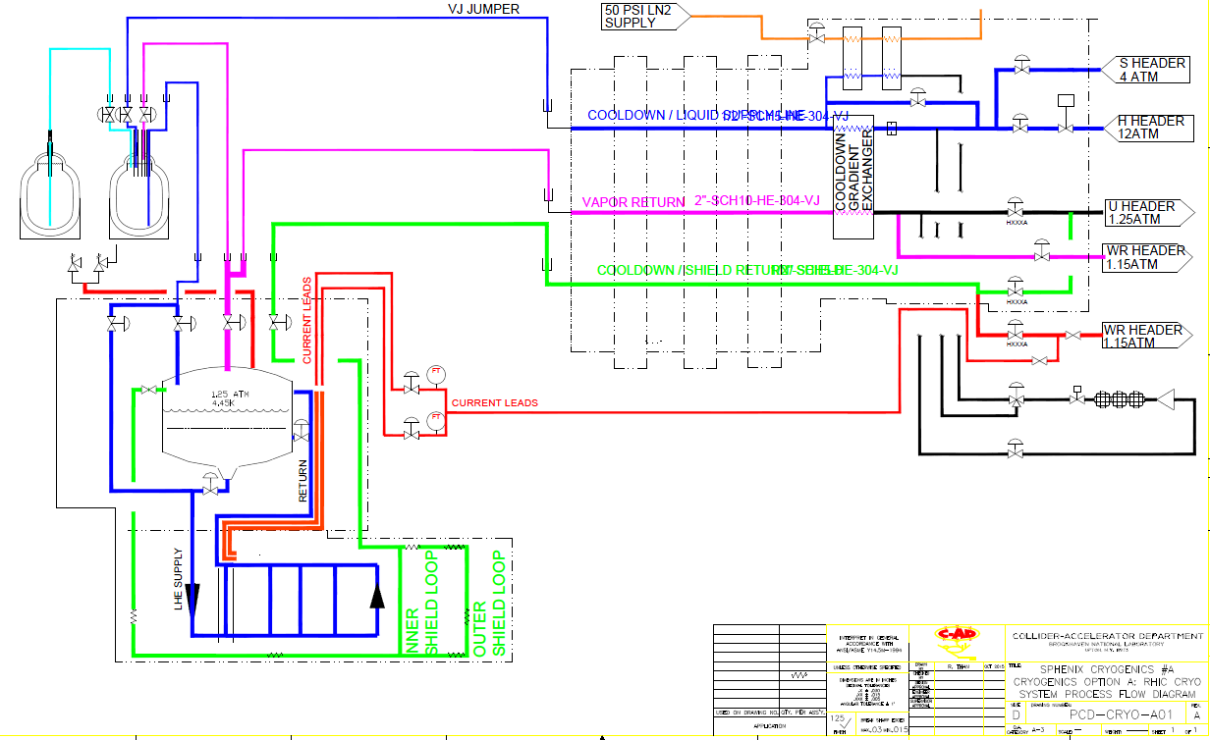
SPHENIX: MAGNET: Cryogenics
System diagram: RHIC Interface Option A

Slide 15
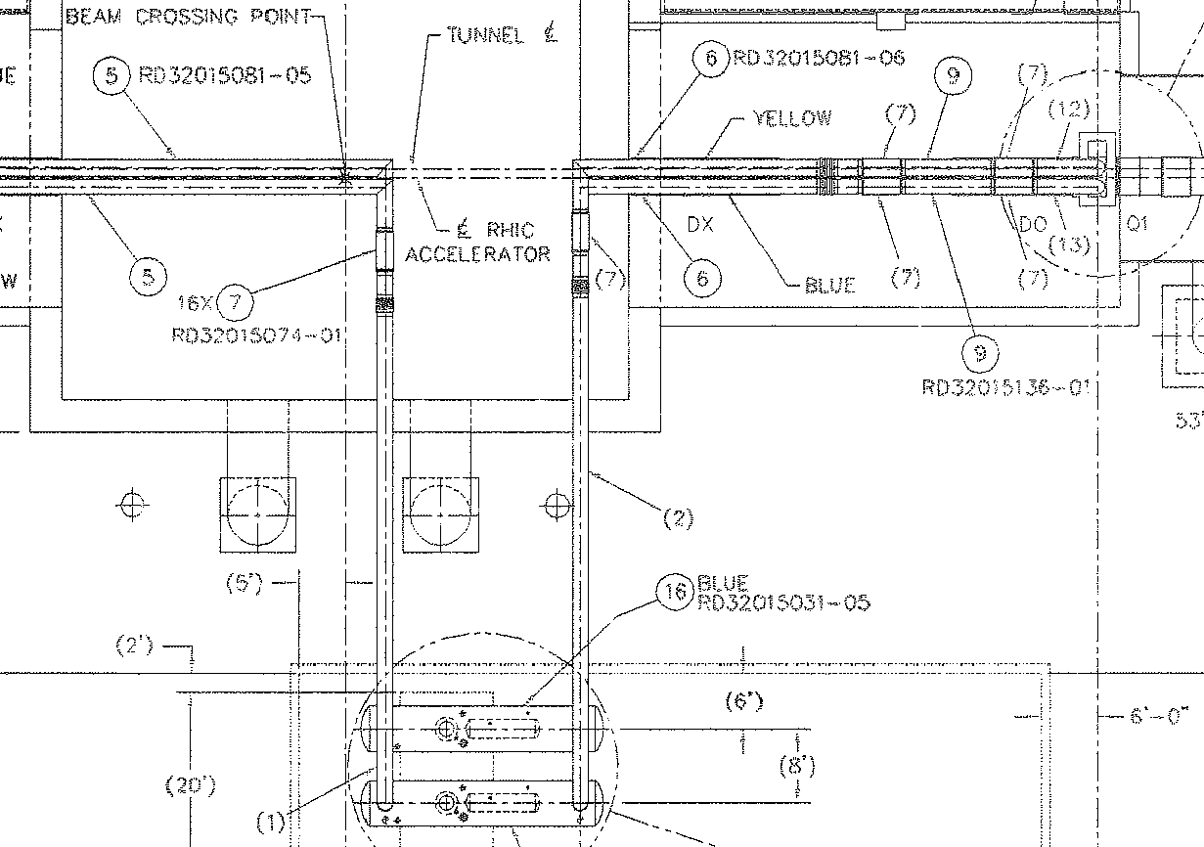
SPHENIX: MAGNET: Cryogenics
System diagram: RHIC Interface Option

Slide 16
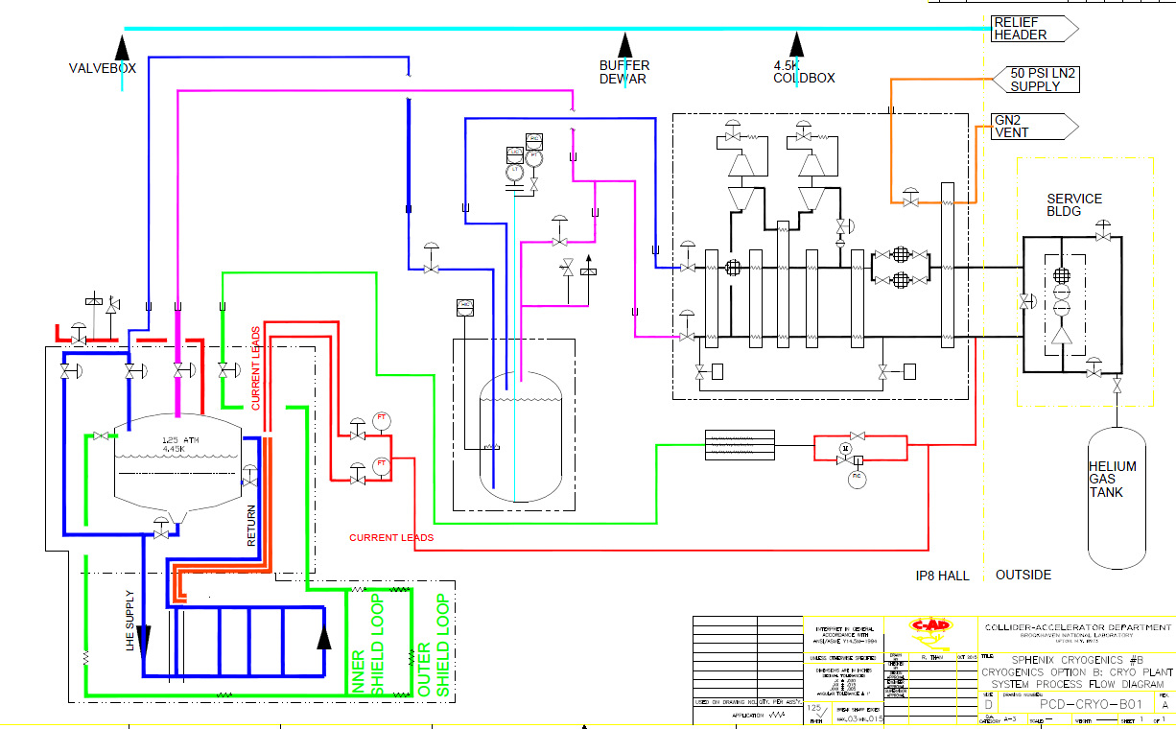
SPHENIX: MAGNET: Cryogenics
INDEPENDENT PLANT OPTION B

