Slide 1
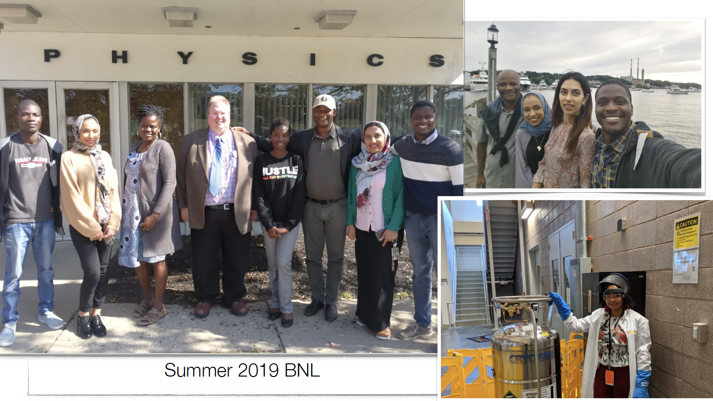
ASP short-term visits for research — Introduction
January 23, 2024
Kétévi A. Assamagan
‹#›

Slide 2
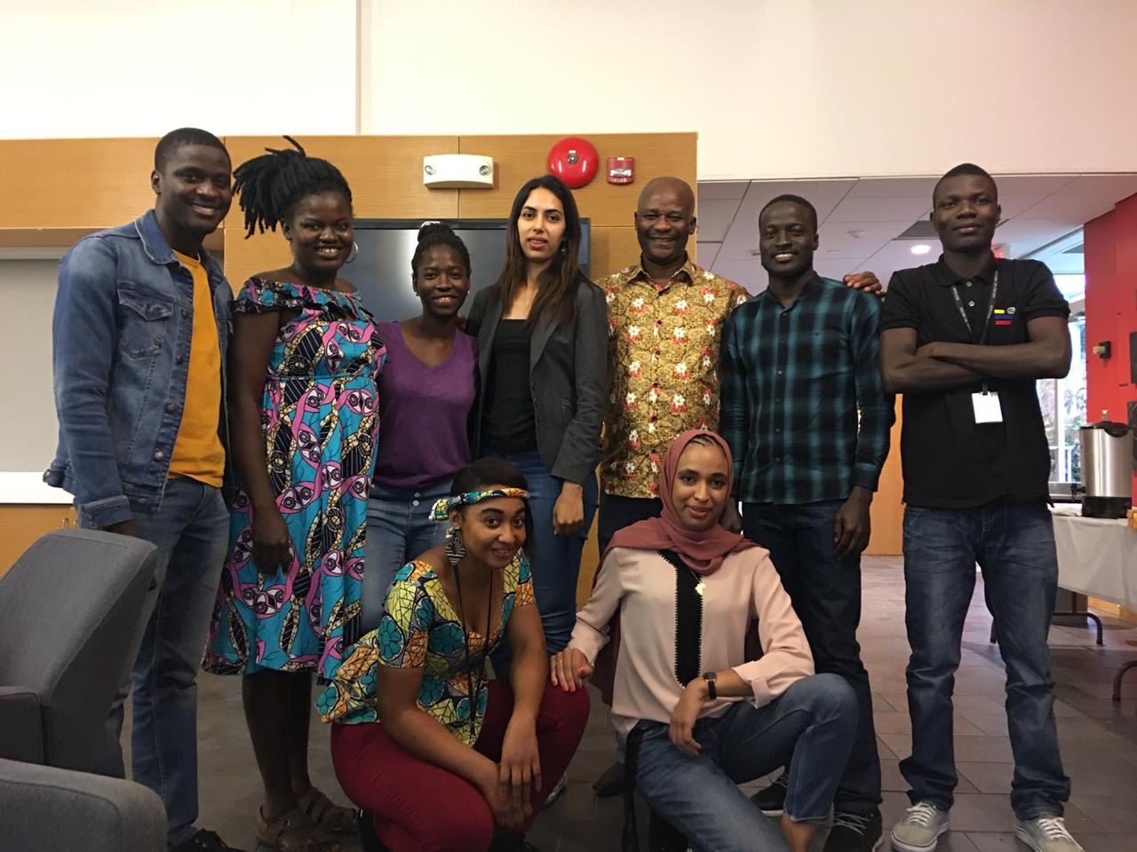
ASP Alumni at BNL 2019-2023
June-December 2019. From left:
In front, Christelle Ekosso (Cameroon), Dr. Mounia Laassiri (Morocco); standing, Diallo Boye (Senegal), Dr. Somiealo Azote (Togo), Jesutofunmi Fajemisin (Nigeria), Hassnae El Jarrari (Morocco), Dr. Kétévi A. Assamagan, Raymond Yogo (Kenya), and Yves Kini (Burkina Faso). Heba Sami Abdulrahman (Egypt), not in the figure, arrived in September 2019.
July 2022 – February 2023. From left:
Asmaa Aboulhorma (Morocco),
Zainab Soumaimi (Morocco),
Kétévi A. Assamagan,
Antalia Rabarisoa (Madagascar),
Xola Mapekula (South Africa),
Kayode Dada (Nigeria),
Rado Fanantenana (Madagascar)

Slide 3
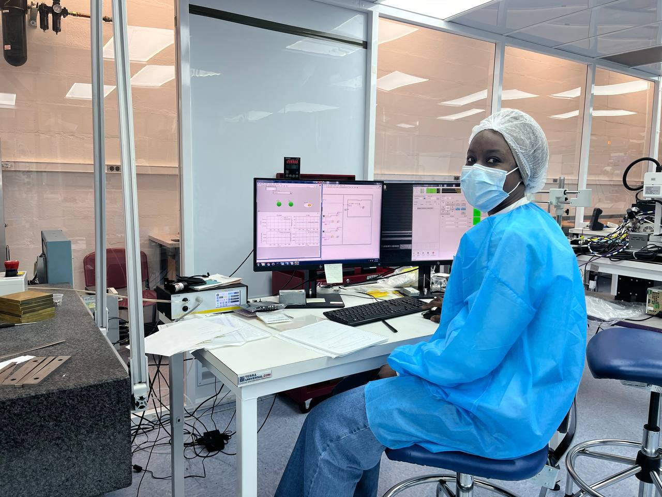
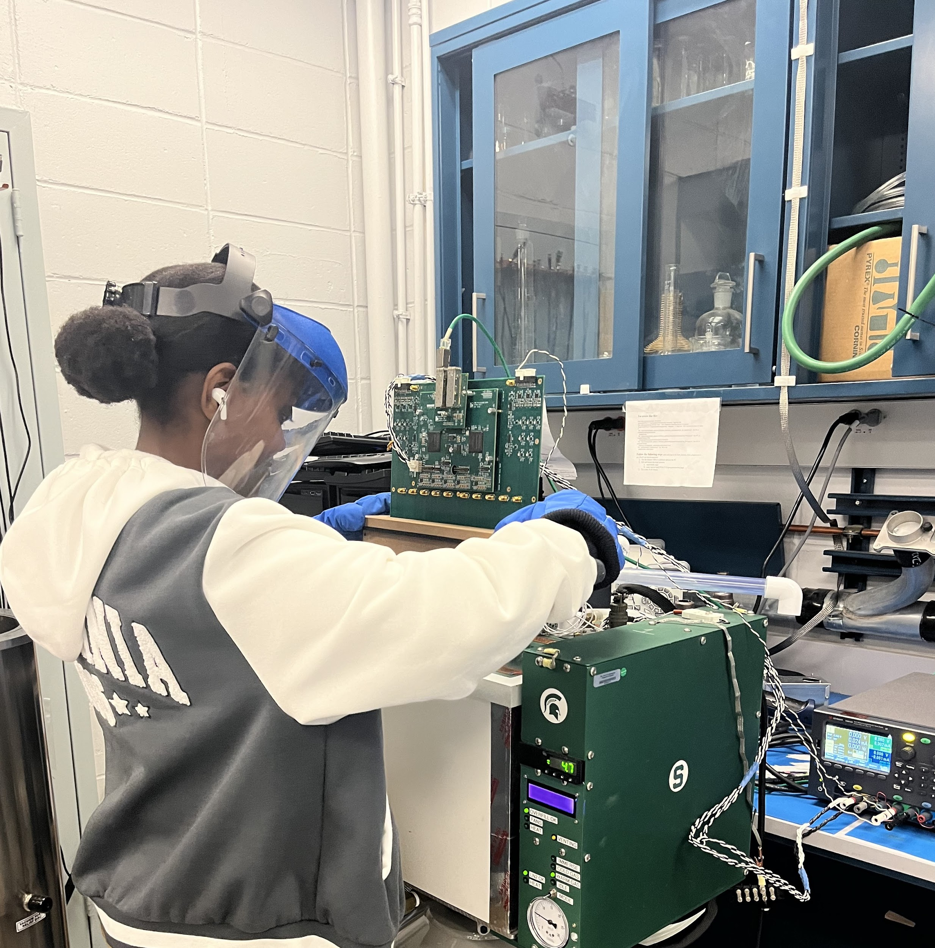
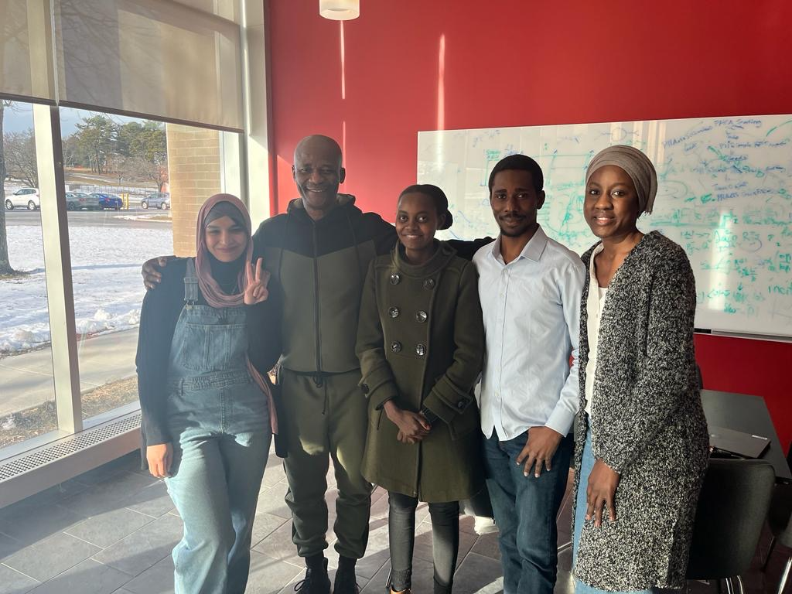
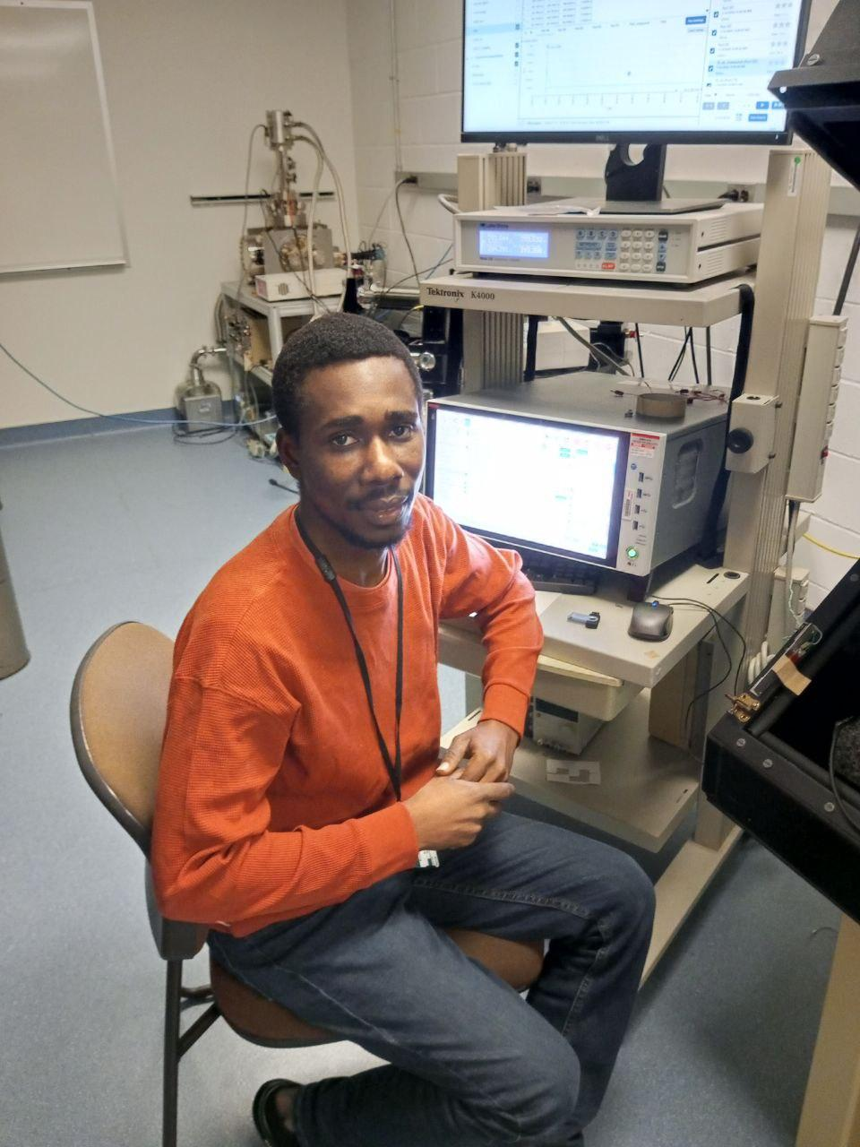
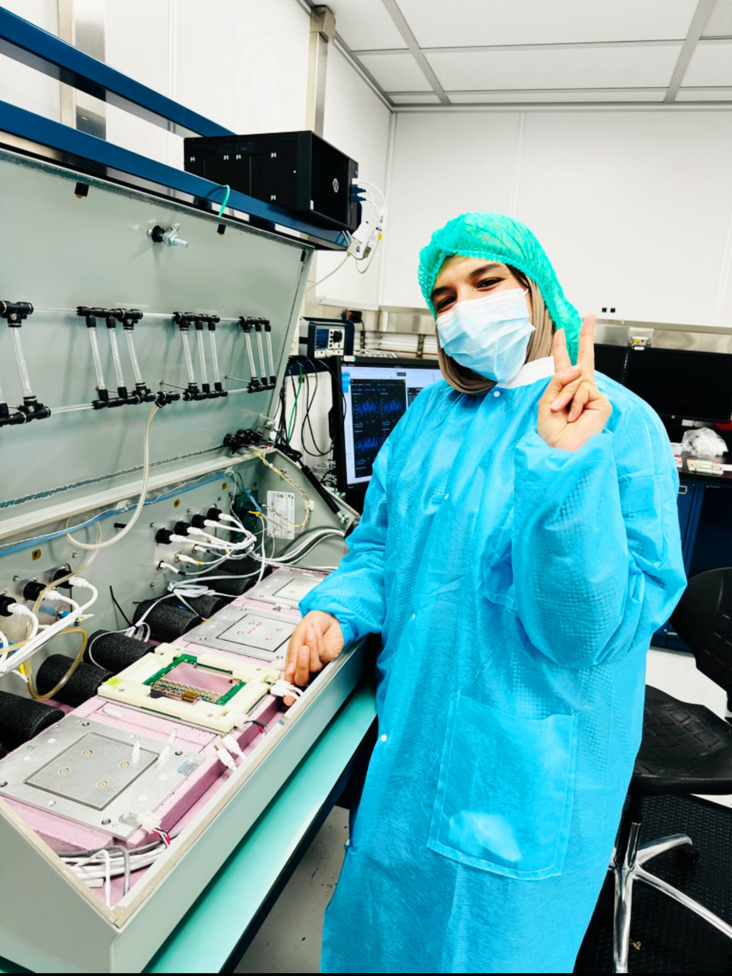
ASP Alumni at BNL 2023-2024
6 ASP alumni for the period of June 2023 - April 2024
From Kenya, Morocco, Senegal and Togo
1 arrived on June 18, 2023
4 arrived on July 31, 2023
1 arrived on January 21, 2024
Today, we will hear from 4 who will depart on January 28, 2024, after 6 months at BNL
Aissata Ly (Senegal)
Gloria Maithya (Kenya)
Fatima Bendebba (Morocco)
Augustin Sokpor (Togo)

Slide 4
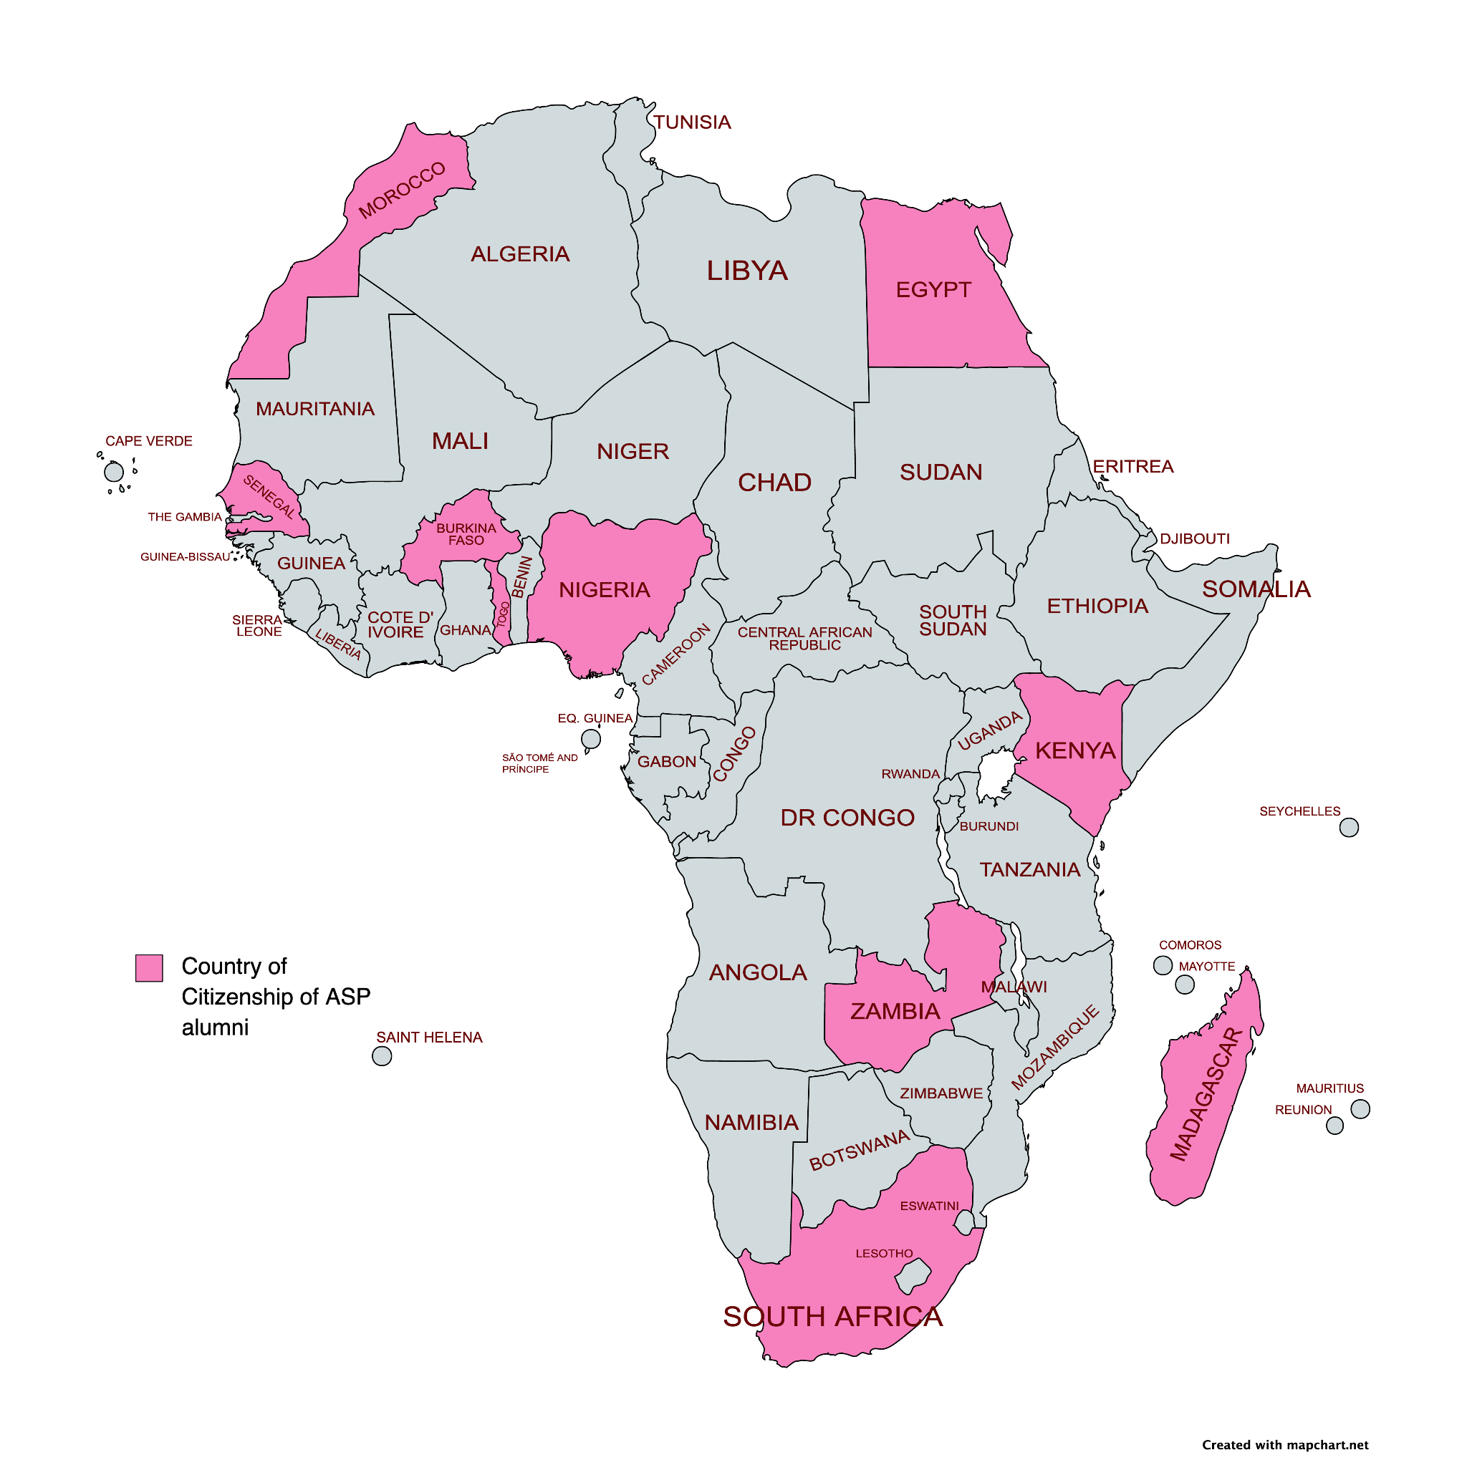
ASP alumni countries of citizenship
2019 (9)
2022-2023 (6+)
2023-2024 (6)
22 alumni
From 10 countries
Areas of concentration:
Astrophysics & cosmology, nuclear physics, particle physics, light sources & materials characterization, nanoscience, nuclear instrumentation, radionuclide production & medical physics, particle accelerators, HEP computing.

Slide 5
Acknowledgements
DOE Office of Science
BNL DEI Office, NPP Diversity Council
US-ATLAS
Departments that hosted African students
Physics Department, Collider Accelerator Department, Center for Functional Nanomaterials, NSLS-II, Advanced Technology Research Office
Groups / Departments & advisors that hosted students
Electronic Detector Group, Omega Group, Medical Isotope Research and Production, CFN Soft and Bio Nanomaterials, Physics Theory Group, Astro & Cosmology Group, ATLAS Software & Computing, Instrumentation Division, ATF, all the Advisors & mentors
Administration
Linda Feierabend, Eileen Morello, Tracy Trent, Menzel Smith-Jones, Grace Webster, Suzanne Junk, Sara Capp, Ivette Cruz, Linda Nevelino, Office of International Services
Folks who went beyond for quality of life at BNL
Mary Bishai, Scott Snyder, Christian Weber, Robert Pisarski

Slide 6
DUNE Cold Electronics Front End Chip Quality Control Testing and Data Analysis
Gloria Katunge Maithya
The University of Nairobi - Kenya
01/23/2024
Brookhaven National Laboratory
‹#›

Slide 7
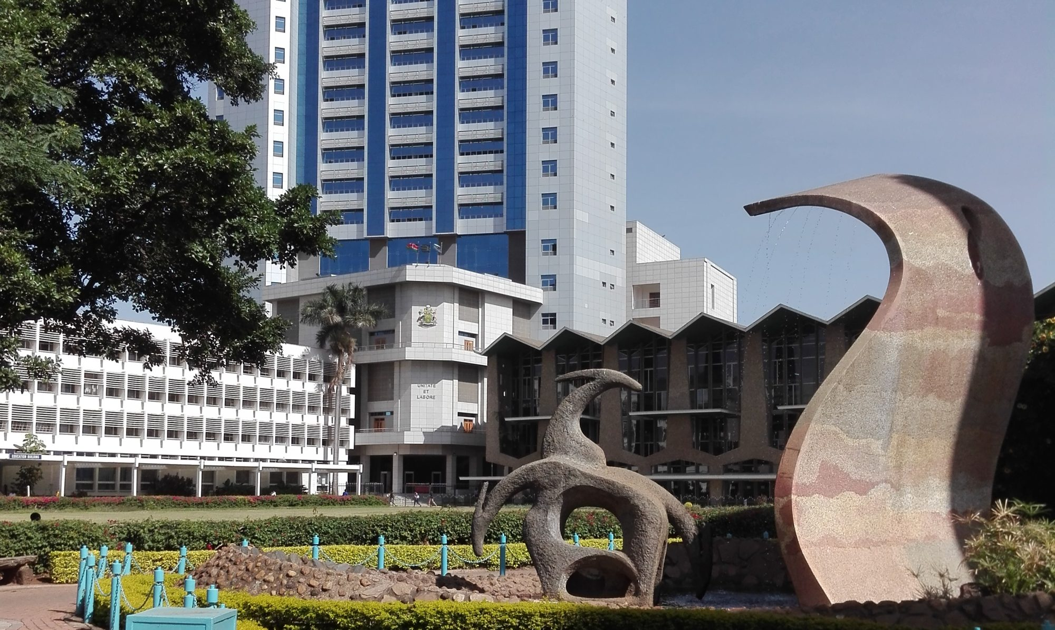
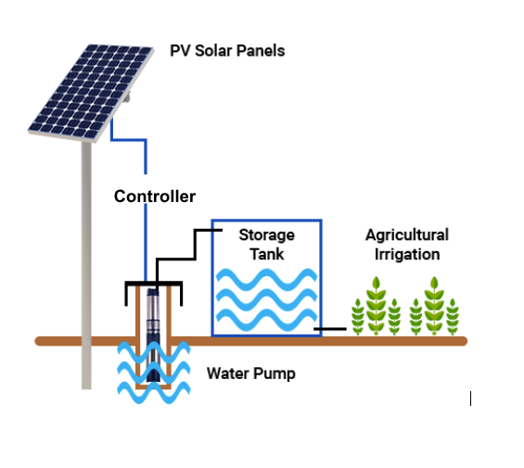
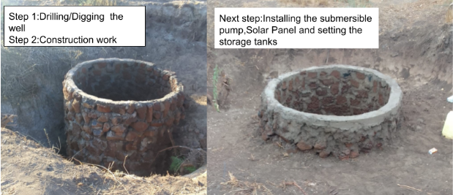
Academic path
Sept 2016 – Sept 2020: Bachelor’s degree in Physics - University of Nairobi.
Sept 2020– Sept 2023: Master’s degree in Physics –University of Nairobi.
July 2023 - Became a licensed Solar Technician-Class 3 –EPRA, Kenya.
*Aug-Sept-2023:Solar Water Pumping Project*
Goals:

Slide 8
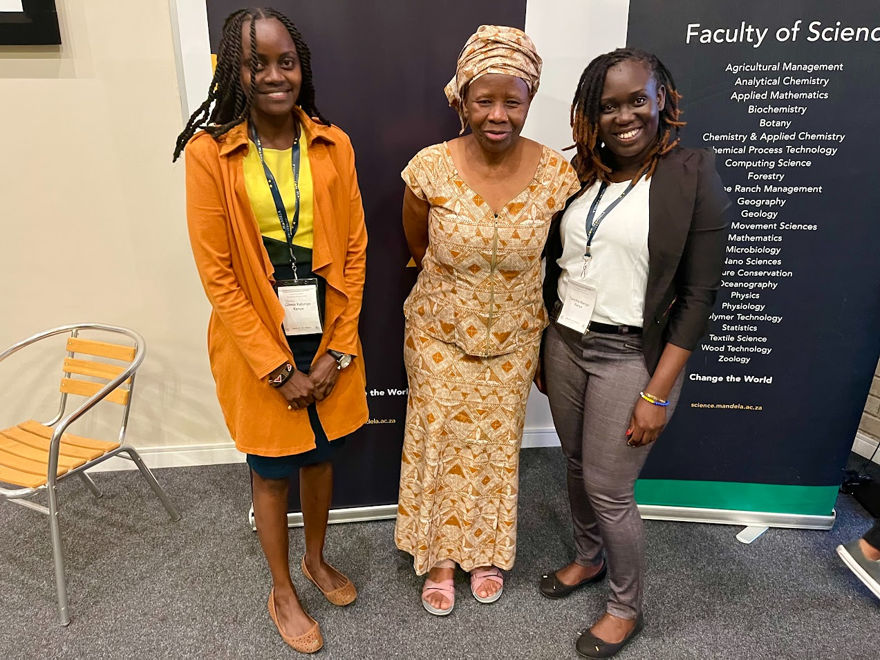
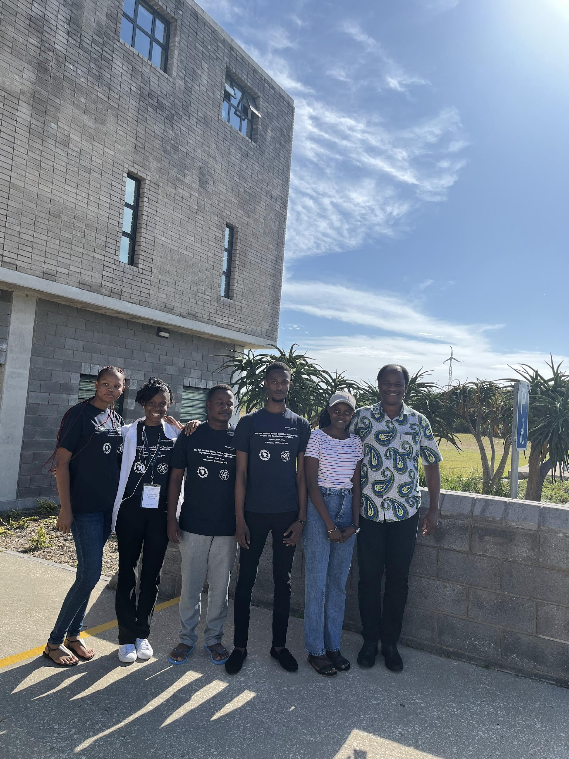
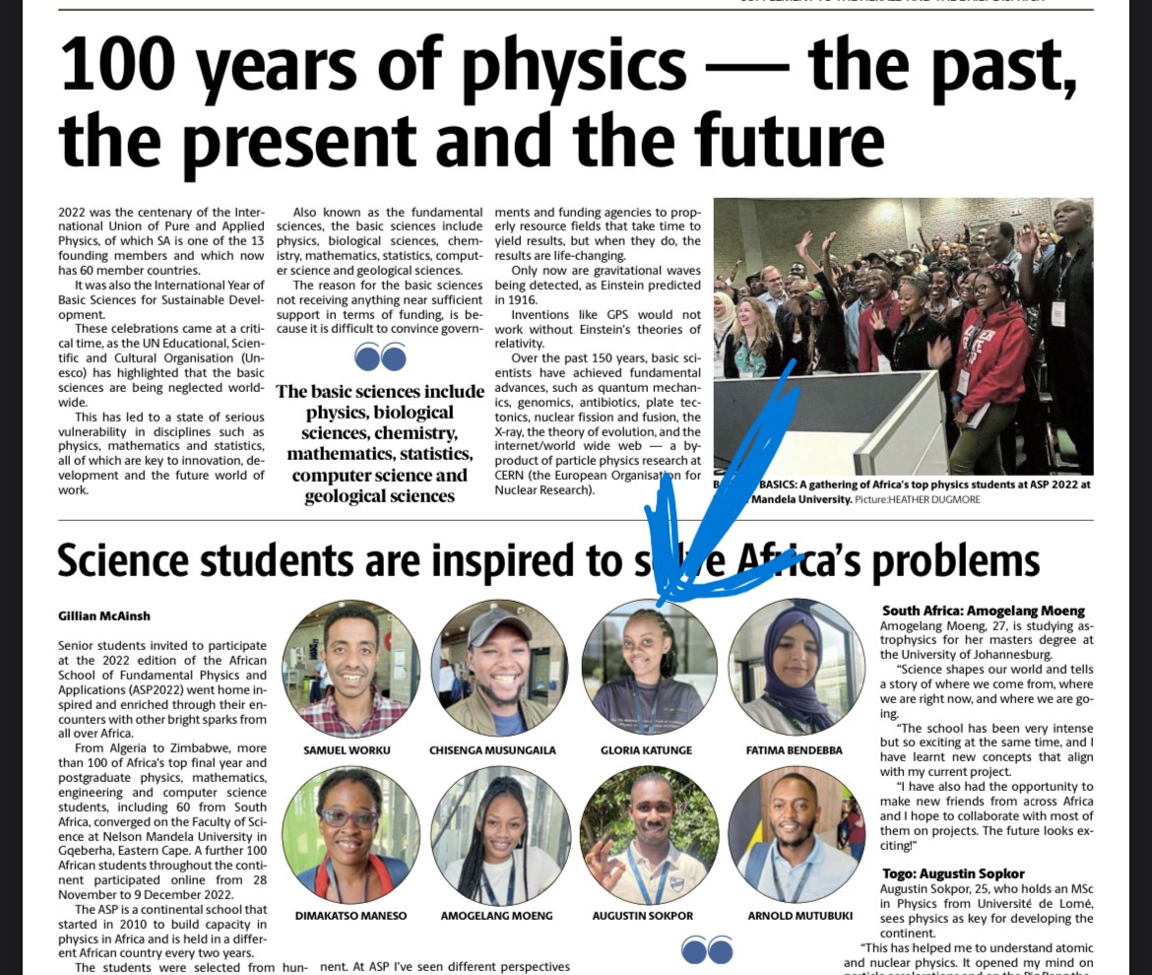
ASP Attended:
Nov 2022- Dec 2022: Participation in the ASP Summer School program at Nelson Mandela University in South Africa
Gloria
Dr. Ketevi
Featured in the ASP magazine
1st Aug 2023 – 28th Jan 2024: Intern at BNL working with the Electronic Detector Group and Cold Electronic Group.

Slide 9
Deep Underground Neutrino Experiment
Introduction:
The goals of DUNE:
Neutrino oscillations
Charge Parity violations in neutrino
Mass hierarchy
The experiment will consist of a beam generator, Near Detector-Fermilab, and Far Detector at SURF
The Far Detector is designed to use a large Liquid argon Time Projection Chamber (LArTPC)

Slide 10
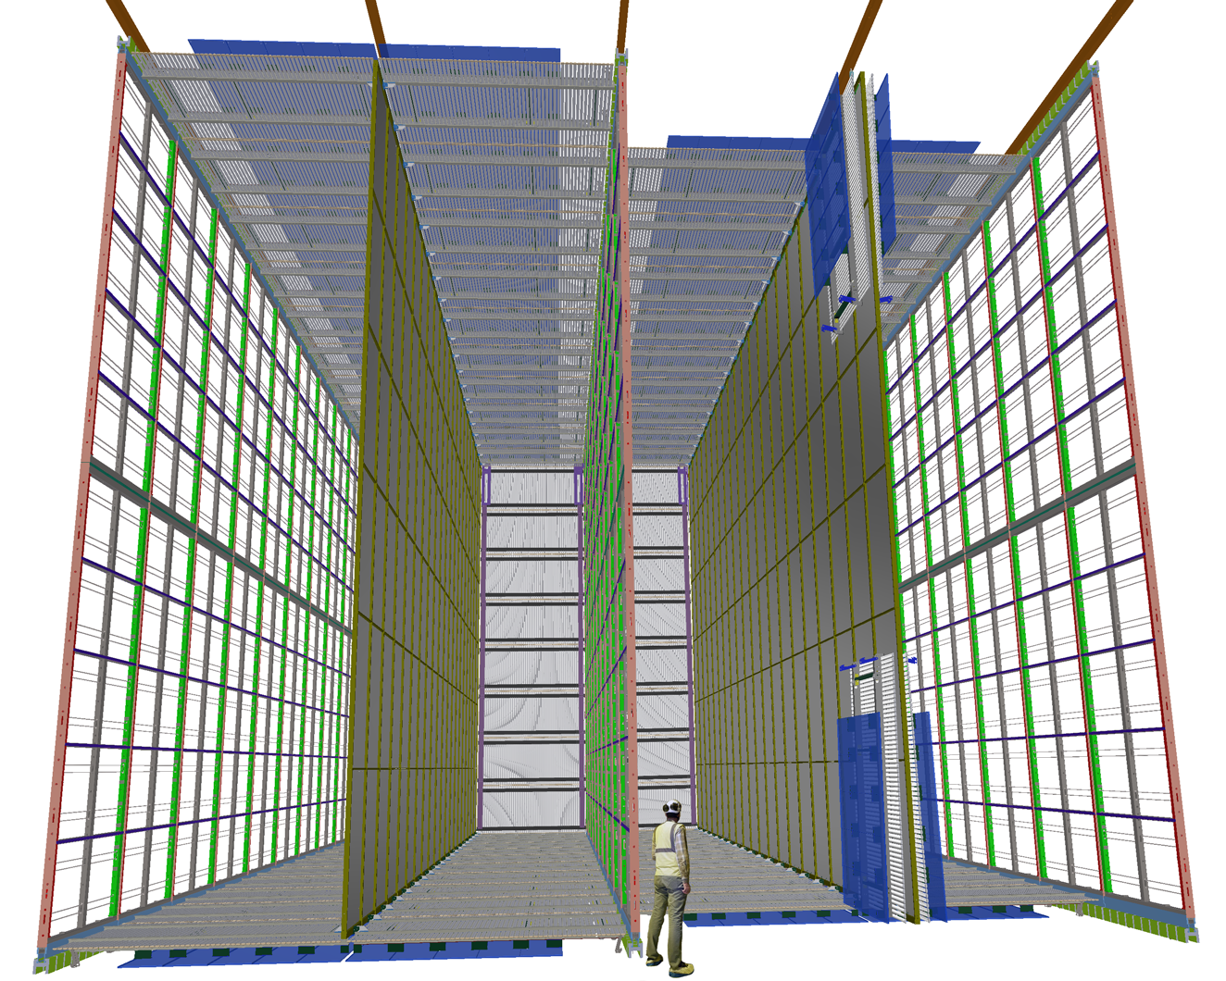
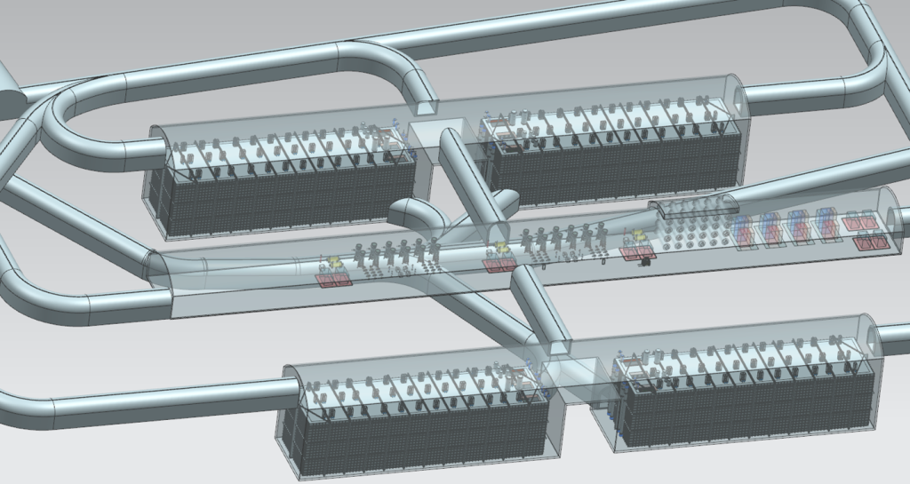
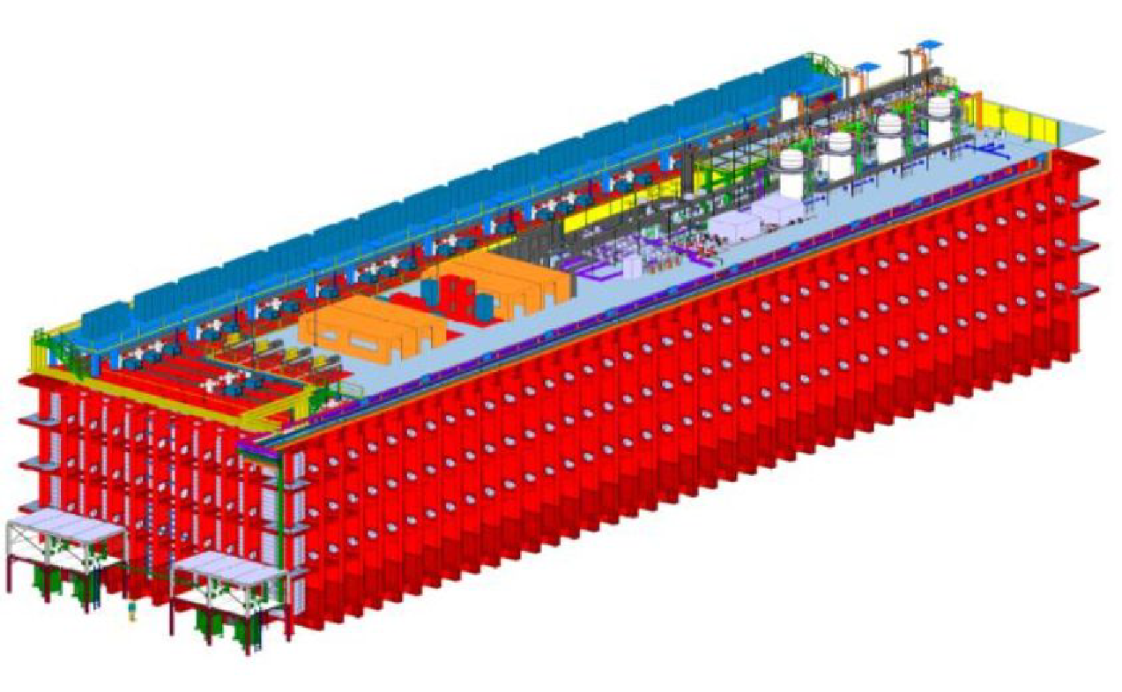
DUNE LArTPC Detector Read-outs
The first 10 kt Far Detector LArTPC
150 Anode plane Assembly (APA) units 384,000 channels
Each APA has 2560 channels
Each APA has 160 LArASIC chips
For 150 APAs = 24,000 LArASIC chips

Slide 11
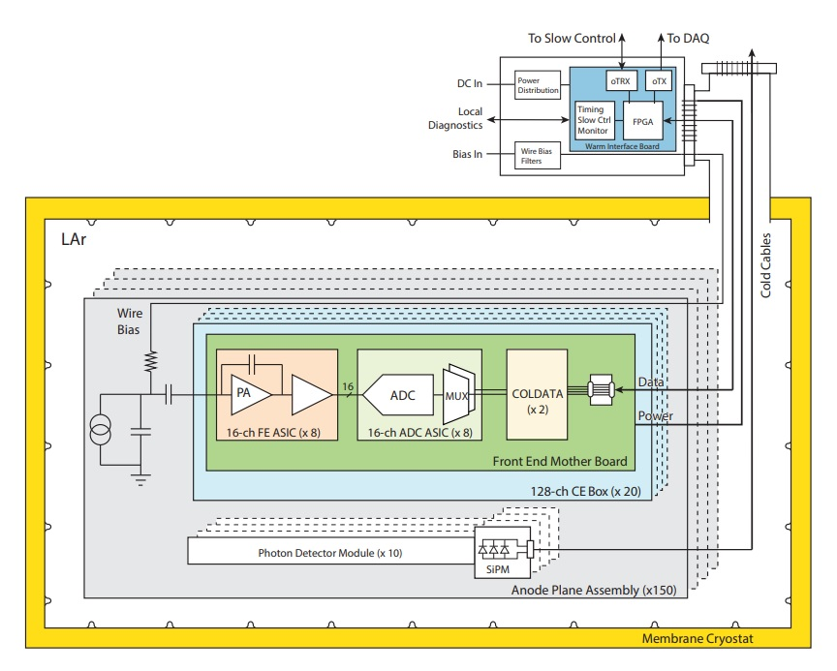
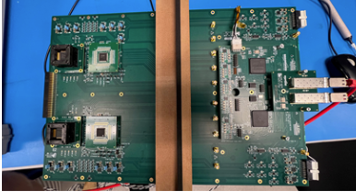
Cold Electronics (CE)
CE remains an optimal solution for giant LArTPC
BNL is leading TPC readout electronics SYSTEM design
Advantages
Much lower noise
yields high SNR
Much less cryostat penetrations
Minimize detector construction complexity
The goal is to have 30 years of operation without replacement and maintenance
LArASIC chip designed by BNL: 16 channel charge sensitive amplifier for cryogenic operation
CE schematic block diagram
DUAL DUT Test Board

Slide 12
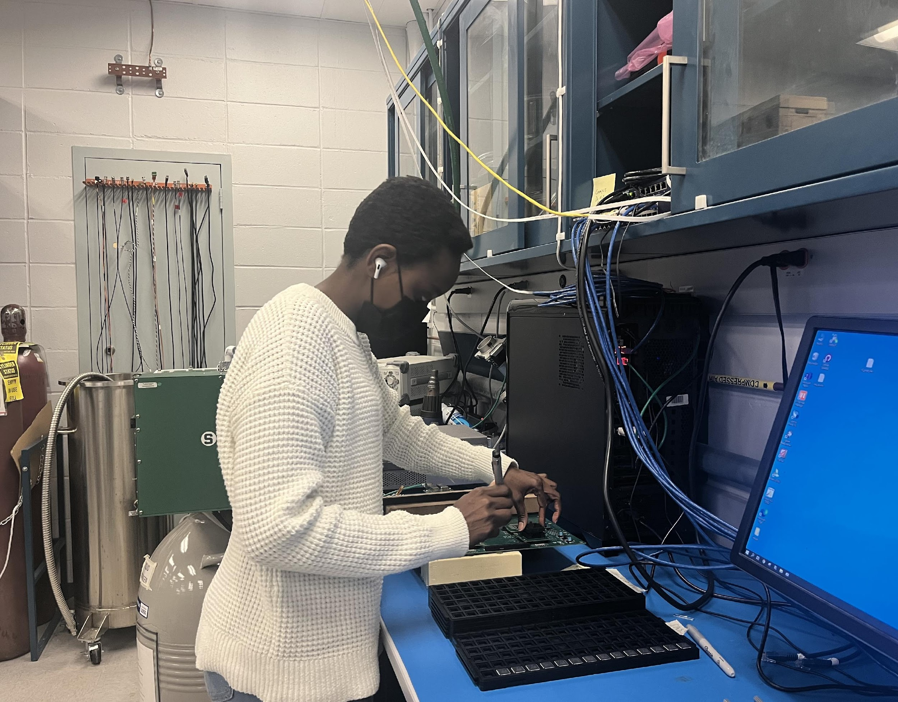
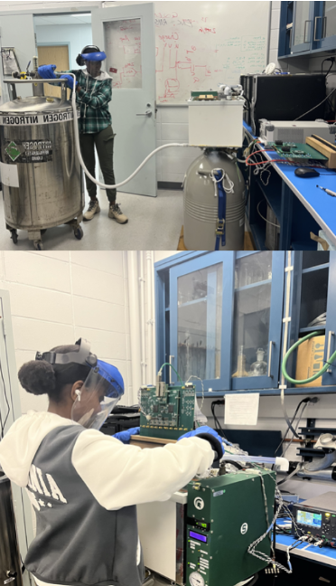
LArASIC chip QC tests
RT Test Liquid Nitrogen/Cold Test
Filling the CTS to the appropriate level
The chips that pass the warm test are then tested at the Liquid Nitrogen(LN) temperature to ensure the cold yield.
Tested more than 1200 chips in RT - the highest number tested by any student
The data is read through the interface of the Dual FPGA mezzanine and then transmitted through an Ethernet cable- both in RT and LN

Slide 13
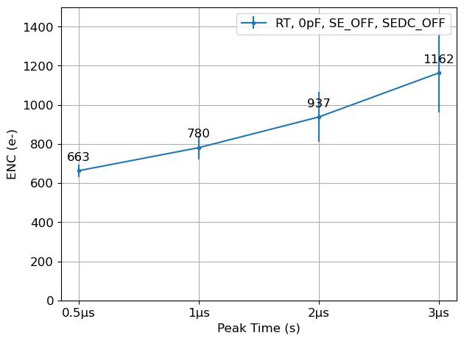
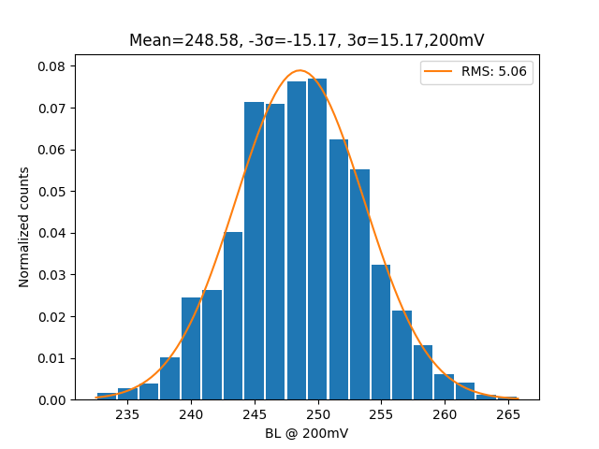
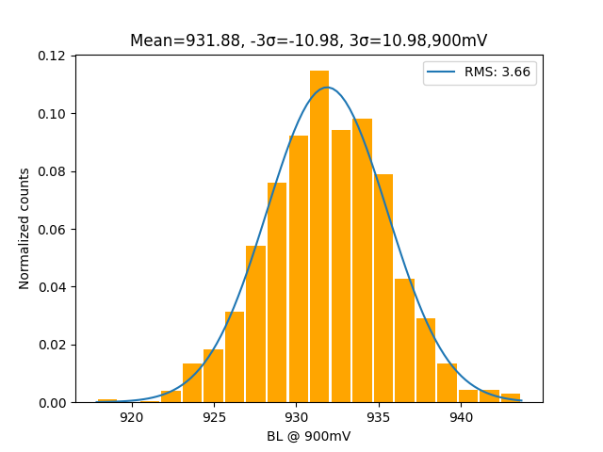
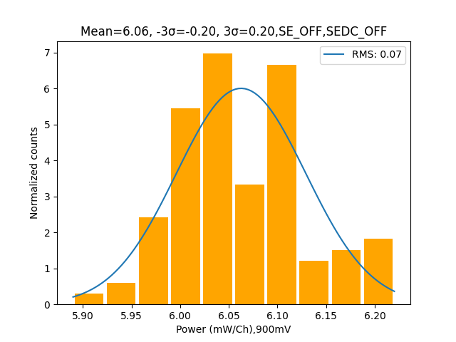
Insights from LArASIC Chip QC: Analytical Findings
Env: RT
Noise Measurement
Gain Measurement
Baseline distribution
@200mV
@900mV
Power Consumption(6.06mW/ch)
Mean =248.58
Mean= 931.88
σ= 5.2mV
σ = 3.7mV

Slide 14
Summary and Next Step
Testing Quantity: More than 1200 LArASIC chips tested at room temperature (RT) and 20 in liquid nitrogen (LN).
Automation: Python program developed for automating the Quality Control (QC) analysis hence significant time will be saved.
Yield: Achieved about 98% yield for the tested chips at room temperature (RT)
Statistical Analysis: Statistical analysis of LArASIC data for four test items
Statistics study helps determine the acceptance criteria
Parameters Studied: Baseline, gain, noise and power distribution giving the expected behavior
Future of the LArASIC Testing
Automation of the LArASIC testing process
Next Step:
Looking for a graduate program in Condensed matter physics

Slide 15
Acknowledgments
ASP organizers: For the opportunity to do this short-term visit and research work at BNL.
EDG and Cold Electronic groups: For allowing me to work with them.
My BNL advisors, Mary Bishai, Shanshan Gao, Vladimir Tishchenko, for guidance and help
Family and colleagues: For their great support
Thank you all for listening!!

Slide 16
Backup

Slide 17
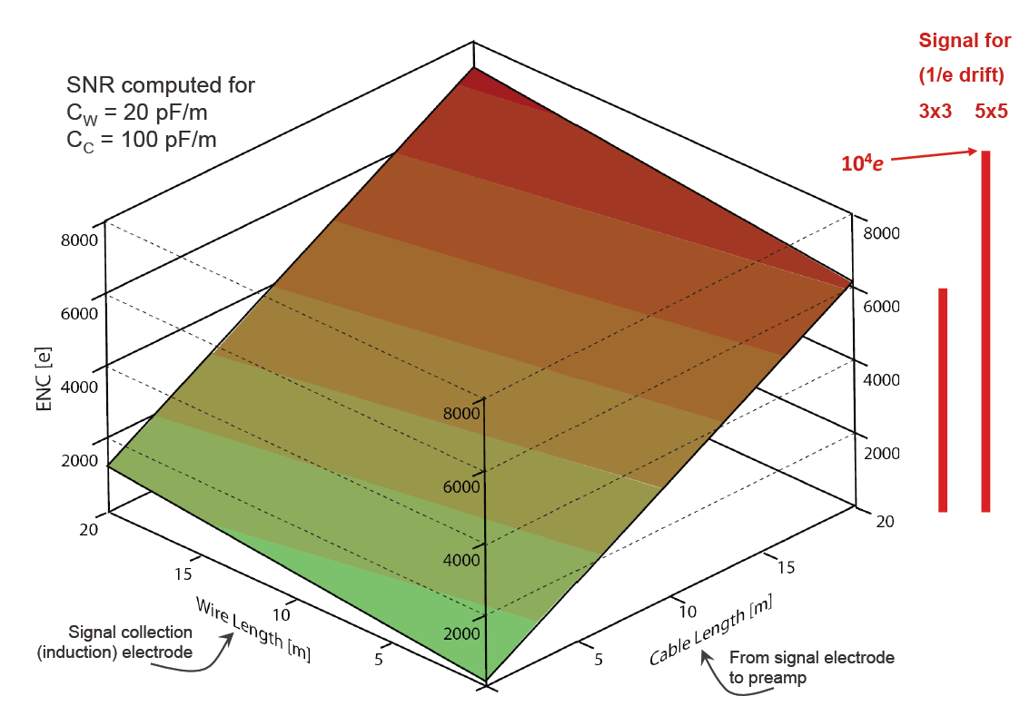
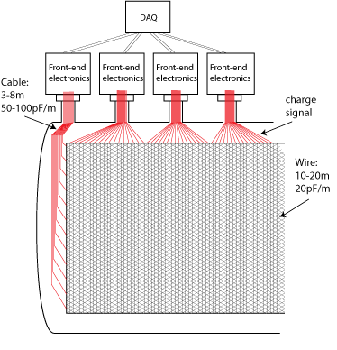
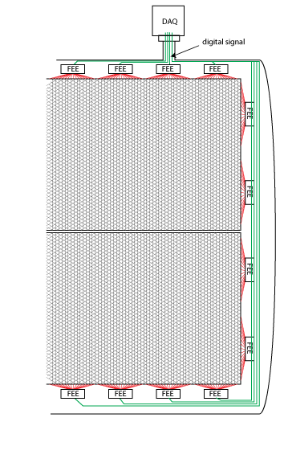
Advantages of CE in Large LAr TPC
Much lower noise
Much less cryostat penetrations
Warm Readout vs. Cold Readout
Signal digitization and multiplexing to high-speed links inside the cryostat results in large reduction in cables and feed-through penetrations, and the freedom to choose the optimum configurations for both the TPC and the cryostat
Integrated front-end electronics close to detector electrodes yields the best SNR
CMOS in LAr has less than half the noise as that at room temperature

Slide 18
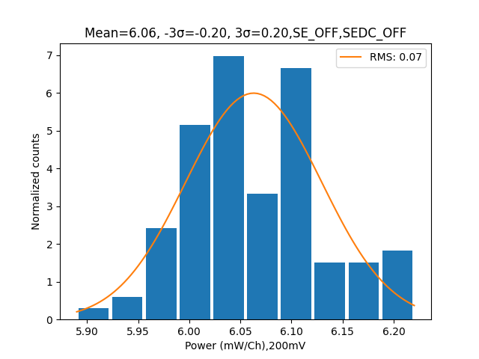
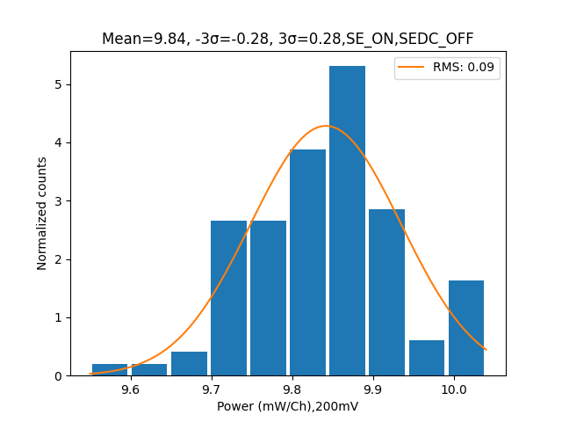
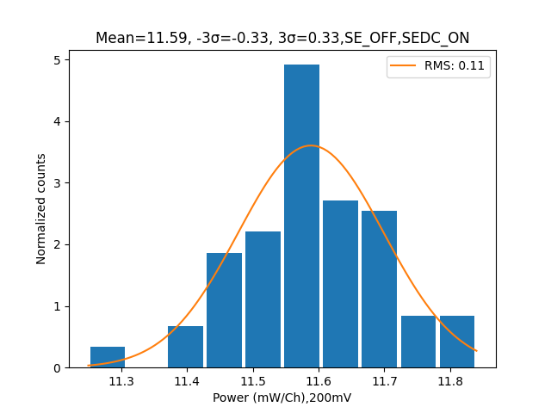
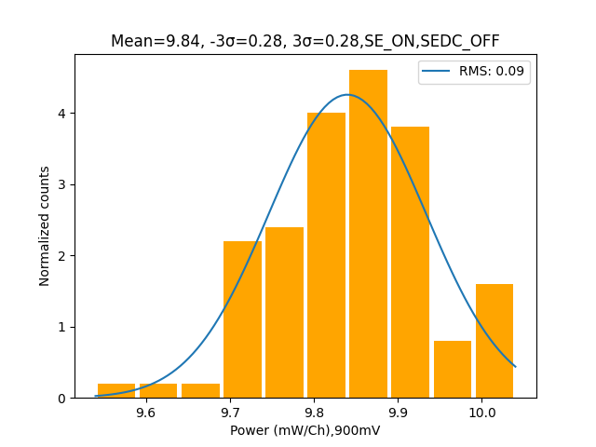
Power consumption distributions
@ 200mV
Env: RT
@900mV

Slide 19
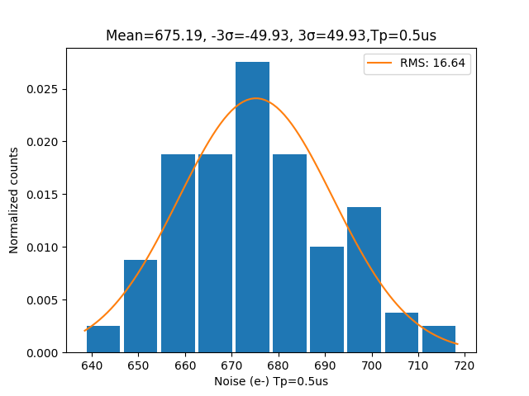
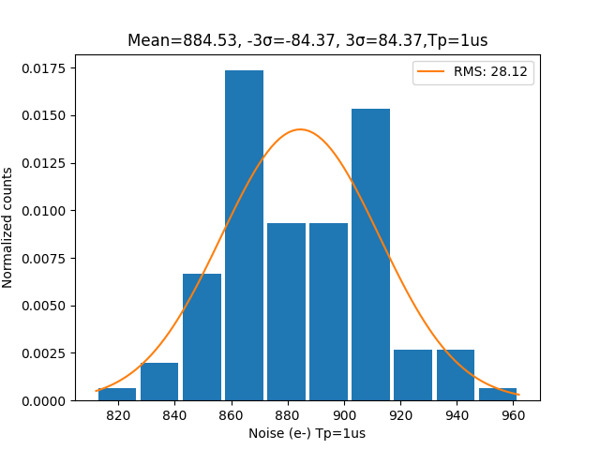
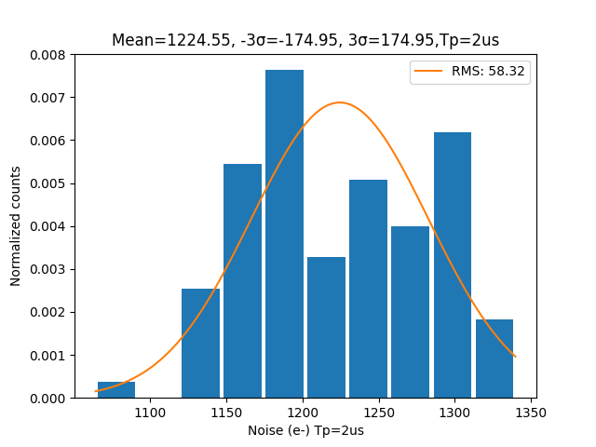
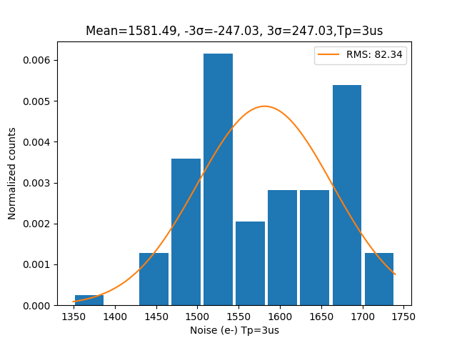
Noise measurements -ENC -RT
Noise Averages are increasing as the peaking time increases, and this is due to the fact at RT, the setup is not shielded hence the chips under test are affected by the surrounding noise

Slide 20
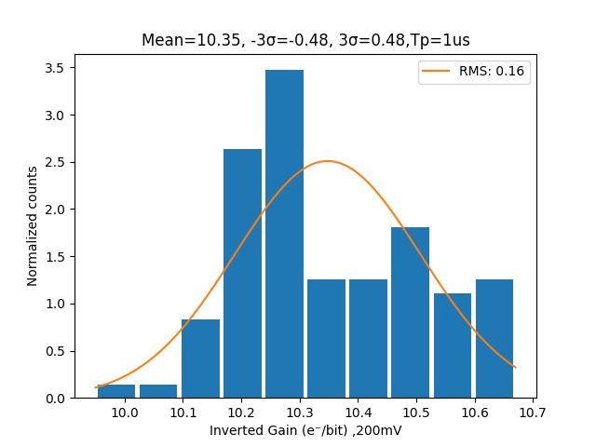
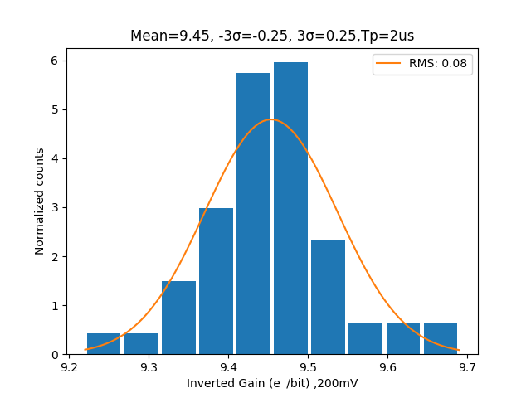
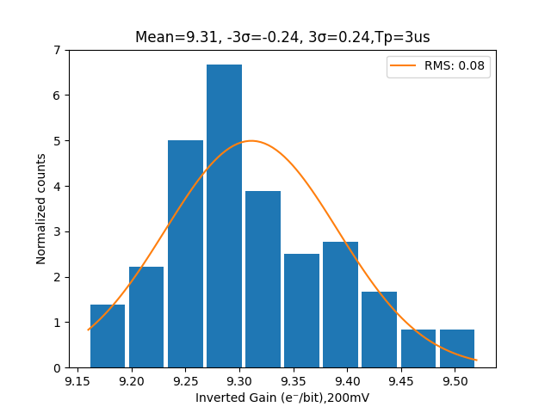
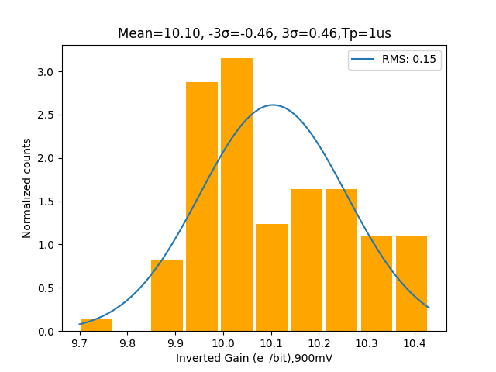
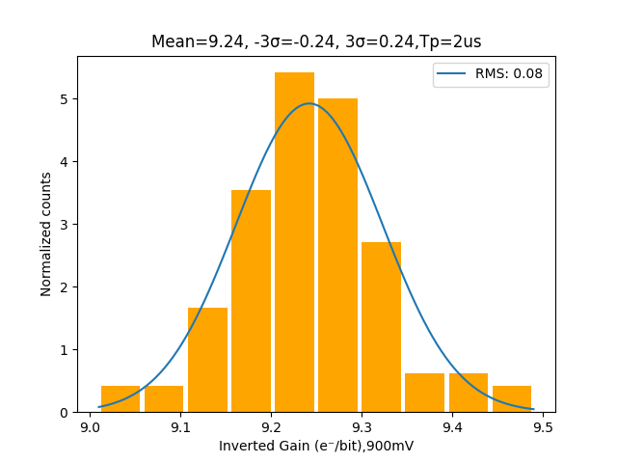
Gain Measurements
Helps to understand the response of the chips to input signals.
As the peaking time increased, the average inverted gains decreased
Gain @ 200mV -RT
Gain @900mV -RT

Slide 21
ITK stave assembly at BNL
Aissata Ly
Institute of Applied Nuclear Technology-Cheikh Anta Diop university of Dakar
Senegal
January 23, 2024
Brookhaven National Laboratory
‹#›

Slide 22
outline
Academic path
Motivation of ATLAS upgrade
ITK stave assembly for barrel
Quality control features to be added to LabView assembly program
Summary
Prospects and acknowledgements

Slide 23
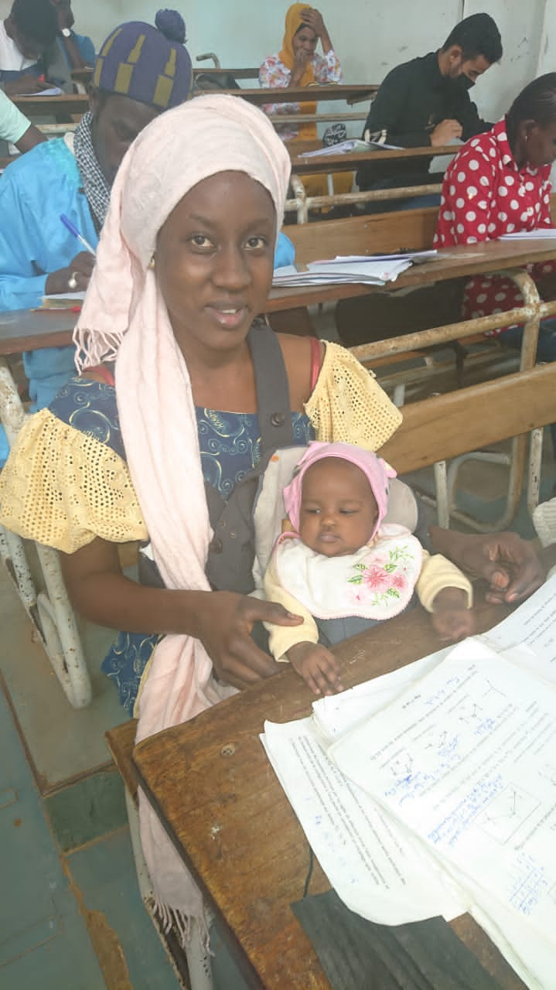
Academic path
Bachelor in physics and Chemistry Science of Substance from 2017 to 2021
Master in nuclear and atomic physics started at 2021
First year of high school waiting for my first daughter
First year of master, taking courses with my second daughter

Slide 24
African school of fundamental physics and applications (ASP) 2024
I had a good result in physics field such as the Advanced Quantum Mechanics, Atomic and Nuclear physics.
This is reason why I was selected by our director to participate in this internship program and to participate for the ASP in 2024.

Slide 25
Motivation
The inner detector of ATLAS will be replace by the
an All-Silicon Inner Tracker
Run 3 average pileup : 50 interactions/bunch crossing
HL-LHC average pileup :200

Slide 26
ITK at BNL
Working on the ITk stave assembly under supervisor of Alessandro Tricoli
Contribution to stave assembly operations by implementing quality control features in the LabView program that is used by technicians during assembly operations

Slide 27
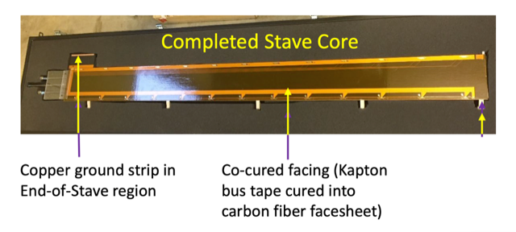
ITK stave assembly for barrel
Two types of modules:
Long strip (LS) and short strip(SS)
14 modules loaded on a carbon-fibre support structure called stave.
5 locking point essential for stave integration into ATLAS.

Slide 28
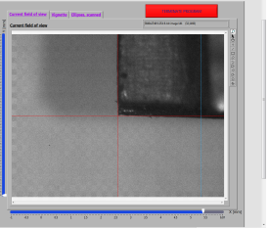
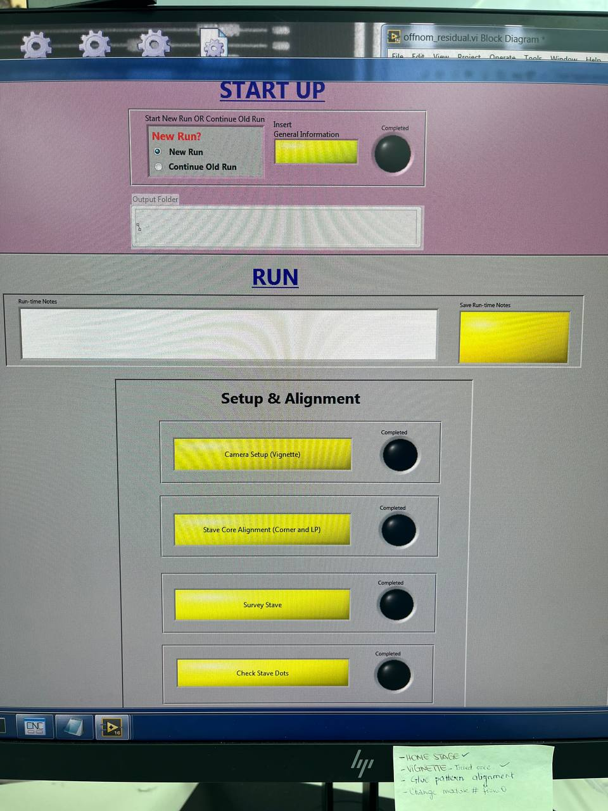
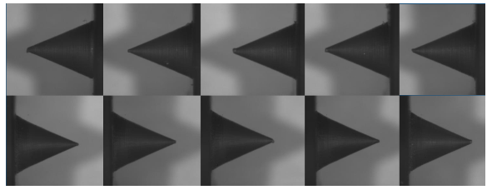
ITK stave assembly for barrel
Setup and alignment
Corner stave
Locking point setup and alignment process. In some case the pattern recognition fails and the locking point position are not found and the software return ‘Not a Number (NaN)’ instead of value.

Slide 29
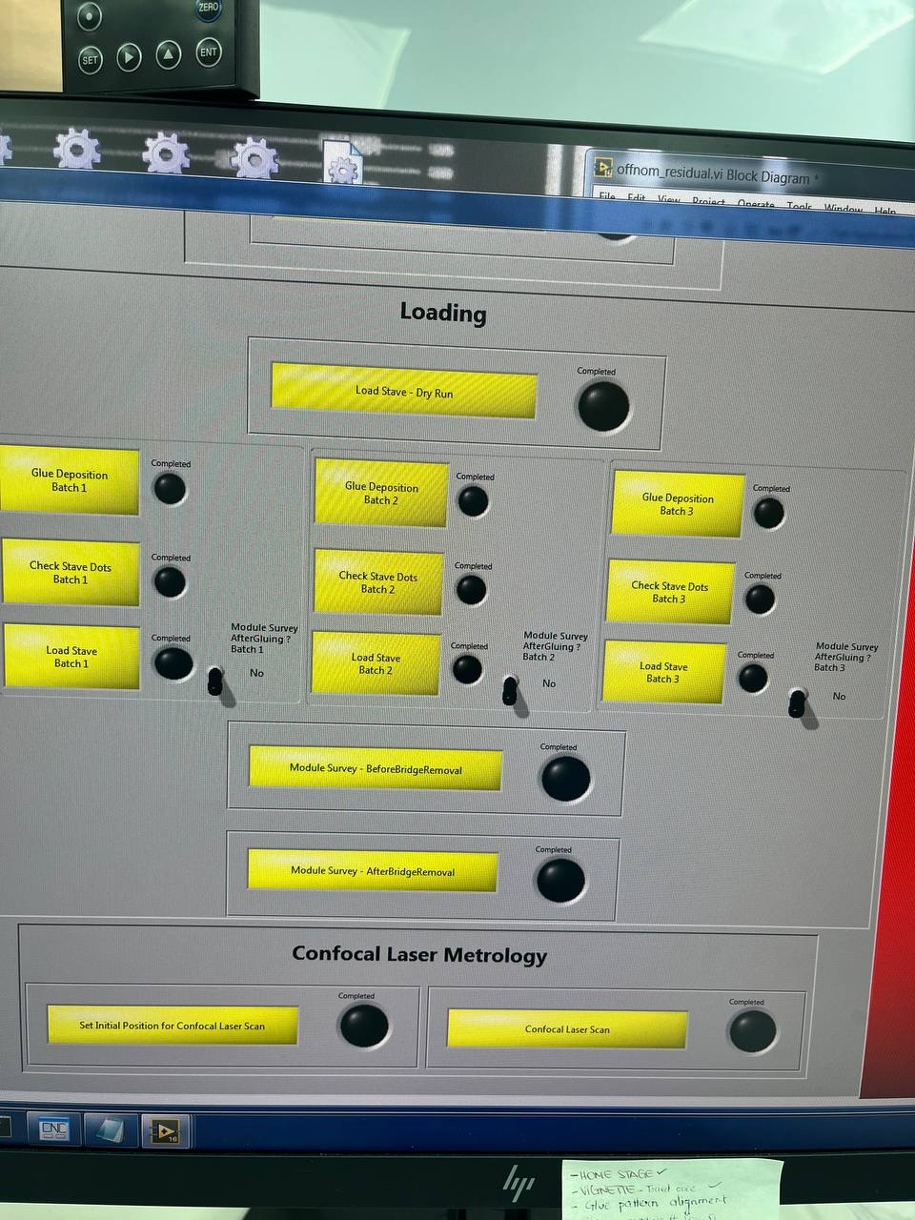
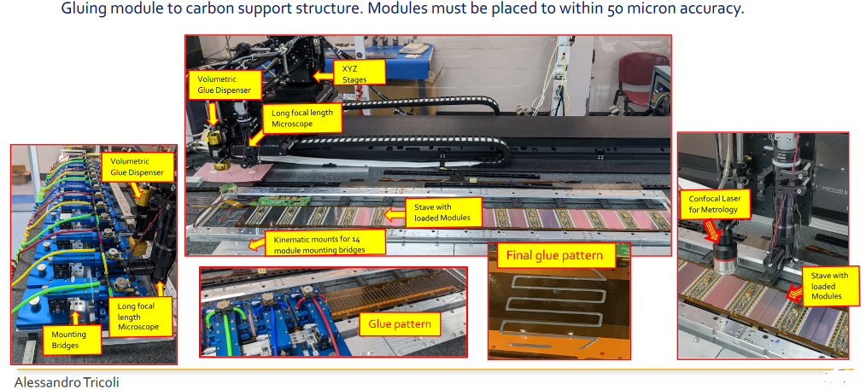
ITK stave assembly for barrel
Stave loading
During and after modules loading the operator needs to monitor the quality of the assembly. The reference positions are the locking points.

Slide 30
Quality control features to be added to LabView assembly program
In the LabVIEW program, we want to add a button that will indicate if there are a NaN in the output csv file with locking point positions
We want the operator identify if the module position is correct within 50 microns to the nominal position
We want also want to make available to the operator plots that inform if some modules are out of specifications

Slide 31
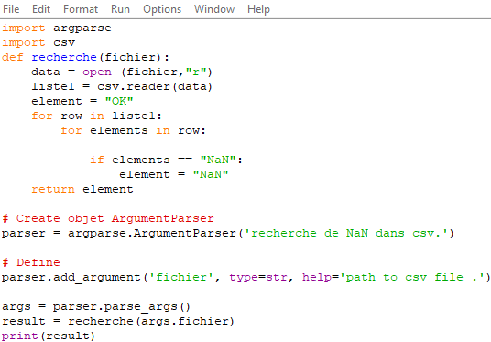
Quality control features to be added to LabView assembly program
How to know if there are NaN in the csv file coordinates in LabVIEW?

Slide 32
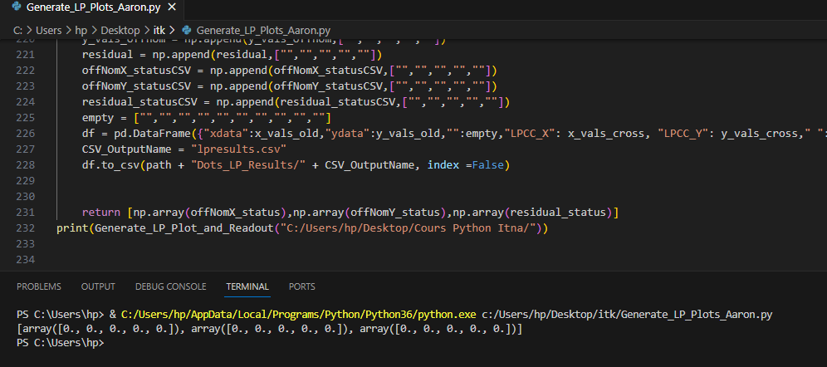
Quality control features to be added to LabView assembly program
Python code that calculates differences between locking ploint actual positions and nominal positions, and will be used for a ‘traffic-light’ indicator

Slide 33
Quality control features to be added to LabView assembly program
Scheme for the ‘traffic-light’ indicator in LabVIEW

Slide 34
Quality control features to be added to LabView assembly program

Slide 35
Summary
In this work we are trying to improve the quality control in the following case:
Before the loaded modules with the locking point positions which are the references for stave alignment
During and after the loaded operations to make sure that modules are positions on a stave within specifications, with respect to their nominal position

Slide 36
Prospects and acknowledgements
I would like to thank the community that made my stay at BNL possible
Many thanks to my supervisors:
Assamagan Ketevi who brought me here and made me discover many things
Alessandro Tricoli for his availability and the tasks he entrusted on me.
Thanks to Christian Weber for her help
Many thanks to the omega group team

Slide 37
Thanks for your attention

Slide 38
DEVELOPMENT OF EQUIPMENT AND SETUP AIMED AT TESTING NOVEL AC-LGAD SILICON DETECTOR
Komlan Augustin Sokpor
University of Lomé, Togo
January 23, 2024
Brookhaven National Laboratory
‹#›

Slide 39
Outline
Short synopsis of my academic path
The African School of Physics (ASP) that I attended
My arrival at BNL and my departure
My work at BNL
Summary
Prospects and acknowledgements

Slide 40
Academic path
2015-2020: Bachelor’s degree in Physics at the University of Lomé
2020-2022: Research Master in Materials Physics at the University of Lomé
From 4 to July 14, 2022: introduction to the IAEA and safeguards course in Austria
From November 27 to December 9, 2022 Attended the 7th edition of the African School of Physics (ASP2022), in Nelson Mandela University (South Africa)
From July 31, 2023 until January 28, 2024 Internship in the Department of Physics at Brookhaven National Laboratory (Internship in progress)
From 10 to 20 October 2023 Excellence in Detector and Instrumentation Technologies (EDIT School) at Brookhaven National Laboratory

Slide 41
ASP program I attended
I participated in ASP2022, the 7th edition which took place at Nelson Mandela University. Being interested in research in High Energy Physics, I benefited from internship at BNL with the aim of acquiring knowledge and practical experience in Particle Physics.

Slide 42
Low-Gain Avalanche Diodes based Silicon Detector
LGAD are class of silicon sensors developed for the fast detection of minimum ionization particle. Built on thin silicon substrates and featuring an internal moderate gain, they provide fast signals, for excellent timing, performance, which are therefore useful to distinguish the different tracks. We distinguish several families of LGAD, namely: capacitively coupled LGADs (AC-LGAD), deep-junction LGADs (DJ-LGAD) and trench-isolated LGADs (TI-LGADs).

Slide 43
Measuring Instruments
Probe station is used to test single device or full wafers
ProberBench and Chuck Navigation softwares are used to move the probe station chuck
Clarius software connects to the parameters analyzer and power supply. It is used for IV measurements, plotting and saving the data.

Slide 44
The image of the diode wafer and the characterized silicon sensor
The Pad
The Guard Ring
Uncut Wafer
Measurement in progress: testing of single device

Slide 45
Electrical Characterization Results
The plots show the guard ring leakage current as a function of bias Voltage. It is important to ensure that there are no early failures or currents so high (above the milliamp range) that the device is damaged.

Slide 46
The graphs show the difference of IV curves between a diode and an LGAD. The diode does not go in breakdown (until way after 200V)
The LGAD does. The Break Down voltage is a function of thickness, doping and temperature.

Slide 47
THE INSULATION OF THE DOME ON THE COLD PROBE STATION FOR THERMAL CHARACTERIZATION
Microscope
The Dome of Probe station
Chuck
Peltier heat sink
Chiller pipes
Chuck knobs

Slide 48
Thermal Characterization Results
The graph shows the temperature at which the cold probe station stabilizes and how long it takes.
The goal is to have a chuck temperature of -30 Celsius degrees. Therefore we need good insulation.

Slide 49
Summary
This work allowed me to learn about the operating principles of LGAD. I determined the electrical properties of LGAD and diode in order to study the electrical performance of LGAD.
We are commissioning a cold probe station in which we can perform electrical characterization, primarily IV scans on LGAD sensors at low temperatures. Initially we have been working on the thermal insulation of the probe station and identifying the optimum functionalities of instruments like the Chiller, Peltier which we use to cool down on the chuck on which sensors will be placed. We also worked on the Nitrogen supply to the station which is used to prevent condensation in the station when the temperature drops below 0C. This probe station will enable us to handle many sensors at a time to take IV below -30 C. This station will also help take IVs of irradiated sensors at low temperatures and prevent reverse annealing.

Slide 50
Prospects
As for prospects, I would like to do a PhD in Particle Physics.
Acknowledgements
Kétévi Assamagan
Alessandro Tricoli
Enrico Rossi
Gabriel Giacomini
Omega Group Staff
Apélété Amou

Slide 51
Probing the Higgs self-coupling with HH->bbll+MET final states at the LHC and beyond
Fatima Bendebba (Hassan II University of Casablanca)
Advisors : Dr. Elizabeth Brost (BNL),
Dr. Abraham Tishelman-Charny (BNL)
Host : Dr. Kétévi Assamagan (BNL)
Tuesday, 23 January 2024
The 2nd ASP colloquium 2024
January 23, 2024
Brookhaven National Laboratory

Slide 52
About me and my Academic Journey in Brief
Fatima Bendebba
From Casablanca - Morocco
2017: Got my B.S. in Nuclear Physics at Hassan II University of Casablanca (3 years)
2019: Got my master’s degree in Computing and Scientific Instrumentation in High Energy Physics at Hassan II University of Casablanca (2 years)
2020: Started my PhD at the same institute working in collaboration with the ATLAS experiment of CERN (still ongoing):
ATLAS High Granularity Timing Detector (HGTD) Project on which I did my QT
Working on Higgs pair production

Slide 53
My experience as an ASP2022 Alumni
2022: Selected to attend the 7th edition of the African School of Physics, ASP2022, in Gqeberha, South Africa
Great and memorable experience, both academically and socially
ASP2022 was a very successful edition thanks to the community organizers and lecturers that gave amazing lectures and accompanied us throughout the journey
Thanks to this wonderful program, I got the chance to be here today with you at BNL 🙏

Slide 54
My experience at BNL
Started my journey at BNL in July 31
Working on Higgs boson production by focusing on the bbll final state with guidance from Dr. Elizabeth Brost and Dr. Abraham Tishelman-Charny
Acquired knowledge about the ATLAS Inner Tracker (ITk) and participated in module testing with guidance from Emily Duden
Engaged with the vibrant scientific community at the lab, fostering connections with colleagues, and had the opportunity to visit various experiments within the facility
Got the opportunity to attend the the Excellence in Detector and Instrumentation Technologies (EDIT) school at BNL where I had the chance to learn about silicon detectors and interact with researchers from diverse backgrounds

Slide 55
Outline (My work at BNL)
The analysis overview
HH→bbℓℓ+MET : Results with full Run 2 data
HH→bbℓℓ+MET : Ongoing R&D for Run 3 data
HL-LHC and ATLAS Inner Tracker (ITk)
Motivation
ITk Module Testing at BNL
Summary
Notes:
Focus on b-tagging

Slide 56
Analysis Overview - arXiv:2310.11286v1
After the famous experimental discovery of the Higgs boson on July 4, 2012
Ongoing hard work to studying its properties
Comparing them to the Standard Model (SM) predictions
The Higgs self-coupling can be measured directly in the Higgs pair production (HH) process at LHC
The main dominant HH production mode is gluon-gluon fusion (ggF) (Sensitive to trilinear Higgs self-coupling k_{𝛌} )
The Next leading HH production mode is Vector Boson Fusion (VBF) (Sensitive to k_{𝛌} , k_{V} , k_{2V} )
In the SM at √s = 13 TeV, non-resonant HH production is Extremely rare => BSM modifications of the self-coupling lead to higher cross-sections in the current LHC dataset
LHC Timeline:
Run 2 analyses concluded (2015-18)
Starting the analysis of the Run 3 data (2022-25)
Preparing for HL-LHC data collection and analysis (starting in 2029)

Slide 57
HH→bbℓℓ: Results with full Run 2 data
Multiple HH decay channels contribute to bbll + MET final state (l = e, μ)
HH→bbW(ℓ𝜈)W(ℓ𝜈), HH→bb𝜏(ℓ)𝜏(ℓ), HH→bbZ(ℓℓ)Z(𝜈𝜈), HH→bbZ(ℓℓ)Z(qq)
Event Selections
Pre-selection :
Single and dilepton triggers
Exactly two light opposite charge leptons
Exactly two b-jets, identified using DL1R algorithm with 77% efficiency Working Point
Signal and control regions :
Further selections based on ℓ-pair mass and b-pair masses
Further selections for VBF category : at least 2 extra non-b-tagged jets
Control regions are defined to constrain major backgrounds (from Top, Z+jets)
Different MVA to select ggF (DNN) and VBF (BDT) 𝐻𝐻 signal
Upper limits on signal strength :

Slide 58
HH→bbℓℓ: Ongoing R&D for Run 3 data
Check the possibility of using new samples format for the HH → bbll analysis
A new file format is being considered for Run 3 analysis
Contains calibrated objects & variables to calculate systematic variations
All further di-Higgs channels analyses will be based on a new HH framework adapted to the new samples format
I am implementing the bbll selection in the new HH framework:
Implement the Baseline HH→bbll pre-selection, including basic leptons and jet selections
Add all kinematic variables, including
masses, useful for the analysis study.
Add the definitions of Triggers same as
the ones used in legacy Run 2
Implement the Cutflow checks focusing
on the non-resonant ggF signal samples

Slide 59
HH→bbℓℓ: Ongoing R&D for Run 3 data
Compare the standard Cutflow efficiency for the three different channels to legacy Run 2
ε = Number of events passing cut_i and cut_(i-1) and … and cut_(0) , divided by the total number of events.
Compare shape of lepton-pair mass between Run 3 and legacy Run 2 samples
Notes:
Also spin, width, CP. https://indico.ijclab.in2p3.fr/event/9063/timetable/?view=standard

Slide 60
HL-LHC and ATLAS Inner Tracker (ITk) : Motivation
The Standard Model (SM) HH production cross section is too small to measure in the current LHC dataset
The High-Luminosity (HL-LHC) will provide new challenges
HH production is anticipated to reach ~100,000 events at HL-LHC (by delivering an integrated luminosity of 3000 fb⁻¹ at √s =14 TeV )
HL-LHC is the upgrade to the LHC, expected to be fully operational by 2029
Increasing the peak of the luminosity 5 times higher than that of the actual machine
HL-LHC Impact on ATLAS Tracking Detector (ID) :
Increased luminosity causing radiation damage
Higher data rates rendering the current ATLAS Tracking detector unusable
The current ATLAS ID will be replaced with a full-silicon Inner Tracker (ITk) : strip and pixel detectors
Strip Barrel
Strip End-Cap
ITk Strip detector :
4 barrel layers + 6 End-Cap disks on both sides
392 staves, provide mechanical support for modules + provide space for the electrical, optical connections, and cooling services
28 silicon-strip modules on each stave
Pixel Barrel
Pixel End-Cap

Slide 61
ITk Module Testing at BNL
Modules consist of sensor, PCBs hosting the readout ASICs called hybrids and one power board
The hybrid is housing up to 11 read-out ASICs
After the Modules production, each module passes through electrical and thermal quality control (QC) testing before progressing to the stave assembly step
Thermal cycle technique aims to mimic operations conditions + ensure modules are mechanically robust
Modules thermal-cycled 10 times from -35℃ to +20℃ : At each temperature change , an electrical test (noise occupancy, gain…) and IV scan are performed to investigate the module
IV scan is used to determine whether the sensor is experiencing an early electrical breakdown

Slide 62
ITk Module Testing at BNL
The aim of the QC test is to ensure stable noise and current
✅
Breakdown
Noisy channels

Slide 63
Summary
ATLAS has begun the analysis of the LHC Run 3 data, following up on many exciting results from Run 2
HH -> bbll+MET was a new analysis introduced during Run 2, with sensitivity to ~10x the SM HH cross section
I worked on the simulation of the signal for this result
We are now starting the search for HH->bbll+MET in the Run 3 data
I have contributed to an initial implementation of the bbll package in the new HH framework
I am exploring the use of a new ATLAS data format for the bbll search, by implementing the cutflow and studying the kinematics of the signal simulation
HL-LHC will introduce new challenges, addressed by the ITk detector
BNL optimizes the protocols used for effective, efficient module testing after production and before stave assembly
Being part of this project at BNL has provided me with valuable experience in both hardware and software

Slide 64
Acknowledgements
My deepest thanks to my host, Dr. Kétévi Assamagan, for granting me the opportunity to be among the selected African students for this program
Sincere gratitude to my advisors, Dr. Elizabeth Brost, and Dr. Abraham Tishelman-Charny, for their continuous guidance and support since my arrival at BNL
Appreciation to the ITK staff for generously sharing valuable information about this project. A special thanks to Emily Duden, for guiding me on the ITK module testing
Heartfelt thanks to the ATLAS Omega group for their kindness and sociability, making us feel truly welcome, looking forward to meeting you again

Slide 66
Backup

Slide 67
Analysis Overview - arXiv:2310.11286v1
After the famous experimental discovery of the Higgs boson in 4 July 2012
Ongoing hard work to studying its properties
Comparing them to the Standard Model (SM) predictions
The Higgs self-coupling can be measured directly in the Higgs pair production (HH) process at LHC
The main dominant HH production mode is gluon-gluon fusion (ggF)
σ_{ggF}(pp → HH) = 31.05 fb at √S = 13 TeV
Sensitive to trilinear Higgs self-coupling k_{𝛌}
The Next leading HH production mode is Vector Boson Fusion (VBF)
σ_{ggF}(pp → HH) = 1.726 fb at √S = 13 TeV
Sensitive to k_{𝛌} , k_{V} , k_{2V}
In the SM at √s = 13 TeV, non-resonant HH production is Extremely rare
BSM modifications of the self-coupling ( ) can lead to higher cross-sections in the current LHC dataset

Slide 68
HH→bbℓℓ: Results with full Run 2 data
Multiple HH decay channels contribute to bbll + MET final state (l = e, μ)
HH→bbW(ℓ𝜈)W(ℓ𝜈)
HH→bb𝜏(ℓ)𝜏(ℓ)
HH→bbZ(ℓℓ)Z(𝜈𝜈)
HH→bbZ(ℓℓ)Z(qq)
Event Selections
Pre-selection :
single and dilepton triggers
exactly two light opposite charge leptons with p_{T} > 9 GeV
exactly two b-jets with p_{T} > 20 GeV, using DL1R b-tag with 77% WP
Signal and control regions :
further selections based on ℓ-pair mass and b-pair masses
further selections for VBF category : at least 2 extra non-b-tagged jets with pT > 30 GeV and 𝒎𝒂𝒙(𝚫𝜼_{𝒋𝒋} ) > 4 and 𝒎𝒂𝒙(𝒎_{𝒋𝒋} ) > 600 GeV
Control regions are defined to constrain major backgrounds (from Top, Z+jets)
Different MVA to select ggF (DNN)) and VBF (BDT) 𝐻𝐻 signal
Upper limits on signal strength :

Slide 69
HH→bbℓℓ: Ongoing R&D for Run 3 data
Compare shapes of lepton-pair mass, leading lepton transverse momentum (p_{T}), leading lepton pseudo-rapidity (𝜂) between Run 3 and legacy Run 2 samples
Compare shapes of leading lepton transverse momentum (p_{T}), leading lepton pseudo-rapidity (𝜂) between Run 3 and legacy Run 2 samples

Slide 70
HH→bbℓℓ: Ongoing R&D for Run 3 data
Exactly two leptons (e or 𝜇) passing the ID “Medium” and Iso “Loose” criteria
Events are selected based on a combination of the single-lepton and di-lepton triggers available per year
Exactly two light opposite charge leptons
Exactly two b-tagged jets (DL1d 77 % WP )
SR1 : 15 GeV < mll < 75/110 GeV for SF/DF
SR1 : Veto VBF selection (!(≥ 2 additional 𝑝T > 30 GeV jets with max (Δ𝜂𝑗𝑗) > 4 and max (𝑚𝑗𝑗) > 600 GeV))
SR2 : 75 GeV < mll < 110 GeV, SF only
SR2 : 40 GeV < mbb < 210 GeV

Slide 71
ITK Module Testing at BNL
An example of a simpler thermal cycling diagram:

