Slide 1
Pair Spectrometer
Simulation results
N. Zachariou
Jan 16th 2024

Slide 2
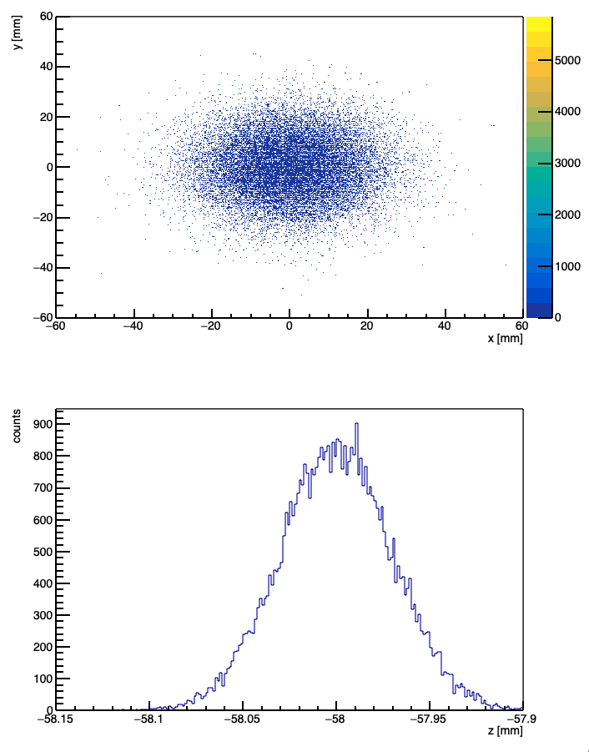
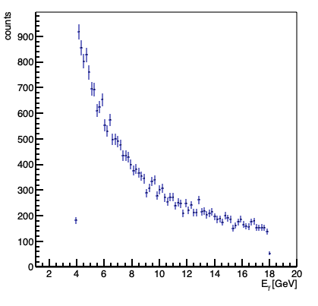
MC distributions
Photon Position at Converter
Photon Energy Spectrum

Slide 3
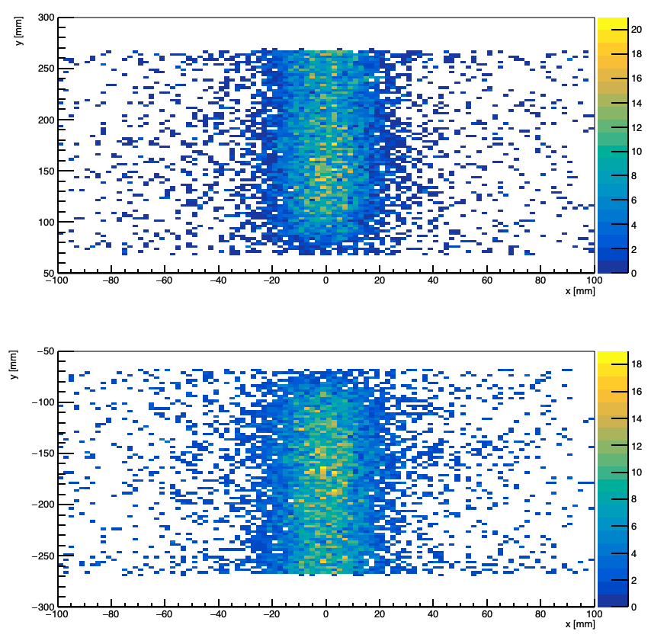
Electron-Positron Hit positions
Distributions show the hit positions at the second tracker
X spread driven by beam size
Y spread driven by e+e- energy
Upper Calorimeter
Lower Calorimeter

Slide 4
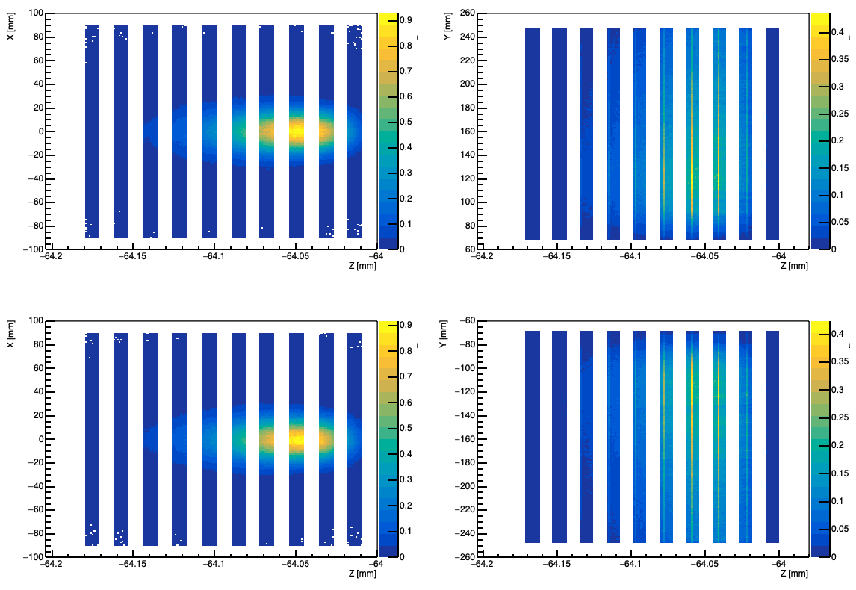
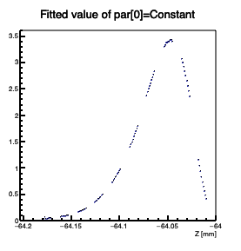
Calorimeter Energy Distributions
Spread of distribution driven by beam size and Moliere radius
Spread of distribution driven by e+/e- energy
Shower Profile
Upper Calorimeter
Lower Calorimeter

Slide 5
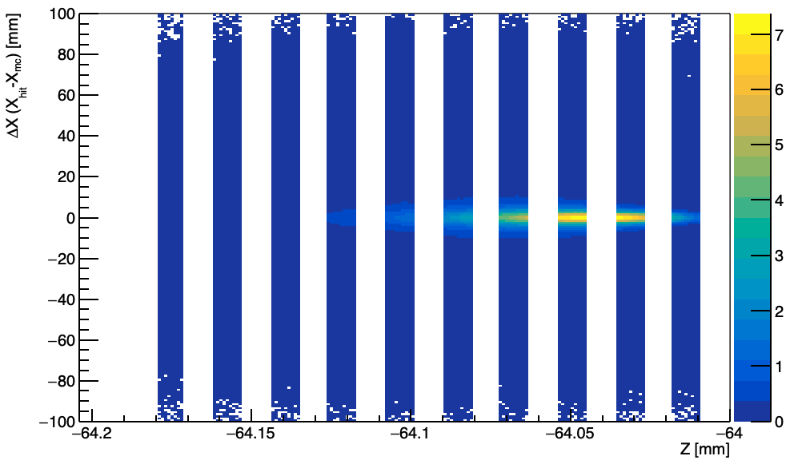
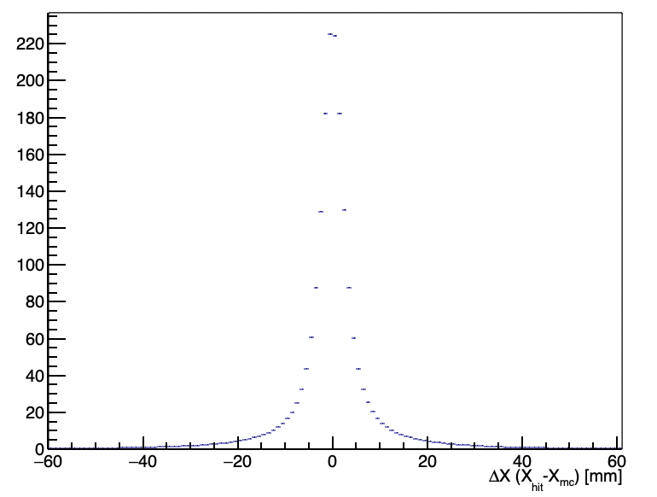
Moliere Radius
Moliere Radius (95% of the total shower) was determined to be 21 mm
Determined from X hit – X mc position (Energy distribution)

Slide 6
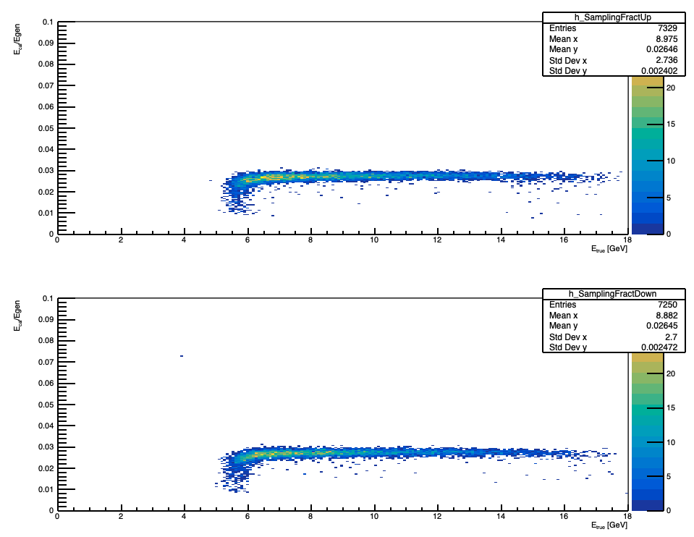
Sampling fraction
Upper Calorimeter
Lower Calorimeter

Slide 7
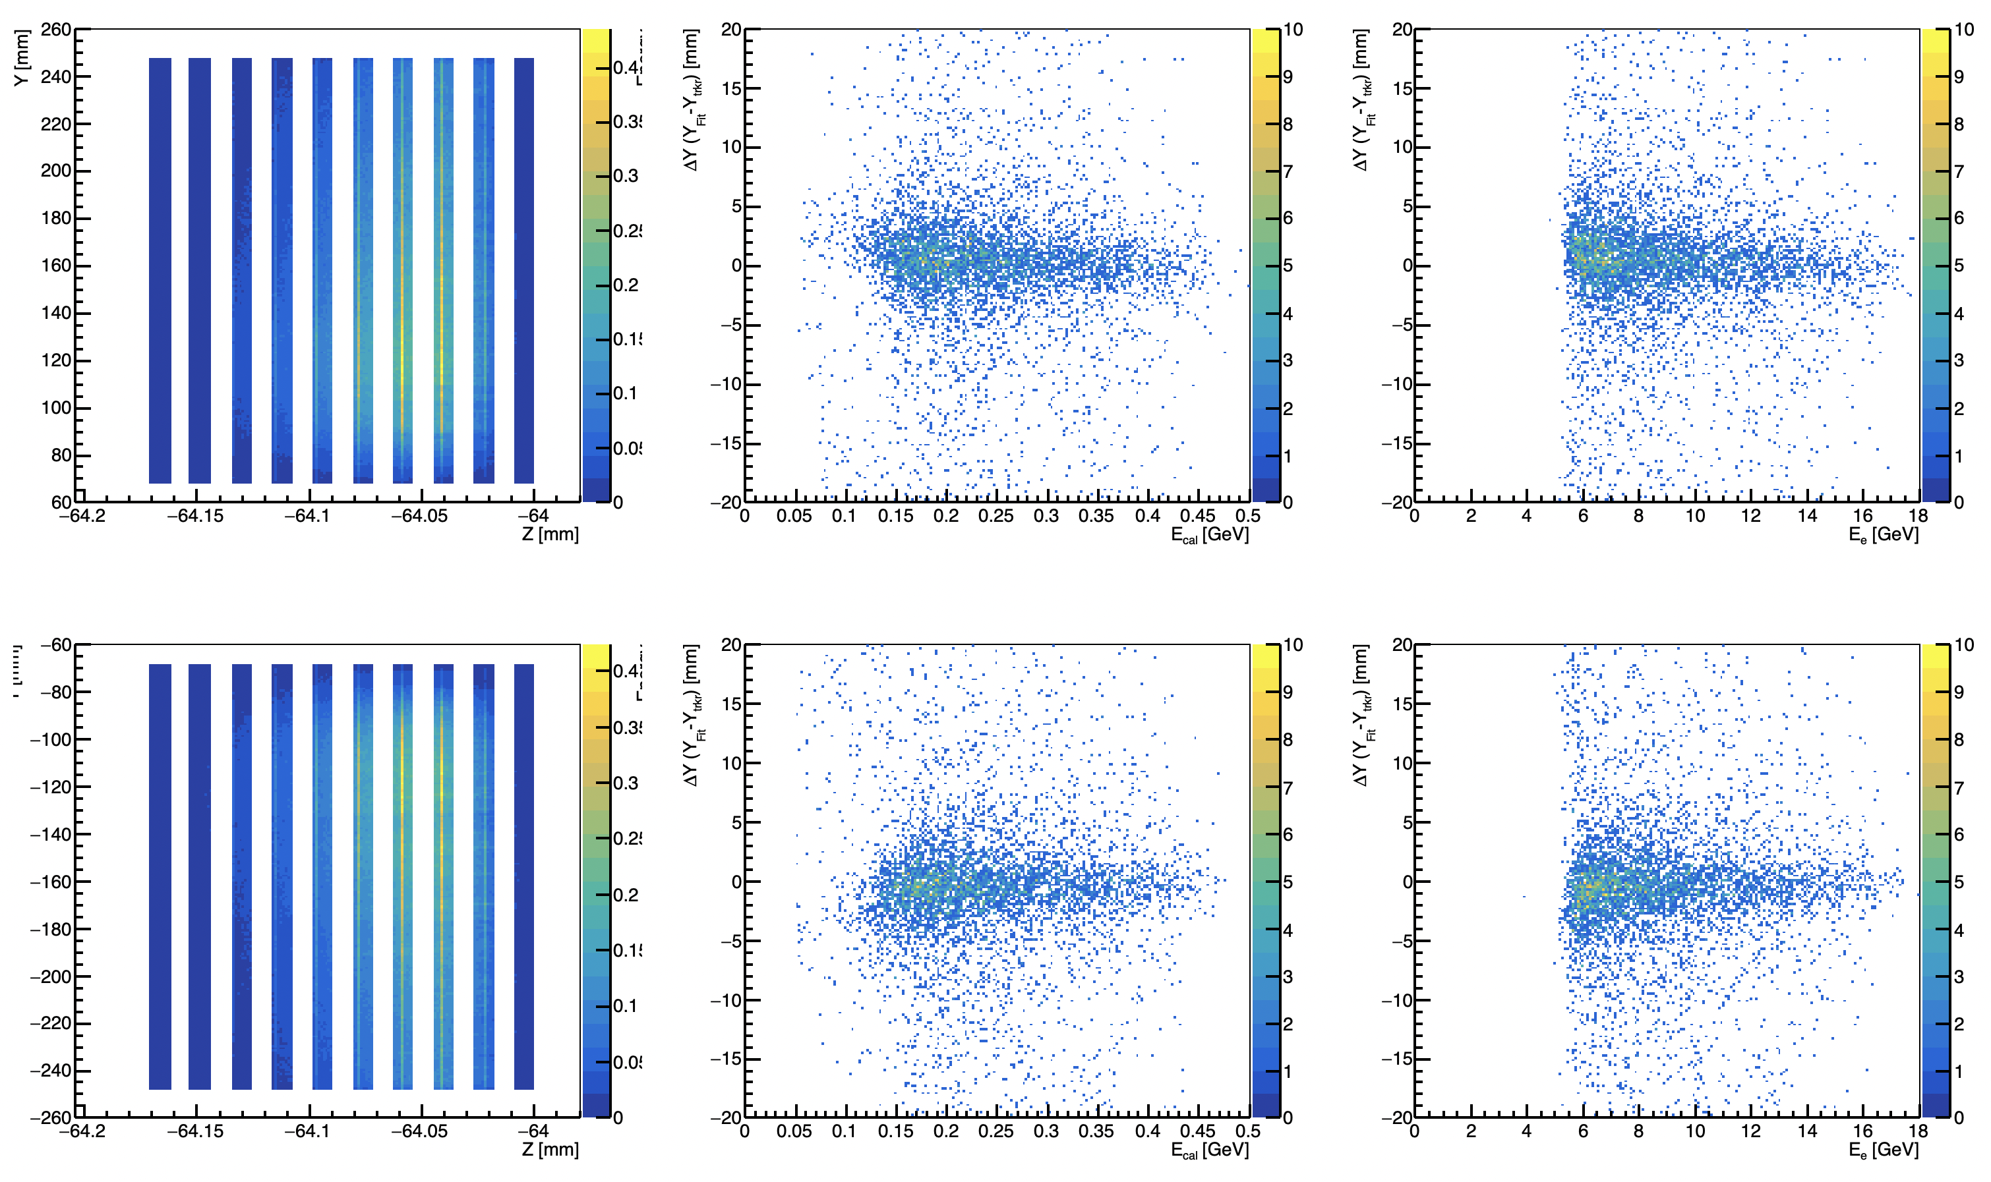
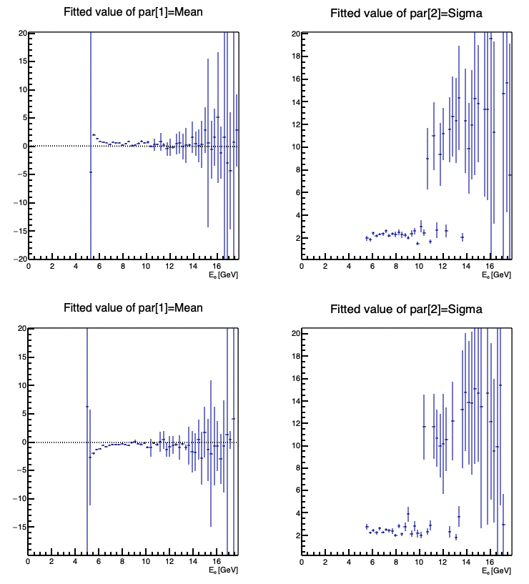
Y Position Resolution
For each event (Eclust>0.05 MeV):
Fit Slices y vs z with Gaussian
Fit Gaussian Means vs Z with linear function
Extrapolated to y_tracker
Compare to tracker y hit position
1 mm pixel size
Pixel size determined from histogram binning
Upper Calorimeter
Lower Calorimeter

Slide 8
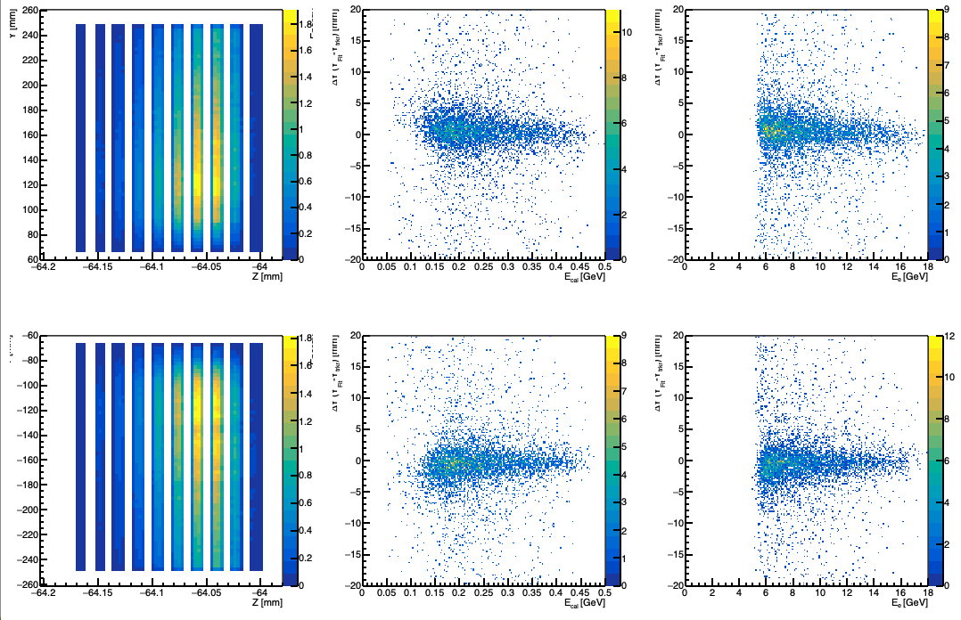
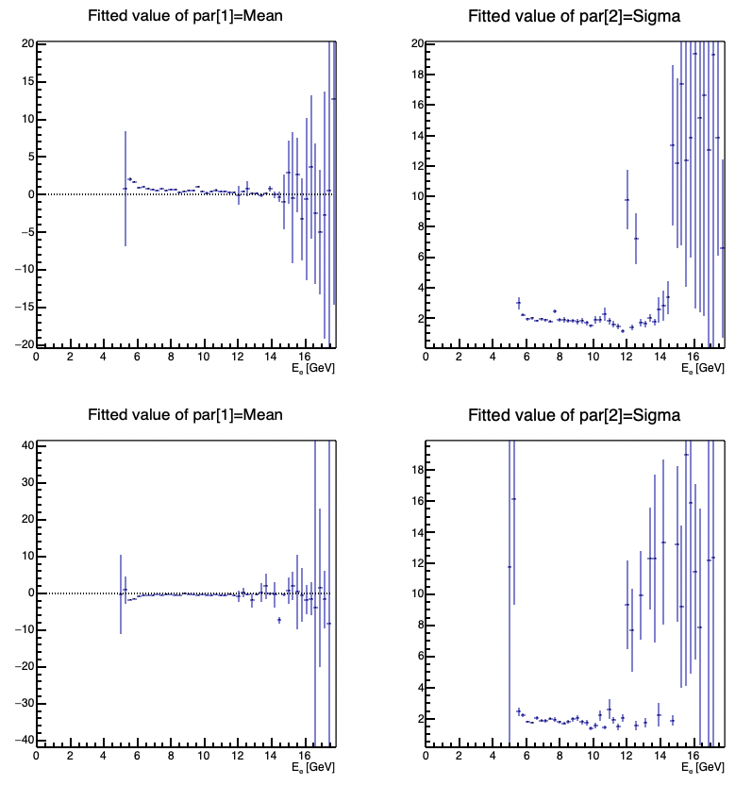
Y Position Resolution
For each event (Eclust>0.05 MeV):
Fit Slices y vs z with Gaussian
Fit Gaussian Means vs Z with linear function
Extrapolated to y_tracker
Compare to tracker y hit position
3 mm pixel size
Pixel size determined from histogram binning
Upper Calorimeter
Lower Calorimeter

Slide 9
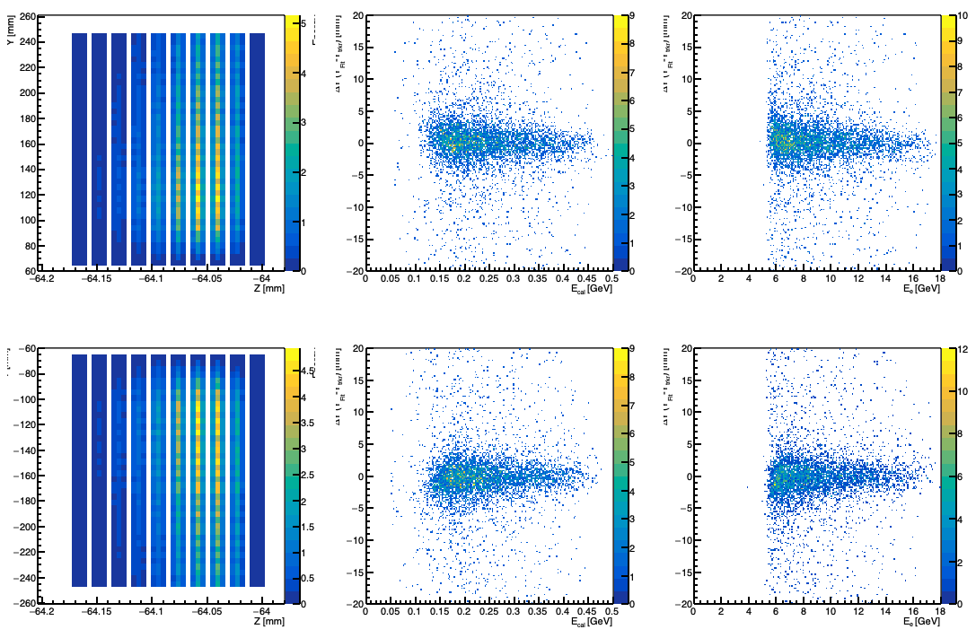
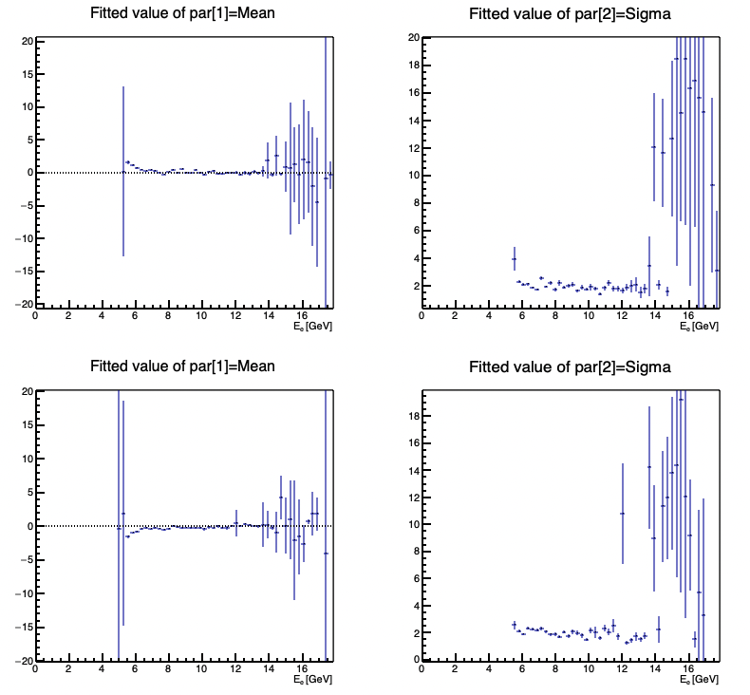
Y Position Resolution
For each event (Eclust>0.05 MeV):
Fit Slices y vs z with Gaussian
Fit Gaussian Means vs Z with linear function
Extrapolated to y_tracker
Compare to tracker y hit position
4.5 mm pixel size
Pixel size determined from histogram binning
Upper Calorimeter
Lower Calorimeter

Slide 10
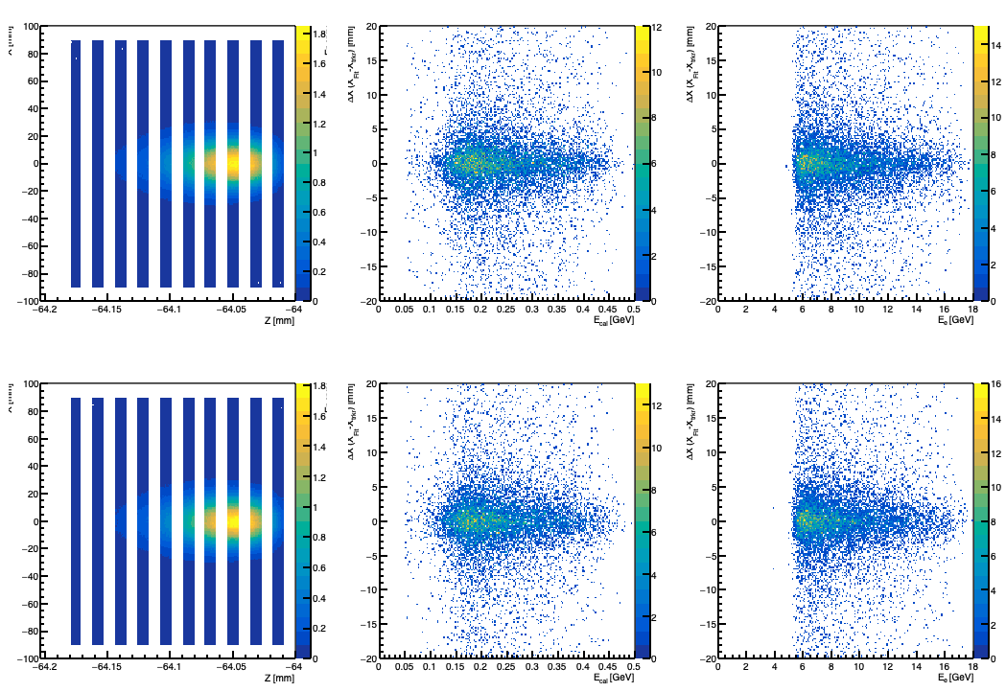
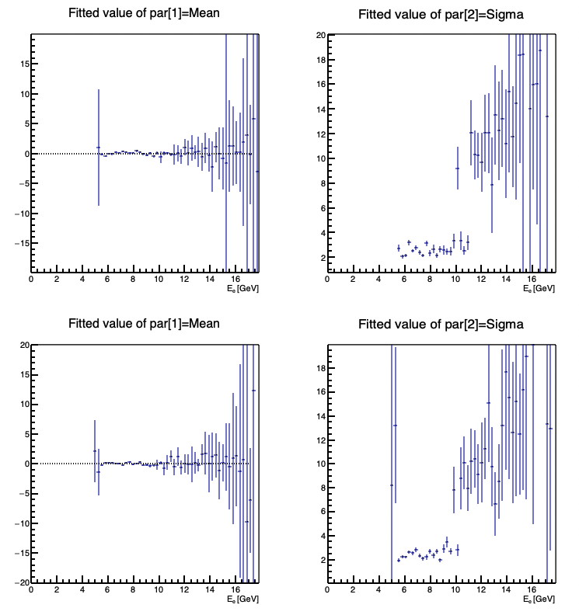
X Position Resolution
For each event (Eclust>0.05 MeV):
Fit Slices X vs z with Gaussian
Fit Gaussian Means vs Z with a linear function
Extrapolated to x_tracker
Compare to tracker x hit position
1 mm pixel size
Pixel size determined from histogram binning
Upper Calorimeter
Lower Calorimeter

Slide 11
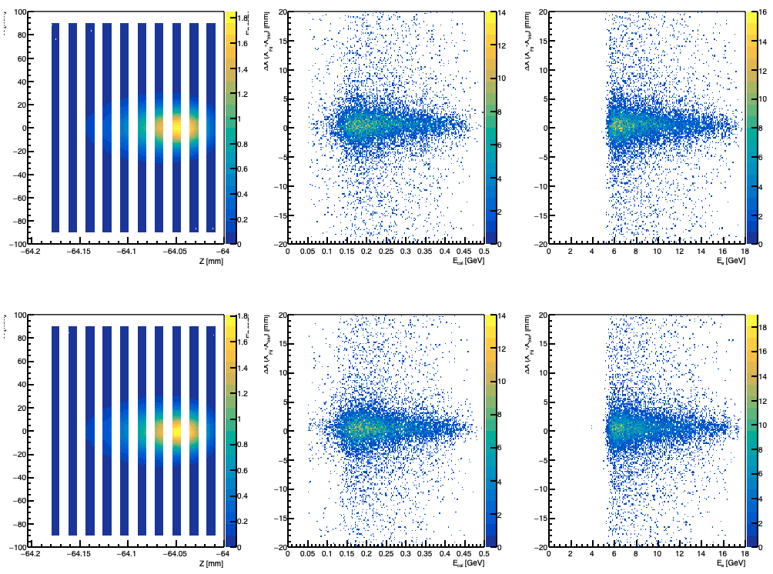
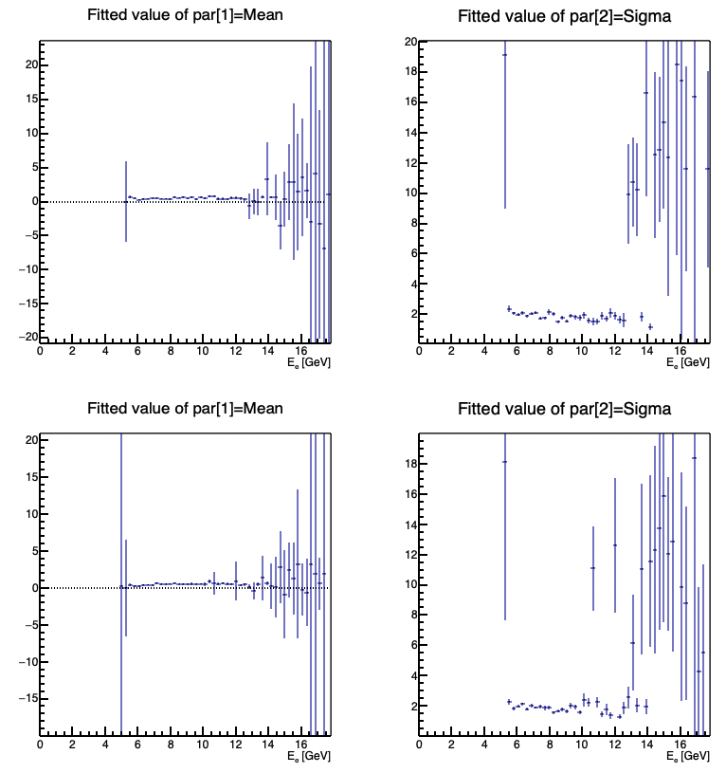
X Position Resolution
For each event (Eclust>0.05 MeV):
Fit Slices X vs z with Gaussian
Fit Gaussian Means vs Z with a linear function
Extrapolated to x_tracker
Compare to tracker x hit position
3 mm pixel size
Pixel size determined from histogram binning
Upper Calorimeter
Lower Calorimeter

Slide 12
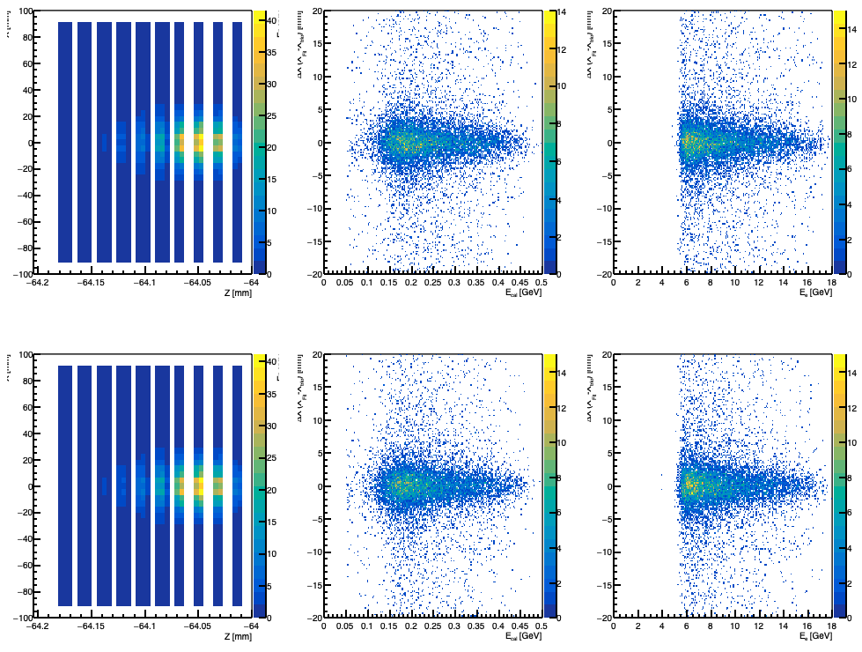
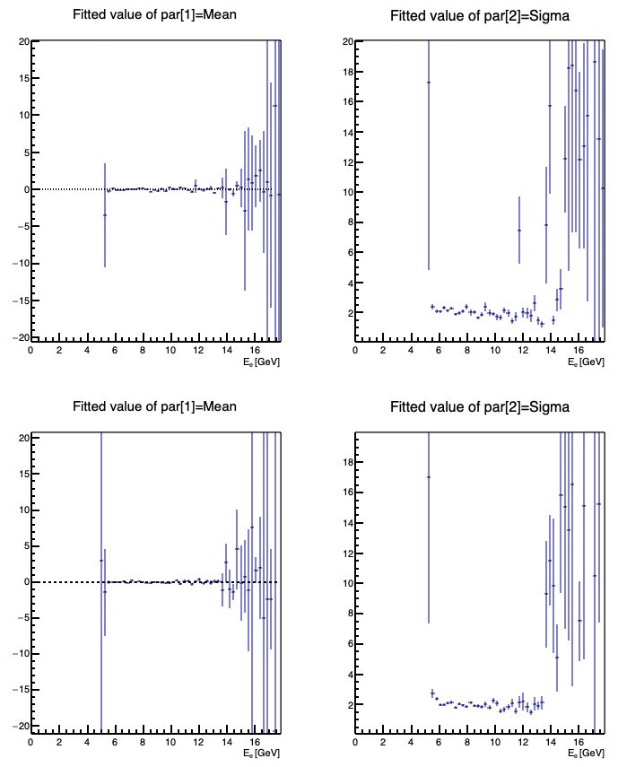
X Position Resolution
For each event (Eclust>0.05 MeV):
Fit Slices X vs z with Gaussian
Fit Gaussian Means vs Z with a linear function
Extrapolated to x_tracker
Compare to tracker x hit position
4.5 mm pixel size
Pixel size determined from histogram binning
Upper Calorimeter
Lower Calorimeter

Slide 13
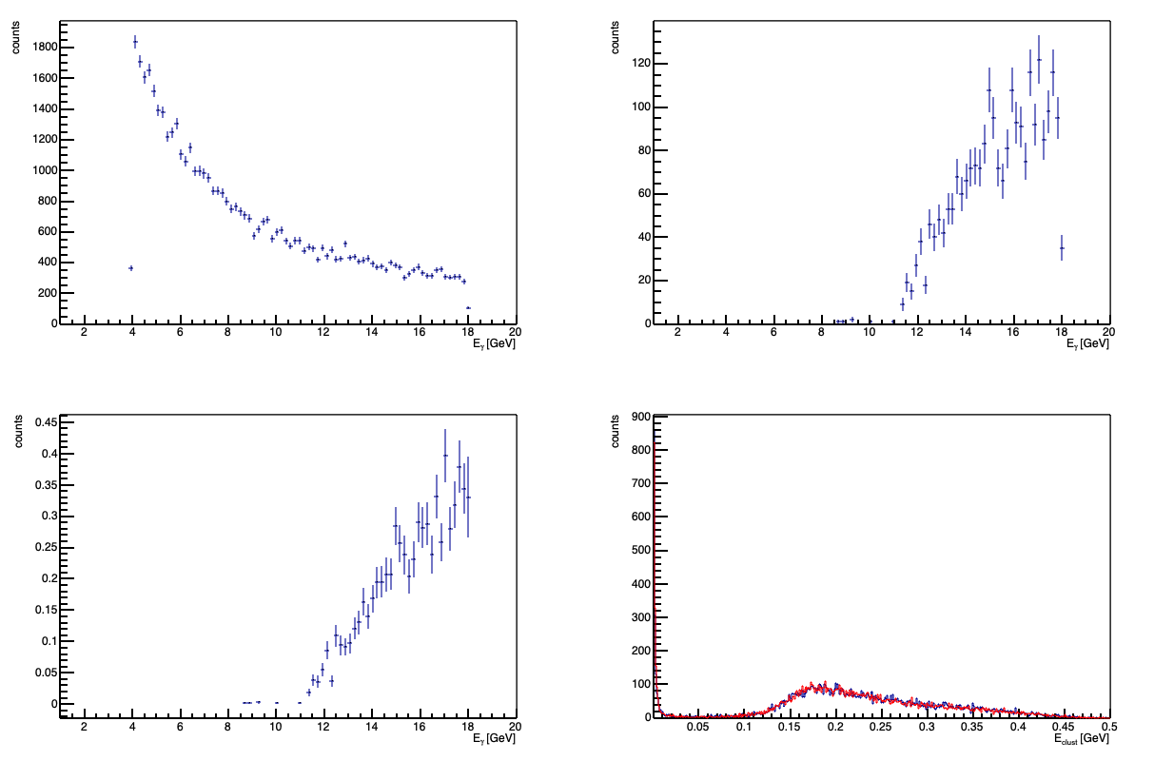
Acceptance
Photon energy for events where e+e- are reconstructed
Photon energy generated
Acceptance
Cluster energy in up (blue) and down (Red) cal

