Slide 1
Engineering Design and Mechanical Support Structures
Jonathan Smith (JLAB), Ron Lassiter (JLAB)
Far-forward/Far-backward Review
Feb. 12, 2024

Slide 2
Charged Questions
How do we synchronize CAD models between BNL (Creo) and JLab (NX12)?
What’s the status of the current CAD model?
What can be expected future CAD development?

Slide 3
Outline
Project Link CAD model synchronization
Current Developed Area
Upcoming Design Development

Slide 4
CAD Sharing Process
Jefferson Lab creates a model based on the requirement demands provided by Engineering, Physicists, or Simulations
Upon approval, the model then gets converted to a .step/.stp file and shared with BNL (Karim Hamdi) via OneDrive.
BNL uploads the model into a consolidated arrangement in CREO and uploads the file in a shared Project Link folder in Windchill
Jefferson Labs has access to the folder and uploads the arrangement into their NX Arrangement

Slide 5
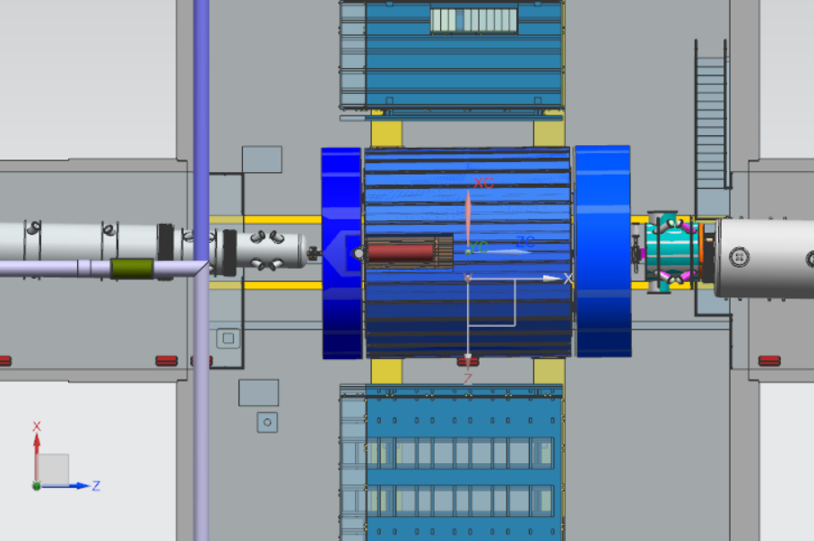
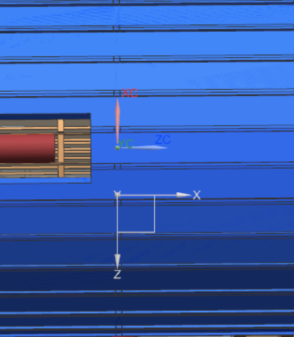
X,Y,Z Coordinate Alignment
IP (JLAB)
81cm
RHIC (BNL)
- Jefferson Lab CSYS (0,0,0) is located at the IP
- Brookhaven Lab CSYS (0,0,0) is located at the RHIC
There is an 81cm gap between the IP and RHIC in X-axis (Z-Axis from BNL coordinate)

Slide 6
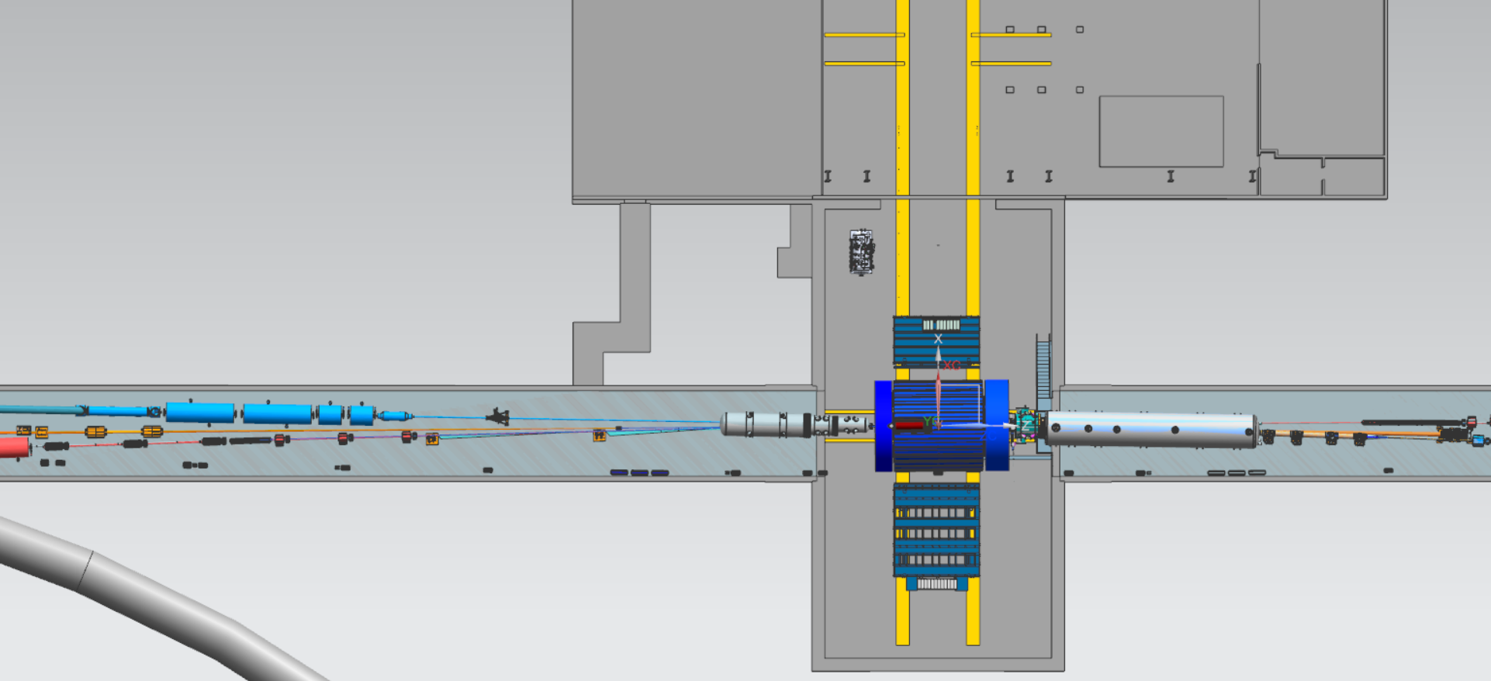
Far-Forward and Far-Backward
Far-Backward, Sector 6
Far-Forward, Sector 5

Slide 7
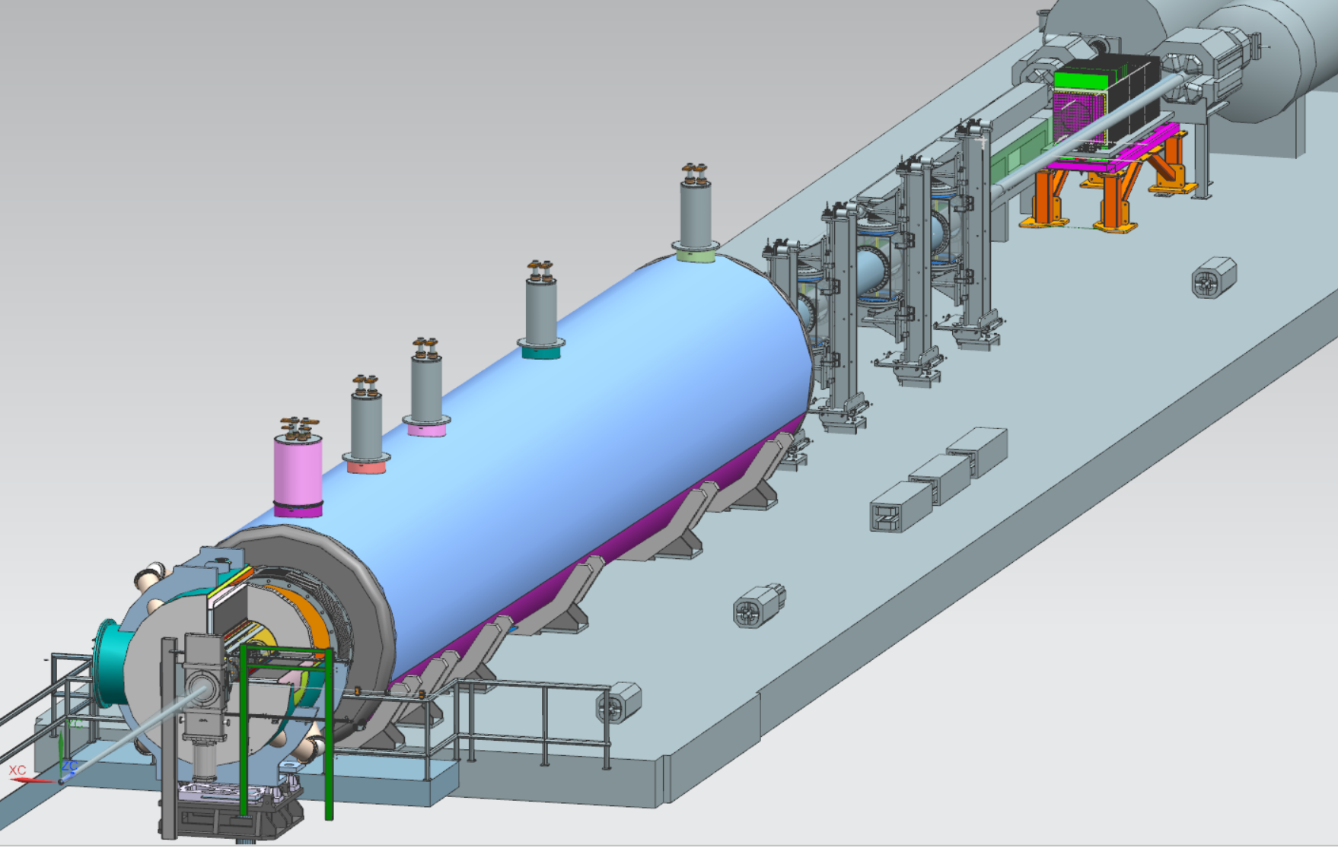
Far-Forward Region, Region 5
Zero-Degree
Off Moment // Roman Pots
B0 Detector

Slide 8
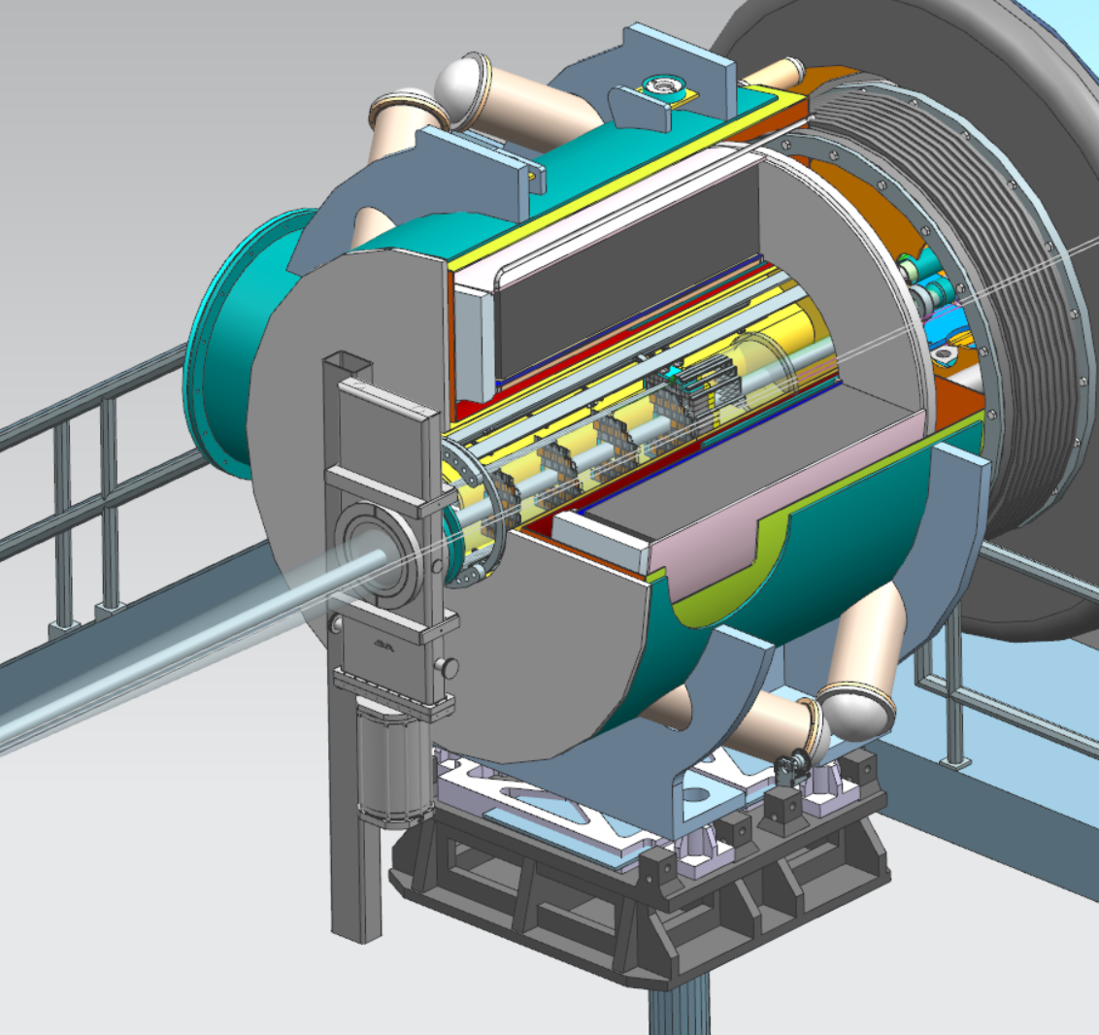
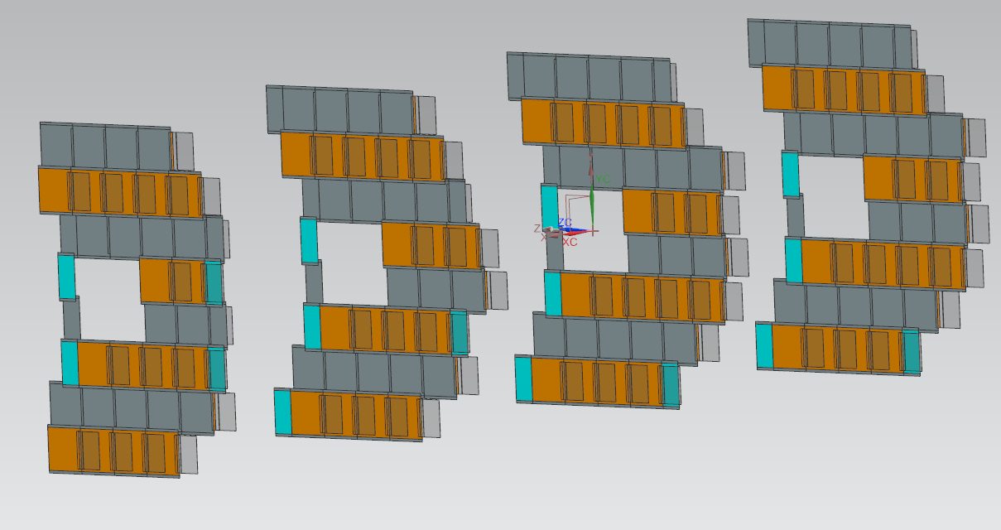
B0 Magnet Detector
Detector 3
Detector 1
Detector 4
Detector 2

Slide 9
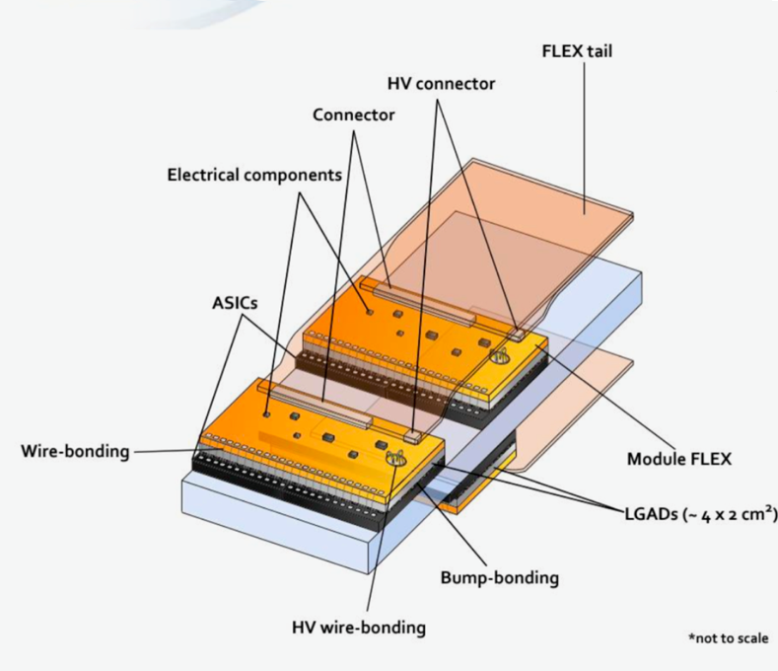
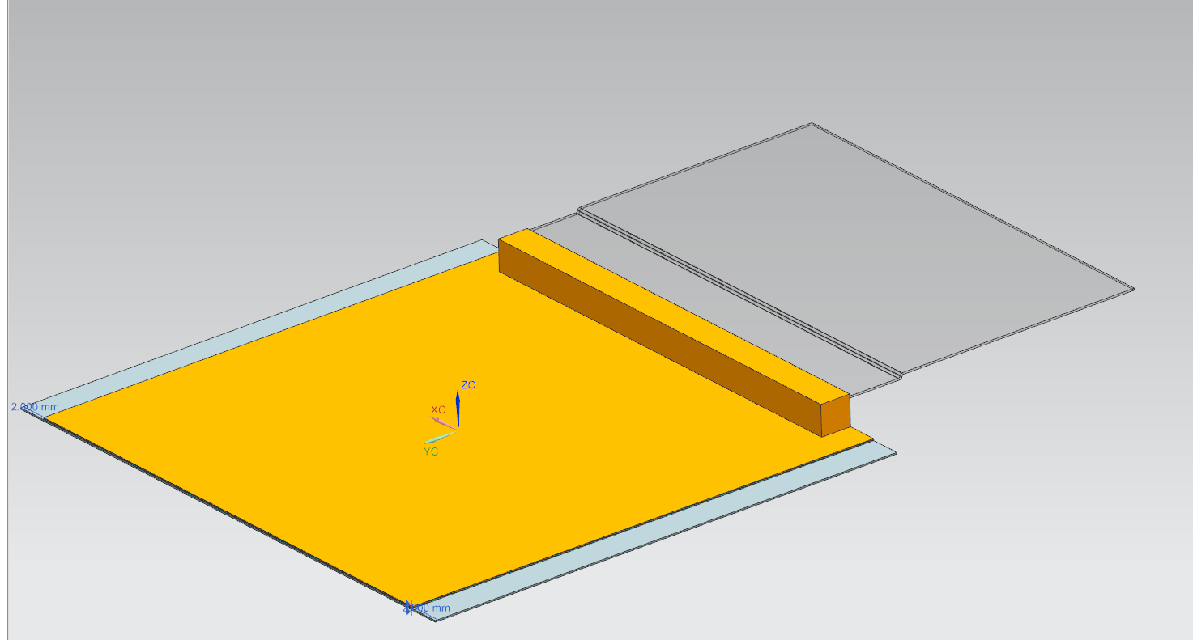
B0 Magnet Detector
FLEX tail
LGADs
Module FLEX

Slide 10
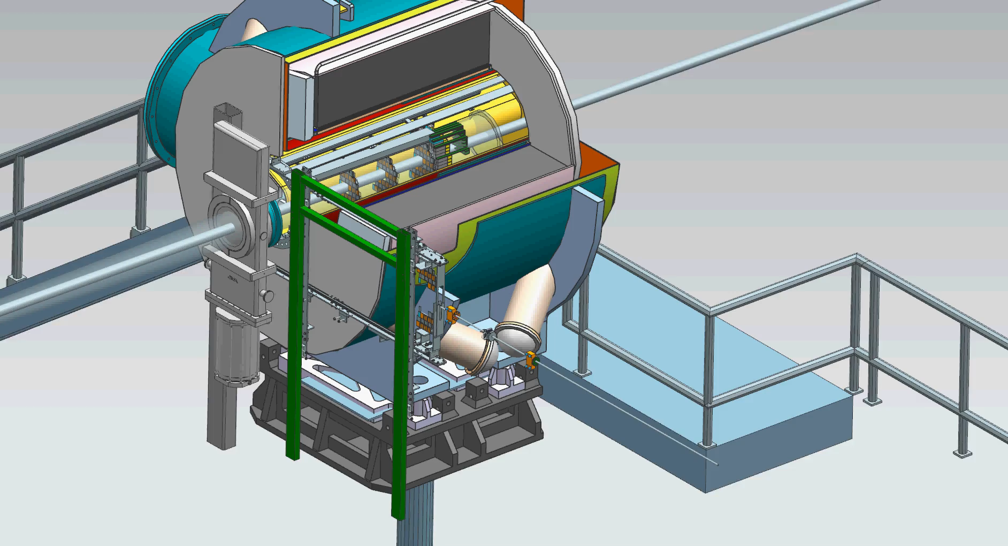
B0 Detector Placement

Slide 11
B0 Future Design Development
Further development of detector layers and calorimeter maintenance/removal rail system.
Additional structural support for a larger calorimeter (from 7cm crystals to 20cm crystals)
Pending R&D detector updates for heating/cooling requirements.

Slide 12
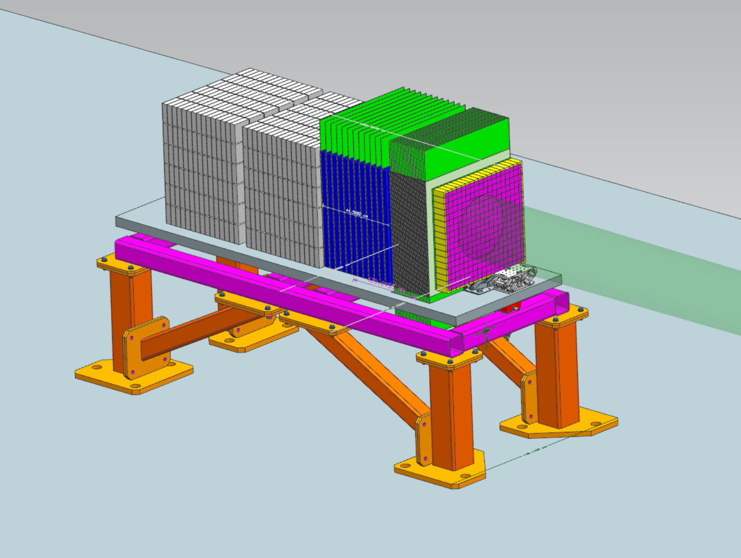
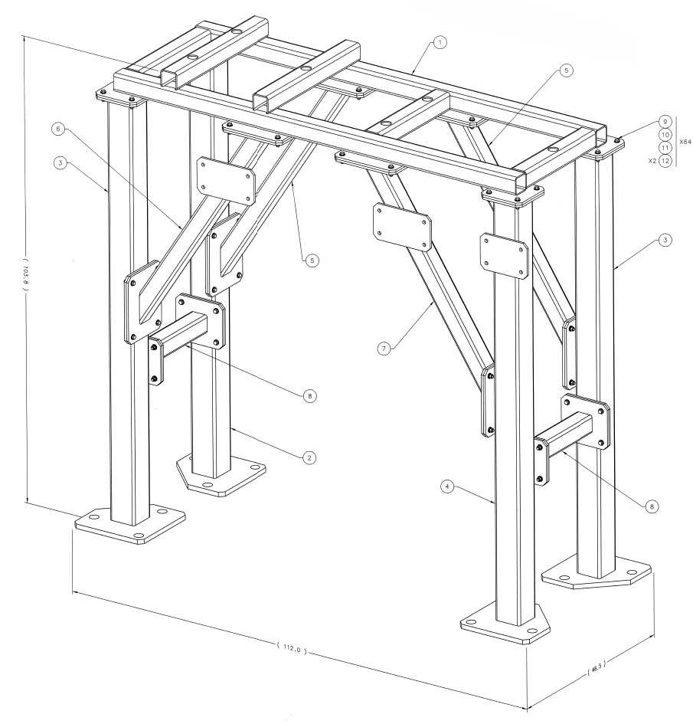
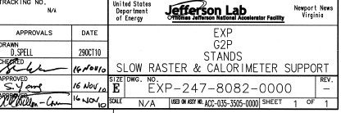
Zero-Degree Calorimeter Support
- Currently utilizing existing JLAB support designs.

Slide 13
Zero-Degree Station Future Development
Upcoming changes to the Zero-Degree Calorimeter to include a third calorimeter to the table
Analyze current support for the increase weight requirement

Slide 14
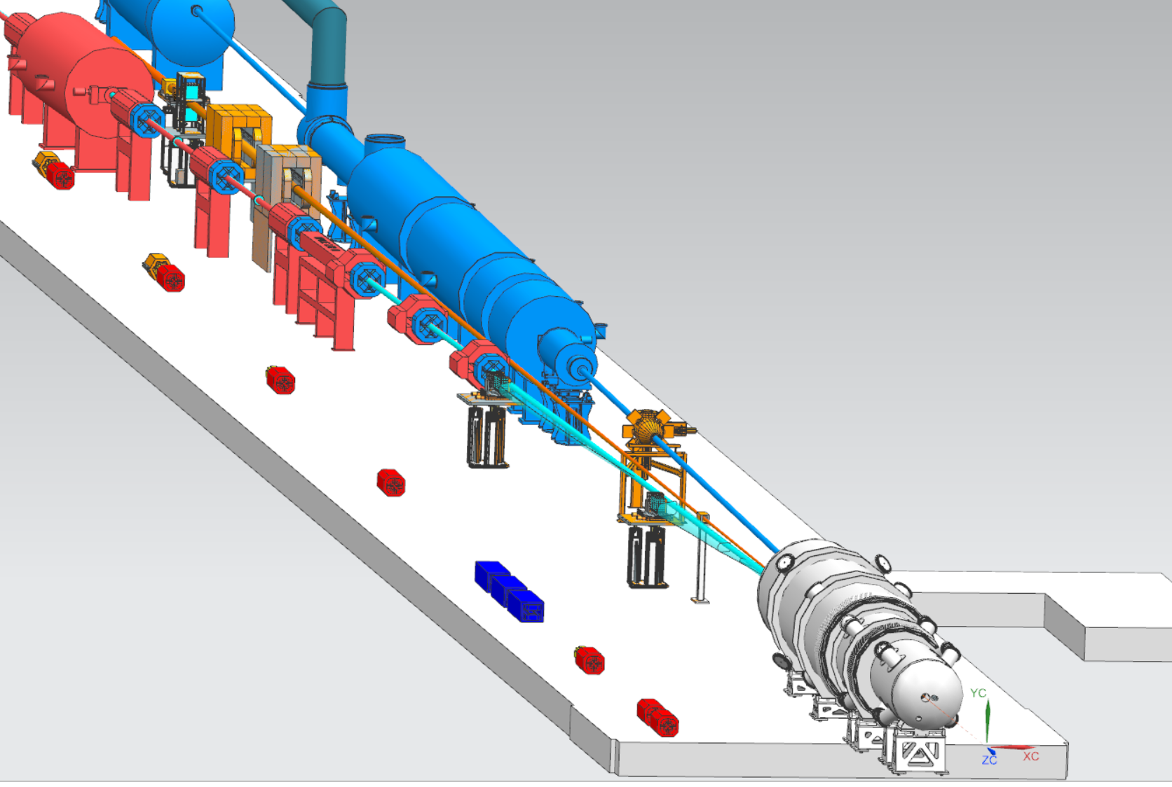
Far-Backward Region, Region 6
Lumi Spectrometer and Photo Calorimeters
Low Q2 Taggers

Slide 15
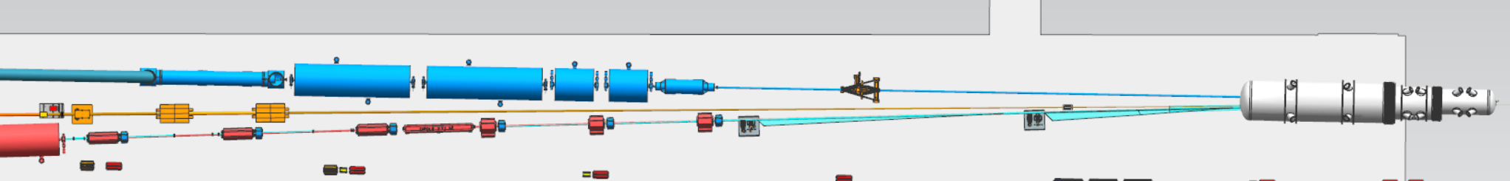
Far-Backward Region, Region 6
Lumi Detector System
Electron Detector System

Slide 16
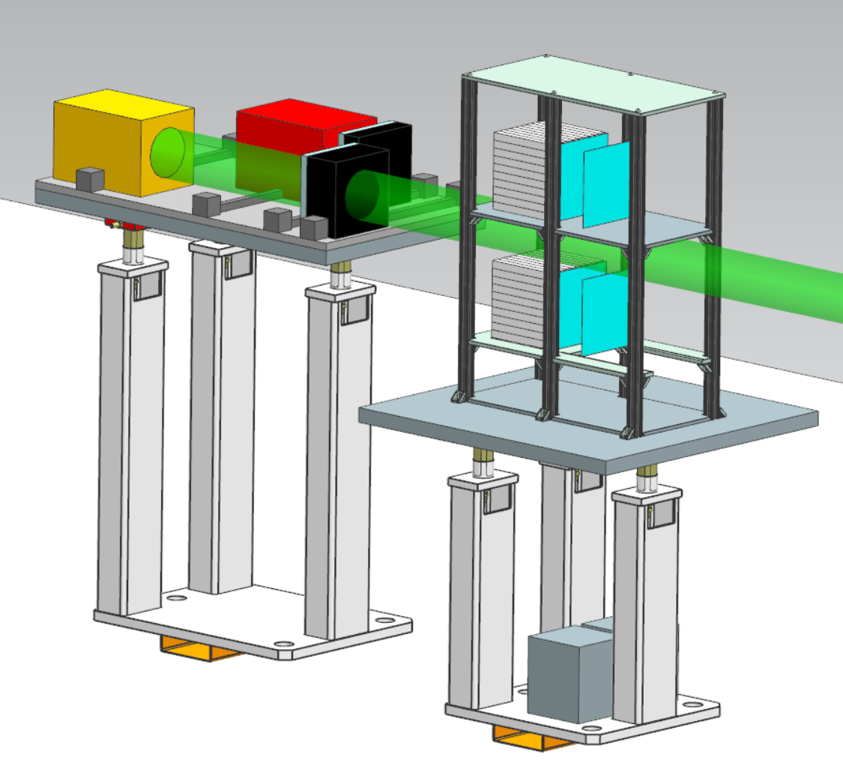
Lumi Spectrometer Detectors and Calorimeters
Currently utilizing 80/20 Supports for Photon and Spectrometer Detector Layers
Repurposing existing JLAB pedestal drawings for supports for both the Lumi and Electron Detector Systems
Credit: Dhevan Gangadharan & Nick Zachariou

Slide 17
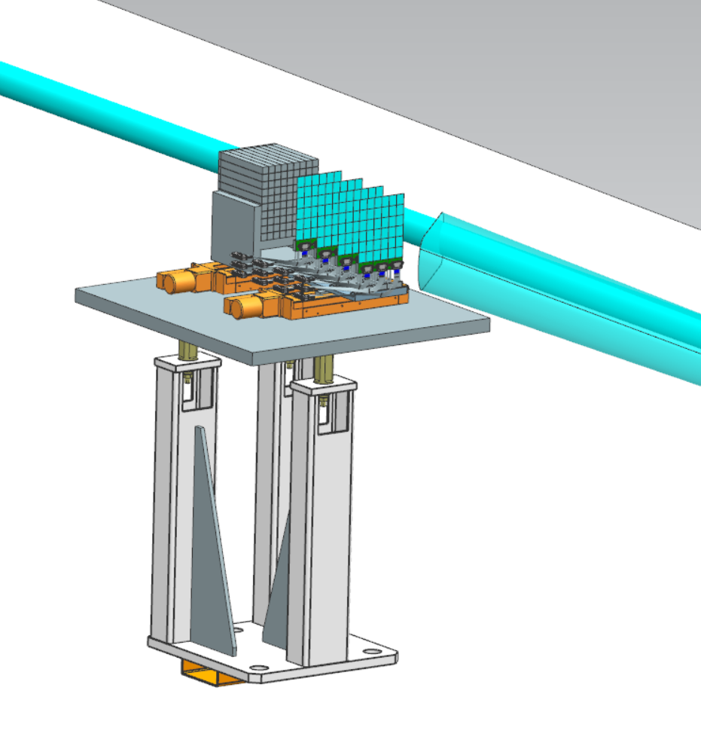
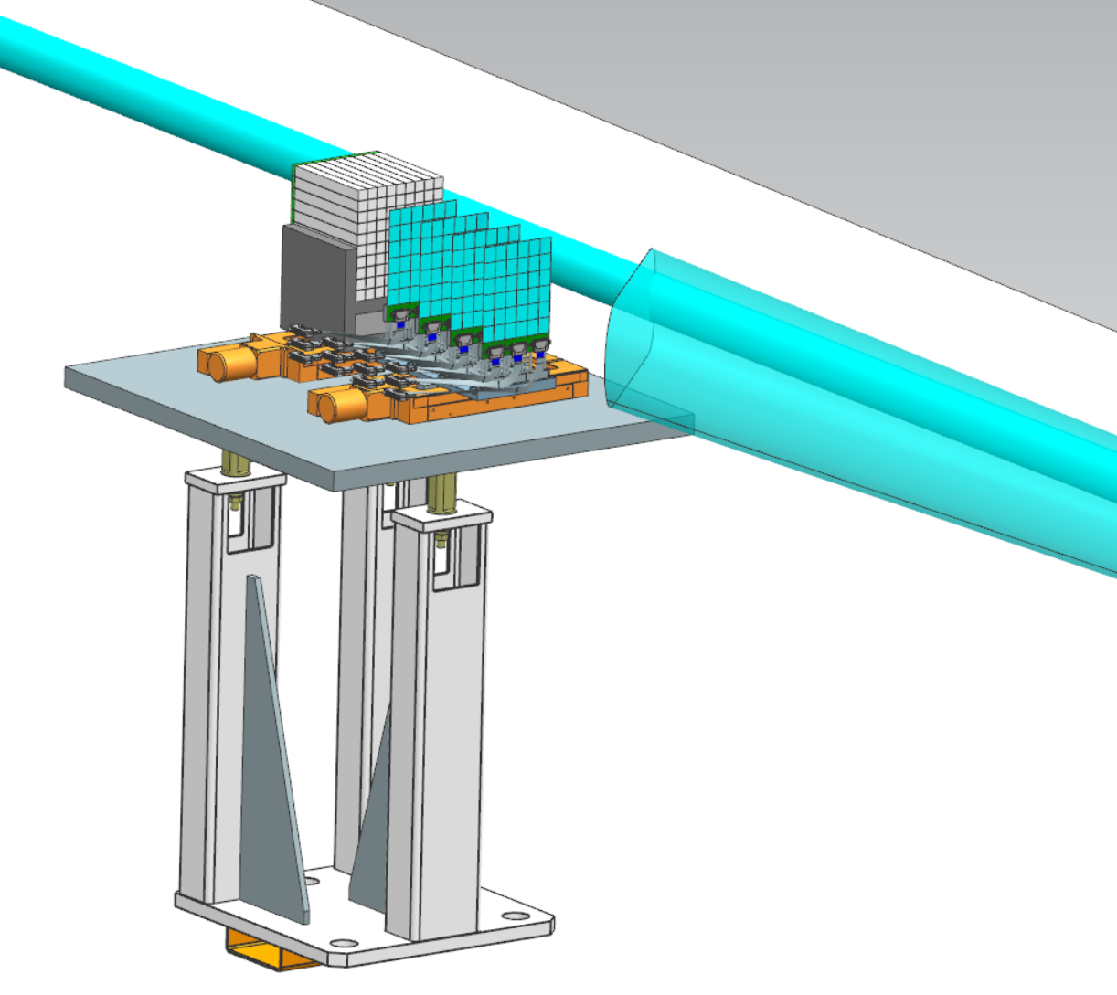
Low Q2 Tagger Stations 1 & 2
Calorimeter
(4) Detector Layers
Exit Window
Tagger Station 2
Tagger Station 1

Slide 18
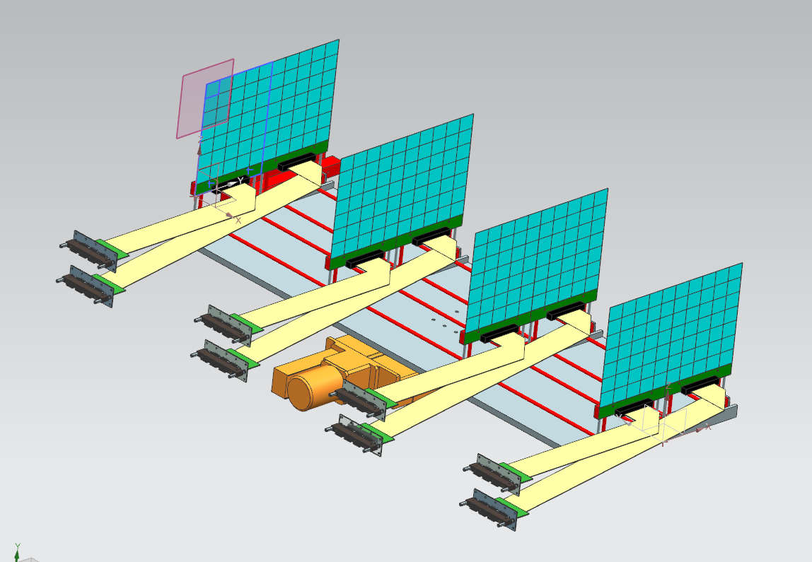
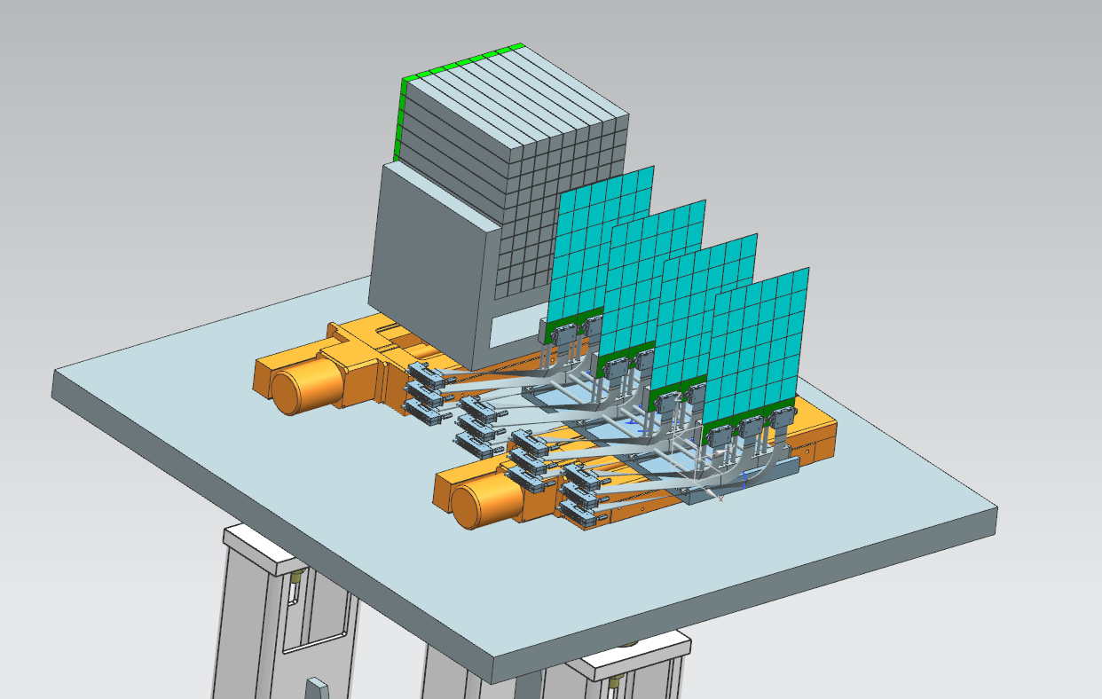
Low Q2 Tagger Detector Design History
Utilizing a calorimeter with adjustable motor for both stations.
Reducing detector layer distance from 30cm to 10cm.
Detector layers updated from TWO panels per layer to THREE per layer.
Preliminary Concept Design
Current
Credit: Ken Livingston & Simon Gardner

Slide 19
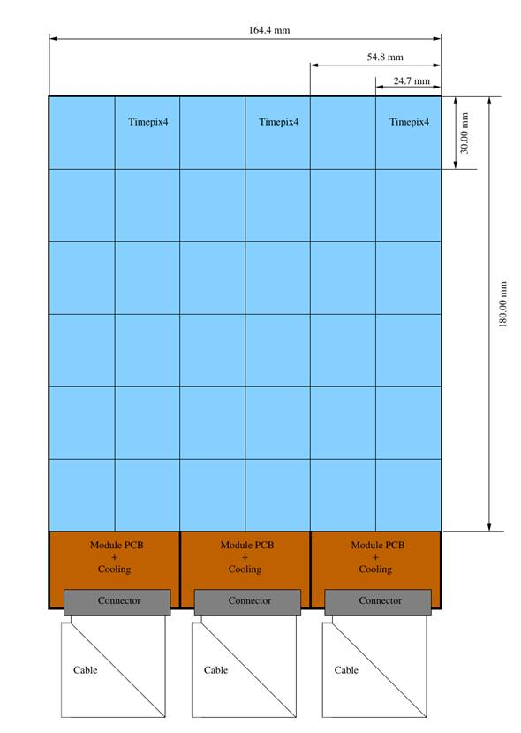
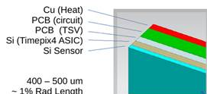
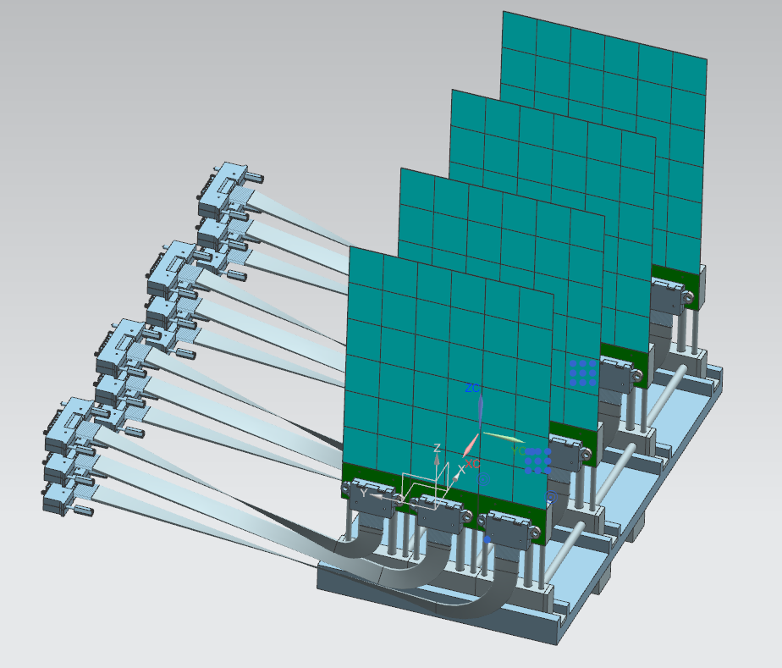
Low Q2 Tagger Requirement / Timepix4
Credit: Ken Livingston & Simon Gardner

Slide 20
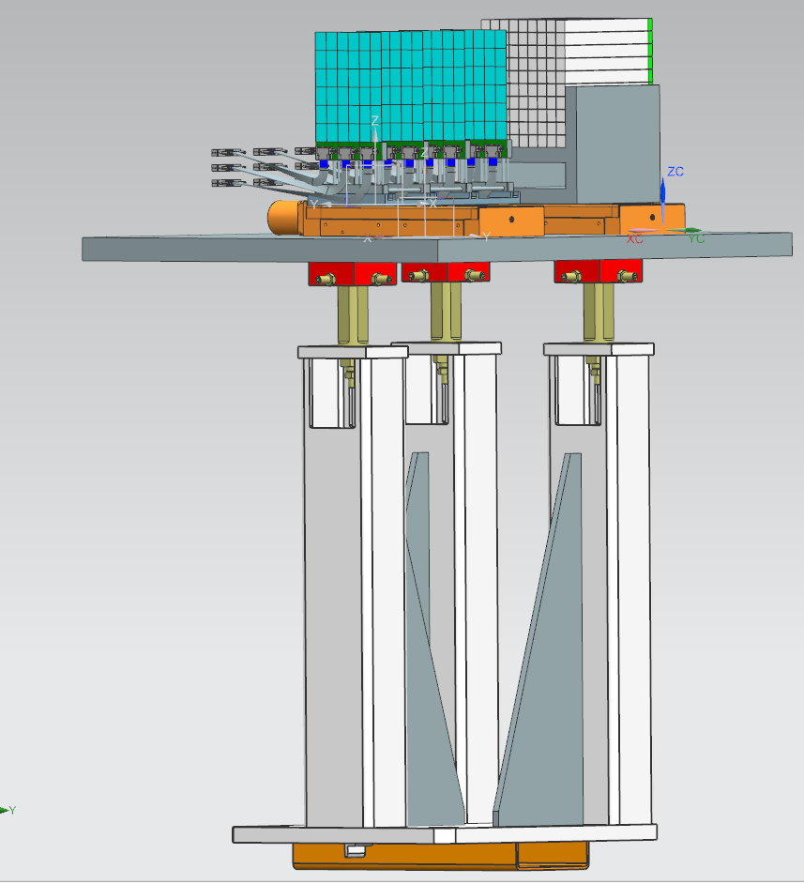
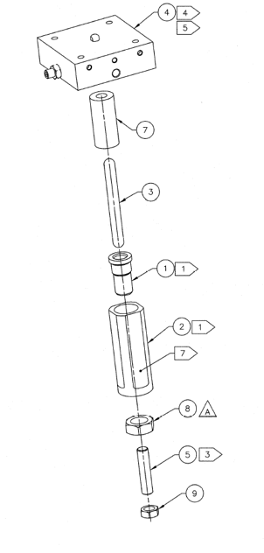
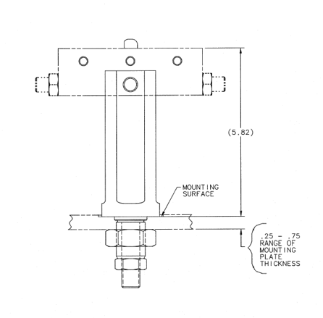
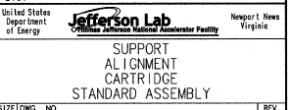
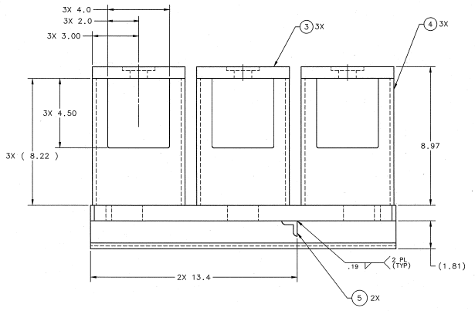
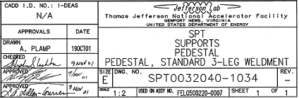
Support Tables / Hardware
Alignment cartridges enable to table top to adjust the Roll and Pitch as necessary by the user

Slide 21
Future Design Development
Establish an official design history to archive CAD model updates
Updating JLab CAD Software from NX12 to NX2306 and update file sharing requirements with BNL Windchill as necessary

