Slide 1
Engineering Design and Mechanical Support Structures
Jonathan Smith (JLAB), Ron Lassiter (JLAB)
Far-forward/Far-backward Review
Feb. 12, 2024

Slide 2
Outline
CAD model and arrangement synchronization between BNL (CREO) and JLAB (NX12).
Current developed areas based on existing design requirements.
Upcoming known areas of design impacts.

Slide 3
CAD Model File Exchange Process
Jefferson Lab creates a model based on the requirement demands provided by Engineering, Physicists, or Simulations
Upon approval, the model then gets converted to a .step/.stp file and shared with BNL (Karim Hamdi) via OneDrive.
BNL uploads the model into a consolidated arrangement within CREO and the file in a shared Project Link folder within Windchill.
Jefferson Labs has access to the folder and uploads the arrangement into the NX Arrangement.

Slide 4
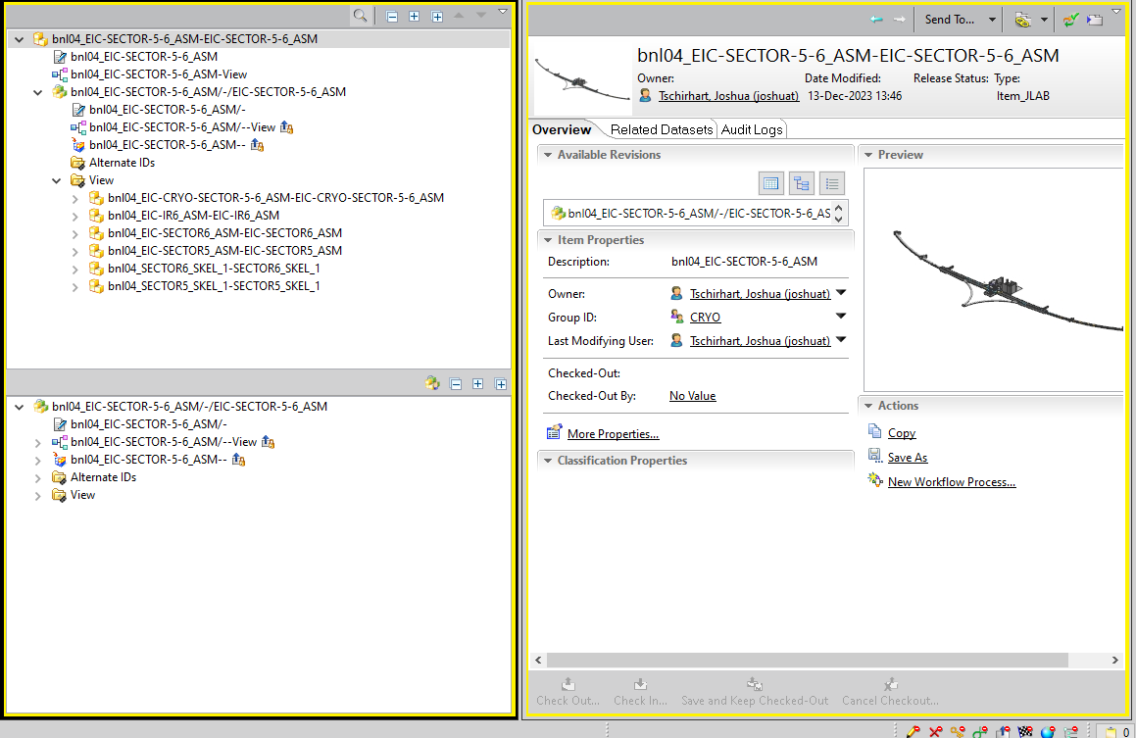
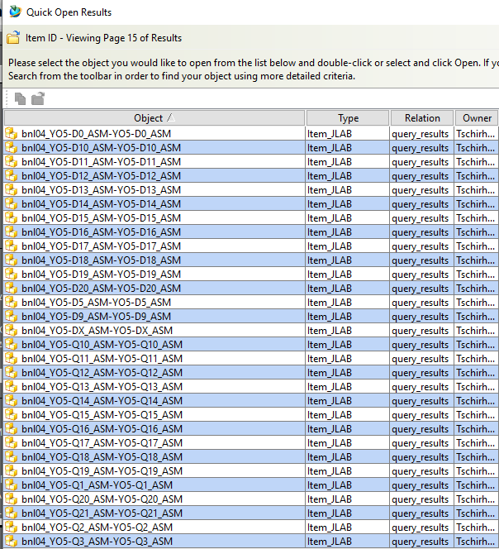
Teamcenter Import

Slide 5
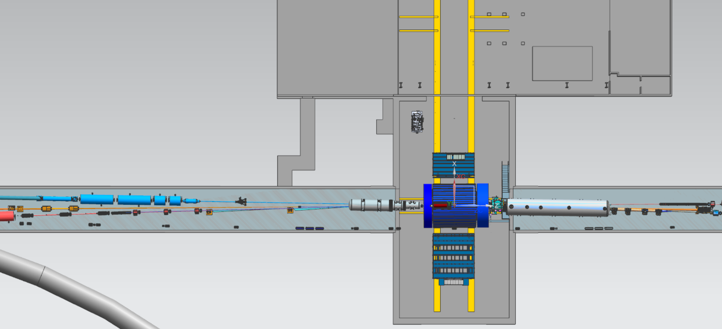
Far-Forward and Far-Backward
Far-Backward, Sector 6
Far-Forward, Sector 5

Slide 6
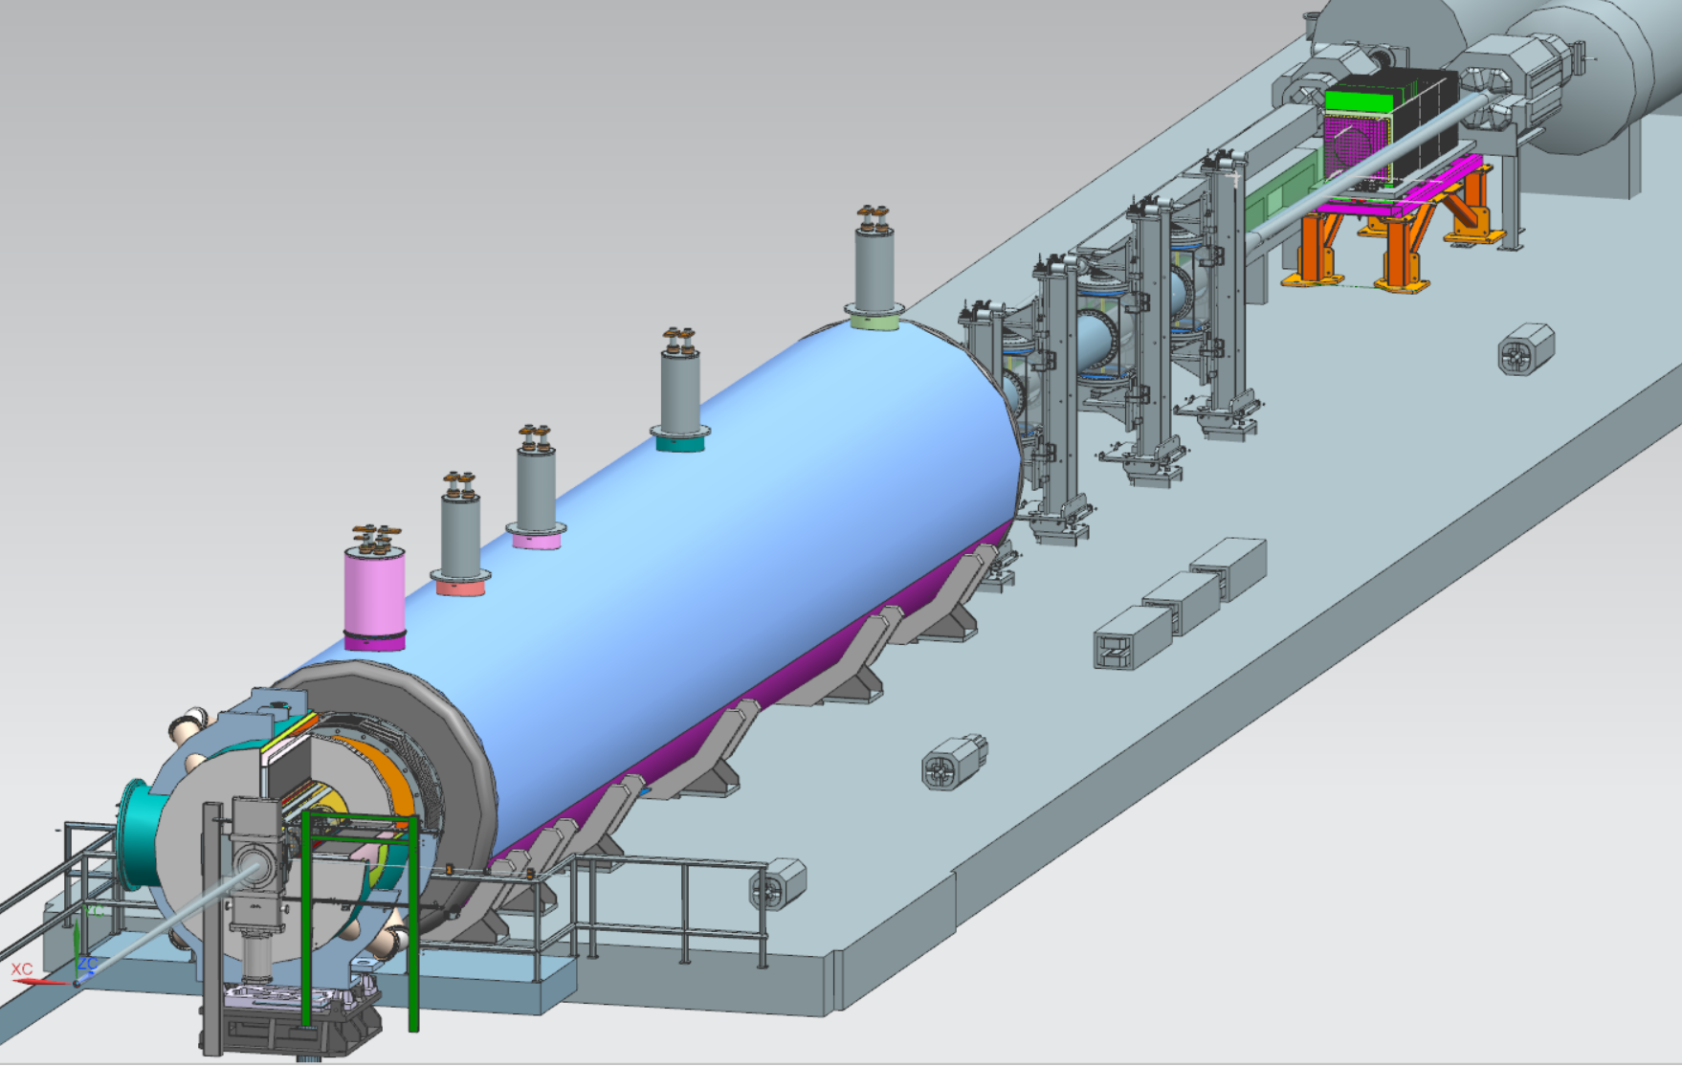
Far-Forward Region, Region 5
Zero-Degree Calorimeter Stand
Off Moment // Roman Pots
B0 Detector

Slide 7
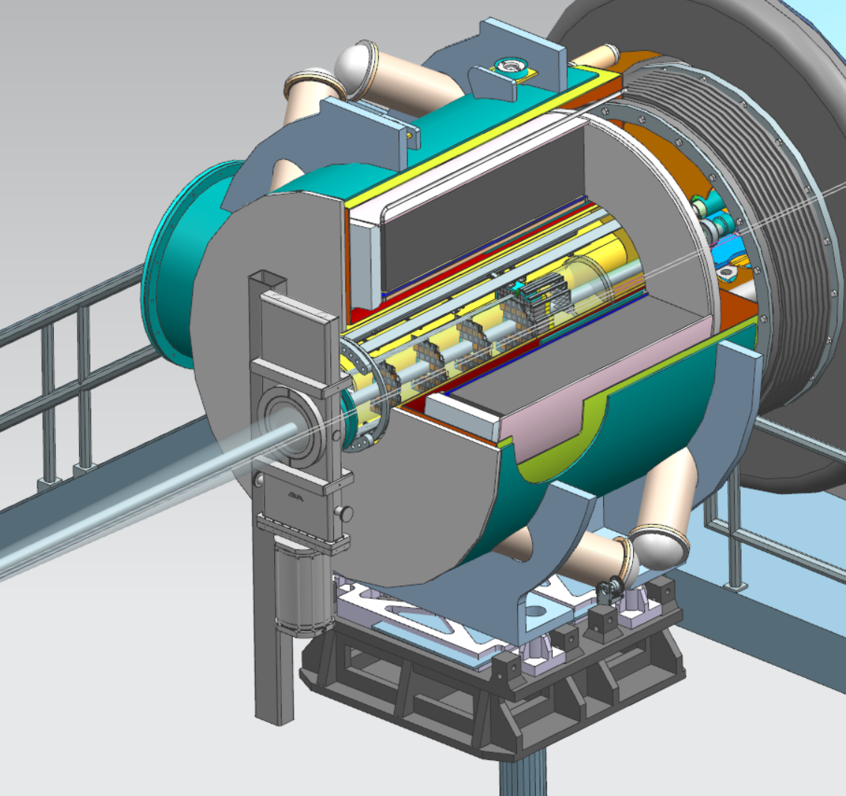
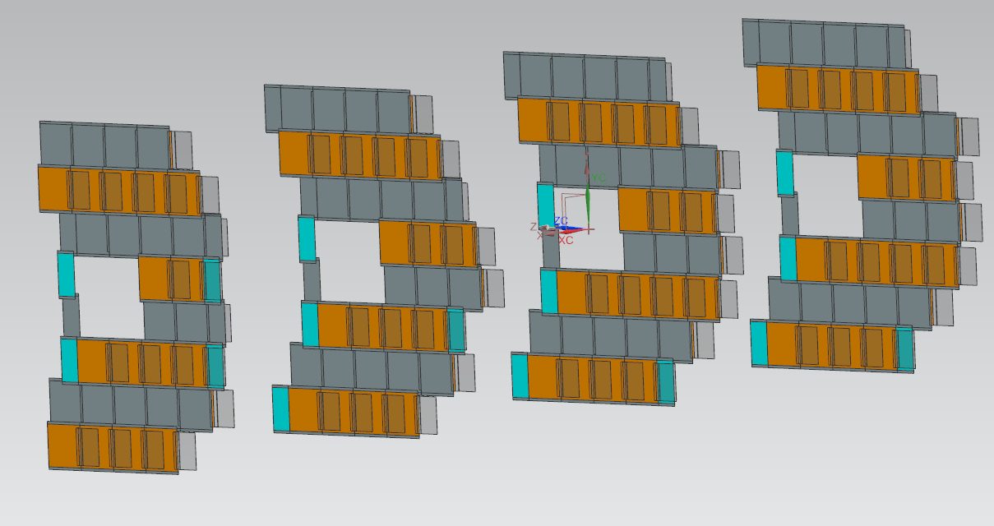
B0 Magnet Detector
Detector 3
Detector 1
Detector 4
Detector 2

Slide 8
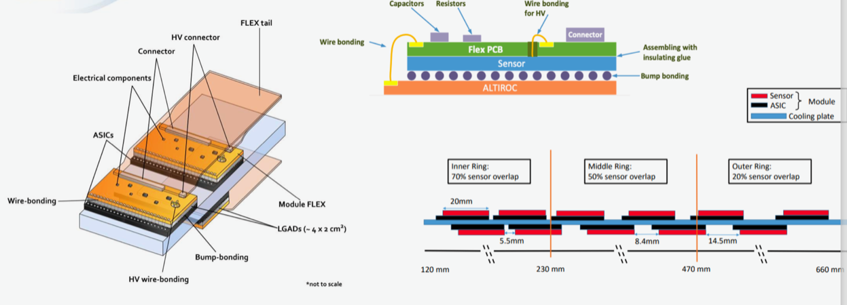
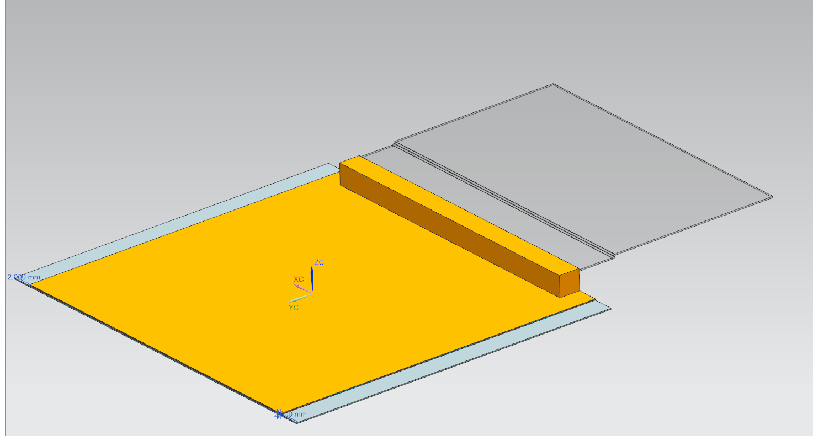
B0 Magnet Detector
FLEX tail
(Cable connection)
LGADs
Module FLEX

Slide 9
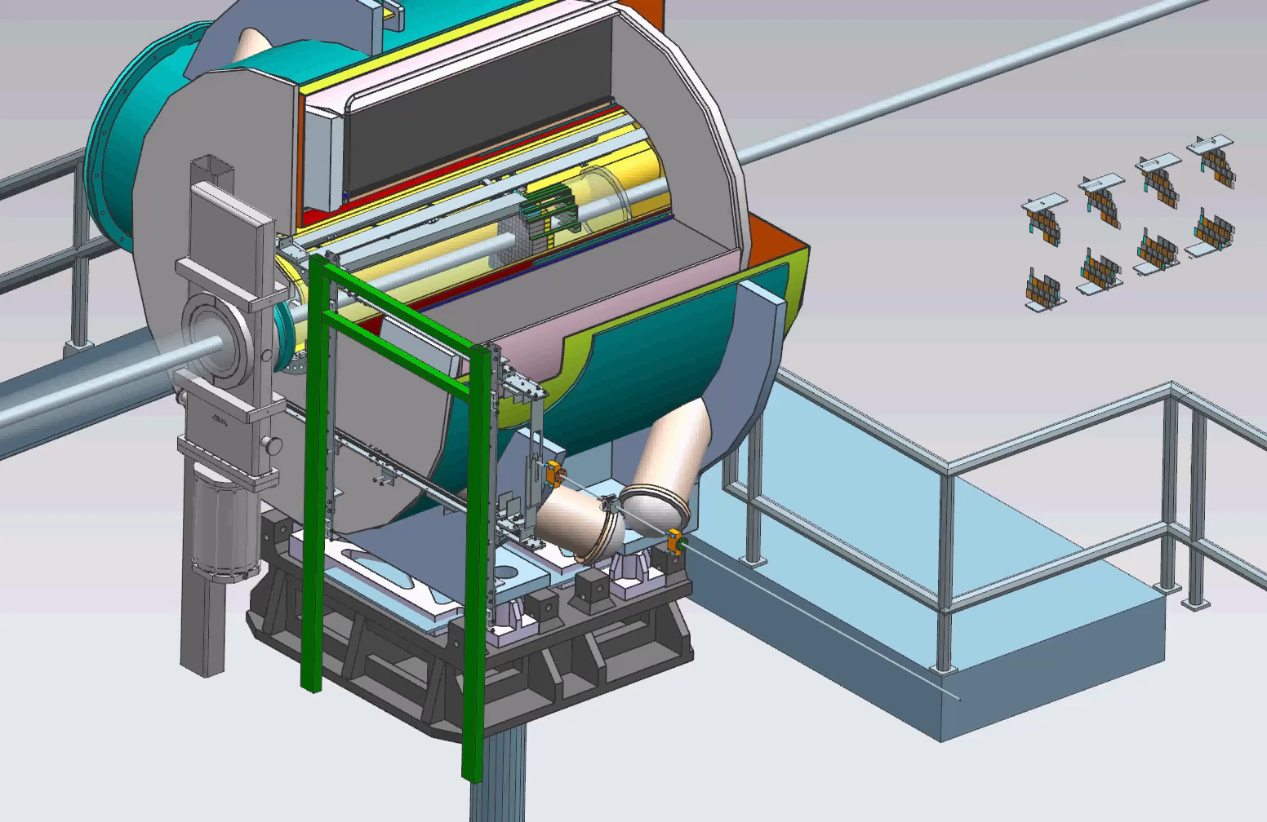
B0 Detector Placement

Slide 10
B0 Future Design Development
Further development of detector layers and calorimeter maintenance/removal rail system.
Additional structural support for a larger calorimeter (from 7cm crystals to 20cm crystals)
Pending R&D detector updates for heating/cooling requirements.

Slide 11
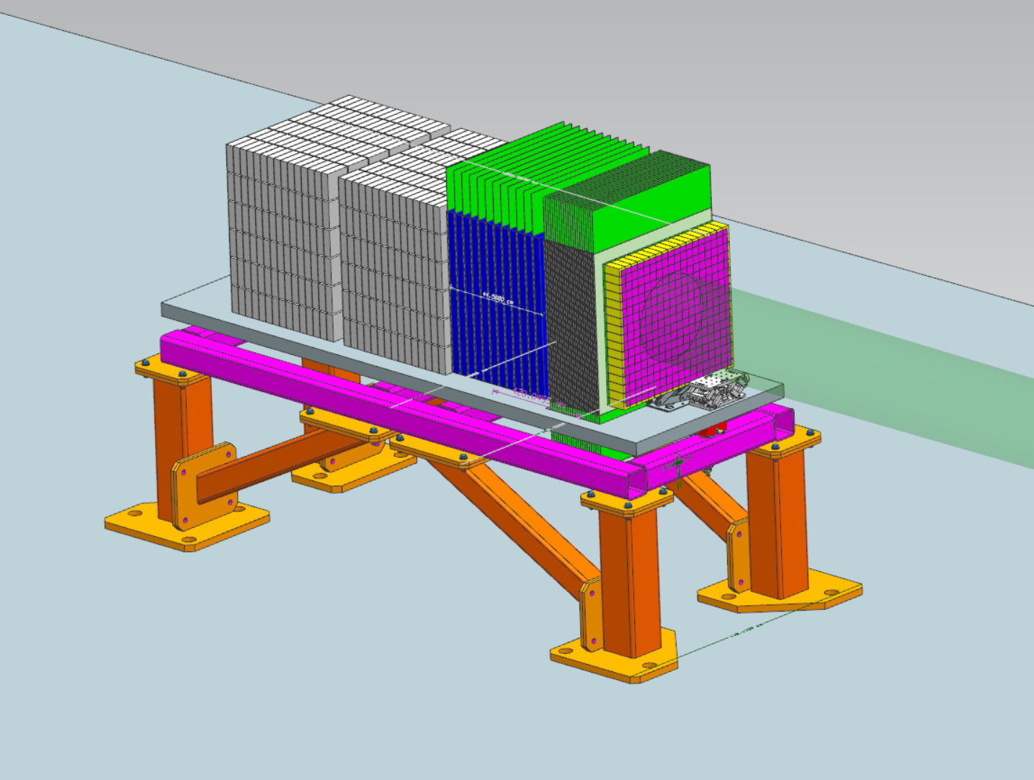
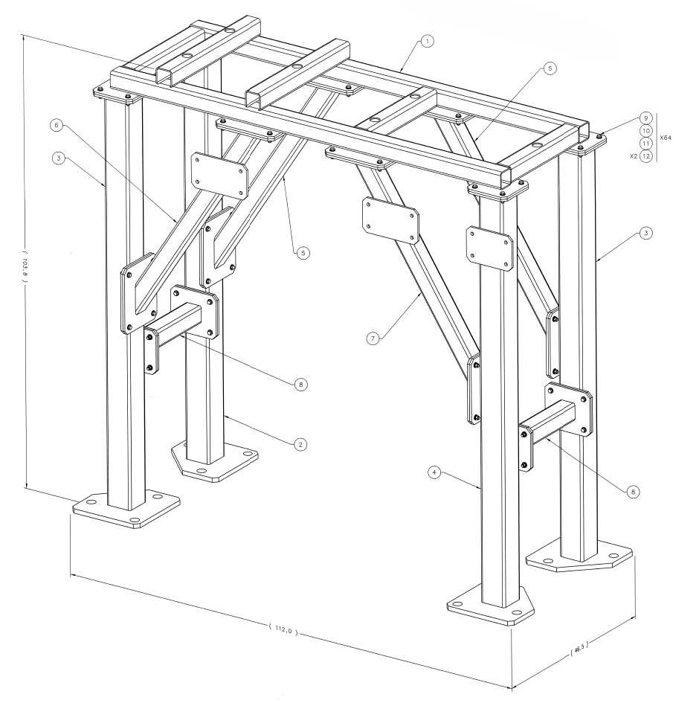
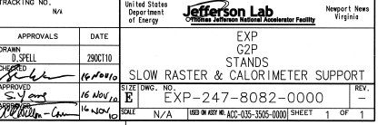
Zero-Degree Calorimeter Support
- Currently utilizing existing JLAB support designs.

Slide 12
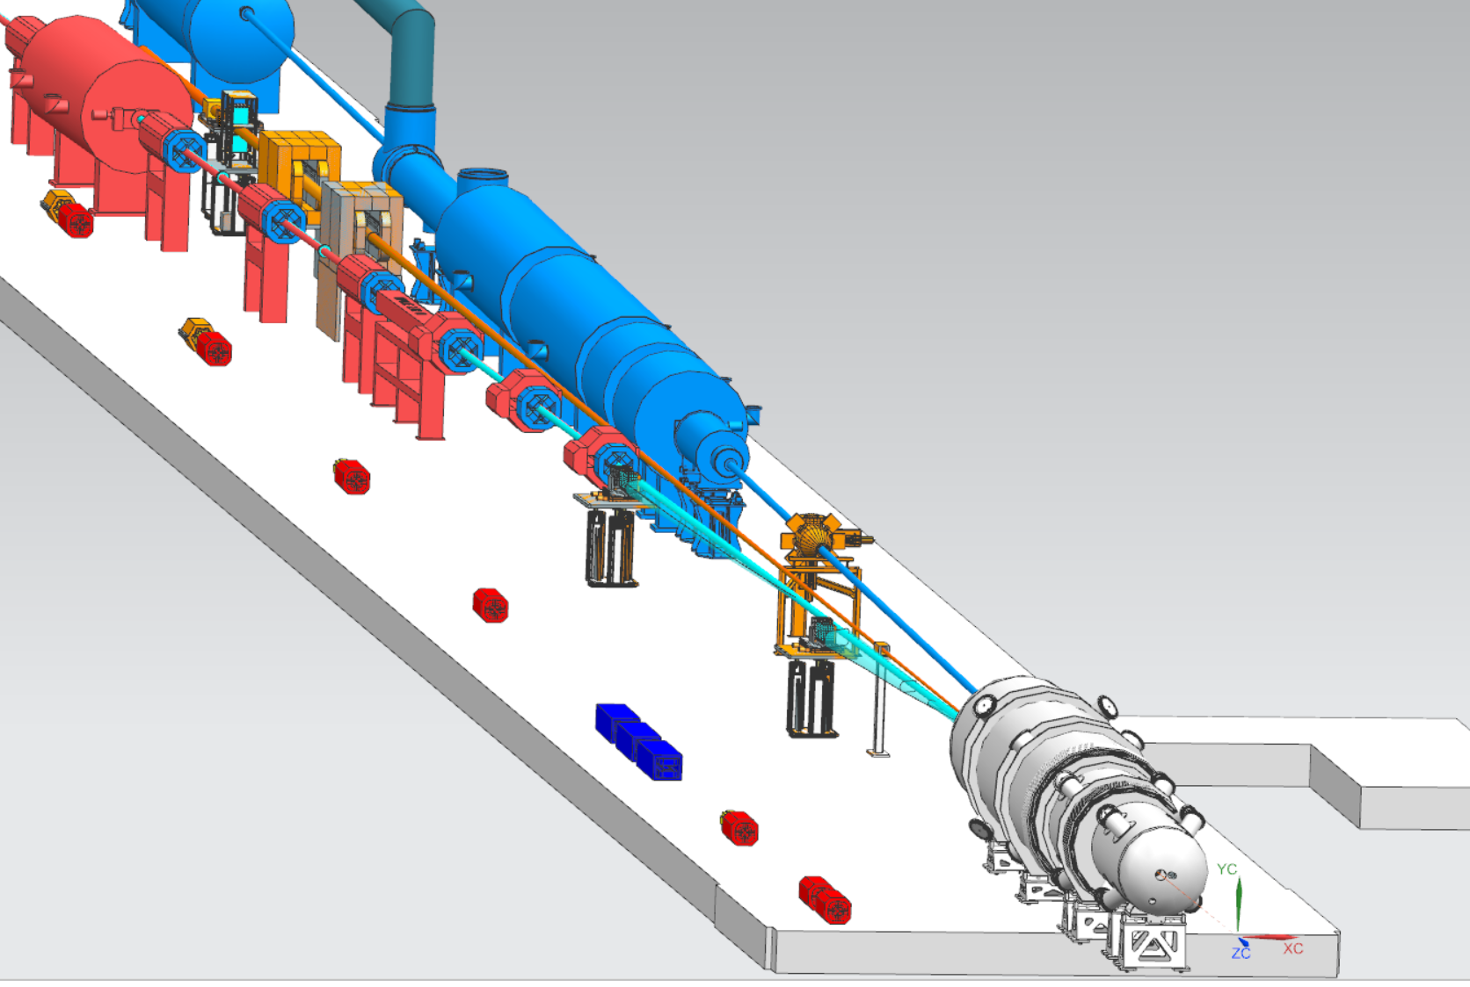
Far-Backward Region, Region 6
Lumi Spectrometer and Photon Calorimeters
Low Q2 Taggers

Slide 13
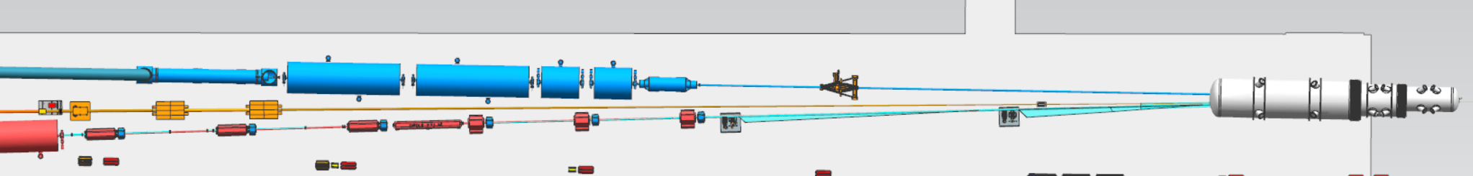
Far-Backward Region, Region 6
Lumi Detector System
Electron Detector System

Slide 14
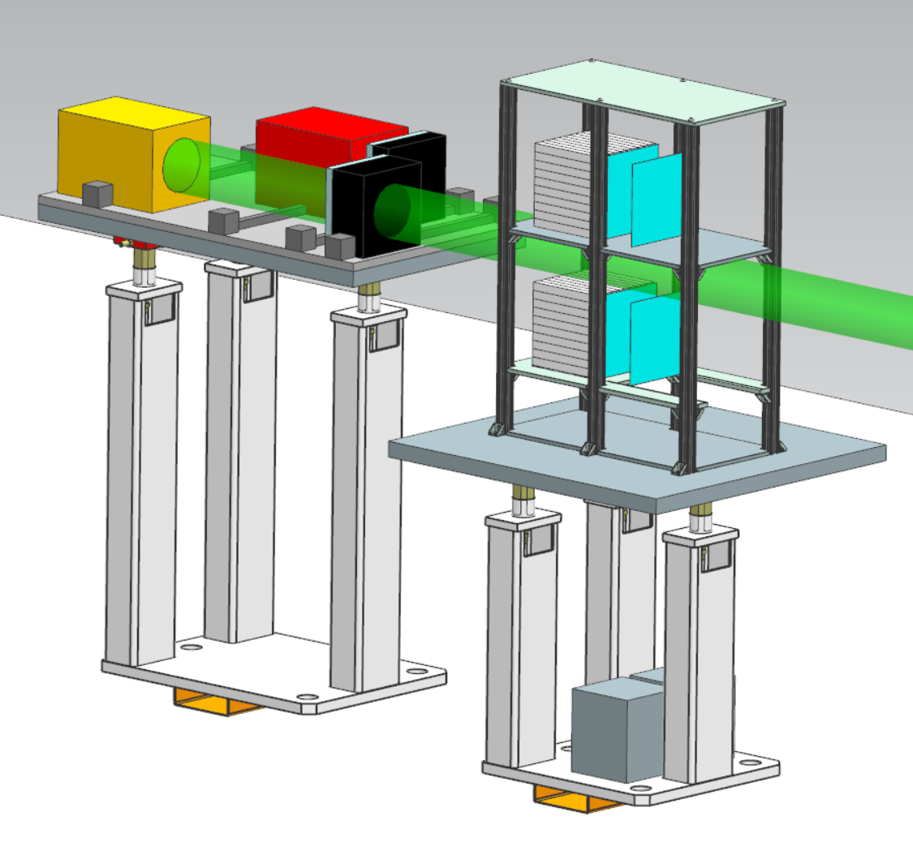
Lumi Spectrometer Detectors and Calorimeters
Currently utilizing 80/20 Supports for Photon and Spectrometer Detector Layers
Repurposing existing JLAB pedestal drawings for supports for both the Lumi and Electron Detector Systems

Slide 15
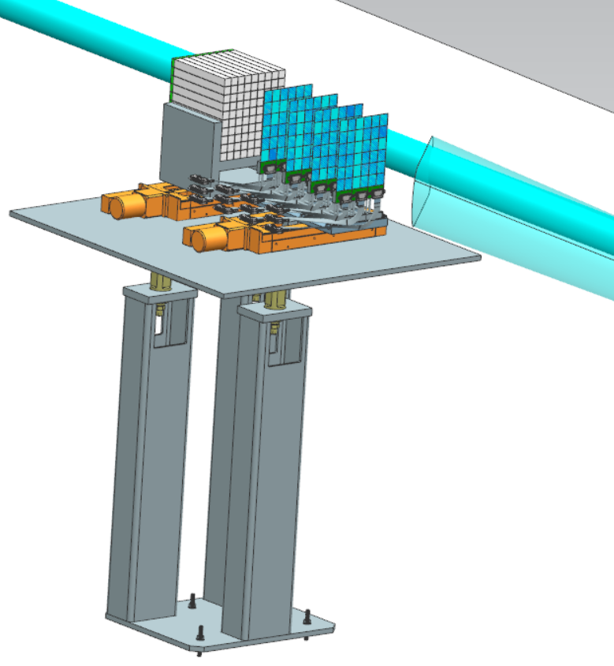
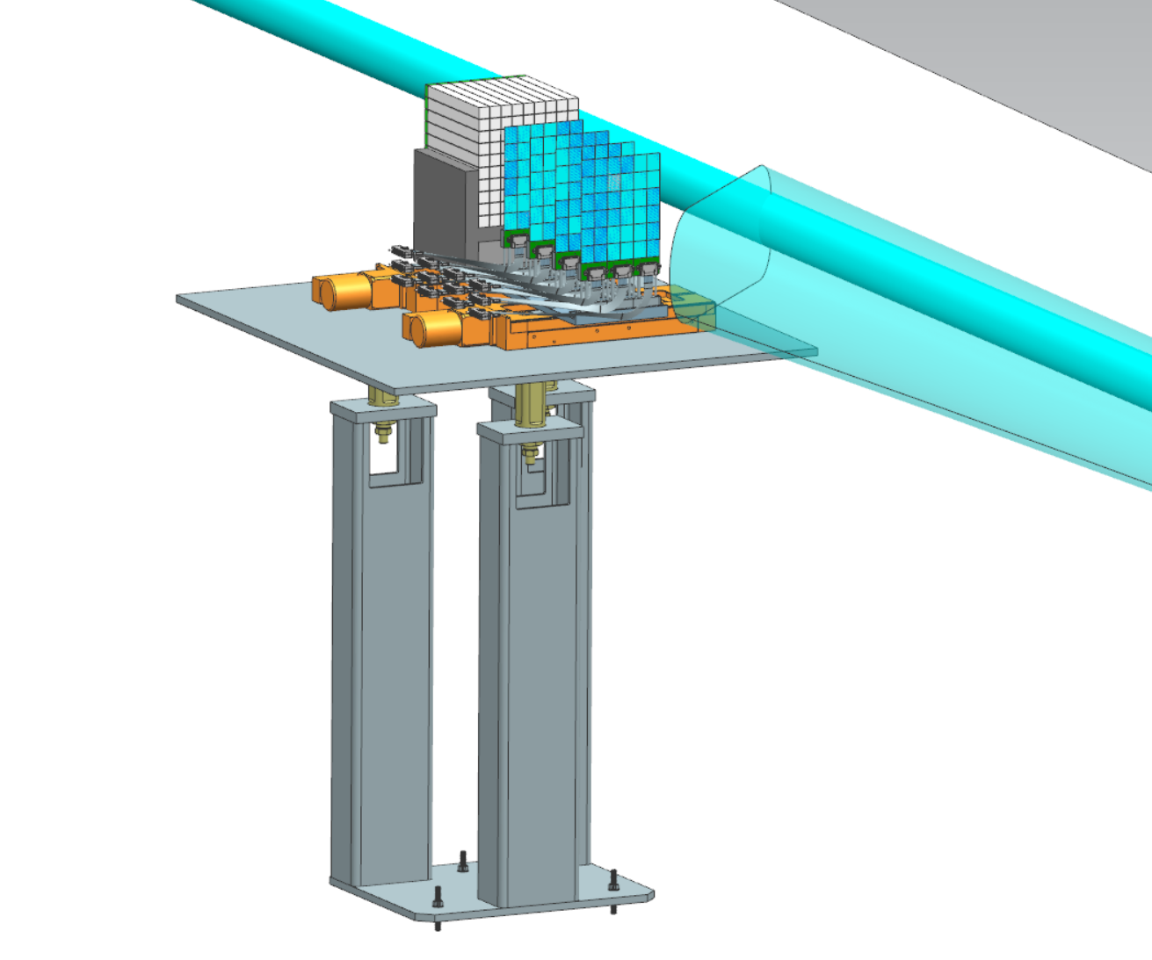
Low Q2 Tagger Stations 1 & 2
Calorimeter
(4) Detector Layers
Alignment Motor
Exit Window
Tagger Station 2
Tagger Station 1

Slide 16
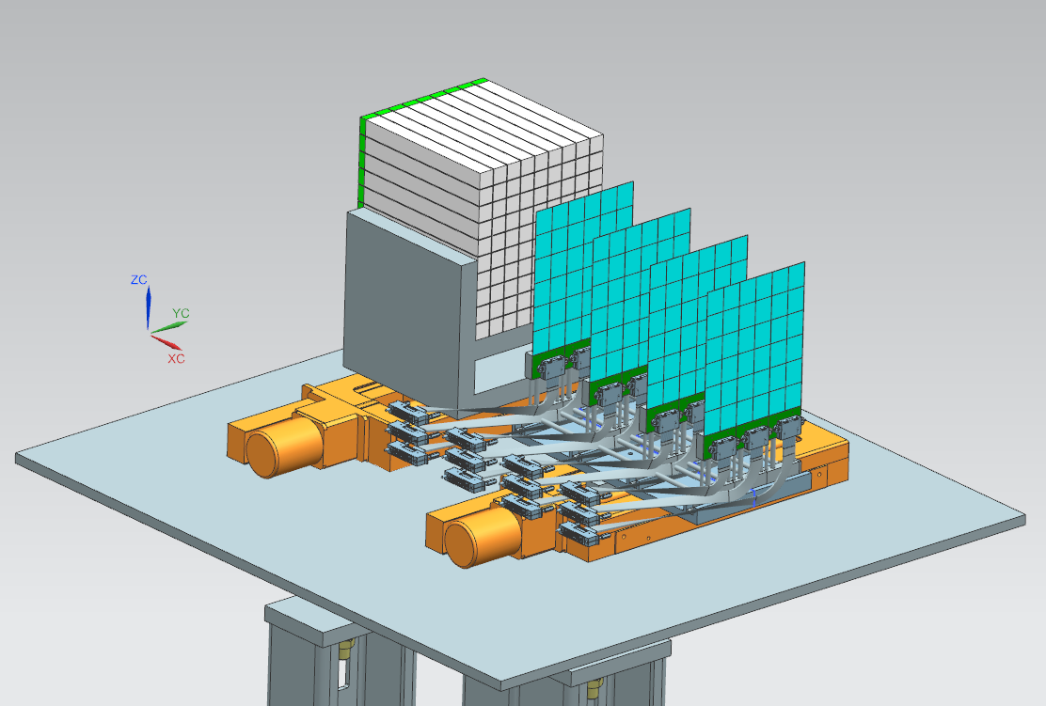
Low Q2 Tagger Detector Design
Drive motor to align Low Q2 Tagger and Calorimeter with electron beamline.
Detector layers each spaced at 10cm apart.
Each detector layer will consists of (3) individual boards.
Detector Layers (10cm Spacing)
Drive Motor
Credit: Ken Livingston & Simon Gardner

Slide 17
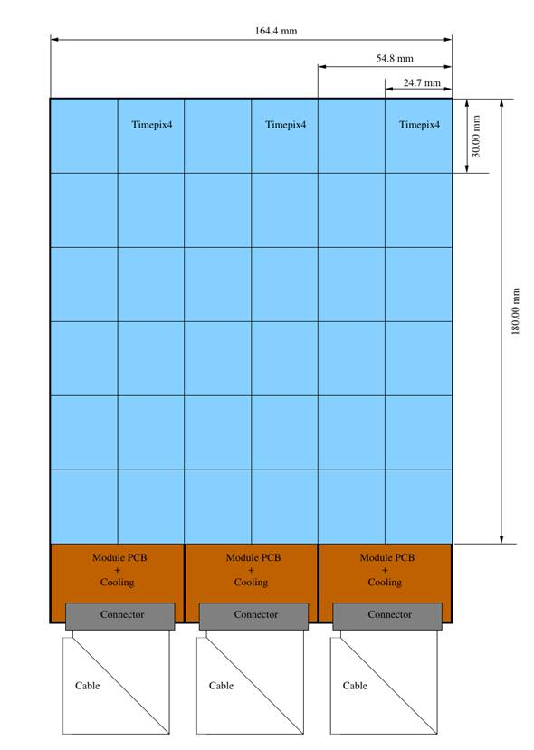
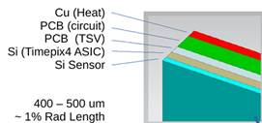
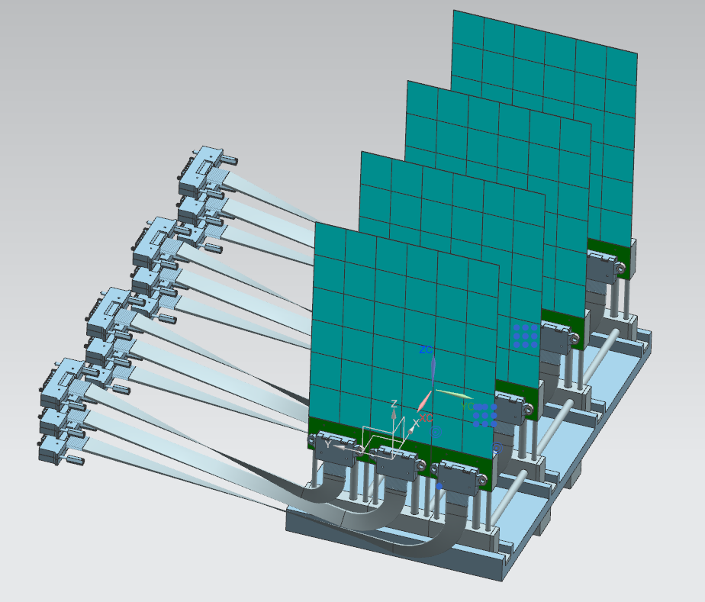
Low Q2 Tagger Detector Design (continued)

Slide 18
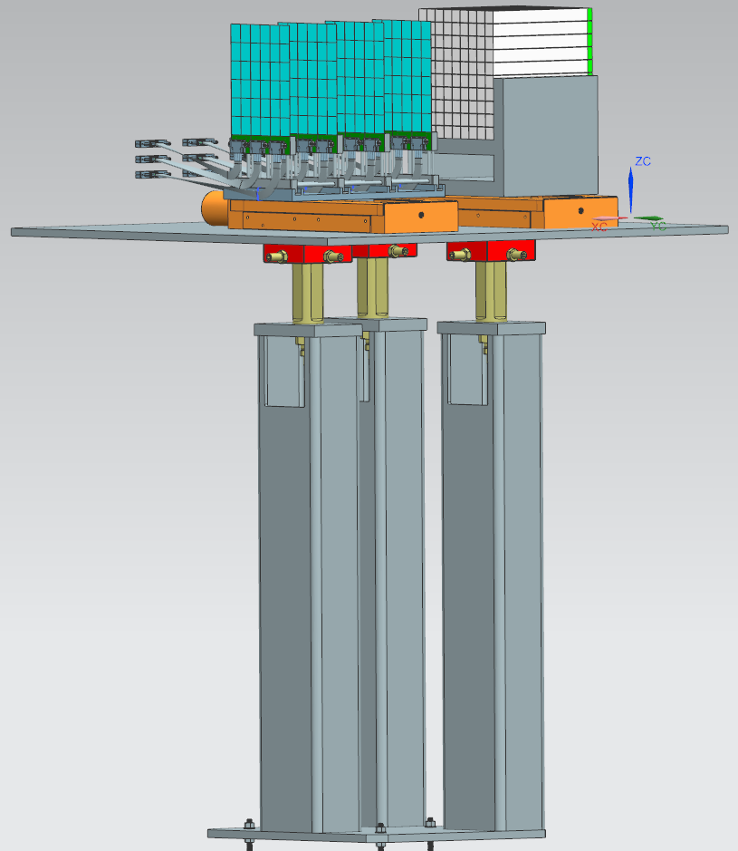
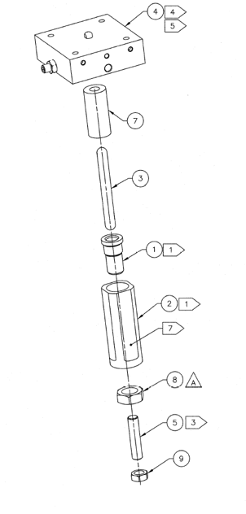
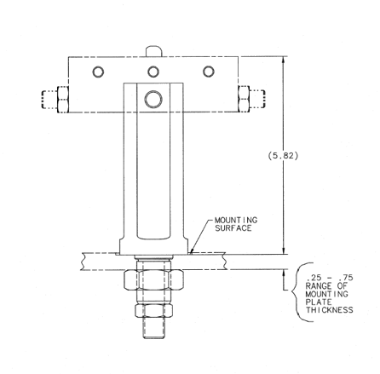
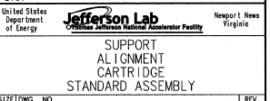
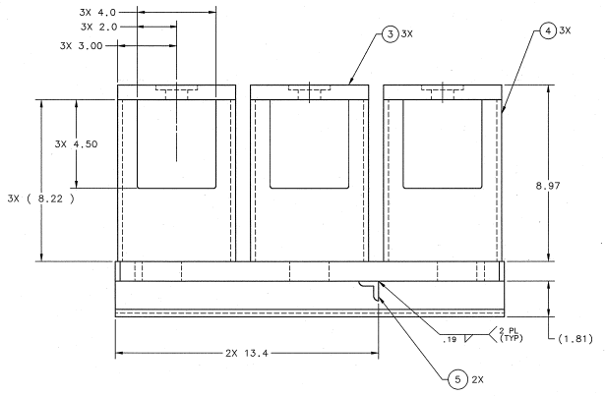
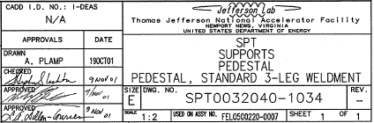
Support Tables / Hardware
Alignment cartridges enable to table top to adjust the Roll and Pitch as necessary by the user

Slide 19
Future Design Development
Establish an official design history to archive CAD model updates
Updating JLab CAD Software from NX12 to NX2306 and update file sharing requirements with BNL Windchill as necessary

