Slide 1
Data Acquisition (DAQ)/Computing
WBS 6.10.09
David Abbott (JLAB) & Jeff Landgraf (BNL)
L3 Managers
WBS 6.10.09 Data Acquisition (DAQ)
Far-forward/ Far-Backward Review
Feb. 12, 2024
Jefferson Lab

Slide 2
Outline
The technology and scale of the ePIC DAQ
  Streaming readout community
  Streaming architecture
  System components and operational concepts
  Considerations for Far Forward and Backward Subsystems
  Component counts & expected data flow
  Status of DAQ components
  DAQ computing model
Schedule
Summary

Slide 3
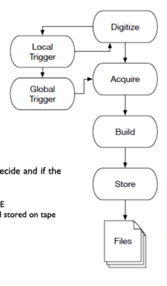
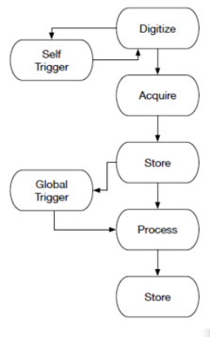
Streaming Readout
  No hardware-based trigger (well just optional…)
    Elimination of dedicated hardware and ability to select events based upon the full detector are the main advantages.
    Exposure to background and noise is the main challenge
    All front-ends are free-running (or self-triggered)
    Data flow (congestion) is managed at individual sources
  Streaming requires a common, robust and accurate distributed clock delivered and synchronized to all the front-end sub-systems.
    All data are characterized by Detector/Channel ID and a Timestamp
  Real time filtering, processing and reconstruction
    Online vs Offline tasks become blurred – but very ”flexible”
    Adds requirements such as the need for event identification & quasi-real time monitoring/calibration for filtering and physics results
    This is a focus of the ePIC Software/Computing and Streaming Working Groups
Triggered DAQ
Streaming Readout (SRO)

Slide 4
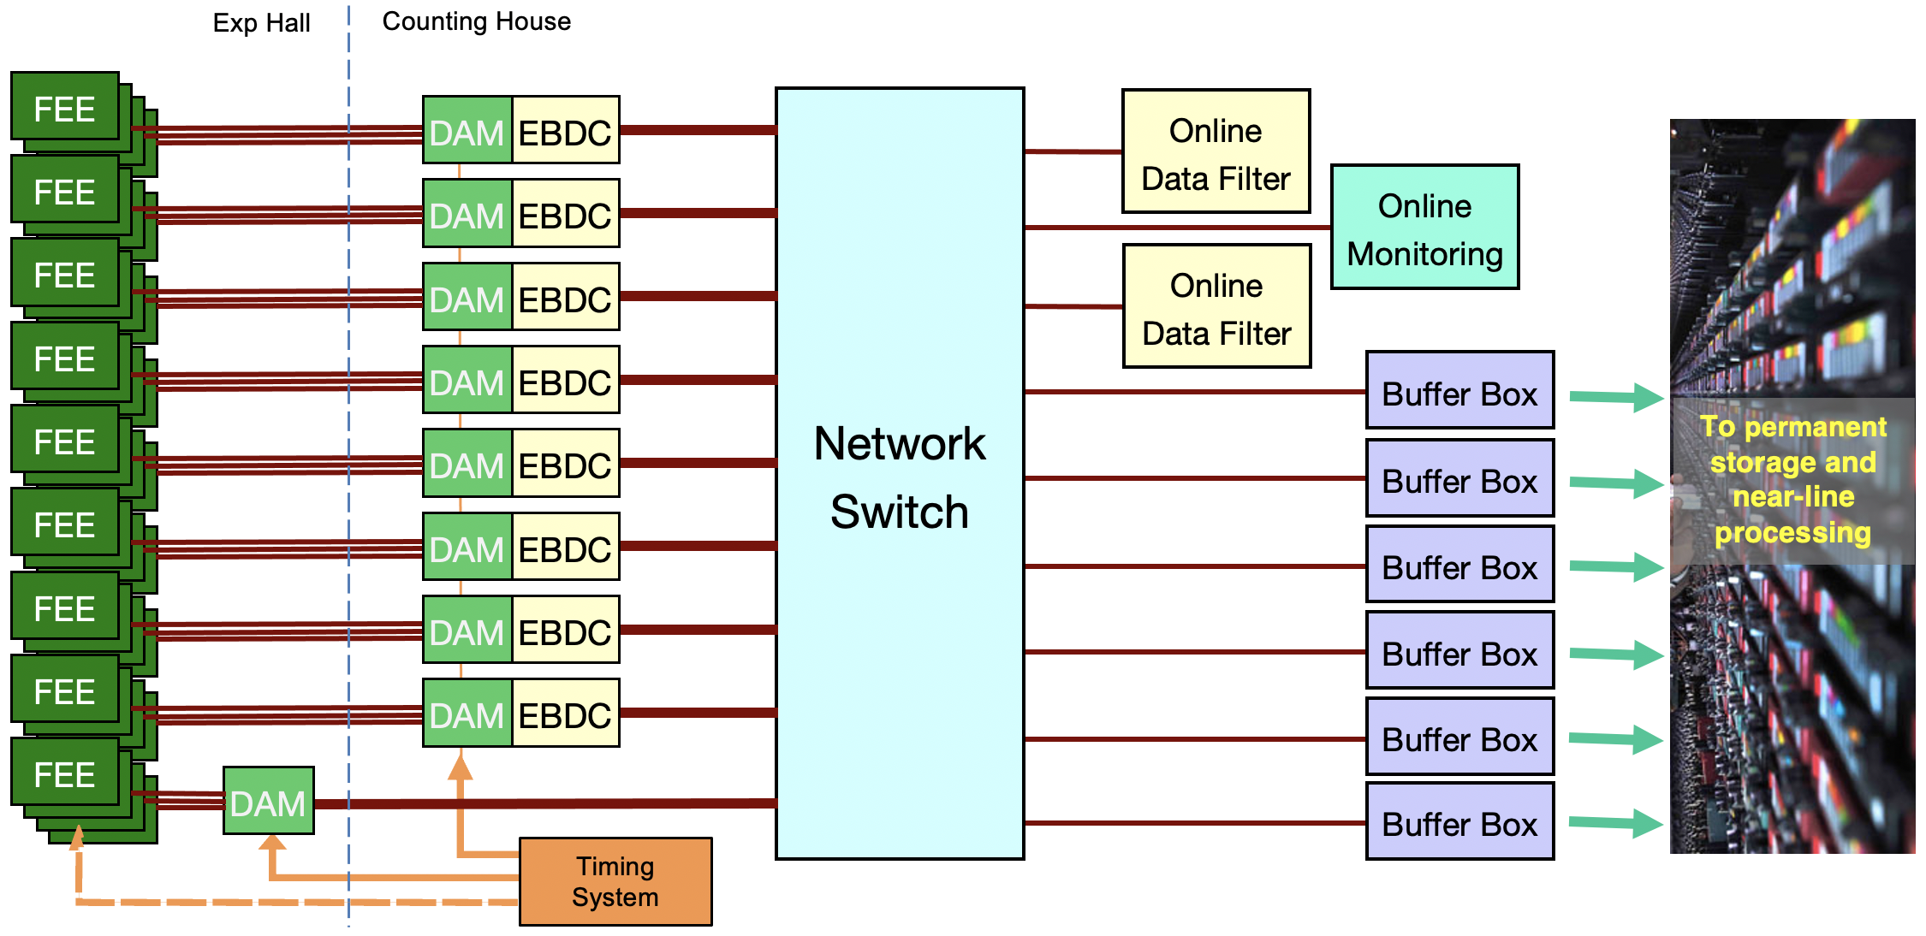
EIC Streaming DAQ/Computing Architecture
Bunch Crossing ~ 10.2 ns/98.5 MHz
Interaction Rate ~ 2 us/500 kHz
Low occupancy
BW O(100Tbps)
RDO
RDO
RDO
RDO
ePIC DETECTOR
BW O(10Tbps)
RDO
RDO
RDO
BW O(100Gbps)
RDO
RDO
GTU/Distributed clock
(jitter ~5ps)

Slide 5
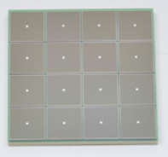
ePIC Readout Chain
Global Timing Unit (GTU)
-Interfaces to Collider, Run Control & DAM
-Config & Control
-Clock & Timing
DAQ/Computing
WBS Focus
On Detector
SMT BGA
Name
Design
Function
Attributes
Sensor
Detector Specific
Multi-Channel Sensor
MAPS, AC-LGAD
MPGD, MCP-PMT
SiPM, LAPPD
Adapter
Detector Specific
-HV/Bias Distribution
-HV divider
-Interconnect Routing
-Sensor Specific
-Passive
Front End Board
(FEB)
Detector Specific
-Amplification
-Shaping
-Digitization
-Zero Suppression
-Bias Control & Monitoring
-ASIC/ADC
-Discrete
-Serial Link
Readout Board
(RDO)
Few Variants
-Communication
-Aggregation
-Formatting
-Data Readout
-Config & Control
-Clock & Timing
-FPGA
-Fiber Link
Data Aggregation Module (DAM)
Common
-Computing Interface
-Aggregation
-Software Trigger
-Config & Control
-Clock & Timing
-Large FPGA
-PCIe
-Ethernet
Computing
Common
-Data Buffering and Sinking
-Calibration Support
-QA/Scalers
-Collider Feedback
-Event ID/Building
-Software Trigger
-Monitoring
-COTS
-Ethernet

Slide 6
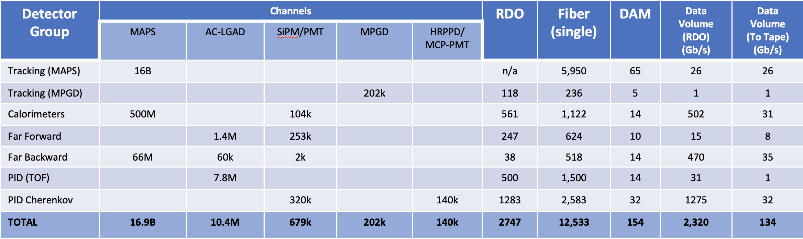
Summary of ePIC Channel Counts and Data Flow
ePIC Detector
24 total sub-systems
General Strategy
  Supply enough bandwidth to account for maximum data volume to the DAM boards
  Apply cross-detector correlation filters with other sub-systems in the Online Farm and Readout computers including AI/ML techniques to reduce recorded data volume
Summary of Data Flow
Detector
FEB
Copper
RDO
Fiber
DAM
PCI/Eth
Readout Computer
Eth
100% Occupancy | 27.5-1760 Pb/sec
Aggregate | 134 Gb/sec
Collision Signal | 40 Gb/sec
Synchrotron Rad | .01 Gb/sec
Electron Beam | 57 Gb/sec
Hadron Beam | 4 Gb/sec
Noise | 33 Gb/sec
Aggregate | 2.3 Tb/sec
Noise | 1.9 Tb /sec
Signal from Physics + Background | 400 Gb / sec
Aggregate | 2.0 Tb/sec
Per RDO (Avg) | 0.7 Gb/sec

Slide 7
Summary of ePIC Channel Counts and Data Flow
ePIC Detector
24 total sub-systems
Summary of Data Flow
Detector
FEB
Copper
RDO
Fiber
DAM
PCI/Eth
Readout Computer
Eth
After online processing we expect roughly equal contributions from:
- Collision hits
- Beam Background
- Noise
100% Occupancy | 27.5-1760 Pb/sec
Aggregate | 134 Gb/sec
Collision Signal | 40 Gb/sec
Synchrotron Rad | .01 Gb/sec
Electron Beam | 57 Gb/sec
Hadron Beam | 4 Gb/sec
Noise | 33 Gb/sec
Aggregate | 2.3 Tb/sec
Noise | 1.6 Tb /sec
Signal from Physics + Background | 400 Gb / sec
Aggregate | 2.0 Tb/sec
Per RDO (Avg) | 0.7 Gb/sec

Slide 8
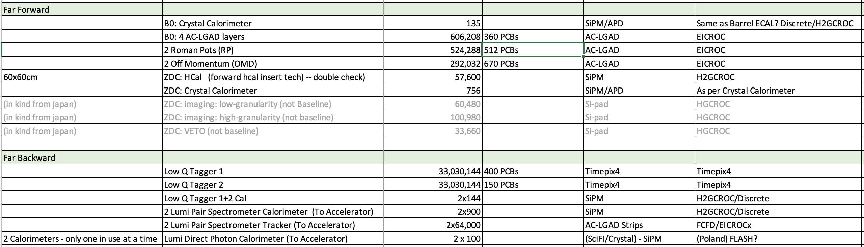
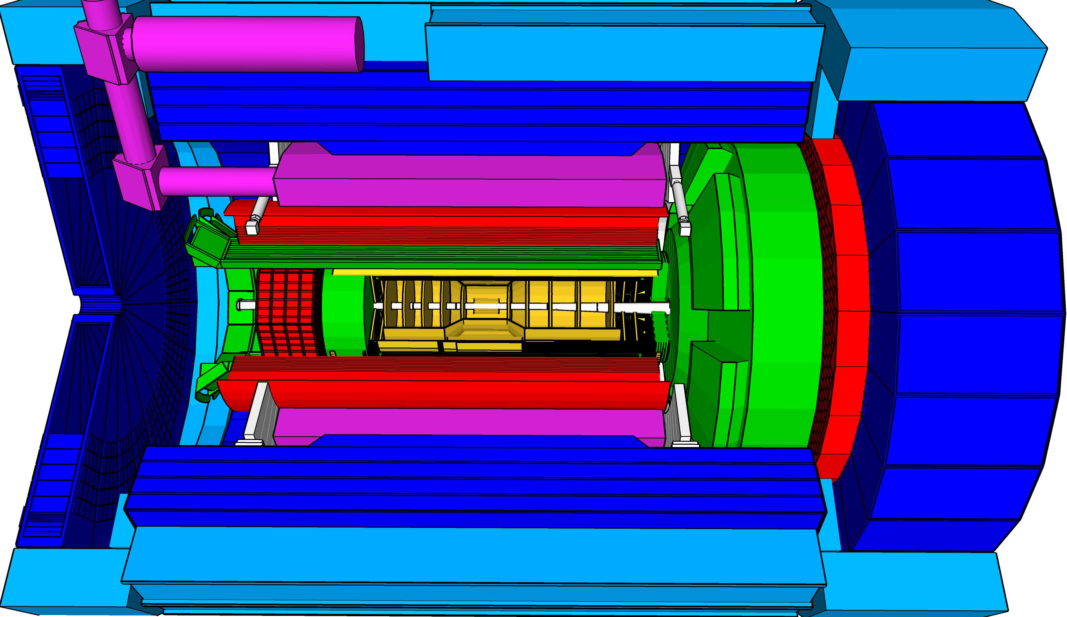
Far-Forward/Far-Backward Specifics
Detector System
Channels
Sensor Readout
ASIC/Digitizer
Most FF/FB FEB/ASIC choices are consistent with other detector sub-systems.
Requires specialized RDOs
Still finalizing readout options for some detectors
Luminosity
Monitors
low Q² electron-tagger
B0
off-Momentum
taggers
Roman
Pots
Zero-Degree
Calorimeter
p/A beam
e beam
p: 41 GeV, 100 to 275 GeV
e: 5 GeV to 18 GeV

Slide 9
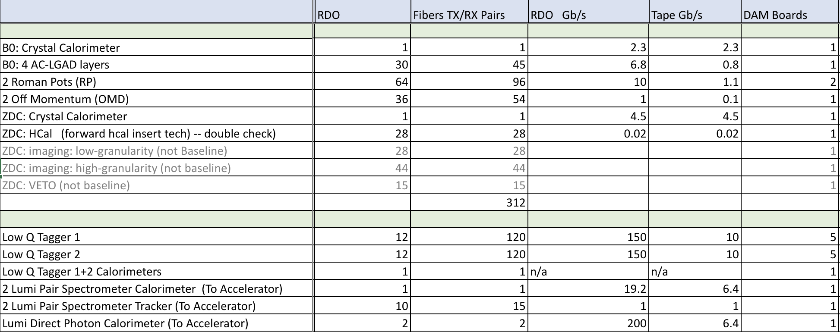
Far-Forward/Far-Backward Specifics Cont…
Detector System
Far Forward
FF/FB Systems
~ 16% of DAQ resources
~ 32% of total accepted rate
Far Backward
DAQ Considerations
Timing for most FF/FB systems important (e.g. AC-LGADs,)
Low Q2 tracker will require Physics software filtering
Lumi Direct Photon counter will require filtering and data summarization
Pair Spectrometers – data rates are “tunable” based on interactions (e-p or e-A)

Slide 10
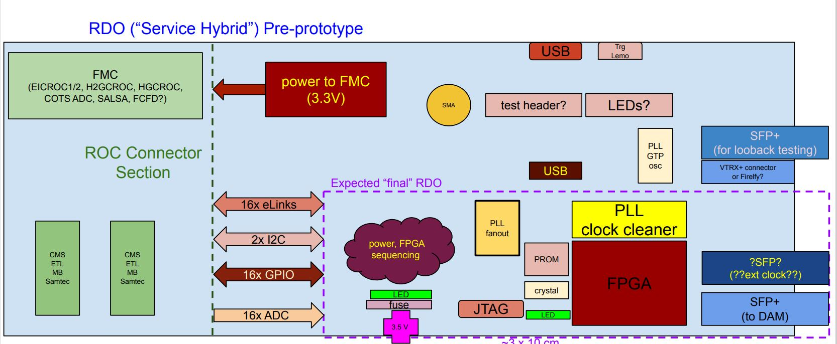
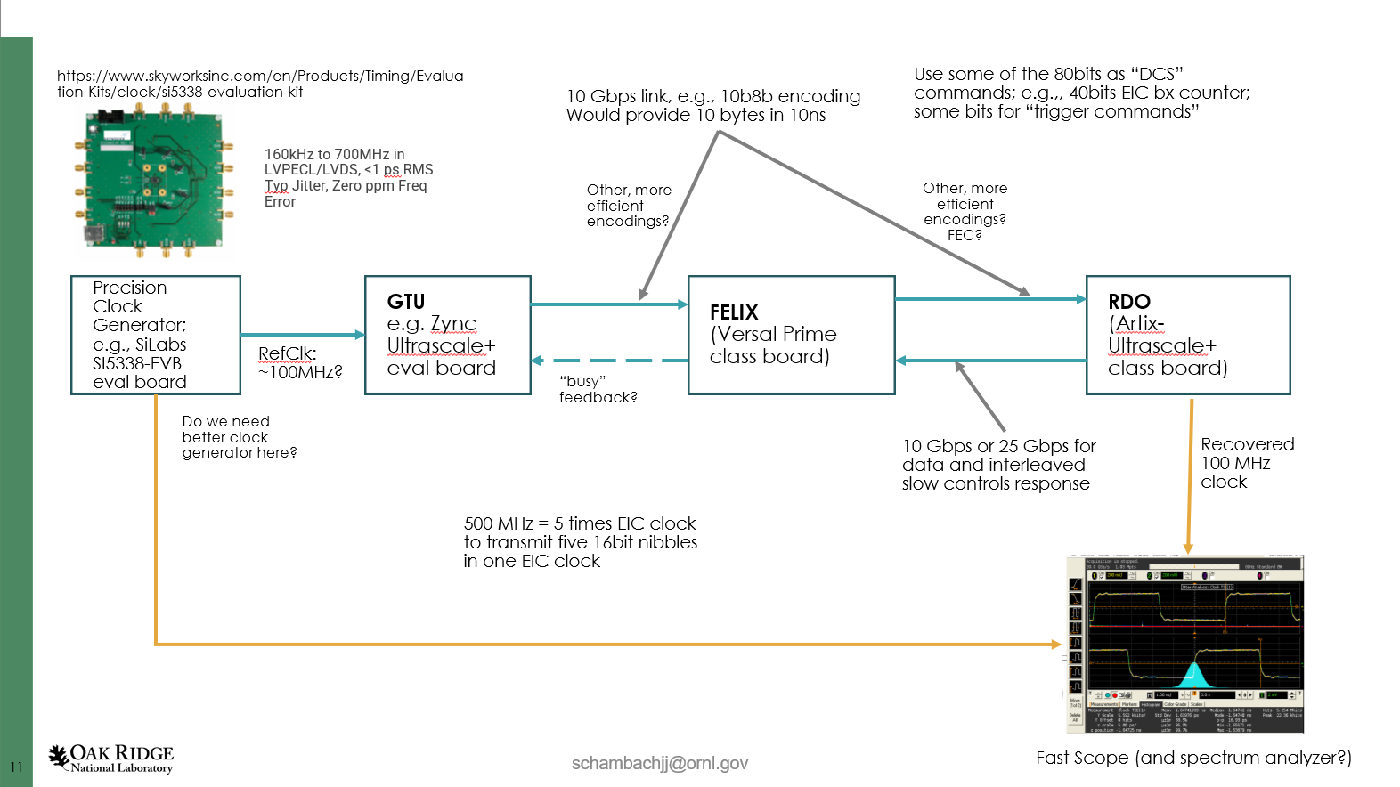
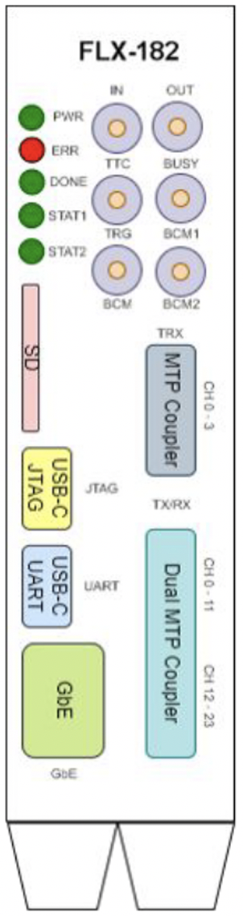
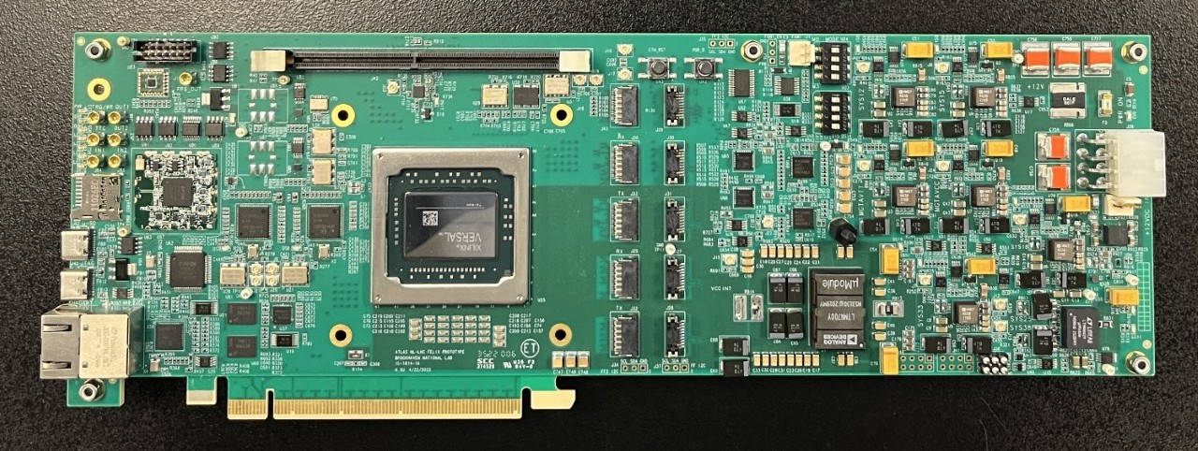
System Component Status
Detailed Electronics production starts with CD3.
The current status is that we are evaluating system design and interfaces between components.
RDO Status:
Mocking up with devkits for initial studies
Nominal 2.5” x 2.5” for common elements + connector space
FPGA defined by price (Artix Ultrascale+ Class)
Power 3-5 Watts. 2 LV +5V for optical interfaces, lower for FPGA/digital components
Accept 2 or 3 fibers for potential very low jitter timing
Optical Protocol
Defines the data flow between the GTU, RDO, and DAM boards
Optical Protocol Requirements
  Timing (<=5ps Hi-Res Detectors)
  Timing (<=100ps Lo-Res Detectors)
  Timing phase stability on power cycle
  Configuration and slow control monitoring passthrough for ASICS/FEBs
  Real-Time Command / Control
  Data Transfer (>=10Gb/s per RDO)
Optical protocol choices under evaluation
  ePIC – simple custom protocol
  GBT in FPGA
  Dedicated Clock/Reconstructed Clock (2 or 3 fibers per RDO)
GTU status:
Mocking up with devkits for initial studies
Interface to collider (Bunch crossing clock, Spin Patterns per bunch crossing)
Distribution of timing to ~150 DAMs + ~220 RDOs of Hi-Res Timing Detectors
User command interface & distribution
Interface to Run Control
DAM Status:
FELIX engineering article obtained
Xilinx Versal FPGA
PCIe Gen4 x16 or 100Gb Ethernet output
24 Firefly links up to 25Gb/s options
Additional front panel I/O
48 link upgrade planned in 2024

Slide 11
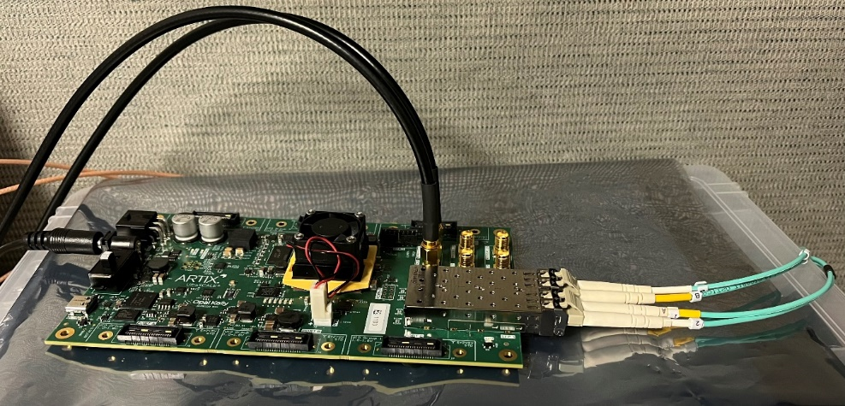
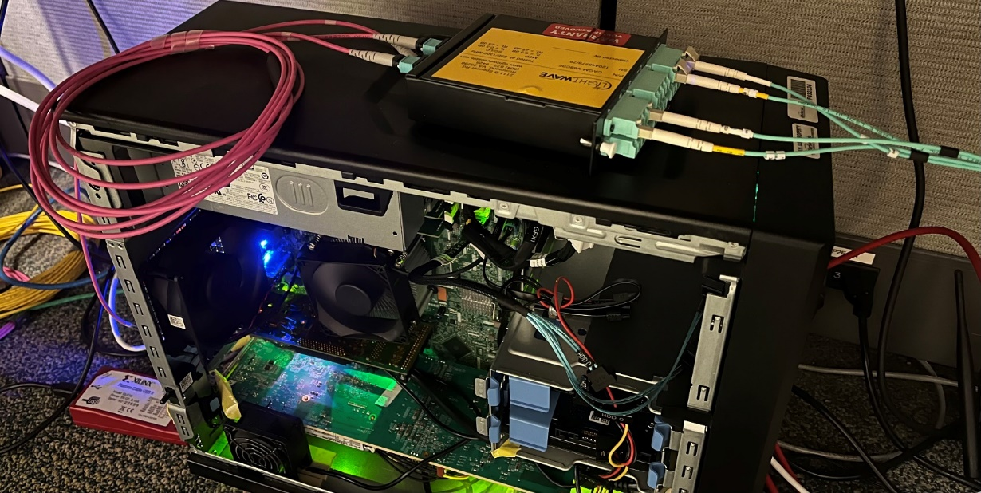
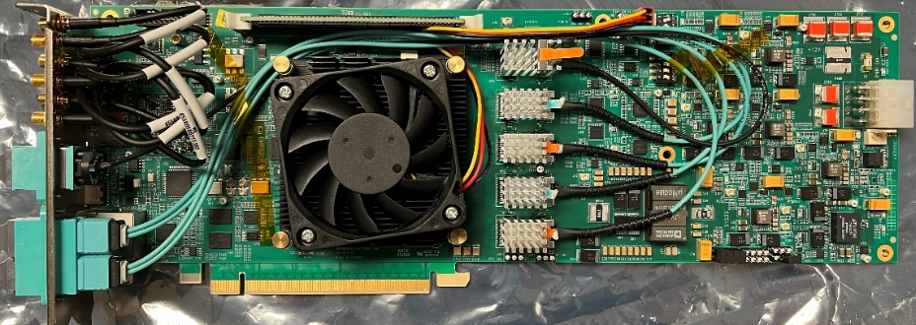
DAQ/Computing tasks in 2024
Finish timing studies
  Define clock/command distribution protocol
  (Do we need dedicated fiber for the clock?)
  Refine requirements for the GTU
  (scale of the distribution)
Establish requirements for FELIX development to define EIC DAM Board.
Finalize expected RDO counts for all detector sub-systems and required interfaces with FEB electronics (ASICS).
Better estimates of backgrounds and expected data volumes.
All for development of the TDR and CD2 baseline.
XEM8320,
Artix Ultrascale+
(RDO)
FLX182

Slide 12
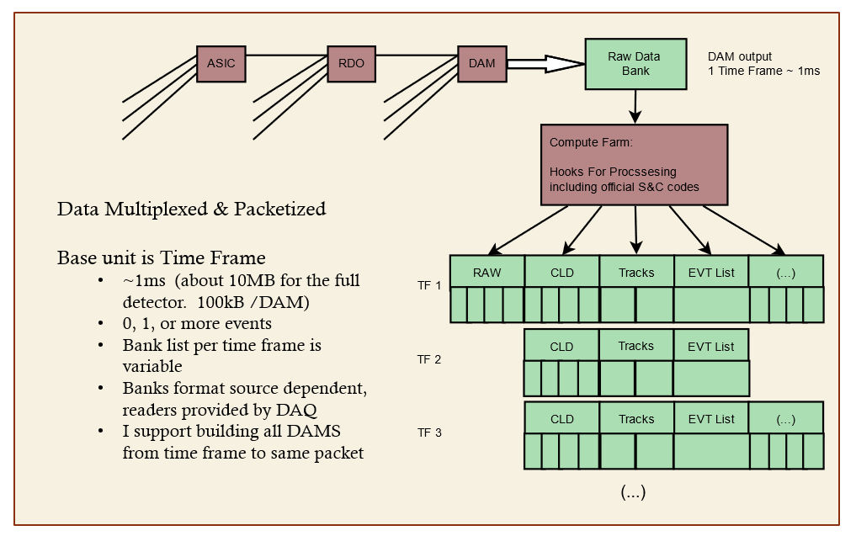
DAQ Computing - Streams
DAQ
Time Frames (~665µs)
  ~350 collisions per Frame
  ~10MB data per Frame
  ~2.0MB input per DAM
  ~100kB output per DAM
Online Computing
Routing data
Formatting data
Processing data
  DAM FPGA & CPUs
  Cluster finding
  Software filters
  Sanity Checkers
  QA Monitoring
  Metadata
  Slow controls integration
Scalers / continuously running DAQ components
Additional “Banks” can be created to facilitate online processing
  Bank structure can be variable for different time frames.
  Bank format can differ depending on the data source.

Slide 13
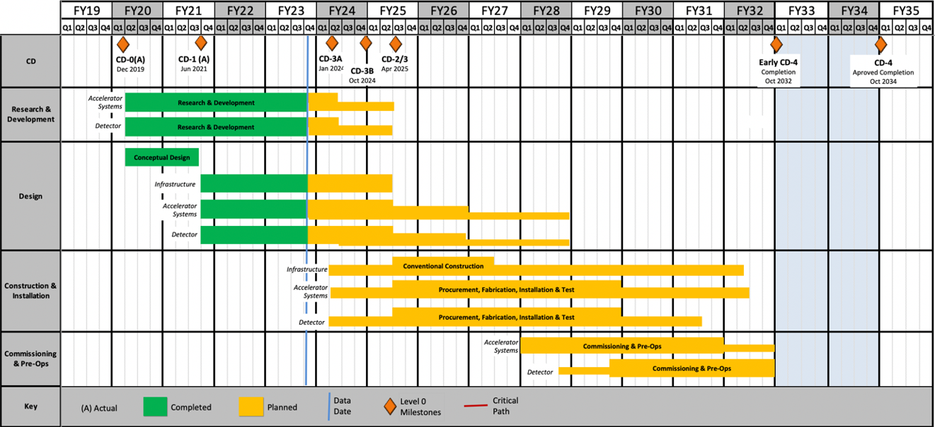
DAQ/Online Schedule
The DAQ and computing schedule is planned to be accelerated in relation to the full detector construction.
A functional DAQ will be necessary for small scale detector testing as well as commissioning and pre-ops.
Computing resources are staged to make purchases when the hardware is needed, taking advantage of price savings and performance improvements in time.
Hardware and software development early in the construction phase will produce a series of releases with increasing functionality.
Detector Install: FY29Q2 - FY31Q2
Cosmics: FY31Q3
Early CD-4: FY32Q1
DAQ Releases:
PicoDAQ FY26Q1
  Readout test setups
MicroDAQ: FY26Q4
  Readout detector data in test stand using engineering articles
MiniDAQ: FY28Q1
  Readout detector data using full timing chain
Full DAQ-v1: FY29Q2
  Full functionality DAQ ready for full system integration & testing
Production DAQ: FY31Q3
Ready for cosmics
Mini
DAQ
Production
DAQ

Slide 14
Summary
We have given a quantitative picture of the scope, scale and technologies we expect to require for the ePIC Data Acquisition System.
Technical, Cost, Schedule and EH&S risks mitigated by:
  Significant COTS-based solutions
  Existence of viable candidate for a front-end interface and data management hardware (DAM - FELIX)
  Accelerated schedule for detector sub-system readout support is planned
Integration plans for all the detector subsystems are currently under development.
  Channel counts, data volumes, and FEB<->RDO interface requirements are being refined.

Slide 15
Back-up

Slide 16
EIC SRO Community
The EIC Streaming Readout (SRO) Consortium
  Formed in 2018 with the goals of engaging the nuclear physics community to explore a streaming readout architecture for the EIC detectors.
  Series of 11 workshops since 2018 (last in Dec 2023)
  Led to adoption of SRO for Yellow Report the physics program for EIC.
ePIC Electronics/DAQ Working Group
  Conveners: F. Barbosa (JLab), J. Huang (BNL), J. Landgraf (BNL)
  Regular meetings to focus on design and requirements specifically for the new ePIC detector
  Interface to detectors, readout, DAQ, online processing, monitoring and control.
ePIC Software/Computing Working Group
  Conveners: M. Diefenthaler (Jlab), S. Joosten (ANL), T. Wenaus (BNL), W. Deconinck (UM)
  Coordinate software development for EIC physics
ePIC Software/Computing Streaming DAQ Working Group
  Conveners: M. Battaglieri (JLab), J. Huang (BNL)
  Streaming Reconstruction

Slide 17
Detector System | Channels | RDO | Gb/s (RDO) | Gb/s (Tape) | DAM Boards | Readout Technology | Notes
Si Tracking: Inner Barrel (IB) Outer Barrel (OB) Backward Disks (EE) Forward Disks (HE) | 16B pixels | 136* 440* 410* 410* | 26 | 26 | 7 20 19 19 | ITS-3 sensors & ITS-2 staves / w improvements | RDO corresponds to number of VTRX+
MPGD tracking: Electron Endcap Hadron Endcap Inner Barrel Outer Barrel | 16k 16k 30k 140k | 8 8 30 72 | 1 | 0.2 | 1 1 1 2 | uRWELL / SALSA uRWELL / SALSA MicroMegas / SALSA uRWELL / SALSA | 64 Channels/Salsa, up to 8 Salsa / FEB&RDO 256 ch/FEB for MM 512 ch/FEB for uRWELL
Forward Calorimeters: LFHCAL HCAL insert ECAL W/SciFi Barrel Calorimeters: HCAL ECAL SciFi/PB ECAL ASTROPIX Backward Calorimeters: NHCAL ECAL (PWO) | 63,280 8k 16,000 7680 5,760 500M pixels 3,256 2852 | 74 9 64 9 32 340 18 15 | 502 | 28 | 2 1 2 1 1 8 1 1 | SiPM / HG2CROC SiPM / HG2CROC SiPM / Discrete SiPM / HG2CROC SiPM / HG2CROC Astropix SiPM / HG2CROC SiPM / Discrete | Assume HGCROC 56 ch * 16 ASIC/RDO = 896 ch/RDO 32 ch/FEB, 16 FEB/RDO estimate, 8 FEB/RDO conserve. HCAL 1536x5 *HCAL insert not in baseline Could be 7x this if choose to have RDO for every Stave 24 ch/feb, 8 RDO estimate, 23 RDO conservative
Far Forward: B0: Crystal Calorimeter 4 AC-LGAD layer 2 Roman Pots 2 Off Momentum ZDC: Crystal Calorimeter 20 Silicon pad layer 3/1 Silicon pad layers HCAL | 135 606,208 524,288 292,032 756 60,480 134,640 57,600 | 1 30 64 36 1 28 59 28 | 15 | 8 | 1 1 2 1 1 1 2 1 | SiPM AC-LGAG / EICROC AC-LGAD / EICROC AC-LGAD / EICROC APD HGCROC as per ALICE FoCal-E HGCROC as per ALICE FoCal-E SiPM | 4 layer x 37 module x 4 EICROC x 1024 ch 2 stations x 2 layer x 32 module x 4 EICROC x 1024 ch 2 stations x 2 layer x 18 module x 4 EICROC x 1024 ch 20 Low granularity layers 3 High granularity layers + Veto Layer 3 blocks
Far Backward: 2 x Low Q Tagger 2 x Low Q Tagger Cal 2 x Lumi PS Calorimeter 2 x Lumi PS tracker Direct Photon Lumi Cal | 66M pixels 144 1750/48 60k 81 | 24 1 1 10 2 | 300 - 19 1 150 | 20 - 7 1 7 | 10 1 1 1 1 | Timepix4 SiPM (SiPM/HG2CROC) or(PMT/FLASH) AC-LGAD: FCFD or EICROC (strip) SiPM | Software Trigger to reduce output rate Low Q Calorimeter doesn't run at high luminosity
PID-TOF: Barrel Endcap | 2.2M 5.6 M | 288 212 | 31 | 1 | 8 6 | AC-LGAD: FCFD or EICROC (strip) AC-LGAD: EICROC (pixel) | bTOF 128 ch/ASIC, 64 ASIC/RDO eTOF 1024 pixel/ASIC, 24-48 ASIC/RDO (41 ave)
PID-Cherenkov: dRICH pfRICH DIRC | 317,952 69,632 69,632 | 1242 17 24 | 1240 24 11 | 13.5 12.5 6 | 30 1 1 | SiPM / ALCOR HRPPD / EICROC (pixel) MCP-PMT (or HRPPD) | Worse case after radiation. Includes 30% timing window. Requires further data volume reduction software trigger

Slide 18
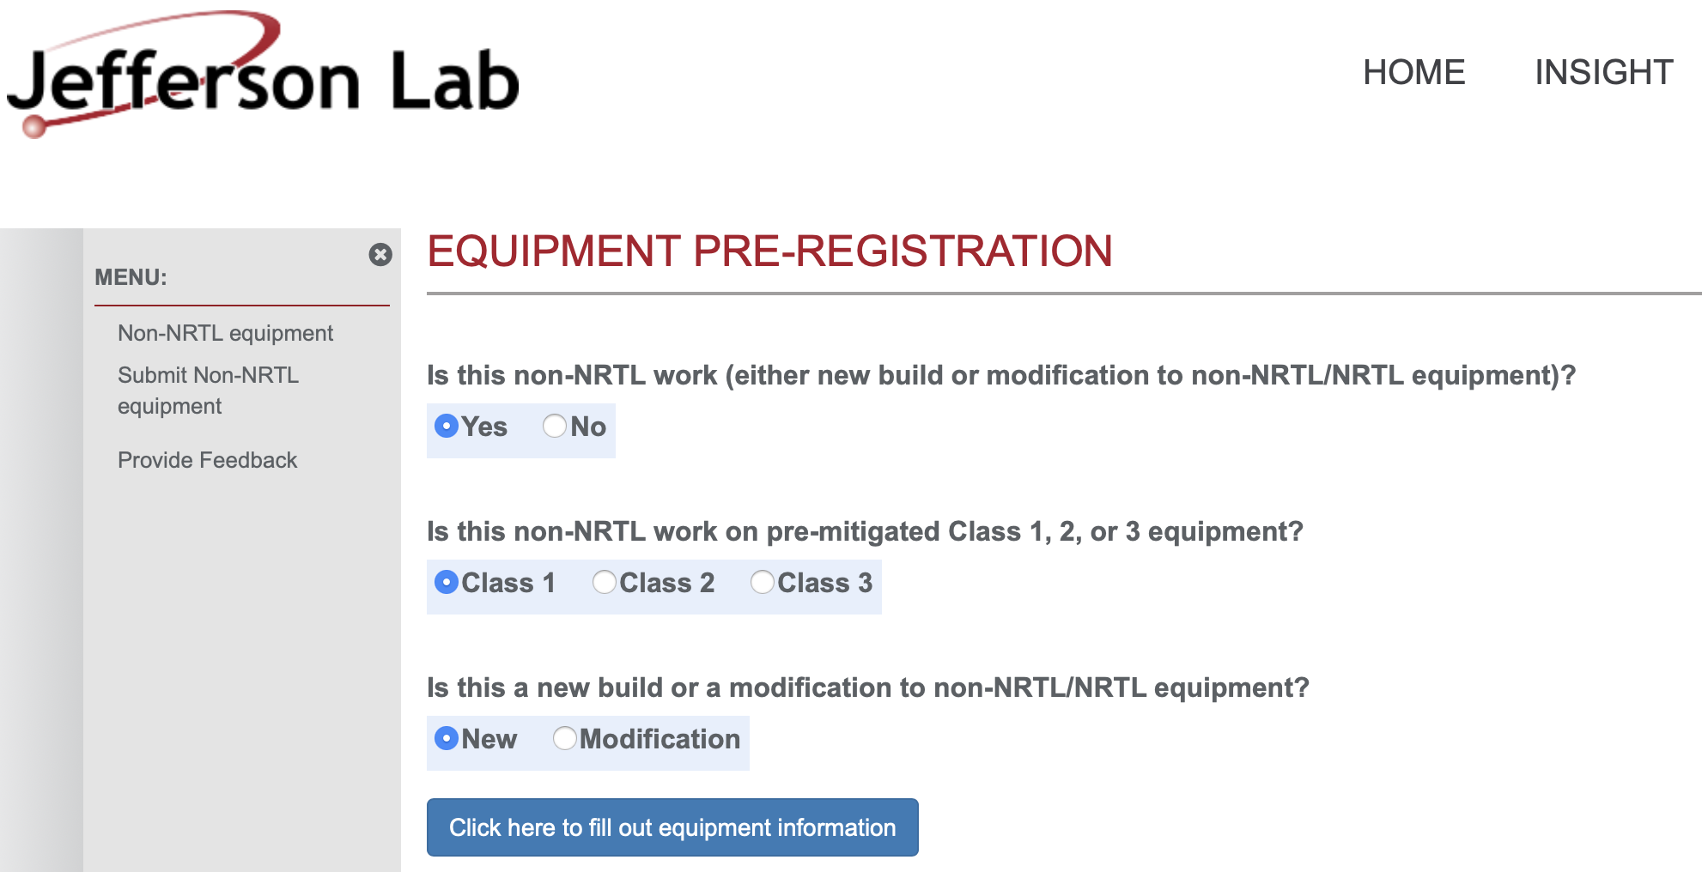
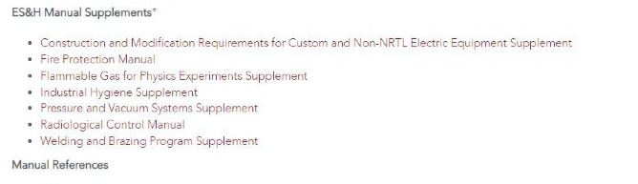
ES&H Considerations
Charge 6
Both JLab and BNL have EHS&Q processes for “in-kind” Electronics
At JLab, custom electronics built by collaborators for use in experiments must go through a registration process first. This includes any equipment that is NOT certified by a Nationally Recognized Test Lab (NRTL) like UL and recognized by OSHA.
The JLab EHS&Q Manual has a supplement guide for construction and/or modification of any custom or non-NRTL equipment.
BNL Experimental Safety Review Process
  The experimental details and hazards are submitted to the ESH Coordinator
  An ESR form must be submitted to the C-A department
  The local representative must give a formal presentation to an ESH committee
  Before operations, the equipment must be inspected by the review committee and approved for operation

Slide 19
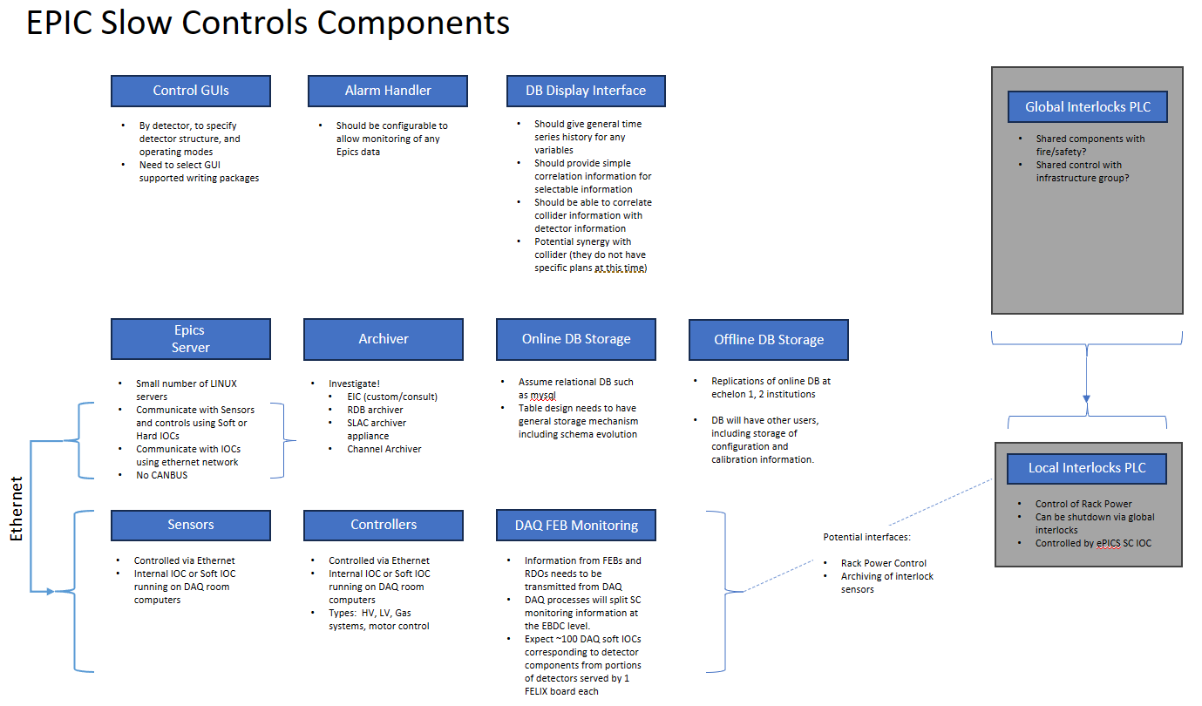
Slow Controls Integration
Slow controls
  Outlining design
    Interlocks
    SC infrastructure
    Gather info regarding detector needs

Slide 20
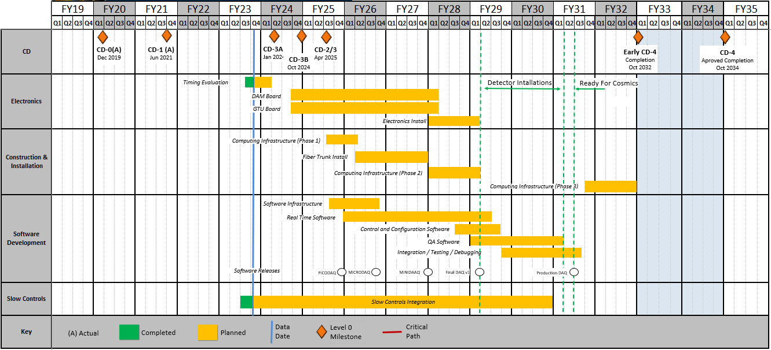
Detailed DAQ Schedule
Releases:
PICODAQ:
  Communicate with electronics test setup
MICRODAQ:
  readout detector data in test stand
MINIDAQ:
  readout detector data using full timing chain
Final:
  Full functionality DAQ

Slide 21
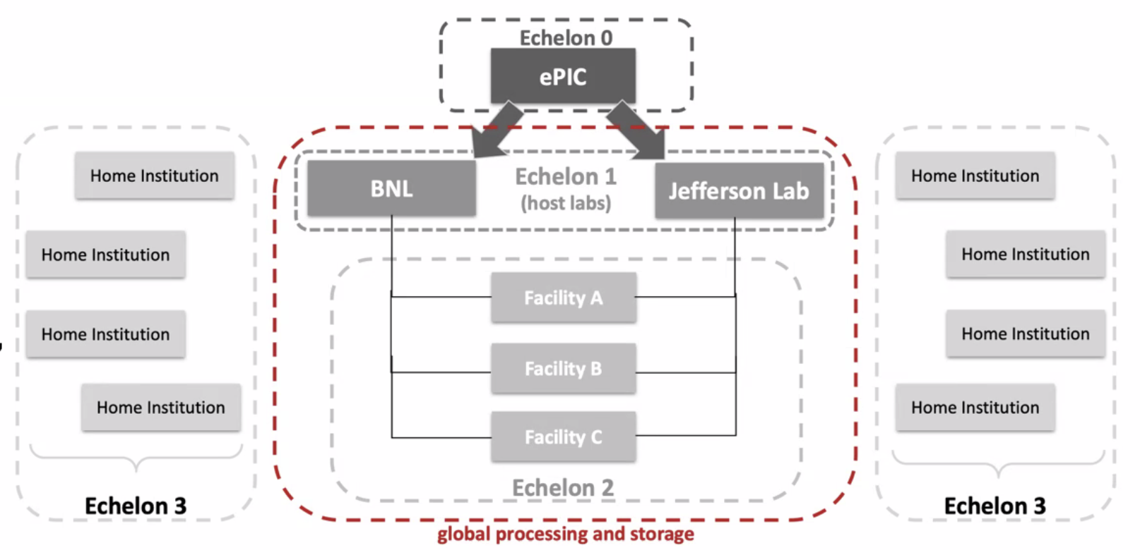
Boundary between Online and Offline
Charge 1
The streaming architecture allows for some blurring of the offline and online processing with respect to calibrations, QA monitoring, and potential seed analysis to improve reconstruction turn around. These aspects are not yet fully specified.
Require an interface to allow sharing of code between offline / online processing
Local buffering (Echelon 0) provides elasticity in the transfer of data to computing facilities
Offline buffering (Echelon 1) will allow several weeks for calibration and reconstruction.
ePIC Scientific Computing
Is a dependency for the project handled in conjunction with host labs. (ECSAC computing review – Oct 19-20, 2023)
The Resource Review Board (RRB) looks at the international detector and computing resources.
The ePIC computing groups are actively implementing scientific software as well as working with the DAQ to define the interface with the streaming DAQ system.

Slide 22
ePIC Software & Computing Review Summary
On October 19–20, the EIC Computing and Software Advisory Committee (ECSAC) assessed the ePIC computing model in preparation for the EIC RRB meeting in December 2023.
The scope of this review also included the organization of the EIC Computing and Software Joint Institute (ECSJI), which has been formed by BNL and JLab.
The documents from the review, including the closeout report, can be accessed publicly on the ePIC Indico.
All five charge questions answered in the affirmative with three recommendations shared:
  Q1 (… comprehensive and cost-effective long-term plan …):
    We recommend that ECSJI verify the readiness of simulation and reconstruction for the TDR by May 2024.
    We recommend that ePIC document a first computing needs assessment by the next ECSAC review, in roughly one year.
  Q3 (… integrated with the HEP/NP community developments …):
    We recommend that the ePIC collaboration starts, by the time of next year’s ECSAC review, an evolving list of software dependencies that includes: the packages, who the primary supporters are, and what the ePIC collaboration contributes to them.

