Slide 1


1
2
Low Q² Tagger
Jaroslav Adam¹, Simon Gardner², Derek Glazier², Ken Livingston²
Far-forward/ far-backward Review
Feb. 12, 2024

Slide 2
Charge Questions to be Addressed
Are the technical performance requirements appropriately defined and complete for this stage of the project?
Are the plans for achieving detector performance and construction sufficiently developed and documented for the present phase of the project?
Are the current designs and plans for detectors and electronics readout likely to achieve the performance requirements with a low risk of cost increases, schedule delays, and technical problems?
Are the fabrication and assembly plans for the various detector systems appropriately developed for the present phase of the project?
Are the plans for detector integration in the interaction region appropriately developed for the present phase of the project?
Have ES&H and QA considerations been adequately incorporated into the designs at their present stage?
1

Slide 3
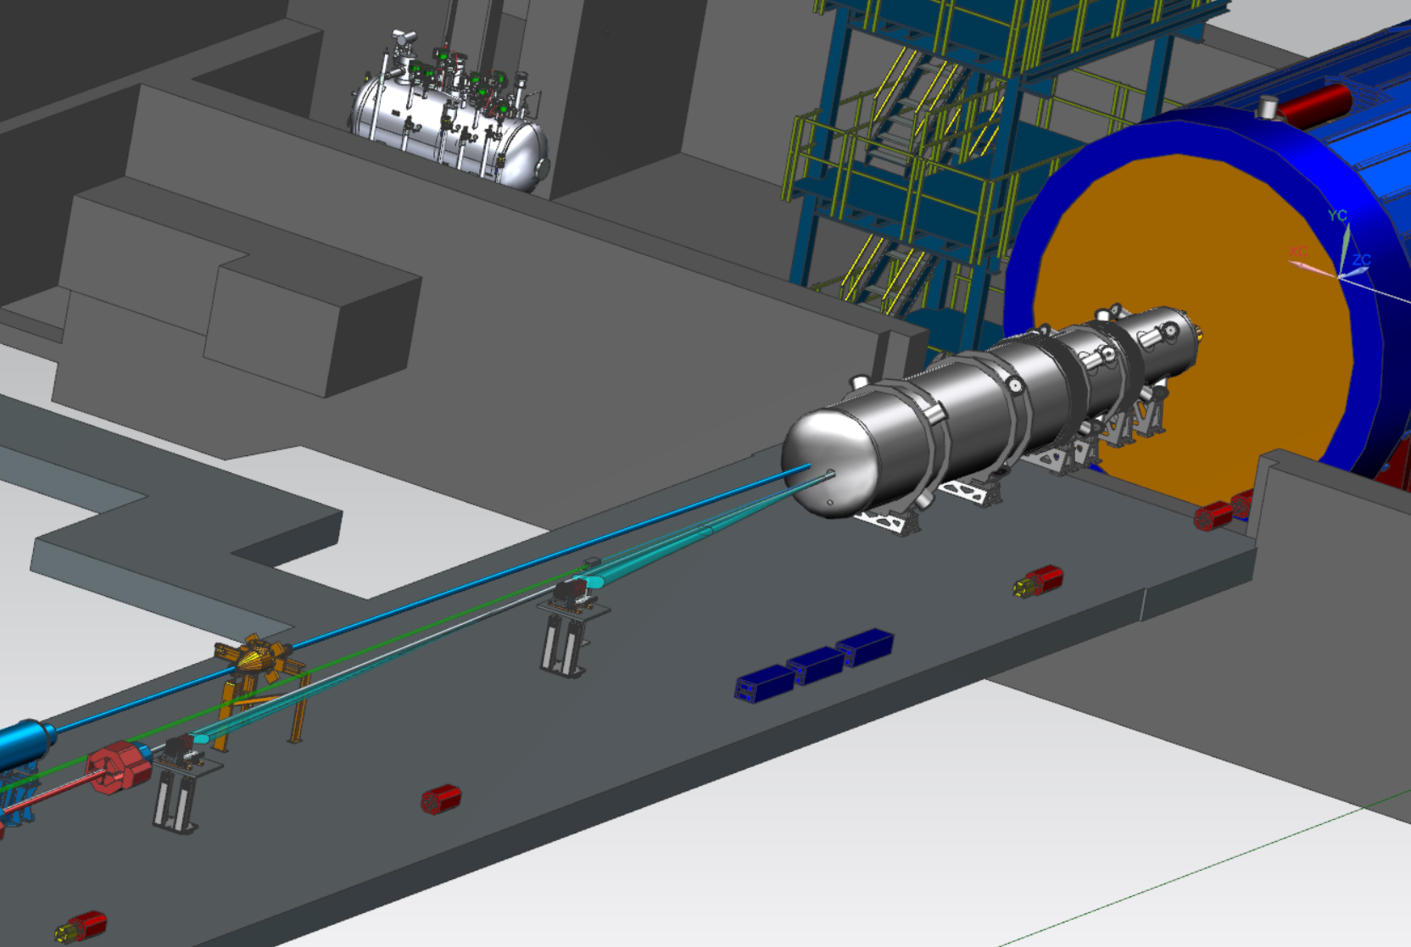
Outline
Requirements for Low Q² detector
Technology
Simulation
Status and Plans
Quality Assurance
EH&S
Summary
p/A
e
Low Q² Tagger
1

Slide 4
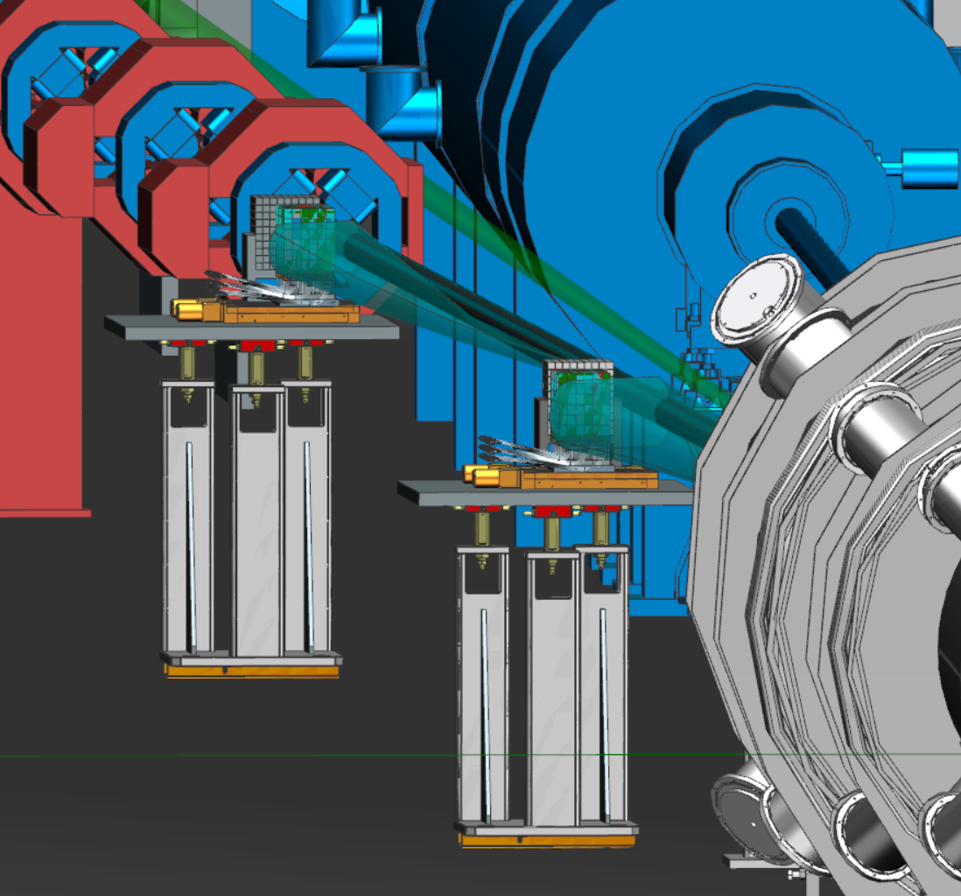
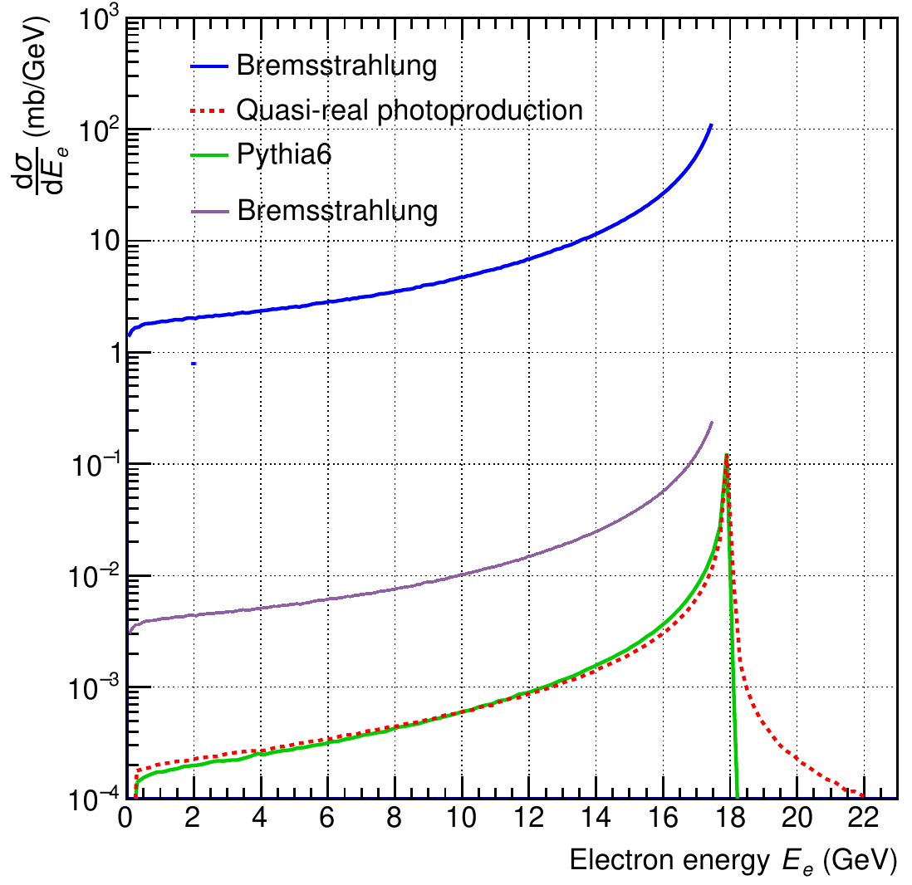
Requirements
Charge 1, 5
Increase Q² acceptance
Allow quasi real (Q²~0) physics
Very close to beamline.
  2 Taggers
  Pixel based trackers
    Rate capability and pixel resolution to identify > 10 tracks per beam bunch (brem BG)
    Eσ < 1%, θσ < 0.5 mrad, Φσ < 5 deg
  Calorimeters
    for calibration, alignment and monitoring of trackers, Luminosity and PS.
1

Slide 5
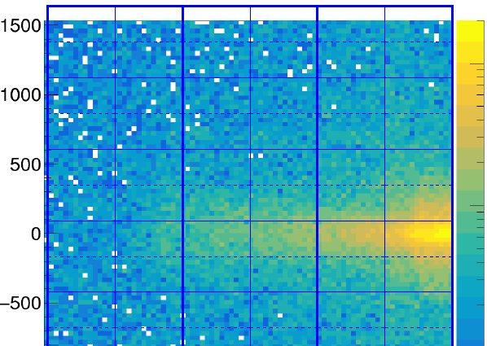
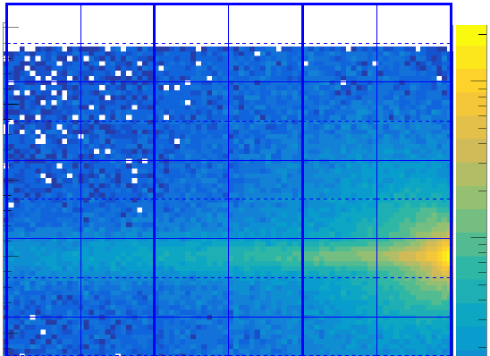
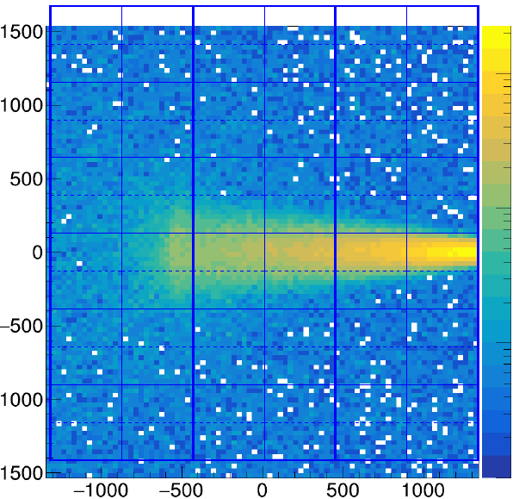
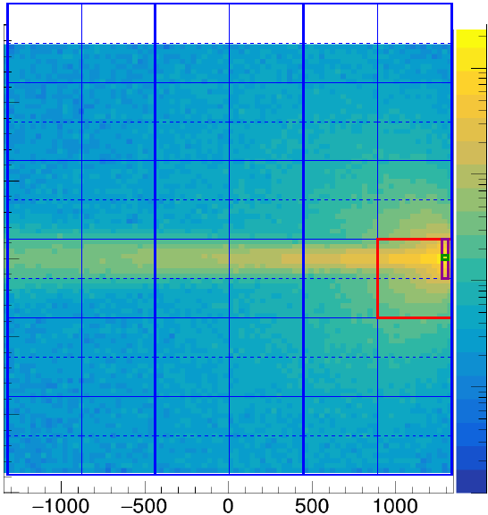
Requirements - Rate
Charge 1, 2
High Brem BG, Non uniform distribution.
Maximum rates
Pixel (P1) 70 kHz
2 column (C1) 8 MHz
Tpix4 (T1) 600 MHz 38 Gb/s
Board (B1) 1500 MHz 96 Gb/s
Layer (L1) 2500 MHz 160 Gb/s
Total integrated rates
Tagger 1 2 GHz 130 Gb/s
Tagger 2 7 GHz 480 Gb/s
Total 9 GHz 600 Gb/s
Data buffered & filtered: need a hadron in main detector
Trigger rate: 500 kHz: 99.4% rejection (brem only)
Data rate (signal): 4 Gb/s
Data rate (incl BG and rand sample) <20 Gb/s To tape
Low Q² tagger rates kHz / pixel. (18x275 GeV @ 10³⁴ cm⁻² s⁻¹ )
10⁻¹
1
Q.R.
T1
10⁻³
T2
10⁻²
Brem.
10³
10⁴
P₁
C₁
T₁
B₁
L₁
y pixel
T1
T2
1
1
~150mm
x pixel
1

Slide 6
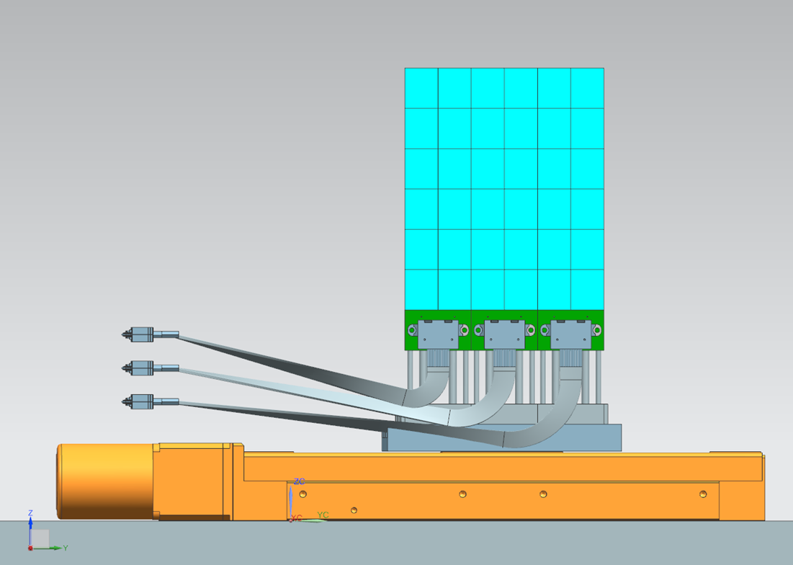
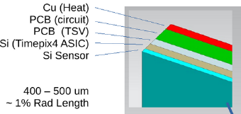
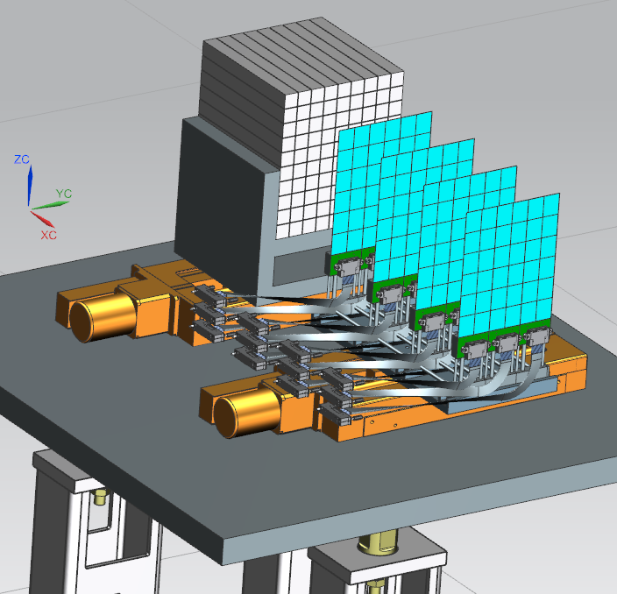
Technology
Charge 1, 2
Tracker
  Timepix4 Hybrid (ASIC+Si) + SPIDR4 readout.
    Pixels: 55x55 um. 448 x 512 pixels. Area = 6.94 cm²
    Individual thresholds, data driven
    Timing: < 2 ns.
    Rates: < 5.5 MHz per 2x256 column
  Layout
    1 board: 6x2 Timepix4 → SPIDR4 readout.
    1 layer: 3 boards
    1 tagger: 4 layers → total of 12 boards, 144 x Timepix4
    Documented at https://arxiv.org/abs/2305.02079
Calorimeter
  Scintillating Fibre Calorimeter. See Other FB Calorimeters, fECAL.
    18x18x18 cm cube → 900 3x3 mm Hamamatsu SiPMs
Timepix4
Board
Calorimeter
Tracker
4 Layers
1

Slide 7
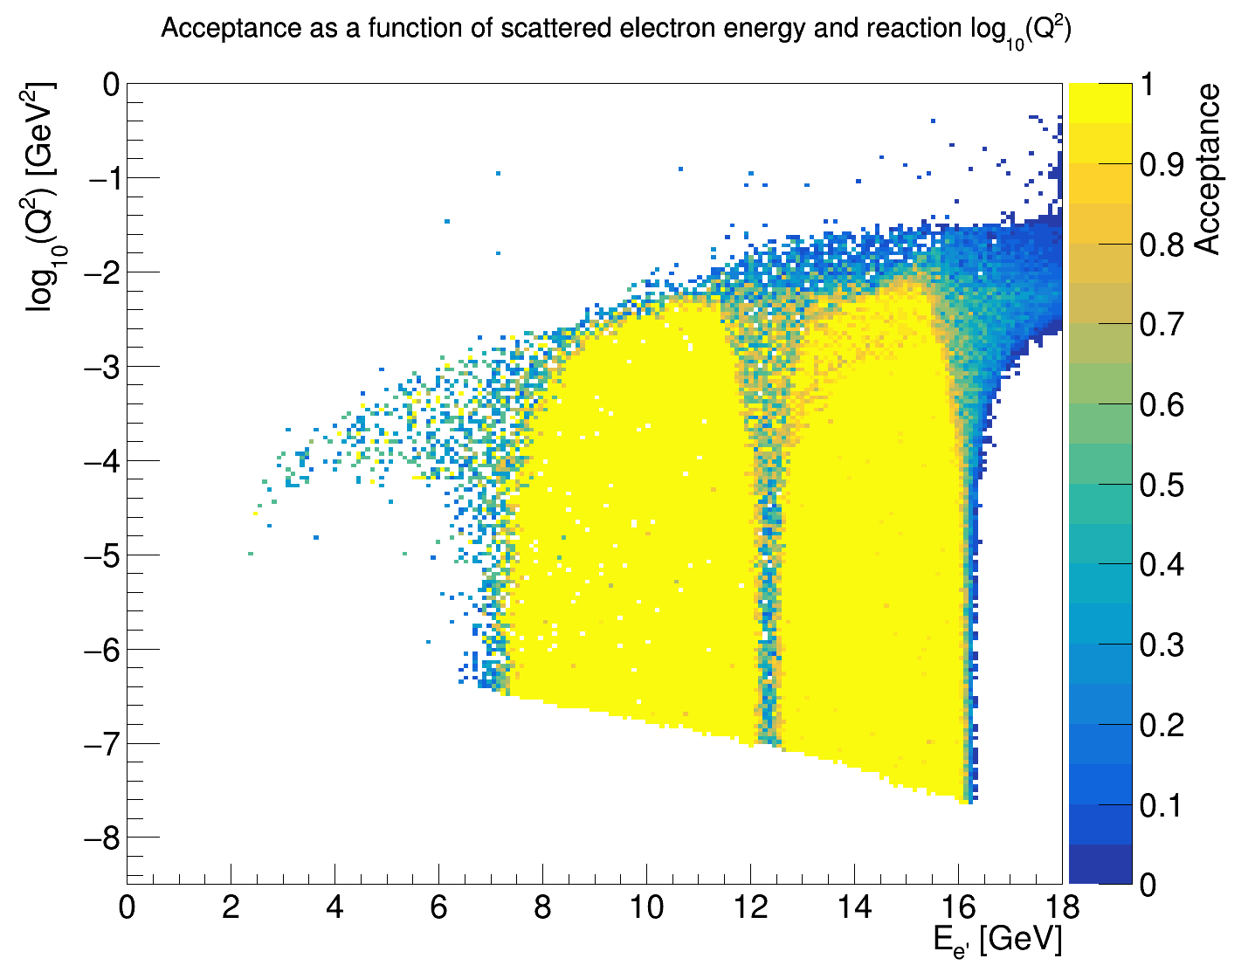
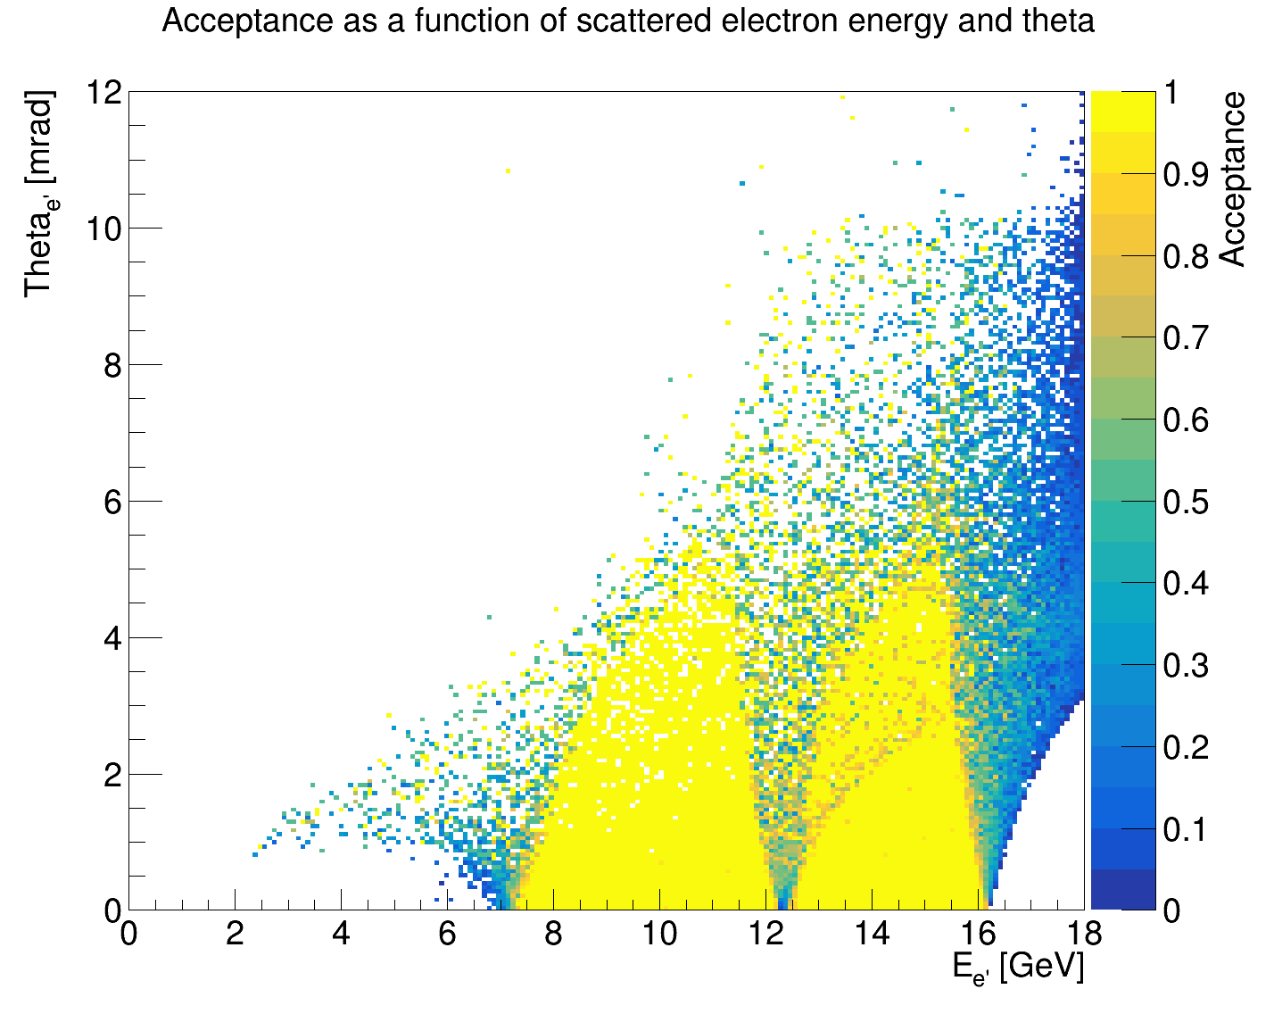
Simulation – acceptance (275 / 18 GeV)
Charge 1, 2
Simulation includes all mechanical components, beam smearing.
Not beam gas, synchrotron radiation.
% scattered electrons reconstructed in tagger :
10% from all collisions
15% of all electrons < 11 mrad (Low Q²)
θe [mrad]
1

Slide 8
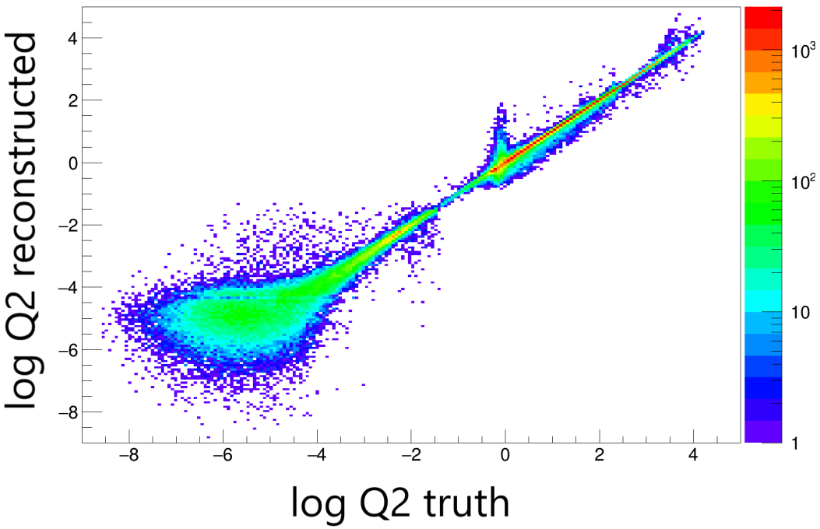
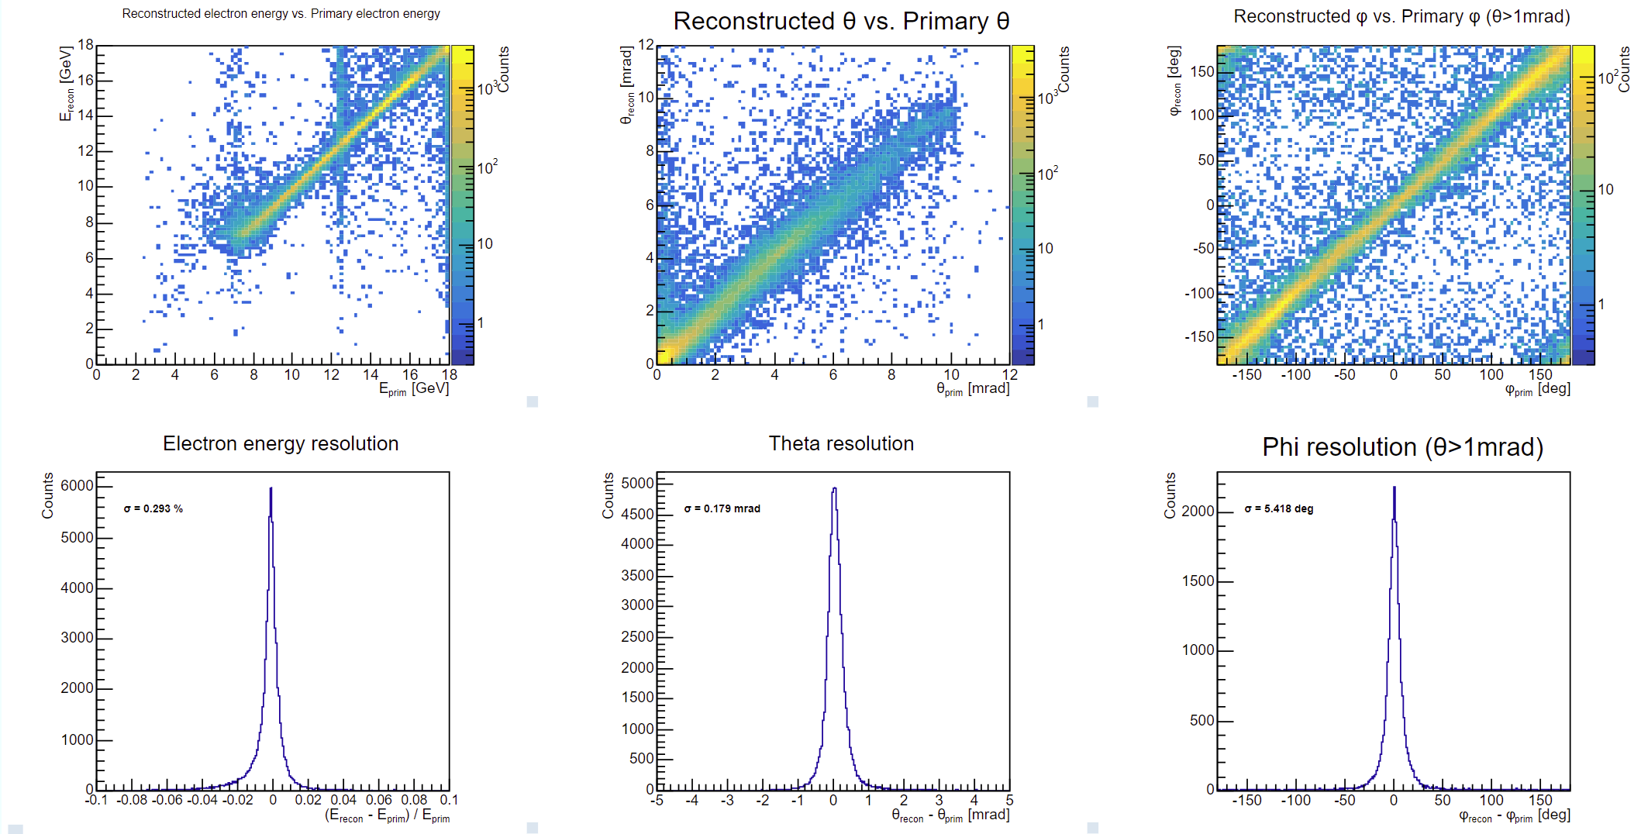
Simulation – resolution (275 / 18 GeV)
Charge 1, 2
Low Q2 tagger
Log Q² reconstructed
Log Q² truth
Integrated resolutions of reconstructed particles
Eσ = 0.3 %
θσ = 0.2 mrad
Φσ = 5 deg
1

Slide 9
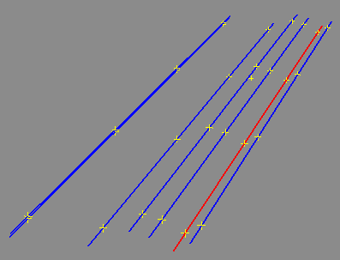
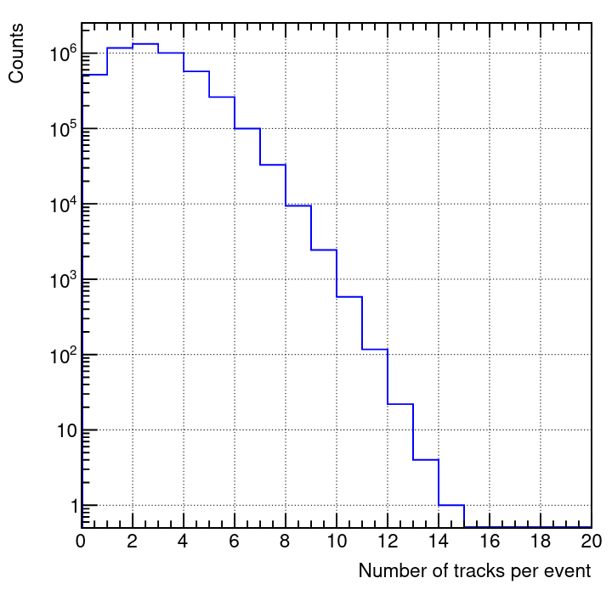
Simulation – tracking
Charge 1, 2
Tracking
  Can be many tracks per event, and extra clusters from noise + BG.
  Most events are brem only.
  Machine Learning
    >99% efficient on mix of QR+brem
Q.R. and Brem events in 4 layer Tracker
ML + FPGA
  Collaborating with Jlab group (generic R&D project)
    Particle identification and tracking in real time using Machine Learning on FPGA
  Excellent preliminary results (See backups)
    S. Gardner: Object Condensation for Track Building in a Backward Electron Tagger at the EIC @ AI4EIC, Nov 2023, CUA, Washington D.C.
1

Slide 10
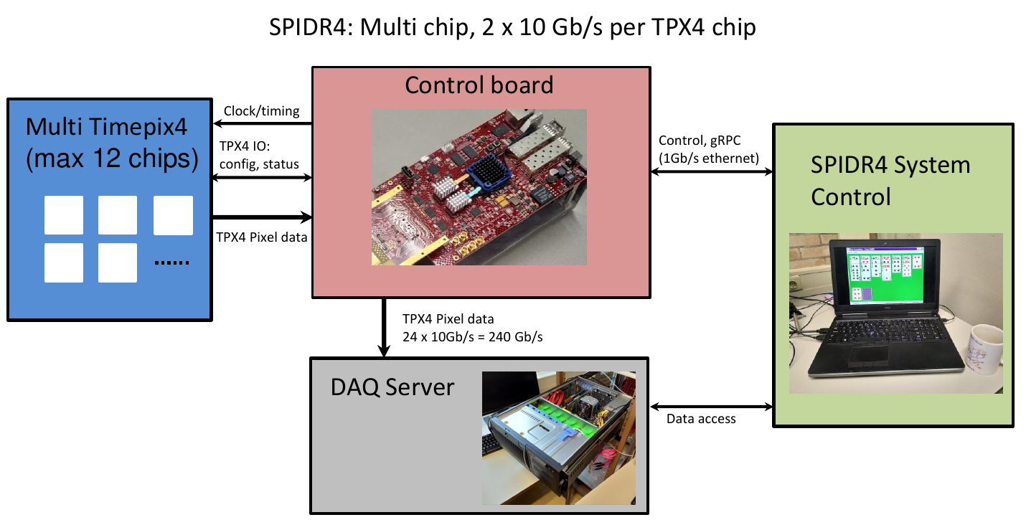
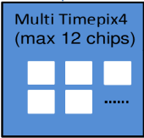

Readout and DAQ
Charge 1, 2, 5
Tracker
  Timepix4 readout SPIDR4, NIKHEF
  Digitization on ASIC. Individual thresholds. Very low noise.
  Control board, handle up to 12 Timepix4
  Data → FELIX boards / Buffering
  Buffered data filtered on coincidence with central detector
Calorimeter
  Fibres → SiPM → standard DAQ channels
  2 x 900 channels per calorimeter = 900
x3
FELIX
1

Slide 11
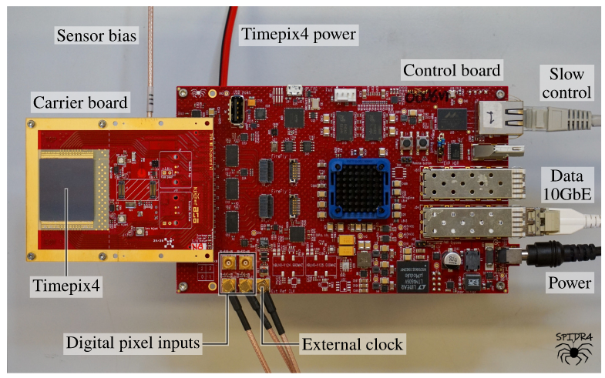
Status and plans
Charge 5
Tracker
  2 x SPIDR4 kits in Glasgow Jan 2024
  Engineering test model. May 2024
  Engineering tests in Europe Summer 2024
  Final design complete May 2025
  Engineering + DAQ test in Jlab Sep 2025
  Start of construction Oct 2026
Calorimeter
  Final design complete, review, start of construction May 2025
  Ready for installation ( cosmic tests at BNL) Oct 2030
1

Slide 12
Quality assurance
Charge 6
Tracker
  Timepix4 trackers developed in cooperation with the Timepix collaboration and Glasgow ATLAS group, who were played a leading role in the producing the ITk pixel tracker for the LHCB upgrade. Well tested. Robust for production an testing across several institutes in different countries.
  Pre-production: Test beams (full chain production test and DAQ), Rates, Radiation hardness, cooling.
  During production: Manual on production and testing, check-lists, detailed spread-sheets with numbers and QA parameters. Test beams (full chain production test and DAQ)
  Transportation procedure: define and document.
  Assembly and installation procedure: define and document.
Calorimeter
  Synergy with others: FB calorimeters and fECAL
  QA and production procedures: to be developed together with above groups.
1

Slide 13
ES&H
Charge 6
Follow all procedures laid out by BNL and other labs where preduction test and development are carried out.
During the engineering design phase: Include production of mockups and engineering test articles to insure the proper functionality and quality.
Full production chain tests for each sub-system.
  For operation with HV and Cooling: we will ensure that these are mechanically secure and not a trip hazard, have proper warning signs and follow the lab procedures for electrical safety.
  Operation near the beam-pipe and vacuum: anyone working near the far-forward/backward detectors to wears ear protection, and will post signage to that effect.
1

Slide 14
Summary
Low Q² Tagger
  Pixel based tracker
    Timepix4 + SPIDR4
      Required due to extremely high rates
        small pixels
        high rate readout
    Basic design well established
    Construction of first test article already underway
  Calorimeter
    Design established
    Close synergies with other FB calorimeters and fECAL.
1

Slide 15
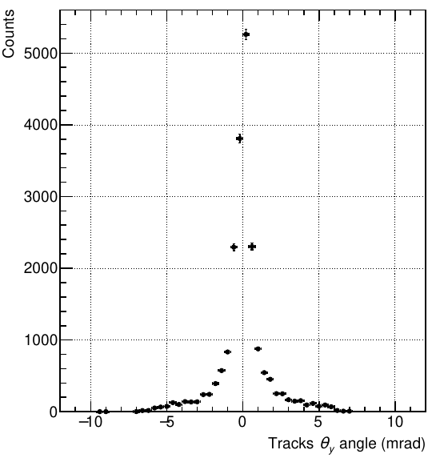
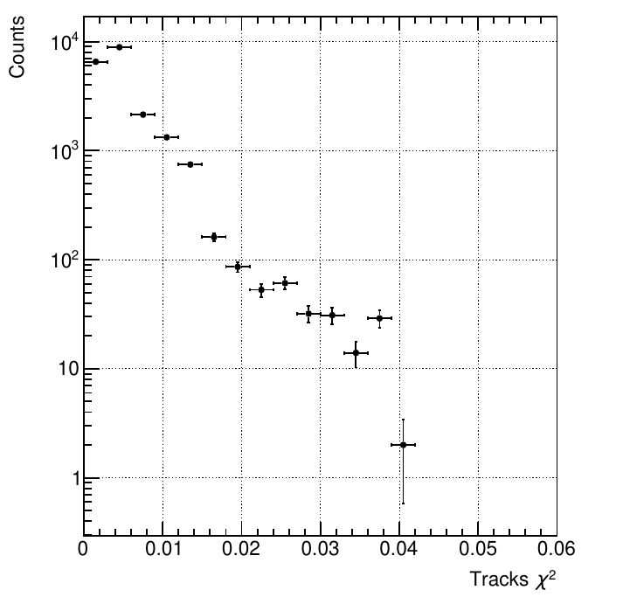
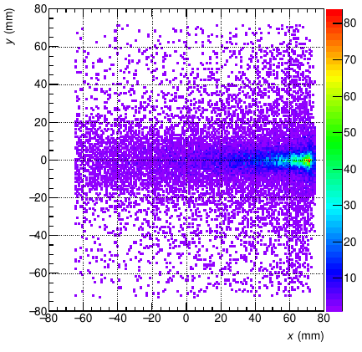
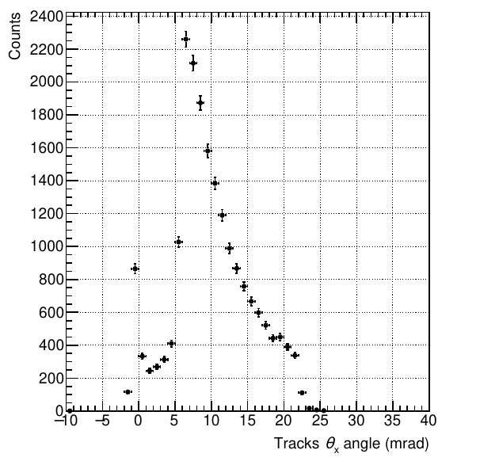
Backup slides
Tracking
1

Slide 16
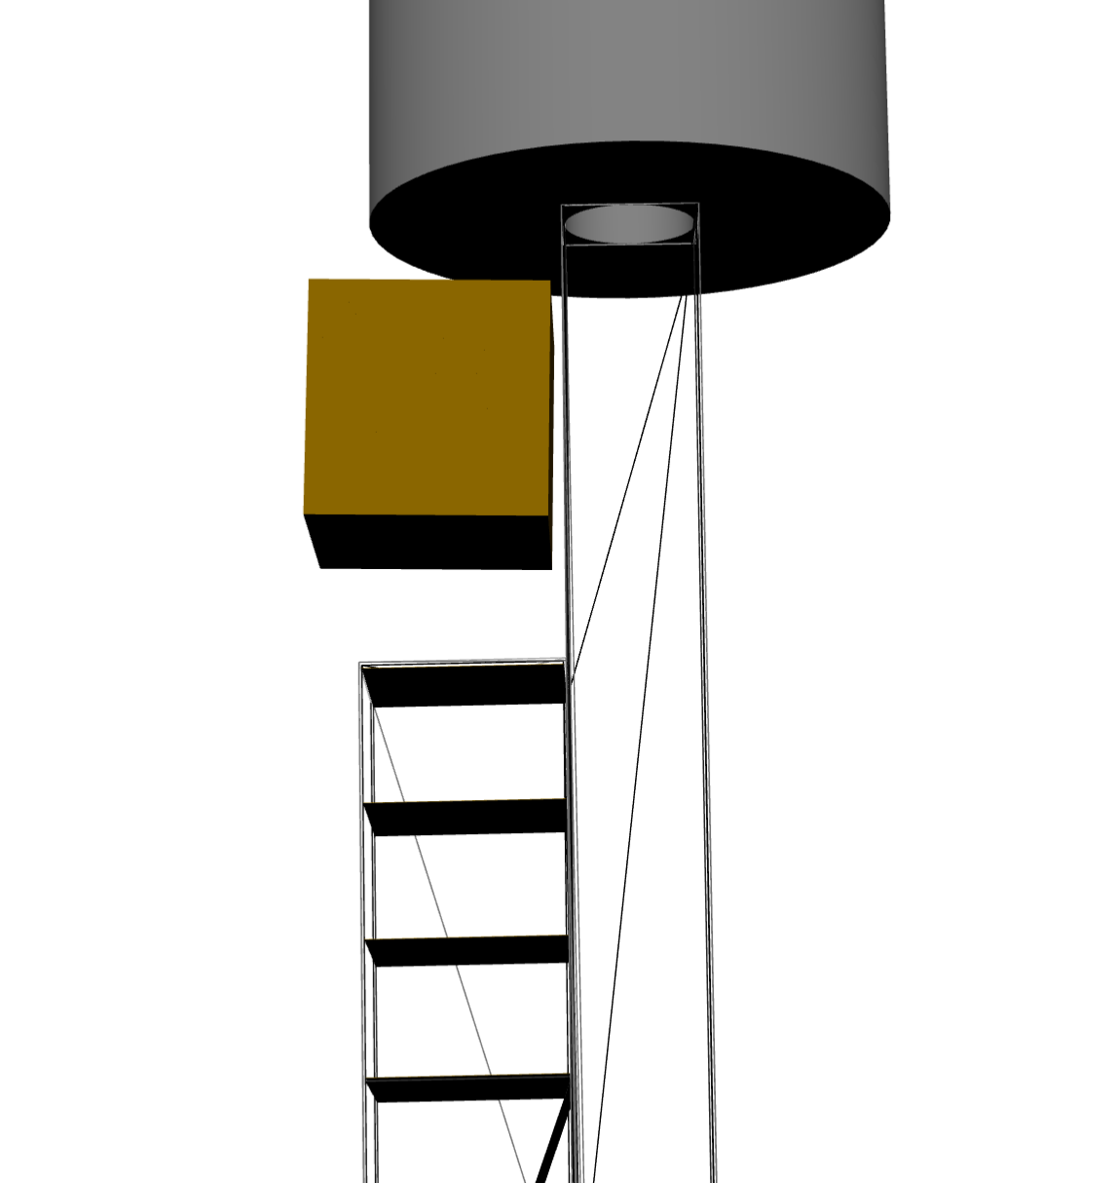
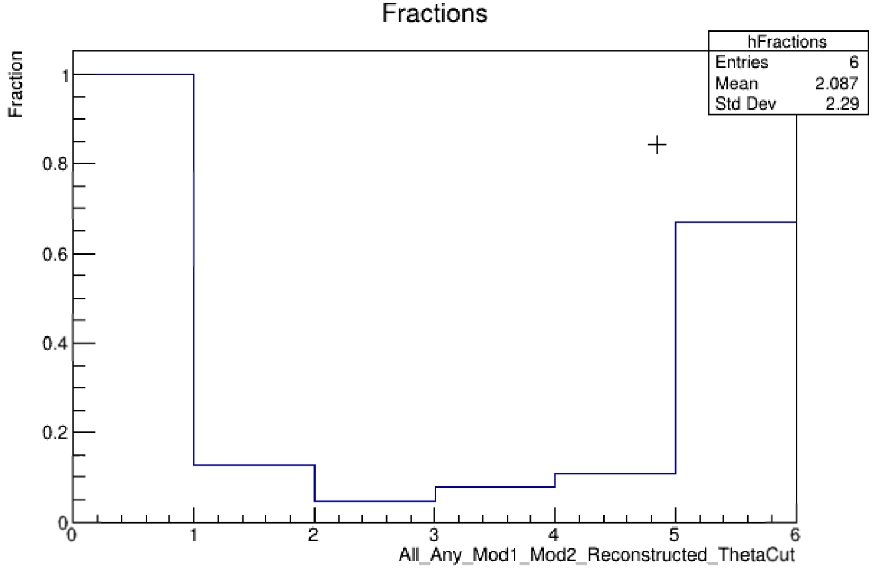
Backup slides
Tagger acceptance fractions
Reconstructed
All
Any
Tagger 1
Tagger 2
11 deg Theta cut
1

Slide 17
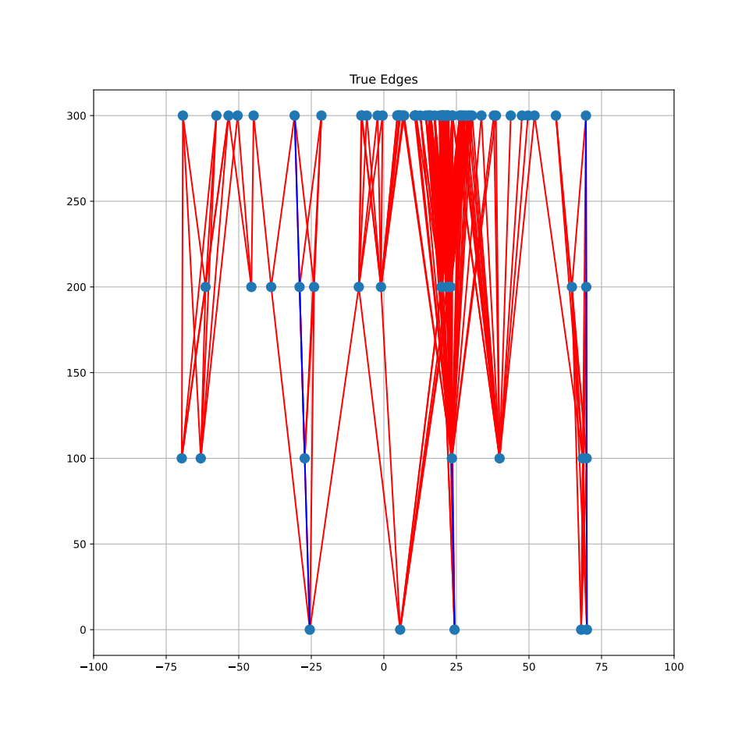
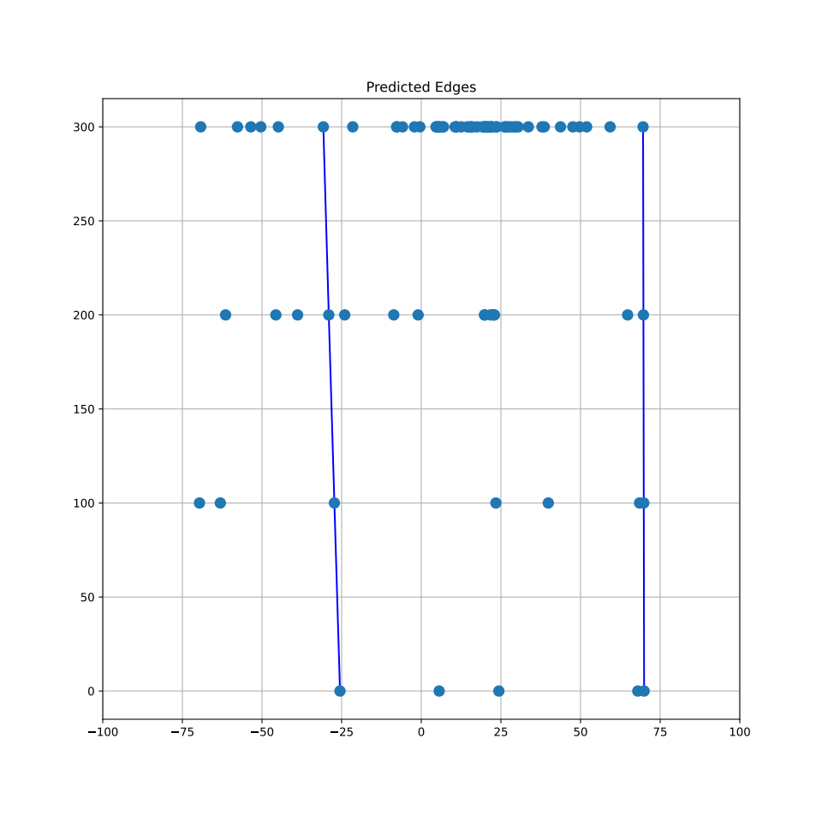
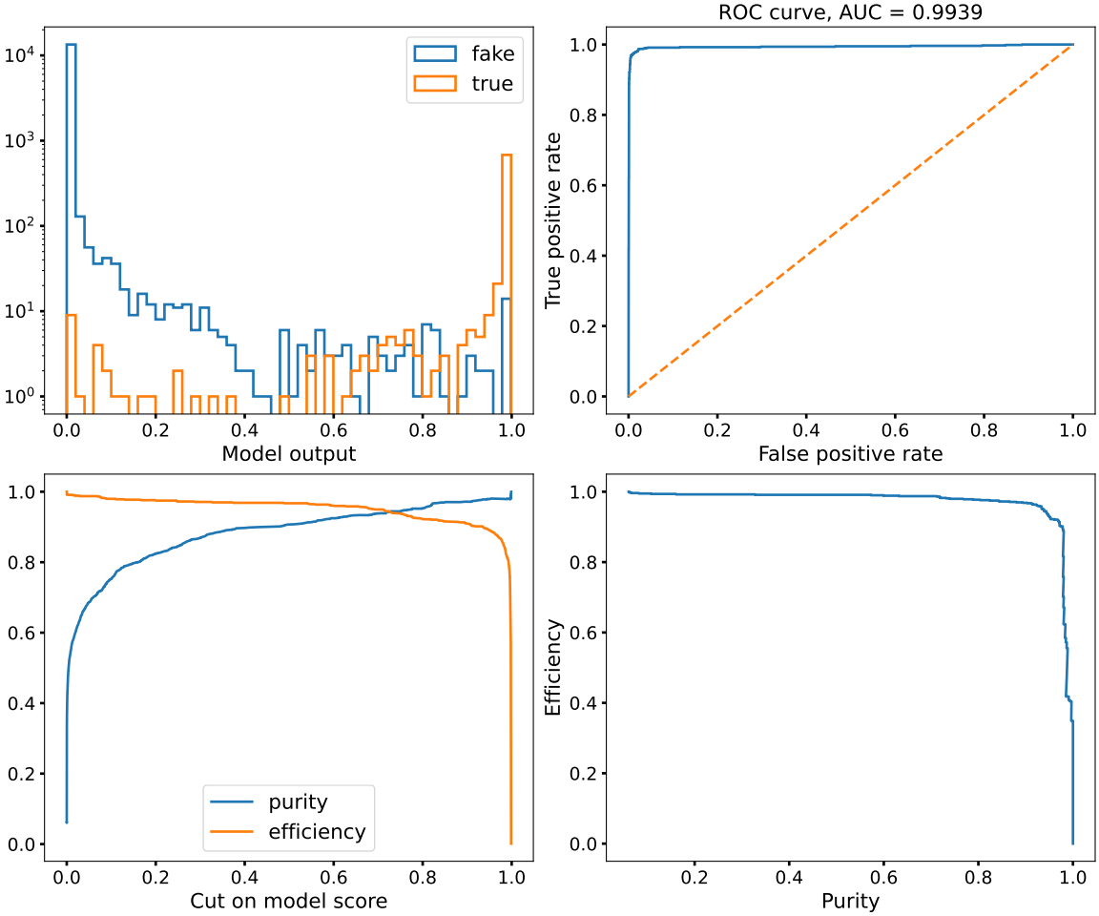
Backup slides. FPGA Machine Learning
1

Slide 18
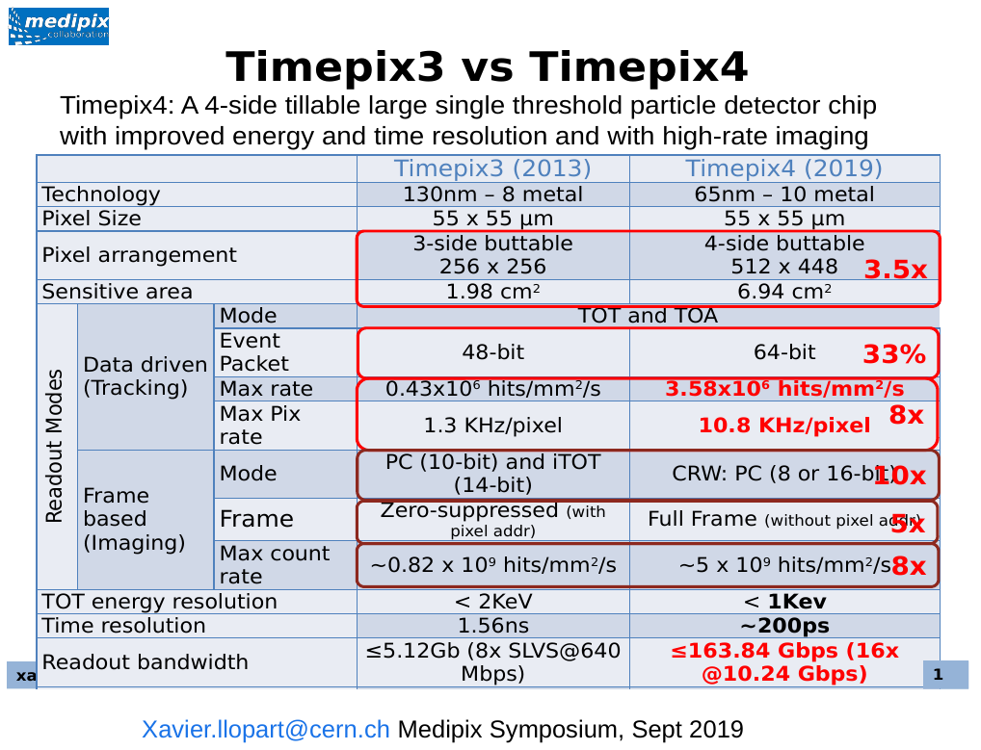
Backup slides
Timepix4 + SPIDR4 Engineering test setup.
K. Heijhoff et al 2022 JINST 17 P07006
1

Slide 19
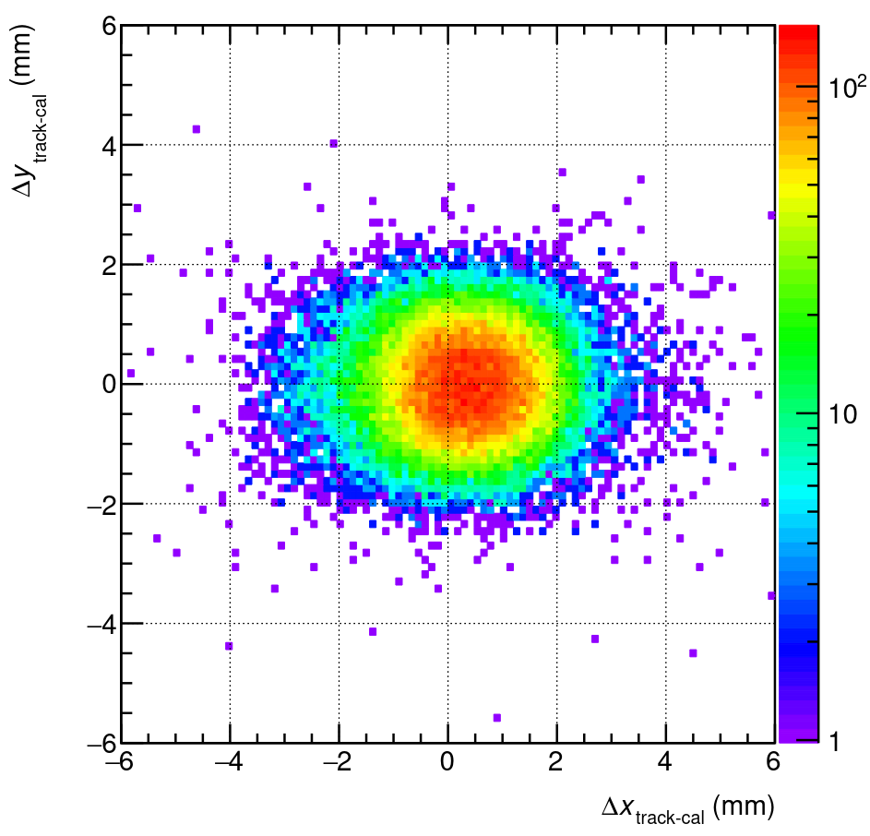
Backup slides
Calorimeter
Position resolution.
The tracks are projected
to the calorimeter front and difference is taken between track projected position
and calorimeter reconstructed position in x and y, shown on the plot as DeltaX_track-cal
and DeltaY_track-cal.
1

