Slide 1


Luminosity Detector
Pair Spectrometer
Dhevan Gangadharan, Nick Zachariou
EIC Preliminary Design & Safety Review of the EIC Auxiliary
Far-Forward/Far-Backward Detectors
February 12th, 2024

Slide 2
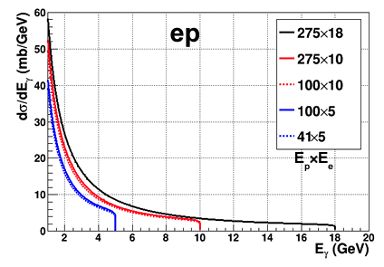
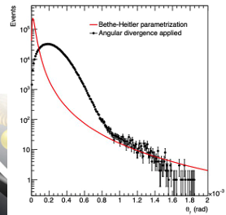
LUMI Process: Bremsstrahlung
Bremsstrahlung processes ep → epƔ, eA → eAƔ
σ_{BREMS} precisely known from QED (~0.5%) Bethe-Heitler 1934
At EIC both beams are polarised
  σ_{BREMS} polarised component negligible (D. Gangadharan EPJA 59:303 (2023))
Large σ_{BREMS} ⇒ high statistics
Lumi significantly higher than HERA
(100x - 1000x)
ɣ energy spectrum
Diverges E_{γ}→0
Endpoint @ E_{γ}=E_{e-beam}
Nuclei σ_{eA}=Z_{A}² . σ_{ep}
ɣ angular distribution
Strongly peaked @ beam 0º
Dominated by e-beam divergence
Diagnostic for beam steering, tuning

Slide 3
Requirements
Physics:
  Precise determination of absolute luminosity at 1% level
  Precise determination of relative luminosity at 10⁻⁴ level
    Spin-sorted lumi for different polarisation orientations double BSA unc. @ RHIC 10⁻⁴ (Phys. Rev. D 93, 011501(R) (2016))
  Complementarity and redundancy
  (direct photon, and pair spectrometer sensitive to different systematics)
Detector: Pair Spectrometer (PS):
  Energy resolution < 15%/sqrt(E)
  Good timing resolution ~5 ns
  (sufficient to resolve bunches 10.15 ns)
  Tracker dimensions larger than CAL
  to enable acceptance determination
  Less than 5 mm photon position resolution from trackers (X_{Ɣ} and Y_{Ɣ})
  Unobstructed photon aperture
  High accuracy in converter chemical composition (~0.3%)

Slide 4
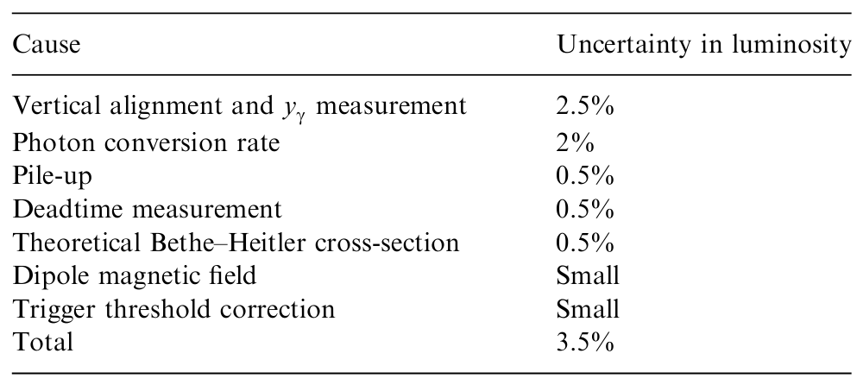
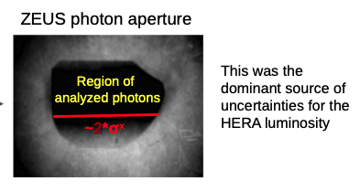
What we learned from Zeus
ePIC mitigations
Obstruction-free aperture
System redundancy (Low Q² coincidences, tracker info)
Systematic handles (sweeper magnet and adjustable analysing magnet)
Trackers/Cal dual operation for self-calibration
Precisely known chemical composition of all
conversion materials (exit window and conversion foil).
Dedicated thin conversion foil
Not a simple, well-defined photon acceptance (fuzzy)

Slide 5
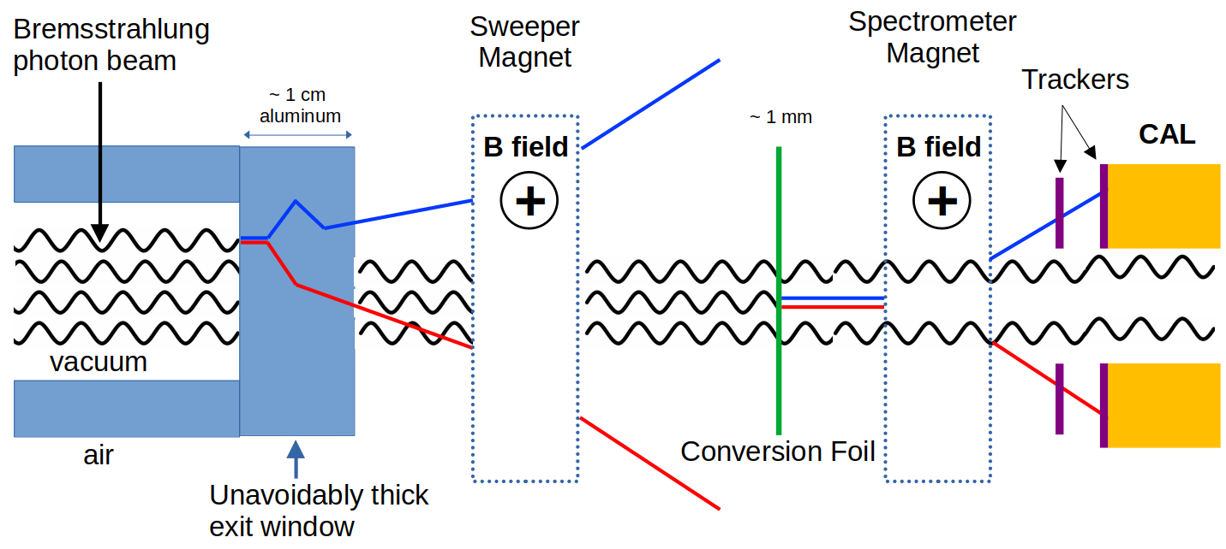
Experimental Approach

Slide 6
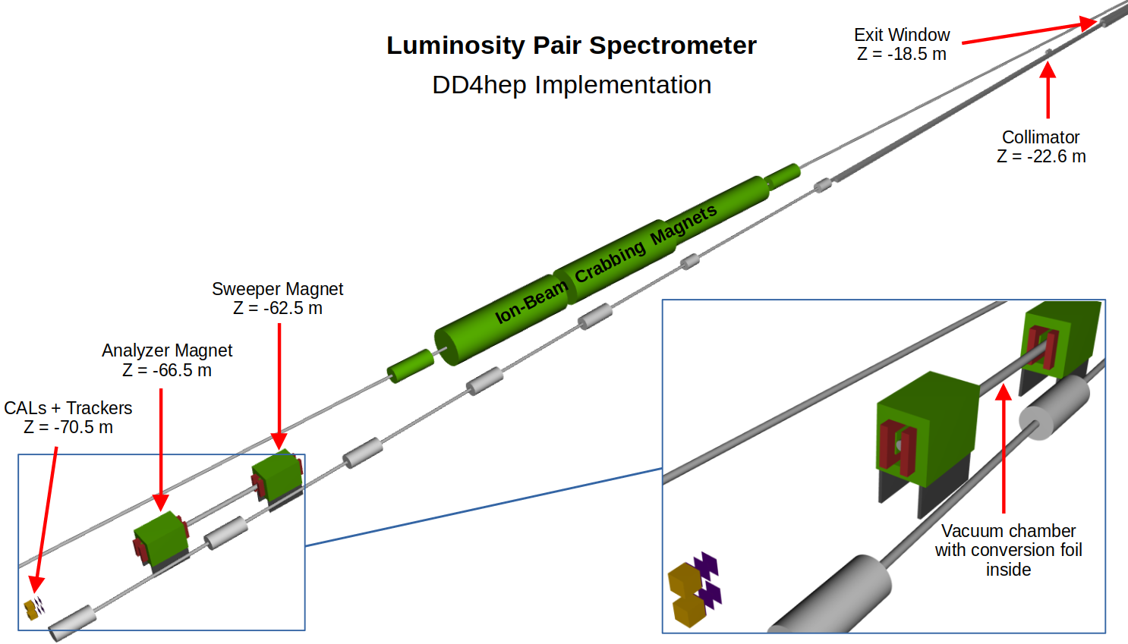
Far Backward region -- Exit Window, collimator
Unobstructed photon path (5 σ)
Exit window
  Simple geometry with uniform thickness and well-known composition
  Conversion rate well established
  (special runs with sweeper magnet off)
Collimator
  Shield detectors from unnecessary radiation
  Defines the outer limits of our acceptance
  (5σ → ~5 cm radius at our detectors)
Sweeper magnet to remove pair conversions from the thick exit window
  Multiple scattering in thick exit window degrades resolution of measurement: Sweep these away.
  Also rates from thick exit window will be very large: might lead to pileup.

Slide 7
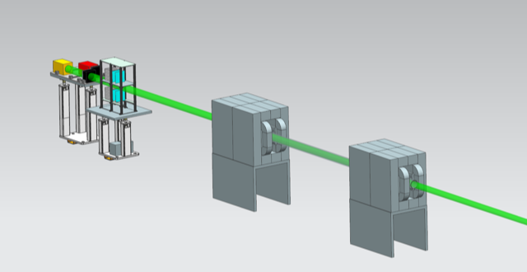
Far Backward region - Converter, Vacuum, and analysing magnet
Vacuum Chamber
  Key to minimise conversions
  in air within dipole magnets
  Requirements:
    Diameter 5σ beam size
    Thin exit cap (Beryllium 1.4%X₀)
Thin Aluminum converter
  Placed within vacuum pipe in between Sweeper and Analyzer magnet.
  1 mm thin→ 1% conversion rate
  Precise and accurate determination of conversion rate
Tunable magnetic field
  Large and uniform Bdl (~1Tm)
  Allows additional handle on rates
  Adjustable acceptance coverage for PS
Analysing magnet
Sweeper magnet
Vacuum pipe

Slide 8
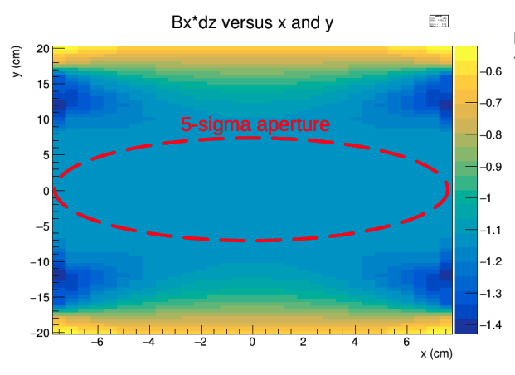
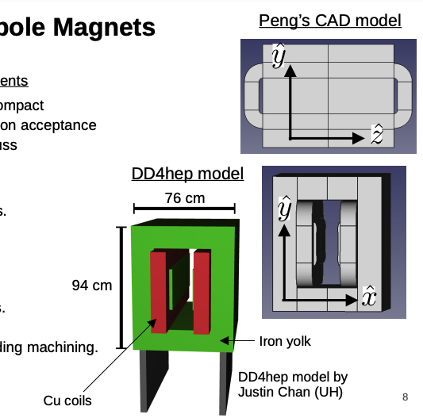
Dipole magnets
Sweeper & Analysing Magnet Requirements
  Large ∫B_{x} dz ~ 1 Tm to keep system compact
  15 cm bore diameter: 5σ unobstructed photon acceptance
Properties (Designer: Peng Xu)
  1.2 m long with field of 0.8 T
  15 cm bore diameter
  Uniform field
    1σ: 〈B_{x}dz〉=-1.1385 Tm and std 0.00005 Tm
    5σ: 〈B_{x}dz〉=-1.1395 Tm and std 0.0015 Tm

Slide 9
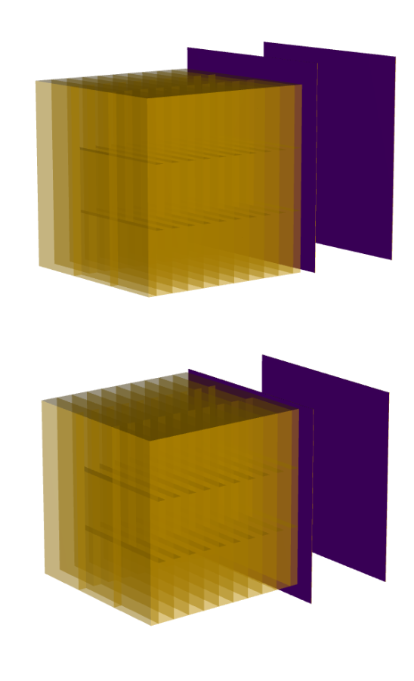
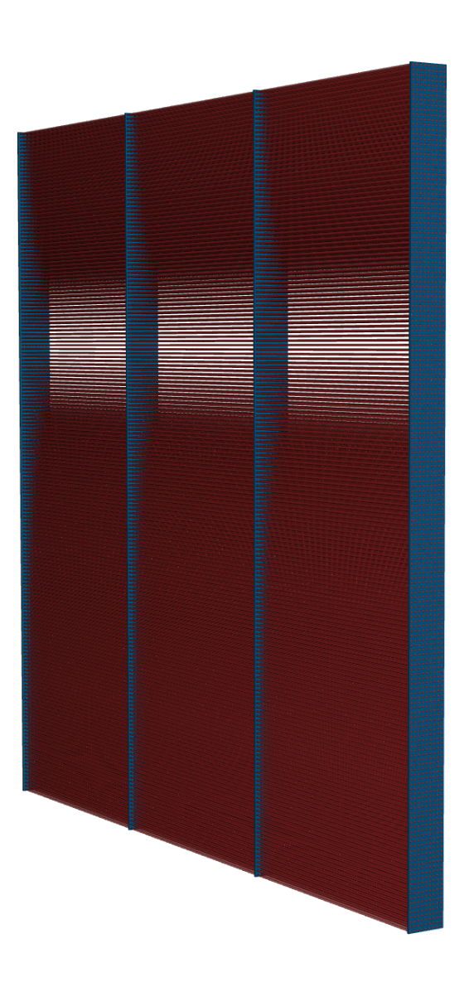
Pair Spectrometer - Calorimeters
Technology of choice: Scintillating Fiber Calorimeter
  W-powder + epoxy infused into a bundle of scintillating fibers
  Technology utilised in ePIC (fECAL)
  Existing R&D and expertise*
  Meets all requirements
Dimensions 18x18x18 cm³
Radiation length ~ 8 mm
20 layers → 23X₀
Scintillating Fiber 0.5 mm diameter (Kuraray or Luxium -- samples for tests) - (see backup slide 19 for specs)
Epoxy: DE NEEF or Epotek 301-1
W-Scifi Ratio: 4:1 → Density 10.95 g/cm³
One layer
*O D Tsai et al 2012 J. Phys.: Conf. Ser. 404 01202

Slide 10
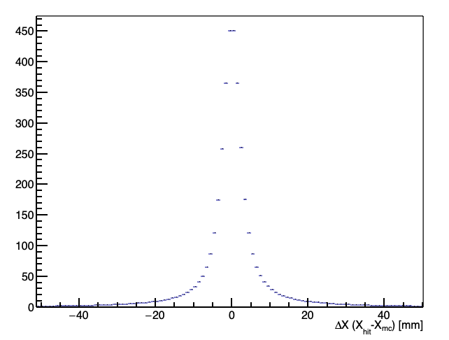
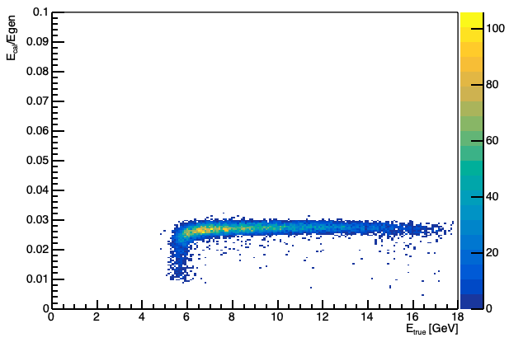
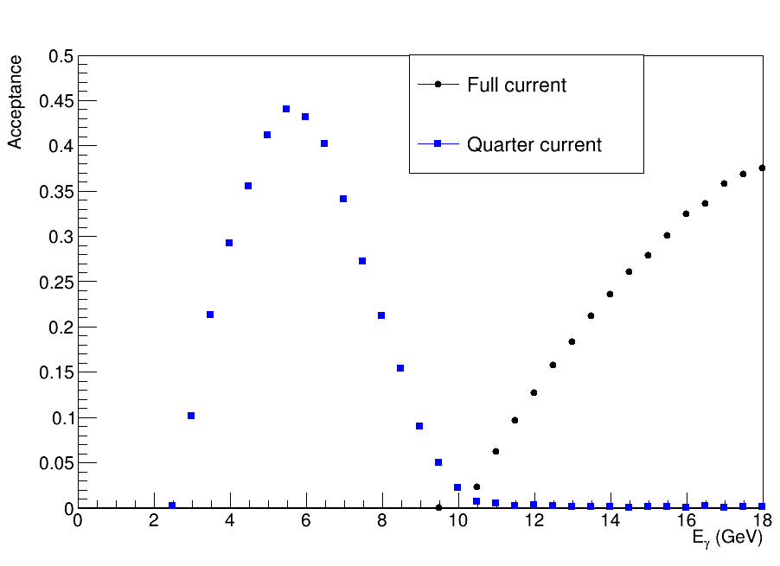
Pair Spectrometer - Calorimeters
Simulation studies
Moliere radius ~1.5 cm (0.9 cm for pure W)
Sampling fraction ~3%
Linear response
Energy resolution
  Stochastic term 10% / sqrt(E)
Shower profile determination
  Position resolution ~ 2 mm
Tunable acceptance with different magnet currents

Slide 11
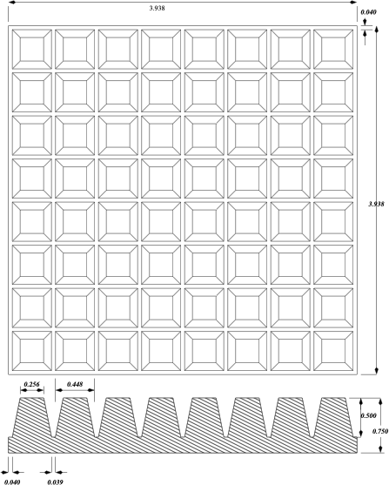
Pair Spectrometer - Calorimeters
Fibers Kuraray or Luxium (sample for tests)
Readout
  900 3x3mm Hamamatsu SiPMs per Calorimeter
  (options to be evaluated)
  Optical guides - Following design by O. Tsai that maximises light collection efficiency
Support Structure designed by University of York
No significant space requirement/constraints
High rate (~0.1 event / bunch crossing) dictates FEE different from FeCAL. Support from UoY technicians and UCLA.

Slide 12
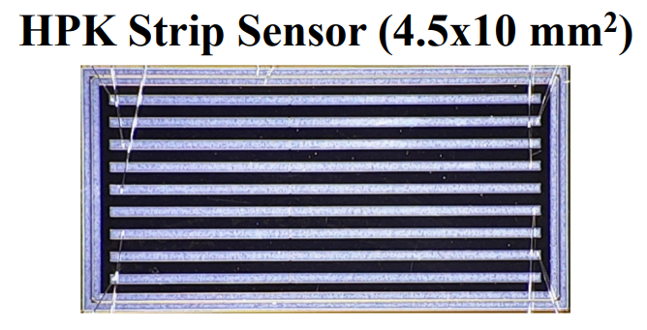
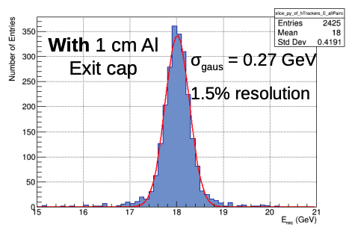
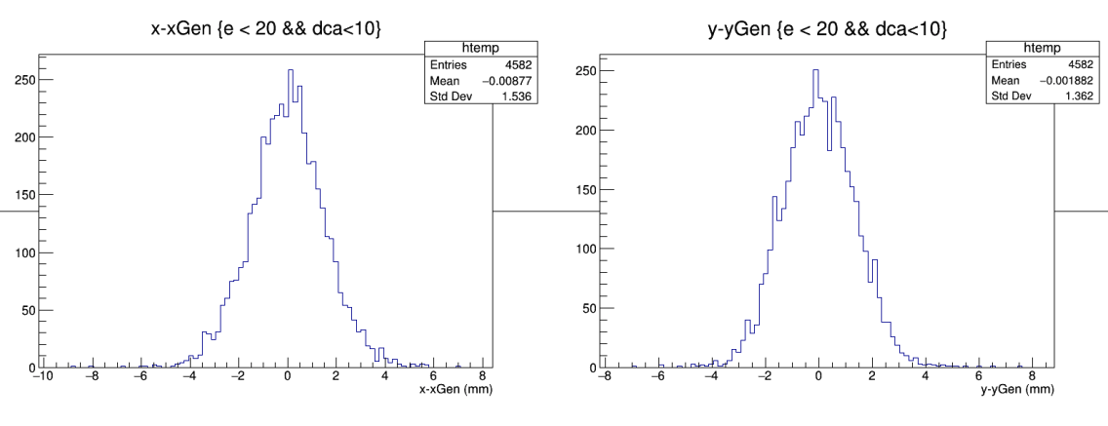
Tracker design
Trackers provide redundancy to the CALs
Trackers enable precise photon acceptance determination (major uncertainty at ZEUS)
Mitigates multiple hits
Allow for a precise energy calibration (2%) for CALs
Technology choice: AC-LGAD strips
  Strip sensors, with strip pitch 500 μm. 30 μm position resolution with charge sharing and 1/√12.
  → 2 mm photon position resolution
  Technology of choice for different systems in ePIC
  (Synergy with BTOF)
  2 stations per calorimeter
  (2 layers per station: X and Y orientation)
  Small material budget (~1% X₀ per layer):
  low multiple scattering
  = good angle resolution
  = good E resolution.

Slide 13
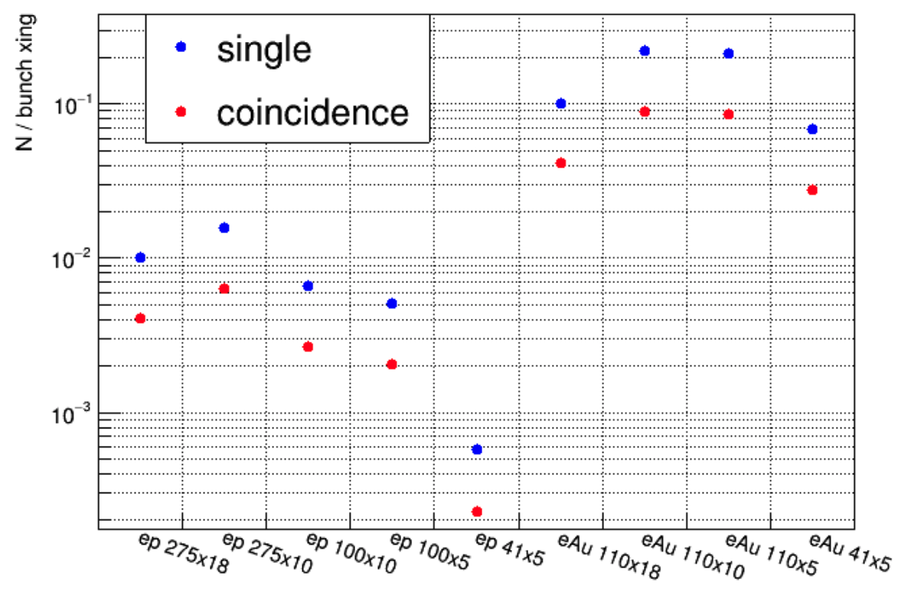
Expected Signal Rates
Determined using nominal luminosity
accounting for
1 cm conversion at exit window (9% conv prob)
-- swept away
37 m Air (9%)
-- swept away
1 cm Al Vacuum chamber entrance cap (9%)
-- swept away
1 mm Al Conversion foil (1%)
-- detected in PS
At most ~0.2 electrons per bunch crossing on average

Slide 14
Quality assurance
Expertise within ePIC collaboration (technologies of choices used in other parts of ePIC)
-- Synergies with fECAL and BTOF
Continuous progress review by ePIC Technical and Integration Council
Engineering tests soon underway building on existing work done by O. Tsai
Initial tests planned for 2024/2025
Development of full documentation for test and commissioning

Slide 15
Health and safety
We will be using the appropriate Radiation Safety measurements as dictated by the University of York and Brookhaven national Laboratory.
Construction: The University has extensive ES&H measures in placement that need to be followed in all our labs and ensure Radiation, Chemical, and Electrical safety, as well as proper occupational Health and safety measures
  Use of fume boxes, protective equipment for hands/eyes/body.
  The university ensures all personnel working within the labs have the appropriate training to ensure adherence to these safety protocols.
We will strictly follow the laboratory safety procedure for electrical safety (HV supply) and ensure that all equipment is mechanically secure.
Trip hazards from cabling will be minimised by proper cable routing.
Ear protection and proper signage will indicate clearly areas of high-magnetic field.
No fire risk is anticipated from scintillating fibers as these are enclosed within the calorimeter.

Slide 16
Summary
Requirements well defined
Technologies of choice (Scifi Cal and AC-LGADS) satisfy all requirements
Detector setup mitigates systematics (lessons from Zeus)
  Sweeper magnet
  Thin converter (ability to have different converters)
  Vacuum pipe (mitigating conversions in air within magnetic field)
  Unobstructed photon acceptance
Engineering test soon underway (Mainz 2024)
Optimisation ongoing utilising DD4HEP simulations

Slide 17
Extras

Slide 18
Fiber Specification
A. Light yield shall exceed 8000 photons/MeV
B. Diameter mean value and variation shall be 0.47 +/- 0.004 mm, RMS ≤0.02 mm.
C. Attenuation length for blue light > 3m.
D. Batch to batch or lot to lot variation of light yield <10%.
E. Emission spectrum in blue-green light
F. Scintillation decay time <3ns
Luxium BCF10 https://www.mi-net.co.uk/product/scintillating-fiber/
Kuraray https://www.kuraray.com/products/psf

Slide 19
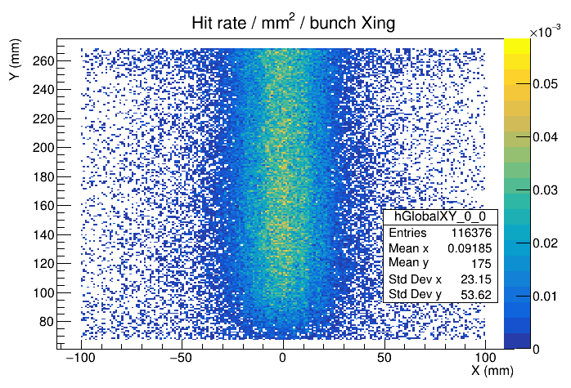
Tracker Occupancies
Hit rate / mm^2 / bunch crossing for max bremsstrahlung rates in e-Au 10x110.
Hits concentrated in narrow vertical band. But band may move for different EIC beam configurations.

Slide 20
Radiation hardness
Calorimeter components do not require hardness studies
  Epoxy tested to 15 MRad→ no degradation in mechanical properties
  SiPM to light guide coupling → Silicone, selected by CMS in 2002 used for STAR FCS
  Scintillating fibers → Radiation hard. Do not expect to see noticeable changes in LY or transparency
Plans for SiPM irradiation following feCAL studies
No space constraints → Can easily shield FEE

Slide 21
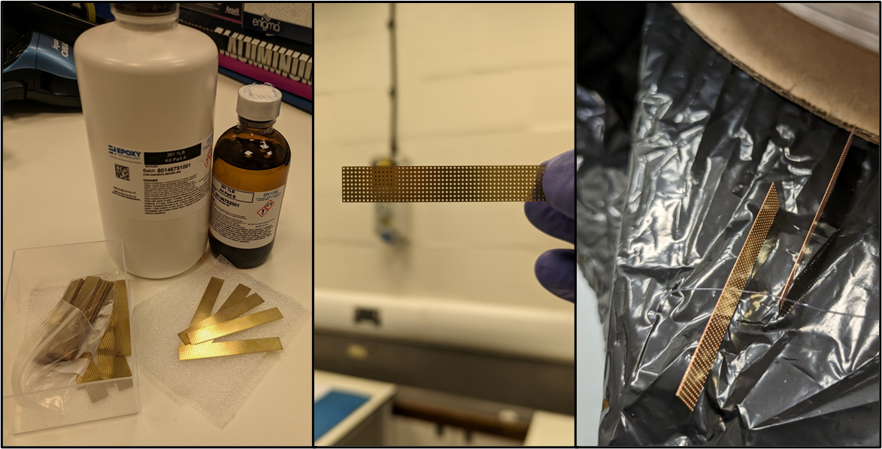
Plans for engineering test articles
Engineering tests will follow well established procedures developed by O. Tsai (FeCAL)
Materials are ordered and anticipate module construction to commence ASAP
  Epoxy (left) and brash mesh (all) acquired
  Fiber sample acquired (right)
    Tested with mesh (right)
  Tungsten powder sample acquired
  Construction mould design in progress
Work is needed to establish FEE
Initial test to be performed at MAINZ in 2024

