Slide 1
B0 Detectors
Zvi Citron for B0 team
Far-forward/ far-backward Review
Feb. 12, 2024

Slide 2

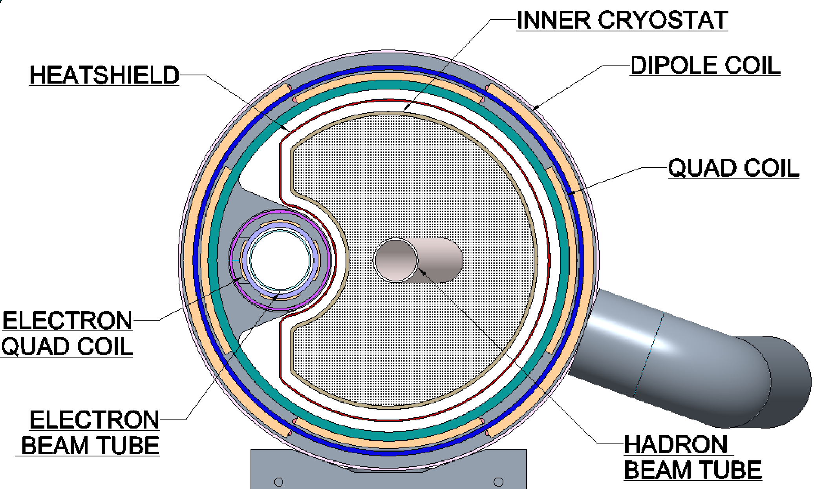
B Detectors – Overview
Four layers of silicon tracker
EM Calorimeter

Slide 3
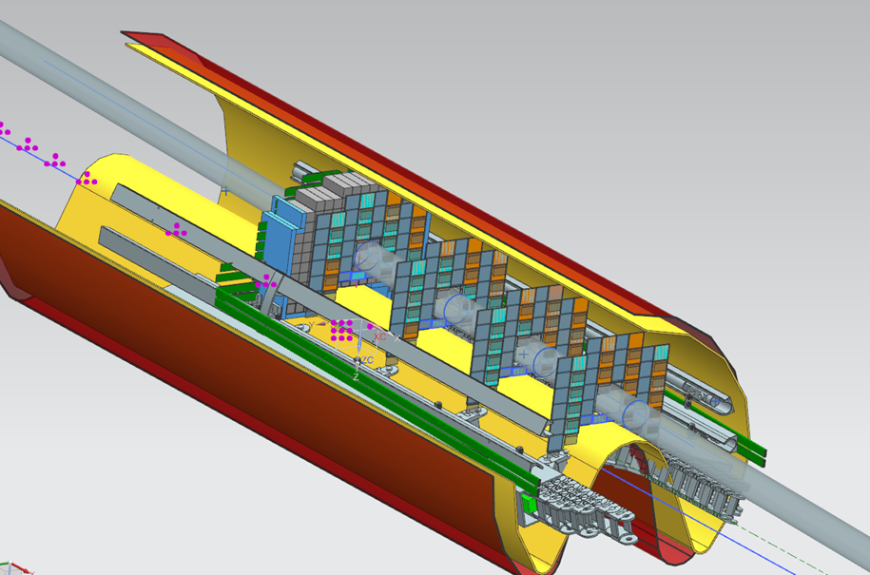
B Detectors – Overview
Credit: Jonathan Smith
Readout & cable space
Four layers of silicon tracker
EM Calorimeter
135 scintillating crystals
Rails for installation & support
4 Tracking layers, back-front overlapping arrangement to minimize dead area

Slide 4
B Detector – Tracking Detector
Forward (4.6<𝜂<5.9) charged tracking & proton tagging
Requirements:
4 layers inside magnet bore (in the funny B0 geometry)
Momentum resolution up to 6%
Timing resolution sufficient to suppress background
Radiation hard for forward environment
Detector design:
4 layers of AC-LGAD
27 cm spacing between layers, situated at front (IR side) of B0 magnet

Slide 5
Choice of AC-LGAD for Si Tracker
Previous design called for 3 layers of MAPS (ITS3) + 1 layer AC-LGAD
Problems with MAPS
Timing is too slow
Covering the geometry would be difficult with default fabrication options, special geometry costly if possible
AC-LGAD
Fast
With charge sharing gives acceptable spatial resolution
Technology overlap with Roman Pots, BNL expertise

Slide 6
B Detectors – Tracker Design and Status
Four layers separated by 27 cm
Populated by pixilated AC-LGAD sensor with 20μm effective resolution
Study by Alex Jentsch
4 Tracking layers, back-front overlapping arrangement to minimize dead area
Note: momentum resolution (dp/p) is ~2-4%, depending on configuration.

Slide 7
B Detectors – Tracker Design and Status
Four layers separated by 27 cm
Populated by pixilated AC-LGAD sensor with 20μm effective resolution
Remaining Questions/optimization
Precise location/spacing still to be optimized
Previously assumed homogeneous B field in magnet bore
Reality is worse, would like all layers in “good” part of the field
Study by Alex Jentsch

Slide 8
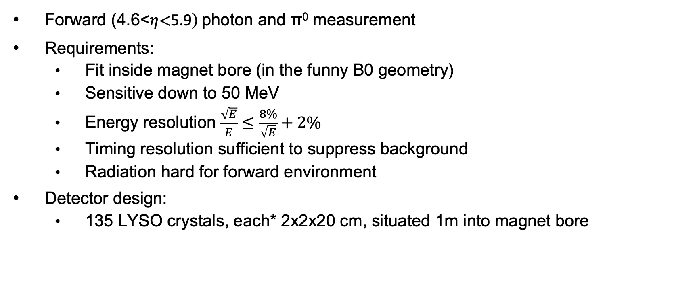
B Detector – EM Calorimeter
Forward (4.6<𝜂<5.9) photon and π⁰ measurement
Requirements:
Fit inside magnet bore (in the funny B0 geometry)
Sensitive down to 50 MeV
Energy resolution $\frac{\sqrt{E}}{E}≤\frac{8\%}{\sqrt{E}}+2\%$
Timing resolution sufficient to suppress background
Radiation hard for forward environment
Detector design:
135 LYSO crystals, each* 2x2x20 cm, situated 1m into magnet bore

Slide 9
Choice of LYSO for EM Calorimeter
Considered PbWO₄
Slightly better energy containment (density = 8.3g/cm³, rad length =0.92 cm)
Lower light yield at room T - O(10nγ/MeV), and high T sensitivity
LYSO
Slightly worse E containment (density = 7.1g/cm³, rad length =1.12 cm)
Better light yield O(10³ nγ/MeV), stable to T
Crucial for soft photons
More expensive
Notes:
Taiwan Applied Crystal has experience growing,wrapping, & preparing for CMS

Slide 10
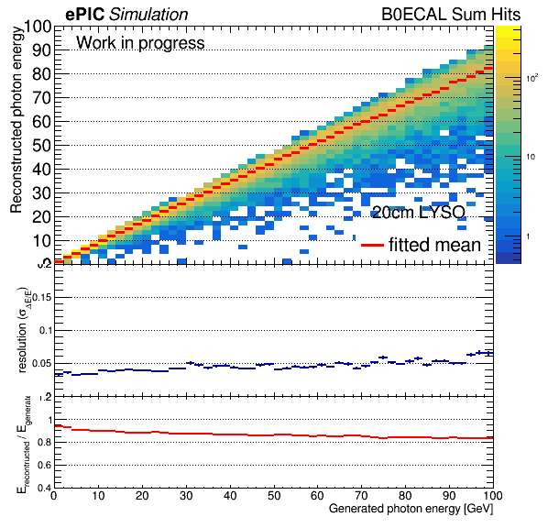
B Detectors – EMCal Design and Status
135 crystals 2x2x20 cm crystals
Read out by front (IR side) coupled SiPM
Study by Michael Pitt
135 scintillating crystals

Slide 11
B Detectors – EMCal Design and Status
135 crystals 2x2x20 cm crystals
Read out by front (IR side) coupled SiPM
Remaining Questions/optimization
Precise location still to be optimized
To make more room for tracker would like to push as far back as possible
Outer radius crystals must be shorter to stay in mechanical envelope, lose radial acceptance
Study by Michael Pitt

Slide 12
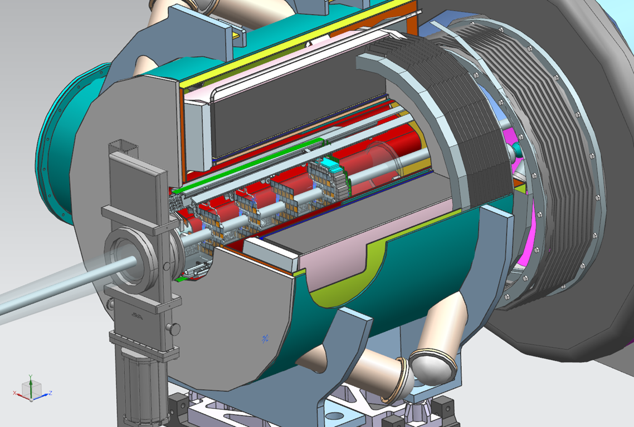
B Detectors – Installation Concept
Credit: Jonathan Smith

Slide 13
B Detectors – Installation Concept
Installation is non-trivial and staged
Detectors sit on rail for placement (and support)
Once upstream vacuum valve is closed only 10-15 cm of clearance
Crystals (20 cm long) installed before closing valve
After beam commissioning, rest of detector and electronics installed including coupling of SiPM to crystals

Slide 14
B Detectors – Open Issues
Finalizing detector placement
Finalize cooling scheme
Tracker
Confirming expectation of rad hardness (especially for charge sharing)
Finalizing mechanics, cabling, etc
Calorimeter
Finalizing readout (i.e. SiPM) and coupling
Finalizing mechanics, cabling, etc

Slide 15
B Detectors – Simulation Studies
Simulation of both detectors in standard ePIC framework
Detector parameters can be adjusted
Parameterized realistic magnetic field for tracking
Benchmarking with
Particle gun
Soft photons from BEAGLE, harder photons ,π⁰ , and protons from eSTARLIGHT (backwards DVCS mode)

Slide 16
B Detectors – Summary
Baseline detector design and technology choice fixed
Optimization ongoing
Basic installation/integration approach set
Simulation framework exists and simulations ongoing
Some finalization of supporting apparatus still to be done

