Slide 1

B0 Detectors
Zvi Citron for B0 team
Far-forward/ far-backward Review
Feb. 12, 2024

Slide 2

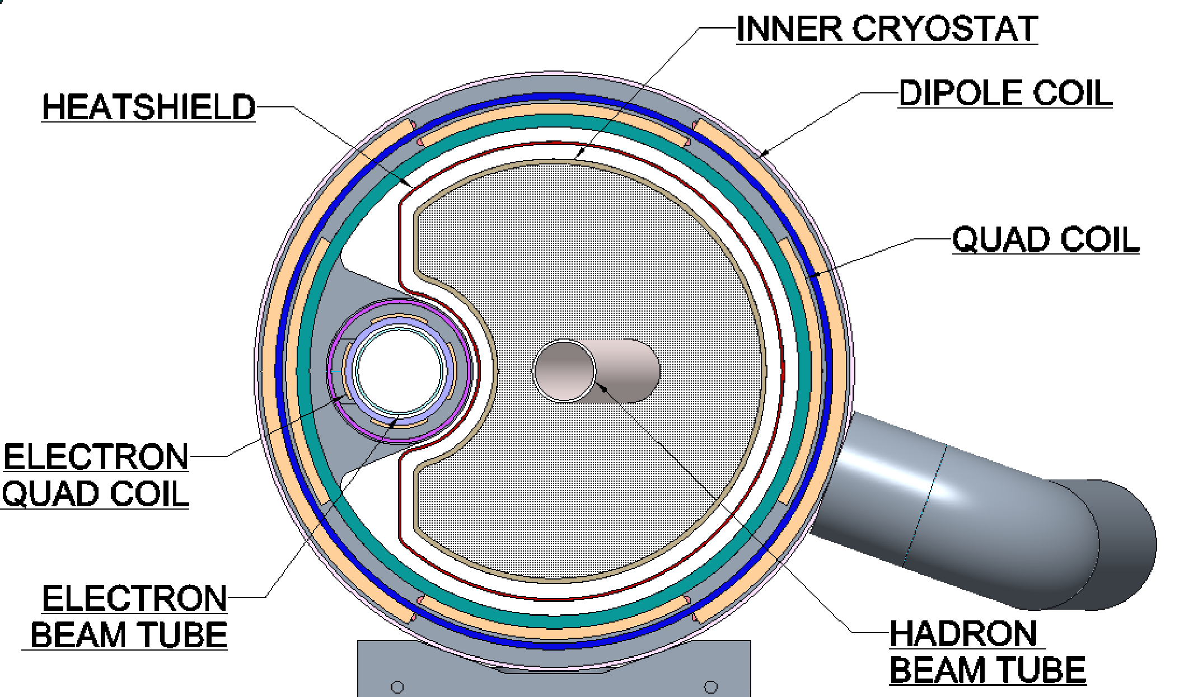
B Detectors – Overview
Two detectors inside B0 magnet:
Four layers of silicon tracker
EM Calorimeter

Slide 3
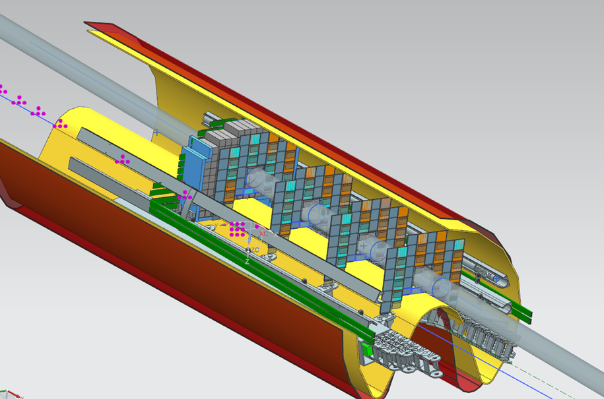
B Detectors – Overview
Credit: Jonathan Smith
Two detectors inside B0 magnet:
Four layers of silicon tracker
EM Calorimeter
Readout & cable space
135 scintillating crystals
Rails for installation & support
4 Tracking layers, back-front overlapping arrangement to minimize dead area

Slide 4
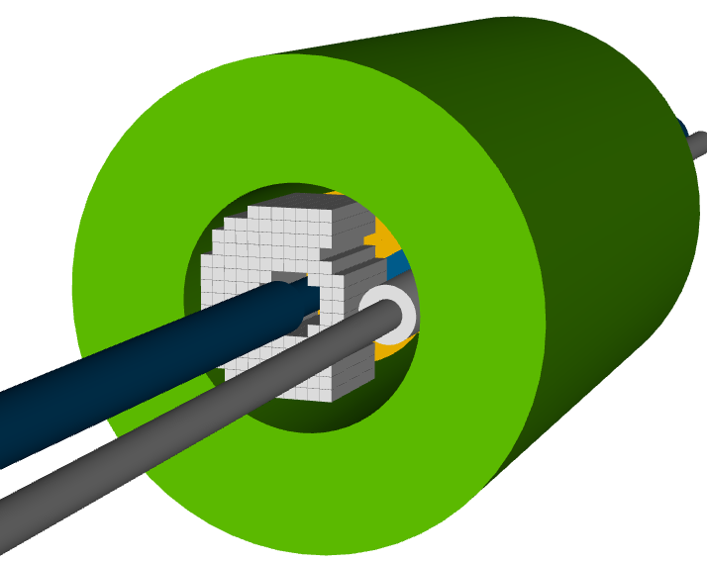
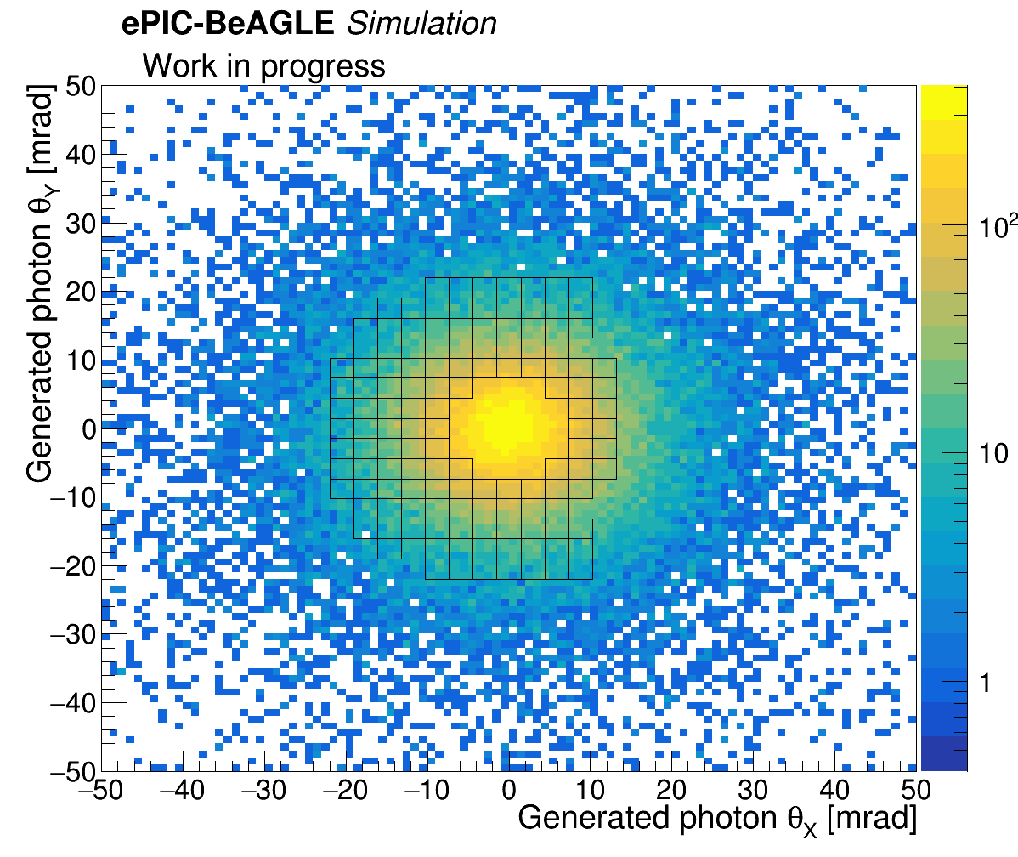
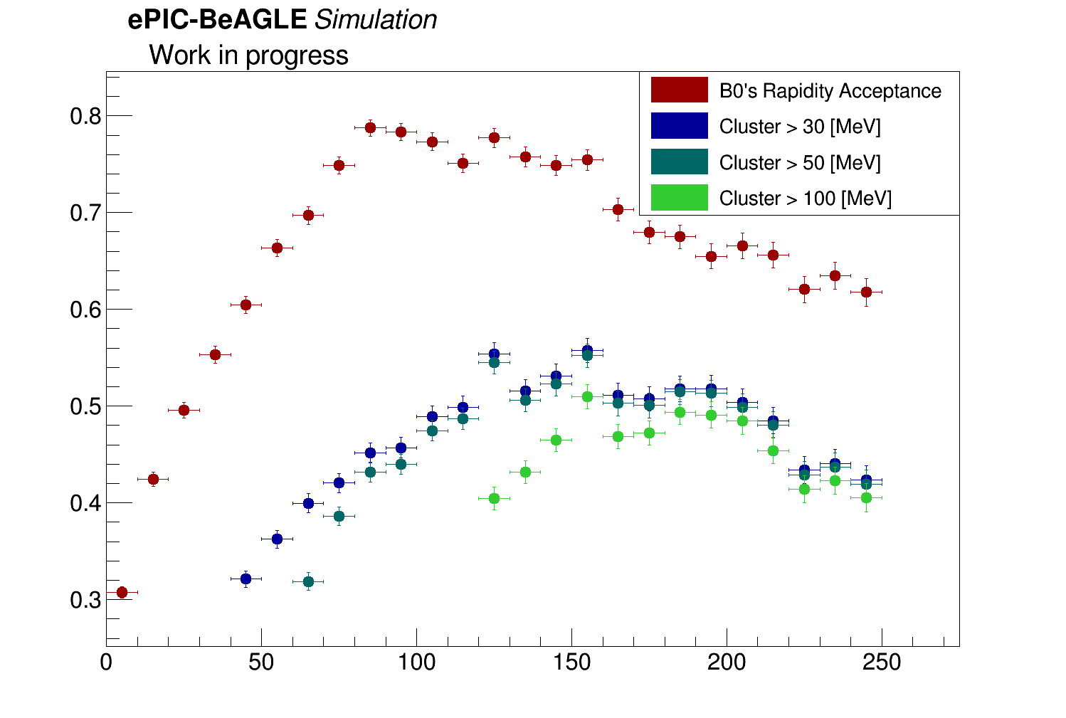
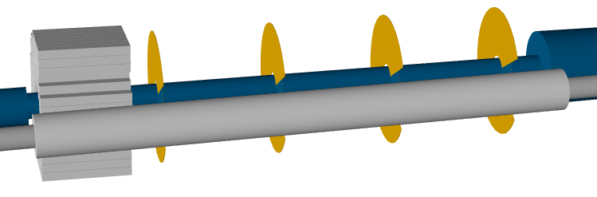
B Detectors – Simulation Status
Simulation of both detectors was developed in standard ePIC framework
Detector parameters can be adjusted
Parameterized realistic magnetic field for tracking
Benchmarking with
Particle gun
physical processes such as coherent/incoherent vector meson production, ep DVCS
Efficiency
Photon energy in lab frame [MeV]

Slide 5
B Detector – Tracking Detector
Forward (4.6<𝜂<5.9) charged tracking & proton tagging
Requirements:
Momentum resolution < 6%
Radiation hard for forward environment
Timing precision sufficient to deal with vertex smearing¹
Accommodate available mechanical envelope
Detector design:
4 layers of AC-LGAD
Use 3.2cm² pixel sensors
W/ charge sharing acceptable resolution
Fast ~30 ps
27 cm spacing between layers, situated at front (IR side) of B0 magnet
(Serious consideration of MAPS but integration time is too slow → unacceptable background)
¹See RP&OMD talk

Slide 6
B Detectors – Tracker Design and Status
Four layers separated by 27 cm
Populated by pixilated AC-LGAD sensor with 20μm effective resolution
Study by Alex Jentsch
4 Tracking layers, back-front overlapping arrangement to minimize dead area
Note: momentum resolution (dp/p) is ~2-4%, depending on configuration.

Slide 7
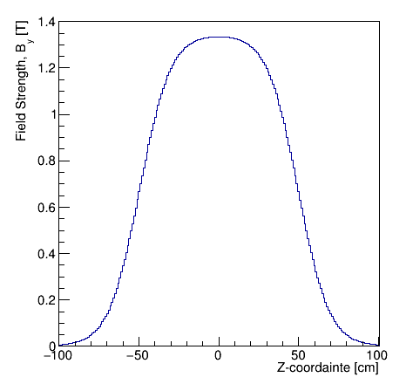
B Detectors – Tracker Design and Status
Four layers separated by 27 cm
Populated by pixilated AC-LGAD sensor with 20μm effective resolution
Remaining Questions/Optimization
Previously used homogeneous B field in magnet bore
Now optimizing detector positions/spacing for real B field²
Study by Alex Jentsch
Z [cm]
²More details in FF update

Slide 8
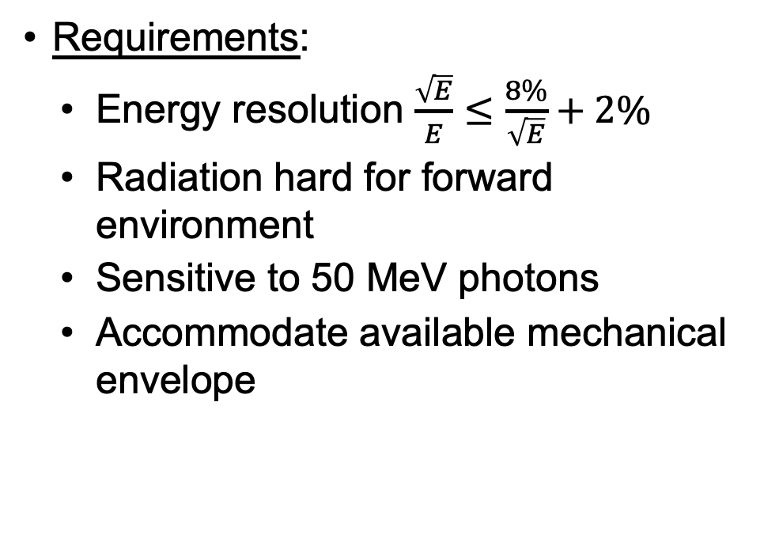
B Detector – EM Calorimeter
Forward (4.6<𝜂<5.9) photon and π⁰ measurement
Requirements:
Energy resolution $\frac{\sqrt{E}}{E}≤\frac{8\%}{\sqrt{E}}+2\%$
Radiation hard for forward environment
Sensitive to 50 MeV photons
Accommodate available mechanical envelope
Detector design:
135 Scintillating crystals , each* 2x2x20 cm, situated 1m into magnet bore
LYSO and PbWO₄ meet requirements
Preference for LYSO for low energy measurements (and better T behavior)

Slide 9
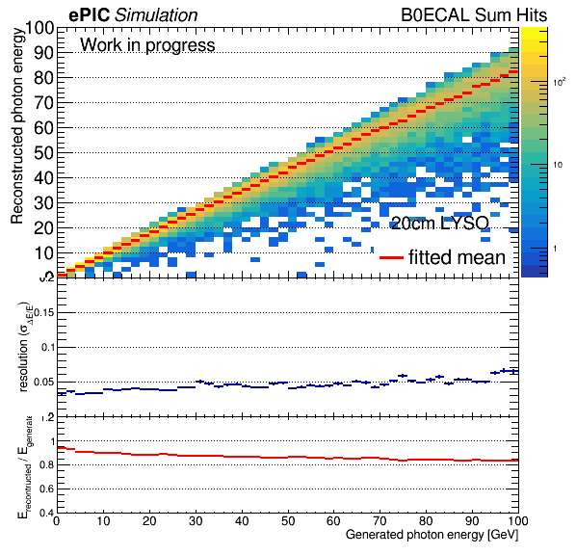
B Detectors – EMCal Design and Status
135 crystals 2x2x20 cm crystals
Read out by front (IR side) coupled SiPM
Study by Michael Pitt
135 scintillating crystals

Slide 10
B Detectors – EMCal Design and Status
135 crystals 2x2x20 cm crystals
Read out by front (IR side) coupled SiPM
Remaining Questions/Optimization
Precise location still to be optimized
To make more room for tracker would like to push as far back as possible
Outer radius crystals must be shorter to stay in mechanical envelope, lose radial acceptance
Finalize coupling to readout device
Study by Michael Pitt

Slide 11
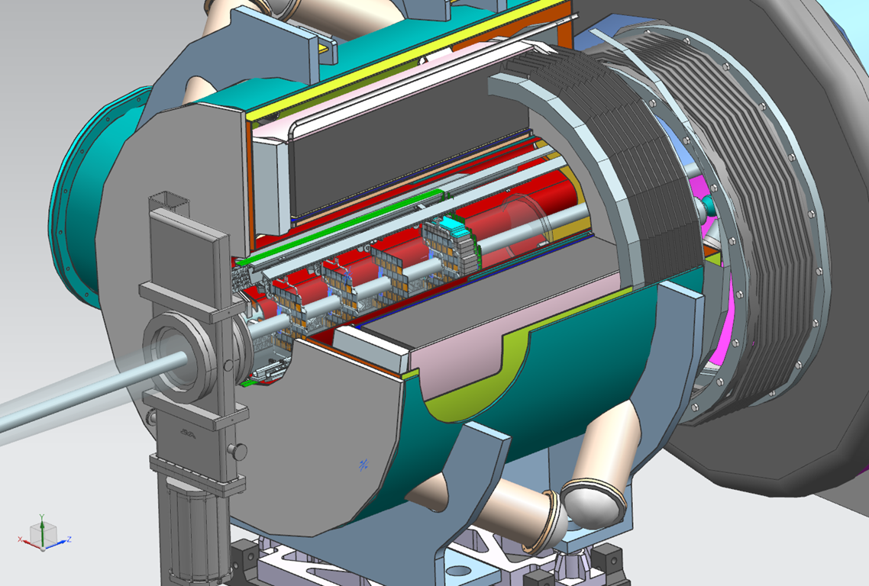
B Detectors – Installation Concept
Credit: Jonathan Smith

Slide 12
B Detectors – Installation Concept
Challenge: Detectors are inside magnet, with access only from the front (IR side), after vacuum valve is closed only 10-15 cm of clearance
→ Installation is staged
Crystals (20 cm long) installed before closing valve
After beam commissioning (valve closed), rest of the detector(s) and electronics are installed including coupling of SiPM to (front of) crystals
Detectors sit on rails for installation and mechanical support

Slide 13
B Detectors – Next Steps/Plan for 2024
Finalizing detector placement
Finalize cooling scheme (outside of vacuum – much simpler than RP)
Tracker
Confirming expectation of rad hardness (especially for charge sharing)
Finalizing mechanics, cabling, etc
Calorimeter
Finalizing readout (i.e. SiPM) and coupling
Finalizing mechanics, cabling, etc
ES&H
No major challenges expected but full plan needs to be developed
Quality Assurance plans need to be developed
AC-LGADs for tracker should by synchronized w/other detectors
Testing regimen for crystals needs to be developed (possibly together with ZDC)

Slide 14
B Detectors – Summary
Baseline detector design and technology choice fixed
Some optimization ongoing
Basic installation/integration approach set
Simulation framework exists and simulations ongoing
Some finalization of supporting apparatus still to be done

Slide 15
B Detectors – Backups

Slide 16
LYSO preference for EM Calorimeter
PbWO₄
Slightly better energy containment (density = 8.3g/cm³, rad length =0.92 cm)
Lower light yield at room T - O(10nγ/MeV), and high T sensitivity
Read out in visible (>400 nm) with SiPM
LYSO
Slightly worse E containment (density = 7.1g/cm³, rad length =1.12 cm)
Better light yield O(10³ nγ/MeV), stable to T
Crucial for soft photons
Read out in visible (>400 nm) with SiPM/APD
More expensive
Notes:
Taiwan Applied Crystal has experience growing,wrapping, & preparing for CMS

