Slide 1
Status of the ePIC ZDC
29th January 2024
Michael Murray for the ZDC group
Japan: RIKEN, Universities of Kobe, Shinshu, Tsukuba
Taiwan: NCU, Academia Sinica
Korea: Sejong Univ.
USA: UC Riverside, Pacific Northwest Lab, Kansas

Slide 2
ZDC requirements

Slide 3
Changes since last year
Major effort to reduce cost of hadronic calorimeter
Moving to Fe/Scintillator with SiPMs on each tile gives major reduction in cost
Also has significant synergies with Forward Hadron Calorimeter
New radiation estimates, ~ 2 10¹¹ N equivalent, suggest design OK
For EM section 20cm PbWO₄ is default also consideri to LYSO to improve resolution for very low energy photons.
  Working to find synergies with B0 calorimeter

Slide 4
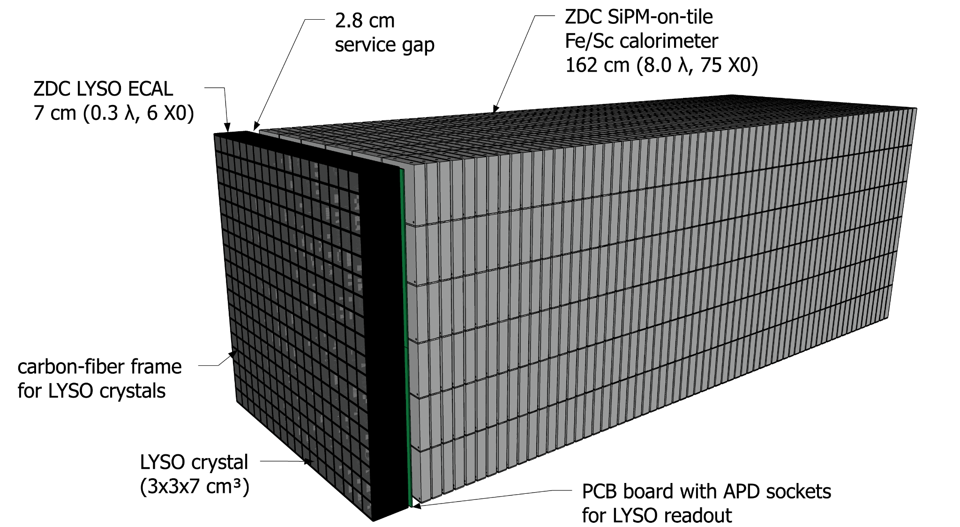
Current Design

Slide 5
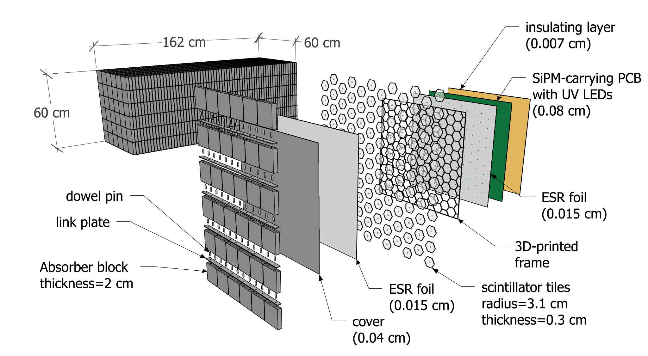
Hadronic Section
Design is very similar to forward hadron calorimeter

Slide 6
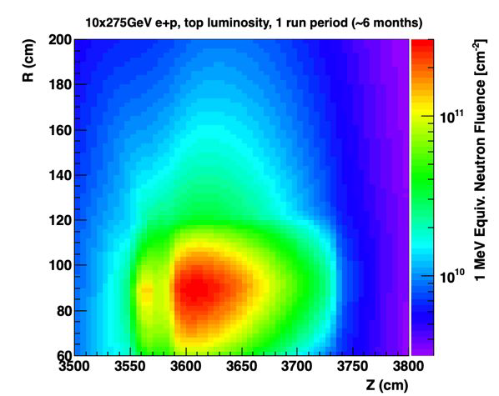
Radiation Load ~ 2 10¹¹ N equivalent/running year
Radiation load comparable to peak of forward hadron calorimeter

Slide 7
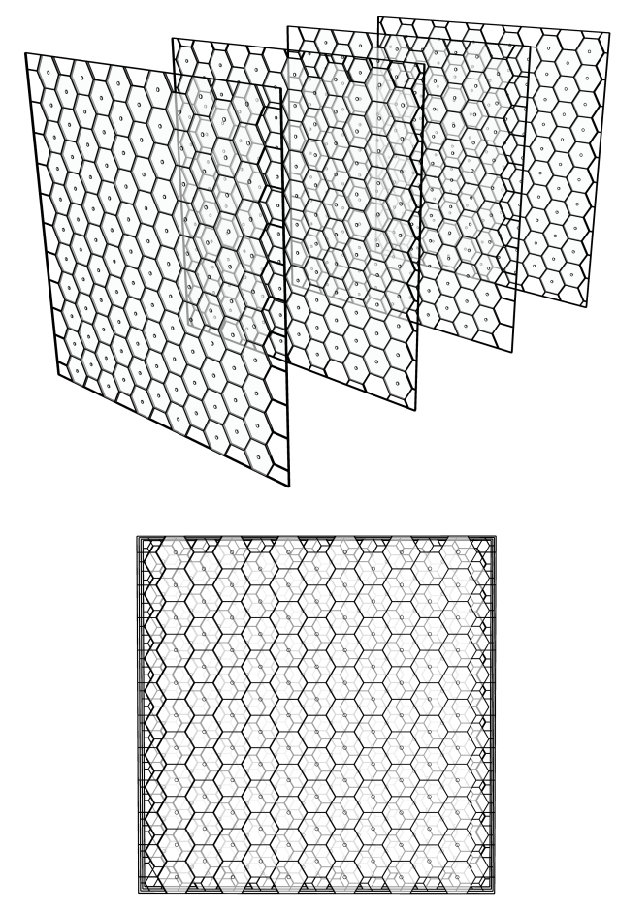
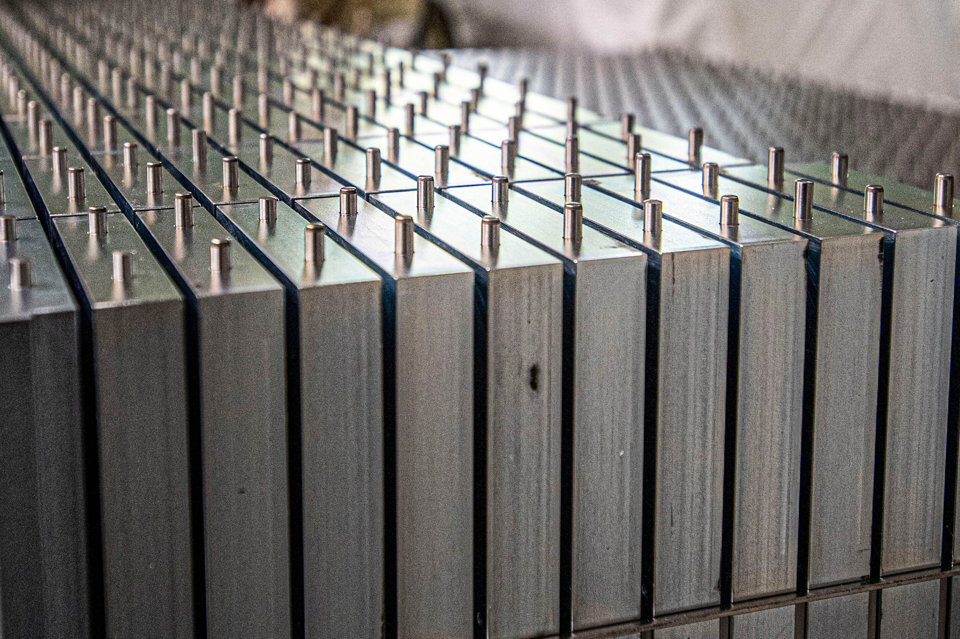
Tessellation of hexagons improves position resolution
Cells~25 ㎠
Fe blocks from STAR
arXiv:2308.06939

Slide 8
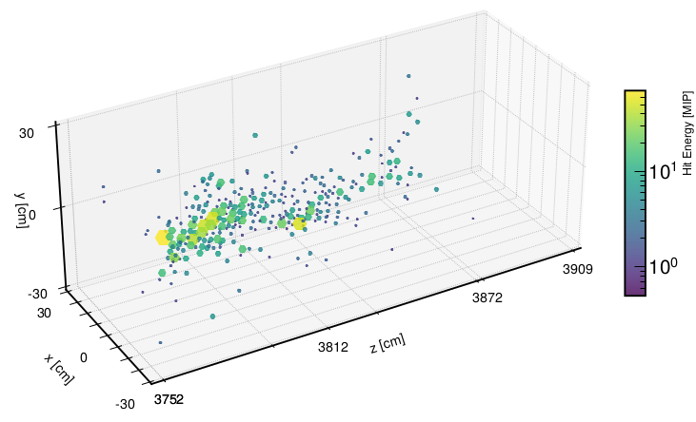
Example of 100 GeV neutron shower
Example 100 GeV
neutron shower
Cells~25 ㎠

Slide 9
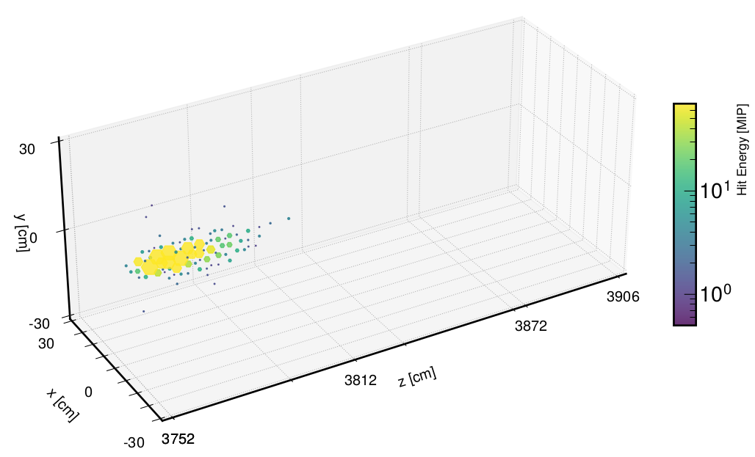
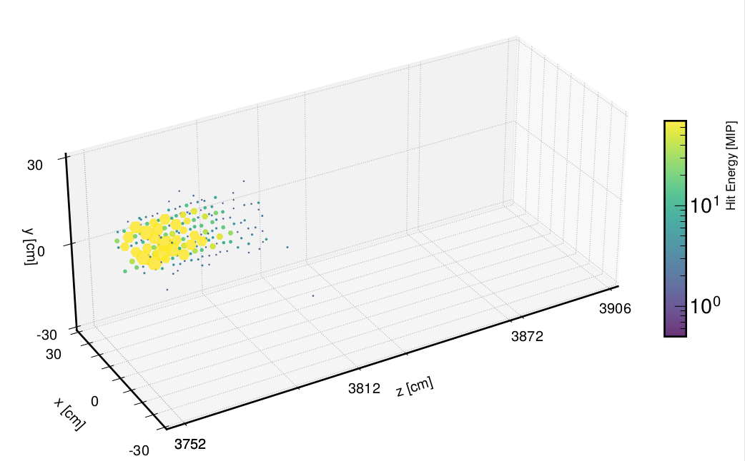
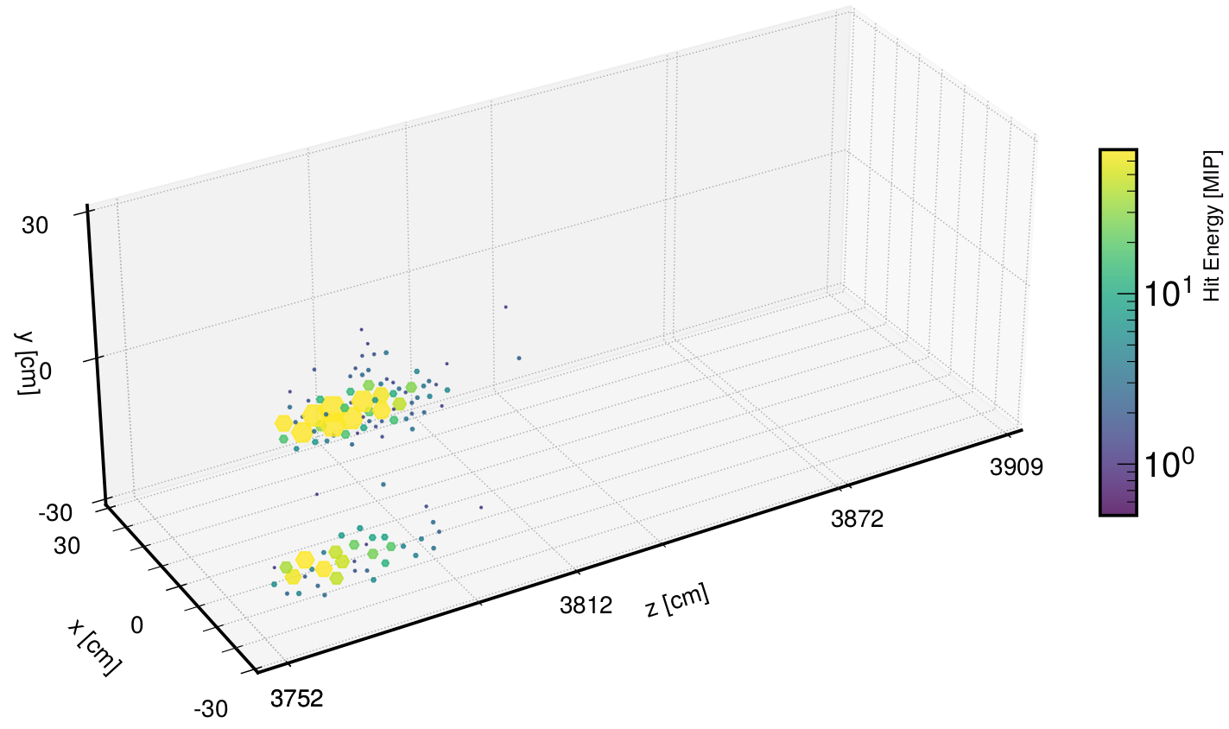
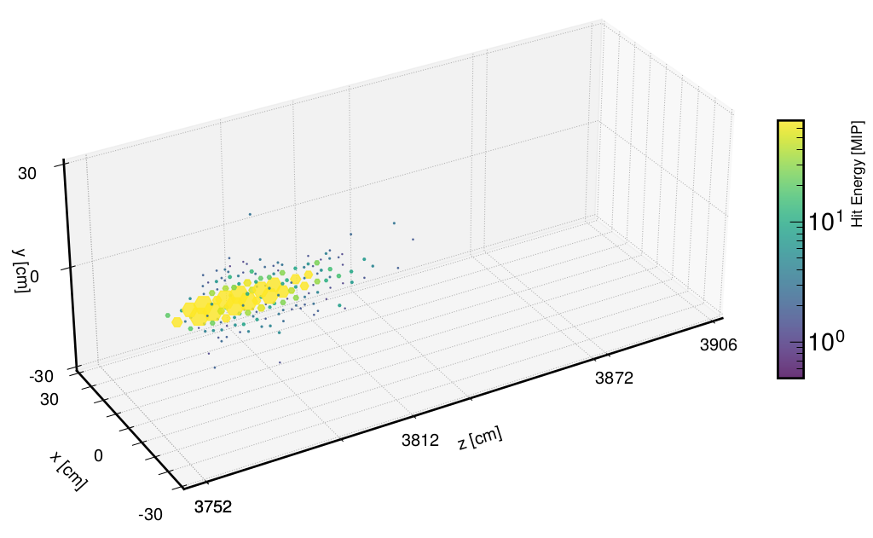
Example one and two photon showers

Slide 10
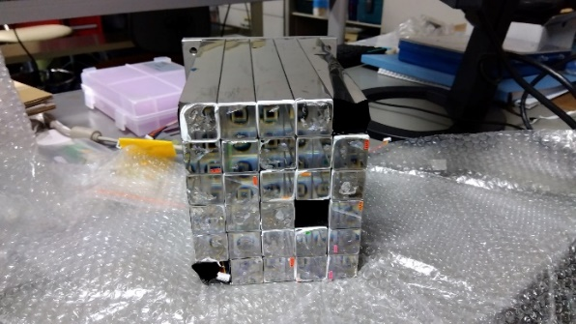
Comparison of PbWO₄ and LYSO
ALICE Phos PWO prototype
Need to reconstruction both high energy and very low energy (300 MeV) photons

Slide 11
LYSO Test module built by Taiwan Group

Slide 12
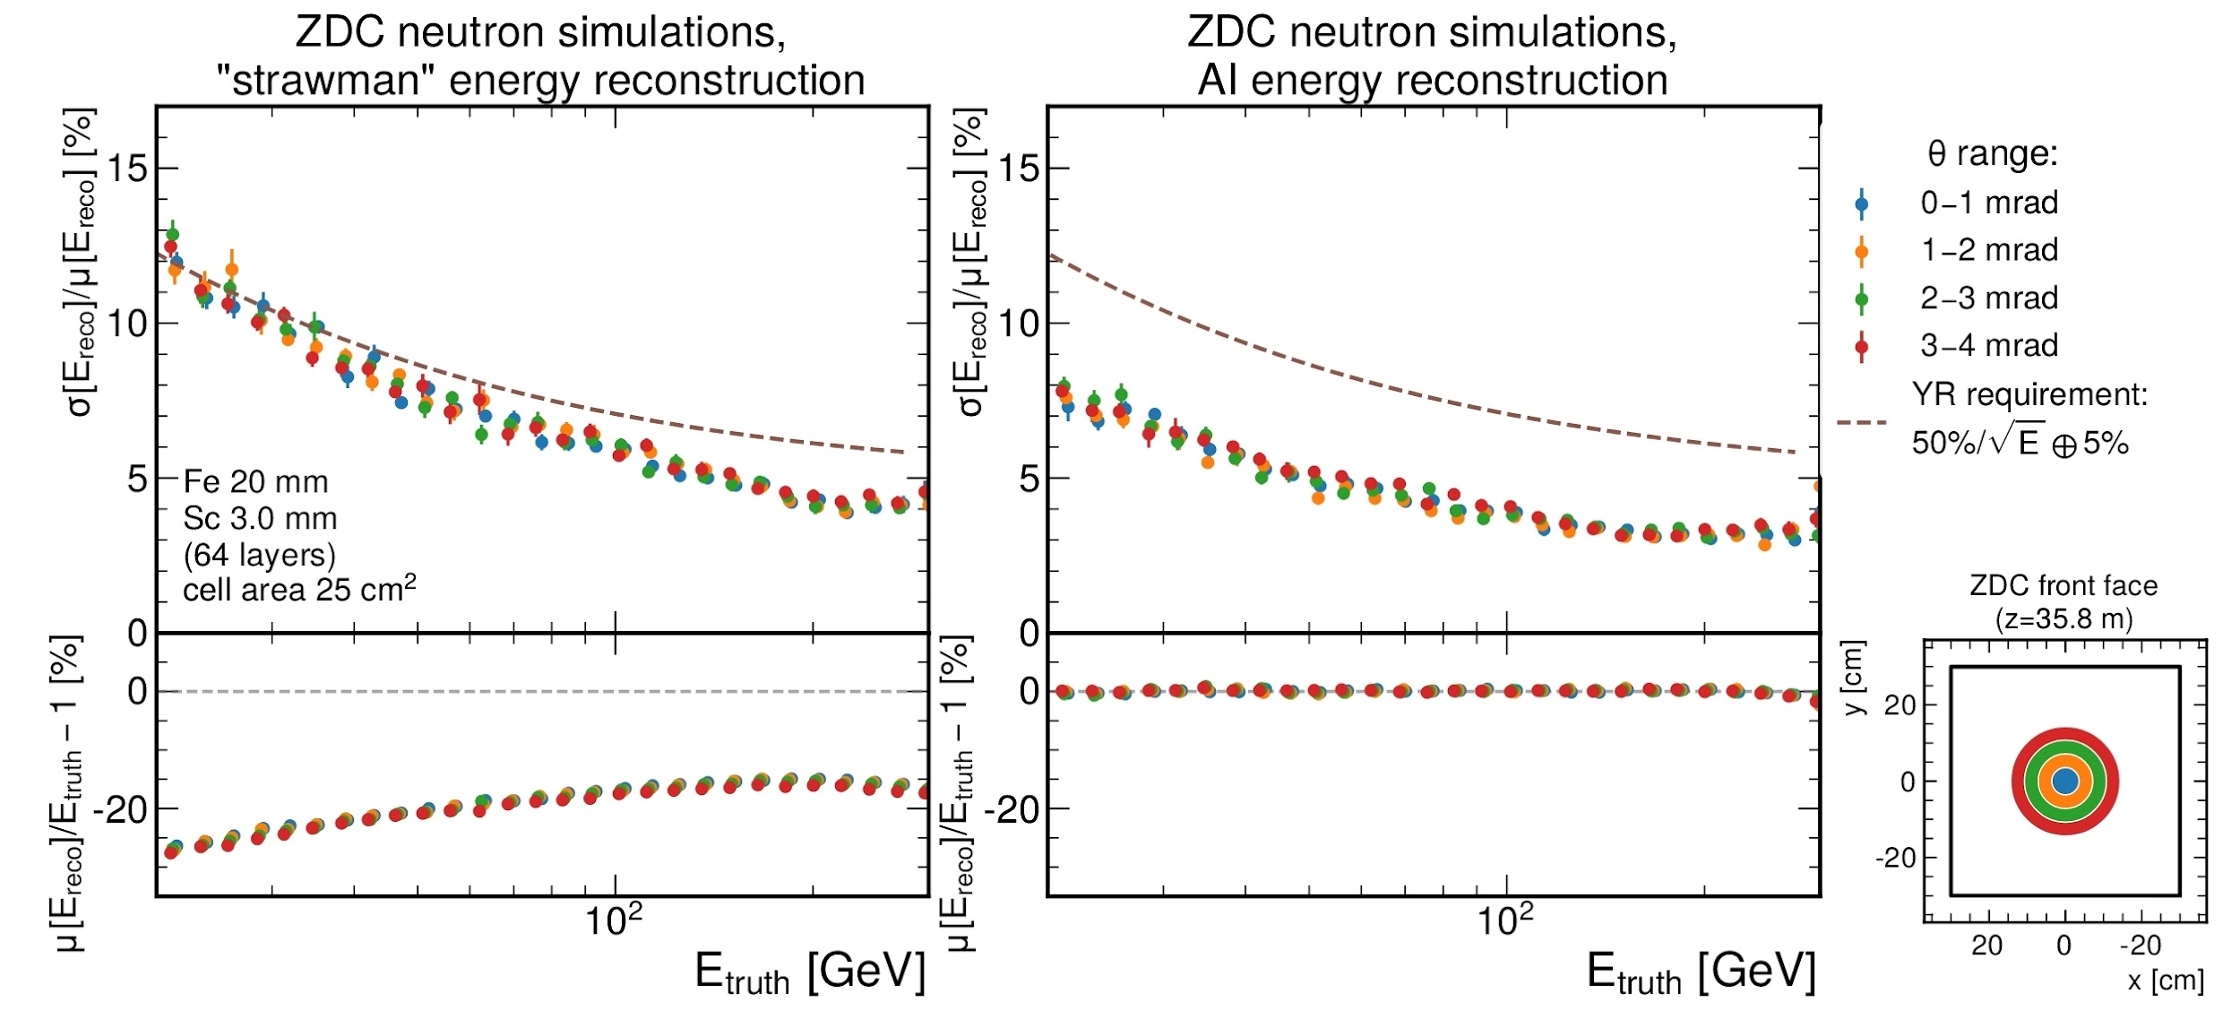
AI shower reconstruction improves resolution

Slide 13
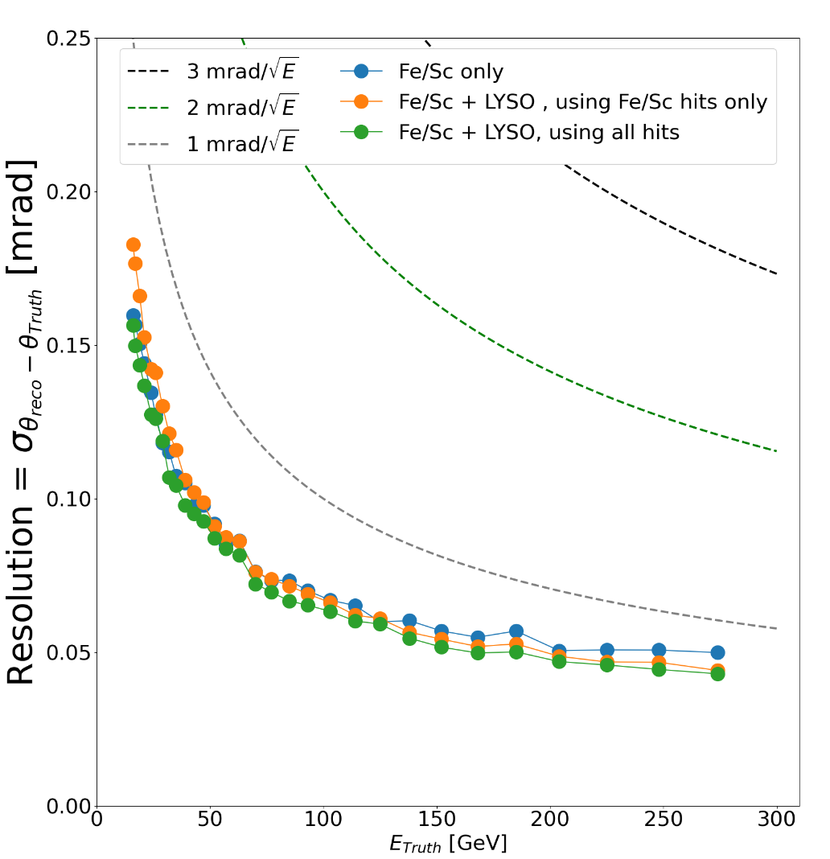
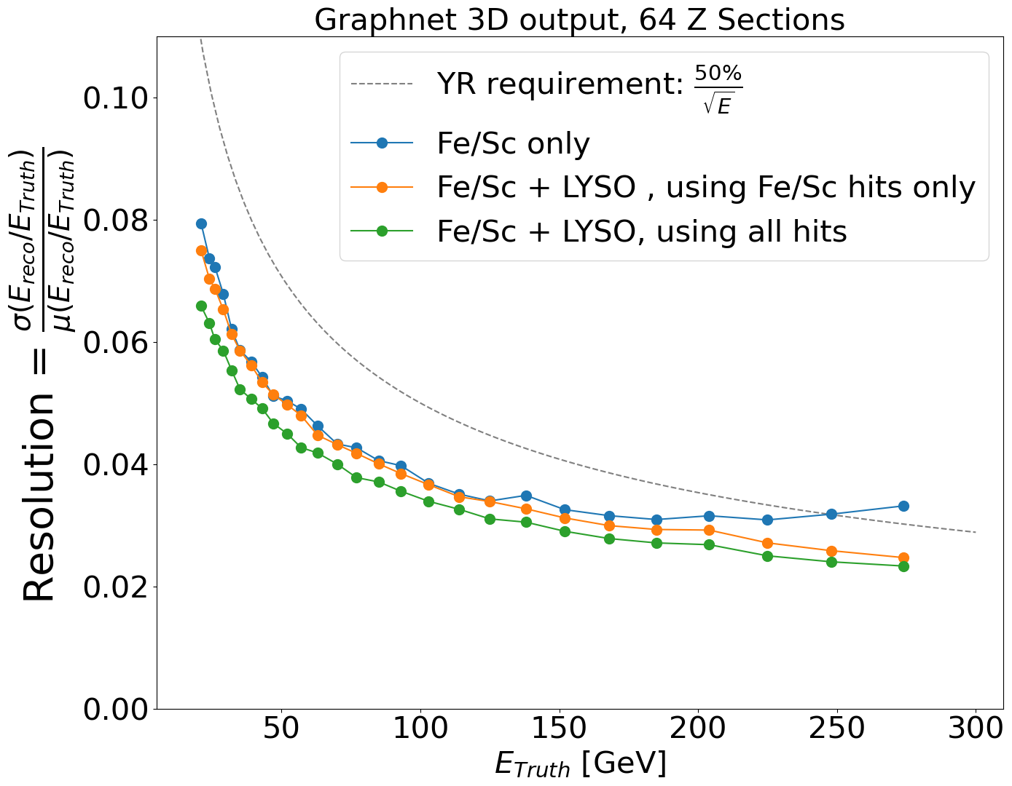
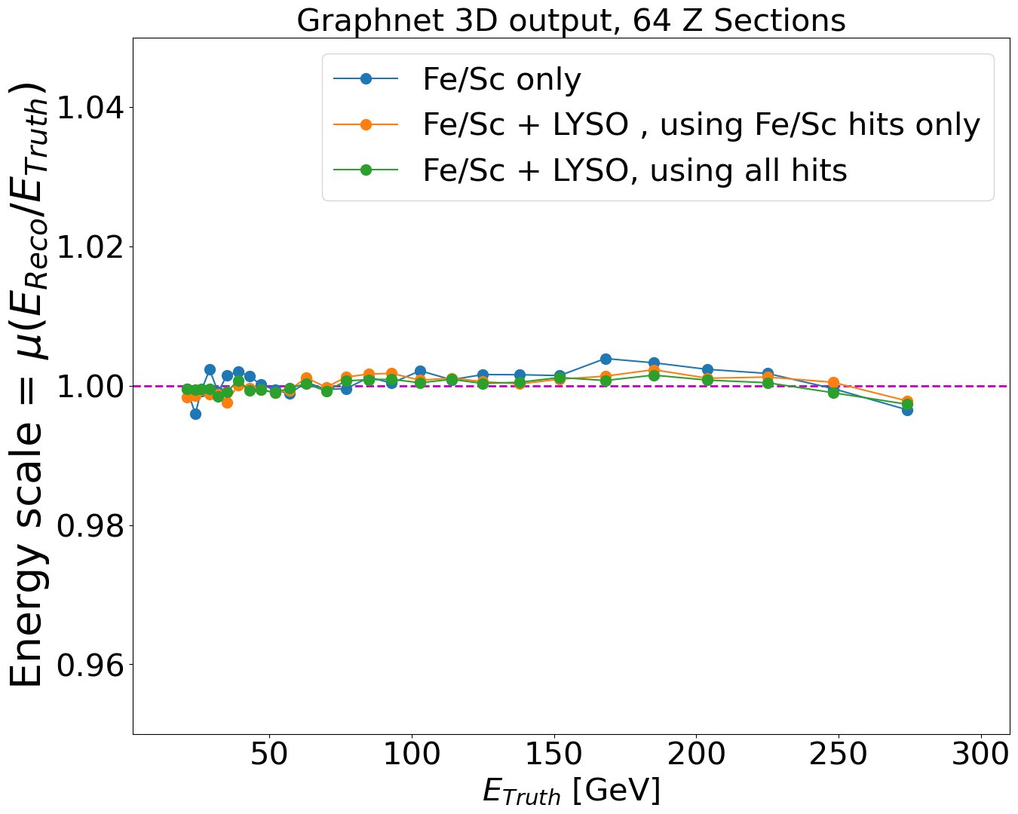
Resolution of combined EM and Hadronic sections.
Layer by layer information allows software compensation
Adding LYSO slightly improves energy resolution.
No significant impact on the angular resolution

Slide 14
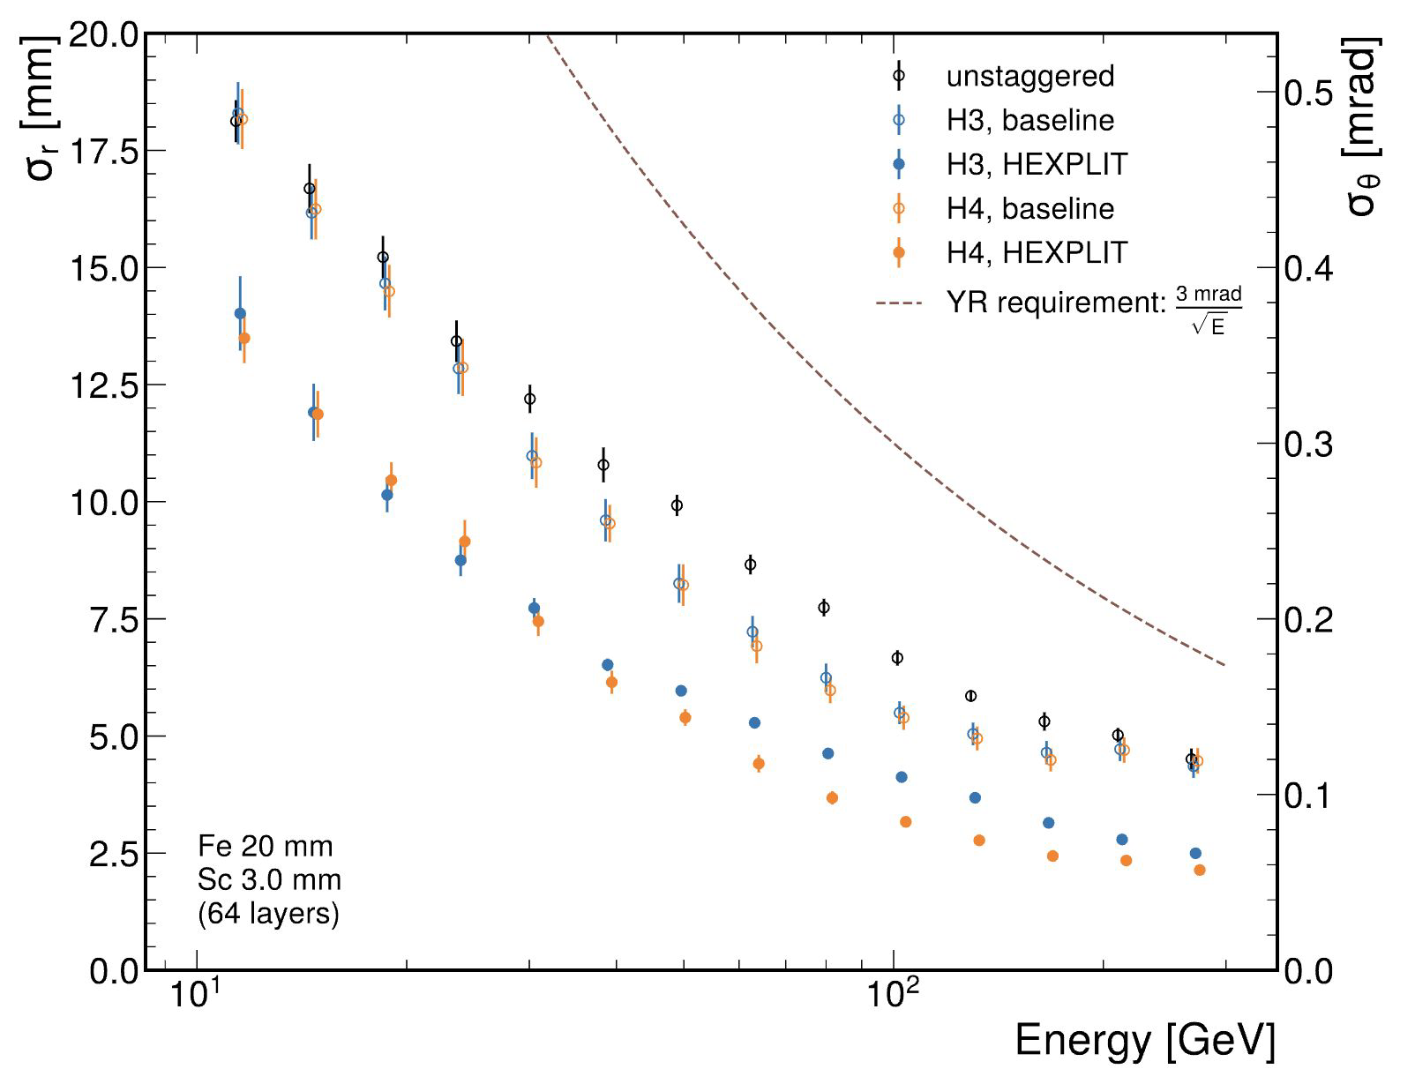
Neutron position resolution meets requirements

Slide 15
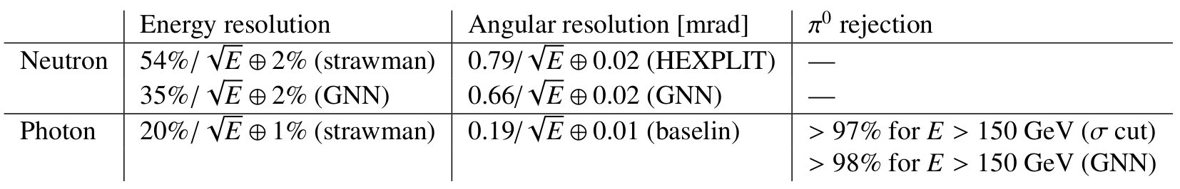
Summary: Current design meets physics requirements
At 100 GeV, the neutron angular resolution is 2.5 mm or 80 μrad, which added in quadrature with beam divergence in the high-acceptance configuration (56 μrad) yields a pT resolution of 10 MeV
At 100 GeV, the position resolution for photons is 0.6 mm.

Slide 16
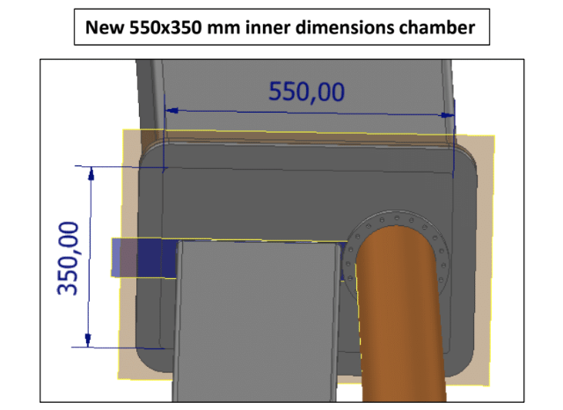
New beam pipe is larger with a thin exit window
Window will be a few mm of either copper or steel
Cone of forward neutron and photon paths

Slide 17
Need to stay clear of cryostats, hadronic beam pipe and electron crab cavity
Current hadron beam pipe cuts acceptance for photons. Machine is aware of this.

Slide 18
Safety and operational considerations.
Current design envisions whole of calorimeter as one piece
Will need strong internal structure to give rigidity to frame while maximizing active area.
It may be possible to go to stackable design for mechanical reasons.
There is space around the ZDC for cooling, power and other services.
Layout of services will be designed for modularity and simplicity to minimize tripping and mechanical risks.

Slide 19
Plan for 2024: Getting to final design
Need to finalize length of LYSO crystals: Ideally the same length as other detectors.
Taiwan group working on realistic CAD design & test beam of prototype
Realistic mechanical design that is sufficiently rigid to pass safety review.
Include realistic distribution of services.
Get full simulation and physics benchmarks into ePIC framework
  This is vital for integration with detector elements such as beam pipe.
Work to strengthen group by working for all possible funding options.

Slide 20
BACKUP

Slide 21
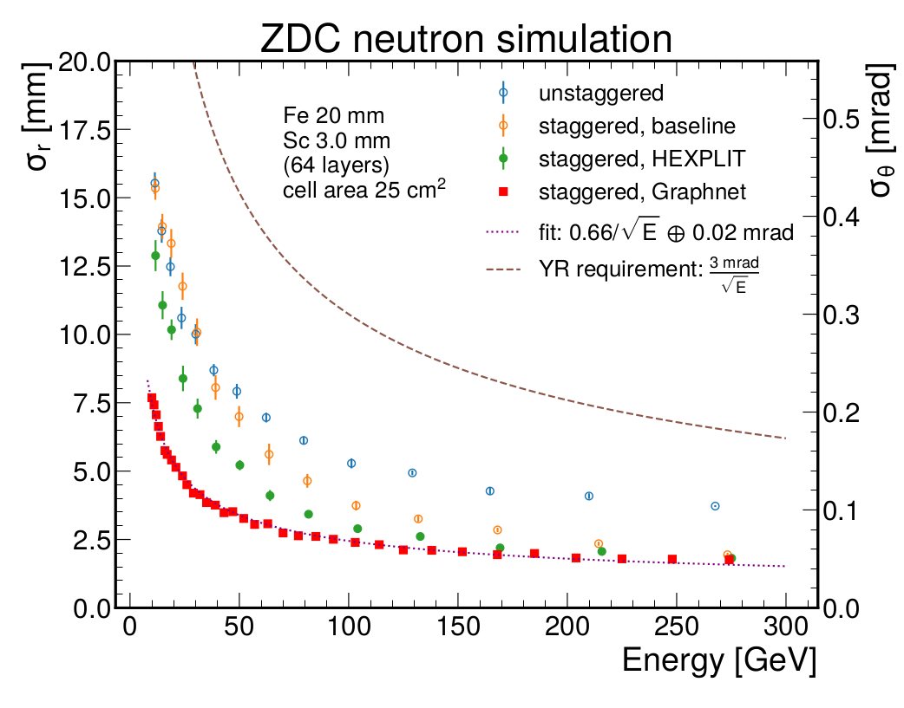
Reminder: standalone neutron performance

Slide 22
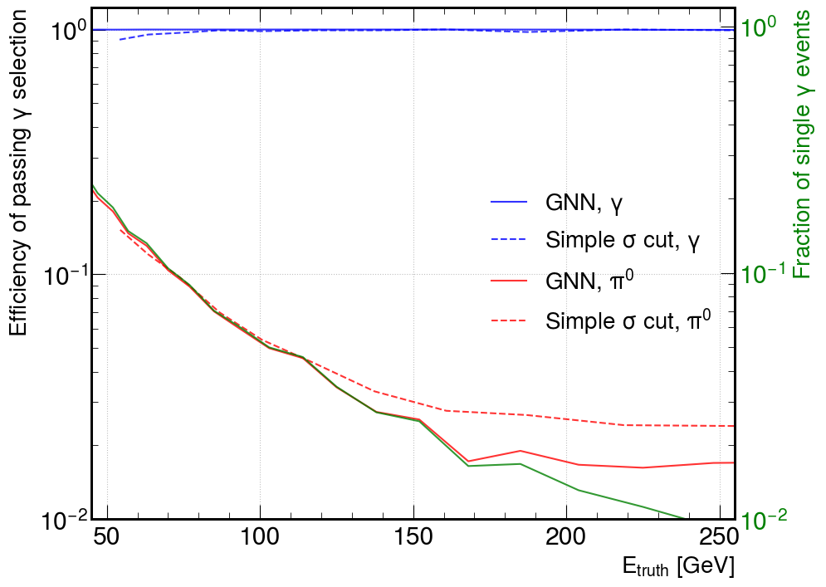
SiPM-on-tile standalone performance on π0/Ɣ separation
GNN (solid red) improves simple shower-shape cut above ~120 GeV
GNN reaches ~2% misclassification rate above 150 GeV
For reference, a perfect detector would yield a performance shown in green (true fraction of π0 that yield only on photon in acceptance).
Simple shower shape close to perfect case until ~120 GeV, GNN close to perfect until ~170 GeV.
Take home message: SiPM-on-tile granularity good enough for this application.
Higher granularity would yield insignificant gains, which are neither required nor justified by physics.

Slide 23
ZDC SiPM-on-tile software in DD4HEP and ePIC
DD4hep plugin for hexagonal segmentation and staggering was added to official DD4HEP core software https://github.com/AIDASoft/DD4hep/pull/1161
ZDC Fe/SiPM-on-tile was added to official ePIC sim DD4HEP geometry model
New: Digitization parameters tuned and added to EICrecon:
https://github.com/eic/EICrecon/blob/sipmzdc/src/detectors/ZDC/ZDC.cc
New: Fe/Sc + LYSO configuration added to dedicated branch of ePIC sim: https://github.com/eic/epic/tree/ZDC_LYSO
New: new branch of EICRecon for ZDC SiPM-on-tile algorithms:
https://github.com/eic/EICrecon/tree/sipmzdc
New: HEXPLIT algorithm C++ version is on EICrecon:
https://github.com/eic/EICrecon/blob/sipmzdc/src/algorithms/calorimetry/HEXPLIT.cc
New: LogWeighting 3D position reco algorithm is on EICrecon:
https://github.com/eic/EICrecon/blob/sipmzdc/src/algorithms/calorimetry/LogWeightReco.cc
New: ZDC Physics Benchmark with Deeply-exclusive meson events created
https://github.com/eic/physics_benchmarks/tree/demp_zdc/benchmarks/demp/analysis
New: 3D Topological clustering algorithm deployed for ZDC benchmark:
https://github.com/eic/EICrecon/blob/sipmzdc/src/algorithms/calorimetry/ImagingTopoClusterConfig.h

Slide 24
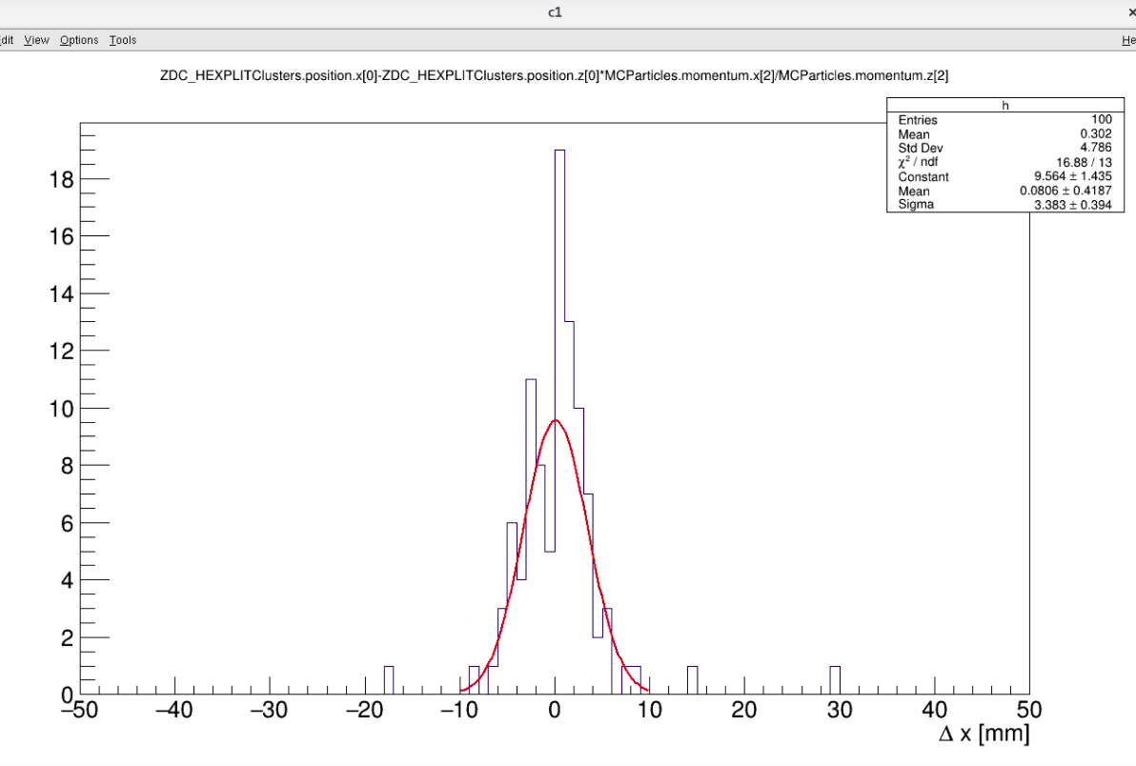
Complete neutron reconstruction is now built in (part of EICrecon output)

Slide 25
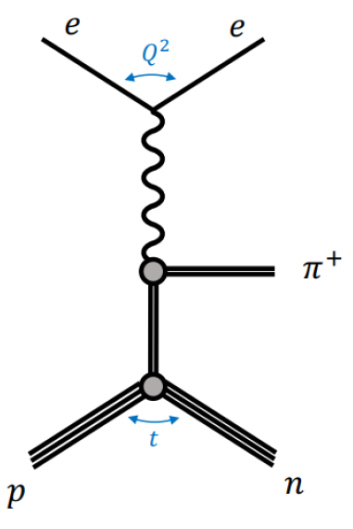
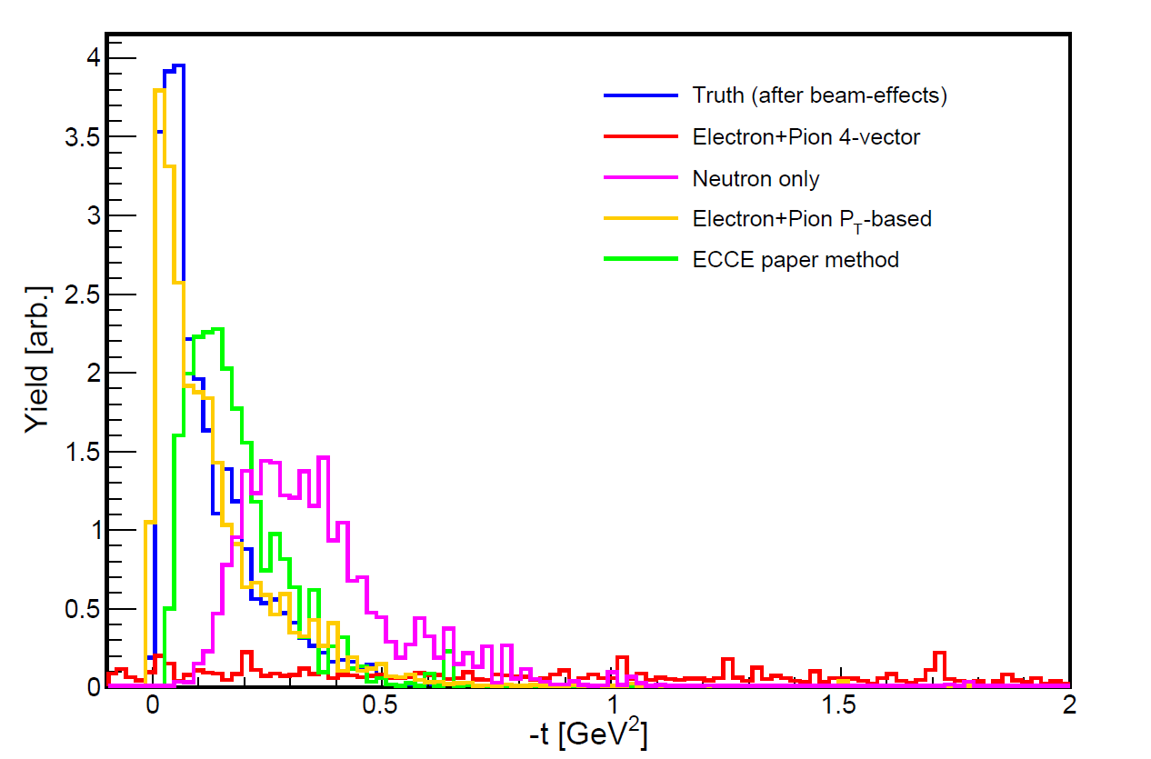
ZDC Physics Benchmark https://github.com/eic/physics_benchmarks/tree/demp_zdc/benchmarks/demp/
Includes full neutron reconstruction in ZDC
Events from DEMPgen read from S3
Credit, Barak Schmookler, Sebouh Paul

Slide 26
Software status Summary
Updates on standalone γ/π0 performance studies
→ Fe/Sc SiPM-on-tile performance is close to be dominated by “irreducible” background of π0 yielding only 1 photon in ZDC acceptance.
Updated combined system studies
→ Adding LYSO slightly improves energy resolution and does not impact much the angular resolution for neutron showers.
Updates related to software and physics benchmarks
→ Entire chain of algorithms is in ePIC software now
→ Flagship benchmark is in place up and running

Slide 28
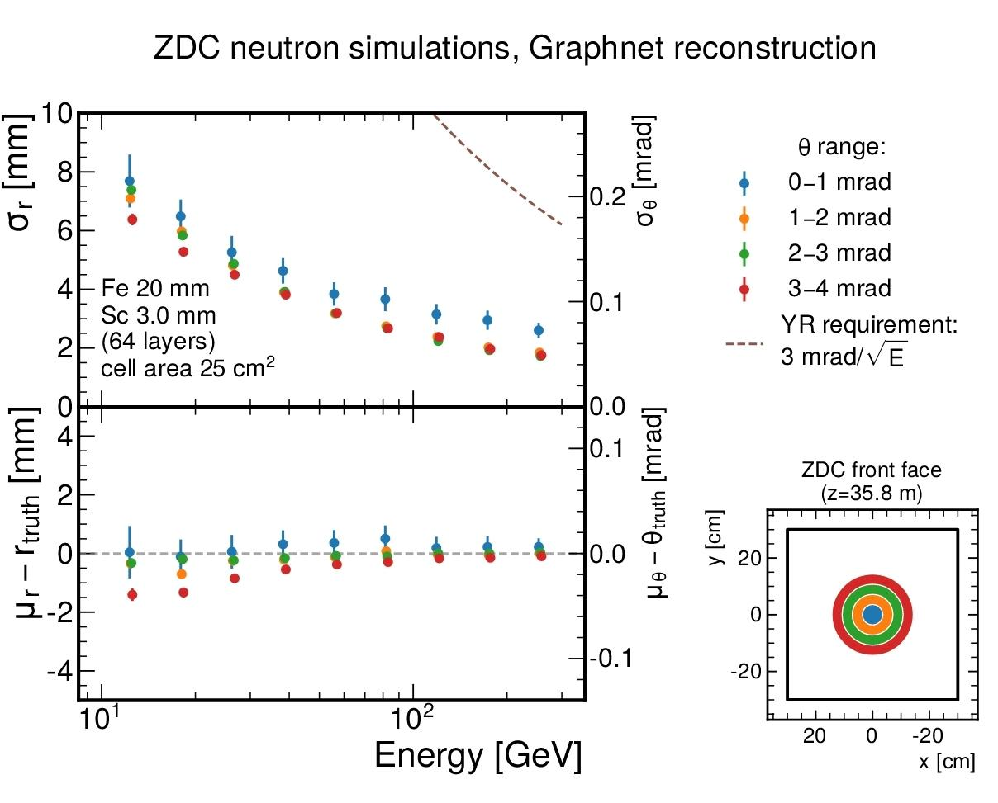

Slide 29
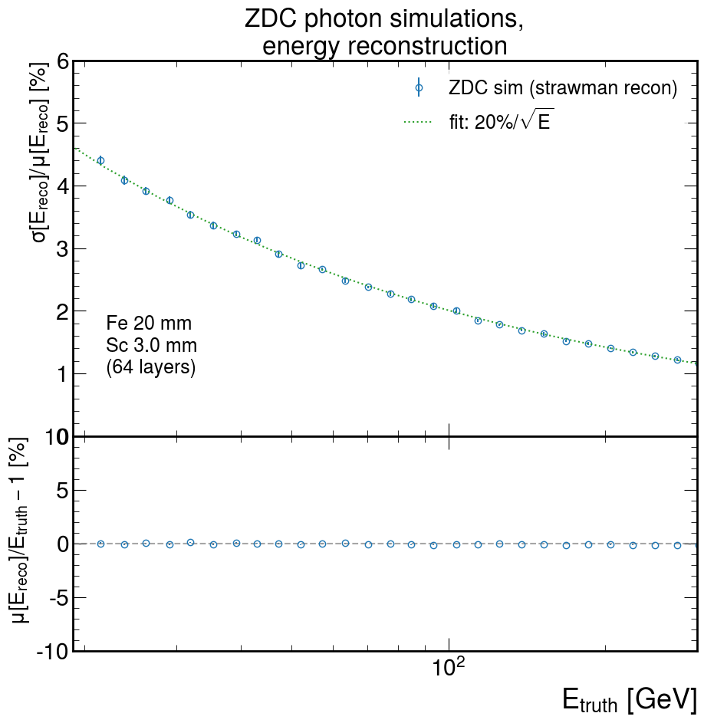
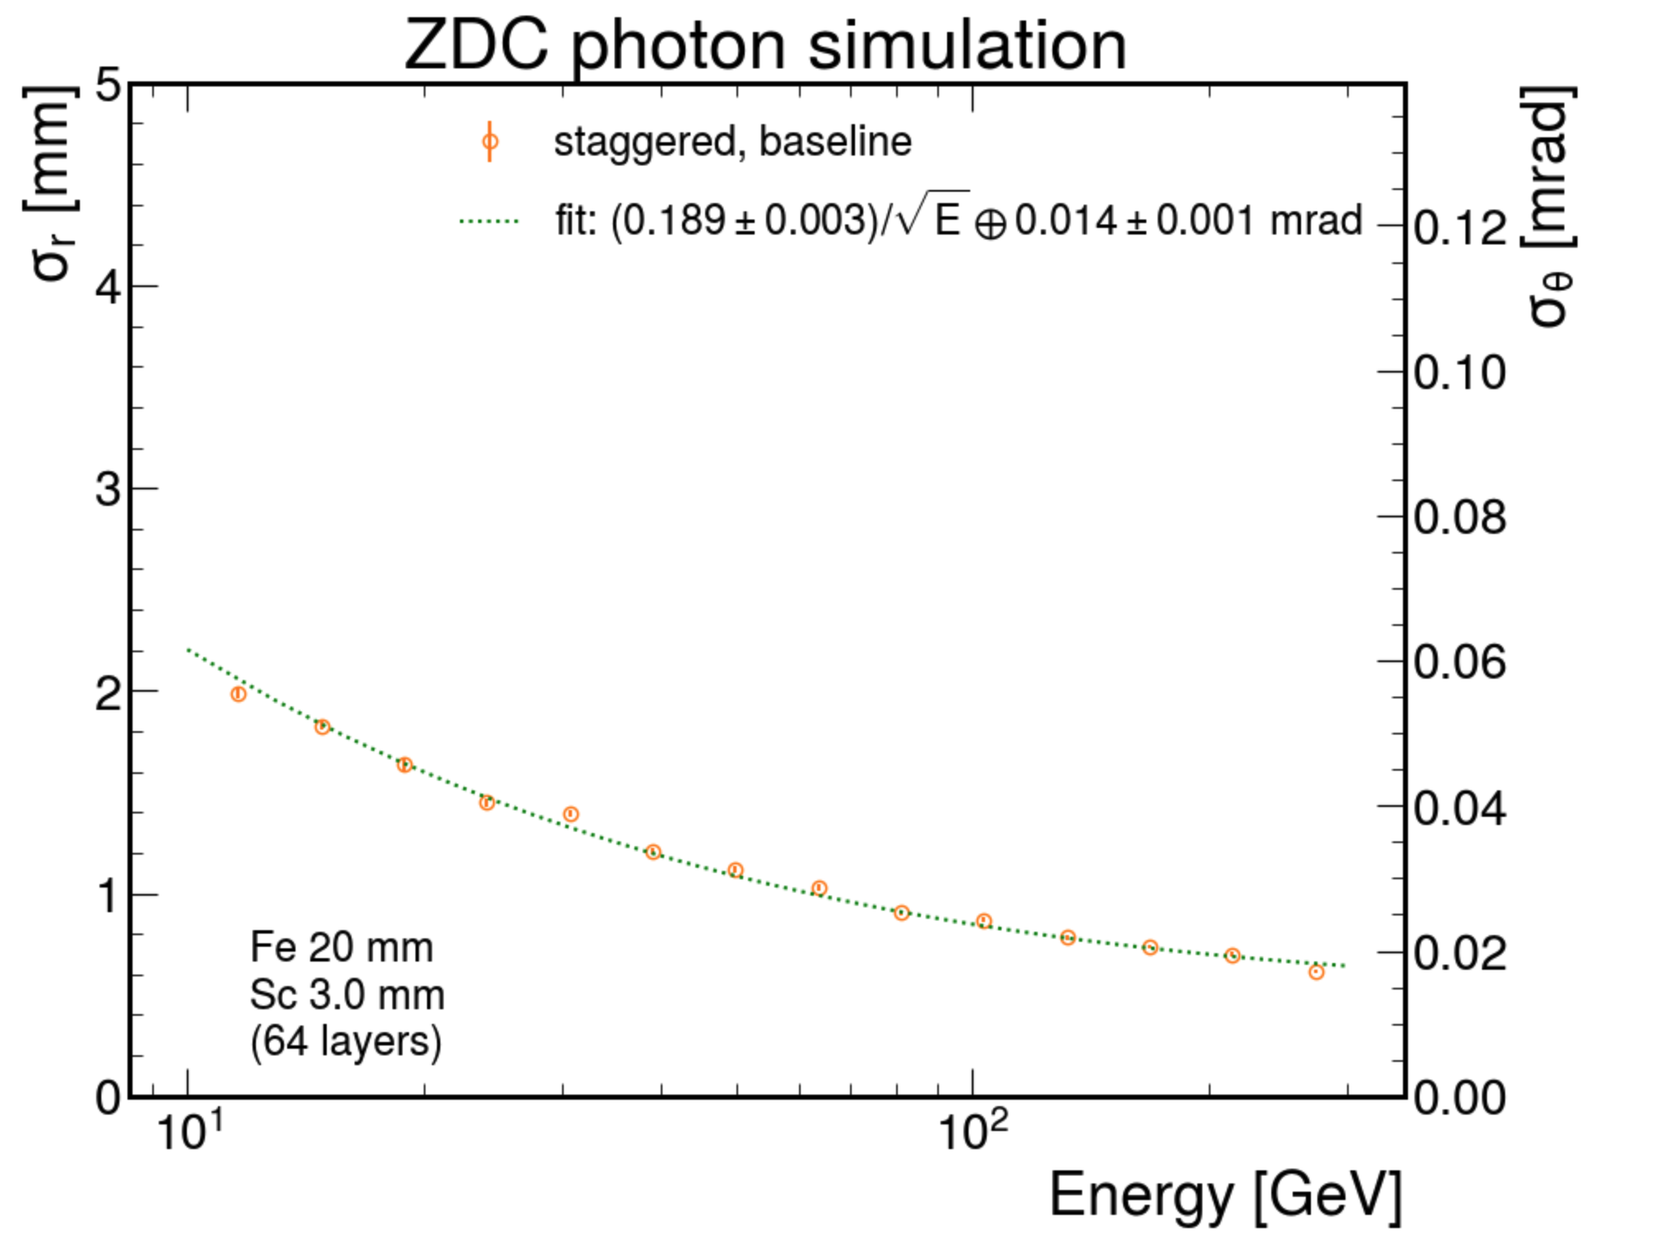
Fe/Sc SiPM-on-tile photon performance
Credit: Sebouh Paul
Fe/Sc SiPM is adequate for high-energy photons

Slide 30
FoCal-E design

Slide 31
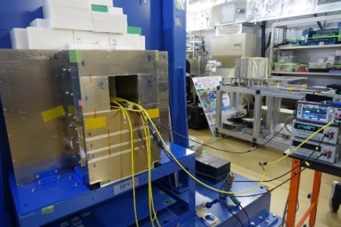
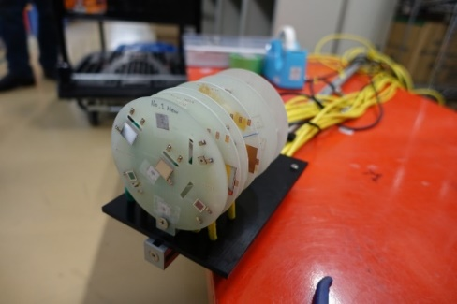
Test-beam studies
ALICE FoCal-E test beam @ Tohoku-ELPH & CERN-PS/SPS
  p-sub sensor, HGCROC v2 for readout
  Clear MIP peaks observed for almost all channels and layers
  Reaching full depletion voltage around 300 V
Neutron irradiation test @ RIKEN-RANS
  Sensor, photodetectors, chips, cables
  For FoCal-E, sPHENIX, ePIC-ZDC
  Up to ~10¹⁴ neutrons/cm²
Inaba’s slide

Slide 32
ALICE-FoCal structure
Including cooling & support

Slide 33
Integration with beam pipe

