Slide 1
Roman Pots and Off-Momentum Detectors
Alex Jentsch (BNL)
EIC Preliminary Design & Safety Review of the EIC Auxiliary
Far-Forward/Far-Backward Detectors
February 12th, 2024

Slide 2

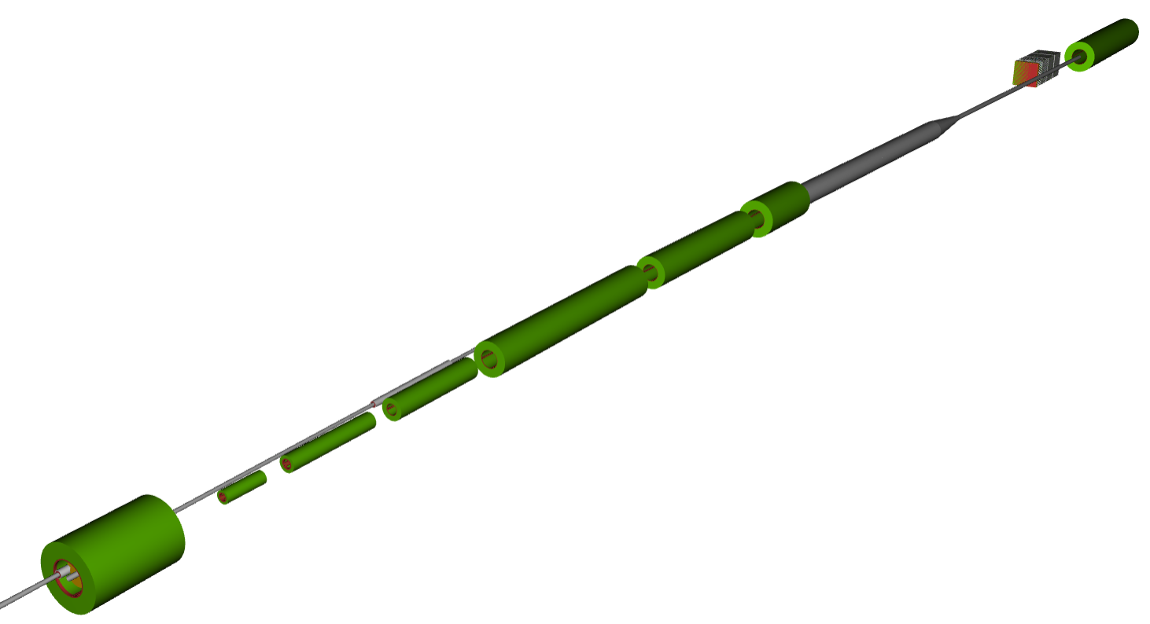

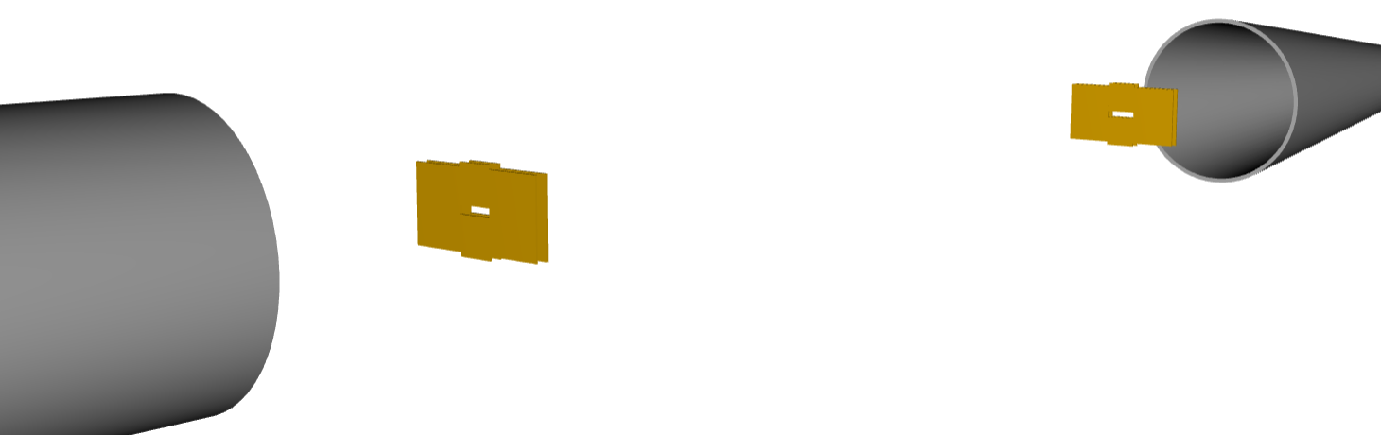
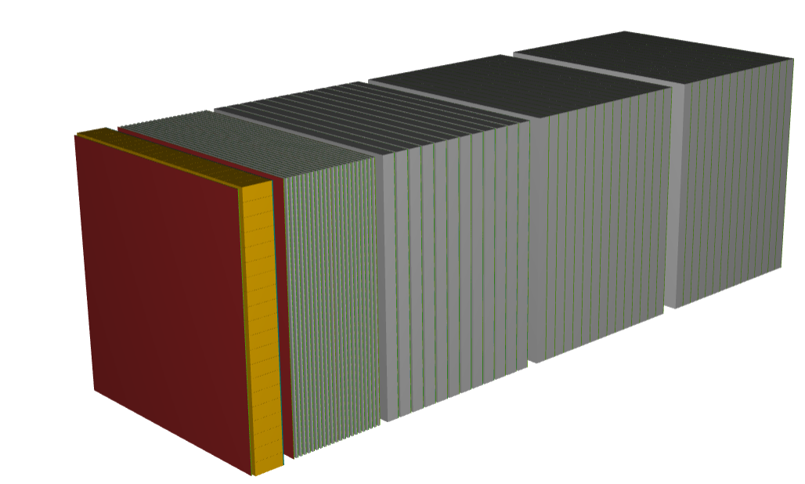

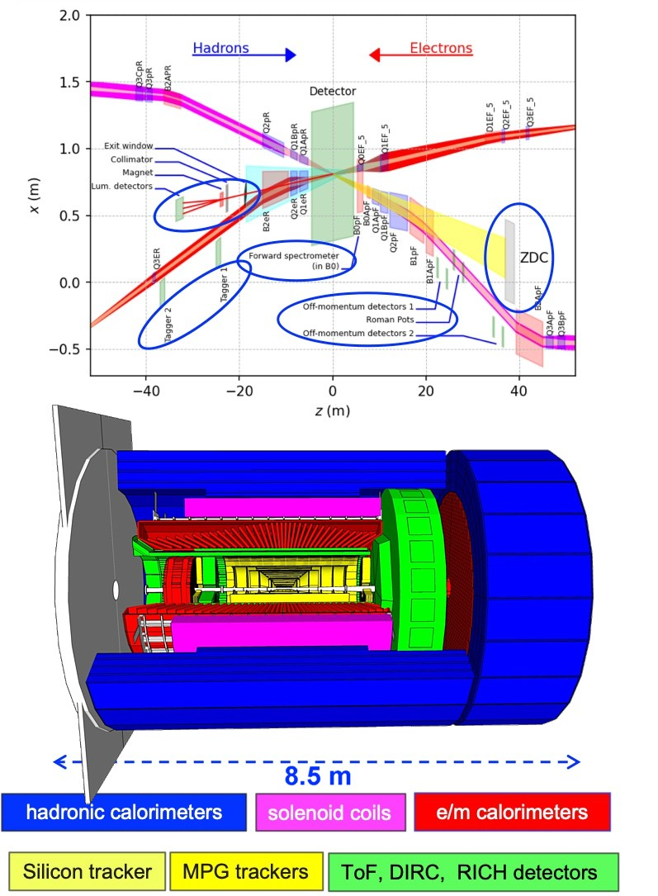
The Far-Forward Detectors
B2apf
RP
B0 detector
ZDC
B1apf
OMD
B0pf combined function magnet

Slide 3
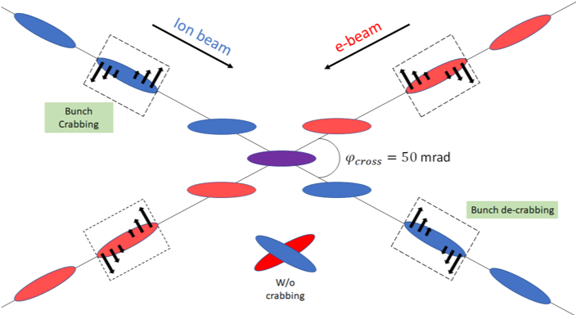
Beam Effects
Angular divergence
  Angular “spread” of the beam away from the central trajectory.
    Transverse momentum kick to the beam particles.
Crab cavity rotation
  Rotates beam bunches in 2D.
  Used to account for the luminosity drop due to the crossing angle – allows for head-on collisions to still take place.
  Induces effective vertex smearing.
25 mrad
These effects introduce smearing in our transverse momentum reconstruction.

Slide 4
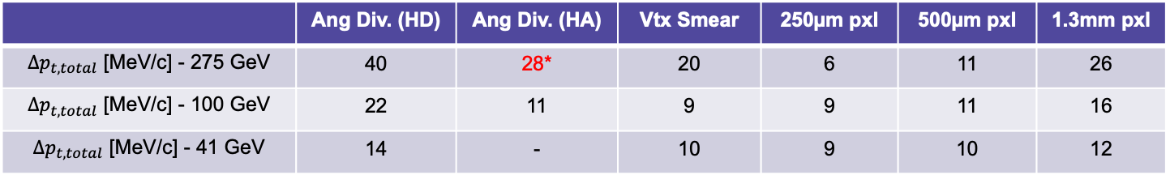

Generic Performance Requirements
Study from eRD24 effort
The various contributions add in quadrature (this was checked empirically, measuring each effect independently).
$$∆p_{t,total}=\sqrt{{(∆p_{t,AD})}^{2}+ {(∆p_{t, CC})}^{2}+ {(∆p_{t,pxl})}^{2}}$$
These studies based on the “ultimate” machine performance with strong hadron cooling.
Angular divergence
Primary vertex smearing from crab cavity rotation.
Smearing from finite pixel size.
 | Ang Div. (HD) | Ang Div. (HA) | Vtx Smear | 250µm pxl | 500µm pxl | 1.3mm pxl
$∆p_{t,total}$ [MeV/c] - 275 GeV | 40 | 28* | 20 | 6 | 11 | 26
$∆p_{t,total}$ [MeV/c] - 100 GeV | 22 | 11 | 9 | 9 | 11 | 16
$∆p_{t,total}$ [MeV/c] - 41 GeV | 14 | - | 10 | 9 | 10 | 12
These requirements can be met by the new AC-coupled LGAD sensor technology (eRD24 was focused on applications of this technology to the far-forward detectors).
Beam angular divergence
  Beam property, can’t correct for it – sets the lower bound of smearing.
Vertex smearing from crab rotation
  Correctable with precise timing (~35ps).
Finite pixel size on sensor
  500µm seems like the best compromise between potential cost and smearing.

Slide 5
Generic Performance Requirements
Spatial resolution requirement → 140um or less.
  Angular divergence largest contributor, reduces impact of detector choice.
Crab cavity rotation of the bunches → transverse “kick” to the particles, dependent on the location along the bunch.
  Results in effective vertex smearing, disentangled with fast timing → 35ps to remove the full effect.
Timing also needed for background rejection.
Technologies need to be radiation hard → expected radiation load on the RP and OMD ~ 100x less than at the LHC.
  Radiation damage has impact on timing resolution and spatial resolution (when charge sharing is used.
  Radiation studies carried out for ePIC indicate that doses delivered to AC-LGADs for RP/OMD will not lead to reduction in performance during life of experiment.

Slide 6
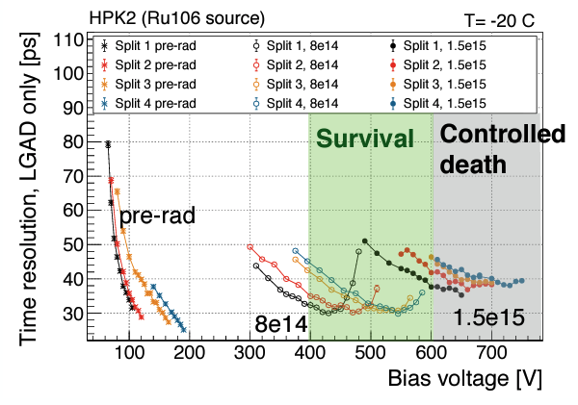
Generic Performance Requirements
From: https://indico.cern.ch/event/1029124/contributions/4411270/attachments/2269713/3854416/heller_LGAD_mortality_RD50.pdf
Plot shows time resolution as a function of bias voltage for various levels of irradiation of a batch HBK DC-LGADs used by ATLAS and CMS.
Split 1 — Split 4 (lowest to highest operating voltage)
Radiation: n_{eq} = 8e14 and 1.5e15 n/cm²
***Note: the fluences shown here are ~ 2-3 orders of magnitude higher than what is expected at ePIC.
Technologies need to be radiation hard → expected radiation load on the RP and OMD ~ 100x less than at the LHC.
  Radiation damage has impact on timing resolution and spatial resolution (when charge sharing is used.
  Radiation studies carried out for ePIC indicate that doses delivered to AC-LGADs for RP/OMD will not lead to reduction in performance during life of experiment.

Slide 7
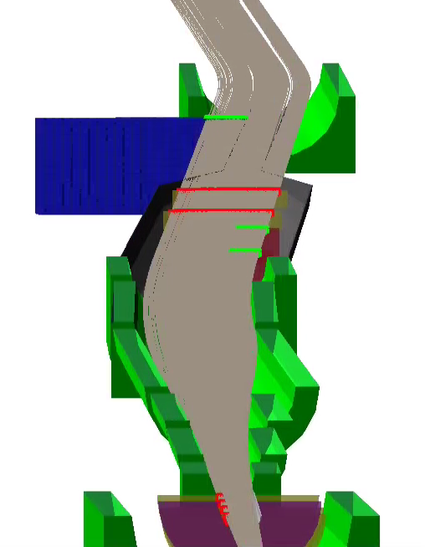
Roman Pots @ the EIC
  Full GEANT4 simulation.
Acceptances for the detectors driven by IR design itself (combination of apertures and optics).
  IR was designed with the beamline detectors in-mind.
Protons
E = 275 GeV
0 < 𝜽 < 5 mrad
Proton
trajectories

Slide 8
Roman Pots @ the EIC
Two stations, separated by ~1-2 meters, each with two layers (minimum) of silicon detectors.
2 m
Station 2
Station 1
Scattered proton in RP
Beam
Layer 2
Layer 1
Layer 1
Layer 2

Slide 9
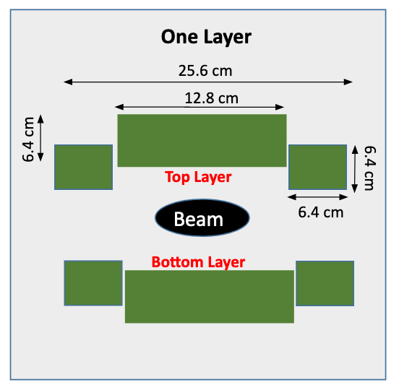
Roman Pots @ the EIC
2 m
Station 2
Station 1
Layer 2
Layer 1
Layer 1
Layer 2
Silicon detectors placed directly into machine vacuum.
  Enables maximal geometric coverage, and minimizes impact on the beam.

Slide 10
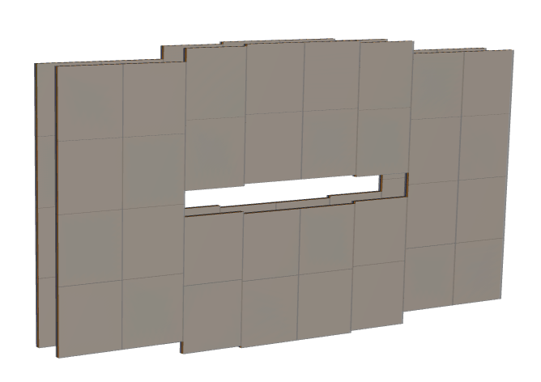

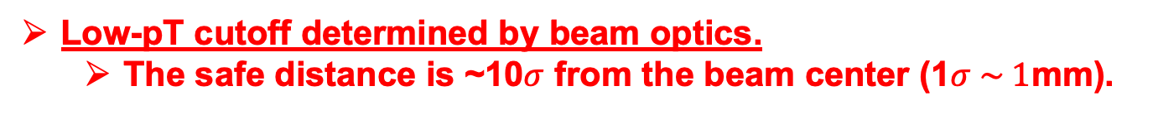
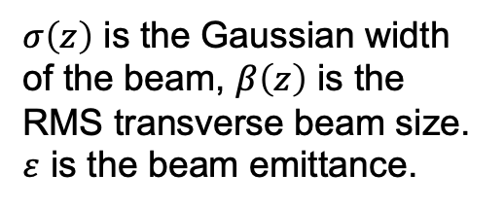
Roman Pots @ the EIC
25.6 cm
$σ\left(z\right)$ is the Gaussian width of the beam, $β\left(z\right)$ is the RMS transverse beam size.
$ε$ is the beam emittance.
12.8 cm
$$\boxed{σ\left(z\right) \sim \sqrt{ε∙β(z)}}$$
Low-pT cutoff determined by beam optics.
  The safe distance is ~10$σ$ from the beam center (1$σ \sim 1$mm).
DD4HEP Simulation
Optics change with energy
  Can also be changed within a single energy to maximize either acceptance at the RP, or the luminosity.
Detectors need to be able to move to different positions for different optics configurations.
Without strong hadron cooling, detectors also need to be moved during a fill to account for emittance growth. (IBS time is ~ 2h → doubling of emittance)

Slide 11
Off-Momentum Detectors
B2apf
Crucial for the entire light-nuclei program (e.g. deuterons)!
ZDC
neutrons and photons
RP
B1apf

Slide 12
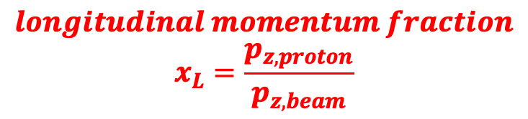
Off-Momentum Detectors
B2apf
Crucial for the entire light-nuclei program (e.g. deuterons)!
ZDC
neutrons and photons
Off-momentum protons (e.g. spectators in deuteron breakup) → smaller magnetic rigidity → greater bending in dipole fields.
Protons with ~50-60% momentum w.r.t. steering magnets.
RP
$$longitudinal momentum fraction$$
$$x_{L}=\frac{p_{z, proton}}{p_{z, beam}}$$
B1apf
OMD

Slide 13
Off-Momentum Detectors
B2apf
Crucial for the entire light-nuclei program (e.g. deuterons)!
ZDC
neutrons and photons
Off-momentum protons (e.g. spectators in deuteron breakup) → smaller magnetic rigidity → greater bending in dipole fields.
Protons with ~50-60% momentum w.r.t. steering magnets.
RP
$$longitudinal momentum fraction$$
$$x_{L}=\frac{p_{z, proton}}{p_{z, beam}}$$
Protons with ~35-50% momentum w.r.t. steering magnets.
B1apf
OMD

Slide 14
Summary of Detector Performance
Includes realistic considerations for pixel sizes and materials.
Roman Pots and Off-Momentum detectors suffer from additional smearing due to improper transfer matrix reconstruction (sub-dominant effect).
  Software issue → A ML-based solution is almost ready for deployment.
All beam effects included (dominant impact on smearing).
  Angular divergence.
  Crab rotation/vertex smearing
  Crossing angle.

Slide 15
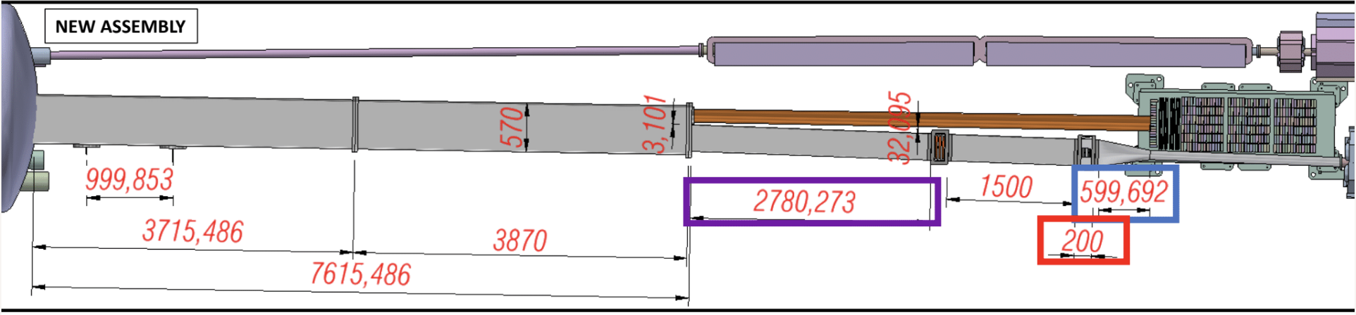


Preliminary Design of Vacuum System (not yet in global CAD)
Roman Pots
OMD
Updated preliminary setup for hadron FF region including vacuum design.
Vacuum system design → in-kind contribution from Brazil.

Slide 16
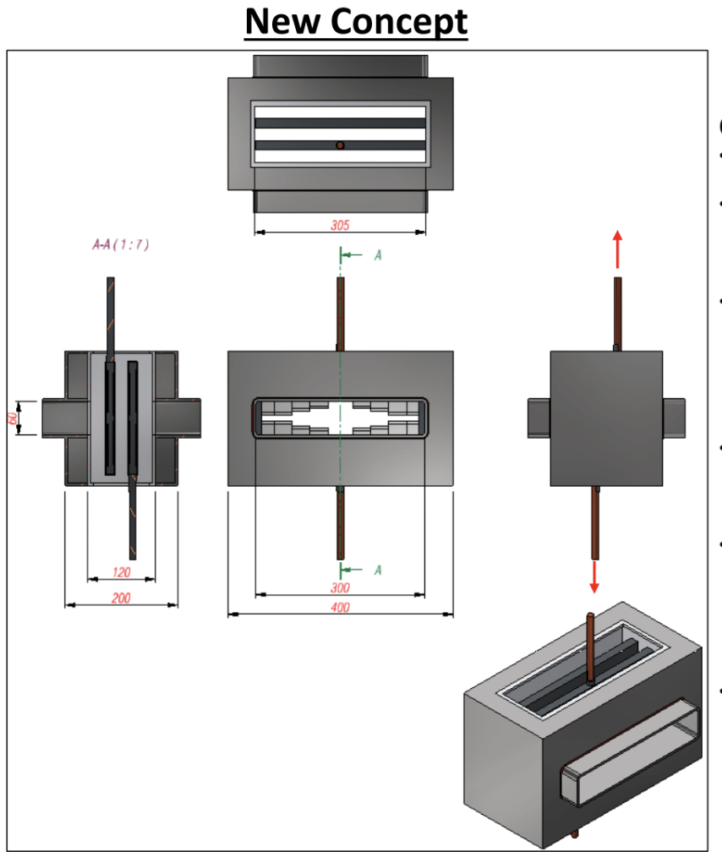
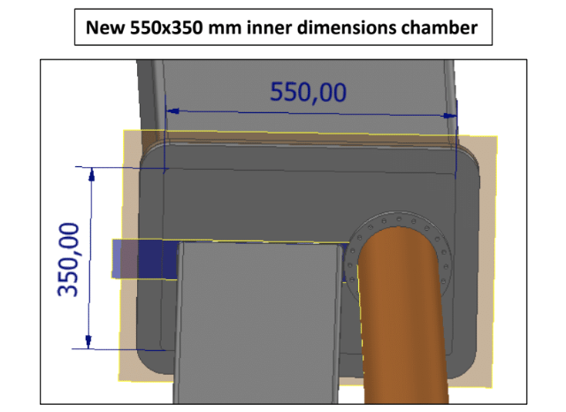
Preliminary Design of Vacuum System (not yet in global CAD)
New concept for Roman pots scattering chamber
Transition region from larger beam pipe containing OMD to smaller pipe containing RP (left) and exit window for neutrals (right).
Scattering chamber design for RP sensor packages.
Vacuum system design → in-kind contribution from Brazil.

Slide 17
Effect of Vacuum Design on Beam Operation
Shape and tapering of beam pipe(s) has impact on impedance of ion beam.
Space between detector stations (e.g. 1.5 meter separation between RP stations) creates resonating cavity.
  Impedances under study and will require iteration.
MolFlow calculations planned with new vacuum system design.
  Goal is to achieve vacuum at similar level to RHIC (~1e-10 mbar).

Slide 18
Detector Technology

Slide 19
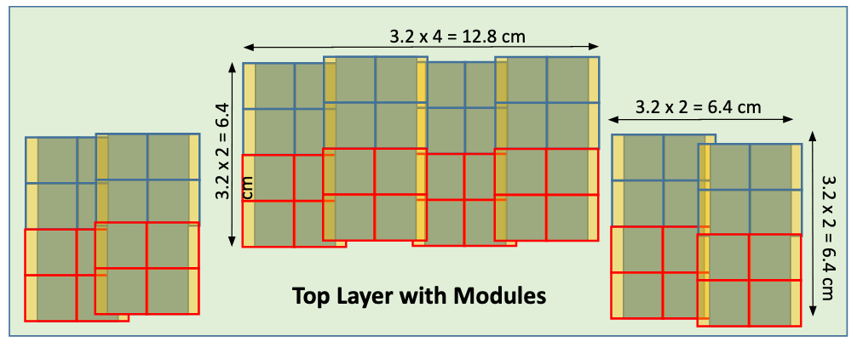
Technology: AC-LGAD
25.6 cm
12.8 cm
  AC-LGAD sensor provides both fine pixilation (500um square pixels), and fast timing (~30ps).
    Based on extensive work from EIC generic R&D (eRD24) to establish needs for the Far-Forward detectors and evaluate usage of AC-LGADs.
DD4HEP Simulation

Slide 20
Technology: AC-LGAD
Updated layout for the Roman Pots with current design for AC-LGAD sensor + ASIC.
Sensor 3.2 cm
Sensor 3.2 cm
Module
ASIC 1.6 cm
Approach based on bump-bonding four custom ASICs to a single AC-LGAD sensor to make a “module”.
ASIC 1.8 cm
ASIC size | ASIC Pixel pitch | # Ch. per ASIC | # ASICs per module | Sensor area | # Mod. per layer | Total # ASICs | Total # Ch. | Total Si Area
1.6x1.8 cm² | 500 𝜇m | 32x32 | 4 | 3.2x3.2 cm² | 32 | 512 | 524,288 | 1,311 cm²

Slide 21
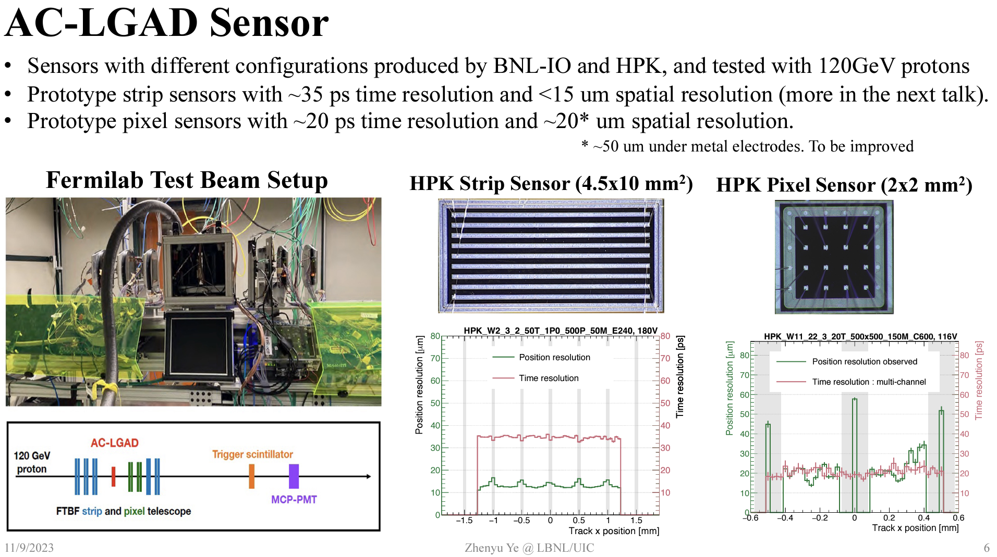
Progress on AC-LGAD development
Strong synergy with ePIC forward TOF system.

Slide 22
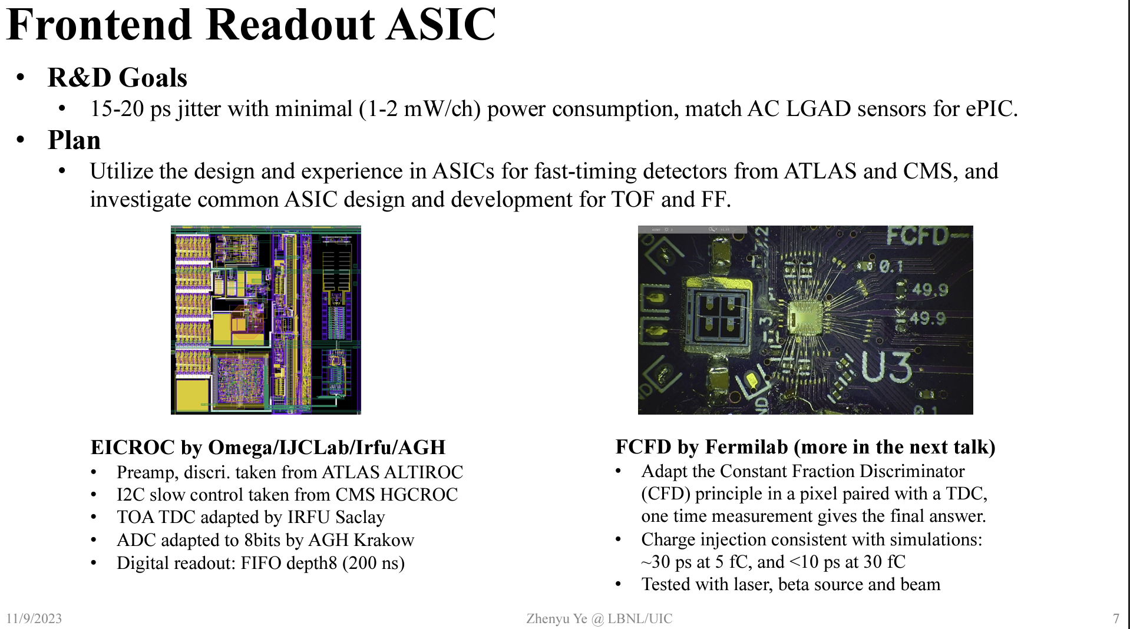
Progress on AC-LGAD ASIC (EICROC0)
First version of EICROC (version 0; 4x4 channels) has been tested at IJCLab, BNL, and Hiroshima U.
  Analog response of AC-LGAD + EICROC0 observed using Sr90 source.
  Digital signals (TDC and ADC) still under study.
  New version of EICROC (4x4 channels, minor update to EICROC0) from IJCLab/OMEGA will be ready for testing in coming months.
    Final version Sept. 2025 (eRD109)
See talk by Christophe de la Taille (Omega):
https://indico.bnl.gov/event/20473/contributions/85274/attachments/51864/88689/CdLT_EICROC_9jan24.pdf

Slide 23
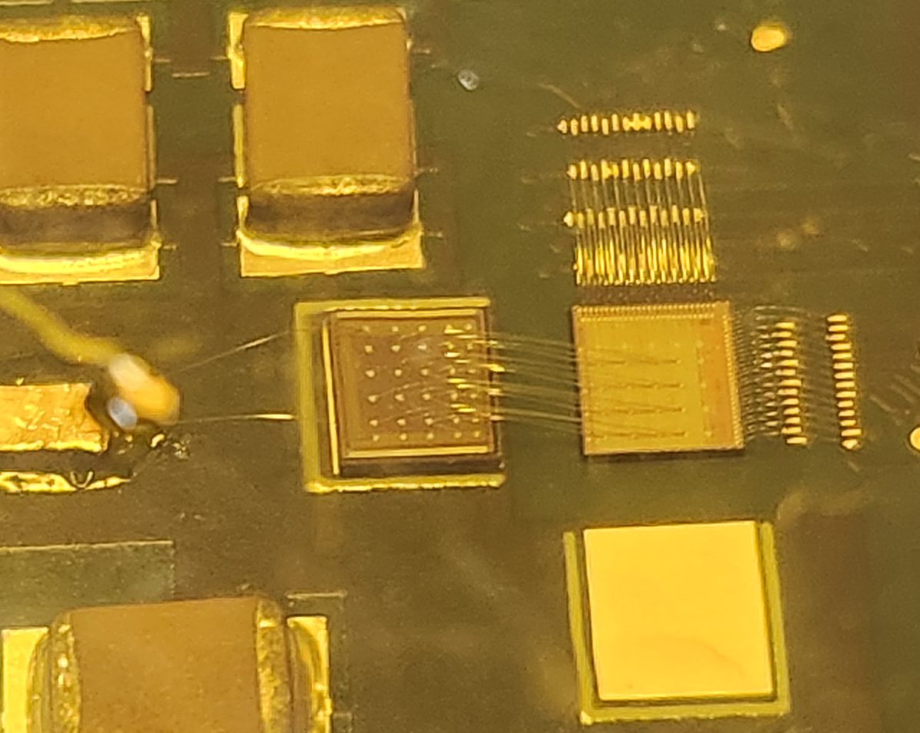
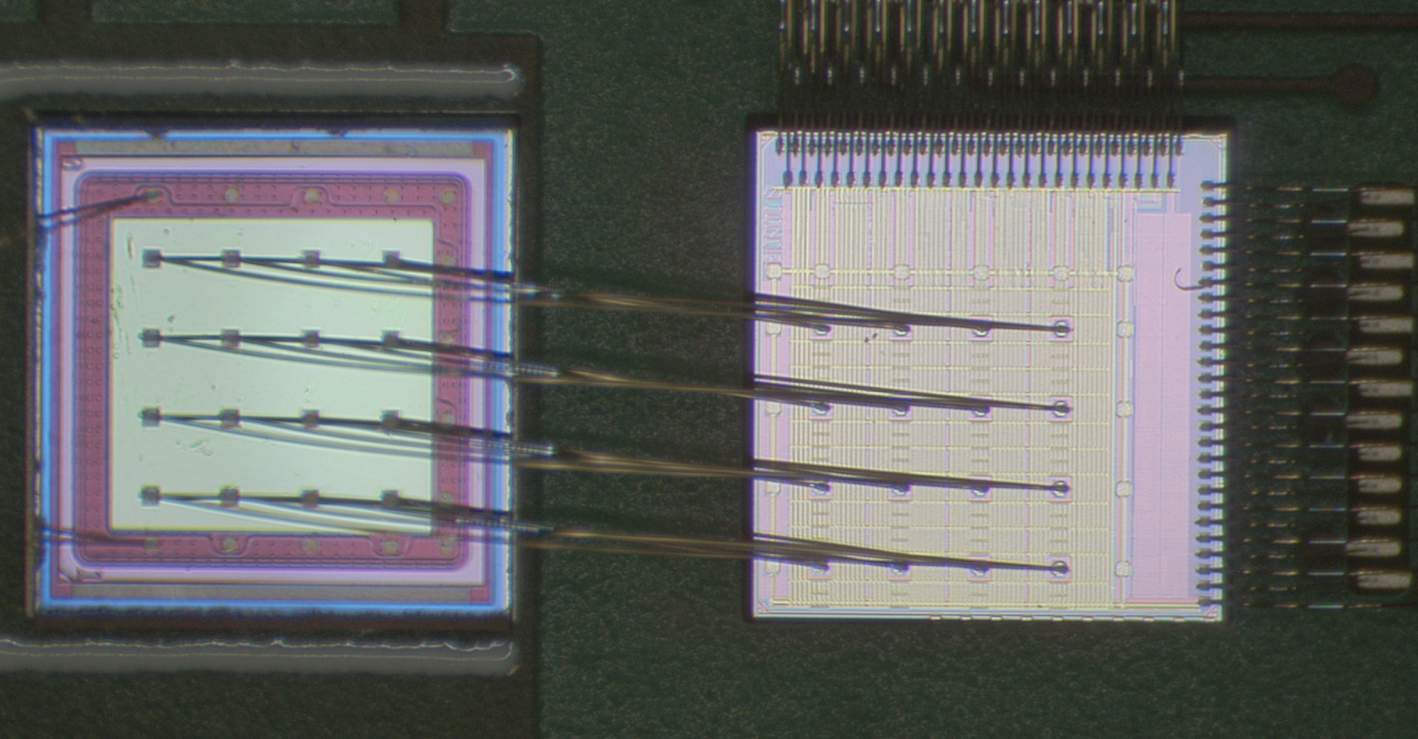
AC-LGAD + EICROC0 testing
AC-LGAD
EICROC0
BNL AC-LGAD:
500x500 um² pixel pitch
100x100 um² metal electrode
30um active thickness
Setup is presently wire-bonded (done at BNL) for initial tests.
  First bump-bonding to be performed in the coming weeks at BNL.
Two other similar boards with EICROC0 were produced and sent to IJCLab and Hiroshima U. for testing.
AC-LGAD sensor (BNL) wire-bonded to EICROC0 (OMEGA/ICJLab) for testing on custom test board produced by OMEGA.
Beam test with bump-bonded AC-LGAD + EICROC0 planned for June 2024.

Slide 24
Summary and Takeaways
Major takeaway: we are on-track to meet our goals for the TDR.
  Next Steps:
    Cooling of detector packages.
    Quality assurance plan for production of AC-LGAD sensors and ASICs needs to be developed.
    Details of movement system for both subsystems (easier for OMD).
    Full impedance calculations with new vacuum design underway → will lead to iteration and re-evaluation.
Basic technology considerations understood for the Roman Pots and Off-Momentum Detectors.
  Sensor + ASIC design is progressing → performance criteria met, but beam tests with full package to be carried out.
  Shared design criteria → Detector packages need to be movable, placed directly in vacuum, and have precise timing (35ps) and spatial resolution (< 140um).
AC-LGAD consortium exists with and project-supported R&D (eRD112).
  Overlap with TOF system in ePIC → allows for sharing of resources in terms of sensor/ASIC development and efficiency in very limited availability of test beams.
  ASIC design (EICROC) is the primary focus to complete the detector packages → final version delivered by Sept. 2025 (eRD109).
Simulations include beam and detector effects → impacts of engineering design (e.g. vacuum system) needs more work.
  This pipeline exists already, and has been used for evaluation up to now → lots of dedicated expertise available here.

Slide 25
Backup

Slide 26
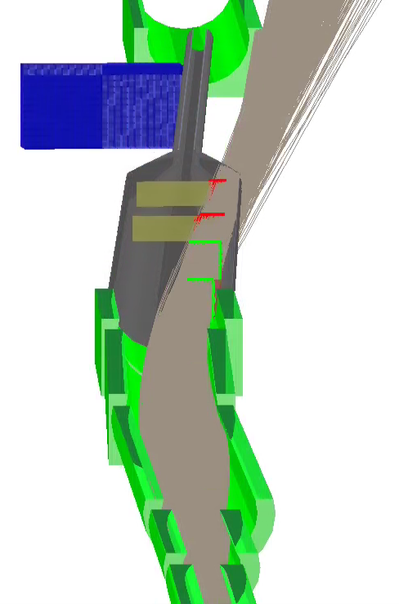
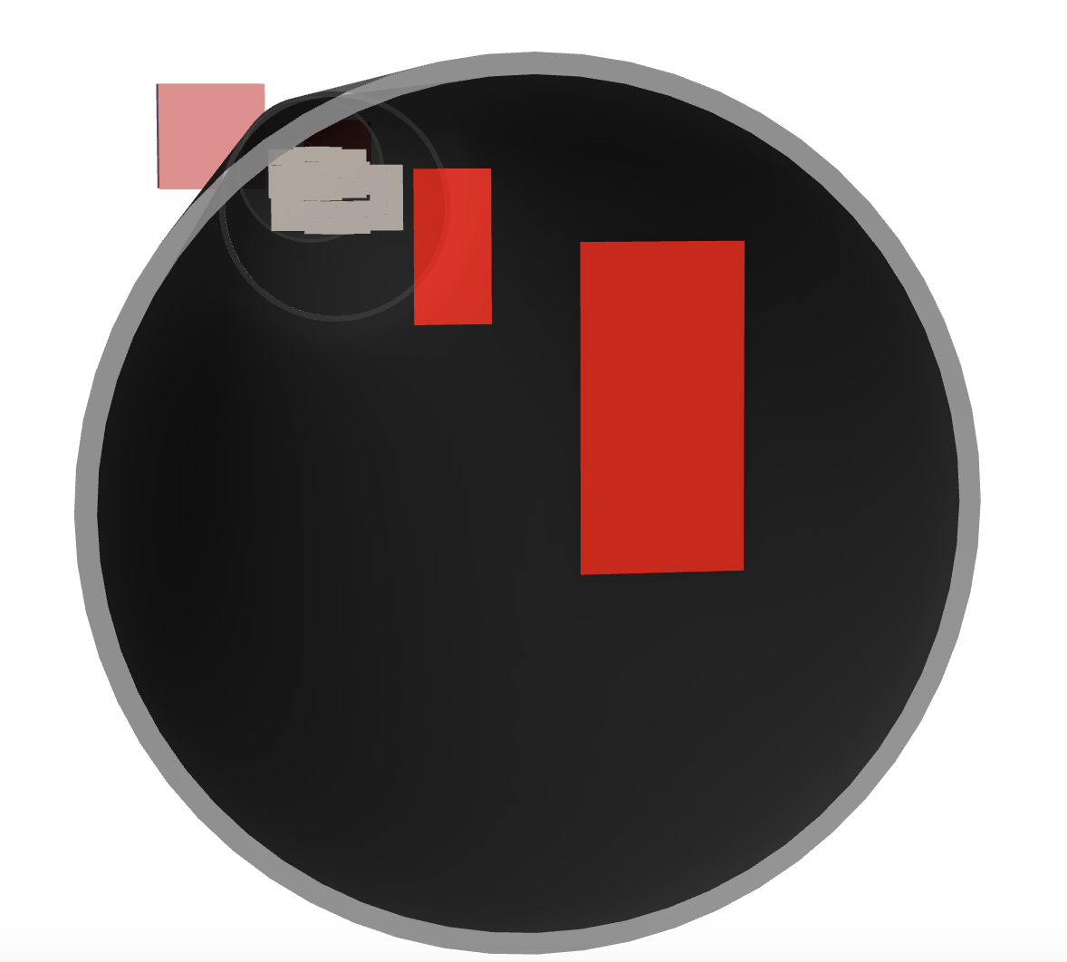
Off-Momentum Detectors
ZDC
RP
Same technology choice(s) as for the Roman Pots.
Need to also study use of OMD on other side for tagging negative pions.
OMD
DD4HEP Simulation
Protons
123.75 < E < 151.25 GeV
(45% < xL < 55%)
0 < 𝜽 < 5 mrad
Proton
trajectories
Off-momentum detectors implemented as horizontal ”Roman Pots” style sensors.
  EICROOT GEANT4 simulation.

Slide 27
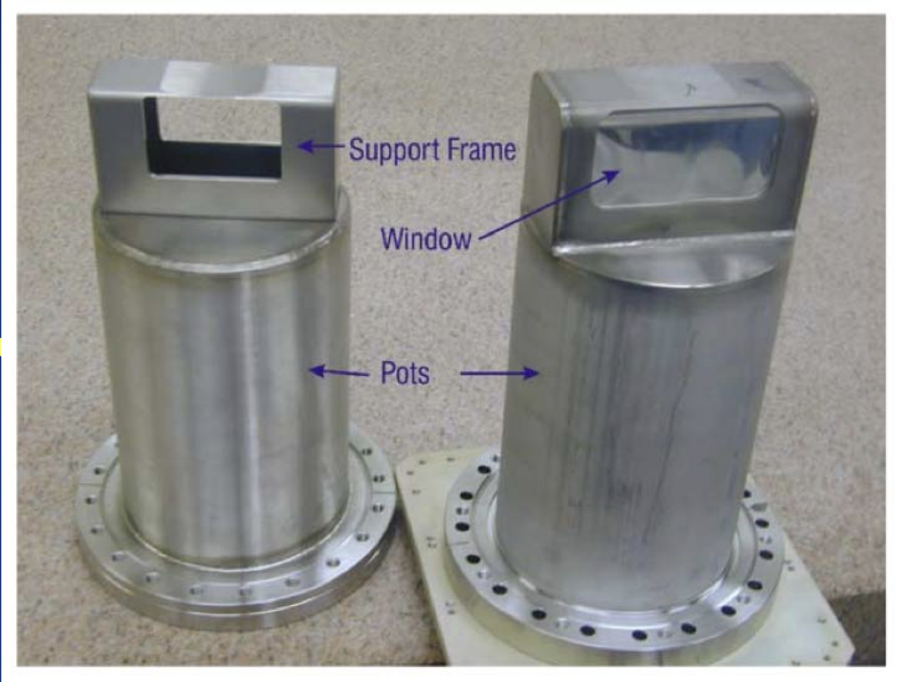
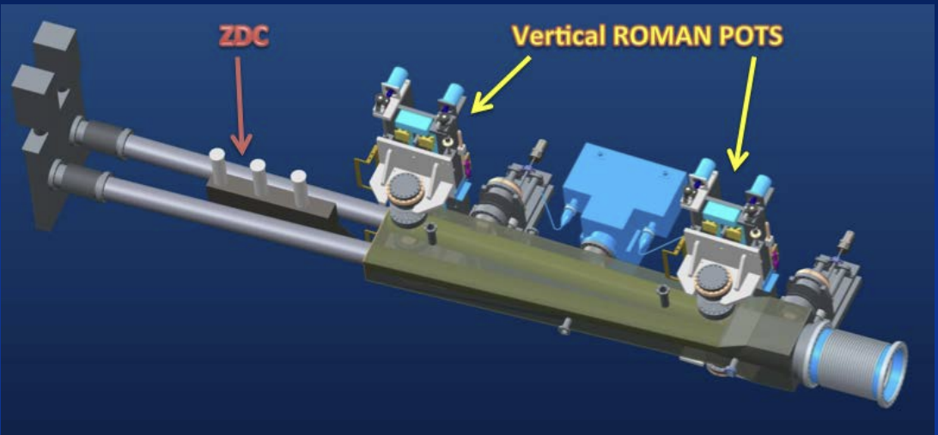
Roman Pots @ STAR
protons
Roman Pots setup at STAR.
Silicon detectors sit inside a “pot” with a thin-window to tag protons scattered at small angles (e.g. near the beam).

Slide 28
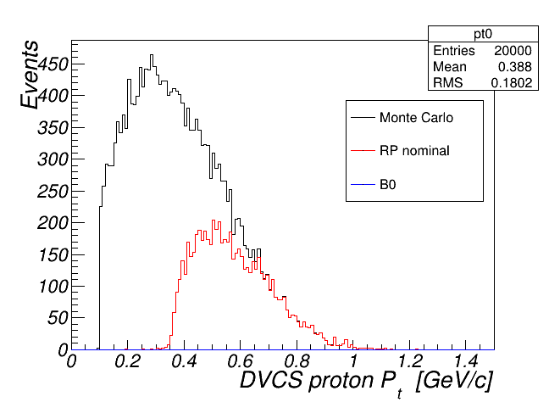
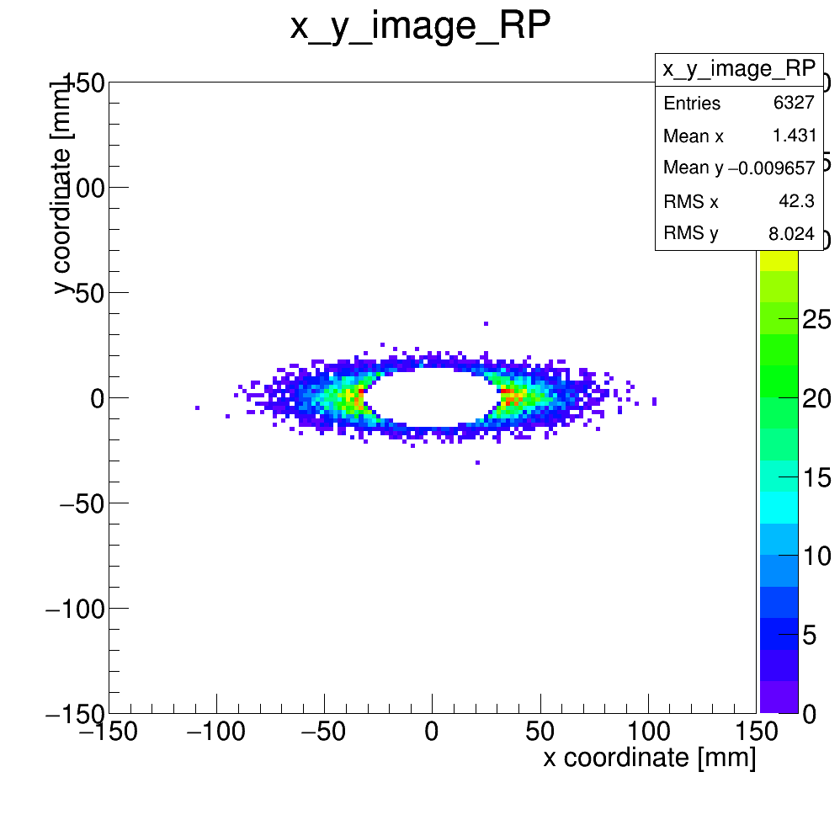
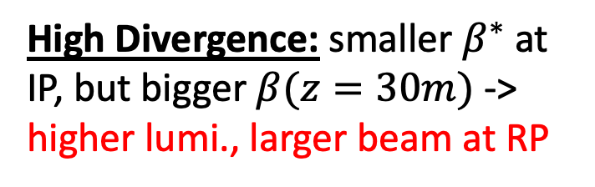
Digression: Machine Optics Impact
275 GeV DVCS Proton Acceptance
High Divergence
High Divergence
High Divergence
~20 cm
High Divergence: smaller $β^{∗}$ at IP, but bigger $β(z=30m)$ -> higher lumi., larger beam at RP

Slide 29
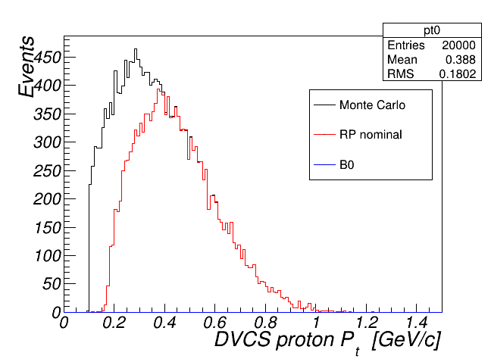
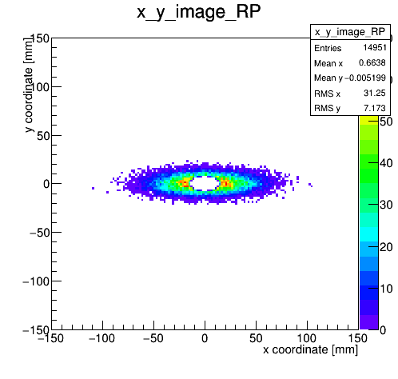
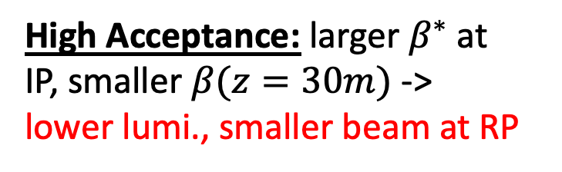
Digression: Machine Optics Impact
275 GeV DVCS Proton Acceptance
High Divergence
High Divergence
High Divergence
~20 cm
High Divergence: smaller $β^{∗}$ at IP, but bigger $β(z=30m)$ -> higher lumi., larger beam at RP
High Acceptance
High Acceptance
High Acceptance: larger $β^{∗}$ at IP, smaller $β(z=30m)$ -> lower lumi., smaller beam at RP

Slide 30
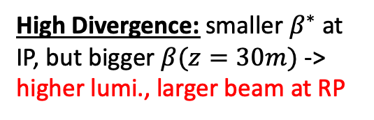
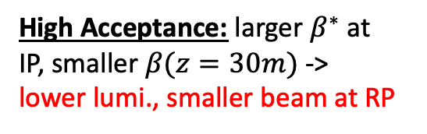


Digression: Machine Optics Impact
275 GeV DVCS Proton Acceptance
High Divergence
High Divergence
Using the two configurations, we are able to measure the low-$p_{T}$ region (with better acceptance) and high-t tail (with higher luminosity).
Detectors need to be able to move to different positions for different optics configurations.
~20 cm
HA
HD
High Divergence: smaller $β^{∗}$ at IP, but bigger $β(z=30m)$ -> higher lumi., larger beam at RP
High Acceptance
High Acceptance
High Acceptance: larger $β^{∗}$ at IP, smaller $β(z=30m)$ -> lower lumi., smaller beam at RP
$$p_{T}^{2} [{GeV}^{2}]$$

Slide 31
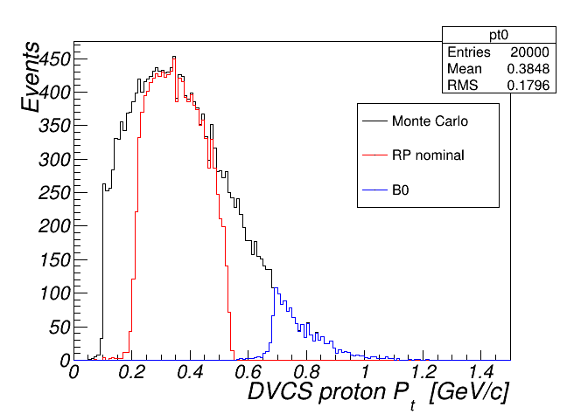
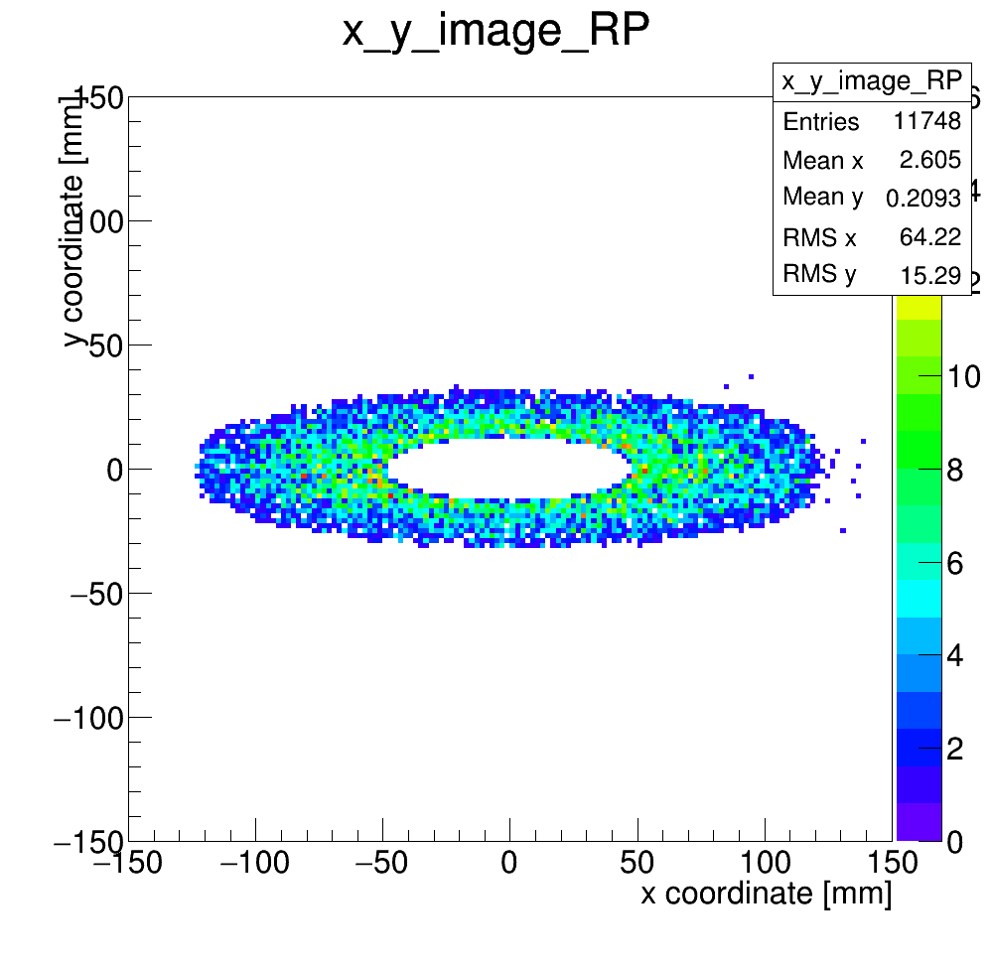

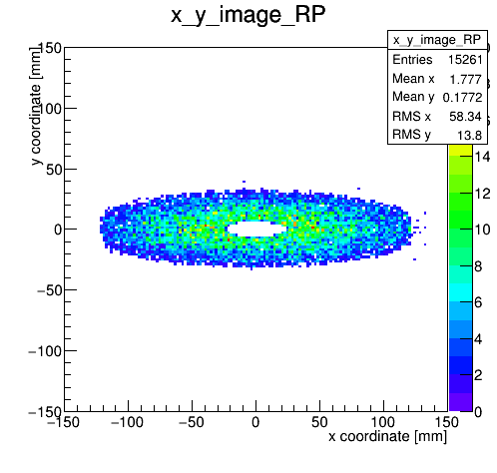

Machine Optics: Roman Pots
100 GeV DVCS Proton Acceptance
High Divergence
High Divergence
~25 cm
Need both detector systems together here!
High Acceptance
High Acceptance
Improves low $p_{t}$ acceptance.
31/14

Slide 32
Momentum Resolution – Timing
For exclusive reactions measured with the Roman Pots we need good timing to resolve the position of the interaction within the proton bunch. But what should the timing be?
~1.25mm
Looking along the beam with no crabbing.
What the RP sees.
RMS hadron bunch length ~10cm.
Because of the rotation, the Roman Pots see the bunch crossing smeared in x.
Vertex smearing = 12.5mrad (half the crossing angle) * 10cm = 1.25 mm
If the effective vertex smearing was for a 1cm bunch, we would have .125mm vertex smearing.
The simulations were done with these two extrema and the results compared.
From these comparisons, reducing the effective vertex smearing to that of the 1cm bunch length reduces the momentum smearing to negligible from this contribution.
This can be achieved with timing of ~ 35ps (1cm/speed of light).

