Slide 1
Summary on Backgrounds
Elke-Caroline Aschenauer
Co-Associate Director for the Experimental Program
EIC Preliminary Design & Safety Review of the EIC Auxiliary
Far-Forward/Far-Backward Detectors
February 12th, 2024

Slide 2
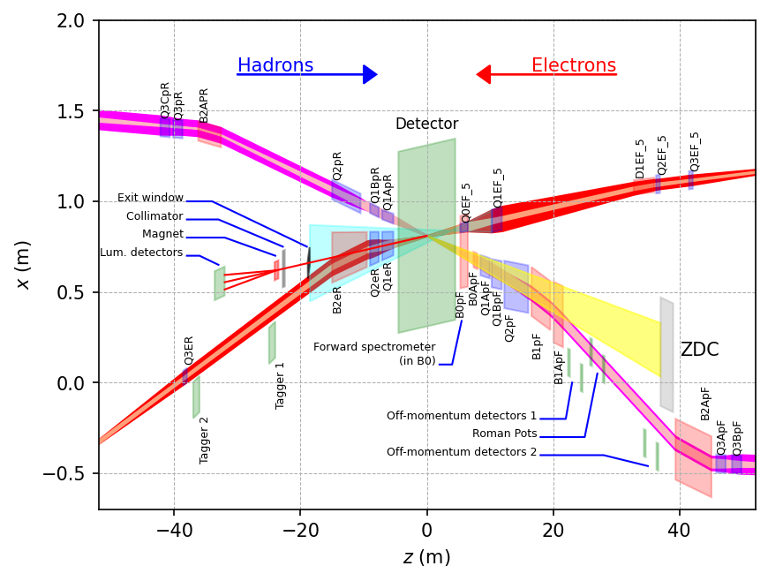
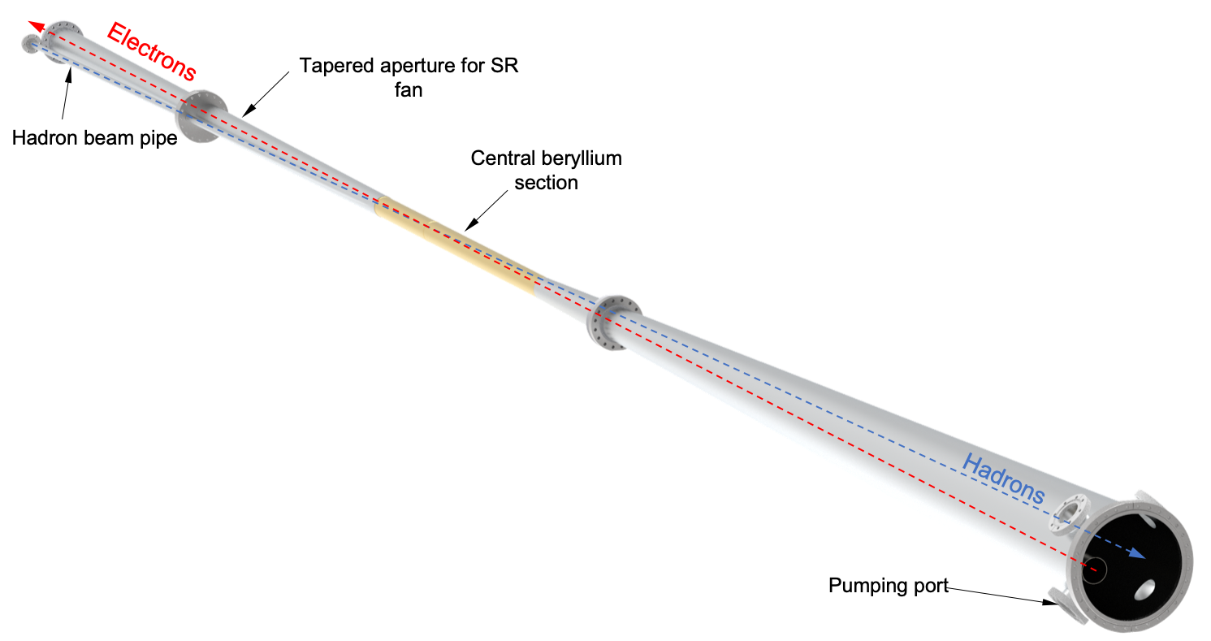
Beam Background / Radiation at IR
The HERA and KEK experience show that having backgrounds well understood, is crucial for the EIC collider and detector performance
There are several background/radiation sources :
  primary collisions
  beam-gas induced
  synchrotron radiation
Note:
different to HERA and KEK the length of beam pipe the both beam share, is thanks to the crossing angle minimized
Ring Inside
GEANT4
Ring Inside
Ring Outside

Slide 3
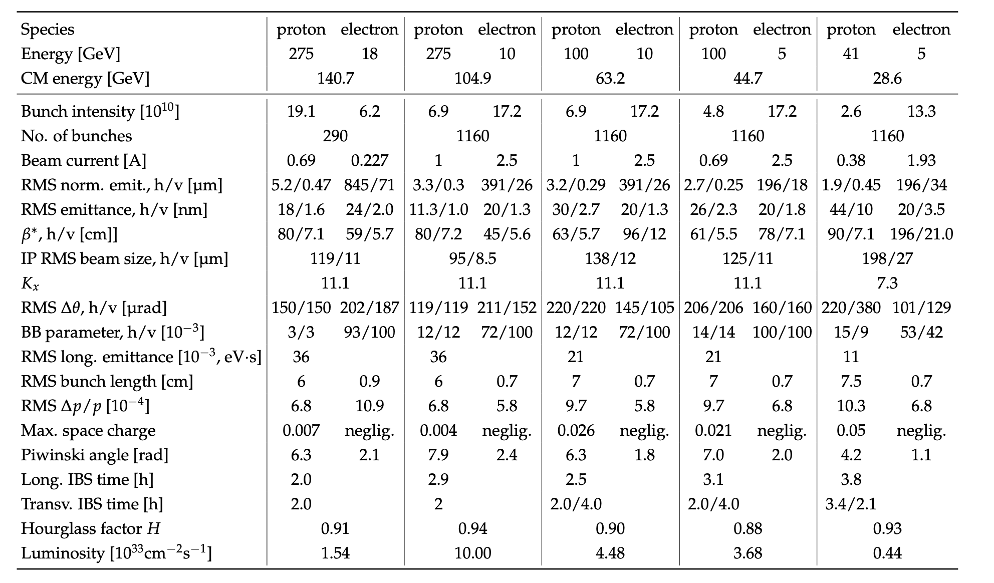
EIC Beam Parameters
electron beam current and energy impact electron beam gas background and synchrotron radiation
→ Radiated SR power: P(kW)=88.46 E_{B}(GeV)⁴ / r(m)² I (A)
hadron beam current impacts hadron beam gas
beam energies and luminosity impact the radiation and neutron fluence

Slide 4
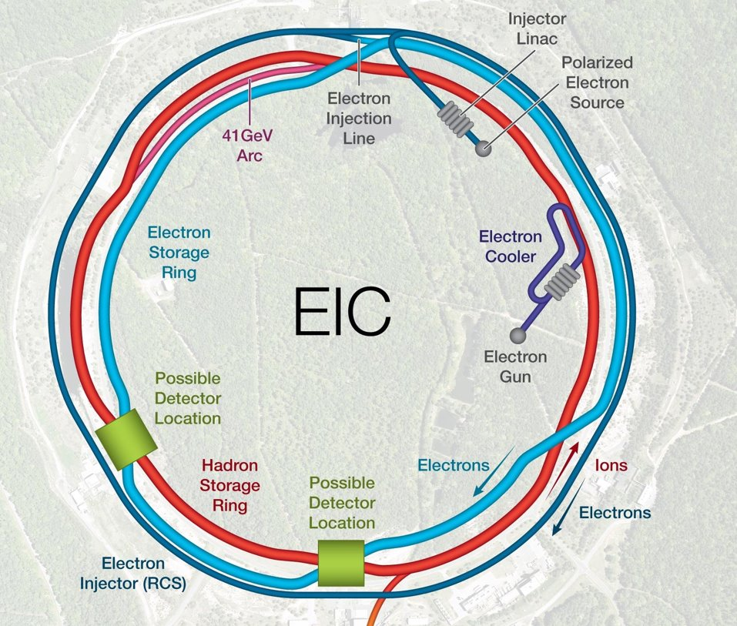
Beam Background / Radiation at IR
Electron beam:
background due to de-excitation of beam if bunches are replaced
  Note: all electron bunches are replaced after 2.2 min @ 18 GeV
  There should be “no” background for the experiment as the idea is to shave off the electron tails beyond 6 σ in the transfer line.
  Electrons are injected on orbit and on energy (with reasonable errors) in one sigma, this is also required to not impact the proton beam performance
  Injection is at IP-12
  6 σ electron beam would always be well within the geometric aperture limits of 13.5/23 σ.
  Dynamic aperture limits are very similar.
GEANT4

Slide 5
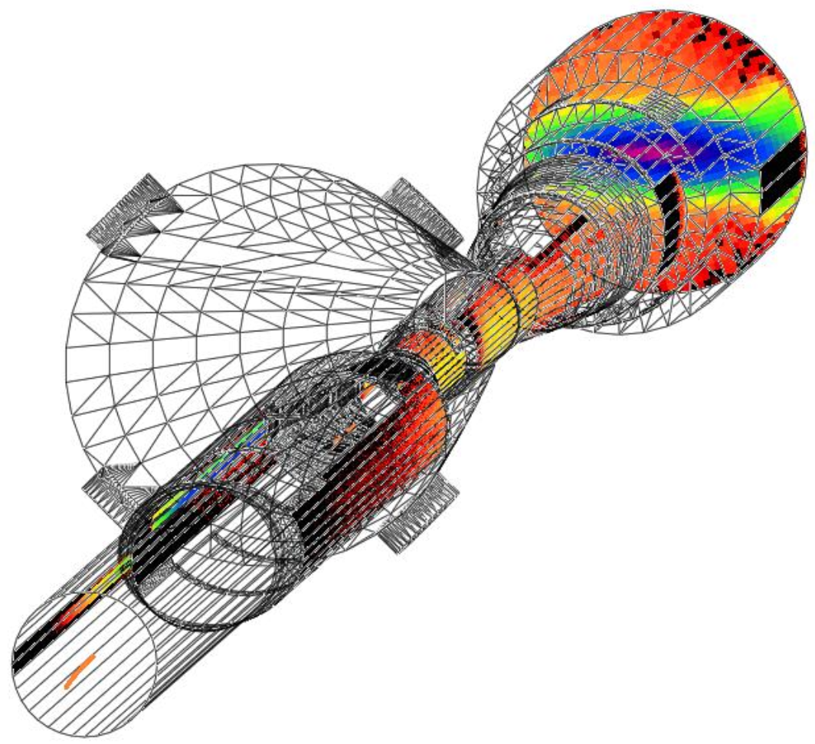
Beam Background / Radiation at IR
Electron beam:
Synchrotron radiation
  extensive simulations by of SR accelerator background WG group
  SynRad+ modeling software
  Input:
  3D model of beampipe
  Beam emittance, current Magnet locations and fields
  bunch geometry – core and tails
  Output:
  Synchrotron Radiation – Position, Flux, Energy, Direction
  Synchrotron Radiation Mitigation:
  Photon absorber configuration:
  Horizontal plane only
  Annular configuration
  Length, diameter, position
  Beamline dimensions:
  Wider beam pipe for
    13.5 σ clearance in x
    23 σ clearance in y
  Beampipe material/structure
  2-5 μm Au coating
  Sawtooth/ridge texture for photon absorption

Slide 6
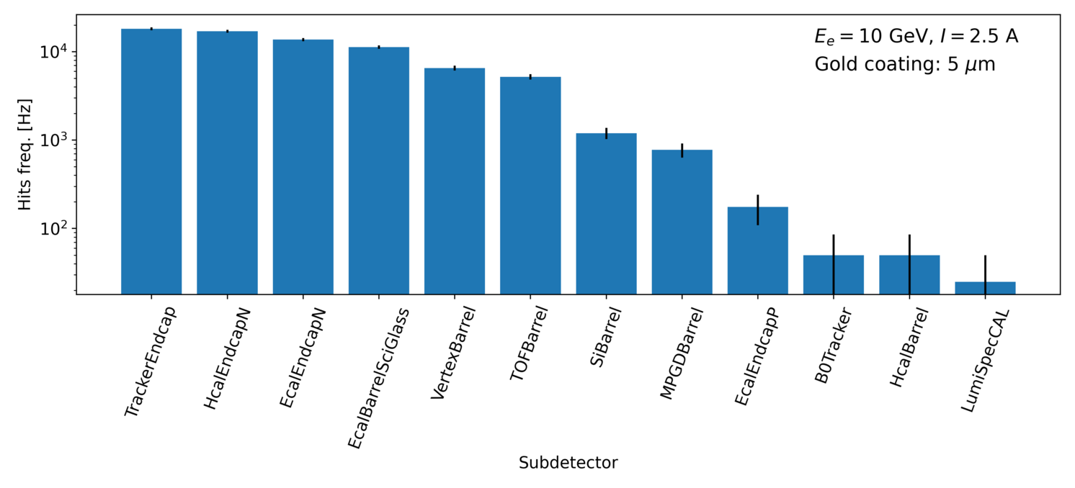
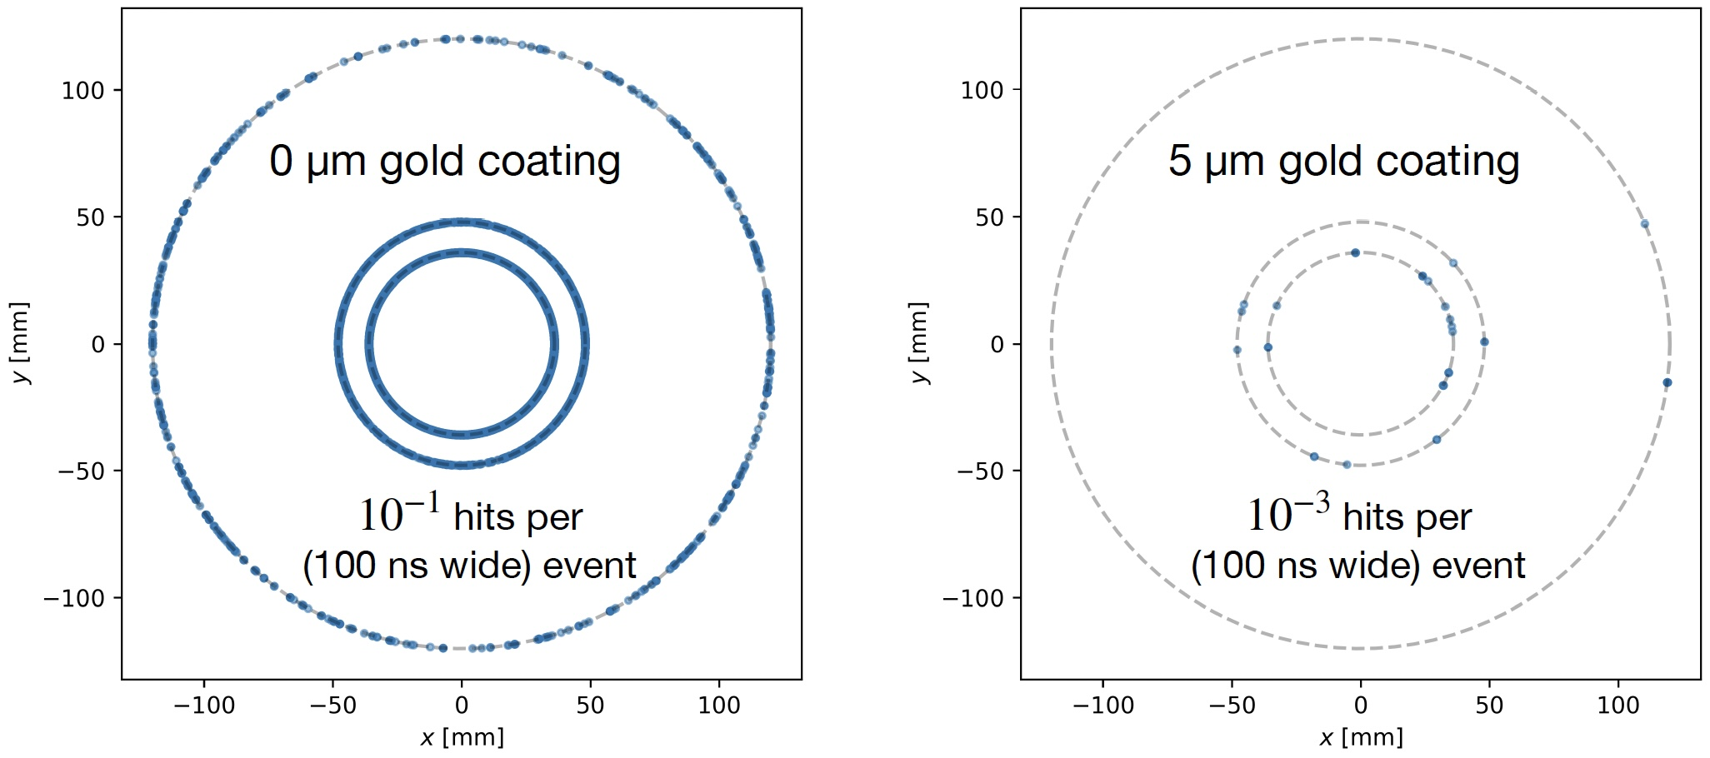
Synchrotron Radiation Results
Rates in different subdetectors:
Effect of gold coating on SR
→ Example μvertex MAPS layers
Need to repeat all synchrotron radiation studies due to recent lattice change

Slide 7
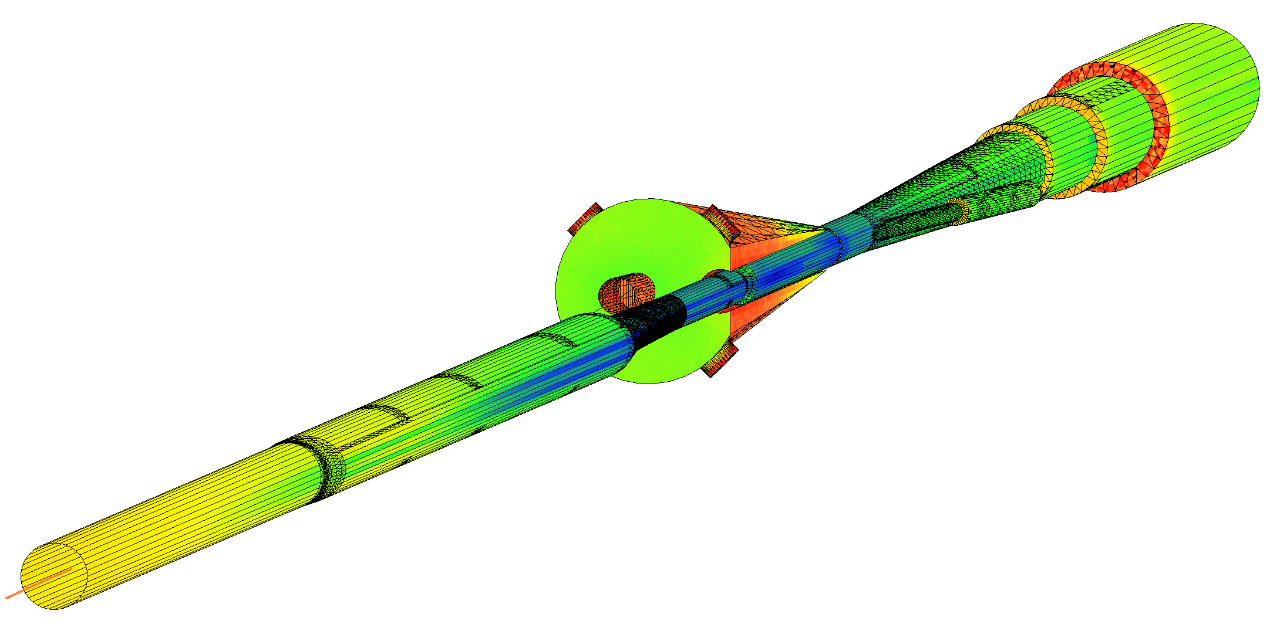
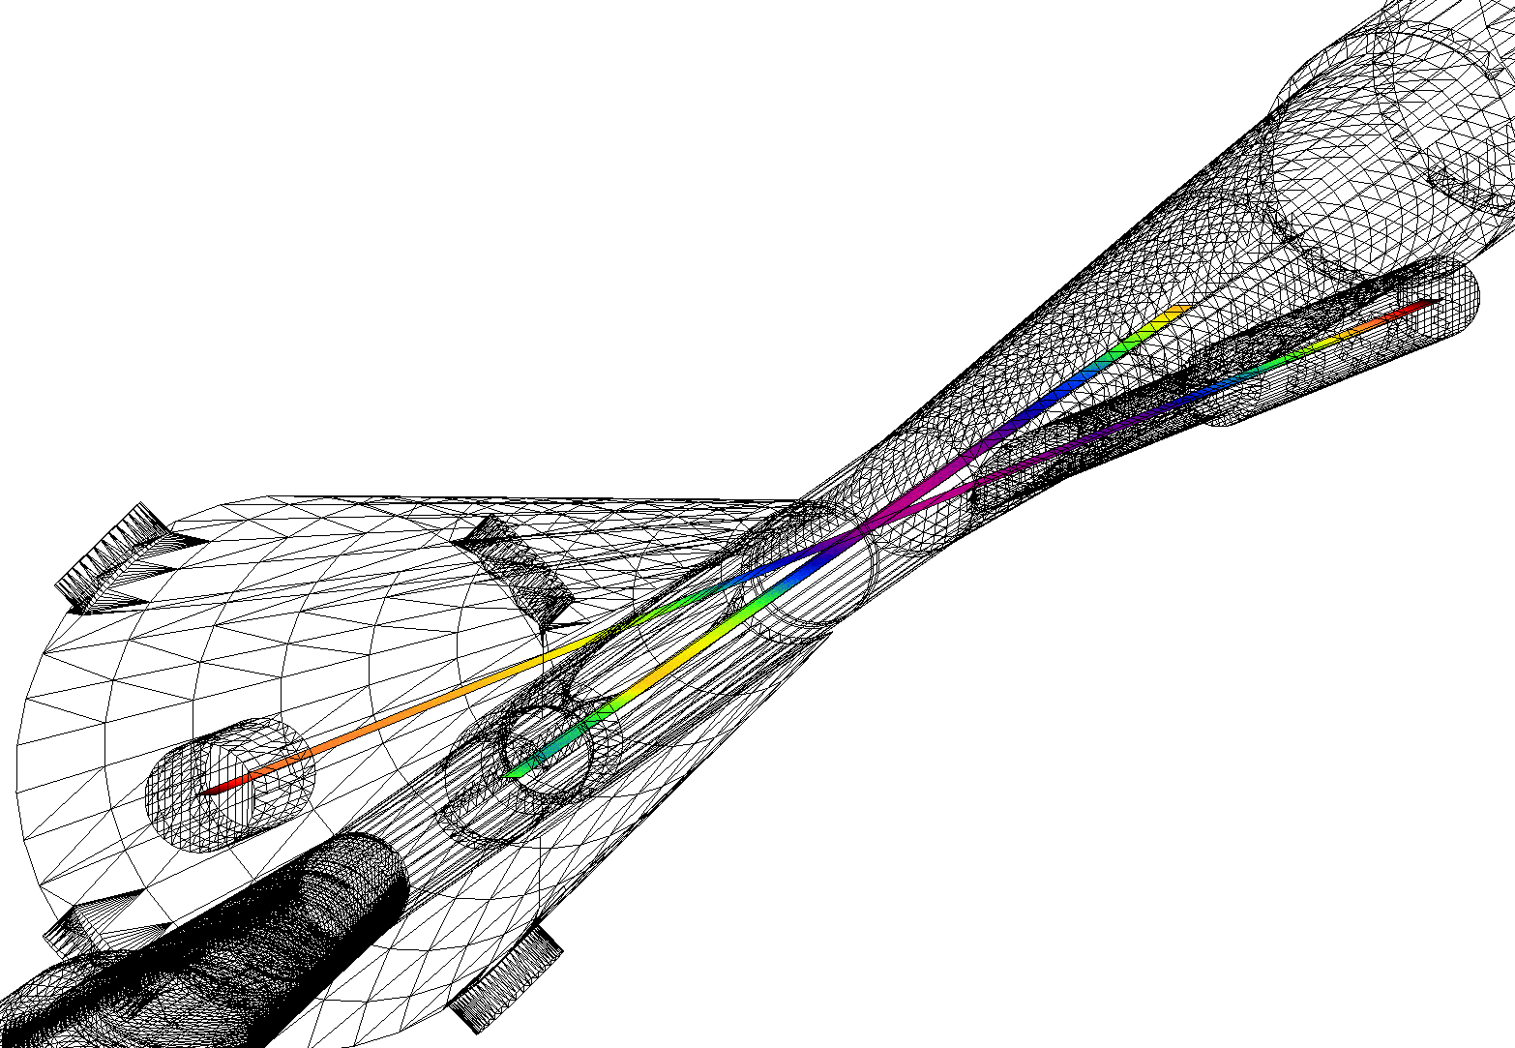
SynRad+/Molflow+ Coupled Simulations
Pump ports
Geometry imported from SynRad+ to Molflow+
Photon flux density on surfaces
Convert to desorption
Pressure profile along beamlines
Applied as surface outgassing
SR no impact on vacuum of far-forward beam pipe → ZDC, RP, ….

Slide 8
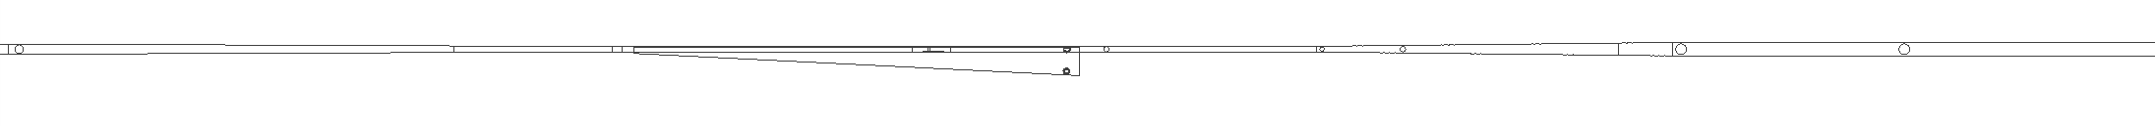
Pressure Profile along IP
eR IP1
FPA
eF IP1
eF IP2
eF IP3
eF IP4
eF IP5
Detector
Q0eF
Q1eF
10GeV, 2.5A
e-beam
100 Ahr, no pumps in cryostat
+5/-15m Avg: 1.5e-7
+4.5/-5m Avg: 3.5e-8
10,000 Ahr, no pumps in cryostat
+5/-15m Avg: 1.3e-8
+4.5/-5m Avg: 3.3e-9
10,000 Ahr, all pumps
+5/-15m Avg: 3.0e-9
+4.5/-5m Avg: 2.7e-9
IP
All simulations presented use green curve: 10000 Ah correspond to 5month @ 10³⁴ cm²s⁻¹
→ beam pipe bake-out critical to keep a good vacuum

Slide 9
Beam Gas Background
Electron beam:
Beam gas interactions
  generation of non-gaussian tails → accounted in accelerator simulations
    Off momentum electrons → will be shielded by collimators → simulations of collimation system underway
  Big contribution for detector background
  Bethe-Heitler process: e_{Beam} + H²_{restgas} → e’ + γ + H²_{restgas}
  Kinematics: fixed target → particles boosted towards outgoing electron direction
  Generate real tracks not random hit pattern like SR
  Mitigation: excellent vacuum
Proton beam:
Low beam lifetime during injection and ramping → collimator setup → simulation by accelerator colleagues, but ample experience for 21 y of RHIC running
Beam gas interactions
concern: large hadronic cross section p/A + H²_{restgas}
  Secondary interactions with aperture limitations, i.e. magnets, beam pipe, masks
  Beam-gas interactions are also a source of neutrons that thermalize within the detector hall and can cause damage → need still to model it
  Kinematics: fixed target → particles boosted towards outgoing hadron direction
  Generate real tracks not random hit pattern like SR
  Mitigation: excellent vacuum
GEANT4

Slide 10
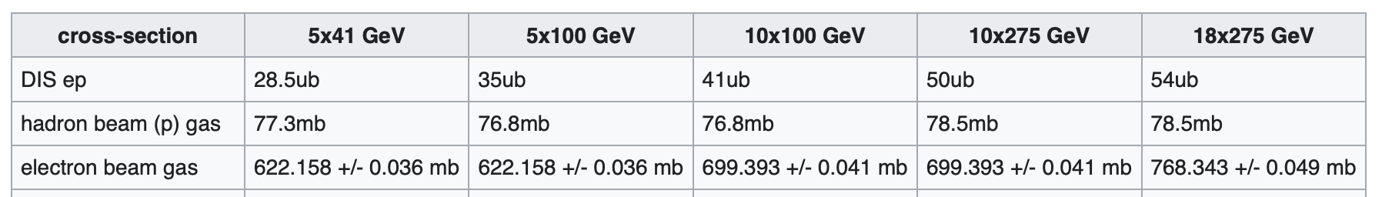
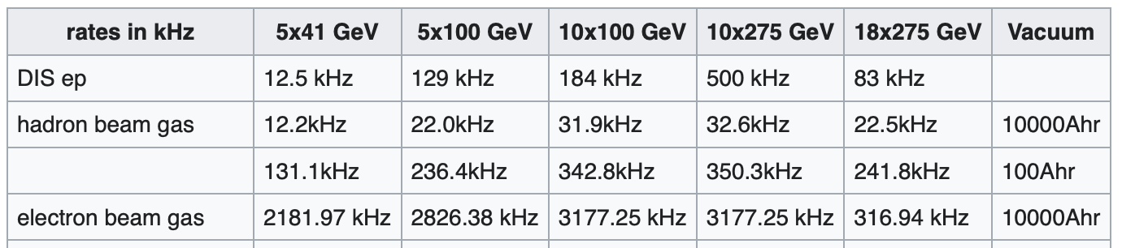
Cross Section and Rate Comparisons
Total ep
Bethe Heitler | 197.5 mb | 208.5 mb | 217.7 mb | 229.6 mb | 236.8 mb
Different to hadron-hadron colliders beam related background cross-sections are larger than signal cross-section
Remember:
electron beam current and energy impact electron beam gas background and synchrotron radiation
hadron beam current impacts hadron beam gas
Total ep
Bethe Heitler | 86.9 MHz | 767.3 MHz | 975.3 MHz | 2296 MHz | 364.7 MHz

Slide 11
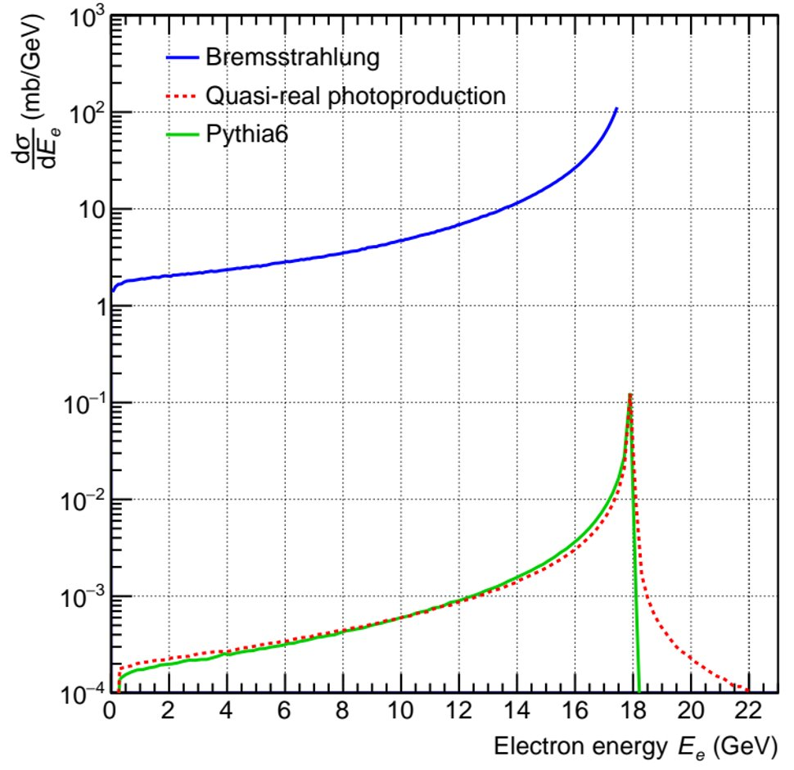
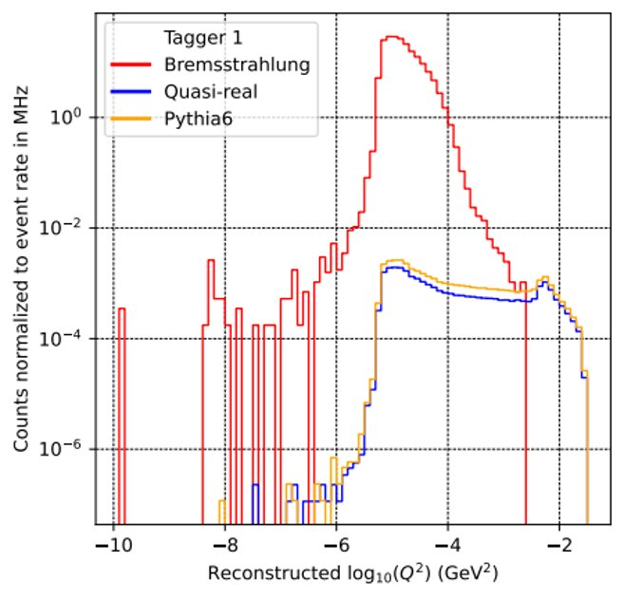
Notes on Far-Forward and Backward
Far-Forward:
”no” contribution from synchrotron radiation and electron beam gas
hadron beam gas contribution
  good vacuum in hadron beam pipe → acceptance only for limited region along beam pipe
Far-Backward:
”no” contribution from hadron beam gas
electron beam gas contribution
  vacuum level good in this part of electron beam pipe – 5 x 10⁻¹⁰ mbar
Need still to simulate synchrotron radiation for this region
low-Q2 tagger sees large rate from process used to measure luminosity
→ Bethe Heitler ep → e’p’γ lepton goes to the low-Q2 taggers
Total cross section for elastic bremsstrahlung and for two models for inelastic ep scattering​
Large bremsstrahlung cross section implies a pile-up interaction in each bunch crossing​
The bremsstrahlung makes a background in photoproduction measurement​
Reconstructed Q² shown for bremsstrahlung and photoproduction
True Q² for bremsstrahlung in consistent with zero​
Distributions are normalized to event rates​
Opportunity to extract clean photoproduction signal over a limited interval in Q^2

Slide 12
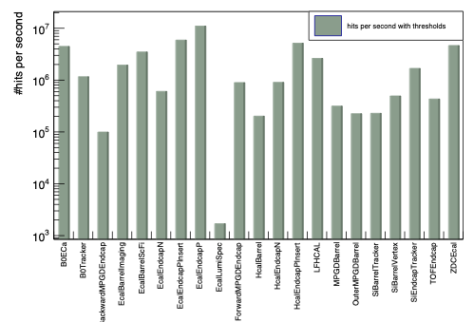
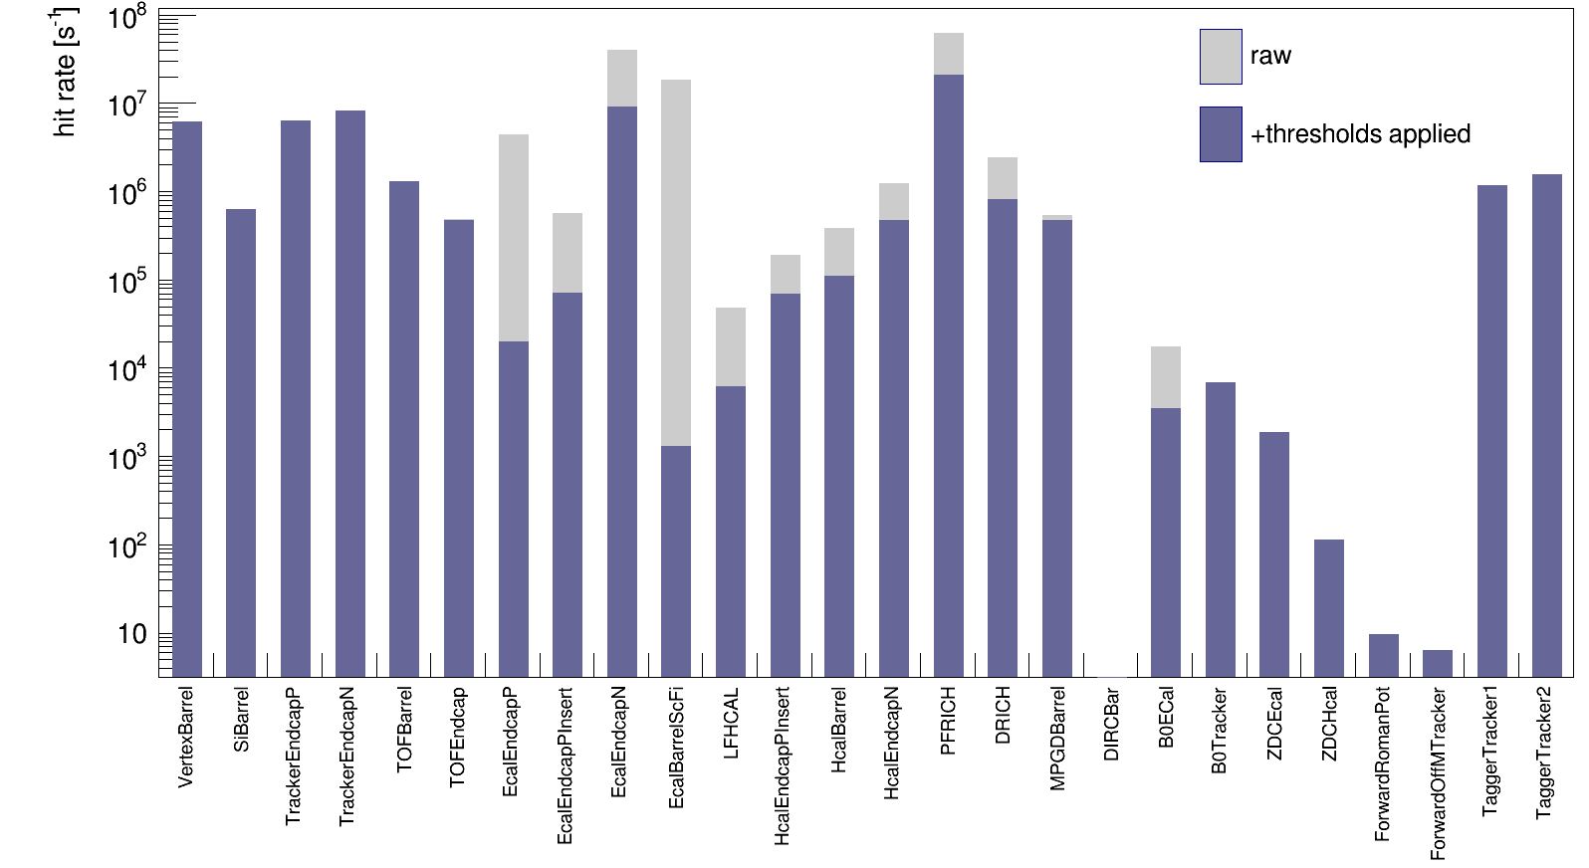
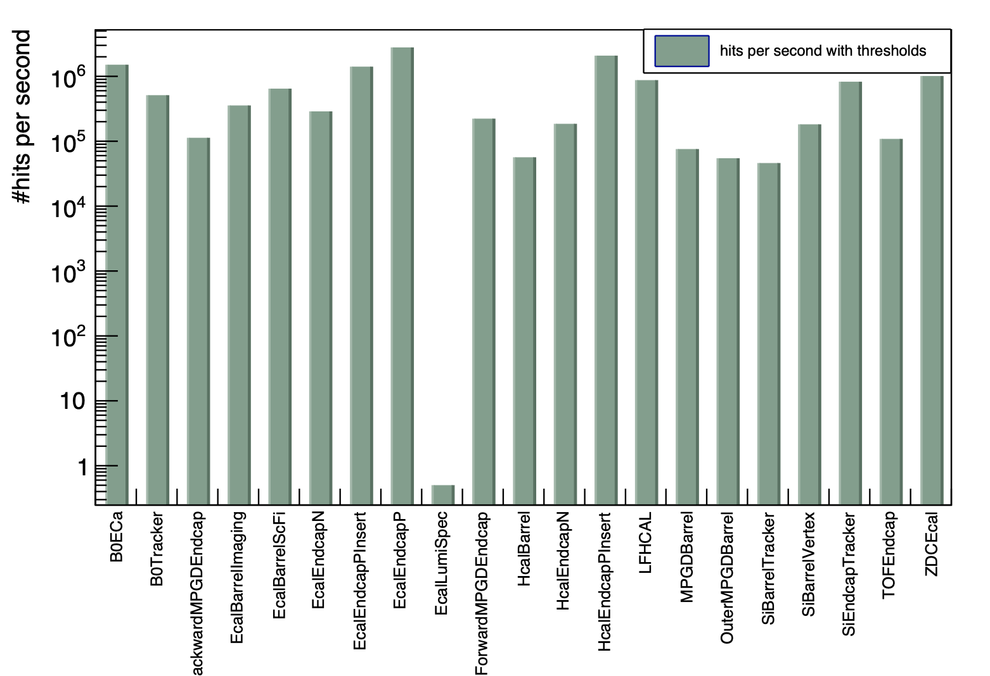
DIS and Beam Gas Background Rates
ep: 18x275 GeV Q² < 1 GeV
Electron Beam Gas
10 GeV
vacuum after 10000 Ah
Hadron Beam Gas
protons: 275 GeV
vacuum after 10000 Ah

Slide 13
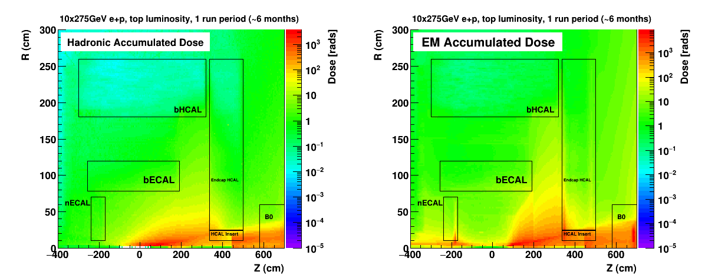
Radiation at IR
Primary collisions contribute a substantial fraction of the ionizing radiation and low energy neutron fluence in the experimental hall
Simulations use Pythia-6 well tuned to HERMES, COMPASS and HERA
  rates: “min-bias” DIS data → Q²> 10⁻⁹ GeV²
  Validation: Yuri Fisyak et al. NIM A 756 (2014) 68-72, arXiv:1310.2495
Study dependence on physics-list in GEANT-4 → especially for low energy neutrons → see many of Alex’s presentations in TIC-Meetings

Slide 14
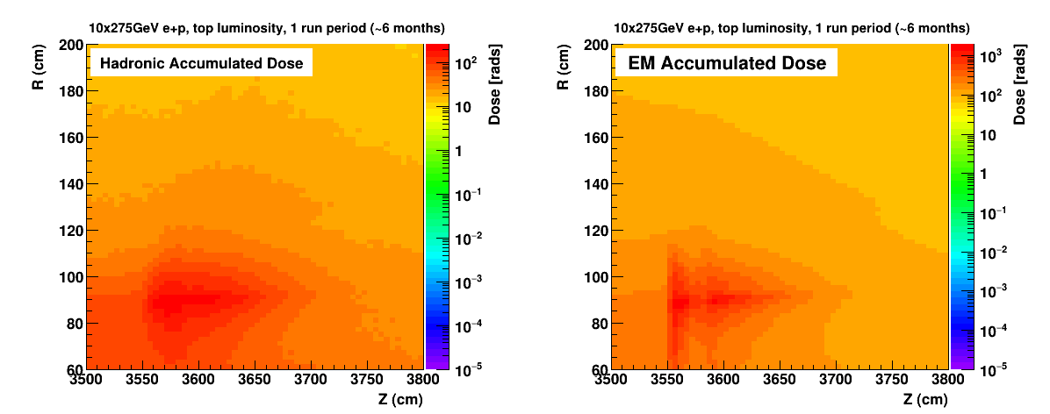
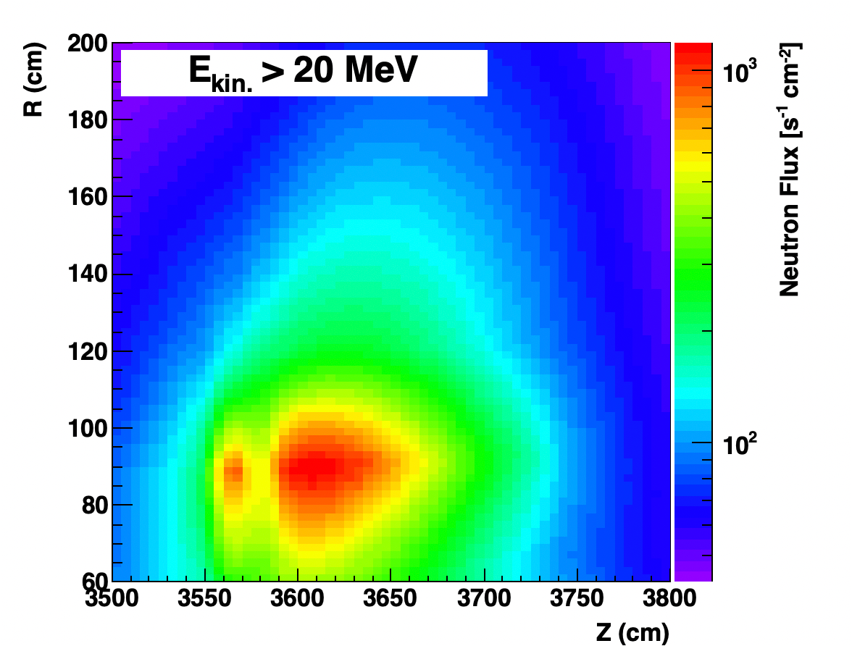
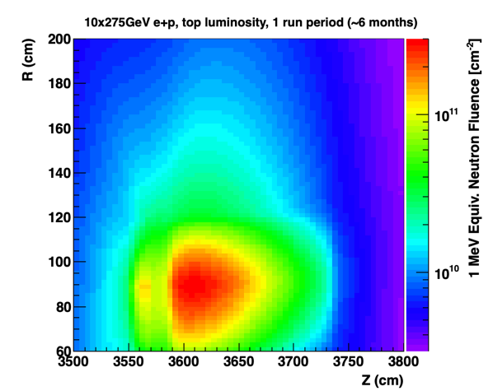
Radiation in ZDC

Slide 15
Radiation in Far-Forward Region
slice @ y = 0
total ep c.s.:
10x275 GeV
slice @ y = 0
electron beam gas
10x275 GeV
Radiation from backgrounds easily
manageable
→ Radiation dominated by signal process
Bethe Heitler

Slide 16
Impact of Beam Background on Detector Performance
Background hits will impact the track finding and reconstruction
  Embedding of beam background events in signal event in MC simulations
  Impact depends on speed of subdetector readout speed, MAPS 2 μs AC-LGAD 30 ps
Background will impact of energy reconstruction in calorimeters
Need to know the total rate per readout channel (== Background + DIS) for DAQ
  impact needed data rate capabilities
Total Radiation (== Background + DIS) impact subdetector lifetimes

Slide 17
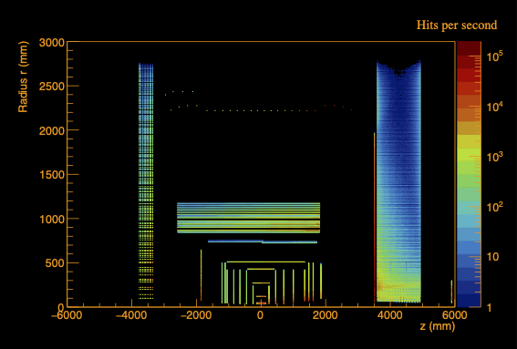
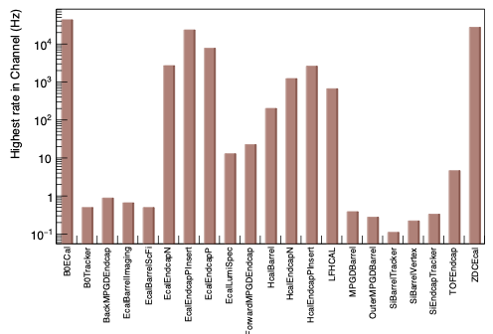
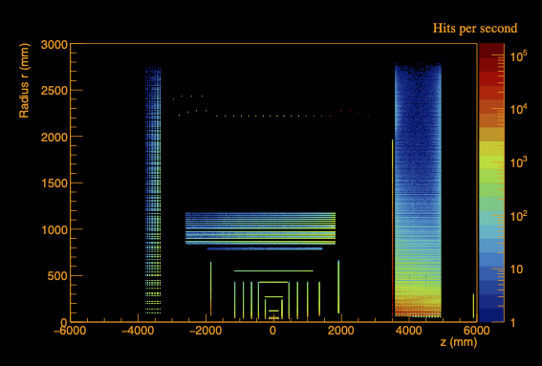
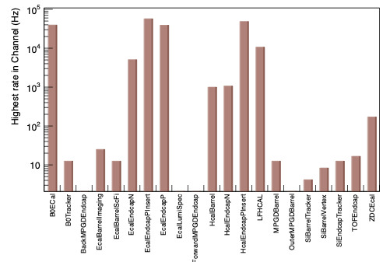
Rates per Channel – first Results
eP – no Q2
Hadron Beam Gas – 275 GeV

Slide 18
Summary and Outlook
All background sources are understood and simulated
  well documented on the wiki: https://wiki.bnl.gov/EPIC/index.php?title=Background
  good vacuum is critical to keep beam gas related backgrounds under control
Impact of SR and beam gas events on detector performance under study
  embedding of beam backgrounds in DIS events under way → to study the full impact on physics

Slide 19


Slide 20
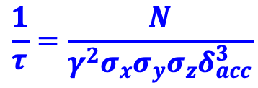
Beam Background / Radiation at IR
Both beams
Touschek scattering is related to intra-beam scattering, leads to particle loss, and hence a reduction in the beam lifetime → simulated by accelerator colleagues → design of momentum collimators
Touschek: Single-scattering IBS, so to speak. Transfer of transverse momentum, from the transverse focusing, into the
longitudinal direction when two electrons scatter off each other. The resulting longitudinal momentum exceeds the bucket height.
Touschek lifetime: from EIC-CDR is 5.27 h @ 10 GeV
and such not a major concern for EIC
→ currently reevaluating the conclusion is still true
$$\frac{1}{τ}=\frac{N}{γ^{2}σ_{x}σ_{y}σ_{z}δ_{acc}^{3}}$$
GEANT4

Slide 21
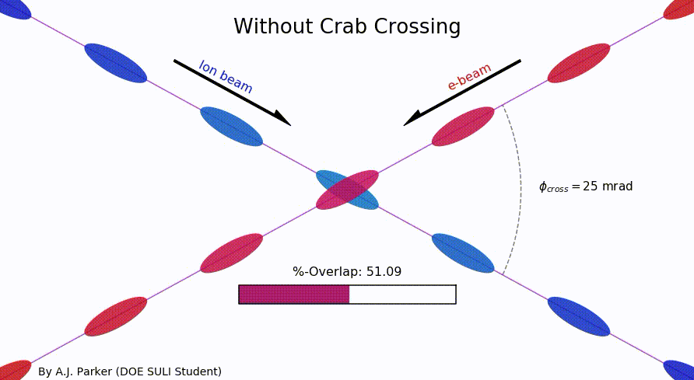
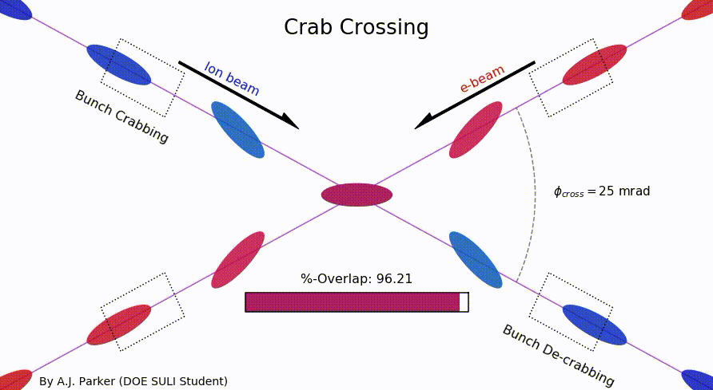
SR-Mitigation → Crossing Angle
Brings focusing magnets close to IP
→ high luminosity
Beam separation without separation dipoles
→ reduced synchrotron radiation
background
But significant loss of luminosity
Solution: Crab crossing
Head-on collision geometry is restored by rotating the bunches before colliding (“crab crossing”)
Bunch rotation (“crabbing”) is accomplished by transversely deflecting RF resonators (“crab cavities”)
Actual collision point moves laterally during bunch interaction
Completely new concept for a collider

Slide 22
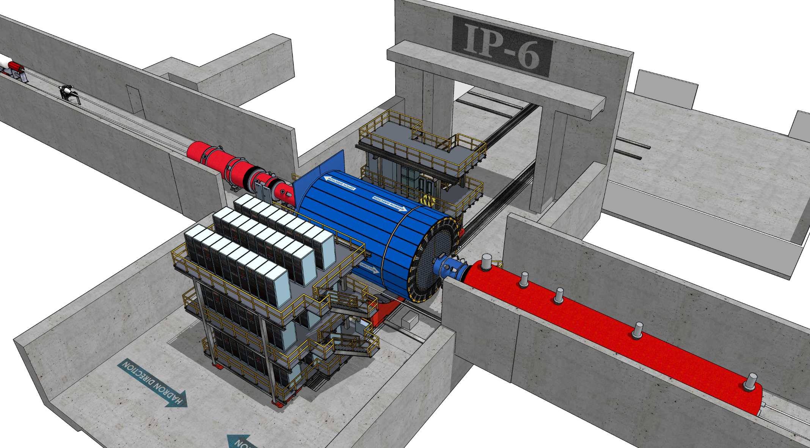
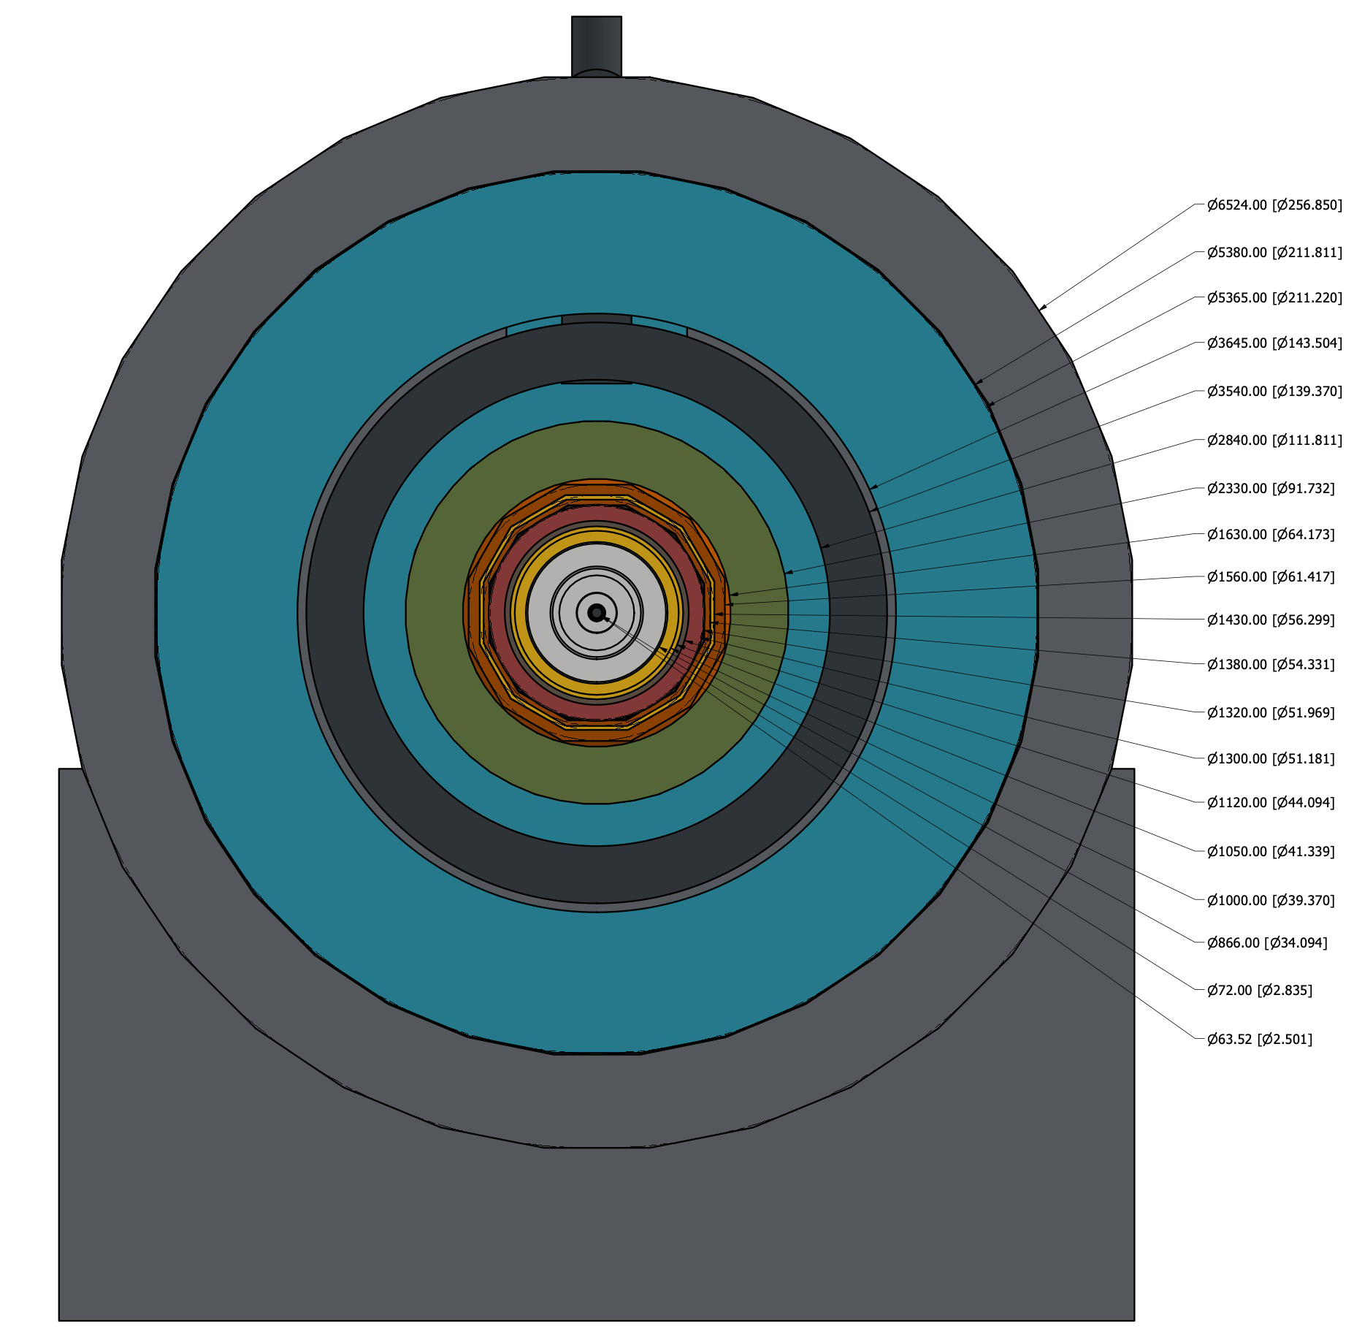
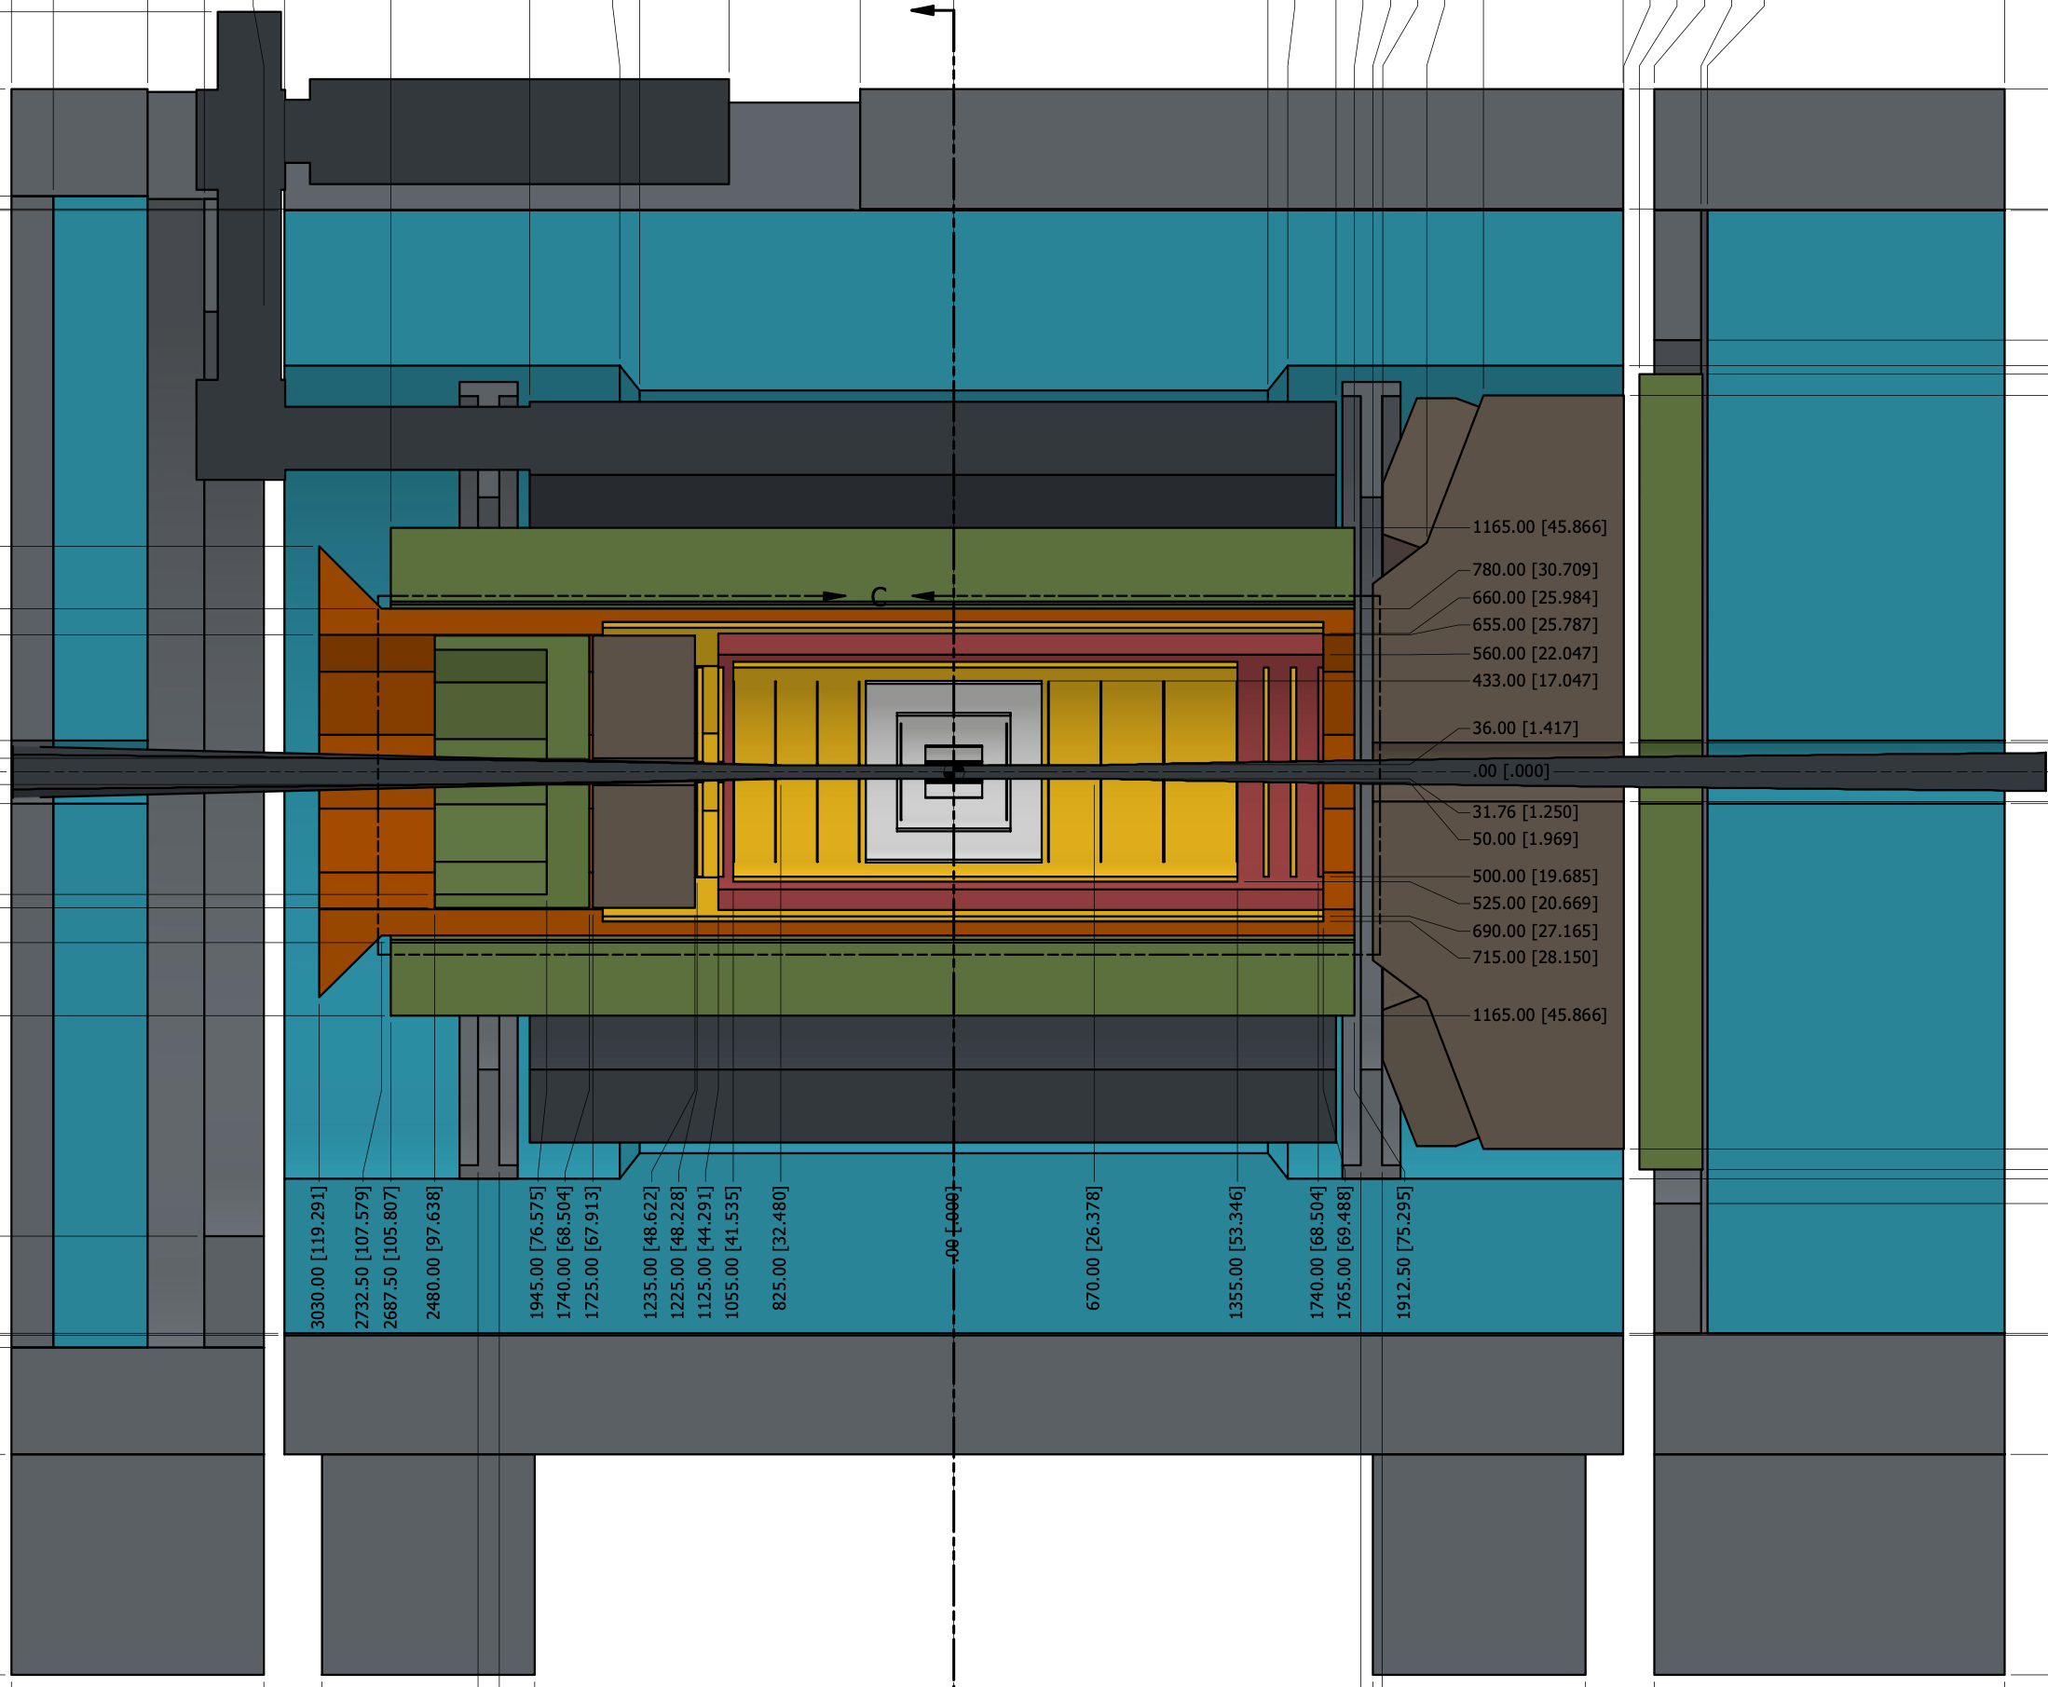
Beam Pipe Bake-Out
Remember: limited installation and maintenance possible in Collider Hall due to space constrains
Will have to break vacuum each time we roll into the assembly hall for maintenance
  will have separation valves around the detector
    no pumping over 9.5 m
  will vent under nitrogen and keep beam pipe rolling
  with detector under nitrogen
  will need to bake-out beam pipe integrated in central detector
Considerations for central beam pipe bake-out
  1st MAPS μvertex tracker sits at 36 mm radius, so 5 mm from the beam pipe
  MAPS sensor cannot go higher as 30ºC
    rules out std. bake-out methods and NEC
    pumping
    want to cool with air to keep material budget
    as low as possible
  Investigate baking out the central beam pipe
  with hot gas at > 100ºC to break water bonds
rolling to
assembly hall

Slide 23
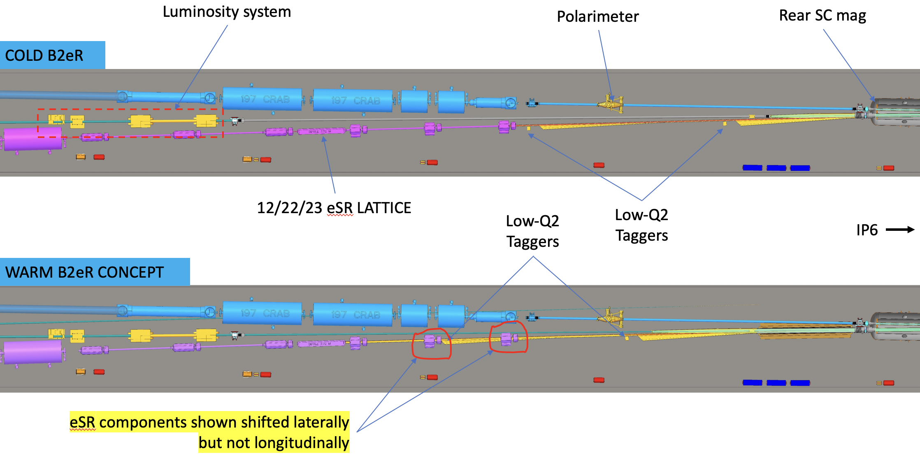
Notes on Far-Forward and Backward
Current
Potential New Layout
Will have to redo all background estimated for Far-Backward and iterate location of
low-Q2 tagger position and maybe luminosity monitor

Slide 24
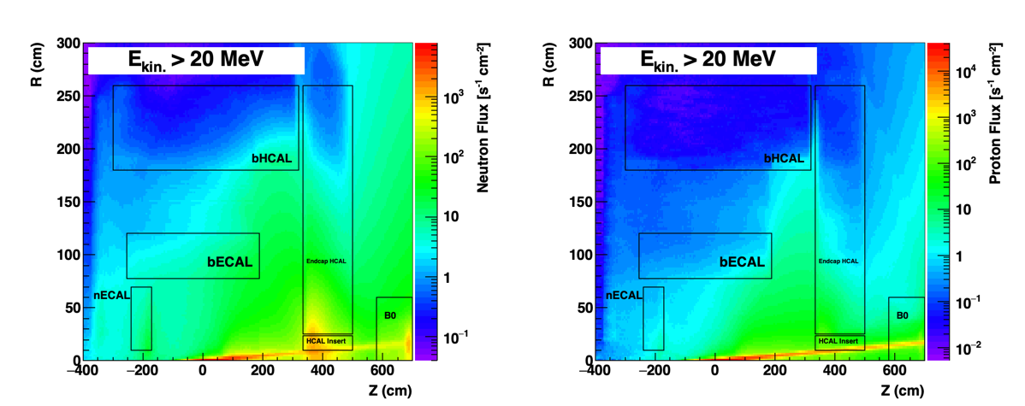
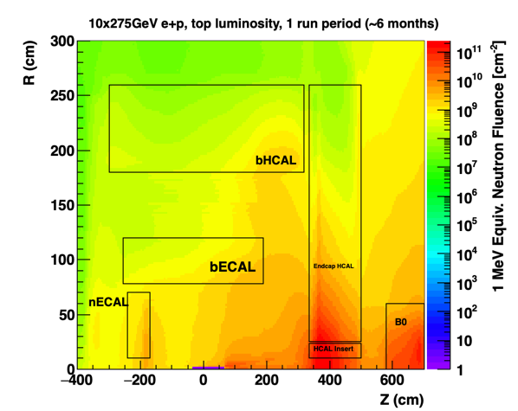
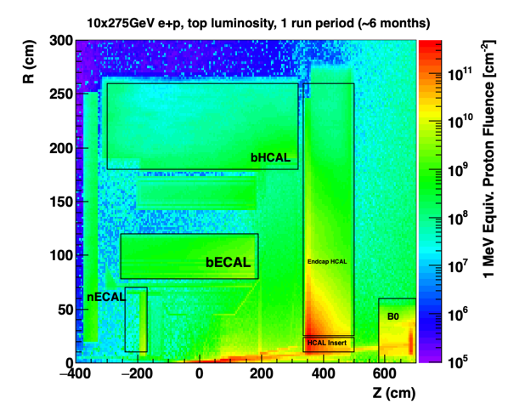
Proton and Neutron Radiation

Slide 25
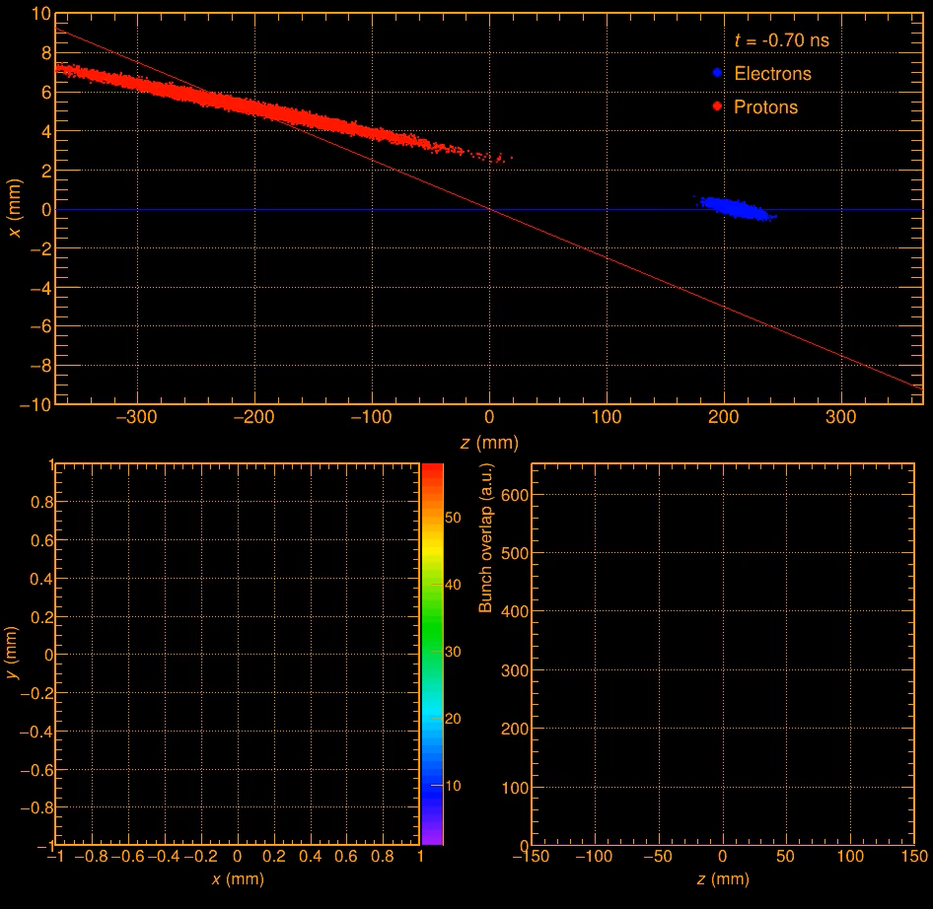
Impact of Beam Background on Detector Performance
need to start thinking how to deal with background in our data
timing of hits will be key
need a good time of the collision → t₀ → vertex will give excellent t₀
need to integrate in our software

