Slide 1
3D layout of IR6
Bijan Bhandari
Far-forward/ far-backward Review
Feb. 12, 2024

Slide 2
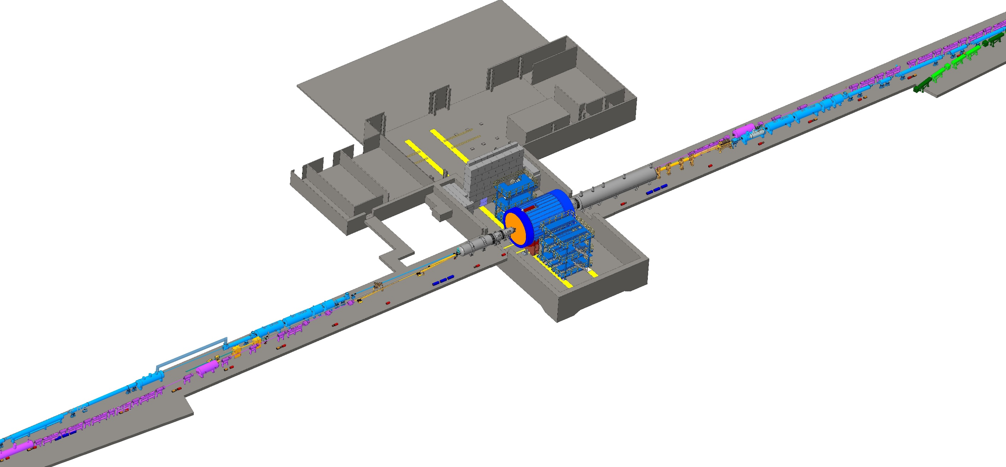
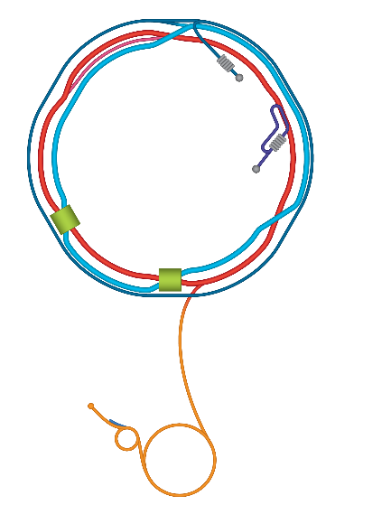
Overview of Interaction Region 6
Forward Side
SC Magnet Cryostat
Central Detector
ePIC
eSR Forward side
IP6
SECTOR 5
Hadron Injection Line
Rear Side
SC Magnet Cryostat
HSR Forward Side
HSR Rear Side
EIC
SECTOR 6
RCS
With Detector Bypass
eSR Rear side

Slide 3
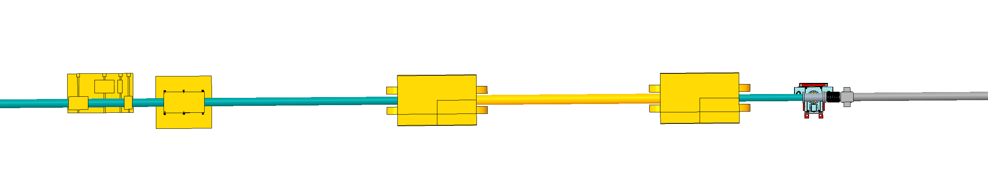
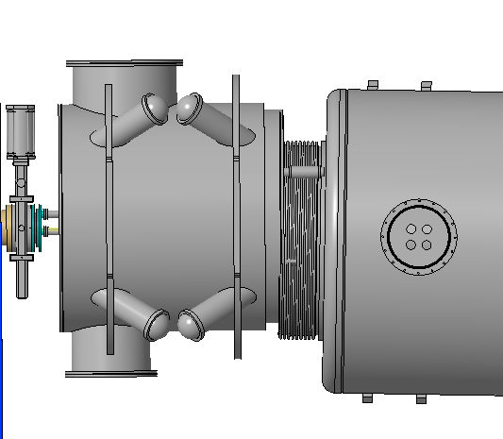
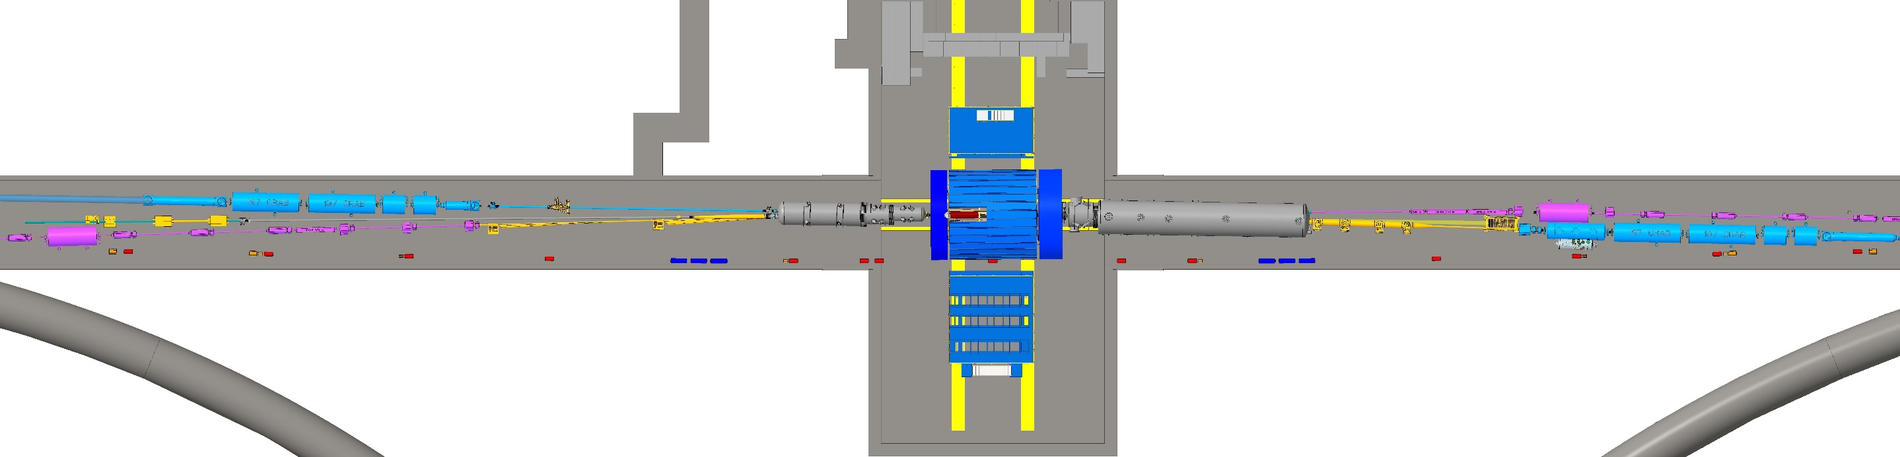
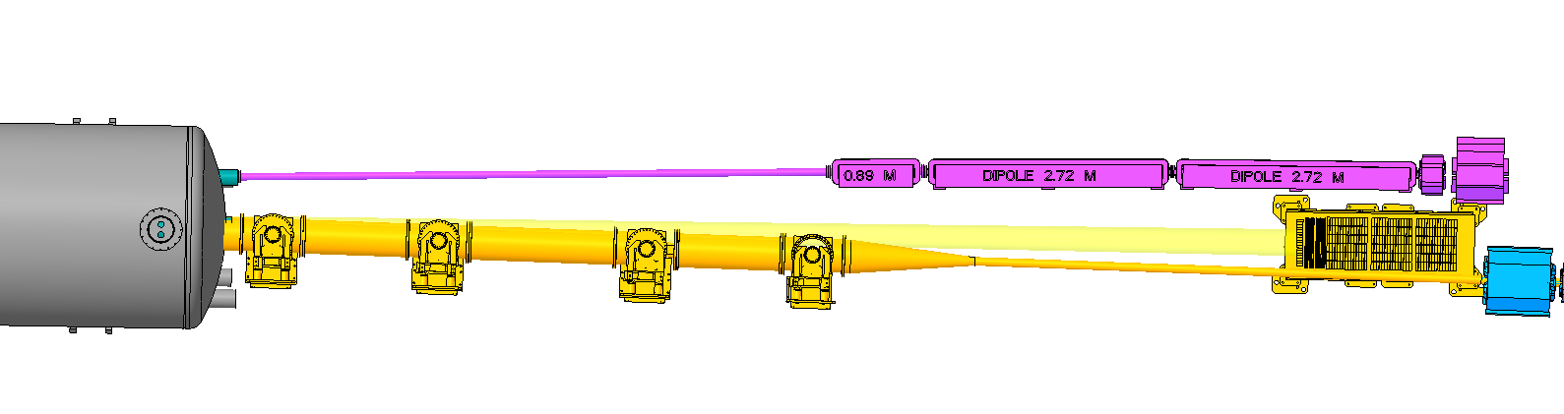
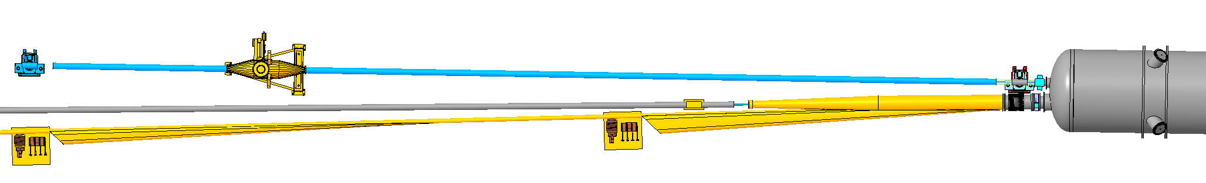
Auxiliary Far-Forward/Far-Backward Detectors’ Integration
LUMINOSITY SYSTEM
B0 DETECTOR
LOW Q² TAGGERS
OFF MOM DET, ROMAN POTS & ZDC

Slide 4
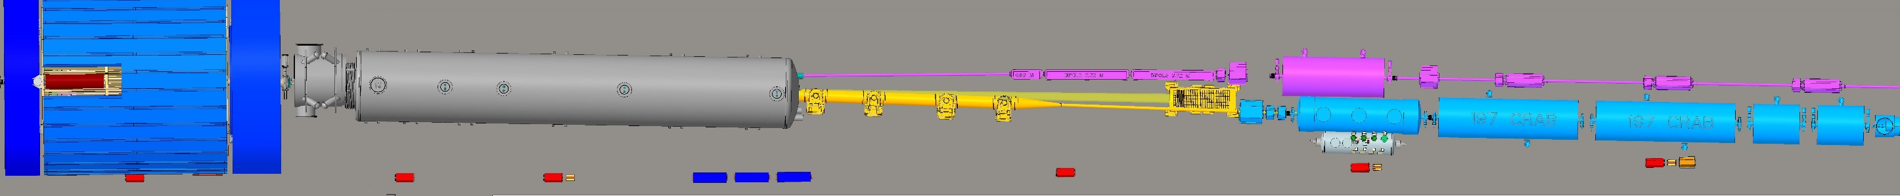
SECTOR 5
HSR
eSR
RCS
ePIC
B0 MAGNET/
DETECTOR
FAR FORWARD SC MAGNET
DIPOLES
QUADS
eSR CRAB
CAVITY
QUADS
OFF MOMENTUM
DETECTORS
MATCHING
SC DIPOLE
CRAB CAVITIES
ROMAN POTS
NEUTRON CONE
ZERO DEGREE
CALORIMETER
QUADS

Slide 5
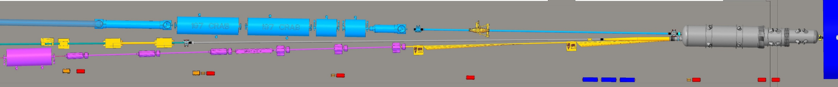
SECTOR 6
HSR
eSR
RCS
LUMINOSITY SYSTEM
POLARIMETER
CRAB CAVITIES
PHOTON BEAM
FAR BACK SC MAGNET
ePIC
eSR CRAB
CAVITY
QUADS
DIPOLE
QUADS
LOW Q² TAGGERS

Slide 6





COLLABORATION BNL/JLAB
WEEKLY ZOOM
MEETINGS
3D CAD SYSTEMS
  NX @ JLAB
  CREO @ BNL
FILE EXCHANGE
SHAREPOINT / WINDCHILL PROJECT LINK

