Slide 1
Far-forward/far-backward overview and requirements
Yulia Furletova
Far-forward/ far-backward Review
Feb. 12, 2024

Slide 2
Charge Questions to be Addressed
Are the technical performance requirements appropriately defined and complete for this stage of the project?
Are the plans for achieving detector performance and construction sufficiently developed and documented for the present phase of the project?
Are the current designs and plans for detectors and electronics readout likely to achieve the performance requirements with a low risk of cost increases, schedule delays, and technical problems?
Are the fabrication and assembly plans for the various detector systems appropriately developed for the present phase of the project?
Are the plans for detector integration in the interaction region appropriately developed for the present phase of the project?
Have ES&H and QA considerations been adequately incorporated into the designs at their present stage?

Slide 3
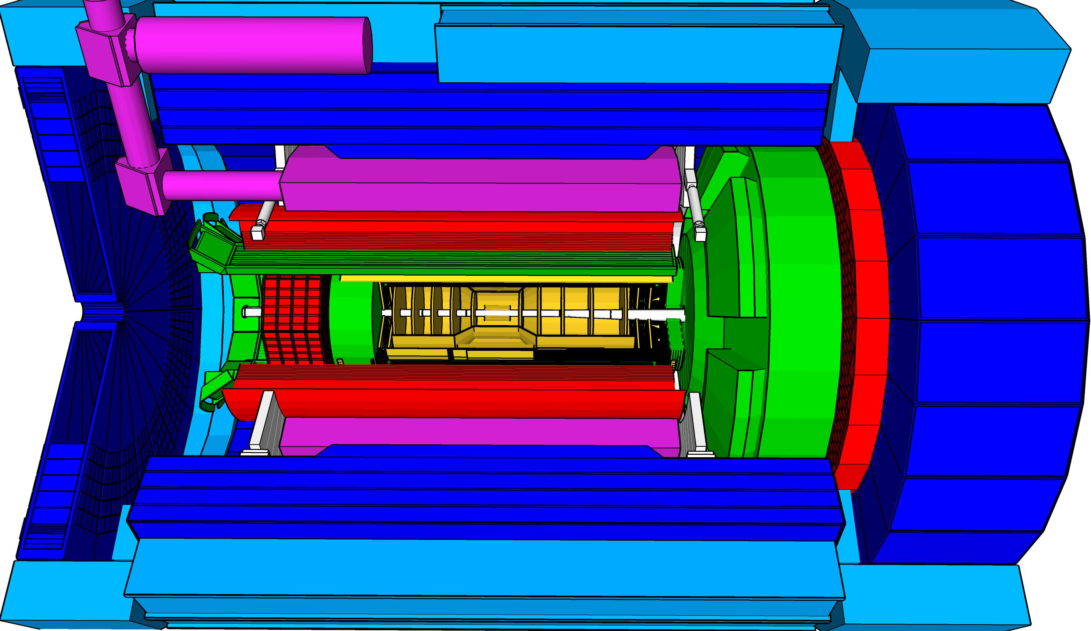
Outline
Collaboration formation
IR layout
Requirements & integration aspects
Far-forward area
Far-backward area
QA/ES&H
Timeline and Plans
Summary
local hadron polarimeter
hadronic calorimeters
Time.of.Flight,
DIRC,
RICH detectors
MPGD trackers
Solenoidal Magnet
MAPS tracker
e/m calorimeters
Luminosity
Monitor
low Q² electron-tagger
off-Momentum
taggers
Roman
Pots
Zero-Degree
Calorimeter
p: 41 GeV, 100 to 275 GeV
p/A beam
e beam
e: 5 GeV to 18 GeV

Slide 4

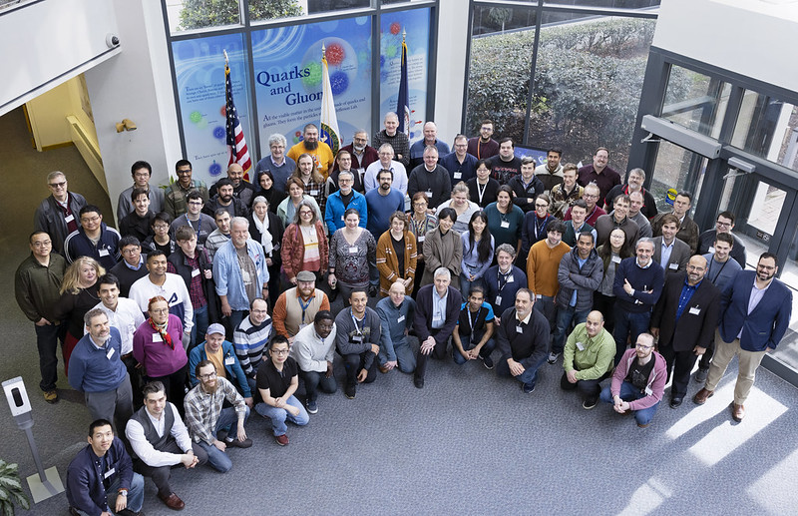
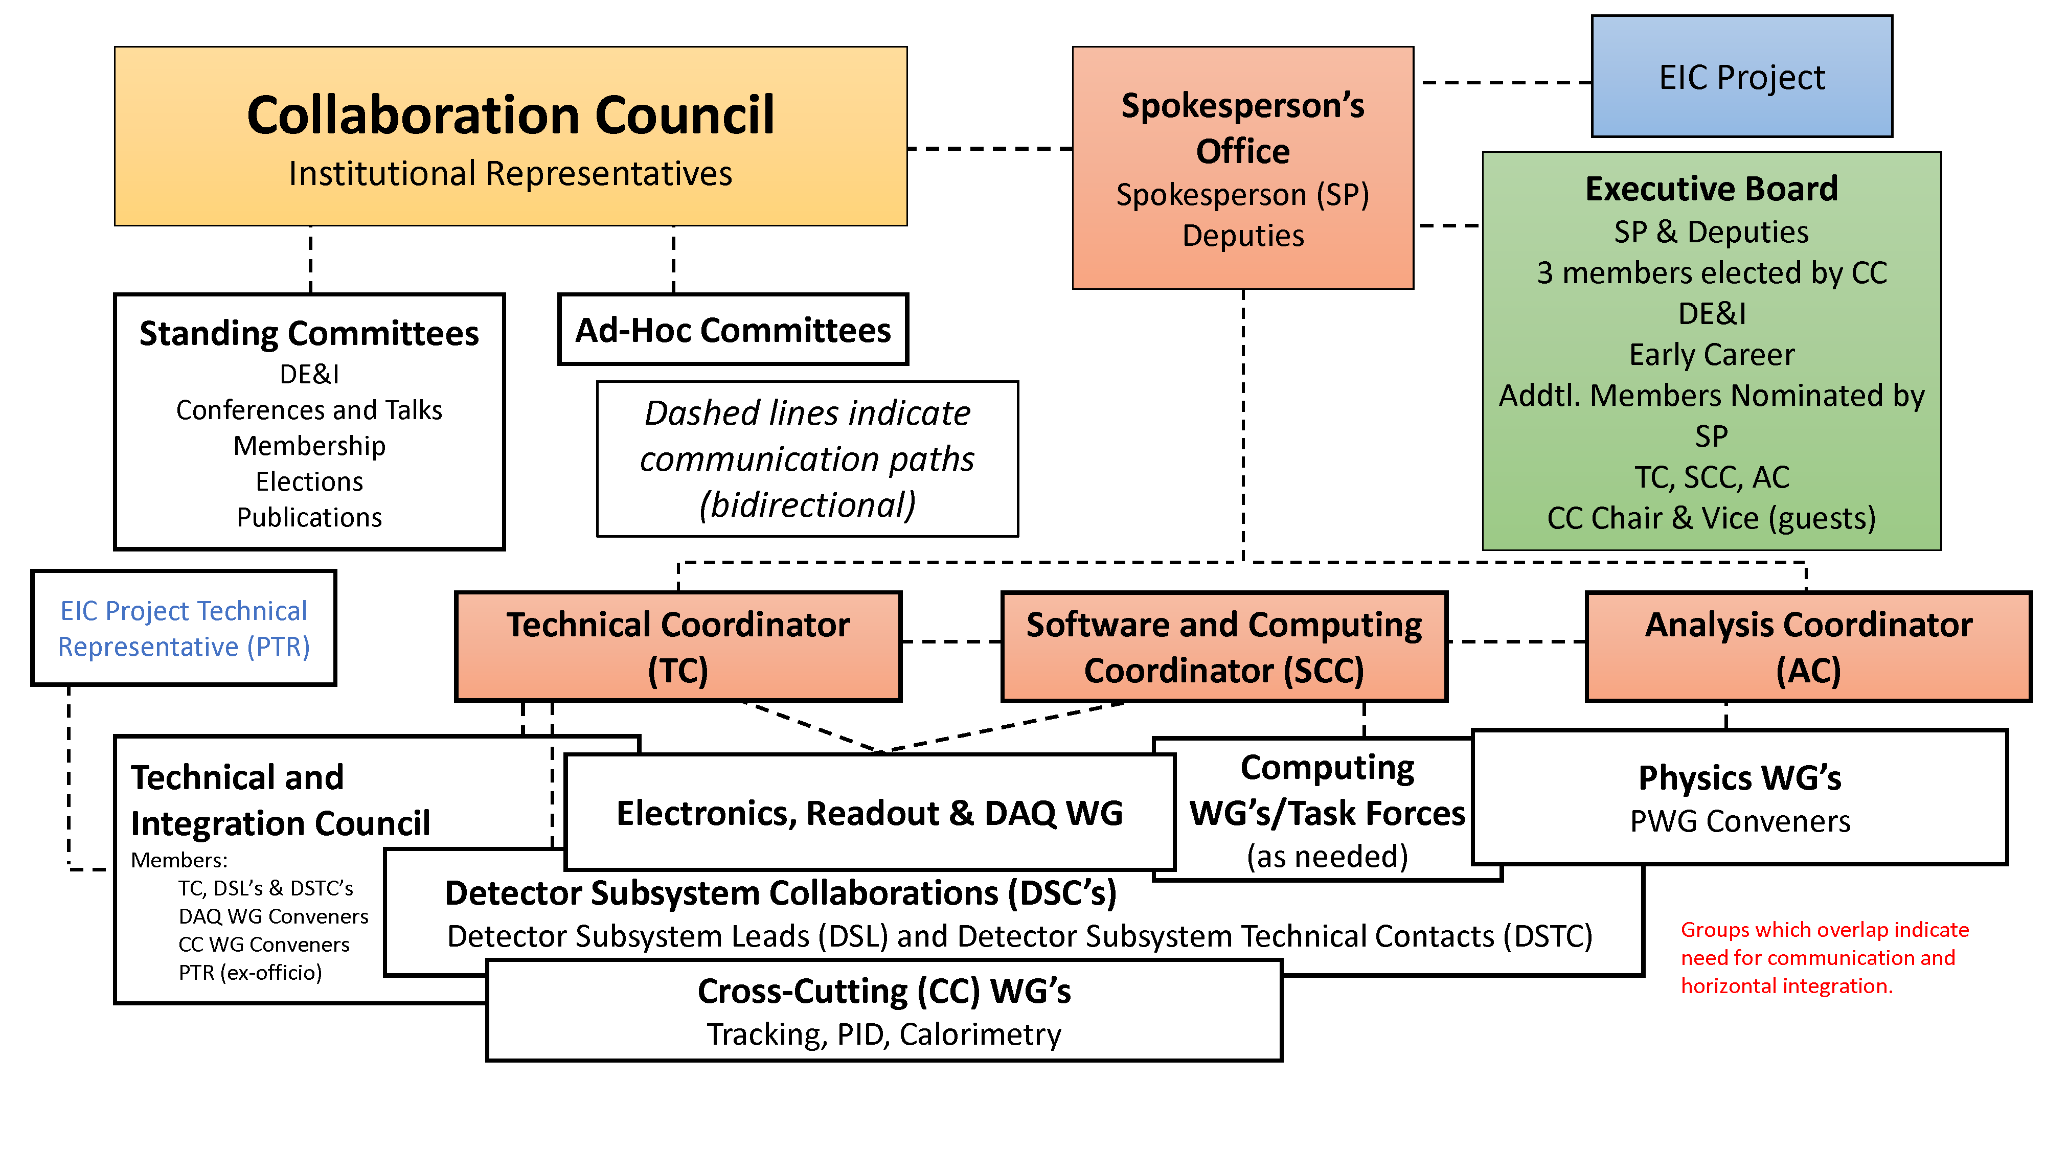
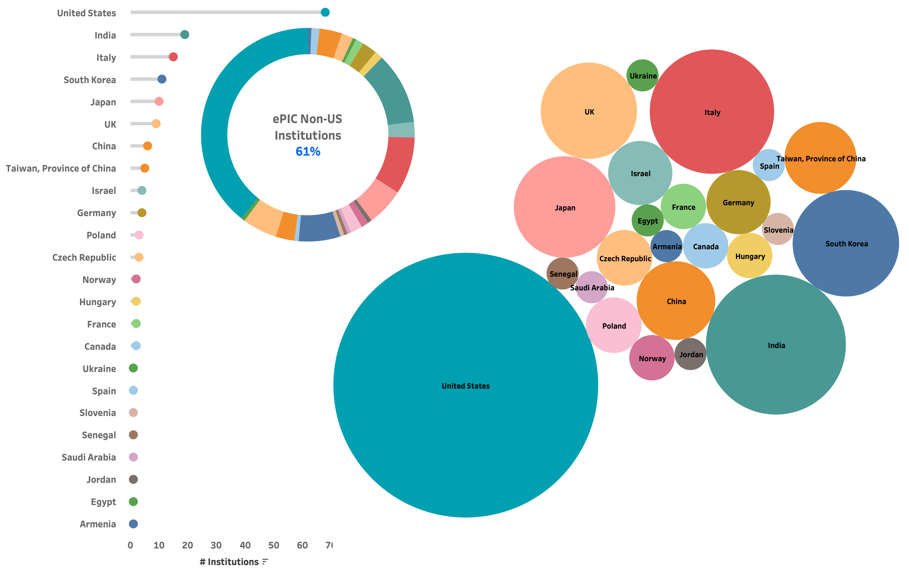
Collaboration formation
CD0 - Site selection - Dec 2019
CD1 - conceptual design (CDR) and cost range - June 2021
Detector proposals (ECCE,ATHENA, CORE) - March 2021-22
First FF/FB review 27 April 2022
ePIC collaboration formation - starting spring 2022
173 institutions (as on Jan. 2024)
24 countries
Many international groups and institutions are participating in FF/FB instrumentation
Spokeperson:
J. Lajoie,
Co-spokeperson:
S. Dalla Torre

Slide 5
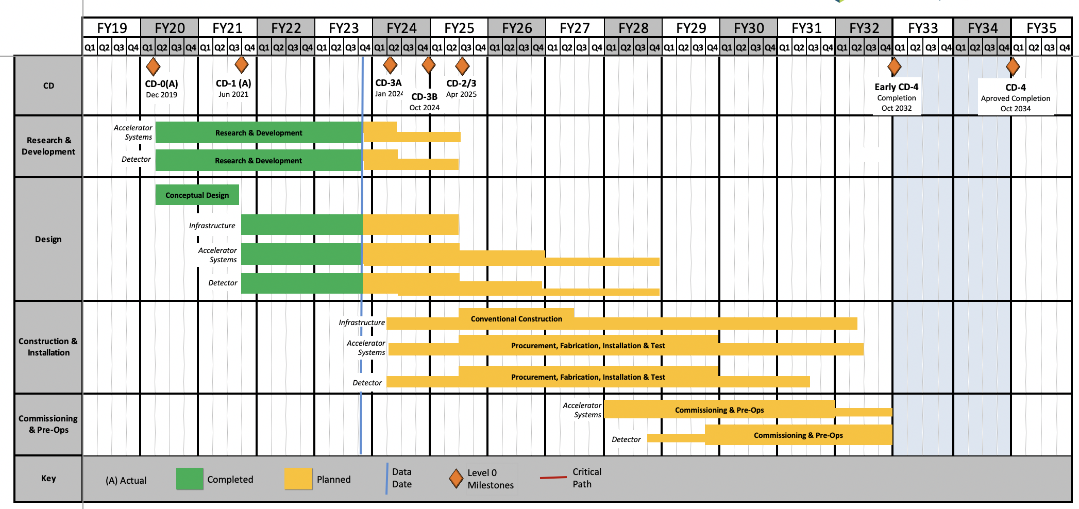
Integration with the EIC project
EIC Critical Decision Plan
CD-0/Site Selection December 2019 ✓
CD-1 June 2021 ✓
CD-3A January 2024
CD-3B October 2024
CD-2/3 April 2025
early CD-4 October 2032
CD-4 October 2034
RHIC
shutdown
CD-2 (Performance baseline approval )
Approve preliminary design for all subdetectors
Design Maturity: >60%
Need “pre-”TDR
Baseline project in scope, cost, schedule
EIC project CAMs and ePIC collaboration detector sub-system leaders (DSL) and technical coordinators (DSTC) are working together and coordinating their activity
Fall 2023: DAC review, directors review and CD3A /LLP
2024 is a year of the EIC pre-TDR ! ( finalize by Dec 2024)
Today: preliminary design review of FF/FB detectors:
Baseline technology
Progress since last review
plans and roadmap for CD2 ( 60-80% design readiness, pre-TDR)
CD-3(Start of constructions approval):
Approve final design for all subdetectors
Design Maturity: ~90%
Need full TDR

Slide 6
3D view
Far forward and far backward detector components are distributed along the beam line within +/- 50 m
We are keeping a full detector integration in sync with the accelerator design from the early stages on ( accelerator design is evolving and we are adjusting our FF/FB design accordingly)
e
Far-forward area
p/A
Far-backward area
Large center of mass range √s ~ 30- 140 GeV
e-: 5- 18 GeV
p : 41-275 GeV
Ion species: d to U
High Luminosity upto 10³⁴ cm⁻²s⁻¹

Slide 7
FF/FB overview
In total 7 sub-detectors (12 sub-components) => maximizing synergies between different sub-detectors as much as possible, but keeping performance
Many international groups and institutions are participating in FF/FB instrumentation
Previous recommendations ( see backup slides): Make sure that all collaborating institutes are familiar and on-board with the integration strategy and systems.
Weekly meetings to discuss engineering and integration aspects with JLAB/BNL designers, collaborating institutions.
Next slides: requirements for FF/FB detectors

Slide 8
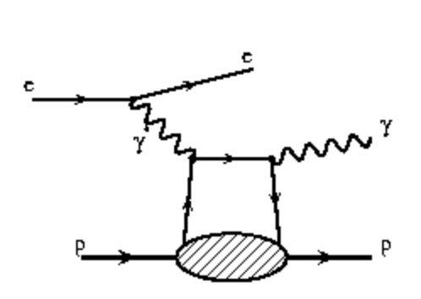
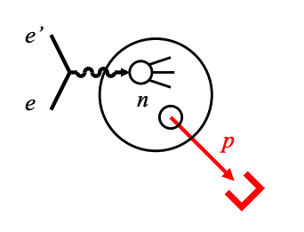
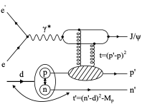
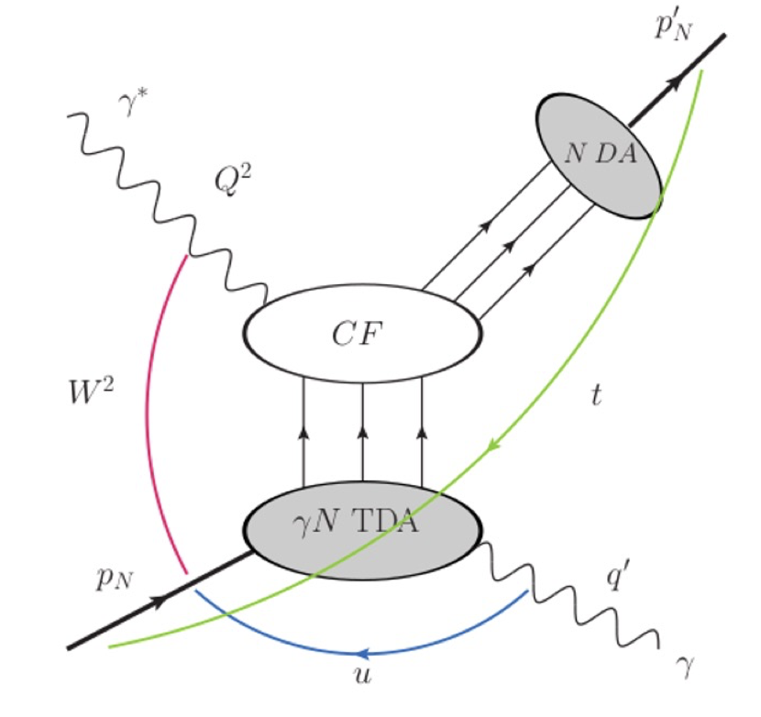
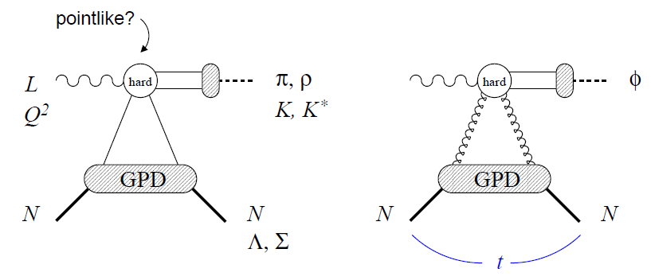
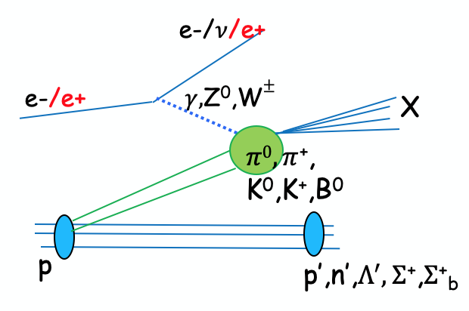
Forward physics overview
Lots of important final-states which require Far-Forward detectors!!
e+p DVCS events with proton tagging.
DIS on the deuteron
e+d exclusive J/Psi events with proton or neutron tagging
Neutron structure;
EMC effects
Gluons
Proton spin: orbital angular momentum;
imaging
Short^{-Range} Correlations
Proton mass
coherent/incoherent J/$ψ$production in eA
Sullivan process:
with neutron tagging (ep$→\left(π\right)→$e’ n X) and Lambda decays ($Λ→$p$π−$ and $Λ→nπ0$)
u-channel backward exclusive electroproduction
J/Ψ, φ
Saturation
Backward-angle colinear factorization
Meson structure

Slide 9
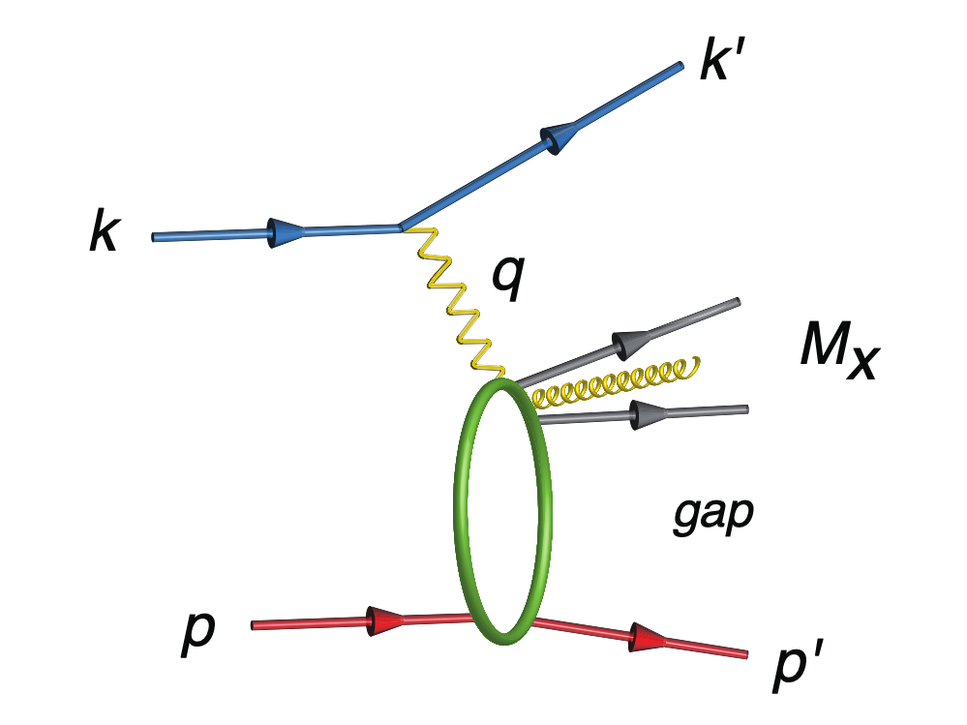
Far-Forward detectors (hadron outgoing)
Exclusive /diffractive reactions driving the design of FF area -> reconstruction of particles outside of the central detector acceptance
, n’
t=p_{t}²
IP
 | Particles | Angle [mrad] |  | Distance from IP
B0-tracker | Charged particles Photons ( tagged) | 5.5 - 20 |  | ca 6-7 m
Off-momentum | Charged particles | 0-5.0 | 0.4< xL< 0.65 | ca 23-25 m
Roman Pots | Protons Light nuclei | 0*-5.0 | 0.6 < xL< 0.95 | ca 27-30 m
ZDC | Neutrons Photons | 0-4.0 (5.5) |  | ca 35 m
protons at wide range of $p_{T}^{2}$
protons with different rigidity
neutrons and photons

Slide 10
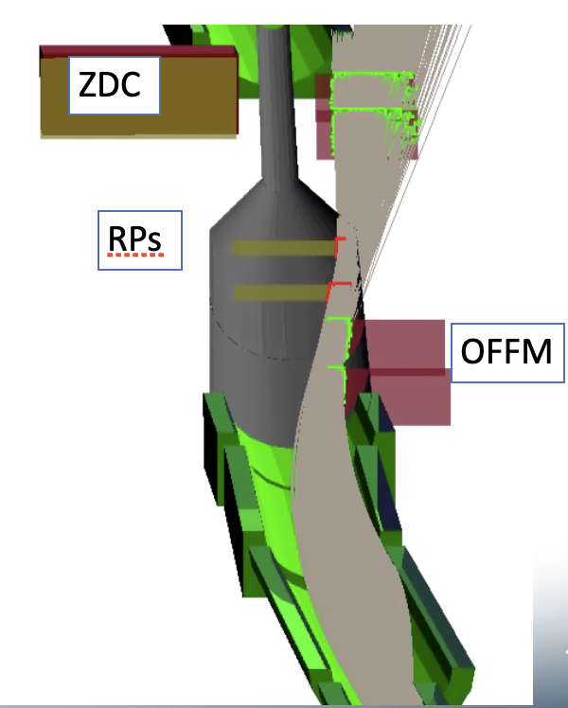
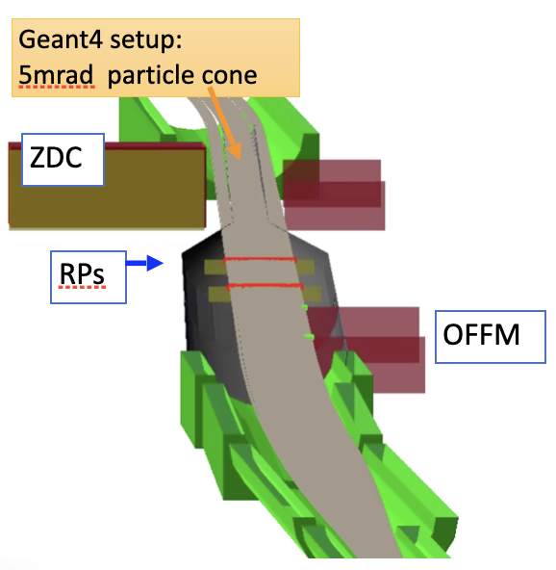
Detector requirements: RPOT and OMD
-> talk by Alex Jentsch
Roman-Pots
-- small |t| value
Off-Momentum Detectors:
(0.0 < 𝜽 < 5.0 mrad, (𝜂 > 6))
0.0* (10$σcut)$ < 𝜽 < 5.0 mrad
$$\boxed{σ(z)=\sqrt{ε∙β(z))}}$$
$σ\left(z\right)$ is the Gaussian width of the beam,
$β\left(z\right)$ is the RMS transverse beam size.
$ε$ is the emittance.
The Roman-Pots should provide measurements of charged particles close to the beam core, as close as $10σ$ away from the beam;
Movable, integrated into the vacuum system => very close contact with accelerator to avoid negative impacts on the machine operation
Minimize amount of material in front of ZDC (top-bottom insertion)
For good t-measurements => momentum resolution < 5%, and pT resolution of 5% for pT > 500 MeV/c
Timing < 35ps
Must be resistant to background conditions at the levels specified by the simulation studies.
Protons that come from nuclear breakup have a different magnetic rigidity than their respective nuclear beam (x_{L}<1) . Such protons experience more bending in the dipoles. As a result, small angle (𝛳 < 5mrad) protons from these events will not make it to the Roman Pots.
Movable, vacuum system integration
Timing and spatial resolution requirements are the same as for RPOTs

Slide 11
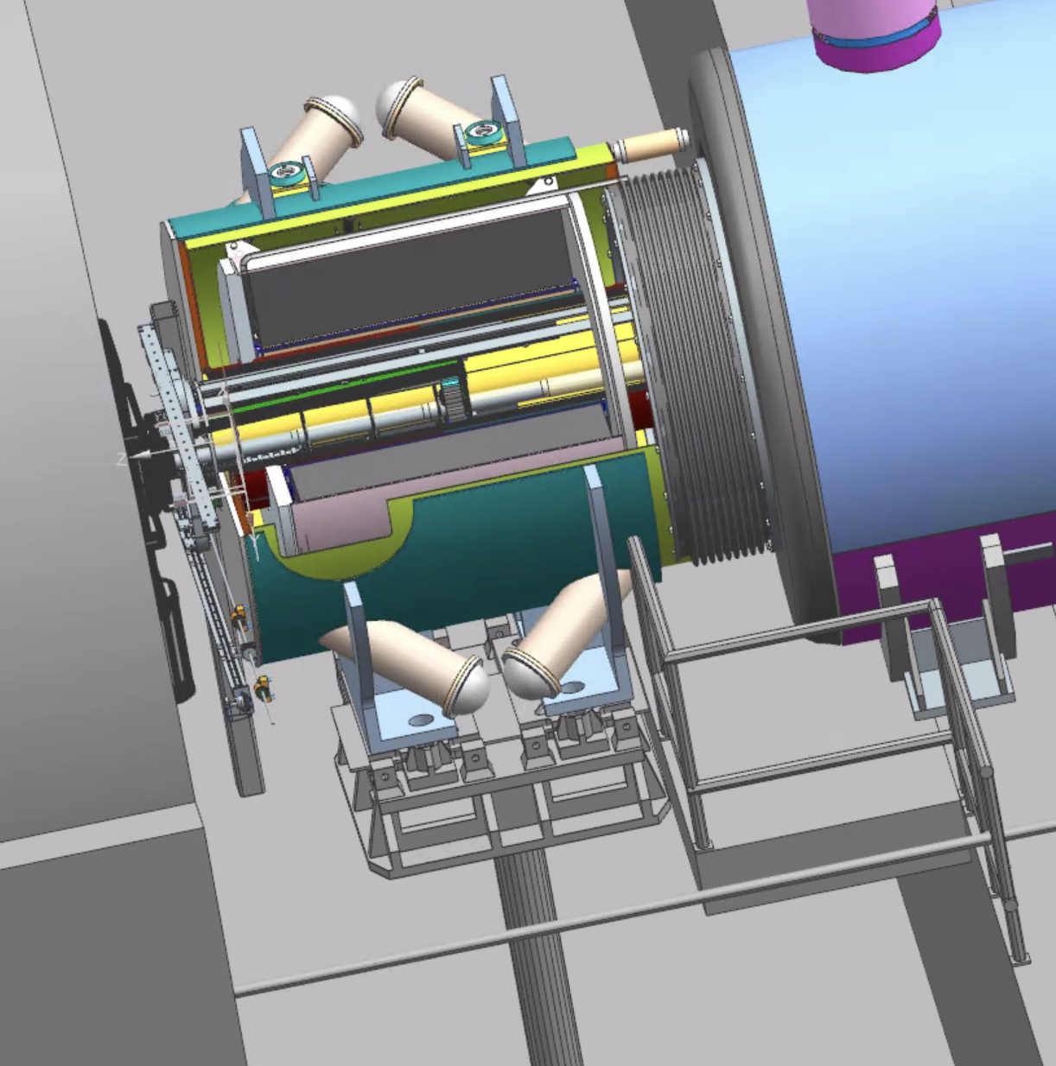
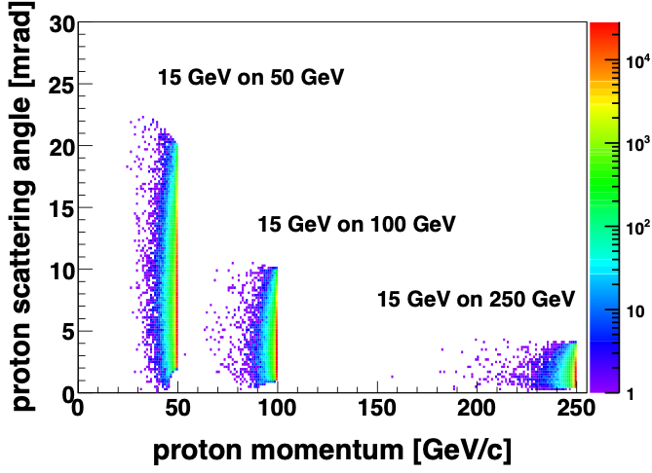
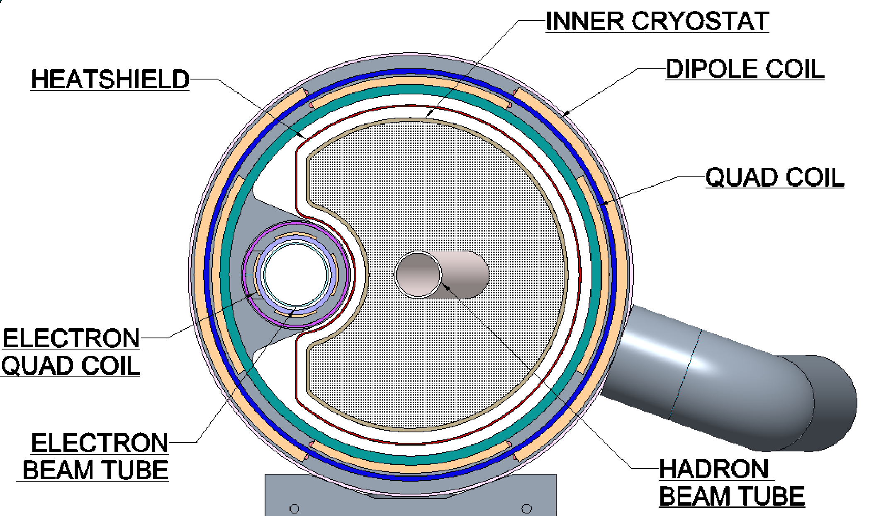
B0- detectors
-> talk by Zvi Citron
Placement:
B0-dipole: length is ca 1.5m, field 1.3T for momentum reconstruction, ~20cm inner bore (design is on the way)
Zero field line at electron beam axis.
Warm space for detector package insert located inside a vacuum vessel to isolate from insulating vacuum.
Beams are separating into two independent beam-pipes in front of B0; Vacuum pump in front
crossing angle: unequal space between beam-pipes
Limited space:access to B0-detectors only from one side ( after opening HCAL) : ~ 15cm in front
Full p_{T} coverage for forward-going protons is critical for EIC physics, but the high p_{T}-acceptance in RPOTs is limited by magnet’s apertures => B0 detectors. Especially important for low-energy operation
B0-system shall provide theta coverage in the range 5.5 < 𝜽 < 20.0 mrad (4.6 < 𝜂 < 5.9) with respect to the hadron beam line. For tracking momentum resolution < 6%.
Need to provide measurements of forward photons and pi0: $γ+γ$ from $π^{0}$ separation to clearly isolate u-channel DVCS
Energy resolution for photons $σ$(E)/E < 8%/sqrt(E) + (2)%.
Must be resistant to extreme background conditions, high neutron flux in particular

Slide 12
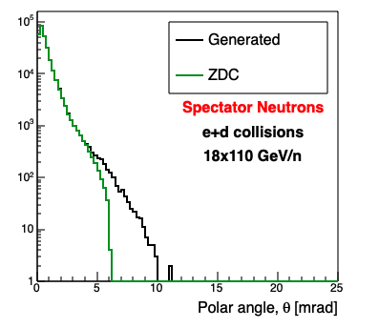
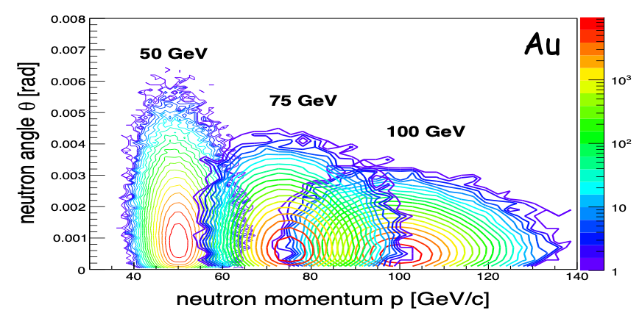
Zero Degree Calorimeter
-> talk by Michael Murray
EMCAL
HCAL
Neutrons
Photons
The Zero Degree Calorimeter should provide measurements of neutral particles (neutrons and photons).
need +/- 4 mrad coverage => beam element free cone before the zero degree calorimeter to detect the breakup neutrons from heavy Ions
For neutrons: provide good angular resolution and energy measurements (<50%/$\sqrt{E}$+5%)
For photons: provide photon measurements down to 100 MeV. Also $π^{0}$ detection => energy resolution resolution for photons < 3%/sqrt(E) + (1-3)%.
Position resolution < 1cm

Slide 13
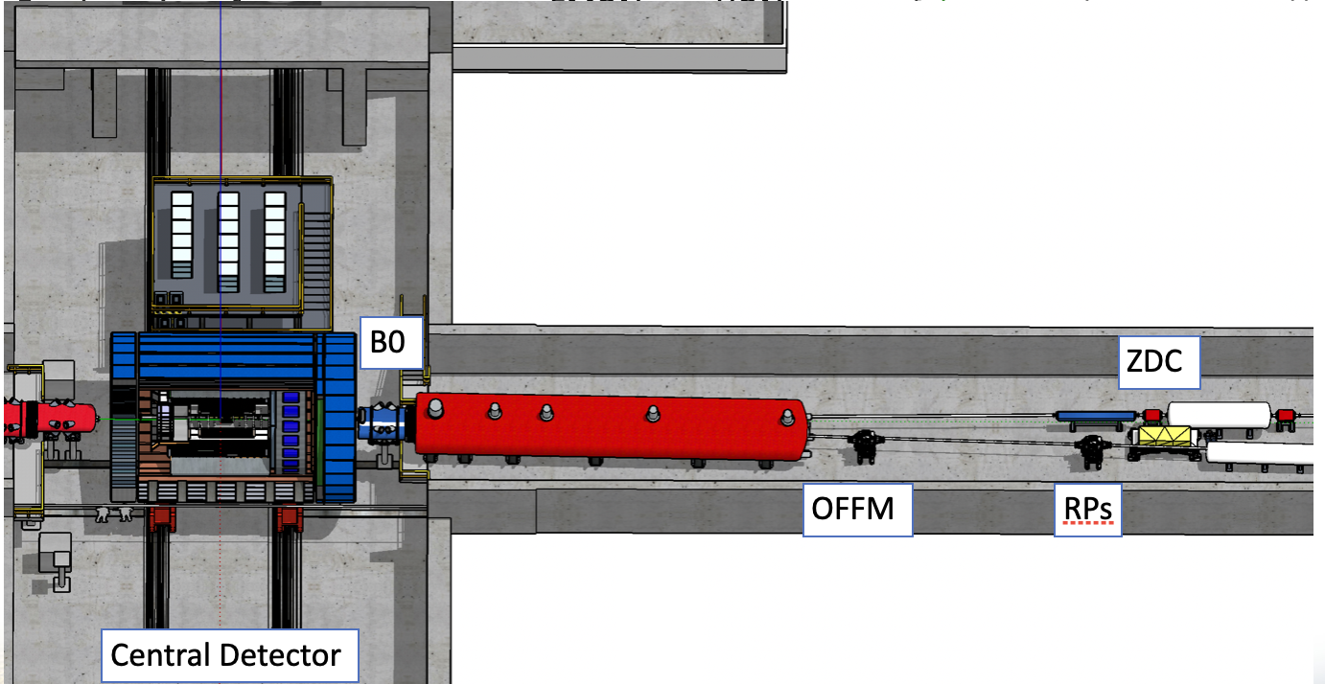






Far-forward: participating institutions
B0 detectors
Tel Aviv University, Israel
Hebrew University of Jerusalem, Israel
Ben Gurion University of the Negev, Israel
ZDC
Riken, Japan
Kobe, Japan
also recently joined Uni’s from Taiwan and
South Korea
Kansas university, USA
PNNL, USA
UCR, USA
RomanPots and OMD
AC-LGAD consortium :
BNL, USA
IJCLab - Orsay, France
OMEGA , France
IRFU/CEA-Saclay, France

Slide 14
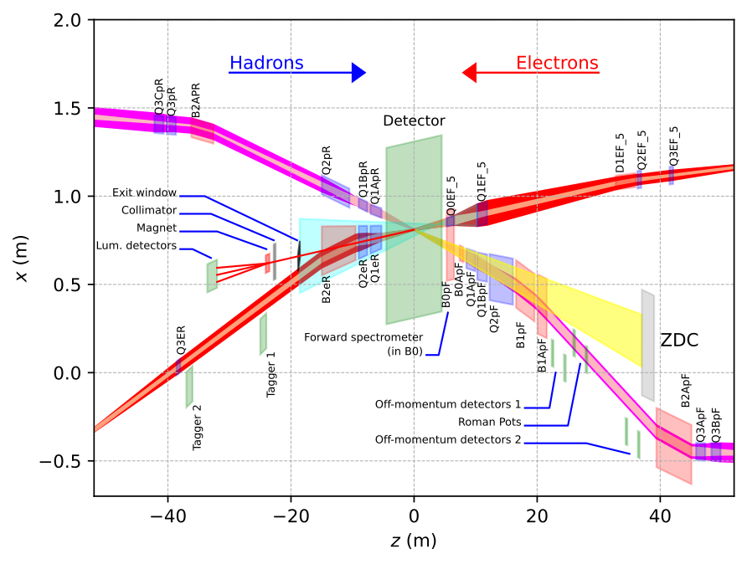
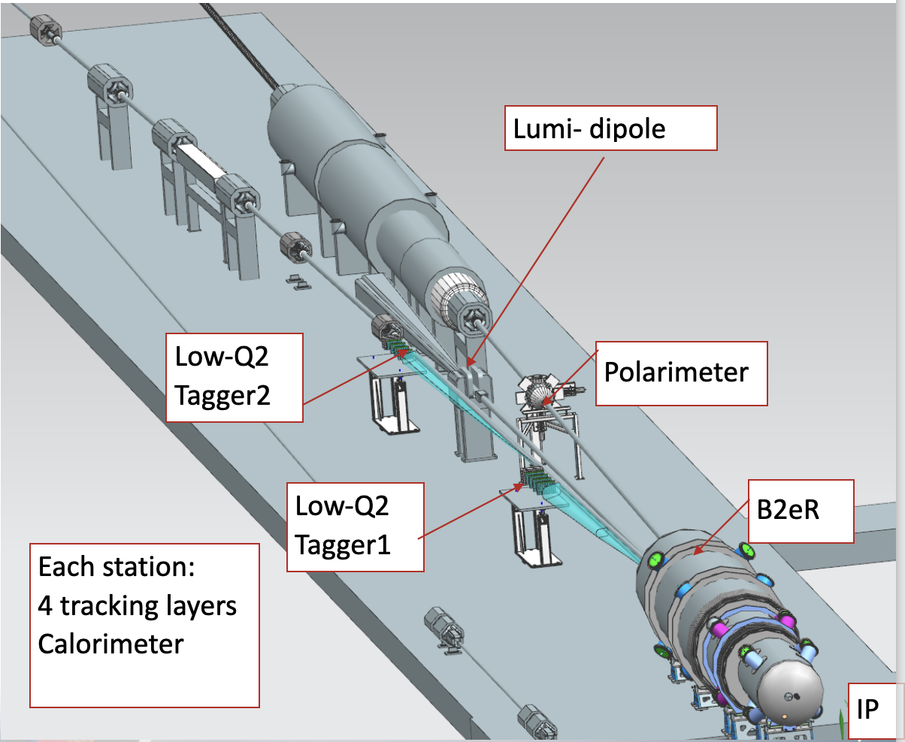
Far-backward (electron-outgoing) region
Top view
far-backward area
far-forward area
This area is designed to provide coverage for the low-Q² events (photoproduction, $Q^{2}<∼1GeV^{2}$) . Need to measure a scattered electron position/angle and energy
And luminosity detector (ep -> e’p$γ$ bremsstrahlung photons)
Yulia Furletova

Slide 15



Far-backward: participating institutions
Low-Q2 tagger - tracker :
Glasgow, UK
Prague, CZ
W&M, USA
Low-Q2 tagger - calorimeter :
Prague, CZ
Lumi system
York, UK
Low-Q2
tagger2
Lumi - photon calorimeter:
Low-Q2
tagger1
Kraków, Poland
Prague, CZ
York, UK
Lumi - pair-spectrometer :
York, UK
Prague, CZ
Kraków, Poland
JLAB/BNL
Houston, USA
IP
Weekly meetings to discuss engineering and integration aspects with JLAB/BNL designers, collaborating institutes

Slide 16
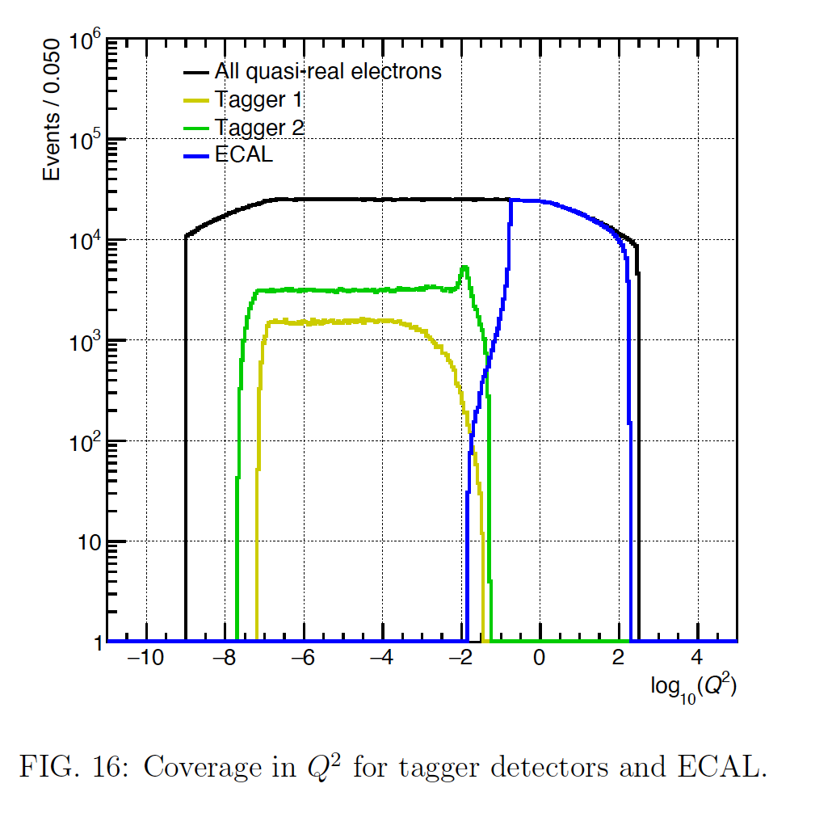
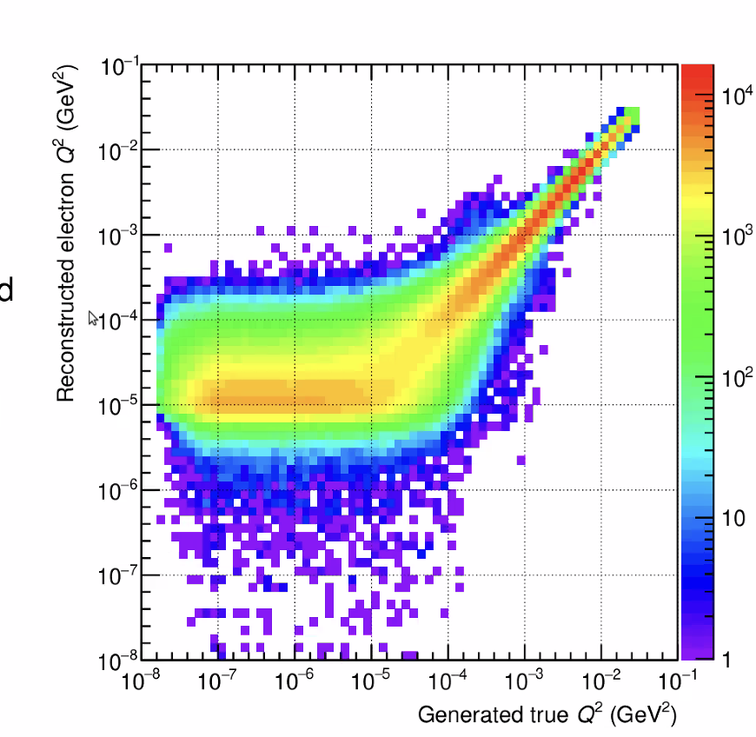
Low-Q2 tagger: requirements
=> talk by Kenneth Livingston
The Low- Q² detectors need to measure the energy and position of the scattering electrons with Q² below 1GeV² in the far-backward directions.
The acceptance for the low- Q² tagger should complement the central detector to reach the coverage close to the limit given by the divergence of the beam.
Low-Q2 system should have a spatial resolution providing a momentum resolution < 5%
Provide timing resolution sufficient to resolve 10ns beam buckets
High rate capability ( due to brem. background) : ~ 20kHz per 55um pixel (near the beam-pipe)

Slide 17
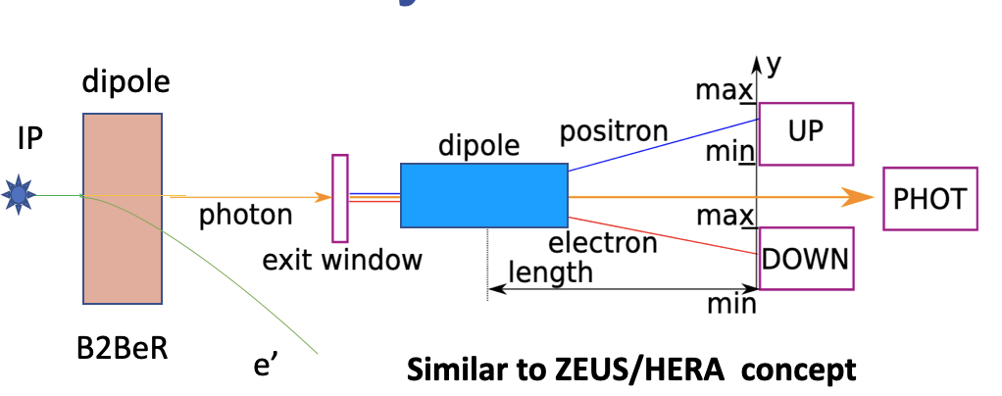
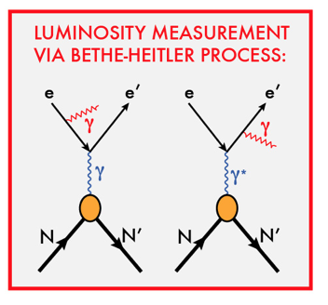
Luminosity system: requirements
=> Talks by
Nick Zachariou
Krzysztof Piotrzkowski
To measure integrated luminosity with precision δL/L< 1%
Done using two complementary measurements:
e+
e-
pair spectrometer:
Low rate ( due to conversion)
High precision measurement for physics analysis $σ$(E)/E < 15%/sqrt(E) .
The calorimeters are outside of the primary synchrotron radiation fan
Luminosity measurements via Bethe-Heitler process
Photons from IP collinear to e-beam
First dipole bends electrons
Photon conversion to e-/e+ pair
Pair-spectrometer / direct photon calorimeter
zero degree photon calorimeter
high rate
measured energy proportional to # photons
Energy resolution: $σ$(E)/E < 15-25%/sqrt(E).
subject to synchrotron radiation
Fast feedback for machine tuning

Slide 18
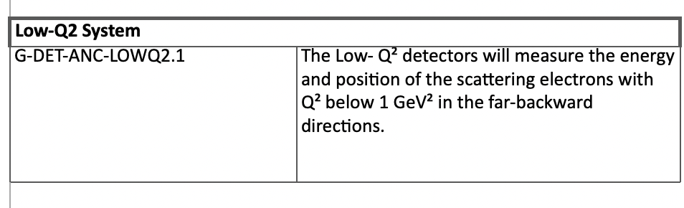
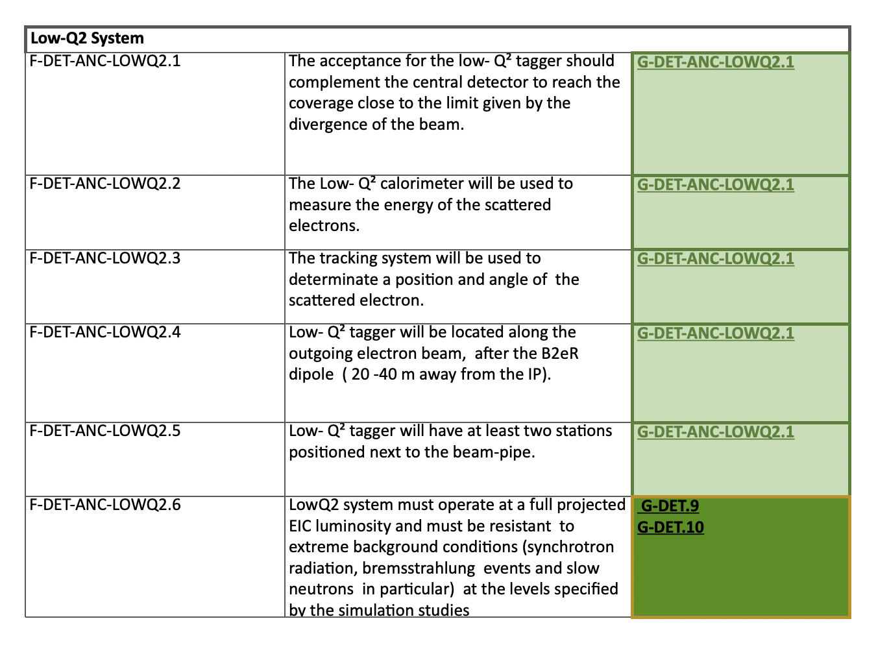
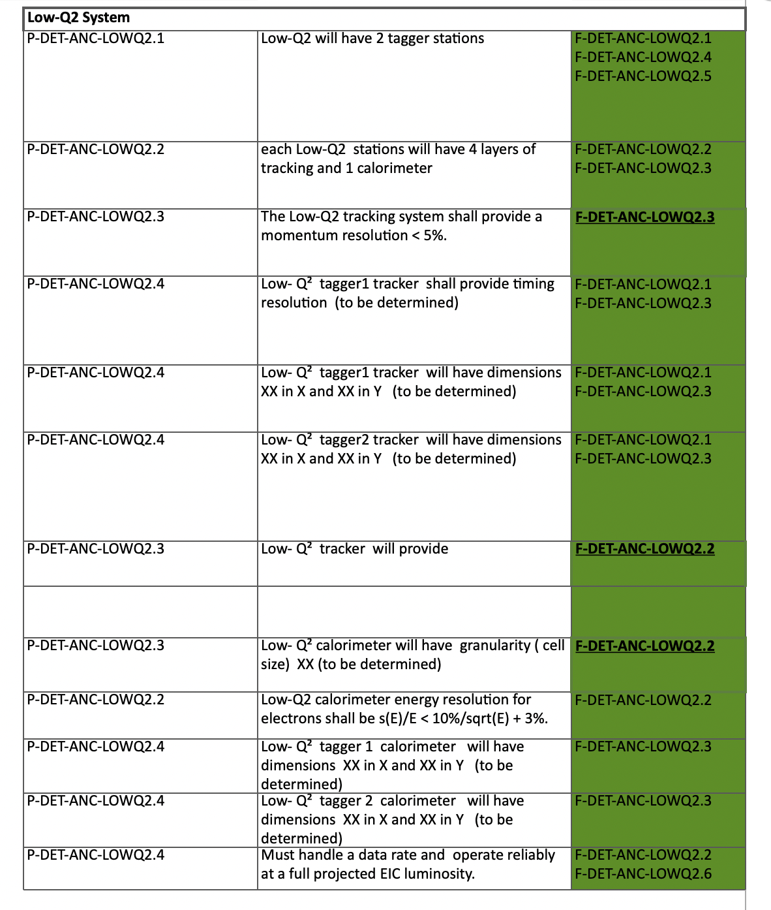
Requirements document - example for low-Q2
https://eic.jlab.org/Requirements/
GENERAL REQUIREMENTS
FUNCTIONAL REQUIREMENTS
PERFORMANCE REQUIREMENTS
=> Next step: detector specification

Slide 19
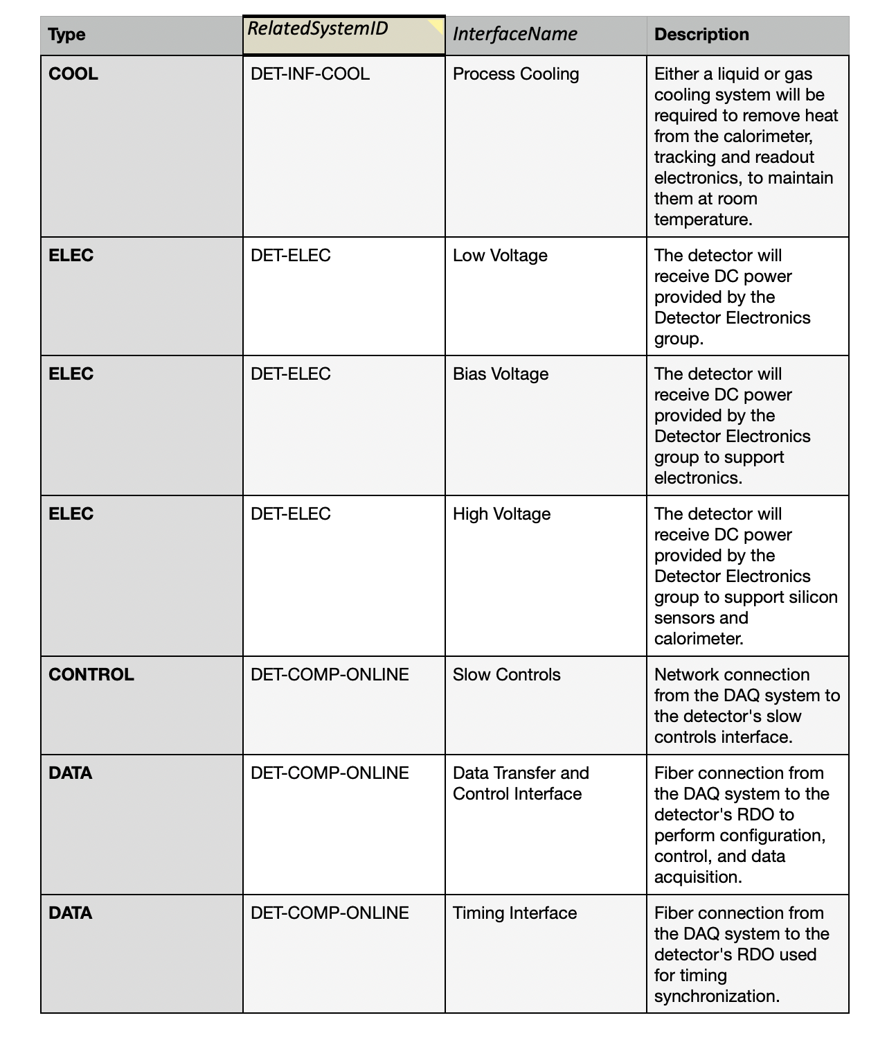
Interface documents - example for low-Q2
https://eic.jlab.org/Interfaces/Interfaces.html
Space constrains ( including interface with accelerator)
Power and Cooling needs
Data Acquisition ( fibers, clock/synchronization, slow controls )

Slide 20
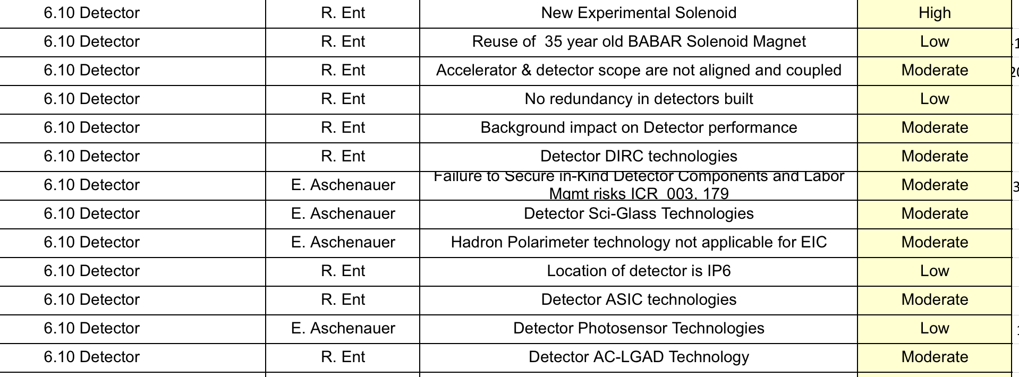
Risks
Keep IR and detector design integrated. Develop interface control documents.
Maintain strong communication with accelerator design teams developing hardware that could impact or mitigate backgrounds, e.g. collimator design, beam-pipe and vacuum.
(background simulation -> Elke Aschenauer talk)

Slide 21
Quality Assurance
During the engineering design phase:
considering to production of mockups and engineering test articles to insure the proper functionality and quality.
Full-chain integration with DAQ at early stage.
Beam tests, etc.
During the production and testing:
developing a document with a detailed steps of production and test procedures
production yield control, noise level characterization, light yield, and other parameters.
X-ray, source and beam tests
Hardware status will be included into the data-base.

Slide 22
Environment, safety, and health (ES&H)
We will be using the appropriate ES&H and Radiation Safety measures as dictated by the participating universities and labs(BNL/JLAB). All personnel working within the labs have to have the appropriate training to ensure adherence to these safety protocols.
Flammable materials: fibers
Use of proper storage, extinguishing system, keep away from the open fire or hot temperature.
Electrical/ Cooling/Trip safety:
For operation with HV and Cooling: we will ensure that these are mechanically secure and not a trip hazard, have proper warning signs and follow the lab procedures for electrical safety.
Operation nearby magnets/magnetic fields:
In coordination with accelerator team: flashing signs or lights indicate magnet is on and magnetic fields may be present. Posting signs.
Operation near the beam-pipe and vacuum:
we will require that anyone working near the far-forward/backward detectors to wears ear protection, and will post signage to that effect.

Slide 23
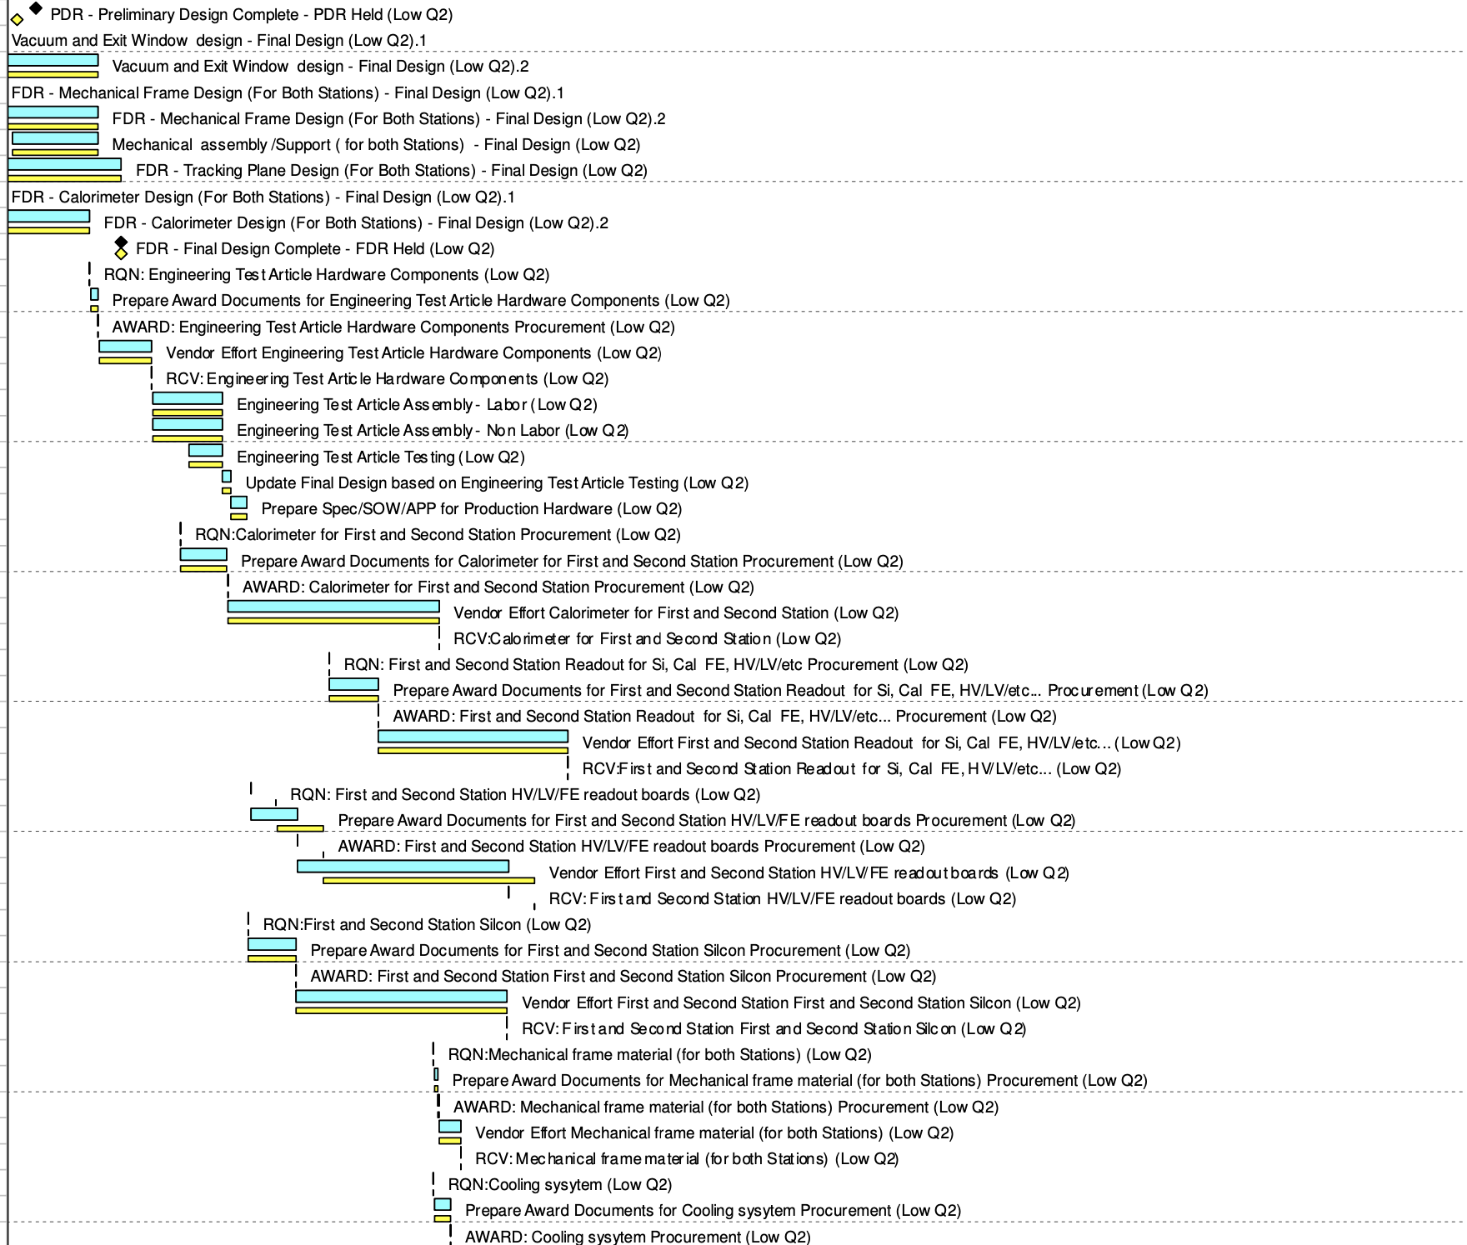
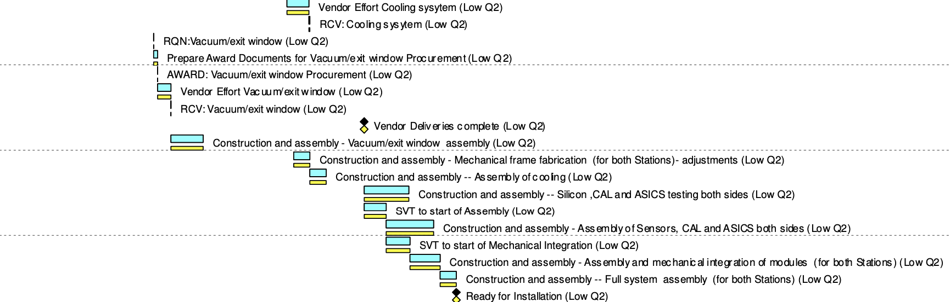
Timeline
now
Pre-OPS
Apr. 2031
CD3A
Nov
2023
CD3B
Oct
2024
CD2/3
Apr
2025
early
CD4
Oct 2032
CD4
Oct
2034
FF/FB review
Apr 2022
R&D, TDR,
engineering test articles
assembly and tests
FF/FB PDR
Feb 2024
FF/FB FDR
May 2025
Detailed schedule for each sub-detector component in P6.
Preliminary design review of ANC detectors in Feb 2024, next review is expecting in May 2025.
The installation of far-forward equipment is at later stage ( after accelerator commissioning ). All scattering chambers that house detectors will be installed from the start of pre-ops. The detector packages will be installed later, after achieving a stable operation of the accelerator.
Luminosity detectors has to be at start of pre-ops.

Slide 24
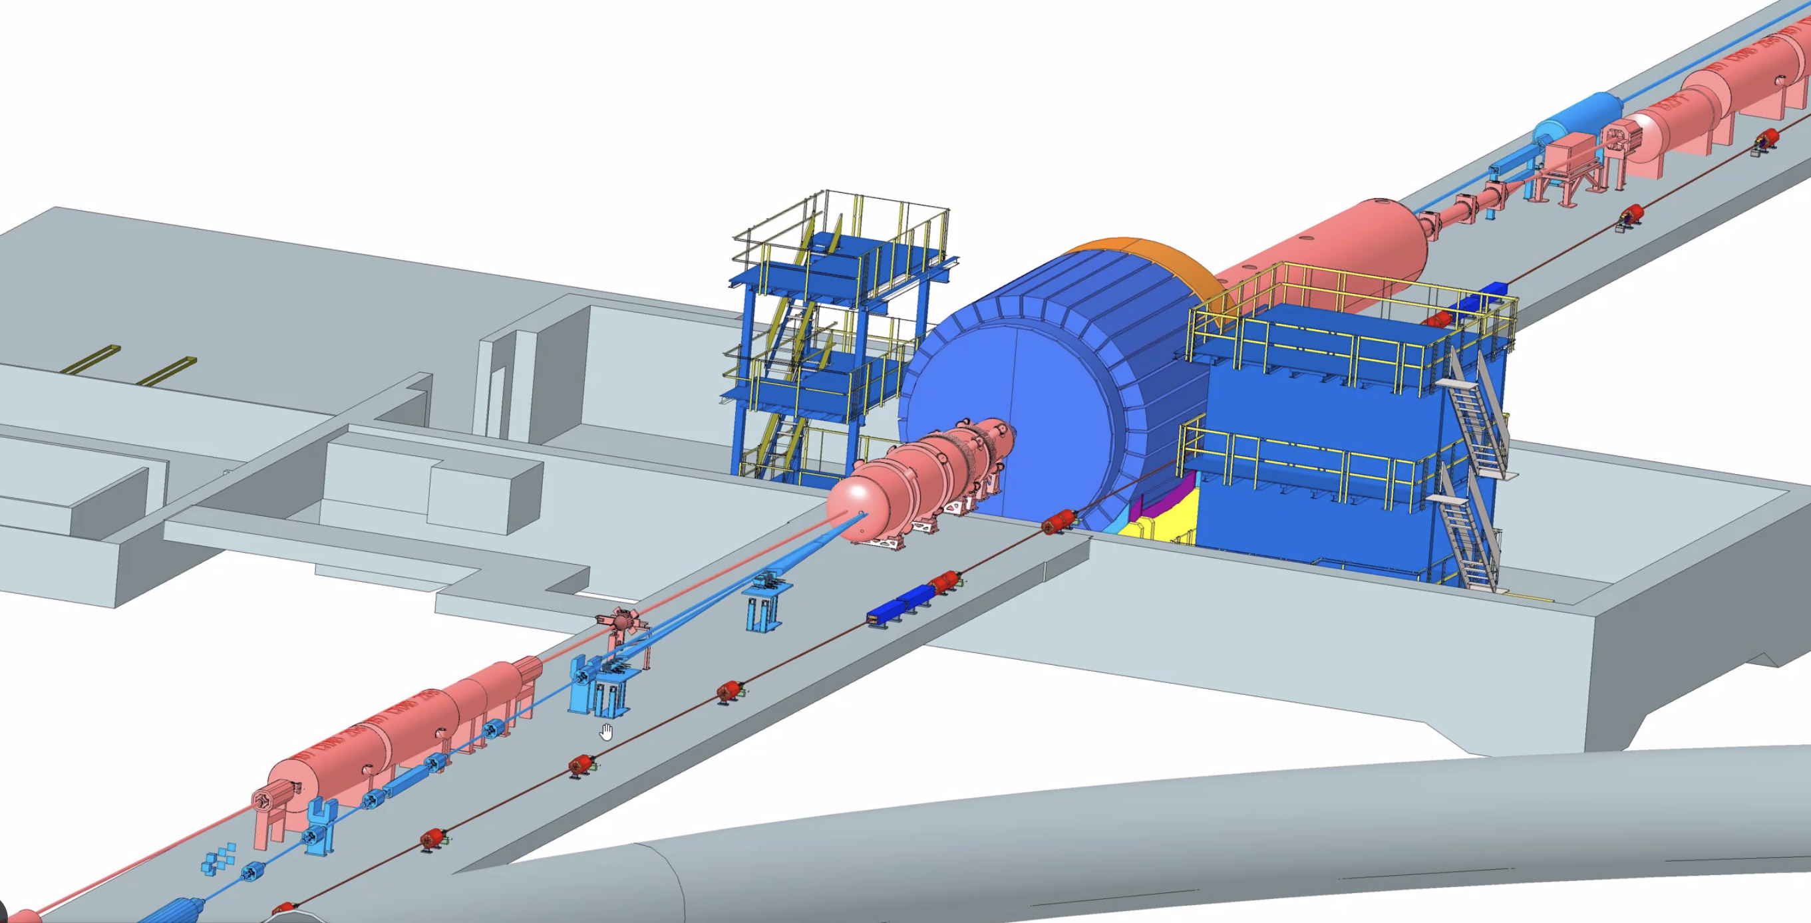
Summary
EIC physics goals drive the design and requirements of Far-forward and Far-backward regions.
The baseline far-forward/backward detectors satisfies the requirements.
ePIC collaboration is formed, detector optimization in FF/FB area is driven by the community efforts
All FF/FB detectors have full geometry implementation in Geant4/DD4HEP. Transport matrix and beam effects are included. Track and energy reconstructions have been developed.
Baseline requirements and interfaces are documented. Starting pre-TRD documentation.
Keeping a close contact with the EIC accelerator group to insure no negative impact.
Work on the detector support structure, services, detector installation and maintenance (CAD) is progressing well to reach CD2/3. No CD3A Long Lead Procurement items.
The installation of ancillary detectors needs to be synchronized with the installation of the accelerator equipment.

Slide 25
Backup

Slide 26
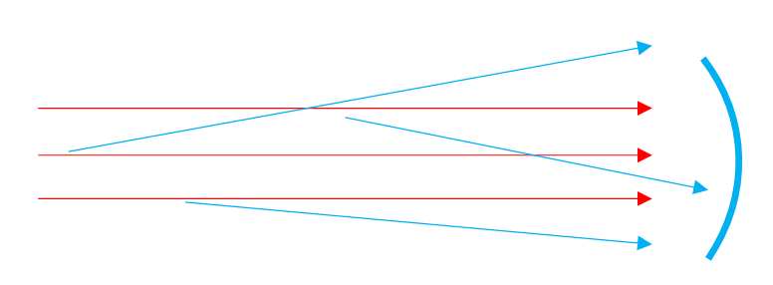
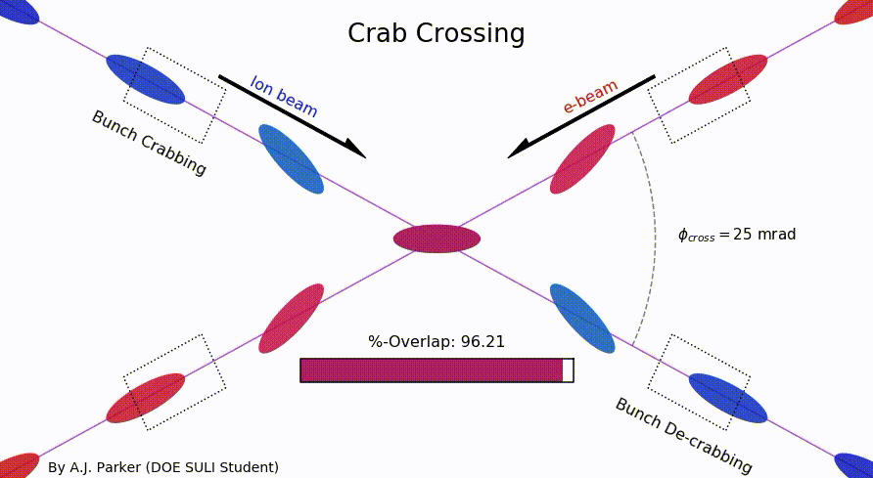
Software: Geant4 and reconstruction
- All FF/FB detectors have full geometry implementation in DD4HEP
To study an impact of support structure on a material budget - layers of material are included. Next step is to import realistic “CAD” model.
Accelerator beam elements are included in DD4HEP ( simplified version)
Magnetic fields for accelerator beam elements are included. We use only “official configuration” for primary beam energies (18x275, 10x100, 5x41)
A full B0 magnetic field map is available for experts and will be added to the main branch very soon.
Vacuum system/beam-pipe - preliminary design exist. Further optimization on ZDC performance will be performed.
Transport matrix is included and used for reconstruction of RPOTs/OMDs
ACTS track-reconstruction is used to reconstruct particle momentum for B0-tracker
- In addition, we are also probing alternative ways of reconstruction, using modern ML/ A.I. tools, including FPGA-based
- Crossing angle and beam effects are included into the simulation
Beam smearing effects are included”
Angular divergence ( uncorrectable)
Crab-rotation
Vertex smearing => timing
=> pt smearing

Slide 27
Charge Questions to be Addressed
Are the technical performance requirements appropriately defined and complete for this stage of the project?
Simulation and engineering effort towards integration
Are the plans for achieving detector performance and construction sufficiently developed and documented for the present phase of the project?
Default technology are selected,Requirements document, interface document, pre-TDR preparation
Are the current designs and plans for detectors and electronics readout likely to achieve the performance requirements with a low risk of cost increases, schedule delays, and technical problems?
Most of sub-components are based on the standard, well-developed technologies. For critical components (EICROC for AC-LGADs pixel) R&D is on-going . Alternative technologies and design have been evaluated.

Slide 28
Charge Questions to be Addressed
4. Are the fabrication and assembly plans for the various detector systems appropriately developed for the present phase of the project?
Quotes for most of detector components have been collected. Cost and schedule will be updated this year to reflect this. Working on the plan for assembly steps and Quality assurance test.
5. Are the plans for detector integration in the interaction region appropriately developed for the present phase of the project?
Good communication between accelerator, engineering and detector team. CAD layouts are shared between sub-divisions. Interface document is in place.
6. Have ES&H and QA considerations been adequately incorporated into the designs at their present stage?
Yes. A first draft version of ES&H and QA document exist and will be further developed and it will be a part of the in-kind contribution agreement.

Slide 29
Detector Non-DOE Interest & In-Kind
E.C. Aschenauer (BNL), R. Ent (JLab)
Entity | Interest and Important Facts
NSF | NSF-MSRI pre-proposal submitted by 10 US universities – aims at full scope of backward EM calorimetry (eECal). Armenia, Czech, France/IN2P3 as unfunded contributors. Invited to submit proposal. Final internal NSF review is ongoing.
CERN | MAPS sensor design developed by CERN/ITS-3 Group providing synergy with ALICE. Synergy of gaseous-based Cherenkov detectors and photon-sensors with ALICE & LHCb. Synergy of Forward AC-LGAD design with CMS endcap timing layer.
Armenia | Contributions, mainly labor to eECal and many EM calorimetry and particle id detectors component tests.
Canada | EIC included in 2022 Canadian Subatomic Physics Long-Range Plan; Interested in Compton Polarimetry, Barrel Electromagnetic Calorimetry and Software
China | Interested in Forward EM Calorimeter – working on NSF-China proposal.
Czech | Working with funding agency; Interested in eECal (PbWO4 crystals and glass) and Silicon
France/IRFU | Interested in MPGD/racking, electronics. Provided in-kind contributions to SC magnet design and interested to continue labor oversight during magnet construction.
France/IN2P3 | International contribution to backward EM calorimetry (including in-kind design) and to readout electronics (two ASICs for AC-LGAD detectors and Calorimetry). IRFU & IN2P3 discussing together for higher-level contributions.
India | Consortium is working with Funding agency; Interested in detector software (non-project scientific contribution), contributions to DAQ/slow controls. Investigating further hardware contributions (including possible links with Si groups and plants).
Italy/INFN | Aims at major scope of forward particle identification detector (dRICH), at (part of) the Si/MAPS tracker scope, and at photo-sensor contributions as well as contributions to the μRwell. tracker. Further investigating possible interest in EIC detector magnet scope.
Israel | B0 Detectors (Si tracking and PbWO4)
Japan | Interested in a US-Japan agreement; Aims at full scope of Zero-Degree Calorimeter in collaboration with Taiwan/Korea. Pursuit of full scope of barrel AC-LGAD detector as EIC-Asia consortium. Contribution to DAQ/streaming.
Korea | Aims at major scope for fiber-based barrel EM calorimeter, Also work packages for barrel AC-LGAD and Si-based hadronic calorimetry for ZDC.as part of EIC-Asia consortium (includes also Japan,Taiwan), Collaboration on Si tracking detector.
Poland | Actively working with ministry/funding agency; Interested in detectors along the beam line (luminosity detector, Roman Pots)
Taiwan | Pursuit of full scope of barrel AC-LGAD as part of EIC-Asia consortium. LYSO-based EM calorimeter for ZDC, Also optical readout/fiber. Possible later interest in PCBs. Computing.
UK | STFC seed funding for UK detector R&D (3M£). Interest in Si/MAPS tracker, polarimetry and detectors along the beams (Low-Q2/TimePix). Follow-up STFC/UKRI request for 5-7 years submitted early 2023 (includes accelerator part).

Slide 30
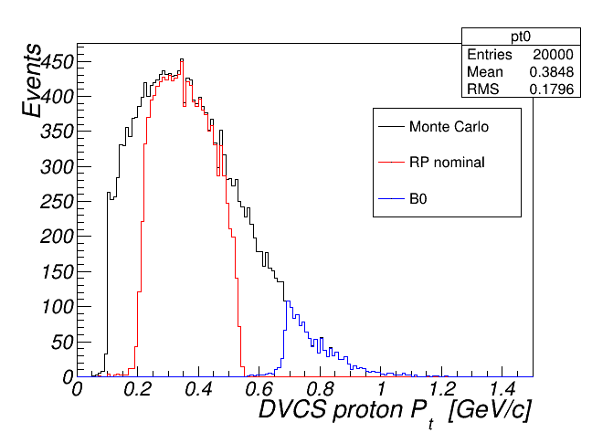
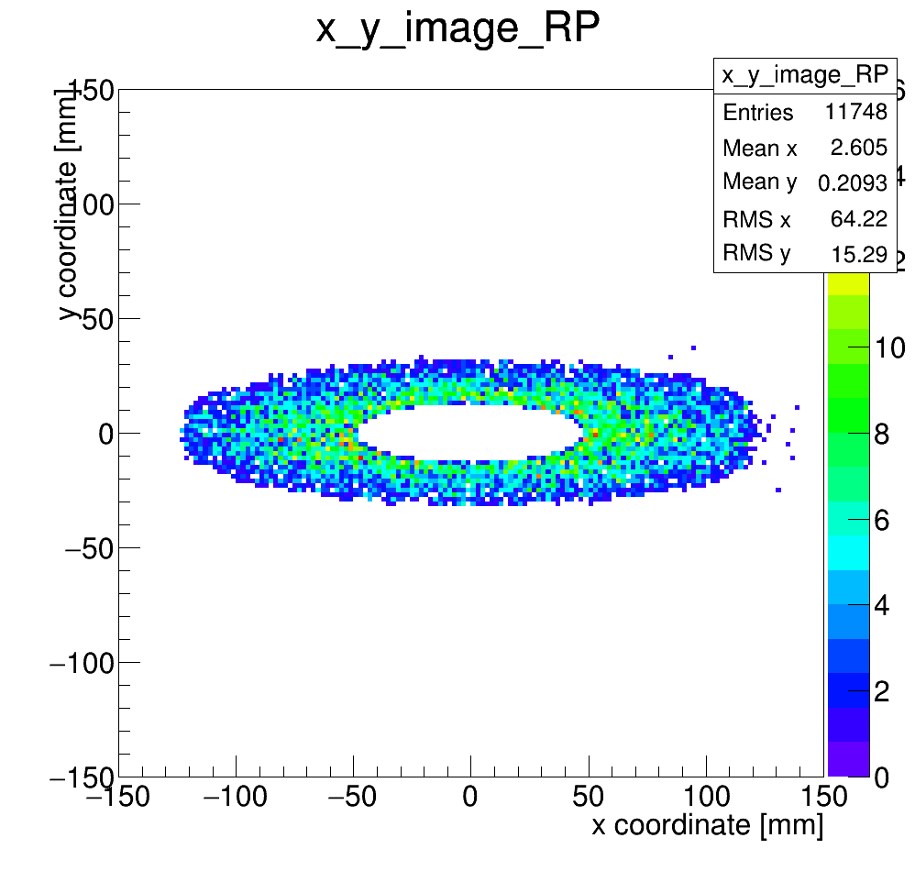
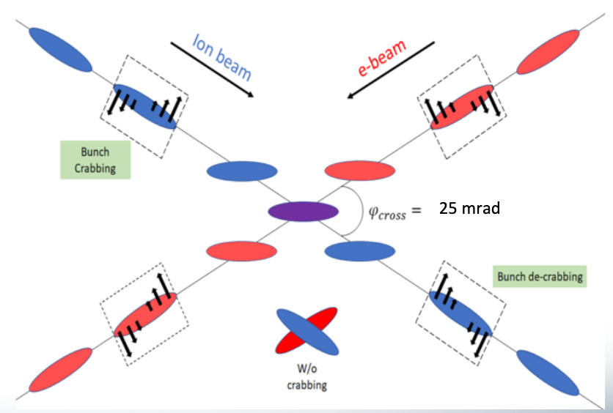
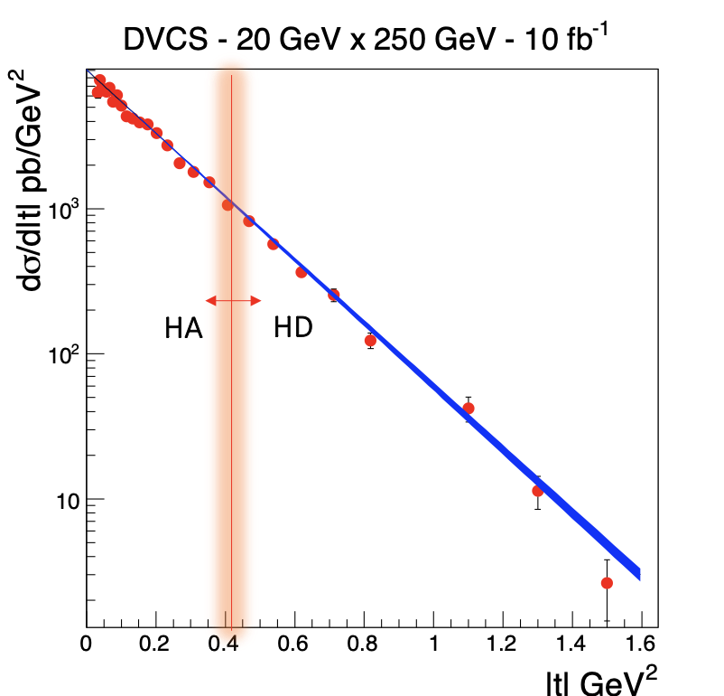

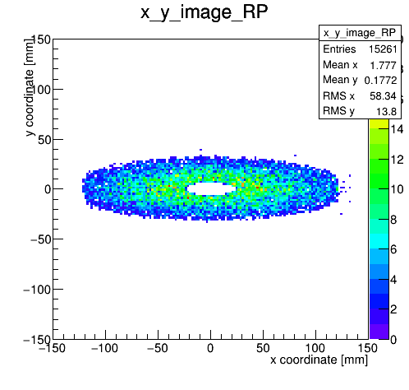
Example for 100 GeV DVCS protons
Beam parameters, effects and operation
Beam effects:
Angular divergence
Crab-rotation
Vertex smearing => timing
High Divergence
High Divergence
=> pt smearing
~25 cm
Operation modes:
Need both detector systems together here!
High divergence (HD):
smaller 𝛽∗ at IP, but bigger 𝛽(𝑧 = 30𝑚) ->
higher lumi., larger beam at RP
High acceptance (HA) :
larger 𝛽∗ at IP, smaller 𝛽(𝑧 = 30𝑚) ->
lower lumi., smaller beam at RP
High Acceptance
High Acceptance
Improves low $p_{t}$ acceptance.

Slide 31
Beam parameters, effects and operation

Slide 32
Recommendations from previous review
Ensure that WBS 6.06 continues to develop comprehensive dynamic aperture evaluations including effect of crab cavities, auxiliary components and imperfections to demonstrate the requirements technical feasibility before CD-2.
All beam effects are included into the simulation of FF/FB detectors. The dynamic aperture evaluation is ongoing by the accelerator team
Fast track the engineering design of B0 and Roman Pots, before CD2.
The engineering design of B0 and RPOTs are ongoing . Waiting for feedback on the RPOT design from the vacuum team. RF calculations needs to be performed.
Develop and review the readout strategy.
In the process. Regular meetings with DAQ team to discuss number of channels, detector occupancy, background and synchronization.
Provide as soon as possible milestones towards technology choices for the detectors.
The default configuration is chosen. Value engineering on the technology choices are ongoing ( synergies with other sub-detectors). Preliminary design review is scheduled for mid Dec 2023.
Continue making system accessibility a priority in system and sub-system design.
The engineering design to improve integration and accessibility is ongoing.
Make sure that all collaborating institutes are familiar and on-board with the integration strategy and systems.
Weekly meetings to discuss engineering and integration aspects with JLAB/BNL designers, collaborating institutes
Consider the adoption of formal engineering and system management system such as PLM (Product Lifetime Management) and AM (Asset Management) early in the life of the EIC facility.
The project elected "Visure" to provide management and system tracking . Also using excel tables.
For future review, include an ESH&Q slide in every presentation. -> yes
Make sure you work with the Project to plan your Accelerator Readiness Reviews (ARR) well in advance. -> yes
Develop and review an overall project plan for Quality Assurance and Control. -> working on

