Slide 1
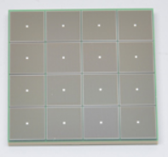
Electronics & DAQ WG – TDR Plans
Global Timing Unit (GTU)
Echelon 1
(BNL)
On Detector
ASIC
SMT BGA
Echelon 0
Echelon 1
(JLAB)
Name
Sensor
Adapter
Front End Board
(FEB)
Readout Board
(RDO)
Data Aggregation Module (DAM)
Echelon 0
Computing
Detector Groups
6.10.x
Electronics CAM
6.10.8
DAQ CAM
6.10.9
Joint
Institute
Electronics and DAQ WG
DSCs &
Integration
Software WG
SRO WG

Slide 2
Electronics & DAQ WG – TDR Plans
Global Timing Unit (GTU)
Echelon 1
(BNL)
On Detector
ASIC
SMT BGA
Echelon 0
Echelon 1
(JLAB)
Name
Sensor
Adapter
Front End Board
(FEB)
Readout Board
(RDO)
Data Aggregation Module (DAM)
Echelon 0
Computing
Detector Groups
Electronics CAM
6.10.8
DAQ CAM
6.10.9
Joint
Institute
Electronics and DAQ WG
DSCs &
Integration
Software WG
SRO WG

Slide 3
Electronics & DAQ WG – TDR Plans
Deliverables
System Design Documents
System Operation / Framework
Data volumes
Requirements
Basis of Estimates
Detailed Documentation
Specifications
Design Documents
Engineering Drawings / Readout Chain
Tests and results
Status
Components
ASICs
FEB
RDOs
DAM
GTU
EBDC
Echelon 0 computing
Echelon 1 computing (SRO)
Slow Controls

Slide 4
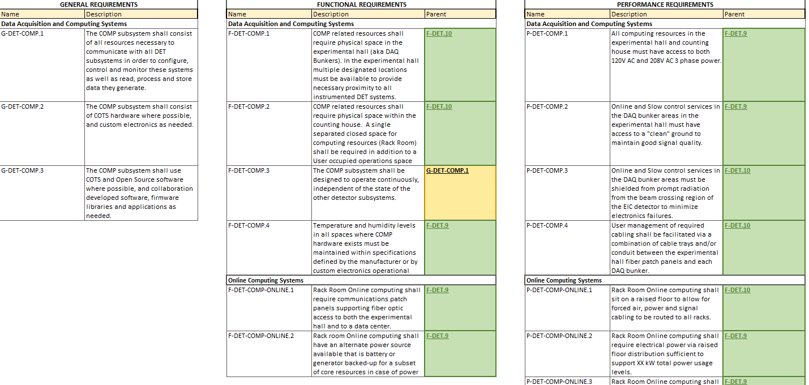
System Level Docs
Requirements Documents
Project level requirements documents exist
Need to extend these to the component level
This has been started in a series of overleaf documents
RDO Requirements
GTU Requirements*
DAM / Felix
Echelon 0 Compute Requirements*
Protocol Requirements*
Finish Initial Drafts March 15th
Get buy in…
Data Volumes
New data available
Projecting this information to DAQ level components
End of February, with some caveats…
Compile detailed list of components
What plugs into what! Ensure that nothing is missing
Another round of “readout chain discussions”. Do we understand envelopes, and locations of each piece of electronics
Specification Documents
Implicit topic of most of our DAQ meetings
Push to document specific boards that are the furthest along
Document the status of sub-projects (prototypes/types & schedule for tests)

Slide 5
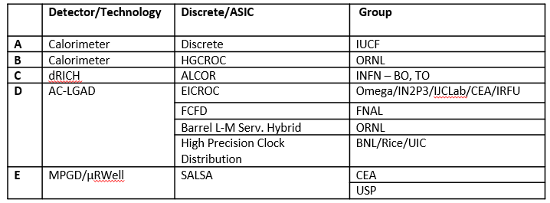
ASICs
ASICs
TDR to evolve from eRD109 reports
As organized through Fernando
Schedule for completion of ASIC developments is later than pre-TDR (and in many cases later than TDR)
Understood and implies that TDR will be snapshot
FEBs
Tied to the ASICs that they carry, so not designed in some cases
Data transfer requirements
Focus on needed components
Powering Schemes (DC/DC converters)
lpGBT / VTRX+
Electronics and DAQ need to be involved in the readout chain discussions, but the envelopes, cooling, etc… are expected to be discussed in the integration portions of the TDR

Slide 6
GTU / RDO
GTU Timing Measurements
Devkit development
Timing measurement
Finalize / writeup these measurements. do we have phase stability over time/power cycles?
Need distribution scheme to be designed
Need check-in with collider controls group
Will proceed with dedicated fiber possibility through at least TOF RDO prototype phase (summer ‘24)
Unification of RDO / FEB development
Document requirements, protocol specification
Radiation Tests for ASIC/FEB/RDO?
dRICH (late ‘24, early ‘25)
TOF (pre-prototype fabricated summer ’24, but no beam exposure yet defined?)
Bootstrap from known component evaluations

Slide 7
DAM / EBDC
DAM
Board is the FELIX
FLX184 in hand
FLX155 likely sufficient for ePIC and procure when available
Full documentation exists. Need to appropriately summarize it for TDR!
Getting experience handling board
Need procurement/fabrication plan
Firmware
Fiber Protocol specification
“software triggers”
Hardware configuration must be described in detail, several options exist but they each require physical resources on boards to be allocated
Have to write down details of buffering, latencies, and data transfers to demonstrate feasibility. Scheme can make potentially also make use of EBDC resources
Need some detailed description of potential algorithms
Detail fiber runs
EBDC
Fiber Protocol specification defines operation/bookkeeping
Basis of estimate update, specification of type of servers, layout in DAQ room

Slide 8
Echelon 0 / Echelon 1
Echelon-0 (DAQ) Computing
O(200) computers
Document computer roles, physical location, and “data center” requirements
Framework
CODA, rcdaq, SPADI, STAR tools
Time frame building accounting & data flow needs to be defined
Fiber Protocol specification
Structure of time frames
Diagram / Data flow simulation / Data flow prototype
Echelon-1 Computing (SRO WG)
Streaming DAQ and computing section of TDR
Streaming reconstruction
Produce example time frames with (noise + background + events identified by time)
Demonstrate tracking can be done
Define interface to streaming DAQ
Map calibration plans

Slide 9
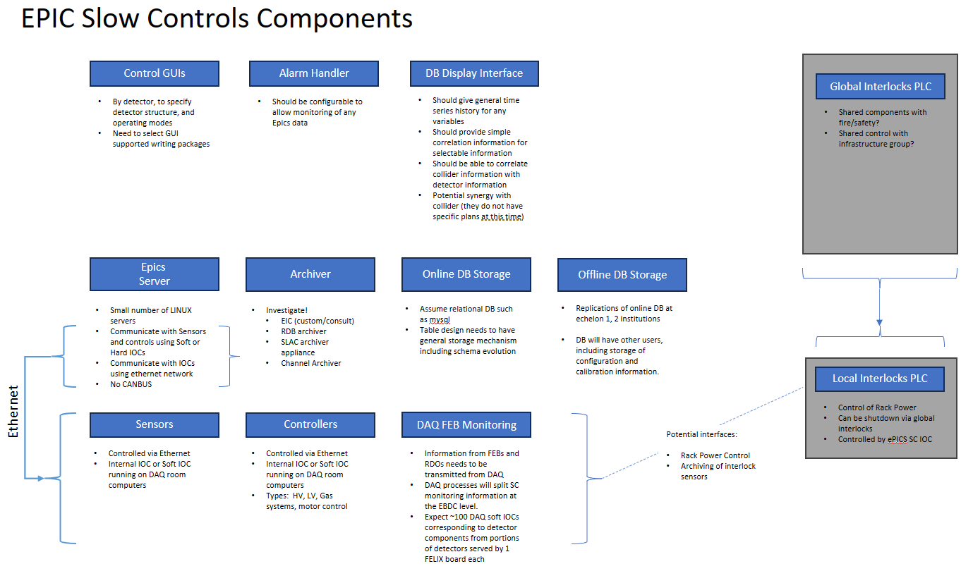
Slow Controls
Elements part of DAQ TDR sections:
Mediation of SC information from FEBS via DAQ IOCs
Configuration DBs
ePIC detector controls
Scope still uncertain regarding interlocks, power, etc….

