Slide 1
Hadron and Lepton Polarimetry at EIC A real technology challenge

Slide 2
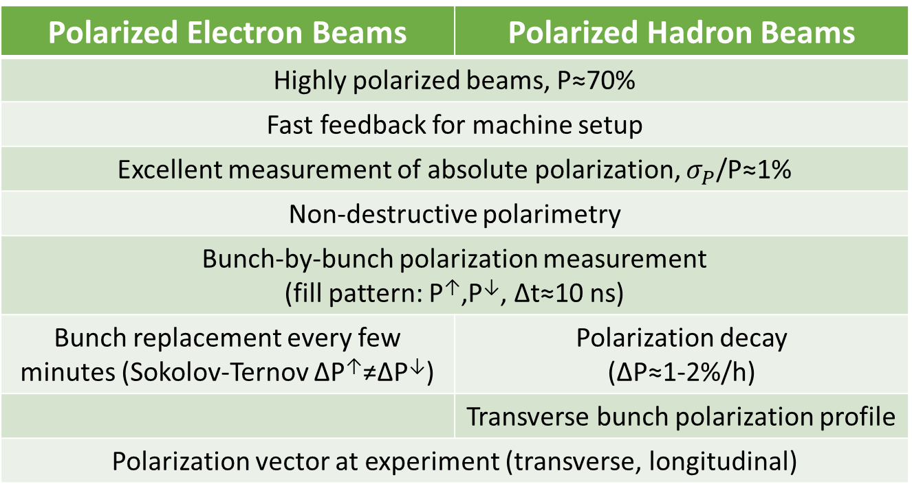
Requirements
Polarized Electron Beams | Polarized Hadron Beams
Highly polarized beams, P≈70%
Fast feedback for machine setup
Excellent measurement of absolute polarization, $σ_{P}$/P≈1%
Non-destructive polarimetry
Bunch-by-bunch polarization measurement (fill pattern: P↑,P↓, Δt≈10 ns)
Bunch replacement every few minutes (Sokolov-Ternov ΔP↑≠ΔP↓) | Polarization decay (ΔP≈1-2%/h)
 | Transverse bunch polarization profile
Polarization vector at experiment (transverse, longitudinal)
Physics requirement

Slide 3
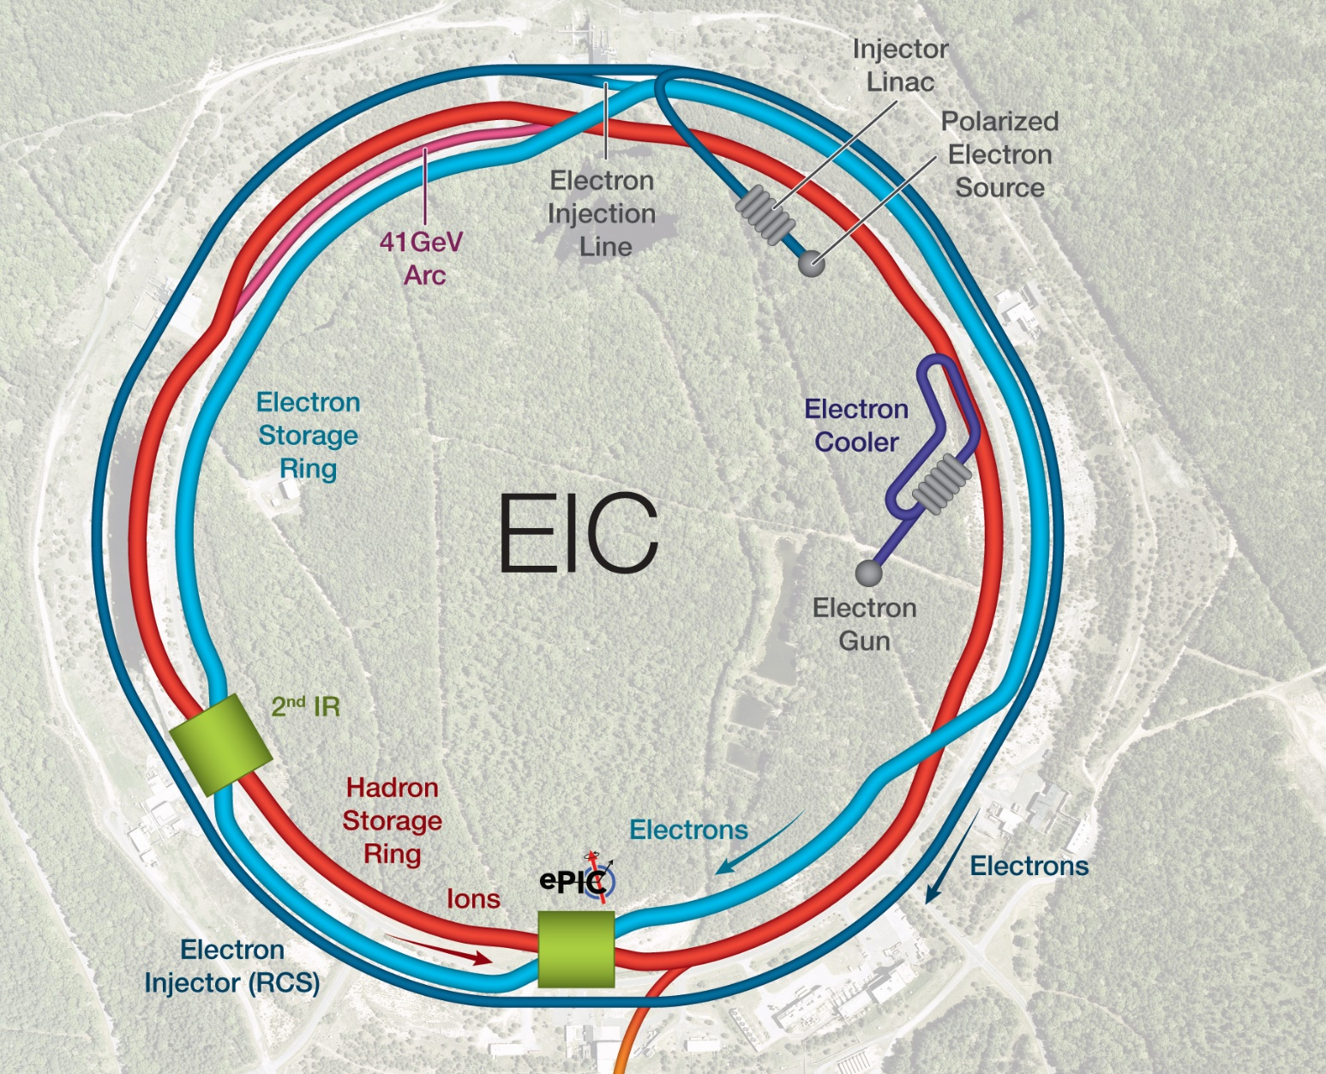

Scope
IR-6
Local polarimetry
Inside spin rotators
Fiber target for hadron polarization orientation
Compton backscattering for electron polarization
Electron Storage Ring
Rapid Cycling Synchrotron
IR-4
Hadron polarimetry
HJET for absolute polarization
Fiber target for time dependence and bunch profile
$$10 \text{ns}$$
Electron bunches are replaced every few seconds.
Hadron bunches are stored for many hours.
transverse
longitudinal

Slide 4
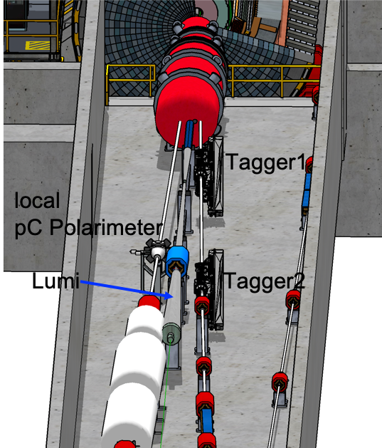
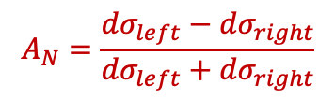

Hadron Polarimeter at IR-4
RCS
ESR
Sector 3
Sector 4
HSR Q4
D0 replacement dipole
HSR Triplet
3X HSR 98 MHz
10X Kickers
Hadron Storage Ring
Tagger location & drift space
needed for He-3 polarimetry
HJET
Carbon polarimeter
Principle:
Recoil particles from elastic scattering
$$A_{N}=\frac{{dσ}_{left}−{dσ}_{right}}{{dσ}_{left}+{dσ}_{right}}$$
Local IP-6 polarimeter
Spin rotators for longitudinal polarization → monitor degree of polarization
Crab cavities for increased luminosity in collision → monitor possible impact
Limited space in hall / straight section
Polarimeter in incoming hadron beam
H-Jet:
$$P_{Beam}=\frac{ε_{Beam}}{ε_{Target}}P_{Target}$$

Slide 5
Hadron Polarimeter Challenges
General:
Improvement to RHIC want to measure all spin components
H-Jet:
need new Si-sensors and readout fitting the EIC bunch structure
need to have a beam gas analyzer integrated in the system
Polarimetry for He-3
Updated DAQ and controls
p-C:
need to resolve the problem with the carbon targets
if the issue with the targets cannot be solved one needs to develop a completely new technology to measure
polarization, polarization decay over fill, polarization profiles
new Si-sensors and readout fitting the EIC bunch structure
potential synergy with AC-LGAD in far-forward and backward detectors

Slide 6
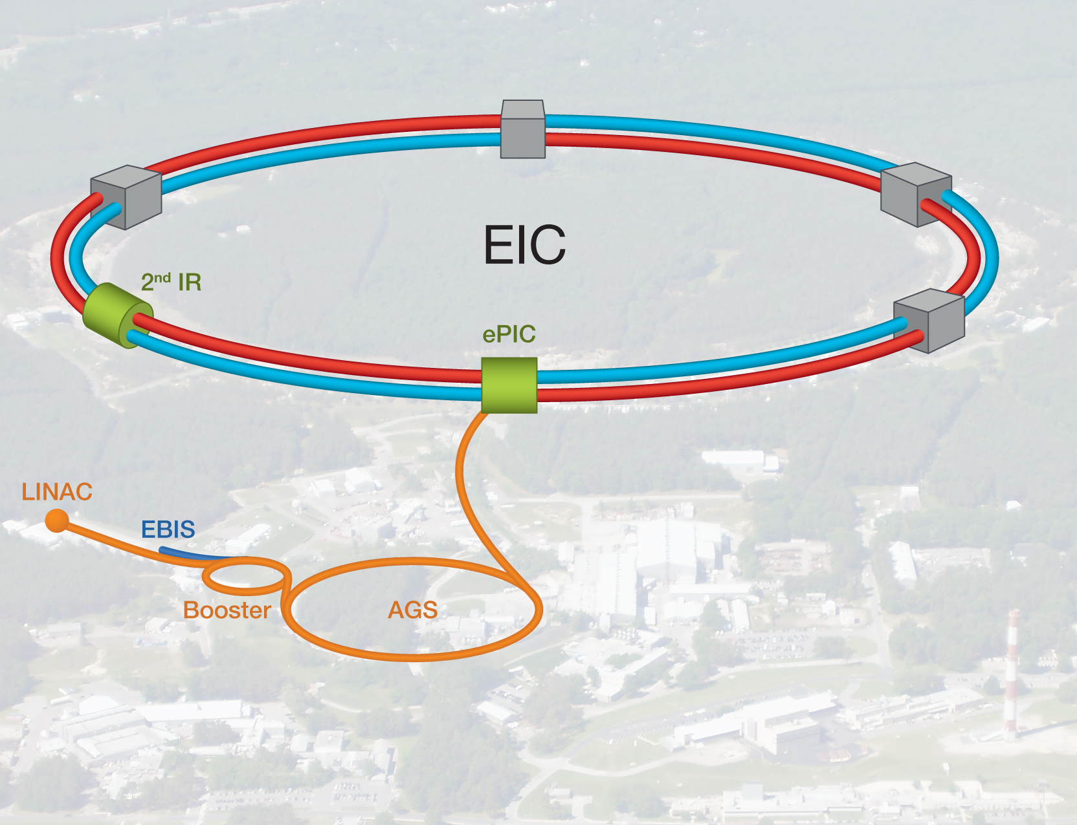
Electron Polarimetry at EIC
Electron polarization will be measured via Compton polarimetry at EIC
ESR Compton
→ Upstream of IP6, between IP and spin rotating solenoid
Will measure polarization for each bunch
Measure both transverse and longitudinal beam polarization
Detect backscattered photon and scattered electron
RCS Compton
Primarily for machine setup – less stringent precision requirements
Detect backscattered photons, multi-photon mode
Average over several bunches
Rapid Cycling Synchrotron Compton polarimeter
Electron Storage Ring Compton polarimeter

Slide 7
Rapid Cycling Synchrotron Compton
RCS properties
RCS accelerates electron bunches from 0.4 GeV to full beam energy (5-18 GeV)
Bunch frequency → 2 Hz
Bunch charge → up to 28 nA
Ramping time ~ 100 ms
Polarimetry challenges
Analyzing power often depends on beam energy
Low average current
Bunch lifetime is short
Compton polarimeter can also be used for measurement of polarization in RCS
Measurements will be averaged over several bunches – can tag accelerating bunches to get information on bunches at fixed energy
Requires measurement in multiphoton mode (many backscattered photons/electron bunch)
Bijan Bhandari - BNL
Laser IP
Photon detector

Slide 8
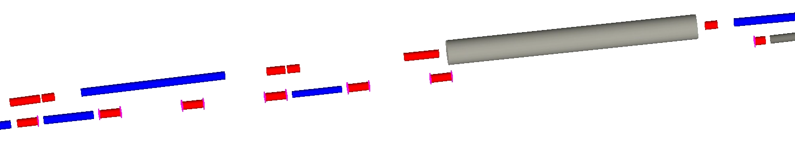
ESR Compton Polarimeter
Quads
Dipoles
Hadron beamline
electron beamline
Beam energy | P_{L} | P_{T}
5 GeV | 96.5% | 26.1%
10 GeV | 86.4% | 50.4%
18 GeV | 58.1% | 81.4%
laser
Compton IP (before quad)
Electron detector
Photon detector
ESR Compton will be upstream of detector IP
Key components:
Laser system → single-shot laser, pulsed at bunch frequency (25 or 100 MHz)
Position sensitive electron detector → placed after dipole and horizontally defocusing quad
Photon detector → calorimeter + position sensitive detector
At Compton interaction point, electrons have both longitudinal and transverse (horizontal) components
Longitudinal polarization measured via asymmetry as a function of backscattered photon/scattered electron energy
Transverse polarization from left-right asymmetry
Beam polarization will be fully longitudinal at detector IP, but accurate measurement of absolute polarization will require simultaneous measurement of P_{L} and P_{T} at Compton polarimeter

Slide 9
Summary
Both hadron and lepton polarimeters are small systems but challenging on technology and absolutely critical for the science program
→ current challenges can be super interesting for a hardware lovers to solve.
→ also a unique change to really learn a lot about accelerator science
Team right now is very small so there is plenty opportunity to get involved
How to get involved
Meeting: first Wednesday of the month at 3pm EDT
Mailing-list: eic-epol-hpol-l@lists.bnl.gov
subscribe at https://lists.bnl.gov/mailman/listinfo/eic-epol-hpol-l
Indigo: https://indico.bnl.gov/category/280/

