Slide 1
Semi-Coherent eU reconstruction
JiaJun Huang

Slide 2
Background
BeAGLE + FLUKA for eU collision and pre-fragment decay process
Semi-Coherent are events where the final nucleus is equal to the beam nucleus
Seems to occur mostly in Pythia process 91, 92
91: elastic vector meson production on a nucleon
92: single diffractive process on a nucleon
Semi-Coherent events approaches can be transferred to study general BeAGLE events
Check if semi-coherent events behave like coherent events (GW paradigm)
General events produce low-energy gammas for study of level structure of vaiouse nuclei
Probe how well does BeAGLE + FLUKA predicts photon spectrum at low energy

Slide 3
Simulation Steps
Generate BeAGLE events for eU 18 x 110 GeV/nucleon
BeAGLE output to afterburner for beam crossing and smear effects
Filter semi-coherent events
Run hepmc file through epic_craterlake.xml using DD4HEP
Uranium-238 fragment was not being bend correctly by magnets (changed to non-final state)
Reconstruction using EICRecon

Slide 4
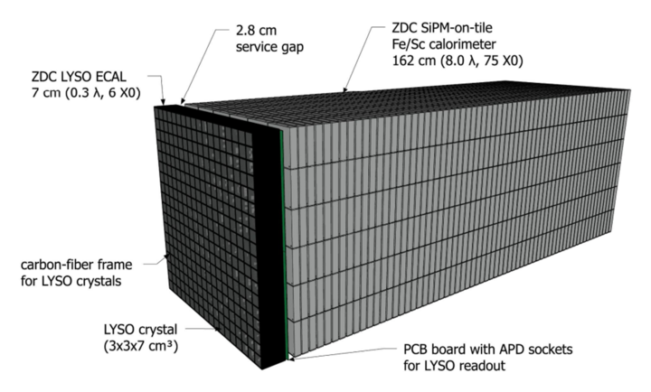
ZDC Structure

Slide 5
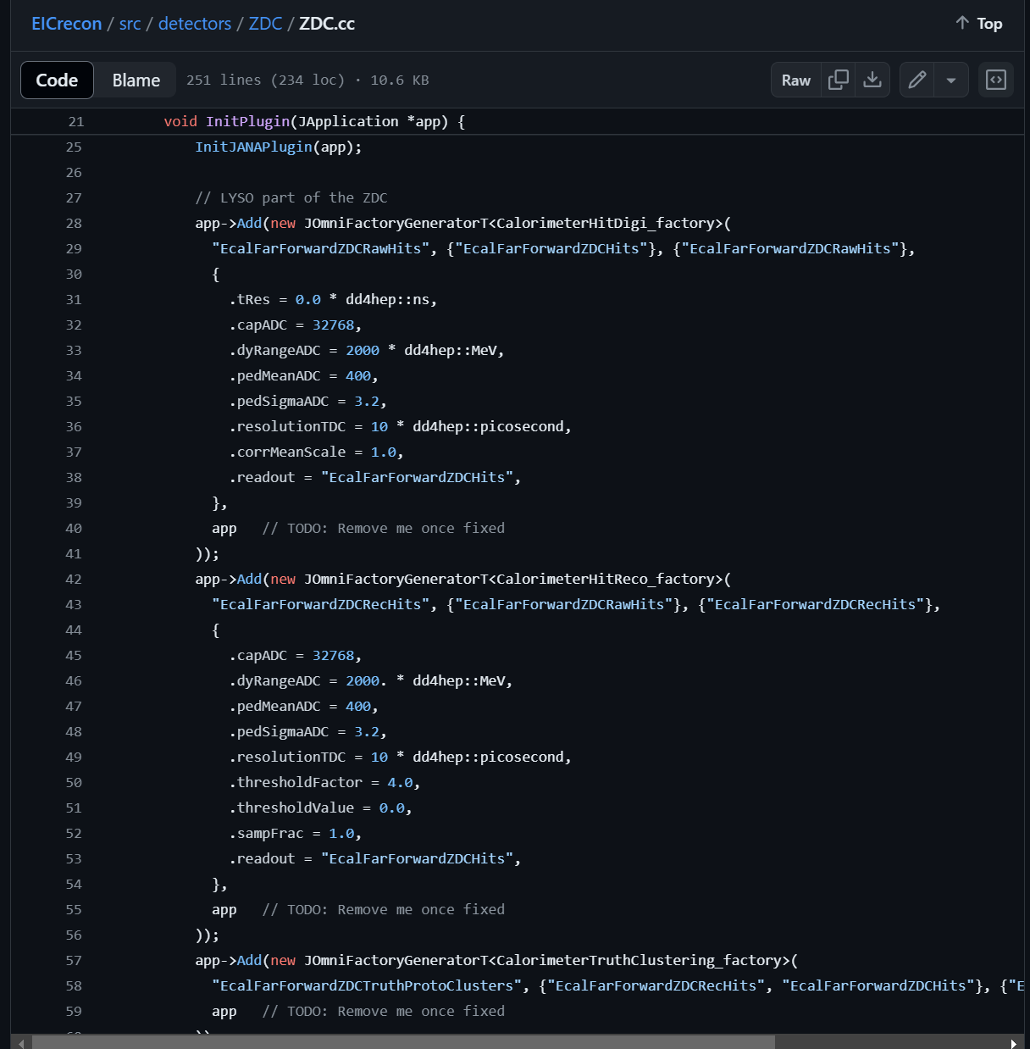
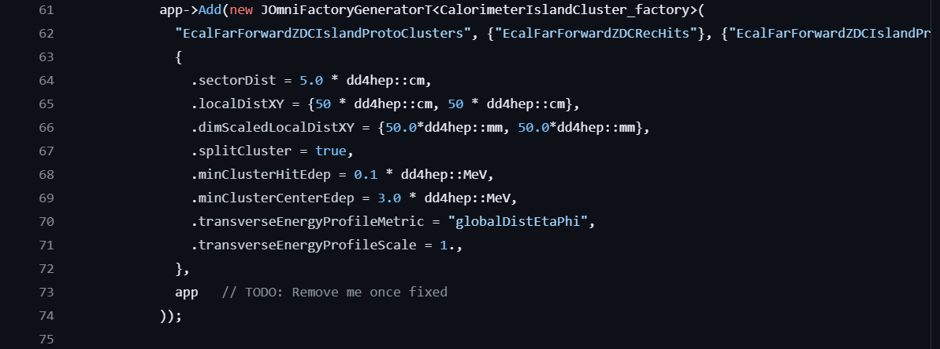
EICRecon Parameters
Current minimum clustering energy is at 3 MeV which is lower than the lowest 10 MeV gamma expected

Slide 6
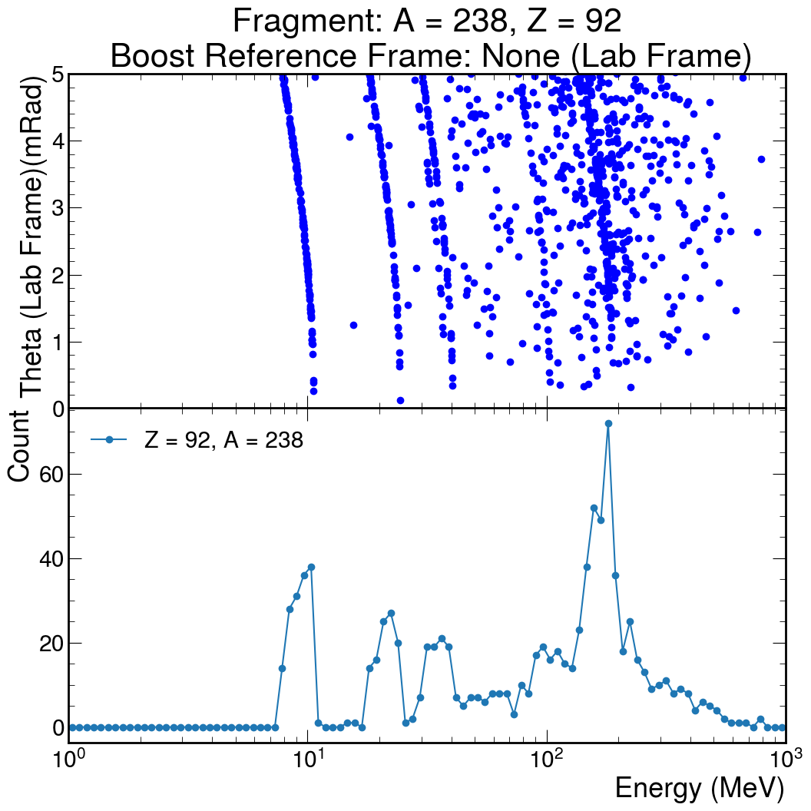
Photon Kinematics
Photon expected at the ZDC (mRad < 5)
e + U-238 → e + U-238* + X
U-238* -> U-238 + n*γ

Slide 7
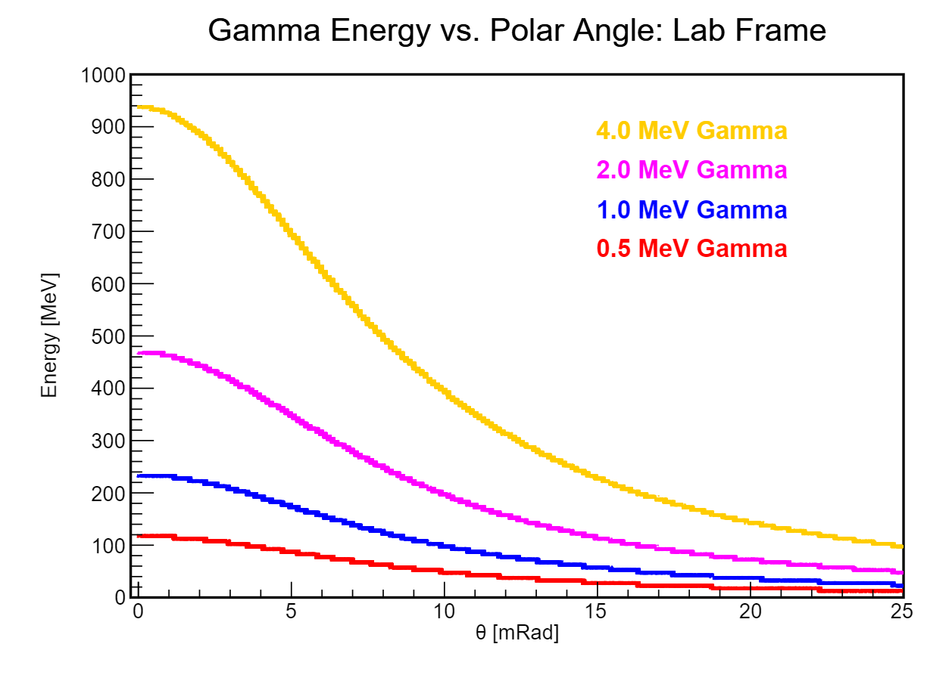
Expected Energy vs. ZDC Theta
Lorentz transformation into the beam rest frame

Slide 8
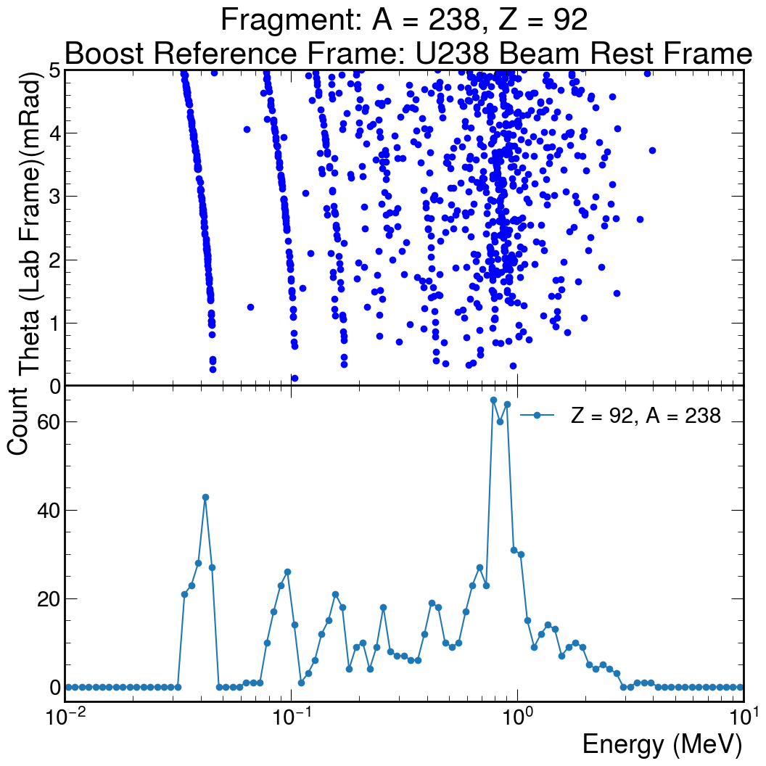
Gamma Spectrum

Slide 9
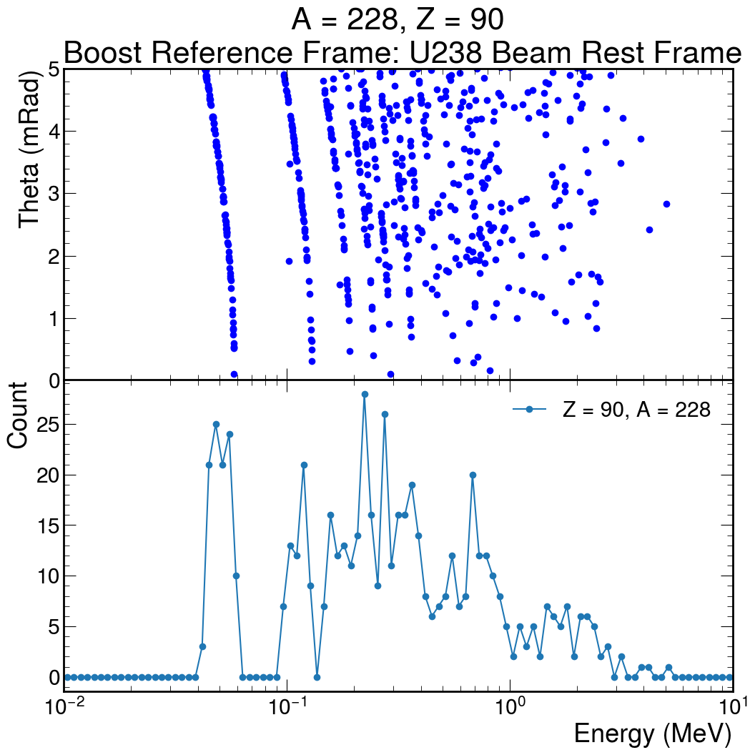
Evaporation Isotope
Thorium - 228
e + U-238 → e + Th-228* + X

Slide 10
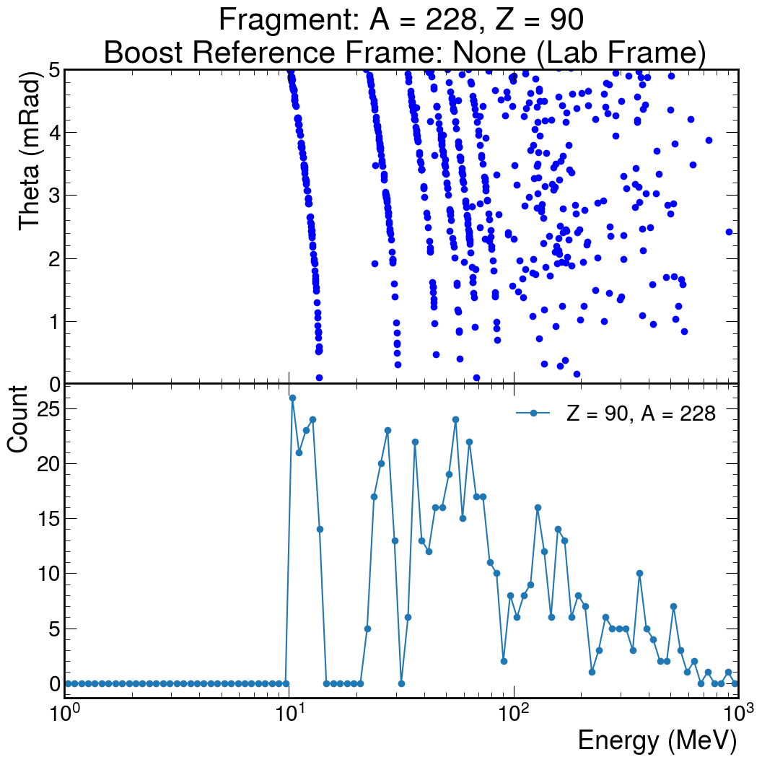
Lab Frame

Slide 11
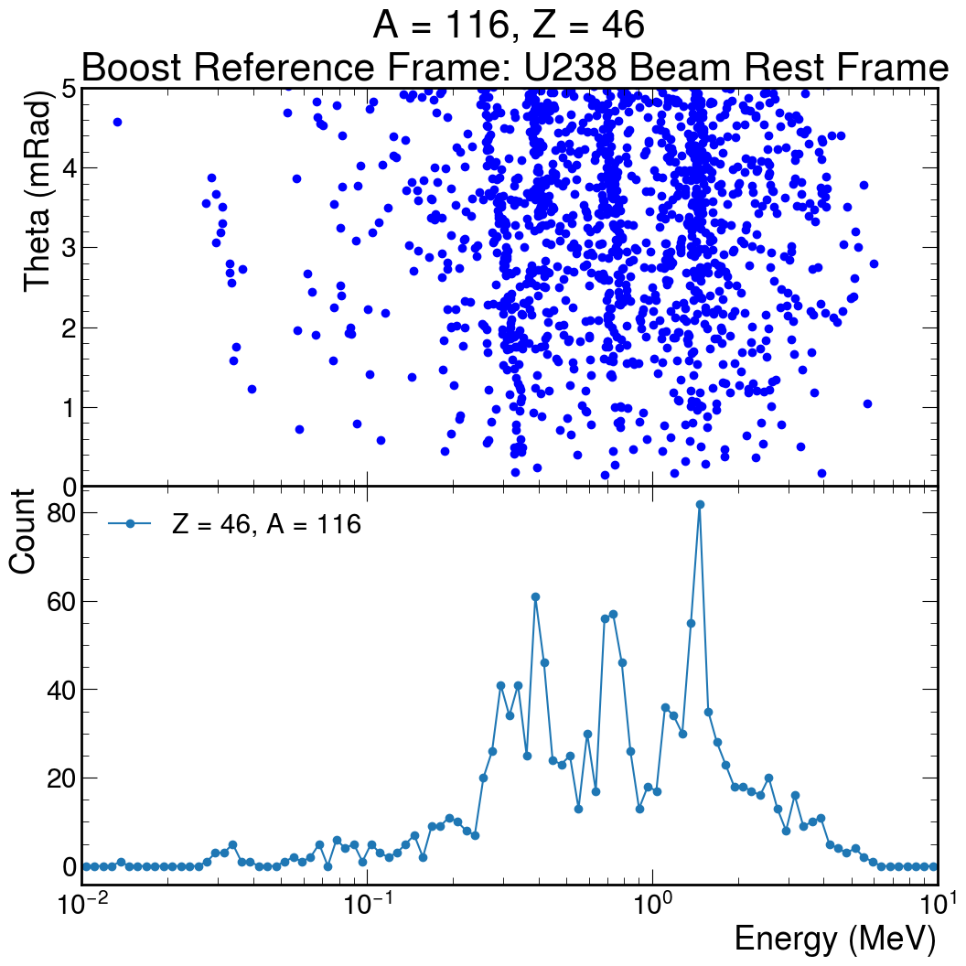
Fission Isotope - Palladium
e + U-238 → e + Pd-116* + X

Slide 12
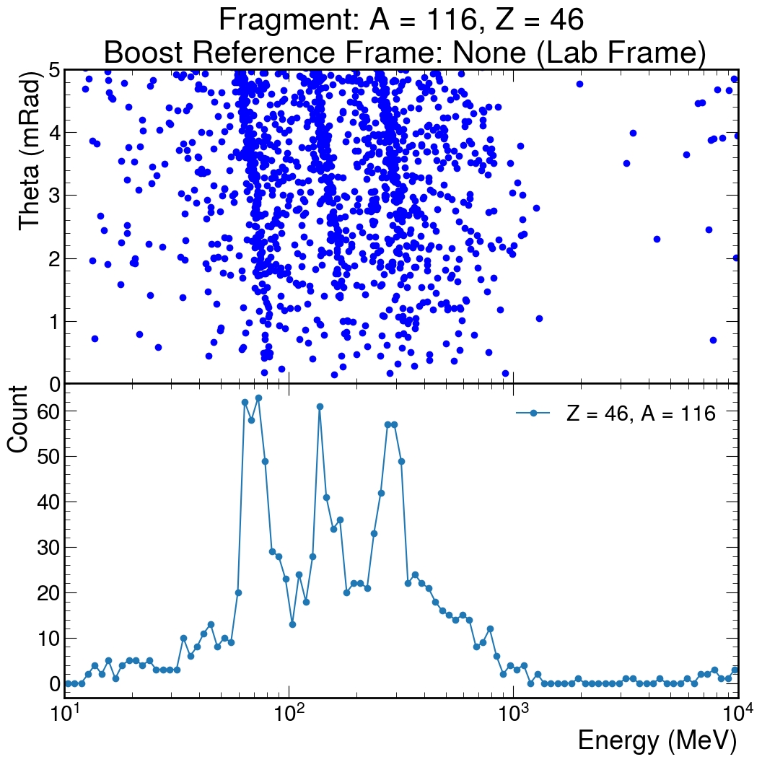
Lab Frame

Slide 13
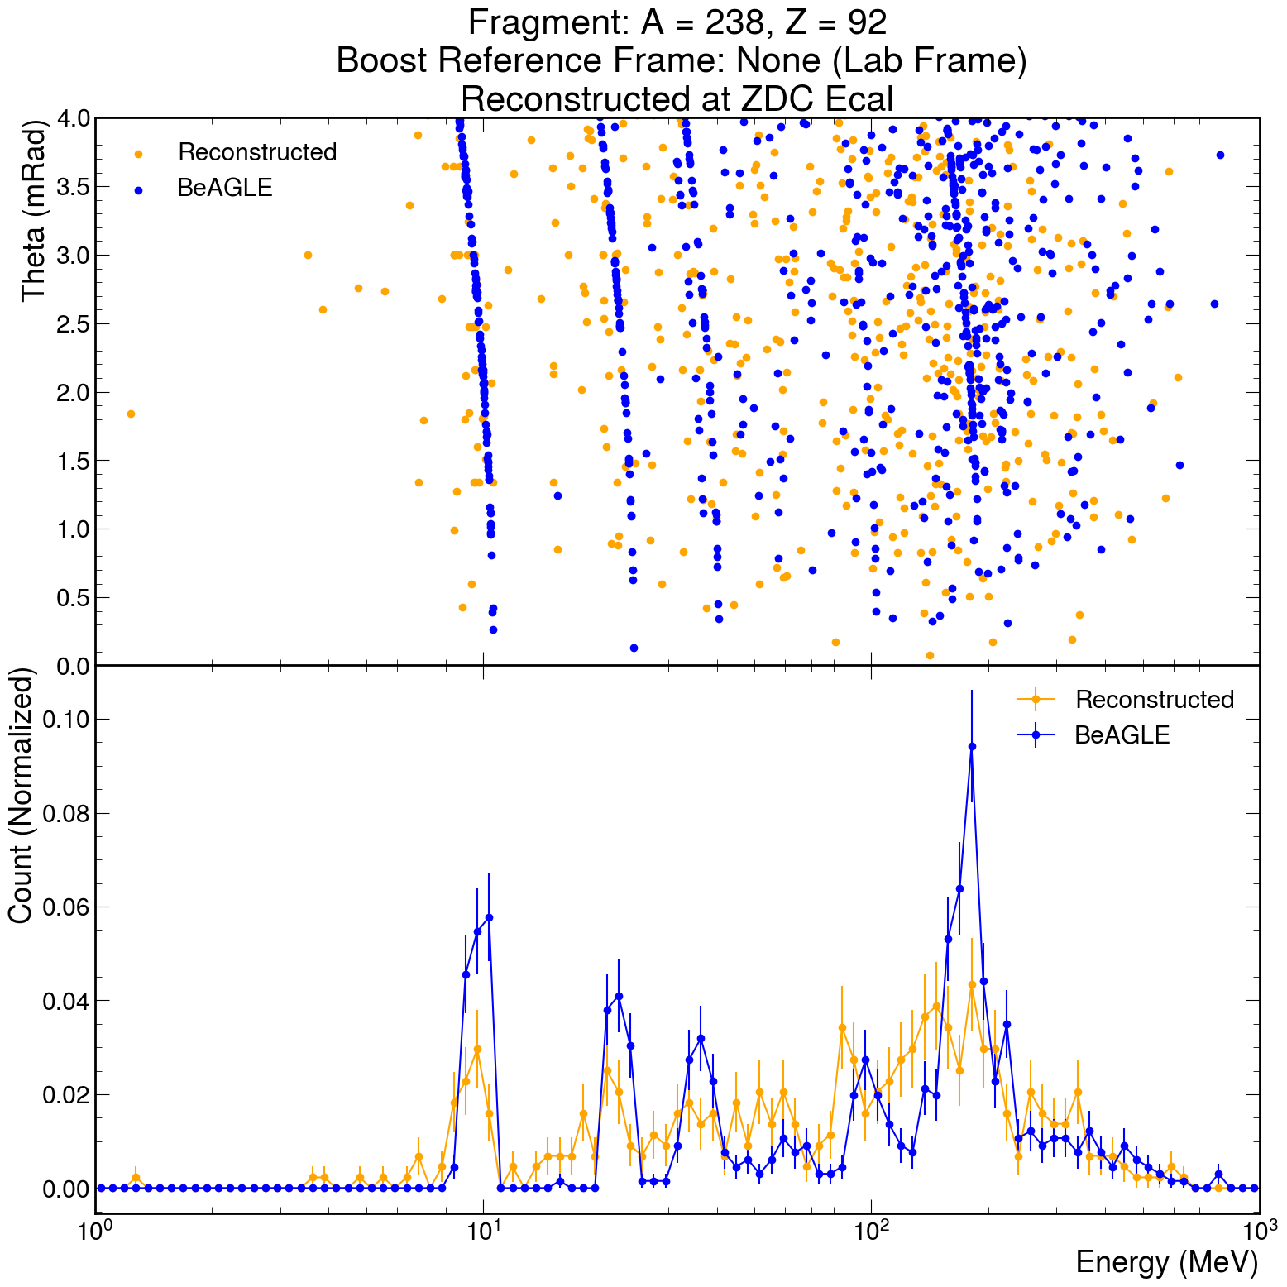
ZDC-LYSO Hit Reconstruction
DD4HEP simulation with filter coherent events. Plotting gamma kinematics at the ZDC and reconstruction efficiency

Slide 14
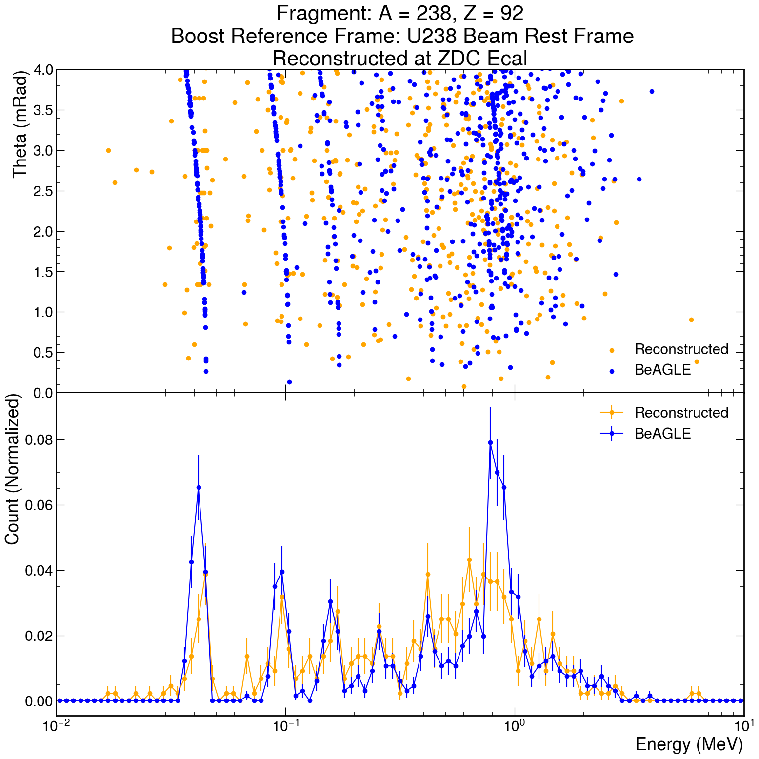
Boosted to Rest Frame

Slide 15
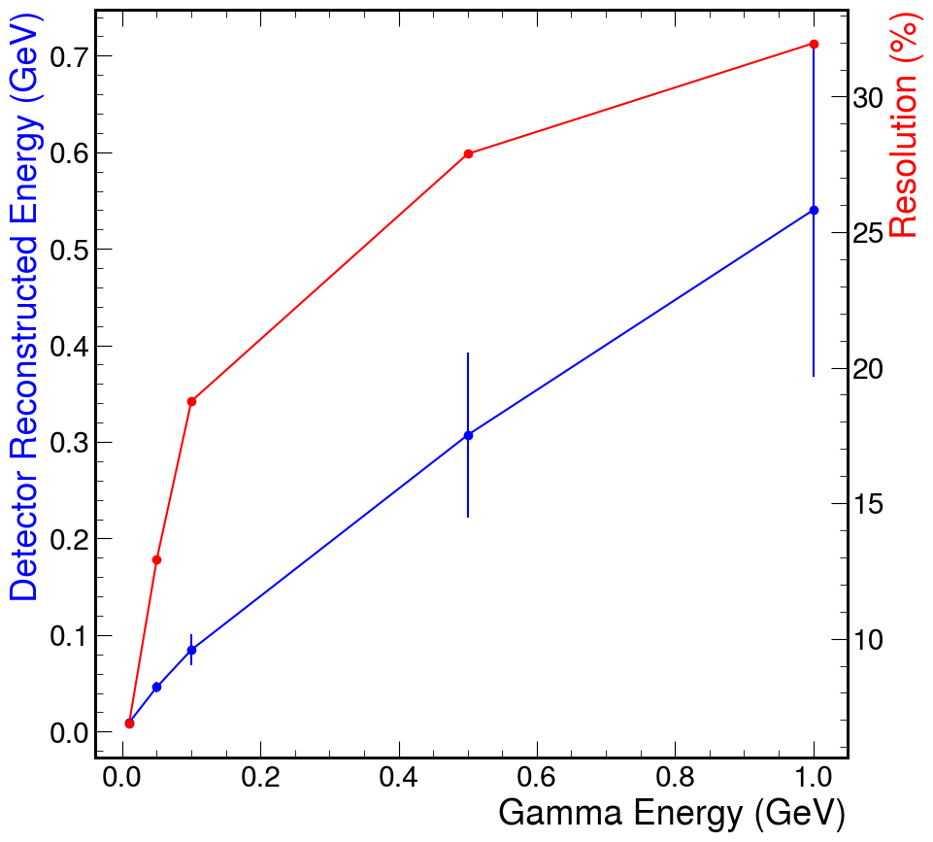
ZDC-LYSO Resolution
Single gamma simulation at ZDC with various energies.
Maximums around 1 GeV photon, able to detect 10 MeV photon

Slide 16
Backup

Slide 17
Commands Used
Detector: epic_craterlake.xml
Afterburner: abconv eU_filter.hepmc -p 2
Python: filtering coherent events and U-238 fragment
DD4HEP: npsim $Detector $Python.hepmc
EICRecon:
EcalFarForwardZDCRawHits
EcalFarForwardZDCRecHits
EcalFarForwardZDCClusters

