Slide 1
Soft Photons Update
eA Group Meeting
Zvi Citron, Michael Pitt, Eden Mautner
BGU RHI Group
9.7.2023

Slide 2
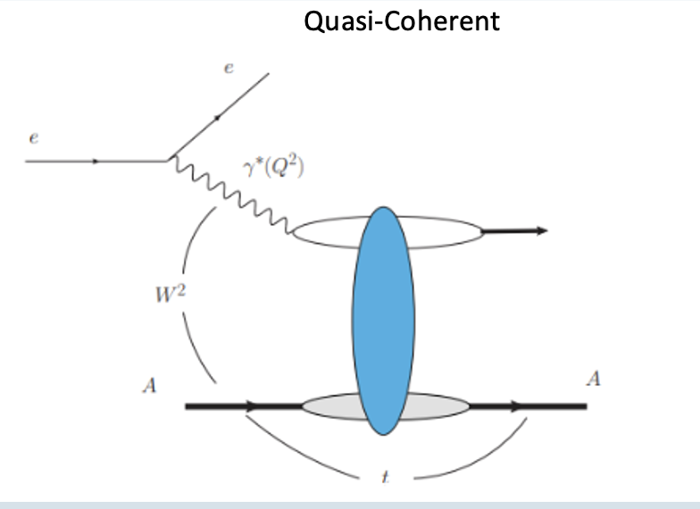
The Process
We are examining events in the form of $e+Pb →e^{′}+Pb+J/ψ+nγ$ , $n∈$ Whole Number. For convenience , we call these events “Quasi-Coherent” events.
“Quasi-Coherent”
$$J/ψ$$
+$nγ$

Slide 3
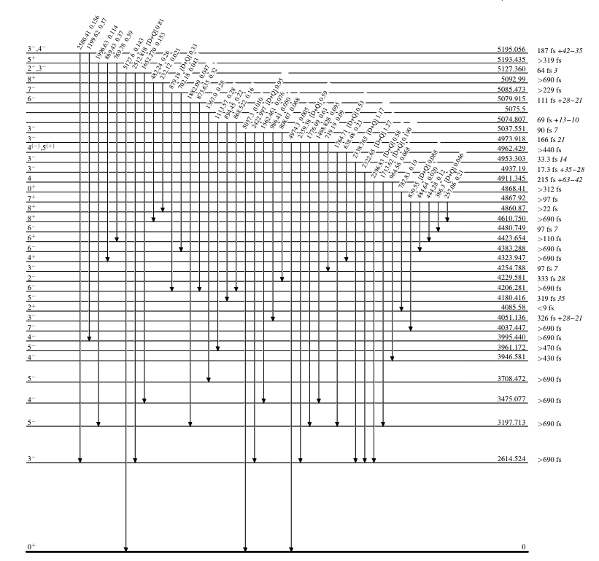
Introduction
“Quasi-Coherent”
$J/ψ$+$nγ$
Pb208 has a wide variety of excited states.
Lowest excited energy level: 2614.522 [KeV].
During each de-excitation process, at least one photon is emitted. The photons energy is equal to the energy gap between the different levels.
Usually, more than one photon is emitted in the de-excitation process due to a decay sequence through intermediate energy levels until the Pb208 ion reaches the ground level.
Since the energy difference between the lowest excited state to the ground is 2614.522 KeV, we expect this peak to appear in all type of quasi-coherent events.
For more info we can look at the NDCC website.

Slide 4
Our Simulation Data
We look at quasi-coherent events, simulated using BeAGLE event generator.
** We look at both decay channels of $J/ψ$ ($e^{+}e^{−}$ & $μ^{+}μ^{−}$).
Simulation Configurations:
$H_{beam energy}$= 275 GeV
$Z_{Pb}$ = 82
$A_{Pb}$= 208
Truth Level Analysis
Data from BeAGLE ($\sim 460K$) events
Geomtry Simulation (DDSIM)
Reconstruction using EICRECON
Detector + Reconstructed Level Analysis
Nucleon Energy (lab frame): ${ H}_{beam}∗\frac{Z_{Pb}}{A_{Pb}}=108.4$ GeV

Slide 5
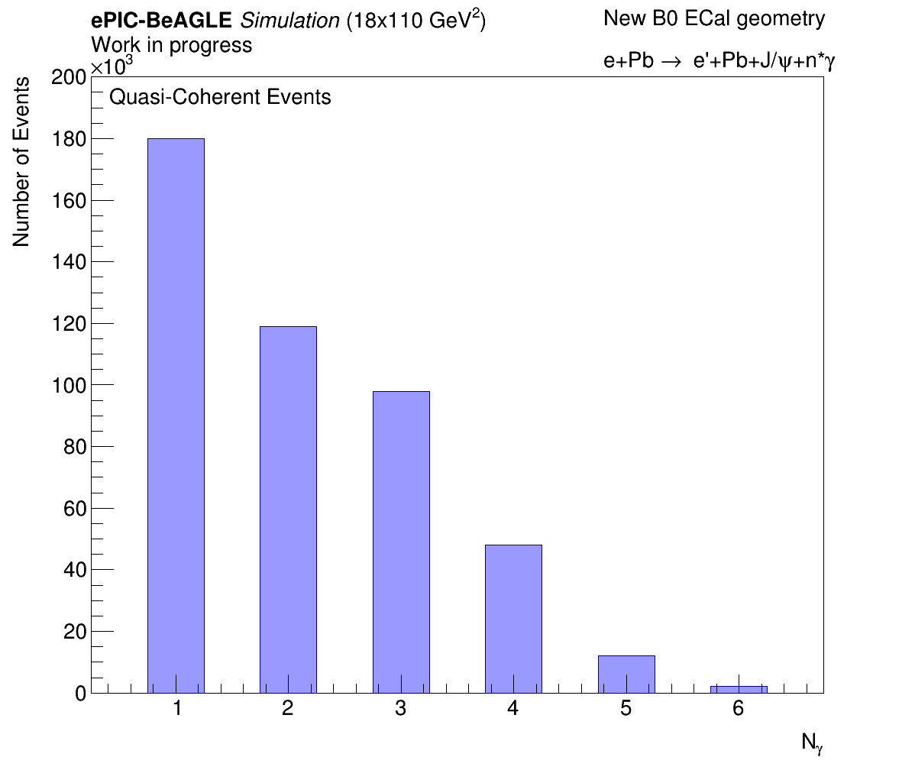
Photons Multiplicity
In total we analyzed $≈460$K Quasi-Coherent events. Number of photons per event distribution is shown below:

Slide 6
Boost to Pb restframe
The truth data is generated in the labframe.
We boost the generated photons to the Pb rest frame.
We look at the energy spectrum of the emitted photons.
When analyzing reconstructed events we boost the reconstructed 4-vector.

Slide 7
Definition – N Photon QC Event
In general, we will refer to a N photon event as an event that N photons were emitted in the deexcitation process.
As an example, let’s look at data of a 3-photon event. The photons energies after the boost:
1st Photon: $E_{γ_{1}}=\sim 1271$ [KeV]
2nd Photon: $E_{γ_{2}}=\sim 578$ [KeV]
3rd Photon: $E_{γ_{3}}=\sim 2613$ [KeV]
Energy level after excitation | Energy level after 1st emission | Energy level after 2nd emission | Energy level after 3rd emission
$\sim 4463$ [KeV] | $\sim 3192$ [KeV] | $\sim 2614$ [KeV] | $0$[KeV]
${ΔE}_{6^{+ }→ 5^{−} }=1271$ [KeV]
${ΔE}_{5^{− }→{ 3}^{−} }=578$ [KeV]
${ΔE}_{3^{− }→ 0 }=2613$ [KeV]
All the possible energy levels of Pb208 can be found in the NDCC website.

Slide 8
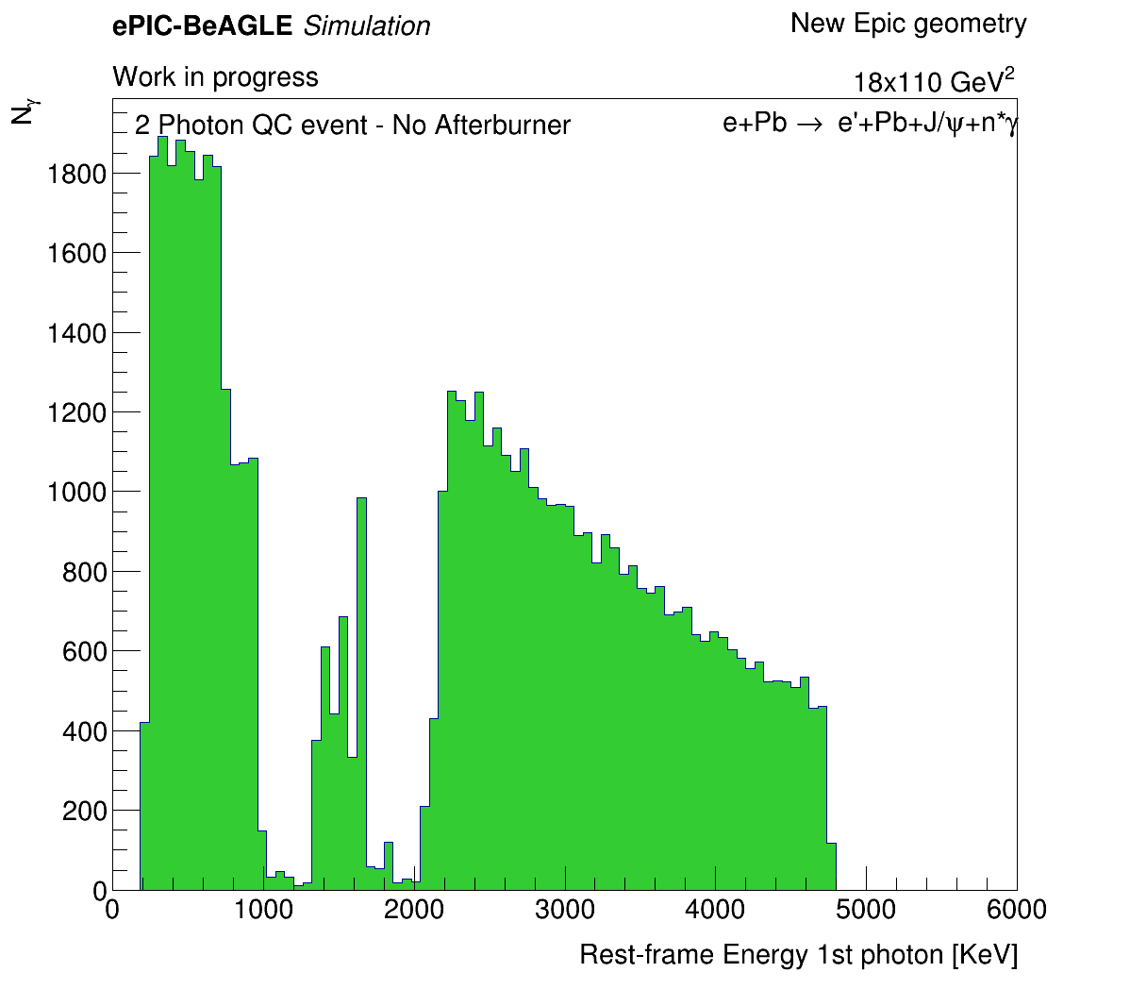
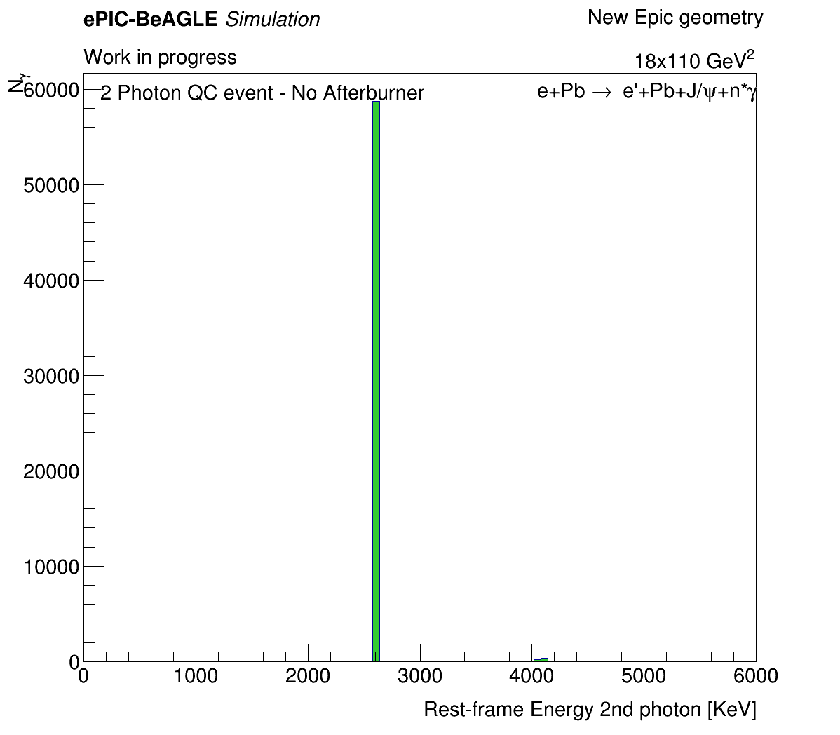
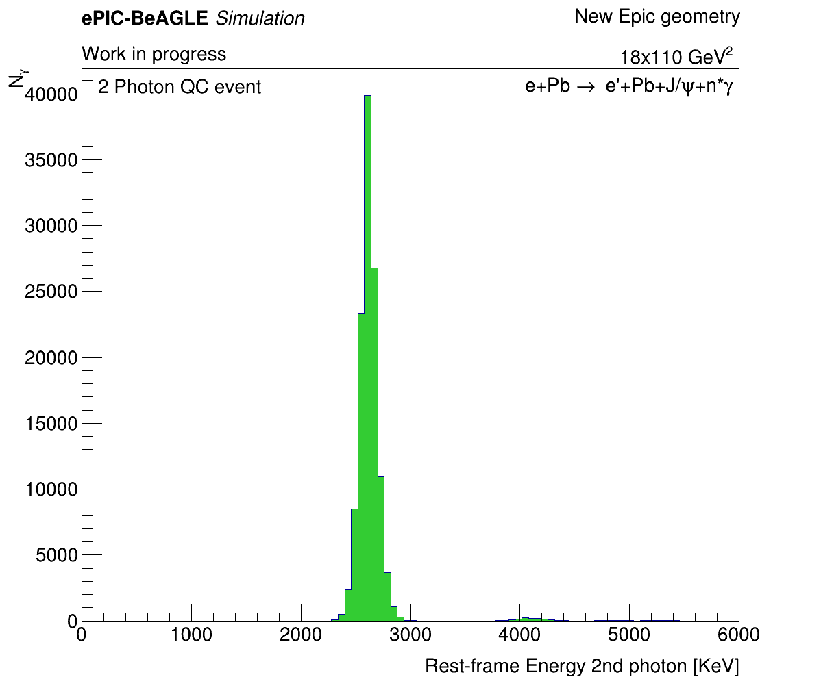
2 Photon Events – Truth data no afterburner
--- I select “1st ”and “2nd” photon just by the order they appear in the BeAGLE output.
$1^{st}$ photon:
$2^{nd}$ photon:
$2^{nd}$ photon with afterburner:
We see that the afterburner does not have any unintentional effects.

Slide 9
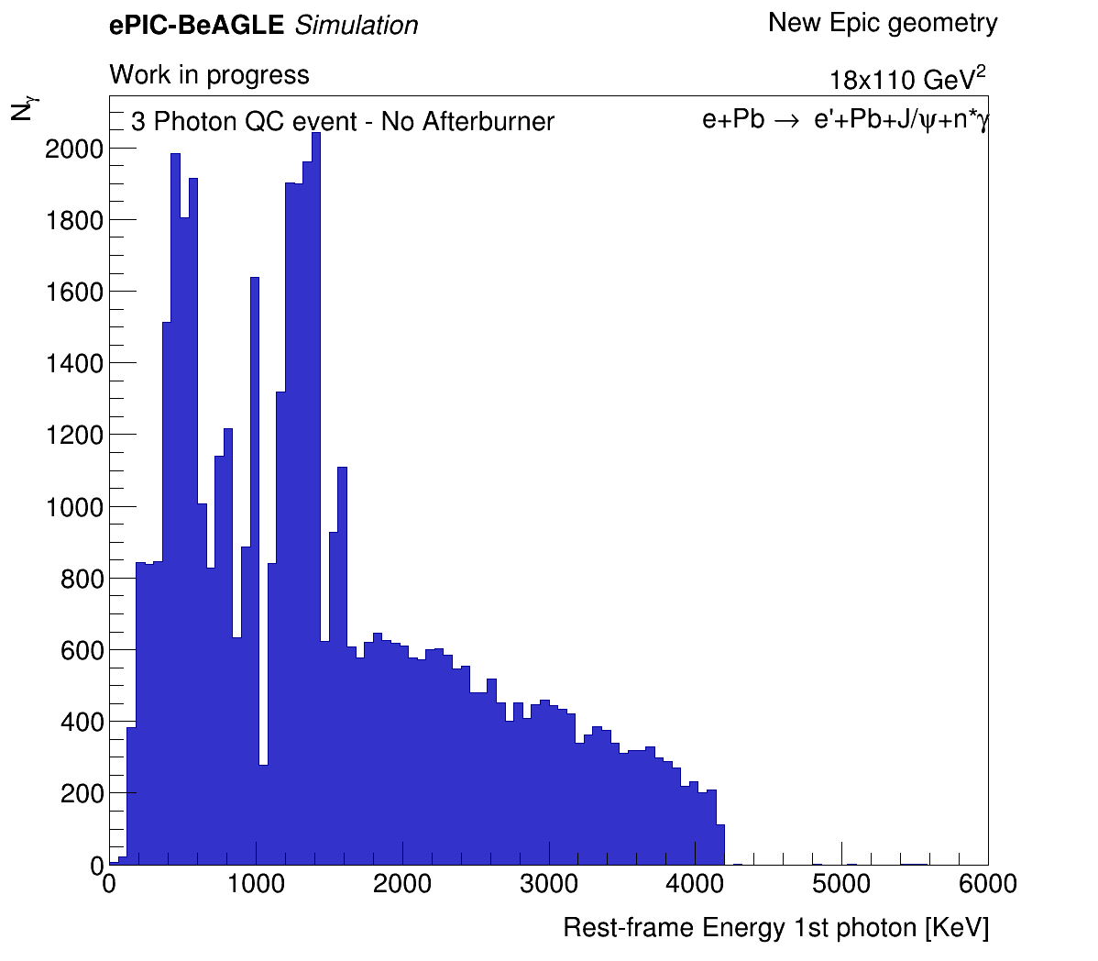
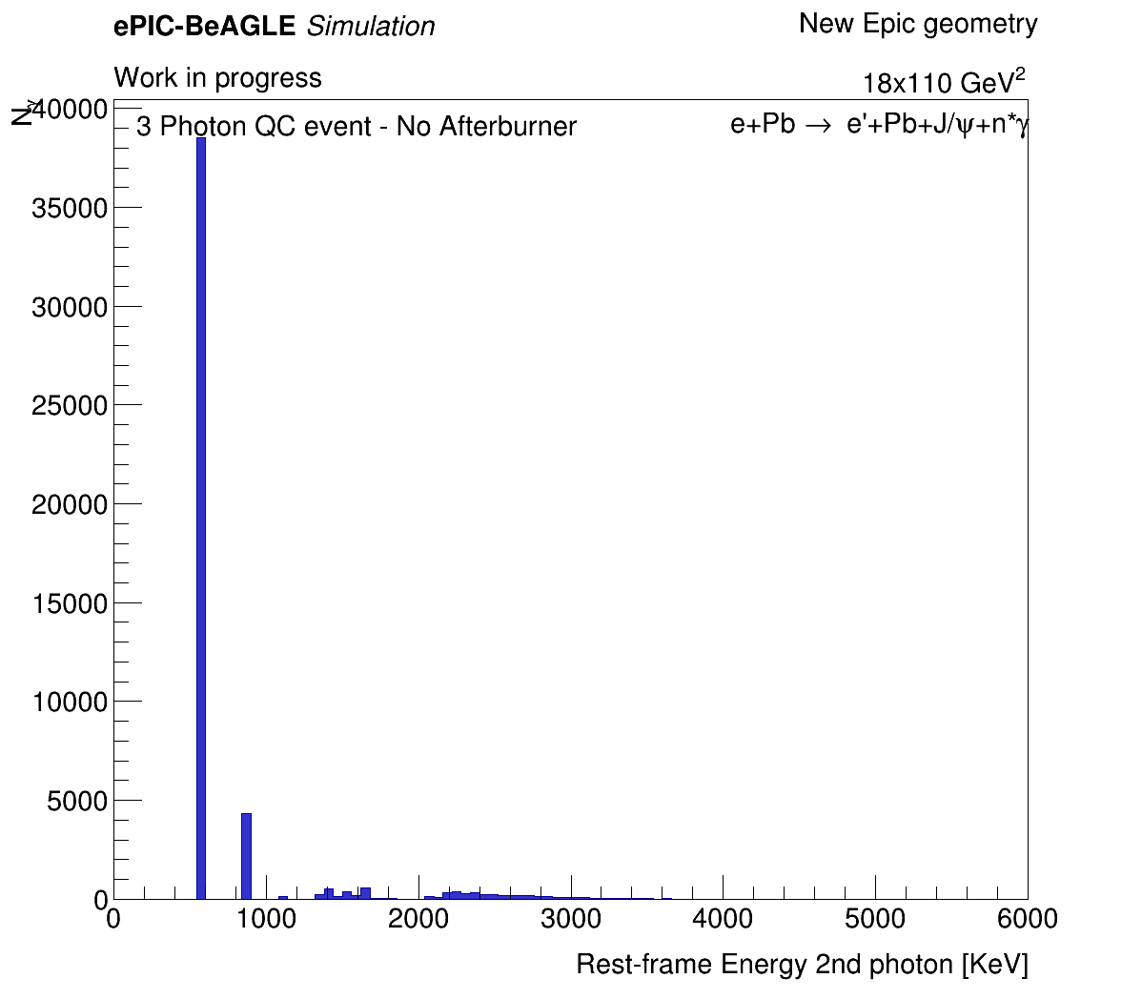
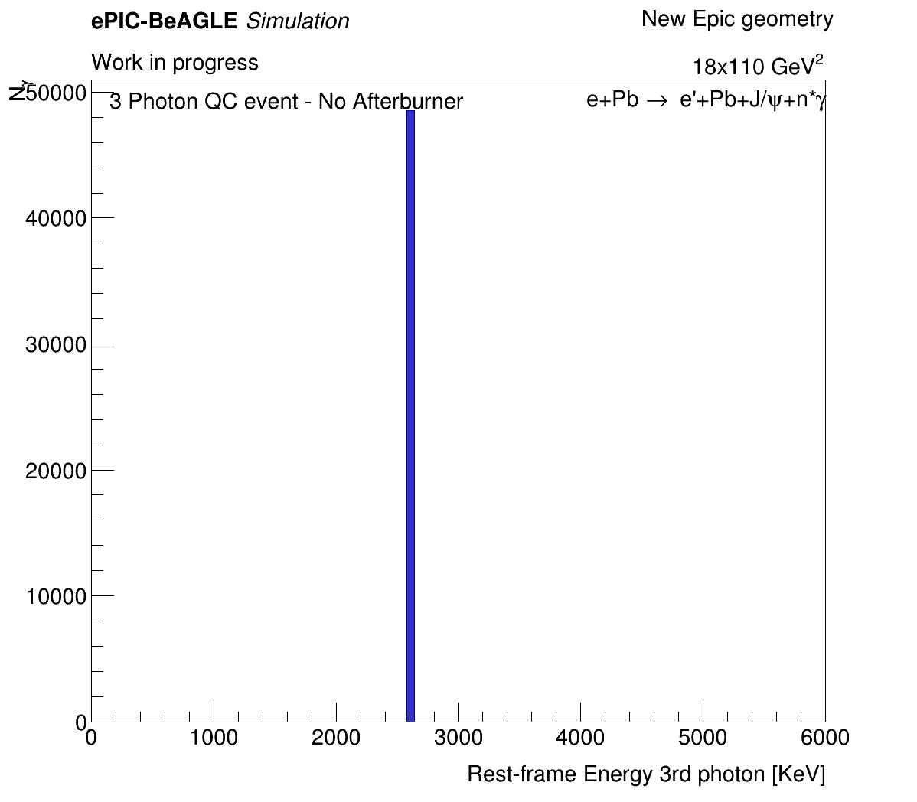
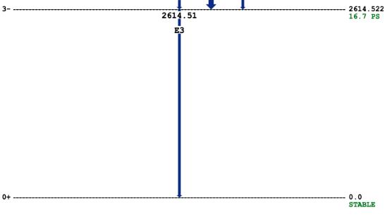
3 Photon plots – Truth data no afterburner
$1^{st}$ photon:
$2^{nd}$ photon:
$3^{rd}$ photon:
In any “n photon quasi-coherent event” we see the 2.6 MeV line. This is deexcitation from 1st excited state to ground level.
And there are many many more energy levels and allowed intermediate deexcitations
The desecrate energy lines correspond to photons that are emitted in deexcitation between intermediate energy levels.

Slide 10
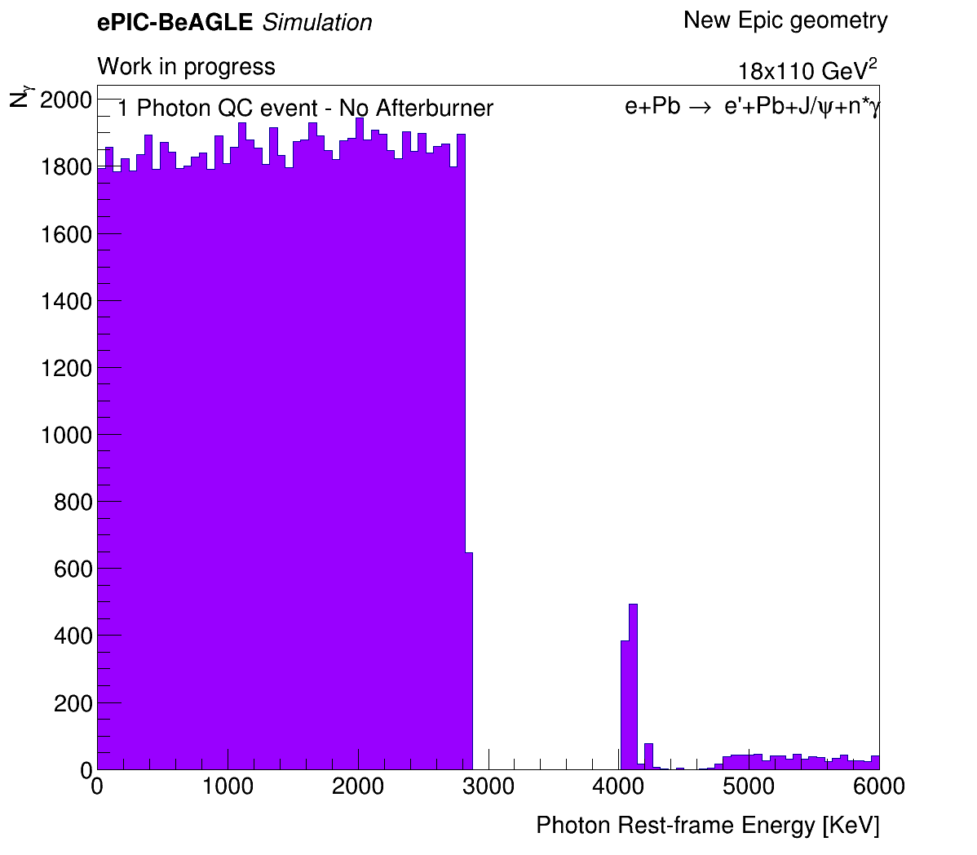
1 Photon plot
What would we expect?
Events with only 1 emitted photon are events where the Pb208 ion was excited to a higher energy level than the ground state and then de-excited straight back to the ground level (no intermediate decays).
There are several energy levels that allow this decay mechanism. The minimal energy gap for this process is when the Pb208 ion is excited to the first excited state.
The energy gap between the first excited state and ground level is $ΔE=2614.514$ [KeV].
Taking this into account we would expect that the energy spectrum of the emitted photons would start at around $2614.514$ [KeV]
We can see that this is not the case...

Slide 11
Reconstructed Level Analysis – with Cluster Matching
Only looked at photons that reach the B0 and leave a cluster in the Ecal.
Had to do some “truth - cluster matching” and make sure that the cluster I am looking at is indeed the cluster from the truth photon I am looking at.
Many photons don’t reach the B0 Ecal (Mcparticle.endpoint.z < 7 m) but still leave a cluster in the B0 → Photons that interact with the B0 tracker (no B0 tracker recon yet) and decay to $e^{+}e^{−}$ pairs and leave a signal in the Ecal → I made a toy model to check if the trajectory (assumed straight line kinematics in this distance) of the photon reaches the B0’s XY geometry boundaries → Accepted only clusters with $dist\left(trajectory_{xy} , recon cluster_{xy}\right)<2 cm$ (used 1 photon events to get estimation).
For now, I identified ”1st”, “2nd”,etc.. Photons just by the order they appear in the simulation, which is order of de-excitation.
In the future we will include event selection into this study.

Slide 12
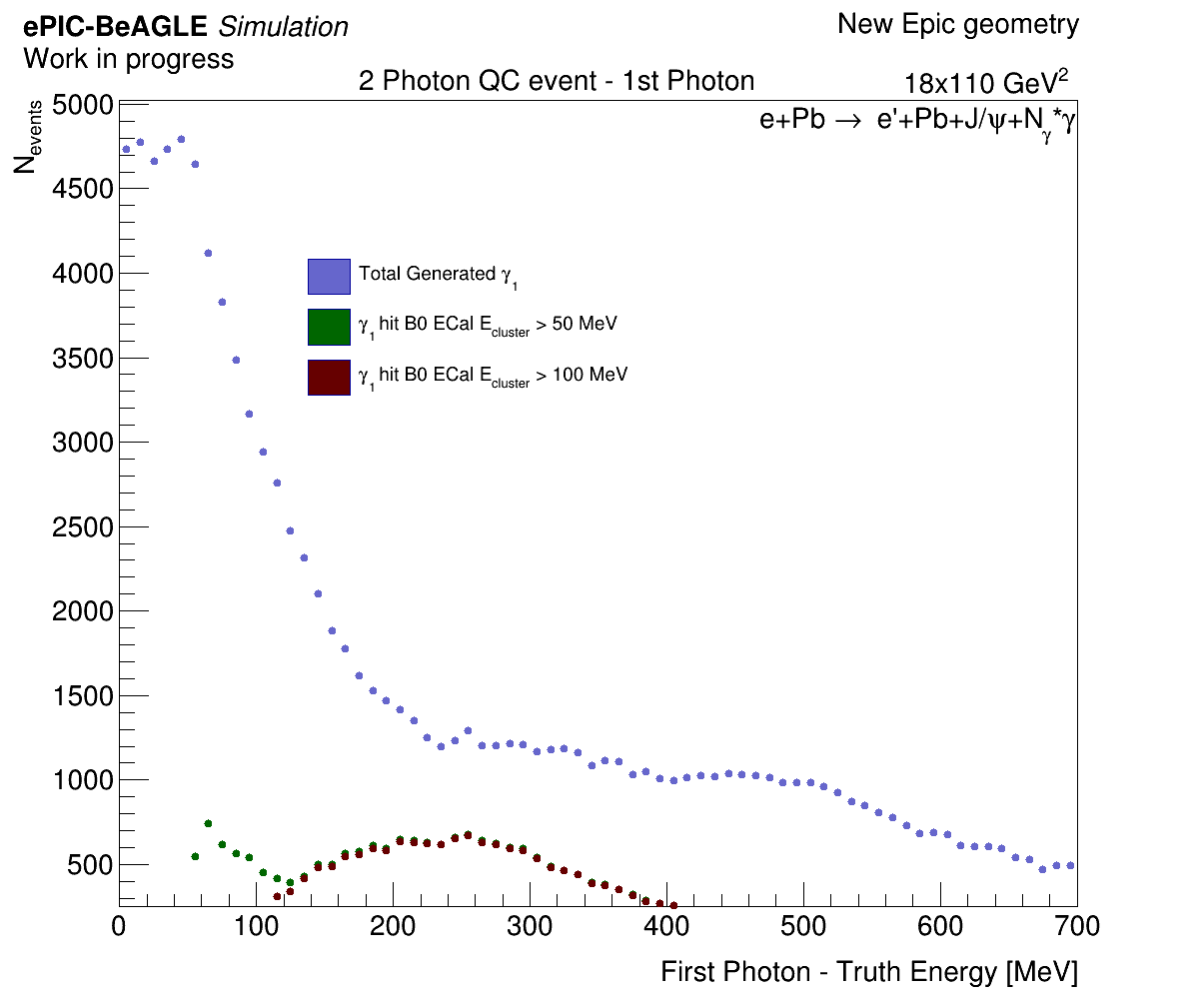
2 Photon Events – 1st Photon Truth Energy

Slide 13
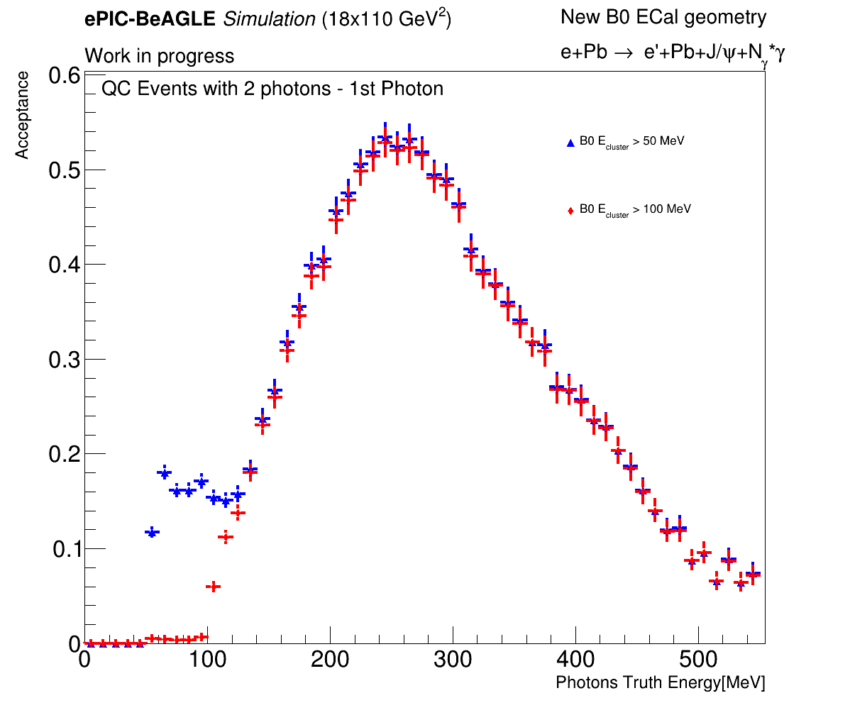
2 Photon Events – 1st Photon Acceptance
Acceptance $≡\frac{ E_{γ_{1}}^{B0 cluster} ( E > E_{threshold})}{Total Generated γ_{1}}$

Slide 14
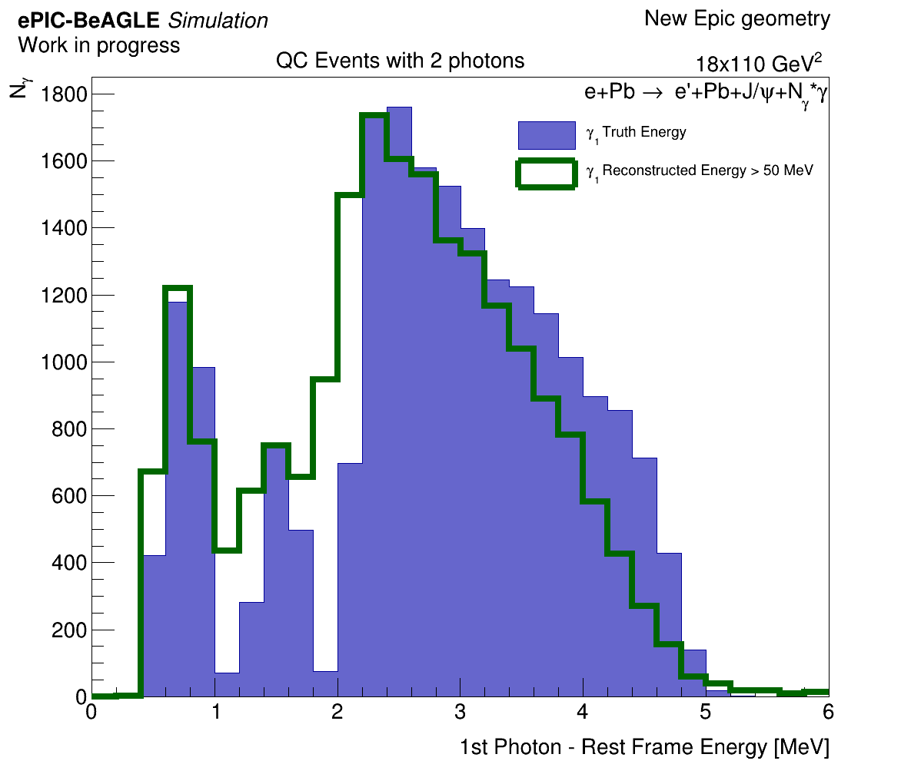
2 Photon Events – 1st Photon Recon Rest Frame Energy
We boost the truth 4-vector and reconstructed 4-vector to the Pb ions rest frame.

Slide 15
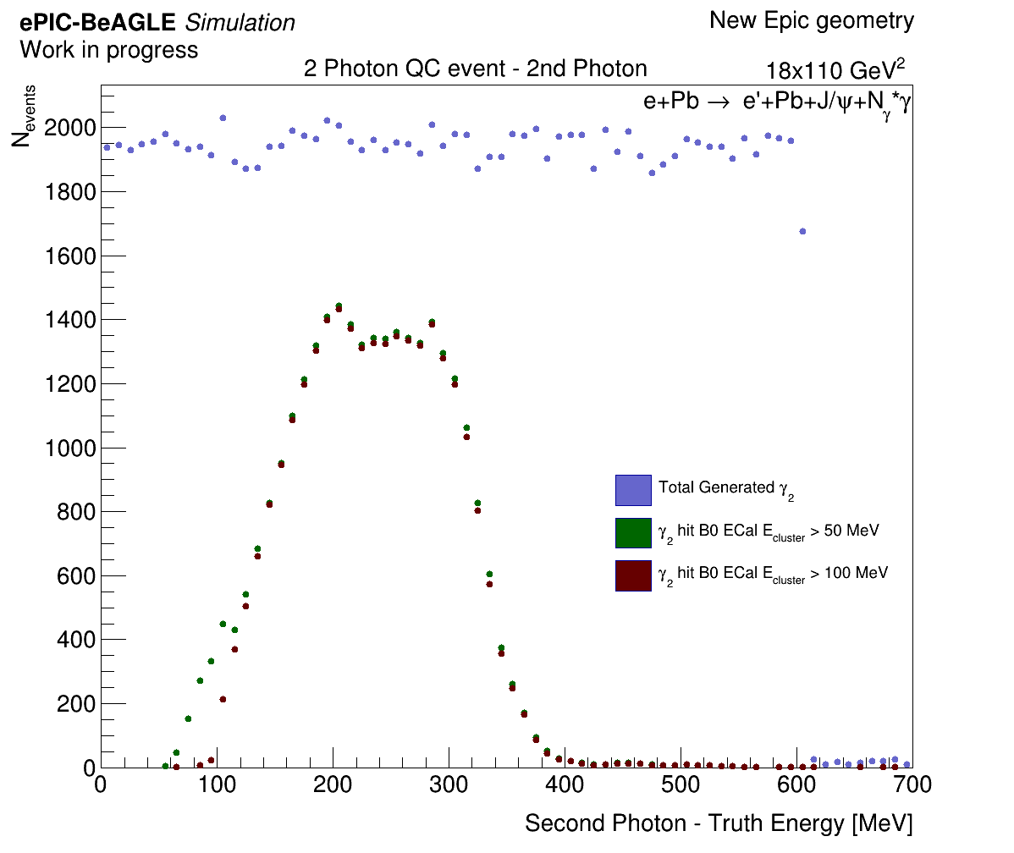
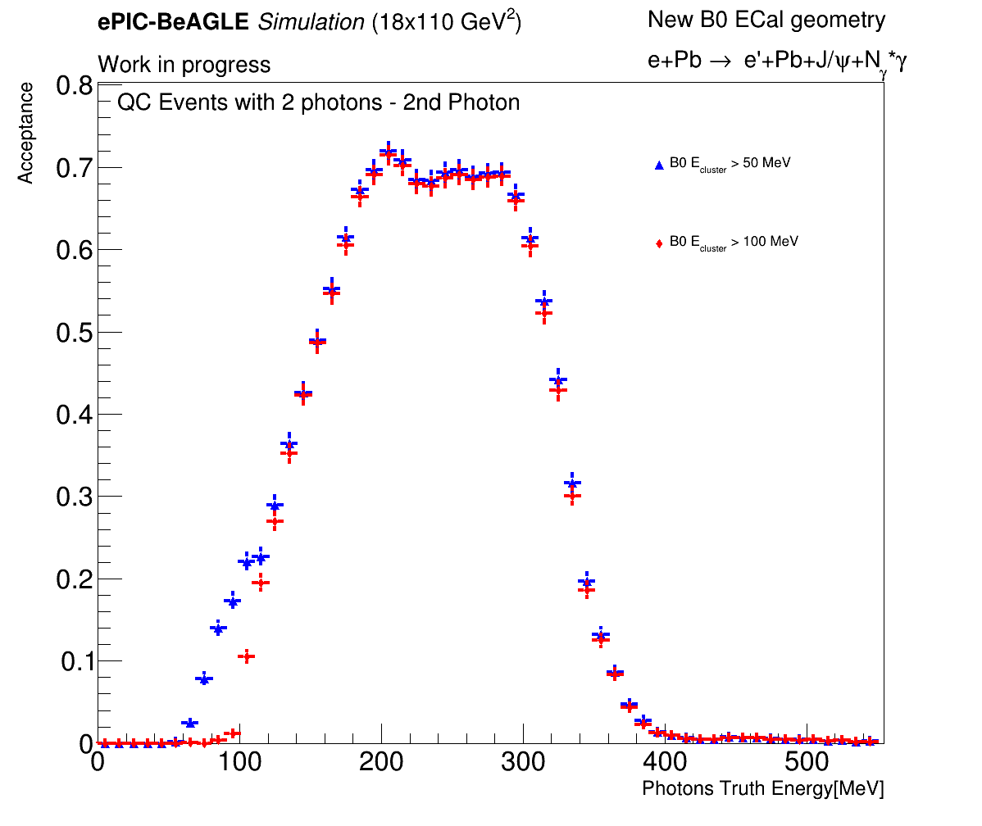
2 Photon Events – 2nd Photon Truth Energy

Slide 16
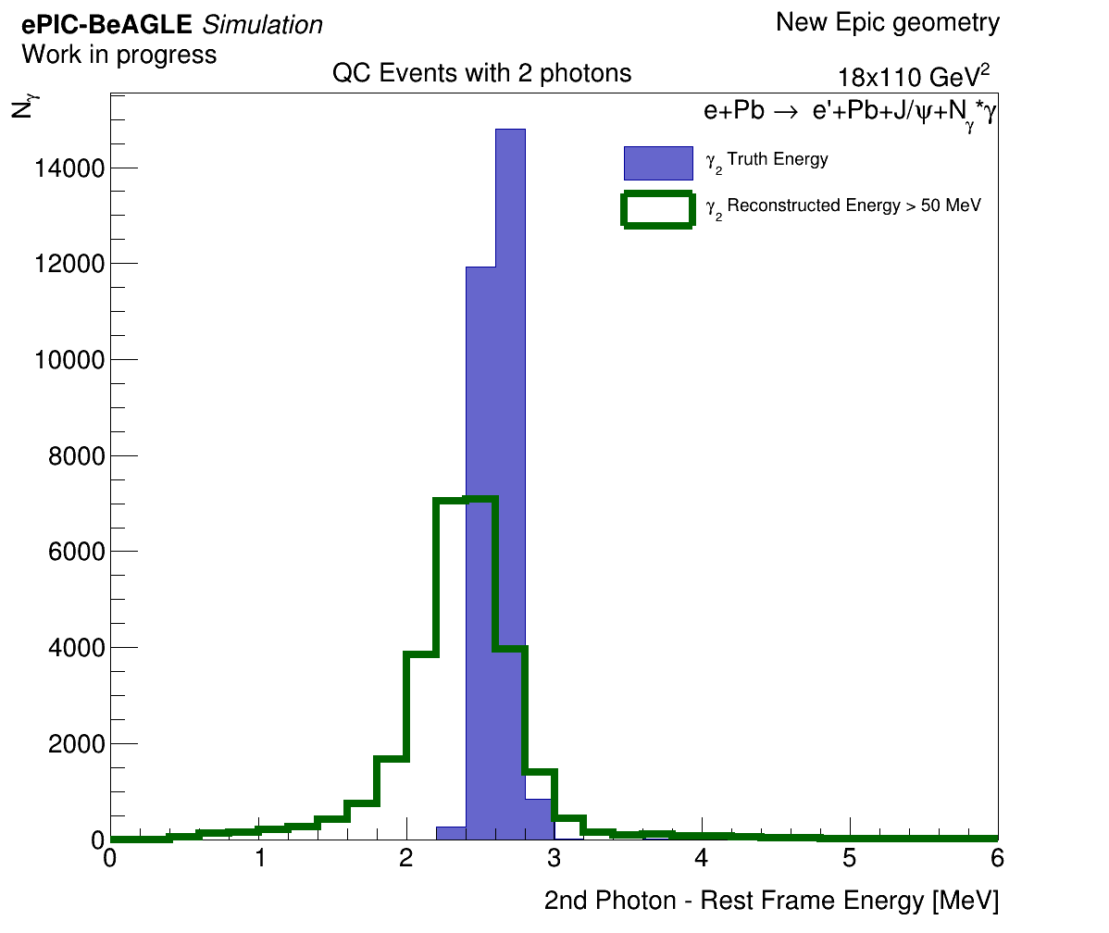
2 Photon Events – 2nd Photon Recon Rest Frame Energy
We boost the truth 4-vector and reconstructed 4-vector to the Pb ions rest frame.
Although the broad energy range in the lab frame, when looking at the rest frame energy they all correspond to the narrow 2.6 MeV energy of the 1st excited state. This is due to the different $P_{z}$ when emitted.

Slide 17
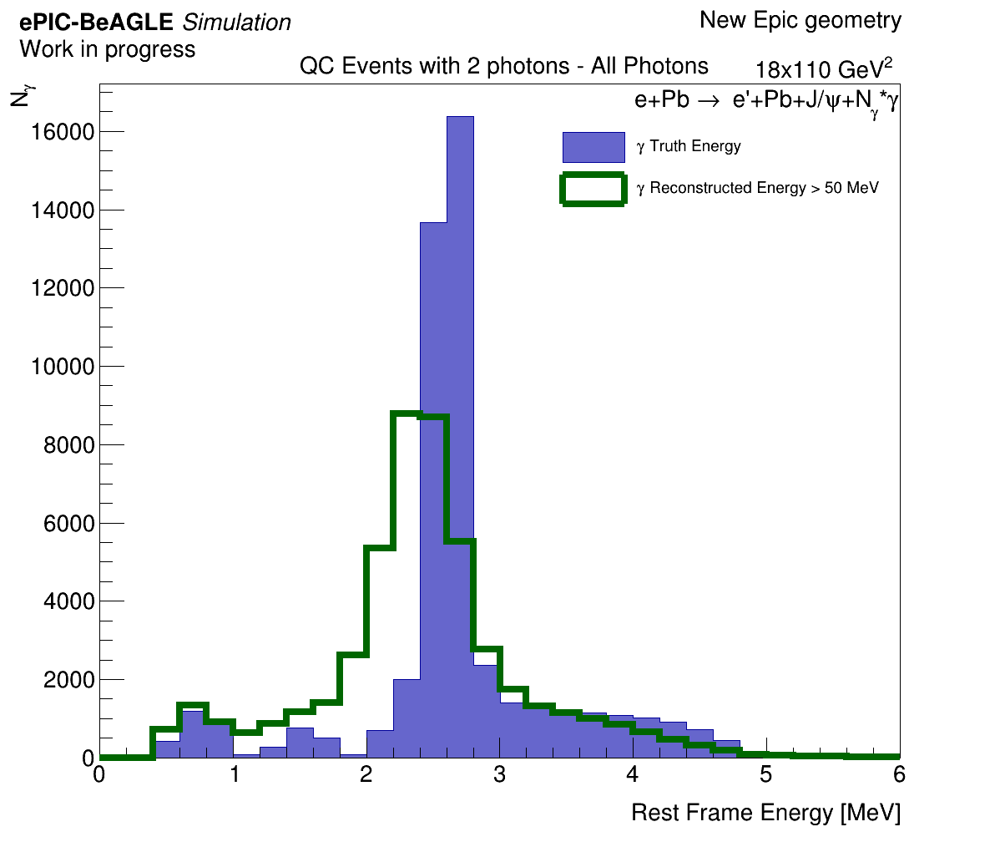
2 Photon Events – Both Photons Recon RF Energy
Only looking at the truth photons that are within the B0’s acceptance. (integrals of truth and recon are the same)
Both photons here are matched and plotted on the same histogram.

Slide 18
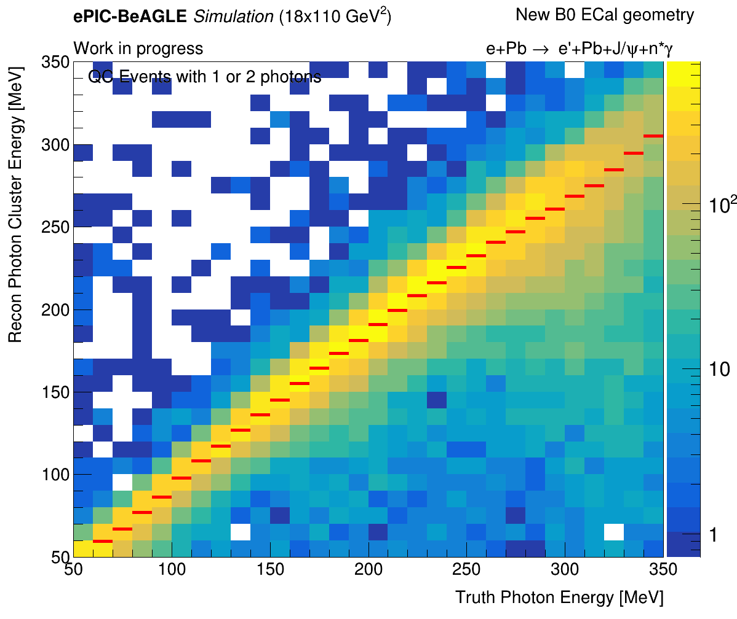
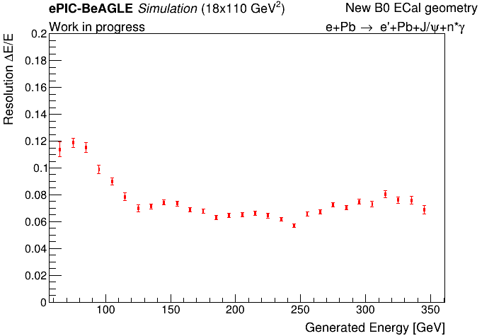
2 Photon Events – Both Photons Resolution
MeV

Slide 19
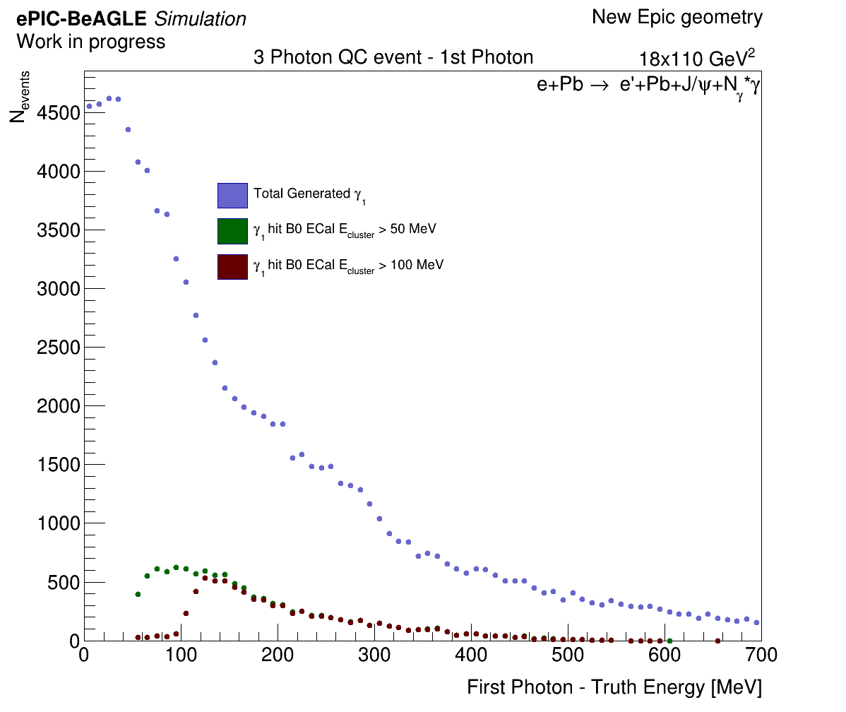
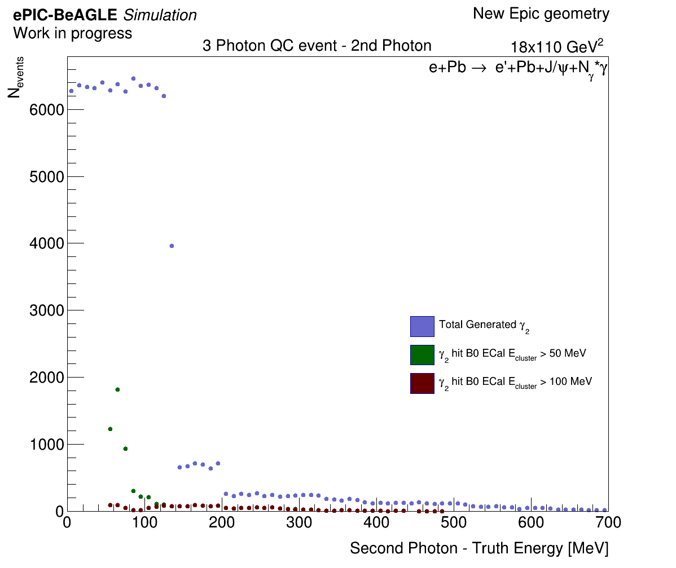
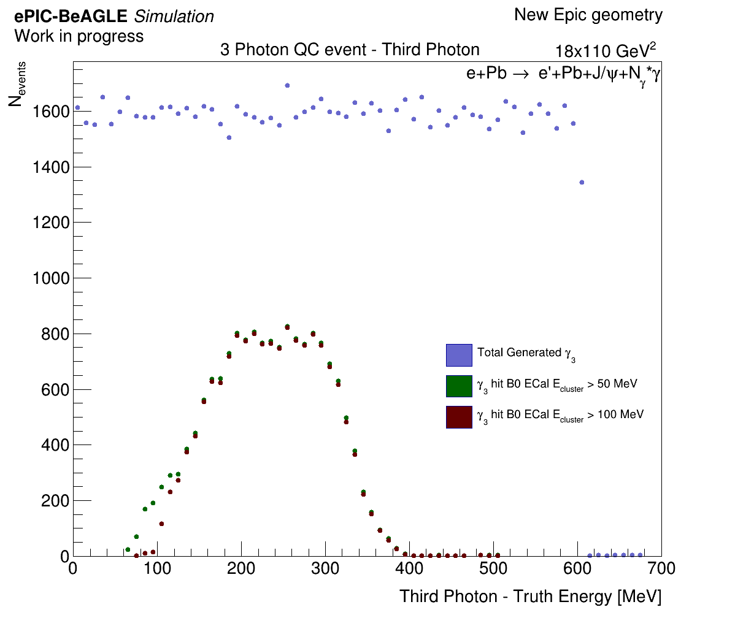
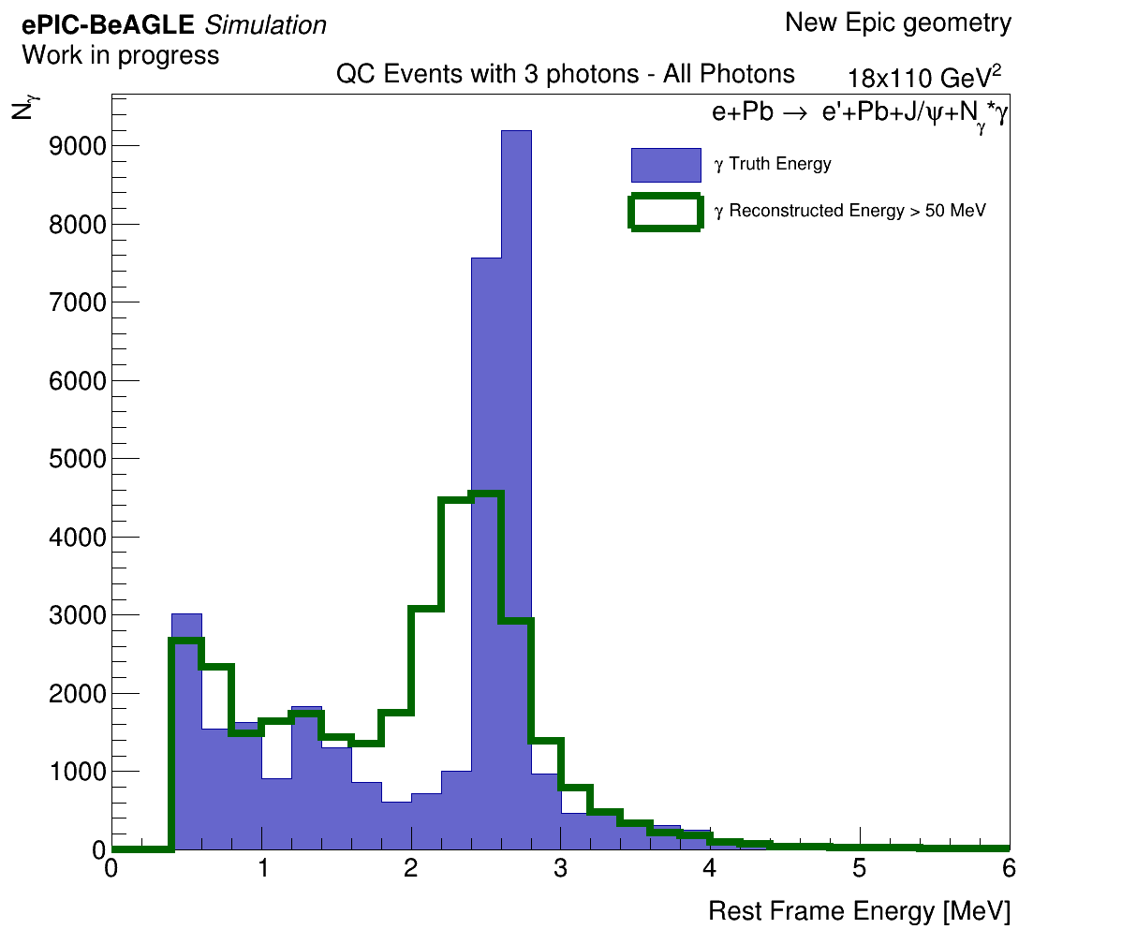
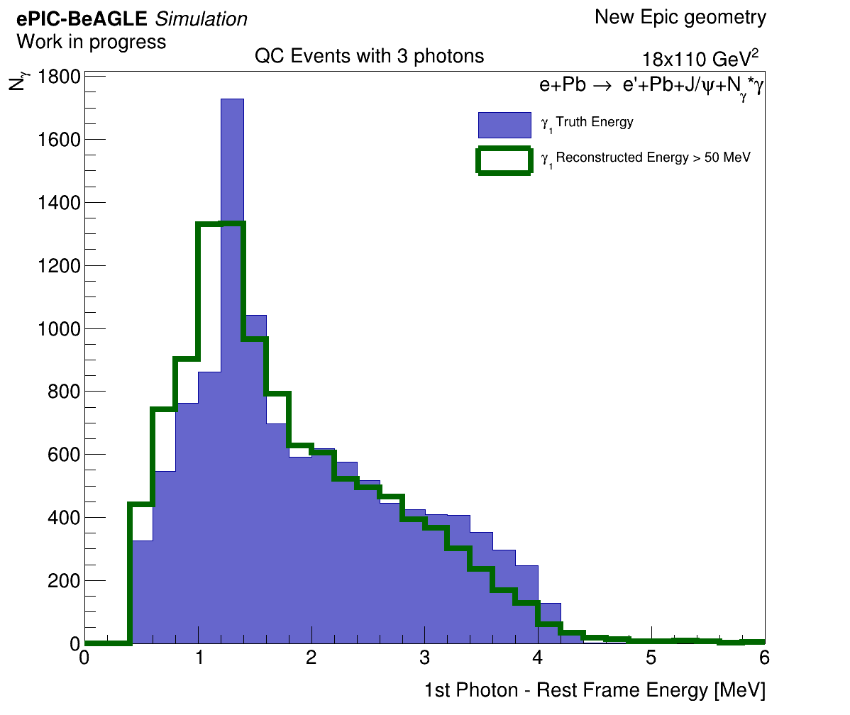
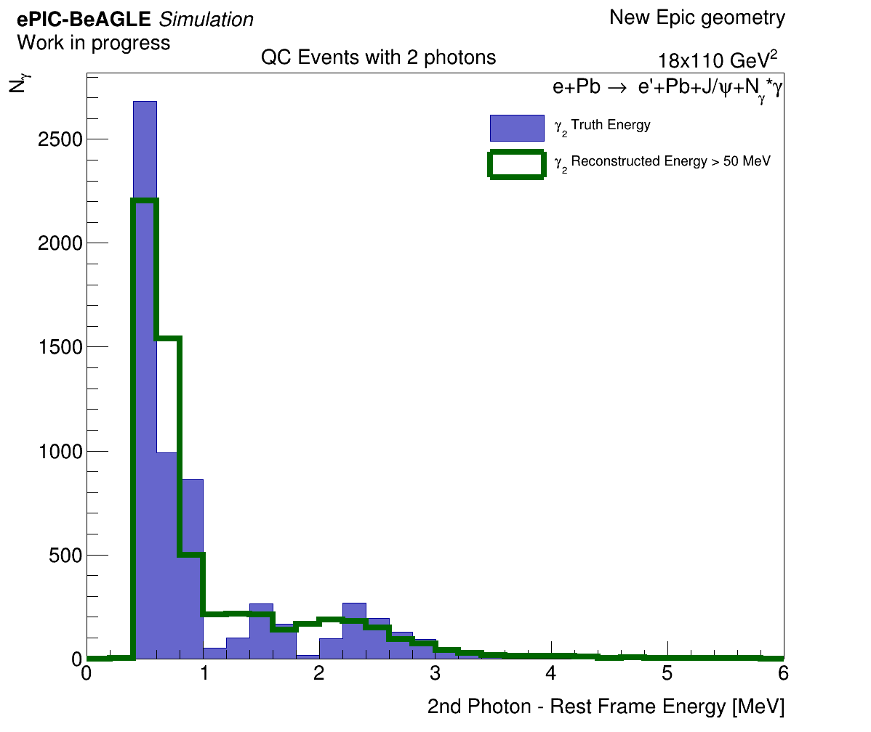
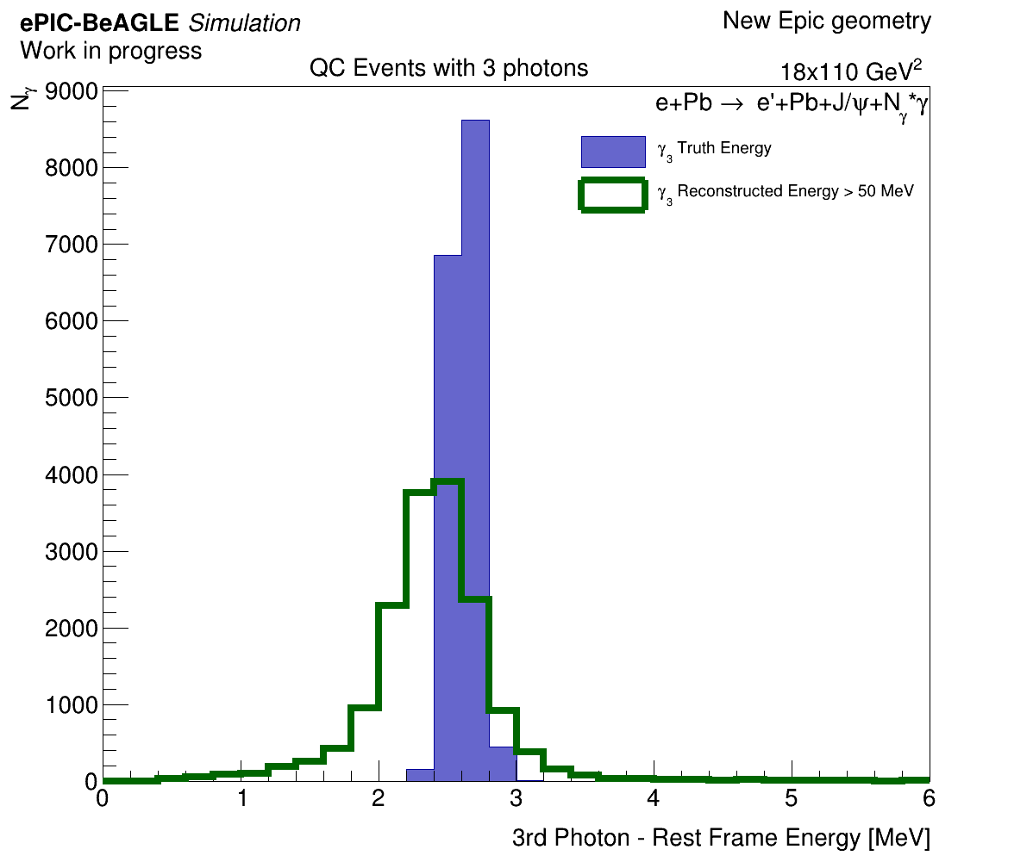
3 Photon Events – Photons Truth/RF Energies

Slide 20
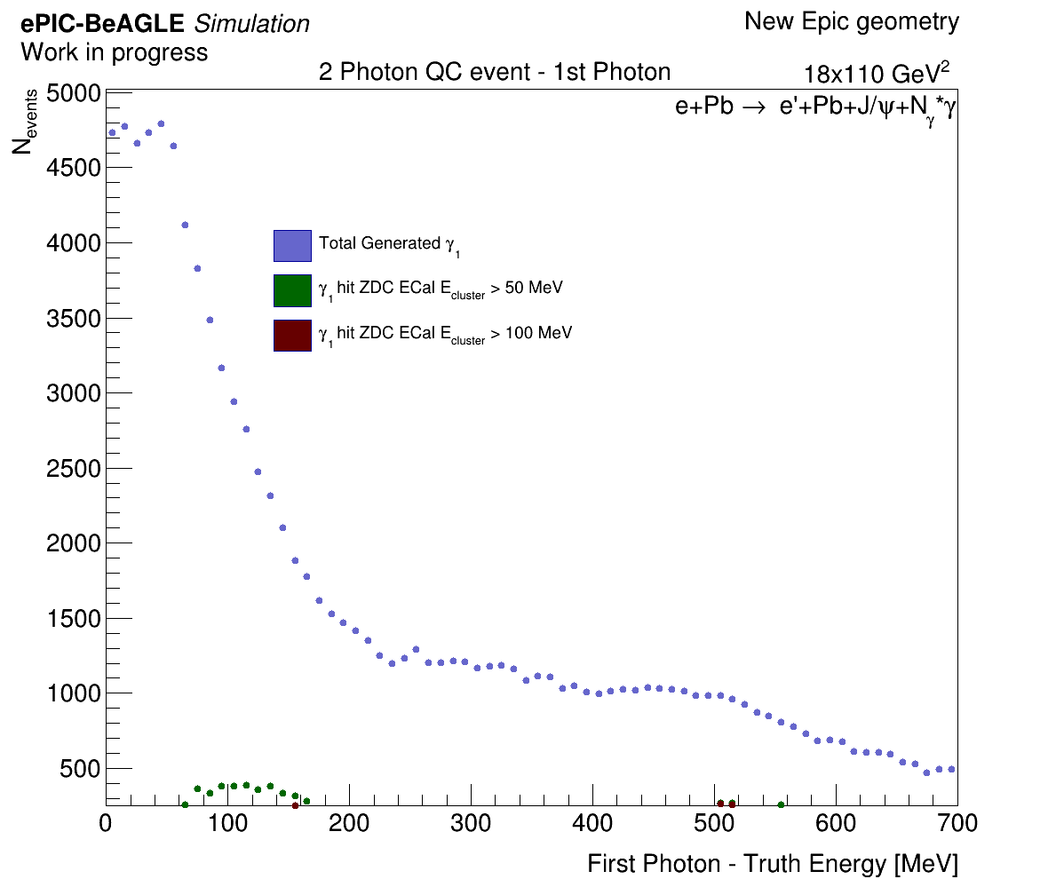
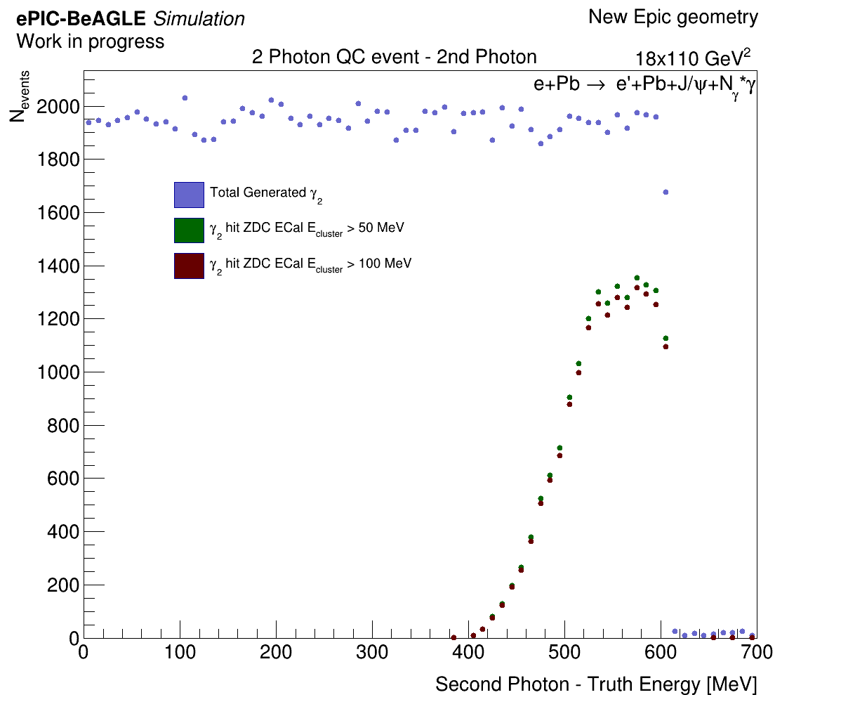
Let’s talk about the ZDC – 2 Photon Events

Slide 21
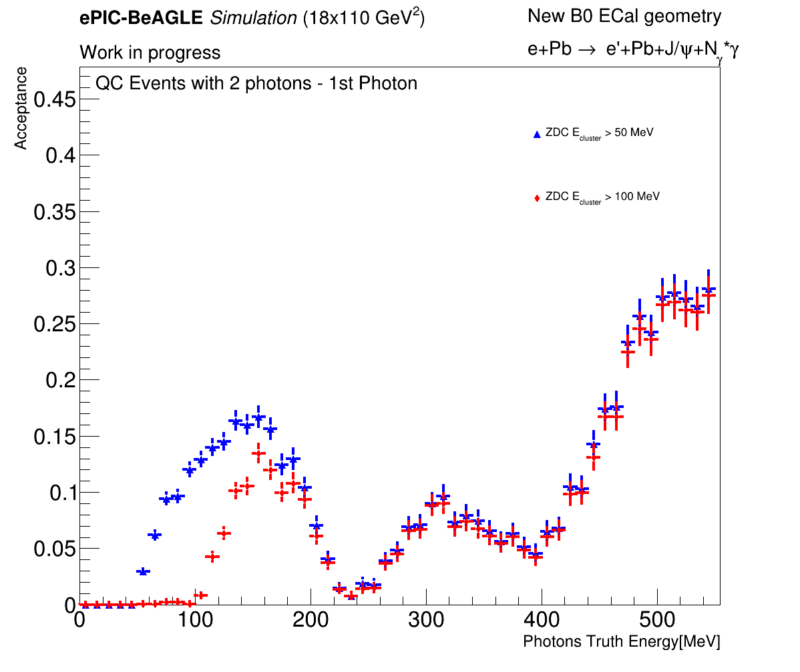
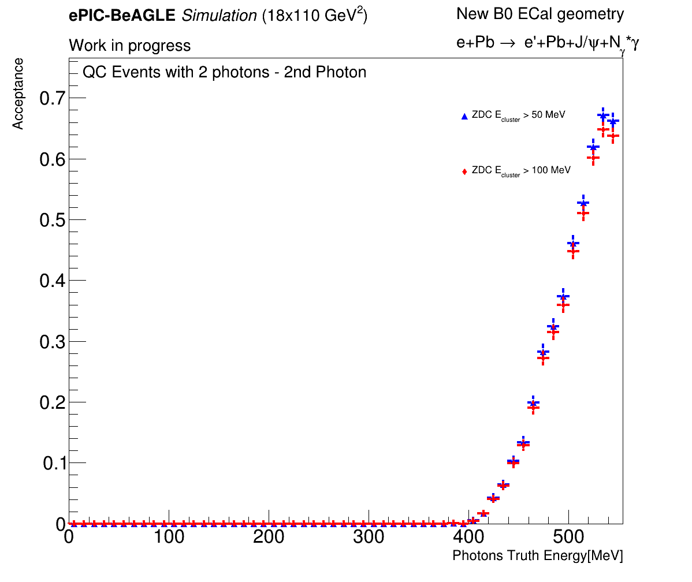
Let’s talk about the ZDC – 2 Photon Events

Slide 22
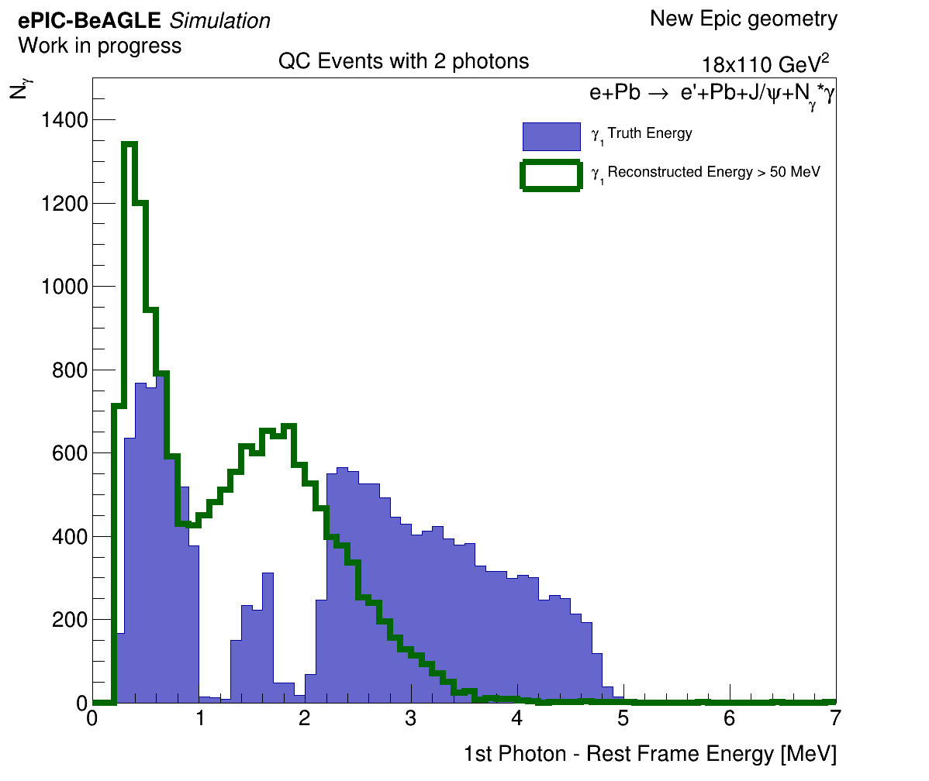
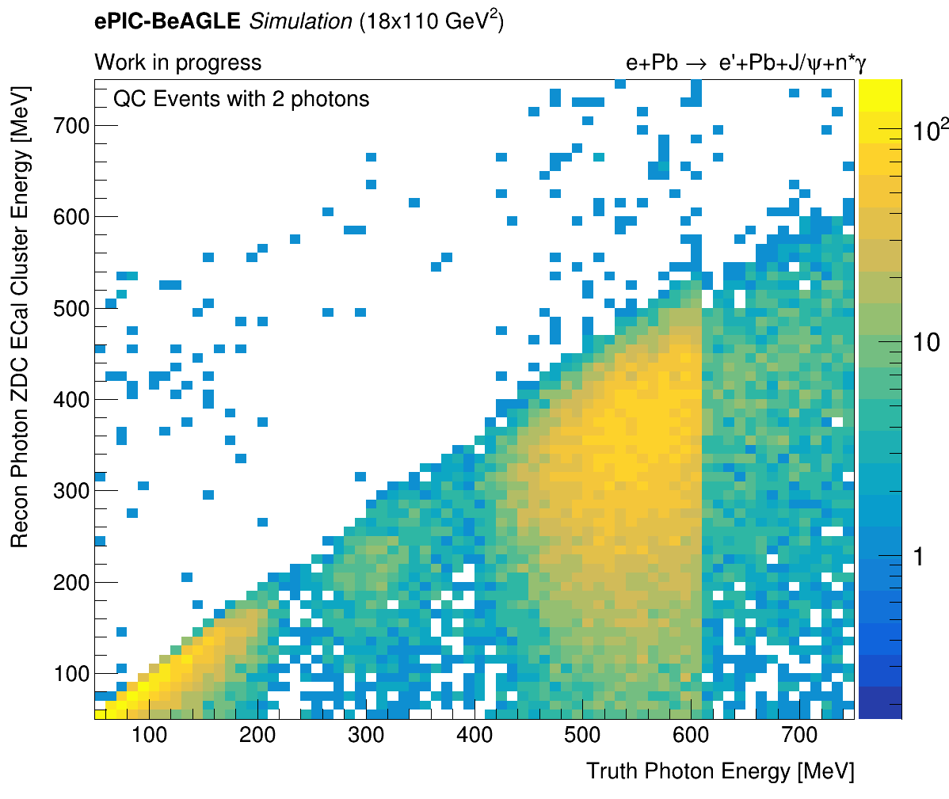
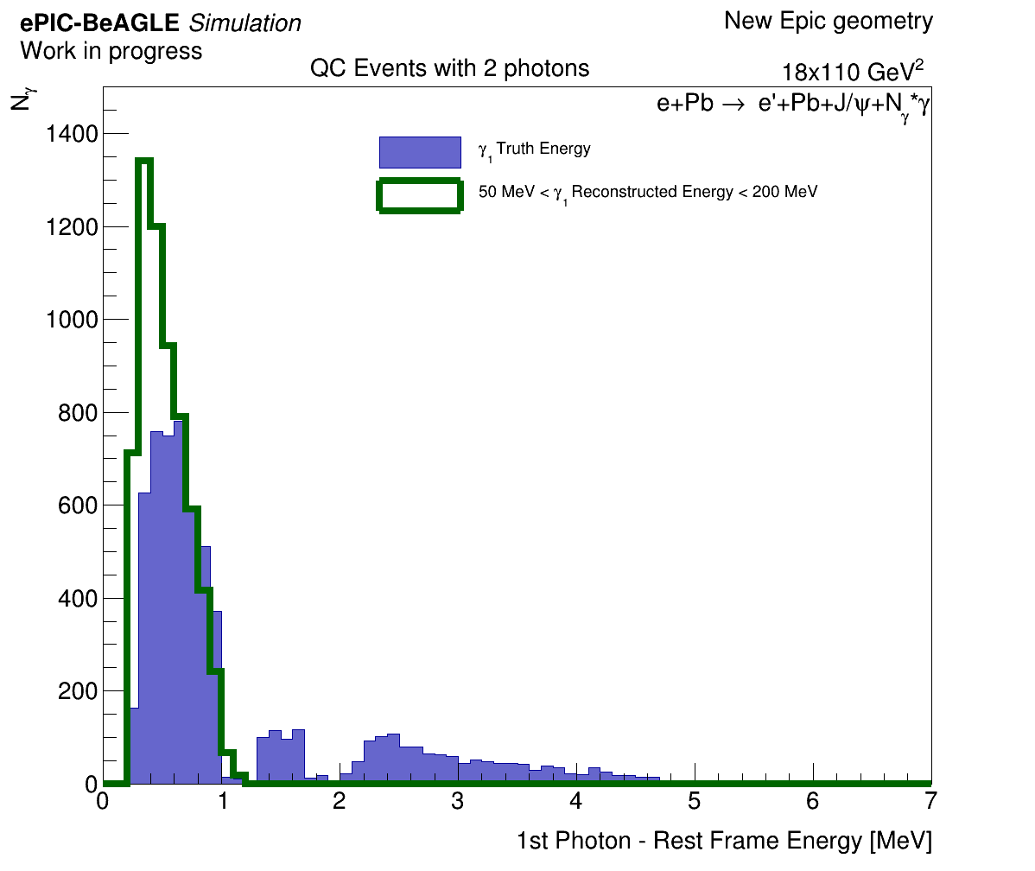
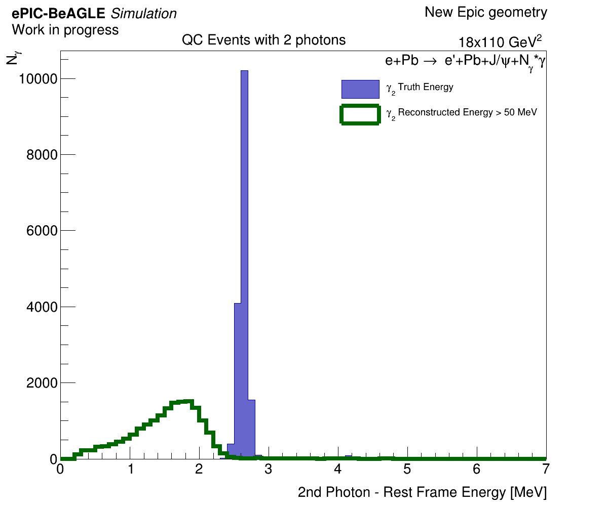
Let’s talk about the ZDC – 2 Photon Events
We can see that the reconstruction is not so good when using only ZDC ECal cluster energy…
We can see bad energy correlation for photons with energy above 400 MeV.
TODO: More investigation needed here. Maybe add also HCal cluster energy in the ZDC cluster matching.

Slide 23
2 Cluster Events – Without Cluster Matching
We also looked at events with 2 and 3 clusters with no “cluster matching” (only using detector data like in real life) . We define an event as a 2-cluster event if:
--- 2 clusters in B0 + no clusters in ZDC ECal (50 MeV signal threshold) → Use the B0 cluster E (for now).
--- 1 B0 cluster in B0 + 1 cluster in ZDC ECal (50 MeV signal threshold) → Use the B0 cluster E (for now).
*** Looked only on ZDC ECal cluster hits. Need to include the HCal recon data soon.
We define an event as a 3-cluster event if:
--- Exact same logic as for the 2-cluster events.
We don’t use for now the ZDC cluster E since we have a reconstruction problem.

Slide 24
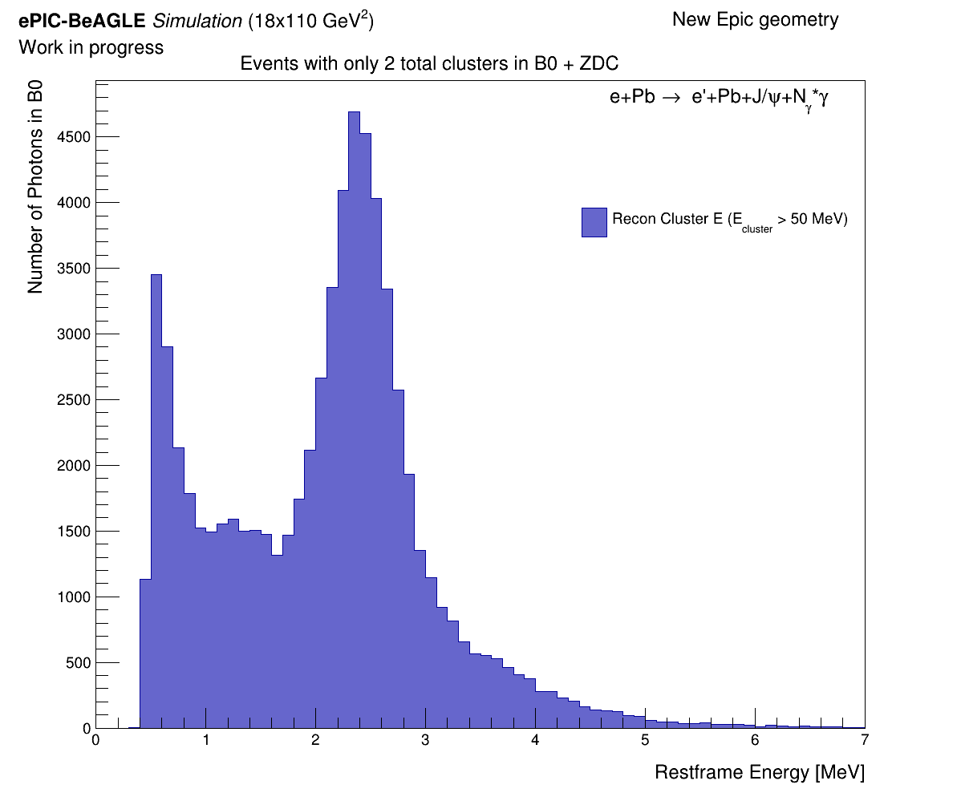
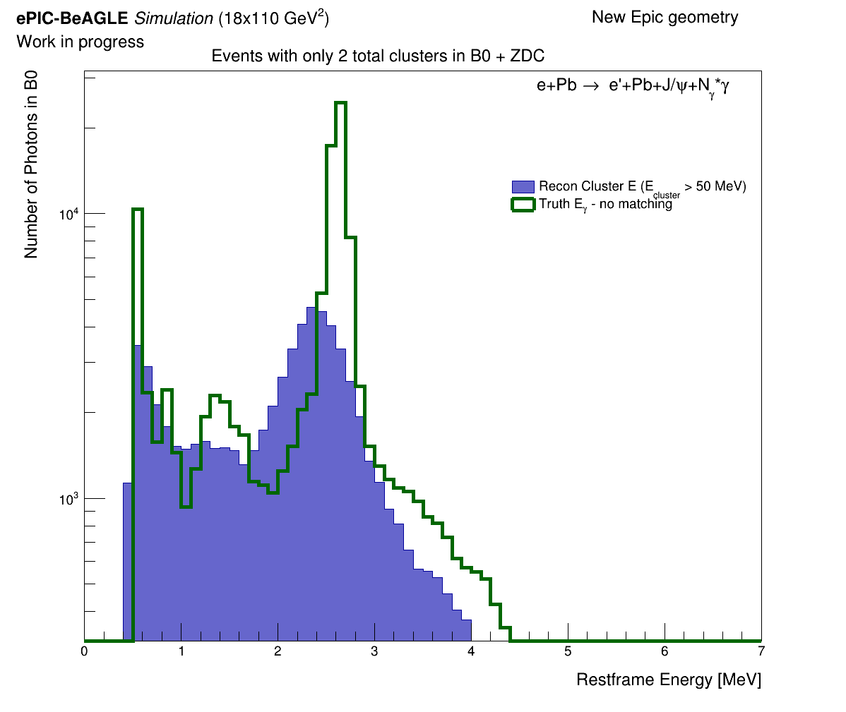
***No cluster matching
2 Cluster Events – Rest frame Energy
 | Number of events with no threshold | Number of events with threshold | Percentage %
All Events | 459948 | 459948 | 100%
2 cluster events (2 in B0 or 1 B0 + 1 ZDC) | 66331 | 54771 | 14.4% / 11.9%
Events with 2 B0 clusters | 18906 | 15583 | 4.1% / 3.4%
Events with 1 B0 + 1 ZDC clusters | 47425 | 39188 | 10.3% / 8.5%

Slide 25
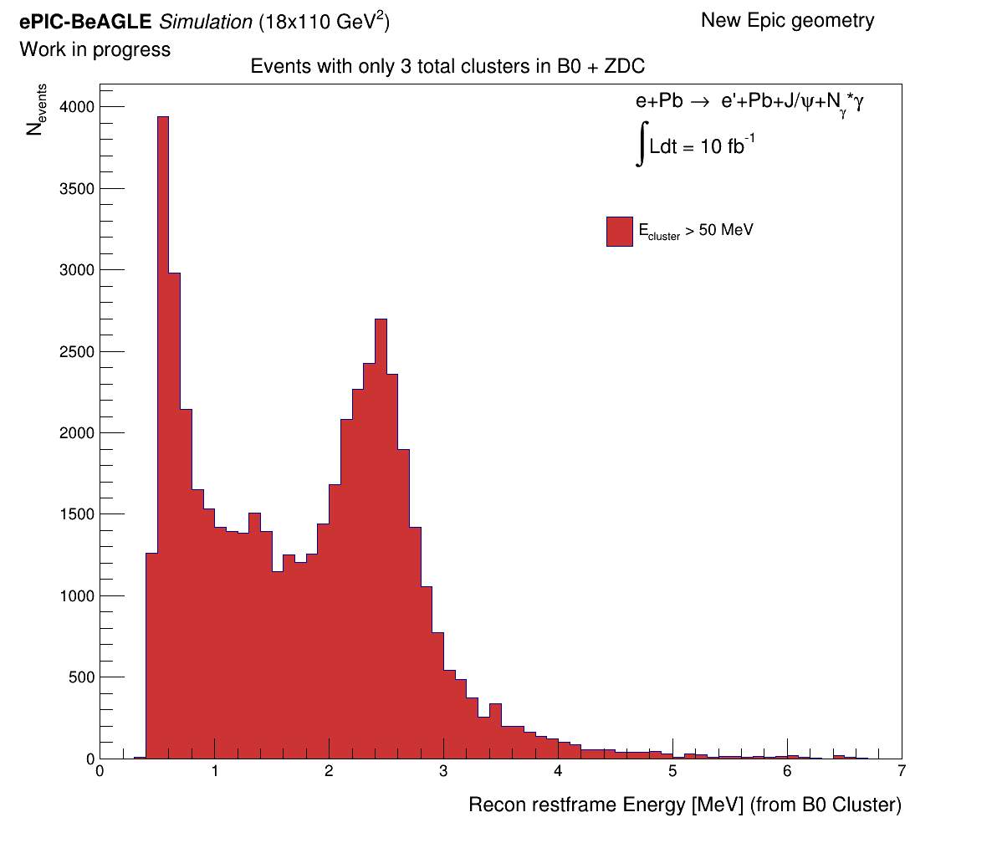
***No cluster matching
3 Cluster Events – Rest frame Energy
 | Number of events with no threshold | Number of events with threshold | Percentage %
All Events | 459948 | 459948 | 100%
3 cluster events, at least one in B0 | 12774 | 1943 | 2.77% / 6.77%
Events with 2 B0 clusters | 18906 | 8034 | 4.1% / 1.75%
Events with 1 B0 + 1 ZDC clusters | 47425 | 23112 | 10.31% / 5.02%

Slide 26
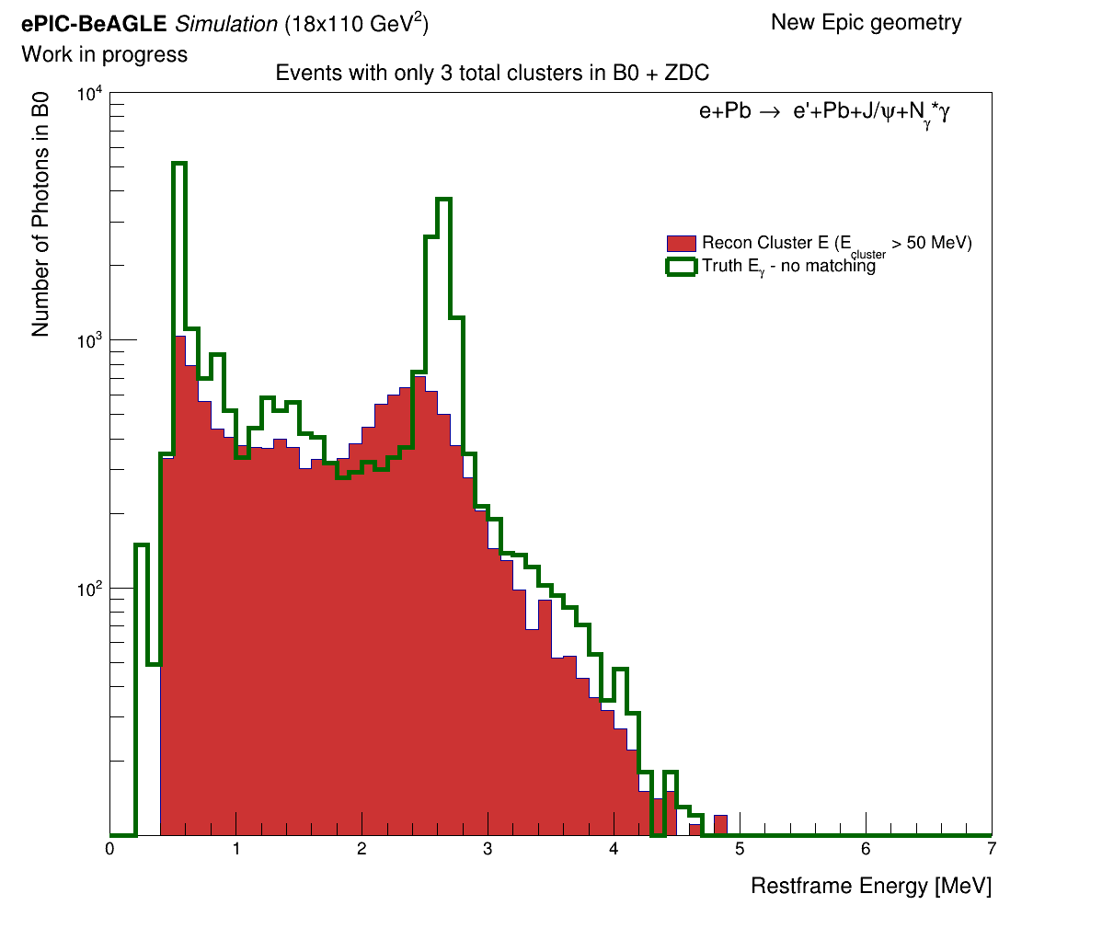
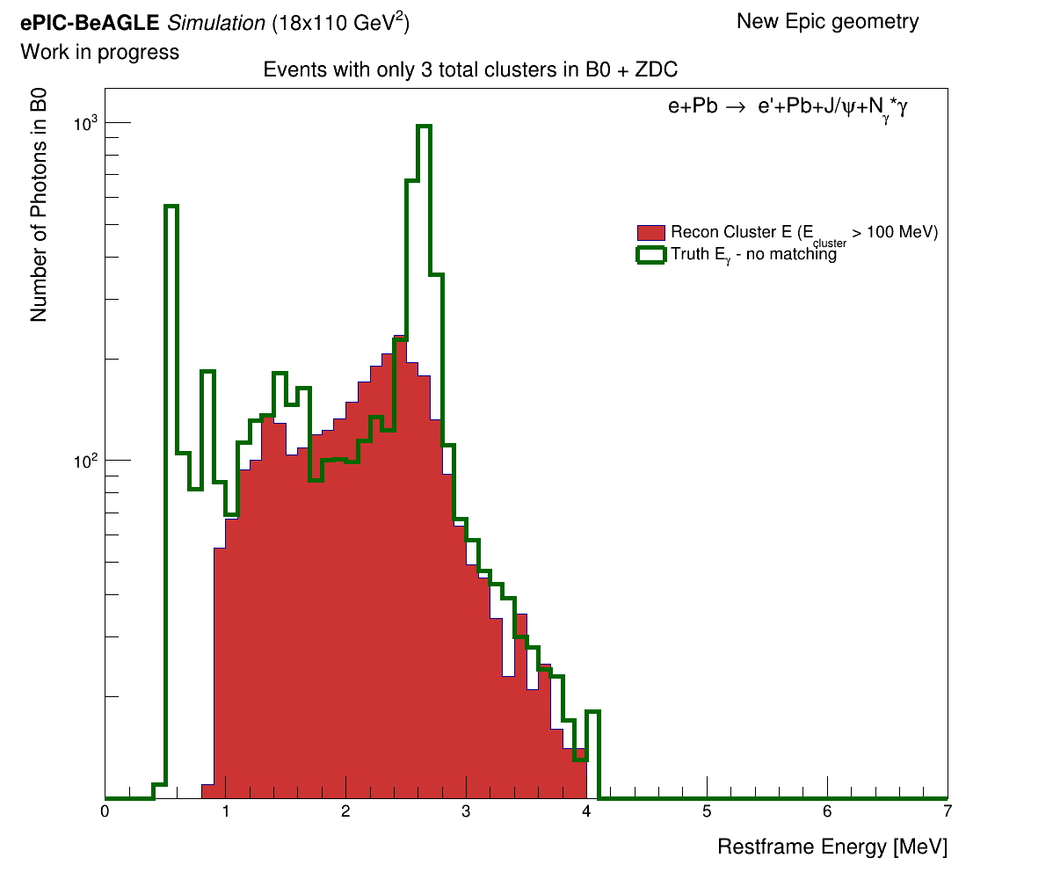
***No cluster matching
3 Cluster Events – Rest frame Energy
Wondering if the lower energy peaks are real peaks or just ”noise”.
We plot the truth data with (generated) with no cluster matching (for 50 and 100 MeV cluster threshold).
Hard to know if the 0.6 MeV and 1.5 MeV peaks are indeed real peaks… More investigation needed here.

Slide 27
Conclusions & Future Work
The B0 ECal is sensitive to soft photons with energy under 350 MeV in the lab frame.
The ZDC’s sensitivity needs more investigation. We need to add the HCal clusters into the analysis.
We are currently working on the event selection for quasi-coherent events.
We need to include backgrounds to this study - Beam halo + coherent events might be identified as quasi-coherent → Background.
Following this study we aim to make a benchmark for the TDR.

