Slide 1
Agenda
(https://indico.bnl.gov/conferenceDisplay.py?confId=2204)
Dave’s and overall schedule for the High-Field Test ?
Jon Hock’s design work and John Cozzolino’s analysis
Update on power supply preparation
AOB

Slide 2
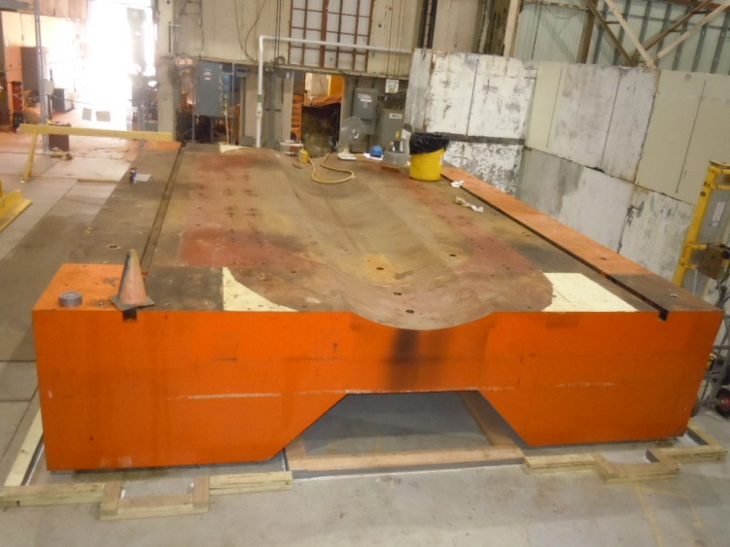
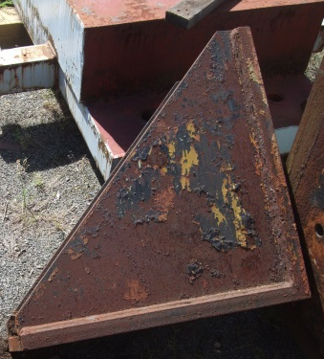
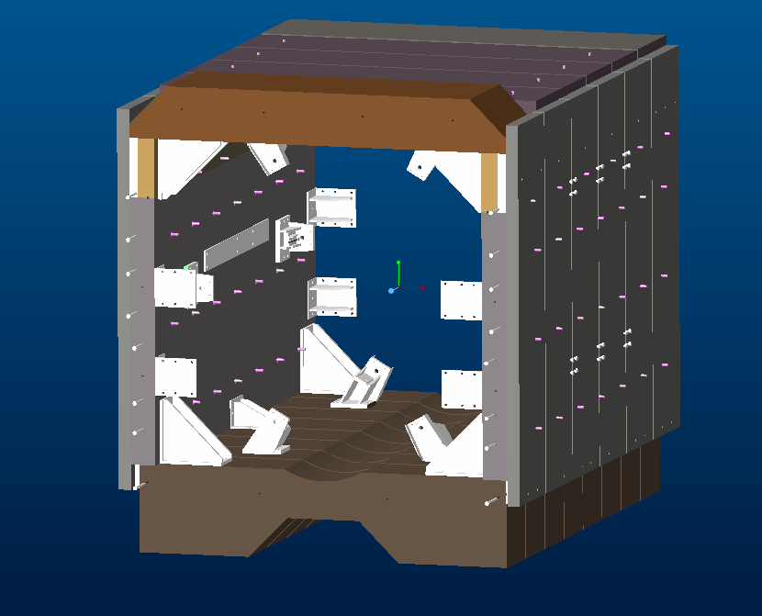
sPHENIX FULL FIELD TEST
LARGER BRACKETS TO BE USED IN THE CORNERS
ASSEMBLED BASE IN 912
RETURN STEEL 3D MODEL SHOWN WITHOUT END WALLS AND SOLENIOD
RETURN STEEL STATUS:
GOING FAWARD WITH THE BOLTED DESIGN
ADDING BRACKETS AND STRAPS TO SUPPORT THE RETURN STEEL AS A RESULT OF THE FEA ANALYSIS
CENTRAL SHOP WELDER IS CURRENTLY PREPARING THE RETURN STEEL FOR ASSEMBLY
TECHICIANS ARE CURRENTLY TAPPING HOLES IN THE BASE TO SUPPORT THE SIDE AND END WALLS

Slide 3
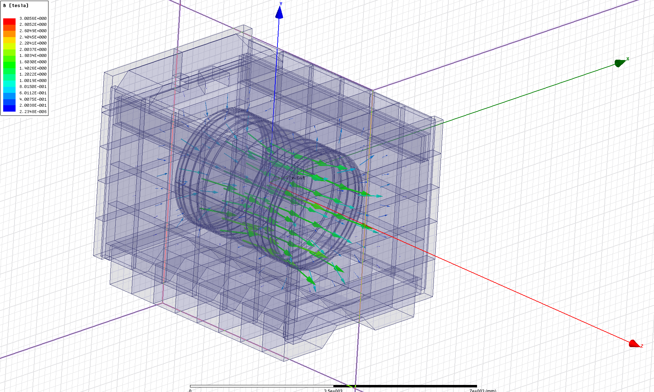
John Cozzolino’s ANSYS Maxwell 3D analysis result compared with Wuzheng’s results

Slide 4
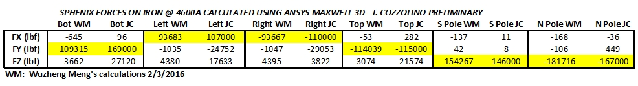
Status from John Cozzolino (June 21, 2016) : Here is what I have so far. My iron forces are shown compared to Wuzheng’s data. Also see the attached B vector plot. The last page of Wuzheng’s PPT presentation from 2/3/16 shows his results at full current. My coordinate system is consistent with his. My smaller force summations are sometimes in the reverse direction of Wuzheng’s but fortunately all the values exceeding 100,000 lbf are in the same direction (highlighted in yellow). Therefore the smaller reversals are probably not too big a deal (I’m venturing to guess) at the magnitudes involved. It’s not clear to me why this happens but I think I’m beginning to make progress. Please be advised that this is all quite preliminary.
These results were obtained using ANSYS Maxwell 3D on Jon Hock’s simplified Creo model. The coil is shifted north respect to the iron center by about 2.5 cm. My next task will be to generate stresses and deflections in the actual coil, its support structure, and the surrounding iron. But to do this accurately, I’ll need to use Jon’s detailed Creo model which contains many parts. This will pose quite a challenge indeed, though it should be doable.

Slide 5
Email conversation on June 17, 2016 :
Pablo Rosas said :
We are testing the local control of the PS into next week and starting in July we would start on power testing the PS. The New contactor will be at the Lab mid to end of July and we will start mechanical and electrical connections of it.
During summer shutdown we will start on the maintenance of the AGS and RHIC PS, I will probably have to stop work on the sPHENIX PS until later September.
Kin asked: What you said is more or less what you have expected a few months ago, right ? You still think that by sometime in October, the sPHENIX PS will be ready for use ???
Pablo Rosas : Yes, we will have a better idea once the summer shut down begins and see the job that we need to do.

