Slide 1
Admixed Background Effects on Tracking Reconstruction
By Benjamen Sterwerf

Slide 2
Overview
Pipeline
Cuts and Observables
Vertex Cut Effects on Efficiency

Slide 3
Tracking Reconstruction Effects of Backgrounds
Uses the HEPMC Admixing Code found at: https://github.com/eic/HEPMC_Merger/tree/koljadev
Using DIS for the signal event
10x100 GeV^2
Min Q^2=10
Three Main Background Types included in the study:
Synchrotron Radiation, Proton Beam Gas, and Electron Beam Gas
Currently focusing on Proton Beam Gas
Signal File(s)
Merger Code
GEANT/EICRECON
Analysis
Background Files

Slide 4
Merger Code Modification
Admixing Code works with the frequency of background events.
Not every signal event was being admixed to a background event
Does not reflect the performance of EICRECON with admixed background events
Modified the background admixing code so that there is always At Least One (ALO) background event admixed

Slide 5
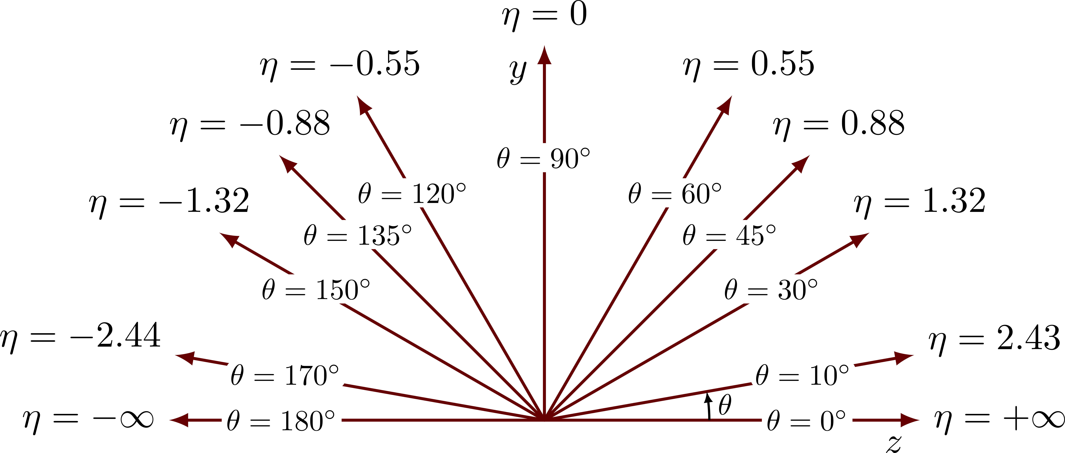
Cuts Applied and Geometry Used
Pt Cut=150 MeV
Rudimentary Multiple Track Filtering:
Parameters to reject duplicates:
PDG=/=0 (Flag that the particle was not matched)
Eta Difference between two candidates >0.002
Phi Difference between two candidates >2 mrad
pT Difference between potential duplicates of >10% of the matched pT
(pT2-pT1)/pT1 *100%
Charge =/= 0 (Only Charged Particles)
η$=\operatorname{arctanh}\left(\frac{p_{L}}{\left|p\right|}\right)$
$$φ=arctan2(\frac{p_{x}}{p_{y}})$$
$$p_{T}=\sqrt{{\left|p_{x}\right|}^{2}+{\left|p_{y}\right|}^{2}}$$
Hadron
Electron

Slide 6
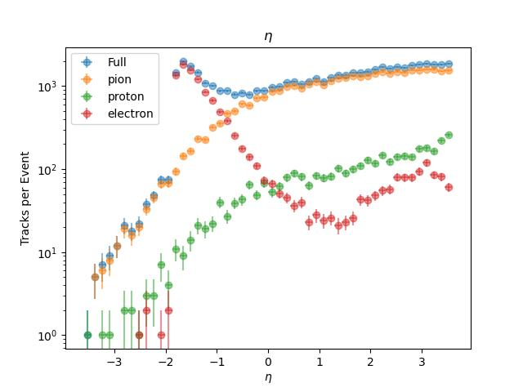
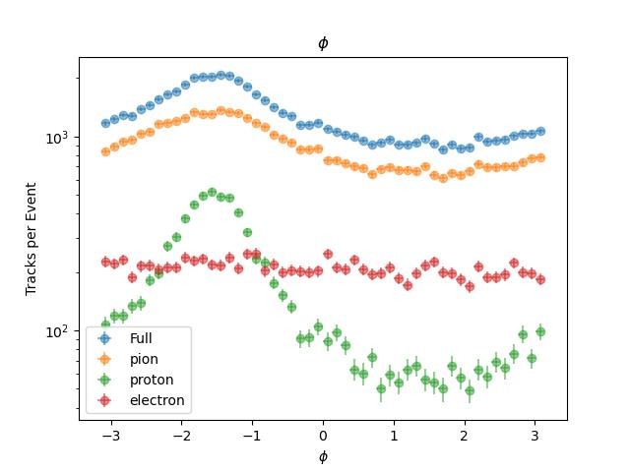
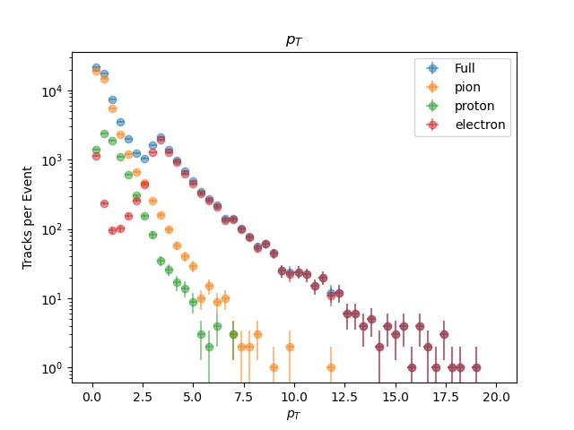
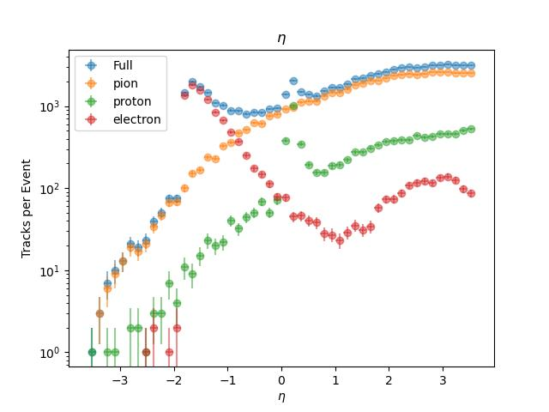
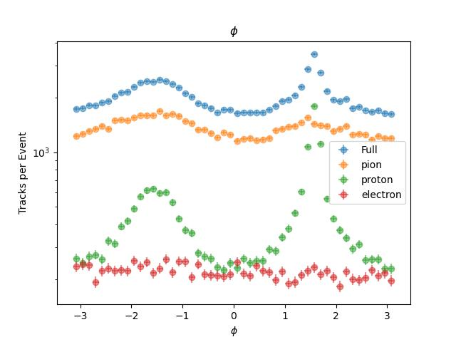
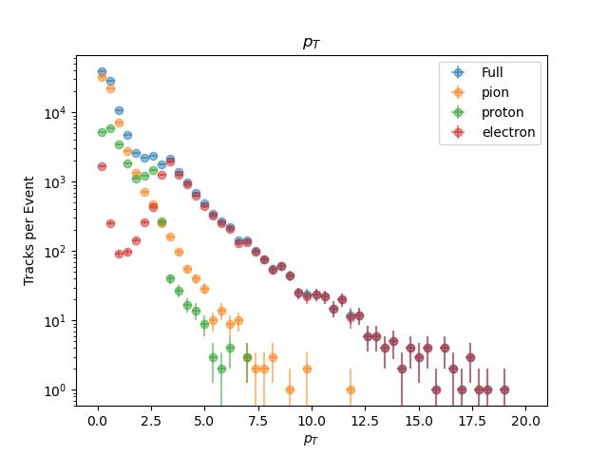
Observables (eta, pT, phi)
Pure Signal
Pure Signal
Pure Signal
Hadron Gas Admixed
Hadron Gas Admixed
Hadron Gas Admixed

Slide 7
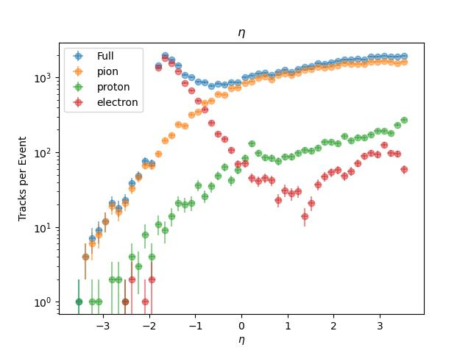
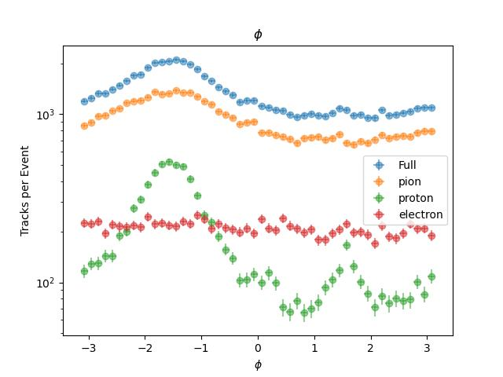
Observables (eta, pT, phi)
Old Admixed
Old Admixed
Old Admixed
Hadron Gas Admixed
Hadron Gas Admixed
Hadron Gas Admixed

Slide 8
Vertex Cut Study

Slide 9
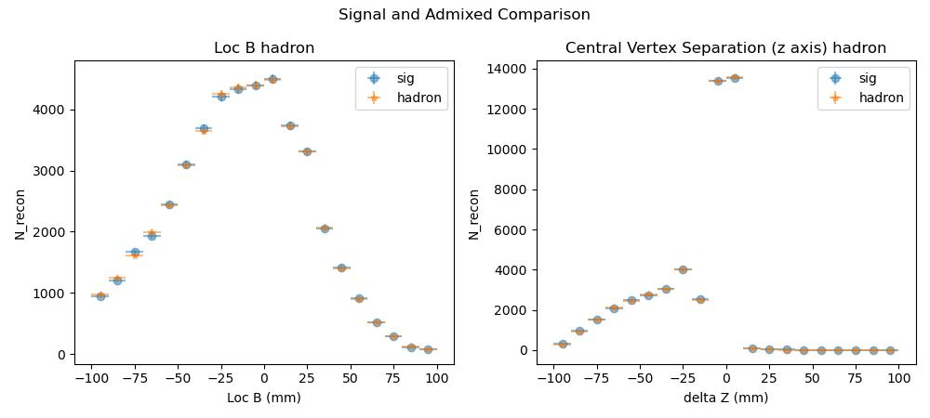
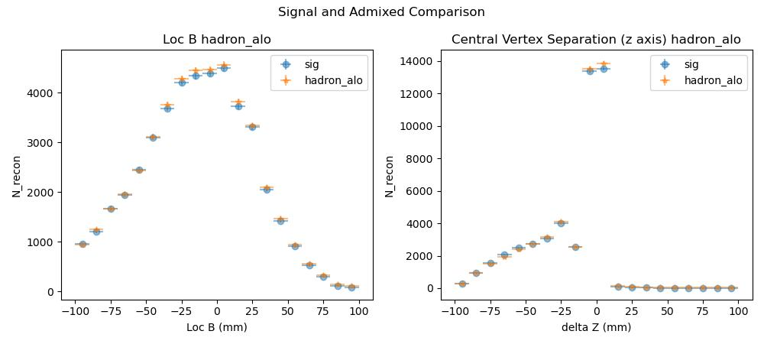
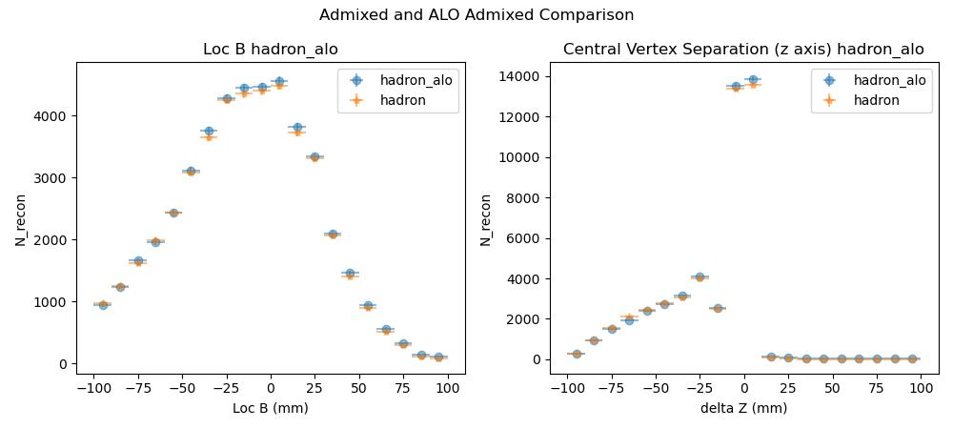
ACTs Location B
Z coordinates of the reconstructed central vertex
Delta Z= Loc B Reconstructed - Simulation Central Vertex

Slide 10
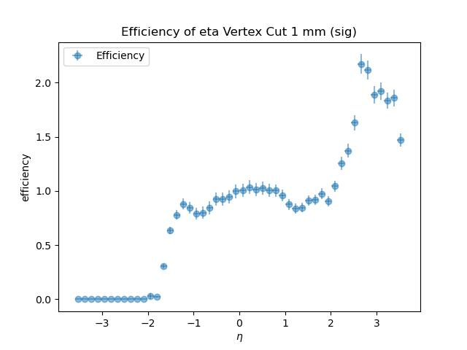
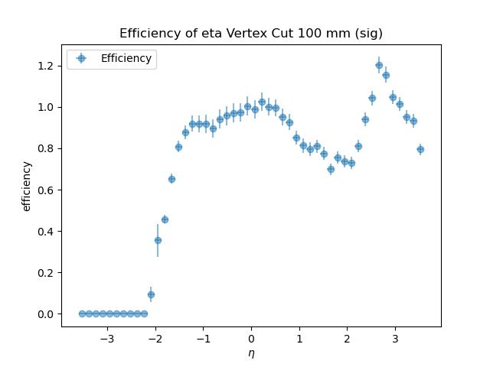
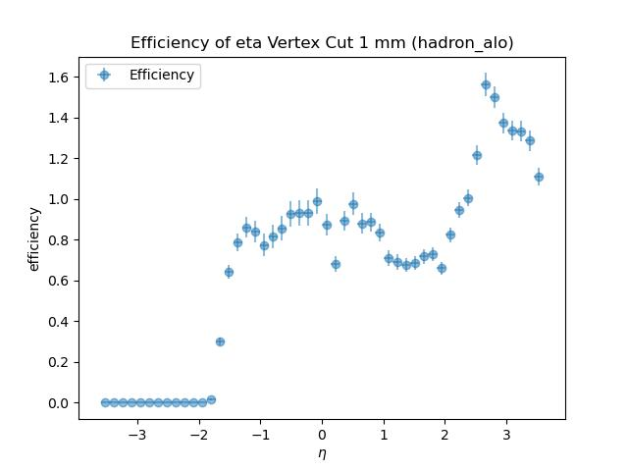
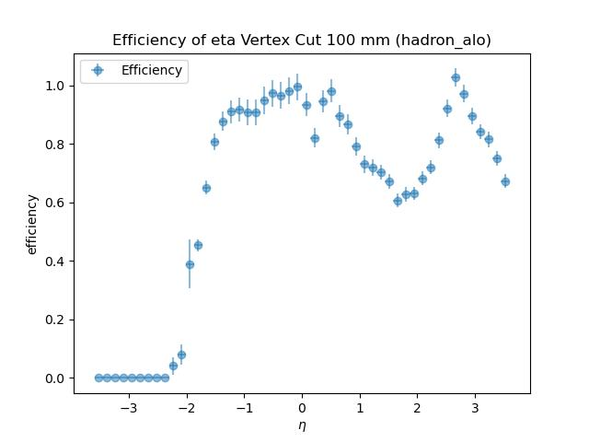
Efficiency Comparison (Bin by Bin)
Efficiency= (Recon, matched)/(Generated, matched + Gen, Unmatched)
Smallest Cut of 1mm
Cut of 100 mm
Pure Signal
At least One Hadron Gas event added

Slide 11
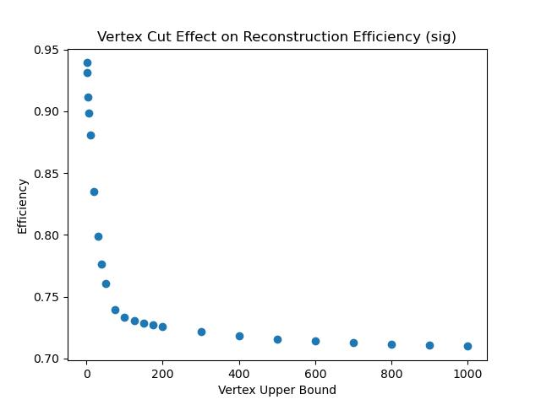
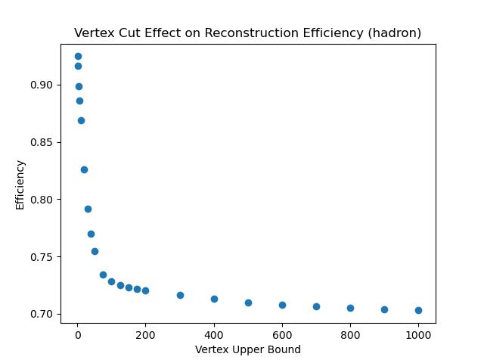
Vertex Cut Study
At least One Hadron Gas event added
Original Admixing Code result
Pure Signal
(mm)
(mm)
(mm)
Efficiency= (Recon, matched+ Recon, unmatched)/(Generated, matched + Gen, Unmatched)

Slide 12
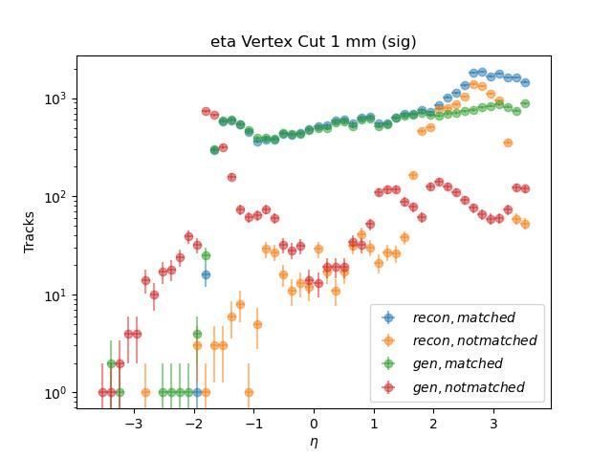
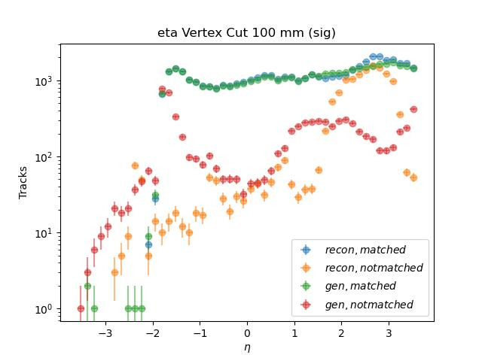
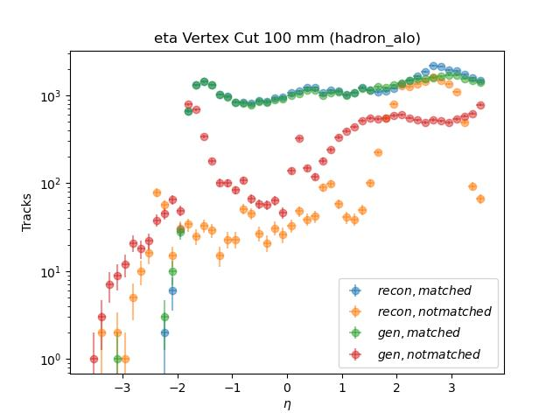
Observables
Notable Feature: Excess in Reconstructed tracks towards positive eta.
Largest Cut of 1cm
Smallest Cut of 1mm
Pure Signal
At least One Hadron Gas event added

Slide 13
Reconstructed Particle Breakdown

Slide 14
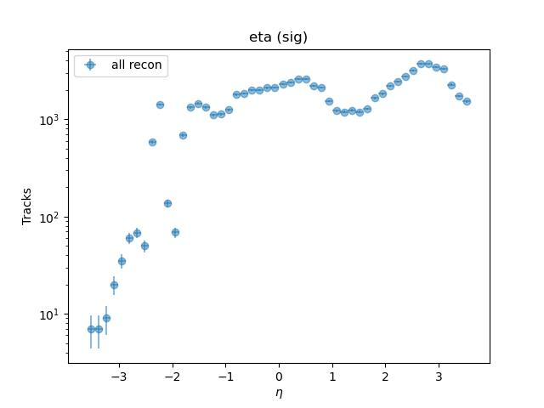
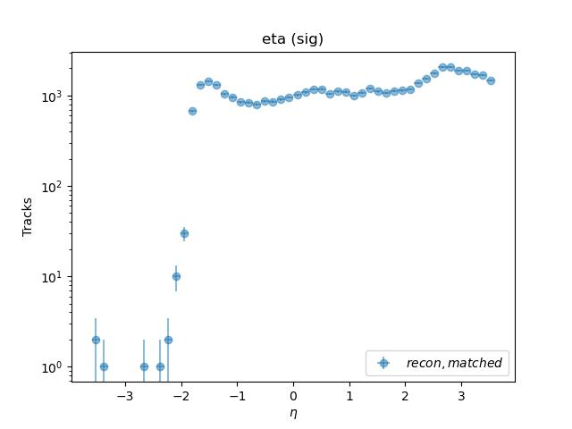
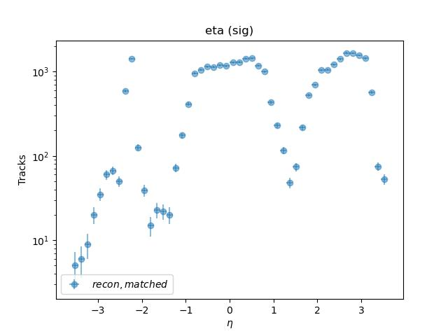
Eta of Reconstructed Tracks
Important Tracks
Reconstructed Tracks With:
PDG=/=0
Extraneous tracks
Reconstructed Tracks With:
PDG=0

Slide 15
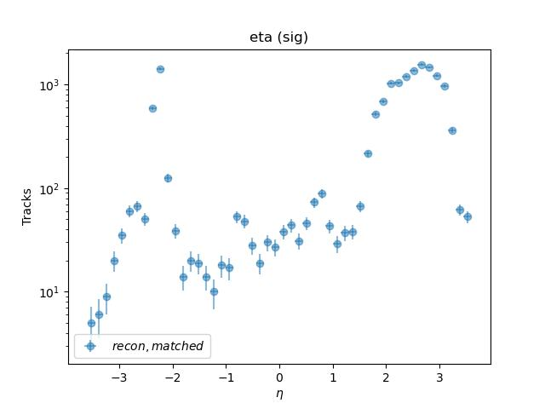
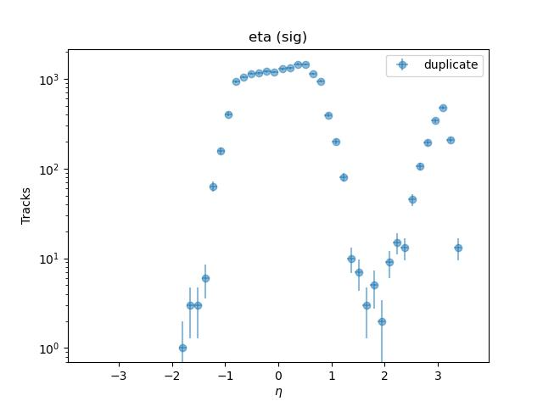
Eta of Reconstructed Tracks (PDG=0 Breakdown)
Not Matched and
Not Duplicates
Filtered out Duplicates
The reconstructed tracks that are not matched and not duplicates of matched tracks inherit the reconstructed tracks in the negative eta regime.

Slide 16
Next Steps
Figure out the root cause of the extra reconstructed tracks
Use the truth information to sort tracks into signal or background

