Slide 1
Installation of Prototype in STAR Hall, and Hodoscope Tracking
Peter Carney

Slide 2
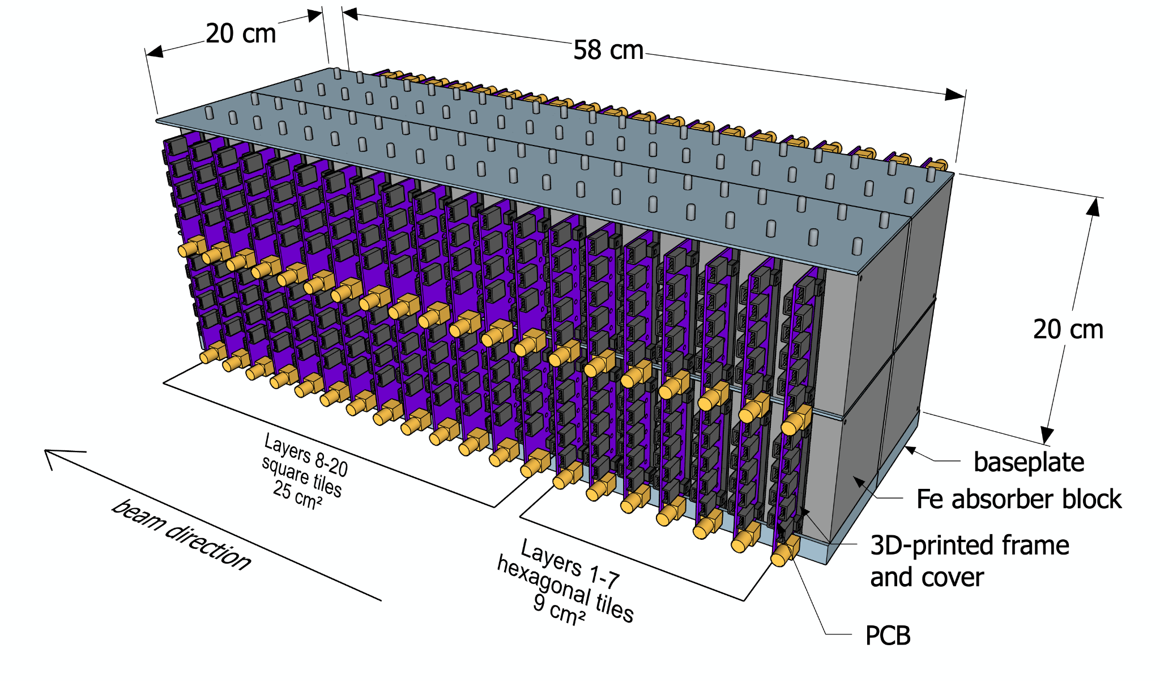
Overview of Calorimeter Structure

Slide 3
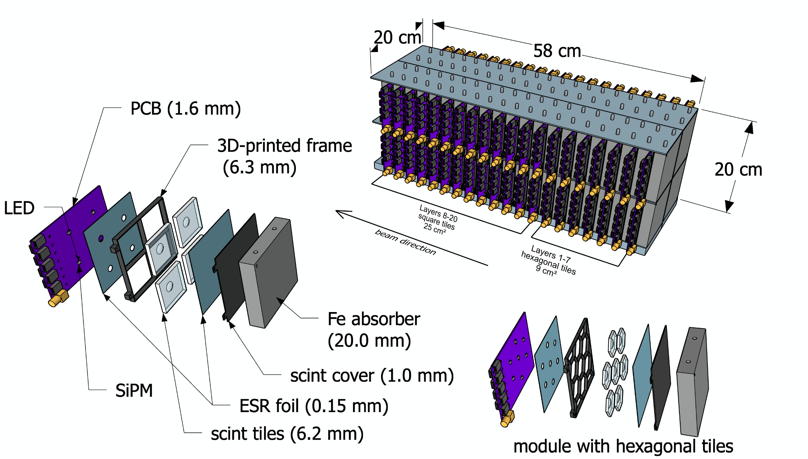
Overview of Calorimeter and Board Structure

Slide 4
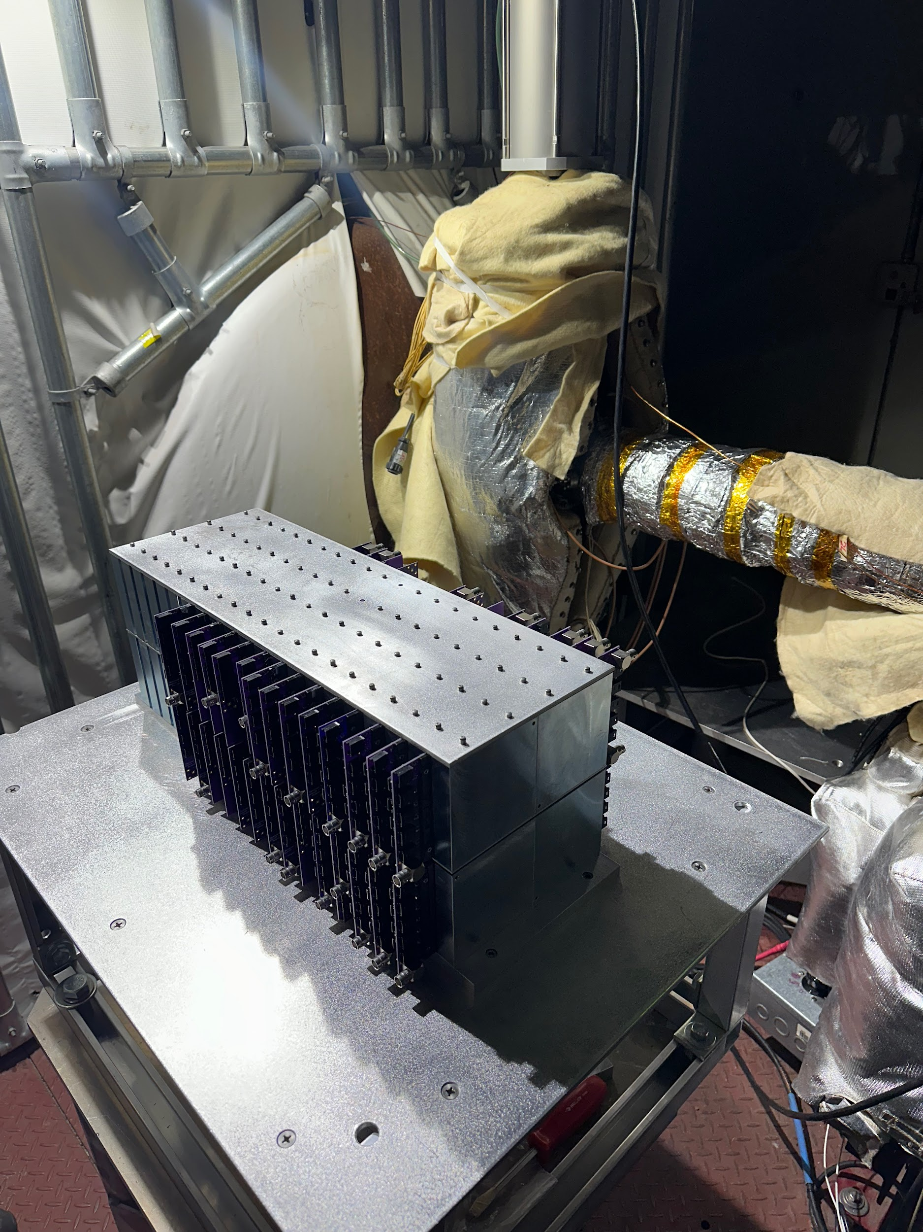
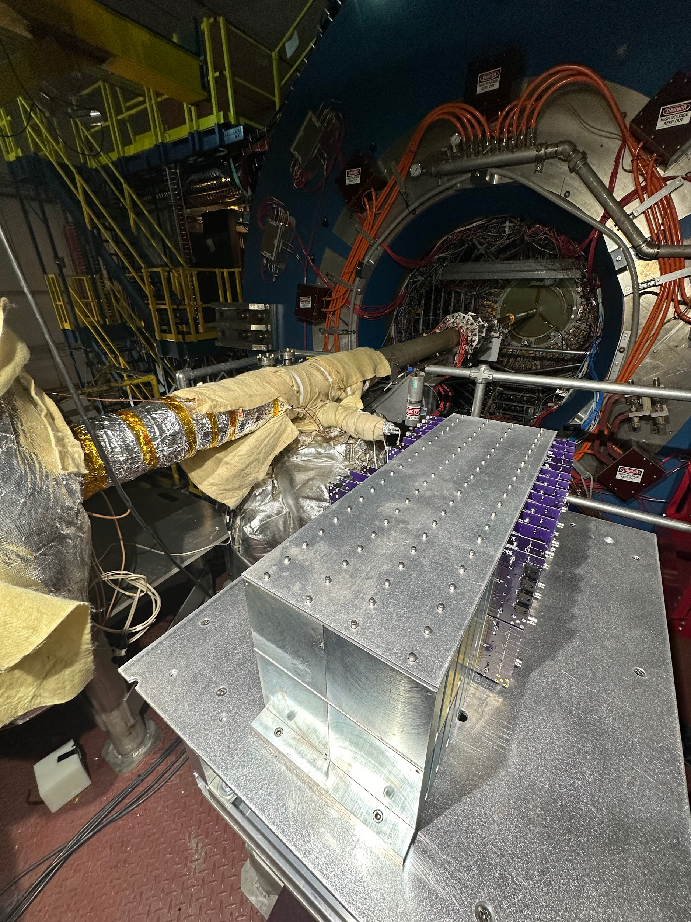
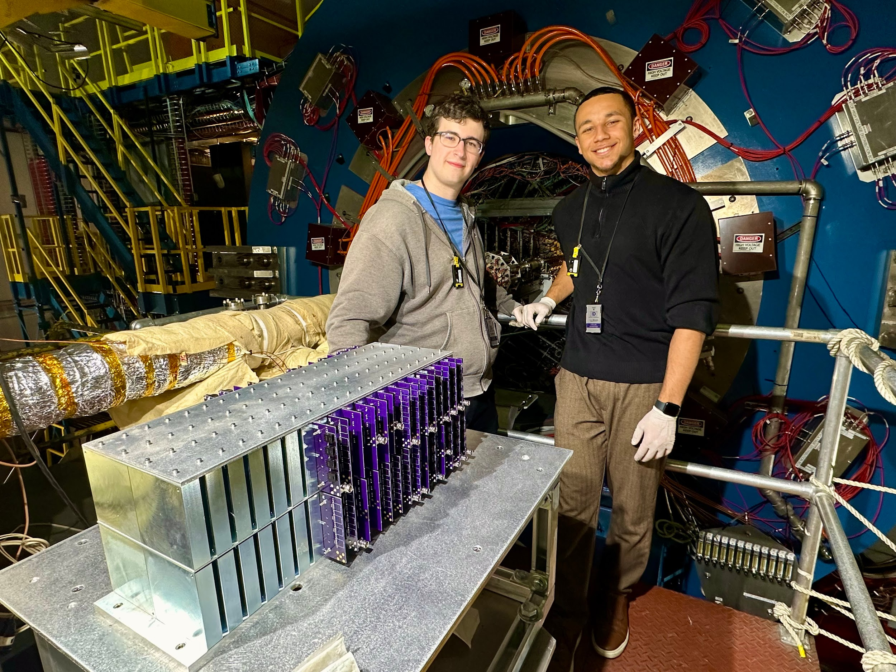
Prototype Placement
Center of Prototype ~45 cm away from beampipe
Prototype bolted into table

Slide 5
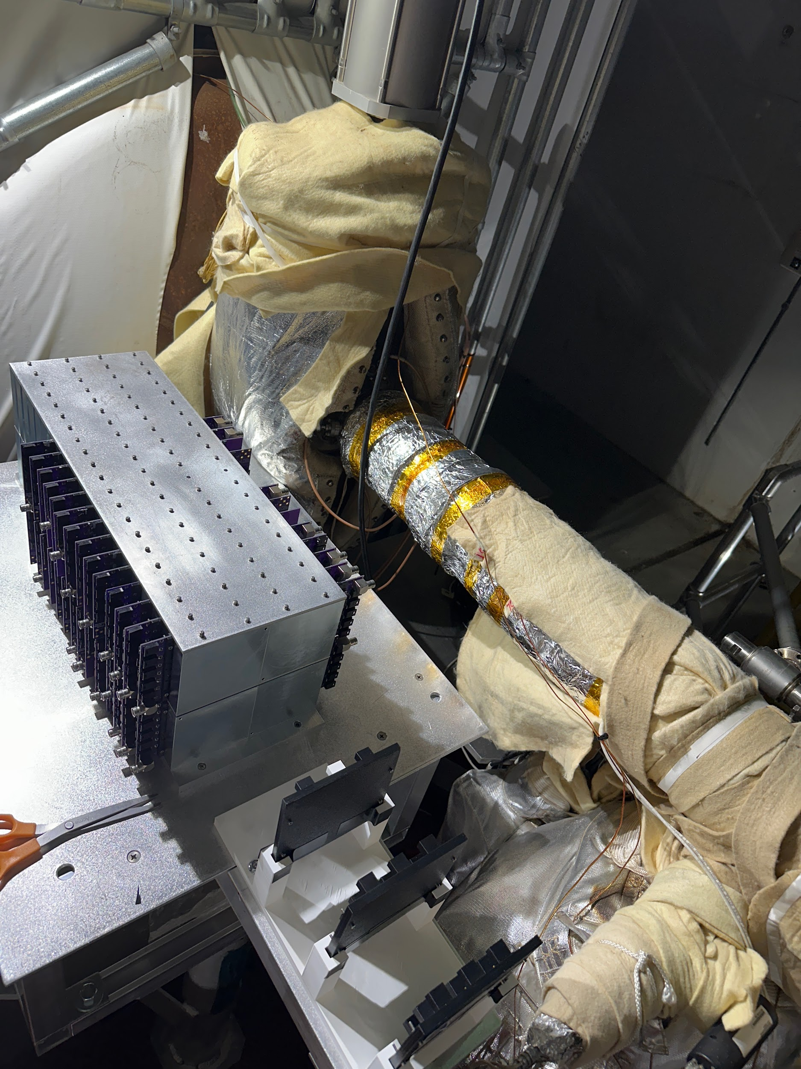
Introduction of the Hodoscope
Hodoscope platform added to long table.
The hodoscope is three sets of 3x3 cell plates.
Uses SiPM on tile approach. Scintillating tiles painted with reflective white paint.

Slide 6
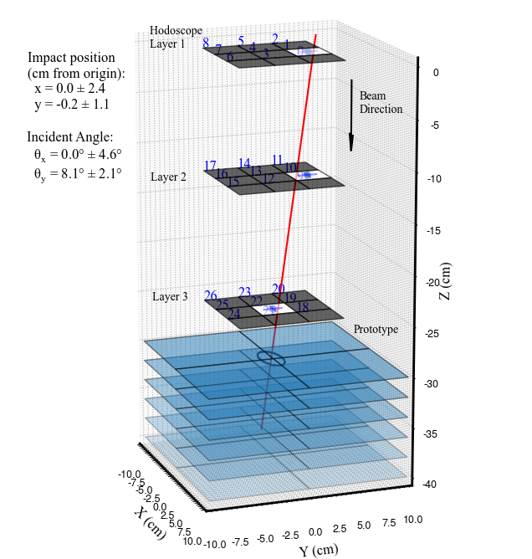
Hodoscope Performance with Cosmic Ray Analysis
A linear vector fit is done through the cells with hits.
Error is taken as cell size /sqrt(12), or ~1 cm.
Trajectory mapped onto GEN II Prototype surface at arbitrary position

Slide 7
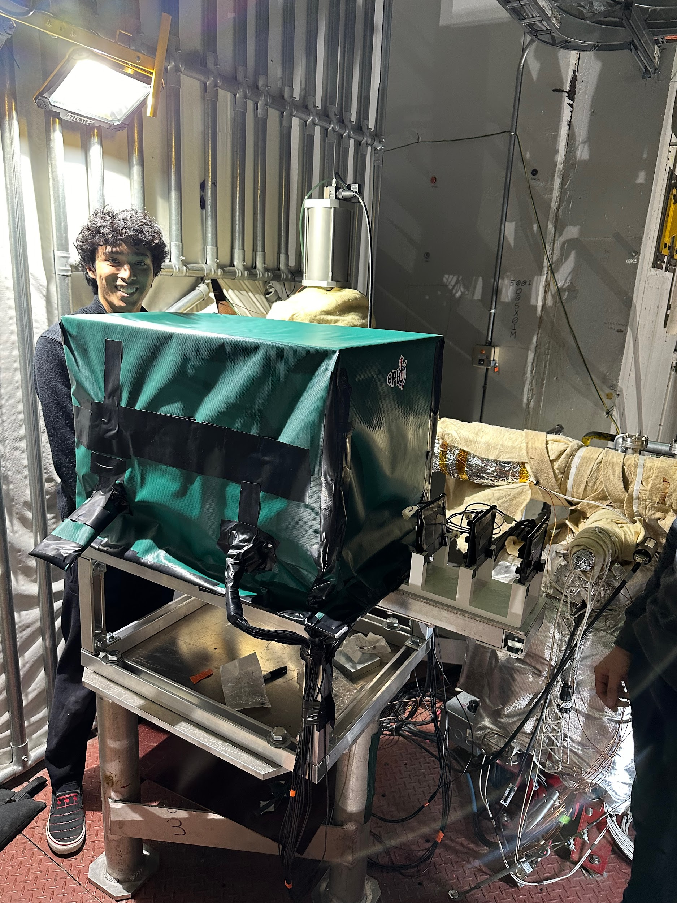
Wiring + Dark Box
Dark box encased around Prototype
25 cables used → 3 boards and 4 channels of the Hodoscope

Slide 8
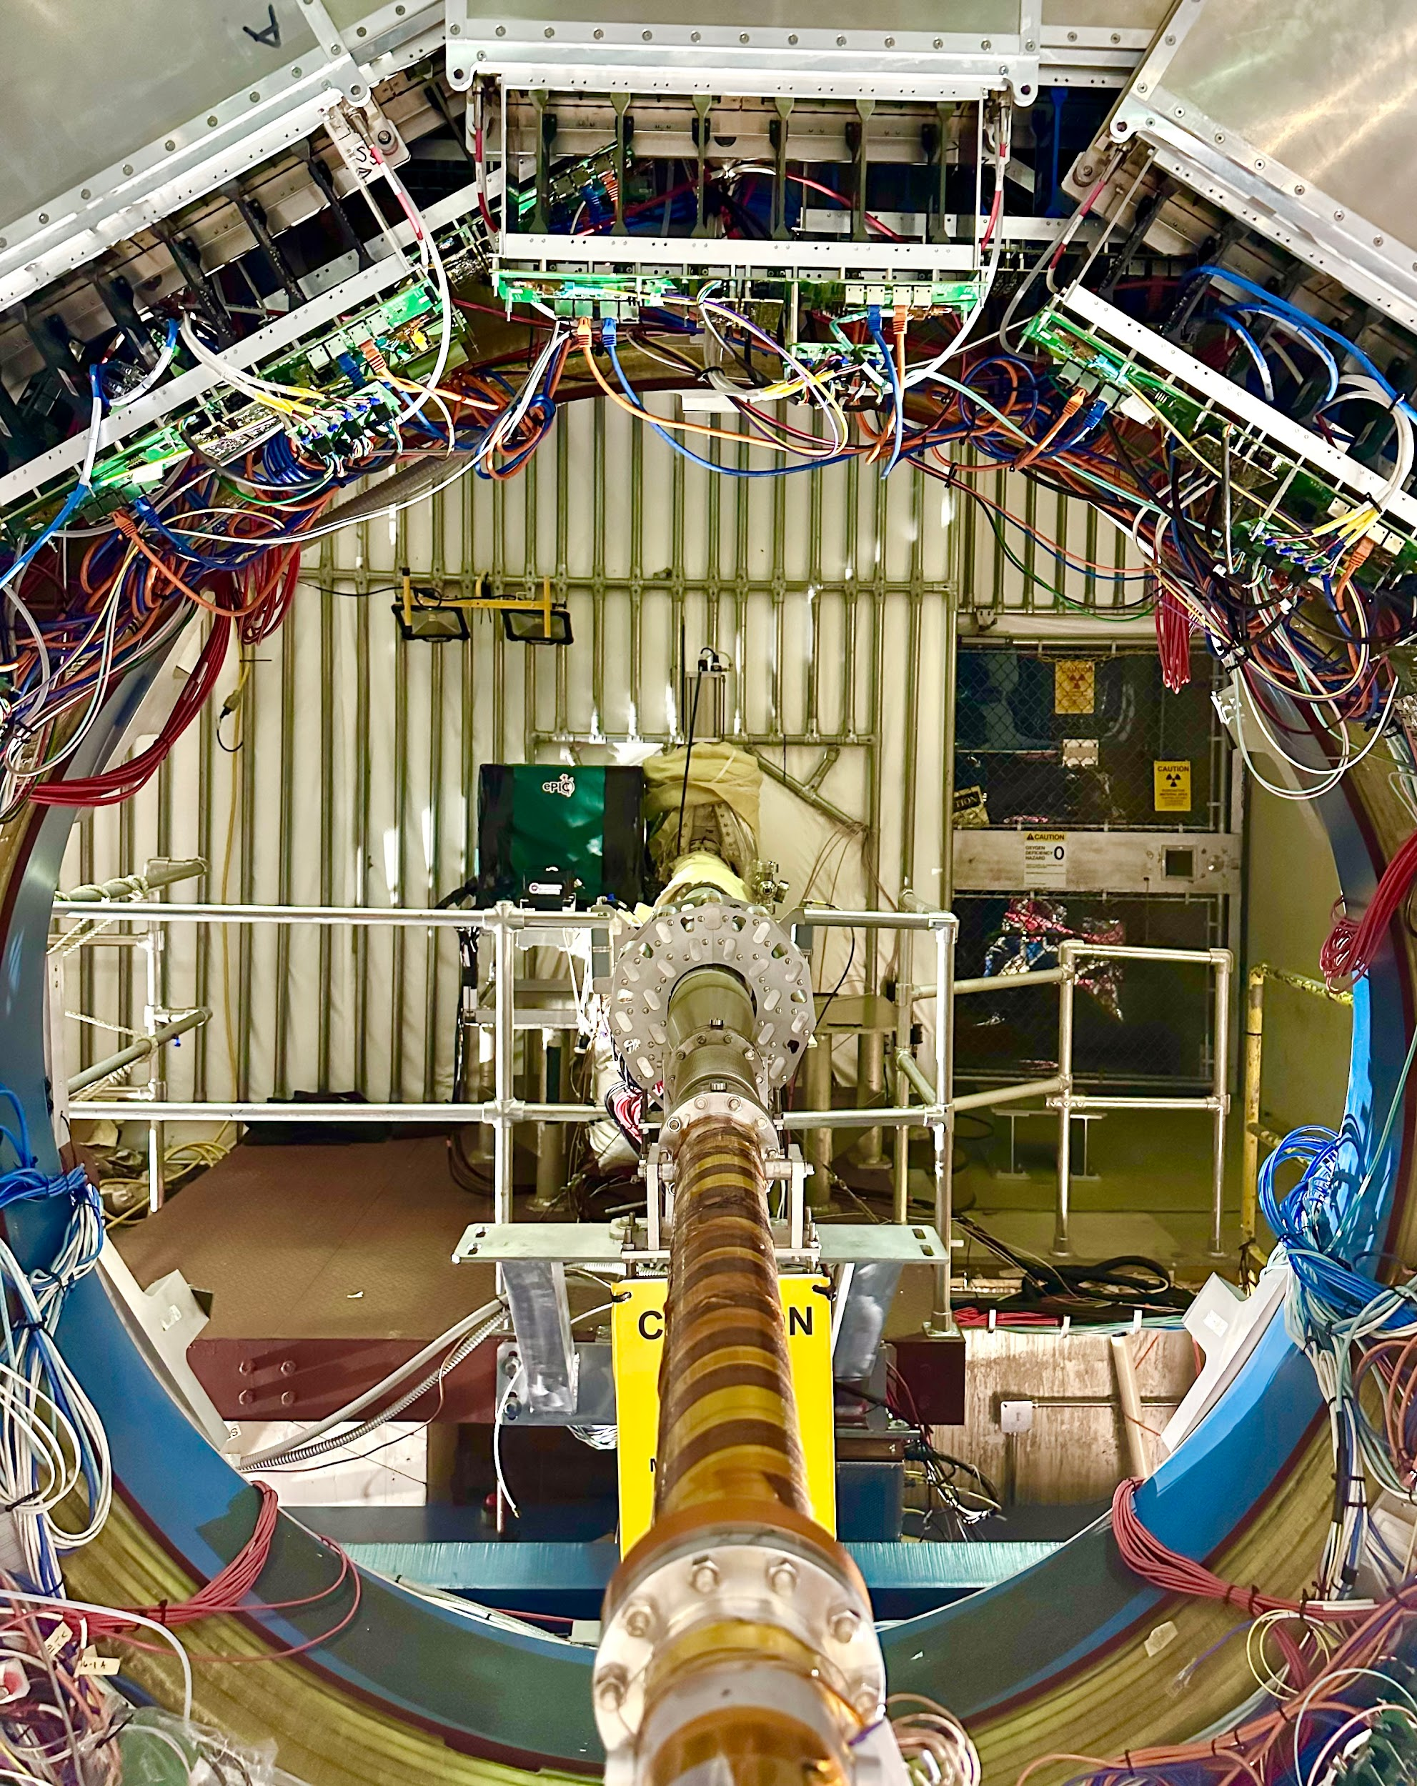
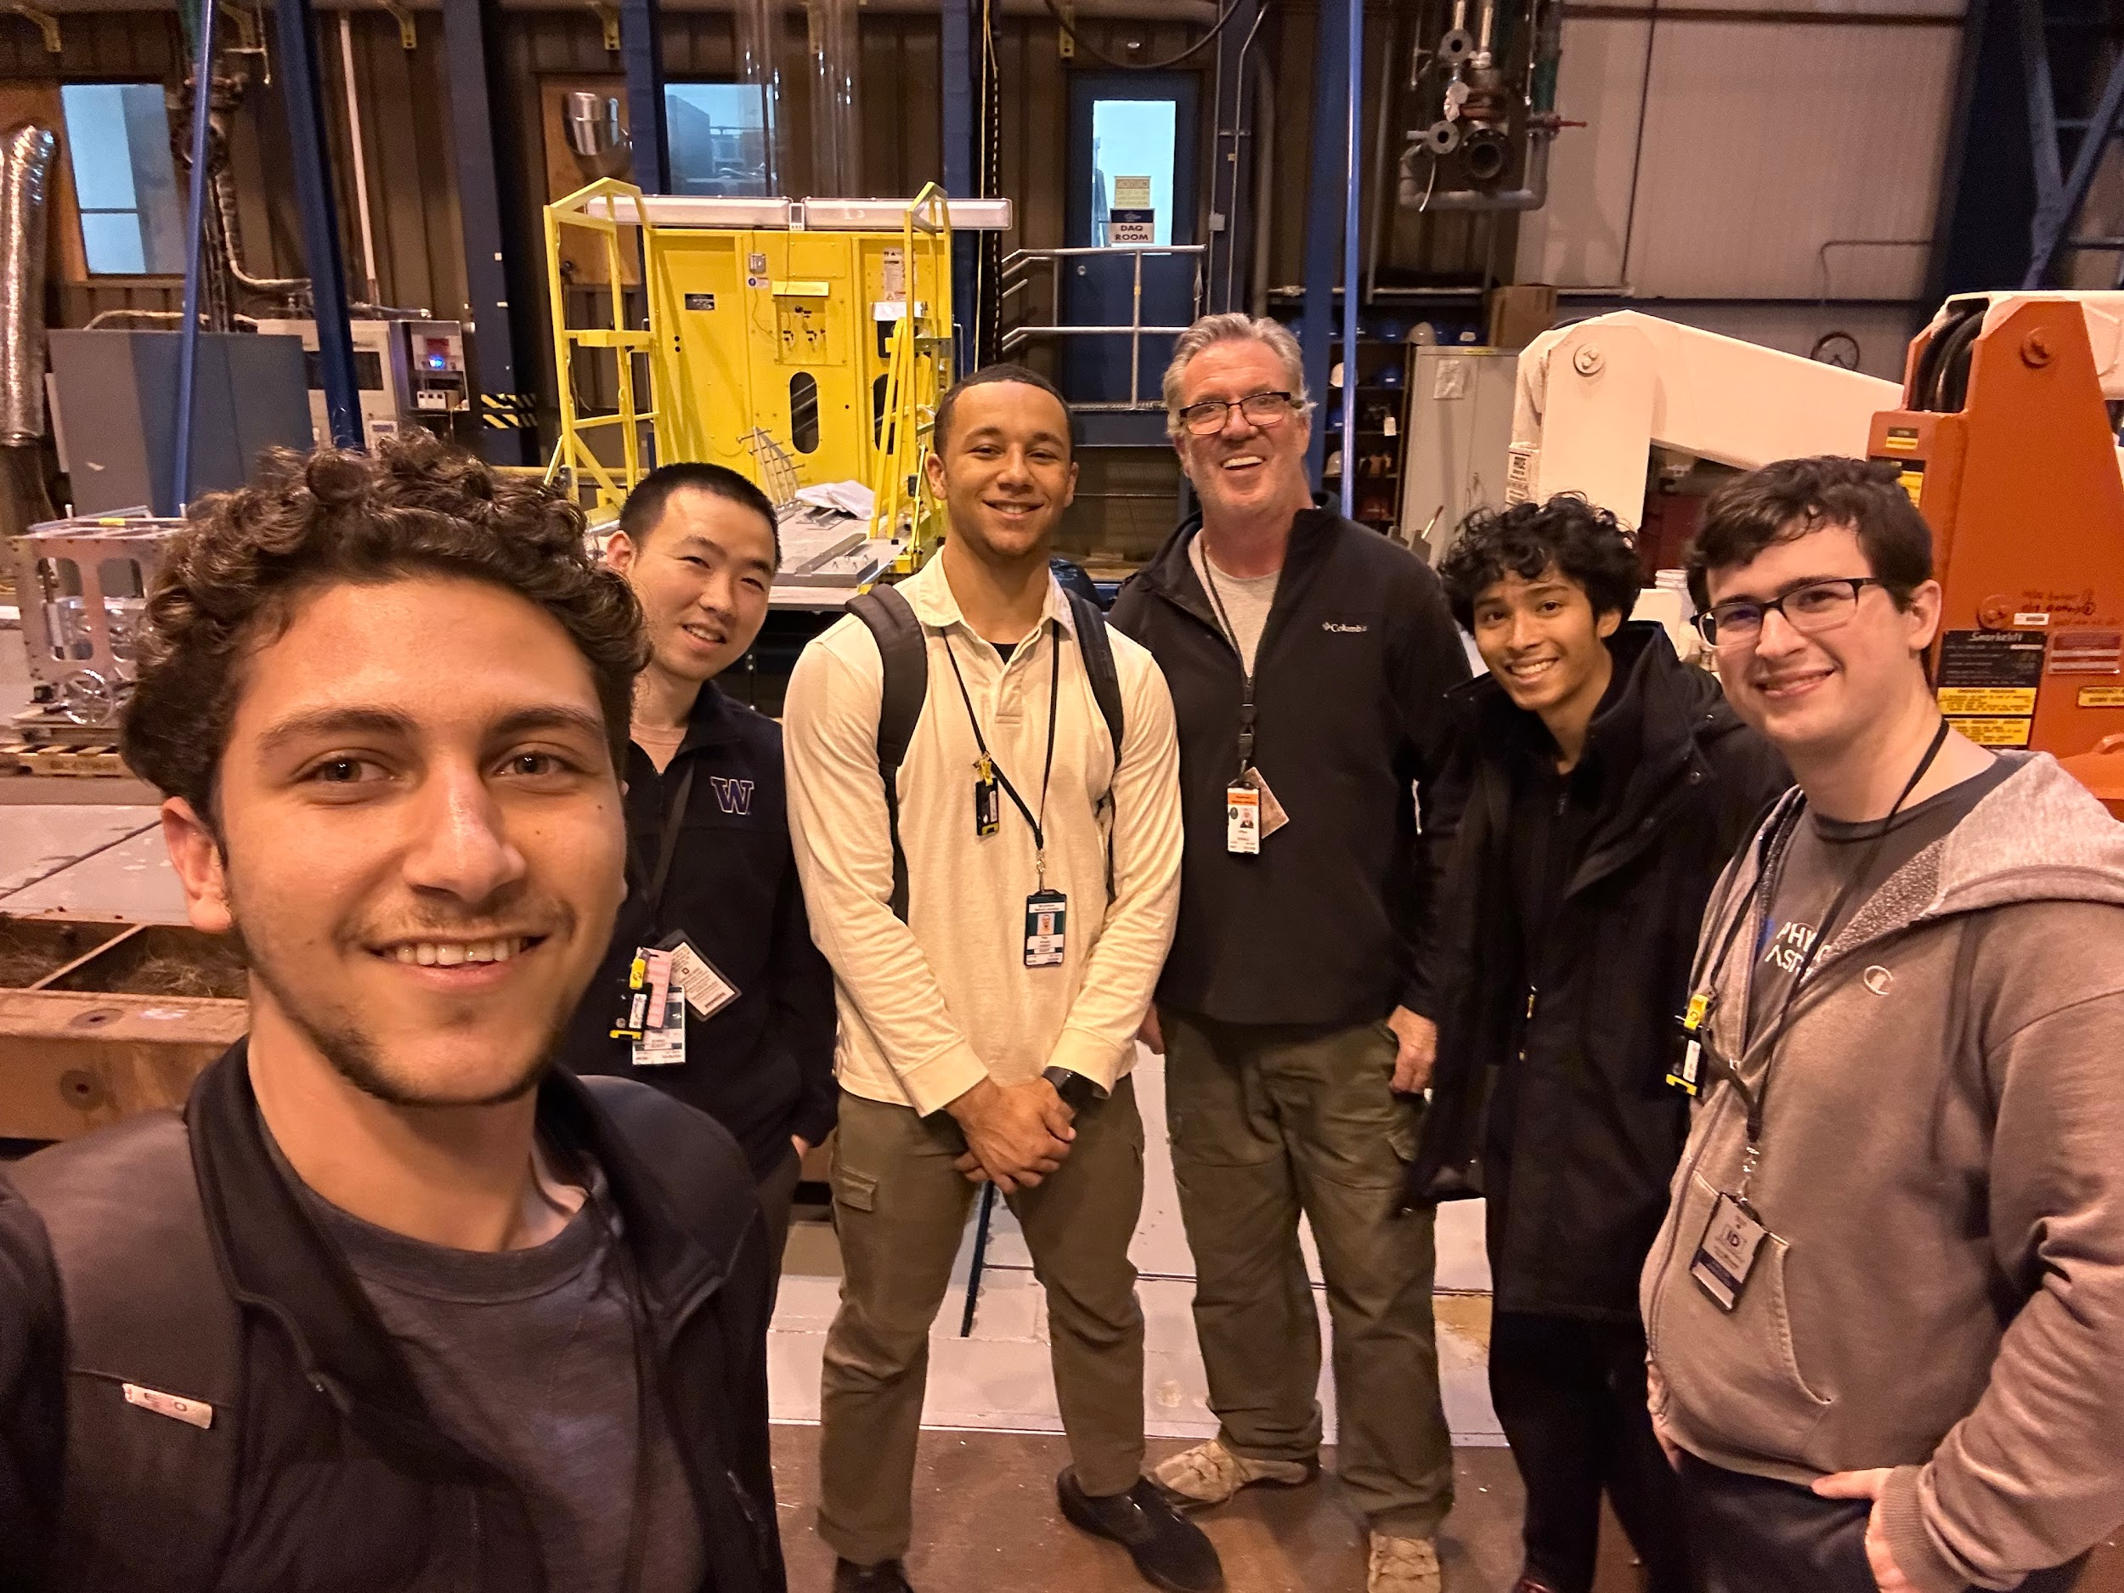
Acknowledgements

