Slide 1
Reconstruction of Nuclear Fragments in IP-8
JiaJun Huang, Barak Schmookler
UC Riverside, California EIC consortium

Slide 2
Introduction
EIC e-A collisions have the possibility of inducing fission or evaporation of the excited pre-fragment nucleus, as well as Fermi-breakup and multi-fragmentation
We use the BeAGLE event generator to model the initial scattering + intranuclear cascade; and FLUKA and ABLA07 to then simulate the decay of the excited pre-fragment
Previous studies of production and detection of nuclear fragments were shown at the 2023 EIC UG meeting (here)
Focus in this presentation will be on the reconstruction of the pre-fragment based on nuclei and escaped nucleons

Slide 3
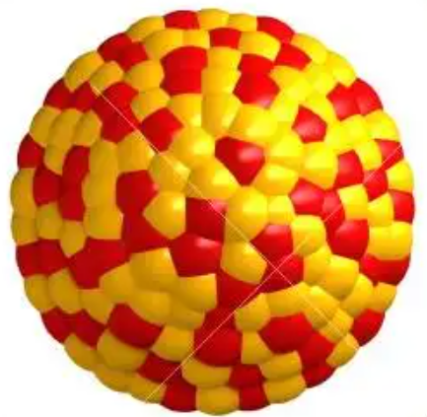
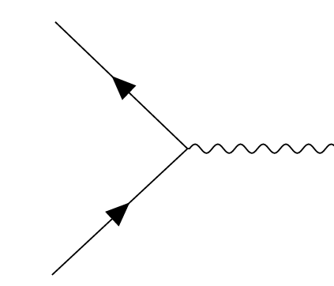
One way the 2nd focus can be used – Nuclear fragments
Hard scattering and intranuclear cascade
High-energy fission or evaporation
Gamma de-excitation
Decay of radioactive isotopes
Incoming GeV electron beam and 100 GeV/nucleon heavy ion beam
Excited intermediate nucleus (i.e. pre-fragment)
Fission or evaporation products
Isotopes in ground state and gammas
Isotopes after radioactive decay
Abraded
Ablated
Detector Level
t = 0
t = 10⁻²² s
t = 10⁻²⁰ - 10⁻¹⁷ s
t = 10⁻¹⁴ s
t = ? – never (stable)
Slide from: Barak Schmookler

Slide 4
EIC Detectors – far-forward region
Fission Product Detector (FPD)
B0 and ZDC detect neutron and gamma ray
Roman Pots detect the fragment trajectory and A/Z
Fission Product Detector (cherenkov or scintillator) detects fragment Z
Slides from: Barak Schmookler

Slide 5
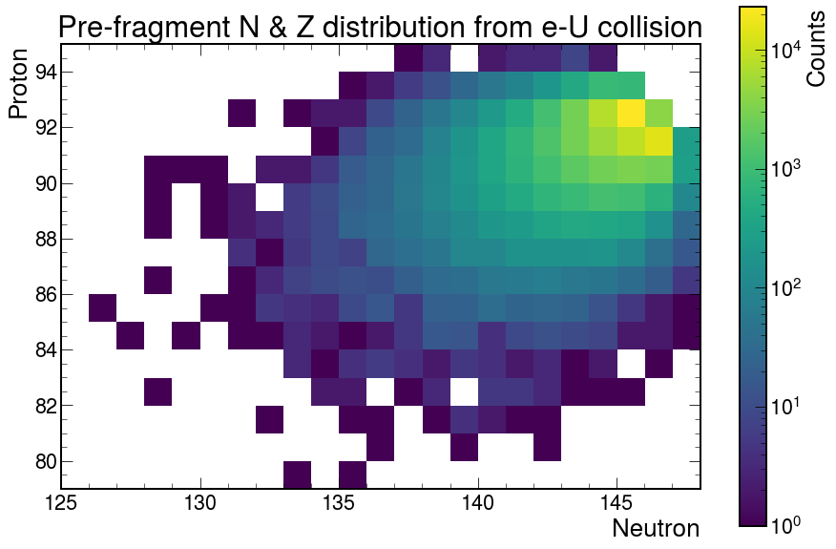
BeAGLE excited pre-fragment production distribution
Production of excited pre-fragment nuclei can have a variety of N & Z combination from the ²³⁸U beam
What we want to measure

Slide 6
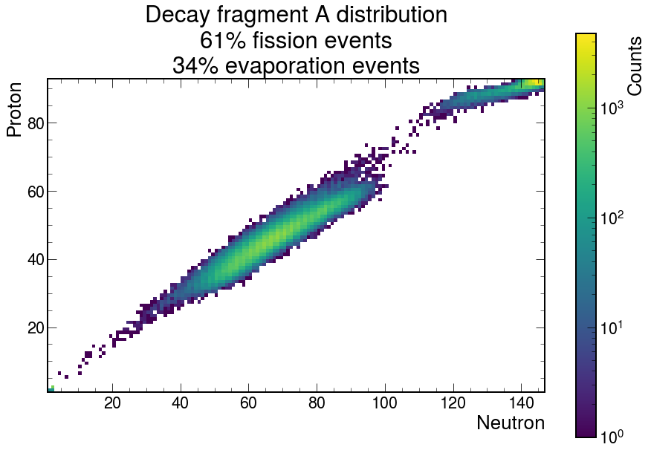
BeAGLE + FLUKA
100,000 event generation of scattering + decay process of e+²³⁸U collision
60510 fission di-fragment events
33650 evaporation events
Other events includes: 6%
Multi-fragmentation
Fermi-breakup
Evaporation Region
Fission
Region

Slide 7
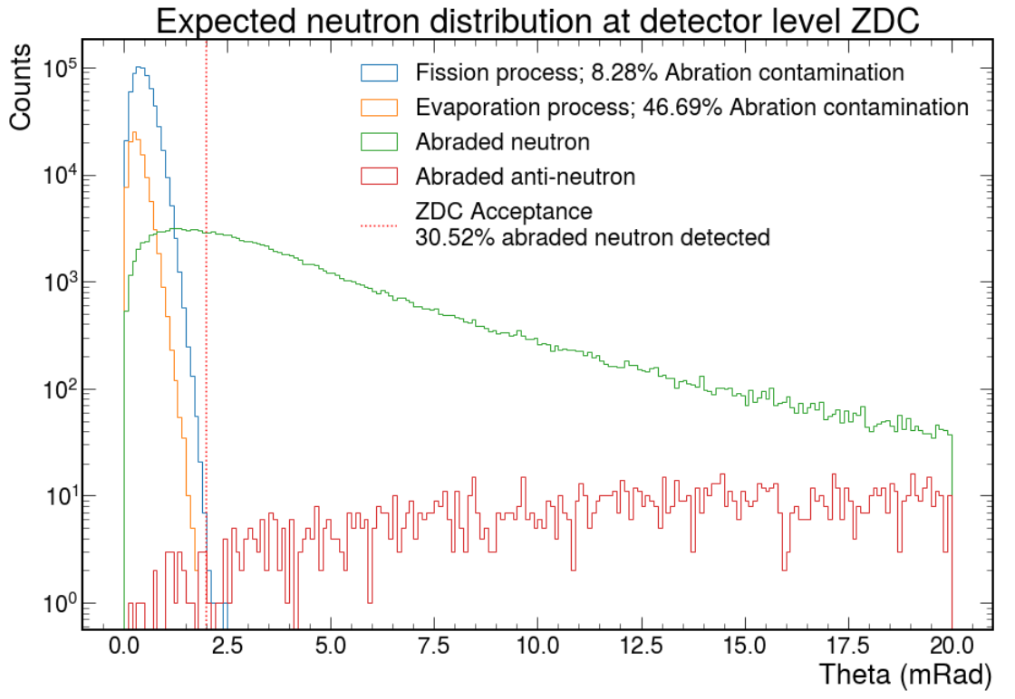
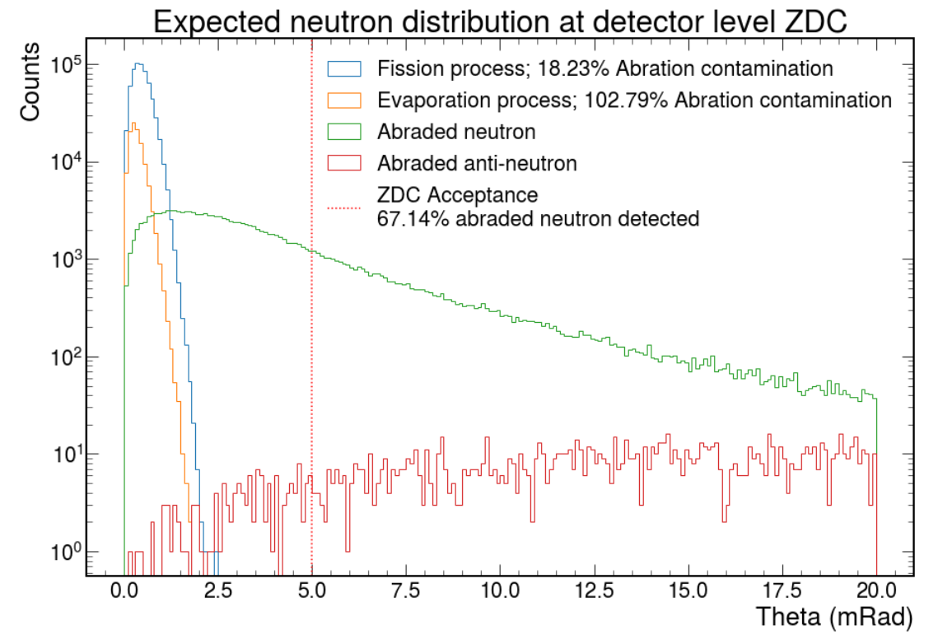
Results from FLUKA
Kinematics of neutrons from the BeAGLE+FLUKA simulation show a confined region within the ZDC acceptance that the ablated neutrons will hit.
Abraded nucleons within the angular cut will result in background noise for reconstructing the pre-fragment
Abraded nucleons: produced in the hard scattering or intranuclear cascade.
Ablated nucleons: produced during the de-excitation of the excited pre-fragment.

Slide 8
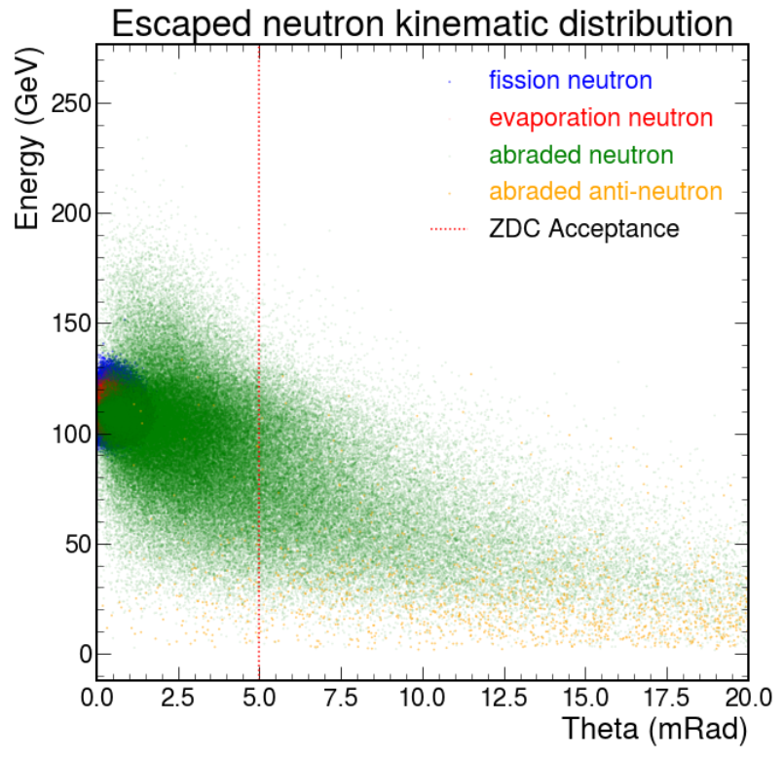
Neutron kinematics
Abraded neutrons have a wide range of angular and energy spectrum
Ablated neutrons are confined into smaller theta and close to the beam energy
Abraded nucleons: produced in the hard scattering or intranuclear cascade.
Ablated nucleons: produced during the de-excitation of the excited pre-fragment.

Slide 9
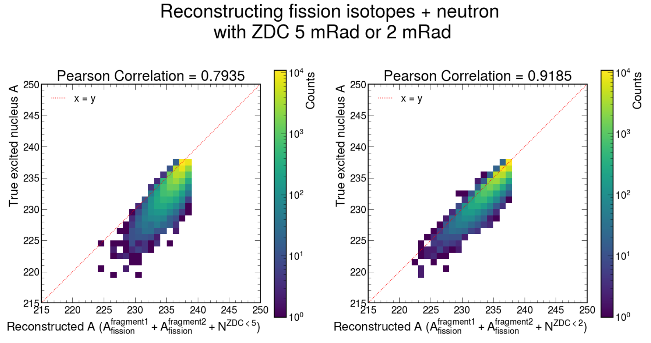
Fission reconstruction using only neutrons
Using neutrons seems to be enough for reconstructing the pre-fragment
Reconstructing the A of fragment 1(2) will require the Roman Pots and a detector to determine Z.

Slide 10
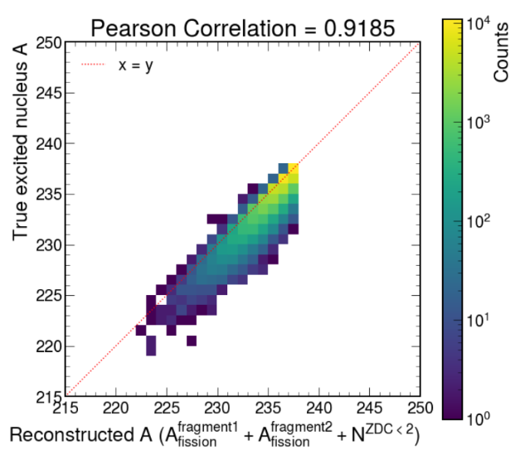
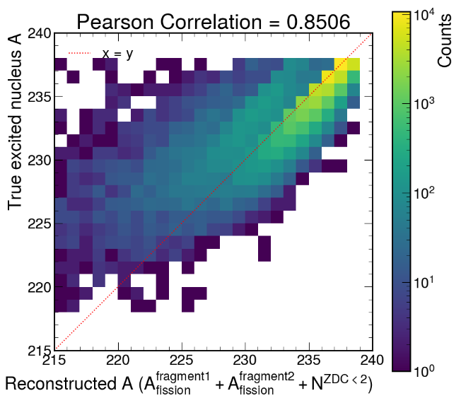
Light charge nuclei events
The previous plot filtered away events with light charged particles (Deuterium, He3, He4), which consist of ~7% of the fission events
But we hope to also detect and differentiate those particles, so we are expecting the same reconstruction as before
Counting light charge particle production events

Slide 11
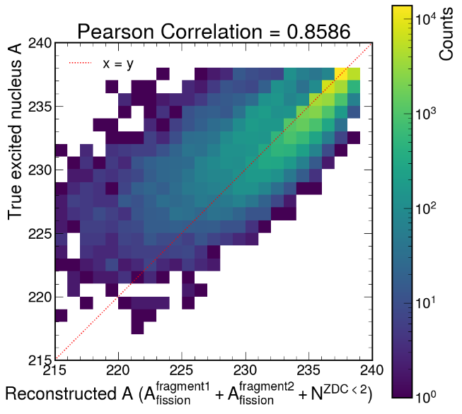
Results from ABLA - reconstruction
We also use ABLA and follow the same method to find the fragments from fission events and reconstruct the pre-fragment based on the neutrons ablated from the decay model
The same abraded neutrons were applied as background in FLUKA and ABLA, since we use the pass the same set of BeAGLE events into both de-excitation codes.

Slide 12
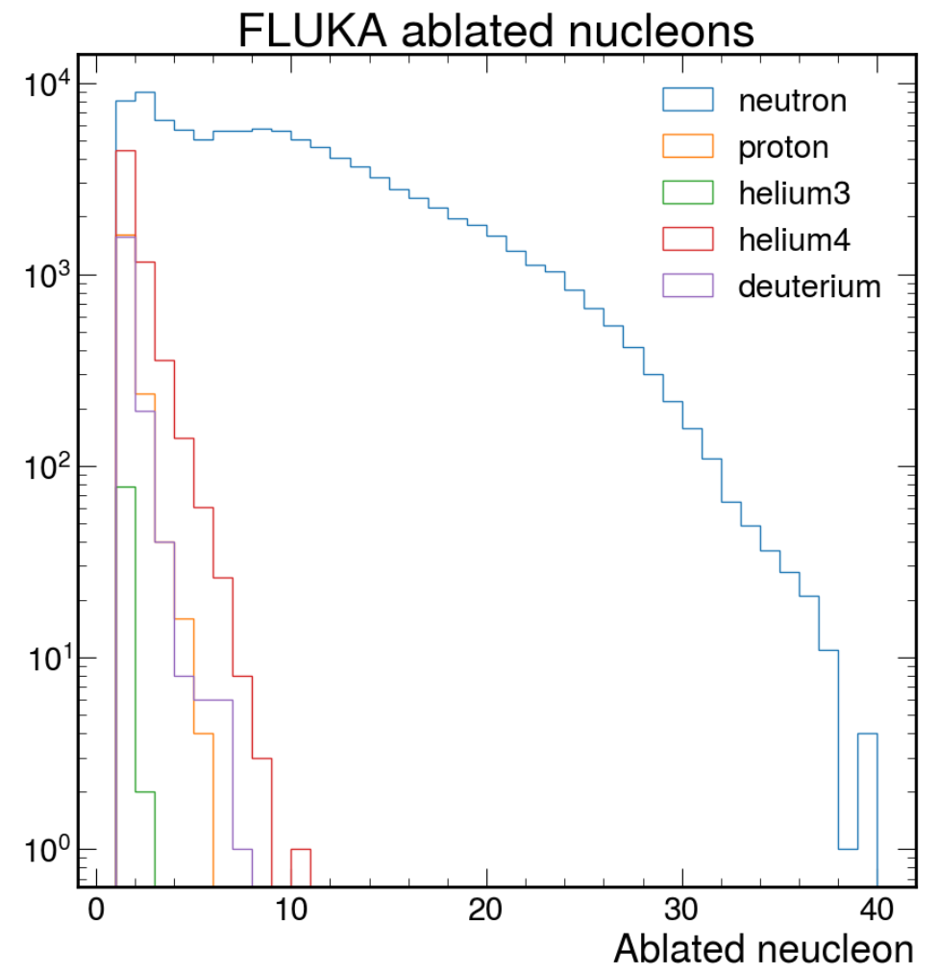
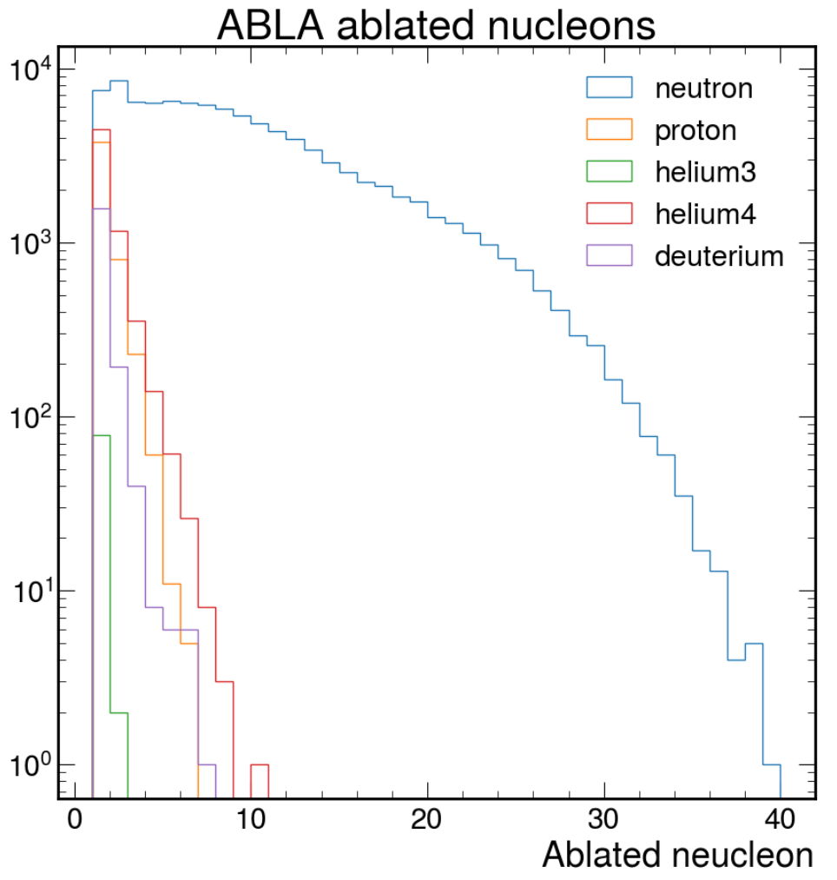
Comparing ablated nucleons from FLUKA and ABLA
The pre-fragment decay process can produce nucleons and light charge particles.
FLUKA and ABLA are in general agreement on production rates.

Slide 13
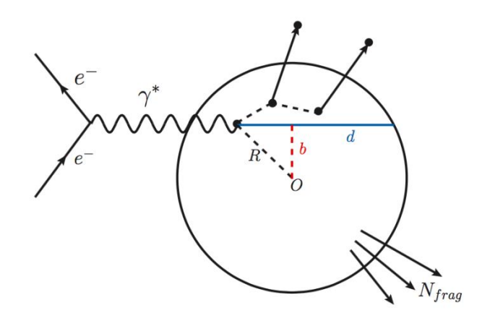
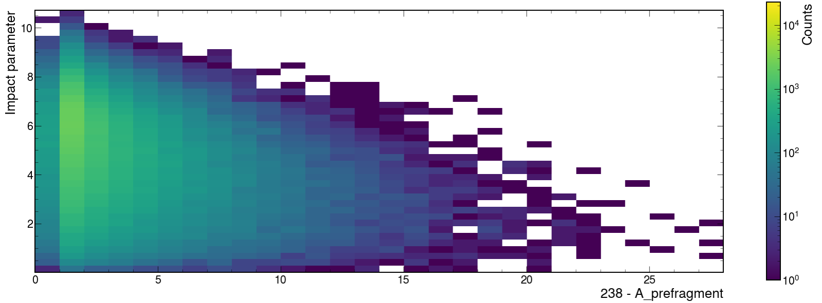
Impact parameter anti-correlation
Anti-correlation between impact parameter (b) vs. ablated nucleons for possible hadronization studies

Slide 14
Impact parameter anti-correlation
Increasing the number of abraded nucleons (A_beam - A_prefragment) means a larger intranuclear cascade – which happens more often in central collisions.
So, reconstruction of the pre-fragment can allow a potentially more robust way to determine centrality than using only the neutrons in the ZDC.
Anti-correlation between impact parameter (b) vs. ablated nucleons for possible hadronization studies

Slide 15
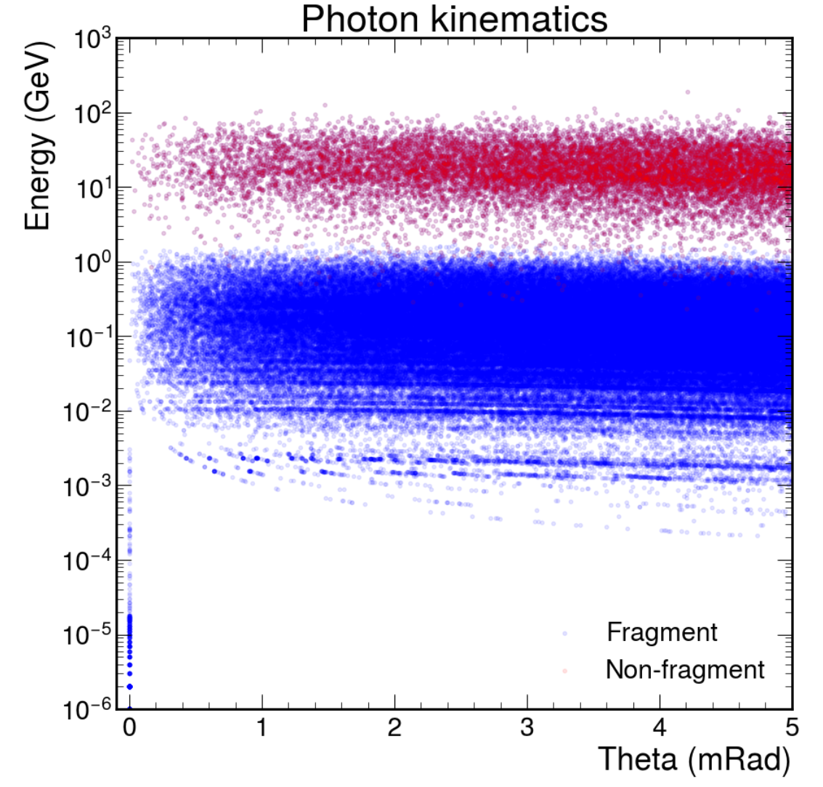
Photon kinematics at ZDC
Two primary group of interest:
pi⁰
fragment de-excitation from the fission and evaporation process
Photons energy is distinctive between fragment de-excitation and particle decay
FLUKA is not able to differentiate the photons from de-excitation of fragments

Slide 16
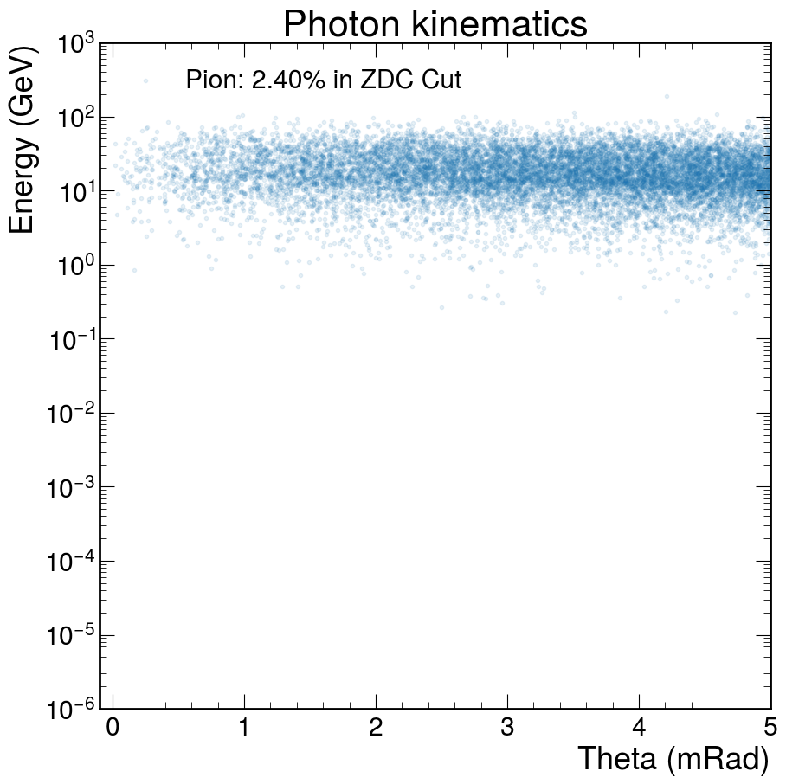
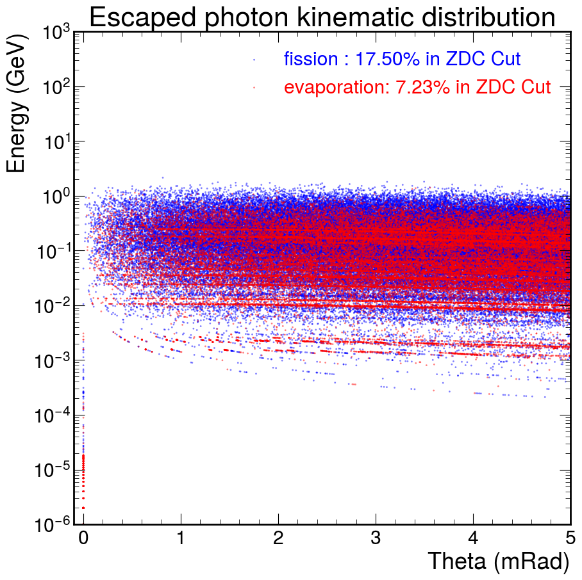
Photon kinematics at ZDC

Slide 17
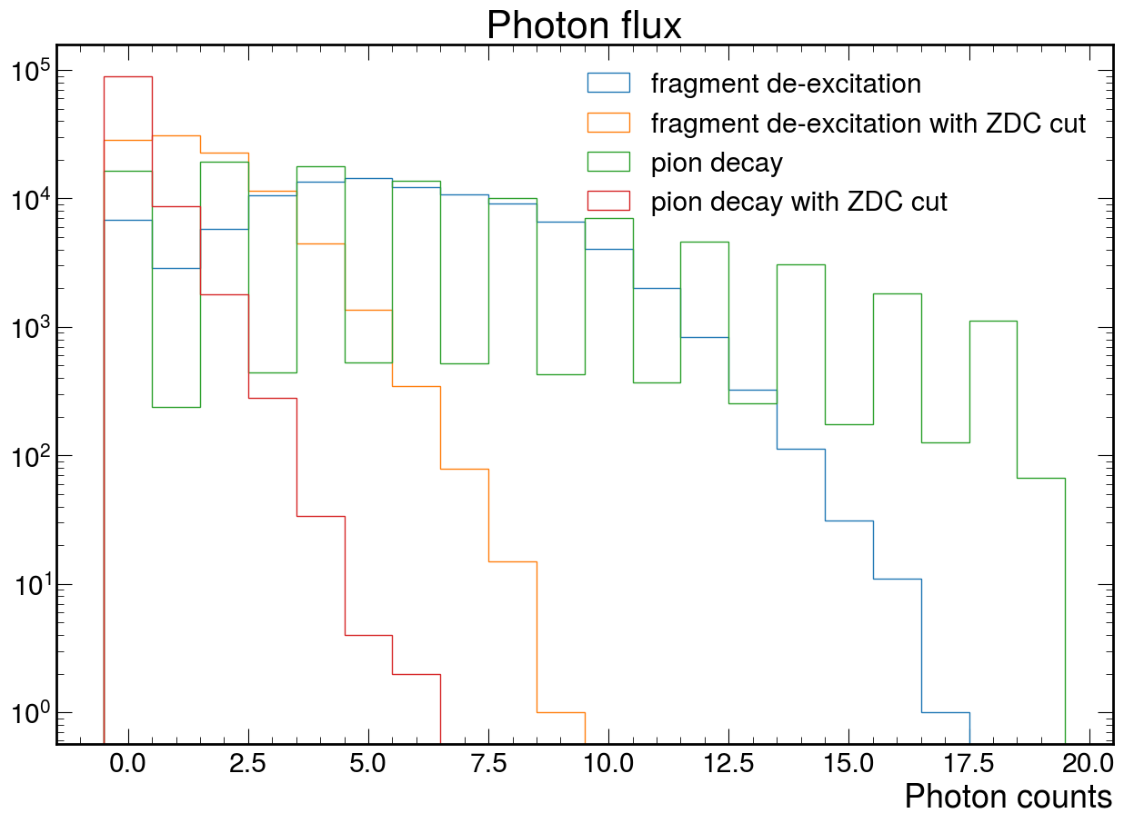
Expected photon flux per event
Di-photon production from pion can undergo further decay into electron or interacting, resulting in odd number of photons

Slide 18
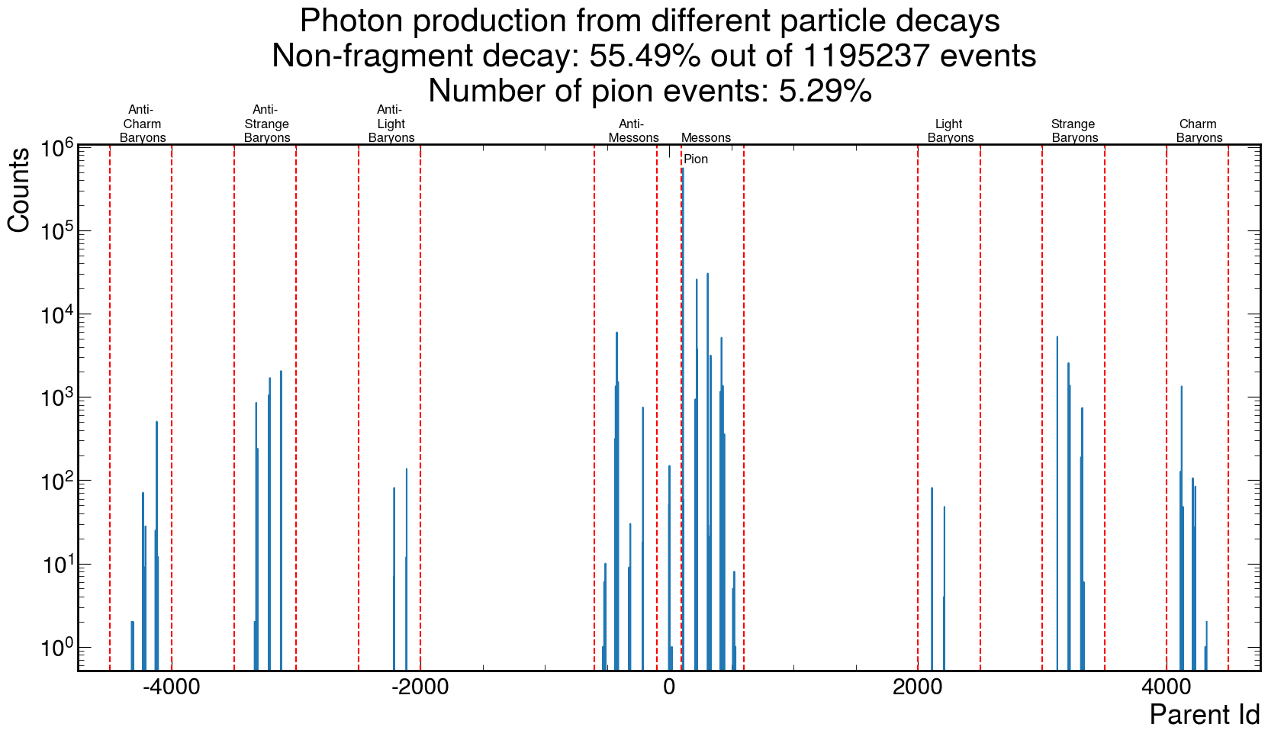
Expected photon flux from non-fragments
Pion is not distinctive in the total photon production process

Slide 19
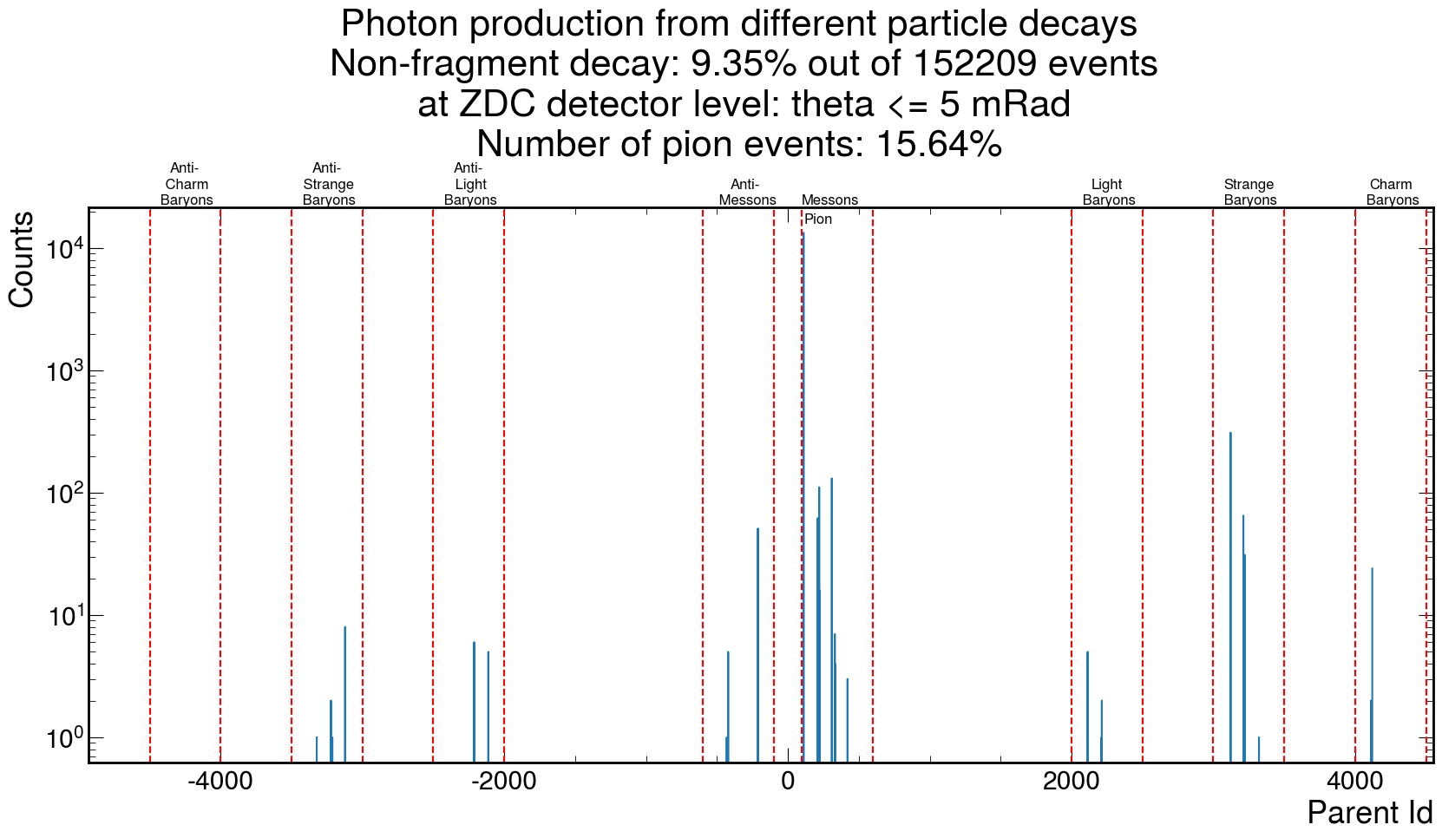
Expected photon flux from non-fragments
At the ZDC, pion have a better resolution from other background photons

Slide 20
Thank you for your time!

Slide 21
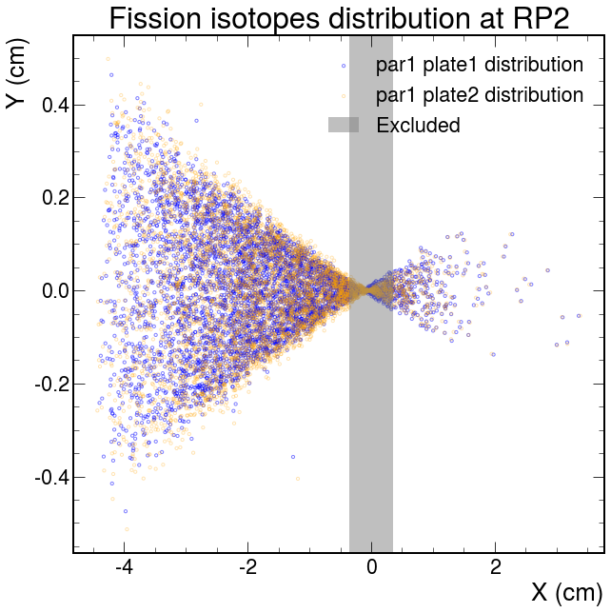
Gen4 2nd Roman Pots simulation
Fragment separation in X is larger than Y,
due to configuration of magnets
Magnet effects accounted for fragment separation

Slide 22
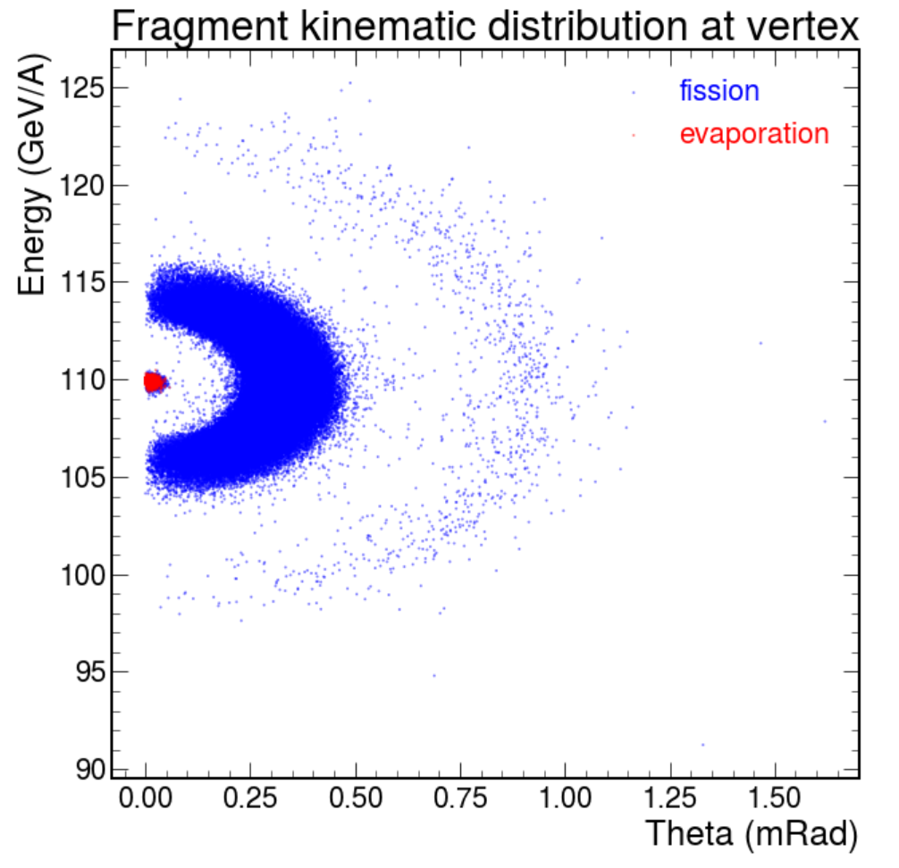
Fragment kinematics

