Slide 1
ePIC MPGD trackers – Current Detector Design
K. Gnanvo on behalf of the MPGD-DSC
EPIC Detector TIC Weekly Meeting
February 26, 2024
Slides from Matt, Annalisa, Seung Joon, Francesco and Andy - Thanks

Slide 2
Outline
Inner Barrel: Cylindrical Micromegas Barrel Layer (CyMBaL)
Thin-gap GEM-µRWELL Barrel Outer Tracker (µRWELL-BOT)
End Cap Disc: GEM-µRWELL End Cap Tracker (µRWELL-ECT)
ePIC MPGD Readout Electronics

Slide 3
Overview of ePIC Gaseous Trackers
ePIC MPGD trackers
MPGD trackers in ePIC provide additional hit points and fast timing hit to the core Si trackers for pattern recognition background rejection and hit information to the PID detector in the barrel region
Two MPGD technologies in ePIC:
Micromegas (inner barrel tracker)
GEM-µRWELL hybrids (outer barrel layer and end cap discs)
Detector | Zmin [cm] | Zmax [cm] | Rmin [cm] | Rmax [cm]
CyMBaL | -105 | 135 | 50.25 | 52.25
$\text{µ}$RWELL-BOT | -164.5 | 174.5 | 72.5 | 75
µRWELL-ECT 1 (Forward) | 148 | 150.5 | 7.01 | 50
µRWELL-ECT 2 (Forward) | 161 | 163.5 | 7.01 | 50
µRWELL-ECT 1 (Backward) | -112.5 | -110 | 4.65 | 50
µRWELL-ECT 2 (Backward) | -122.5 | -120 | 4.65 | 50
Barrel Outer MPGD Layer µRWELL-BOT
Electron End Cap discs µRWELL-ECT
Forward MPGD discs µRWELL-ECT
Barrel Inner MPGD Layer CyMBaL

Slide 4
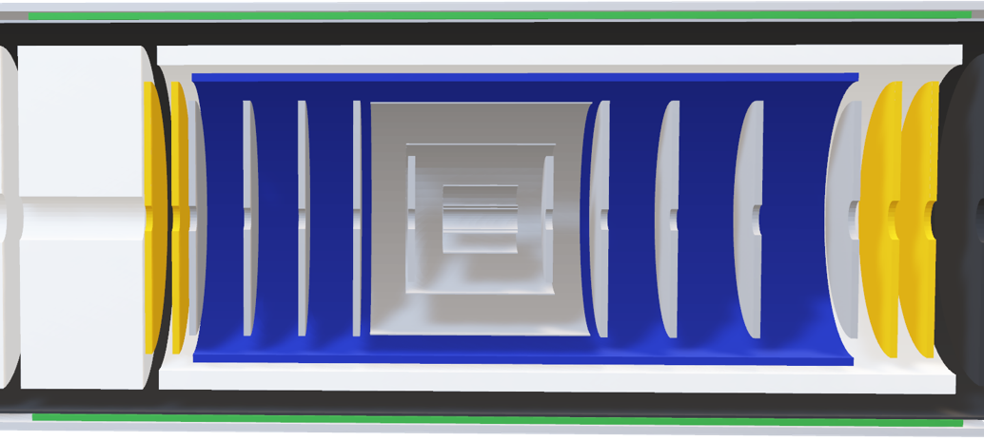
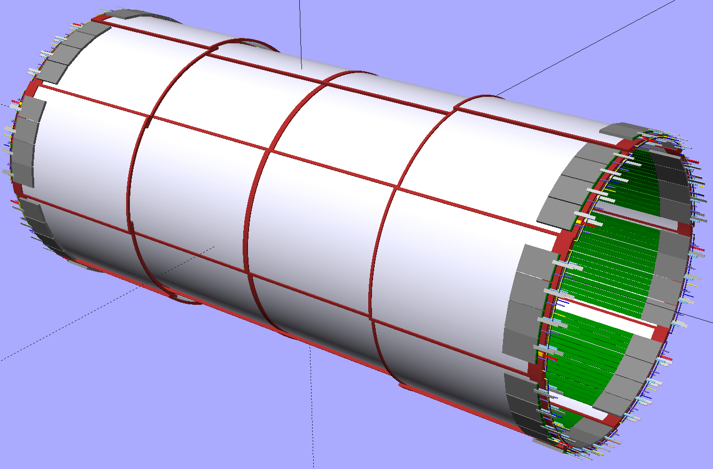
Barrel Inner Layer : Cylindrical Micromegas Barrel Layer (CyMBaL)
Material from Francesco’s slides @ Workshop for Inner Detector Support Structures and Cooling https://indico.bnl.gov/event/22387/contributions/87642/attachments/52775/90266/Inner_detector_workshop_CyMBaL_2024_02_20.pdf
CyMBaL
CyMBaL
Part of the Inner detector (central tracker) with Si trackers and AC-LGAD
Fast timing and additional hit point to complement the Si tracker for pattern recognition and background rejection
Single layer based on curved 2D Micromegas modules
Technology: evolution of the CLAS12 Micromegas, 1D → 2D
Hermetic in phi and z with 4 cm acceptance gap in the middle ➔ no overlap

Slide 5
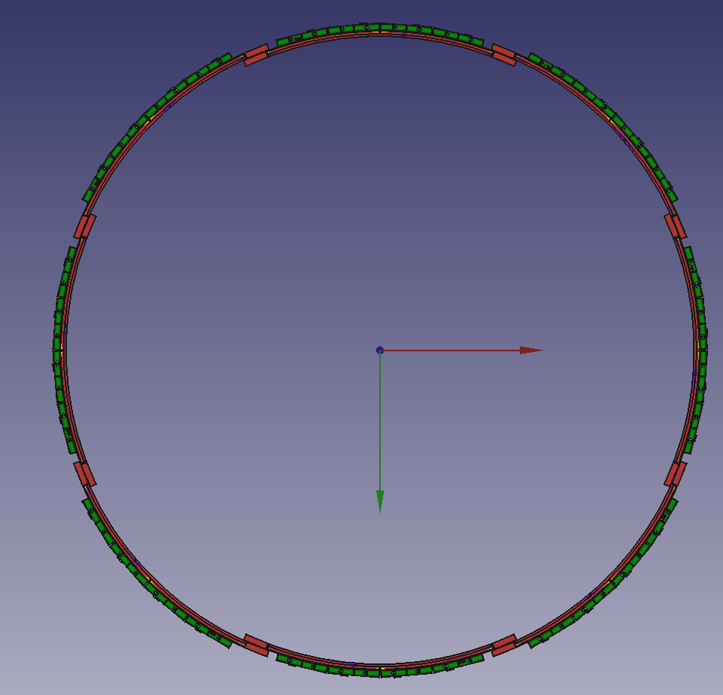
CyMBaL - Overview
CyMBaL : a single layer of curved 2D Micromegas modules
Length in z -105 cm, 135 cm
Envelop in radial direction 5 cm ➔ 2 radii layers:
50 cm for two central modules and 52.5 cm for the two outer modules
Use a single module design to simplify manufacturing and assembly
Hermetic in phi and z with 4 cm acceptance gap in the middle ➔ no overlap
Total of 32 Micromegas tiles
No overlap
8 modules per sector along phi
4 cylindrical sectors along z

Slide 6
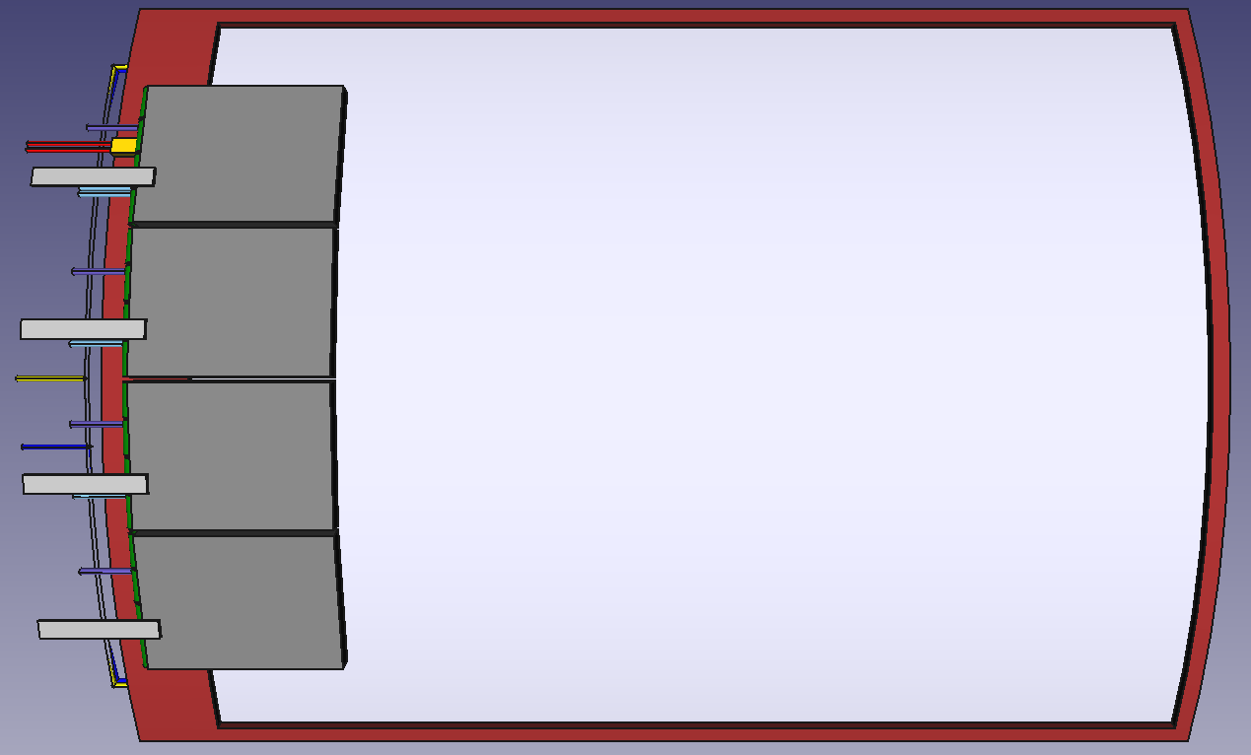
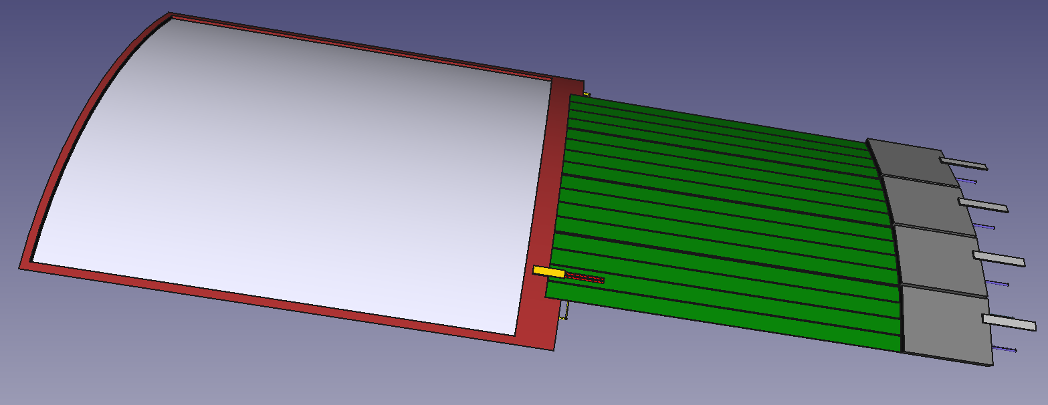
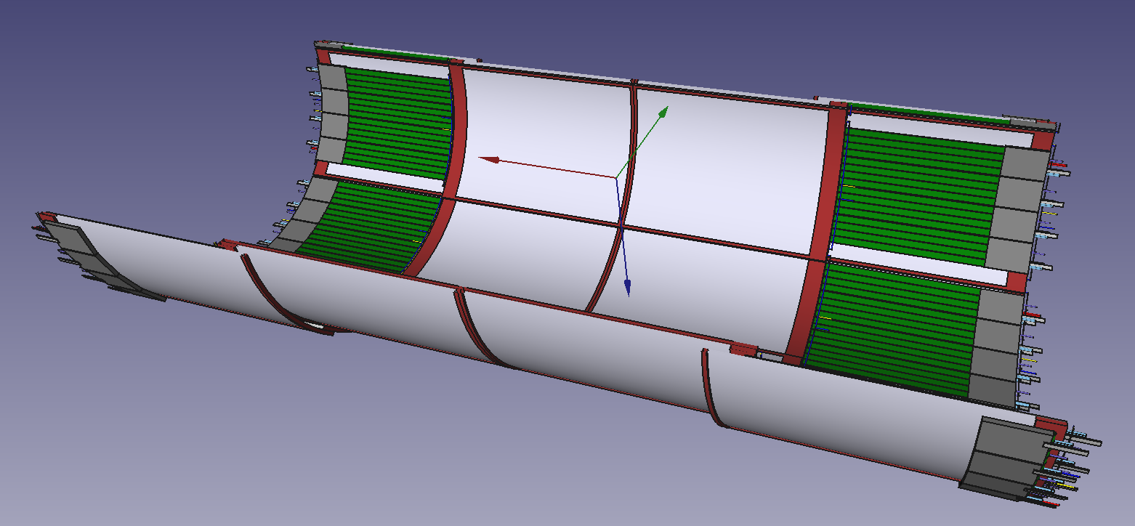
CyMBaL - Basic module
Module characteristics:
Thickness: 1 cm
Total Size: 65 × 46 cm² and active area: 59 × 44 cm²
~1 mm pitch in both directions ➔ 1024 strips per tile
32 channels per connector→ 32 connectors
curved Micromegas tile
HV
Cooling
Z; (r phi)
LV
FireFly to RDO
C; (z)
Gas in
Gas out
Signal flex
return trail for C strips
On-detector front end board (FEBs)
SALSA chip under development @ Saclay / San Paulo
4 FEB per tile assuming 4 ASICs per FEB:
Thickness of FEB: ~1cm
1 × 8 ch FireFly per FEB to the RDO
2 flex cables (green) per 64-ch SALSA ASIC ➔ 8 / FEBs
LV & Cooling in and out, possibly in series
Services:
HV: 2 channels (drift and resistive layer)
Gas: 2 tubes (in and out) ➔ Two tiles can be in series

Slide 7
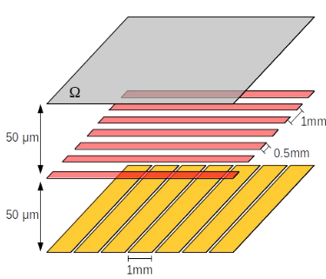
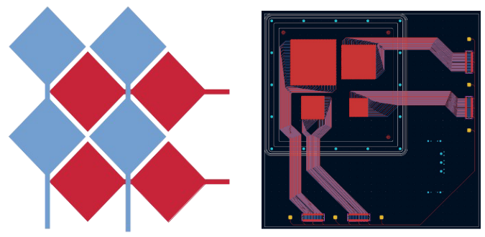
CyMBaL – Ongoing R&D & test beam plans
Development of 2D readout Micromegas for ePIC
Study of various 2D strip readout options
Several 10 cm x 10 cm prototypes tested in beam at MAMI June 2023
Resistive readout with high surface resistivity ~10 MΩ/□
X and Y strips on two different layers
Straight strips & ASACUSA like pattern
Plans for beam test at CERN in 2024 with muon beam to minimize multiple scattering
Mock up for a full size prototype
Straight strip pattern
ASACUSA-like pattern

Slide 8
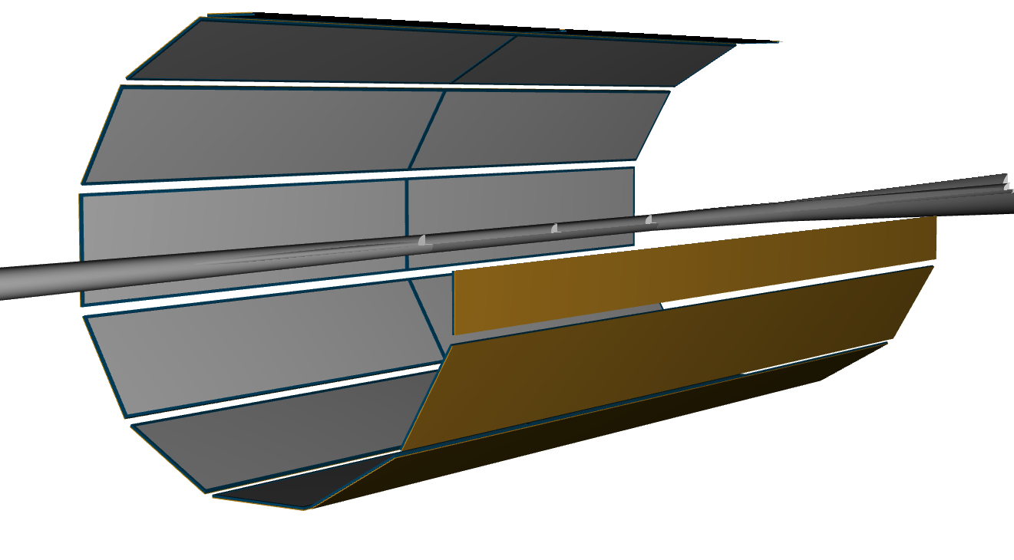
Barrel Outer Tracker: Thin-gap GEM-µRWELL (µRWELL-BOT)
µRWELL-BOT
µRWELL-BOT
Provide hit and directional tracking information for DIRC in addition to pattern recognition and additional timing hit point for central tracker
Flat long rectangular thin-gap MPGD detector (active area 34 cm × 170 cm)
2 modules along z direction and 12 modules along radial axis
Same segmentation as the DIRC bars in ePIC detector
Modules installed in the ECAL support structure under DIRC bars

Slide 9
µRWELL-BOT - Overview
V-strips
U-strips
Top view
340 mm
360 mm
1700 mm
Back view
24 uRWELL-BOT modules
Thin-gap (1-mm drift) hybrid amplification GEM-µRWELL detector
Capacitive-sharing U-V strips readout layers(45^{O} stereo angle)
Pitch: ~1.14 mm (1792 U-strips and 1792 V-strips per modules)
On-detector Front End Boards (FEBs) based on SALSA chips
14 FEB / modules (assuming 4 SALSA chips i.e 256 e-ch / FEB)
Total of 336 FEB for the full 24-module µRWELL-BOT
Direct connection on the back of the modules (no need for flex cables)
Likely different FEB design than for CyMBAL
Driven by space contraints
1800 mm
Cross section view
2.5 cm

Slide 10
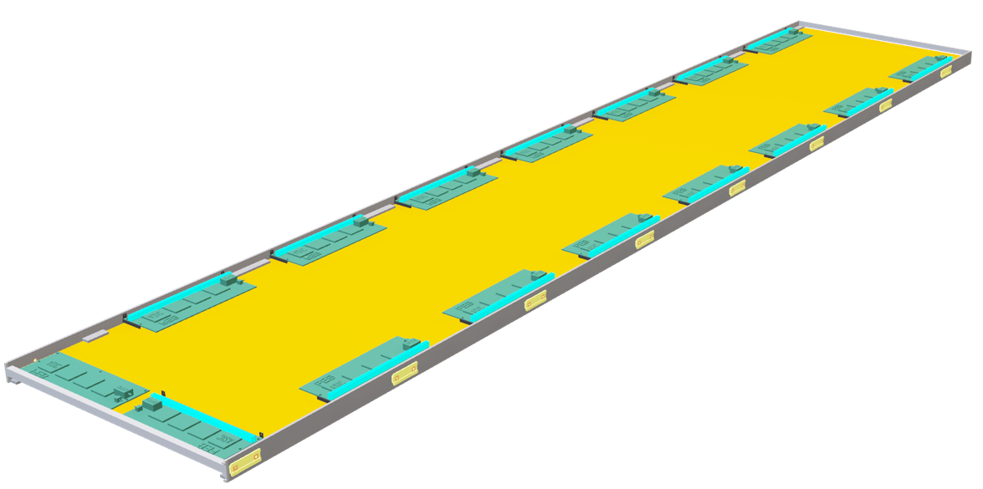
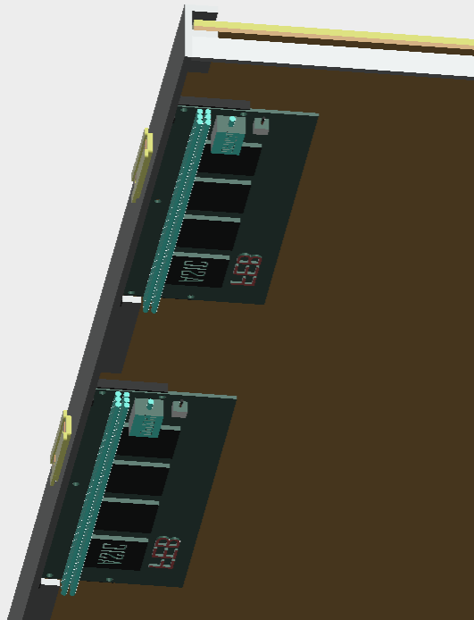
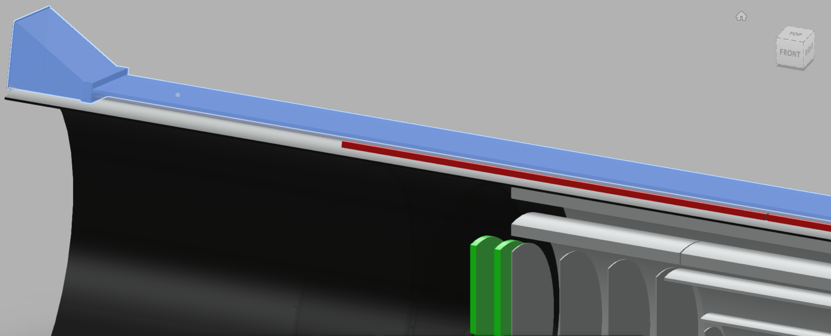
µRWELL-BOT – Integration in ePIC (CAD drawings)
Status of integration of µRWELL-BOT into ePIC
Installed in the ECAL support structure underneath the DIRC bar boxex
Working out real estate “conflict” with our DIRC colleagues
Preliminary design include FEB boards, HV and LV cables, Gas and HV services
Lots of progress over the past 3 months with the CAD drawings (Seung Joon @ Jlab)
Design of the module is in advance stage ➔ still working on final details
Preliminary design with FEB boards, HV and LV cables, Gas and HV services
Virtually no space left in the envelop after the integration of the complete module
µRWELL-BOT bottom side facing DIRC bar bx
Hardware for insertion rails
FEB
370 mm
Zoom in on FEB
µRWELL-BOT
DIRC bar box
µRWELL-BOT

Slide 11
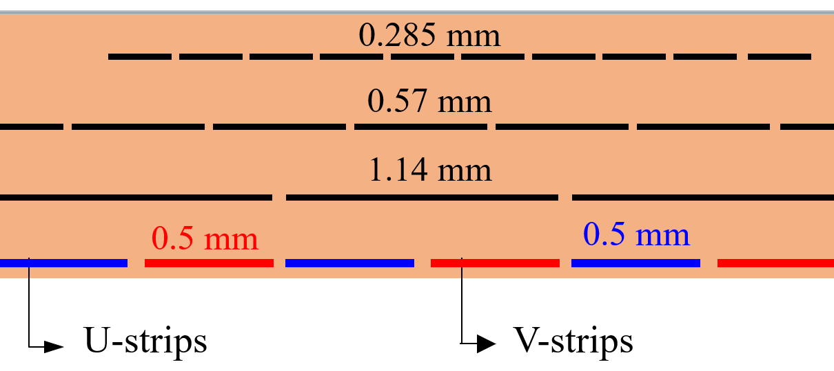
µRWELL-BOT – Technology choice
Thin-gap GEM-µRWELL design (tg-GRWELL)
Double amplification layers: GEM (preamplification) and µRWELL (main amplification)
Thin gap ionization / drift volume
1 mm ionization gap (GEM to cathode) & 2 mm induction gap (GEM to µRWELL)
3-layer capacitive-sharing U-V strip readout
Strip pitch: 0.8 mm (along U and V axis)
Trace pitch: 1.14 mm along horizontal axis (traces)
Connectors on the back of the rigid PCB detector ➔ vias connected strips to connectors
The design of the detector module parts will start in a couple of weeks involving interaction with expert at CERN
1.14 mm
0.8 mm
V-strips
U-strips
U-V strip configuration
Active area 36 cm
Active area 34 cm
3 mm honeycomb
G10 frames
µRWELL
GEM
cathode
rigid PCB
cross-section view of thin-gap GRWELL detector
FEB
cross-section view of capacitive-sharing U-V readout

Slide 12
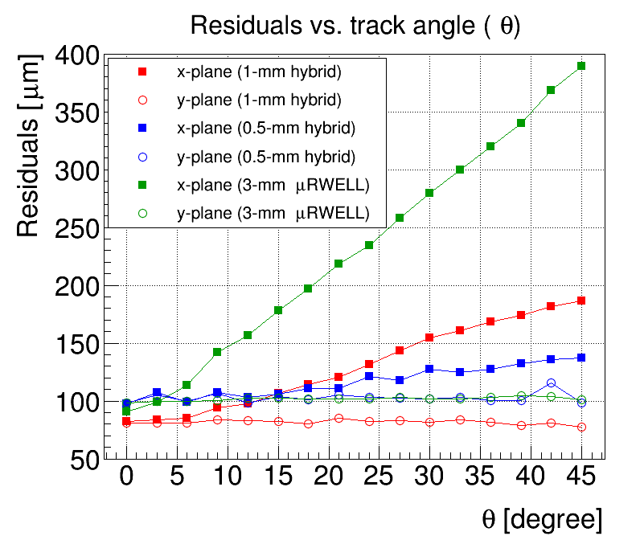
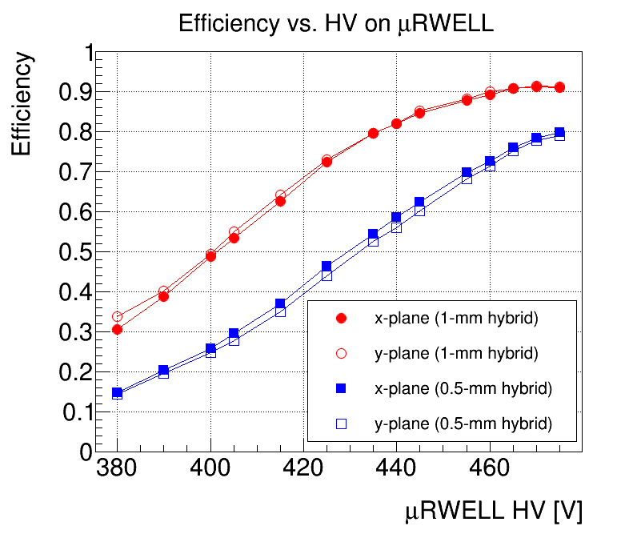
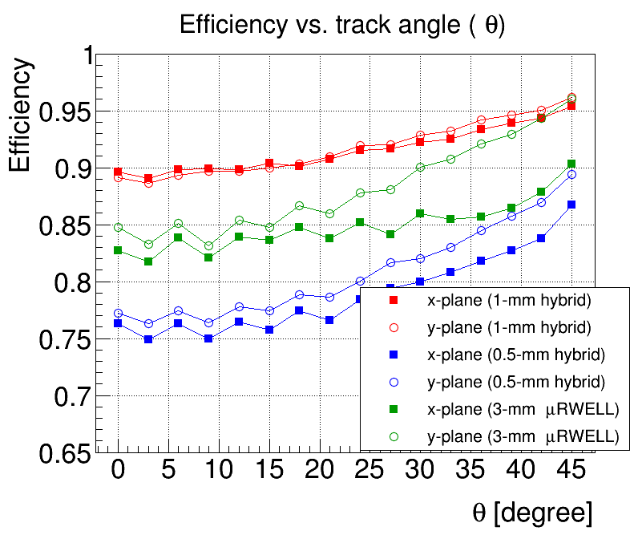
µRWELL-BOT – Performance of thin-gap GEM-µRWELL in test beam
Performance of thin-gap GEM-µRWELL protos with track angle
Position resolution steadily increases with track angle but thin-gap protos shows better performance at large angle than 3-mm protos
Efficiency is angle-dependent and varies from ~90% to ~95% for 1-degree and 45-degres tracks respectively for 1-mm GEM-µRWELL and from ~75% to ~85% for 0.5-mm GEM-µRWELL
Strip multiplicity is also angle-dependent. Normalized strip multiplicity plot shows 60% and ~22% increase of the strip multiplicity for 3-mm gap uRWELL and 1-mm GEM-µRWELL respectively
Efficiency
Residuals
Efficiency

Slide 13
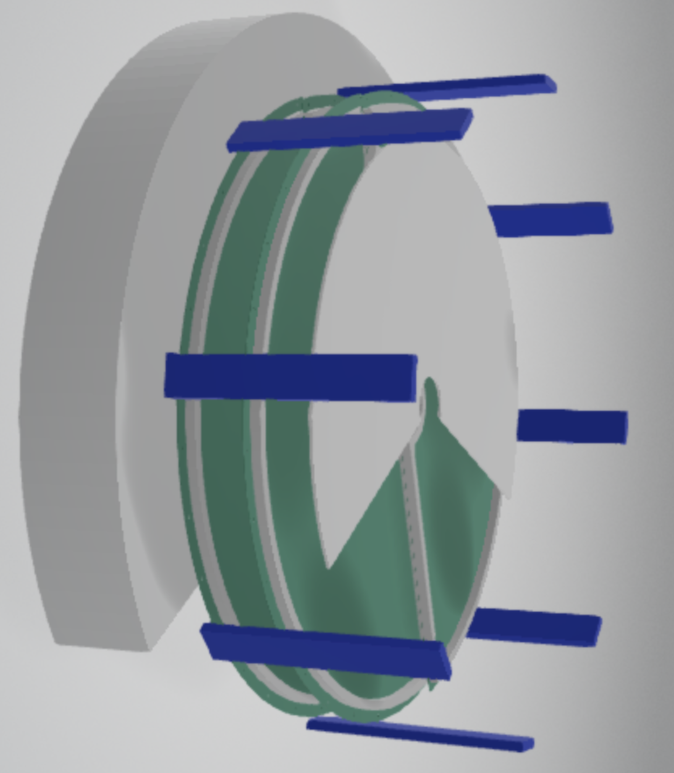
End Cap Disc: GEM-µRWELL End Cap Tracker (µRWELL-ECT)
µRWELL-ECT
Provide fast timing and additional hit in forward and backward trackers
Planar GEM-µRWELL discs
Both thin gap and standard gap been explored
2 discs in either end cap ➔ radius 50 cm
2 semi-circle or 4 quadrants still under consideration
Design and CAD drawings of implementation in ePIC just started
Effort led by A. D’Angelo form INFN Roma Tor Vergata
Jlab helping with CAD design and inetgration
End Cap MPGD Discs µRWELL-ECT
Material from Annalisa’s slides @ Workshop for Inner Detector Support Structures and Cooling
https://indico.bnl.gov/event/22387/contributions/87601/attachments/52771/90294/EIC_endcaps_Integation_feb_20_2024.pptx

Slide 14
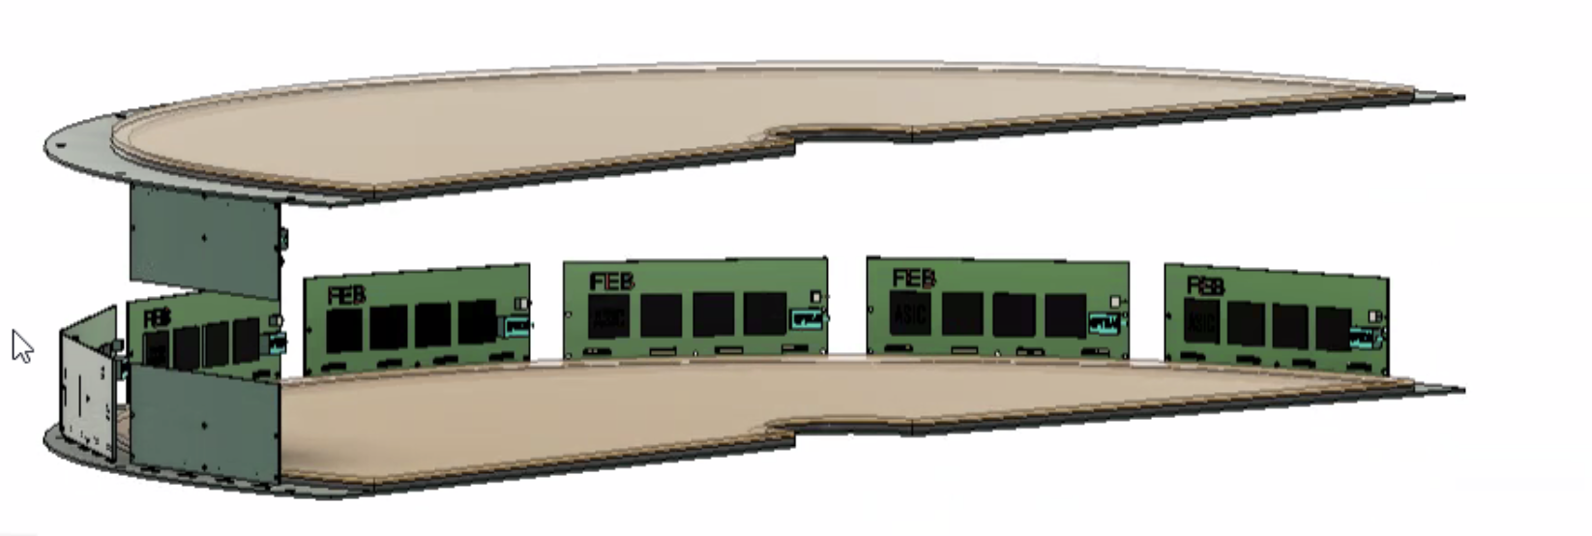
µRWELL-ECT - Overview
Last update: Jan. 17th2024
https://eic.jlab.org/Geometry/Detector/Detector-20240117135224.html
Endcaps - dimensions
50 cm external radius - including frames and services
5$÷8$ cm inner radius

Slide 15
µRWELL-ECT - Overview
Overlap thickness (free from frames) = 2 cm
1000 mm
525 mm

Slide 16
µRWELL-ECT – Disc segmentation options
2 semi-circles
4 Quadrants
52.5 cm
100 cm
52.5 cm
52.5 cm
PROs | CONs
One vertical/horizontal overlap only – less material | Larger detector surfaces are more difficult to handle.
The two endcaps may be rotated by 90$°$ one respect to the other to recover overall symmetry
PROs | CONs
Smaller dimensions are easier to handle | Two vertical and horizontal overlapping regions – more material
Each endcap is intrinsically symmetric

Slide 17
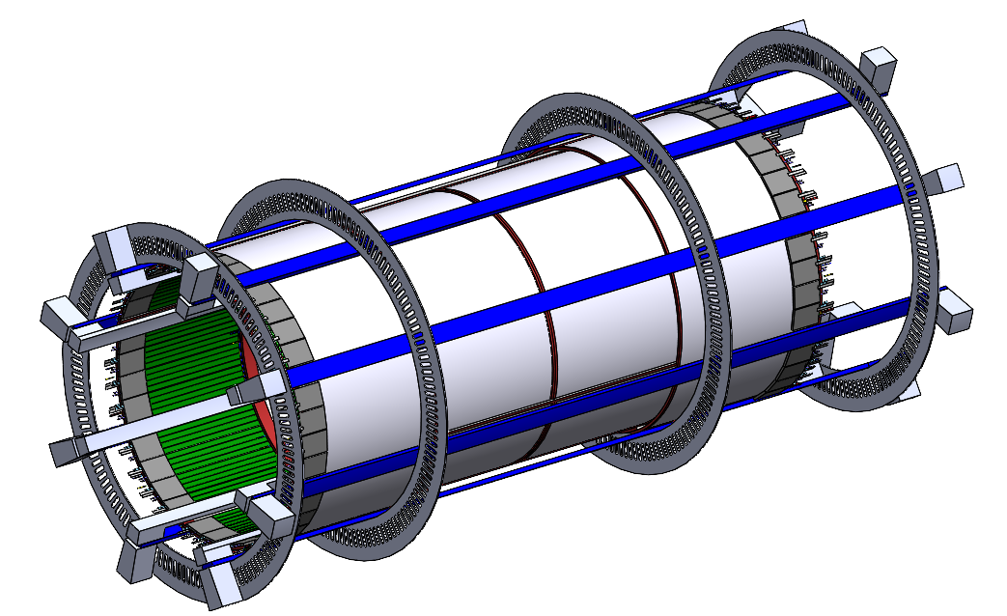
µRWELL-ECT - Integration in ePIC (CAD drawings)
Status of integration of µRWELL-ECT discs into ePIC
Effort just started with Annalisa for the overall design and Seung Joon for the mechanical drawings and integration into ePIC
Good understanding of how the end cap discs will be integrated into inner detector support structure (Andy)
Still need to finalize the envelop of the µRWELL-ECT ➔ will require to increase the radius of CyMBaL to make room for cables and services
Preliminary design with FEB boards, HV and LV cables, Gas and HV services
For each endcap disk (4 disks in total):
16 HV cables
4 gas inlets and 4 gas outlets
32 data cables
32 low voltage cables
2 temperature sensors cables
2 humidity sensors cables
2 dry air inlet and 2 dry-air outlet cooling hoses
Space for 32 RDO cards

Slide 18
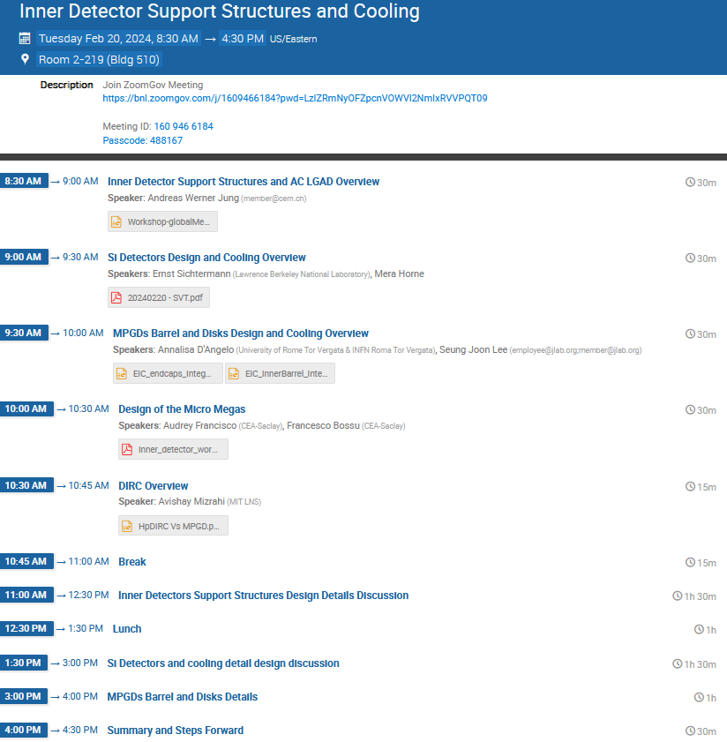
Workshop for Inner Detector Support Structures and Cooling
@ BNL - 02/20/2024
Action items from the workshop - Rahul’s email 02/242024
Weight estimates for detectors and services:
Silicon Detectors : Ernst Sichtermann
CyMBaL : Francesco Bossu
MPGDs (µRWELL) : Kondo, Seung Joon, Annalisa
Services are shown fanned out evenly in the service estimates model. Attachment points for discs and other support features will need space. Extra 25% room should be accounted for that at detector interfaces - Roland
Andy and Sushrut will develop conceptual design of support structures to the extent that we can get realistic estimates of detector envelopes to subgroups.
1 cm gap is needed for the adjustment of the inner detectors (CyMBaL and µRWELL-ECT).
Subgroups need to work with Andy, Sushrut and Roland if any updates to the service estimates, RDOs etc. is needed in the detector volume.
Si group only needs 4 two inch ducts or equivalent coming from both side (8 total) to cool entire Si volume using air. Silicon group will be responsible for the design of the cooling layout within the detector volume. Integration group will look into providing air into that volume and let them know if it’s possible.
Add North-South, Hadron-Lepton and Forward-Backward on the integration and envelope drawings to avoid confusion.
https://indico.bnl.gov/event/22387/

Slide 19
ePIC Gaseous Trackers – Readout electronics & DAQ
From Irakli’s presentation at the DAQ meeting: https://indico.bnl.gov/event/22316/
DCDC on (or close by) FEBs
LDO based powering scheme
PRO: Small cross section cables
CON: DCDC might be bulky
PRO: No DCDC on FEBs
CON: Large cross section cables for high current delivery
FEB-RDO: on copper twinax cables
FEB-RDO: on optical fibers
FEB
copper twinax cables
RDO
DAM
FEB
Optical fibers
RDO
DAM
Few meters
Any distance
PRO: no intelligence on FEBs
CON: RDO MPGD specific, radiation hard, space?
PRO: small cross section for service and no problem of space for RDO
CON: intelligence on FEB, consumption, radiation hardness
CyMBaL - Inner Detector Workshop

Slide 20
Summary
Design of all three ePIC MPGD tracking layers is ongoing and in good shape
CAD drawing and integration in ePIC detector made progress with regular meeting with the Integration and support structures groups
This include our first understanding of the services and cables need for these detectors
A couple of technical details regarding integration and detector envelops still need to be addressed
Very productive workshop took place at BNL on 02/20/2024 to discuss issues regarding mechanical support structure and cooling and cabling of the inner detector
R&D and PED effort of the various technologies ongoing with positive initial performance results from beam test in 2023

Slide 21
Back up

Slide 22
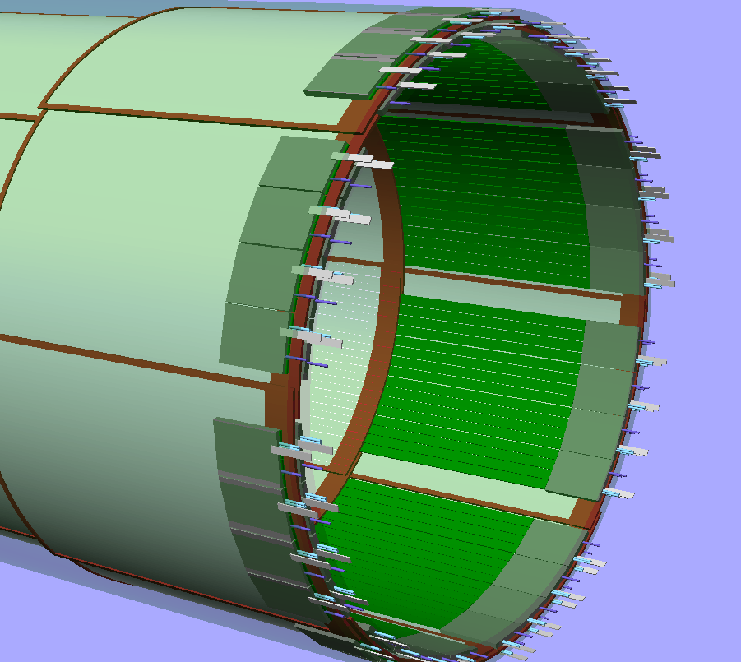
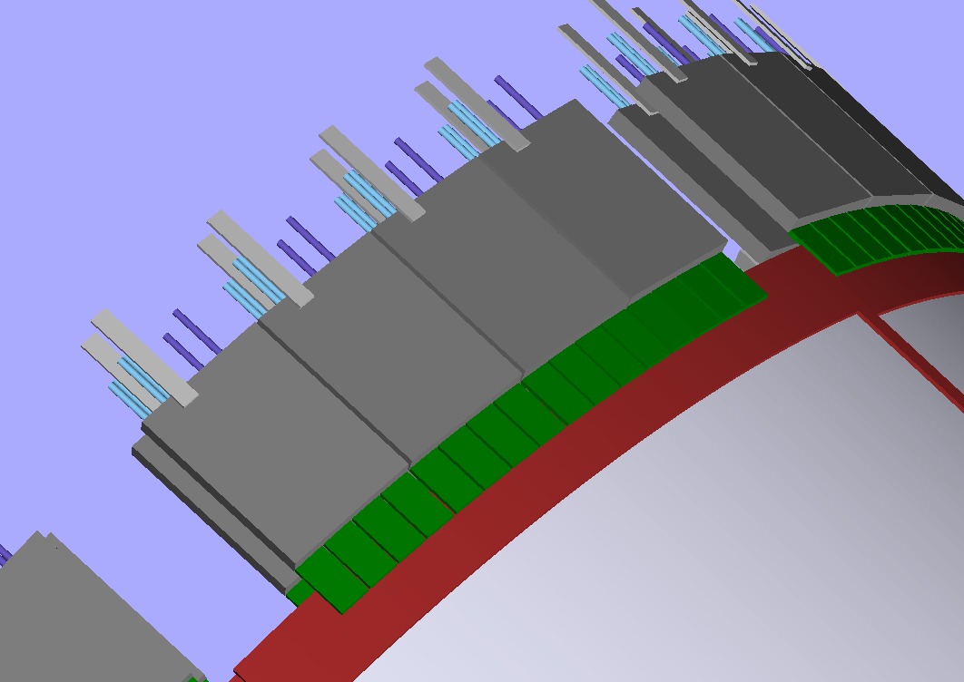
Inner Barrel: Cylindrical Micromegas Barrel Layer (CyMBaL)
Z = [-1050 , 1350 ] mm
r = [ 500, 550 ] mm (green shade in the picture)
Assumptions for the radial keeping zone:
Thickness of a tile structure ~1cm
Thickness of FEB ~1cm
But this is still a crude (and safe) estimate:
We need better estimates for the FEB (see later)
Results from the mechanical mock up (later in the year)
FEB on the extremities of the system to avoid too much material in the active region
The inner modules will need longer flex cables (~50cm) to bring the signals to the FEB
QUESTION: If the 5cm radial keeping zone is not available, we could save some radial space by moving the FEBs close to the modules
Is there enough space in z?

Slide 23
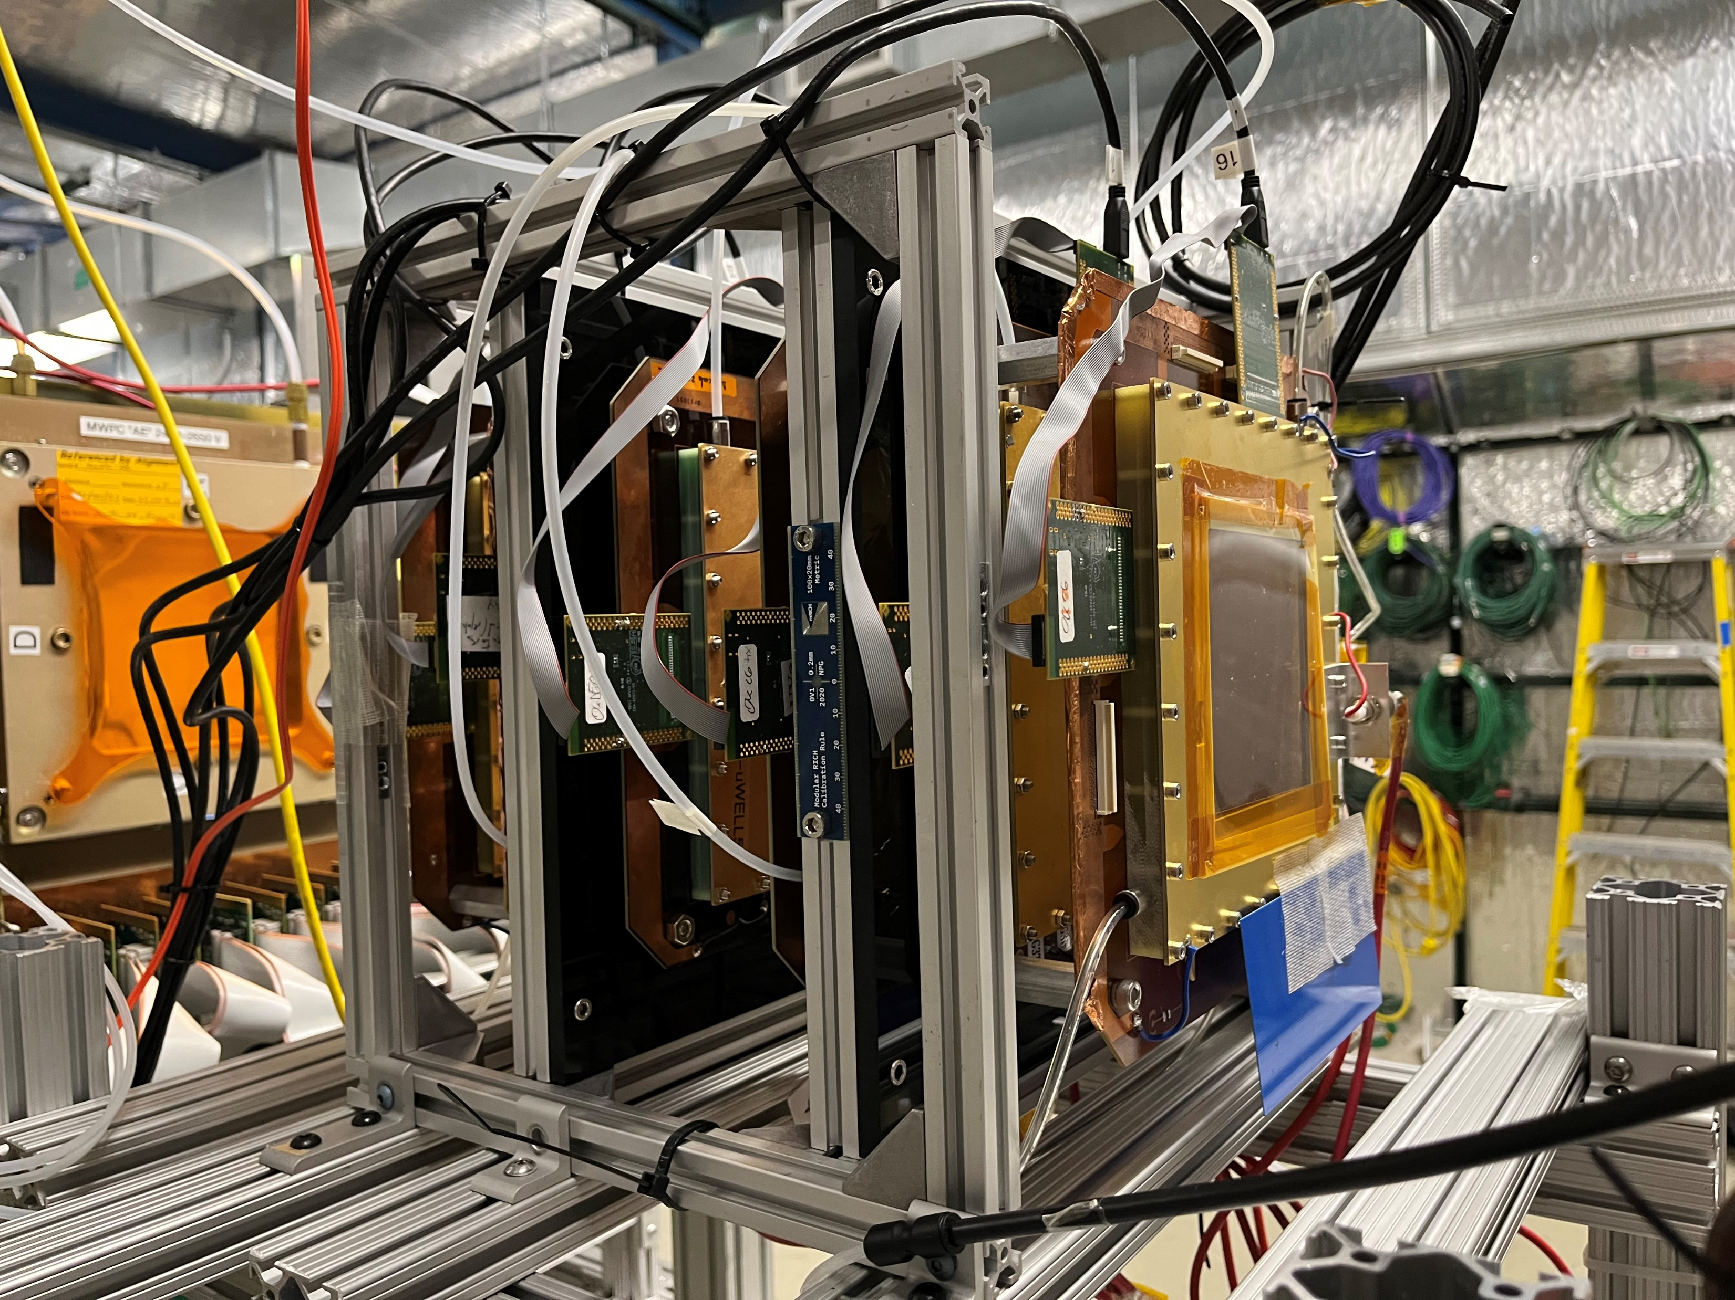
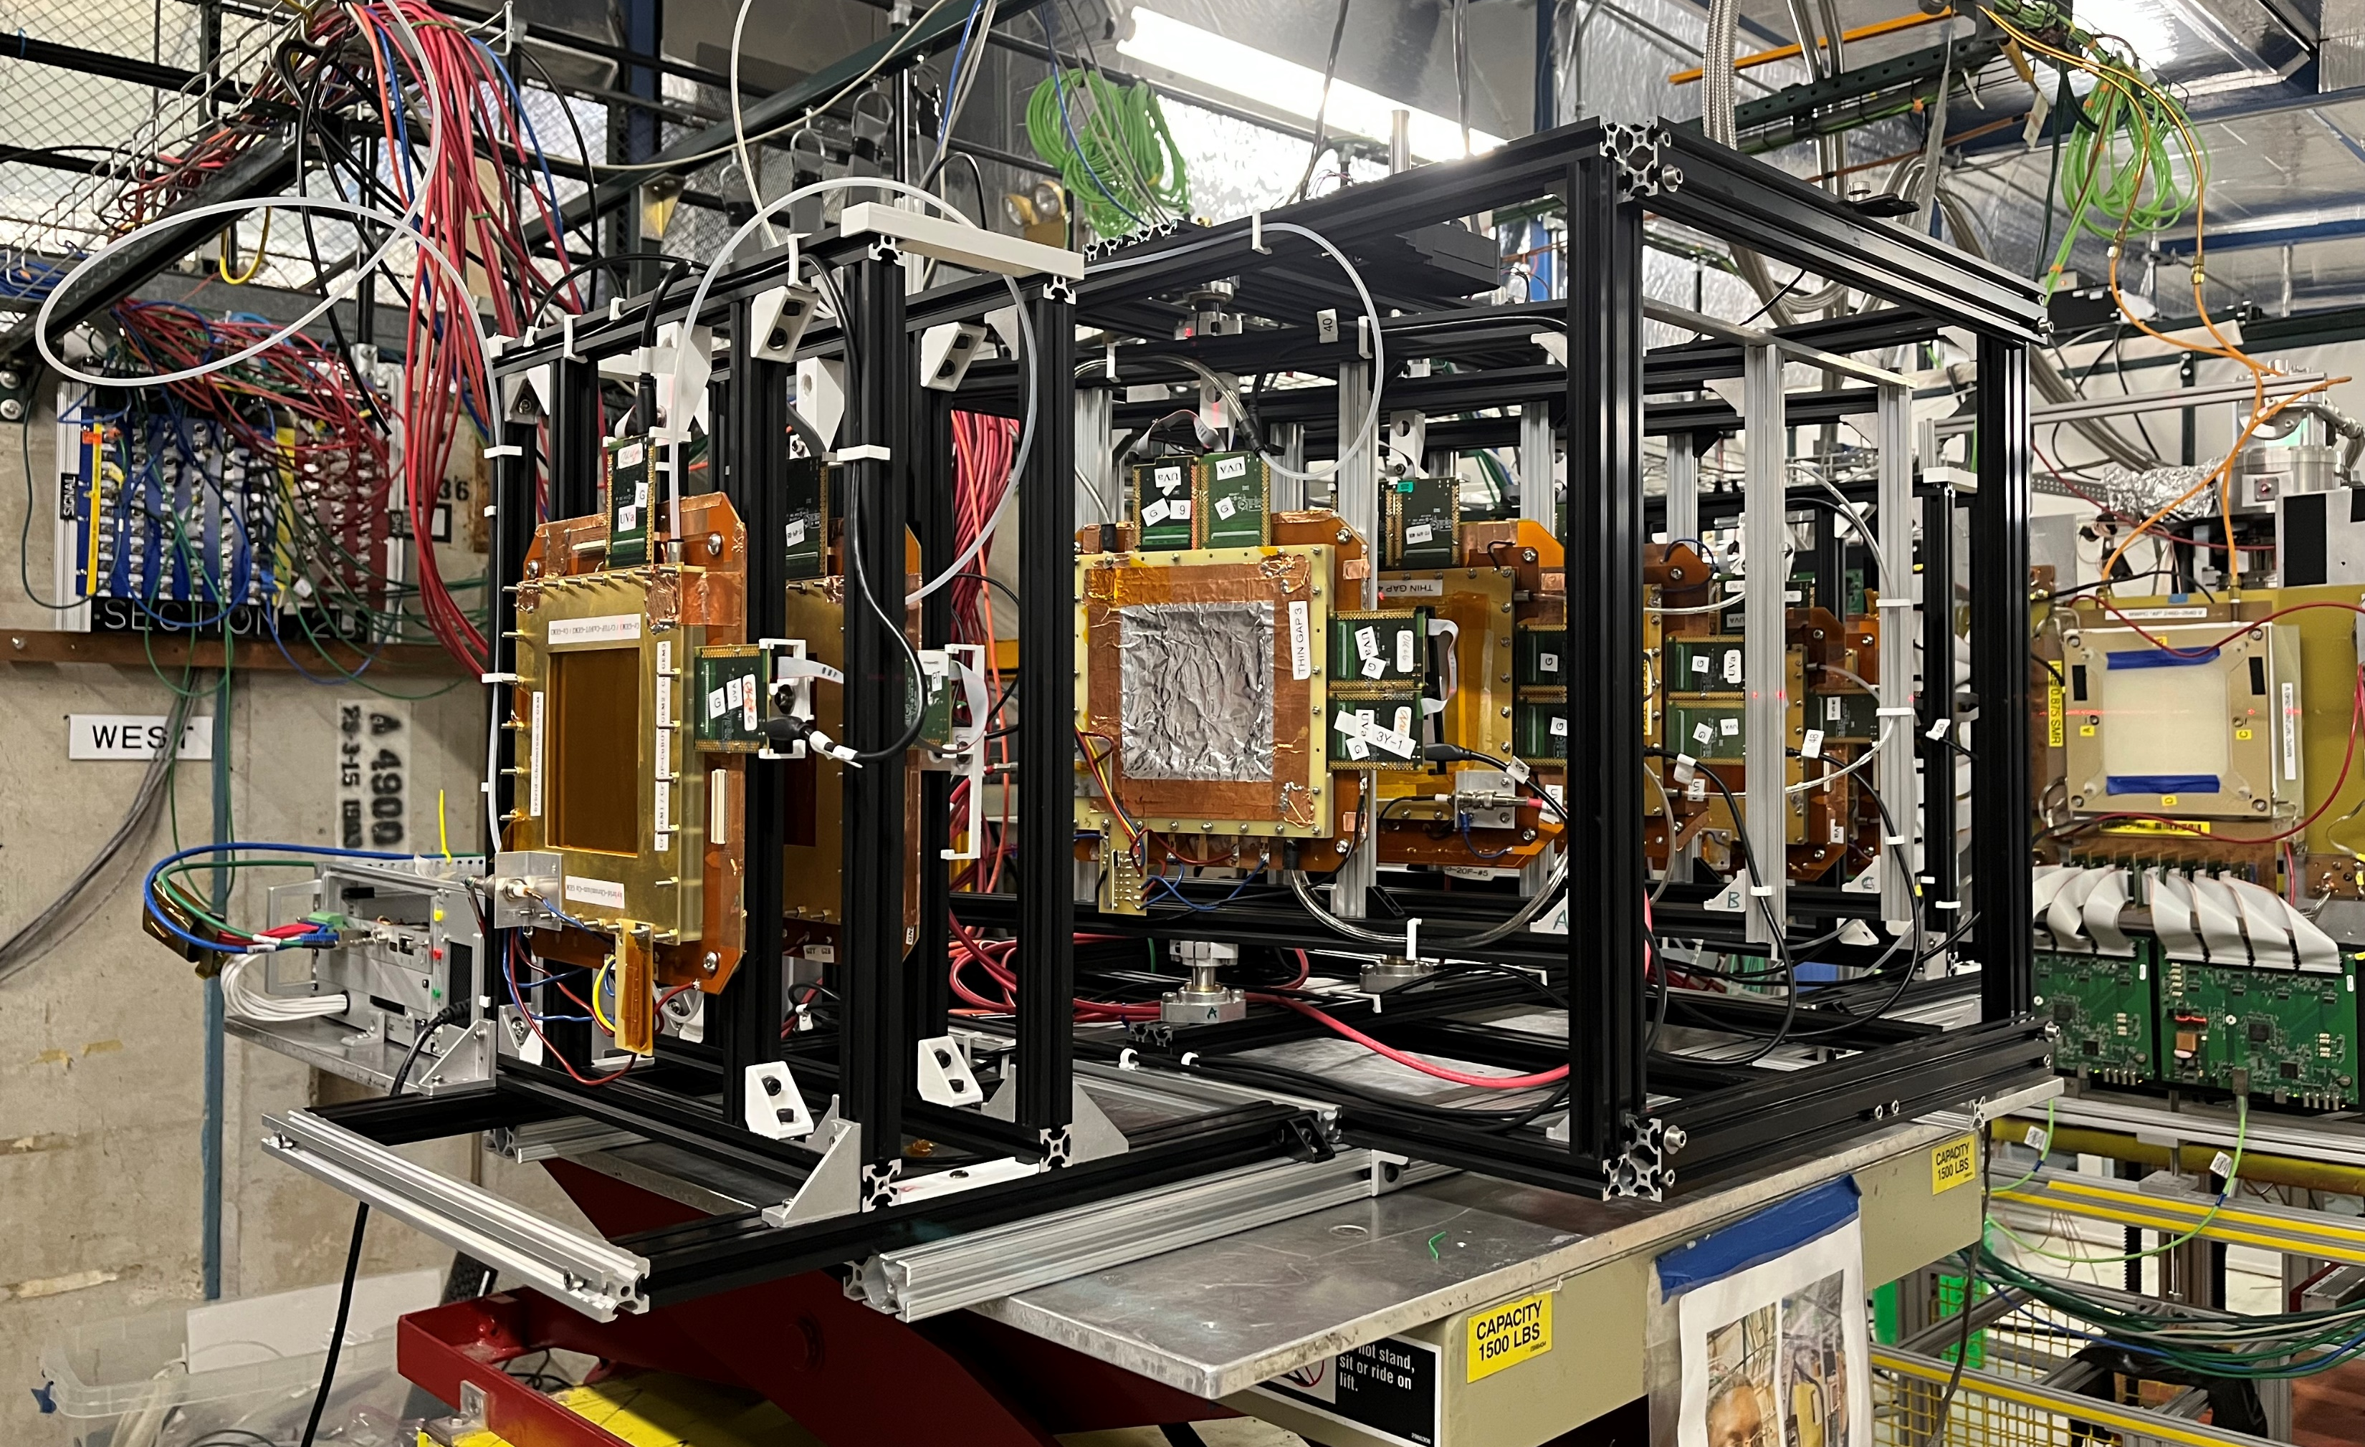
µRWELL-BOT – Thin-gap MPGD test beam @ FNAL June 2023
All ten various thin-gap MPGD prototypes successfully were tested in the 120 GeV proton beam at the Fermilab Test beam Facility (FTBF) in June 2023
Multi-institution common test beam with two tracking telescopes running simultaneously with 5 prototypes tested for efficiency and position resolution studies
Several prototypes tested with both Argon and Krypton based gas mixture to study best gas for efficiency
Test also performed against standard 3-mm gap GEM and µRWELL prototypes for position resolution performance
Y-axis
Y-axis
θ
Beam axis
X-axis
SRS crate
Rotation stand
Upstream tracker
X-axis
Rotation stand
Setup I: HV scan setup
Efficiency with different gas mixtures
2 thin-gap prototypes in the stand
4 trackers: 2 upstream & 2 downstream
Setup II: Spatial resolution vs. angle scan setup
Rotation stand rotate the X-Y plane by an angle θ (0 - 45 degrees) w.r.t to Y-axis
Up to 3 thin-gap prototypes tested in the rotation stand at the time
2 trackers upstream and 2 downstream on a fixed separate stand

Slide 24
µRWELL-BOT – Production of components & assembly of modules
Production and procurement of GEM foils and µRWELL PCBs
GEM foils and µRWELL will be produced by CERN MPT workshop (aka Rui’s workshop)
Production of these components will start after the design is validated with the PED pre-production modules (may need 2 iterations)
Design validation is expected to be complete by mid 2025
Korean GEM Production facility express interest in fabricating GEM foils and µRWELL for ePIC MPGDs
Facility located at the Korean Institute of Basic Science (IBS) ➔ The group is already member of the ePIC collaboration and just join the MPGD-DSC
The equipment were relocated from Mecaro (semi conductor company) that produces large GEM foils for CMS GEMs
Inseok Yoon will present the status of this Korean GEM facility at our next General MPGD-DSC meeting March 07
Assembly and characterization of µRWELL-BOT module
Three institutions expresses interest for the assembly, full characterization and QA of the µRWELL-BOT modules
JLab, Florida Tech and University of Virginia ➔ all 3 sites have extensive experience with MPGD projects for NP and HEP experiments
It is critical to maintain these experience within ePIC MPGD-DSC for MPGD production
Total of 30 µRWELL-BOT modules (24 production + 6 spares) for the barrel outer tracker
3 month for the assembly and full characterization and QA of one µRWELL-BOT module
Assuming production is conducted in parallel in the 3 assembly sites ➔ 2.5 years for all 30 modules
Assuming production start January 2026 ➔ all 30 µRWELL-BOT modules will be on site at BNL July 2028
We welcome additional institutions interested in joining the ePIC MPGD the effort

Slide 25
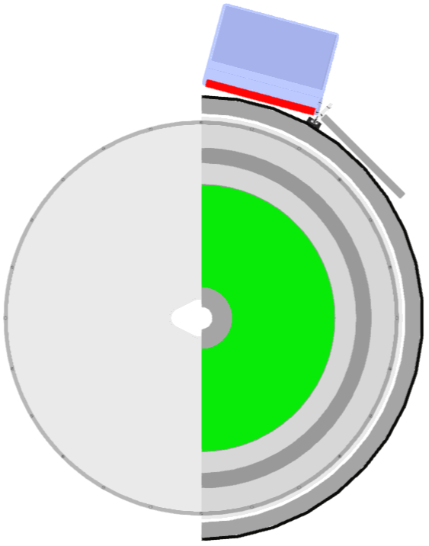
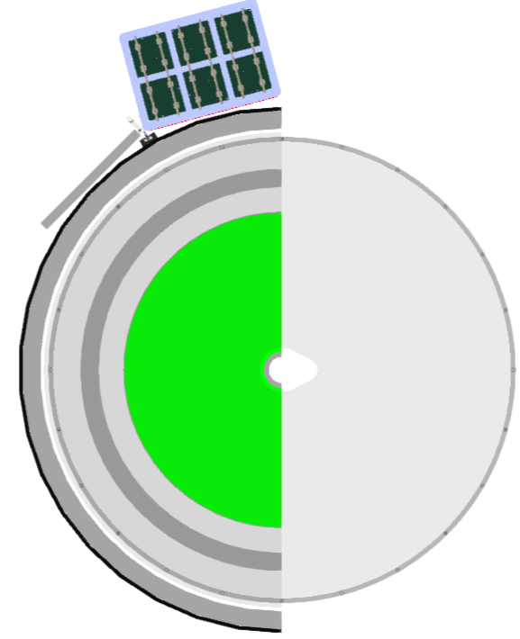
µRWELL-BOT – Integration in ePIC (CAD drawings)

